Slide 1
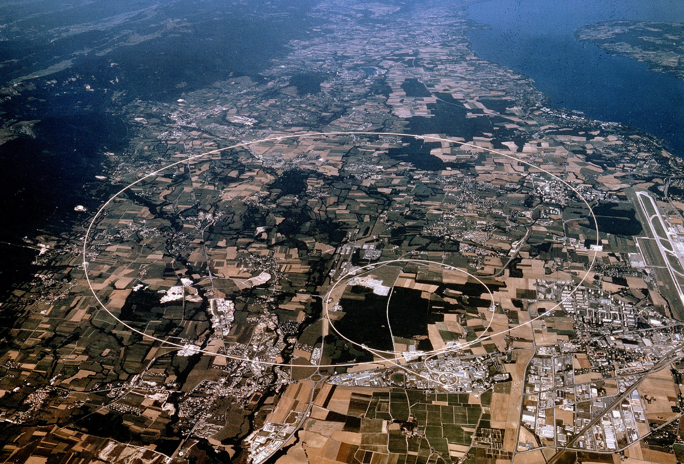
Experimental Particle Physics
Part 4: Searches Beyond the SM (part I)
Prof. Albert De Roeck
CERN, Geneva, Switzerland
Antwerp University Belgium
UC-Davis California USA
NTU, Singapore
July 29 – August 7 Weihai, China

Slide 2
Lecture Plan
Overview of the 5 lectures in the next days
Lecture 1: Accelerators and the LHC
Lecture 2: Experimental Techniques and experiments, in particular LHC experiments
Lecture 3: Tests of the Standard Model at the LHC, including the Higgs
Lecture 4 & 5 : Searches Beyond the Standard Model at the LHC
The lectures mainly cover ATLAS & CMS results plus a few results from other experiment

Slide 3
In this Lecture
Now: Introduction to physics Beyond the Standard Model (BSM) and searches for exotic phenomena at the LHC
Afternoon: Searches for Supersymmetry, the connection to dark matter searches and an outlook for the future.
Note: many new results are becoming public today/tomorrow at ICHEP
but just too late for these lectures

Slide 4
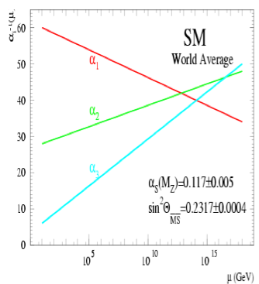
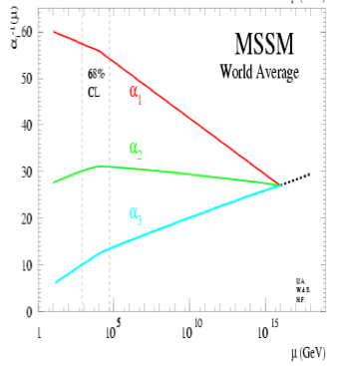
Physics case for new High Energy Machines
Understand the mechanism Electroweak Symmetry Breaking
Discover physics beyond the Standard Model
Reminder: The Standard Model
- tells us how but not why
3 flavour families? Mass spectra? Hierarchy? 19 parameters!
- needs fine tuning of parameters to level of 10⁻³⁰ !
- has no connection with gravity
- no unification of the forces at high energy
- Supersymmetry
- Extra space dimensions
Many other ideas: More symmetry and gauge bosons, composite
Higgs models, L-R symmetry, quark & lepton substructure,
Little Higgs models, Technicolor, Hidden Valleys, 4th generation…
Most popular extensions since 2000
Higgsless models somewhat disfavoured these days

Slide 5
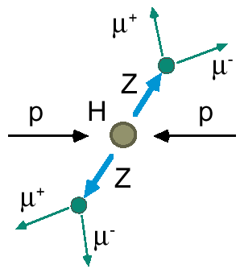
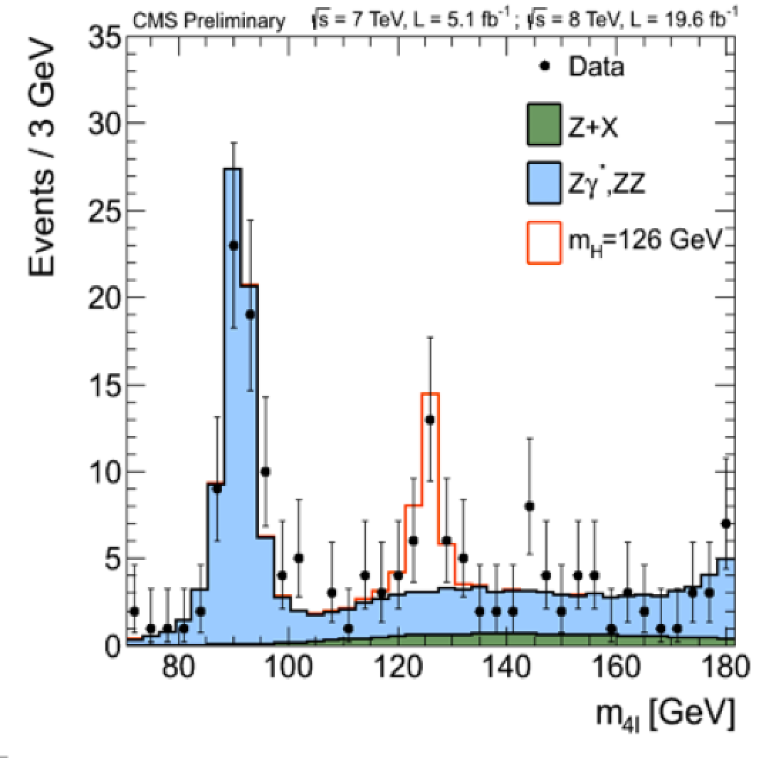
2012: A Milestone in Particle Physics
Observation of a Higgs Particle at the LHC, after about 40 years
of experimental searches to find it
proton
proton
2013
The Higgs particle was the last missing particle in the Standard Model
and possibly our portal to physics Beyond the Standard Model

Slide 6
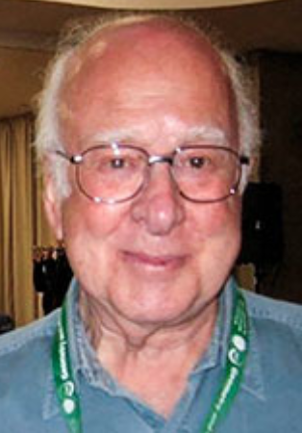
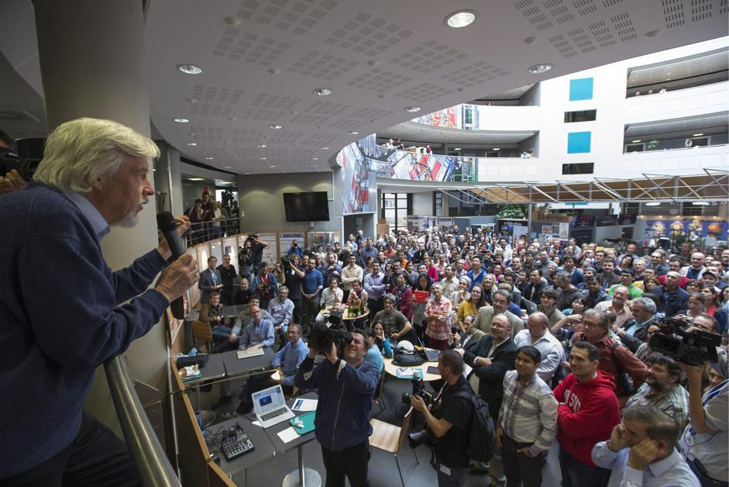
Tuesday 8 October 2013
Francois Englert
Peter Higgs
Congratulations!!!!

Slide 7
The Theorists…
A. Pomarol ICHEP2012
“ We made more progress in the last few years than the last 30 years….”

Slide 8
The Theories??

Slide 9
The Theories ??

Slide 10
A Higgs @ 125 GeV…
125.0 +/- 0.3 GeV
0.2
Guido Altarelli
Stockholm Nobel Symposium
May 2013
1941-2015
“We do not understand why the mass of the Higgs is 125 GeV
It most likely tells us something on what is Beyond the Standard Model”

Slide 11
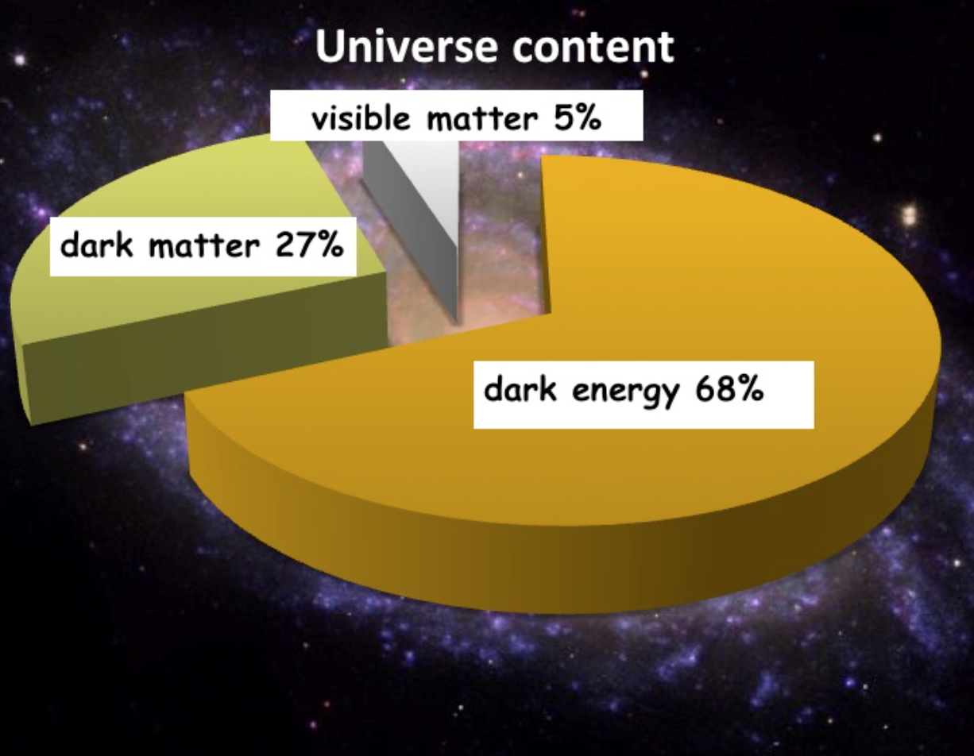
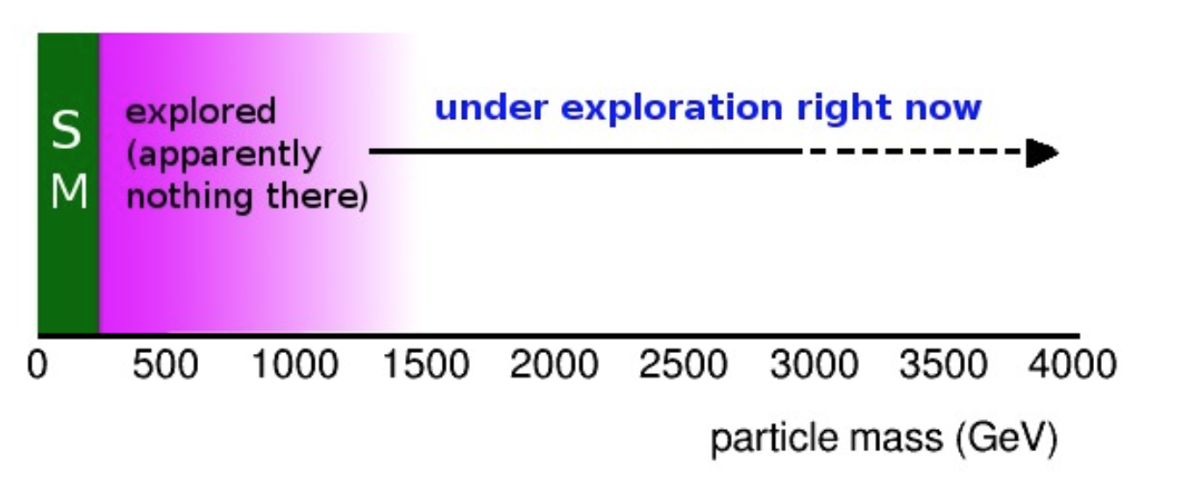
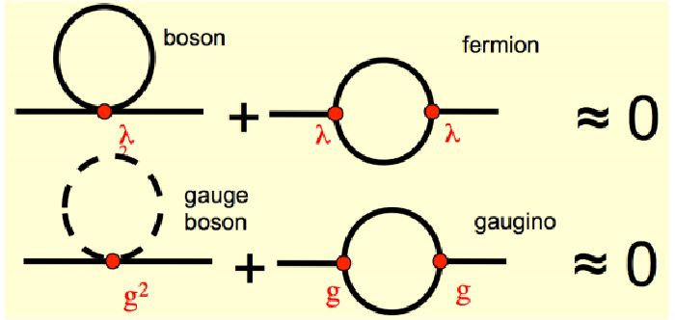
Physics Beyond the Standard Model?
A Higgs at 125 GeV
Precise measurements of the top quark and the Higgs mass
arXiv:1403.6535
We also know that:
New Physics inevitable?
But at which scale/energy?
Searches!!
N. Arkani-Hamed

Slide 12
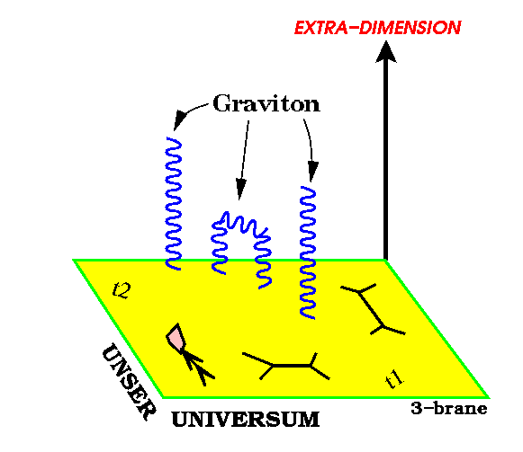
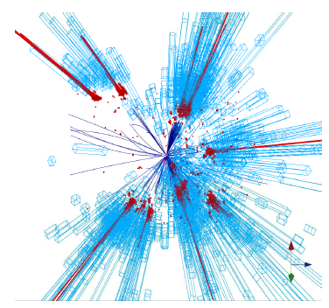
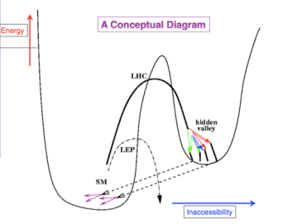
New Physics?
New Gauge Bosons?
Supersymmetry
ZZ/WW resonances?
Technicolor?
Little Higgs?
Extra Dimensions?
Hidden Valleys?
Black Holes???
What stabelizes the Higgs Mass? Many ideas, not all viable any more
A large variety of possible signals. We have to be ready for that
Notes:
11

Slide 13
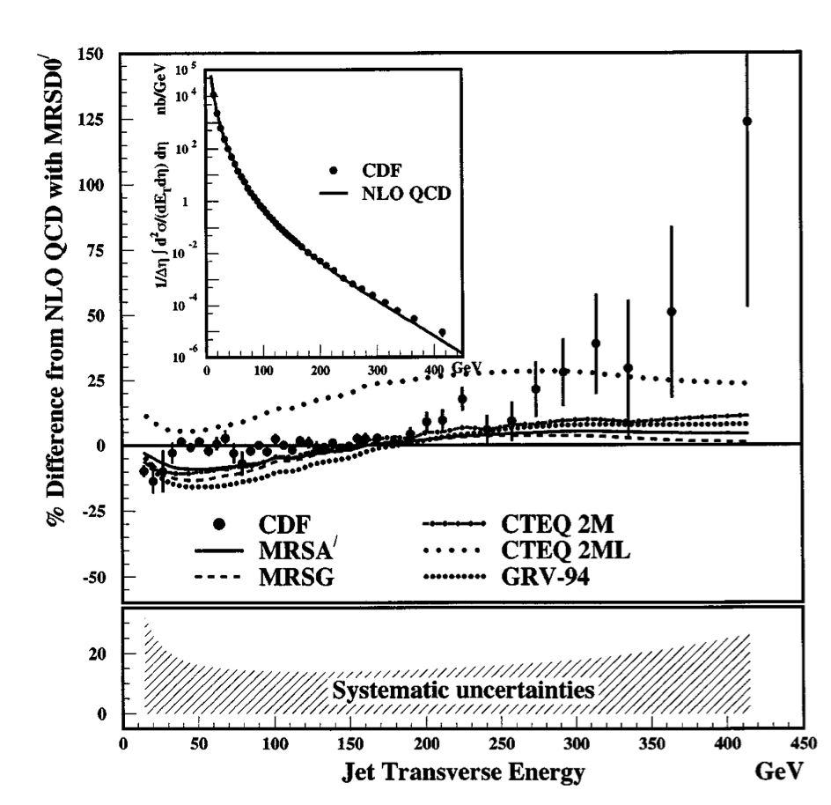
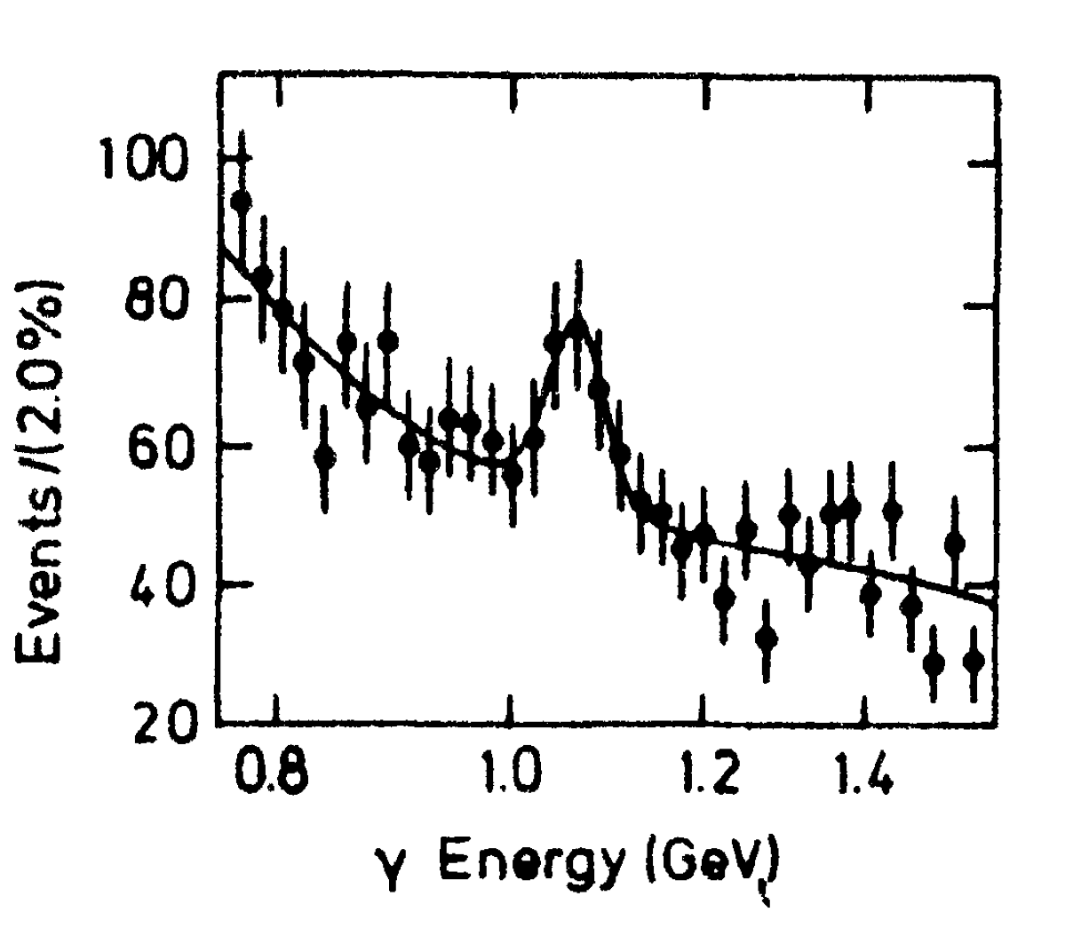
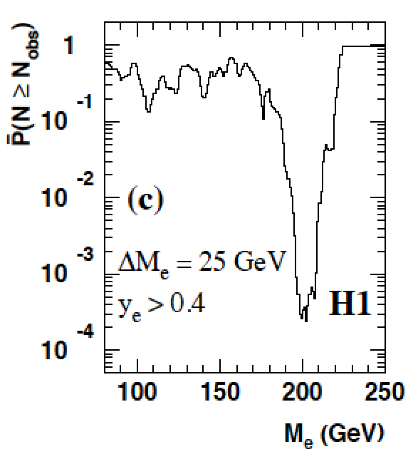
Careful with “Discoveries”!
4σ effect
Excess in inclusive jet
analysis
Is the X(8.31 GeV) the
Higgs particle? A lot of
excitement summer 1984
NON of these were
actual discoveries!!
Excess of events at high Q² in ep DIS at HERA, mainly in H1:
•7 events found with an electron-quark mass of ~200 GeV, expected ~1 event
•4 events found with expected 2 events in ZEUS

Slide 14
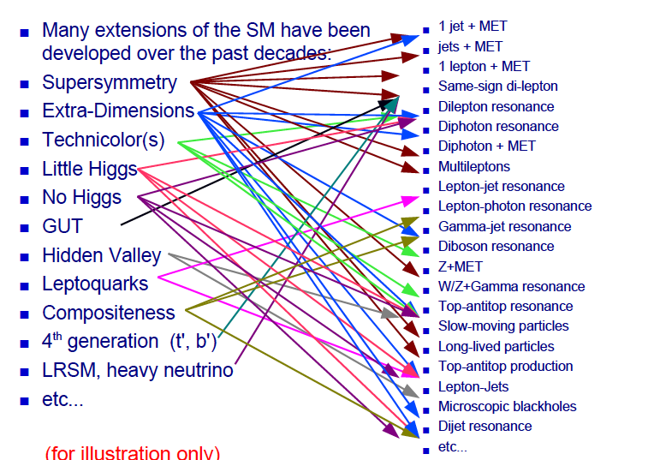
Beyond the SM Signatures

Slide 15
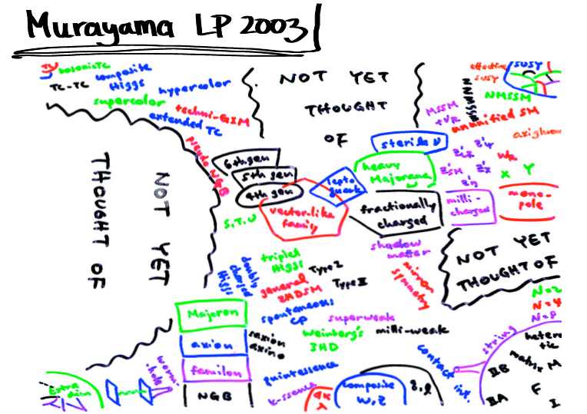
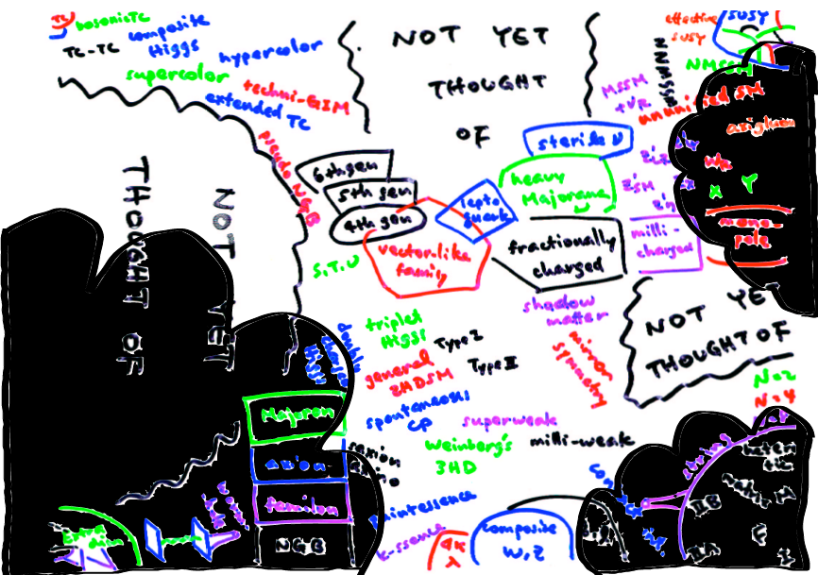
2010-2012: LHC data and Theorists
NOW!

Slide 16
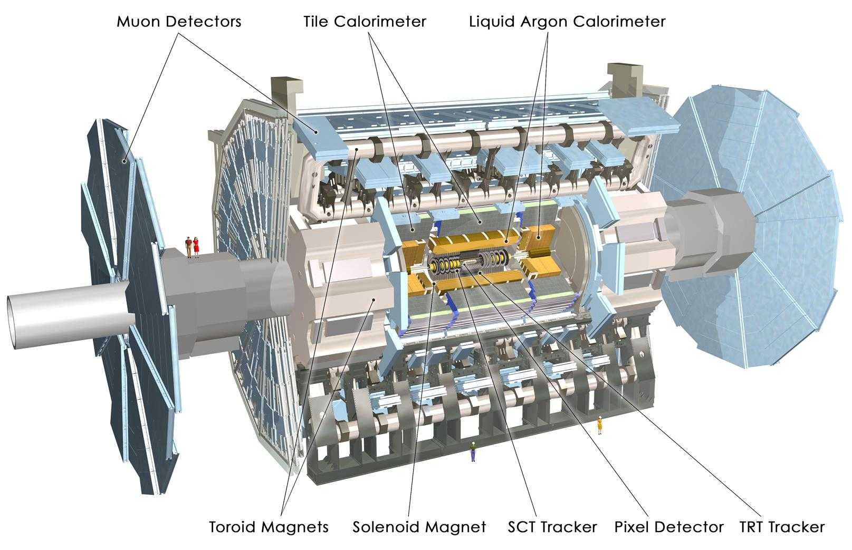
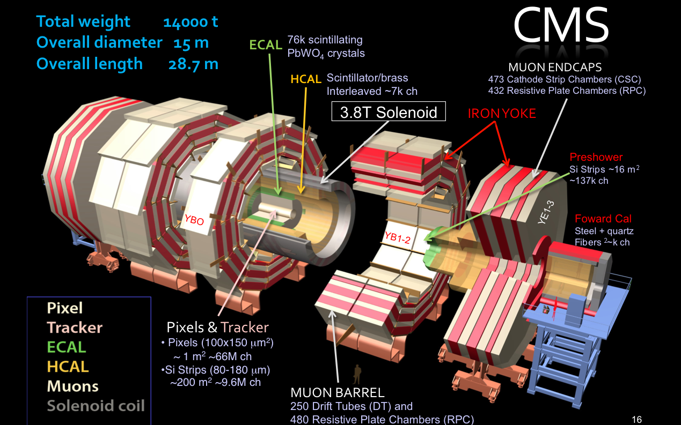
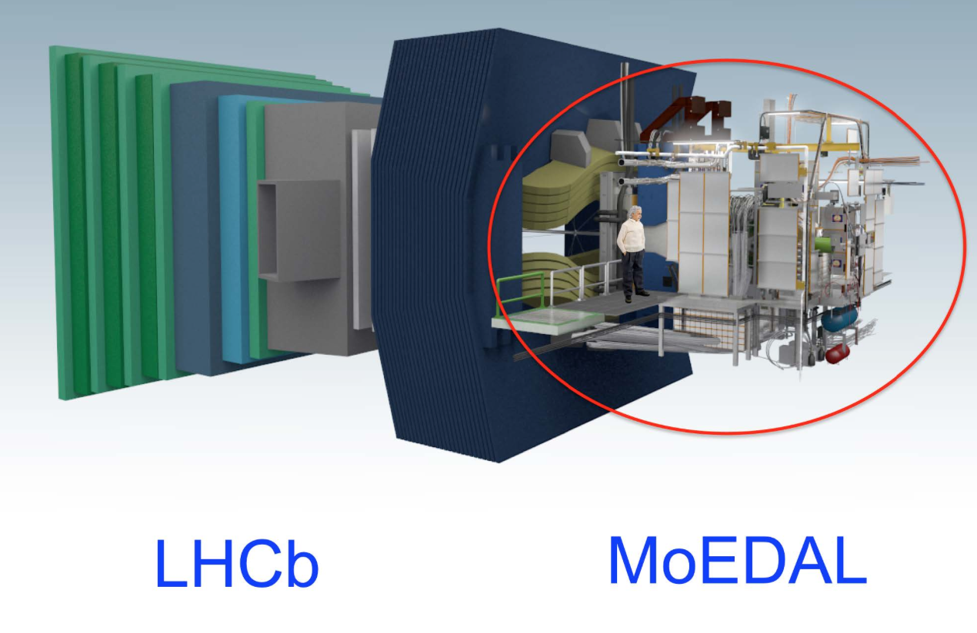
New Physics Hunters @ the LHC
The ATLAS experiment
The CMS experiment
…And also LHCb and MoEDAL

Slide 17
Searches for BSM Physics
First Searches at the LHC (2010-2012)
Supersymmetry with MET plus jets, lepton(s), photons
Extra Dimensions and black holes, heavy resonances (in electrons, muons, taus, jets), leptoquarks, excited leptons and quarks, 4th generation, a few very exotic signatures (R-hadrons)…
Evolved Searches (2013-…)
Supersymmetry on third generation squarks, compressed spectra, stealth SUSY, EWKinos, VBF processes…
Higgs in decays or as study object, vector-like quarks, boosted objects, long lived particles, fractional charges…
More dedicated Dark Matter searches!
We now restarted of the machine at 13 TeV…
Back to the basics or do we change paradigm?

Slide 18
Summary of Exotica Searches
2014
Similar results for ATLAS

Slide 19
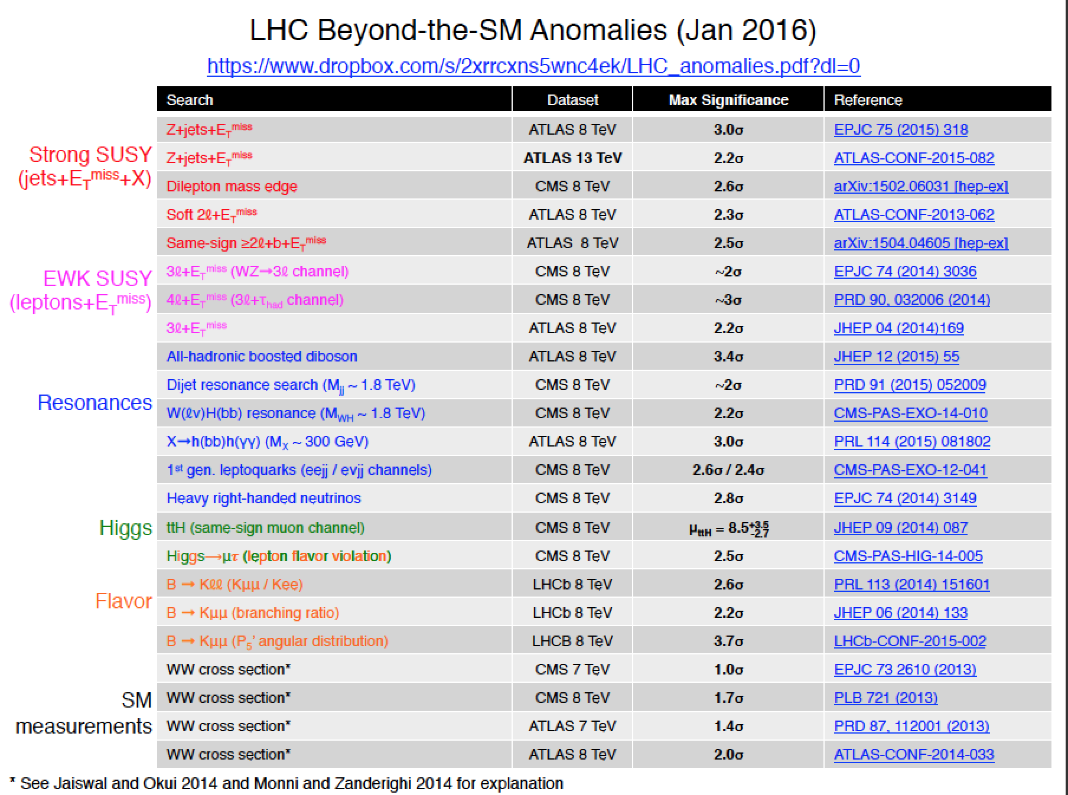
Run-1: We Observed Mild Deviations!
B. Hooberman
November 2015

Slide 20
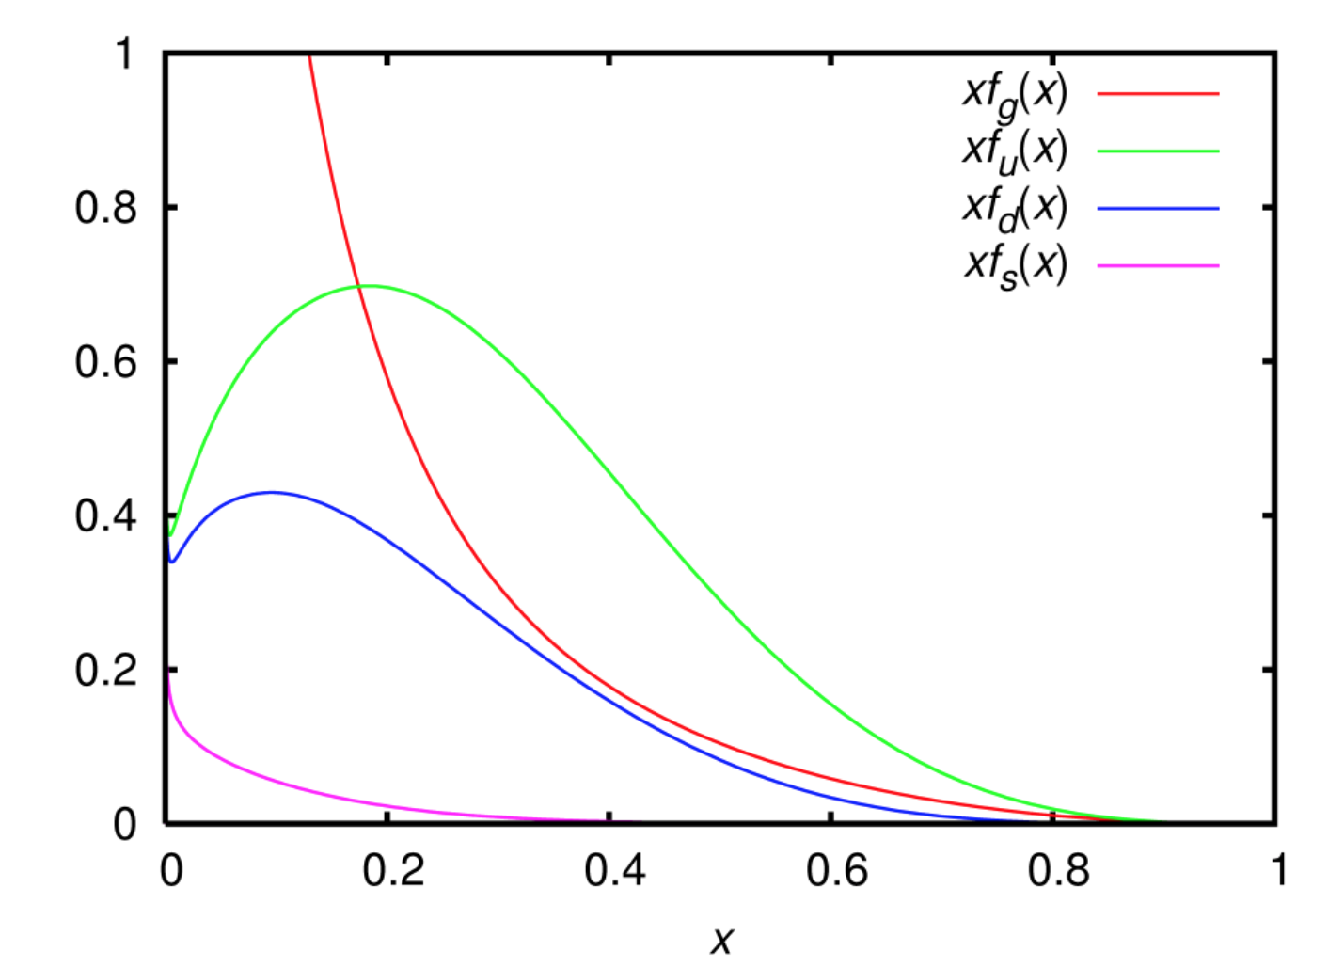
New Physics Searches with 2015 Data
For searches above 1-2 TeV the 2015 data sample becomes already important

Slide 21
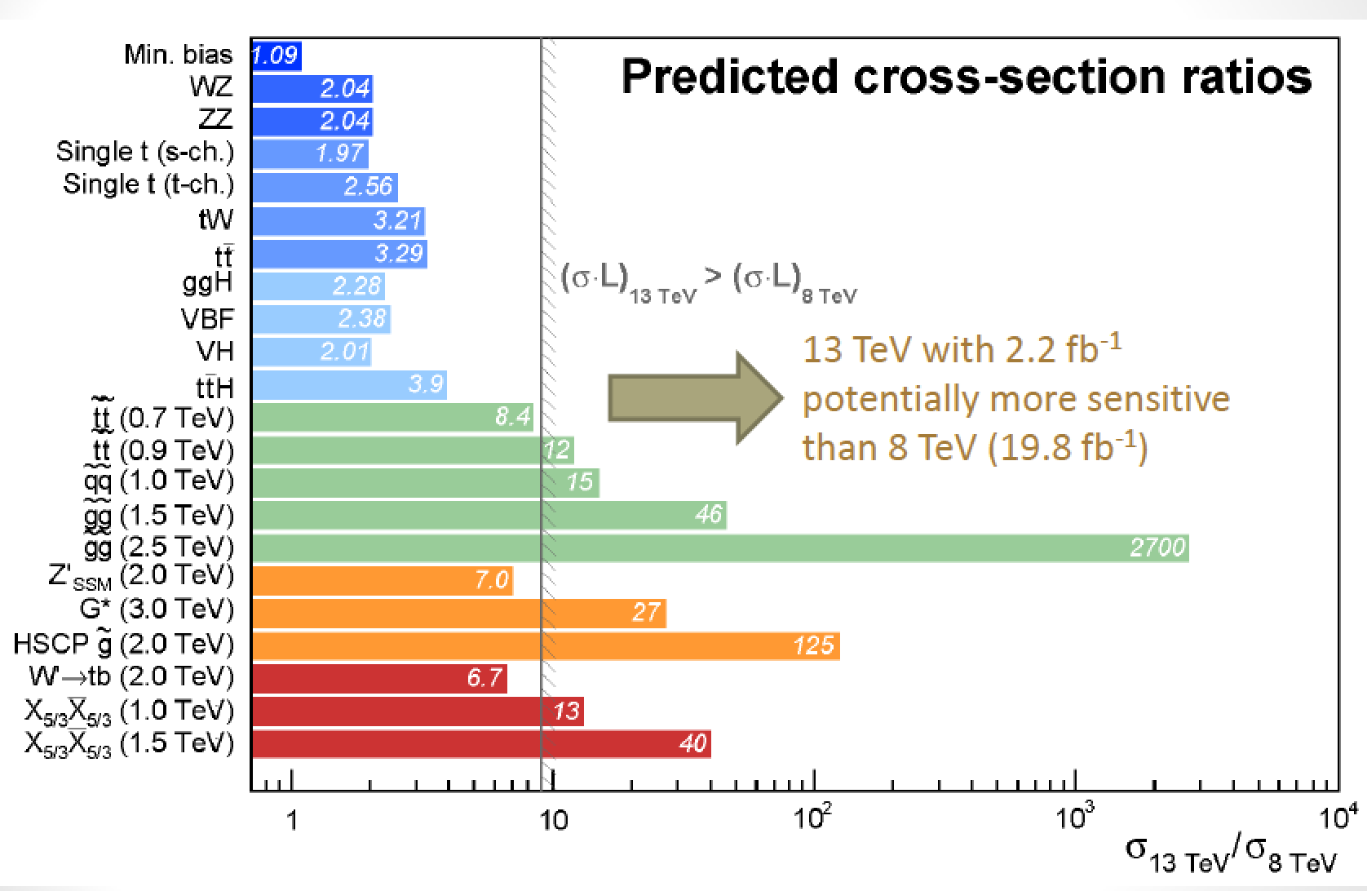
Run-II: From 8 TeV to 13 TeV

Slide 22
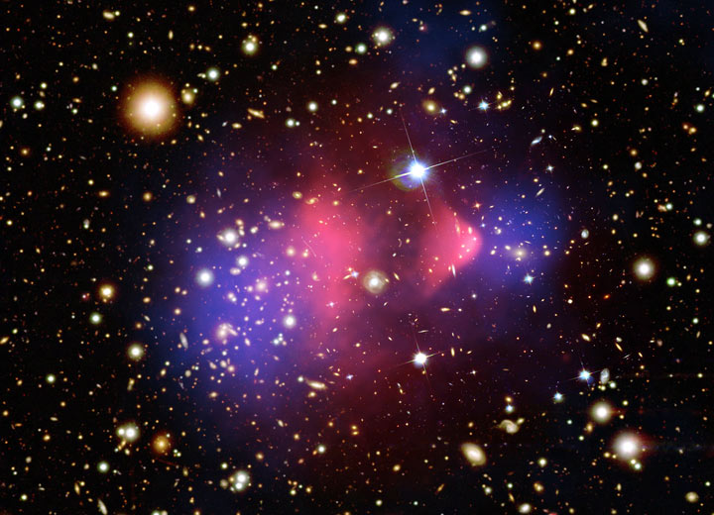
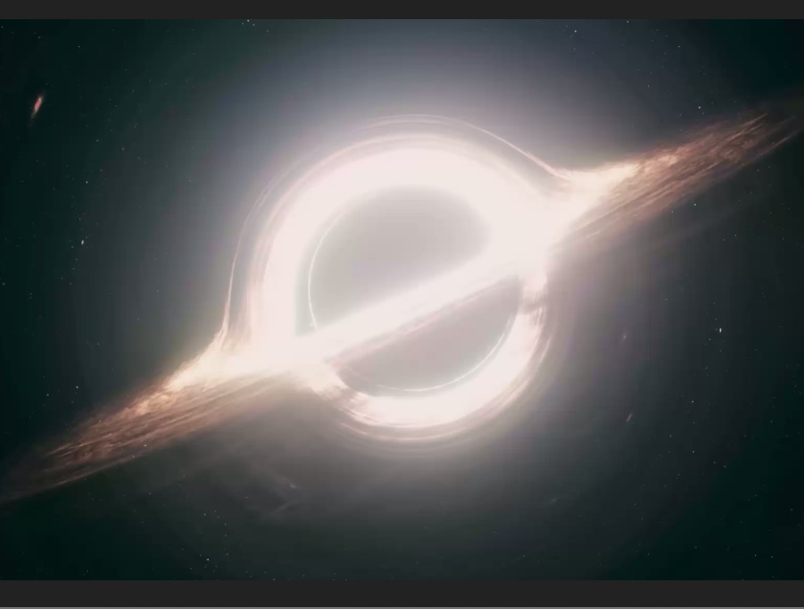
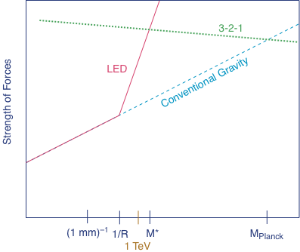
Extra Space Dimensions
Problem:
Interstellar
The Gravity force becomes strong!

Slide 23
Planck scale (M_{D}) ~ TeV
ADD
Arkani-Hamed Dimopoulos Dvali
RS
Randall Sundrum
look-like SUSY
UED
Universal Extra Dimensions

Slide 24
Large Extra Dimensions

Slide 25
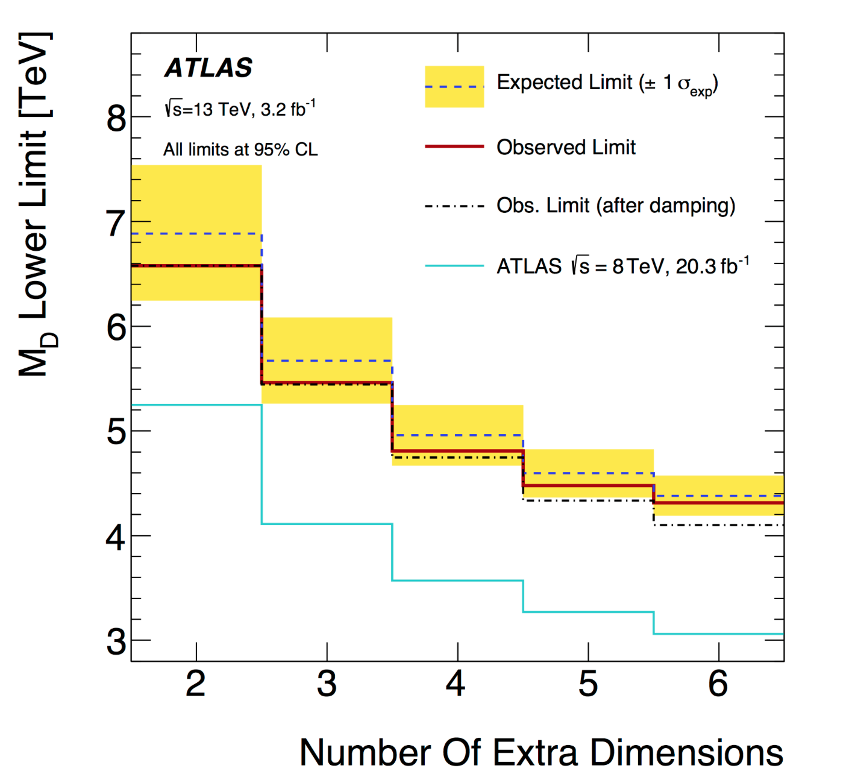
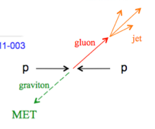
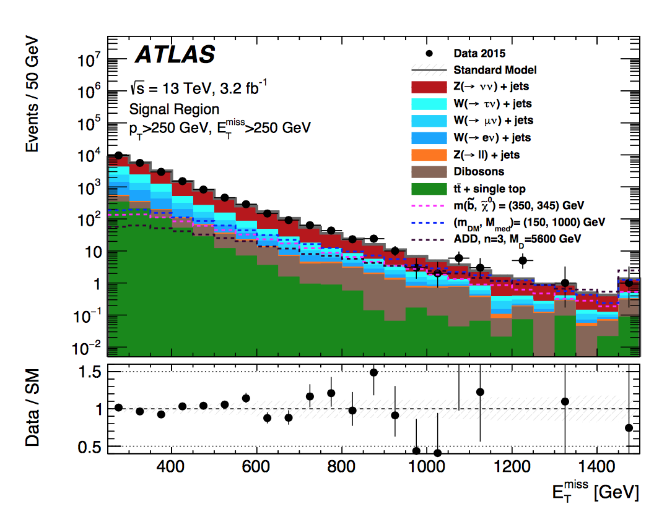
Search for Large Extra Dimensions
Example:Mono-jet final state +Missing E_{T} (ADD)
arXiv:1604.07773
Limits on M_{D}
between
~ 7 and 4 TeV
Lower limit on the Planck Scale
versus number of extra dimensions
p_{T} jet > 250 GeV
MET > 250-700 GeV

Slide 26
A High p_{T} Mono-jet event

Slide 27
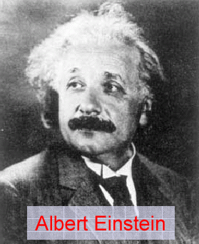
Quantum Black Holes at the LHC?
Black Holes are a direct prediction of Einstein’s
general theory on relativity
If the Planck scale is in ~TeV region:
can expect Quantum Black Hole production
Quantum Black Holes are harmless for the environment: they will decay within less than 10⁻²⁷ seconds ⇒ SAFE!
Quantum Black Holes open the
exciting perspective to study
Quantum Gravity in the lab!
Simulation of a Quantum Black Hole event

Slide 28
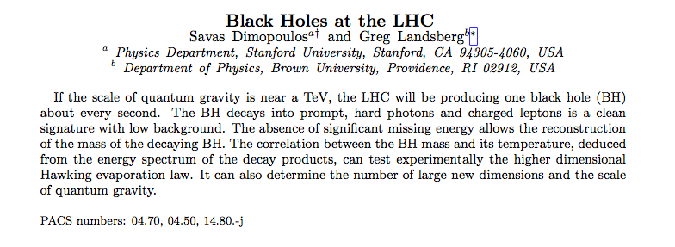
Black Holes at the LHC?
Savas Dimopoulos, theorist
New York times 9/11/2001
Snowmass 2001
Greg Landsberg
Previous CMS physics coordinator

Slide 29
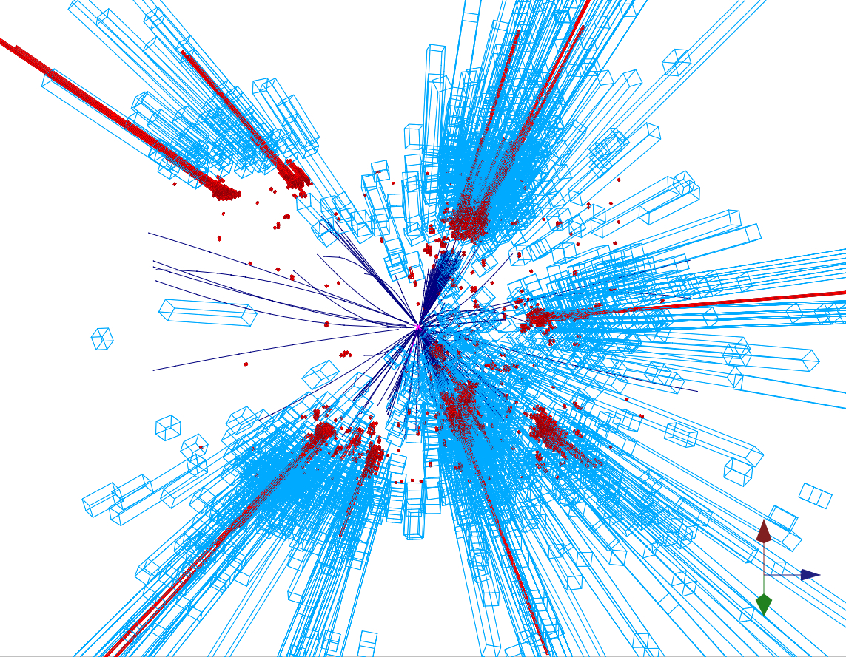
Quantum Black Holes
Schwarzschild radius
Landsberg, Dimopoulos, Giddings, Thomas, Rizzo
4-dim., M_{gravity}= M_{Planck} :
R_{s} → << 10⁻³⁵ m
R_{s} → ~ 10⁻¹⁹ m
4 + n-dim., M_{gravity}= M_{D} ~TeV:
Since M_{D} is low, tiny black holes
of M_{BH} ~ TeV can be produced if
partons ij with √s_{ij} = M_{BH} pass at a
distance smaller than R_{S}
R_{S}
Large partonic cross-section : σ (ij → BH) ~ π R_{S}²
σ (pp → BH) is in the range of 1 nb – 1 fb
e.g. For M_{D} ~1 TeV and n=3, produce 1 event/second at the LHC
Evaporates in 10⁻²⁷ sec
Black holes decay immediately by Hawking radiation (democratic evaporation) :
-- large multiplicity
-- small missing E
-- jets/leptons ~ 5
expected signature (quite spectacular …)

Slide 30
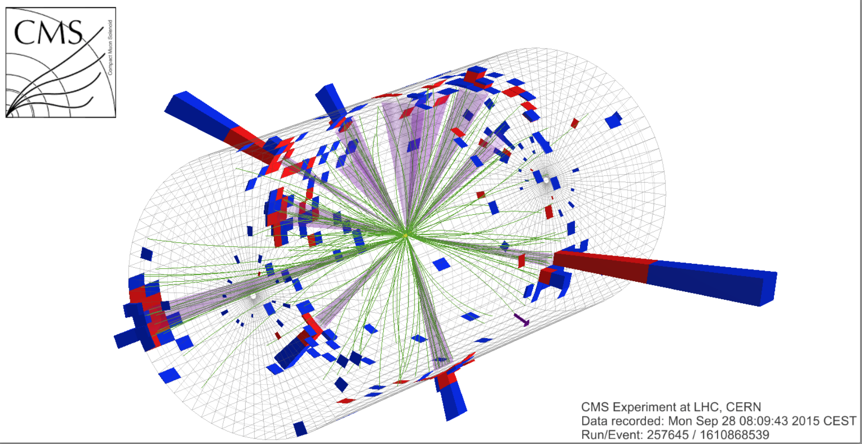
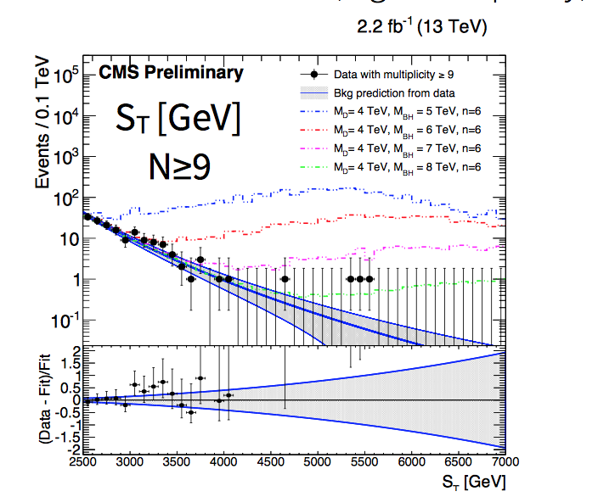
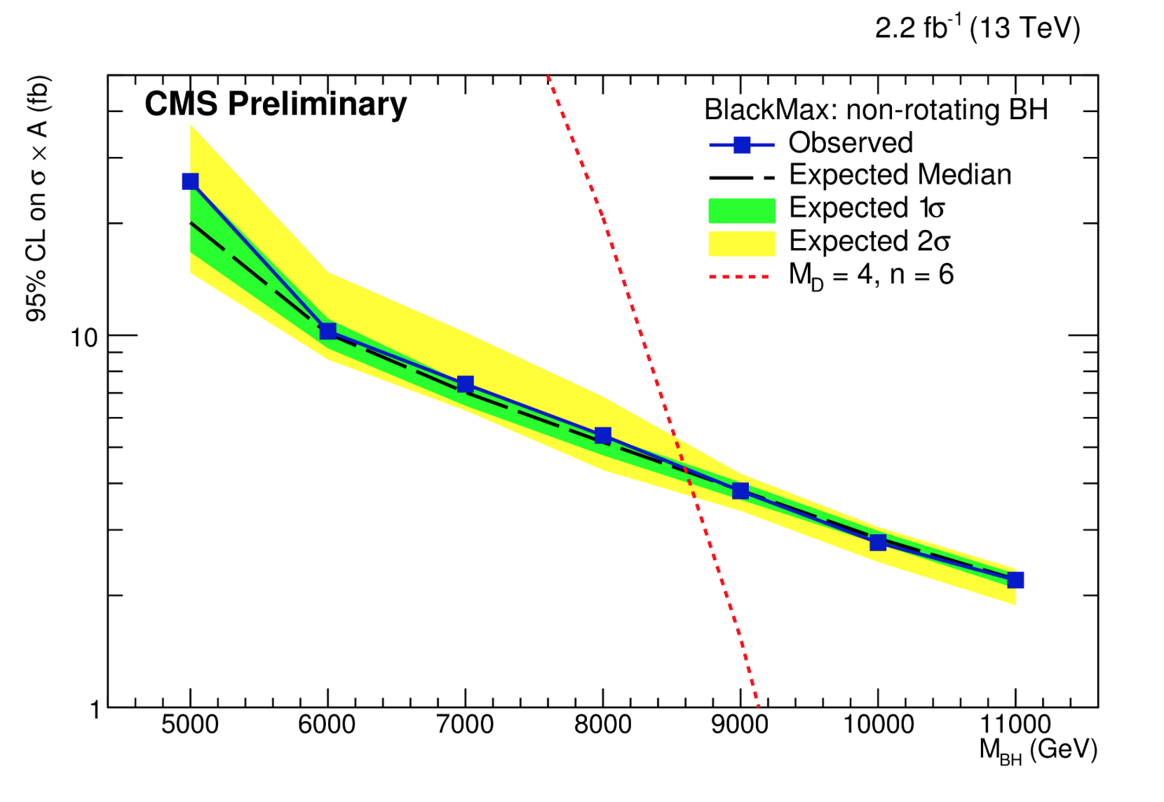
Search for Micro Black Holes
Extra Dimensions!
2015: 12 jet event with S_{T}=5.4 TeV
Planck scale
a few TeV?
CMS-EXO-15-007
Look for the decay producs
of an evaporating black hole
•Define S_{T} to be the scalar
sum of all high p_{T} objects
found in the event
•Look for deviations
at high S_{T}
Black hole mass excluded in range below ~8-9 TeV depending on assumptions

Slide 31
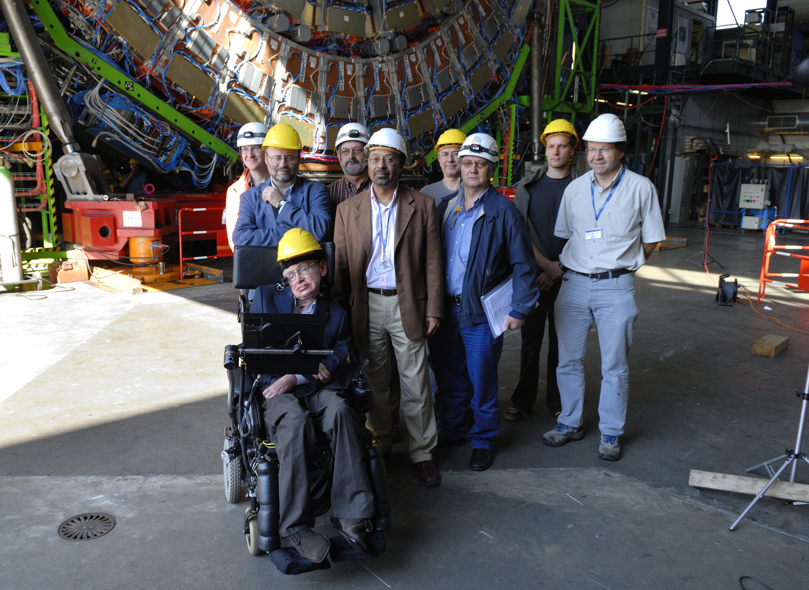
Black Holes Hunters at the LHC

Slide 32
Search for High Mass Resonances

Slide 33
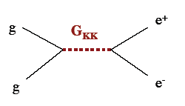
E.g. Di-lepton Resonance
Example
pp→μμ +X
Plot the di-lepton
invariant mass
A peak!!
A new particle!!
A discovery!!
G ?
μ
μ
If we are lucky:
a signal could be
seen very early on

Slide 34
2011: Z’ Boson to ee or μμ?
Extension of the symmetry?
New Gauge bosons?
Mid 2012
Did additional
data confirm
the excess??

Slide 35
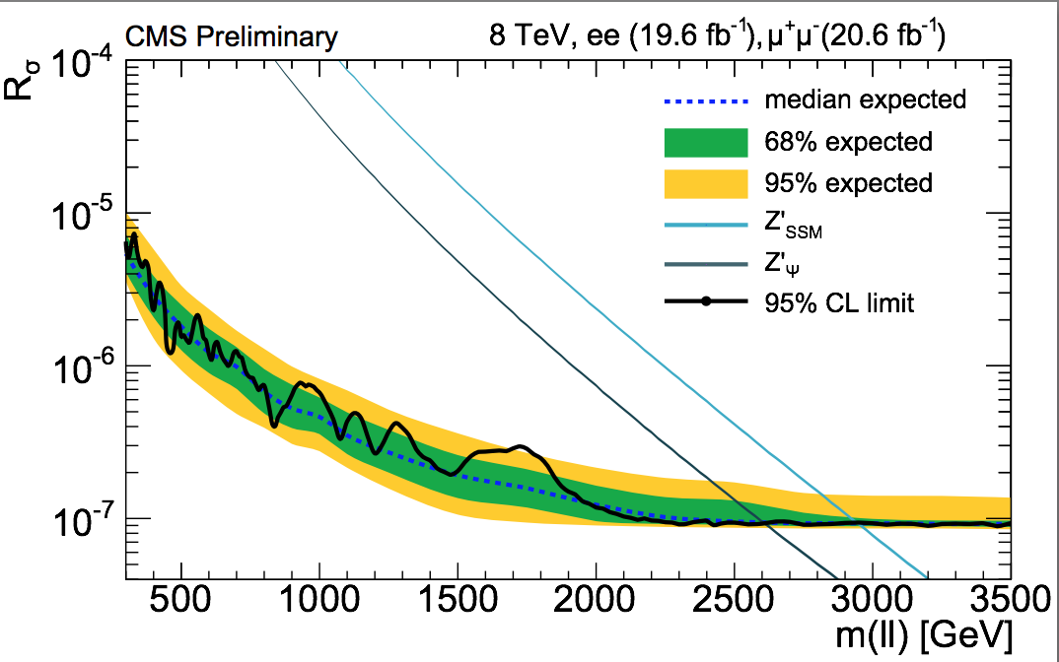
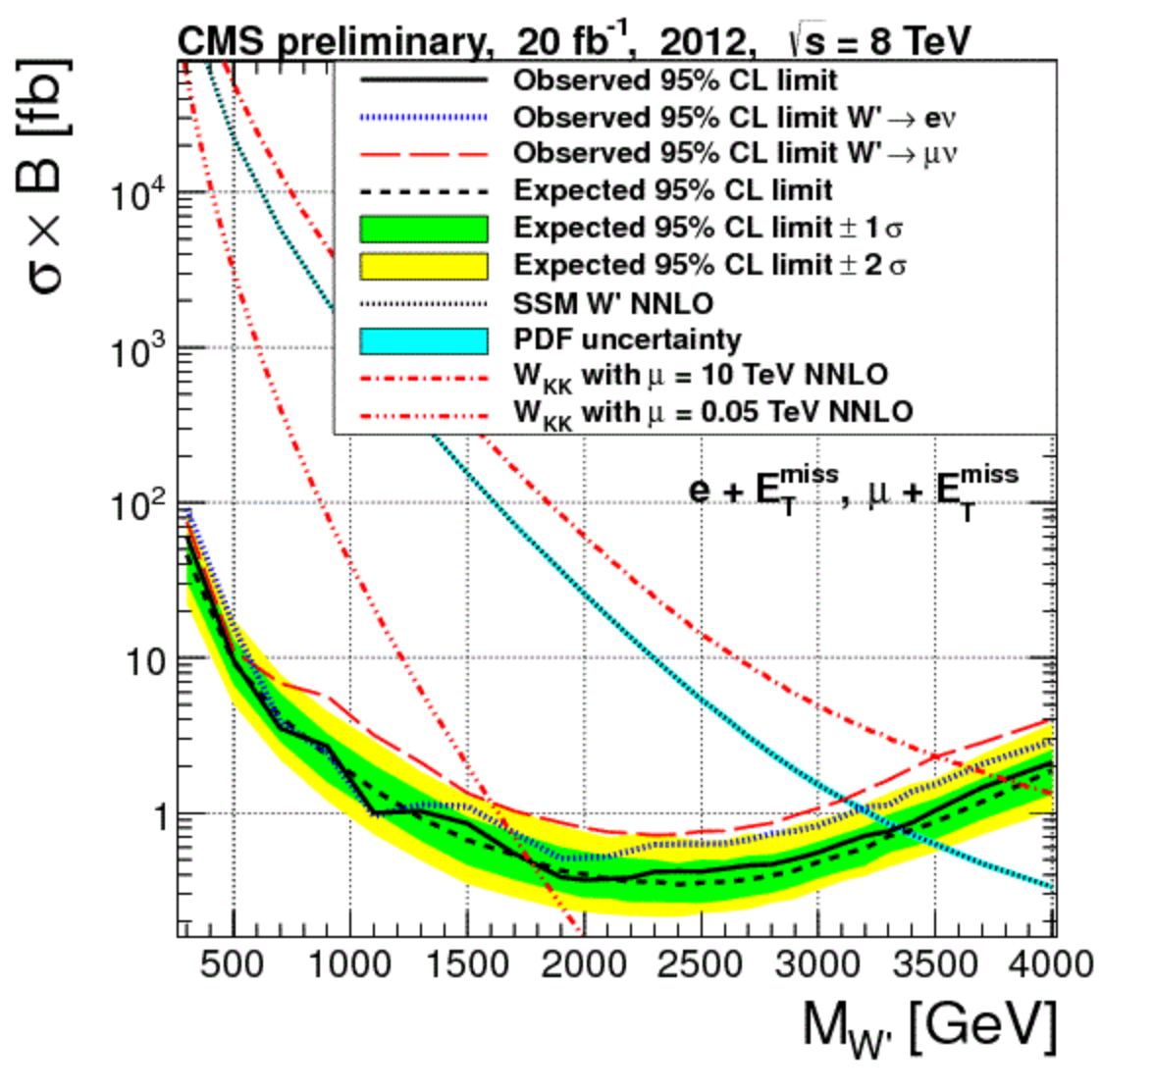
New Gauge Bosons: Z’, W’
Early 2013
Z’
W’
No… ☹
W,’ Z’ Limits are around 3 TeV in
Run-1

Slide 36
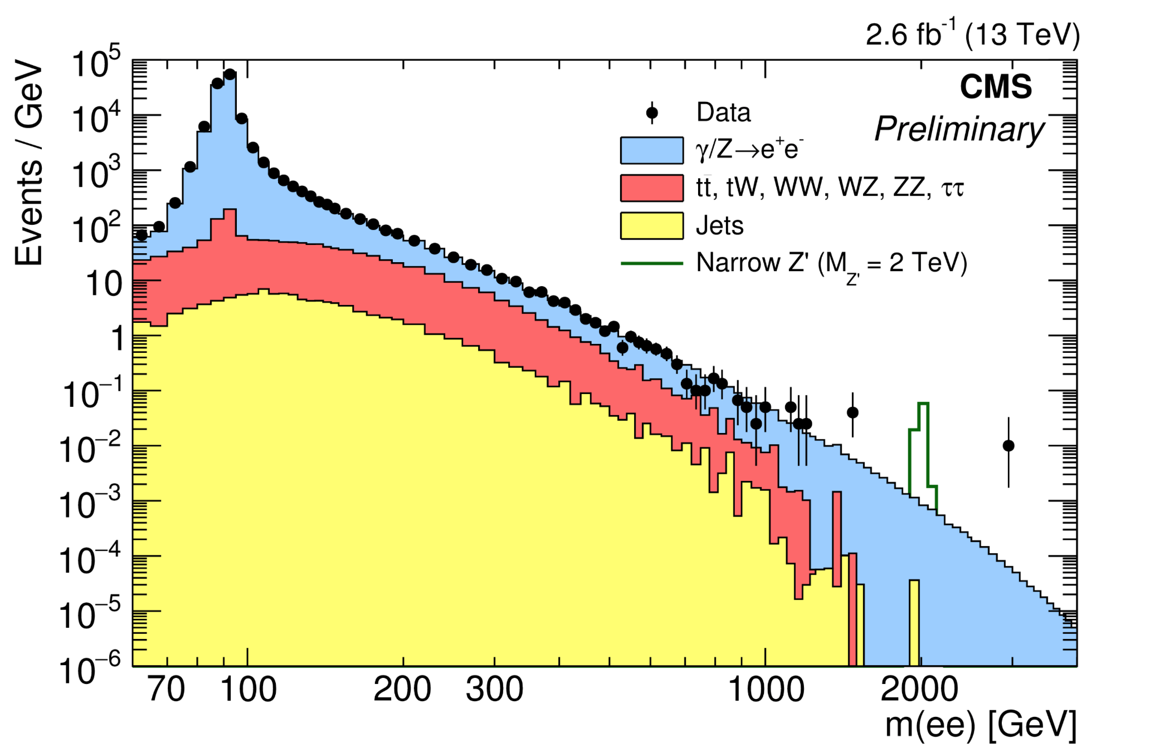
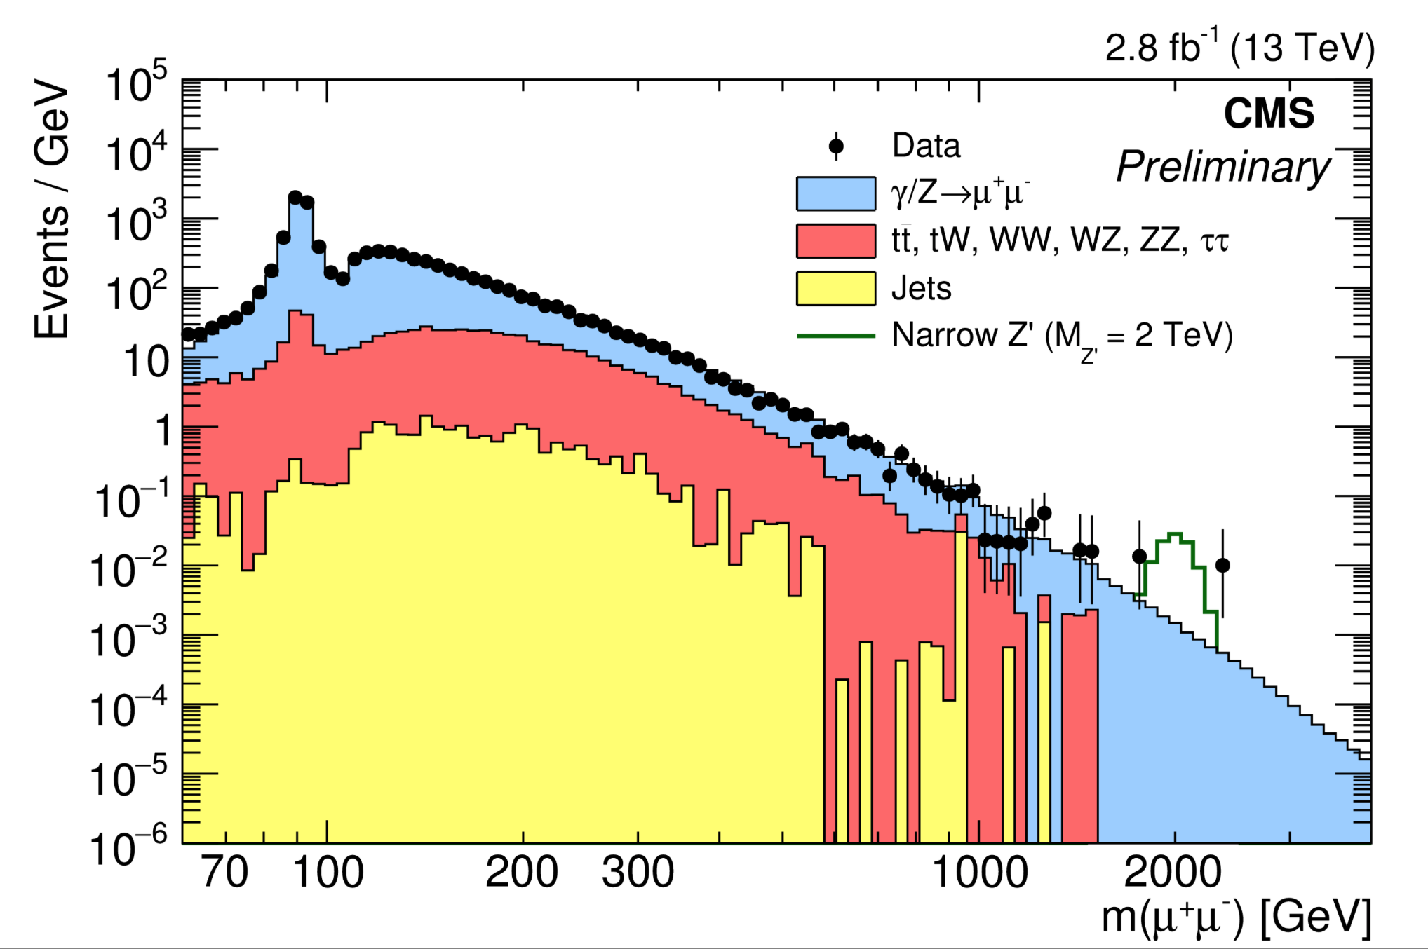
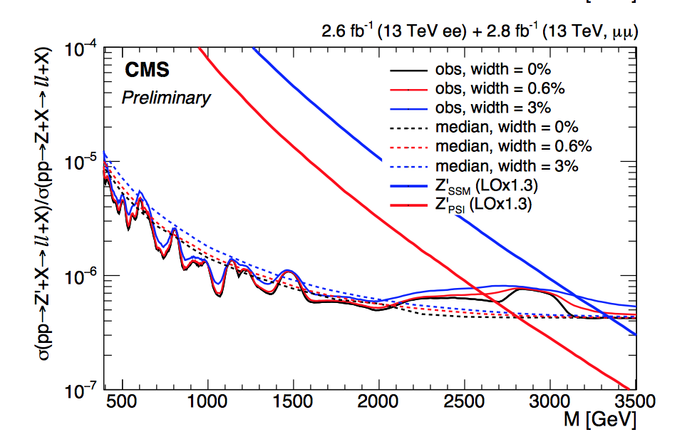
Search for New Gauge Bosons
EXO-15-005
Search for Z’ in dilepton decay channel
Within the first week of the
new run we got a spectacular
new event (~10 pb⁻¹ of data)
We had no event at such high
invariant mass in 2011-2012

Slide 37
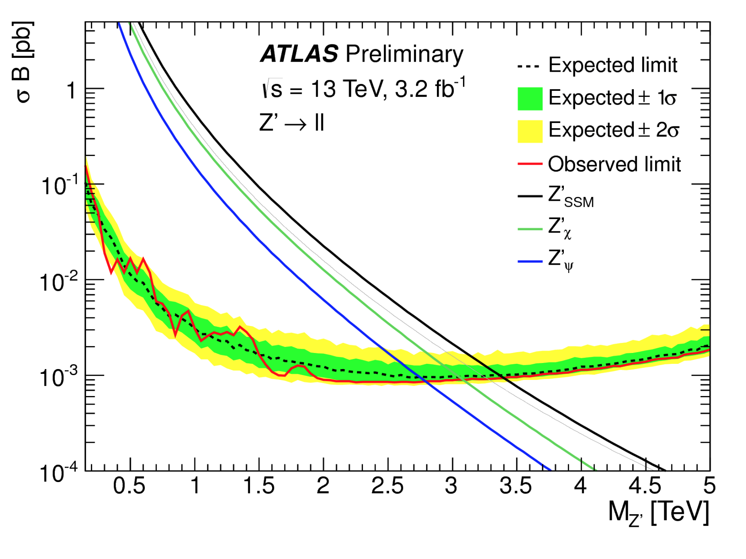
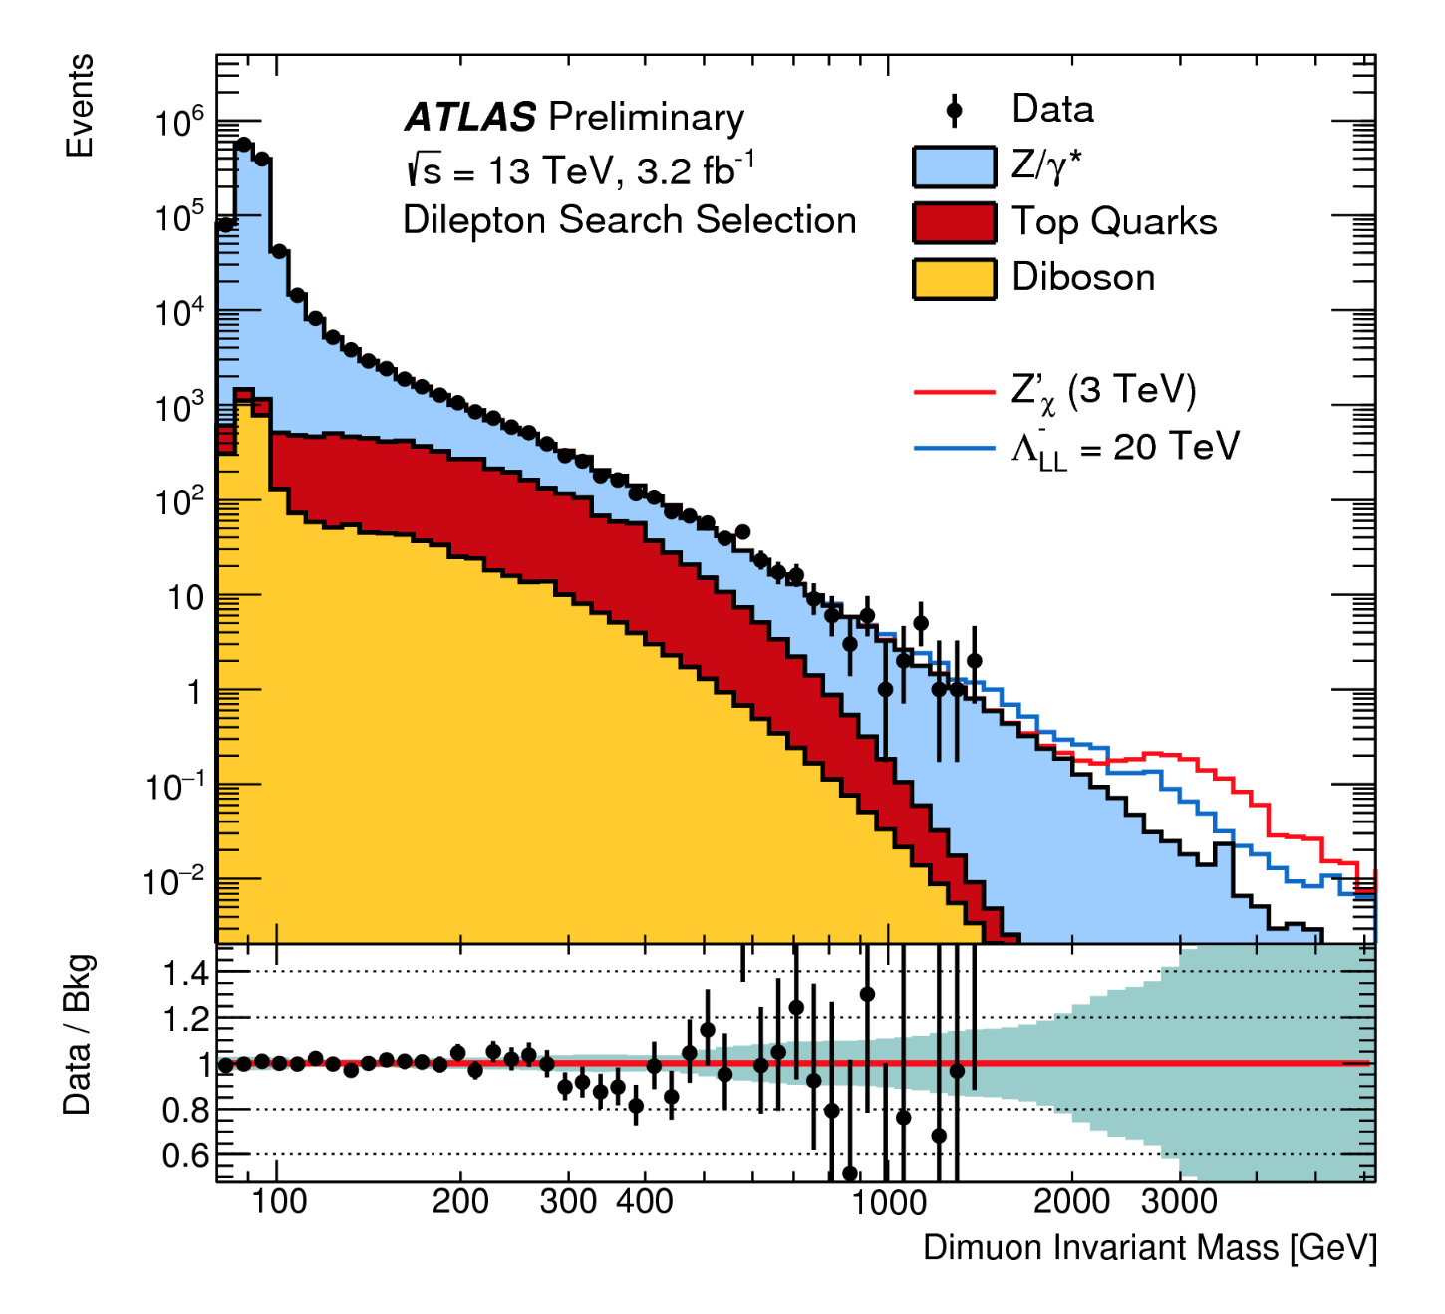
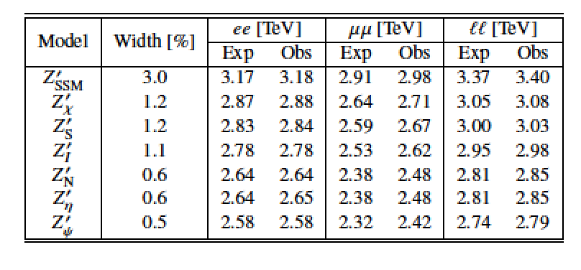
Search for New Gauge Bosons
ATLAS-CONF-2015-070
Limits (95% CL) on various Z’ models

Slide 38
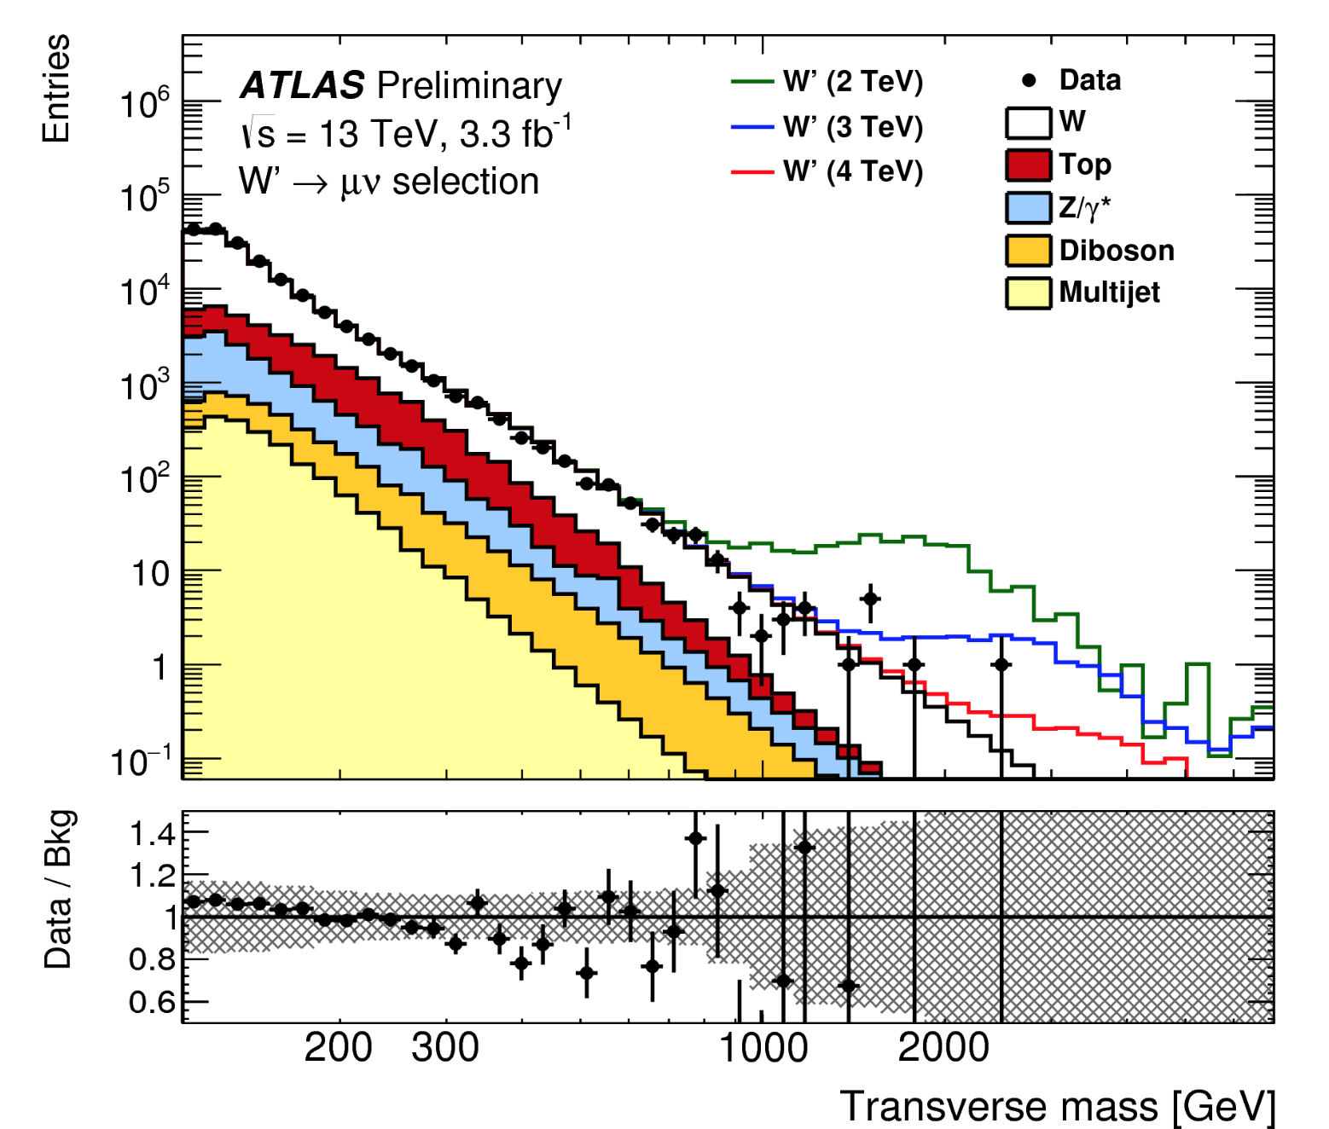
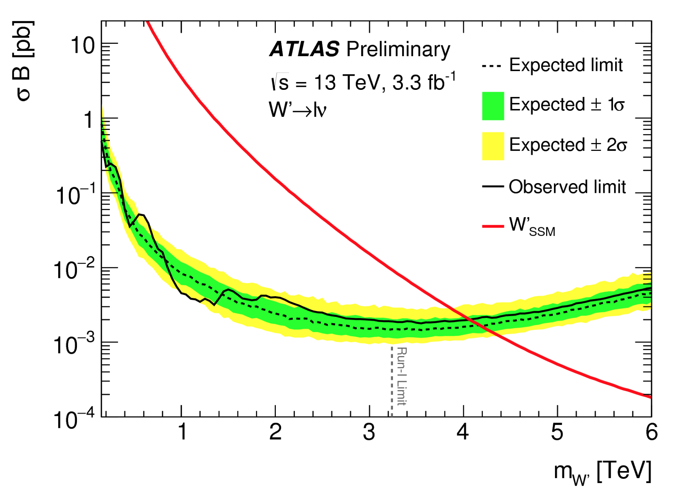
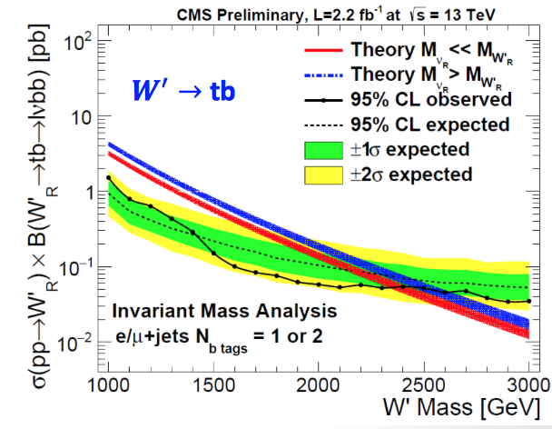
W’ Search in lν and tb Final States
ATLAS-CONF-2015-063
CMS-EXO-15-004
Mass exclusion
limits up to
4.4 TeV in lν
and 2.3 TeV in
tb channel
Lepton+jets channel

Slide 39
Di-jet Resonances

Slide 40
Dijet Resonance Search
The highest mass dijet events
recorded so far in run-2
Dijet invariant mass = 6.14 TeV
Dijet invariant mass = 7.9 TeV

Slide 41
Di-jet Searches
Run-1
CMS-EXO-12-059
arXiv:1407.1376

Slide 42
Early Di-jet Searches: 13 TeV
A first look with early data …

Slide 43
Dijet Searches: 13 TeV
arXiv:1512.01224
2.4 fb⁻¹ limits from 13 TeV already
surpass the 20 fb⁻¹ limits from 8 TeV

Slide 44
Excited Quark in Dijet Search
invariant mass of 4.69 TeV, and jets with
a jet-p_{T} of 2.29 TeV and 2.19 TeV
arXiv:1407.1376
Limit on the mass of excited quarks > 4.09 TeV at 95% CL

Slide 45
Photon+Jet: Excited Quarks Search
arXiv:1512.05910
•Search for q* and quantum black holes
•Background modelling similar to di-jet
Search with function:
95% CL Limit on q* is now 4.4 TeV

Slide 46
Are Quarks Elementary Particles?
Rutherford experiment:
Unexpected backscattering
of α-particles:
Evidence for the structure
of atoms !! (1911)

Slide 47
Are Quarks Elementary Particles?
Measurement of the production angle
of the jet with respect to the beam
-> High Energy Rutherford Experiment
Quarks remain elementary particles after these first results

Slide 48
Dijet Angular Distributions
arXiv:1512.01530
CMS-EXO-15-002
Limits on contact interactions up to Λ=12 TeV
No evidence for substructure of quarks

Slide 49
Search for a 4th(-like) Generation
We can’t be sure that there are only 3 generations (u,d) (s,c) (b,t)
A possible new generation should be heavy!
Look for b’ and t’ quarks

Slide 50
4th Generation Searches
•No evidence found for a new quark
generation for quarks with mass < 550 GeV!
•A chiral 4th generation would also affect
the Higgs rate in a substantial way, so it
is unlikely to exist!

Slide 51
Searches for Top/Bottom Partners
Vector-like quarks
Relevant eg in
composite Higgs
models
Exclusions up
to masses of
800 GeV

Slide 52
Searches with Boosted Objects

Slide 53
TeV Resonances into Top Quark Pairs
Recent developments in models: a prominent role of top production
light SM fermions live near Planck brane, heavy (top) near TeV brane
decay of Randall Sundrum gravitons into top pairs!!
TeV resonances ⇒ Highly boosted tops
The jets typically appear as ‘fat’ jets
with internal structure

Slide 54
Searches with Boosted Objects
Discussed in topical “Boost Workshops”
Last one Zurich 18-22 July 2016
https://indico.cern.ch/event/439039/

Slide 55
Resonances Decaying into VV?
Search for heavy resonances decaying into VV jets
using boosted jets and jet substructure analysis
arXiv:1506.00962
arXiv:1606.04833
Jets start to merge for
X = 700-900 GeV
arXiv:1405.1994
EXO-15-002
Run-1: Excess in ATLAS in WZ channel of 3.4σ (2.5σ with LEE) around 2 TeV.
Bump around 1.9 TeV in CMS in different channels (~2σ)
Run-2: Excess not confirmed
But more data needed to
completely settle the issue

Slide 56
Real Exotic Objects!
Many new searches for truly exotic particles, ie long-lived
particles or other unusual signatures

Slide 57
Searches for Unusual Particles
Heavy stable charged particles with unit charge traversing the detector
Heavy stable charged particles with multiple charge traversing the detectors
Heavy stable charge particles with fractional charge traversing the detector
Heavy new particles decaying in the detector
Heavy new particles stuck in the material in or before the detector

Slide 58
W. Wulsin

Slide 59
Fractional Charged Particles
M. Perl et al., 2004
Search possible @ LHC
Both for q=1/3e and q=2/3e
Tracks with a high number of low-ionizing hits in the tracker

Slide 60
Particles with Fractional Charge
GeV
GeV

Slide 61
Long Lived Particles
Split Supersymmetry
The only light particles are the Higgs and the gauginos
- Gluino can live long: sec, min, years!
- R-hadron formation (eg: gluino+ gluon): slow, heavy particles
Gravitino Dark Matter and GMSB
In some models/phase space the gravitino is the LSP
⇒ NLSP (neutralino, stau lepton) can live ‘long’: “heavy muon-like?
⇒ non-pointing photons
Hidden Valley modes!…
Plethora of possibilities for long lived neutrals
EG: K. Hamaguchi,M Nojiri,ADR hep-ph/0612060
ADR, J. Ellis et al. hep-ph/0508198
Sparticles stopped in the detector,walls
of the cavern, or dense ‘stopper’ detector.
They decay after hours---months…
⇒Challenges to the experiments!

Slide 62
HEP-PH/0202233; 853 citations!

Slide 64
Hidden Valley Physics: New Signatures
M. Strassler, K. Zurek
Possible new
Higgs decay
modes
Will produce “Weird Jets”
and a lot of secondary
vertices from b-quark jets
⇒ Difference with QCD jets??
⇒ Study SM jet structure!!
63
Notes:
63

Slide 65
Muon-based

Slide 67
Stopped R-hadrons or Gluinos!
The R-hadrons may loose
so much energy that they
simply stop in the detector
…and decay some time later
⇒ Special triggers needed, asynchronous with the bunch crossing

Slide 68
Eg. R-hadrons

Slide 69
Heavy Stable Charged Particles
Detection techniques used for heavy (multiple/fractional ) stable charge particles in CMS
• Abnormal energy loss (de/dx) for given momentum
• Slower than speed of light (lowβ) via time of flight measurements
with the CMS muon system (CSC/DT/RPC)
• A few special measurements
Time of flight

Slide 70
Heavy Stable Ionizing Particles

Slide 71
Heavy Ionizing Stable Particles
Observed limits

Slide 72
Monopoles
Magnetic Monopoles to explain the quantization of electric charge (Dirac ‘31)
= n 68.5e
Symmetrizes Maxwell equations
Searched for at all colliders
Tevatron limits ~ 400-800 GeV
arXiv: 1112.2999

Slide 73
Monopole Searches: ATLAS
•For Monopoles, expect tacks with high de/dx and particle stopped in ECAL
•Use fraction of hits in TRT above a high threshold f_{HT} and narrowness w
of the shower in ECAL arXiv:1509.08059
Zero events observed

Slide 74
MoEDAL: Search for Monopoles
DC SQUID
Zurich
160 kg Magnetic Monopole Trapper prototype made of 198 aluminium rods of 2.5 cm diameter and 60 cm length (0.75 fb^{-1 @} 8 TeV)
No Monopoles found yet-> Limits!
arXiv:1604.06645

Slide 75
Monopolium ?
Maybe monopoles are not see because they are confined in a monopole- anti-monopole bound state: monopolium
Annihilation into two energetic photons
Sensitivity to new mass range already with 1 fb⁻¹
Monopolium cross section
(example)

Slide 76
Macro-Strings at the LHC?
New strong interactions with small Λ & new quarks m_{Q}> several hundred GeV
Markus Luty/Aspen 07
• Strings do not break up ⇒ Stringy objects in the detector.
• End points are massive quarks (quirks)
• The strings can oscillate ⇒ strange signature in detectors

Slide 77
Possible Quirk Studies
Study zero “curvature tracks” from pairs of quirks

Slide 78
More Quirks…
Harnik & Wizansky arXiv:0810.3948
One possibility of a
fast charged oscillator
Lots of QED radiation
Lots of soft photons
A photon cloud
CMS had a trigger in 2010 to
Look for 160 GeV (HLT) in
ECAL, summing energies in towers larger than 200 MeV.
About 25 pb⁻¹ of data on tape

Slide 79
Do we see anything unexpected?

Slide 80
High Mass Search: X → γγ ???
News from the 2015 data run in last December!!!
->Some excitement on an mild observed excess in both
experiments for a diphoton mass of around 750 GeV
ATLAS-CONF-2015-081
CMS EXO-15-004
A totally unexpected
new particle???
Statistical fluctuation? A new resonance? Excitement…!!

Slide 81
Diphoton Resonance Searches: CMS
arXiv:1606.04093
Find 2 isolated photons
with p_{T}> 75 GeV and
at least one of which is
in the barrel detector
(|η|<1.45)
Use both the 0T and
3.8T field data.
Analysed for
- spin-0 and spin-2
interpretation
Narrow and wide width
tested. Narrow preferred

Slide 82
Diphoton Resonance Searches: CMS
P-values: Significance of the 13 TeV data: 2.7σ (global)
Add (published) 8 TeV data
arXiv:1506.02301
Significance of the 13+8 TeV data: 3.4 σ (global) and 1.6 σ (local)

Slide 83
Diphoton Resonance Searches:(ATLAS)
Two photons with sliding cuts: E_{T1}> 0.4m_{γγ} and E_{T2}> 0.3m_{γγ} (spin-0)
Analysis for both spin-0 and spin-2, and for narrow NW and wide width WW
arXiv:1606.04093
Total width of about 45 (57) GeV preferred for spin-0 (spin-2)
Global significance: 2.9 (3.3)σ for NW and 3.9 (3.8) for WW, for spin-0 (spin-2)
Local significance: 2.1 (2.1)σ for WW, for spin-0 (spin-2)

Slide 84
Diphoton Resonance Searches:(ATLAS)
Re-analysed 8 TeV data with most up to date 2012 calibration
Small excess in spin-0 around 750 GeV of about 1.9σ (not in spin-2 analysis)
13/8 TeV data consistent at the 1.2(2.1)σ level for gg (qq) processes for spin-0

Slide 85
This triggered >500 papers so far!!
Andre David: http://jsfiddle.net/adavid/bk2tmc2m/show/
17/7/2016
Constant rate of 2 papers/ working day!
Some papers got submitted to
the arXiv during the CERN talks!!
(two papers appeared before…
in retrospect)

Slide 86
Search for Diphoton Resonances
March 2016 conclusion
A bit early perhaps? ☺
Data are coming!! ☺☺
PDG 2017?
Will add ~ 13 fb⁻¹
A Strumia :arXiv:1605.09401
•Collected about 12 fb⁻¹/experiment in 2016 so far
•Experiments monitor the data at regular intervals…
•Expect about >10 fb⁻¹ available for ICHEP2016 in August!!
->Plan as it is today: publically release the data at ICHEP2016
ie. this Friday (evening China time)

Slide 87
A New Particle at 750 GeV??
Strumia

Slide 88
More Searches
Heavy fermions EXO-16-001
Leptoquarks EXO-16-007
eμ resonances EXO-16-001
Dark Matter (Mono-j/V) EXO-16-055
Di-jets / data scouting
EXO-14-005
Mono-top EXO-16-017

Slide 89
More Searches
Four tops ATLAS-CONF-2016-020
Extra Dimensions: jets+leptons
arXiv:1606.02265
Leptoquarks
arXiv:1606.02265
Lepton flavour violating
ATLAS-CONF-2016-0xx
Extra Dimensions: photons
arXiv:1604.01306
Diboson resonances arXiv:1606.04833

Slide 90
Summary of Exotica Searches
Similar results for ATLAS

Slide 91
Vector–like Quark Searches
Many ‘explanations’ for a possible
750 GeV diphoton excess include VLQs

Slide 92
End of Lecture IV

