Slide 1
Lecture 6 Fine-tuning Problem and New Physics
黑格斯质量的平方发散：

Slide 4
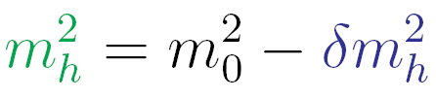
10¹⁵ GeV
大统一
If SM valid up to GUT scale, the theory
has extreme fine-tuning !
100 GeV
参数
Λ² /52
在地球上拿枪瞄准月球上的一只兔子
∼1 TeV
新物理
在光滑的镜面上竖立起一根很尖的针
1693年，牛顿
回答‘引力定律怎样跟静态宇宙自洽’：
∼100 GeV
标准模型

Slide 5
The naturalness problem is that the mass of a fundamental scalar is quadratically sensitive to high energy thresholds
This is a statement about renormalized quantities and has nothing to do with the regularization method used.
We can see this from a toy model that is a Yukawa type theory with two scalars and a fermion：

Slide 6
Using dimensional regularization and the MS renormalization scheme, we obtain at one loop

Slide 7
Thus, scalar masses are unstable, quadratically sensitive to higher energy thresholds whereas fermion masses are stable against radiative
corrections since they are protected by the symmetry.
To see this, we consider

Slide 8
‘t Hooft's Doctrine of Naturalness
G.'t Hooft: in Recent Developments in Field Theories, ed. G.'t Hooft et al., Plenum Press, New York, 1980, page 135.

Slide 9
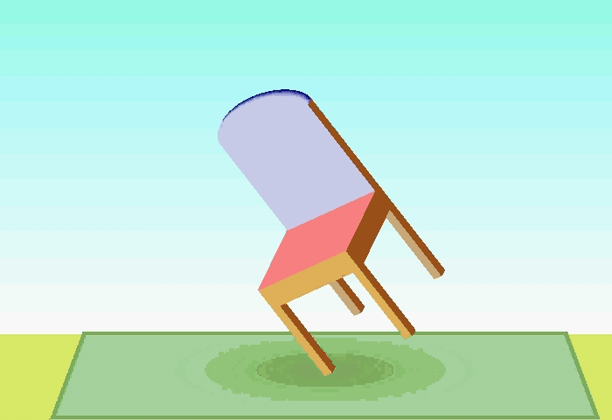
Gerard ’t Hooft,
Beijing
Feb 25, 2014

Slide 10
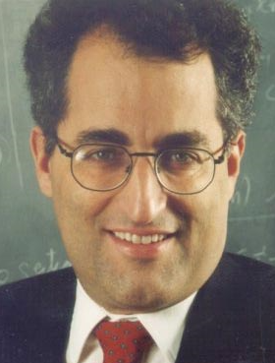
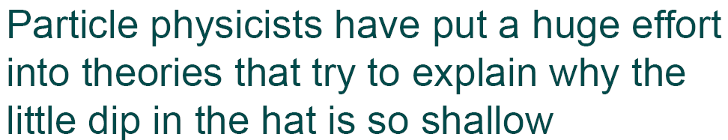
Edward Witten
Hunter College
Mar 4, 2013

Slide 11

Savas Dimopoulos
Beijing
Feb 24, 2014

Slide 14
Savas Dimopoulos
Beijing
Feb 24, 2014

Slide 15
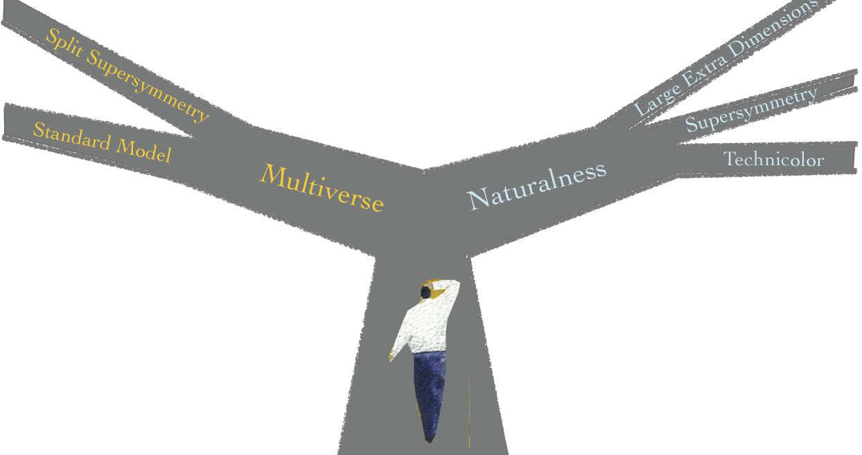
Savas Dimopoulos
Beijing
Feb 24, 2014

Slide 16

Anthropic Principle
In astrophysics and cosmology, the anthropic principle (from Greek anthropos, meaning "human") is the philosophical consideration that observations of physical Universe must be compatible with conscious and sapient life that observes it. It explains why universe has the age and fundamental physical constants necessary to accommodate conscious life. It is unremarkable that universe's fundamental constants happen to fall within the narrow range thought to be compatible with life.
Steven Weinberg noted that cosmological constant has a remarkably low value, some 120 orders of magnitude smaller than the value particle physics predicts (this has been the "worst prediction in physics"). However, if cosmological constant were only one order of magnitude larger than its observed value, universe would suffer catastrophic inflation, which would preclude the formation of stars, and hence life. The observed values of the dimensionless physical constants (like fine-structure constant) governing four fundamental interactions are balanced as if fine-tuned to permit the formation of commonly found matter and subsequently the emergence of life. A slight increase in strong interaction would bind the dineutron and the diproton, and nuclear fusion would have converted all hydrogen in the early universe to helium. Water, as well as sufficiently long-lived stable stars, both essential for the emergence of life as we know it, would not exist. More generally, small changes in the relative strengths of the four fundamental interactions can greatly affect the universe's age, structure, and capacity for life.

Slide 17
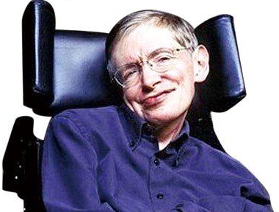
Anthropic Principle and Multiverse
A multiverse of a somewhat different kind has been envisaged within string theory and its higher-dimensional extension, M-theory. These theories require the presence of 10 or 11 spacetime dimensions respectively. The extra 6 or 7 dimensions may either be compactified on a very small scale, or our universe may simply be localized on a dynamical (3+1)-dimensional object, a D-brane. This opens up the possibility that there are other branes which could support other universes
Our own universe appears to be fine-tuned for conscious life. If there were a large (possibly infinite) number of universes, each with possibly different physical laws (or different fundamental physical constants), some of these universes, even if very few, would have combination of laws and fundamental parameters that are suitable for development of matter, astronomical structures, elemental diversity, stars, and planets that can exist long enough for life to emerge and evolve. The anthropic principle could then be applied to conclude that we (as conscious beings) would only exist in one of those few universes that happened to be finely tuned, permitting the existence of life with developed consciousness.

Slide 18
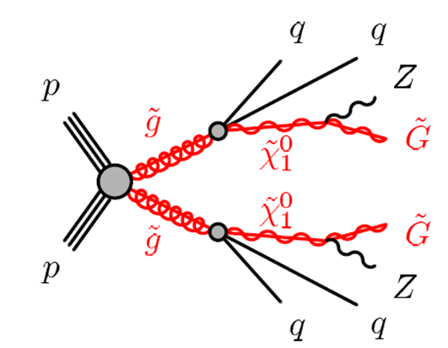


Search for SUSY at LHC
q
q
q
1504.07869 (Cao, Shang, Yang, Zhang)
1504.04390 (with Koba, Saav, Wu, Yang)

Slide 19


Slide 20

Frank Wilczek
超对称何时能被发现？
On SUSY, Frank Wilczek is still a believer, based on the renormalization group calculation he was a co-author of back in 1981. If no SUSY turns up at the next LHC run though, even he will throw in the towel:
I cannot believe this success is an accident. But in science faith is a means, not an end. Supersymmetry predicts new particles, with characteristic properties, that will come into view as the LHC operates at higher energy and intensity. The theory will soon undergo a trial by fire. It will yield gold – or go up in smoke.
He has a bet with Garrett Lisi that superparticles will be detected by July 8, 2015.

Slide 21

谢 谢！

