Slide 1
A Brief Introduction to
Superconducting Accelerator Magnets and
R&D of SPPC High Field Magnets
Qingjin Xu
Institute of High Energy Physics,
Chinese Academy of Sciences
2016.8.1

Slide 2
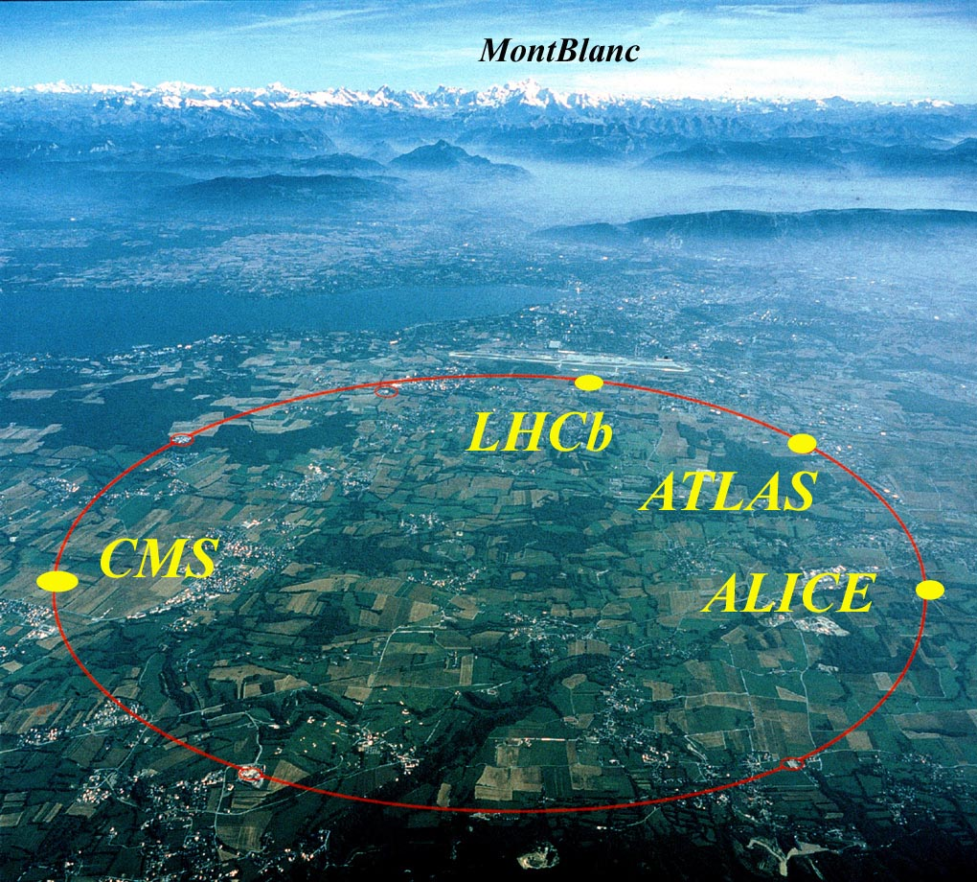
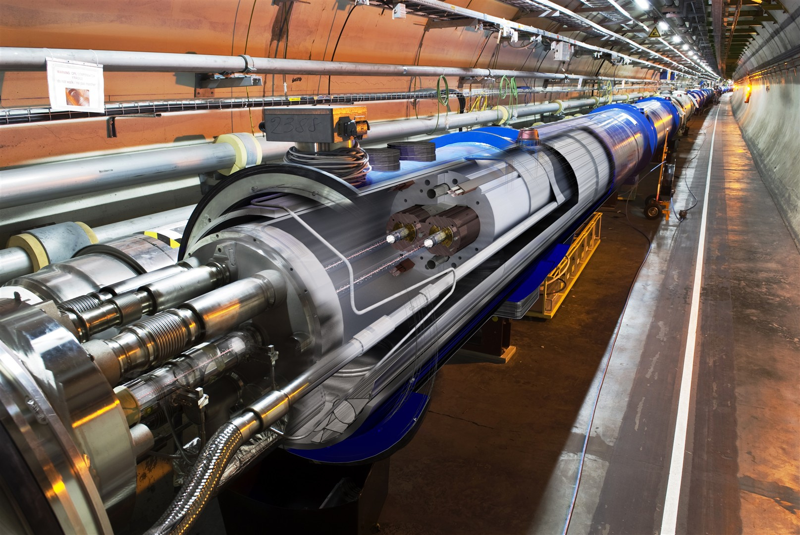
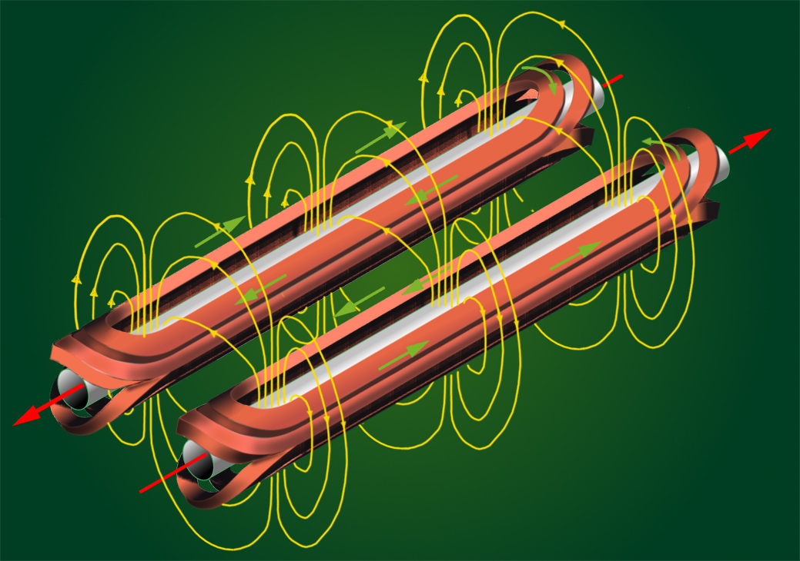
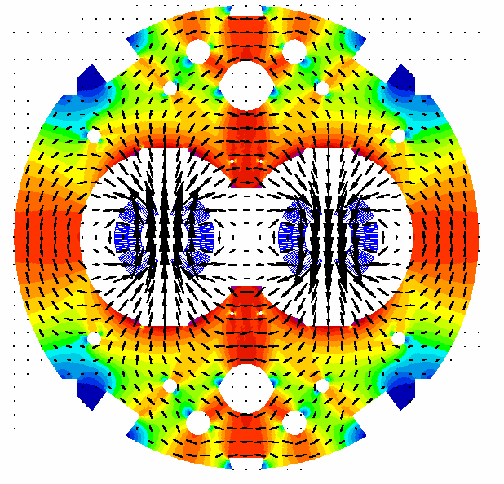


Slide 3
Outline
Basic Knowledge of the Superconducting Accelerator Magnets
PRINCIPLES of a Circular Collider
Design of Superconducting Accelerator Magnets
Superconducting Materials for Accelerator Magnets
R&D of SPPC High Field Magnets
Requirements of the SPPC High Field Magnets
Design Study of the SPPC Dipole Magnets
R&D Steps and Status

Slide 4
Basic Knowledge of the
Superconducting Accelerator Magnets

Slide 5
Acknowledgement
The materials of this section are based on USPAS (U.S. Particle Accelerator School) courses:
“Superconducting Accelerator Magnets” by Soren Prestemon (LBNL), Paolo Ferracin and Ezio Todesco (CERN), June 2015
“Superconducting Accelerator Magnets” by Paolo Ferracin (LBNL), Ezio Todesco (CERN), Soren O. Prestemon and Helene Felice (LBNL), January 2012
“Superconducting Accelerator Magnets” by Ramesh Gupta and Animesh Jain (BNL), January 2006
“Applied Electromagnetism: Magnet and RF-Cavity Design” by Mau Lopes and Jeremiah Holzbauer (FNAL), January 2016
Learn more at USPAS website: http://uspas.fnal.gov/materials/materials-table.shtml
and textbooks:
  Martin N. Wilson, "Superconducting Magnets", 1983.
  K.-H. Mess, P. Schmuser, S. Wolff, “Superconducting accelerator magnets”, Singapore: World Scientific, 1996.
  Fred M. Asner, "High Field Superconducting Magnets", 1999.

Slide 6
PRINCIPLES of a Circular Collider
Colliders: two beams with opposite momentum collide
The arcs: region where the beam is bent
  Dipoles for bending
  Quadrupoles for focusing
  Correctors
Long straight sections (LSS)
  Interaction regions (IR)
    Quadrupoles for strong focusing in interaction point
    Dipoles for beam crossing in two-ring machines
  Regions for other services
    Beam injection (dipole kickers)
    Accelerating structure (RF cavities)
    Beam dump (dipole kickers)
    Beam cleaning (collimators)
A schematic view of a synchrotron
The lay-out of the LHC

Slide 7
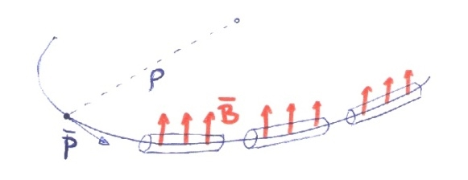
PRINCIPLES of a Circular Collider

Slide 8
PRINCIPLES of a Circular Collider
Arc

Slide 9
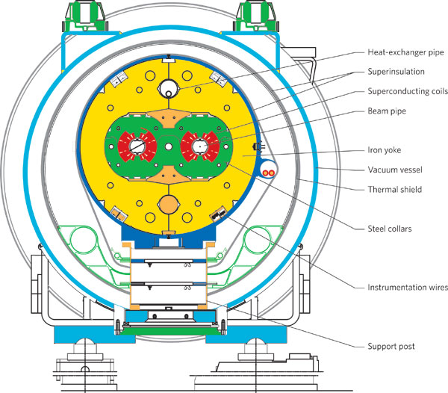
Design of Superconducting Accelerator Magnets

Slide 10
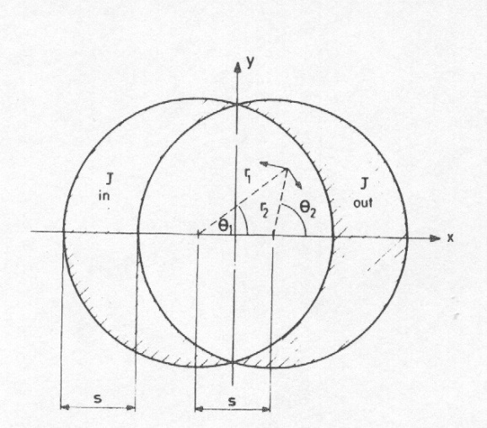
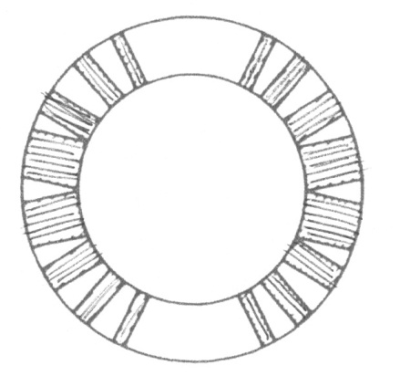
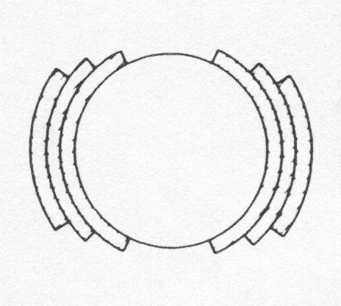
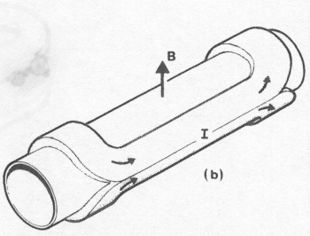
Field Harmonics
Perfect Dipole
Biot-Savart law
  Cosθ: a current density proportional to cosθ in an annulus - it can be approximated by sectors with uniform current density
From M. N. Wilson, pg. 28
A practical winding with one layer and wedges
[from M. N. Wilson, pg. 33]
A practical winding with three layers and no wedges
[from M. N. Wilson, pg. 33]
Artist view of a cosθ magnet
[from Schmuser]
An ideal cosθ

Slide 11
Field Harmonics
  Perfect quadrupole
  Cos2θ, a current density proportional to cos2θ in an annulus- approximated by sectors with uniform current density and wedges
  (Two) intersecting ellipses
    Perfect sextupoles: cos3θ or three intersecting ellipses
    Perfect 2n-poles: cosnθ or n intersecting ellipses
Quadrupole as an ideal cos2θ
Quadrupole as two intersecting ellipses

Slide 12
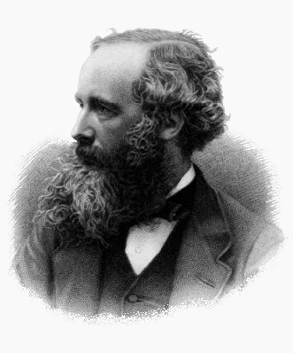
Field Harmonics
Maxwell equations for magnetic field
In absence of charge and magnetized material
If (constant longitudinal field),
then
  and
Gauss's law for magnetism
Ampère's circuital law
James Clerk Maxwell,
Scottish
(13 June 1831 – 5 November 1879)
Cauchy-Riemann conditions

Slide 13
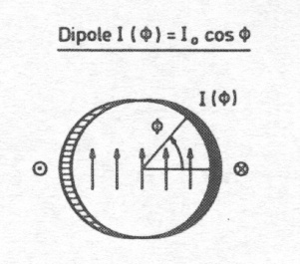
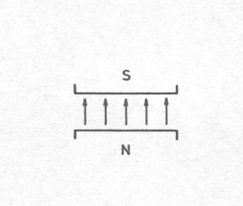
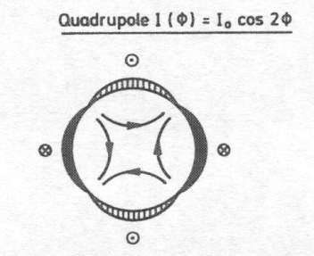
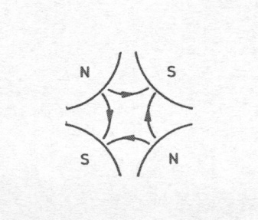
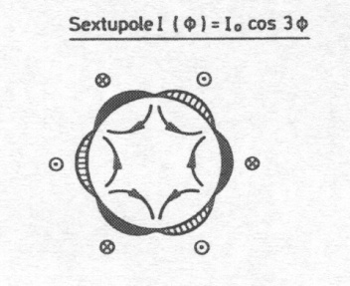
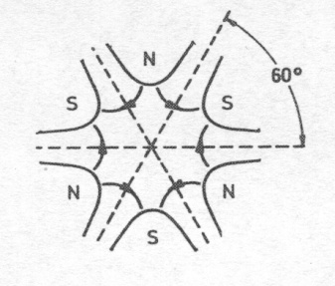
Field Harmonics
Each coefficient corresponds to a “pure” multipolar field
A dipole
A quadrupole
[from P. Schmuser et al, pg. 50]
A sextupole
The field harmonics are rewritten as (EU notation)

Slide 14
Field Harmonics
We recall the equations relative to a current line
we expand in a Taylor series
  the multipolar expansion is defined as
  the main component is
Biot-Savart law

Slide 15
Field Harmonics
We compute the central field given by a sector dipole with uniform current density j
  Taking into account of current signs
  This simple computation is full of consequences
  B₁ ∝ current density
  B₁ ∝ coil width w
  B₁ is independent of the aperture r
For a cosθ,

Slide 16
Field Harmonics
A dipolar symmetry is
  Up-down symmetry (with same current sign)
  Left-right symmetry (with opposite sign)
Why this configuration?
  Opposite sign in left-right to avoid the field created by the left part is canceled by the right one
  In this way all multipoles except B_{2n+1} are canceled
  The field quality specifications concern only first 10-15 multipoles
    The field quality optimization of a coil lay-out concerns only a few quantities ! Usually b₃ , b₅ , b₇ , and possibly b₉ , b₁₁

Slide 17
Field Harmonics
Multipoles of a sector coil
  for n=2
  for n>2
Main features of these equations
  Multipoles n are proportional to sin ( n angle of the sector)
    They can be made equal to zero !
  Proportional to the inverse of sector distance to power n
    High order multipoles are not affected by parts far from the centre

Slide 18
Field Harmonics
First allowed multipole B₃ (sextupole)
  for α=π/3 (i.e. a 60° sector coil) one has B₃=0
Second allowed multipole B₅ (decapole)
  for α=π/5 (i.e. a 36°) or for α=2π/5 (i.e. a 72°) one has B₅=0
  With one sector one cannot set to zero both multipoles … let us try with more sectors !

Slide 19
Field Harmonics
Coil with two sectors
  Note: we have to work with non-normalized multipoles, which can be added together
Equations to set to zero B₃ and B₅
  There is a one-parameter family of solutions, for instance (48°,60°,72°) or (36°,44°,64°) are solutions

Slide 20
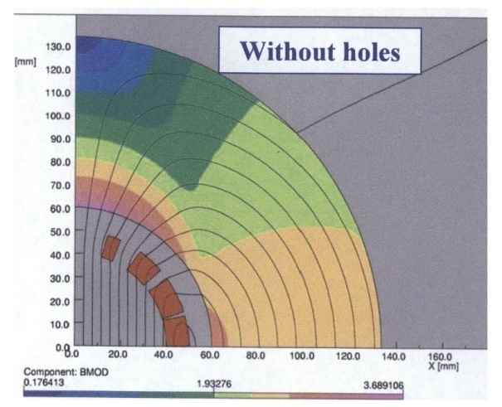
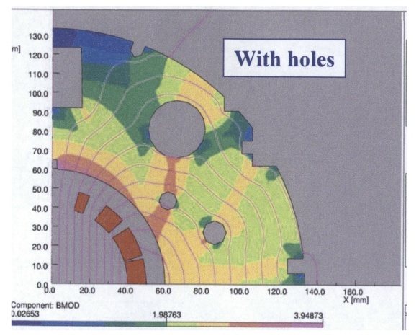
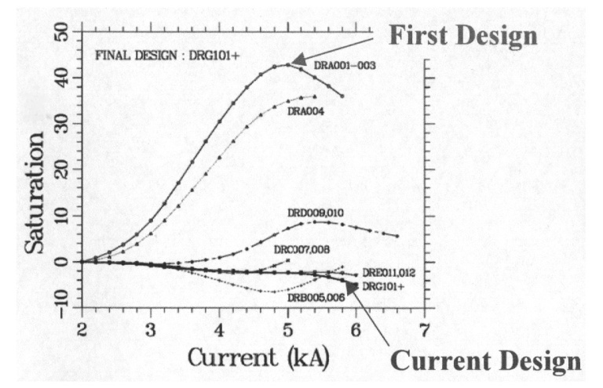
Field Harmonics
Corrective actions: shaping the iron – the RHIC dipole
    The field in the yoke is larger on the pole
    Drilling holes in the right places, one can reduce saturation of b₃ from 40 units to less than 5 units (one order of magnitude), and to correct also b₅
Field map in the iron for the RHIC dipole, with and without holes
From R. Gupta, USPAS Houston 2006, Lecture V, slide 12
Correction of b3 variation due to saturation
for the RHIC dipoles, R. Gupta, ibidem

Slide 21
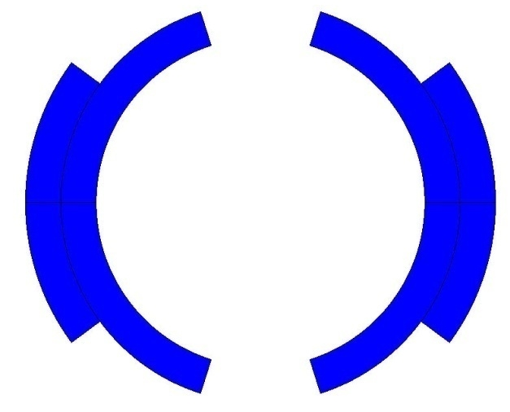
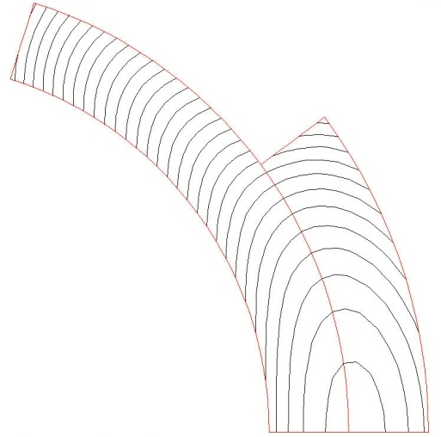
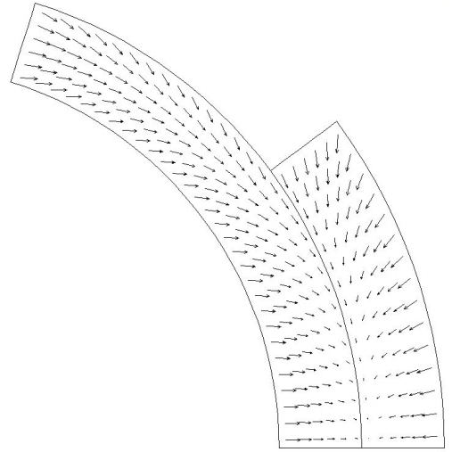
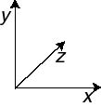
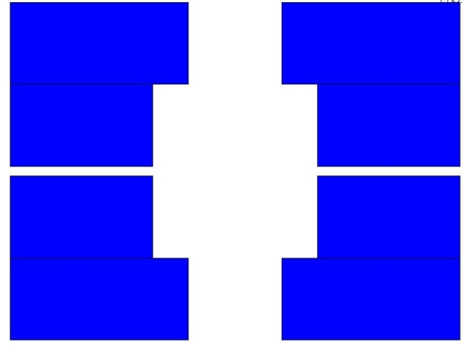
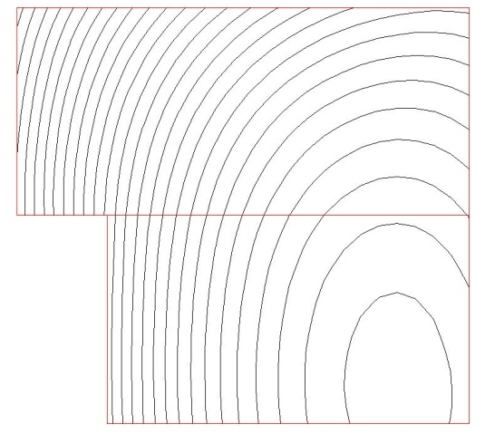
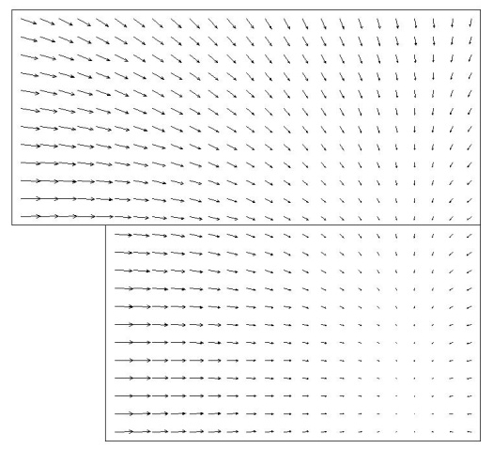
Electro-magnetic Force
The e.m. forces in a dipole magnet tend to push the coil
- Towards the mid-plane in the vertical-azimuthal direction (F_{y} , F_{θ} < 0)
- Outwards in the radial-horizontal direction (F_{x} , F_{r} > 0)
Tevatron dipole
HD2

Slide 22
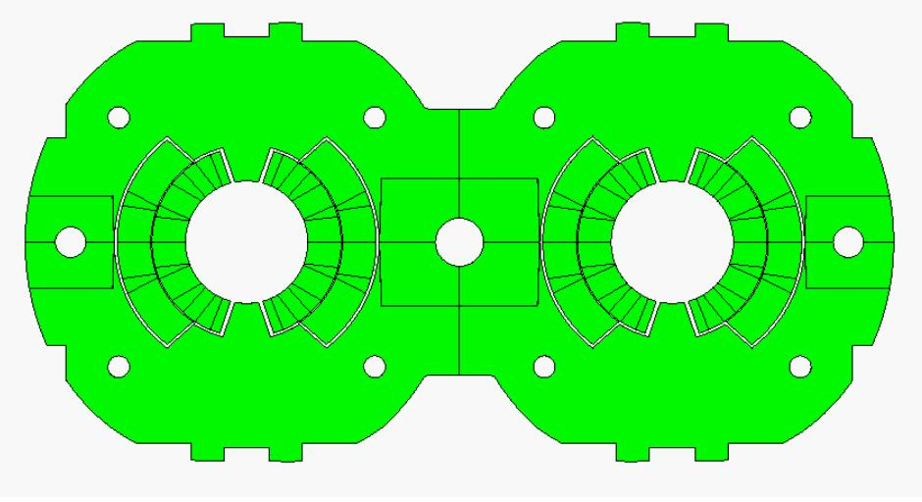
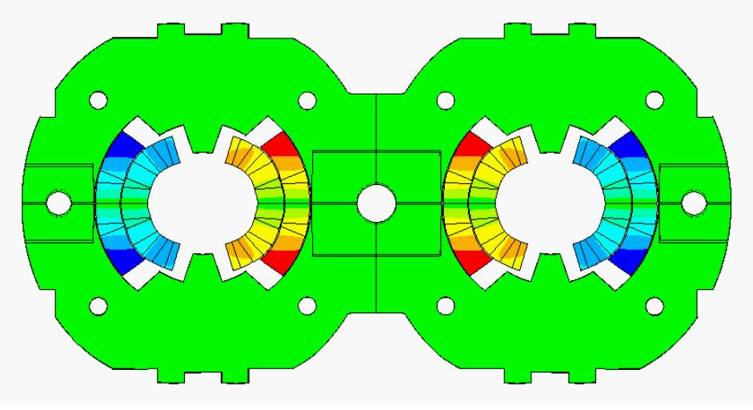
Electro-magnetic Force
LHC dipole at 0 T LHC dipole at 9 T
Usually, in a dipole or quadrupole magnet, the highest stresses are reached at the mid-plane, where all the azimuthal e.m. forces accumulate (over a small area).
Displacement scaling = 50

Slide 23
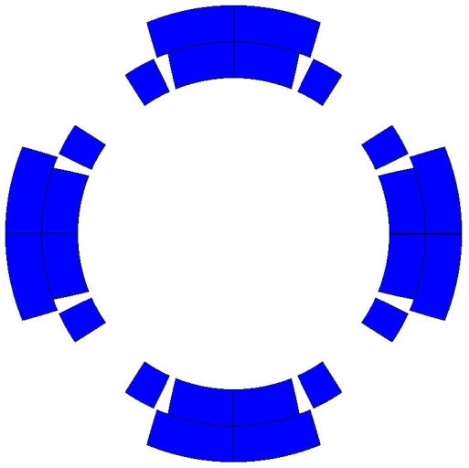
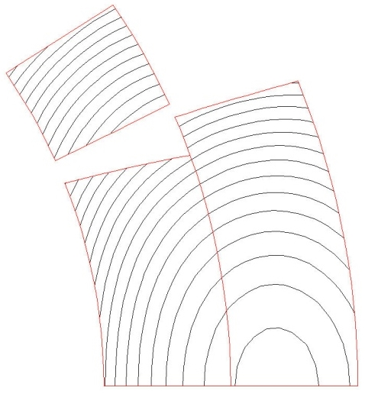
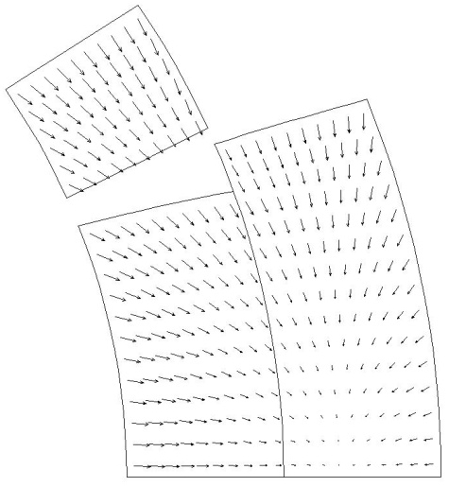
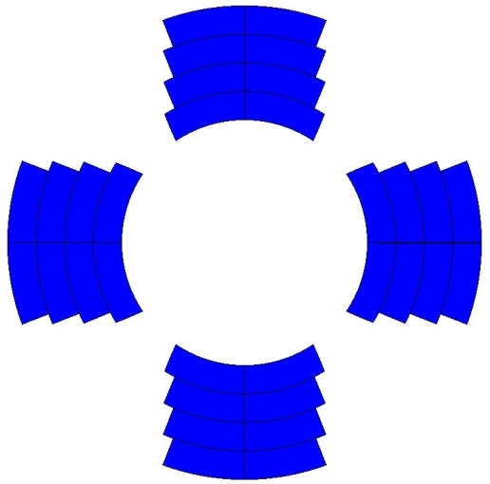
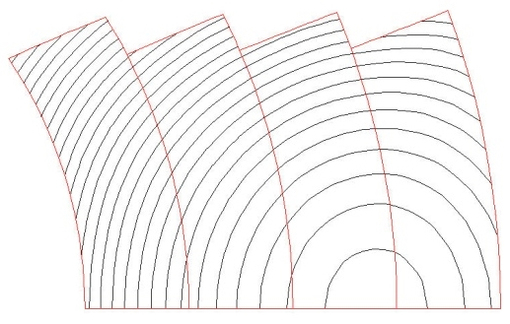
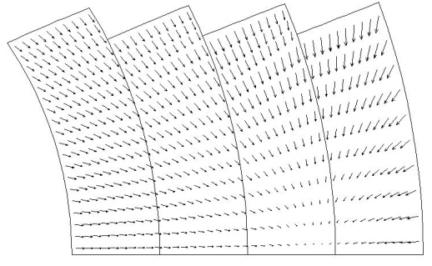
Electro-magnetic Force
The e.m. forces in a quadrupole magnet tend to push the coil
Towards the mid-plane in the vertical-azimuthal direction (F_{y}, F_{θ} < 0)
Outwards in the radial-horizontal direction (F_{x}, F_{r} > 0)
TQ
HQ

Slide 24
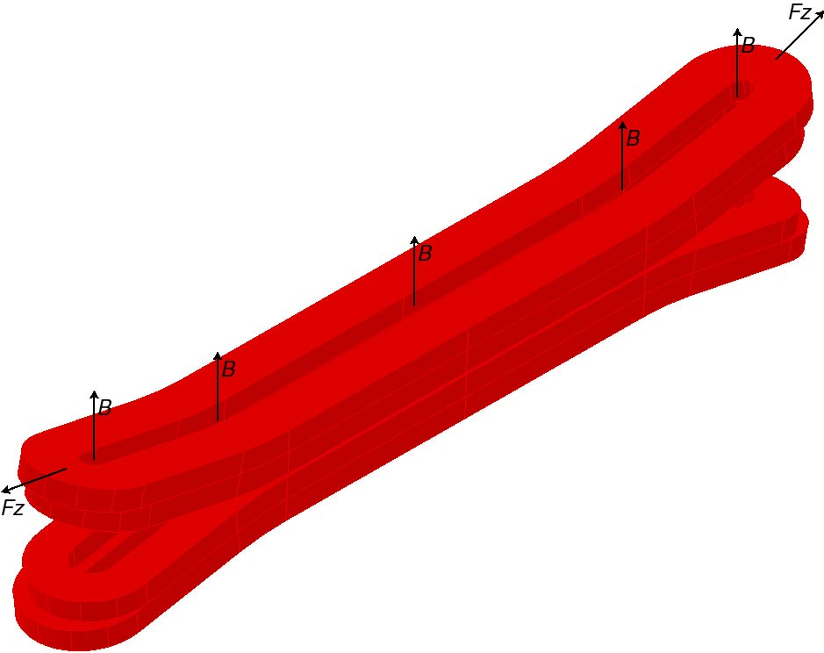
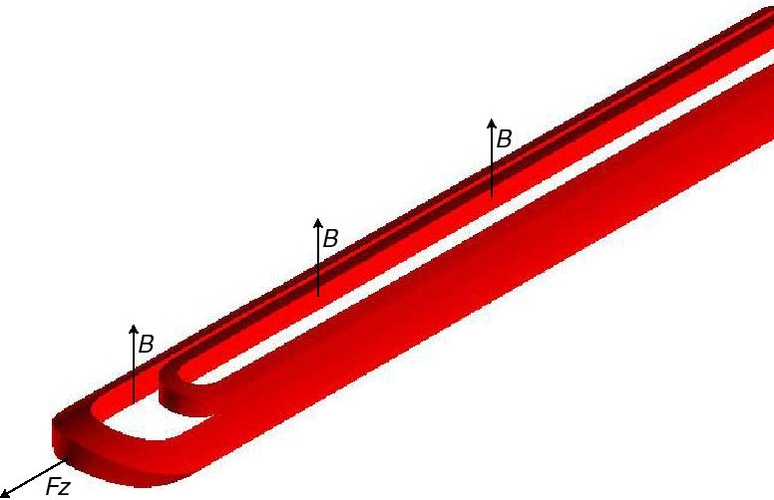
Electro-magnetic Force
In the coil ends the Lorentz forces tend to push the coil Outwards in the longitudinal direction (F_{z} > 0)
Similarly as for the solenoid, the axial force produces an axial tension in the coil straight section.

Slide 25
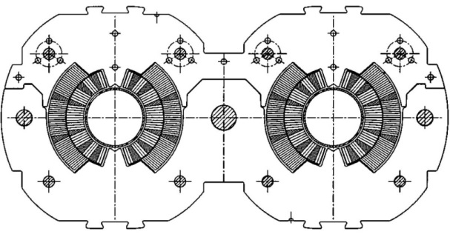
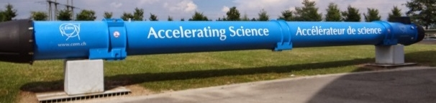

Electro-magnetic Force
Nb-Ti LHC MB (values per aperture)
  F_{x} = 340 t per meter
    ~300 compact cars
    Precision of coil positioning: 20-50 μm
  F_{z} = 27 t
    ~weight of the cold mass
Nb₃Sn dipole (HD2)
  F_{x} = 500 t per meter
  F_{z} = 85 t
  These forces are applied to an object with a cross-section of 150x100 mm !!!
    and by the way, it is brittle

Slide 26
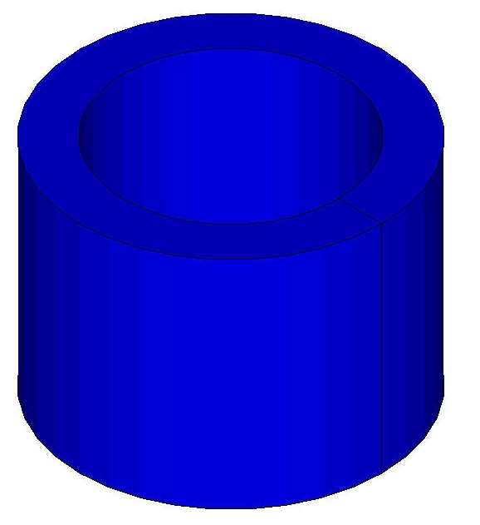
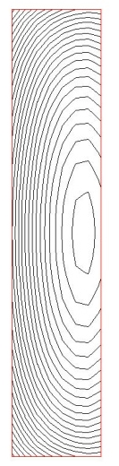
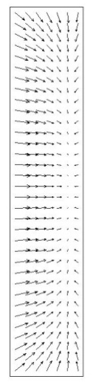
Electro-magnetic Force
The e.m. forces in a solenoid tend to push the coil
  Outwards in the radial-direction (F_{r} > 0)
  Towards the mid plane in the vertical direction (F_{y} < 0)
Important difference between solenoids and dipole/quadrupole magnets
  In a dipole/quadrupole magnet the horizontal component pushes outwardly the coil
    The force must be transferred to a support structure
  In a solenoid the radial force produces a circumferential hoop stress in the winding
    The conductor, in principle, could support the forces with a reacting tension

Slide 27
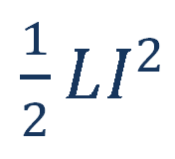
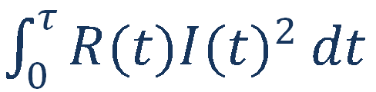
Quench Protection
Magnetic energy
Quench
Normal zone growth
Detection
Converted to heat by Joule heating
Power supply switched off
Trigger protection options
Protection heaters
Extraction
Quenchback
Current decay in the magnet
The faster this chain happens the safer is the magnet

Slide 28
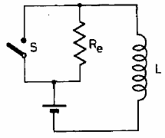
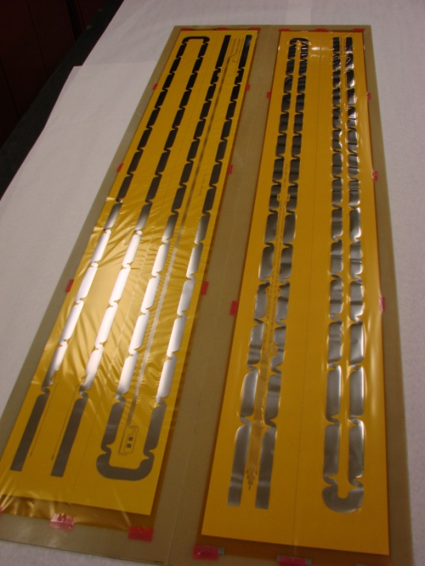
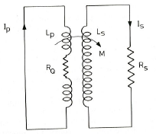
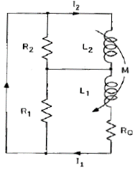
Quench Protection
In most accelerator magnets, the “natural” resistance growth is insufficient to provide a good protection => Need to enhance the resistance
Method 1:
  Add an external resistor
Method 2:
  Protection heaters mounted on the coils
    Optimized to minimize thermal diffusion time
Method 3:
  Use of couple secondary circuits
    Can be external or internal to the coil
    Quench back
Method 4:
  Coil subdivision
Cold

Slide 29
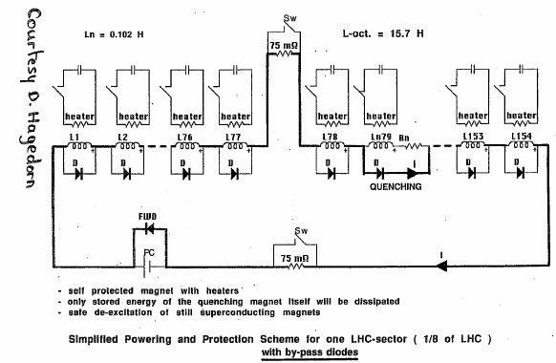
Quench Protection
In the LHC main ring, the dipoles are connected in series. The principle is
  to “by-pass” the quenching magnet to avoid dumping all the string energy in one magnet
  To de-excite the rest of the magnets into a dump resistor
Combination of various methods: heaters, dump resistor, diodes

Slide 30
Superconducting Materials for Accelerator Magnets

Slide 31
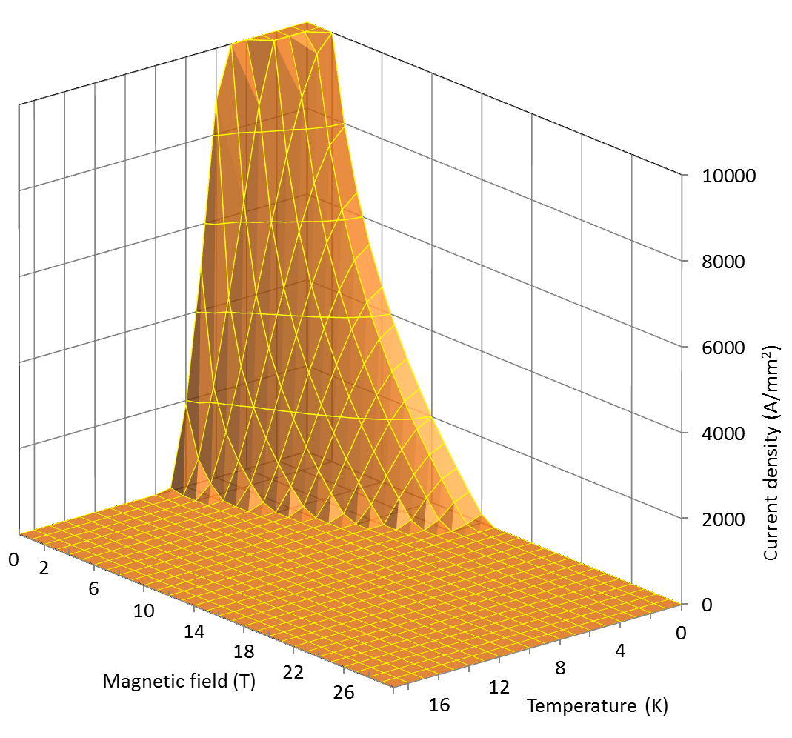

Superconducting materials
Critical surfaces
Nb-Ti
Nb₃Sn

Slide 32


Superconducting materials
Cu
Nb-Ti
Nb₃Sn
Typical operational conditions (0.85 mm diameter strand)
J_{e} ~ 5 A/mm²
I ~ 3 A
B = 2 T
J_{e} ~ 600-700 A/mm²
I ~ 300-400 A
B = 8-9 T
J_{e} ~ 600-700 A/mm²
I ~ 300-400 A
B = 12-13 T

Slide 33



Superconducting materials
The superconducting materials used in accelerator magnets are
  subdivided in filaments of small diameters
    to reduce magnetic instabilities called flux jumps
    to minimize field distortions due to superconductor magnetization
  twisted together
    to reduce interfilament coupling and AC losses
  embedded in a copper matrix
    to protect the superconductor after a quench
    to reduce magnetic instabilities called flux jumps
NbTi LHC wire (A. Devred, [1])
NbTi SSC wire (A. Devred, [1])
Nb₃Sn bronze-process wire (A. Devred, [1])
Nb₃Sn PIT process wire (A. Devred, [1])

Slide 34
Superconducting materials
Flux jumps
  An external magnetic field penetrates in a type-II superconductor in the mixed state through fluxoids.
  If the superconductor is subjected to a thermal disturbance, the local change in J_{c} produces a motion or “jump” of fluxoids, which is accompanied by power dissipation.
  The stability criteria for a slab in the adiabatic condition
  where a is the half-thickness of the slab, j_{c} is the critical current density [A m⁻²], γ is the density [kg m⁻³], C is the specific heat [J kg⁻¹], and θ_{c} is the critical temperature.
  Nb-Ti filament diameters are usually less than 50 µm.
  High conductivity copper reduces instability.

Slide 35

Superconducting materials
Superconductor magnetization
According to the critical state model, when a filament is in a varying external field, its inner part is shielded by a current distribution in the filament periphery.
The shielding currents are proportional to the amplitude of the applied field and do not decay when the external field is held constant.
  When the filament is fully penetrated, the magnetization M is proportional to J_{c}r_{f}.
  Field distortions are proportional to r_{f}. LHC filament diameter 6-7 µm; HERA filament diameter 14 µm.
K.-H. Mess, et al., [5], p. 84.

Slide 36

Superconducting materials
Interfilament coupling
  When a multifilamentary wire is subjected to a time varying magnetic field, current loops are generated between filaments.
  If filaments are straight, large loops are generated, with large currents
    Big losses
  If the strands are magnetically coupled the effective filament size is larger
    Flux jumps
  To reduce these effects, filaments are twisted with a twist pitch of the order of 20-30 times of the wire diameter.
M.N. Wilson, [4], p. 148.

Slide 37
Superconducting materials

Slide 38
Superconducting materials
Quench protection
  Superconductors have a very high normal state resistivity. A filament of Nb-Ti, if quenched in free space, could reach very high temperatures in few ms.
  If the filament is embedded in a copper matrix, when a quench occurs, the current redistributes in the low-resistivity matrix and the peak temperature can typically be maintained below 300 K.
  The copper matrix facilitates quench protection: it allows the quench to propagate and it provides time to act on the power circuit.
  In the case of a small volume of superconductor heated beyond the critical temperature (for instance because of a flux jump), the current can flow in the copper for a short moment, allowing the filament to cool-down and recover superconductivity.
    The matrix also helps stabilizing the conductor against flux jumps (dynamic stability).
by L. Bottura

Slide 39
R&D of SPPC High Field Magnets

Slide 40
Requirements of the SPPC Magnets
SPPC
50/100 km in circumference
C.M. energy 70 TeV or higher
Timeline
Pre-study: 2013-2020
R&D: 2020-2030
Eng. Design: 2030-2035
Construction: 2035-2042
Main dipoles
Field strength: 20 Tesla
Aperture diameter: 40~50 mm
Field quality: 10⁻⁴ at the 2/3 aperture radius
Outer diameter: 900 mm in a 1.5 m cryostat
Tunnel cross section: 6 m wide and 5.4 m high
Qinhuangdao
The CEPC-SPPC ring sited in Qinhuangdao,
50 km and 100 km options .
SPPC accelerator complex
6-m Tunnel for CEPC-SPPC. Left: SPPC collider. Right: CEPC collider (bottom) and Booster (top)
Refer to CEPC-SPPC Pre-CDR, Mar. 2015: http://cepc.ihep.ac.cn/preCDR/volume.html

Slide 41




Why 20-T Dipole Is Difficult ?
Dipole vs Solenoid
Different coil configurations
$B_{dipole}=\frac{1}{2}B_{solenoid}$
Limited coil width for dipole
Magnetic shielding
Cost
Dipole
Solenoid
J_{e} – Current density
t – Coil thickness
J_{e} – Current density
t – Coil thickness
LHC dipole
Martin Wilson
Lucio Rossi

Slide 42

Performance of Superconductors
WHOLE WIRE critical current density of main superconductors @ 4.2 K
Peter Lee
500 A/mm²
NbTi:
11 T @ 1.9K
Nb₃Sn (Nb₃Al)
17 T @ 4.2 K

Slide 43

R&D History of Nb₃Sn Dipole Magnets
Results achieved with Nb₃Sn dipole technology test
16 T achieved with block type configuration (HD1 @ LBNL, 2003)
15 T achieved with common coil configuration (RD3 @ LBNL, 2001)
Results achieved with accelerator level field quality and bore
14 T achieved with block type configuration (HD2 @ LBNL, 2007)
13 T achieved with Cos-theta configuration (D20 @LBNL, 1997)
20 T
HTS
D.R. Dietderich, A. Godeke, Cryogenics 48, (2008)
Nb₃Sn
(no bore)
(no bore)
IHEP
(Single bore)
LBNL(RD3C)
(Two 35 mm bore)
NbTi
(LHC NbTi dipole 8.3 T)

Slide 44
Challenges and R&D Focus of the 20-T Accelerator Magnets
J_{c} and cost of Superconductors: Based on the present J_{c} level, thousands of tons of Nb₃Sn and HTS superconductors are needed to fabricate SPPC magnets. Significant increase of J_{c} and reduction of cost of superconductors are expected.
HTS coils for accelerator magnets, especially tape conductors: field quality (current distribution, magnetization effect,…), quench protection and fabrication method.
Magnetic force in superconducting coils at 20 T: F ̴ B². And both Nb₃Sn and HTS superconductors are strain sensitive! Needs innovative strain management for superconducting coils.

Slide 45



Design Study of the SPPC Dipole Magnets
Q. Xu, K. Zhang, C. Wang et al.
With common coil configuration
20-T dipole magnet with common coil configuration two Φ50 mm beam pipes; load line 80% @ 1.9 K
Integrated b_{n}/a_{n} | Value (10⁻⁴)
b3 | 0.14
b5 | 1.42
b7 | -0.40
a2 | -0.29
a4 | -1.81
a6 | 0.03
Q. Xu, K. Zhang, C. Wang et. al., 20-T Dipole Magnet with Common Coil Configuration: Main Characteristics and Challenges, IEEE Trans. Appl. Supercond., VOL. 26, NO. 4, 2016，4000404

Slide 46




Design Study of the SPPC Dipole Magnets
K. Zhang, Q. Xu, C. Wang et al.
With common coil configuration
D.R. Dietderich, A. Godeke / Cryogenics 48 (2008) 331–340
Lorentz force per aperture:
Fmag_x=23.4 MN/m
Fmag_y=2.38 MN/m
Stress in coil after excitation
Direction of Magnetic force
Stress in shell after excitation
K. Zhang et. al., 2-D Mechanical Design Study of a 20-T Two-in-One Common-Coil Dipole Magnet for High-Energy Accelerators, IEEE Trans. Appl. Supercond., VOL. 26, NO. 4, 2016, 4003705

Slide 47



Design Study of the SPPC Dipole Magnets
Comparison of different coil configurations
Efficiency, field quality, stress management, fabrication method…
Cos-theta dipole
Highest efficiency, complicated ends with hard-way bending
Common coil dipole
Simplest structure with large bending radius, lower efficiency
Block type dipole
Simpler structure with hard-way bending, lower efficiency
Canted cos-theta dipole
Lowest stress level in coil, lowest efficiency

Slide 48






Design Study of the SPPC Dipole Magnets
Comparison of different coil configurations
Common coil vs Cos-theta
Different coil configurations for 20-T dipole magnet
Left: Common coil
Right: Cos-theta
C. Wang et al.
Common coil
Common coil
Coil ends
Cos-theta
Cos-theta

Slide 49



R&D Steps and Status
Q. Xu, K. Zhang, C. Wang et al.
With common coil configuration
a
b
c
1st step ongoing
Fabrication of 15-T Nb₃Sn and Nb₃Sn+HTS subscale magnets, to test the stress management method for Nb₃Sn & HTS coils and the quench protection method for HTS coils;
By the end of 2018.
2nd step
Fabrication of 15-T Nb₃Sn and Nb₃Sn+HTS operational field dipole magnet with two Φ50 mm beam pipes and 10⁻⁴ field quality, to test the field optimization method for HTS coils;
To be funded.
3rd step
Fabrication of the 20-T magnet with Nb₃Sn+HTS or only one of them, if we can get significant progress on the performance of Nb₃Sn or HTS superconductors, i.e., their Jc level is 3~6 times increased or even more, and the cost is significantly reduced.
Q. Xu, K. Zhang, C. Wang et. al., 20-T Dipole Magnet with Common Coil Configuration: Main Characteristics and Challenges, IEEE Trans. Appl. Supercond., VOL. 26, NO. 4, 2016，4000404

Slide 50
R&D Steps and Status
20-T Magnet Working Group in China
Northwest Institute for Non-ferrous Metal Research (NIN, Xi’an) & Western Superconducting Tech. Co, Ltd (WST, Xi’an)
Qualified Nb₃Sn supplier for ITER; R&D and production of High J_{c} Nb₃Sn and Bi-2212 superconductors.
Shanghai JiaoTong U.& Shanghai Superconductor Tech. Co., Ltd (SSTC, Shanghai)
R&D and production of ReBCO superconductor.
Tsinghua U. & Innova Superconductor Tech. Co., Ltd (INNOST, Beijing)
R&D and production of Bi-2223 superconductor.
Institute of Plasma Physics, Chinese Academy of Sciences (IPP, Hefei)
Test stand with 12-T background field, Nb₃Sn CICC cable fabrication;…
High Magnetic Field Laboratory, Chinese Academy of Sciences (CHMFL, Hefei)
Development of High field solenoids;…
Institute of High Energy Physics, Chinese Academy of Sciences (IHEP, Beijing)
30+ years R&D and production of conventional accelerator magnets, plus 10+ years R&D and production of superconducting magnets for particle detectors and industries.
and USTC, IMP, CIAE…
Welcome new members to join us!

Slide 51







R&D Steps and Status
R&D of advanced superconductors: Nb₃Sn & HTS
Super High J_{c} Nb₃Sn
Magnet field Vs. Conductor J_{c}
Over-pressure HTS Bi-2212
Principle: increase of Nb₃Sn pinning force at high field through grain refinement: J_{c}(12 T, 4.2K) from 3.5 kA/mm² @ 100+ nm to 9.6 kA/mm² @ 35 nm !
X. Xu et al, Appl. Phys. Lett. 104 082602 & ASC14
D.R. Dietderich, A. Godeke, Cryogenics
48 (2008) 331–340
D. C. Larbalestier et al, NATURE MATERIALS DOI: 10.1038/NMAT3887, 2014
And, other materials
like …
Iron-based superconductor?
HTS YBCO J_{c} estimation
HTS YBCO cost estimation

Slide 52





R&D Steps and Status (2016-2018)
To fabricate a 14-T dipole magnet (with two apertures) with HTS and Nb₃Sn superconductors, to test the field optimization method of HTS & Nb₃Sn coils.
Clear bore diameter 15mm Inter-aperture spacing 156 mm
I=358A (YBCO)
I=9930A(Nb₃Sn)
Main field: 14.6T
Iron yoke OD:
600mm
YBCO B_{peak}
14.7T @4.2K
Nb₃Sn B_{peak}
14.5T @4.2K
Field distribution in the cross section of the magnet
Main parameters of the cables
Cable | Hight | Width-i | Width-o | Ns | Strand | Filament | Insulation
IHEPW1 | 5.8 | 1.5 | 1.5 | 14 | IHEPWCJC | Nb3Sn | 0.15
IHEPW3 | 12 | 1.5 | 1.5 | 29 | IHEPWCJC | Nb3Sn | 0.15
IHEPWYBCO4 | 4 | 0.2 | 0.2 | 1 | IHEPWYBCO | YBCO | 0
Coil configuration in the 1st quadrant
Main parameters of the strands
For per meter of such magnet, the required length of the strand: YBCO: 0.6 Km; Nb₃Sn in total: 9.12 Km
Strand | diam. | cu/sc | RRR | Tref | Bref | Jc@ BrTr | dJc/dB
IHEPWCJC | 0.82 | 1 | 100 | 4.2 | 12 | 2400 | 400
IHEPWYBCO | - | - | - | 4.2 | 12 | 1020 | 40

Slide 53



R&D Steps and Status
With Nb₃Sn conductors (ongoing), and with HTS conductors (to be done)
Collaboration with WST, Toly Electric, and Changtong Electric
Superconducting Rutherford Cable fabricated by Changtong Electric with WST ITER type Nb₃Sn strand
Superconducting Rutherford Cable fabricated by Toly Electric with WST ITER type Nb₃Sn strand

Slide 54

R&D Steps and Status
With Nb₃Sn conductors (ongoing), and with HTS conductors (to be done)
Collaboration with WST, Toly Electric, and Changtong Electric
Pitch length | Filling factor (%) | Ic degradation(%) | Average Ic degradation(%) | Comments
60 | 90.6 | 9.39~16.04 | 12.48~12.67 | Not acceptable
45 | 90.7 | 3.84~10.33 | 6.31~7.42 | Almost acceptable
52 | 87.4 | 3.18~10.39 | 6.51~6.76
52 | 83.7 | 0.33~6.2 | 3.13~3.60 | Acceptable
Y. Zhu (WST) et al.

Slide 55
Summary
SPPC needs thousands of 20-T level magnets to bend and focus the high energy proton beams .
To achieve the challenging 20-T accelerator magnets, a 10~15 years long term R&D is necessary.
A working group is being organized for the 20-T magnet R&D in China, and expecting international collaboration with worldwide labs.
R&D of advanced superconductors and magnets for SPPC are ongoing. Welcome more collaborators to join us!

Slide 56


Thanks

