Slide 1

High Intensity Electron Positron Accelerator (HIEPA) 物理, 探测器进展
Hai-ping Peng (彭海平)
penghp@ustc.edu.cn
(On behalf HIEPA Steering Committee)
University of Science and Technology of China (USTC)
第六次高能物理战略研讨会 (合肥)
Notes:
Good Morning everyone.
My topic is High intensity Electron Postion Acc…
Tau physics is one of most important topics in our projection.
But Since this is the first time we introduce our projects in the internationial conference,
Also, most of your are all the experts on tau physics,
So I would like to introduce you HIEPA project, rather than focus on tau physics only.
I apologize that I change the title of talk.

Slide 2
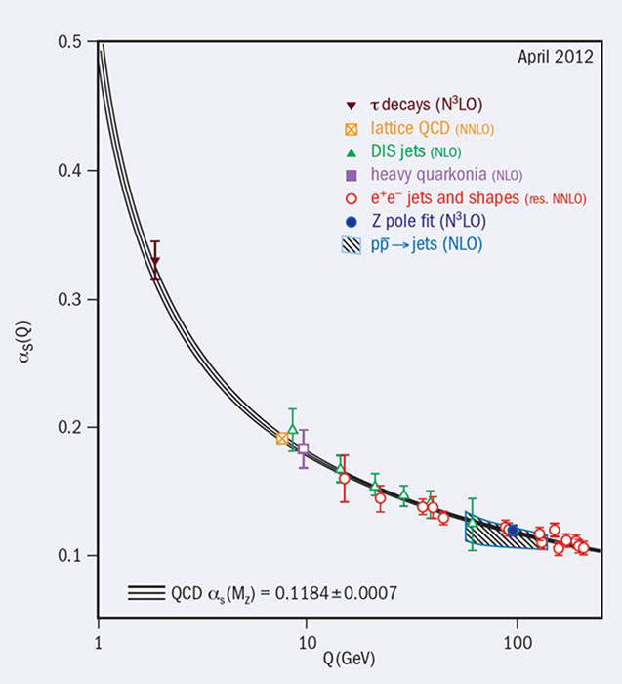
Hadronic Physics
That [intermediate distrance] scale is the richest phenomenologically, and is certainly the crux region to understand …. What QCD is really about. And at the heart of subject is the hadron spectrum, … with question, there is a great need for a new round of experiments
James D. Bjorken (2000)
Non-pQCD
Effective field Theory
pQCD
Asymptotic freedom
2

Slide 3
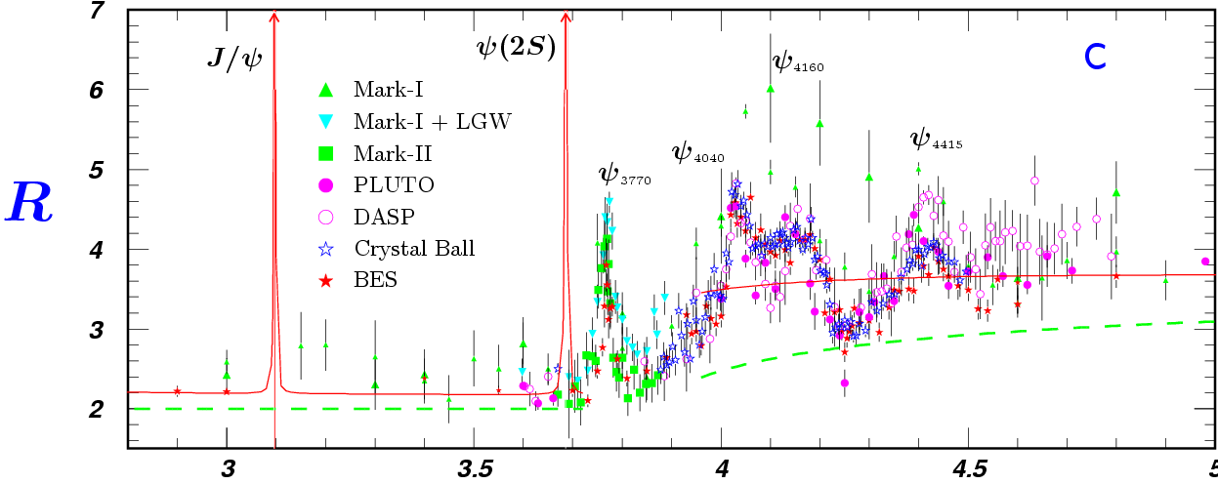
Features of the τ-c Energy Region
τ⁺τ⁻
DD
D_{s}D_{s}
D_{s}D_{s}*
Λ_{C}Λ_{c}
3
Rich of resonances, charmonium and charmed mesons.
Threshold characteristics (pairs of τ, D, D_{s}, charmed baryons…).
Transition between smooth and resonances, perturbative and non-perturbative QCD.
Mass location of the exotic hadrons, gluonic matter and hybrid.
Notes:
Now the naïve question is why we propose the machine on tau-charm energy region.
As we know, the tau-charm energy region have some advanced features.
The region have very rich of resonances, such as charmonium and charmed mesons.
It have threshold characteristics, which can provide a clean enviroment for physics
Also, It is well know that the region is serviced as a transition between soomth and resonances, pertubative and monpertubvative QCD
Also, mass of the extotic hadron, gluonic and hybird are expected in this region

Slide 4
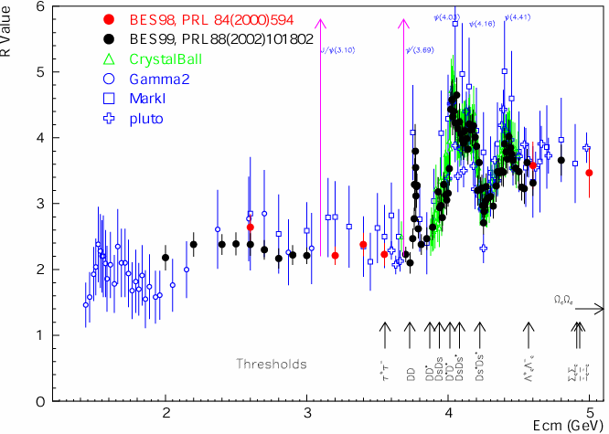
Broad Physics Topics
R=s(e⁺e⁻→hadron)/
s(e⁺e⁻→m⁺m⁻)
Hadron form factors
Y(2175) resonance
Mutltiquark states with s quark, Zs
MLLA/LPHD and QCD sum rule predictions
Light hadron spectroscopy
Gluonic and exotic states
Process of LFV and CPV
Rare and forbidden decays
Physics with τ lepton
XYZ particles
Physics with D mesons
f_{D} and f_{Ds}
D₀-D₀ mixing
Charm baryons
R scan
Precision Δα_{QED}, a_{μ}, charm quark mass extraction.
Hadron form factor(nucleon, Λ, p).

Slide 5
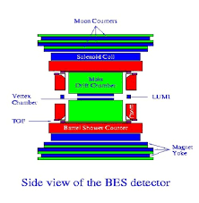
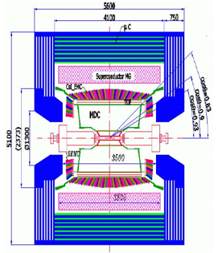
BEPC/BES
BEPCI (1988−2005)
Single Ring
10³¹cm⁻²s⁻¹ ⇒ 10³³cm⁻²s⁻¹
BEPCII (2006−now)
Double Ring

Slide 6
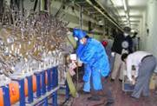
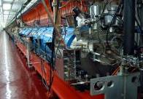
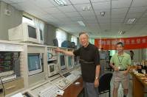
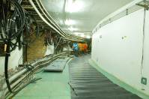
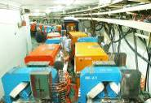
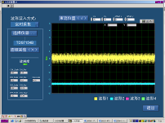
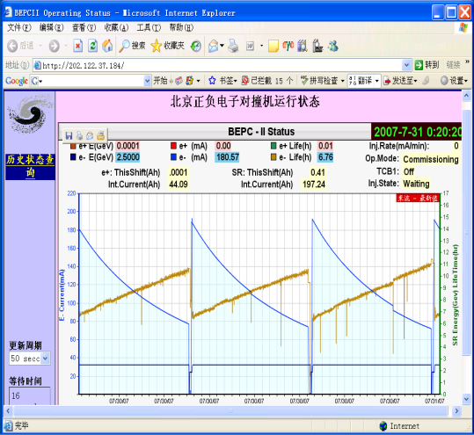
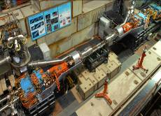
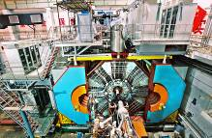
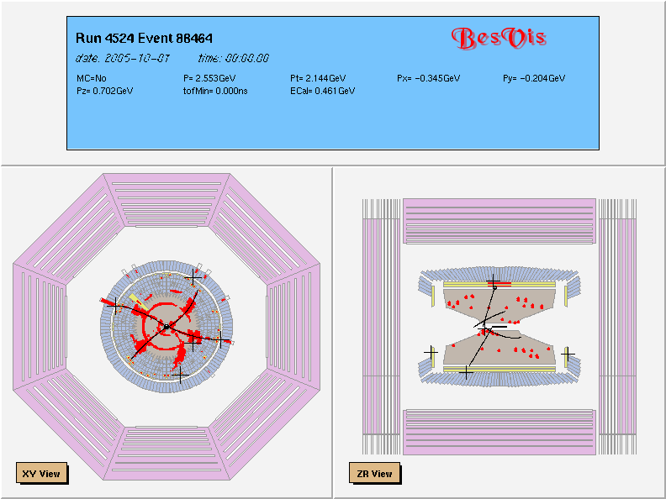

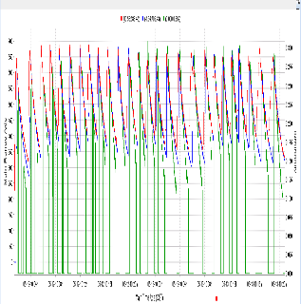
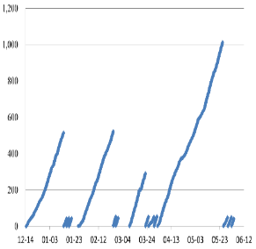
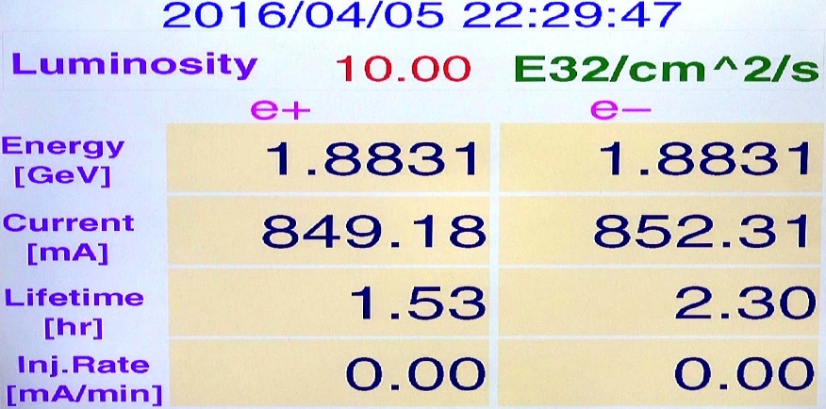
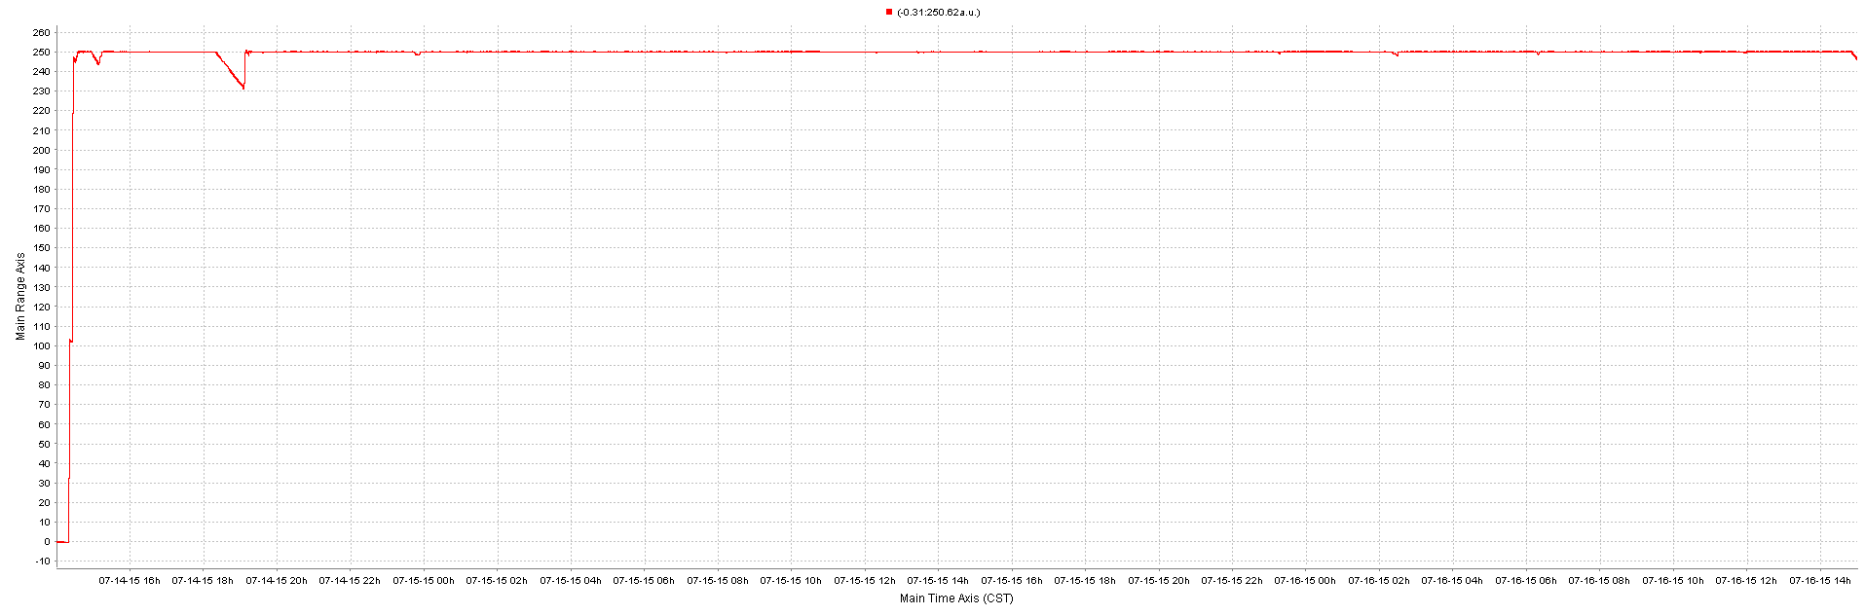
Milestones of BEPCII
Jan. 2004 | Construction started
May. 4, 2004 | Dismount of 8 linac sections
Dec. 1, 2004 | Linac delivered e⁻ beams to BEPC
July 4, 2005 | BEPC ring dismount started
Mar. 2, 2006 | BEPCII ring installation started
Aug. 3, 2007 | Shutdown for IR-SCQ installation
Mar. 28, 2008 | Shutdown for BESIII installation
July 19, 2008 | First hadron event observed
May 19, 2009 | Luminosity reached 3.3×10³²cm⁻²s⁻¹
July 17, 2009 | Pass the National test & check
April 8, 2011 | Luminosity reached 6.5×10³²cm⁻²s⁻¹
April 2013 | Zc(3900) found & confirmed
Nov. 20, 2014 | Luminosity reached 8.53×10³²cm⁻²s⁻¹
April 5, 2016 | Luminosity reached 10.0×10³²cm⁻²s⁻¹
May 2004
Sep. 2004
July 2005
Oct. 2005
Oct. 2006
Nov. 2006
July 2007
Oct. 2007
May 2008
July 2008
May 2009
>1fb⁻¹ @ 4.23
~500pb⁻¹ @ 4.26, 4.36
Top-up
Nov. 2015
May 2010
~300pb⁻¹ @4.26
2012 – 13

Slide 7
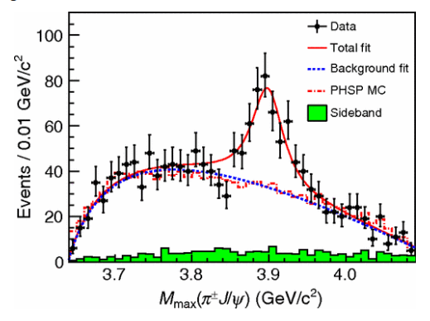
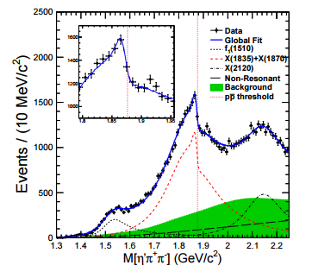
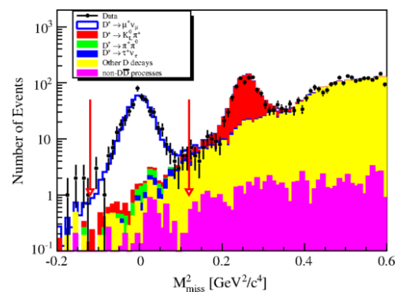
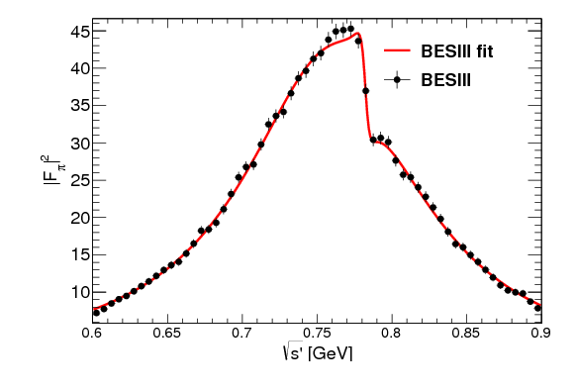
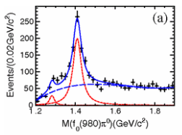
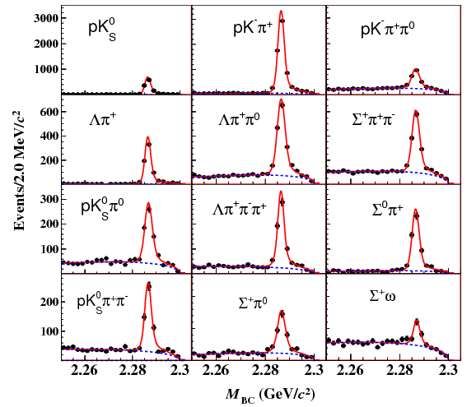
BESIII Fruitful Results
Z_{c}(3900)
Abrupt structure
Most precise measurement for D leptonic decay
X(1835)
Large Isospin Violation
η(1405)→f₀(980)π⁰
First Λc at BESIII
Precise measurement
Precise Measurement on Cross section
e ⁺e⁻→π⁺π⁻
≥130 publications http://bes3.ihep.ac.cn/pub/physics.htm

Slide 8
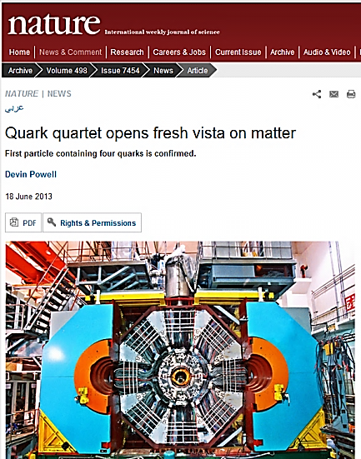
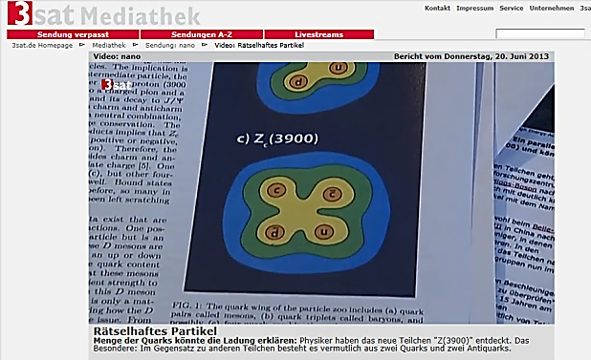
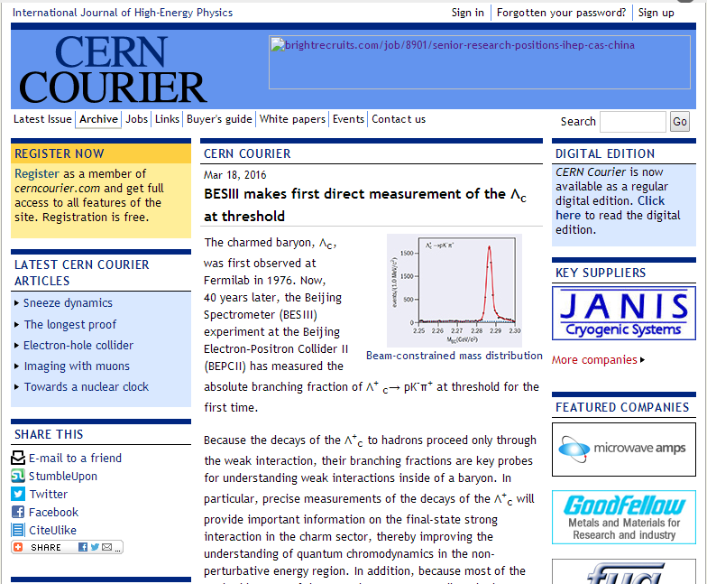
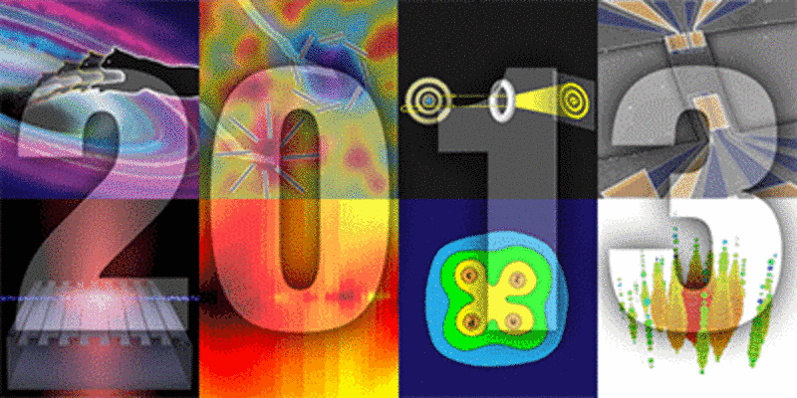
High Reputation
TOP of year’s Highlights of physics research in 2013 selected by the American Physical Society
Z_{c}(3900)
High Reputation in the World，
play leading role in hadronic physics

Slide 9
What a new Project Proposed
Advantage and Shortage of BEPCII/BESIII
Threshold production
Clean Signal, low background
High efficiency and resolution
……….
Small Ecms range : 2-4.6 GeV
In-sufficient luminosity : 10³³ cm⁻² s⁻¹
BEPCII/BESIII will end her mission around 2024
High Intensity Electron Positron Accelerator (HIEPA)

Slide 10
What is HIEPA?
High Intensity Electron Positron Accelerator (HIEPA) Facility
Electron Positron Collider machine
Peaking luminosity >0.5-1×10³⁵ cm⁻²s⁻¹ at 4 GeV for physics
Wide c.m. range coverage : E_{cm} = 2−7GeV
Polarization available on one beam (phase II)
Polarized electron beam source
Siberian Snake curing depolarization
Being a 3rd/4th generation SRF (synchrotron radiation facility).
Reserving the potential for future FEL (free electron laser) study with the long LINAC.
Notes:
BEPCII/BESIII will end her mission around 2020,
Led by the high energy Physics association of China, we are exploring possible
Future collider proejct post BEPCII and BESIII
High intensity Electron Positron accelerator (HIEPA) is one of the options.
HIEPA facility can be serviced as a collider machine,
Which provide peak lumin…..
The energy range from 2-7Gev, polarization available on one beam
And the symmertic machine with low currents and crabbed saist solution for the interation….
It also can

Slide 11
Data Samples / Year
Luminosity
Seconds/days
Running time/year
Efficiency
10³⁵cm⁻²s⁻¹ × 86400s × 180days × 90% = 1.4ab⁻¹
 | CLEO-C |  | BES-III/ year 10³³cm⁻²s⁻¹(10fb⁻¹) | HIEPA/year 10³⁵cm⁻²s⁻¹ (1ab⁻¹)
J/ψ | − | − | 10×10⁹ | 10×10¹¹
ψ(2S) | 54 pb⁻¹ | 27×10⁶ | 3×10⁹ | 3×10¹¹
ψ(3770) | 818 pb⁻¹ | 5×10⁶ D-pair | 4×10⁷ | 4×10⁹
4.17 GeV | 586 pb⁻¹ | 7×10⁵ D_{s}-pair | 1×10⁶ | 1×10⁸
τ⁺τ⁻ (4.25) |  | 4×10⁶ | 3×10⁷ | 3×10⁹
Highlight physics topic
Hadron Spectroscopy (Charmonium)
Tau Physics
Nucleon/hadron electromagnetic form factor
…..
10¹⁰ charm @ (4S)
10¹⁰ τ pairs @ (4S)
BELLE-II/Super KEKB
10³⁶cm⁻²s⁻¹(10ab⁻¹)
Notes:
With assumed 10^35 luminrocity, it is estimated to get the 1.4ab-1 data per year
Taking into account really running days and data taking efficiency.
It is expected to collected 10^9 D meson pair and Tau lepton pairs.
These data is about 1/3 of BELLE-II data/per year which is expected to run with luminosity at 10^36

Slide 12
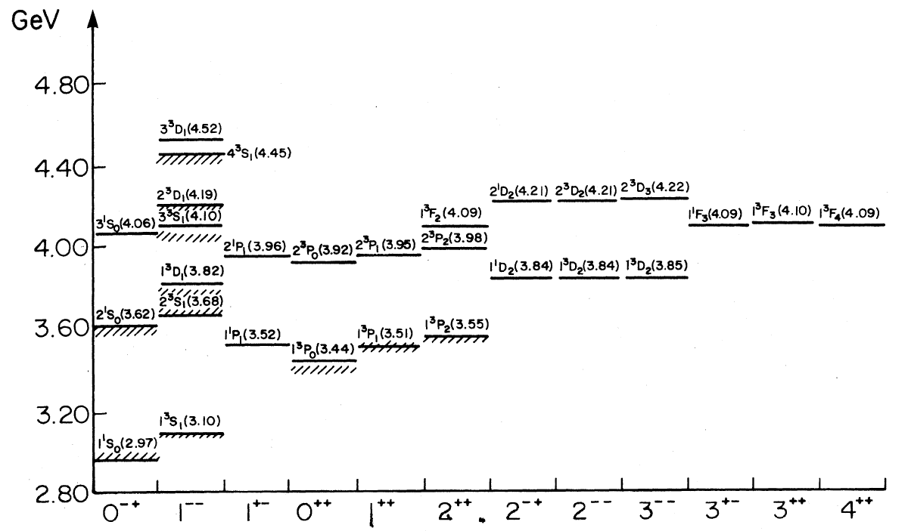
Charmonium (like) Spectroscopy
Key question : Is there any exotic hadron exist
D wave , narrow
P wave Spin-triplet
S/P Wave Spin-Singlets
F Wave
HH
HH
HH
HH
h
h
A better understanding on charmonium spectrum may help to understand natures of QCD
Help to search for the exotic states
Godfrey & Isgur, PRD 32, 189 (1985)
States below charm threshold are all well observed
A lot of missing states above the threshold
Notes:
This plots show the expected charmonium spectronscopy prodicted by QM,
To date, in experiment, states below charm trheshold are all observed well,
But above the charm threshold, there are still some missing states have not be observed yet
Also, in the last decay, a lot of new XYZ states are observed, which is not a obviously conventional charmonium states.
The nature is these new observetion is unclear.
A better understaing on charmonium spectron may help to understand their natures.

Slide 13
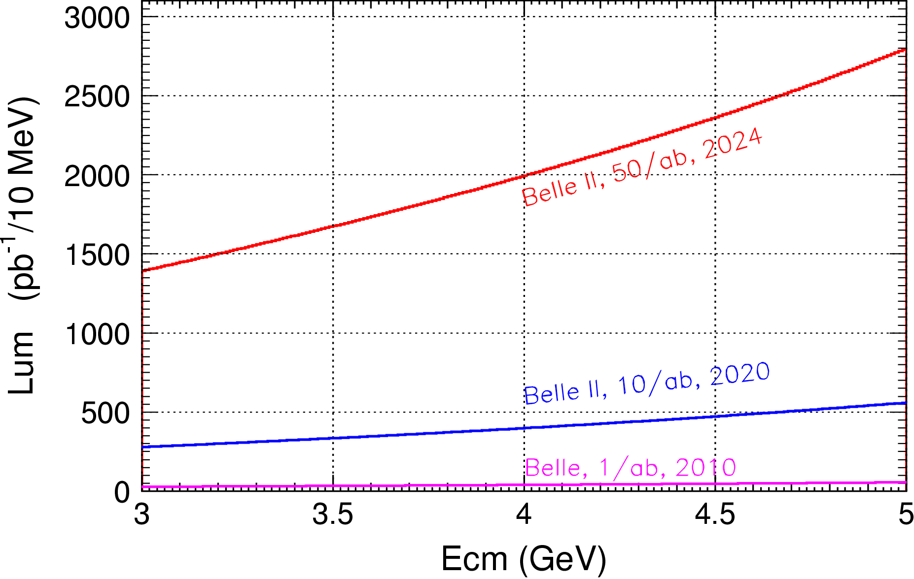
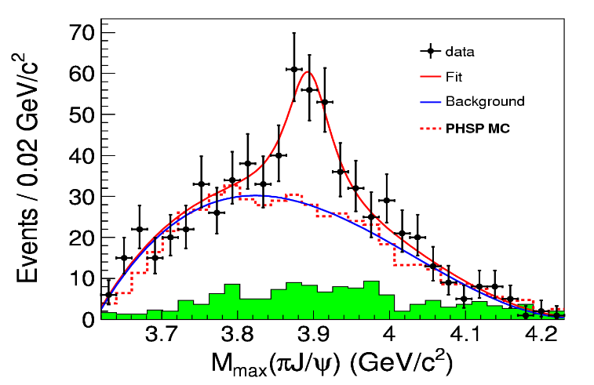

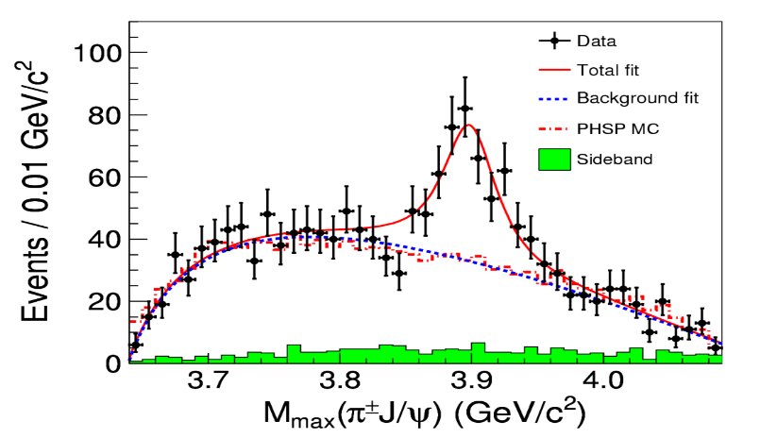

Competition from Belle II?
Integrated luminosity
0.4ab⁻¹ from Belle II 2024
1.0ab⁻¹ from HIEPA/year
Belle with ISR: PRL110, 252002
967 fb⁻¹ in 10 years running time
>5.2σ
@ 4.26 GeV for π⁺π⁻J/ψ
ε_{BESIII} = 46%, ε_{Belle} = 10%
BESIII at 4.260 GeV: PRL110, 252001
0.525 fb⁻¹ in one month running time
>8σ
Have incomparable superiority to explore Charmonium(like) states

Slide 14
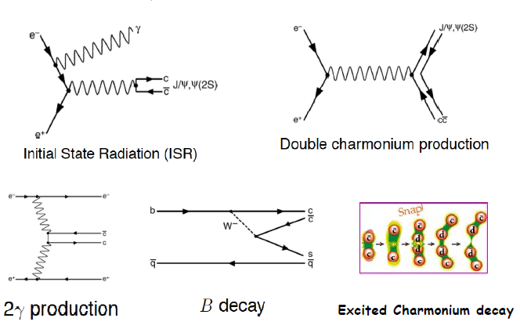
Production Mechanism @ B Factory

Slide 15
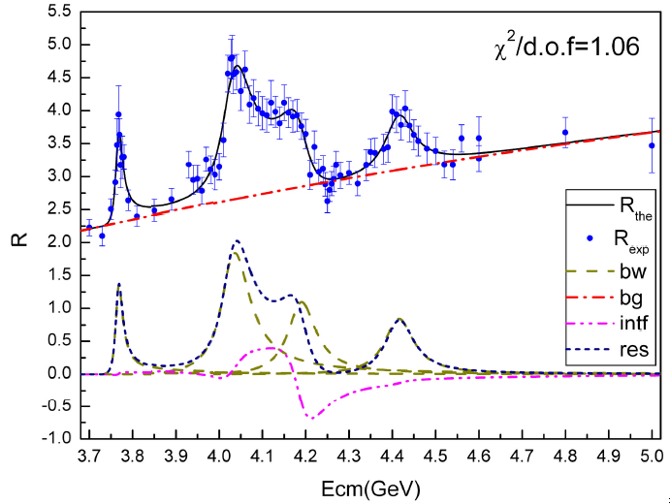
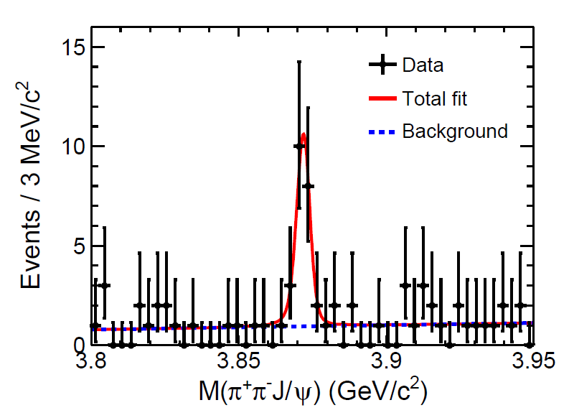
Production Mechanism @ τ-c Factory
ψ/Y/Hybrid(ccg) (1⁻⁻) produced directly in the e⁺e⁻ collision
To determine the resonance parameters for the excited ψ or Y state
Precisely measure the x-sec of inclusive/exclusive final states at different Ecms
Charge parity c=+1 states produced via radiative transition from vector ψ/Y
The decay rate ψ(nS/nD)→γX(3872), X(3940)…
χ_{cJ}(2P)、χ_{cJ}(3P)、η_{c}(3S)、 η_{c}(4S)、 …
  B(ψ(3S)→γχ’_{cJ}) = (7, 3, 1) x 10⁻⁴ for J=2,1,0
Search for new states from hadronic transition
To search for Zc, Zcs, hc(2P) ….
PLB 660, 315 (2008)
PRL 112, 092001 (2014)
σ(Y(4260) →γX(3872))∼6pb
Complementary to B factory

Slide 16
Search for 1⁻⁻ hybrid
B(H_{ccg}→γη_{c}) ~ 2x(B(H_{ccg}→γχ_{c0}) ~ 4x10⁻⁴
[in H,‾cc in spin-singlet! LQCD by Dudek’09]
σ(e⁺e⁻→H_{ccg}) ~ O(10-100) pb [???]
Scan e+e⁻→γη_{c} and γχ_{c0} for exotic structures
εB ~ 10% for γη_{c} and γχ_{c0}→γ+hadrons
L_{peak}=10³⁵/cm²/s, 1 year running = 10⁶pb⁻¹=1 ab⁻¹
At 100 energy points above‾DD threshold
N^{obs}(γη_{c})=O(4~40)/point/year at peak
N^{obs}(γχ_{c0})=O(2~20)/point/year at peak

Slide 17
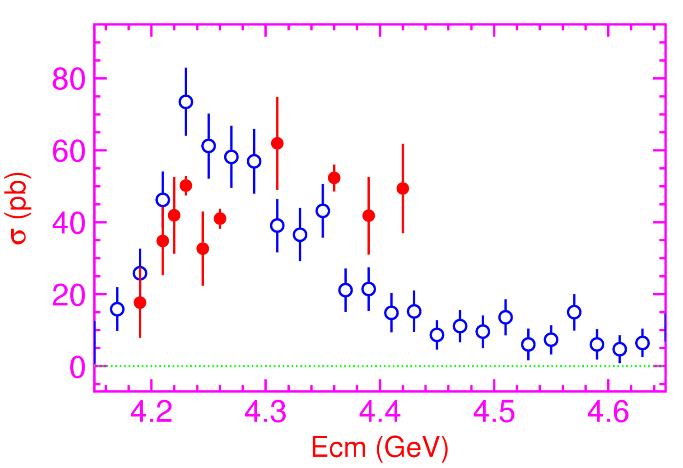
Exclusive Line Shape Measurement
L _{peak}=10³⁵/cm²/s, 1 year running = 10⁶pb⁻¹ = 1 ab⁻¹
At 100 energy points above‾DD threshold
Precisely measure the x-sec for exclusive final states

Slide 18
Explore the Nature of Z_{c}
σ(e+e⁻→ππ(π)+charmonium) ~ O(10) pb
Look for states in π+charmonium
εB ~ 2.7% for ππh_{c}→ππγη_{c}
εB ~ 5.0% for ππJ/ψ
εB ~ 2.0% for ππχ_{c}→ππγJ/ψ
εB ~ 1.0% for ππψ′→ππππJ/ψ
L _{peak}=10³⁵/cm²/s, 1 year running = 10⁶ pb⁻¹=1 ab⁻¹
N^{obs}=O(10⁵)/year; sufficient for PWA or Argand plot analysis

Slide 19
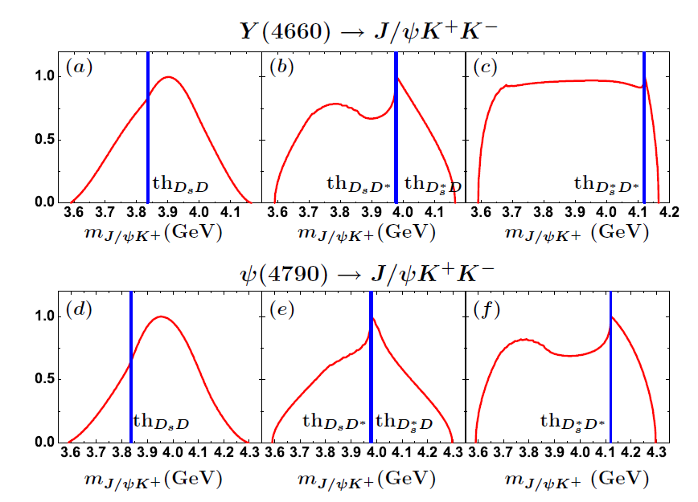
Search for Zcs
search for Excited Z_{c} and Z_{cs} particle@ Ecms>4.5 GeV

Slide 20
Search for η_{c2}(1¹D₂)
B(h_{c}(2P) →γη_{c2}) ∼ 3×10⁻⁴ [E1 trans., Barnes′ 05]
B(η_{c2}→γh_{c}) ∼ (44−54)% [E1 trans., Fan′ 09]
B(h_{c}→γη_{c}) ∼ 54% [E1 trans., BESIII′10]
σ(e⁺e⁻→π⁺π⁻h_{c}(2P)) ∼ 20 pb @ Ecm = ?? GeV
εB(η_{c}→hadrons) ∼ 1.5% at BESIII
N^{obs}=2×10⁻⁵×L (L is int. lumi. in pb⁻¹)
L _{peak} = 10³⁵cm⁻¹s⁻¹, 1 year running = 10⁶pb⁻¹ = 1ab⁻¹
N^{obs}=20 events /year,
Background is expected to be low for narrow h_{c} and η_{c}

Slide 21
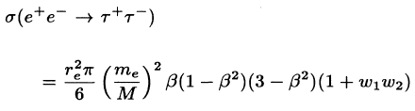
τ Lepton Physics
X sec grows from 0.1nb near threshold to 3.5nb at 4.25GeV
10⁸ tau pairs per year at threshold (x-sec = 0.1nb)
3.5×10⁹ tau pairs/year at 4.25GeV (x-sec = 3.5nb)
10¹⁰ tau pairs per year for Belle II (x-sec = 1nb)
Physics Highlighted Physics program
Precision measurements of α_{s}, m_{s}, V_{us}
Lepton universality : m_{τ}, τ→π⁺ν_{τ} and τ→K⁺ν_{τ}
Lorentz structure of the amplitude for τ→ℓν_{ℓ}ν_{τ}
Search for LFV processes : τ→ℓγ, ℓℓℓ, ℓh
Search for CPV
V-A Structure of the weak current in leptonic decays
Rare hadronic decays
Competition to Belle II
Threshold effect is important for controlling and understanding background
Longitudinal polarization of the initial beams will significantly increase sensitivity in searches for CPV in lepton decays.

Slide 22
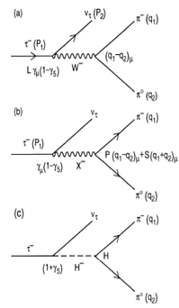



CP Violation in τ Decay
CP violation is observed in B, D and K systems to date
No CPV has been observed in the lepton sector
The discovery of CPV in the tau sector would be a clean signature of NP
One of the most promising CPV channels is τ⁻→K_{S}π⁻ν
SM CP asymmetry from K_{S}-K_{L} mixing is expected to be :
[Bigi & Sanda, PLB 625, 2005, Grossman &Nir JHEP 1204 (2012) 002]
BaBar measurement [PRD 85, 031102]
Belle measurement [PRL 107, 131801]
Charge Higgs, new Scalar,
W_{L}-W_{R} Mixings, LeptonQuarks
A_{cp} = (1.8±2.1± 1.4) ×10^{-3 @} W ∼ [0.89-1.11] GeV
Notes:
Now, we move to the CPV in tau decay.
To day, CP violation is observed in B,D and Ksystem
But no ovserved in the lepton sector,
The discovery of CPV in tau decay is a clean signture of NP.
The most promising CPV channels is tau-Ks pi v,
The SM predicted the CVP at 10-3 level duo to the Ks-Kl mixing,
But Belle and Babar did not observed any evindence for it CPV

Slide 23

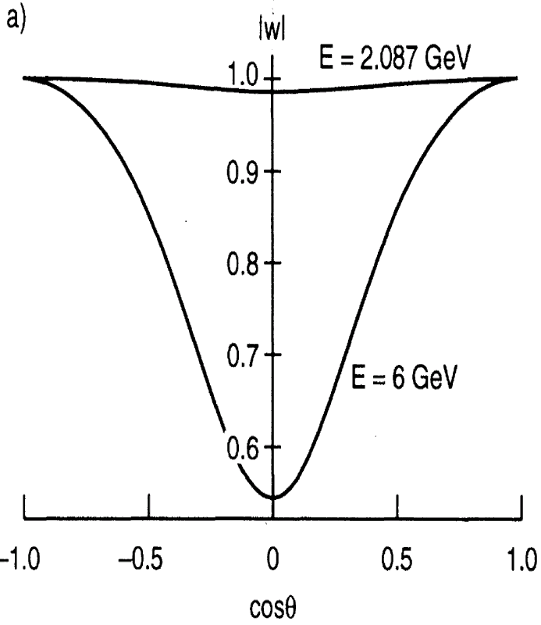

τ CPV in Angle Distribution
Need new measurement on the angular CPV asymmetry
Use T-odd rotationally invariant products : e.g.
in τ⁺ and τ⁻ decays to >=2 hadrons such as :
τ⁻→π⁻π⁰ν_{τ} /k⁻π⁰ν_{τ} , τ⁻→π⁻π⁺π⁻ν_{τ} /K⁻π⁺π⁻ν_{τ} ,
Need
polarized beam
tau-charm
“Figure Of Merits” -- Y. S. TSAI
BESIII @ 4.25 (10³³cm⁻²s⁻¹) FOM=1
HIEPA @ 4.25 (10³⁵cm⁻²s⁻¹) FOM=100
Super B @ (10³⁶cm⁻²s⁻¹ ) FOM=65
B factory
Y. S. Tsai, PRD 51.3172
Notes:
So we need a new measurement on the angular CPV asymmerty.
Like use T-od ratationally invariant products.
The kind of analysis can be performed in the tau decay into final state with more than 2 hadron.
But the polarized beam is necessary.
As we know, the polarization of electron beam can be transver to the produce
Tau,
In tau-charm region, all the produce tau is expected to the 100% poralaztion
While in the super factor, the proporazation is expected to be about 50% with
Tau cos\thet is 0.
A important variable “Figure Of Merits” proposed by the Y.S TSAI which take
into accouting luminorcist, polarization and total cross section,
to quantitative evaluate the feature of different experiment on CPV study
And HIEPA is found to be with the best quilaty.
Evaluate the characters of

Slide 24
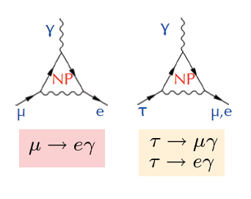
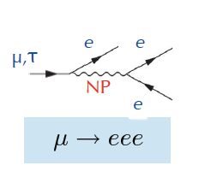
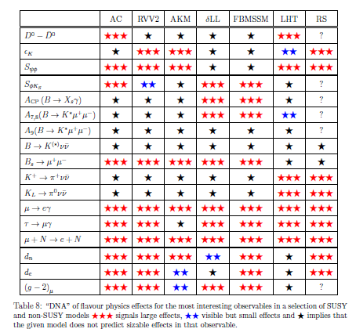
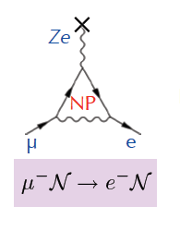
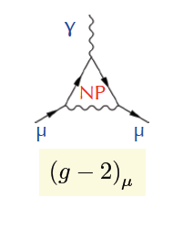
Charged Lepton Flavor Violation (cLFV)
In SM, cLFV is negligibly even taking into account neutrino mass
μ/τ anomalous decays
μ → e
conversion
Anomalous
magnetic moment
In tau-charm factory, τ→μγ decay is a golden mode to search for NP
W. Altmannshofer et al. arXiv : 0909.1333
Notes:
Now we move the new physics,
As we know, the discovery of Higgs complete the list of the partilce in SM.
But there some still a lots questions can not be explain the the SM framework.
To date, there are not any evidence of new physics at high energy frontiers,
So it is important and complementart to directly search for new physics in the presision frontier.
This table is DNA for the new physics search in flavor physics,
and charge letpon Falvor violavation decay is found to be a promising process to find the new physics
And discribmate the different models and contraint theirs parameters.

Slide 25
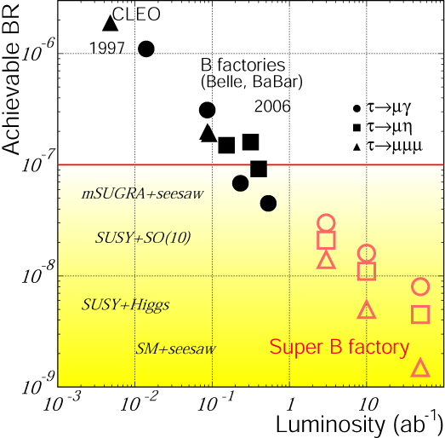
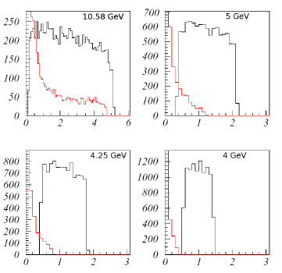
cLFV Decay τ→μγ @ B Factory
From A. Bondar, Charm2010
Current limit : ~ 4×10⁻⁸ (5×10⁸ τ-pairs)
BABAR : 516fb⁻¹ [PRL, 104, 021802]
BELLE : 545fb⁻¹
At (4S) :
ISR background e+e-→τ⁺τ⁻γ
Upper Limit ∝ 1/√L
Expected limit : 3x10⁻⁹@75ab⁻¹ (7×10¹⁰ τ-pairs)
Background e⁺e⁻→τ⁺τ⁻γ
Super-B 75 ab⁻¹
7×10¹⁰ τ-pairs
Does not contribute below √s ≈ 4m_{τ}/√3 ≈ 4.1 GeV.
Notes:
Tua->gamma mu have been detail studying for many years in B facotry.
This plot show the update limint as function of luminosity for the different experiment.
The current update limit is about 4x10-8 from both BABAR and BELLE,
It is clear see that the upper limit is proportional to 1/sqrt(L)
The strudy from Supper B show the expected UL is 3x10-9 with 75ab-1 data.
At HIEPA, we expected to collected 3x109 tau pair per year
It is interesting to know what the expected UL can be acieved in hiepa.

Slide 26
Expected τ→μγ Br upper limit
Dominant background
E(GeV) | σ(nb) | L(ab⁻¹) | N_{ττ}(10¹⁰)
3.686 | 5.0 | 1.5 | 0.75
3.77 | 2.9 | 3.5 | 1.03
4.17 | 3.6 | 2.0 | 0.71
Total |  | 7.0 | 2.49
τ decays, direct (τ⁺→π⁺π⁰ν_{τ}) and combinatorial
QED processes: e⁺e⁻ → μ⁺μ⁻γγ, e⁺e⁻ → e⁺e⁻ μ⁺μ⁻γ
Continuum hadron production e⁺e⁻ → qq
ψ(2S) and D-meson decays
 | σ_{E}/E=1.5% | σ_{E}/E=2.5%
Signal (Br=10⁻⁹) | 17 | 15
Muon background | 7 | 11
Pion background | 83 | 271
Expected 90% CL upper limit for Br | 1.1×10⁻⁹ | 3.0×10⁻⁹
Expected 90% CL upper limit for Br with pion suppression by a factor of 30 | 3.3×10⁻¹⁰ | 5.1×10⁻¹⁰
Supper-B Expected limit : 3x10⁻⁹@75ab⁻¹ (7×10¹⁰ τ-pairs)
Notes:
The study from Vlaimir show with 7ab-1 data, super tau-charm can get
The comparable or better upple limit than that of Supper-B expections.
We are prosssing the correspond fast simulation for NP sensitivity and to
Optimization the detector perfromance.

Slide 27
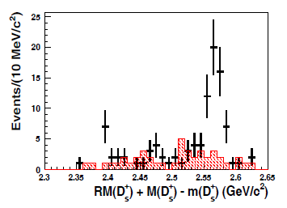
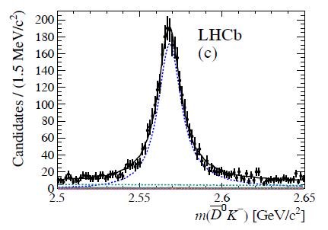
Charm Physics
4×10⁹ pairs of D^{±,0} and 10⁷∼10⁸D_{s} pairs per year
10¹⁰ charm from Belle II/year
Competition to Belle II
The multiplicity of final state is lower by a factor of 2
Threshold effect, clean, double tagging
QM coherent state, J^{PC}=1⁻⁻ for DD,J^{PC}=0⁺⁺ for γDD
Highlighted Physics programs
Precise measurement of leptonic, semi-leptonic decay (f_{D}, f_{Ds}, CKM matrix…)
D⁰-D⁰ bar mixing, CPV
Rear Decay (FCNC, LFV, LNV….)
Excite Charm meson D_{J}, D_{sJ} (mass, width, J^{PC}, decay modes)
Charmed Baryons (J^{PC}, Decay modes, Br)
Some sensitivities @ 1 ab⁻¹ data at threshold
Direct CPV in D→hh sensitivity : 10⁻³∼10⁻⁴
Probe y : Δ(y_{CP})∼0.1%
RM=(x²+y²)/2∼10⁻⁵ in Kπ and Keν channels
Δ(cosδ_{Kπ})∼0.007; Δ(δ_{Kπ}) ∼ 1°
0.5fb⁻¹ ∼ 80Events
1.0ab⁻¹∼ 160000 Events
D_{J2}
3.0 fb⁻¹∼ 4000Events
60.0fb⁻¹∼ 80000 Events

Slide 28
R and QCD Physics
Detailed study of exclusive processes e⁺ e⁻→(2-10)h, h=π,K,η, p…. , Scan between 2-7GeV and ISR √s<2GeV
Meson Spectroscopy
Intermediate dynamics
Search for exotic states (tetraquarks, hybrids, glueballs)
Form factors
High precision determination of R=σ(e⁺ e⁻→hadrons)/σ(e⁺ e⁻→μ⁺μ⁻) at low energies and fundamental quantities
(g_{μ}-2)/2, 92% from < 2GeV, 7% from 2-5GeV
α(M_{z}), 19.0% from < 2GeV, 18.1% from 2-5GeV
QCD parameters (charm quark masses)
Inclusive cross section e⁺ e⁻→h + X
QCD parameters (α_{s}, quark and gluon condensates)
Fragmentation functions
Spin alignment of vector
MLLA/LPHP prediction

Slide 29






Nucleon Electromagnetic Form Factors (NEFFs)
Spatial distributions of electric charge and current inside the nucleon
, Λ Λ
Space-like:
FF real
Time-like:
FF complex
Complete picture of the nucleon structure requires space-like and time-like FF measurements!
Cristina Morales
Notes:
Now we move to the Nuclearon Electromagnetic Form factor topic.
The nucleon (proton and neutron) electromagnetic form factors describe the spatial distributions of electric charge and current inside the nucleon and thus are intimately related to its internal structure; these form factors are among the most basic observables of the nucleon.
There two kind of FF measurement, Space-like FF, which can be measured in the scatter process, while the Time like FF, can be measure in the annihilate in the ee and ppbar process.
An complete picture of the nucleon structrure requires both space-like and time-like FF measurement.

Slide 30


Proton FF : Space-Like
Many measurements of the proton form factors in the space-like region.
At Jlab, the proton factor ratio was measured precisely with an uncertainty of ~1%, based on which the proton electronic and magnetic radii could be extracted.
JLab
JLab
Notes:
Many measurement of proton form factor in the space-like region have performed,
And at JLAB, THE PROTON FACTOR RATIO was measurement precisely with an uncertianty of 1%,
Base on which the proton electronic and magnetic radii could be extracted.

Slide 31







Proton FF : Time-Like
Assume G_{M}=G_{E}
Only 2 measurements,
but results are contradict
10-24% precision from B factory
QCD predict
BES3 0.4fb⁻¹, ∼10% Precision
δ|R_{EM}|/|R_{EM}| ∼ 9% - 35%
δ|G_{M}|/|G_{M}| ∼ 3% - 9%
first time extraction without any assumption.
δ|G_{E}|/|G_{E}| ∼ 9% - 35%
Notes:
However, for the time like proton FF, to day, the experiment statistics are still limit,
It always assume the Gm=Ge in most of experiment, only two results from babar and PSI
To extract the ratio of Ge to Gm, but the results are contradict, and the uncertainty of
Ratio from the B factory is 10-24%.
In BESIII, the uncertainty of the ratio is expected to be round 10% with 0.4pb-1 data,
And it can be first time to extract the Gm and Ge without assumption.

Slide 32



Proton FF @ HIEPA
√s=2.23 GeV
1 day
2 days
HIEPA reach 1
HIEPA reach 2
Using two days data, proton FF can reach 1% precisions at super τ-charm factory !
Notes:
So, for the Ratio of GE and Gm, the uncertainty of BESIII test run is about 24%,
While is expected 10% in BESIII final results,
while in HIEPA, the uncertiant is expected to be 1.5% or 1% with 1 or 2 days date
taking respectively.

Slide 33

Pre-Conceptual Design
SKEKB
HIEPA
BEPC-II
BEPC
2025
A luminosity 1×10³⁵ cm⁻²s⁻¹ at 4 GeV at 2025 is reasonable !!

Slide 34
加速器设计与关键核心技术
对撞亮度高于1×10³⁵@2GeV。
束流流强大于2A：BEPC II2倍以上，CEPC100倍以上
极化电子束/正电子束
质心能量调节范围2-7GeV，覆盖更宽能区
=>加速器物理与技术的新挑战

Slide 35


加速器物理：关键难点
对撞亮度公式
提高亮度的办法：
  流强↑ 对撞点包络β函数↓↓ 束-束因子$ξ_{y}$↑
聚焦↑↑ ☞ 非线性因素高、动力学孔径等优化困难
流强↑ 束团尺寸↓↓ ☞ 集体效应 ↑ ↑ ↑
$$L=\frac{γn_{b}I_{b}}{2er_{e}β_{y}^{∗}}ξ_{y}H$$
Notes:
γ为相对能量，n_{b}为束团数，I_{b}为单束团流强，ξ_{y}为垂直方向束-束效应参数，H为因包络函数β沿束团变化导致的亮度限制参数即Hourlass因数。从式(1)中可以看出，对于在给定能量上优化的对撞机，对撞亮度与流强、垂直方向束-束效应参数、Hourglass效应参数成正比，与垂直方向包络函数数值成反比
集体效应：
流强较强、束团尺寸较小而数量较多、能量较低，是HIEPA束流的三大特征，由此导致束流集体效应十分严重；束流不稳定性主要由尾场导致。严重的束流集体效应将引发粒子振荡频率改变、束流发射度增长、束流寿命下降、束流品质降低以及束流不稳定等现象。

Slide 36


亮度提高的原理
大Piwinski角对撞，Crabbed Waist Scheme
  为提高亮度，必须压缩β_{y}
  克服Hourglass效应，需要束团长度小于β_{y}
  束团长度很难缩短；而且，缩短束团长度会增强束流集体效应→长期存在的传统矛盾
  Large Piwinski Angle避免了此矛盾
  会引入新的束-束共振，限制tune shift，因此需要Crabbed Waist解决
$$L=\frac{γn_{b}I_{b}}{2er_{e}β_{y}^{∗}}ξ_{y}H$$
  E=2GeV，当β_{y}=0.35mm，扁平束， ξ_{y} =0.04 ， 则L=10³⁵/(cm²·s)

Slide 37

加速器物理：研究内容
对撞机制：
  Large Piwinski Angle + Crab Waist
束-束效应参数的优化
总体布局
单粒子动力学
集体效应
Notes:
1 对撞机制：
Large Piwinski Angle，克服束团长度对β函数大小的限制，β函数可以压缩到很小；
Crab Waist，抑制引入的束-束共振效应
2 束-束效应参数的优化：
束-束效应决定了对撞亮度的上限，束-束作用参数可以看做对撞的“效率”。 CEPC预估其垂直方向束-束效应参数约为0.1，BEPC II进行理论设计时假定垂直方向束-束效应参数为0.04。HIEPA采用大Piwinski角和Crab Waist Scheme的对撞机制，与现有的BEPC II、在研的CEPC都完全不同，因此需要对束-束效应参数的优化进行理论推导和计算机数值模拟，更深入地探索其优化方法。
3 总体布局：
对撞机为双环完全对称结构，电子、正电子束流能量相等，全环只有一个对撞点(Interaction Point, IP)。设置两个长直线节，分别作为对撞区和注入区使用，另外设置多个直线节用于安装Damping Wiggler等。为了能同时加速正负电子并且避免对磁铁和电源极性的变换引起的操作复杂度，电子和正电子的注入器各自独立，且只有正电子经过阻尼环。
4 聚焦结构(Lattice)设计与单粒子动力学优化
HIEPA加速器采用模块化设计，设计对撞区时先假设twiss参数为周期解，分别优化对撞区和弧区（Arc）后，再进行全局优化。
对撞区的设计主要是通过超强聚焦磁铁如四极铁、六极铁和螺旋管的排布实现对束团的压缩。超强聚焦将引入较严重的非线性，对撞区同时应进行对聚焦的非线性补偿与优化，从而提供足够的动力学孔径与动量孔径并补偿束流扰动等。除此之外，聚焦系统与探测器位于同一位置，因此还应考虑与探测器的接口，例如部件尺寸、束流引入的背景噪声因素等。需要对整个聚焦系统进行精细的设计计算，给出各磁铁的物理参数（磁场强度、磁场梯度、多极场分量等），并综合考虑探测器部分所提出的要求和限制，以确保聚焦后的束流能够满足对撞实验的要求。
除了对撞区本地补偿外，为了压缩包络函数，还需要对整个Lattice进行动力学优化。超强聚焦需要引入强的非线性补偿，而且对撞区的β函数变化剧烈，磁铁的边缘场效应很强，这些都使得优化难度显著提升。
5 集体效应
束流不稳定性主要由尾场导致。严重的束流集体效应将引发粒子振荡频率改变、束流发射度增长、寿命下降以至束流不稳定等现象。下一代对撞机中，B工厂能量高于韬-粲工厂，Higgs工厂束流能量则接近韬-粲工厂的100倍；CEPC的流强约16.6mA量级，HIEPA则为2A。流强较强、束团尺寸较小而数量较多、能量较低，是HIEPA束流的三大特征，由此导致束流集体效应十分严重，例如由于真空室孔径很小（为了得到强聚焦），电阻性壁尾场更强等。
HIEPA的束流流强较强、束团间距较短，因此以多束团不稳定性为主，如横向阻抗壁不稳定性、耦合束团不稳定性、电子云不稳定性、离子俘获不稳定性等，而束团伸长效应等单束团不稳定性退居次要因素。除此之外，束流集体效应还包括束内散射(IBS)、托歇克散射和残余气体散射等，这些效应将导致束流品质下降与束流寿命降低。

Slide 38

Parameters of Machine

Slide 39
General Consideration of Detector
Efficient event triggering, exclusive state reconstruction and tagging
high efficiency and resolutions for charged and neutral particles
Low noise and High rate
Much larger radiation does hardening, especially at IP and forward regions
The detector and electronics should withstand the expected does
The Systematic error will be dominant in many physics studies
Detector acceptance : geometrical acceptance or detector response
Mis-Measurement : mis-tracking, fake photon, particle mis-id, noise
Luminosity measurement
Reasonable cost

Slide 40
General Consideration
Vertex performance and low-momenta tracking eff.
Tracking : multiple scattering effect is important
P T resolution : 0.5∼0.7%@ 1 GeV/c, and dE/dx resolution: 6%
low material budge.
PID : π/K and K/p separation up to 2GeV/c
modest material budget (<0.5X₀)
Cherenkov detector is necessary
EMC : fast response to match the high luminosity
stochastic term<2%/√E and constant term < 0.75%,
angular resolution?
MUC : large-area fast sensors (RPC/MPRC etc)
μ/π suppression power>10/30, down to p=0.5GeV/c
Large solid angle detector ∼Nearly 4π

Slide 41

Detector
245 cm
MUD
μ/π suppression power >10/30
York/Muon
185 cm
EMC
Energy range: 0.02-2.5 GeV
At 1 GeV σ_{E} (%)
Barrel(Cs(I): 2
Endcap (Cs): 4
Superconducting magnet
(0.7-1 T)
York/Muon
135 cm
EMC
105 cm
PID
π/K (and K/p) 3-4σ separation up to 2GeV/c
PID-barrel
85 cm
20°
PID-endcap
MDC (Low mass )
σ_{xy}=130 mm
dE/dx<7%, σ_{p}/p =0.5% at 1 GeV
MDC
15 cm
PXD/SSD
PXD
Material budget ~0.15%X₀/layer
σ_{xy}=50 mm
10 cm
3~6 cm
IP
120 cm
140 cm
190 cm
240 cm
300 cm
Notes:
We also have very preliminary conception design for the Detector, a very BESIII like symetry
Detectors is proposed.

Slide 42

Tracking Detector
Must balance momentum resolution and curling of low momentum tracks :
Low B field (∼1T), need re-optimized
Multiple coulomb scattering is critical :
  low mass helium-based gas, wires
  Small cells are needed for speed – more wires in tension with low mass
  Carbon fiber support structure to minimize effect on PID, EMC etc
BESIII Drift Chamber
Starting point

Slide 43


Tracking Detector
Simulation : θ= 90⁰
R in = 15 cm
Rout = 85 cm
L = 2.4 m
B = 1 T
He/C2H6 (60/40)
# of layers = 48
Cell size =1.0cm(inner),1.5cm(outer)
Sense wire: 20 um W
Field wire: 110 um Al
0.5%X0 carbon fiber inner wall
Expected spatial resolution: 130 um
Expected dE/dx resolution: 7%
Layer configuration: 8A-5S-5A-5S-5A-5S-5A-5S-5A
Low mass

Slide 44
Vertex Detector
Provide precise hit close to collision vertex.
Secondary vertices reconstruction.
Help on tracking, improve momentum resolution.
Help on vertex finding, improve the position resolution (impact parameter d₀).
Challenge and risk
Develop pixel technology in China.
Material control (low mass must be required).
Man power and cost.
…

Slide 45



Vertex Options
STAR-HFT
Belle II PXD
In the active pixel matrix region: thickness ~ 75 mm.
HFT
SSD
IST
PXL
PIXEL
double layers, 20.7x20.7 um pixel pitch, 2 cm x 20 cm each ladder, 10 ladders, delivering ultimate pointing resolution.
new active pixel technology

Slide 46



Others option
GEM
MicroMegas
在HIEPA上应用的技术难点
  圆柱型
  像素读出

Slide 47


Performances
Option I : MDC + STAR HFT
Geometry not optimized
Detector | radius (cm) | material (%X₀) | resolution (mm)
MDC Outer 9-48 | 23.5-82 | 0.0045 /layer | 130
MDC Inner 1-8 | 15-22 | 0.0051 /layer | 130
SSD | 10 | 1.5 | 250
PXD 2 layers | 3/6 | 0.37 /layer | 30
Beam pipe | 2 | 0.15 | −
Option II: MDC + Belle-II PXD
Detector | radius (cm) | material (%X₀) | resolution (μm)
MDC Outer 9-48 | 23.5-82 | 0.0045 /layer | 130
MDC Inner 1-8 | 15-22 | 0.0051 /layer | 130
PXD 3rd layer | 10 | 0.15 | 50
PXD 2 layers | 3/6 | 0.15 /layer | 50
Beam pipe | 2 | 0.15 | −
Improvement at low pT is small, significant at High pT and the position resolution
Similar in terms of performance

Slide 48




PID Detector
Key Features
Enable π/K (and K/p) 3-4σ separation up to 2GeV/c (30ps for TOF, impossible)
For high luminosity run – fast detector
Radiation hard, especially in the endcap
Compact – reduce costs of outer detectors
Modest material budget - <0.5X₀
Low Momentum
Specific energy loss (dE/dx) in MDC
Better dE/dx resolution for longer track
BESIII MDC (~6%, track length ~0.7m)
clean π/K/p ID for p<0.8/1.1 GeV/c
BELLE TOF+ACC
BELLE-II ARICH
High Momentum
Cherenkov detector is necessary
Two catalogs
  Threshold Cherenkov – simple to build
  Imaging Cherenkov: RICH (large momentum range)/ DIRC / TOP (most compact)
ALICE HMPID
BELLE-II iTOP

Slide 49


PID Detector
Baseline Design
PID by RICH at 0.8<p<2GeV/c, no TOF
Proximity RICH, similar to ALICE HMPID design, but with PHENIX HBD (CsI coated GEM) readout
n~1.3 (liquid C₆F₁₄), UV detection
Already proven
Immune to B field → same structure at both the endcap and the barrel
Alternative Design
No TOF, PID by RICH only
Similar to BELLE-II ARICH design, Aerogel + Position Sensitive Photon Detector
n~1.13 (Below threshold for proton at p<2GeV/c)
Already proven at the BELLE-II endcap, how about the barrel part?
Need R&D
ALICE HMPID
PHENIX HBD

Slide 50



Electromagnetic Calorimeter
EMC Requirements
Good energy resolution
Good position/angular resolution
Good timing resolution if possible
Challenging
Radiation damage
  Decrease light yield
  A function of run time
High photon background rate
  Produce pile-up
  Degrade energy and angular resolution
Babar, NIM A479 (2002) 1
Behavior of the light emitted by a crystal
due the radiative Bhabha photons
0.75 krad
1.2 krad

Slide 51

Crystal Comparison

Slide 52
Barrel EMC
CsI calorimeters (BABAR, BES-III, CLEO-c) are a reasonable first-order, match to a 10³⁵ collider in the 4 GeV region
Similar to that of SuperB
  Adjusts electronics time constants, the barrel calorimeter is adequate
  Such as pure CsI, which were considered for the endcap at SuperB , could be re-evaluated. Need for a fast, efficient readout device that works in a magnetic field.

Slide 53

EndCap : LYSO
SuperB Forward EMC options
A detector faster, with finer granularity and higher radiation hardness
Best performance: Full LYSO (too expensive, crystal cost 3x pure CsI/BGO, 7x PWO)

Slide 54

EndCap : PWO
PWO is dense and fast
Increase light yield:
  improved PWO II
  operation at -25°C
Challenges:
  temperature stable to 0.1°C
  control radiation damage
  low noise electronics
Delivery of crystals started
Barrel Calorimeter
11000 PWO Crystals
LAAPD readout, 2 x 1cm²
σ(E)/E∼1.5%/√E + const.
Forward Endcap
4000 PWO crystals
High occupancy in center
LAAPD readout
Marco Maggiora, Workshop on Tau-Charm at High Luminosity, La Biodola , Isola d’Elba, May 27 – 31, 2013

Slide 55

EndCap BSO
Pros:
Relative fast
Radiation hard
Emission spectrum compatible to different photosensors (PMT, Si)
Small X0 (60% CsI) → more compact
Small Moliere Radius (60% CsI) → finer segmentation
Low raw material cost (~PWO and 50% BGO, mush less than LYSO)
Cons:
LY smaller than CsI(Tl) and LYSO (however, ~ PWOII at -25 ⁰C)
Dose rate dependent LY, fast recovery time → LY Calibration system needed
Not mature (large size available, mass production not proven)
9 crystals from SICCAS, 2x2x20 cm³

Slide 56


Muon Identification
Expected μ/π suppression power >10 (30)
Typically used large area RPCs, scintillator strips with wavelength shifting fiber and pixelated APD or SiPM readout.
A new Muon ID method-Star MTD at STAR
based on the Long-strip MRPC technology
  good timing performance
  moderate spatial resolution
  Cost-effective
using the iron bars as absorber
Requirement on the MRPC
  Time resolution: < 100 ps
  Spatial resolution: ~ 1 cm
  High efficiency
Performance :
Time resolution : 108ps
Spatial resolution :
2.6cm(z), 1.9 cm( φ)

Slide 57


Extending π/μ separation range
The time-of-flight for punch through pion and muon coming out from ECal shows some difference at low momentum.

Slide 58

Activities
http://wcm.ustc.edu.cn/pub/CICPI2011/futureplans/

Slide 59





Workshops for HIEPA
1/11/2015
59

Slide 60









2015 Internal Workshop
Stanford
Caltech
来自中，美，英，德，法，意，日等国 约150名科学家
60

Slide 61









香山会议
九位院士， 十余位千人，杰青，长江教授
1/11/2015
61

Slide 62



Pre-CDR

Slide 63
Conclusion
A τ-charm factory provide a unique playground for Hadronic physics, many key science question and rich physics topics can be investigated
China have high reputation in the world at τ-charm physics, and BEPC/BES play leading role in hadronic physics.
It is natural to propose the e+e- intensity frontier for τ-charm energy region in China
HIEPA is one of the options :
Have challenges in terms of key technologies
Reasonable scale and cost.
Interdisciplinary mode (STCF + SRF + FEL?)

Slide 64
BACKUP SLIDE

Slide 65

极化束
极化电子束/正电子束的产生
  GaAs/GaAsP超晶格光阴极电子枪，产生极化电子束
  无极化电子束，波荡器圆极化光产生极化正电子
  纵向极化电子束，极化轫致辐射产生极化正电子
极化维持与极化翻转
  储存环退极化时间研究；Siberia Snake装置极化翻转

Slide 66
对撞区磁铁与相关技术
聚焦系统的设计
强聚焦
  高场磁铁、螺线管=>超导
高场强Wiggler
  控制发射度与阻尼时间=>超导
本底的屏蔽
Notes:
根据加速器物理设计的结果，确定磁铁与对撞点的距离分布，根据该距离和聚焦需求，给出对磁铁强度的要求。根据磁铁强度需求，确定磁铁的设计方案。
初步计算的结果，当四极磁铁与对撞点距离600mm时，四极铁磁场梯度在107T/m以上，螺线管需要提供4.5T以上的磁场。
为了在整个束流能量范围内对亮度进行优化，维持一个恒定的水平发射度和阻尼时间，束流的阻尼参量需要能够根据其能量进行精确控制，为此可利用超导阻尼Wiggler。Wiggler的磁场随着束流能量的降低而升高，当束流能量在最高值时其值为零，能量为1 GeV时其值为4.9Tesla。

Slide 67
真空系统相关技术
真空室设计
  束流耦合阻抗控制与优化
热负载效应研究
  降低热负载；优化热传导；维持隧道温度
新型镀膜技术
  石墨烯膜，抑制二次电子发射=>抑制电子云效应
Notes:
储存环真空室的阻抗（也叫耦合阻抗）只取决于真空室本身的结构和尺寸，而与束流的性能无关。HIEPA具有周长达600m的双环，在储存环真空室的设计和制造阶段应尽量降低它的阻抗，对未来克服各种束流不稳定性十分重要。
高亮度高流强的环形对撞机同步辐射非常强，导致储存环热负载较高，因此需要研究如何降低热负载、提高热传导效率和维持储存环温度环境。
为符合在高能同步辐射条件下的真空要求，真空室结构及其内部的光吸收器的设计及布置、高负载下光吸收器及真空室的稳定性及真空性能都是要研究的对象，为此需进行模拟计算和实验研究。通过数值模拟计算，可以分析具备复杂的形状和边界条件的真空室的尾场与阻抗。
粒子加速器真空室内的残余气体会被带电粒子束电离产生电子，同时被粒子束轰击及同步辐射光照射的真空部件表面也会产生光电子发射。这些电子轰击真空腔体，导致二次电子发射，并最终导致电子云的形成。高密度的电子云对束流的效应导致横向束流不稳定性上升、束流损失增加、束流横向束团长度增大和真空度降低等后果，极大影响高能高亮度加速器装置的性能。
与目前常用的加速器真空室结构材料的二次电子产额（SEY）如无氧铜（约1.4）及铝（1.3）和不锈钢（1.5）相比，石墨烯具有超低的SEY，约为0.1，大大低于目前常用的镀膜材料的SEY。同时，石墨烯是单原子层厚度膜层，有利于保持表面粗糙度；具有良好的导电性，可以降低尾场效应；具备优良的热传导性，可提高真空室结构的热稳定性；可利用CVD方法形成以利于在小直径管道内形成。石墨烯具有成为高能高亮度加速器真空部件及真空室表面镀膜材料的应用前景，但为在HIEPA中应用石墨烯材料，还需对它在加速器环境中的特性如在同步辐射环境下的超高真空特性、光致解吸特性（PSD）及所获得膜层的机械、电气性能等进行一系列的研究工作。
项目的研究中，首先进行石墨烯等膜层材料真空性能测试，随后进行加速器结构材料上石墨烯等膜层材料及它们的同步辐射环境性能测试与分析，最后研究膜层材料在加速器真空管道腔体内镀膜技术、生长机理及膜层电气、机械等特性。

Slide 68
Possible Schematic Layout
E_{cm}=2−7 GeV, L = 1x10³⁵ cm⁻²s⁻¹ at 4 GeV
3rd or 4th generation SRF
~1000M double ring
Crabbed Waist
For tau-charm physics
Notes:
We were begin to this project from last year, at present we are in the concept design status.
to day, we have very very preliminary concept designed for the accelerator, and detector.
This plot show the our consider design for HIAPC accelearator, a double ring with 1000M,
S siberai snake for the poliztion, and crabbed waist at the IP region for tau-charm factory
And different light sourse service as 3rd or 4th generation SRF

Slide 69


Pre-Design Machine
Symmetric machine with high currents，large crossing + crabbed waist solution for the interaction region
Polarization available on one beam : Sibelian Snake
Notes:
γ为相对能量，n_{b}为束团数，I_{b}为单束团流强，ξ_{y}为垂直方向束-束效应参数，H为因包络函数β沿束团变化导致的亮度限制参数即Hourlass因数。从式(1)中可以看出，对于在给定能量上优化的对撞机，对撞亮度与流强、垂直方向束-束效应参数、Hourglass效应参数成正比，与垂直方向包络函数数值成反比
集体效应：
流强较强、束团尺寸较小而数量较多、能量较低，是HIEPA束流的三大特征，由此导致束流集体效应十分严重；束流不稳定性主要由尾场导致。严重的束流集体效应将引发粒子振荡频率改变、束流发射度增长、束流寿命下降、束流品质降低以及束流不稳定等现象。

Slide 70
Questions need answer
Where are the missing states above the charm threshold
¹D₂(2⁻⁺) : M∼3830MeV, narrow, may be produced in h_{c}(2P) E1 transition
P-wave spin-triplets from S-wave E1 transition
P-wave spin-singlets from S-wave hadron transition
D/F-wave
In the X sector
  Where the X(3872) & X(3823) come from? Resonance decays or continuum production?
  May other X states be produced and where?
In the Y/ψ sector
  Is the Y(4260) a single resonance? Is Y(4008) a real structure?
  Does the Y(4360) decay only to ππψ’? Not to ηJ/ψ ?
  What is hidden behind ππh_{c}? Large coupling to spin-singlet, is a hybrid state observed?
  Correlation between charm production & charmonium transitions?
  May we observe the charmonium 3³D₁ state at ~4.5 GeV?
In the Z sector
  Are the Z_{c} and Z_{c}’ from resonance decays or continuum prod.?
  Are there excited Z_{c} states and Z_{cs} states [D*D_{s} or DD_{s}*]?
Are there hybrids (1⁻⁻, others J^{pc})

Slide 71

Two photon Physics
Measurement of Γ_{γγ} for J^{PC} = 0⁻⁺, 0⁺⁺, 2⁻⁺, 2⁺⁺ states
Study of γγ*→R, R= 1⁺⁺
Transition Form Factors in γ*γ*→R
Total Cross section of γγ→hadrons
Exclusive cross section for γγ→ρρ, φφ, ppbar
Towards a data-driven analysis of hadronic light-by-light scattering
Gilberto Colangelo et al,
arXiv:1402.7081, 1408.2517

Slide 72
Electromagnetic Calorimeter
BSO Crystal
Pros:
Relative fast
Radiation hard
Emission spectrum peak at 480 nm
Small X0 (60% CsI) → more compact
Small Moliere Radius (60% CsI) → finer segmentation
Low raw material cost (~PWO and 50% BGO, much less than LYSO)
Cons:
LY smaller than CsI(Tl) and LYSO (however, ~ PWOII at -25 ⁰C)
Dose rate dependent LY, fast recovery time → LY Calibration system needed
Not mature (large size available, mass production not proven)
PhotoSensors
PIN Photodiode
Mature
Large noise/signal
Large Area APD
Relatively Mature
Large noise/signal
Vacuum photopentode
New, under developing
Low noise, low gain (~10-100)
Sensitive to magnetic field
Multi-Pixel Photon Counter (MPPC/SiPM)
New, under developing
High gain (~10⁶), low ENF, simplify elec.
Insensitive to magnetic field
Good timing resolution

Slide 73


Muon Detector

Slide 74
Organization
HIEPAF
Physics&
Software
Detector
Accelerator
Infrastructure
Theory
Vertex
Injector
Civil
engineering
Generator simulation
Tracker
Ring
PID
Technical
supporting
Calibration
Reconstruction
EMCAL
MUD
Computing network
data service
SCM
Electronics
Safety
Environment
Trigger
DAQ
Collectivity

Slide 75
Summary
HIEPA is one of the possible options for high energy physics in China.
Have interesting physics relating to key science questions
Have challenges in terms of key technologies
Reasonable scale and cost.
Interdisciplinary mode (STCF + SRF + FEL?)
Working groups are formed and are making progress with regular weekly meeting and workshops.
Tend to have a CDR soon, need your contributions
Your ideas, suggestions and inputs are very important for us,
Welcome to join the effort

Slide 76


Hadron : Normal & Exotic
Experiments :
Hadrons are composed of 2 (meson) or 3 (baryon) quarks
Described very well in quark model (QM)
QCD suggests:
Confinement : stable hadrons need to be colorless
Gluon-gluon interactions : hadron with gluons (hybrids and glueballs) could exist
Allow hadrons with N_{quarks}≠2, 3 (multi-quarks)
Key Science question : Is there any exotic hadron exist
A long history of searching for the exotic hadrons,
no solid conclusion was reached in past a few decades,
some hints on charmomium-like and bottomnium-like particles, recently.
08/07/2014 H.P. Peng
ICHEP 2014, Valencia, Spain
Notes:
Let me briefly introduce you some interesting topic.
We bgin from the hadron spectroscopy.
As we know, to date, in experiment, we only observed the meson which is compose with
2 quarks, and baryon with 3 quark.
But QCD suggest the existence of exitoc states such as glueball, multiquark etc.
Search for these exotic hadron is a key science question.
W

Slide 77

Upper limits on τ cLFV

Slide 78

μ→γe .vs. τ→γμ
Hep-ex/1008.1541v1
Large θ13 was established by Daya Bay experiment
Current limit
μ→γe : 2.4×10⁻¹² (MEG)
τ→γμ : 4.4×10⁻⁸ (BELLE)

Slide 79
cLFV in τ and μ: comparisons
 | BR(μ→eγ) | BR(μ→eee) | BR(μN→eN) | BR(→μ/eγ) | BR(→lll)
MEG | 110^{13}
Mu2e/COMET |  |  | 310^{17}
Super-B |  |  |  | 2-310^{9} | 2-810^{10}
Super-tC |  |  |  | 110⁻⁹ | 110⁻⁹
LHC experiments do not appear to be competitive Super-B in Italy: high luminosity and polarized beam
Typically, the μN→eN rates are 1/(200∼400) of μ→eγ rates
Tau and μ LFV are different processes:
Comparison depends on the NP model BF(→μγ)>>BF(μ→eγ)
Mu2e/COMET is 2-3 order of magnitude better than super-B and super-tC
Measurements are complementary.

Slide 80
Summary of τ Physics
With 1ab⁻¹ near tau threshold:
LFV: 10⁻⁹
Lepton universality: 10⁻⁴
CP violation in decay: 10⁻⁴
CPT tests: 10⁻⁴
Tau mass
Vus: (0.1-0.5)%
A super-tau-charm and a BELLEII will be complementary machines for tau physics

Slide 81
Search for τ→lll (@4.26GeV)
Mode | 1.π+μ-μ-μ- | 2.π+e-e-e- | 3.e+μ+μ-μ- | 4.μ+e+e-e- | 5.π+e+e-μ- | 6.e+e+e-μ- | 7. π+μ+μ-e-
Efficiency | 1.41% | 14.31% | 3.02% | 15.32% | 8.61% | 16.28% | 4.27%
N bkg | 0.65 | 2.44 | 1.55 | 11.25 | 3.50 | 63.28 | 1
Nobs | 0 | 5 | 2 | 18 | 4 | 80 | 0
Br(up limit) | ~10-5 | ~10-6 | ~10-5 | ~10-4 | ~10-5 | ~10-5 | ~10-5
Mode | 8.μ+μ+μ-e- | 9.π+e-e-μ+ | 10.μ+μ+e-e- | 11.π+μ-μ-e+ | 12.e+e+μ-μ- | 13 | 14
Efficiency | 5.18% | 8.55% | 9.81% | 4.02% | 8,24% | 5.21% | 16.44%
N bkg | 4.36 | 1.79 | 5.93 | 0 | 9.07 | 2.03 | 25.55
Nobs | 3 | 1 | 7 | 1 | 13 | 1 | 26
Br(up limit) | ~10-5 | ~10-5 | 10-5 | ~10-5 | ~10-5 | ~10-5 | ~10-6
N_{ττ} = 1092pb⁻¹ × 3.5nb = 3.8×10⁶
1ab⁻¹ Y(4260) and the same background : 10⁻⁸-10⁻⁹

Slide 82
Nucleon Electromagnetic Form Factors (NEFFs)
Key science question: why do quarks forms colourless hadrons with only two stable configurations, proton and neutron?
NEFFs are among the most basic observables of the nucleon, and intimately related to its internal structure.
Nucleons are the building blocks of almost all-ordinary matter in the universe. The challenge of understanding the nucleon's structure and dynamics has occupied a central place in particle physics.
The fundamental understanding of the NEFFs and HEFF (hadron form factor) in terms of QCD is one of the outstanding problems in particle physics.

Slide 83



Nucleons FF
提高中子形状因子的测量精度在实验和理论方面都具有重要意义！
意大利曾计划对DAΦNE/FINUDA做重大专门改进来测量核子形状因子

Slide 84





Tracking System

Slide 85


Muon Detector

Slide 86


PID Detector
Time of Flight
Δβ/β= ΔT/T =Δm²/2p²
ΔT =L/cβ * Δm²/2p² ~ L/c * Δm²/2p²
For π/K/p at p=2GeV/c, ΔT ~ 0.1ns*L(m) = 100/270 ps at L~1m. So for 3σ π/K/p separation an overall TOF time resolution ~20/50ps is needed.
TOF alone can not identify π/K to p=2GeV/c
Radiator Index Choice
Take n=1.13/1.3 and N_{photon}=10
~60/38 mrad single photon resolution for 3σ π/K separation at p=2GeV/c
correspond to ~20/14mm photon sensor size (with proximity gap T=10cm)

Slide 87




PID Detector
ALICE HMPID
Liquid C₆F₁₄ radiator n~1.3 @ 175nm
Proximity gap = 80mm
readout pad size 8mm×8.4mm
3σ π/K/p separation up to p=3/5 GeV/c
BELLE-II ARICH
double aerogel, n₀=1.055,1.065
Proximity gap = 200mm
θ_{c}=336mrad, σ_{θ}=15.8mrad
N_{det}= 11.4
>5.5 σ π/K separation at 4 GeV/c

Slide 88
Crystal Comparison

Slide 89

BSO Performance
Measured with XP2262
9 crystals from SICCAS, 2x2x20 cm³
Caltech

Slide 90




MPPC/SiPM test
Hamamatsu S10362-33-050C
3 x 3 mm²
Crystal
3 x 3 x 15 mm²

Slide 91





Linearity and resolution
BGO
CsI(Tl)
PANDA
PWO@-25⁰C+APD
PWO@-25 ⁰C+APD

Slide 92


SiPM/MPPC Products
sensL
Hamamatsu
4 x 4 channel array
3 x 3 mm² each channel
3600 cells per channel
~ ￥1500
4 x 4 channel array
3 x 3 mm² each channel
4774 cells per channel
~ €120

Slide 93
Production mechanism
ψ/Y particles are directly produced :
Measure the production cross section precisely,
Extract the excited ψ or Y states resonance parameters via fitting data.
Study states with C=+1 via radiative transition :
B(ψ(3S)→γχ′_{cJ}) = (7,3,1)×10⁻⁴ for J=2, 1, 0 [E. Eichten et al. Rev. Mod. Phys. 80, 1161 (2008)]
ψ(nS/nD)→γXYZ [X(3872) ,Y(4140) et al.], no theoretical prediction on transition rate,
BESIII : σ(Y(4260) →γX(3872))∼6pb [PRL 112, 092001 (2013)]
Search for states in ψ/Y particles hadron decay :
Y(4260)→πZ_{c}(3900), ψ→πh_{c}(1P/2P) …..
Topics at HIEPA
Where are the missing states above the charm threshold
¹D₂(2⁻⁺) : M∼3830MeV, narrow, may be produced in h_{c}(2P) E1 transition
P-wave spin-triplets from S-wave E1 transition
P-wave spin-singlets from S-wave hadron transition
Can we identify F-wave states?
Can we find the Z_{cs}?
Are there hybrids (1⁻⁻, others J^{PC})
Notes:
In tau-charm energy machine, psi and Y can directly produced with running the machine at a given energy.
And the state with C=1 can be studied via radiative transition.
And hardron decay fro psi or Y states can be used to search for states, like zc(3900)
The interesting charmonium topic in HIEPA is to seraching for the missing particle
Above the charm thredhold, like D wave singlet state and Pwave excited state.
To identify F-wave states and search for Zcs, also to looking for the hybirds states predicted by QCD.

Slide 94


Direct CP Violation in D→hh
World measurements of (LHCb, CDF, and Belle)
No CPV observed yet in charm sector.
In New Physics: CPV up to ~1%;
If CPV ~1% , is it NP or hadronic enhancement of SM?
Strategy: analyze many channels to elucidate source of CPV.
50ab⁻¹ data @BELLE-II can reach to sensitivity : 10⁻³~10⁻⁴
1ab⁻¹ data @HIEPAF sensitivity: 10⁻³~10^{-4 ,}(BESIII 20fb⁻¹, 10⁻²~10⁻³ )
Clean background, better systematic control @HIEPAF would strengthen competitions with future B projects

Slide 95

Determination of γ/φ₃ angle in CMK
The cleanest way to extract γ is from B→DK decays:
current uncertainty σ(γ) ~10~15⁰
however, theoretical error: 10⁻⁶ (!)
over-constrain the Unitarity Triangle
Information of D decay strong phase is needed
Only can be accessed through quantum coherence of DD production at threshold
ADS method: use D doubly Cabibbo-suppressed decays, e.g. D⁰ → K⁺π –
With 1 ab⁻¹ @HIEPAF: σ(cosδ_{Kπ}) ∼0.007; σ(δ_{Kπ}) ∼2º
BELLE-II expects σ(γ) ∼5º; upgraded LHCb: σ(γ) ∼1.3º
GGSZ method: use Dalitz plot analysis of 3-body D⁰ decays, e.g. K_{s} π⁺ π⁻
high statistics; need precise Dalitz model
Belle results from GSSZ method in 2012: γ=(77±15±4±4) º
HIEPAF would reduce the contribution of D Dalitz model to a level of ~0.1º, since expected precision from future B projects would be ~2º.
from D decay model

Slide 96



DDbar Mixing rate at threshold
charm mixing established!
Pure Mixing, PID is crucial
BESIII with 20fb-1 data :
  R_{M} =(x²+y²)/2<10⁻⁴ in Kπ and Keν channels
  Probe y: Δy_{CP} < 0.7%
HIEPAF with 1ab⁻¹ data :
  R_{M} =(x²+y²)/2 ~ 10⁻⁵ in Kπ and Keν channels
  Probe y: Δy_{CP} < 0.1%
Unofficial LHCb Statistical Sensitivities Circa 2015 :
Assume 5 fb⁻¹ @ 13 TeV; charm x-sections grow linearly with √s.
10⁶ WS D⁰→Kπ
  (x’²,y’)±(0.004, 0.08)%
  D⁰-D⁰ WS rate asymmetry (like |q/p|) ±1%
3.7 x 10⁶ D⁰ → K⁻K⁺, 1.7 x 10⁶ D⁰ → π⁻π⁺ y_{CP},, A_{Γ} ± 0.02%
20 x 10⁶ D⁰ → K_{S} ππ (x,y) ± (0.045, 0.030)%

Slide 97



Charm Rare Decays
FCNC suppressed by GIM mechanism in SM:
  Short distance : interested, computable by pQCD, directly test SM
  Long distance effect can enhance the rate to 10⁻⁶ ~10⁻⁷, dominantly.
  Allow with sizeable decay rate in NP
1ab⁻¹ @HIEPAF can achieve the sensitivity to 10⁻⁸∼10⁻⁹, tested SM strictly
Can discriminate NP from SM by measuring :
    D→Vl⁺l⁻ : AFB asymmetry
    D→Pl⁺l⁻ : line shape of dilepton mass, to reveal the interference effect between long-distance and FCNC weak amplitude (NP amplitude);
More detail MC simulation are necessary!
LFV, LNV and BNV decays are forbidden in the SM.
However, NP models can allow at sizable levels.
  HIEPAF: 10⁻⁸~10⁻⁹ ➔ stringent constrains to NP models

Slide 98


Charmed Baryons

