Slide 1
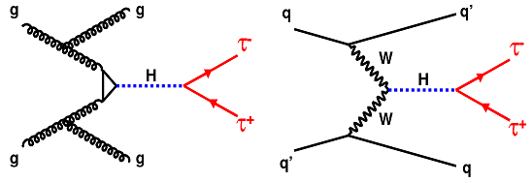
ISTEP 2016 Final Project—
Project on $H→ττ$ and multivariate methods
Wenkai Fan / Hang Zhou / Cheng Chen / Hang Yang / Yongkun Li
Tutor : Glen Cowan
iSTEP 2016, Beijing, Tsinghua

Slide 2
PART ONE
Motivation
iSTEP 2016, Beijing, Tsinghua
“Discovery of the long-awaited Higgs boson was announced on 4 July 2012 and confirmed six months later. The year 2013 saw a number of prestigious awards given for the discovery, including a Nobel Prize. But for physicists, the discovery of a new particle means the beginning of a long and difficult quest to measure its characteristics and determine if it fits the current model of nature.”
“The ATLAS experiment has recently observed a signal of the Higgs boson decaying into two tau particles, but this decay is a small signal buried in background noise.”
Motivation: to explore the potential of advanced machine-learning methods to improve the discovery significance of the experiment.
Notes:
Basically, we can know the outcome with or without the signal. But the experiment result will always contain some statistical fluctuation. We want to test whether the signal is compatible with the data, so as to say, whether the data can not fit well with the background only.

Slide 3
PART TWO
Method—Multivariate analysis
iSTEP 2016, Beijing, Tsinghua
Some of these variables are first used in a real-time multi-stage cascade classifier (called the trigger) to discard most of the uninteresting events (called the background). The selected events (roughly four hundred per second) are then written on disks by a large CPU farm, producing petabytes of data per year. The saved events still, in large majority, represent known processes (called background): they are mostly produced by the decay of particles which are exotic in everyday terms, but known, having been discovered in previous generations of experiments. The goal of the offline analysis is to find a (not necessarily connected) region in the feature space in which there is a significant excess of events (called signal) compared to what known background processes can explain. Once the region has been fixed, a statistical (counting) test is applied to determine the significance of the excess. If the probability that the excess has been produced by background processes falls below a limit, the new particle is deemed to be discovered.
$$p=2.87×{10}^{−7}$$
$$Z=Φ^{−1}\left(1−p\right)=5 sigma$$
Discovery!

Slide 4
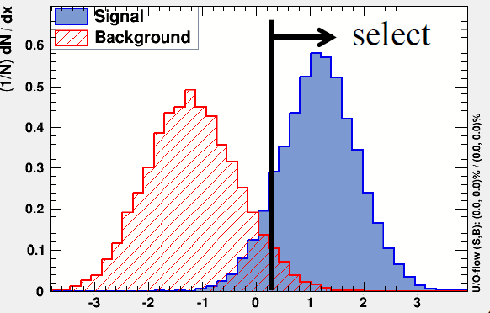
PART TWO
Method—Multivariate analysis
iSTEP 2016, Beijing, Tsinghua
$$\left\{x_{i},y_{i},w_{i}\right\}$$
—the variables, the label of {s,b} and the weight.
$$\sum_{i=s,b}{w_{i}=N_{s,b}}$$
—$N_{s}$and $N_{b}$ are the expected events.
(with luminosity and cross section information integrated in)
There are about 30 variables in $x_{i}$, and a classifier maps them on to one variable $t$.
We apply a simple cut on the $t$ axis, meaning we only retain the data for which its $t$-value is greater than a $t_{cut}$.

Slide 5
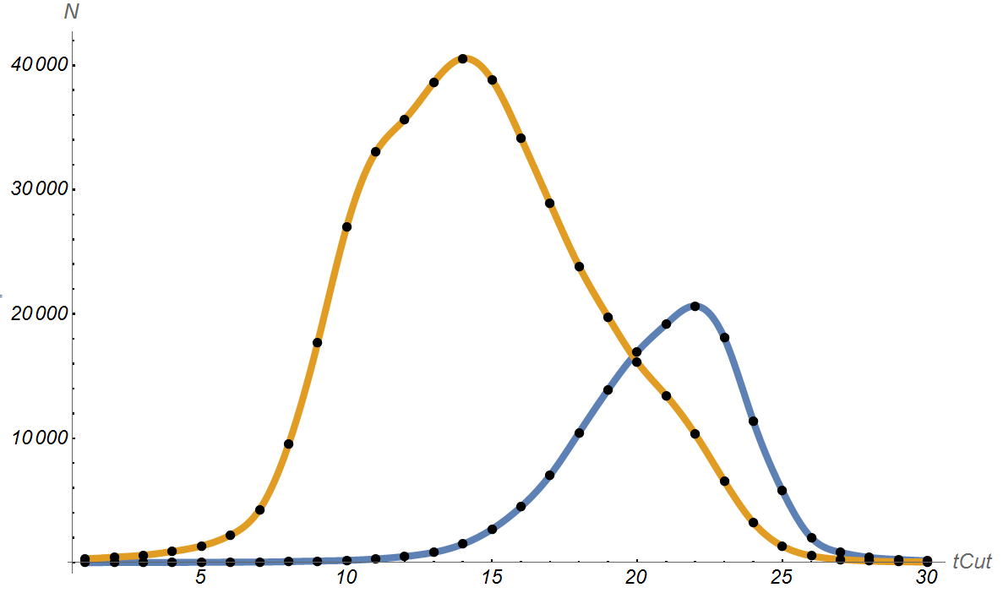
PART TWO
A Digression
iSTEP 2016, Beijing, Tsinghua
The weight have been re-weighted, for a better training effect. But the actual signal events is very scarce compared with the background.
200 signal
background
(Signal is much smaller due to small cross-section.)

Slide 6
PART TWO
Method—Multivariate analysis
iSTEP 2016, Beijing, Tsinghua
The number of signal and background events are:
$$s=\sum_{\begin{aligned}t>t_{cut} \\ i=s\end{aligned}}{w_{i}}$$
$$b=\sum_{t>t_{\begin{aligned}cut \\ i=b\end{aligned}}}{w_{i}}$$
We can compute the expected discovery significance using the “Asimov” formula:
$$Z=\sqrt{2(\left(s+b\right)\ln\left(1+\frac{s}{b}\right)−s)}$$
(Because we assume a Poisson distribution for the number of events detected.)

Slide 7
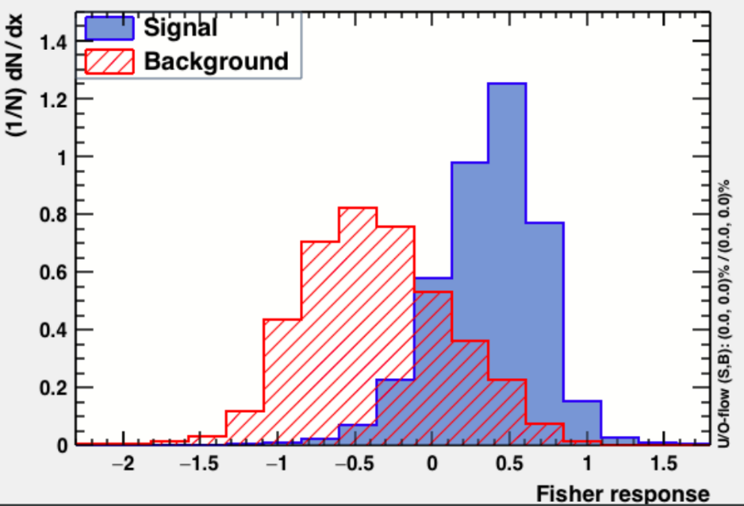
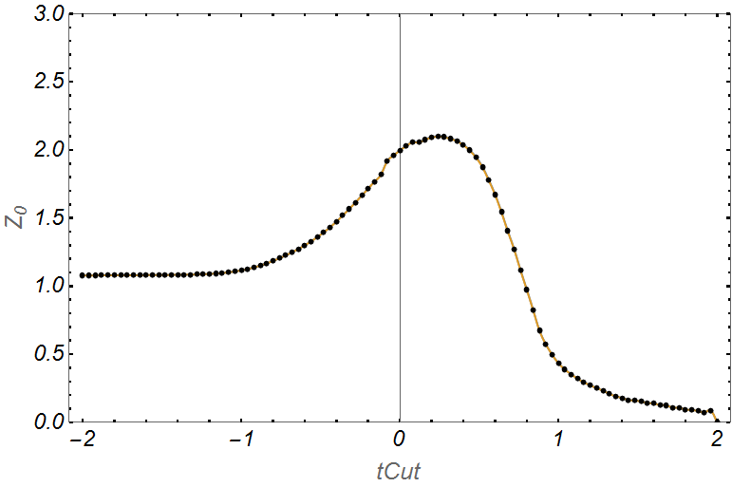
PART TWO
Result for different classifing methods
iSTEP 2016, Beijing, Tsinghua
Fisher Discriminant:
Maximal significance: 2.11
$$tCut$$
$$tCut$$

Slide 8
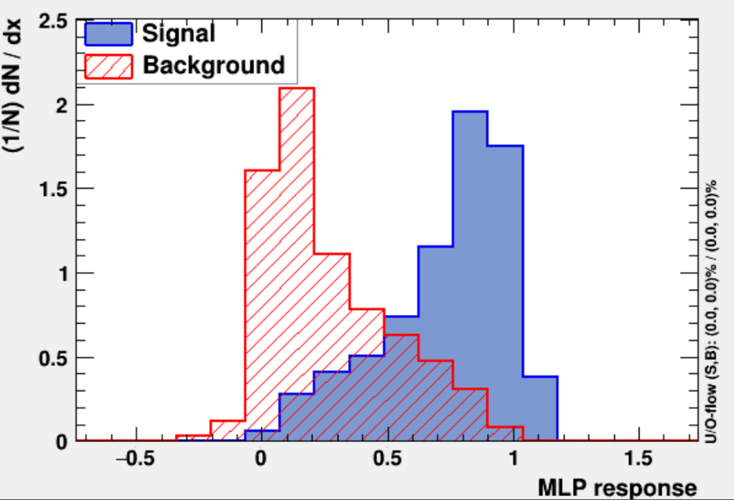
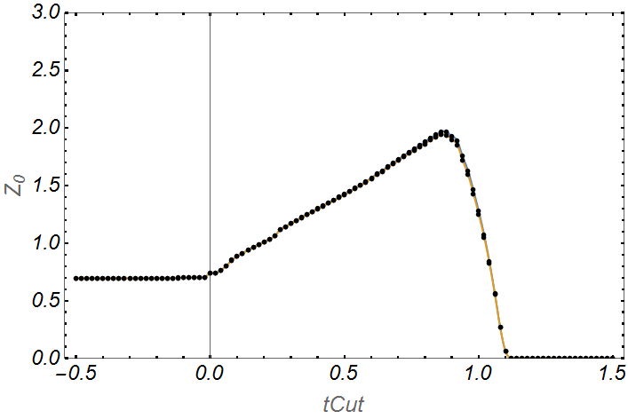
PART TWO
Result for different classifing methods
iSTEP 2016, Beijing, Tsinghua
Multi Layer Perceptron (Neural Network):
Maximal significance: 1.97
$$tCut$$
$$tCut$$

Slide 9
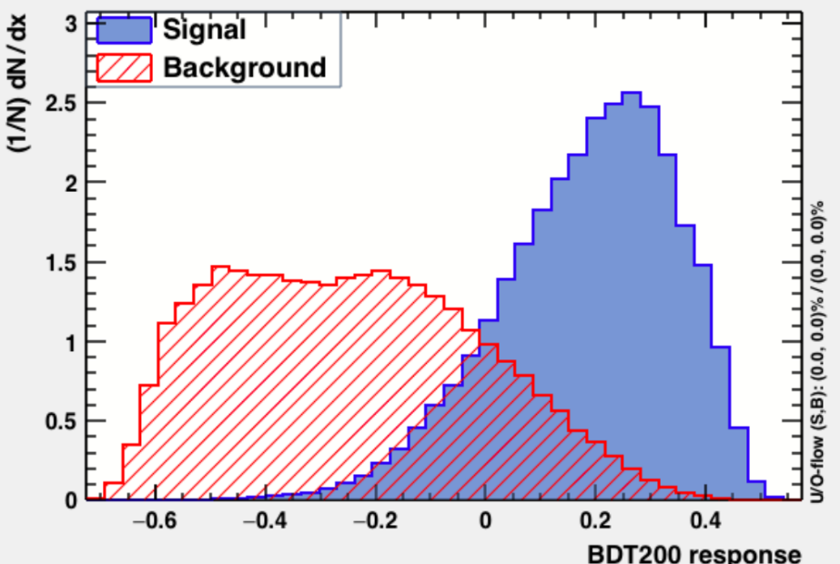
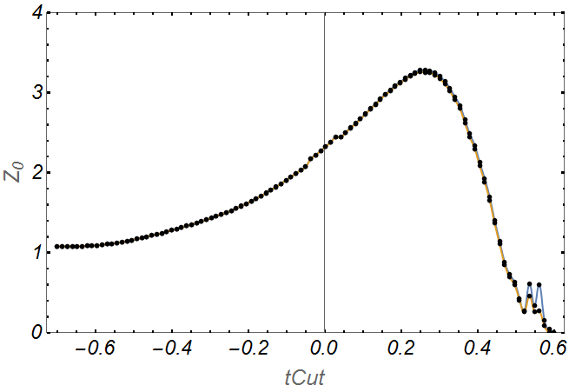
PART TWO
Result for different classifing methods
iSTEP 2016, Beijing, Tsinghua
Boosted Decision Tree :
Maximal significance: 3.25
$$tCut$$
$$tCut$$

Slide 10
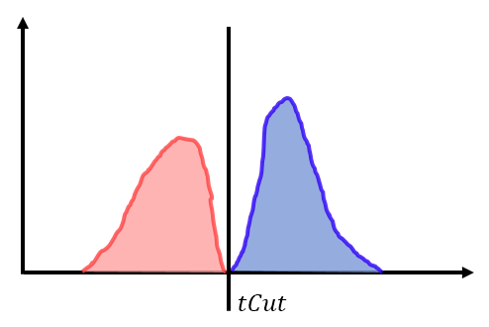
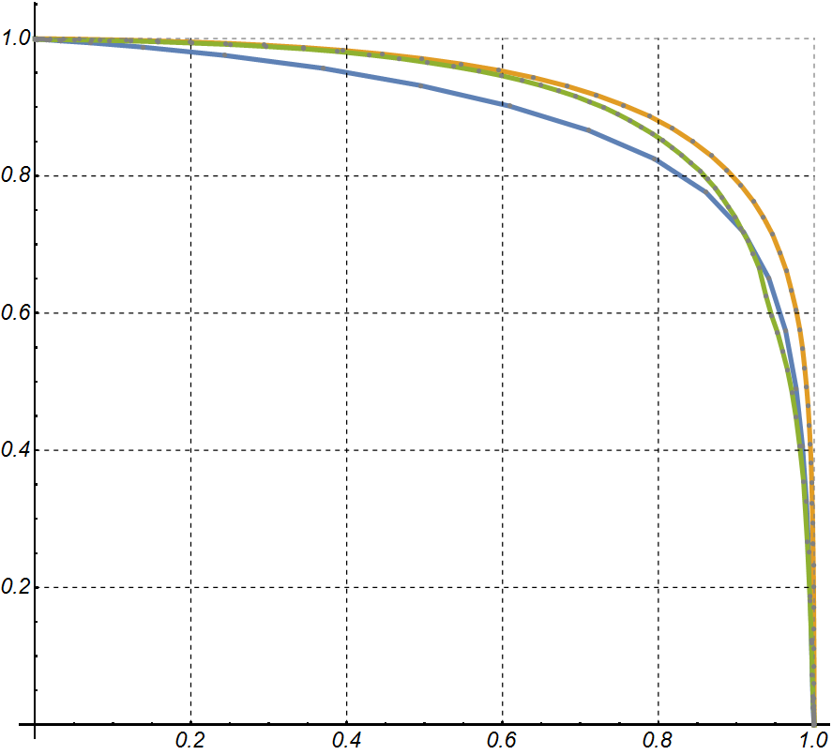
PART TWO
Receiver Operating Characteristic Curve
iSTEP 2016, Beijing, Tsinghua
$${1−ε}_{b}$$
$$\left(0,1\right) reject all the events$$
$$(1,1)$$
Signal
Background
$$tCut↑$$
Show background rejection versus signal efficiency. Closer to the right top, the better.
Fisher
$$tCut↑$$
MLP
BDT
$$ε_{s}$$
$$\left(1,0\right) retain all the signal and background events$$

Slide 11
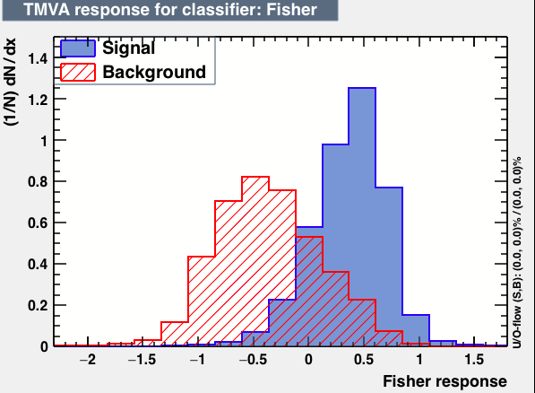
PART THREE
Method—Multivariate analysis
iSTEP 2016, Beijing, Tsinghua
$$bins$$
Multi-bin analysis
Slice the plane into several columns—called bins. Within each column, we can calculate the expected signal and background events for each bin:
$$s_{i}=\sum_{\begin{aligned}tεbin(i) \\ i=s\end{aligned}}{w_{i}}$$
$$b_{i}=\sum_{\begin{aligned}tεbin(i) \\ i=b\end{aligned}}{w_{i}}$$

Slide 12
PART THREE
Method—Multivariate analysis
iSTEP 2016, Beijing, Tsinghua
Likelihood function:
$$L\left(μ\right)=\prod_{i=1}^{N}{\frac{{(μs_{i}+b_{i})}^{n_{i}}}{n_{i}!}e^{−(μs_{i}+b_{i})}}$$
$\hat{μ}$is defined so that it maximizes $L\left(μ\right)$, or the solution to the following equation:
$$\frac{∂lnL}{∂μ}=\sum_{i=1}^{N}{\left[\frac{n_{i}s_{i}}{μs_{i}+b_{i}}−s_{i}\right]}=0$$
($n_{i}=s_{i}+b_{i}$)
For testing no signal hypothesis ($μ=0$) :
$$q_{0}=\left\{\begin{aligned}−2\ln\left(\frac{L\left(0\right)}{L\left(\hat{μ}\right)}\right) \hat{μ}≥0, \\ 0 elsewhere.\end{aligned}\right.$$
Since this equation is monotonic in $μ$, and has a solution at $μ=1$.
(Numerical optimization gives a solution within the range of $1±0.01$.)
Significance:
$$Z=\sqrt{q_{0}}$$

Slide 13
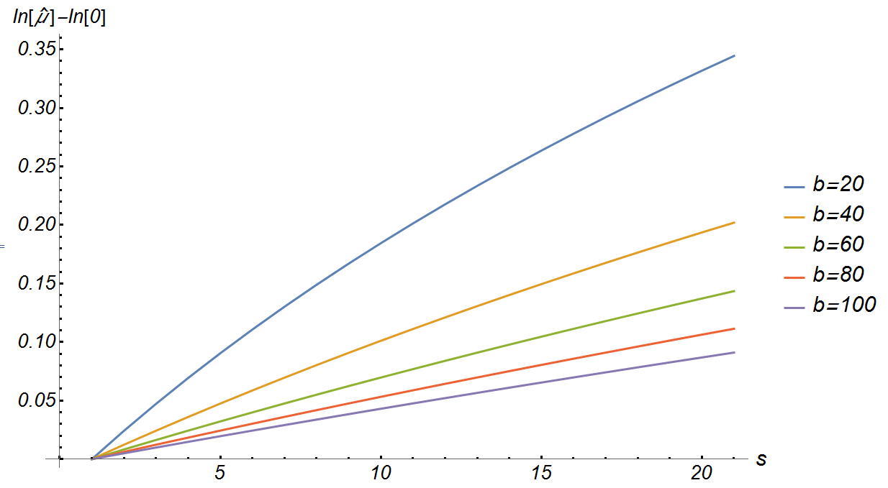
PART THREE
Analysis on the likelihood function
iSTEP 2016, Beijing, Tsinghua
$$q_{0}=2\sum_{i=1}^{N}{lnL_{i}\left(\hat{μ}\right)−lnL_{i}\left(0\right)}$$
If we set $L_{i}\left(μ\right)=\frac{{(μs_{i}+b_{i})}^{n_{i}}}{n_{i}!}e^{−(μs_{i}+b_{i})}$, then $L=\prod{L_{i}}$, and we have:
We want to check how this $lnL_{i}\left(\hat{μ}\right)−lnL_{i}\left(0\right)$ term depend on $s_{i}$and${ b}_{i}$.
The more background you have, the more likely the excess in data belongs to statistical fluctuation, the less significance you will get.
$$\frac{s}{b}↑$$
$$Z↑$$

Slide 14
PART THREE
Analysis on the likelihood function
iSTEP 2016, Beijing, Tsinghua
If we take $\hat{μ}=1,$ then $lnL\left(\hat{μ}\right)−lnL\left(0\right)=ln\frac{{\left(s+b\right)}^{s+b}}{b^{b}}−s$
If we assume $s≪b$, then a Taylor expansion about $s=0$ gives the following equation:
$$\left.lnL\left(\hat{μ}\right)−lnL\left(0\right)≈ln[b\right]⁢s+\frac{s^{2}}{2⁢b}−\frac{s^{3}}{6⁢b^{2}}+\frac{s^{4}}{12⁢b^{3}}+{\left.O[s\right]}^{5}$$
Further assuming that $b=const$, gives:
$$lnL\left(\hat{μ}\right)−lnL\left(0\right)∝t(\frac{t}{2}−\frac{t^{2}}{6}+\frac{t^{3}}{12}+\ln\left(b\right))$$
where $t=\frac{s}{b}$.
This function is monotonically increasing within the range (0,1). This confirms what we saw using numerical method in the previous slide. Larger $\frac{s}{b}$ gives larger $Z$.

Slide 15
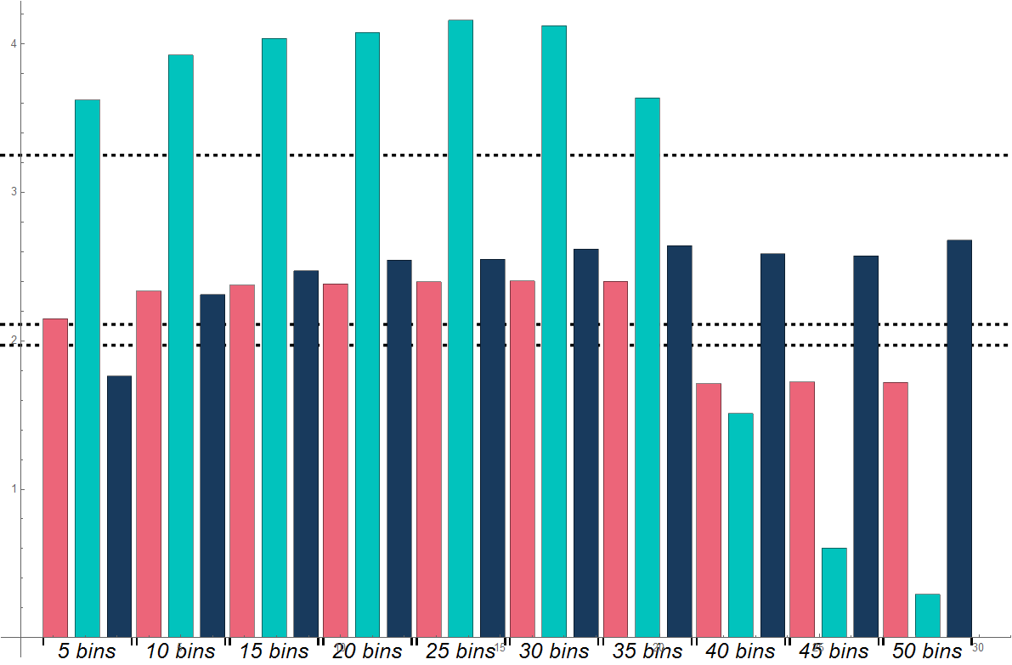
PART THREE
Multi-bin analysis—Result
iSTEP 2016, Beijing, Tsinghua
Fisher
BDT
MLP
tCut maximum Result (BDT)
tCut maximum Result (Fisher)
tCut maximum Result (MLP)
With BDT method and 25 bins, we got an optimized significance about 4.16.

Slide 16
PART FOUR
Summary && Outlook
iSTEP 2016, Beijing, Tsinghua
A simple cut gives a significance around 2-3. BDT algorithm gives the best performance.
2. Multi-bin analysis can improve the result. But it depends on the specific shape of the histogram. Too few or too many bins may deteriorate the performance.
3. The optimized significance is about 4.16(99.9999996% CL). So we can boldly say that, we have “found” the Higgs boson!
4. In order to get greater significance: For classifiers, need to separate the signal from the background as much as possible. For physicists, need to know within which variables do the signal and background differs most, apriori or after checking the data. If signal is much fewer than background, than the significance is determined only by their ratio and is monotonic increasing with it.
5. Further investigation, e.g. using other classifiers(NN,LD,SVM), or tuning the width of each bin to get a further optimization is possible. (NN, SVM, CutsGA, PEDRS etc. have been tried but failed at the training stage.)

Slide 17
iSTEP 2016, Beijing, Tsinghua
THANK YOU
Wenkai Fan
Hang Zhou
Cheng Chen
Hang Yang
Yongkun Li

