Slide 1
Interaction Region of gamma gamma colliders
T.Takahashi
Hiroshima University
April 25,2017
ICFA Mini-Workshop on Future gamma-gamma Collider
Tsinghua University

Slide 3
11/27/98 ACFA WS 清華大学
γγＣｏｌｌｉｄｅｒ
Tohru Takahashi
Graduate School of
Advanced Sciences of Matter
Hiroshima University

Slide 5
Contents
What to be considered
Laser Optics
Electron Beams
Spent electrons
beam backgrounds
Studies have been suspended last 10 years or more

Slide 6
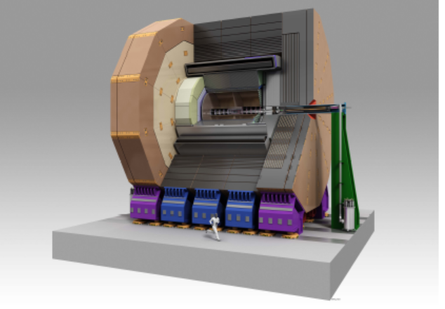
Interaction region is a busy place
ILD

Slide 7
In addition to an e+e- IR….
large angular and energy spred
angles between
e and laser
TW laser pulses
laser
ip
cp
ｄ
e beam
collimated photon beam
e beam
larger xing angle

Slide 8
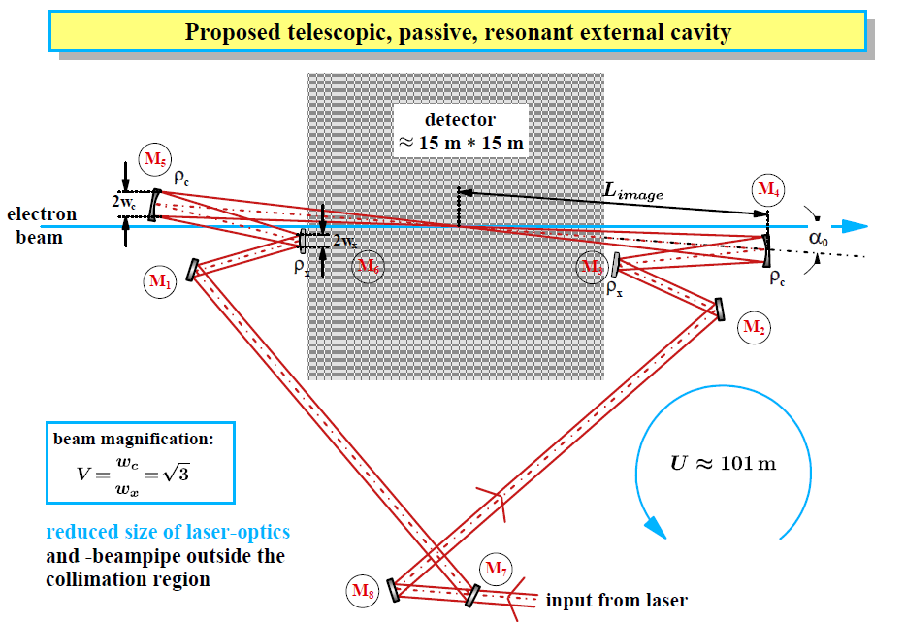
Optics
Klemiz, Monig,Will
An optical resonant cavity
Focusing mirrors are placed at the out side of the detector.

Slide 9
Optics issues
R
~15m
To obtain diffraction limited waist size:
the mirror must be large enough > 4 sigmas in diameter
Large R -> Large α
For ex. R = 160 cm
to be optimized for luminosity

Slide 10
an optimization
Klemiz, Monig, will
~15m

Slide 11
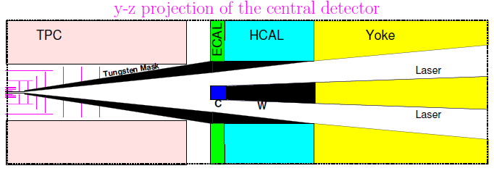
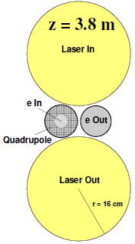
lasers in IP
K.Moenig

Slide 12
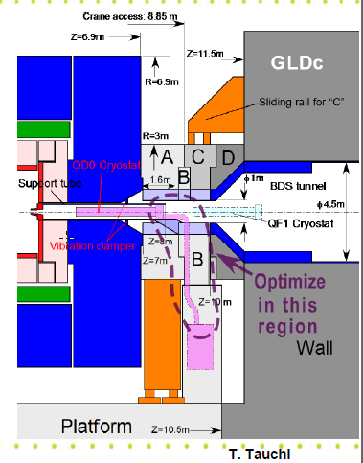
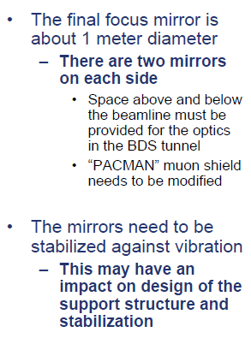
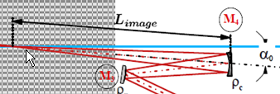
large final focus mirros,,,

Slide 13
A NLC design
NLC ZDR

Slide 14
Focusing mirrors - tight fit
LCD - Large with new mirror placement
Essentially identical to e⁺e⁻ IR
30 mRad x-angle
Extraction line ± 10 mRadian
New mirror design 6 cm thick, with central hole 7 cm radius.
Remove all material from the flight path of the backgrounds
Gronberg

Slide 15
Crossing angle consideration for γγ
Laser
e-
beam simulation
QD0
depend on QD and FF optics
strawman design by MDI group

Slide 16
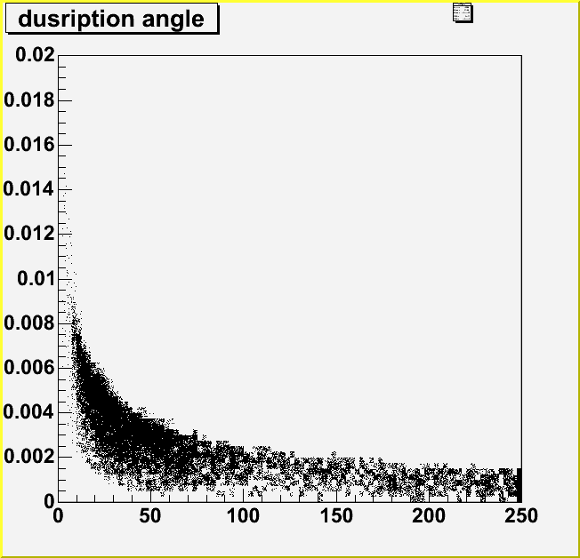
Spent electrons
NLC ZDR
Simulation by CAIN w/
TESLA parameters
Angle(rad)
E(Gev)
large disruption angle
large crossing angle >20mr

Slide 17
pair backgrounds
low energy pairs
KEK report 97-17
beam beam effect is more or less same as the e-e+ collision

Slide 18
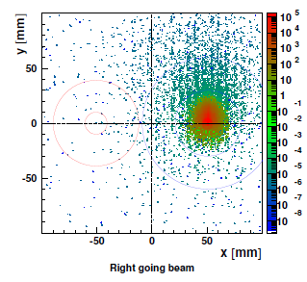
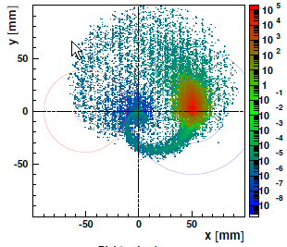
Outgoing Particle
Transverse profile of the beam 3 m from the IP
34 mr crossing angle
B
VTX
QC0
B=0
B=4T
A.F. Zarnecki, LCWS06

Slide 21
Detectors
Muon/York
HCAL
ECAL
TPC
Lasers
4m
Barrel part is the same as the e+e-
Central part and forward/backward part has to be
replaced/ modified for
laser optics and beam backgrounds

Slide 22
Summary
Physics requires the same performances with e+e- for detectors
4 π,
vertex detectors must be as close as possible to the IP
post IP diagnostics..
Lasers and Compton give us additional conditions
larger beam crossing angle > 20 mr
optics to bring TW pulses into/out from the detectors

Slide 23
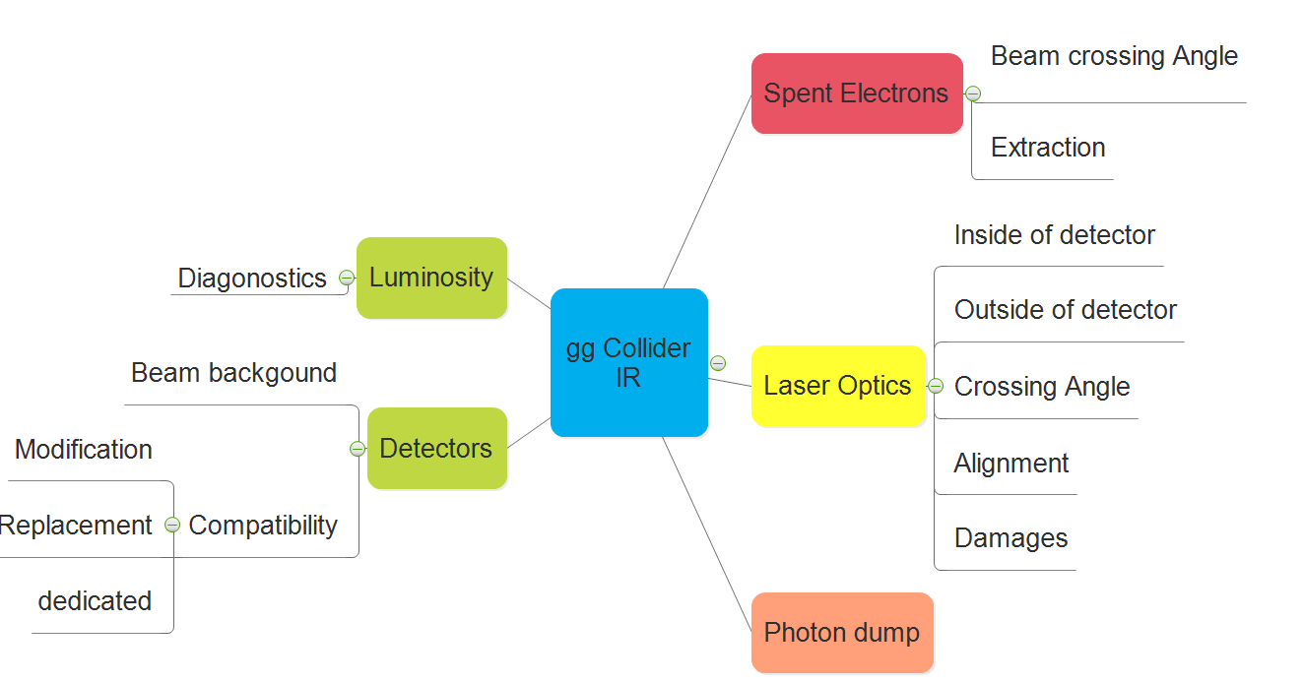
A lot of fun to do !

