Slide 1
Key Physics of Plasma Based Acceleration and its Implication to gamma-gamma Collider
Wei Lu
Tsinghua University
The Mini-workshop on Future Gamma-gamma collider
Beijing, April 23-26 2017

Slide 2
Outline
Plasma based wakefield accelerator (PBA)
Key accelerator physics of PBA
The Blowout regime for electron acceleration
PBA for a g-g collider
LWFA scenario: Hungry for average power
PWFA scenario:Single stage and Cascaded HTR acceleration

Slide 3
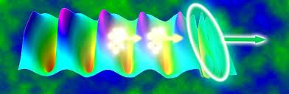
Plasma Based Wakefield Acceleration
Laser or beam Pulse
Trailing beam
Wake
Very large gradient (~10-100GV/m) + small structures (~10-100um)
T.Tajima and J.M. Dawson PRL (1979) LWFA
P.Chen, J.M. Dawson et.al. PRL (1983) PWFA

Slide 4
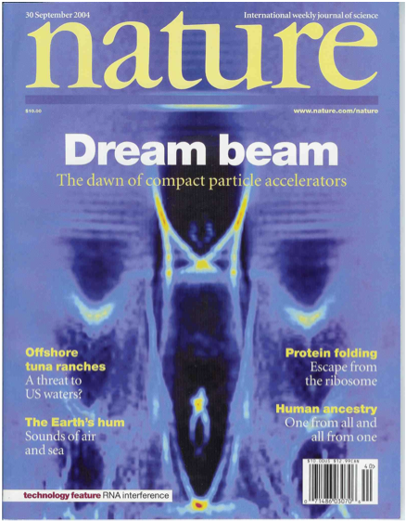
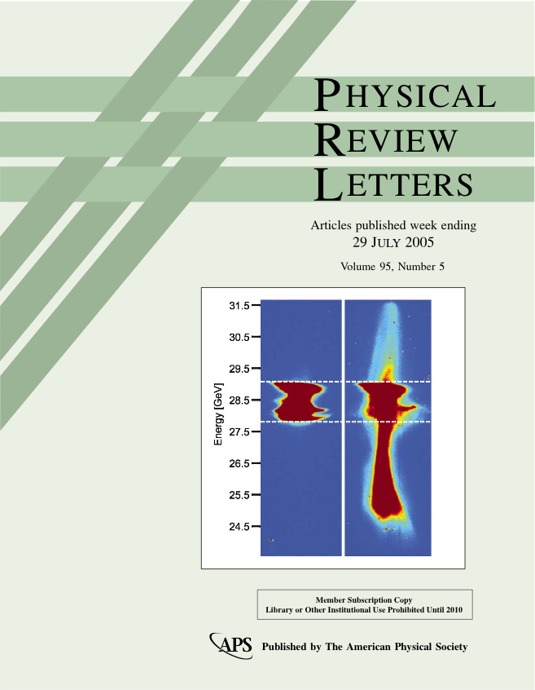
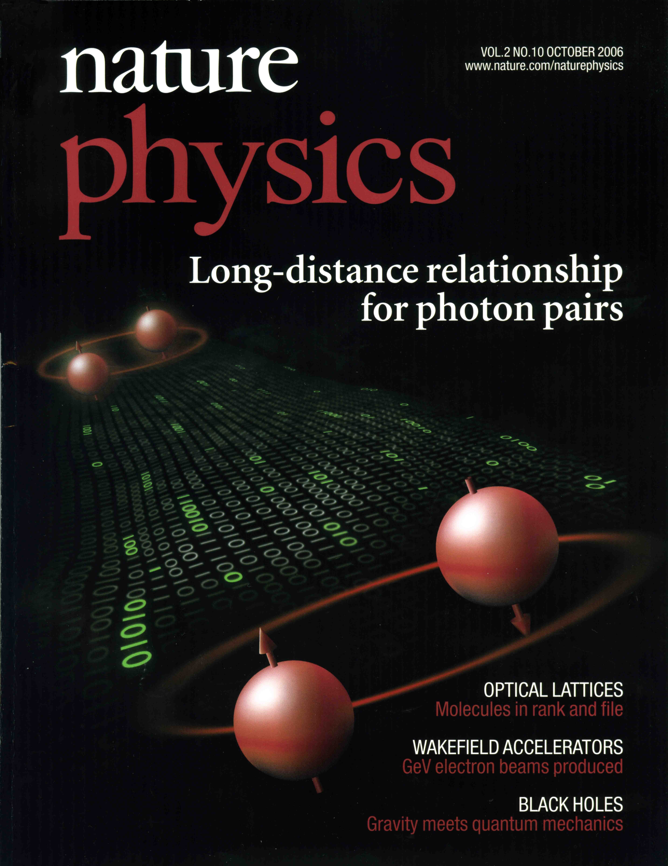

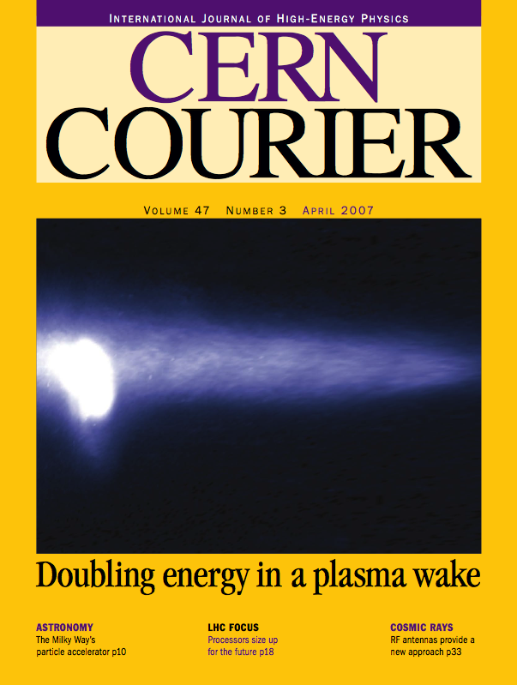
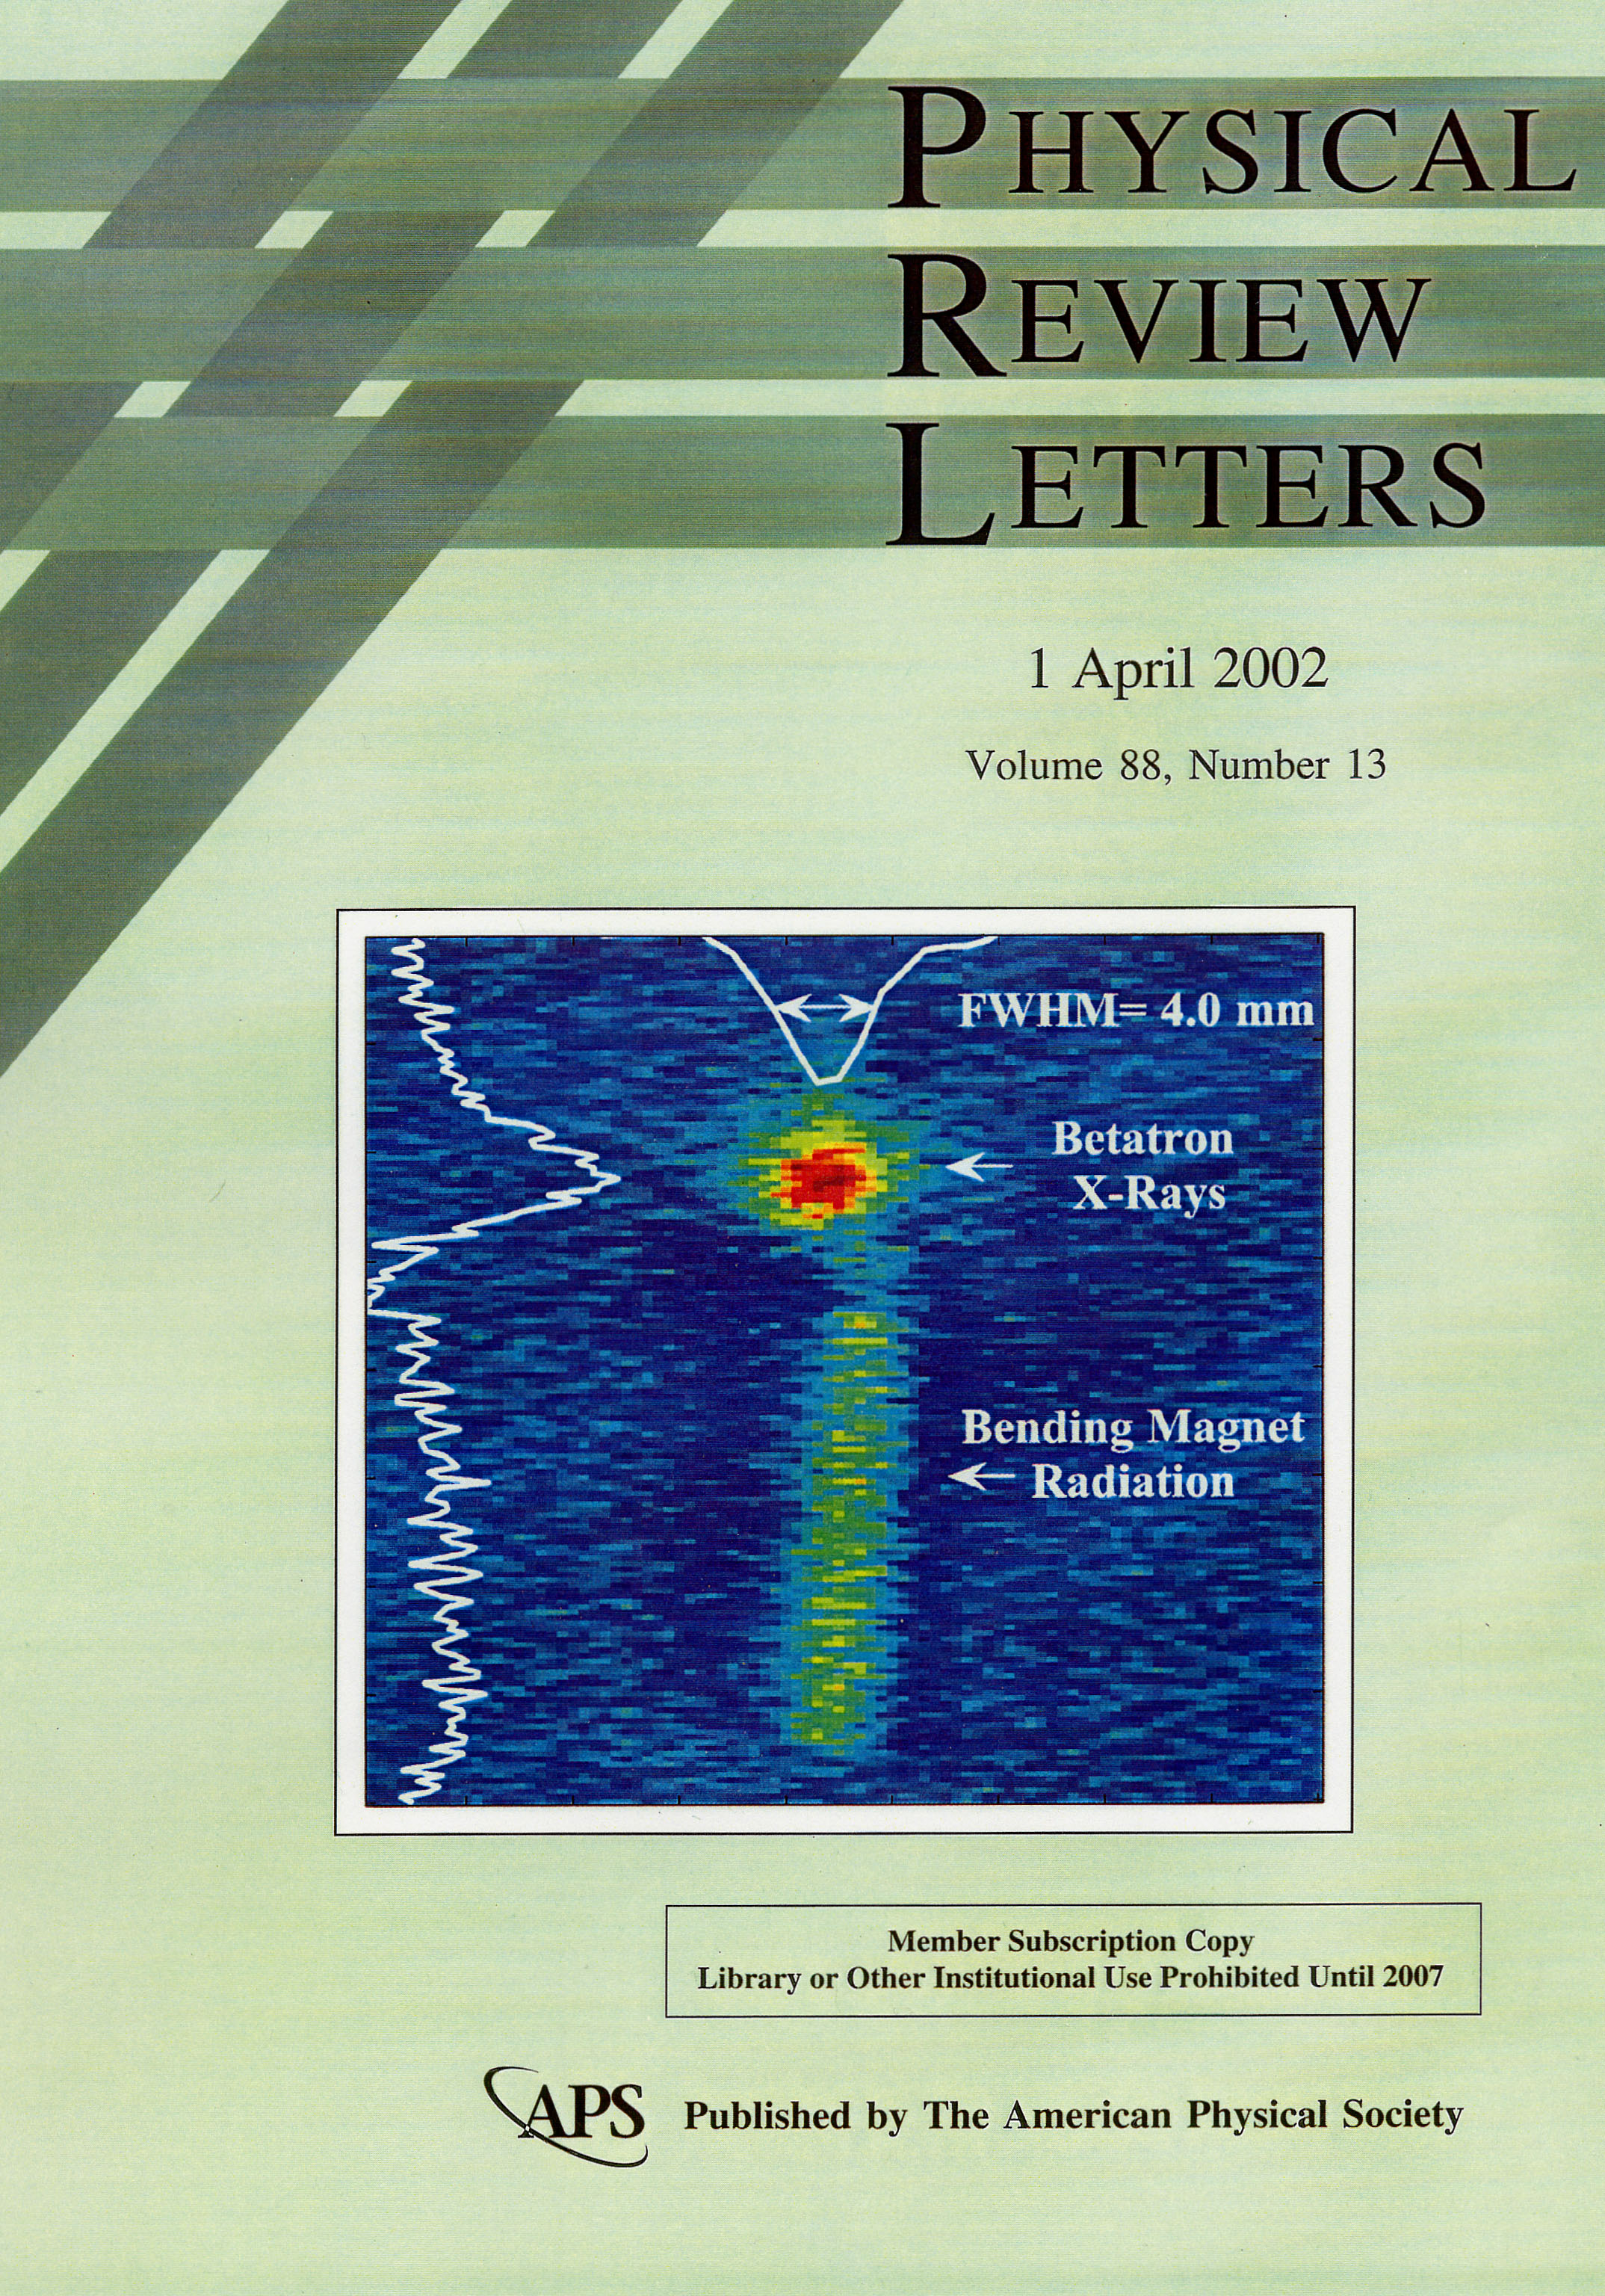
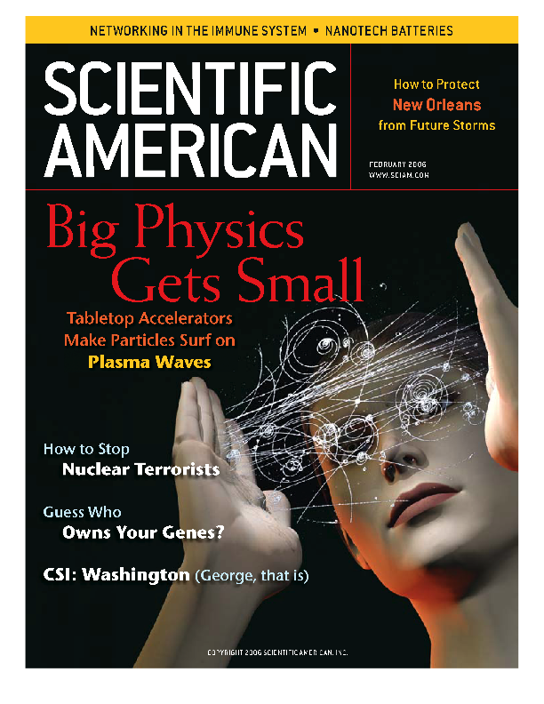
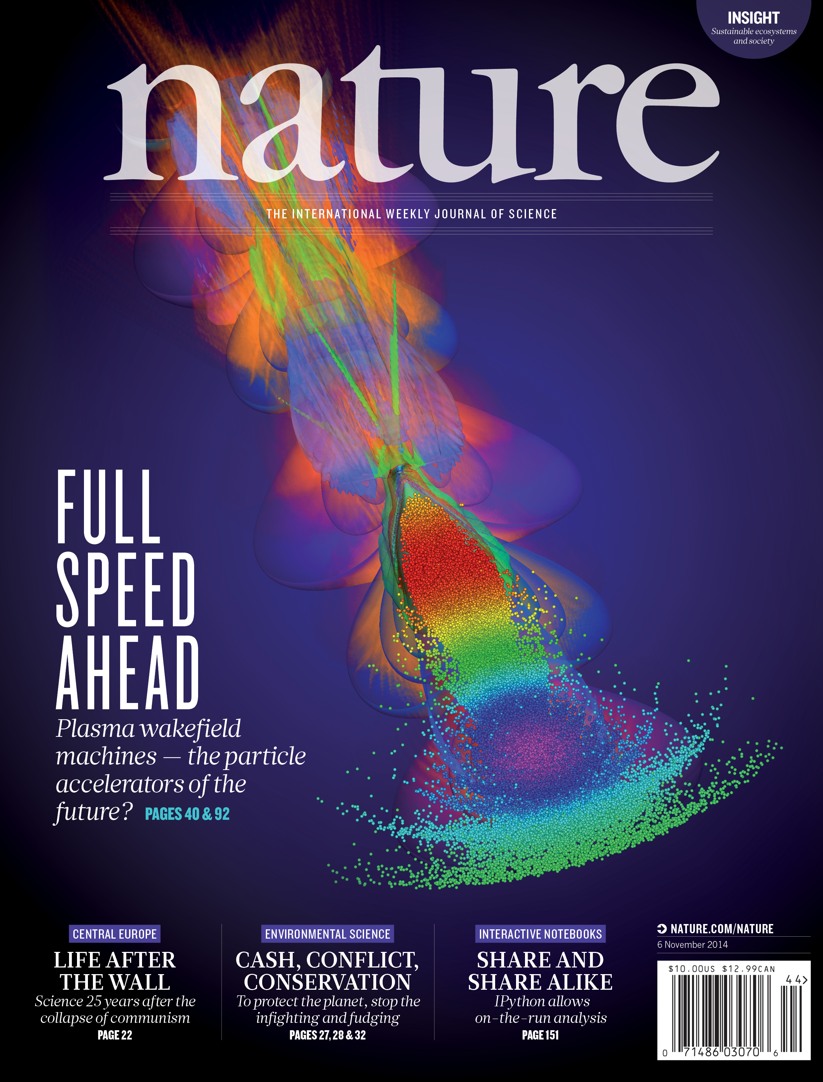
Significant progress in past decade

Slide 5
Real Challenge for Plasma Based Acceleration
From “Acceleration” to “Accelerator”
Understand the physics:
Systematic understanding of all the relevant physics
Develop the technology:
Lasers,plasma sources and structures, diagnostics …..
Find the applications:
Science (light sources, colliders),industry,medical applications ……

Slide 6
Key physics issues for a plasma accelerator
The structure issue:
Wake excitation for given drivers ……
The energy spread and efficiency issue:
Beam loading, pulse shaping, transformer ratio ……
The stability issue:
Driver evolution, matching, guiding, instabilities ……
The injector issue:
Self-injection, high quality controlled injection ….
The overall design and staging issue:
Parameter optimization for a plasma based accelerator to match the requirements on beam quality, staging,external injection ….

Slide 7
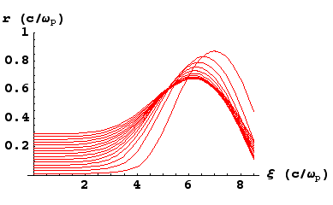
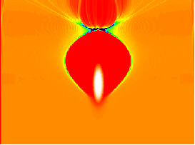
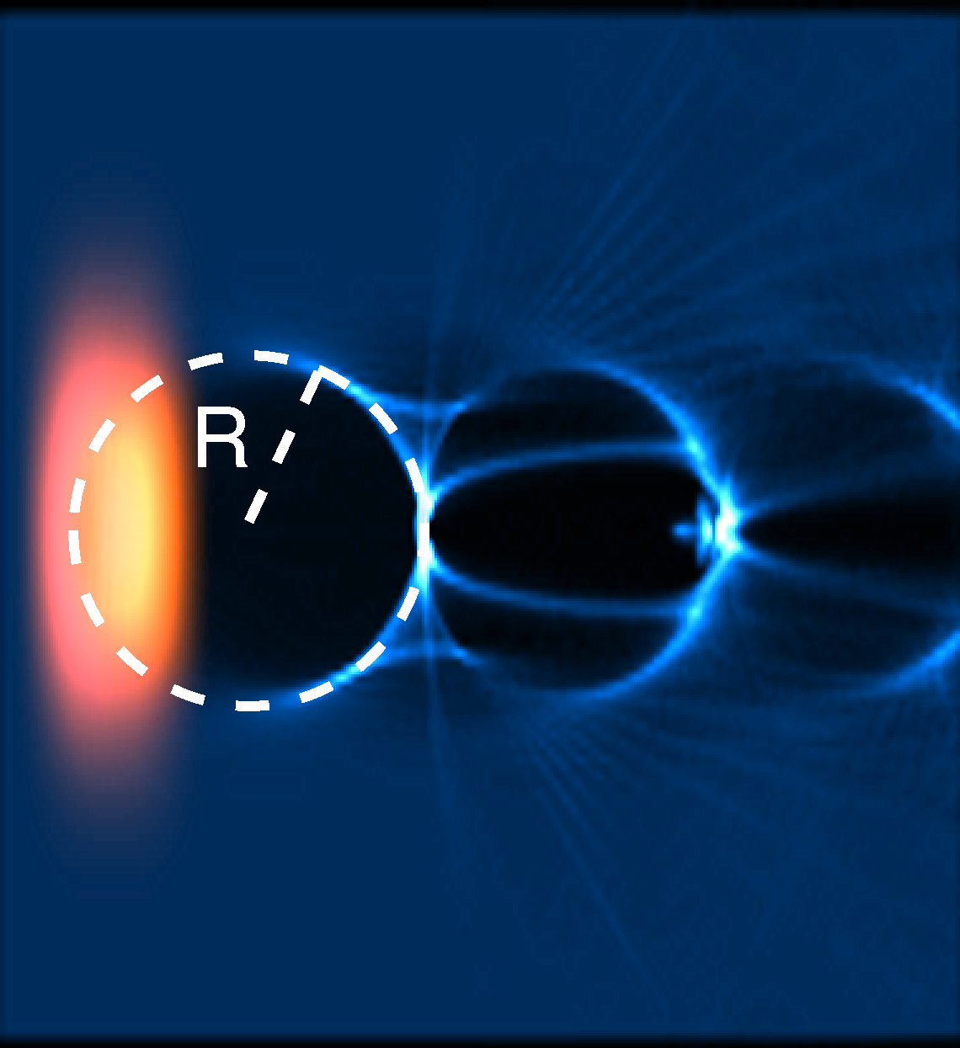
An ideal regime for electron acceleration
the Blowout/Bubble Regime
_{Trajectory crossing}
Driven by an electron beam: nb>np
Driven by a laser pulse: a0>~2
Main advantages:
Uniform acceleration across the transverse slice
Ideal uniform focusing force for electron beam
Beam driver:
Rosenzweig et al., PRA 1991;
Lu et al., PRL 2006;
Laser driver:
Mori et al., PAC proceedings 1991;
Pukhov et al., APB 2002
Lu et al., PRSTAB 2007

Slide 8
Understanding the physics through an integrated approach
UCLA/SLAC/USC/Tsinghua
Theory
Wake excitation and beam loading (PRL06, PRL 08)
Electron hosing instability (PRL 07)
Laser plasma matching and guiding (POP06, PRSTAB07)
Phenomenological framework of LWFA in the blowout regime (PRSTAB07)
Injection dynamics and high brightness beams ( PRL 13, PRL 14, PRL 16b, PRAB 14, PPCF 16)
Perfect staging using plasma structure (PRL 16a)
Simulation
Development of the capability of large scale parallel PIC simulation
3D simulations of LWFA stage from GeV-100GeV
3D modeling of PWFA experiments and proposed TeV stages
Boosted frame simulations ( Nat. Phy. 2010, CPC 2011, 2013,2015)
Notes:
As part of a globle effort on understanding the underling phsics of the blowout regime, ucla is in a quite unique position.

Slide 9
Experiment
1-100GeV level PWFA: acceleration and focusing (PRL05,Nature07)
Betatron X-ray and positron production (PRL02, PRL08)
Matched self-guiding of short pulse laser (PRL09a)
GeV level self-guided LWFA with self-injection (PRL 09b)
Ionization induced injection (PRL07, PRL10a)
Self-guided LWFA with ionization injection beyond 1GeV (PRL10)
Two stage LWFA ( PRL 11)
High efficiency PWFA acceleration of e+/e- ( Nature 14,15, Nat. Comm. 16a, b, c)
Wakefield imaging using electron snapshot ( Sci. Rep.16)

Slide 10
Key questions for high quality electron acceleration
Can uniform and high efficiency acceleration be achieved?
Can the driver (laser or particle beam) propagate stably to form a stable structure?
For beam drivers, can a good transformer ratio (TR) be achieved stably?
Can very high quality beams ( low energy spread, high current,low emittance) be generated in PBA?
Can different sections of accelerators be properly staged with well preserved quality?

Slide 11
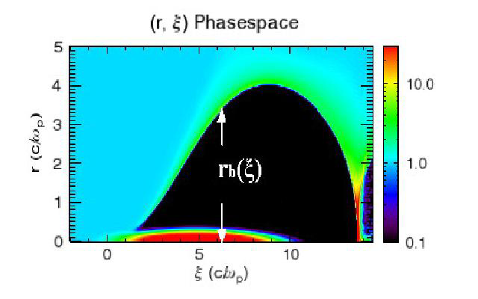
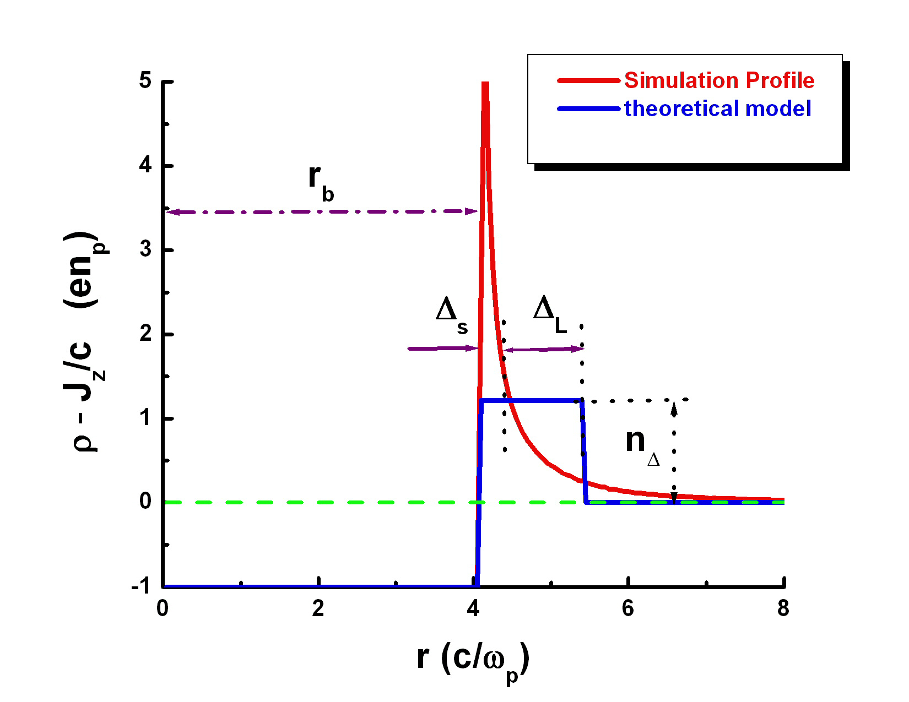
Understand the Blowout Regime:
Wake Excitation
A “double” boundary layer problem
Ion column + sheath + linear region
The key is to understand how the ion channel boundary is formed by narrow electron drivers or matched laser drivers!
W. Lu et al., PoP (2005), PRL (2006), PoP (2006)[invited]

Slide 12
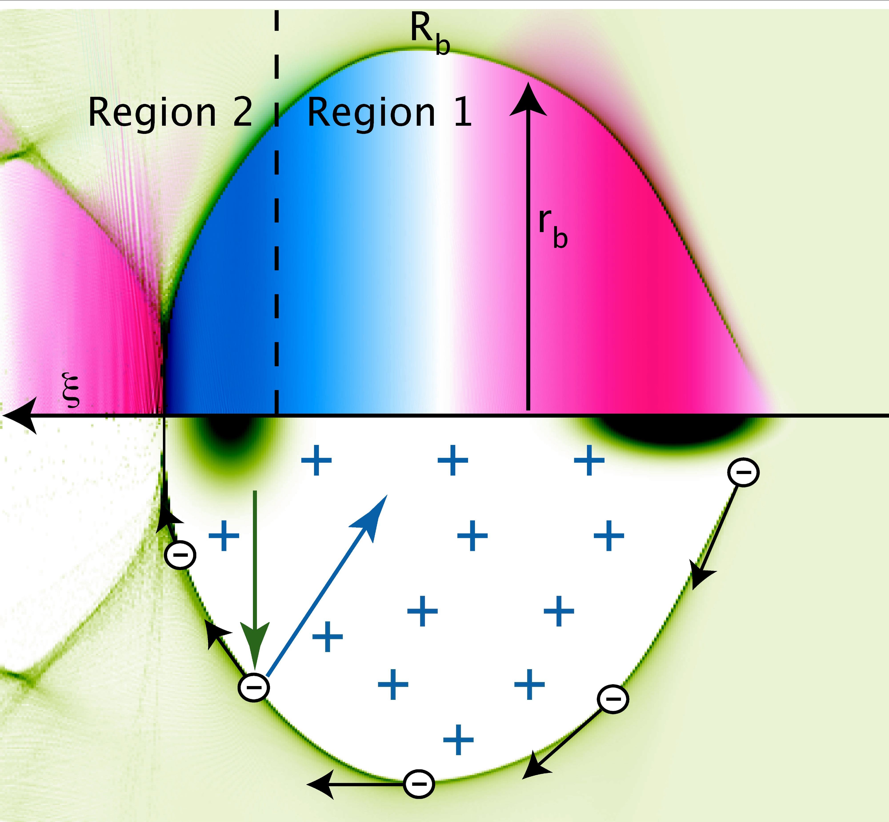
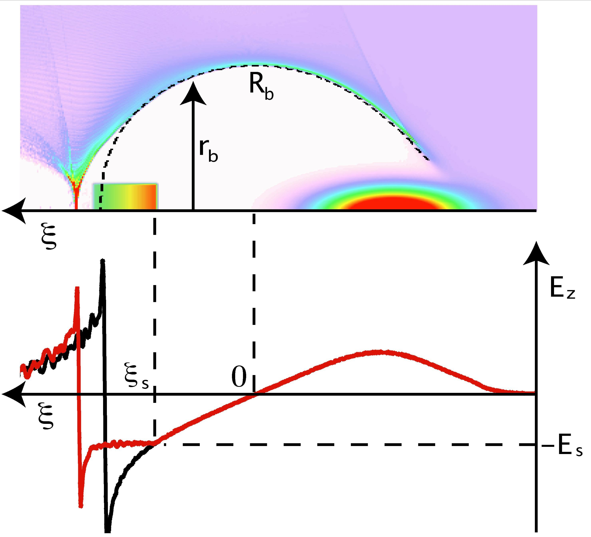
Beam loading efficiency and energy spread
High efficiency (near 100%) + Uniform acceleration
For beam driver, there is no dephasing between bunches
For laser driver, dephasing reduces the overall efficiency
M. Tzoufras,W. Lu et al., PRL (2008), PoP [invited] (2009)

Slide 13
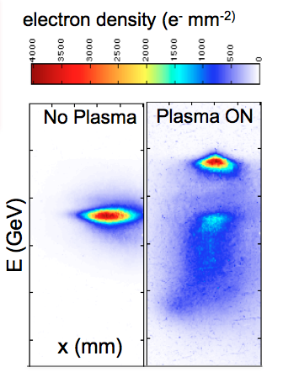
Verified through Experiment
30-50% energy conversion efficiency with 2% energy spread

Slide 14
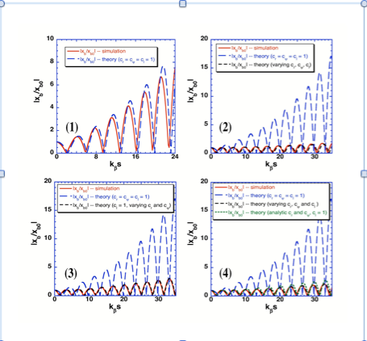
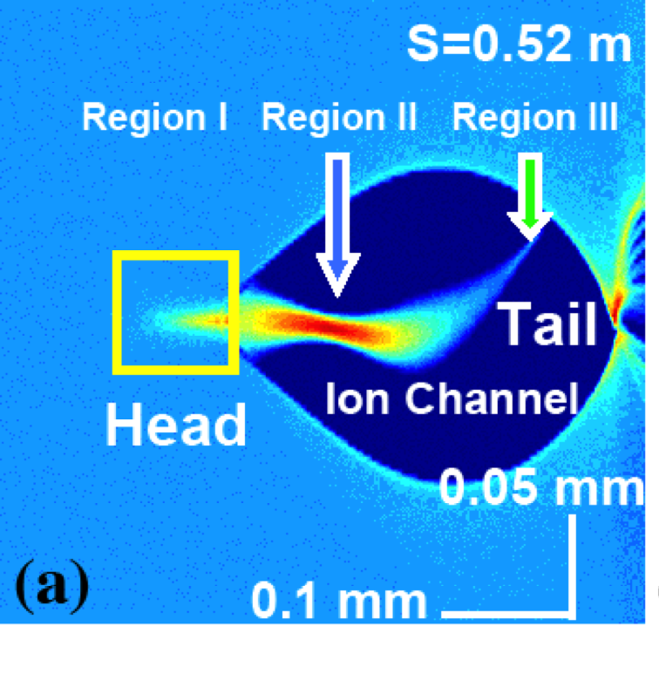
The stability of electron beam:
hosing instability
Due to the coupling between the beam and the ion channel boundary
Four factors come into play, surprisingly all reduce hosing:
Beam current profile
Curvature of ion channel
Relativistic motion
Return current in the sheath
C. Huang, W. Lu et al., PRL (2007)
Notes:
A idea that is crazy enough to work!
It was quite unrealistic at the time when it was born

Slide 15
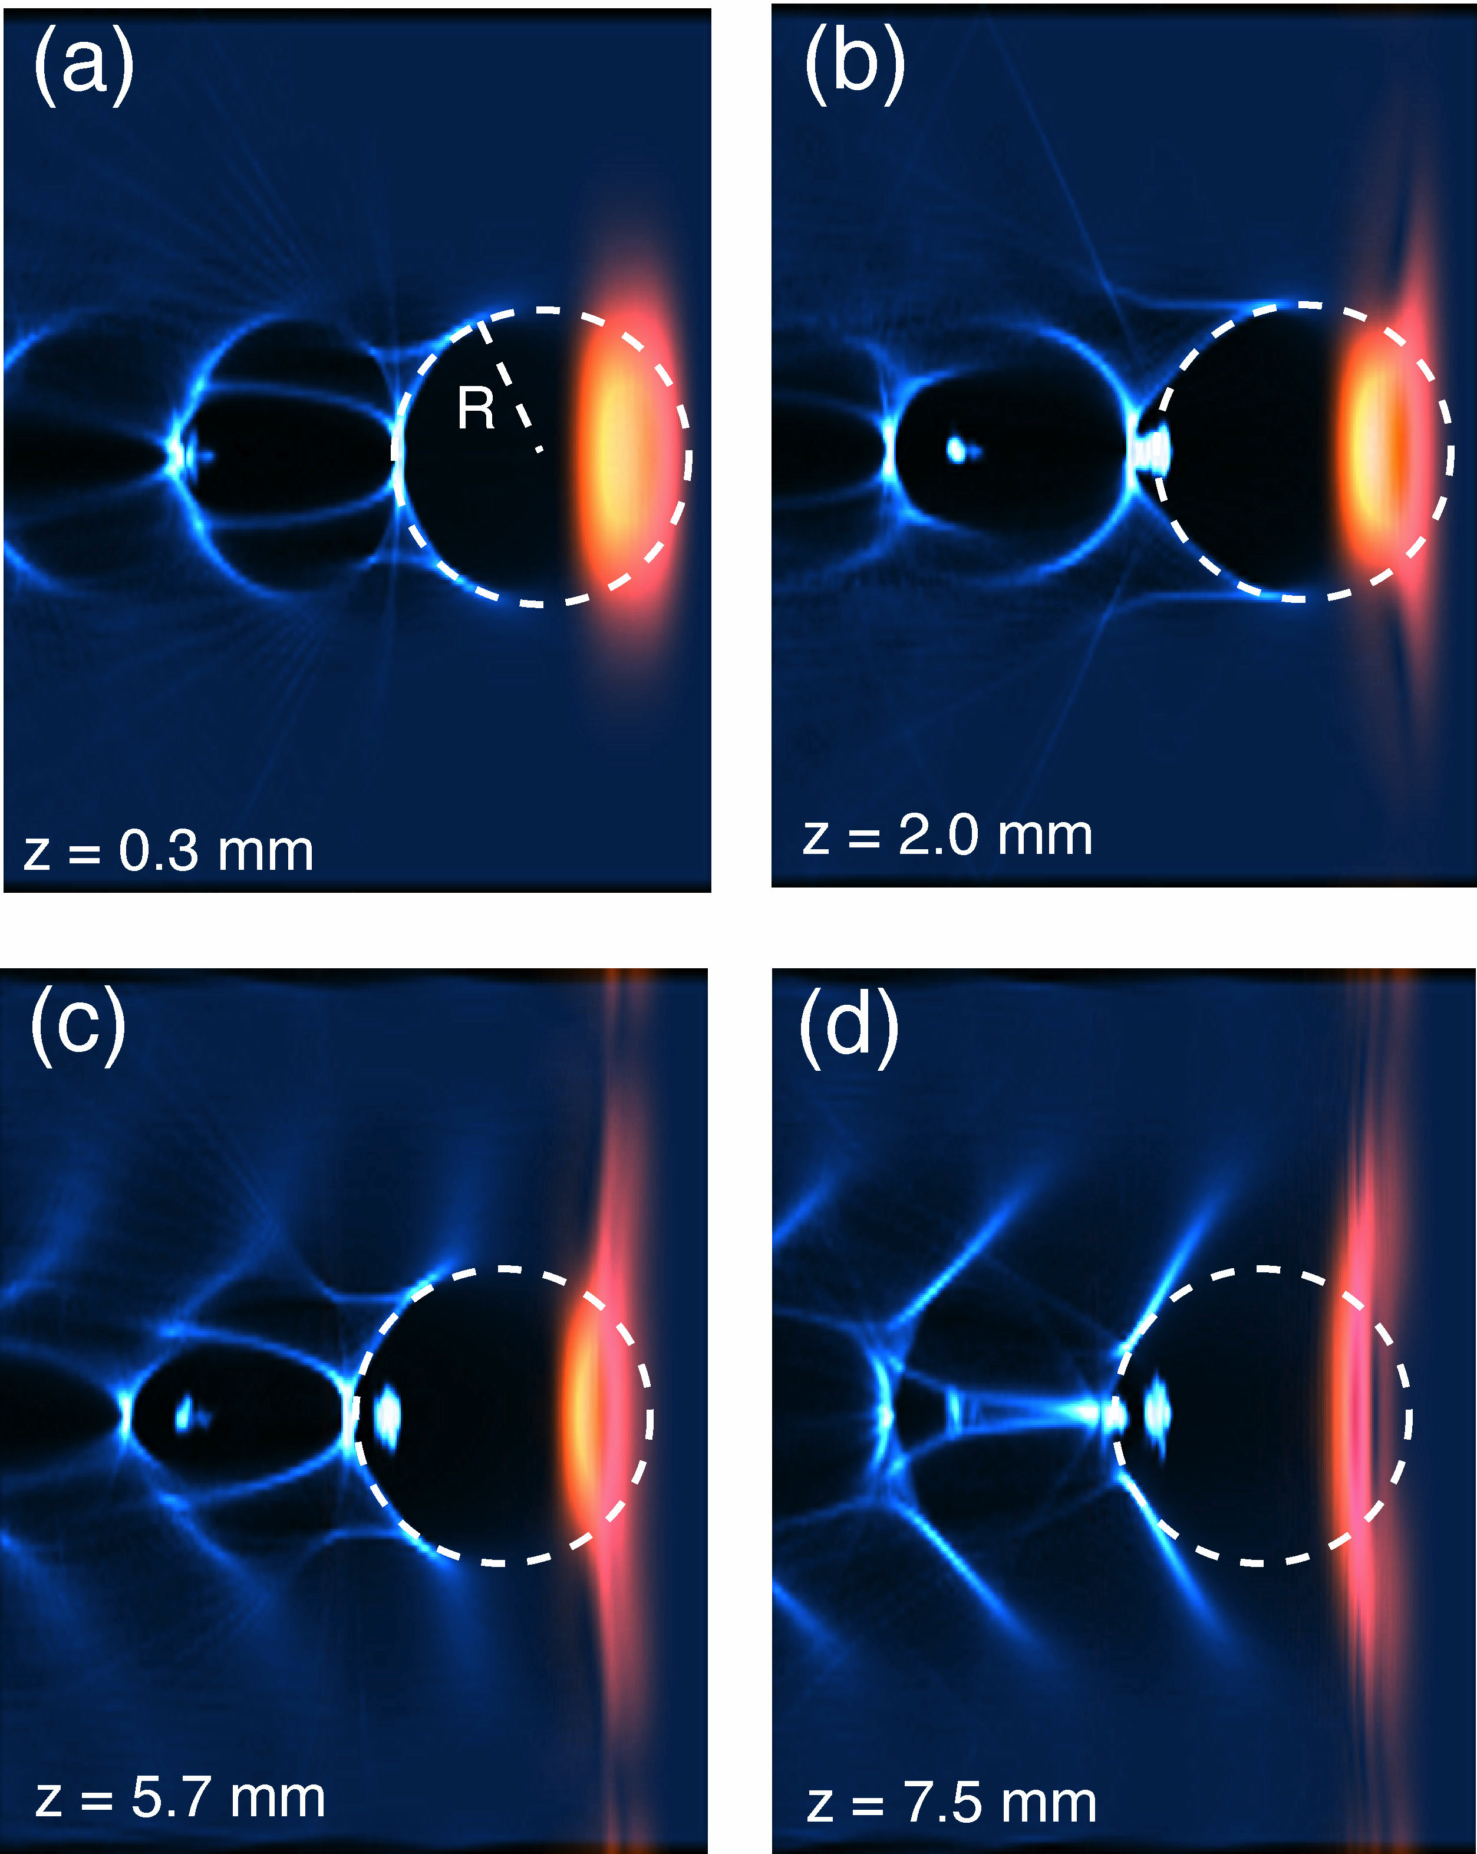
A Phenomenological framework of stable LWFA in the blowout regime
Laser and plasma matching
Wake excitation
Matched laser guiding (self-guiding or by a plasma channel)
Local pump depletion
Wake phase velocity and dephasing
Self and external injection
Beam loading
W. Lu et al., PR-STAB (2007)
Notes:
A idea that is crazy enough to work!
It was quite unrealistic at the time when it was born

Slide 16
High Transformer Ratio PWFA in the Blowout Regime
Transformer ratio: R = E⁺/E⁻
Lower Drive Beam Energy
High efficiency (~60%)
Stably Achievable TR=3-5
low energy spread (1%)
E⁻
E⁺
Lu et al., PAC proceeding 2009

Slide 17
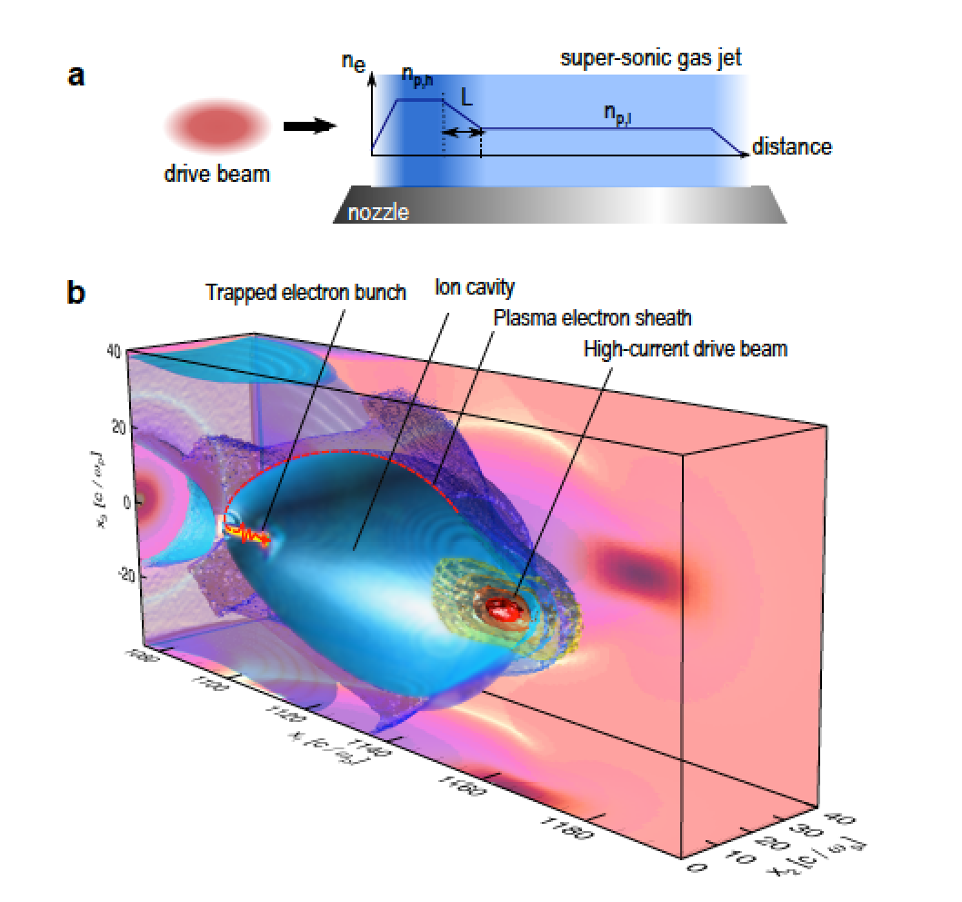
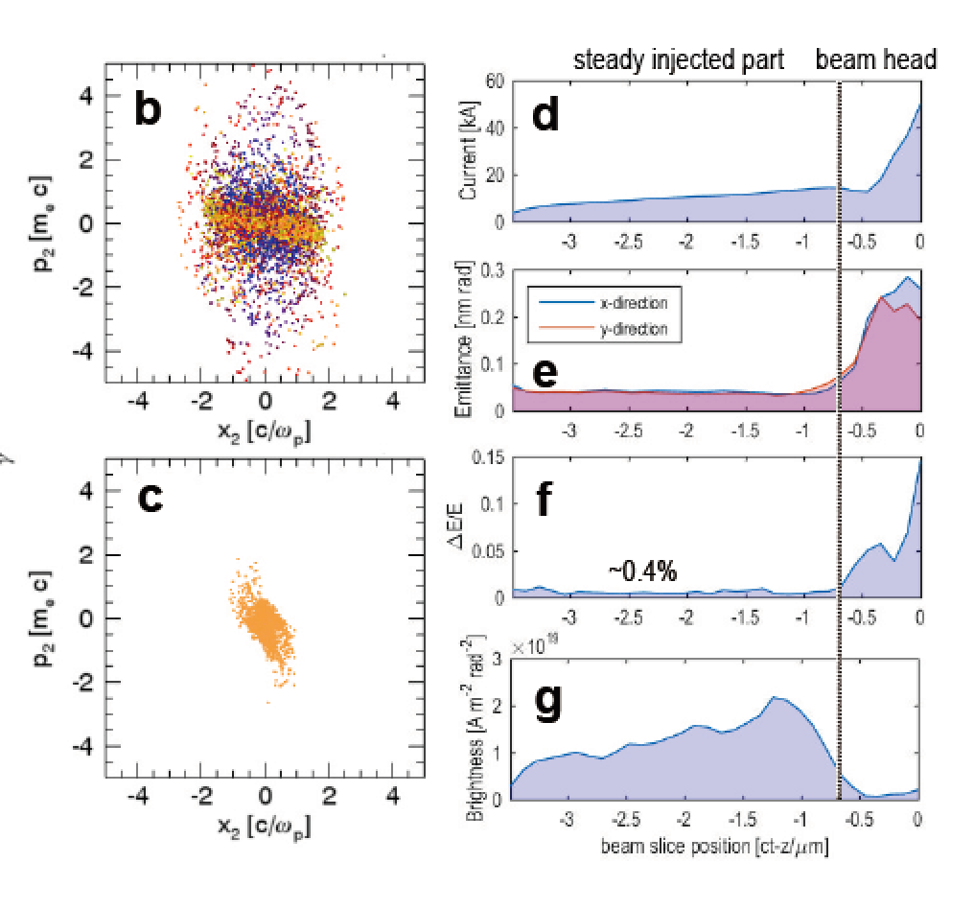
Super Bright electron beam generation on a density ramp
Beam Parameters:
~10kA ~100pC ~10s nm normalized emittance, brightness 10^20A/m2/rad2
~10kA ~1nC ~100s nm normalized emittance
Xu, Li et al., arXiv:1610.00788

Slide 18
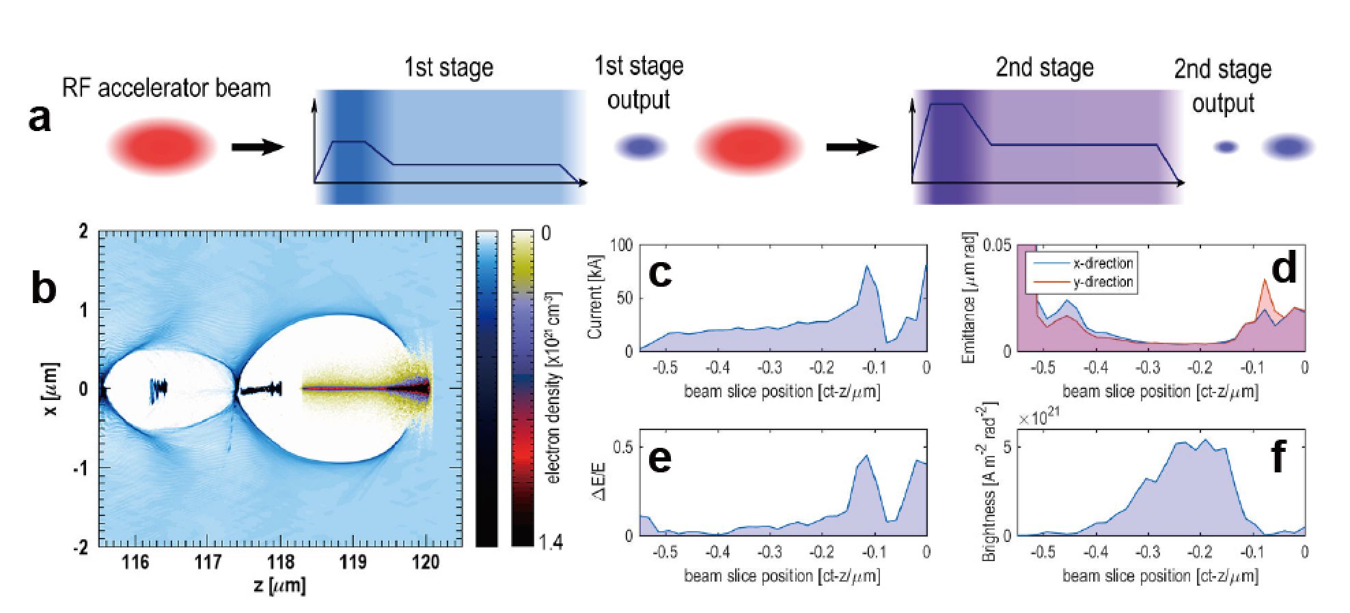
Cascaded Scheme to achieve super brightness
Advantage:
Brightness as high as 10^21-10^22A/m2/rad2
Total TR=TR1*TR2
Fei Li et al., to be submitted

Slide 19
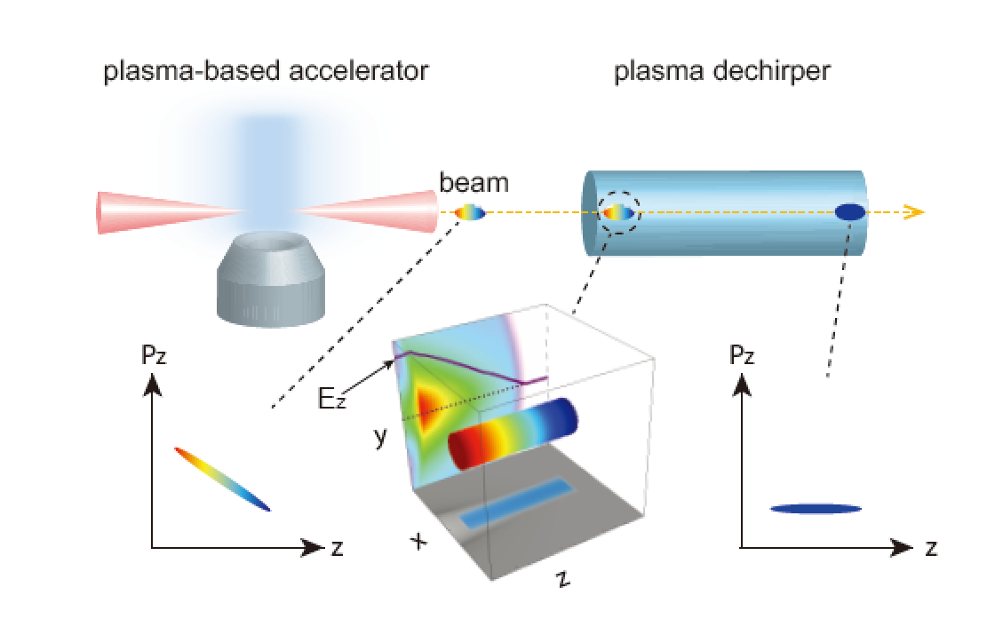
Energy chirp removing of e-/e+ beam by a plasma dechirper
Reducing the percent level energy chirp down to 0.1 percent level
Y.P. Wu et al., IPAC 2017

Slide 20
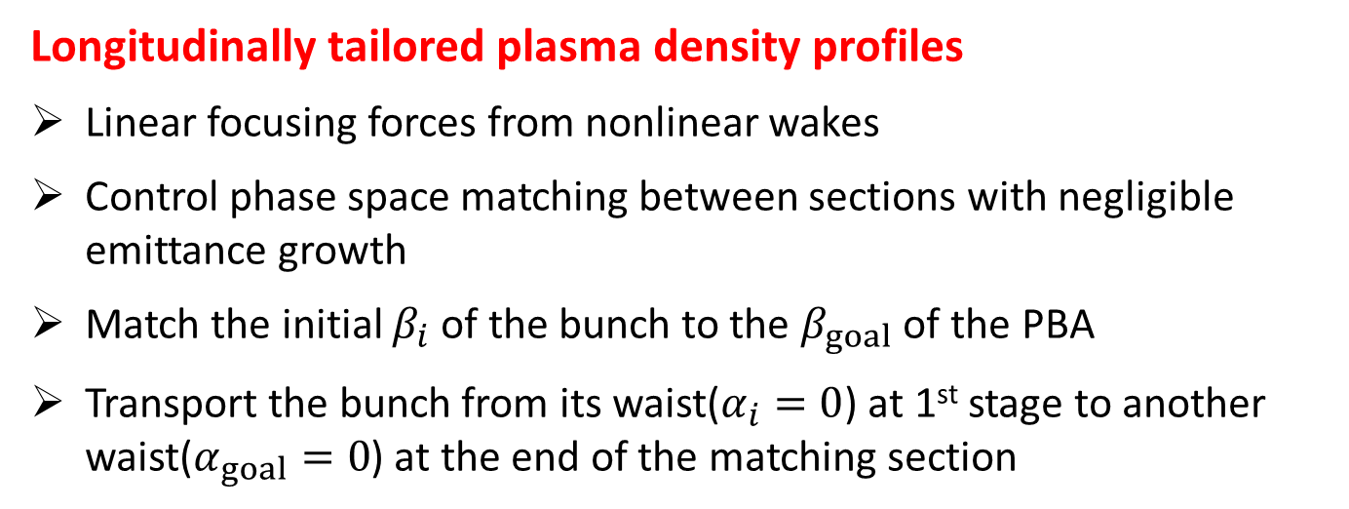
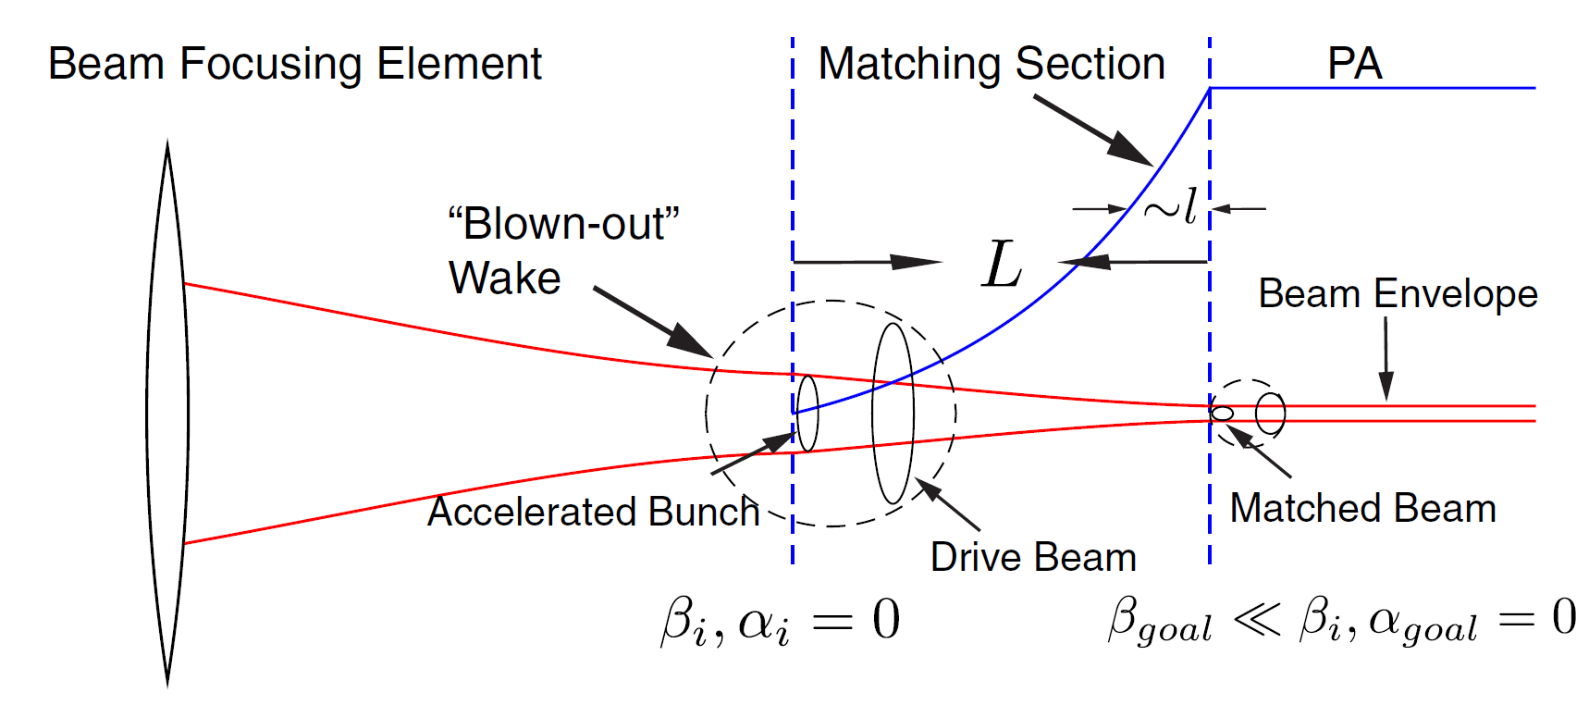
Phase Space Matching for Staging Plasma and Traditional Accelerator Components
  X.L. Xu et al., Phys. Rev. Lett. 116, 124801, 2016

Slide 21
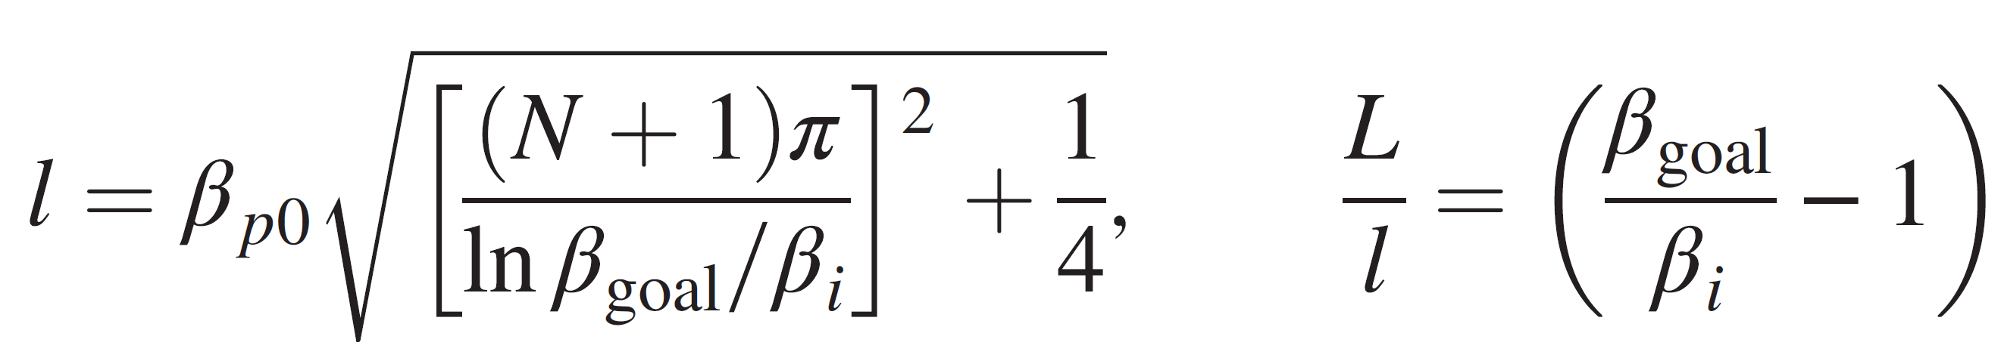
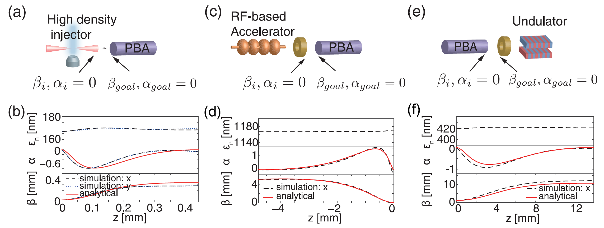
Schematics of staging in matching section
Parameters for exact matching

Slide 22
Some Basic Requirements of accelerator for a g-g collider
Charge per-bunch ( nC)
Beam energy (>80GeV) and energy spread (0.1% )
Normalized emittance (<0.1mm mrad in x or y )
Beam polarization (better be polarized)
Beam average power (~2MW,10-20kHz rep rate)

Slide 23
Laser Wakefield Accelerator Case (LWFA)
Advantage
High average gradient (5-100GeV/m)
High energy gain in single stage (10-100GeV)
Bunch charge on nC level (for 0.8-1um laser)
Reasonable efficiency (5-10%, further optimization is possible)
Disadvantage
Rep rate and average power is low ( ~10Hz kW)
High quality long plasma channel is needed

Slide 24
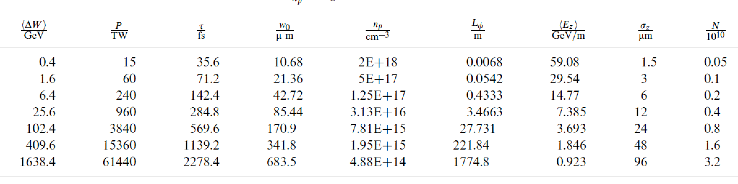
Matched channel guided LWFA with external injection
0.5-1600GeV single stage design of a0=2
Lu et al., PRSTAB 2007, Martins et al., Nat. Phys. 2010, Tzoufras et al., JPP 2012

Slide 25
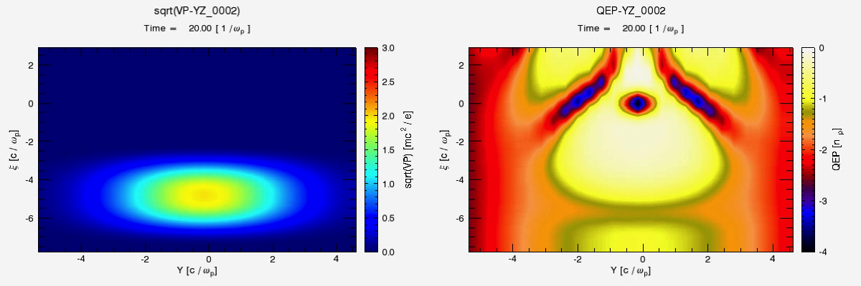
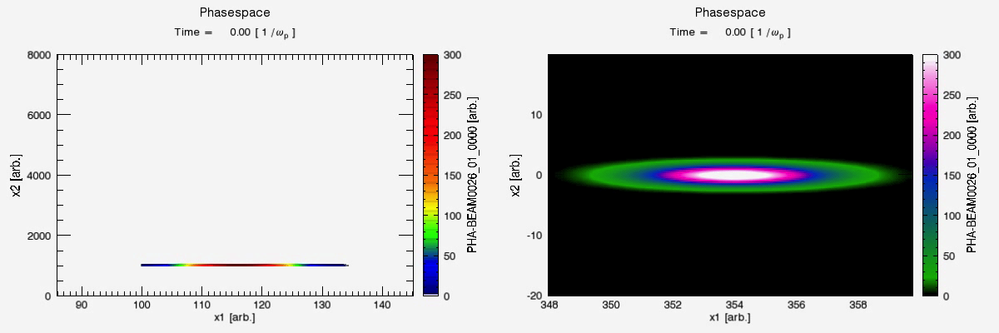
A 40cm long LWFA achieving 6.4GeV by a 34J laser
Efficiency 5.5%, energy spread ~1%, charge 0.32nC

Slide 26
Plasma Wakefield Accelerator Case (PWFA)
Advantage
High average gradient (1-50GeV/m)
High energy gain in single stage (10-100GeV)
Bunch charge >nC relatively ease
High efficiency (30-50% or more)
High rep rate high average power driver available
Disadvantage
Single stage energy gain is limited by the driver energy and transformer ratio

Slide 27
Plasma cell as a super energy and brightness booster for a Linac
Linac1
~200MeV
Linac2
8-15GeV
RF gun
FC
PWFA
BC1
TR=6-12

Slide 28
Key Scheme: Cascaded HTR PWFA
The 1st stage
Two shaped bunches (5ps 25nC, 1ps 5nC)
TR=2 or 3
Efficiency (60%)
The 2nd stage
Controlled injection for e (200fs 1nC or 2nC)
TR=2 or 3
Single stage efficiency (60%)
Overall TR=(1+TR1)*TR2
Overall efficiency Q3(1+TR1)*TR2/(Q1+Q2)=40%

Slide 29
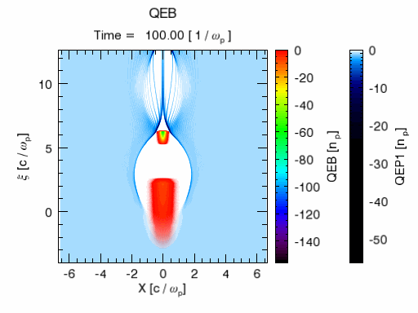
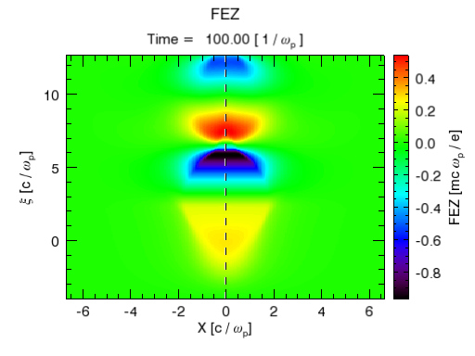
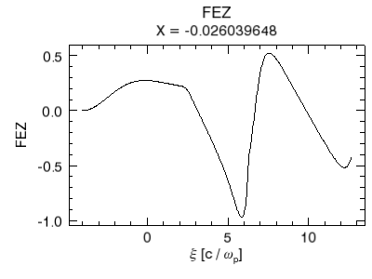
Electron Acceleration Stage ( I and II)
Parameters of Stage I
Driver pulse | 5ps
Driver charge Q1 | 25nC
Driver energy | 2GeV
Trailer pulse | 0.5ps
Trailor charge Q2 | 5nC
Trailor energy | 2GeV
Final energy | 8GeV
Average TR | 3
Efficiency | ~60%
Zhou et al.,
To be submitted
Notes:
补了一张颜色比较深的图~

Slide 30
Possibility of a PWA based g-g collider
Considering the ILC 250GeV case: total beam power ~10MW (20kHz 1nC per bunch e-/e+)
LCLS II beam power: 2MW at 4GeV (MHz, 0.5nC)
What if we use 24MW (20GeV) total beam power, converting with 40% efficiency (or more) into 240GeV 10MW e- beams (with good beam quality)?
The 10MW beams can be used as the drivers for g-g collider
The gradient of the Linac can be lower than 20MeV/m, since the total transformer ratio is 12.

Slide 31
Summary
The physics of plasma based wakefield acceleration has been well established over the decades
Stable, efficient, high quality acceleration of electron beams is within reach in near future
Combining the best part of the traditional accelerator technology, the plasma technology and the laser technology, it may be possible to have a cheaper g-g collider in the future!

Slide 32
Thank you for your attention!

