Slide 1
Circular Accelerator-based & Recirculating Linac-based γγ Collider
Weiren Chou
ICFA Mini-Workshop on Future γγ Collider
April 23-26, 2017, Tsinghua University, Beijing, China

Slide 2
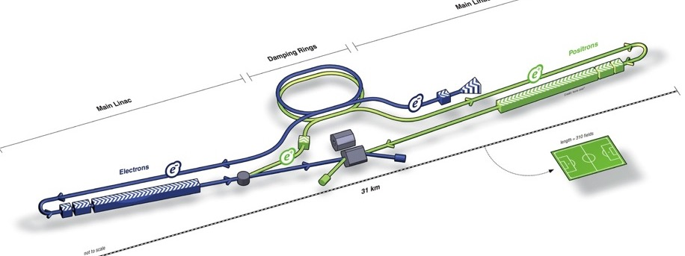
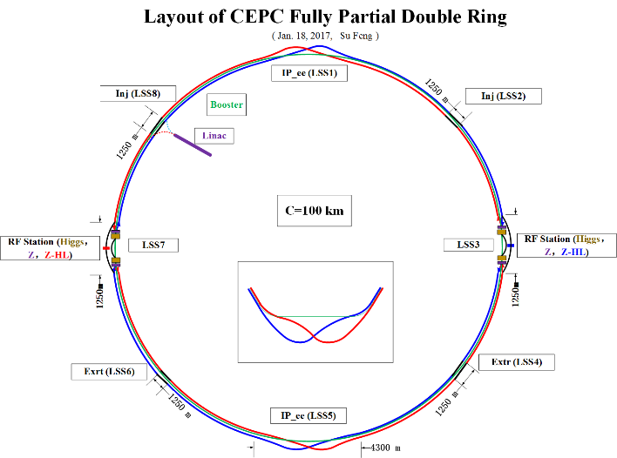
Today’s Landscape of Future Lepton Colliders
Presently four future lepton colliders are being pursued
ILC
CLIC
CEPC
FCC-ee

Slide 3
Timelines
CERN’s takes longer due to LHC operation
ILC (2029)
CEPC (2028)
CLIC (2035)
FCC (2037)

Slide 4
CEPC vs FCC
CEPC was proposed by IHEP in 2012 after the discovery of the Higgs boson. It has two stages:
  A 240 GeV e+e- collider (CEPC) as a Higgs factory, to start construction in early 2020’s and start data taking ~2028.
  A 70-100 TeV pp collider (SPPC) in the same tunnel, to start construction in ~2038.
FCC was proposed by CERN in 2013. There was a TLEP proposal prior to it. FCC includes three options:
  A 350 GeV e+e- collider (FCC-ee)
  A 100 TeV hh collider (FCC-hh)
  An h-e collider (FCC-he)
  It is not yet decided which one – ee or hh – will go first. The tunnel can only accommodate one machine. Data taking ~2037 (after the LHC retires).
CEPC and FCC-ee are similar:
  100 km circumference
  Double ring
  2 IPs
  Booster in the same tunnel
  6 GeV linac

Slide 5
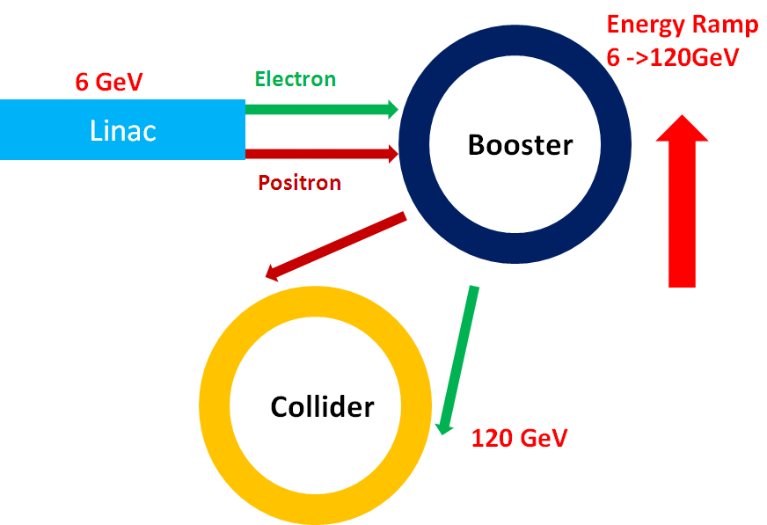
Layout of CEPC and FCC
CEPC Injector
FCC-ee Injector

Slide 6
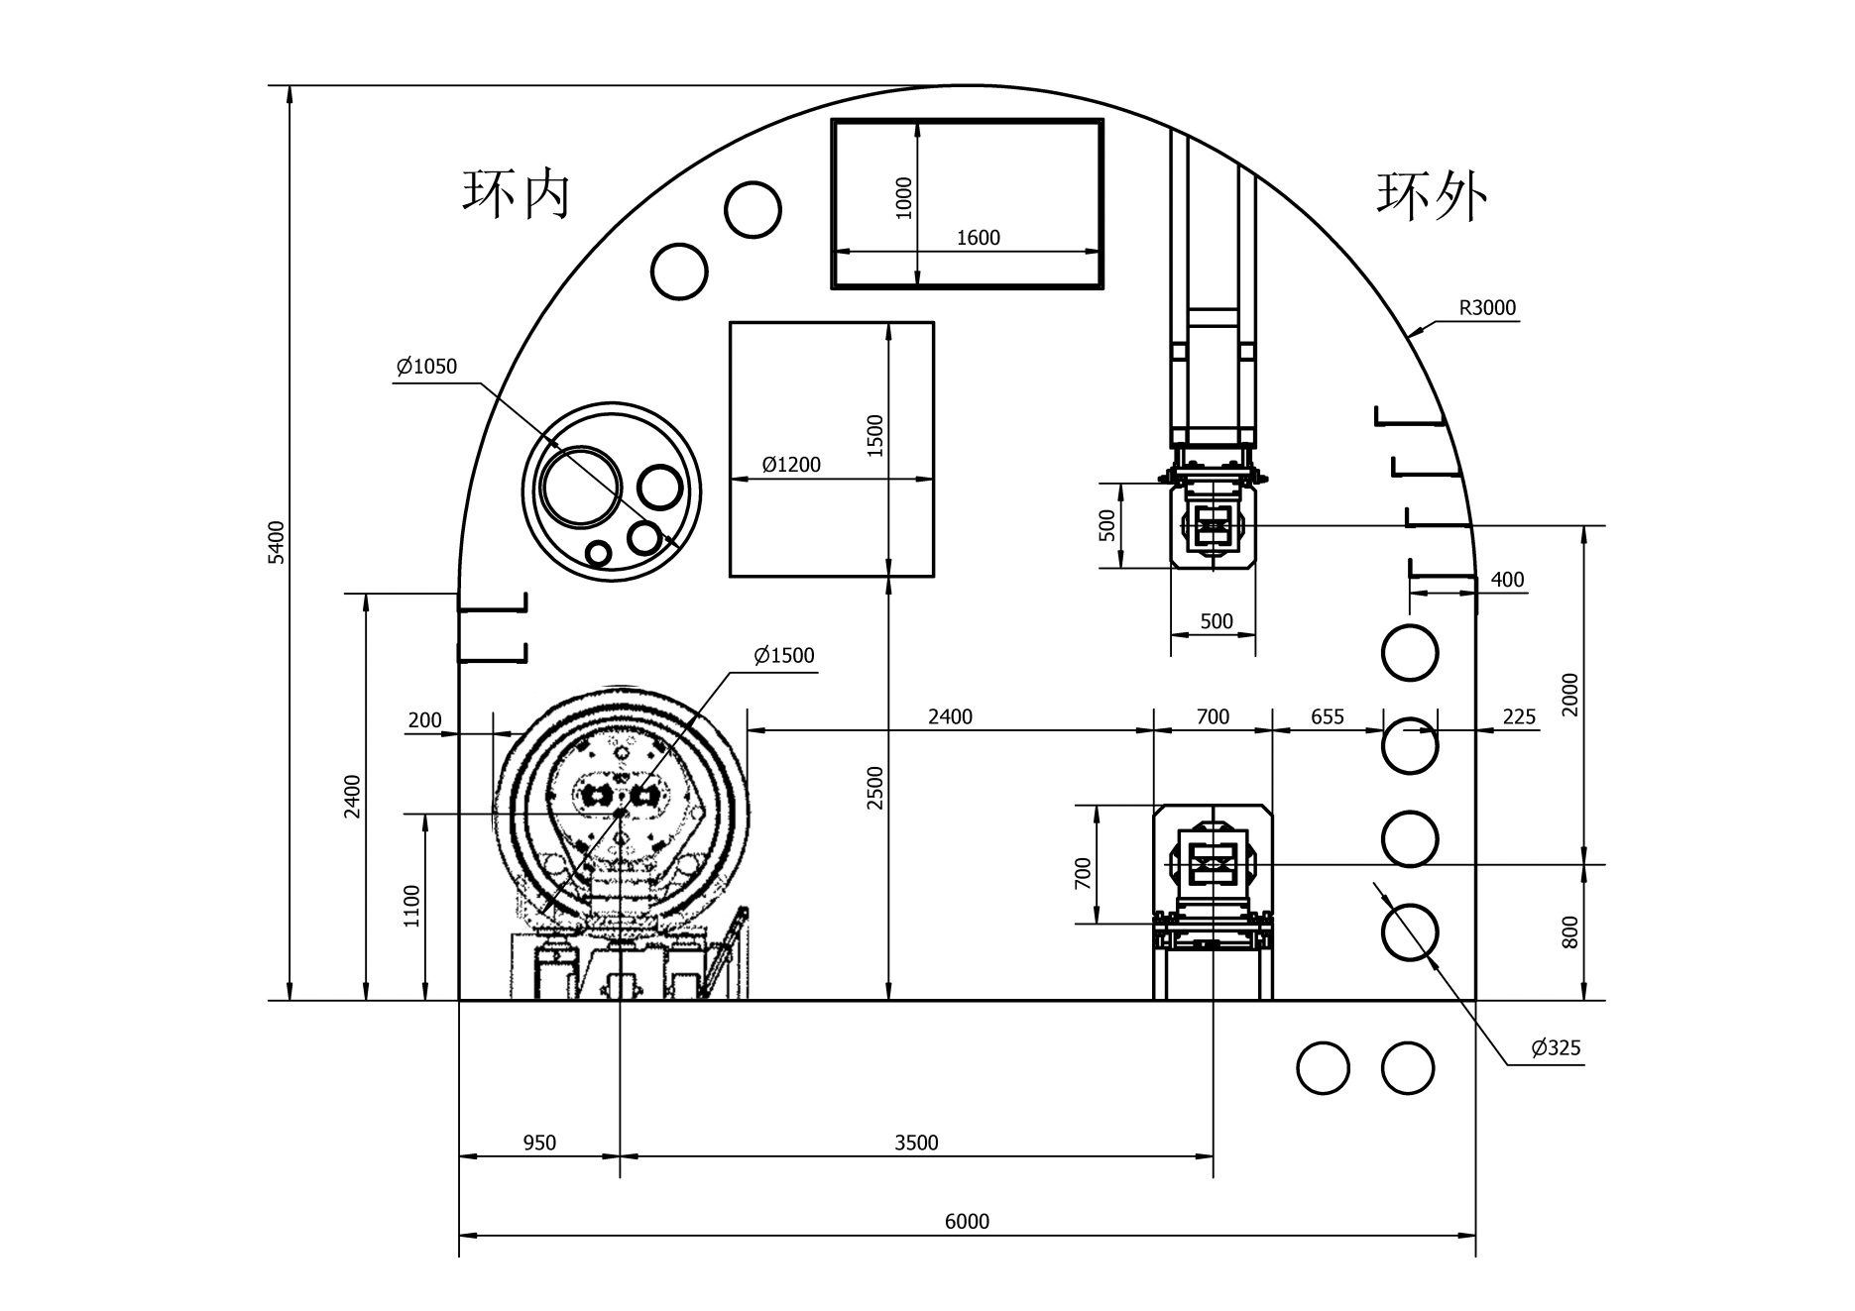
Tunnel Cross Section – SPPC + CEPC Magnets
Drill/Blast Method
Booster
SPPC
CEPC
6 m

Slide 7
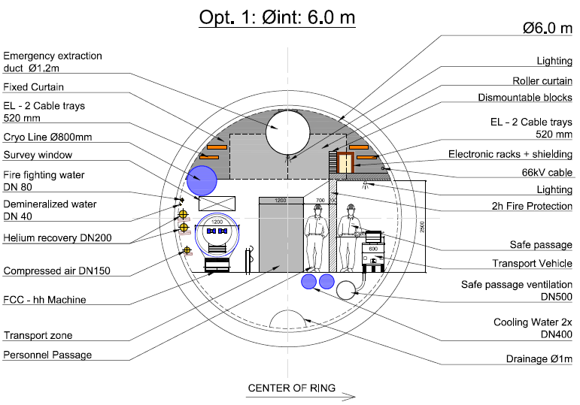
FCC-hh arcs Single tunnel, longitudinal ventilation
P. Lebrun

Slide 8
IPAC 2015 paper

Slide 9
CEPC as a γγ Higgs Factory
Goal: 10,000 Higgs/year
RF (650 MHz, 8 sets, 0.5 GV /set)
RF
RF
e‒ (80 GeV)
Fiber Laser
(0.351 μm, 5 J, 3 kHz)
γγ collision
(125 GeV)
e‒ (80 GeV)
RF
RF
e‒
80 GeV Booster
e‒
E = 80 GeV
ρ= 6000 m
U = 0.6 GeV/turn
I = 48 mA x 2
P(rf) = 58 MW
RF
RF
RF

Slide 10
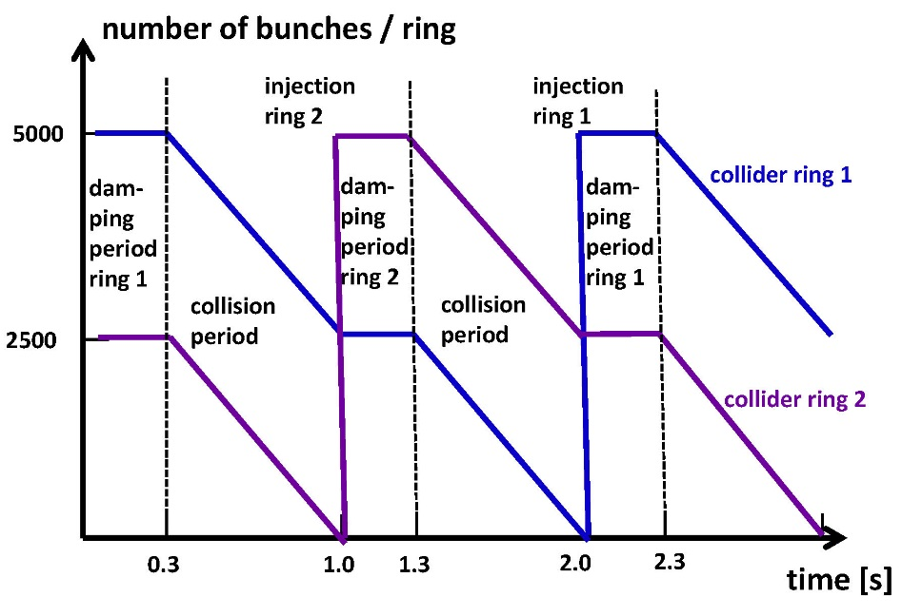
Collider Cycles
(Courtesy R. Aleksan)

Slide 11
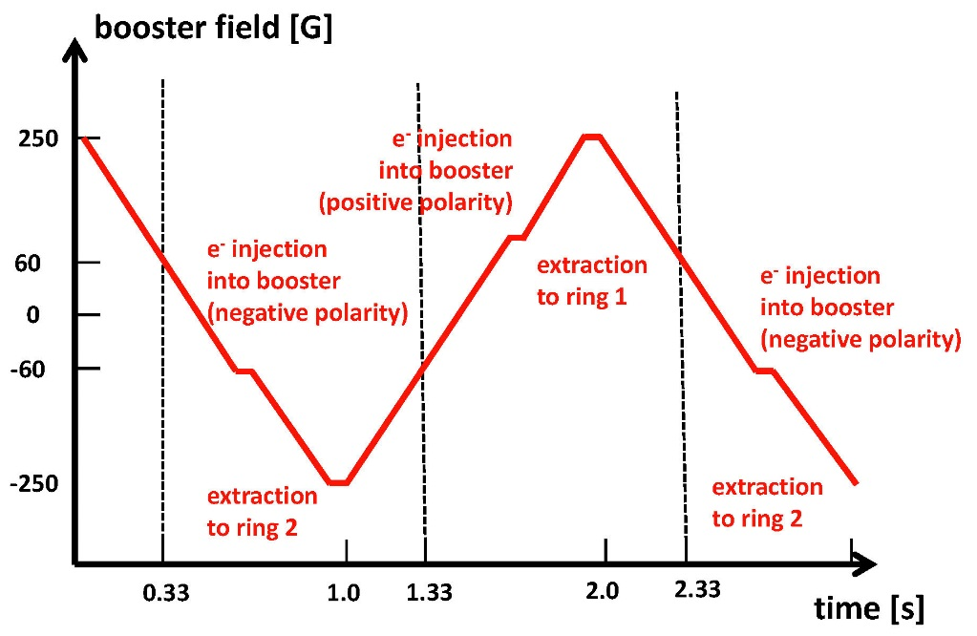
Booster Cycles
(Courtesy R. Aleksan)

Slide 12
Laser Pulses for CEPC(FCC)-γγ Collider
1 ps
333 μs (3 kHz)
Laser Requirements
Pulse width | Pulse energy | Pulse spacing | No. pulses in a train | Laser power in a train | Laser average power | Rep rate | Wavelength | Spot size | Crossing angle
1 ps | 5 J | 333 μs | N/A | N/A | 15 kW | CW | 0.351 μm | 4.2 μm x 4.2 μm | 25 mrad

Slide 13
Nature Photonics (G, Mourou et al., v. 7, p. 258, April 2013)
Figure 2: Principle of a coherent amplifier network (CAN) based on fiber laser technology. An initial pulse from a seed laser (1) is stretched (2), and split into many fibre channels (3). Each channel is amplified in several stages, with the final stages producing pulses of ~1 mJ at a high repetition rate (4). All the channels are combined coherently, compressed (5) and focused (6) to produce a pulse with an energy of >10 J at a repetition rate of 10 kHz (7). [5]

Slide 14
parameters for CEPC double ring
（wangdou20170306-100km_2mmβy）
 | Pre-CDR | Higgs | W | Z
Number of IPs | 2 | 2 | 2 | 2
Energy (GeV) | 120 | 120 | 80 | 45.5
Circumference (km) | 54 | 100 | 100 | 100
SR loss/turn (GeV) | 3.1 | 1.67 | 0.33 | 0.034
Half crossing angle (mrad) | 0 | 16.5 | 16.5 | 16.5
Piwinski angle | 0 | 3.19 | 5.69 | 4.29
N_{e}/bunch (10¹¹) | 3.79 | 0.968 | 0.365 | 0.455
Bunch number | 50 | 412 | 5534 | 21300
Beam current (mA) | 16.6 | 19.2 | 97.1 | 465.8
SR power /beam (MW) | 51.7 | 32 | 32 | 16.1
Bending radius (km) | 6.1 | 11 | 11 | 11
Momentum compaction (10⁻⁵) | 3.4 | 1.14 | 1.14 | 4.49
β_{IP} x/y (m) | 0.8/0.0012 | 0.171/0.002 | 0.171 /0.002 | 0.16/0.002
Emittance x/y (nm) | 6.12/0.018 | 1.31/0.004 | 0.57/0.0017 | 1.48/0.0078
Transverse σ_{IP} (um) | 69.97/0.15 | 15.0/0.089 | 9.9/0.059 | 15.4/0.125
ξ_{x}/ξ_{y}/IP | 0.118/0.083 | 0.013/0.083 | 0.0055/0.062 | 0.008/0.054
RF Phase (degree) | 153.0 | 128 | 126.9 | 165.3
V_{RF} (GV) | 6.87 | 2.1 | 0.41 | 0.14
f _{RF} (MHz) (harmonic) | 650 | 650 | 650 (217800) | 650 (217800)
Nature σ_{z} (mm) | 2.14 | 2.72 | 3.37 | 3.97
Total σ_{z} (mm) | 2.65 | 2.9 | 3.4 | 4.0
HOM power/cavity (kw) | 3.6 (5cell) | 0.41(2cell) | 0.36(2cell) | 1.99(2cell)
Energy spread (%) | 0.13 | 0.098 | 0.065 | 0.037
Energy acceptance (%) | 2 | 1.5
Energy acceptance by RF (%) | 6 | 2.1 | 1.1 | 1.1
n_{γ} | 0.23 | 0.26 | 0.15 | 0.12
Life time due to beamstrahlung_cal (minute) | 47 | 52
F (hour glass) | 0.68 | 0.96 | 0.98 | 0.96
L_{max}/IP (10³⁴cm⁻²s⁻¹) | 2.04 | 2.0 | 5.15 | 11.9

Slide 15
FCC- γγ vs. CEPC-γγ

Slide 16
Discussion on CEPC(FCC)-γγ
Merits for a CEPC(FCC)-based γγ collider:
  While CEPC is a conventional e+e- collider, CEPC γγ would be the world first photon collider.
  A bigger community (HEP + laser) and bigger user society (H + super Z + γγ + intense γ-source).
  For particle physics:
    A γγ collider would open a brand new channel to study Higgs, greatly enhance our understanding of Higgs on top of that based on pp and e+e- collisions.
    For a far future collider based on laser plasma acceleration, this technology will allow physicists to accelerate electrons only and still access annihilation reactions with precisely understood point-like interactions.
  For photon science:
    The ICS is a wonderful amplifier: the energy of the back-scattered photons would be amplified by ~10 orders of magnitude (from eV to tens of GeV) and reach an intensity of 10²⁸ W/cm². There could be applications for this new high intensity γ-ray source.
Technical challenges:
  We never built a photon collider before. We have no experience except some preliminary studies.
  For the laser – how to provide 5 J / 3 kHz pulses?
  For the accelerator – how to make an IR design? Specific challenges to the injector.
  For the detector – how to handle the large background?

Slide 17
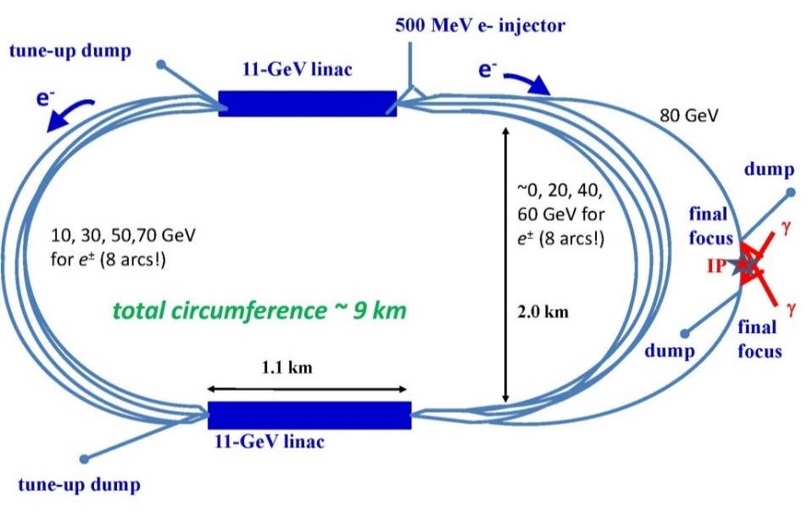
Re-Circulating Linac for γγ Collider
HFiTT
(Higgs Factory in Tevatron Tunnel)
SAPPHiRE

Slide 18
Snowmass2013 White Paper
Fermilab-TM-2558-APC
arXiv: 1305.5202[physics.acc-ph]
HFiTT – Higgs Factory in Tevatron Tunnel (Rev. 3)
Weiren Chou¹, Gerard Mourou², Nikolay Solyak¹, Toshiki Tajima³, Mayda Velasco⁴
¹ Fermilab, USA
² École Polytechnique, France
³ University of California at Irvine, USA
⁴ Northwestern University, USA
May 20, 2013
White Paper for the 2013 US HEP Community Summer Study (Snowmass2013)
Introduction
Among various options for a Higgs factory [1], a photon collider has the distinct advantage of the lowest energy requirement for an electron beam. This advantage is especially important for a circular Higgs factory, in which the synchrotron radiation power increases to the fourth power of the electron energy. For an e⁺e⁻ collider, the minimum required energy per beam is 120 GeV, while for a photon collider it is 80 GeV. The corresponding ratio of synchrotron radiation power is 5 to 1. This makes it possible to consider building a photon collider at Fermilab, which will be named HFiTT, or Higgs Factory in Tevatron Tunnel. The layout is shown in Figure 1.

Slide 19
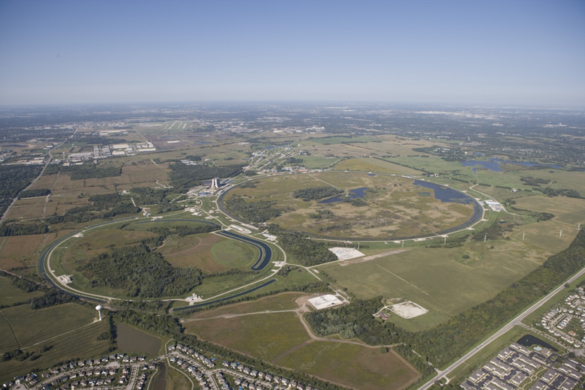
Fermilab – a Bird’s View
Tevatron

Slide 20
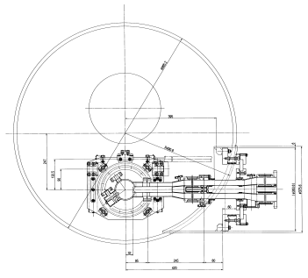
HFiTT – Higgs Factory in Tevatron Tunnel
Goal: 10,000 Higgs/year
RF (1.3 GHz, 8 sets, 5 cryomodules 1.25 GV /set)
RF
RF
e⁻ (80 GeV)
2000 m
Fiber Laser
(0.351 μm, 5 J, 47.7 kHz)
γγ collision
(125 GeV)
2.438 m
(8 ft)
e⁻ (80 GeV)
RF
RF
e⁻ (0.75-8 GeV)
Project X or ASTA
e⁻ (0.75-8 GeV)
E = 80 GeV
= 800 m
U = 4.53 GeV/turn
I = 0.15 mA x 2
P(rf) = 27 MW
Tunnel Cross Section
(16 permanent magnet beam lines,
B = 0.05 – 3.3 kG)
RF
RF
3.048 m (10 ft)
RF

Slide 21
Tevatron Tunnel Cross Section
0.292 m (11.5 in)
0.42 (0.05) kG
0.229 m (9 in)
0.83 (0.47) kG
Recycler-type permanent magnet
1.25 (0.89) kG
2.438 m
(8 ft)
1.67 (1.30) kG
ILC-type crypmodule
2.08 (1.72) kG
2.50 (2.14) kG
φ 0.9652 m
2.92 (2.55) kG
3.33 (2.97) kG
3.048 m (10 ft)

Slide 22
Recycler Permanent Magnet

Slide 23
HFiTT Parameters
Top level parameters
Collision energy (center of mass) | GeV | 126
Luminosity (per IP) | 10³⁴ cm⁻² s⁻¹ | 0.5
definition of luminosity |  | γγ > 125 GeV
Luminosity for e-e- | 10³⁴ cm⁻² s⁻¹ | 3.2
No. of IP |  | 1
No. of Higgs per year (per IP) |  | 10,000
Circumference | km | 6.28
P(wall) | MW | 80
Polarization e- |  | 80%
Polarization γ |  | 90% (lum. peak)
Accelerator parameters
Machine radius | m | 1000
Revolution frequency | kHz | 47.7
Bending radius | m | 800
Bending field | kG | 0.05 –3.3
RF voltage | GV | 10
RF power (total) | MW | 26.7
RF power (per coupler) | kW | 75
No. of recirculating arcs |  | 8
Electron beam parameters
Beam energy | GeV | 80
Energy loss per turn (at 80 GeV) | GeV | 4.53
Number of electrons per bunch | 10¹⁰ | 2
Number of bunches |  | 1
Collision frequency | kHz | 47.7
Circulating beam current | mA | 1.22 × 2
Collision beam current | mA | 0.15 × 2
Beam power | MW | 12.2 × 2
Synchrotron radiation power | MW | 2.3
εx,n | mm-mrad | 10
εy,n | mm-mrad | 0.03
beta_x CP | mm | 4.5
beta_y CP | mm | 5.3
σx, CP | nm | 535
σy, CP | nm | 32
σz, CP | mm | 0.35
sigma_E IP | % | 0.22
Laser beam parameters
Wavelength | μm | 0.351
Pulse energy | J | 5
Repetition rate | kHz | 47.7
Peak power | TW | 1.5
Average power | kW | 240
Rayleigh length | mm | 0.63
σx, CP | nm | 4200
σy, CP | nm | 4200
σz, CP | mm | 0.45
IP<->CP distance | mm | 1.4
Laser-beam crossing angle | mrad
γ beam parameters
n_gamma | 10¹⁰ | 1 (primary)
σx, IP | nm | 480
σy, IP | nm | 10

Slide 24
Laser Pulses for HFiTT γγ Collider
1 ps
21 μs (47.7 kHz)
Laser Requirements
Pulse width | Pulse energy | Pulse spacing | No. pulses in a train | Laser power in a train | Laser average power | Rep rate | Wavelength | Spot size | Crossing angle
1 ps | 5 J | 21 μs | N/A | N/A | 240 kW | CW | 0.351 μm | 4.2 μm x 4.2 μm | 25 mrad

Slide 25
Nature Photonics (G, Mourou et al., v. 7, p. 258, April 2013)
Figure 2: Principle of a coherent amplifier network (CAN) based on fiber laser technology. An initial pulse from a seed laser (1) is stretched (2), and split into many fibre channels (3). Each channel is amplified in several stages, with the final stages producing pulses of ~1 mJ at a high repetition rate (4). All the channels are combined coherently, compressed (5) and focused (6) to produce a pulse with an energy of >10 J at a repetition rate of 10 kHz (7). [5]

Slide 26
Preliminary Cost Consideration
This proposal is at an early stage and it is premature to discuss about its total cost. However, it will be useful to provide cost references for major systems based on the ILC study and Recycler experience.
  40 cryomodules. Cost – $2-3 million each according to the ILC cost estimate. (As a comparison, the ILC would need ~1,700 cryomodules.)
  27 MW of RF power. Assuming 50% efficiency, one needs 54 MW of wall power for RF. Cost – $5 million per MW according to the ILC cost estimate.
  25 MW of wall power for cryogenics. Cost – about 2/3 of the ILC cryogenics.
  16 permanent magnet beam lines. Cost reference – the Recycler permanent magnet total cost was $3.2 million.
  2×240 kW laser system. Assuming wall plug efficiency of 30%, compressor efficiency of 50%, diode price of €5/W and the rule of thumb that “3 times the diode cost equals the cost of the full system,” the laser system will cost ~€50M, or $65 million.
  Civil – the Tevatron tunnel, CDF and DZero experimental halls, service buildings and utilities can be reused to minimize the civil cost.

Slide 27

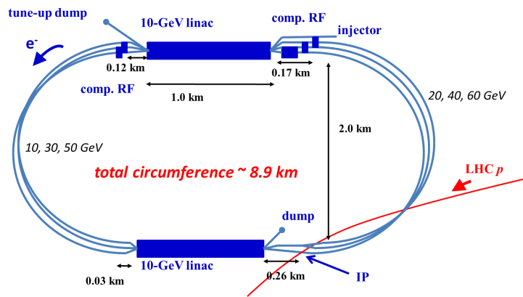
Reconfiguring LHeC → SAPPHiRE
SAPPHiRE*
γγ Higgs factory
LHeC-ERL
*Small Accelerator for Photon-Photon Higgs production using Recirculating Electrons

Slide 28
SAPPHiRE | symbol | value
total electric power | P | 100 MW
beam energy | E | 80 GeV
beam polarization | P_{e} | 0.80
bunch population | N_{b} | 10¹⁰
repetition rate | f_{rep} | 200 kHz
bunch length | σ_{z} | 30 μm
crossing angle | θ_{c} | ≥20 mrad
normalized horizontal/vert. emittance | γε_{x,y} | 5,0.5 μm
horizontal IP beta function | β_{x}* | 5 mm
vertical IP beta function | β_{y}* | 0.1 mm
horizontal rms IP spot size | σ_{x}* | 400 nm
vertical rms IP spot size | σ_{y}* | 18 nm
horizontal rms CP spot size | σ_{x}^{CP} | 400 nm
vertical rms CP spot size | σ_{y}^{CP} | 180 nm
e⁻e⁻ geometric luminosity | L_{ee} | 2x10³⁴ cm⁻²s⁻¹

Slide 29
Parameter | HFiTT | Sapphire | SILC | CLICHE
cms e-e- Energy | 160 GeV | 160 GeV | 160 GeV | 160 Gev
Peak γγ Energy | 126 GeV | 128 GeV | 130 GeV | 128 GeV
Bunch charge | 2e10 | 1e10 | 5e10 | 4e9
Bunches/train | 1 | 1 | 1000 | 1690
Rep. rate | 47.7 kHz | 200 kHz | 10 Hz | 100 Hz
Power per beam | 12.2 MW | 25 MW | 7 MW | 9.6 MW
L_ee | 3.2e34 | 2e34 | 1e34 | 4e34
L_gg (Eγγ > 0.6 Ecms) | 5e33 | 3.5e33 | 2e33 | 3.5e33
CP from IP | 1.2 mm | 1 mm | 4 mm | 1 mm
Laser pulse energy | 5 J | 4 J | 1.2 J | 2 J
ε_{x} / ε_{y} [μm] | 10/0.03 | 5 / 0.5 | 6 / 5 | 1.4 / 0.05
β_{x} / β_{y} at IP [mm] | 4.5/5.3 | 5 / 0.1 | 0.5 / 0.5 | 2 / 0.02
σ_{x} / σ_{y} at IP [nm] | 535/32 | 400 / 18 | 140 / 125 | 138 / 2.6

Slide 30
Low Emittance Polarized Sources
A specific challenge for a recirculating linac- based γγ collider is the need for low emittance polarized e- sources – 1 nC, 1 μm, polarized
At present, there is no RF gun that permits the use of Negative Electron Affinity (NEA) materials in cathodes, e.g., GaAs, that are needed to generate polarized electrons.
Problem – extremely low vacuum needed for the survival of the cathode: 10⁻¹¹ torr. This is achievable when the RF is off, but during the RF pulses, the pressure shoots up to 10⁻⁹ torr and the cathode is destroyed in a finite number of pulses.
Reason – damage to the cathode surface caused by bombardment by light ions and field emitted electrons.
Two possible solutions.
    to develop new cathode materials that are capable of surviving in the lower quality vacuum.
    to develop RF guns with improved vacuum during the RF pulse.

Slide 31
Discussion on HFiTT
Reasons to build the HFiTT:
  This is a Higgs factory with perhaps the lowest cost..
  It can effectively reuse the Tevatron infrastructure, including the tunnel, service buildings, utilities, experimental halls and part of the CDF and D0 detectors
  It fits well to the six criteria specified in the Fermilab’s strategic plan, i.e., it:
    addresses critical and exciting scientific questions
    is bold and establishes world leadership
    leverages the laboratory’s expertise and existing facilities
    attracts international partners
    fits within a global strategy for the field and within reasonable U.S. funding
    is focused, yet broad enough to be resilient in the face of unexpected physics discoveries and funding fluctuations.
Reasons not to build the HFiTT:
  On the global stage, if Japan decides to build the ILC, there may be no resources for another big international project.
  On the domestic stage, if Fermilab will build the LBNF/DUNE and/or Project X, there will be no resources in the next 15-20 years for another big domestic project.
Major technical challenges for HFiTT:
  For the laser – 5 J / 47 kHz pulses
  For the accelerator – low emittance polarized e- gun, IR design
  For the detector – large background

Slide 32
Questions?

