Slide 1
Challenges to the injectors of circular γ-γ colliders
− Taking CEPC γγC as an example −
C. Zhang
ICFA Mini-Workshop on Future γ-γ Collider
Tsinghua University, Beijing, China
April 23, 2017

Slide 2
Parameters of γ-γ Colliders

Slide 3
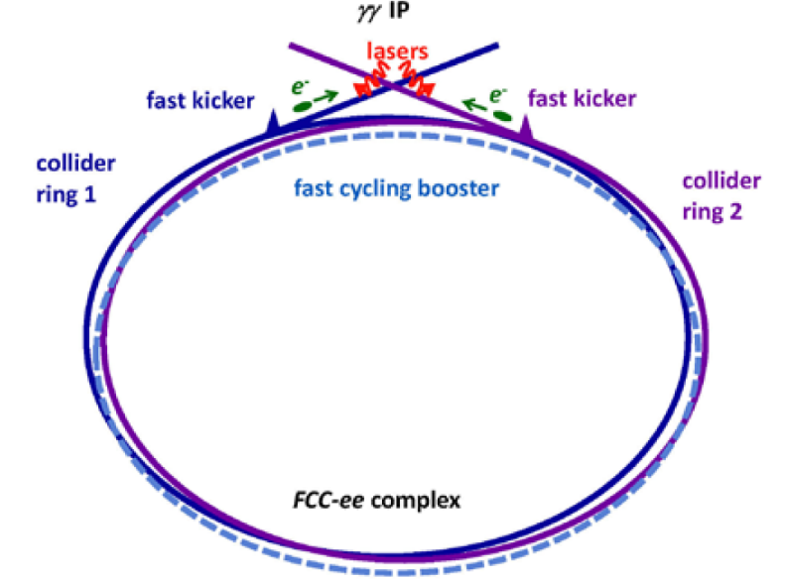
FCC γ-γ collider

Slide 4
Some parameters related to injectors

Slide 5
CEPC and its injector
Bunch number and intensity
Linac injector
Beam polarization
Kickers
RF system
Cycling period
Magnets & power supplies
Beam instability

Slide 6
CEPC-SPPC
(1) CEPC and its injector
e+
IP1
e-
SppC HE Booster
LTB
e+ e- Linac
BTC
BTC
SppC ME Booster
SppC LE Booster
Proton Linac
IP4
IP2
CEPC Booster
CEPC Collider Ring
SppC Collider Ring
IP3
CEPC (Circular Electron Positron Collider)
  Study the Higgs boson with very high precision
Upgraded to a 70 TeV or higher pp collider SPPC
  To study the new physics beyond the standard model
  Depends on the results of CEPC

Slide 7
CEPC main parameters
 | Pre-CDR | Higgs | W | Z
Number of IPs | 2 | 2 | 2 | 2
Energy (GeV) | 120 | 120 | 80 | 45.5
Circumference (km) | 54 | 100 | 100 | 100
SR loss/turn (GeV) | 3.1 | 1.67 | 0.33 | 0.034
Half crossing angle (mrad) | 0 | 16.5 | 16.5 | 16.5
Piwinski angle | 0 | 3.19 | 5.69 | 4.29
N_{e}/bunch (10¹¹) | 3.79 | 0.968 | 0.365 | 0.455
Bunch number | 50 | 412 | 5534 | 21300
Beam current (mA) | 16.6 | 19.2 | 97.1 | 465.8
SR power /beam (MW) | 51.7 | 32 | 32 | 16.1
Bending radius (km) | 6.1 | 11 | 11 | 11
Momentum compaction (10⁻⁵) | 3.4 | 1.14 | 1.14 | 4.49
β_{IP} x/y (m) | 0.8/0.0012 | 0.171/0.002 | 0.171 /0.002 | 0.16/0.002
Emittance x/y (nm) | 6.12/0.018 | 1.31/0.004 | 0.57/0.0017 | 1.48/0.0078
Transverse σ_{IP} (um) | 69.97/0.15 | 15.0/0.089 | 9.9/0.059 | 15.4/0.125
ξ_{x}/ξ_{y}/IP | 0.118/0.083 | 0.013/0.083 | 0.0055/0.062 | 0.008/0.054
RF Phase (degree) | 153.0 | 128 | 126.9 | 165.3
V_{RF} (GV) | 6.87 | 2.1 | 0.41 | 0.14
f _{RF} (MHz) (harmonic) | 650 | 650 | 650 (217800) | 650 (217800)
Nature σ_{z} (mm) | 2.14 | 2.72 | 3.37 | 3.97
Total σ_{z} (mm) | 2.65 | 2.9 | 3.4 | 4.0
HOM power/cavity (kw) | 3.6 (5cell) | 0.41(2cell) | 0.36(2cell) | 1.99(2cell)
Energy spread (%) | 0.13 | 0.098 | 0.065 | 0.037
Energy acceptance (%) | 2 | 1.5
Energy acceptance by RF (%) | 6 | 2.1 | 1.1 | 1.1
n_{γ} | 0.23 | 0.26 | 0.15 | 0.12
Life time due to beamstrahlung (minute) | 47 | 52
F (hour glass) | 0.68 | 0.96 | 0.98 | 0.96
L_{max}/IP (10³⁴cm⁻²s⁻¹) | 2.04 | 2.0 | 5.15 | 11.9

Slide 8
γ−γ collision
Laser
Laser
IP
Electron
Electron
Kicker
Kicker

Slide 9
Main parameters of CEPC booster (PCDR)
Single bunch injection from linac (E=6  10 GeV, I_{p}=3.2nC, f_{rep}=100 Hz,
ε_{x,y}=0.1-0.3 mm⋅mrad) to booster;
Assuming 5% of current decay in the collider between two top-ups ;
Booster operates with repetition frequency of 0.1 Hz.
Overall efficiency from linac to the collider is assumed as 90 %.
SR power density of 45W/m is much lower than in BEPCII of 415W/m.

Slide 10
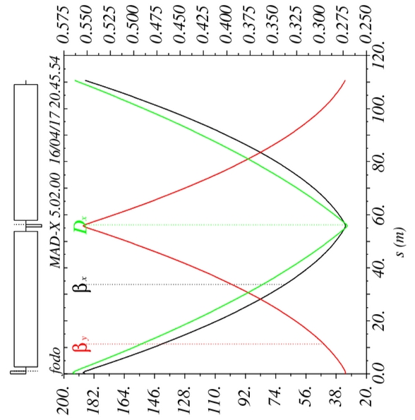
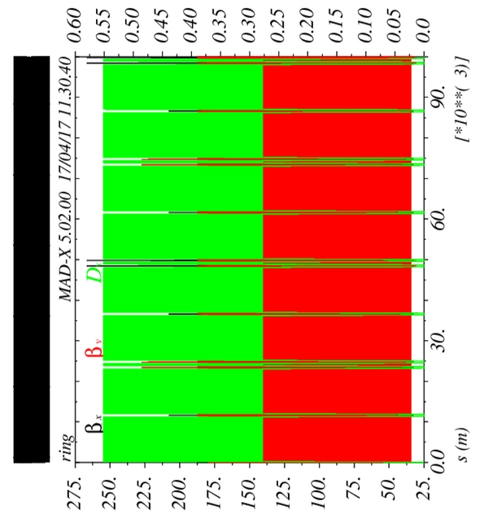
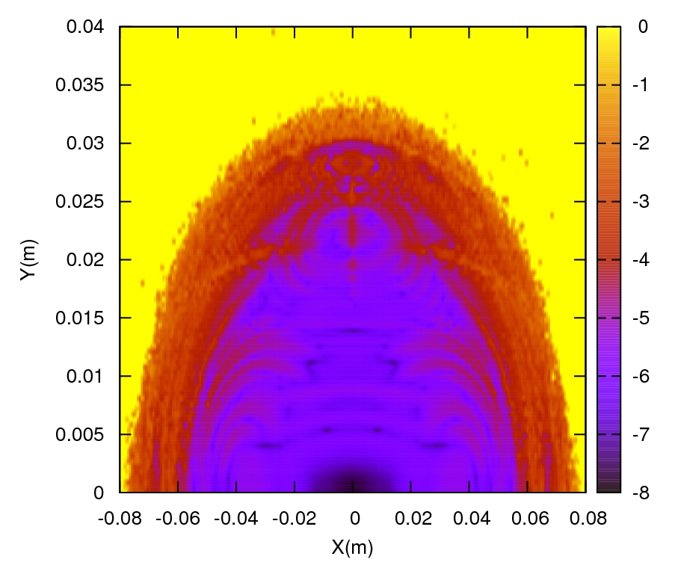
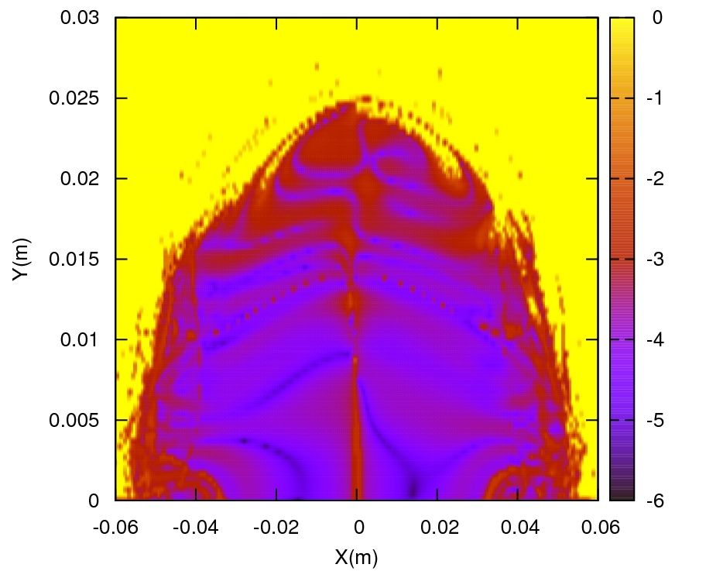
Lattice functions and dynamic aperture
Tianjian Bian
(C = 100 km)
Δp/p=0%
Δp/p=0.5%

Slide 11
(2) Bunch number & intensity
C=100km, ρ=11km, I_{b}=0.05I_{c}/0.95 (e⁺-e⁻), I_{b}=I_{c}/0.99 (γ−γ)

Slide 12
Challenge of high intensity
Injector linac: repletion rate and number of bunches in a pulse;
Injection and ejection Kickers: repletion rate and/or pulse length
RF system: power and HOM;
Cycling period: injection and ejection time;
Magnets & power supplies: fast ramping & bipolar;
Beam instability: single & multi bunch effects;
……

Slide 13
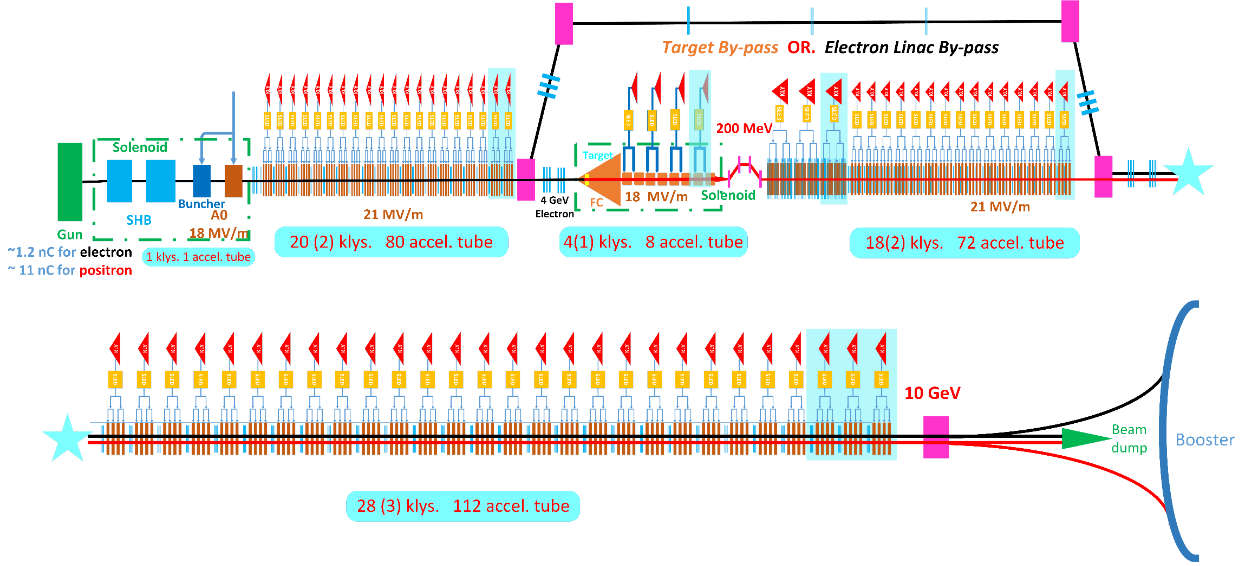
(3) Linac injector
X.P. Li
Conventional S-band linac
4GeV 10nC e⁻ beam on e⁺ converter;
0.2 GeV positron recycling line.



Slide 14
Linac parameters
CEPC-Z: present designed linac may satisfy CEPC-Z injector.
FCC-γγ: may need an ILC-like linac as injector, but very challengeable.

Slide 15
Overall Concept Design
PWFA Option
Wei Lu
Linac1
~200MeV
Linac2
2-4GeV
RF gun
FC
DB
PWFA
BC1
TR=6-12
e+ Target
BC2
LPA
>100MeV
20nC
Damping ring
Linac3
~300MeV
P_{b}~ 200 kW @ 80 GeV

Slide 16
（4）Booster injection & ejection
Injection kickers
Ejection kicker
Ejection kicker

Slide 17
Kickers
On-exit injection & fast extraction;
Kicker angle θ_{k} ~ 10 mrad
  (B⋅ l )_{k}= 0.33 T⋅m @ 10 GeV
  (B⋅ l )_{k} = 2.67 T⋅m @ 80 GeV
Long pulse injection fast extraction;
  τ_{rise} = 60 ns, T_{flat}= T_{rev}= 334 μs, η ~2×10⁻⁴
334 μs
60ns
60ns

Slide 18
Kicker parameters

Slide 19

RF system
Peng Sha
ZJ20170410. 10 GeV injection. Booster machine parameter: CX20170401 | H | W | Z
Extraction beam energy [GeV] | 120 | 80 | 45.5
Bunch charge [nC] | 0.77 | 0.2 | 0.3
Beam current [mA] | 0.37 | 0.33 | 0.96
Extraction RF voltage [GV] | 2.8 | 1 | 0.4
Extraction bunch length [mm] | 4.7 | 2.8 | 1
Cavity number in use (1.3 GHz TESLA 9-cell) | 160 | 64 | 32
Gradient [MV/m] | 16.9 | 15.1 | 12.0
Q_{L} | 2E+07 | 2E+07 | 2E+07
Input power per cavity [kW] (remained detuning 10 Hz) | 5.8 | 4.0 | 2.5
HOM power per cavity [W] | 0.4 | 0.2 | 1.6
Cryomodule number in use (8 cavities per module) | 20 | 8 | 4
Q₀ @ 2 K at operating gradient (long term) | 2E+10 | 2E+10 | 2E+10
Total wall loss @ 4.5 K eq. [kW] (assume CW) | 8.4 | 2.7 | 0.9
γ−γ
10-80
22

Slide 20
RF system
Present RF system of the CEPC booster is based on the 1.3 GHz ILC scheme.
The maximum average beam current is few milliamps limited by HOM and input couplers etc.
The booster RF system with optimized bunch number and cycling rate may be workable for CEPC-Z.
The beam current (~100mA) and RF power (20.4 MW) in γ−γ option is much too high for the present system.

Slide 21
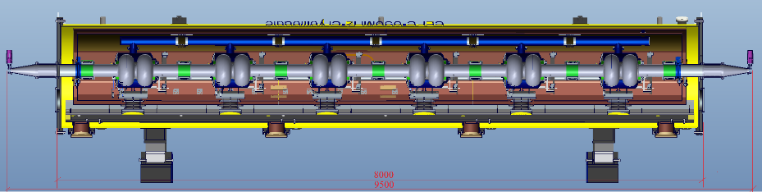
CEPC Main Ring SRF Parameters
Peng Sha
ZJ20170410 Main Ring parameter: WD20170306 | H | W | Z
Luminosity / IP [10³⁴ cm⁻²s⁻¹] | 2 | 5 | 12
SR power / beam [MW] | 32 | 32 | 16
RF voltage [GV] | 2.1 | 0.41 | 0.14
Beam current / beam [mA] | 19.2 | 97.1 | 466
Bunch charge [nC] | 15.5 | 5.8 | 7.3
Bunch length [mm] | 2.9 | 3.4 | 4
Cavity number in use / beam (650 MHz 2-cell) | 336 | 96 | 48
Gradient [MV/m] (with margin for HV-H) | 14 | 9.3 | 6.3
HOM power / cavity [kW] | 0.4 | 0.3 | 1.8
Cryomodule number (6 cavities / module) | 56 | 32 | 16
Q₀ @ 2 K at operating gradient (long term) | 1E10 | 1E10 | 1E10
Total wall loss @ 4.5 K eq. [kW] | 23 | 6 | 1

Slide 22
(6) Magnets & power supplies
beam1 ejection, n_{b}=5590, 334μs
beam1 ejection, n_{b}=5590, 334μs
beam1 injection, n_{b}=5590, 334μs
beam1 injection, n_{b}=5590, 334μs
beam2 injection, n_{b}=5590, 334μs
beam2 injection, n_{b}=5590, 334μs
beam2 ejection, n_{b}=5590, 334μs
ΔB/Δt = 391 G/s
(ΔB/Δt)_{LEP} ~ 500 G/s

Slide 23
(7) Polarization
Design polarization level of electron beams is 80% for CEPC-γγ.
The cycling time of 2.5 s is too short for the polarization to build up. Therefore, polarized electron beams should be provided by the linac injector with a polarized electron gun.
The lattice of the booster should optimized, the closed orbit needs to be well controlled, and the spin tune should be carefully selected in order to reduce the depolarization process.
Detailed studies of these schemes are required to demonstrate the feasibility of implementing polarization in CEPC.

Slide 24
(8) Beam instability
Transverse mode coupling instability
Transverse resistive wall instability
Coupled bunch instability induced by RF HOM’s

Slide 25
Transverse mode coupling instability
The beam instability due to single bunch and multi-bunch effects are estimated at injection energy. The beam is expected to be more stable at high energy.
The single bunch instability is dominated by the transverse mode coupling instability (TMCI).
With the CEPC-γγ data, we have Z_{T}< 5.1 MΩ/m.
Considering the impedance generated from the resistive wall and the RF cavities, we obtain the single bunch threshold current of 27 μA.

Slide 26
Transverse mode coupling instability
N_{b}=3.7×10¹⁰
I_{b}=0.017 mA

Slide 27
Transverse resistive wall instability
The transverse resistive wall instability
with ω_{p,μ,νβ} = (pM + μ + ν_{β}) ω₀ and
For CEPC-booster, Z_{x}= 3.9×10¹⁰ (1-i)ω^{-1/2}, Z_{y}= 1.8×10¹¹ (1-i)ω^{-1/2}
τ _{rise}=34 ms
PCDR
Detailed simulation is underway.

Slide 28
Coupled bunch instability induced by RF HOM’s
The beam current (~100mA) and RF power (20.4 MW) in γ−γ option is much too high for the present system.
The coupled bunch instability induced by RF HOM’s for the booster of CEPC-γγ will be studied based on the main ring RF cavities.

Slide 29
Summary
The CEPC-γγ collision with large number of bunches and high beam current has flung challenges to the booster design, in its linac injector, beam polarization, collective instability, cycling rate，RF system，and etc.
For the booster injector, the superconducting linac is preferable to conventional.
It requires high beam current and RF power of the booster so that one may need to use the similar system of the CEPC main ring.

Slide 30
Thank you for attention

