Slide 1

IFCA Mini-Workshop on Future Gamma-Gamma Collider
April 23-26, Beijing
Ultra-intense laser development and laser driven particle acceleration at SIOM
Jiansheng Liu (刘建胜), Yuxin Leng (冷雨欣), Ruxin Li (李儒新), and
Zhizhan Xu (徐至展)
State Key Laboratory of High Field Laser Physics,
Shanghai Institute of Optics and Fine Mechanics (SIOM),
Chinese Academy of Sciences
Notes:
I am Dong Wu, a staff research scientist in state key lab of high field laser physics. Director Leng Y. X. had planned to give this talk, while he had fly back to Shanghai for some other important staffs. Here, on behalf of Dr. Leng, I shall give this talk and introduce the development of ultra intense laser development and related particle acceleration at SIOM.

Slide 2

Outline
1. Background and motivations
2. Development of ultra intense laser system at SIOM
3. High-quality e-beam generation from cascaded
laser wakefield accelerators (LWFAs)
4. Generation of x- and γ-ray based on LWFAs
5. Summary
Notes:
The outline of this talk is as follows. Firstly, is the background and motivation. in the second part, I shall introduce the development of ultra intense laser systems at SIOM.
In the third part,I shall introduce the high quality e-beam generation from cacaded laser wakefield acceleration based on our own laser facility. The fourth part,is some results of x and gamma rays based on high quality electron beams from LWFAs. Finially is the summary.

Slide 3
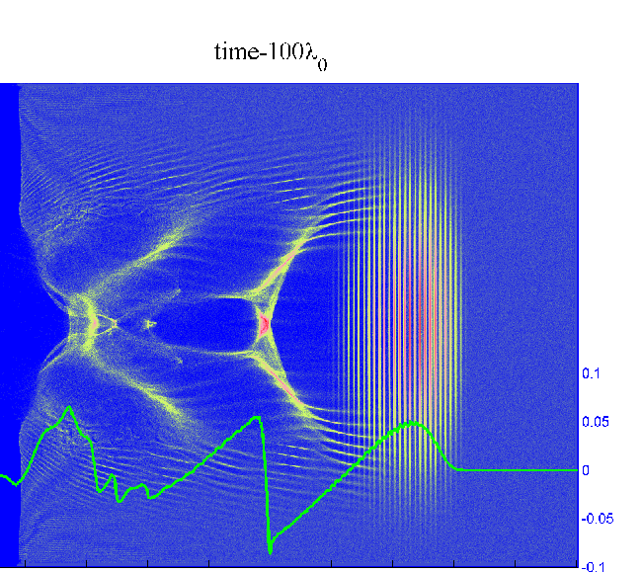
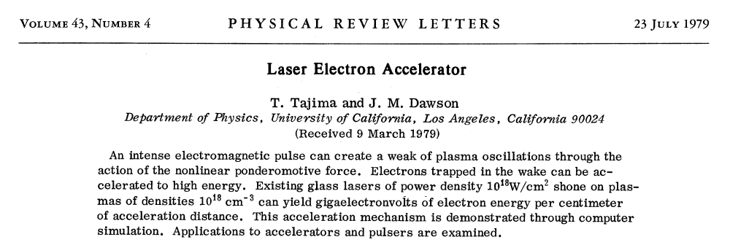
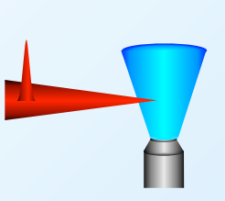

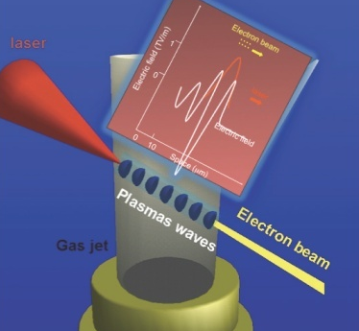
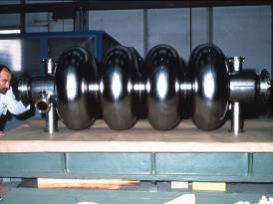
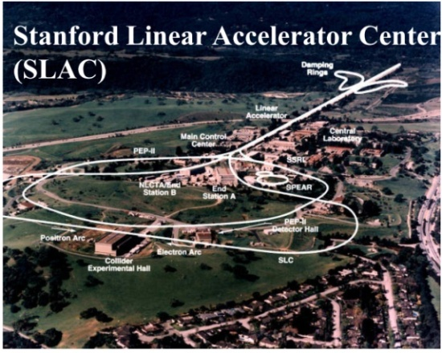
Motivations: LWFAs are compact accelerators
Laser wakefield accelerators—Compact particle accelerators
Gas jet
Driving laser
LWFA: Accelerating gradient
~100 GV/m‏
Stanford LINAC, 2miles long
RF cavity (1 m-long)
(gradient= 10⁷⁻⁸V/m)
RF accelerator
Laser Pulse Phenomena and Applications
Notes:
The basic idea of laser wake field accelerator is when a intense laser beam propagate in low density plasmas, the ponderomtive force of the laser beam shall evacuate electrons anf form a bubble. In the meanwhile, a strong plasma wave can also be exciated. The electric field of the plasma wave can be 3 orders of magnitude higher than tranditional radio frequency accelerators. This unique feature makes it possible to make a compact particle accelerators based on laser wake field accelerations.
This kind of concept looks branch new, while it also havs a very long history just as tranditional accelerators, which can date back to 40 yeats ago. This is paper initially published by Tajima and Dawson, which is the origin of laser electron accelerator.

Slide 4
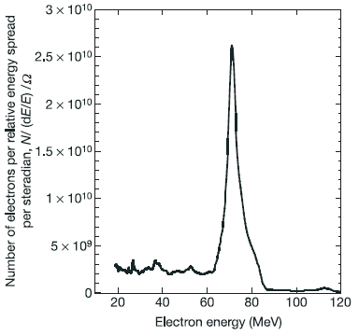
100 MeV-class electron beams were obtained
by laser wakefield acceleration—LWFA.
∆E/E ~ 10%
LOA
Nature, 431, 541( 2004)
RAL
∆E/E ~ 3%
∆E/E ~ 6%
Nature, 431, 535 ( 2004)
Nature, 431, 538 ( 2004)
Nature cover (2004.9.30)
Notes:
The year 2004 is landmark year laser wakefield acceleration. In this year, 100 MeV-class mone-energetic electron beams were obtained in experiment. The expriment retuls form UK, France and US respectively.

Slide 5
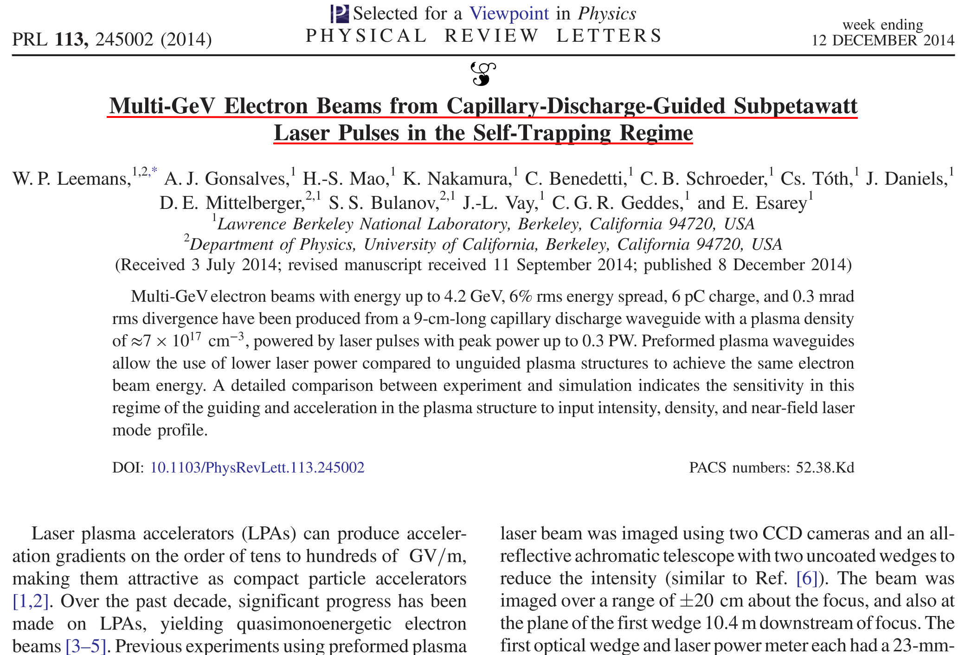
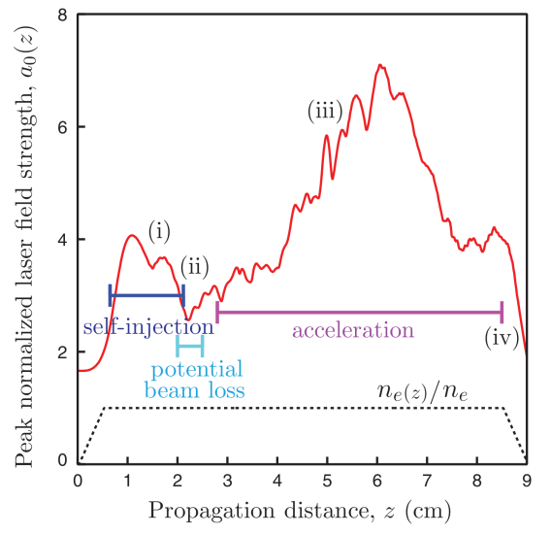
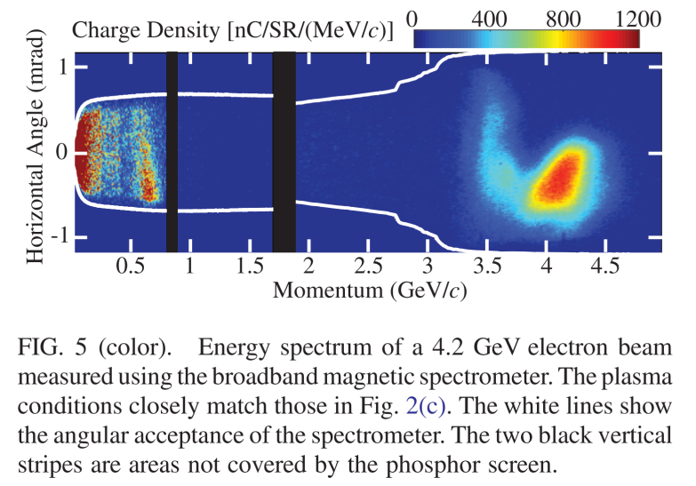
Notes:
Ten years latter, in 2014, multi GeV electron beam was generated by Leemans. Which is based on capillary-discharge guided technique.The peak energy is 4.2 GeV, 6 percent energy spread, and 6 pico Comlomb.

Slide 6
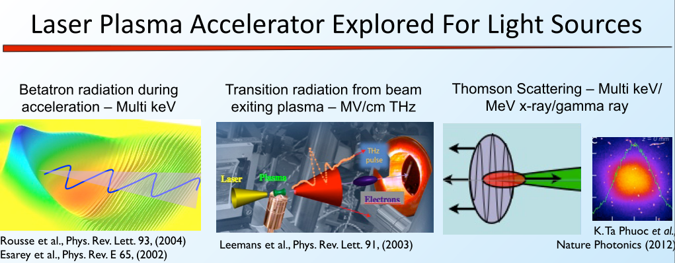
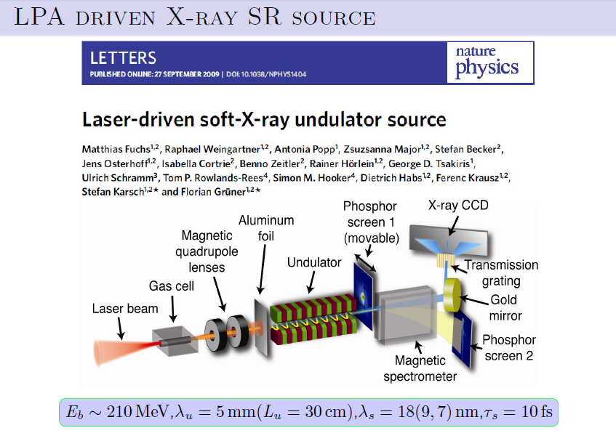
Compact light sources based on a LWFA
Nature Physics 2009
Notes:
This high quality electron beams can be used to generate compact ligh sources.
Include beraron radtion during the laser wake field acceleration, this is an simple idea, when electron accelerated longitudinally by laser wake field, electron's also oscilalte transversely. and emit multi kev Xrays.
Transition radiation: when electrons penetrate through, for example, a metal, on the backside of the metal, conherent transition radiation can be generated, which can be used as a good sources of THZ emmision.
Thomson Scattering. The high quality electron beam can be directly used to collide with a laser beam, which is a very potential way to generate intense gamma ray source.
Also the high quality electron beam can be used as a seed and injected into an external undulator. This is the concept of laser driven soft x-ray undulator source.

Slide 7
Outlines
1. Background and motivations
2. Ultra-intense laser development at SIOM
3. High-quality e-beam generation from cascaded
laser wakefield accelerators (LWFAs)
4. Generation of x- and γ-ray source based on LWFAs
5. Summary
Notes:
The following part is the introduction of ultra intense laser development at SIOM

Slide 8
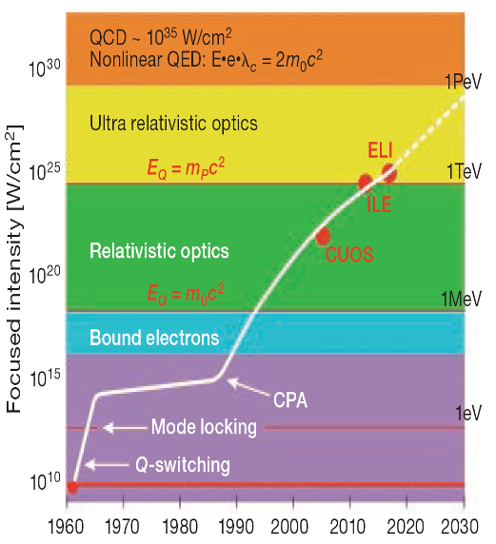
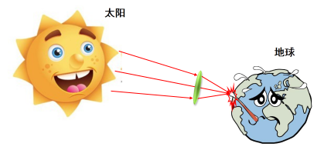
CPA technique and Petawatt lasers
10PW
1PW
1PW laser beam focused down to 10μm spot: 10²¹W/cm²
Courtesy of Gerard Mourou
G. Mourou et al., OPN July(2011)
G. Mourou et al., Science 331, 41 (2011)
Notes:
With the develpment of tehnology, the focused laser intensity increase rapidly with time. Here is the focused intensity value as a `function of time'. Especially, in ninetheen nineties, the invention of CPA, greatly speed up the development. and the focused intensity has become relativistic intense.
Now the 1 pw laser facility has become available, and 10 pw laser facility is also accesible.If we focus the laser beam down to 10 um spot, its intensity can be high as 10^21.
Here is some rough description how strong a 1 pw laser is. If we focus the radiation of the sum into a dimamter of our hear,

Slide 9

Development of Ultra Intense Laser Systems in SIOM
0.1 TW/20ps, 1991
2.8 TW/43fs, 10Hz, 1996
5.4 TW/46fs, 10Hz, 1998
23 TW/33.9fs, 10Hz, 2002
16.7 TW/120fs, OPCPA laser, 2002
890 TW/29fs, single shot, 2007
16 TW/33.9fs, 10Hz, 2001
0.7 mJ/5fs, 1kHz 2007
>1PW, single shot, 2010
120 TW/36fs, single shot, 2004
2 PW/26 fs,
single shot, 2013
1.5 mJ/40fs,
1.2-2.5µm, 1kHz, 2008
0.7 mJ/<9fs,
1.75µm, 1kHz, 2011
5 PW/24 fs,
single shot, 2016
Notes:
Our institute, SIOM, have a very long hitory of bulding laser facility, which can date back to over 50 years ago. However the development of ultra intense laser systems started at 25 years ago. in 1991, the first high power laser facility was built, which is 0.1 TW, 20 pico second laser facility. Three years ago, in 2013, 2 PW laser facility with pulse duration 26 fico second was built. and last year, in 2016, 5 pw laser facility with pulse duration 24 fico second was bulit, as far as I know, this is at present the strong laser power in the world. Please see our achievement in the last 25 years, our achievement is based on solid propess step by step.

Slide 10












2 PW CPA Laser Facility @ SIOM 2012
KHz Ti:S CPA Laser
XPW/OPA+SHG cleaner
Stretcher
High-contrast front-end
Nd:YAG Pump
10HZ/532nm
Nd:YAG Pump
10HZ/532nm
Nd:YAG Pump
10J/5HZ/532nm
Multi-pass Amplifiers 5HZ/10Hz
Reg.Amp 1.8mJ/10HZ
Nd:Glass Pump
150J/Single shot
72.6J
2.0PW
Final Amplifier
Compresser72%/52.3J /26.0fs
Focus & Target
Y. Chu et al., Optics Express 21, 29231(2013)
Notes:
Here is the big structure of 2 pw laser facility. This is a Titanium: Saffire laser facility. Here we have a high repetation commercial CPA laser as a seed. This part is the laser pulse cleaner part. Latter I shall show, this laser pulse cleaner shall dramtically enhace the laser contrast ratio. After streching, it enters into the amplifiers, the first one, second one and the final amplifiers. The amplifiers are pumped by neodymium galss laser,with double frequency.

Slide 11
5 PW CPA Laser Facility @ SIOM (2016.8)
0.2PW/5Hz
1kHz fs source
Pulse cleaner
Strecher
Ti:sapphire
Regen
Ti:sapphire Amplifier I (10Hz)
~400mJ/70nm
10ns Nd:YAG Pump
Ti:s Amplifier II (5Hz)
Synchronization
20ns Nd:glass Pump
Ti:sapphire Amplifier III
~45J/65nm
1-2kJ level/2~3ns Nd:glass Pump
1-2.5kJ@527nm
Ti:sapphire Amplifier III
5PW
25fs
~200J/65nm
Compressor
AO
Notes:
Here is big structure of 5 pw laser facility. It is also a Titanium Saffire laser, and pumped by neodimium laser. But please note the 200 Terawat fron end, this front end by itself is a good laser facility and can be applied directly.in our follwoing slides,I shall introduce this front end in detail.
The key to achieve high power output is the final amplifier.

Slide 12
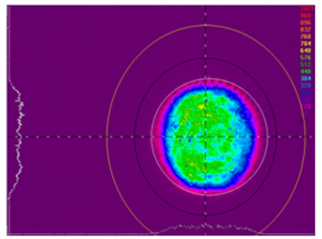
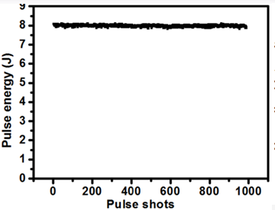
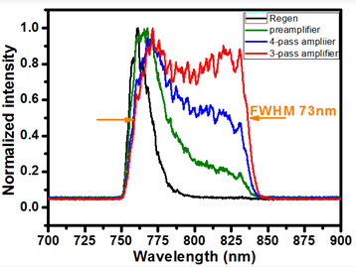
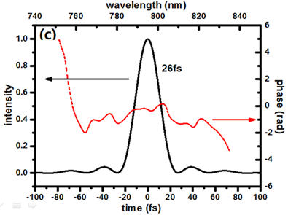
200TW / 5Hz ultrafast Ti:sa laser system at SIOM
Performance of 200TW Ti:sa laser system at SIOM
Homogeneous flat-top spatial beam profiles after 4-stage amplification
Good energy stability with fluctuation <1% in rms
Broadband spectrum can support ~20fs pulse duration
26fs compressed pulse duration without Dazzler
Notes:
The perfomance of 200 TW laser at SIOM,

Slide 13
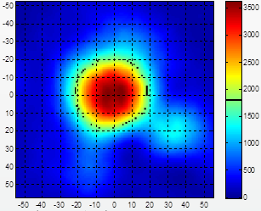
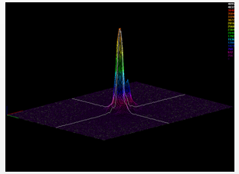
200TW / 5Hz ultrafast Ti:sa laser system at SIOM
Performance of 200TW Ti:sa laser system at SIOM
Parameters of laser： 200 TW / 26 fs
OAP for LWFA：f/30
Spot size ~58um( 1/e²);
1.2~1.3 times DL;
60% energy enclosed in spot size;
The focused beam quality is achieved without deformable mirror !

Slide 14
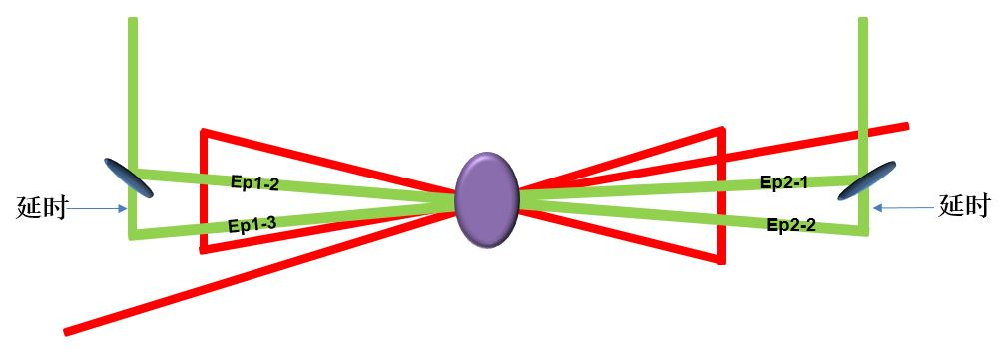
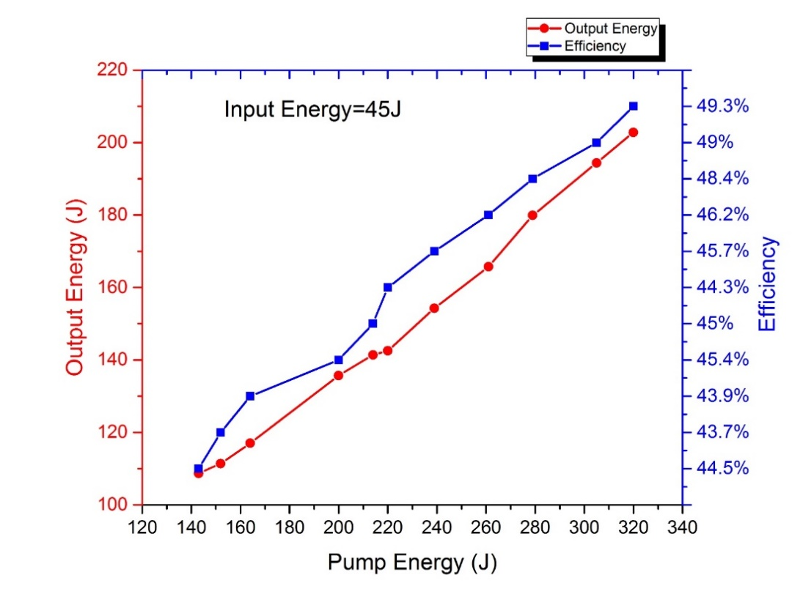
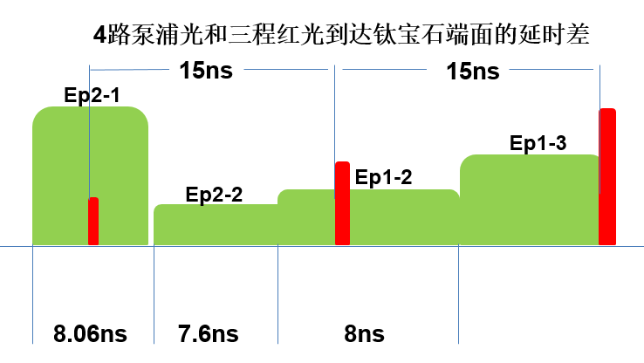
Ti:sapphire Amplifier
First >200J output with 70nm bandwidth
—— Two pump pulses suppress parasitic lasing
Maximum output：202.8J
Convert efficiency: 49.3%
Notes:
In our lab, we have investigated the two pump pulses technique to suppress the parasitic lasing. Here is the Titanium Saffire, illuminated by neodymium glass laser from two sides, In each direction, there are two beam, through the time history control of the pump beam, the parasitic lasing can be significantly suppressed. Here is the fianal output energy as a function of pump energy, it is almost linearly increasing with pump energy, the maxium outout energy can be 202.8 J and the maximum conversion efficiency can be as high as 49.3 percent.

Slide 15
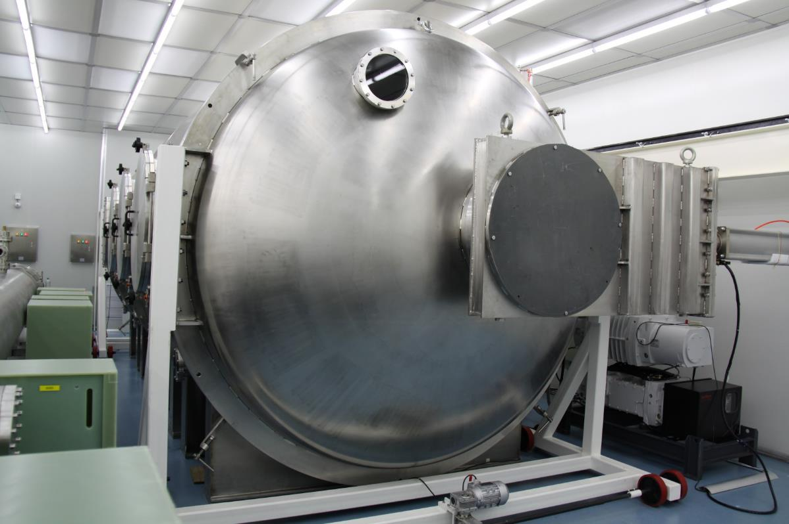
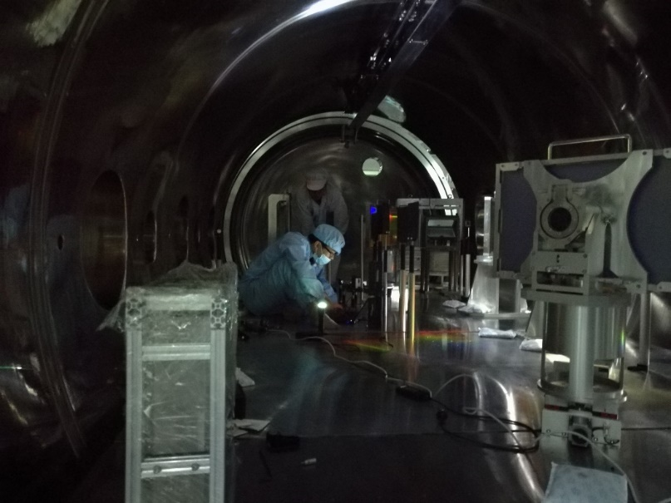
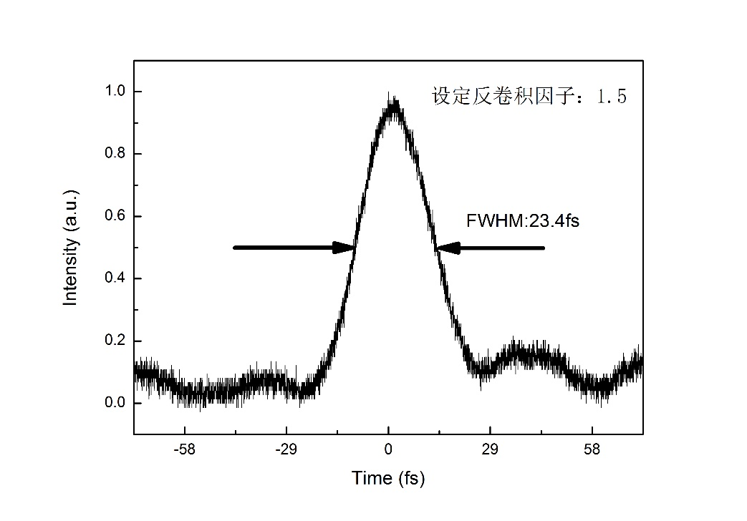
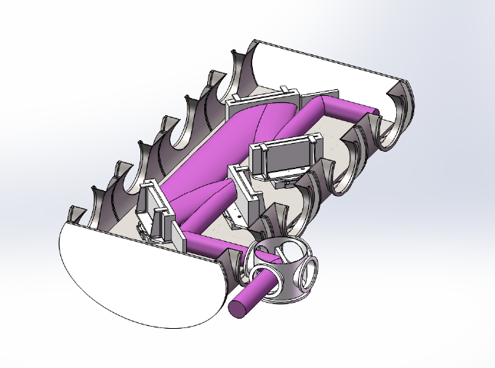
Compressor
After compressor, the maximum peak power is 5.4PW with 24fs (single shot).
Notes:
after amplification, the high energy laser pulse is compreesed into a ultra short pulse with only 24 ficosecond, the maximum peak power can be as high as 5.4 PW.
This is a figure of our compressor, here is a man. Now you can have a feeling, how big it is.

Slide 16
Future:
From Shanghai Superintense Ultrafast Laser Facility Prototype
SULF-Prototype to SULF
Locate in Zhangjiang comprehensive national scientific center, Pudong district, Shanghai
10 PW beam line and 1 PW beam line;
3 platforms for user:
SULF
DMEC
USAP
ACOMM
DMEC（Dynamic of Materials under Extreme Conditions）
USAP (Ultrafast Sub-atomic Physics）
ACOMM (Attosecond Chemistry and Optical Manipulation of Molecules）
Notes:
Actually the story never end. The present 5 pw laser faility is only a prototype of Shanghai Superintense ultrafast laser facility. The real SULF is located in Zhangjiang comprehensive national scientific centor, located in Pudong. Thie SULF facility contains two beam lines, 1pw low frequency 10 pw beam line and 1 high frequency 1 pw beam ligh. We have three platforms for uesers: dynamic of materials under extreme conditions, ultrafast sub-atomic physics and attosecond chemistry and optical manipulation of molecules. Every user platform planed to spare 1200 hours/years to users outside SIOM. In addition, this SULF project also contains a information center, used to store and prosessing experiment data, and physical simulations.

Slide 17
Outlines
1. Background and motivations
2. Ultra-intense laser development at SIOM
3. High-quality e-beam generation from cascaded
laser wakefield accelerators (LWFAs)
4. Generation of x- and γ-ray source based on LWFAs
5. Summary

Slide 18
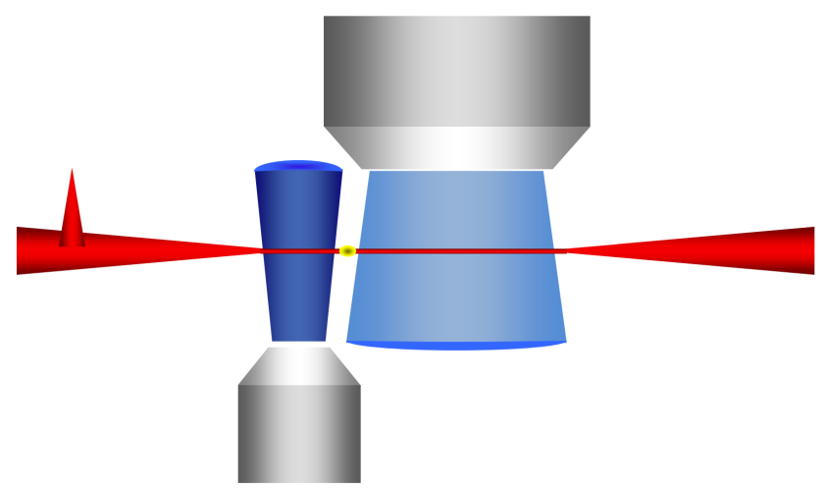
Cascaded LWFA：Generation of controllable high-quality high-energy e-beam by decoupling electron injection and acceleration
Single-staged LWFAs
Gas jet
Election injection
Electron acceleration
Driving laser
High density
Strong nonlinear
Low density
Quasi linear
contradiction
Cascaded/Staged LWFAs
Cascaded LWFAs
3 major issues
Electron injector
Electron seeding phase
Energy spread control and acceleration
Electron injection and acceleration are decoupled
High-quality high-energy e-beams
Notes:
代表性成果1：成功研制GeV级级联激光尾波场电子加速器
相对论强度的超短脉冲激光在等离子体中传输，在激光后沿形成空泡结构的尾波场，由于非线性波破，电子注入到尾波场中加速获得极高的能量。相对传统的射频电子直线加速器，加速梯度高出三个量级以上，因此，激光尾波场电子加速器是一种全新的小型化的粒子加速器。但是单级激光尾场加速器中电子注入和加速两个过程耦合在一起，一方面，电子注入要求高密度和强非线性，而电子加速要求低密度和准线性，因此存在难以克服的重大障碍。解决方案是采用级联加速方案，将电子注入和加速两个过程分离与分别控制。然而级联加速器中有3个主要科学问题，电子注入器，电子注入相位，导引传输和加速，只有解决好这3个科学问题，才能产生高性能高能电子束。

Slide 19
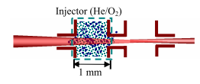
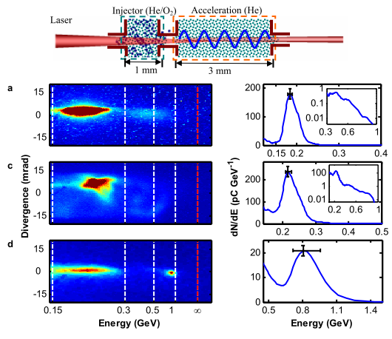
Design of a cascaded LWFA using ionization injection
(SIOM, 2010)
Electron injector
Acceleration stage
Advantages of using ionization-induced injection for the electron injector
Self-injection requires a high input power P/P c > 4
Ionization-induced injection works at lower laser power. a 0 < 2
Ionization-induced injection can be operated at lower plasma density
nonlinear instability can be minimized
phase matching for the electron seeding between the two-stage plasmas can
be satisfied easily.

Slide 20
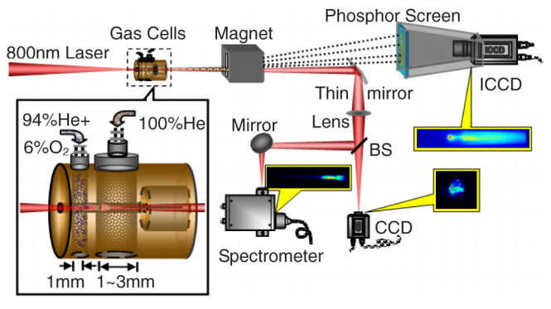
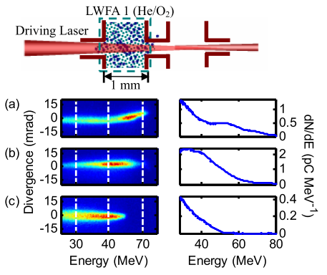
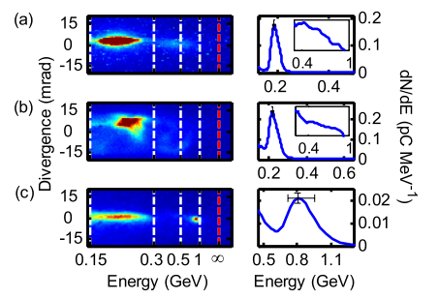
级联尾场电子加速机制的提出
Jiansheng Liu et al PRL, 107, 035001 (2011)

Slide 21
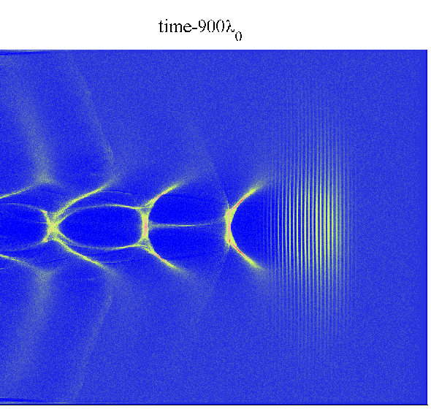
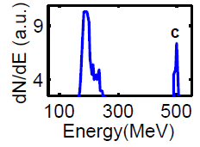
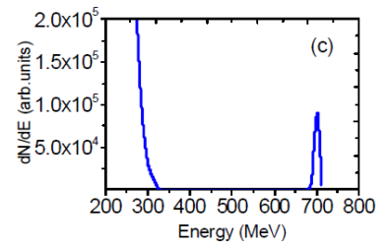
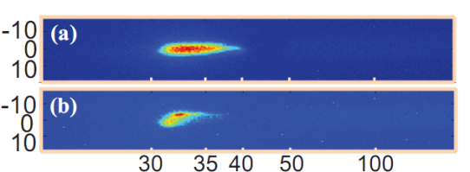
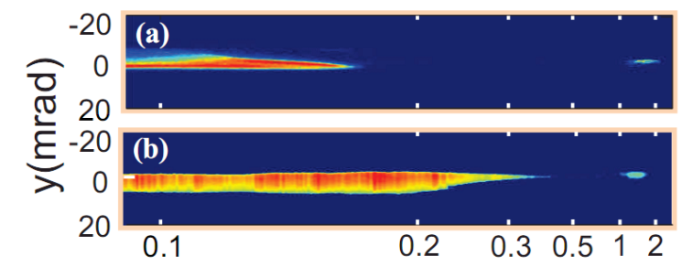
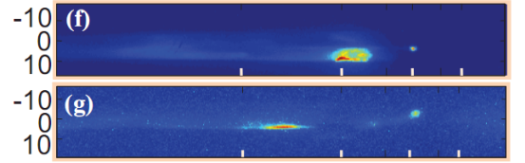


II. Demonstration of a cascaded LWFA using gradient injection
SIOM (2012)
By optimizing the seeding phase of electrons into the second stage, electron beams beyond 0.5 GeV with a 3% rms energy spread were produced over 2 mm. Peak was further extended beyond 1 GeV by lengthening the second acceleration stage to 5 mm.[ Appl. Phys. Lett.103, 243501(2013), Phys. Plasmas 19,023105(2012)]。
Cascaded LWFA
(Gradient injection)
ΔE/E = 0.7%
2-5 mm
Experimental realization
Electron injector
~32 MeV
Cascaded LWFA (1+2 mm)
530 MeV, ΔE/E ~ 3%
Cascaded LWFA (1+5 mm)
~1.3 GeV

Slide 22
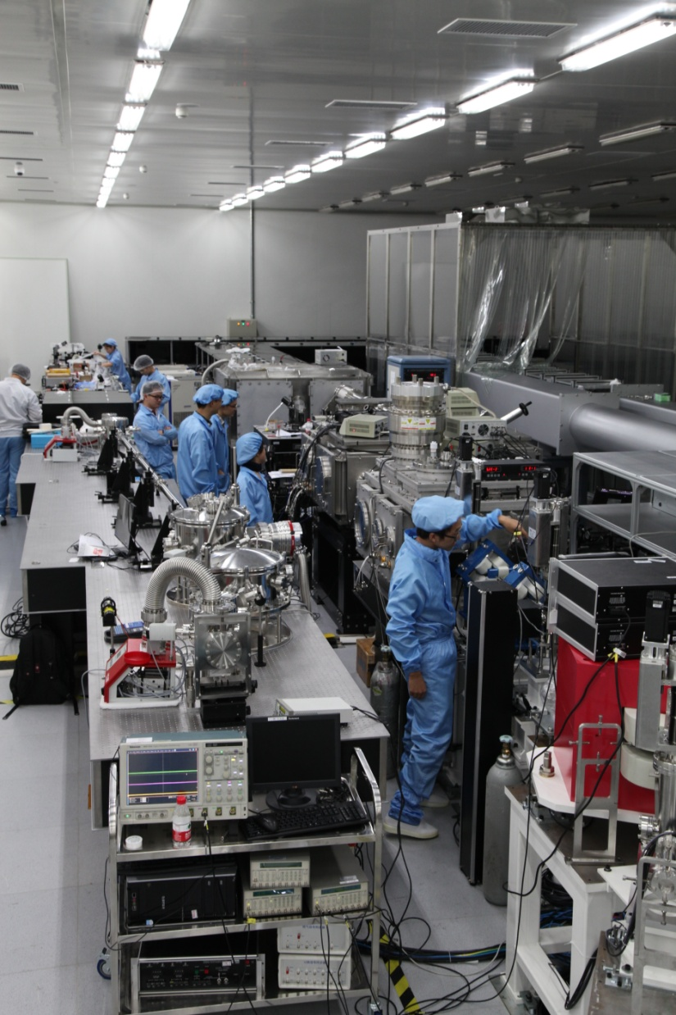
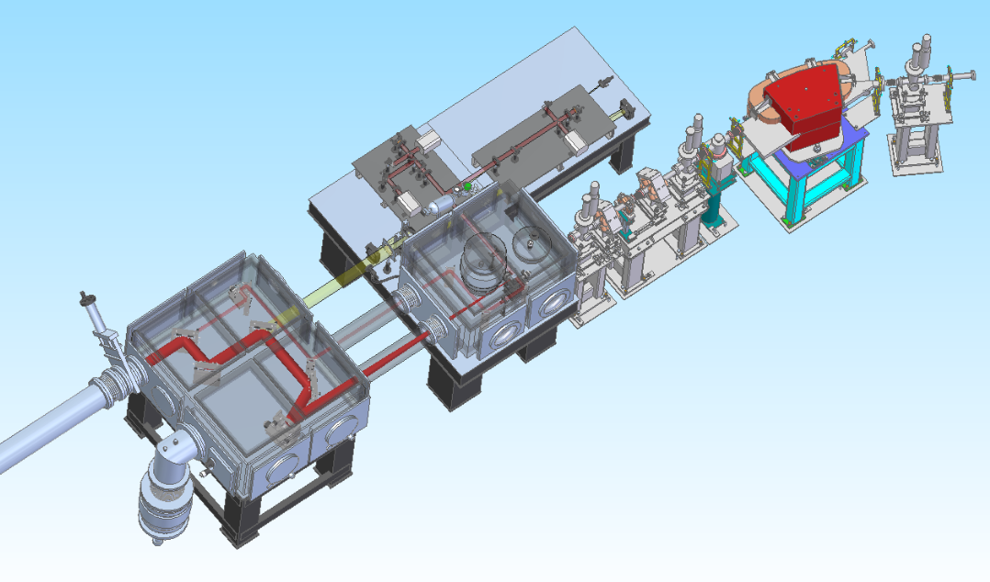
A LWFA platform powered by 5-Hz 200-TW laser system
5-Hz 200-TW CPA laser
100 TW 30 fs
f/30 34 μm(FWHM)
LWFA
Laser
上海光学精密机械研究所

Slide 23
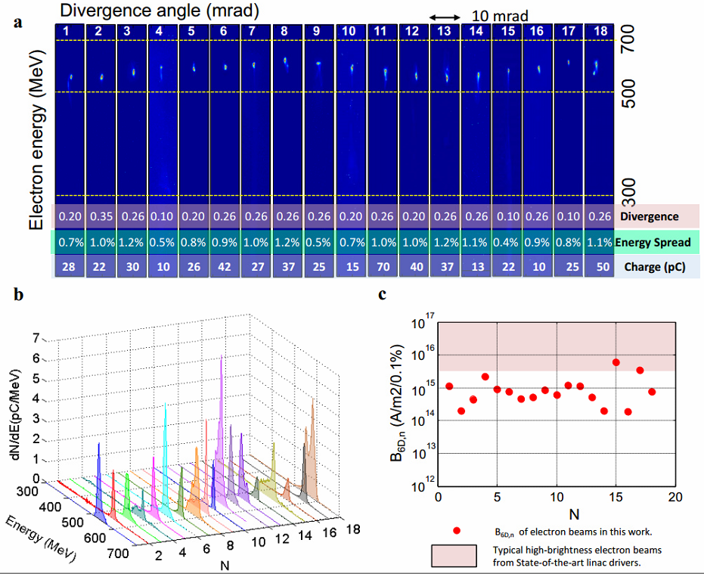
High-quality high-energy electron beams from a cascaded LWFA
(SIOM, 2015)
Peak energy: 0.4-0.6 GeV
Energy spread: <1%
Beam charge : up to 80 pC
Divergence: <0.3 mrad
The 6-D brightness B_{6D,n} of the e-beams at the exit of the LWFA is calculated as the peak current in the e-beam core divided by the product of the rms transverse normalized emittances and the fractional energy spread rms in units of 0.1%.

Slide 24
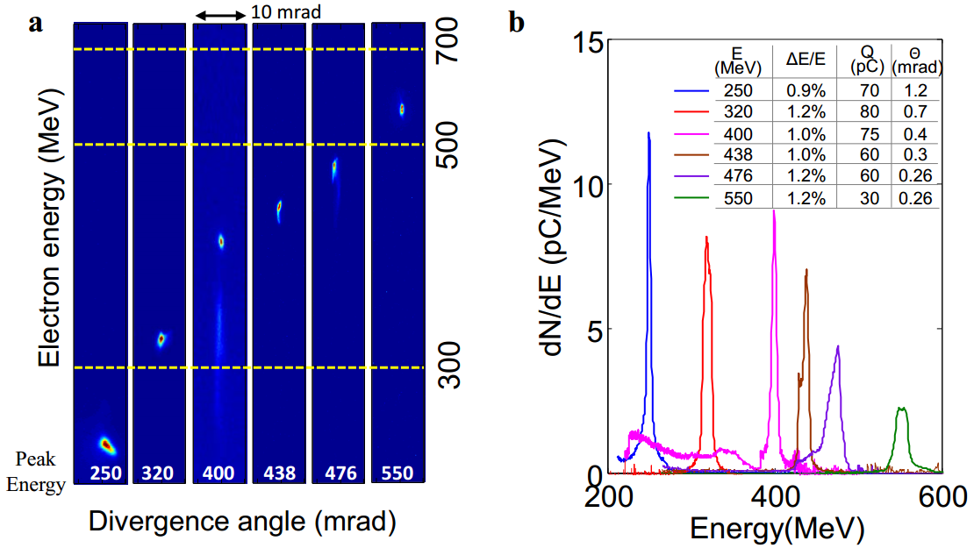
级联激光尾波场加速高性能电子束的产生(SIOM, 2015)
High-quality high-energy electron beams from a cascaded LWFA
(SIOM, 2015)
Wentao Wang et al., Phys. Rev. Lett. 117, 124801(2016)

Slide 25
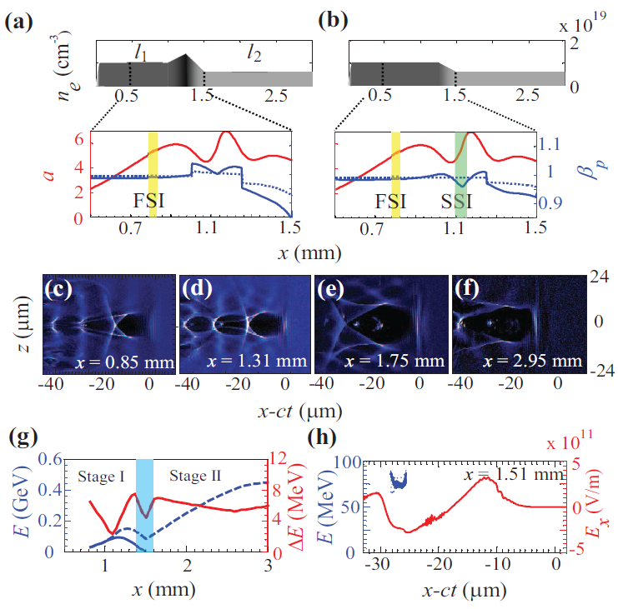
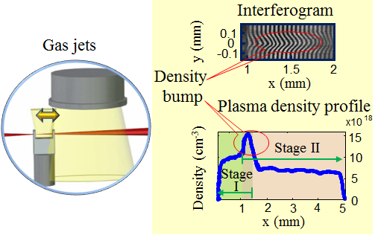
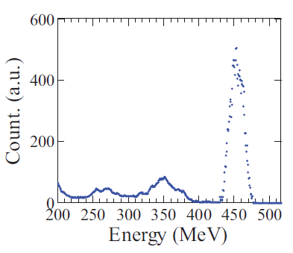
High-quality high-energy electron beams from a cascaded LWFA
(SIOM, 2015)
Compression of energy spread via energy chirp control
Wentao Wang et al., Phys. Rev. Lett. 117, 124801(2016)

Slide 26
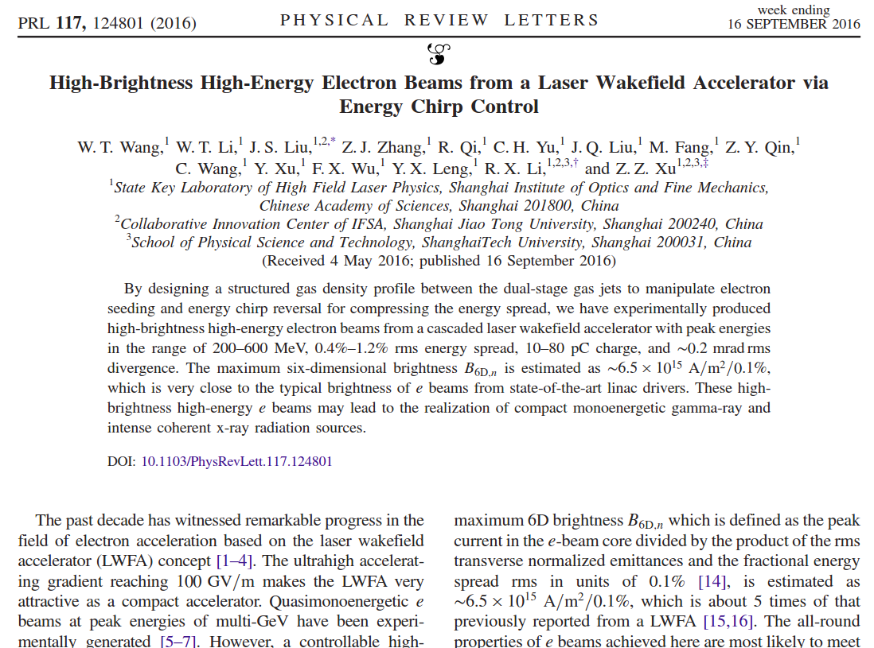
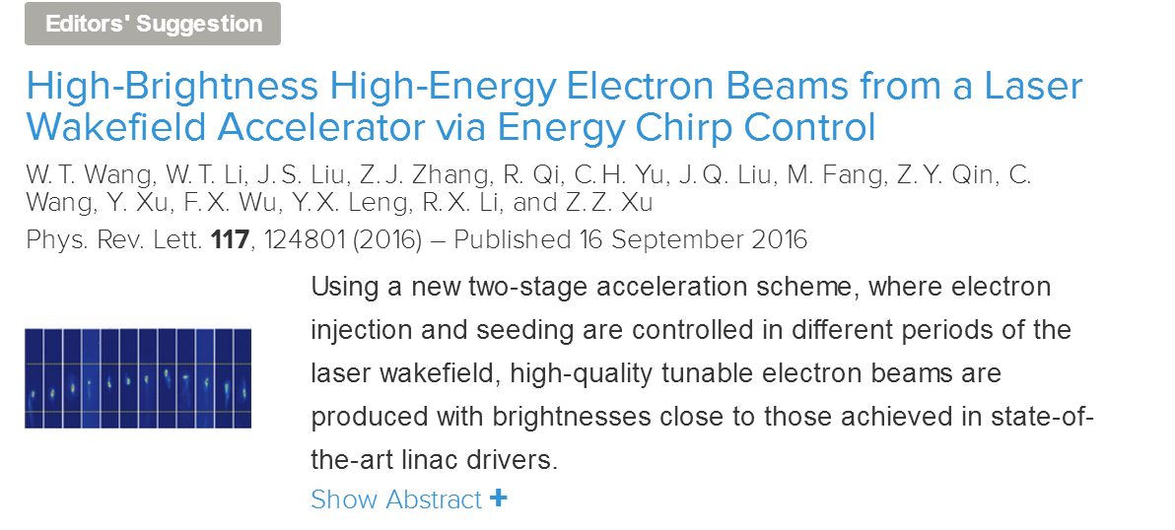

Slide 27
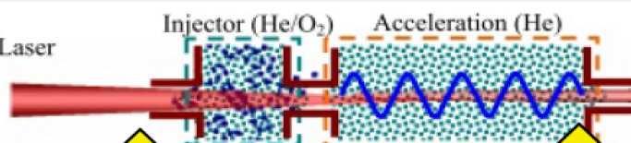
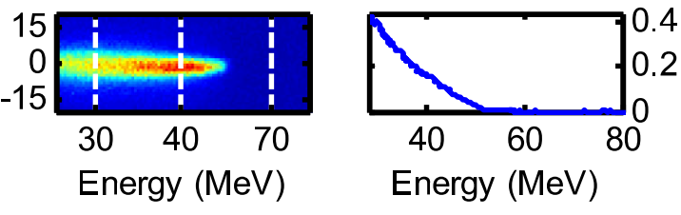




Summary : Progress in generating high-quality electron beams
Ionization-induced injection
Gradient injection
Energy chirp control
5.7×10¹⁹ cm⁻³
2.5×10¹⁸ cm⁻³
7-9×10¹⁸ cm⁻³
~3×10¹⁸ cm⁻³
1.1×10¹⁹ cm⁻³
6×10¹⁸ cm⁻³
Injector: Energy spread 100％
Injector: Energy spread 10％
Injector+ Accelerator
Energy spread <25％
Injector+ Accelerator
Energy spread 3％
Injector+ Accelerator
Energy spread < 1％
Phys. Rev. Lett. 107, 035001 (2011).
Appl. Phys. Lett. 103, 243501(2013).
Phys. Rev. Lett. 117, 124801(2016)

Slide 28

IV. 毛细管波导级联加速-10 GeV级单能电子束
A Cascaded LWFA scheme for reducing energy spread
2-10 cm plasma channel
电子束能量：
2-10 GeV，
能散度 <5%.
电量 >10 pC.
探索优化注入器方案

Slide 29

IV. 毛细管波导级联加速-10 GeV级单能电子束
2015121704
高能部分电量：4.25pC

Slide 30
Outlines
1. Background and motivations
2. Ultra-intense laser development at SIOM
3. High-quality e-beam generation from cascaded
laser wakefield accelerators (LWFAs)
4. Generation of x- and γ-ray source based on LWFAs
5. Summary

Slide 31


I. Generation of γ-ray sources via inverse Compton scattering

Slide 32

Peak energy: 204 MeV
rms energy spread: 1.2%
Charge：44 pC
Divergence：0.48 mrad
Peak energy: 266 MeV
rms energy spread: 1.1%
Charge：48 pC
Divergence：0.75 mrad
Peak energy: 347 MeV
rms energy spread: 1.7%
Charge：39 pC
Divergence：0.71 mrad

Slide 33







(1.5mm)
(1mm)
(0.5mm)
Pb(2.5mm)
Empty
(2mm)
Pb(1mm)
(0.5mm)
(2mm)
(5mm)
(4mm)
(3mm)
(1.5mm)
Empty
(2.5mm)
衰减后的总光子数：
4× 10⁷ photons/shot
γ-ray
yield ： 5× 10⁷ photons/shot
Divergence：
3.8 mrad×4.1mrad
γ-ray duration ：
Photons in :
6.5×10⁴ photons
Peak brilliance
~3×10²² photons s⁻¹ mm⁻² mrad⁻² 0.1% BW

Slide 34
Typical experimental parameters for electron beams and
γ-ray beams
Electron beams |  | Gamma-ray Source
Energy (MeV) | 200~400 | Peak Energy (MeV) | 0.3~2
Energy Spread (rms) | <2% | Bandwidth (FWHM) | 33%~60%
Total charge (pC) | 30~120 | Total Photons/shot | ~ 5×10⁷
Bunch Diameter (um) | 3 | Source size (um) | 4 um
Beam duration (fs) | 6 | Beam duration (fs) | 6
Divergence (mrad) | 0.2~0.5mrad | Divergence (mrad) (FWHM) | 4
 |  | Peak brilliance (photons s⁻¹-mm⁻²-mrad⁻² /0.1% BW) | ~3×10²²

Slide 35


Slide 36


III. A XFEL platform based on a LWFA has been assembled

Slide 37




E-beam transport and synchrotron radiation
e-beam transport and control
e-beam pattern 12 m away
Normal undulator
Synchrotron radiation detected

Slide 38


HHG seeded LWFA based XFEL
(rebuild the frontend of 5 PW as driver laser)
Undulator
200TW ultrafast Ti:sa laser system as driver
LWFA
HHG
Notes:
The front end of the 5 pw laser, is really of high quality. We have rebuild another one, 200 TW laser,one of its application is the High himonic generation seeded laser wakefield acceleration based XFEL. Here is the 200 TW laser, through LWFA, high quality electron beam can be generated,

Slide 39
Summary
A two-stage LWFA for generating high-quality electron beams has been experimentally realized. By optimizing the seeding-phase of electrons into the second low-density acceleration stage, high-quality electron beams near 0.5 GeV with less than 1% energy spread and large charge of ~ 80 pC were produced.
A novel scheme to generate high-quality electron beams with a one-thousandth-level or lower energy spread is proposed via velocity bunching in a cascaded LWFA.
Tunable MeV Gamma-ray Source from Compton Backscattering with ultrahigh brilliance of 3×10²² photons s⁻¹ mm⁻² mrad⁻² 0.1% BW has been experimentally demonstrated.
Synchrotron radiation at ~30 nm based on the LWFA electron-beams has been detected in the first-phase experiments.

Slide 40


Thank you for your attention!

