Slide 1
Motivation of the Workshop
Weiren Chou
ICFA Mini-Workshop on Future γγ Collider
April 23-26, 2017, Tsinghua University, Beijing, China

Slide 2
Brief History of γγ Collider
1980’s:
  BINP played a leading role in the early development of γγ collider as an extension of the proposed VLEPP linear collider.
  SLAC also proposed a γγ collider as an extension of the SLC, a linear collider to be built in the US.
1990’s:
  A number of linear collider proposals put on the table, including the NLC at SLAC, JLC at KEK, TESLA at DESY, etc.
  In each of the three linear collider design reports, there is an appendix on γγ collider as a potential add-on.
2000’s:
  At the 2001 Snowmass meeting, serious and often intense discussion about which linear collider to choose for the future.
  ICFA exercised its authority and formed a “Wisemen” committee headed by Barry Barish to make the selection.
  The committee selected the cold technology and ICFA launched the ILC GDE activity.

Slide 3
Brief History of γγ Collider (cont’d)
2007:
  GDE released an initial ILC cost estimate (US$ 6.74 billion plus 24 million person-hours).
  US quickly pulled out from bidding for hosting the ILC.
  Japan also expressed serious concern about the high cost.
2008:
  To lower the upfront cost, Hirotaka Sugawara (KEK) proposed to build a 90 x 90 GeV ee linac for a γγ collider as a precursor of a 250 x 250 GeV full scale ILC.
  ICFA commissioned a working group headed by Mike Peskin (SLAC) to study this proposal. A report was written in February 2009.
2009:
  At the February meeting at KEK, ICFA made a decision and rejected this proposal for three reasons:
    The physics of a γγ collider is not as strong as an e+e- collider
    The cost saving is not significant enough (US$ 3.52B + 12.5M psn-hrs)
    Need a big laser R&D program, which ICFA is not prepared to initiate

Slide 4
Recent Progress on γγ Collider
There are two important developments after the ICFA decision:
2010:
  A formal ICFA-ICUIL collaboration was formed.
  For the first time the laser community came to the accelerator community and offered help to build future HEP colliders together.
  γγ collider is a natural candidate for this collaboration.
  This removes the 3rd reason for ICFA not to pursue the γγ collider option.
  The other two ICFA reasons would become invalid:
      If γγ is an add-on instead of a replacement of e+e-
      (e.g., ILC, CLIC, CEPC, FCC), or
      If γγ uses a new technology that e+e- can’t
      (e.g., AAC), or
      If γγ uses an existing infrastructure that e+e- can’t
      (e.g., HFiTT)

Slide 5
ICFA-ICUIL Collaboration
Copper/Steel meet Mirror/Glass

Slide 6
Recent Progress for γγ Collider (cont’d)
2012:
  The Higgs boson was discovered at the LHC.
  Because of its low mass (125 GeV), everybody thinks he or she can build a Higgs factory, including:
      Linear collider
      Circular collider
      Muon collider
      Photon collider
  These four options were presented to the ICFA workshop HF2012 at Fermilab and a summary report was published.

Slide 7
A Recent Review Article on γγ Collider

Slide 8
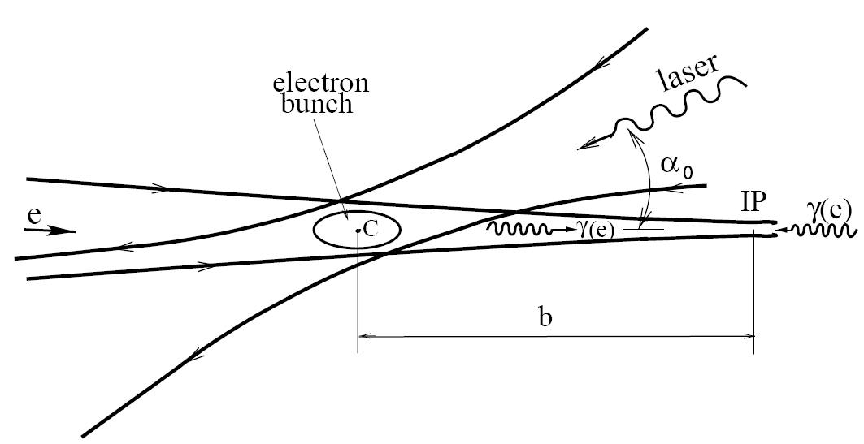
γγ Collider as a Higgs Factory
Two steps:
Inverse Compton Scattering (ICS) → high energy γ
γγ → H

Slide 9
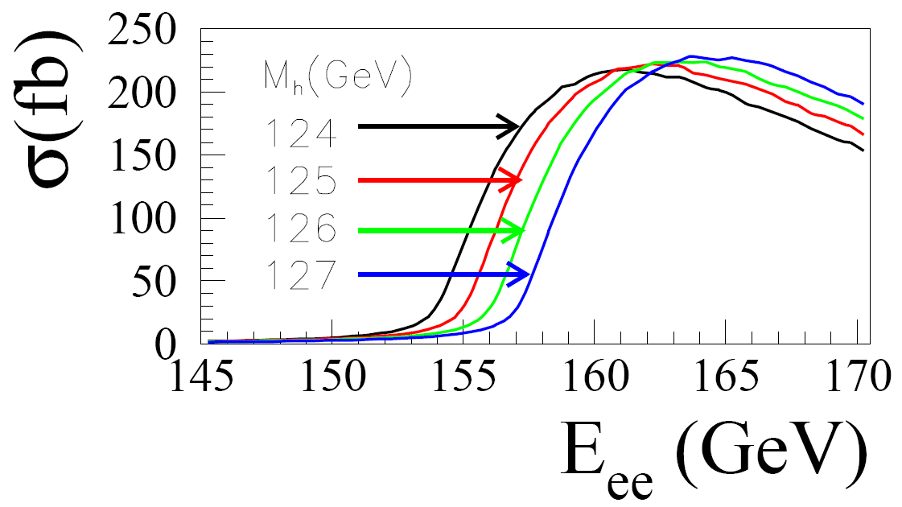
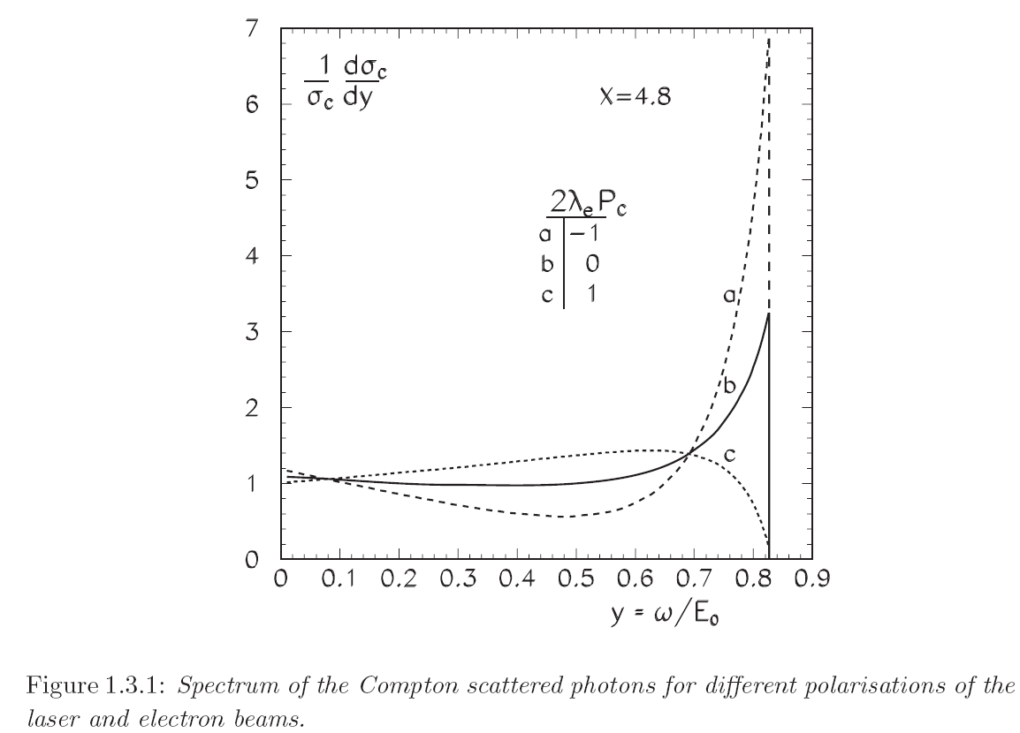

γγ Collider as a Higgs Factory (cont’d)
γγ → H cross section
Dependence of photon spectrum on polarization
Comparable to 240 GeV e+e- → ZH but only need 160 GeV

Slide 10
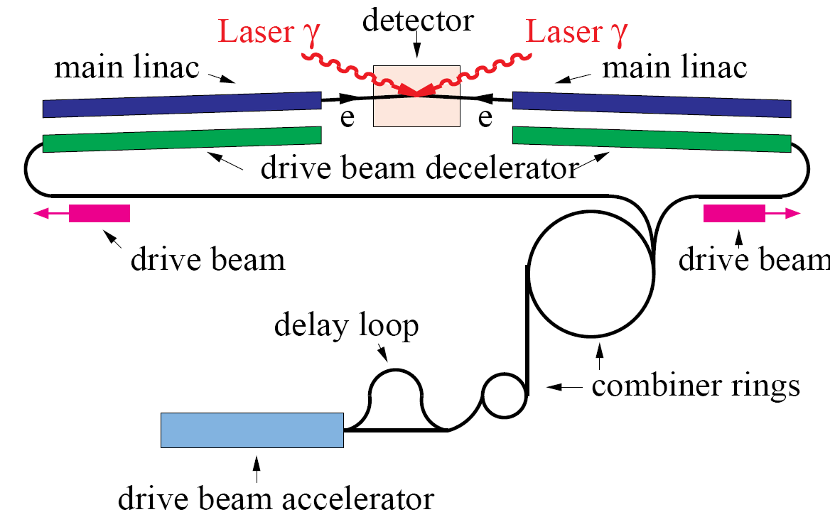
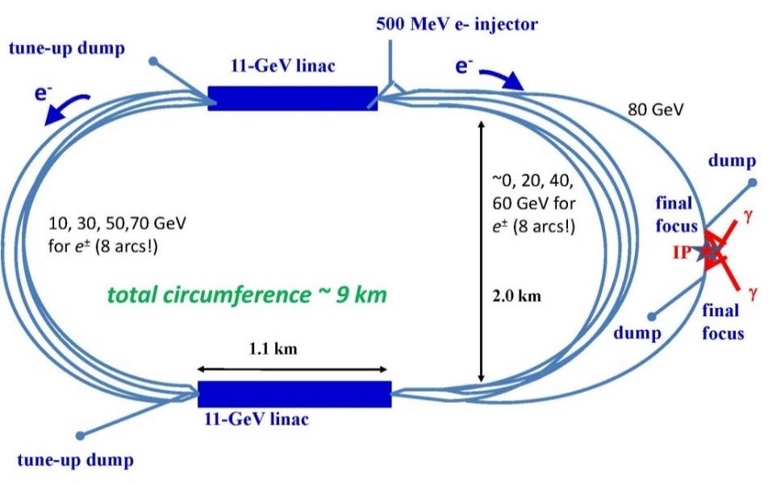
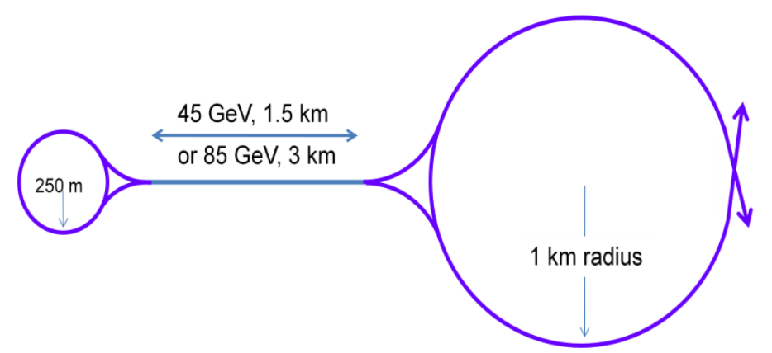
Various Proposals for Photon Collider
HFiTT
CLIC-based
SAPPHiRE
SLC-type

Slide 11
Comparison Table – Photon Collider as a Higgs Factory

Slide 12
CEPC as a γγ Higgs Factory
Goal: 10,000 Higgs/year
RF (650 MHz, 8 sets, 0.5 GV /set)
RF
RF
e‒ (80 GeV)
Fiber Laser
(0.351 μm, 5 J, 3 kHz)
γγ collision
(125 GeV)
e‒ (80 GeV)
RF
RF
e‒
80 GeV Booster
e‒
E = 80 GeV
ρ= 6000 m
U = 0.6 GeV/turn
I = 48 mA x 2
P(rf) = 58 MW
RF
RF
RF

Slide 13
AAC - Another Option for Photon Collider
U.S. DOE AAC R&D Roadmap Workshop
(February 2016, from C. Schroeder’s slide)
(M. E. Peskin)
    A γγ collider requires a high-efficiency, high-average power laser system for Compton scattering. At TeV energy, optical wavelengths are required (1-2 micron); same laser system used to drive the LPAs could be employed as Compton source.

Slide 14
ILC-based γγ Collider
1 ps
370 ns
980 μs (2640 pulses in a train)
200 ms (5 Hz)
Laser Requirements
Pulse width | Pulse energy | Pulse spacing | No. pulses in a train | Laser power in a train | Laser average power | Rep rate | Wavelength | Spot size | Crossing angle
1 ps | 10 J /Q | 370 ns | 2640 | 25 MW /Q | 150 kW /Q | 5 Hz | 1 μm | 120 nm x 2.3 nm | 25 mrad
Need an optical cavity with Q ~ 300

Slide 15
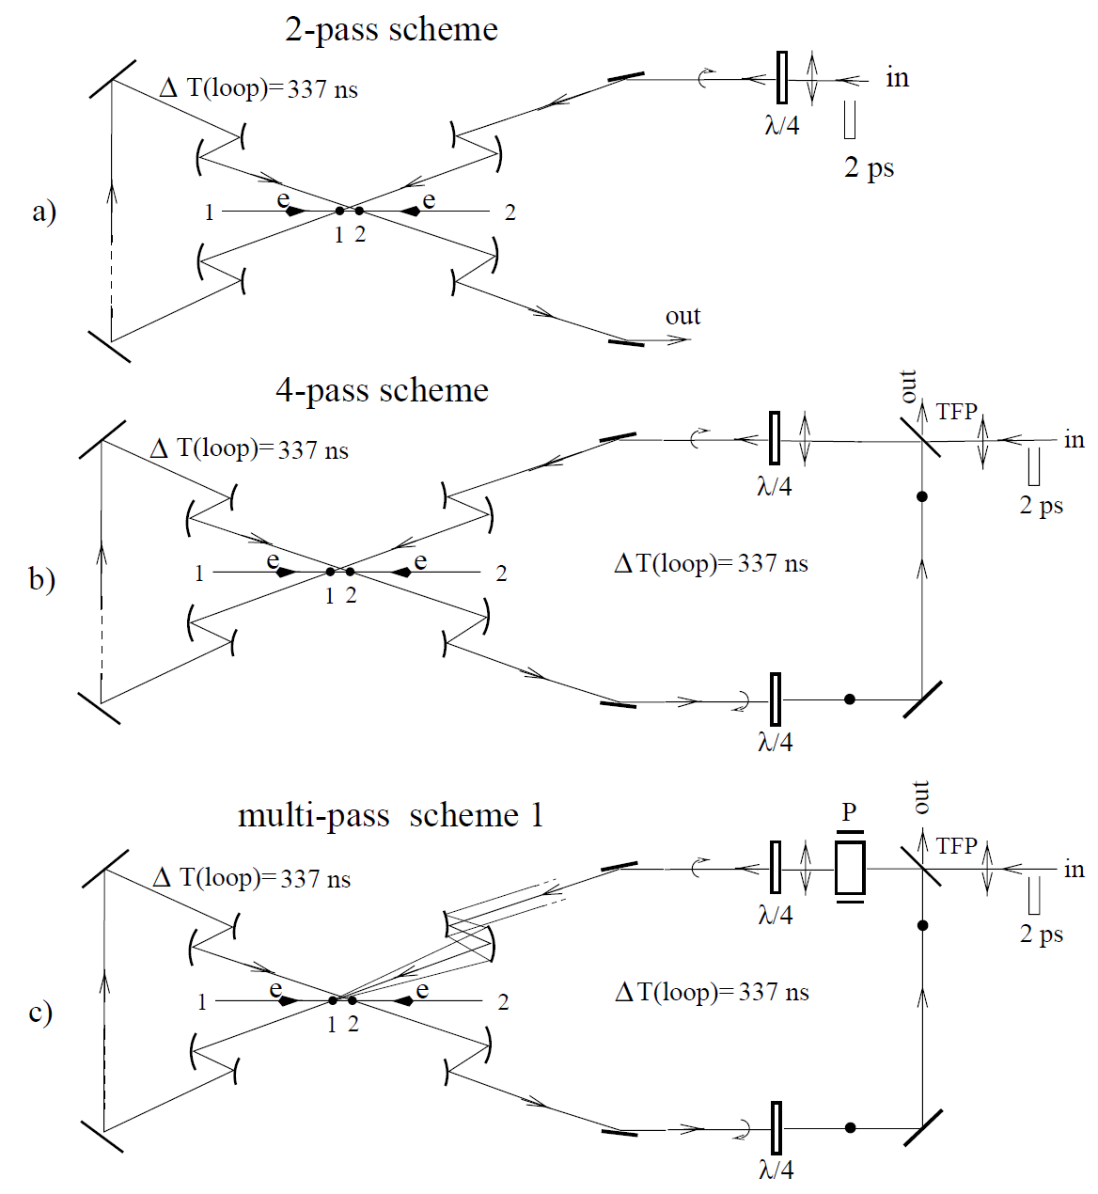
Multi-pass Optics (from the DESY TESLA Design)

Slide 16
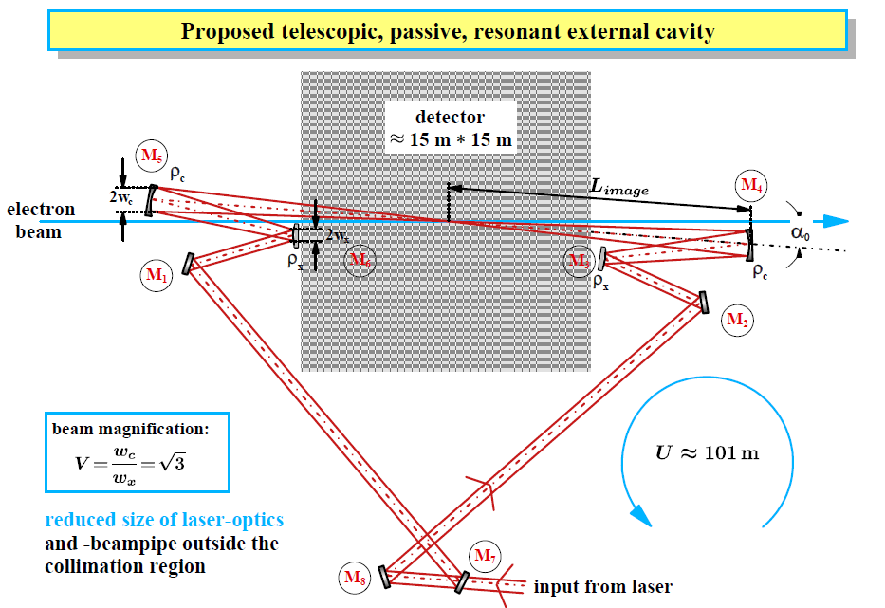
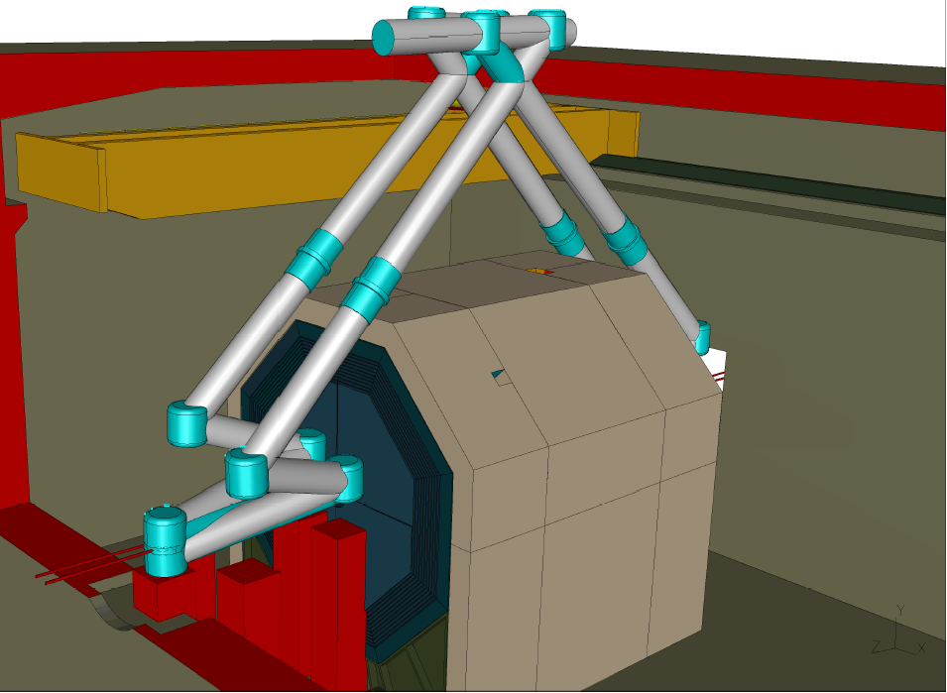
Pulse Stacking Cavity for ILC
total length ~100m
power enhancement ~100
K. Moeing

Slide 17
CLIC-based and X band-based γγ Collider
1 ps
0.5 ns
177 ns (354 pulses in a train)
20 ms (50 Hz)
Laser Requirements
Pulse width | Pulse energy | Pulse spacing | No. pulses in a train | Laser power in a train | Laser average power | Rep rate | Wavelength | Spot size | Crossing angle
1 ps | 5 J | 0.5 ns | 354 (5 x 354 = 1770 J per train) | 10 GW | 88.5 kW | 50 Hz | 1 μm | 120 nm x 2.3 nm | 25 mrad
Livermore LIFE fusion project laser beam: 130 kW average power, 8100 J /pulse, 16 Hz
(LIFE would have 384 such beams)

Slide 18
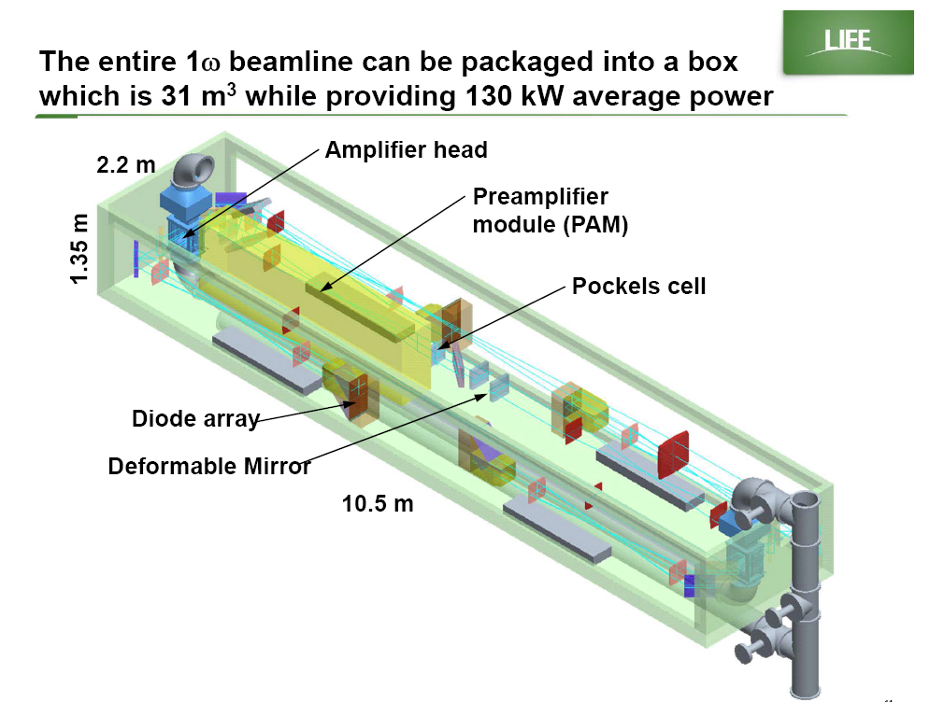
Livermore fusion project LIFE will have 384 laser boxes
One would be enough for γγ collider

Slide 19
Recirculating linac- and Circular accelerator-based γγ Collider
1 ps
21 μs (47.7 kHz)
Laser Requirements
Pulse width | Pulse energy | Pulse spacing | No. pulses in a train | Laser power in a train | Laser average power | Rep rate | Wavelength | Spot size | Crossing angle
1 ps | 5 J | 21 μs | N/A | N/A | 240 kW | CW | 0.351 μm | 4.2 μm x 4.2 μm | 25 mrad

Slide 20
Nature Photonics (G, Mourou et al., v. 7, p. 258, April 2013)
Figure 2: Principle of a coherent amplifier network (CAN) based on fiber laser technology. An initial pulse from a seed laser (1) is stretched (2), and split into many fibre channels (3). Each channel is amplified in several stages, with the final stages producing pulses of ~1 mJ at a high repetition rate (4). All the channels are combined coherently, compressed (5) and focused (6) to produce a pulse with an energy of >10 J at a repetition rate of 10 kHz (7). [5]

Slide 21
γγ Collider as a Higgs Factory (cont’d)
Advantages:
  Allow access to CP property of the Higgs
  Lower beam energy (80 GeV per e- beam to generate 63 GeV γ beam)
  High polarization in the colliding γ beams
  No need for e+ beam
  160 GeV e- linac has a lower cost w.r.t. a 240 GeV linear e+e- collider
  Can be added on a linear e+e- collider or a circular e+e- collider
Challenges:
  Background problem
  IR design
  No comprehensive study; design study report needed.
Specific issues:
  ILC-based
    Optical cavity
  CLIC-based
    Laser can piggy-back on the Livermore LIFE fusion project. (But the project schedule is unknown.)
  Recirculating linac-based:
    Polarized low emittance e- gun
  Circular accelerator-based:
    Challenges to the injectors (linac and booster)
    Polarized e- beam

Slide 22
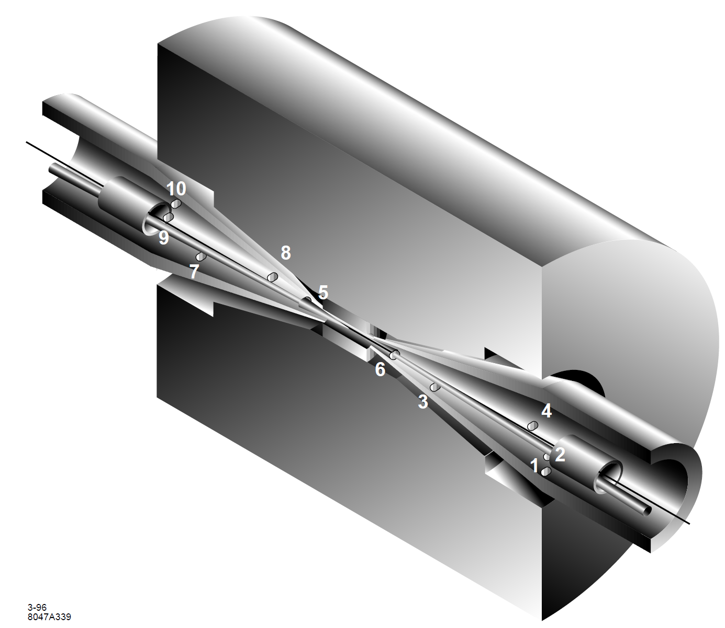
Strawman’s IR (from the SLAC 0th Order NLC Design)

Slide 23
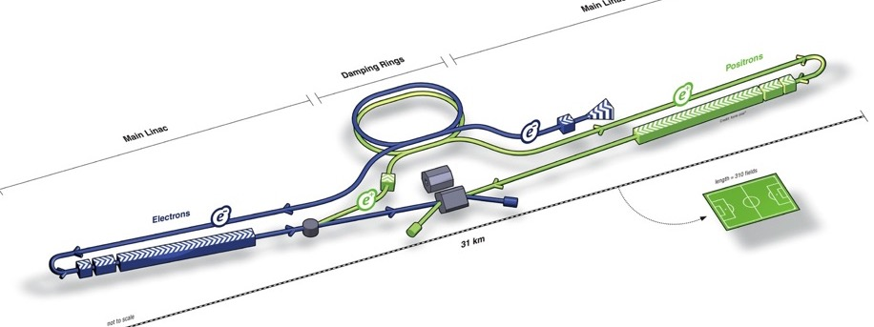
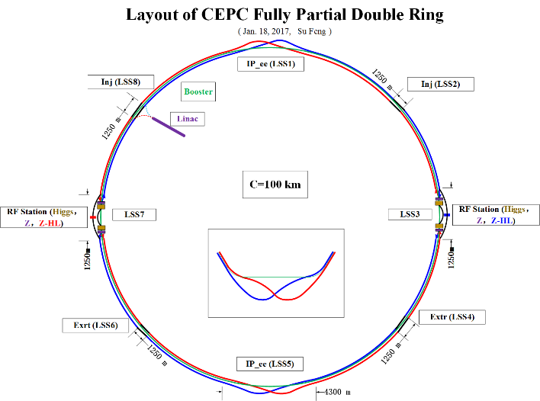
Today’s Landscape of Future Lepton Colliders
Presently four future lepton colliders are being pursued
ILC
CLIC
CEPC
FCC-ee

Slide 24
Program of this Workshop – 33 Talks
Overview and Science cases
Accelerator technologies for γγ collider:
  Linac-based: ILC, CLIC, x-band
  Circular accelerator-based: FCC-ee, CEPC
  Recirculating linac-based: Sapphire, HFiTT
  AAC-based:
    Beam driven
    Laser driven
    Dielectric wakefield
    Direct laser acceleration
Laser technologies for γγ collider
  Large laser facilities: NIF, LIFE, ELI, LERC, etc.
  Fiber laser (XCAN)
  CO₂ laser
  Other lasers
Beam-laser interaction
  Theory and simulations
  Interaction Region (IR) design
  Experiments

Slide 25
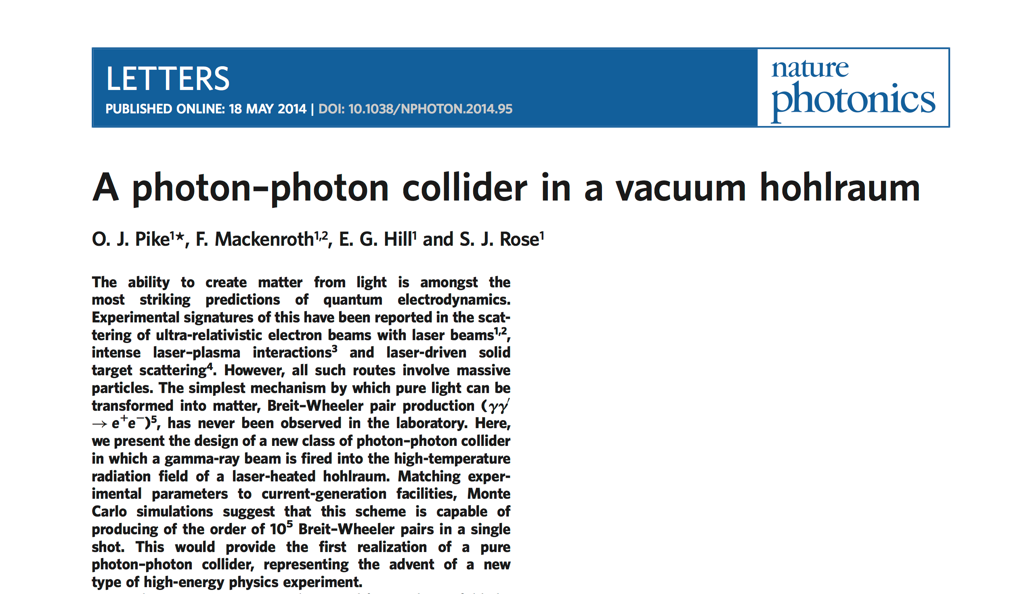
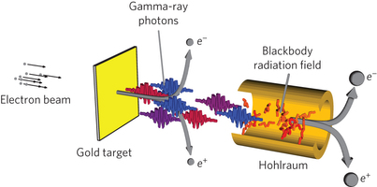
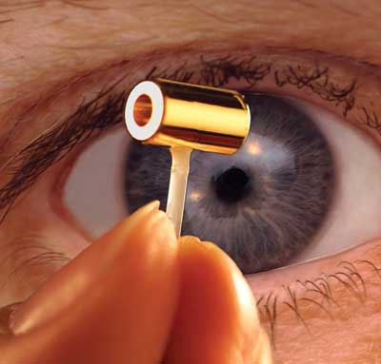
Ranked 1st in Altmetrics of all papers published in Nature Photonics
Picked up by 54 news outlets around the world
On of the 10 biggest Science and Technology stories in 2014 in Phys.Org
One of top 10 Imperial College news stories of all time (website hits)
Slides from Steve Rose
Notes:
The paper created a huge amount of media attention from around the world (including radio appearances on US radio station!)

Slide 26


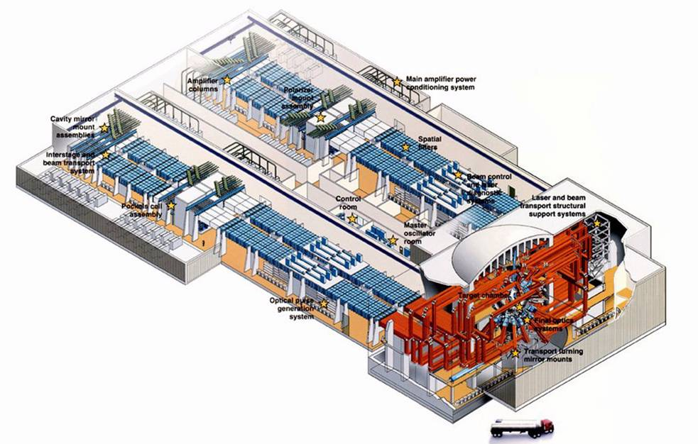
A photon-photon collider in a vacuum hohlraum:
new HEP experiment using HEDP (High Energy Density Physics) facilities such as the US National Ignition Facility
Breit-Wheeler pair production γγ′ → e⁺e⁻
Gold target
Hohlraum
Gamma-ray
beam
Thermal x-ray field
e⁺
e⁺
Ultra-relativistic
electrons
e⁻
e⁻
short-pulse laser on NIF (ARC)
accelerates the electrons
long-pulse laser on NIIF
heats hohlraum
National Ignition Facility (NIF)
Slides from Steve Rose
Pike, Mackenroth, Hill and Rose, Nature Photonics 2014
Notes:
However, most importantly the collider can be created using existing HEDP technology – potentially the National Ignition Facility in the USA
Here is a schematic of how it may be created using a leading ultra-short pulse laser couples to an energetic long-pulse system
The setup splits up into three main parts
First, electrons are accelerated to ultra-relativistic energies using, e.g., a laser wakefield
This electron beam is then converted into a high-energy gamma ray beam using the bremsstrahlung emission in a gold target. Any charged particles emerging from the back surface are deflected using a magnetic field
The gamma-ray beam is fired into the high-temperature radiation field of a vacuum hohlraum, where the two photon sources interact, forming electrons and positrons - these emerge from the far side, where they can be detected

Slide 27
OECD data – Gross domestic expenditures on R&D

Slide 28
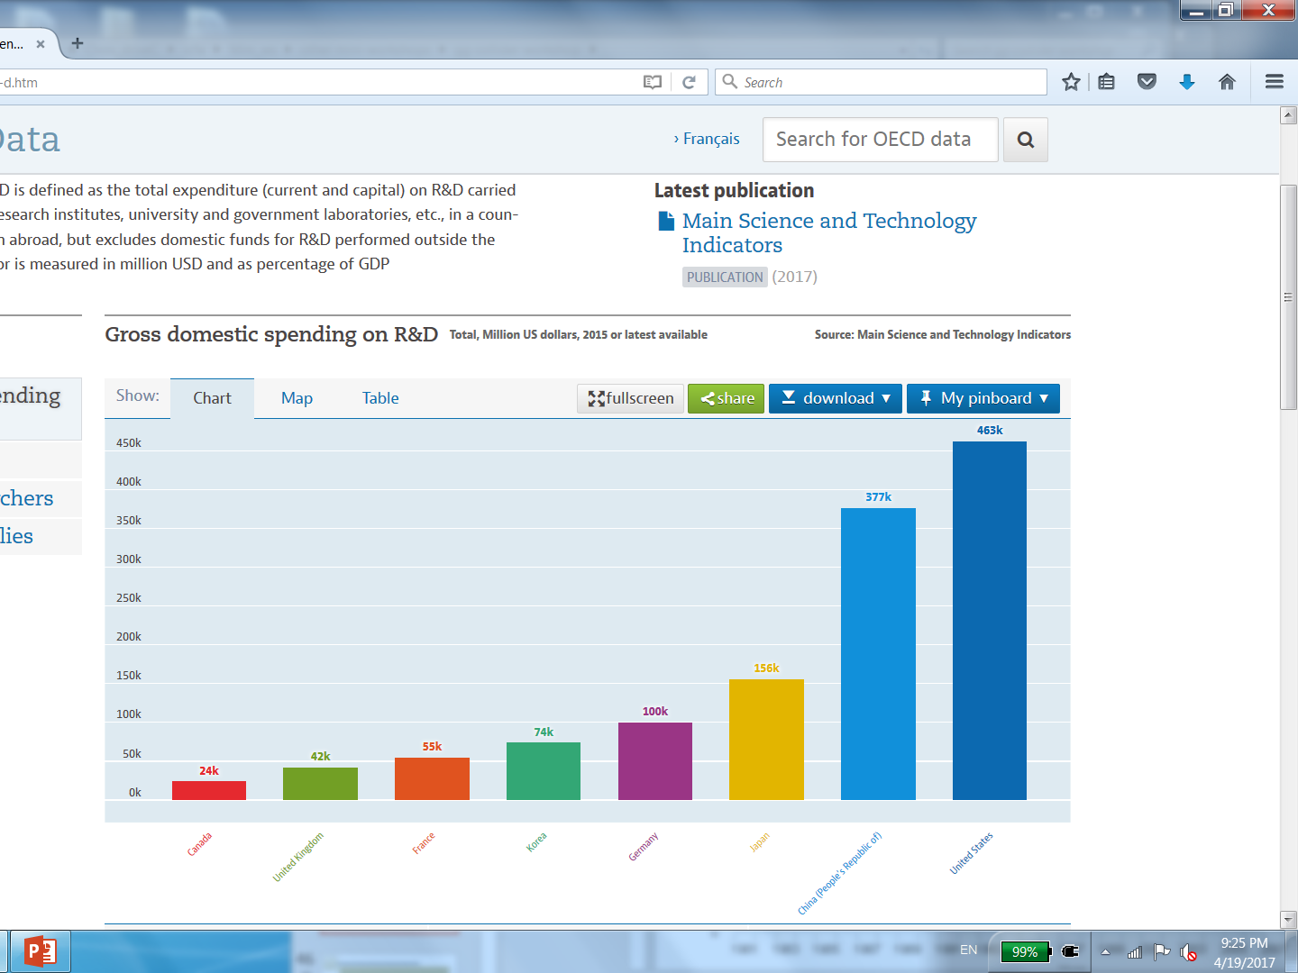
OECD data – Gross domestic expenditures on R&D
USA
China
Japan

Slide 29
Summary
In nearly half a century, we have built a number of e+e- colliders as well as six hadron colliders. But we have never built any photon collider. We have no experience except some preliminary studies (mostly paper study but also a few experiments).
The challenges are big and real. But the potential rewards and spin-offs are enormous.
To design and eventually build the world’s first photon collider requires the best talents from two different communities – accelerator and laser. The “marriage” of the two will have profound impact on the future of our field.
This workshop provides a communication channel and may also serve as a launch pad of a worldwide effort to pursue a photon collider.
We will discuss different options, compare their pros and cons, and explore the possibility of identifying a shortest path for designing and constructing a proof-of-principle photon collider.
China offers an excellent opportunity for this activity.

Slide 30
Questions?

