Slide 1

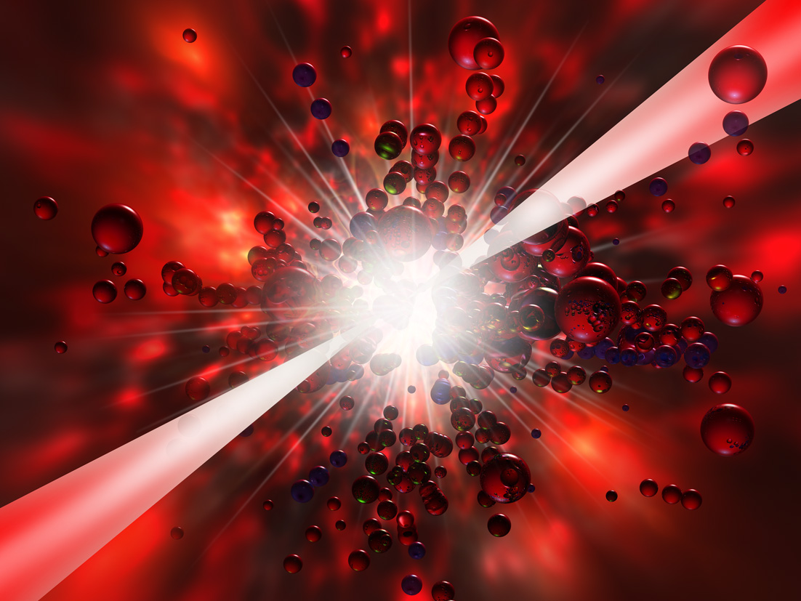
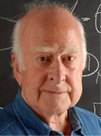
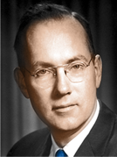

XCAN
A Laser Architecture for
Gamma-Gamma Collider
ICFA Mini-Workshop on Future
Gamma Gamma Colider
23-26 Tsinghua U. Beijing China
Gérard Mourou,
Ecole Polytechnique, France
“The discovery of this particle is potentially the beginning of another road, which is to explore what lies beyond the Standard Model”
- Peter Higgs
“I realized there would be many applications for the laser, but it never occurred to me that we'd get such power from it!”
- Charles Townes
Notes:
1

Slide 2
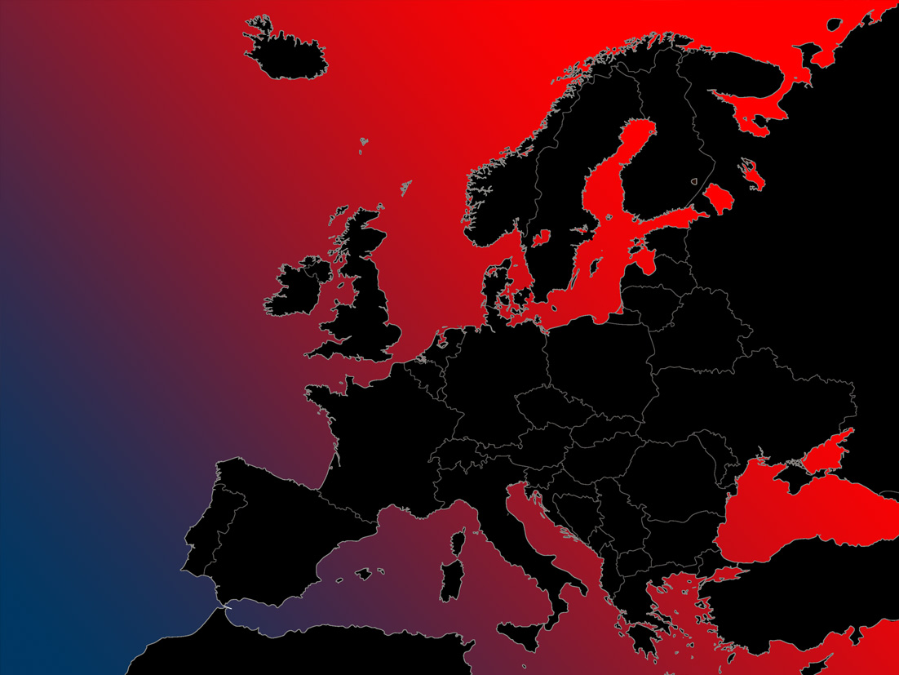

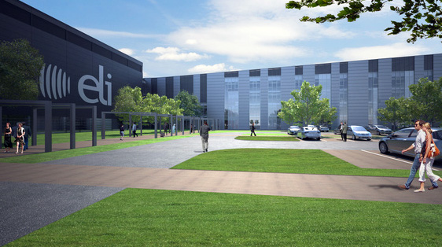
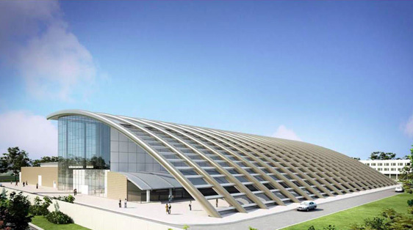
Extreme Light Infrastructure - ELI
The Largest Civilian Laser Infrastructure
Initiated and Coordinated(PP) by, G. Mourou (EP)
ELI (Delivery Consortium) W. Sandners
Czech Republic
Hungary
Romania
Notes:
2

Slide 3
Solving the Peak Power-Average Power Quandary

Slide 4
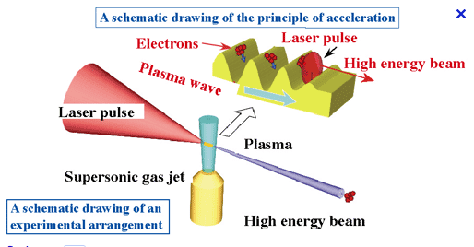
Laser Wake field Acceleration
40W
GeV, 100 pC
=100mW.

Slide 5
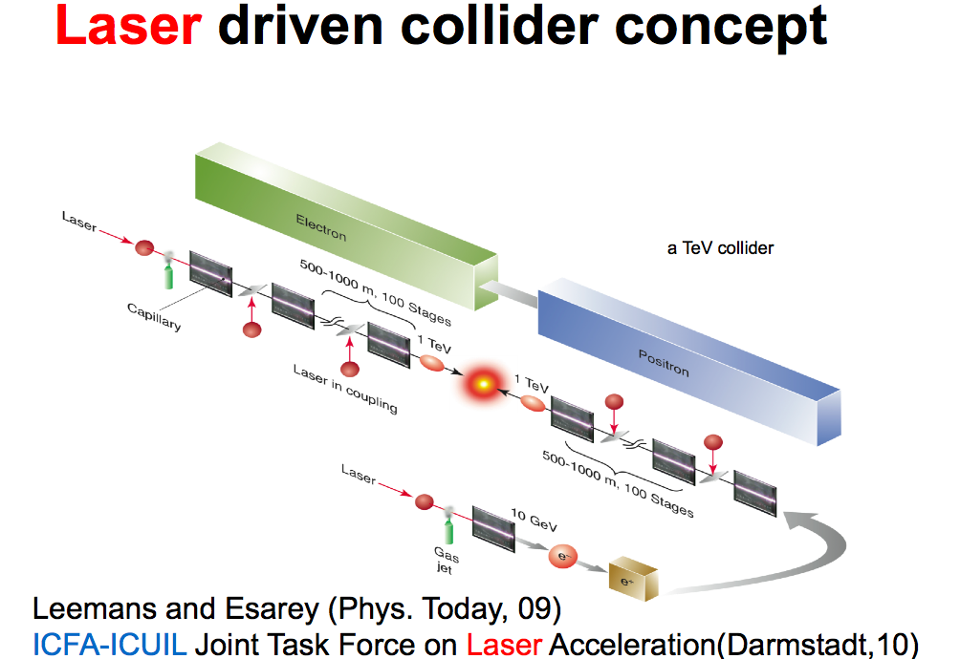
TeV Collider

Slide 6
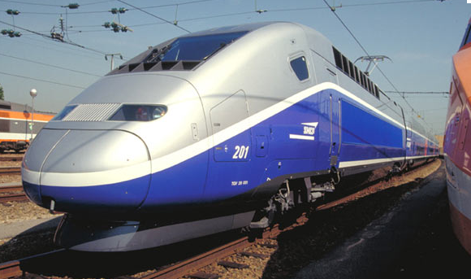
We need to Power a TGV (10MW)
TeV, 4nC, 13kHz

Slide 7
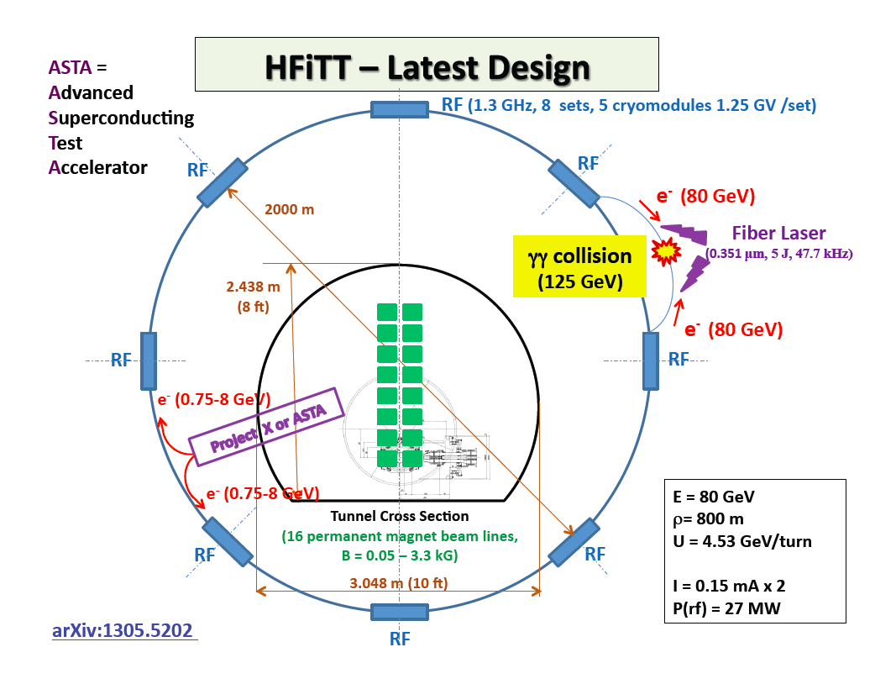

Slide 8


Coherent Amplifying Network
CAN
A Revolution in Laser Architecture
Peak Power, Average Power , Efficiency
G. A. Mourou,et al D. Hulin and A. Galvanauskas,
AIP Conference Proceedings, vol. 827, 152-163 (2006).
G. Mourou, W. Brockelby, J. Limpert, T. Tajima, Nature Photonics April(2013)

Slide 9
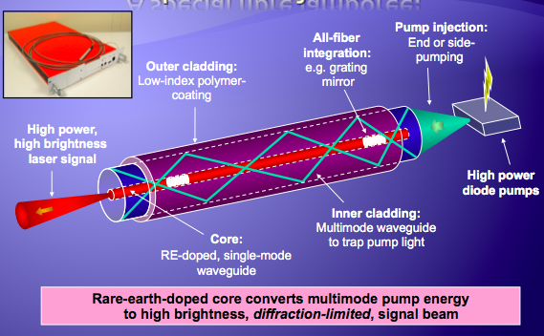

The basic brick: the Yb doped Single mode fiber
Eidam, T. et al. Fiber chirped-pulse amplification system emitting 38 GW peak power.
Optics Express 19, 255 (2010).

Slide 10
CAN Basic Bricks
The Yb-doped Fiber (continued)
Yb:fiber transforms efficiently (70%) of low quality inexpensive ($10/W) light from a diode laser into a high quality single mode light with outstanding beam quality.
Fiber provides the highest beam quality with the highest laser efficiency.
The fiber can be precisely reproduced and pumped with 0.1% pump power precision/fluctuation
Single fiber can produce up to 2mJ, 200fs pulse with an average power ~ 800W, 40kHz (Jena Group)
A Phased-Fiber-Array emitting 50J, 50fs will be composed of 2 10⁴ fibers.
Is it conceivable?

Slide 11
However Need to Phase
32 J/1mJ/fiber~ 30 10³ Phased Fibers!!
(G. Mourou patent 2005)
Electron/positron beam
Transport fibers
~1mm
~70cm
Length of a fiber ~2m Total fiber length~ 5 10⁴km

Slide 12
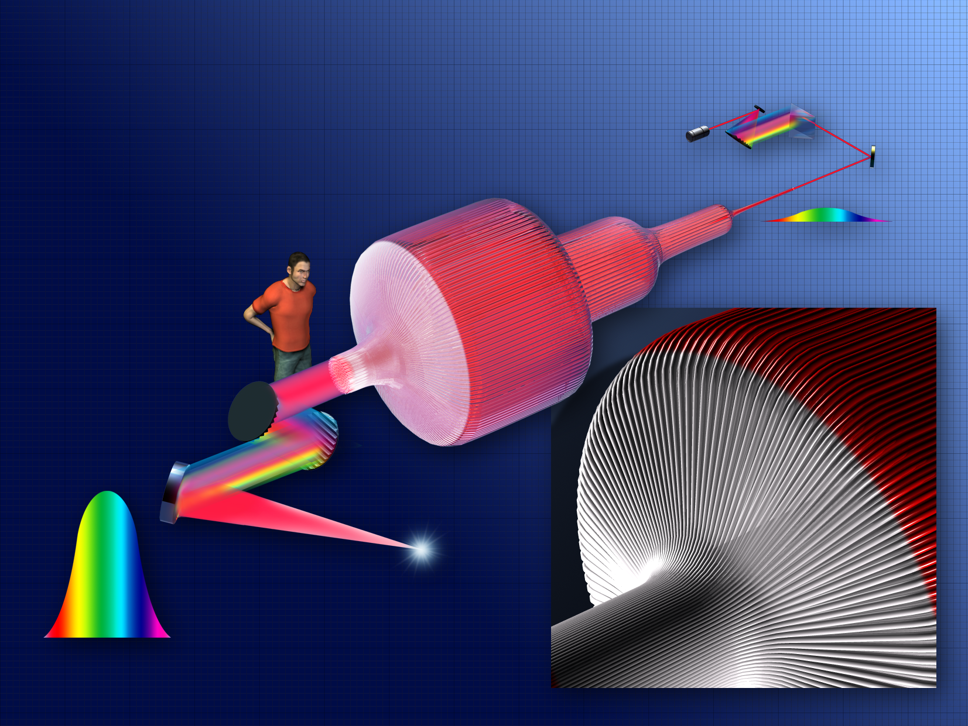
ICAN (European Project)
CAN Coherent Amplification Network
G. Mourou, W. Brocklesby, J. Limpert, T. Tajima, Nature Photonics April 2013
« The future of Acceletaor is Fiber »

Slide 13


Slide 14
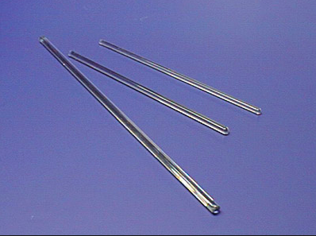
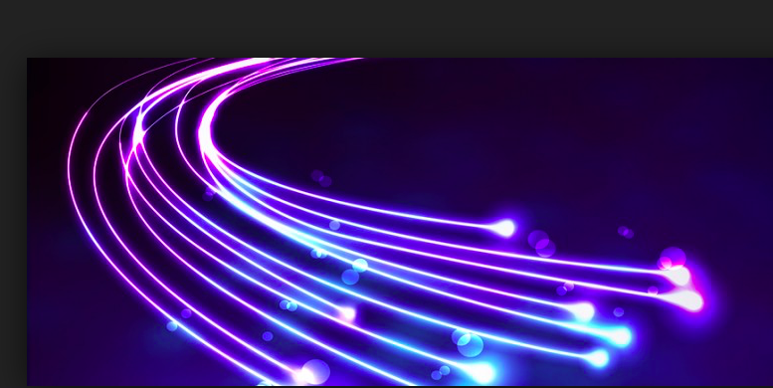
Moving from sub-mJ/ fiber to 10mJ /Rod
Single mode
rods
Single mode
fibers

Slide 15
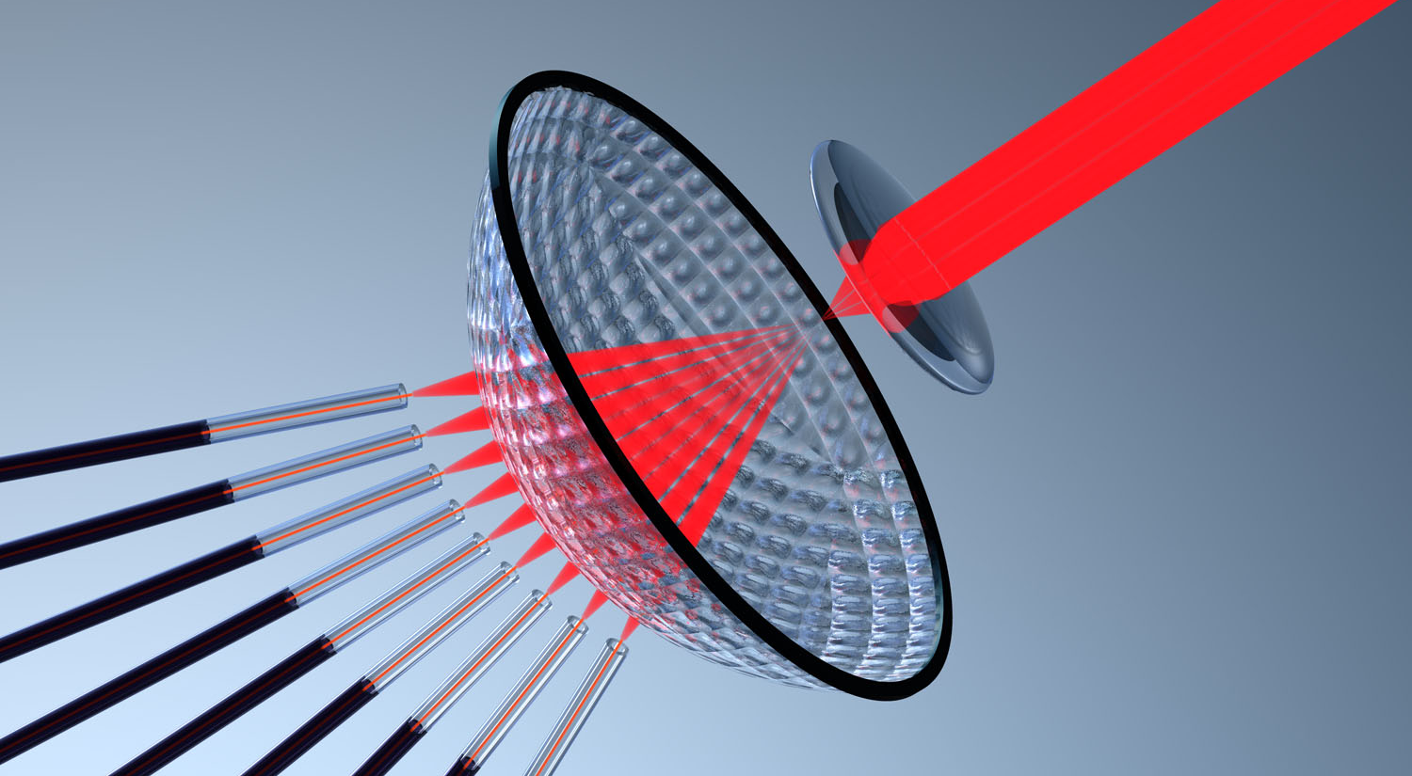
Rod-based CAN for High energy, High repetition rate applications

Slide 16
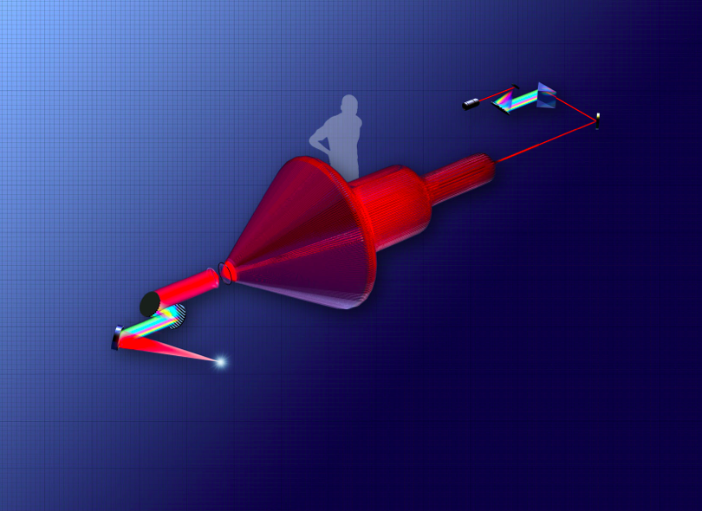
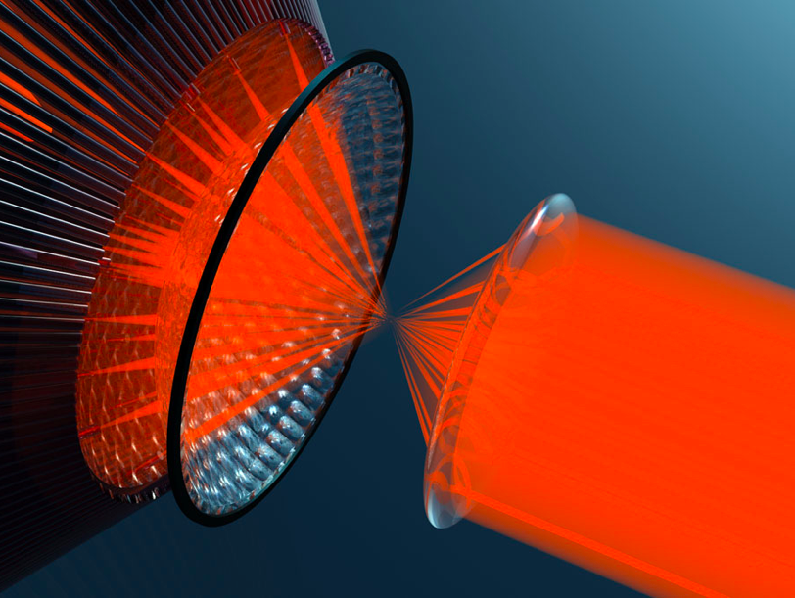
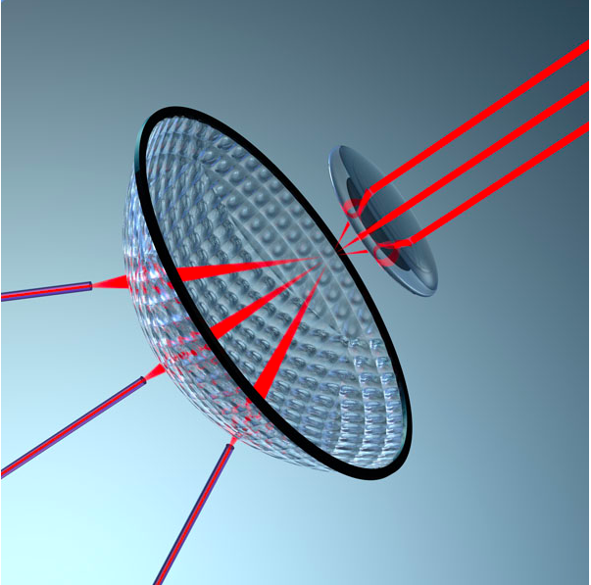
HERISSON ARCHITECTURE
R. Soulard, M. Quinn, G. Mourou, Applied Optics 54 15. 2015
HERISSON: Fibers are replaced by rods
10X more energy /channel
Gérard Mourou, Toshiki Tajima et Remi Soulard, Laser Femtoseconde à Grande puissance Impulsionnelle Patent EP 218267FR

Slide 17
First Step:
Understanding the Fiber Laser Noise

Slide 18
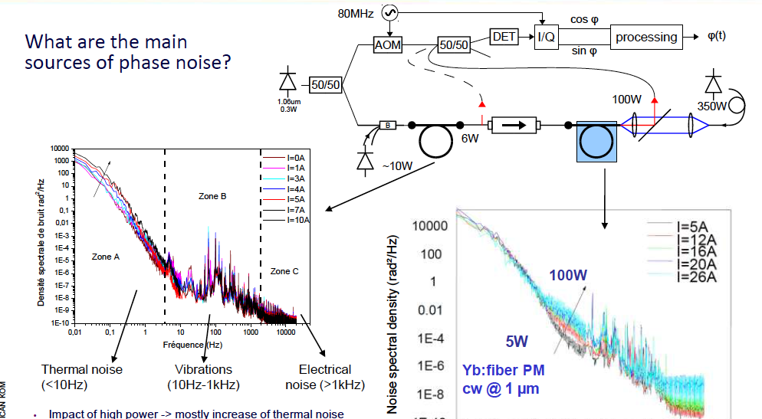
ICAN
Sources of Phase Noise

Slide 19
Second Step:
Micron Precision
Fiber Assembly Fabrication

Slide 20
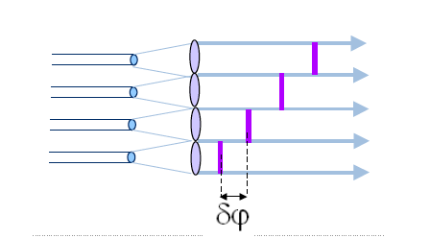
The fiber must be mounted on a precision mechanical mount.
Each fiber is at the focus of a lens,forming a microlens array matrix

Slide 21
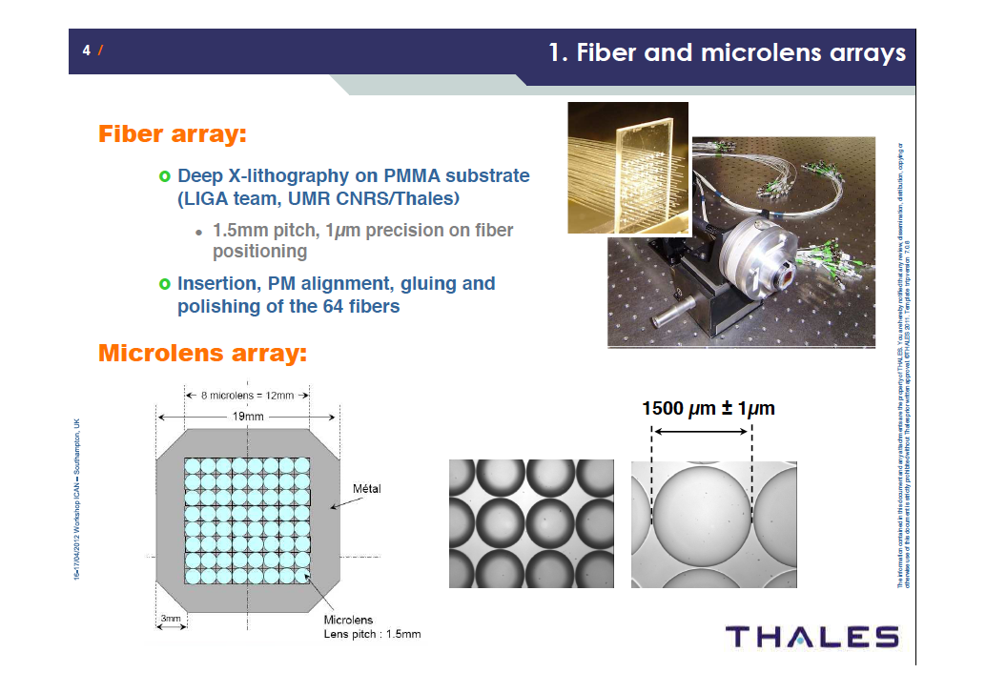
Microlens Arrays

Slide 22
Third Step:
Fiber-to-Fiber Phase Shift Measurement:
The Quadriwave Lateral Shearing Interferometer

Slide 23
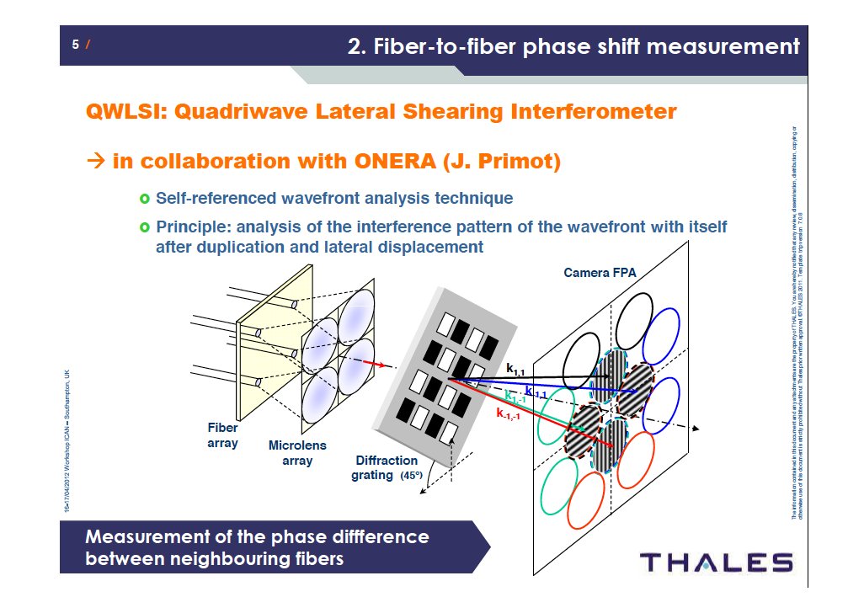

Slide 24
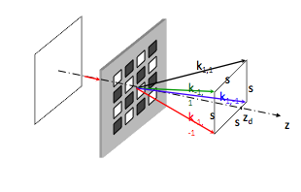
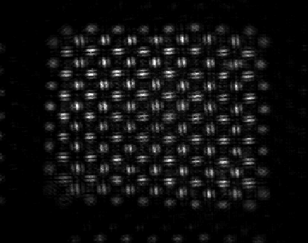
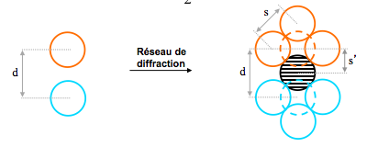
Phase Noise Measurement with a
Quadrilateral Shearing Interferometer
(10⁴ fibers with λ/60 precision at kHz)
1) Grating Making 4 replicas of each fiber
2) Neighbor fibers interfer with replicas
Making fringes
3) A phase map is captured every ms,
making possible phase correction with phase
modulator
Only 6 pixels are necessary to reach
λ/60 precision.

Slide 25
Phase Noise Measurement with a Quadrilateral Shearing Interferometer
(10⁴ fibers with λ/60 precision at kHz)
For 10⁴ fibers , 6 pixels per fiber for a resolution of
λ/60 @ 1kHz, off-the-shelf camera with 10⁶ /1kHz are
available.
Algorithm to control the phase distribution of fibers
40Gops Possible with a GPU.

Slide 26
Fourth step:
Phase Correction by Optical Modulator

Slide 27
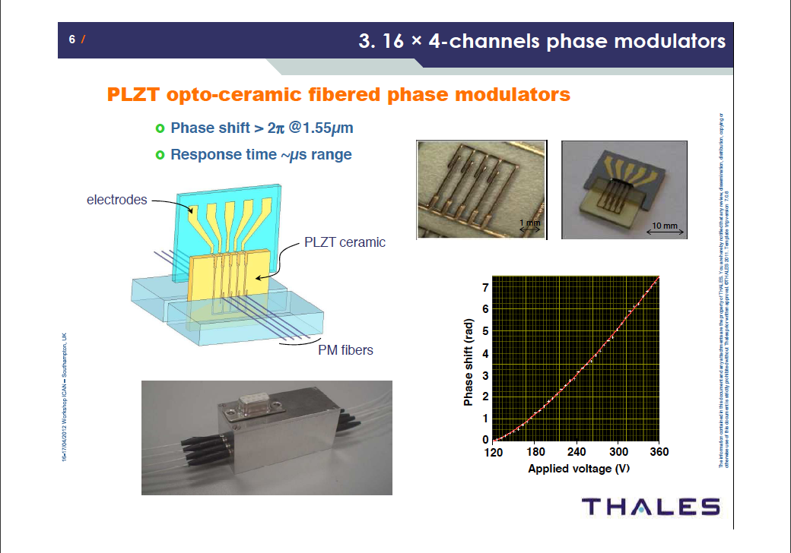

Slide 28
J. Bourderionnet, A. Brignon (Thales), C. Bellanger, J. Primot (ONERA)
Coherent Fiber Combining
Phase processing and feedback loop
1×2 splitters
1W PM
EDFAs
fiber array
1W PM EDFA
2:1image relay
QWLSI
polar. controller
lenslet array
laser output
Laser diode
1.55µm
1×16 splitters
16 × 4-channels PLZT phase modulators
far-field
observation
Achievement 2011
→ 64 phase-locked fibers

Slide 29
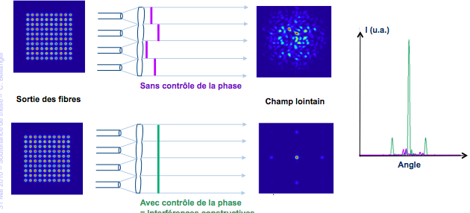
64 CW fibers have been phased
(This experiment in fact validates an extension possible to >10⁴ phased fibers at 1kHz)

Slide 30
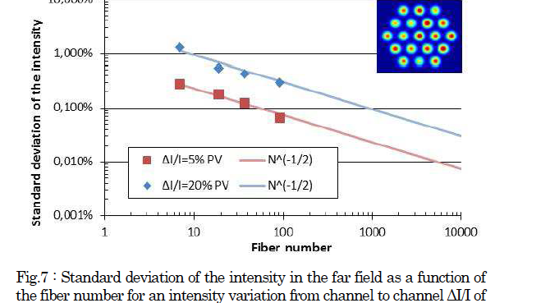

Slide 31
Fifth Step:
Measuring and keeping at Bay the Nonlinear effects

Slide 32
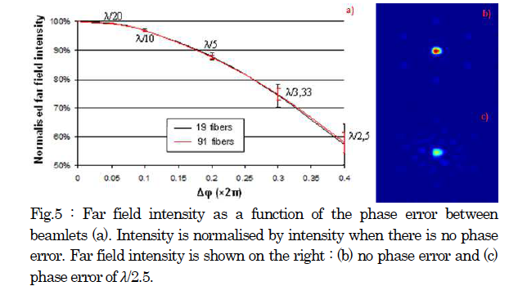

Slide 33
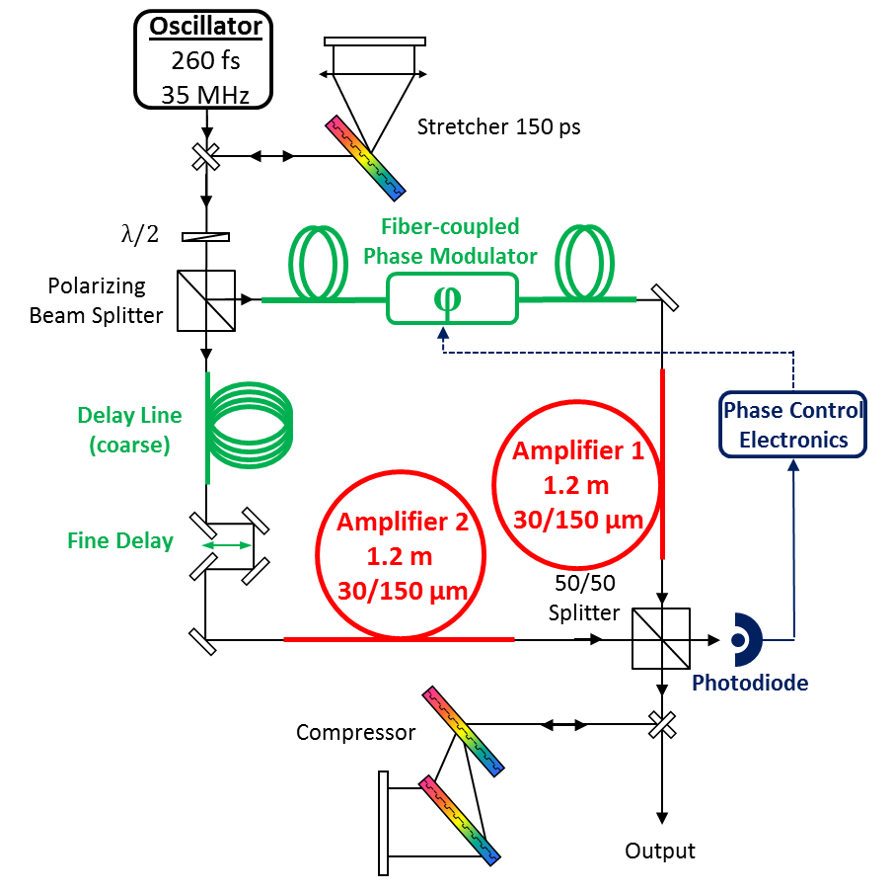

CAN results / phase locking technique
In the femtosecond
Combining efficiency > 90%
L. Daniault, M. Hanna, L. Lombard, D. Goular, P. Bourdon, F. Druon, P. Georges
“Coherent combining of two femtosecond fiber chirped pulse amplifiers“
Oral : Advanced Solid State Photonics, ASSP 2011, Istanbul, Turkey (February 13-16 2011)
Accepted: Optics Letters, L. Daniault et al, « Coherent beam combining of two femtosecond fiber chirped pulse amplifiers »
Notes:
- Small modulation at a high frequency is added to the feedback signal
- The resulting intensity modulation depends on the operation point
- Subsequent lock-in amplifier and PID gives an error signal

Slide 34
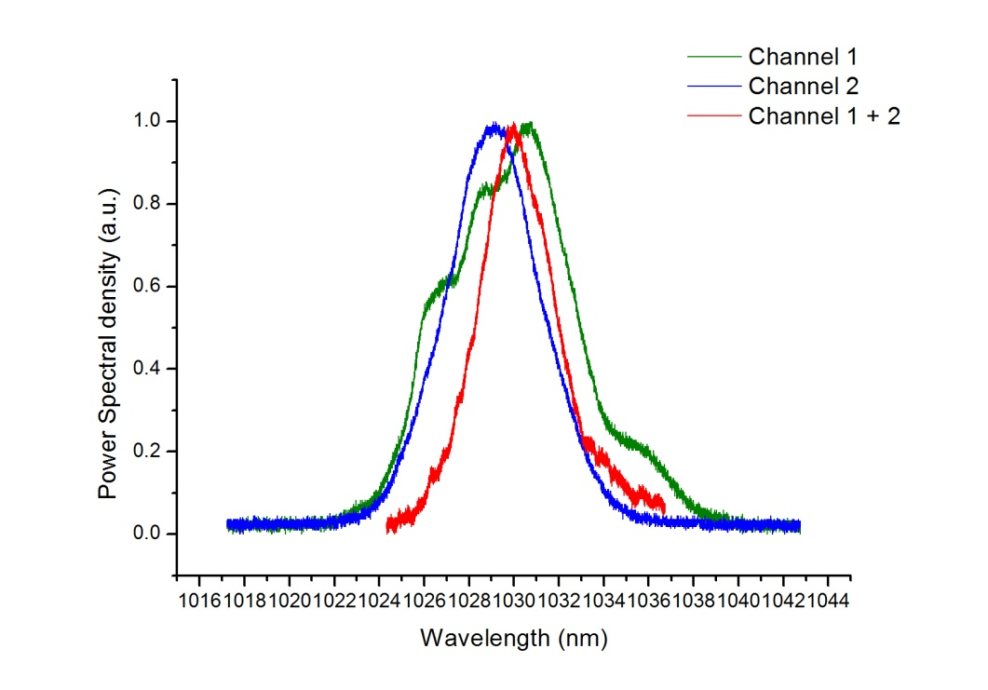
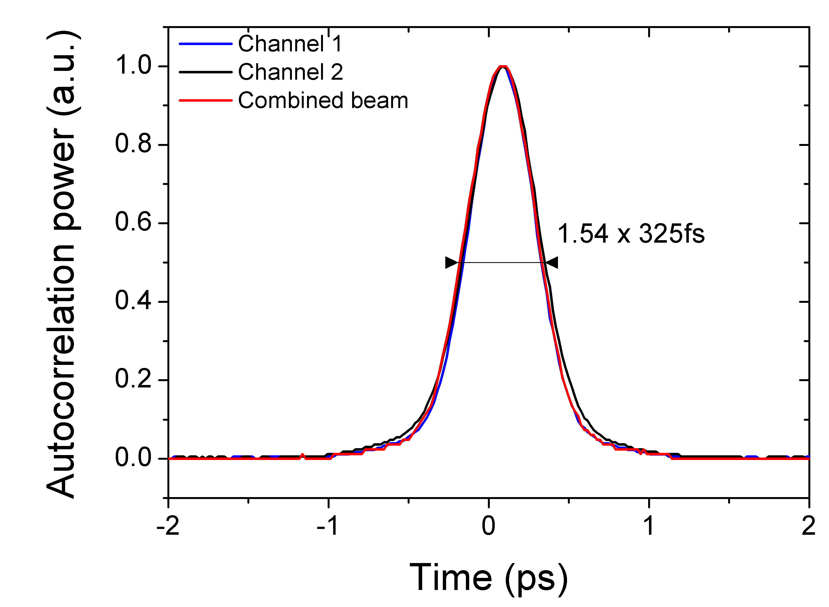
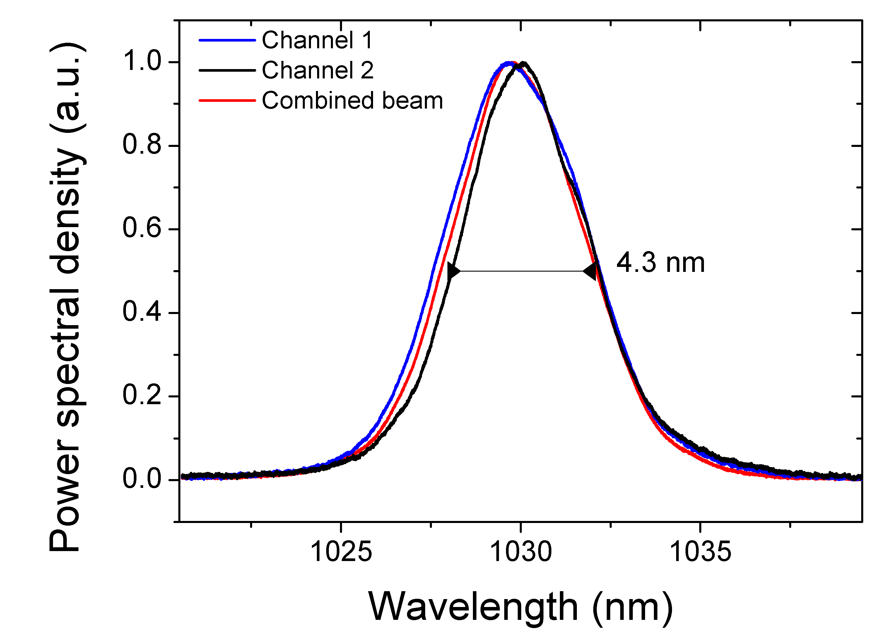
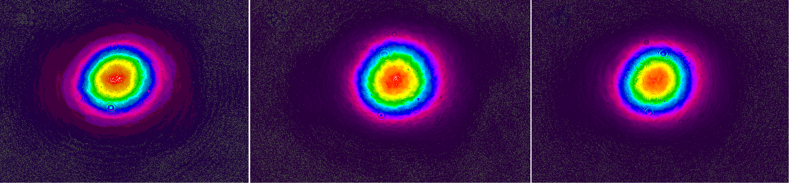
CAN recent results / phase locking technique (2)
Autocorrelations
325 fs pulsewidth
Spectra
4.3 nm FWHM
Notes:
the recent results on phase locking are very nice, and their novelty has to be emphasised

Slide 35
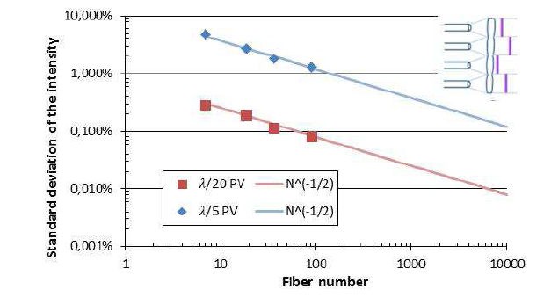

Slide 36
From Prototype to Large Scale Applications
X CAN is an Ecole Polytechnique - Thales consortium to demonstrate that the CAN concept is capable to provide:
  High Peak Power 100TW
  High Average power in the 100kW
  High Eficiency >30%
  A budget of 3M€ has been allocated to build a 61 high energy fiber prototype that will validate the construction a 10^4 fiber unit for grand scale applications.

Slide 37
High average and Peak power laser
Agile, precision and heuristic laser
Capable to provide, 100TW peak power at MW average power in the visible 2W and 3W.
Efficient 40%
Total phase amplitude control of each fiber with : Phase <1% and amplitude <1%
A superior spatial resolution with 10⁴ fibers.
A control of the phase and much less of 1% over the beam
A system constantly aligned
Heuristic: Spatial and Temporal shape reconfigurable with extreme agility (1kHz).

Slide 38
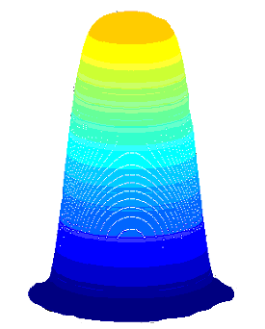
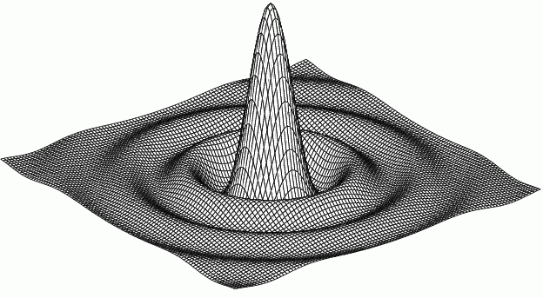
The ICAN-concept: a versatile digital laser
Choose a far-field of your liking ➔ Fourier transform provides E and φ distribution for fibres
➔
Bessel J₁(r)/r
top-hat
High Resolution Phase and Amplitude control across the out put pupil at 1KHz
➔top-hat model is example of complete control of the laser electromagnetic field
➔Megawatt ICF-application: randomize phase in order to minimize coherent
excitation of parametric instabilities (SBS, SRS)

Slide 39
Cost of a PW@10kHz
Cost based on 7€/watt for a 50J/pulse at 10kHz
Average power 500kW
Wall plug efficiency: 30%
Factor 50% for the grating efficiency
A factor of 3 is taken to go from diode cost to the full system cost
System cost ~ 70M€

Slide 40
6th Step: The cost

Slide 41





Slide 42

Expected performances
61 channels
350 fs
>10 mJ
50 kHz

Slide 43
Conclusion
I don’t see any road block to build an EFFICIENT Laser with 10⁴ fiber system for HEP applications:
  Peak Power in the PW level
  MW Average Power
  5- 10joules
  Efficient Harmonic conversion possible
  10 to 100KHz repetition rate
  Pristine spatial and temporal stability
  Heuristic and configurable at kHz speed

Slide 44
Acknowledgements
CERN
J.P. Koutchouck
ORC, Southampton
D. Payne
W. Brocklesby
D. Nilson
Fraunhofer Institute, Jena
A. Tunnermann
J. Limpert
T. Schrieber
Ecole Polytechnique
  Thales
    A. Brignon
    J. Borderionnet
  ONERA
    C. Bellanger
    J. Primot
    L. Lombard
    V. Michau
  Institut d',Optique
    M. Hanna
    L. Daniault
  U. Michigan
    A. Galvanauskas

Slide 45
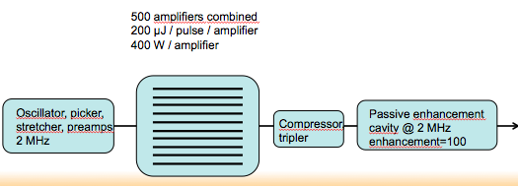
Reducing the Number of fibers
DPA (Division Pulse Amplification) and enhancement Cavity combination
J. Limpert et al

Slide 46
The 7th Step: the Applications

Slide 47
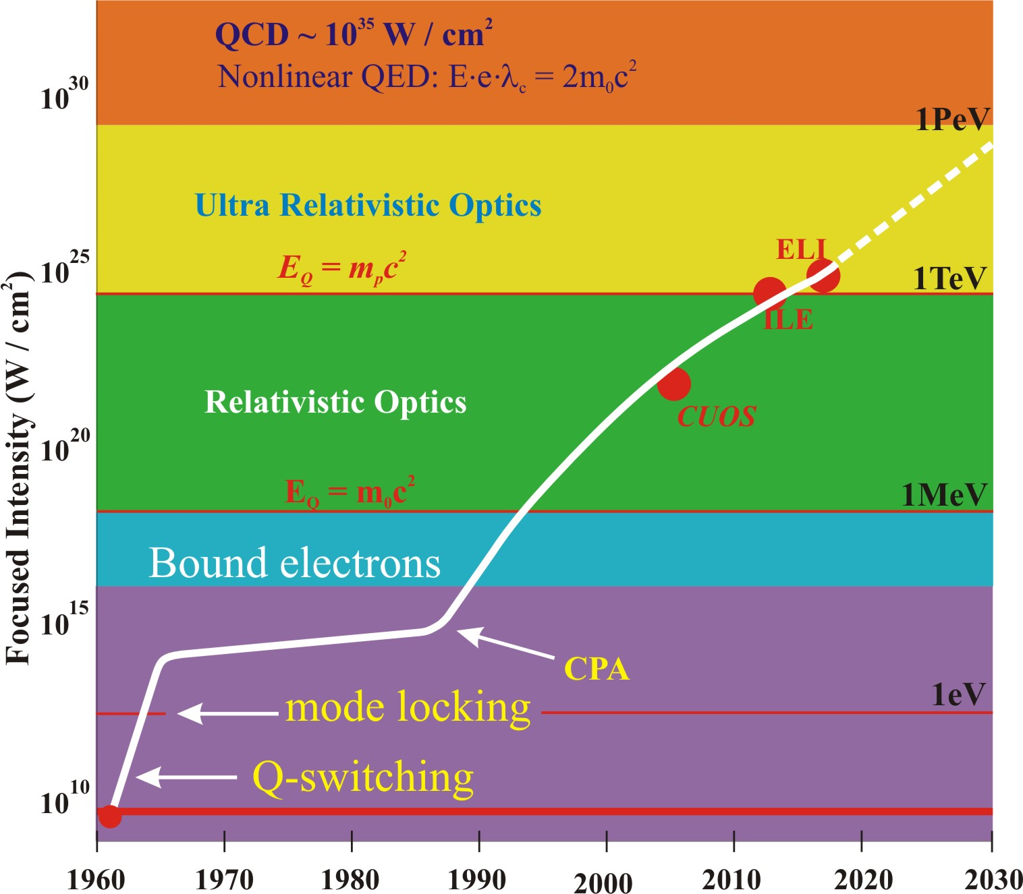
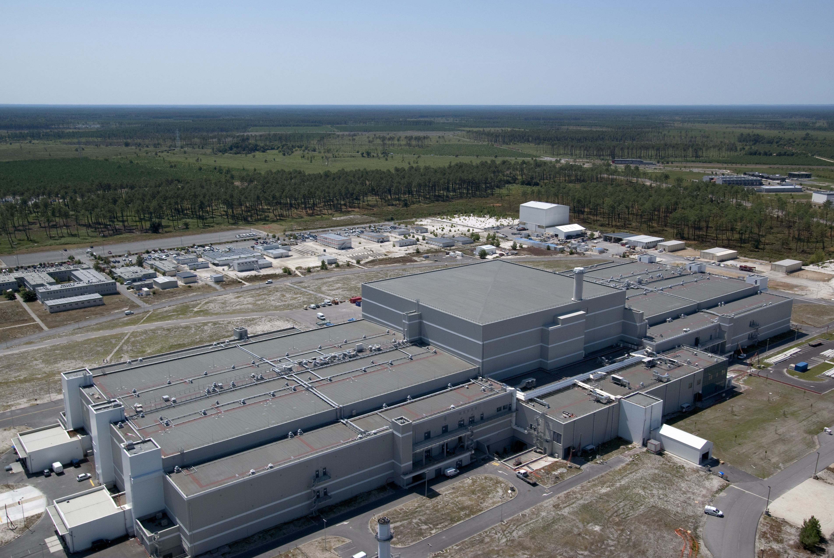
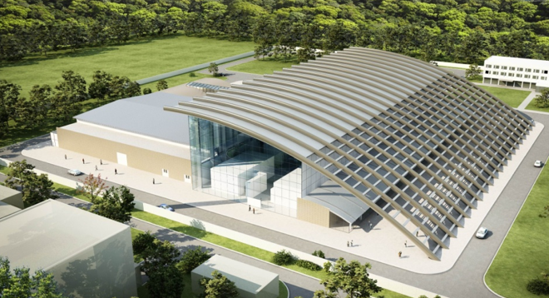
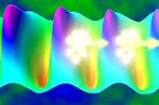
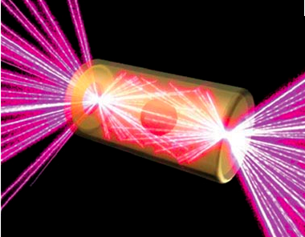
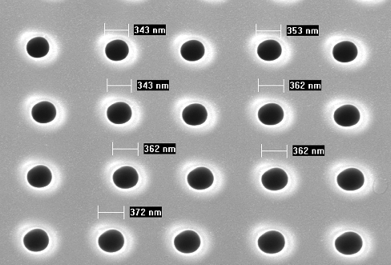
Extreme Light Road Map
LMJ/NIF, 2MJ, 3B€
MJ
TeV
Vacuum Polarization
IZEST C³
XCELS
ELI, kJ .3 B€
E_{p}=m_{p}c²
kJ
GeV
E_{e}=m₀c²
MeV
J
MeV
mJ
eV

Slide 48
Rational Behind Fiber Choice
The fiber choice comes from the current thinking in the community
that the highest brigthness will come from advances in fiber lasers.
Modern lasers will try to eliminate bulk components as much as possible to the benefit of fibers.
We can use all the low cost fibre telecom tricks: special fiber, filters, compression ,Couplers, etc..
Thin disk Complex systems for pump are cycling and regeneratieve amplifiers
SlabThermal effect modify the beam
Complex Management of pump and signal beams
But

Slide 49
Scientific and Societal Applications of Relativistic, electron Protons(>GeV)
Megawatt Power level (B€)
Proton Colliders (Tevatron, LHC)
Neutron sources (SNS, ESS)
Neutrino Sources(SNS, ESS)
Radioactive Ion Beam (FRIB, Eurisol)
Accelerator Driven Systems(Ch-ADS,MYRRHA)
Electron linear collider
Muon collider
Free Electron laser at 10kHz
Higgs factory

Slide 50

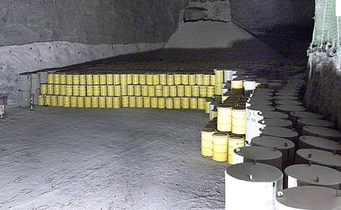

Societal Application
Nuclear Waste Transmutation
ADS(Accelerator Driven System)

Slide 51
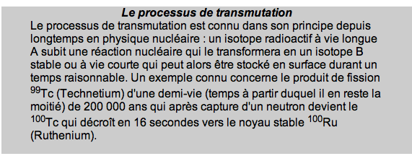
Transmutation

Slide 52
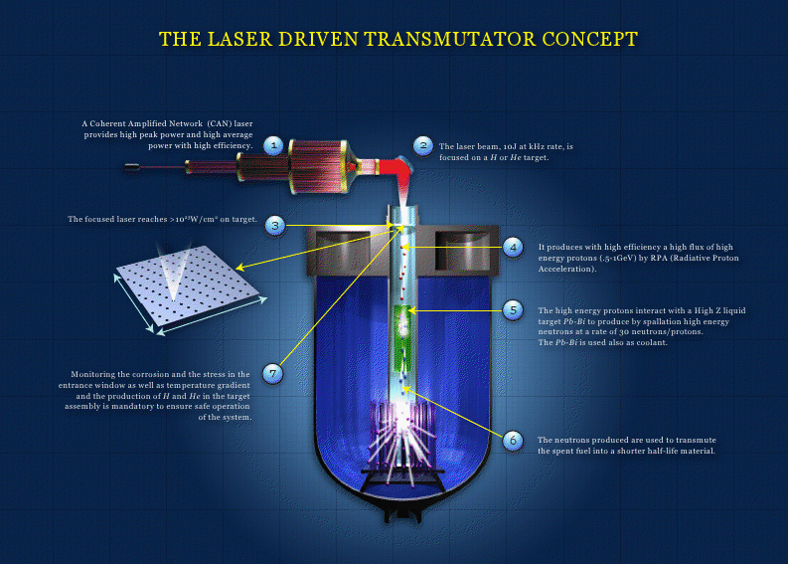

Slide 53
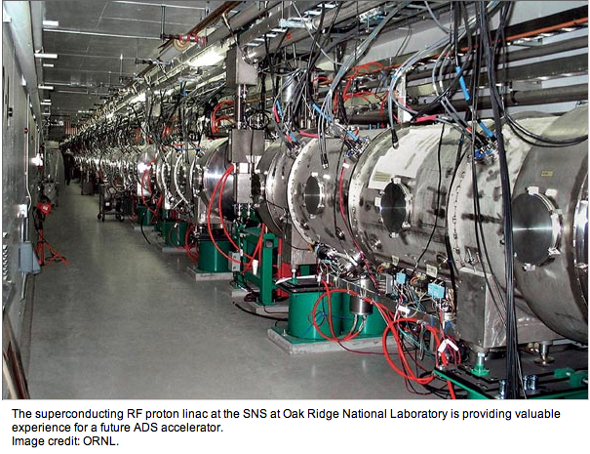

Slide 54
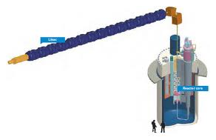

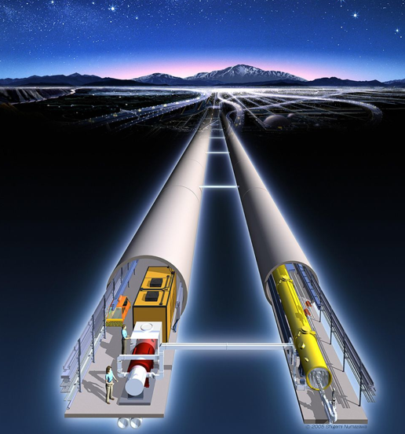

ICAN APPLICATIONS
Accelerator Driven System
MYRRHA
Radioactive Ion Beam
Free Electron Laser
European Spallation Source

Slide 55



Slide 56
Conclusion
Moving from Analog to Digital and Smart Laser
The key elements of CAN has been validated and have shown no Show stopper to produce simultaneously:
  Peak Power in the >PW
  Average Power in the >MW
  Wall plug efficiency >30%
The CAN Concept exhibits new and precious features:
  Each fiber can be individually control with 1pixel presicion
  High resolution Wavefront control in amplitude 1% at 1kHz
  High Resolution Wavefront contrôle in phase with l/60 at 1kHz
To move Further we will endeavor to form a world wide consortium, ICAN-B (read: I can be) Horizon 2020

Slide 57
Next Action Item
An International Infrastructure
ICAN-B
First Create ICAN Consortium ICAN-B (Academe, industry)
An infrastructure highly relevant to science, societal Applications with the specifications >50J, >10kHz, >30% efficient (>10kW capable to produce 10GeV electrons and GeV(relativistic protons).
  Such an infrastruture could validate a:
  TeV laser collider concept
  Free Electron Laser in the High X-ray regime comparable to LCLS-SLAC but at >1kHz.
  ADS Accelerator Driven System Transmutation
  Proton therapy
  X- ray, Gamma ray

Slide 58

Source of Phase Noise (100W CW)
(Extremely low f> 10Hz)
λ/6
λ/600
Thermal <10Hz
Vibration 10Hz-1Hz
Electrical <1kHz

Slide 59

Can the Future of Accelerator Be Fibers?
“The discovery of this particle is potentially the beginning of another road, which is to explore what lies beyond the Standard Model”
- Peter Higgs
ICAN Symposium
June 27-28, 2013
CERN, Geneva
“I realized there would be many applications for the laser, but it never occurred to me that we'd get such power from it!”
- Charles H. Townes

Slide 60
https://www.izest.polytechnique.edu/izest-home/ican/news-events-documentation/ican-conference-can-the-futur-of-accelerators-be-fiber-cern-geneva-switzerland-288403.kjsp?RH=D1_IZEST-EN

Slide 61
Smart Laser
Optimization of the signal by Genetic Algorithm (pending)Patent
Phase processing and feedback loop
1×2 splitters
1W PM
EDFAs
fiber array
1W PM EDFA
2:1image relay
Detector
QWLSI
polar. controller
lenslet array
laser output
Laser diode
1.55µm
1×16 splitters
16 × 4-channels PLZT phase modulators
far-field
observation
For 10⁴ fibers The laser can fire at 10kHz, the wave from can be changed in phase and
Amplitude at a kHz.

Slide 62





Laser Acceleration-Telecom virtuous Cycle
Coherent Amplifying
Network+ Laser Wake Field
WWW
Tim Berners-Lee
Optical Fiber
Charles Kao

Slide 63
Can the Futur of Accelerator Be Fibers?
1st European Advanced Acceletrator
Concept 2013
Elba, June 2-7, 2013
“The discovery of this particle is potentially the beginning of another road, which is to explore what lies beyond the Standard Model”
- Peter Higgs
“I realized there would be many applications for the laser, but it never occurred to me that we'd get such power from it!”
- Charles H. Townes
Gerard Mourou
IZEST Ecole Polytechnique – Paris – France
150th Anniversary of Politecnico di Milano

Slide 64
Laser-Accelerator concepts
Scientific and Societal Applications
Applications
electron-positron Collider
  Proton Colliders (Tevatron, LHC)
  Neutron sources (SNS, ESS)
  Neutrino Sources(SNS, ESS)
  Radioactive Ion Beam (FRIB, Eurisol)
  Accelerator Driven Systems(Ch-ADS,MYRRHA)
  Muon collider
  Free Electron laser at 10kHz
  Higgs Factory

Slide 65
Introduction
Laser Driver concepts
Basic requirements
  1) Peak Power 100TW to PW, Relativistic and Ultra relativistic regime for electrons (10¹⁸W/cm²) and protons (10²³W/cm²), with MW average power
  2) High Wall Plug Efficiency >30%.
  3)Way to Optimize laser Plasma interaction for laser-plasma Interaction efficiency, Smart-laser.

Slide 66


There is a parallel between ICAN and the ELT (Extreme Large Telescope (42m): 1000 mirrors, 40000 actuators, 2kHz sampling rate

Slide 67
Accelerators for Discovery Science
  Nuclear
  Particle
  Neutron
  Photon
Accelerators for Energy and the Environment
  clean energy through safer nuclear power
  clean up polluted air and water,
Accelerators for Industry
  contribute to the development of new materials
Accelerators for Medicine
  targeted cancer treatment with minimal side effects;
Accelerators for Security and Defense
  inspecting cargo
  monitoring of test bancompliance

Slide 68

ICAN
Mitigating Thermal and Nonlinear Focusing in Amplifiers
Large Amplifier
Small cooling area/to
Volume ratio
Thermal defocusing
Small scale self focusing
Single mode
Little thermal focusing
Little small scale self foc.
Small energy and peak
power.
ICAN
Little thermal focusing
Little small scale self foc.
Energy and peak power

