Slide 1
A Freon-Filled Bubble Chamber for Gamma-Ray Detection in Intense Laser-NCD Plasma Interaction
23, June, 2016, Beijing
邹宇斌，赵伟博，马文君 宋炜 郭兆珩，颜学庆
Institute of Heavy Ions Physics (IHIP)
State Key Laboratory of Nuclear Physics and Technology Peking University, China

Slide 2
Contents
背景
探测器选型
气泡室
初步实验及结果
展望

Slide 3
Ⅰ. 背景
Generating Overcritical Dense Relativistic Electron Beams via Self-Matching Resonance Acceleration
PHYSICAL REVIEW LETTERS 110, 045002(2013)

Slide 4
Ⅰ. Next generation of light source ？
PHYSICS OF PLASMAS 22, 080704 (2015)

Slide 5
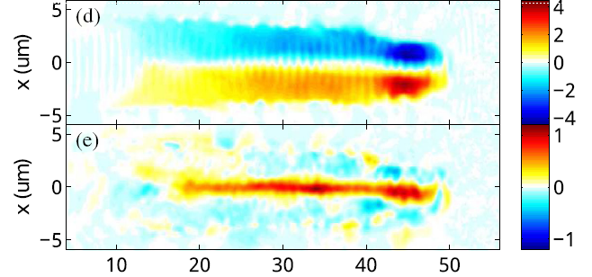
an intense laser pulse in near critical dense plasma
Ⅰ. Self-Matching Resonant Acceleration
100 fs
Radius~1micron
B.Liu, et al.,PRL 110, 045002 (2013)

Slide 6
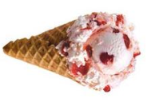
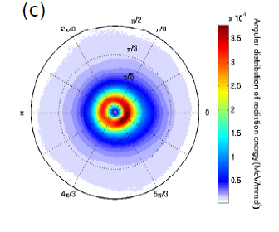
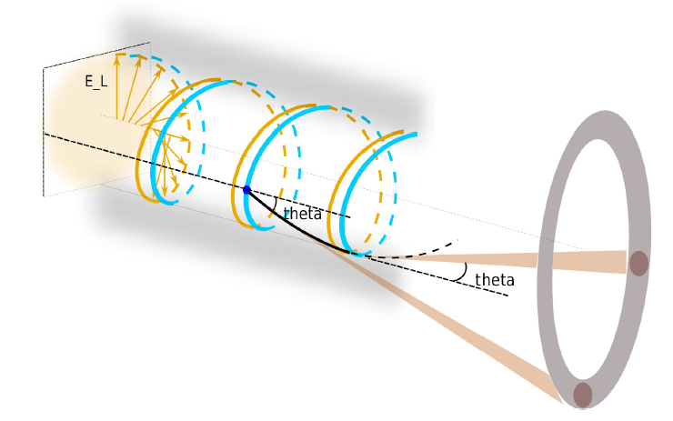
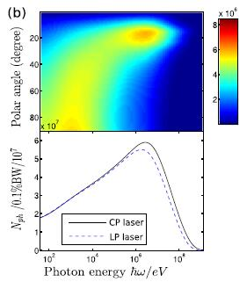
Ⅰ. Next generation of light source ？
Up to 100MeV
～10²⁴ photons/s/mm²/mrad²/0.1BW
emission angle π/18< θ <π/9
ROI
PHYSICS OF PLASMAS 22, 080704 (2015)

Slide 7
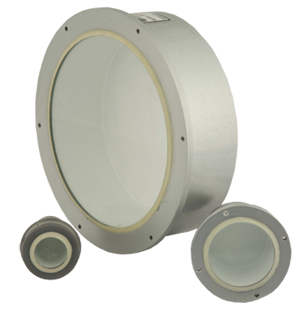
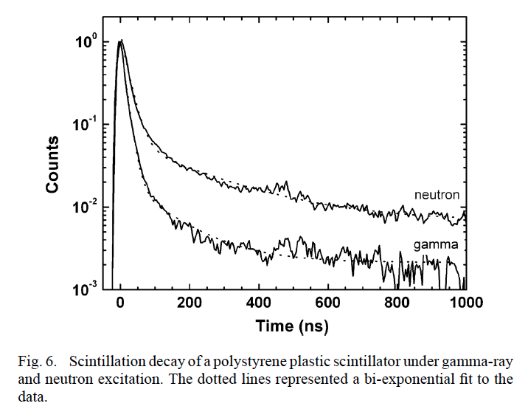
Ⅱ. 怎么探测-1
The difficulty of scintillator detector：
The detector array is composed of independent component
需要大于10000路的阵列

Slide 8
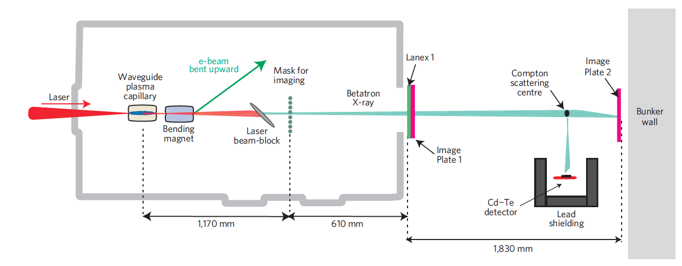
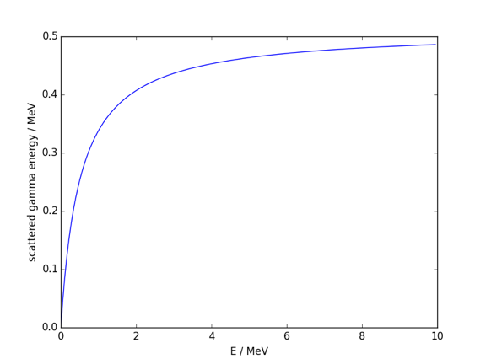
Ⅱ. 怎么探测-2
通过康普顿电子降低探测器直接探测的光子能量，降低对探测器灵敏体积的需求
高能区能量分辨急剧降低
Nature Physics DOI:10.1038
Gamma-rays from harmonically resonant betatron oscillations in a plasma wake

Slide 9
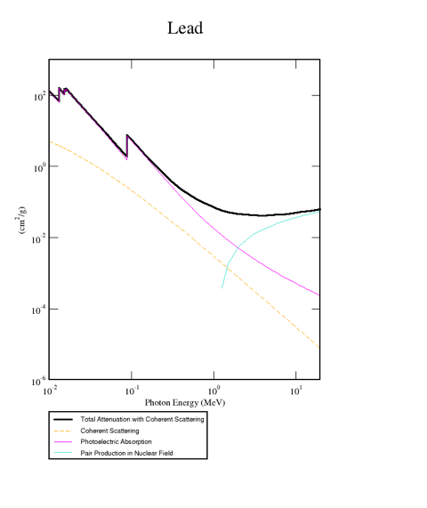
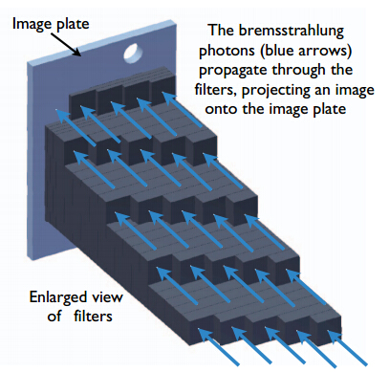
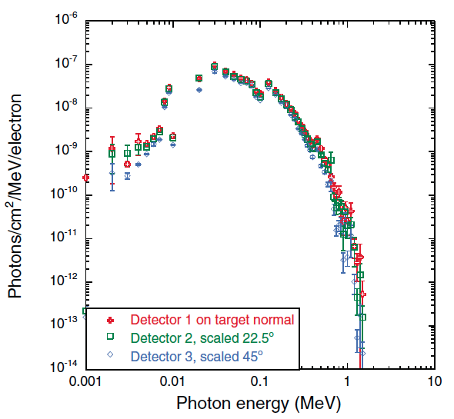
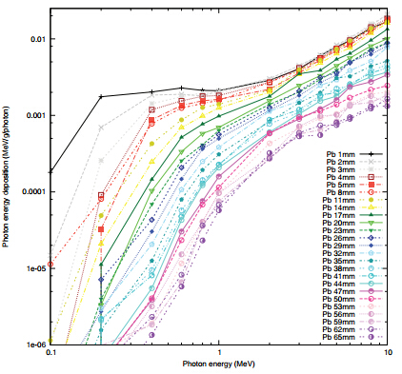
Ⅱ. 怎么探测-3
衰减法？
几MeV以上失去能量分辨
Review of Scientific Instruments 84, 083505 (2013)

Slide 10
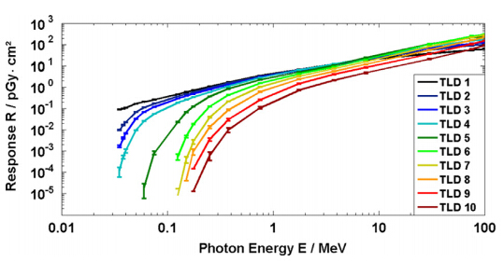
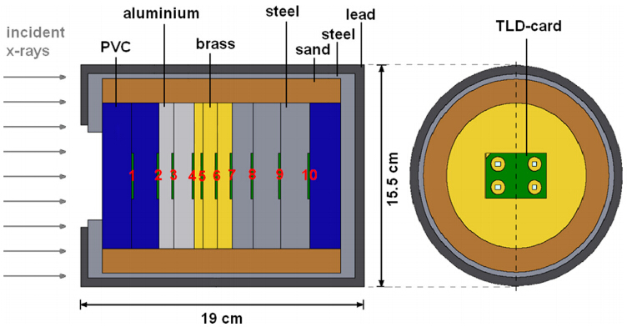
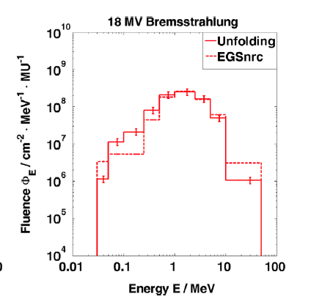
A TLD-based ten channel system
for the spectrometry of bremsstrahlung generated by laser-matter interaction
F. Horst et al. / Nuclear Instruments and Methods
in Physics Research A 782 (2015) 69–76

Slide 11
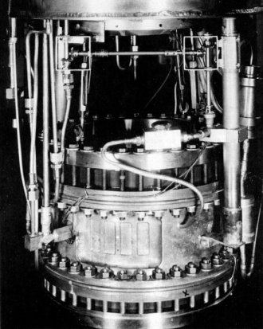
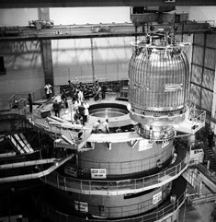
气泡室
阿耳瓦雷茨1959年建成的72英寸气泡室
建于上世纪70年代的、直径3.7米、高4米的欧洲大气泡室BEBC

Slide 12
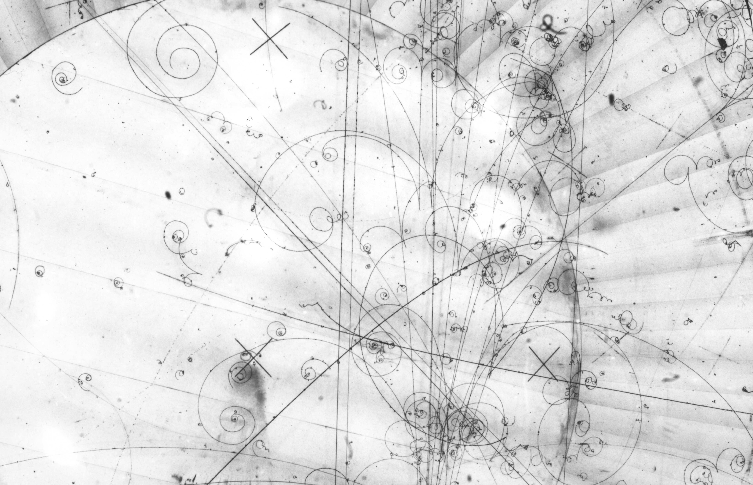
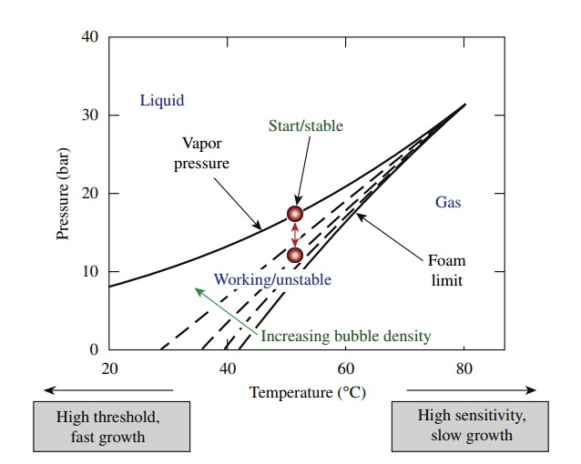
基本原理
P₁T₁
temperature being constant,
decrease the pressure
M. C. Ghilea, D. D. Meyerhofer, and T. C. Sangster, Rev. Sci. Instrum. 82, 033305 (2011)

Slide 13
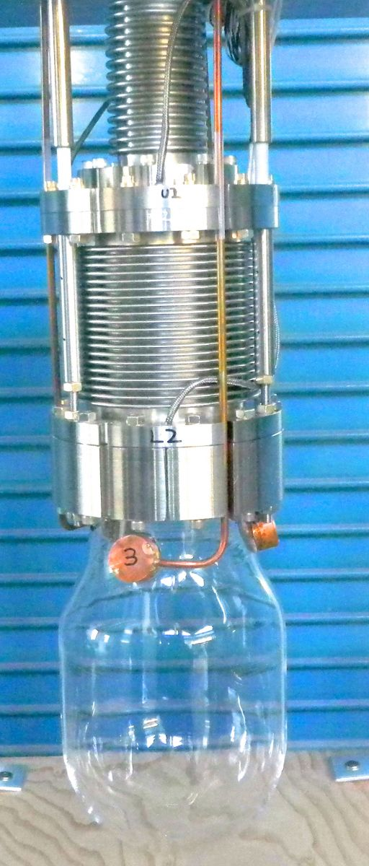
气泡室
重复频率低
装置复杂，维护困难
数据获取困难（胶片拍照）
数据处理困难（人工处理图像）
目前不需要高重频
小型装置，新型执行机构降低复杂度
数字化相机获取数据，自动化预处理
程序自动进行数据处理
The PICO project aims to detectect dark matter particles with the bubble chamber technique. The expriment is installed at a depth of 2 km in the SNOLAB underground laboratory at Sudbury, Ontario, Canada. The PICO collaboration is presently operating two dark matter search experiments: a bubble chamber filled with 37 kg of CF₃I and a chamber loaded with 3 kg of C₃F₈. A much larger version of the experiment with 500 kg of active mass is in development.
From: http://www.picoexperiment.com/

Slide 14
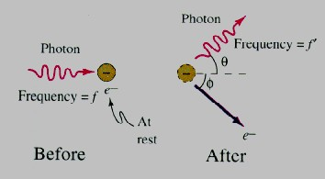
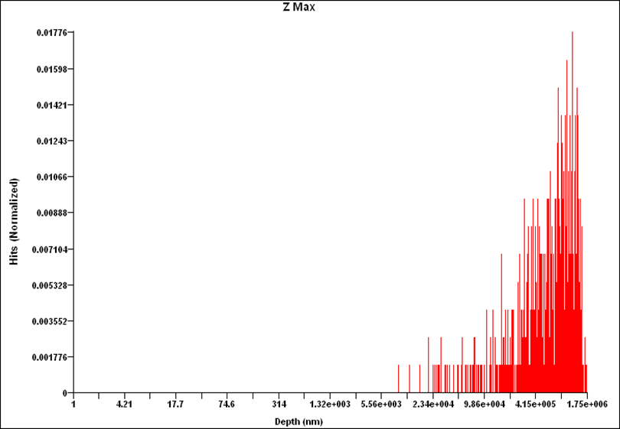
Ⅲ. The operating principle of bubble chamber
Active medium:R134a
Gamma-ray interacts with substances
测量原理：
气泡串得到康普顿电子径迹长度
计算康普顿电子能谱
计算入射gamma能谱
By CASINO，For 1MeV elevtron ,1000，Incident upon R134a
Depth 1.75mm

Slide 15
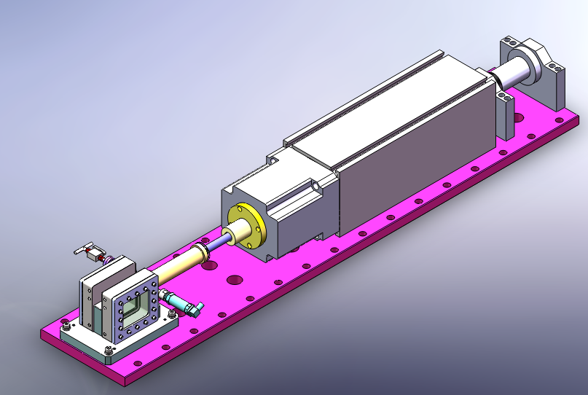
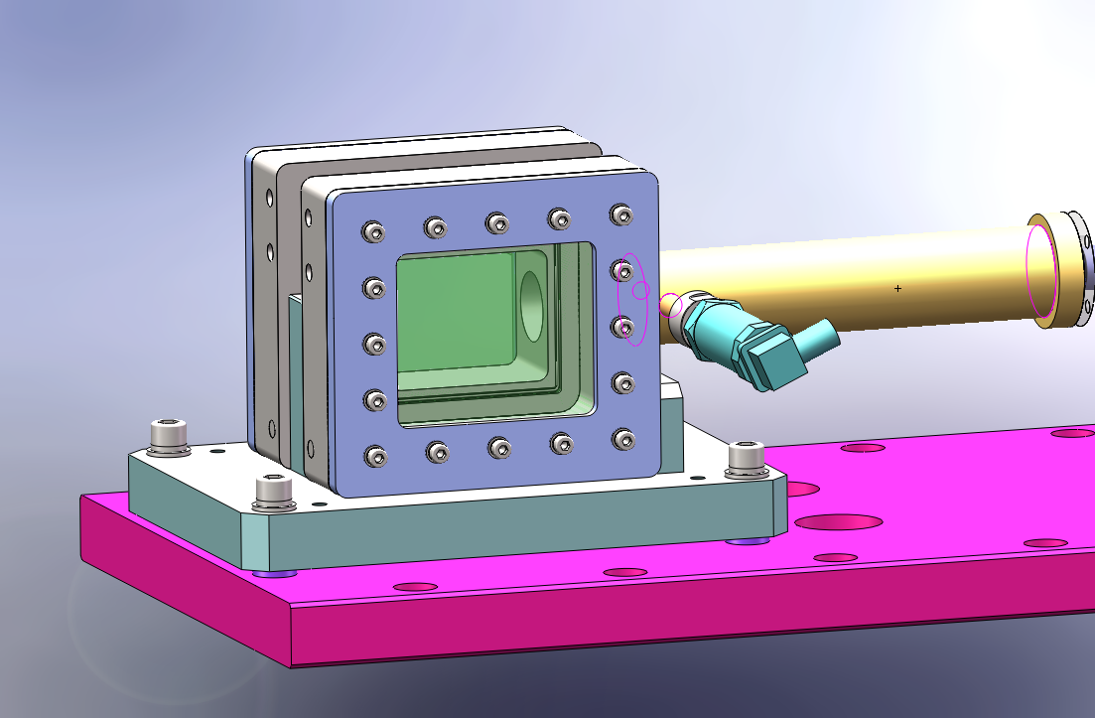
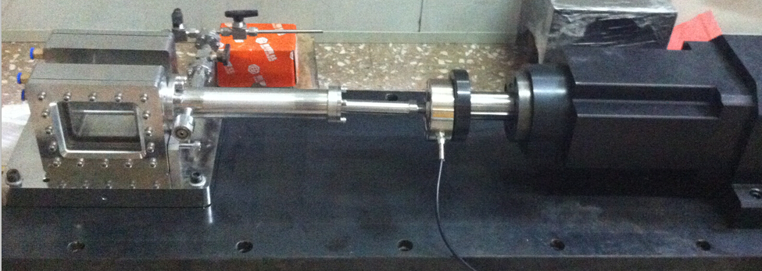
原型设计
Bubble Chamber：
45mm* 60mm * 75 mm
基本覆盖辐射场宽度，探测效率超过20%

Slide 16
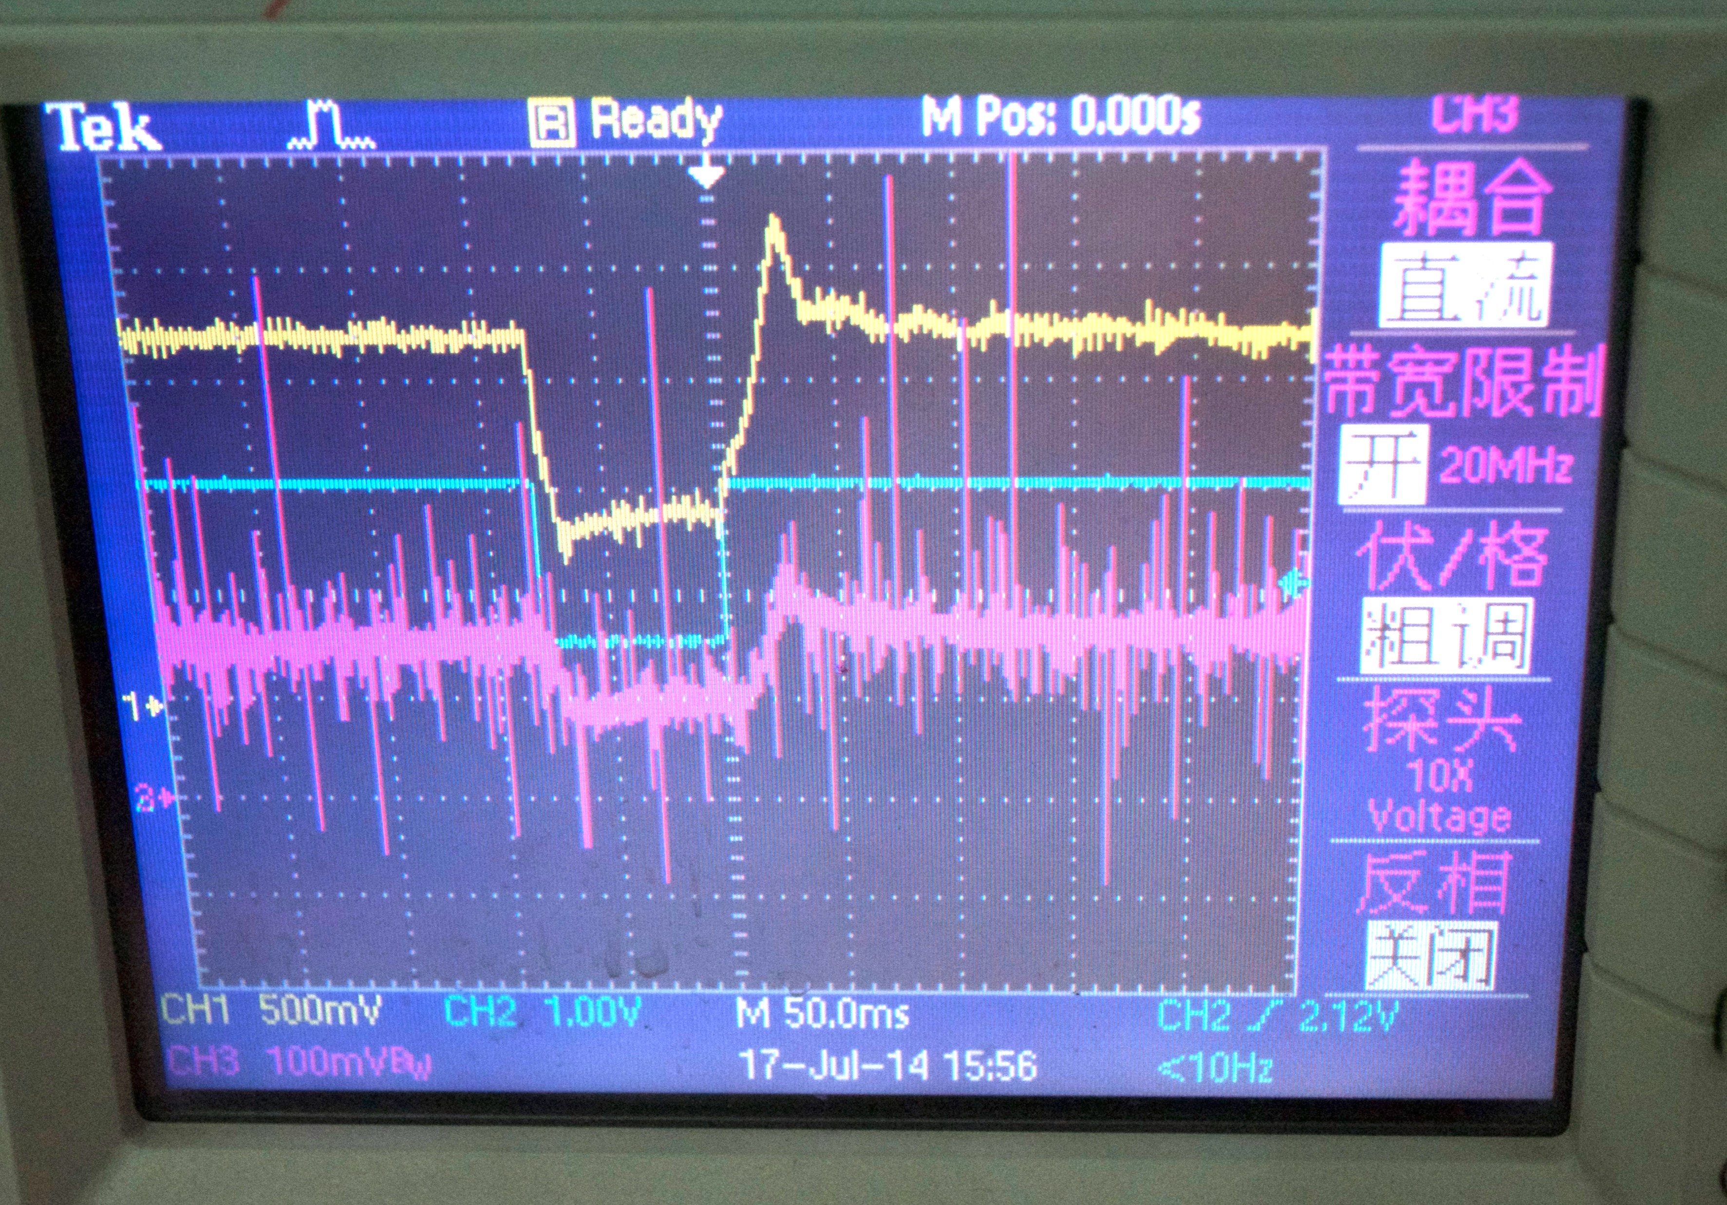

Slide 17
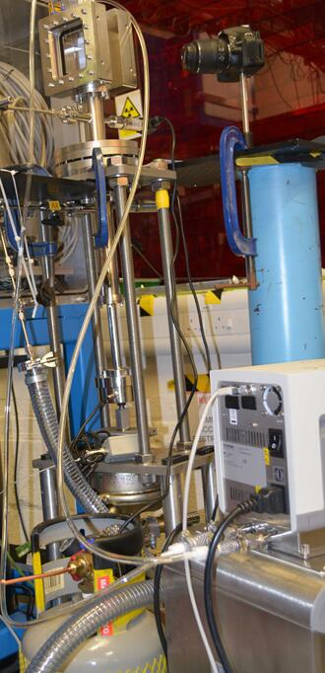
Ⅲ. The operating principle of bubble chamber
Bubble chamber head
Pressure control
Temperature control
Media source

Slide 18
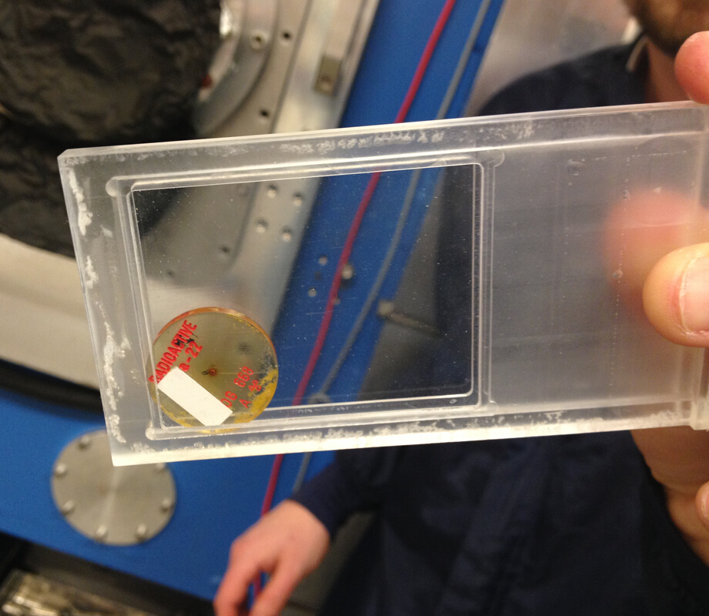
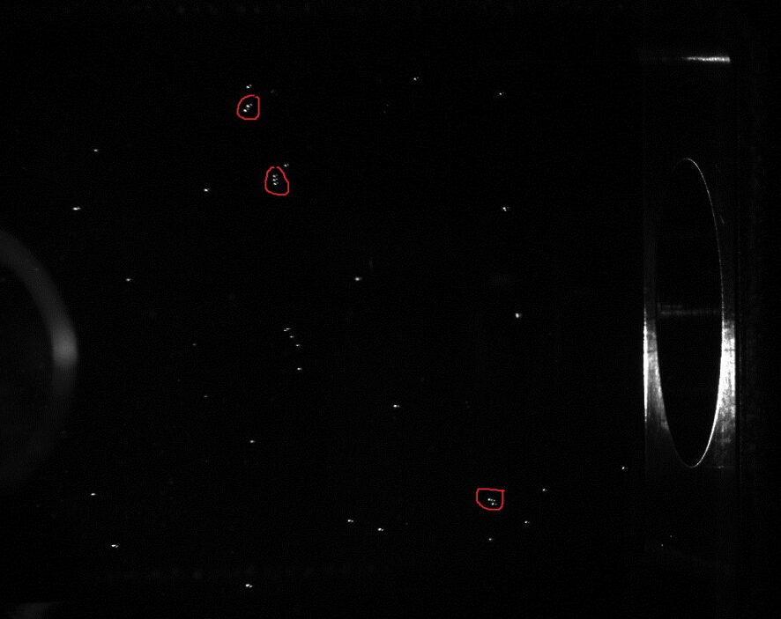
标定实验
calibration experiment
²²Na ~ 1.27MeV
300kBq

Slide 19
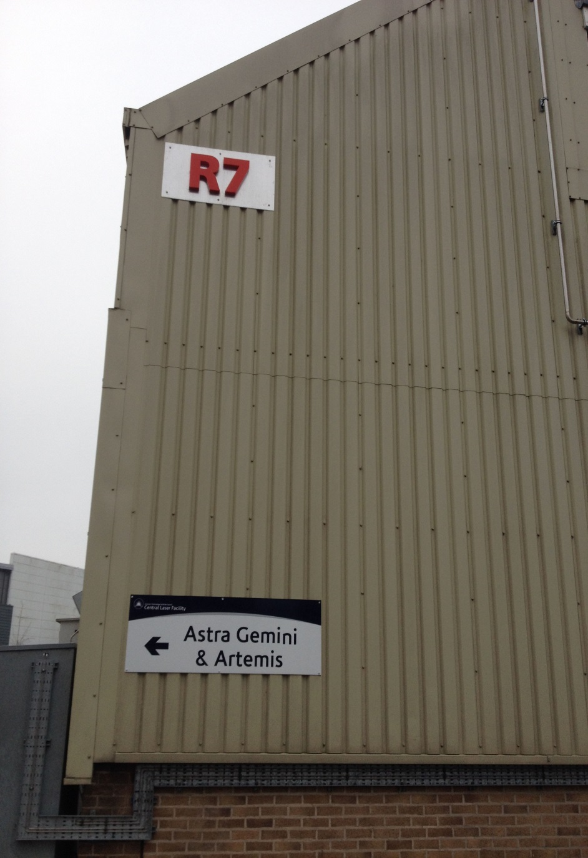
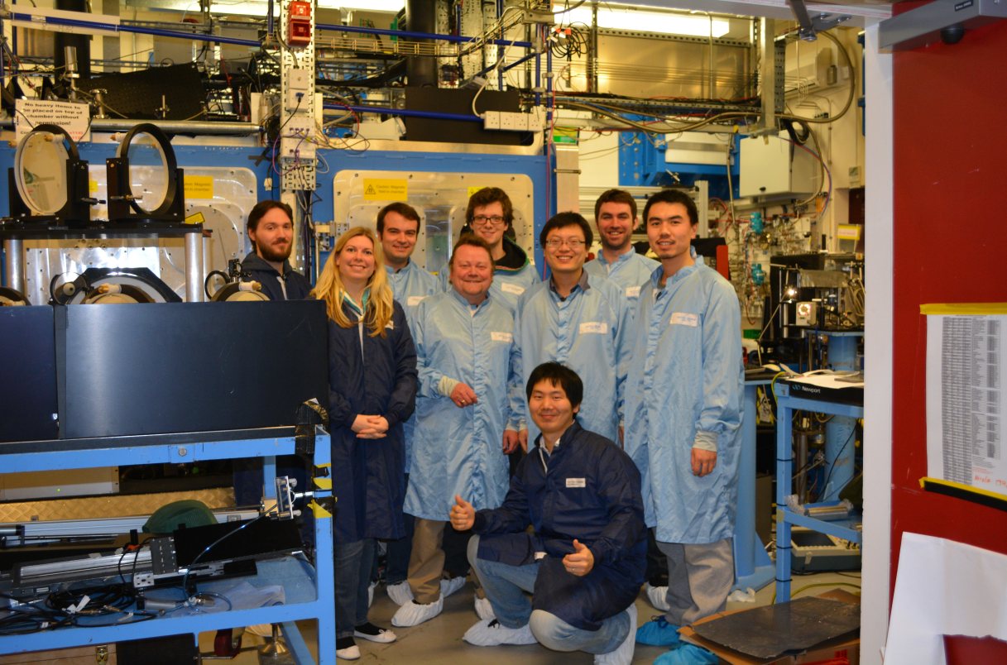
The experiment and results @ RAL
Astra Gemini
~ 10 J
wavelength
800nm
peak power of ~ 0.5 PW
Plasma lense
40 femtoseconds
~ 2x10²⁰ Wcm⁻²
Target : CNT

Slide 20
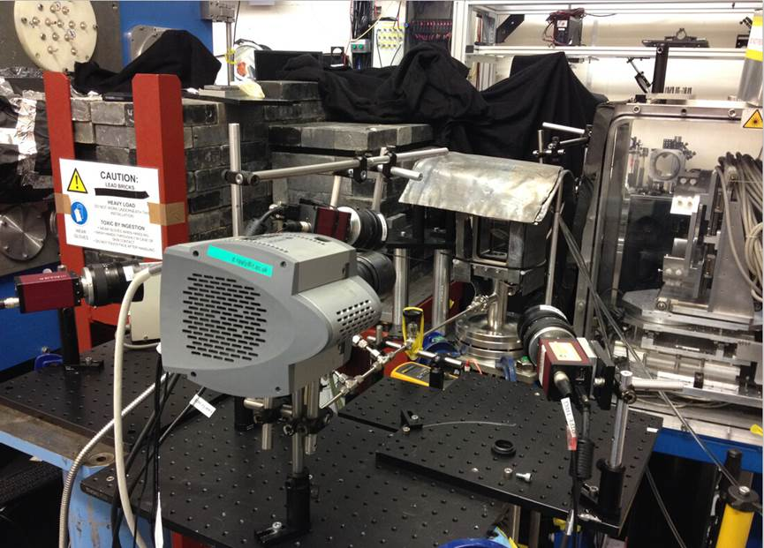
Ⅲ. The experiment conditions and results @ RAL
3
RAL, Gemini Laser
a~10, n~0.4 nc
MeV photons
observed
2
1
PKU: Novel Bubble Chamber gamma spectrum

Slide 21
一个结果
Notes:
Error should be taken into account in the reconstruction

Slide 22
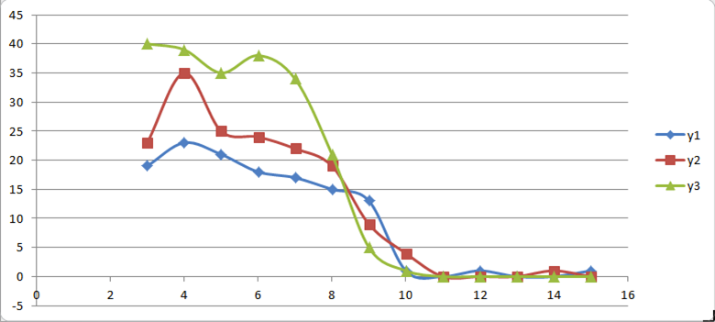
V. Our instruments and energy spectrum analysis
约1.3 MeV
径迹中气泡数

Slide 23
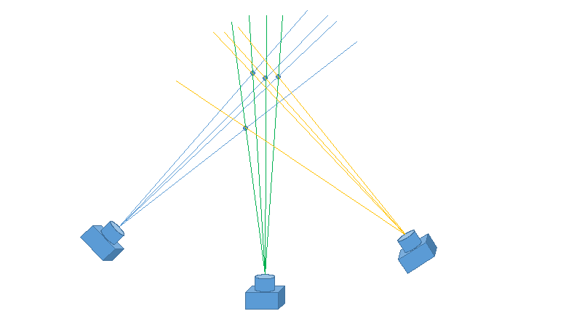
VI. Outlook 三维重建

Slide 24
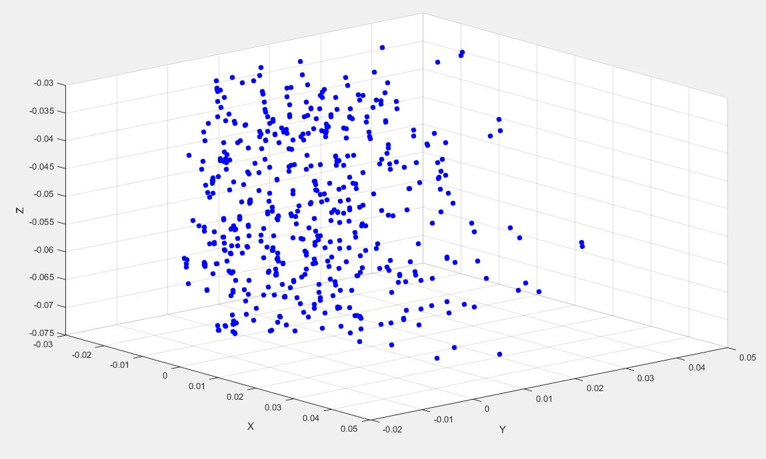
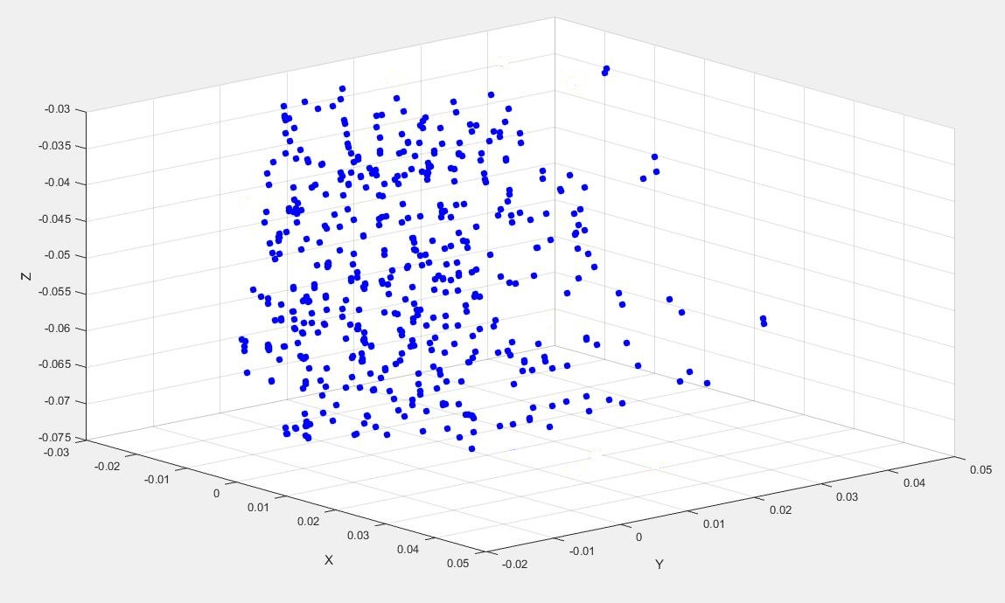
VI. Outlook
By Cloud Compare software

Slide 25
VI. Outlook
完成三维重建
加入康普顿散射角进行能谱重建

Slide 26
Thanks for your attention

