Slide 1

High Gain Compton Free Electron Laser
Chuan Yang
June 24, 2016
Acknowledgment:
K. Fang, R. Bosch, J.Y. Liang, M.H. Wang and J. Wu (SLAC)
NSRL, USTC
Institute of High Energy Physics, CAS June 23-June 25,2016
Chuan Yang

Slide 2
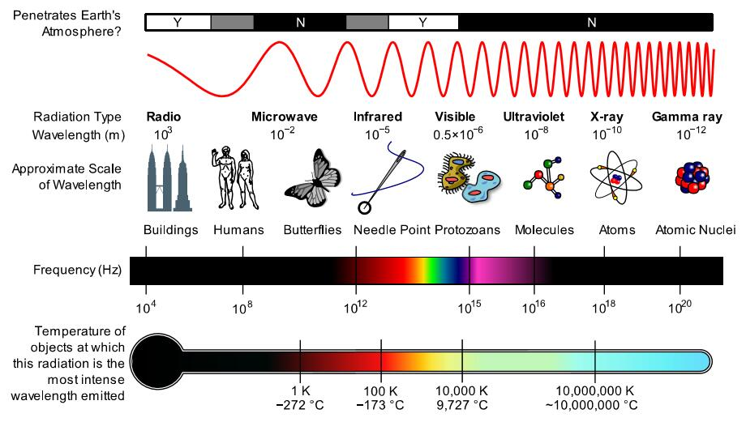

Spectrum of electromagnetic radiation
https://en.wikipedia.org/wiki/Electromagnetic_spectrum
NSRL, USTC
Institute of High Energy Physics, CAS June 23-June 25,2016
Chuan Yang

Slide 3
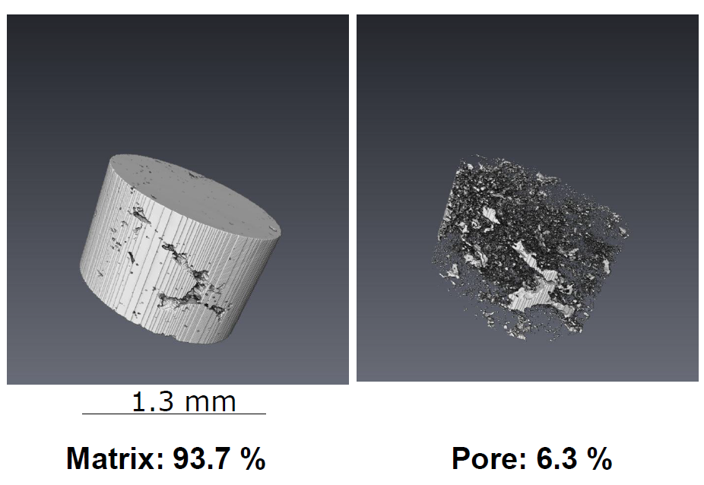
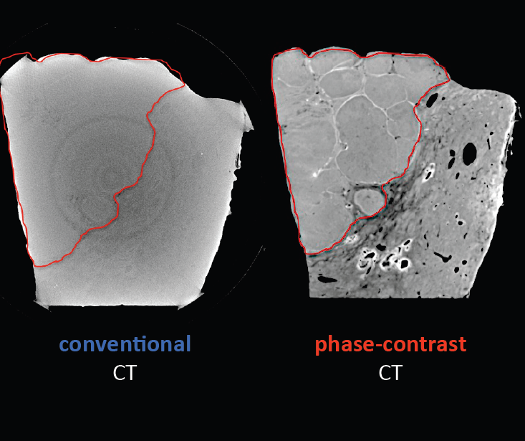
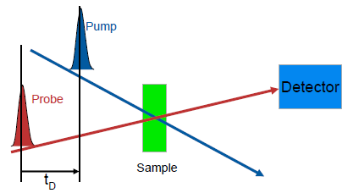
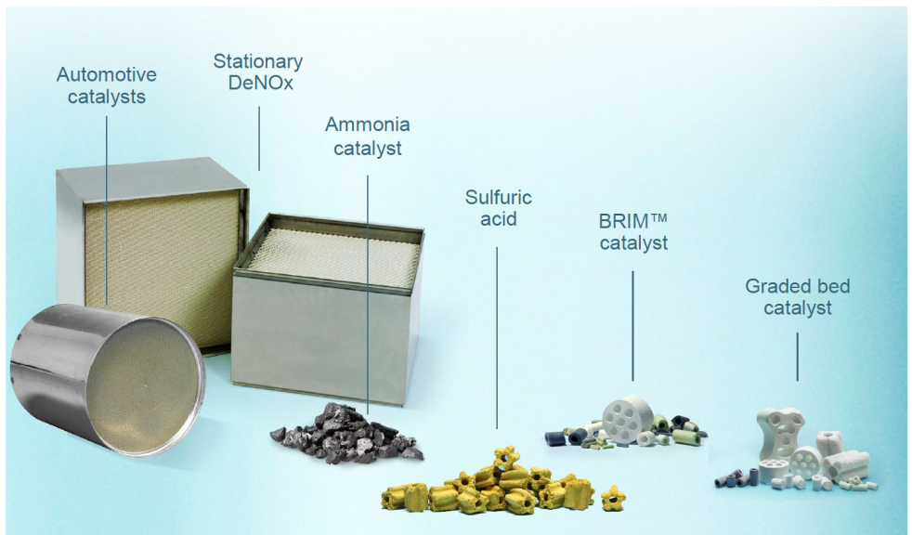
Potential with Coherent Compton sources
Porosity estimation
X-Ray phase contrast imaging
Pump Probe Method
In situ study under operating conditions.
25 (28%) of the 2015 LCLS papers used Optical Pump X-Ray probe
ALS BL 6.0.2, 44 publications (2010-2015)
NSRL, USTC
Institute of High Energy Physics, CAS June 23-June 25,2016
Chuan Yang

Slide 4
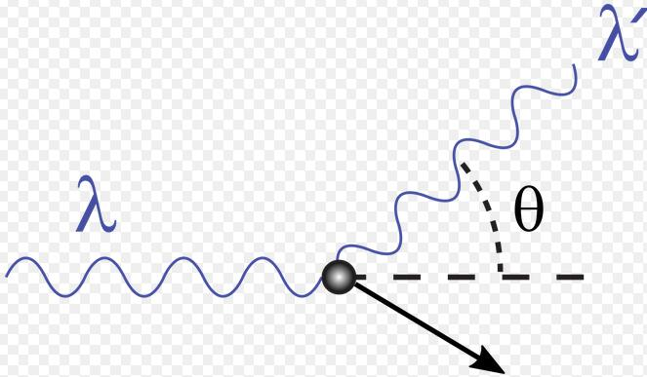
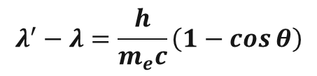
Compton Scattering
$$λ^{′}−λ=\frac{h}{m_{e}c}\left(1−\cos{θ}\right)$$
Strategy
Conclusion
https://en.wikipedia.org/wiki/Compton_scattering
NSRL, USTC
Institute of High Energy Physics, CAS June 23-June 25,2016
Chuan Yang

Slide 5
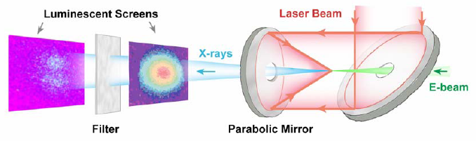
Compton Scattering
Sub Text
Compton Experiment at Brookhaven ATF
(record number of X-rays with 10 μm laser)
Source:
Collaboration meeting, Beijing, January 29-February 1, 2006
V. Yakimenko, I. Pogorelsky , BNL
NSRL, USTC
Institute of High Energy Physics, CAS June 23-June 25,2016
Chuan Yang

Slide 6
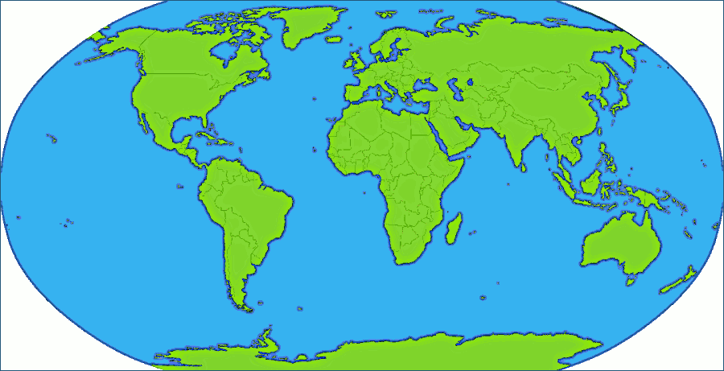
Compton X-ray facilities, projects, experiments around the world
Daresbury
ISU
NSC KIPT
MIT
BNL
J-Lab
LAL
THU
KAERI
MXI
INFN
AIST
Tokoy Univ.
Waseda Univ.
KEK
Lyncean Tech.
SINAP
Many facilities exist; more are planned
NSRL, USTC
Institute of High Energy Physics, CAS June 23-June 25,2016
Chuan Yang

Slide 7
Major Compton Gamma source facilities
around the world
MAX-Lab
ROKK
GRAAL
LADON
LEGS
LEPS
HIGS
SLEGS
Source:
48th ICFA future light sources workshop (FLS2010),SLAC. Y.K.Wu, Duke
NSRL, USTC
Institute of High Energy Physics, CAS June 23-June 25,2016
Chuan Yang

Slide 8
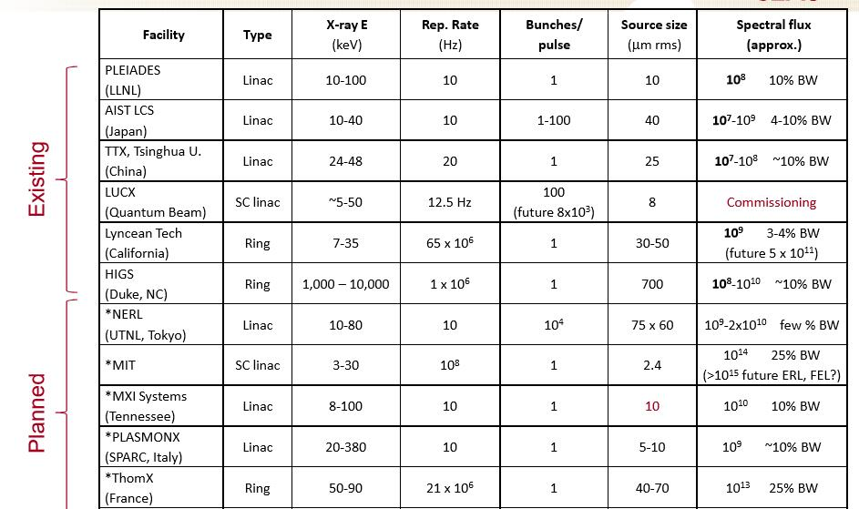
Some Existing or Planned Compton Sources
Source: SLAC summer school on electron and photon beams, July 22-26, 2013
NSRL, USTC
Institute of High Energy Physics, CAS June 23-June 25,2016
Chuan Yang

Slide 9
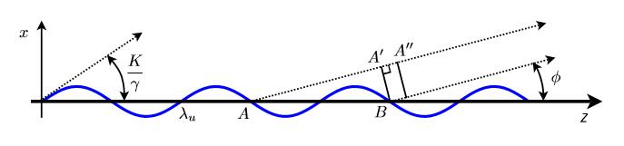
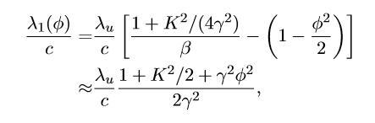
Resonance condition in an undulator
Source:
“Synchrotron Radiation and Free Electron Lasers : Principles of Coherent X-Ray Generation”
Kwang-Je Kim (ANL), Zhirong Huang (SLAC), Ryan Lindberg (ANL) May 15, 2013
NSRL, USTC
Institute of High Energy Physics, CAS June 23-June 25,2016
Chuan Yang

Slide 10
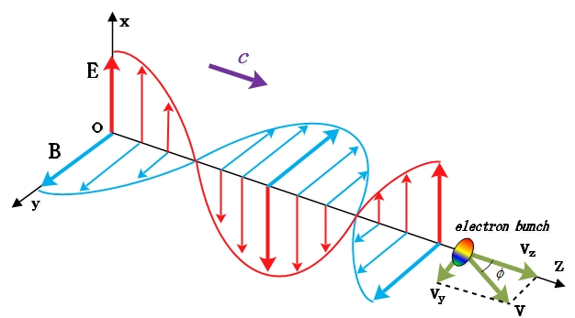

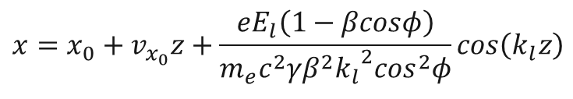
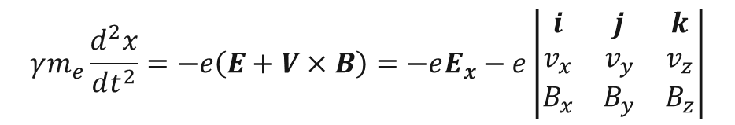
Electron’s trajectory in a laser undulator
The Lorentz force can be written as
$$γm_{e}\frac{d^{2}x}{dt^{2}}=−e\left(E+V×B\right)=−eE_{x}−e\left|\begin{matrix}i & j & k \\ v_{x} & v_{y} & v_{z} \\ B_{x} & B_{y} & B_{z}\end{matrix}\right|$$
Electron’s trajectory in $x$ direction
Resonance condition
$$x=x_{0}+v_{x_{0}}z+\frac{eE_{l}\left(1−βcosφ\right)}{m_{e}c^{2}γβ^{2}{{k_{l}}^{2}cos}^{2}φ}cos\left(k_{l}z\right)$$
NSRL, USTC
Institute of High Energy Physics, CAS June 23-June 25,2016
Chuan Yang

Slide 11
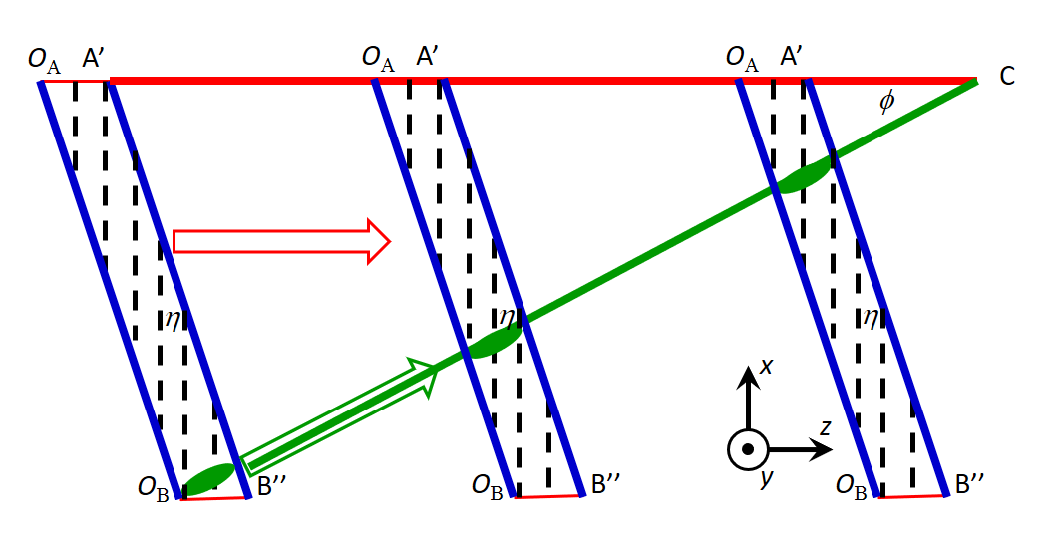

Coherent Compton Source (CCS) at SLAC
  We propose to study the feasibility of a new coherent X-ray source -- a High-Gain Compton source that utilizes laser pulse wavefront tilt to extend the electron-laser interaction time, therefore leading to high-gain X-ray production.
$$L_{u}$$
w
NSRL, USTC
Institute of High Energy Physics, CAS June 23-June 25,2016
Chuan Yang

Slide 12
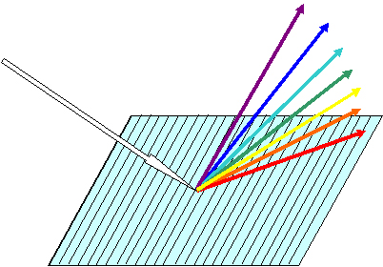
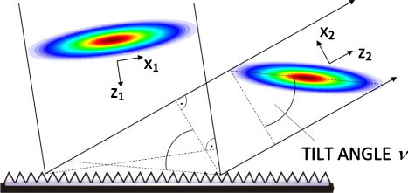
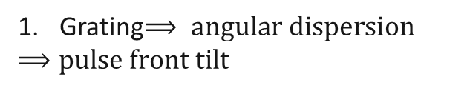
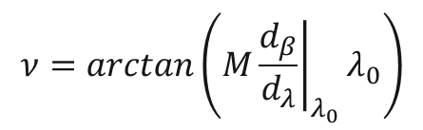
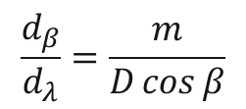
Laser beam
How can we get the pulse front tilt and pulse flattop we wanted ?
Grating$⟹ angular dispersion$
$$⟹pulse front tilt$$
Angular dispersion:
$$\frac{d_{β}}{d_{λ}}=\frac{m}{D\cos{β}}$$
grating generate angular dispersion
Pulse front tilt:
$$ν=arctan\left(M{\left.\frac{d_{β}}{d_{λ}}\right|}_{λ_{0}}λ_{0}\right)$$
pulse front tilt caused by angular dispersion
NSRL, USTC
Institute of High Energy Physics, CAS June 23-June 25,2016
Chuan Yang

Slide 13
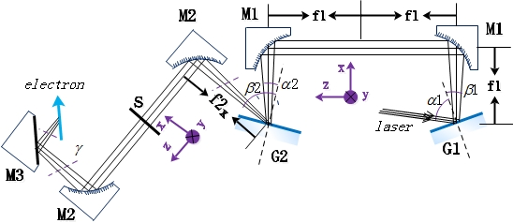
Pulse front tilt and pulse flattop
Laser beam
The following figure shows the dispersive plane (x-z plane) of the optics design which can realize the tilted front and flattop.
Dispersive plane (x-z plane) Where G1 means grating, G2 is a DMD which can act as a grating M1: parabolic mirror, M2, M3: cylindrical mirror, S: slit
NSRL, USTC
Institute of High Energy Physics, CAS June 23-June 25,2016
Chuan Yang

Slide 14
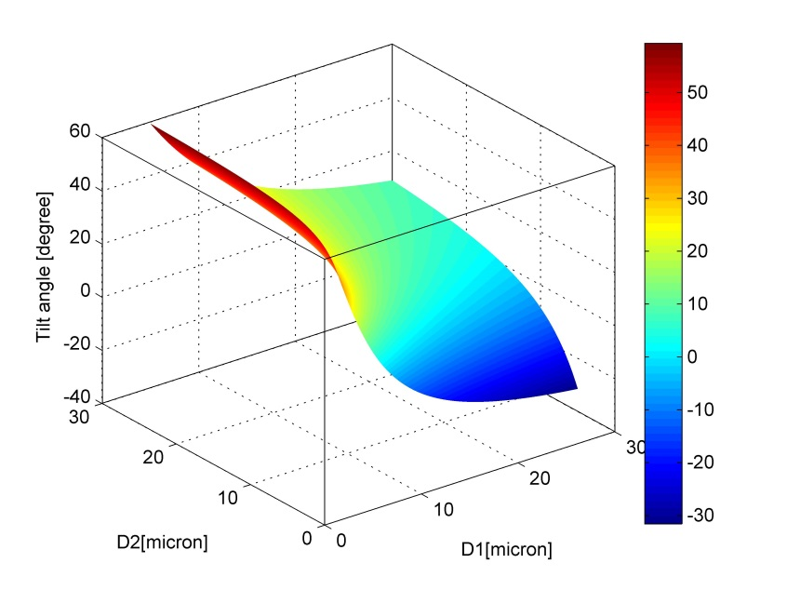
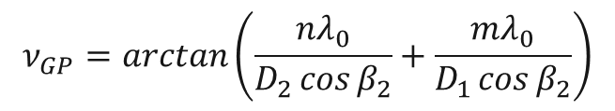
Laser beam
The tilt angle caused by G1 and G1
$$ν_{GP}=arctan\left(\frac{nλ_{0}}{D_{2}\cos{β_{2}}}+\frac{mλ_{0}}{D_{1}\cos{β_{2}}}\right)$$
pulse front tilt caused by grating pair
NSRL, USTC
Institute of High Energy Physics, CAS June 23-June 25,2016
Chuan Yang

Slide 15
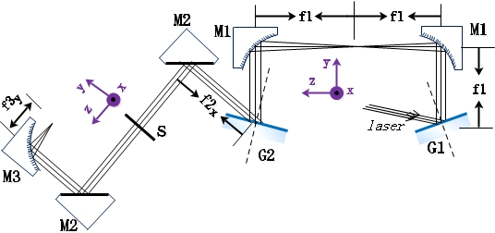
Laser beam
Pulse focusing
The optics in the vertical plane focus the sheared laser beam onto electron trajectory.
--Our optics system is designed for a sheared laser undulator with 1cm width and tens of micron height.
NSRL, USTC
Institute of High Energy Physics, CAS June 23-June 25,2016
Chuan Yang

Slide 16
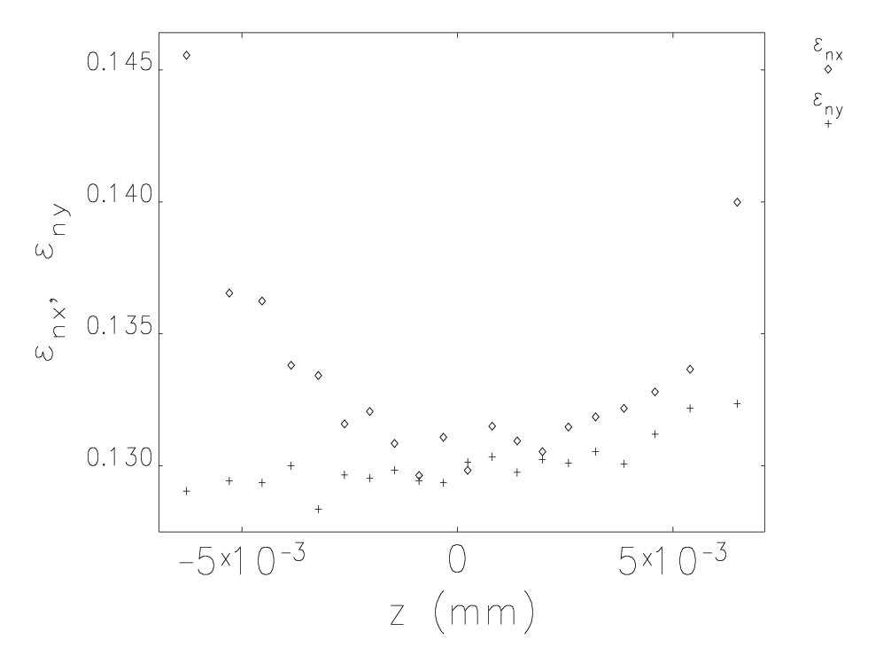
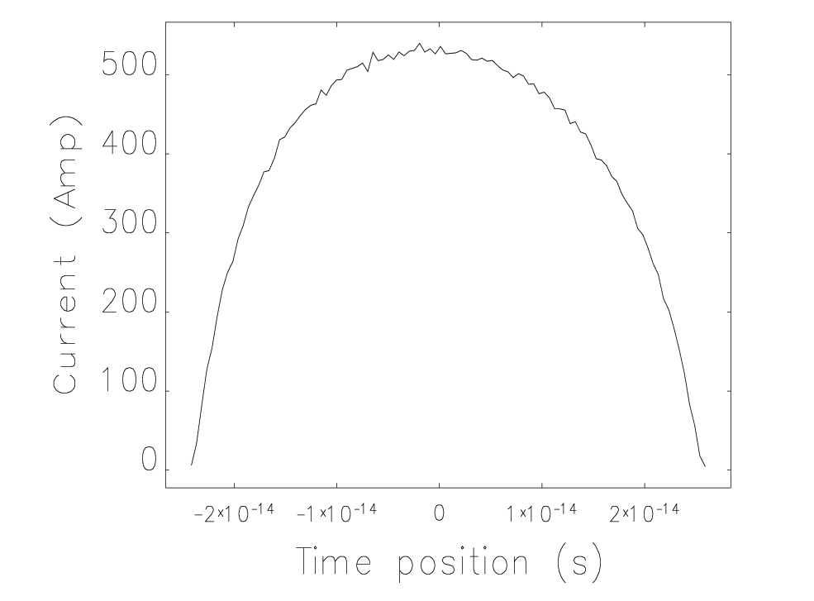
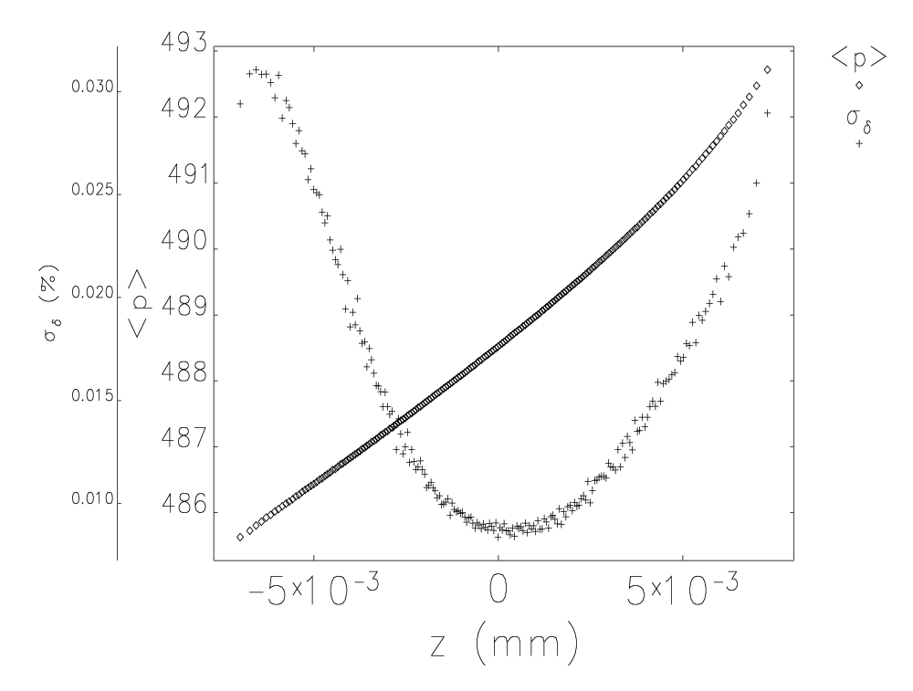
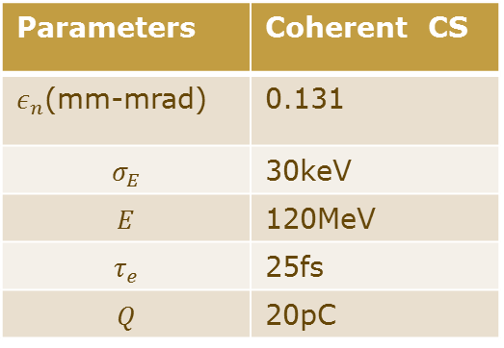
Electron Beam
Parameters | Coherent CS
$ε_{n}$(mm-mrad) | 0.131
$$σ_{E}$$ | 30keV
$$E$$ | 120MeV
$$τ_{e}$$ | 25fs
$$Q$$ | 20pC
NSRL, USTC
Institute of High Energy Physics, CAS June 23-June 25,2016
Chuan Yang

Slide 17

FEL interaction
$λ_{u}=\frac{λ_{pump}}{1−\cos{φ}}$
$λ_{s}=\frac{1+a_{w}^{2}}{2γ^{2}}λ_{u}$
$L_{u}=\frac{w}{\sin{φ}}$
$a_{w}^{2}=\frac{{r_{e}λ}_{p}^{2}}{πm_{e}c^{3}}\frac{E_{pump}}{τwσ_{y}}$
$L_{u}∝β_{e}$
$$L_{u}$$
w
Only beam energy $γ$and laser width w are free parameters.
NSRL, USTC
Institute of High Energy Physics, CAS June 23-June 25,2016
Chuan Yang

Slide 18
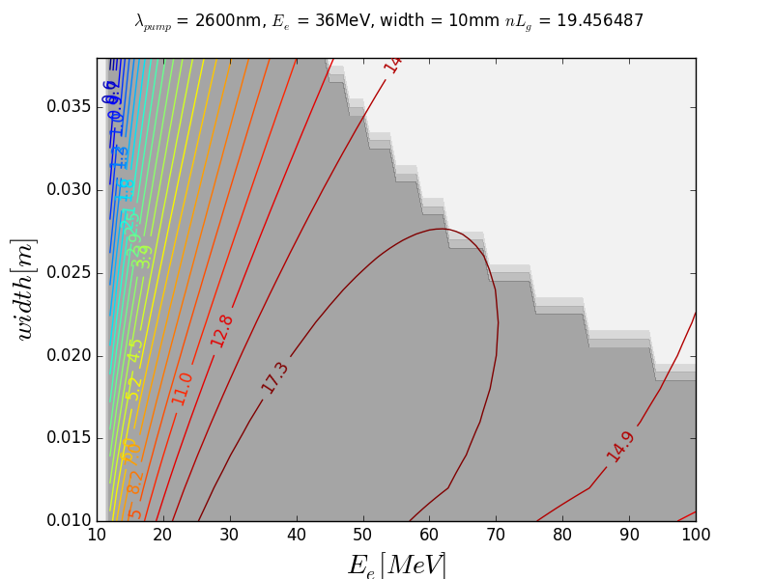
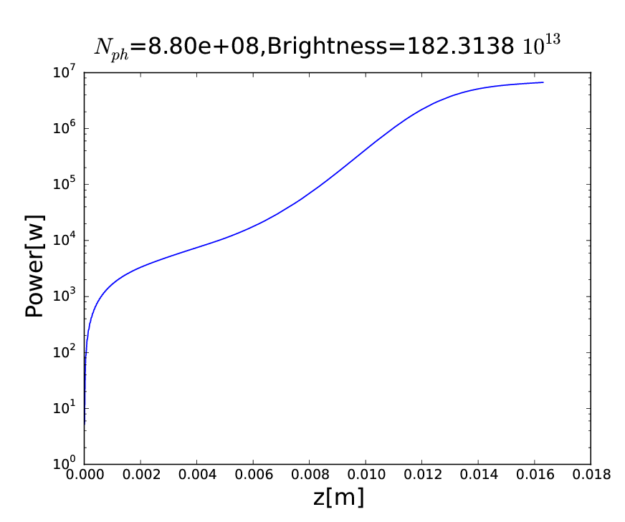
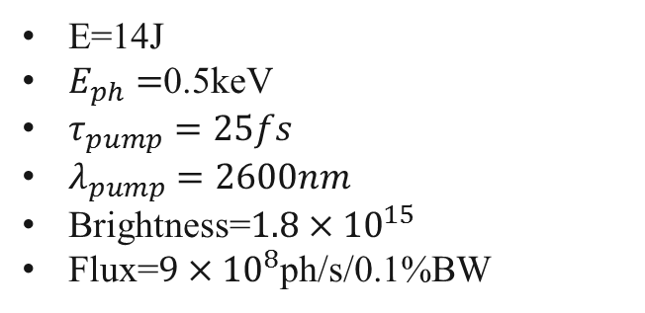
FEL optimization
E=14J
$E_{ph}=$0.5keV
$τ_{pump}=25fs$
$λ_{pump}=2600nm$
Brightness=$1.8×{10}^{15}$
Flux=$9×{10}^{8}$ph/s/0.1%BW
19 Gain Length
NSRL, USTC
Institute of High Energy Physics, CAS June 23-June 25,2016
Chuan Yang

Slide 19
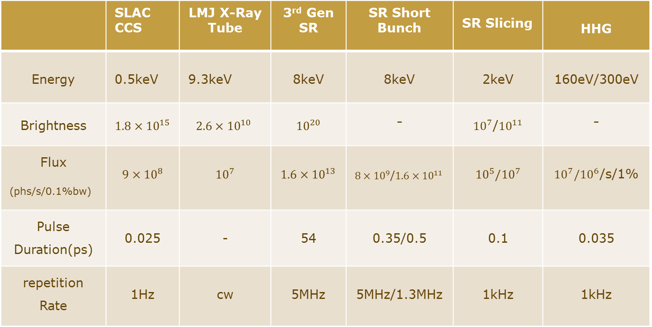
Comparison with other X-Ray sources
 | SLAC CCS | LMJ X-Ray Tube | 3rd Gen SR | SR Short Bunch | SR Slicing | HHG
Energy | 0.5keV | 9.3keV | 8keV | 8keV | 2keV | 160eV/300eV
Brightness | $$1.8×{10}^{15}$$ | $$2.6×{10}^{10}$$ | $${10}^{20}$$ | - | ${10}^{7}$/${10}^{11}$ | -
Flux (phs/s/0.1%bw) | $$9×{10}^{8}$$ | $${10}^{7}$$ | $$1.6×{10}^{13}$$ | $8×{10}^{9}$/$1.6×{10}^{11}$ | $${10}^{5}/{10}^{7}$$ | ${10}^{7}/{10}^{6}$/s/1%
Pulse Duration(ps) | 0.025 | - | 54 | 0.35/0.5 | 0.1 | 0.035
repetition Rate | 1Hz | cw | 5MHz | 5MHz/1.3MHz | 1kHz | 1kHz
LMJ X-Ray Tube: Liquid Metal Jet X-Ray tube.
SR Short Bunch: High order cavity and low alpha
NSRL, USTC
Institute of High Energy Physics, CAS June 23-June 25,2016
Chuan Yang

Slide 20
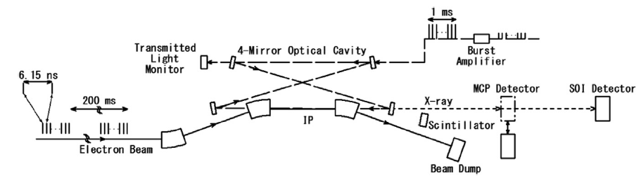
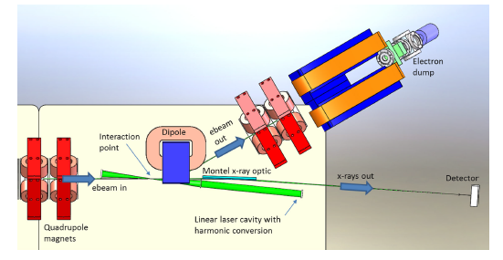
Future work
Investigate the possible laser cavity schemes.
Quantum Beam
Design MW storage power
Non stacking. Pulses train see the same decaying laser pulse.
MIT
NSRL, USTC
Institute of High Energy Physics, CAS June 23-June 25,2016
Chuan Yang

Slide 21
Thank you!
NSRL, USTC
Institute of High Energy Physics, CAS June 23-June 25,2016
Chuan Yang

