Slide 1
Bremsstrahlung and nonlinear Compton scattering simulation in the ultraintense Laser interacting with high-Z Plasmas
Wan Feng, Xie Baisong
Beijing Normal University

Slide 2
outline
Background
Simulation tools
Primitive results
Outlook

Slide 3
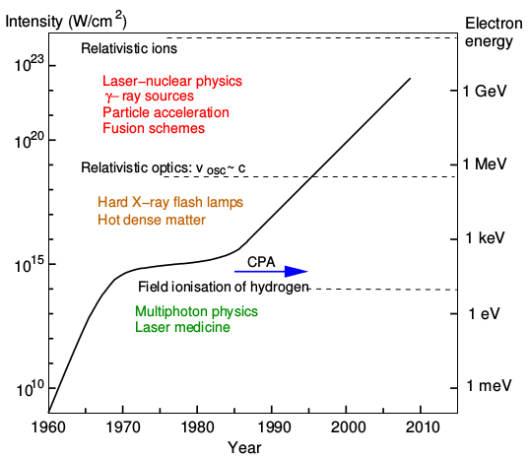
Laser development
The Eli-beam → $10 PW, I≈{10}^{23}W/cm^{2}$ with focus $r=1μm, λ=1μm, 30fs$

Slide 4
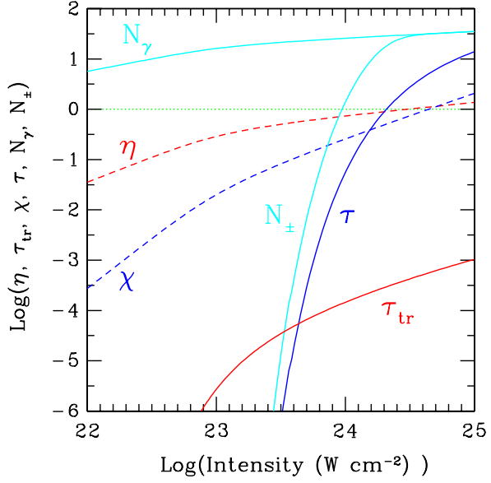
Nonlinear Compton scattering
Quantum parameters controlling the nonlinear Compton scattering and pair conversion:
$$η=\frac{eℏ}{m^{3}c^{4}} \left|F_{μν}p^{ν}\right|$$
$$χ=\frac{eℏ^{2}}{2m^{3}c^{4}} \left|F^{μν}k_{ν}\right|$$
$$\frac{dτ_{e}}{dt}=\int_{0}^{η/2}{\frac{d^{2}N}{dtdχ\left(η,χ\right)}dχ=λ(η)}$$
$$\frac{dτ_{±}}{dt}=\frac{2πα_{f}c}{λ_{c}}\frac{m_{e}c^{2}}{hν_{γ}} χT_{±}\left(χ\right)=λ_{±}\left(χ\right)$$
Ridgers, C. P., Kirk, J. G., Duclous, R., Blackburn, T. G., Brady, C. S., Bennett, K., … Bell, A. R. (2014). Modelling gamma-ray photon emission and pair production in high-intensity laser–matter interactions. Journal of Computational Physics, 260, 273–285.
Figure : Pair production parameters vs laser intensity cf(Bell, A. R., Kirk, J. G. (2008). Phys. Rev. Lett., 101(20), 200403.)

Slide 5
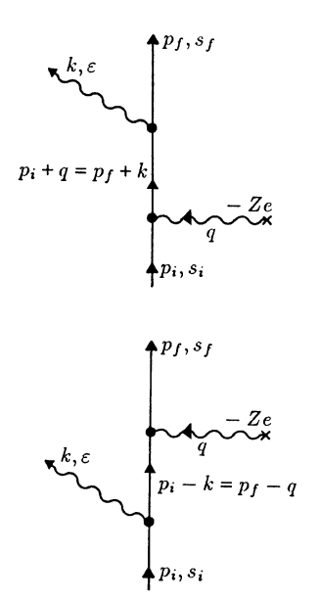
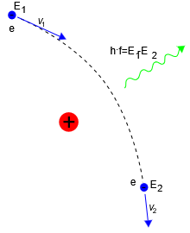
Bremsstrahlung

Slide 6
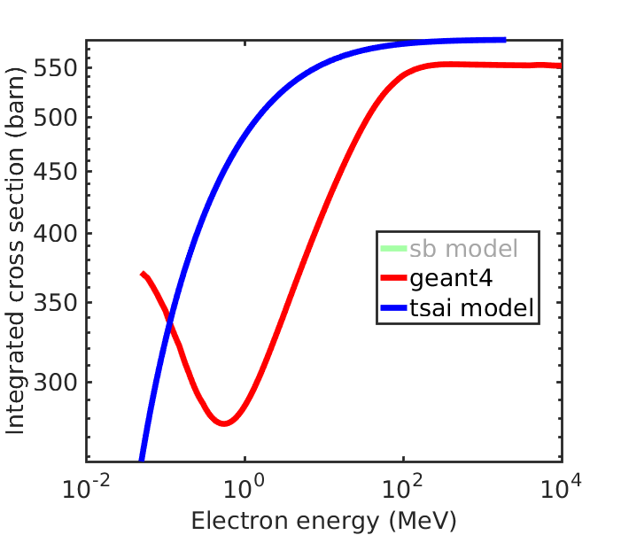
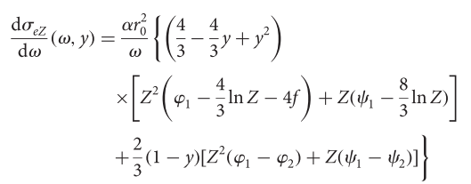
total cs for Au(79)
$$y=\frac{ℏω}{E_{e}}$$
$φ_{1,2}, ψ_{1,2}$ Atomic electron screen function
$f$ Coulomb correction term.
Tsai, Y.-S. (1974). Pair production and bremsstrahlung of charged leptons. Reviews of Modern Physics, 46(4), 815–851.

Slide 7
Implement to PIC
Nonlinear Compton
Bremsstrahlung
PIC
Breit-Wheeler pair
Bethe-Heitler pair

Slide 8
Implement to PIC
Calculate target density on grid $n_{i}$
Find the electron’s correspond total cs $σ(E)$
Reaction Probability $P=1 −exp⁡(−n_{i}σ\left(E\right)v∆t)$
Random Probability $R_{1}$
$$ℏω=Eκ, \frac{\vec{k}}{\left|k\right|}=\frac{\vec{v}}{\left|v\right|}$$
$$σ\left(E, κ\right)=R_{2}σ(E)$$
$$R_{1}<P$$

Slide 9
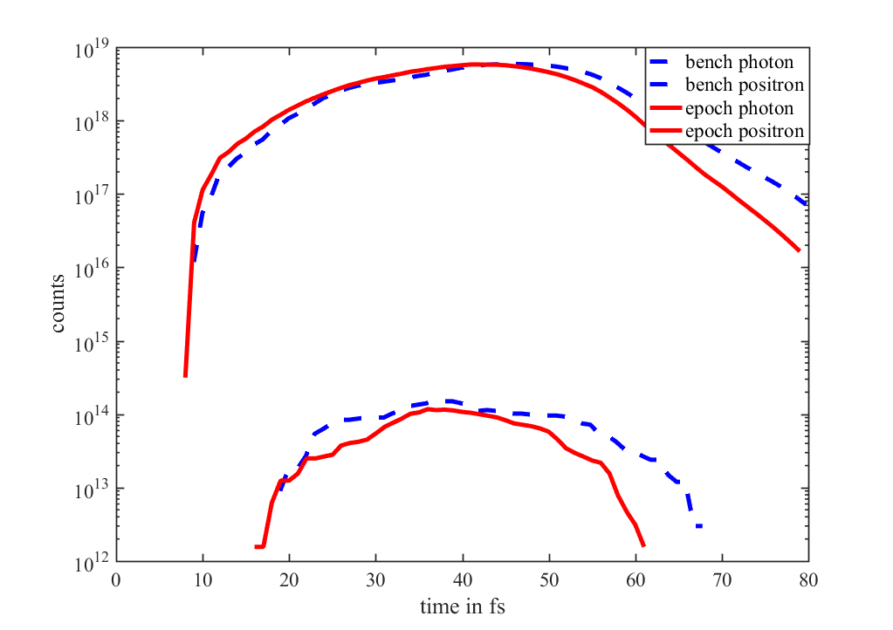
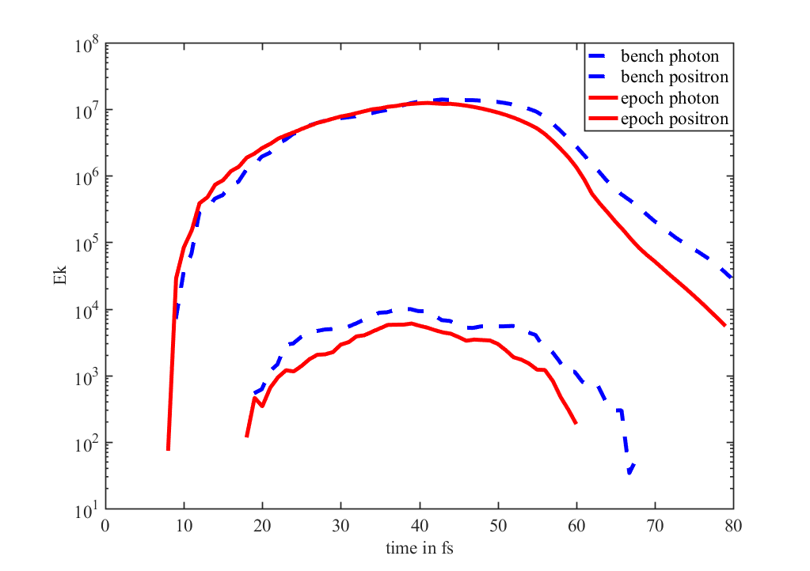
Benchmarking with EPOCH

Slide 10
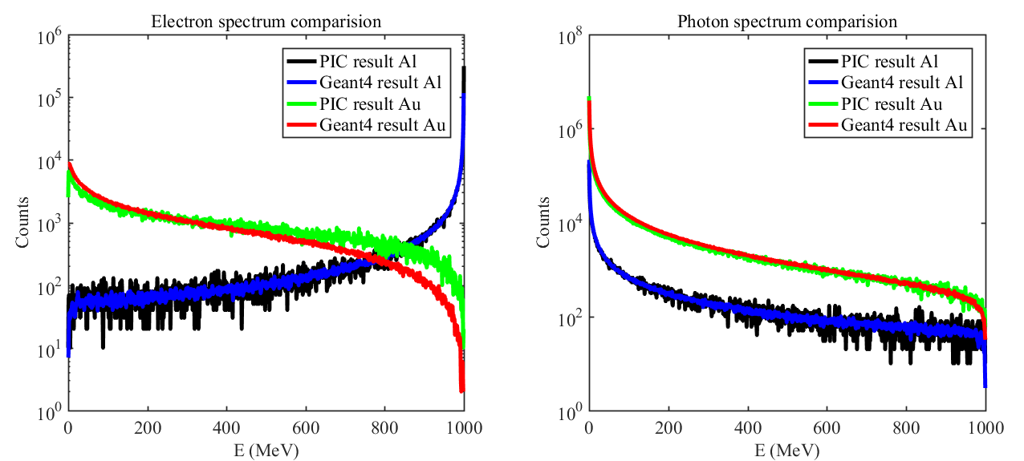
Benchmarking with geant4
$$E_{e^{−}}=1 GeV$$
In the PIC simulation $N_{e^{−}}={10}^{5}$
The angular distribution has not been ignored.
Thick $t=5mm$
In the Geant4 $N_{e^{−}}={10}^{6}$
The spectra of PIC have been multiplied with 10.

Slide 11
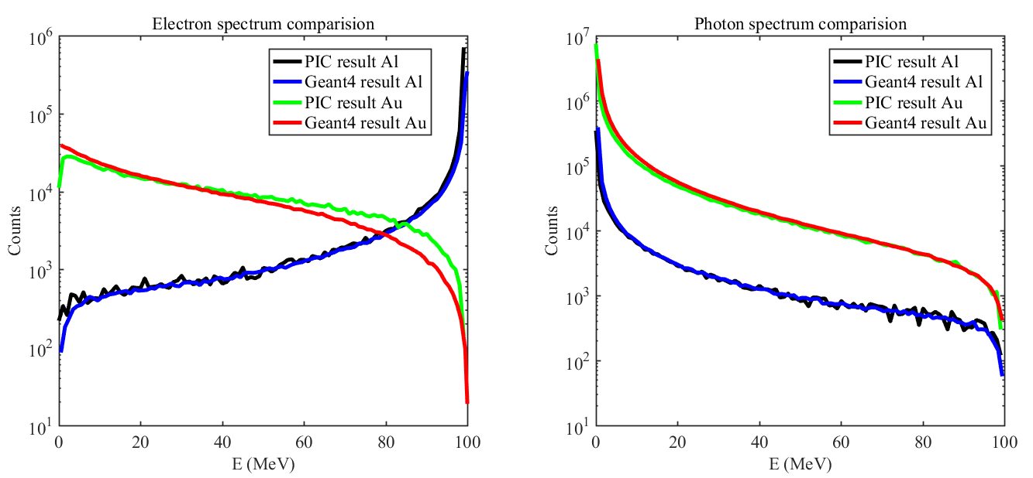
Benchmarking with geant4
$$E_{e^{−}}=100 MeV$$
In the PIC simulation $N_{e^{−}}={10}^{5}$
The angular distribution has not been ignored.
Thick $t=5mm$
In the Geant4 $N_{e^{−}}={10}^{6}$
The spectra of PIC have been multiplied with 10.

Slide 12
Studies on low Z target H, C, Al
Brady, C. S., Ridgers, C. P., Arber, T. D., & Bell, a R. (2013). Gamma-ray emission in near critical density plasmas. Plasma Physics and Controlled Fusion, 55(12), 124016
Brady, C. S., Ridgers, C. P., Arber, T. D., & Bell, A. R. (2014). Synchrotron radiation, pair production, and longitudinal electron motion during 10-100 PW laser solid interactions. Physics of Plasmas, 21(3), 033108.
Brady, C. S., Ridgers, C. P., Arber, T. D., Bell, A. R., & Kirk, J. G. (2012). Laser absorption in relativistically underdense plasmas by synchrotron radiation. Physical Review Letters, 109(24), 1–5.
Bulanov, S. S. (2004). Pair production by a circularly polarized electromagnetic wave in a plasma. Physical Review E, 69(3), 036408.
Bulanov, S. V., Esirkepov, T. Z., Habs, D., Pegoraro, F., & Tajima, T. (2009). Relativistic laser-matter interaction and relativistic laboratory astrophysics. The European Physical Journal D, 55(2), 483–507.
Capdessus, R., & McKenna, P. (2015). Influence of radiation reaction force on ultraintense laser-driven ion acceleration. Physical Review E, 91(5), 053105.
Chang, H. X., Qiao, B., Xu, Z., Xu, X. R., Zhou, C. T., Yan, X. Q., … He, X. T. (2015). Generation of overdense and high-energy electron-positron-pair plasmas by irradiation of a thin foil with two ultraintense lasers. Physical Review E, 92(5), 053107.
Chen, M., Pukhov, A., Yu, T.-P., & Sheng, Z.-M. (2011). Radiation reaction effects on ion acceleration in laser foil interaction. Plasma Physics and Controlled Fusion, 53(1), 014004.
Ji, L. L., Pukhov, A., Nerush, E. N., Kostyukov, I. Y., Shen, B. F., & Akli, K. U. (2014). Energy partition, γ-ray emission, and radiation reaction in the near-quantum electrodynamical regime of laser-plasma interaction. Physics of Plasmas, 21(2), 023109.
Ji, L. L., Pukhov, A., Nerush, E. N., Kostyukov, I. Y., Akli, K. U., & Shen, B. F. (2014). Near QED regime of laser interaction with overdense plasmas. The European Physical Journal Special Topics, 223(6), 1069–1082
Luo, W., Zhu, Y.-B., Zhuo, H.-B., Ma, Y.-Y., Song, Y.-M., Zhu, Z.-C., … Chen, M. (2015). Dense electron-positron plasmas and gamma-ray bursts generation by counter-propagating quantum electrodynamics-strong laser interaction with solid targets. Physics of Plasmas, 22(6), 063112.
Ridgers, C. P., Brady, C. S., Duclous, R., Kirk, J. G., Bennett, K., Arber, T. D., & Bell, A. R. (2013). Dense electron-positron plasmas and bursts of gamma-rays from laser-generated quantum electrodynamic plasmas. Physics of Plasmas, 20(5), 056701.
Ridgers, C. P., Brady, C. S., Duclous, R., Kirk, J. G., Bennett, K., Arber, T. D., … Bell, A. R. (2012). Dense Electron-Positron Plasmas and Ultraintense γ rays from Laser-Irradiated Solids. Physical Review Letters, 108(16), 165006.

Slide 13
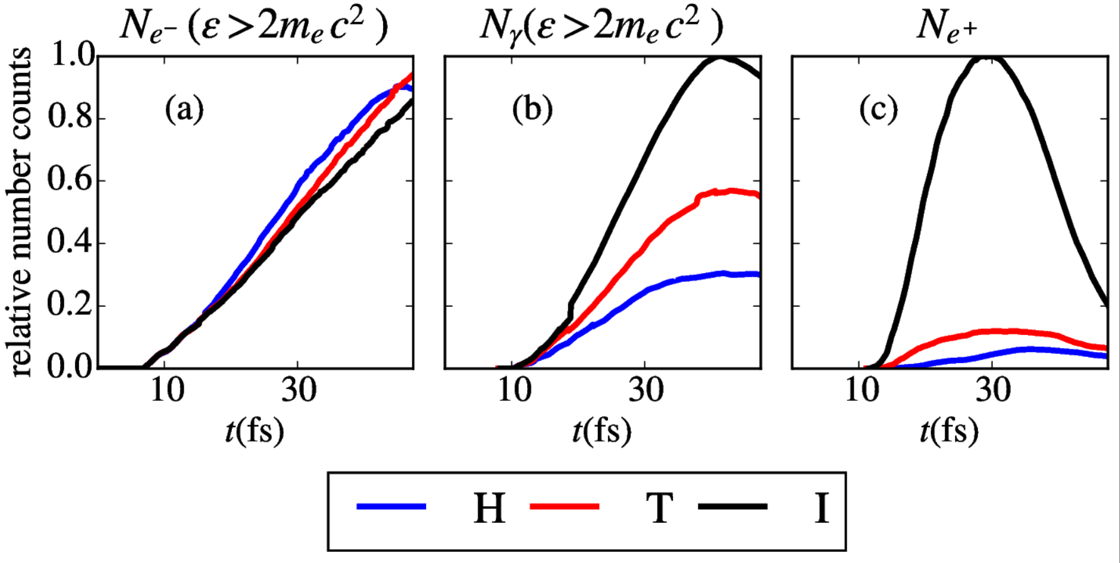
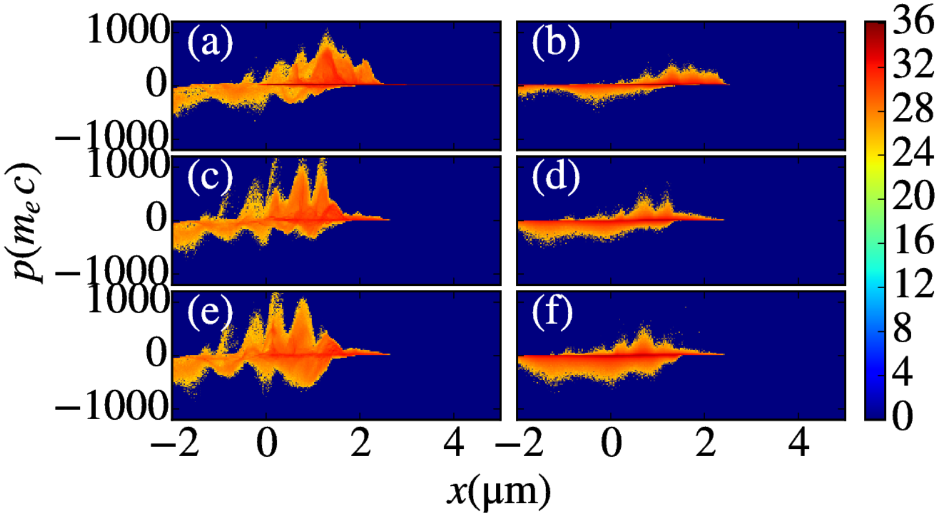
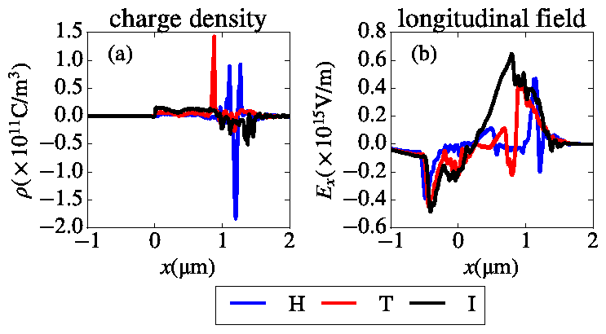
Ion mass effects on the pair production in the interaction of ultraintense laser with plasmas
arXiv:1605.06726

Slide 14
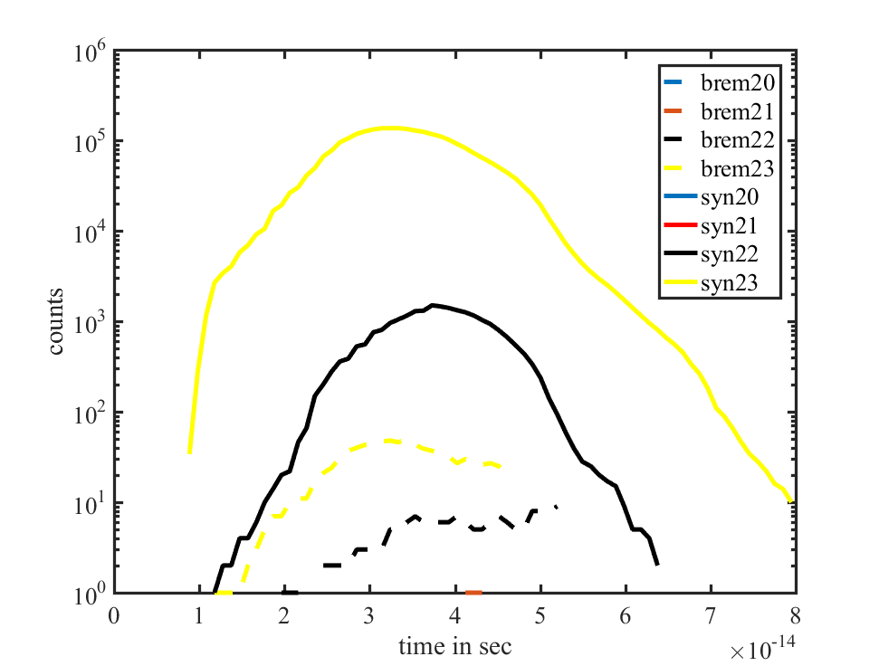
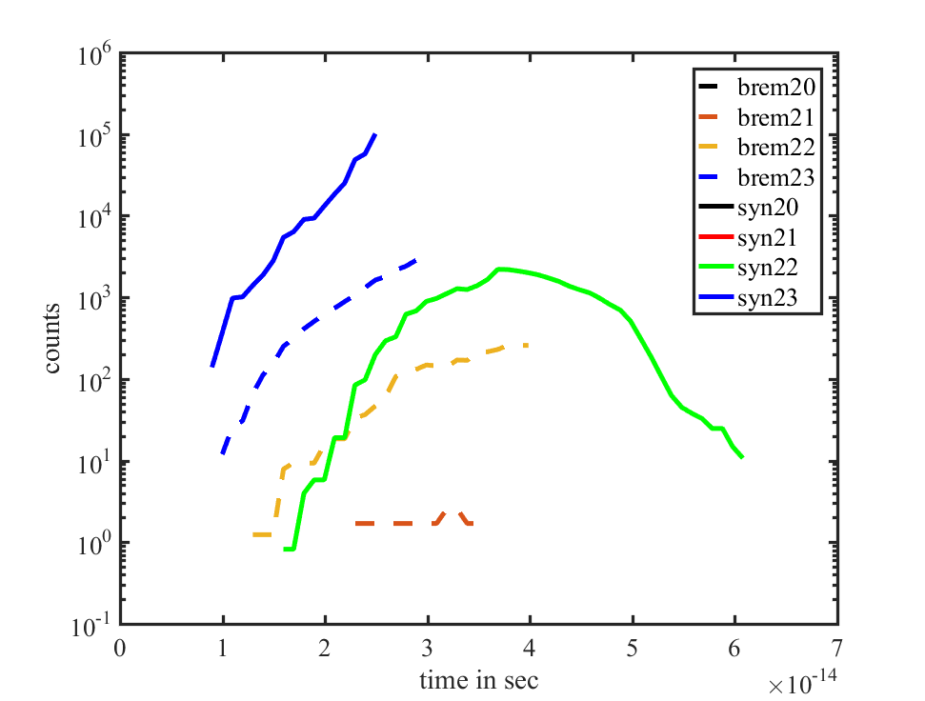
Bremsstrahlung vs Nonlinear Compton scattering
$2mm$ Al target $n_{e}\sim 700n_{c}$
2mm Au target $n_{e}\sim 4244n_{c}$

Slide 15
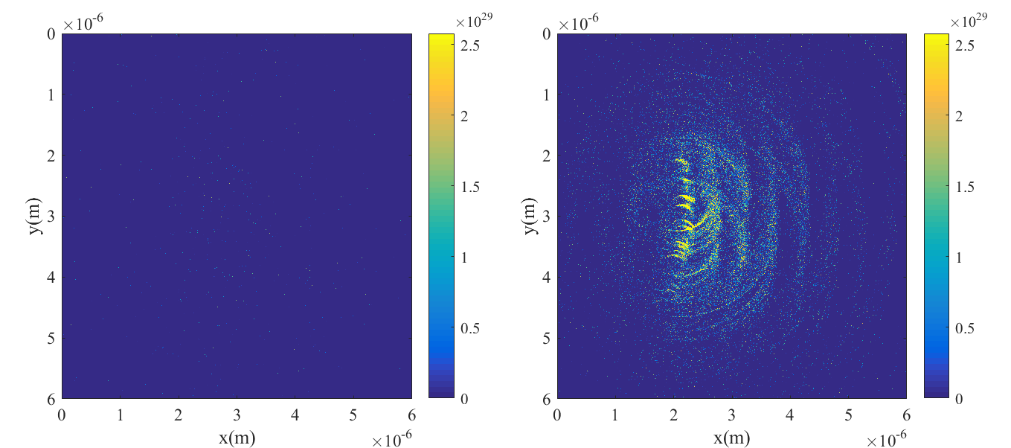
Bremsstrahlung vs Nonlinear Compton scattering
$n_{γ}$ , Au target $n_{e}\sim 4244n_{c}$, $I=1×{10}^{23}W/cm^{2}$

Slide 16
outlook
Angular distribution.
Pair production
In mixture target

Slide 17
Thanks for your attention!

