Slide 1
Beam collimation for SPPC
ZOU ye Tang jingyu, yang jianquan
2016.09.02

Slide 2
Outline
Introduction about beam collimation
Introduction about LHC and HL-LHC collimation system
Consideration about new collimation optics for SPPC
Preliminary multi-particle simulation results
Next step

Slide 3
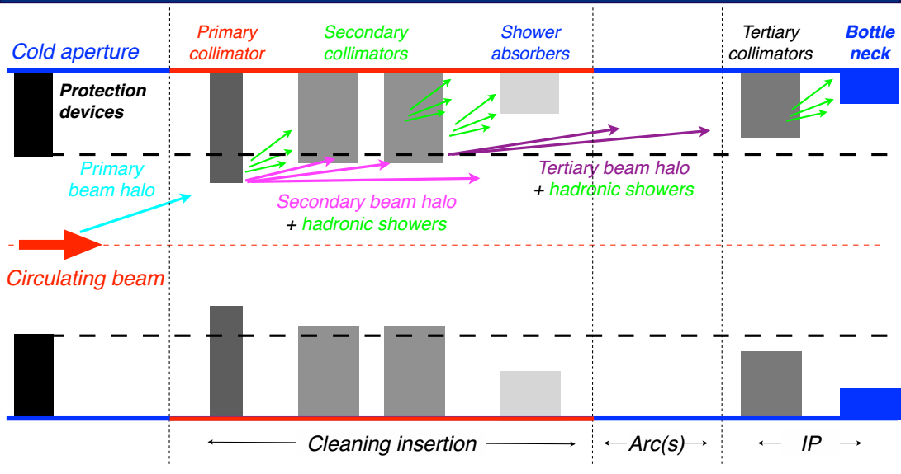
Introduction about beam collimation

Slide 4
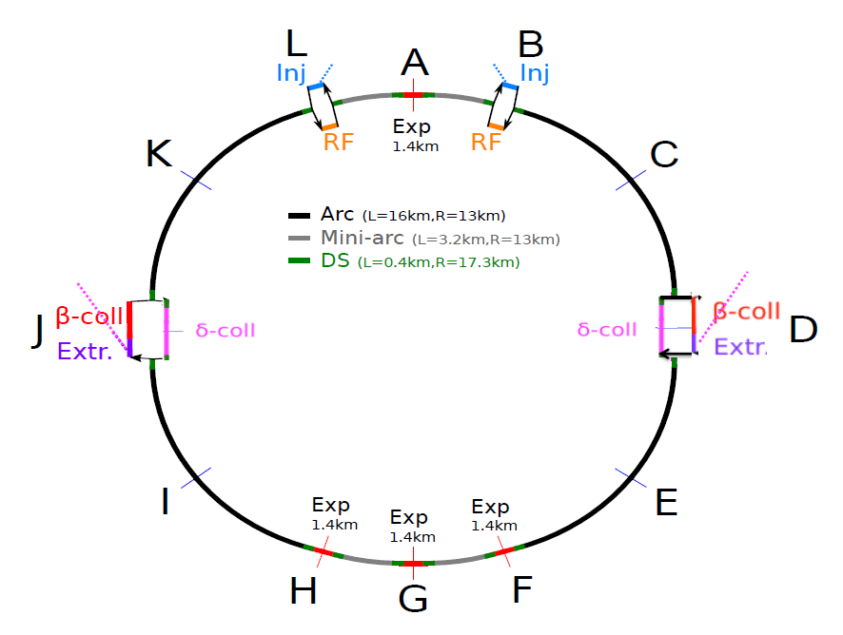
Introduction about LHC collimation system
Very good performance of collimation system so far
Multi-stage collimation system is used
108 movable collimators (TCP, TCSG, TCT, TCLA..)
IR3 for momentum collimation and IR7 for betatron collimation
The cleaning inefficiency ~ ${10}^{−5}$
FCC-hh collimation system is just scaled from LHC’s so far

Slide 5
Limitation of further improving collimation efficiency
Main cold losses: Dispersion Suppression (DS) system downstream of IR7
Cold losses mainly caused by Single Diffractive (SD) effect
Characteristic: with little scattering angle and some energy losses after hitting TCP
Betatron collimation system has no effect about these particles
Cold losses will cause magnets quenching

Slide 6
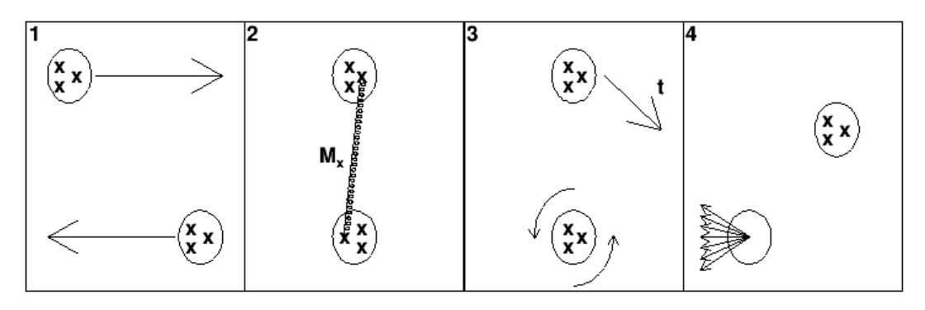
Single diffractive
Two nucleons with quarks denoted as x approach each other.
A pomeron is exchanged between two quarks, with an energy transfer denoted Mx.
The lower proton is excited to a higher angular momentum state, and the upper proton acquires a momentum transfer t.
The lower proton de-excites and decays, whilst the upper proton survives with its trajectory and energy adjusted.
Single diffraction generates an off-momentum beam halo due to the energy loss (Mx) of the incident proton

Slide 7
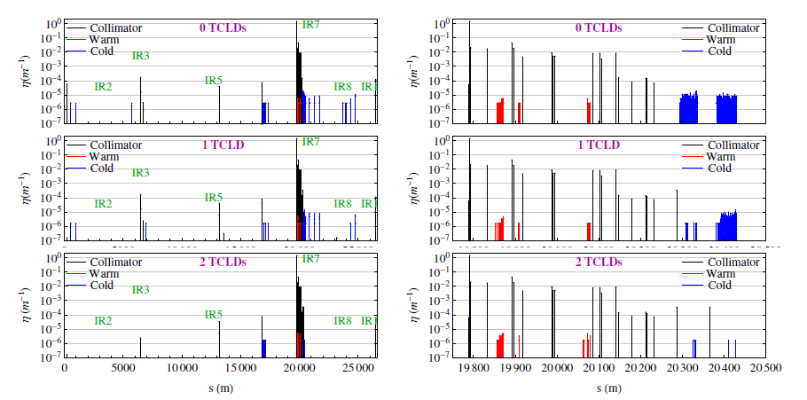
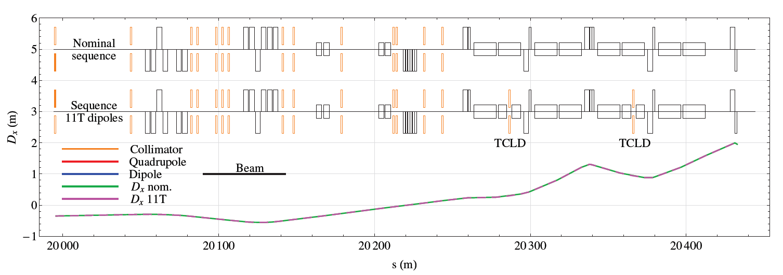
A solution at the HL-LHC

Slide 8
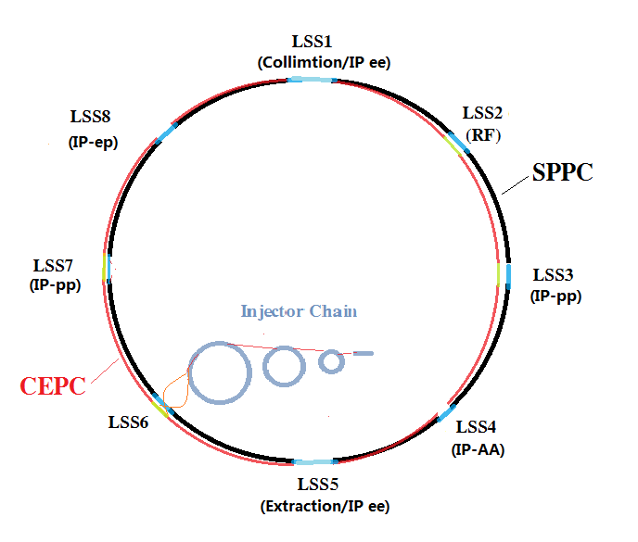
Our solution at the SPPC
Particles with energy loss would be lost in DS downstream the LSS, where the dispersion starts to increase
The method above is not suitable for SPPC due to high neutron radiation from the collimators
If one puts the whole momentum collimation system in the same long straight section after betatron collimation system, one can also remove these particles
A very long straight section is needed…
Fortunately, we have a long straight section to use

Slide 9
Consideration about new collimation optics for SPPC

Slide 10
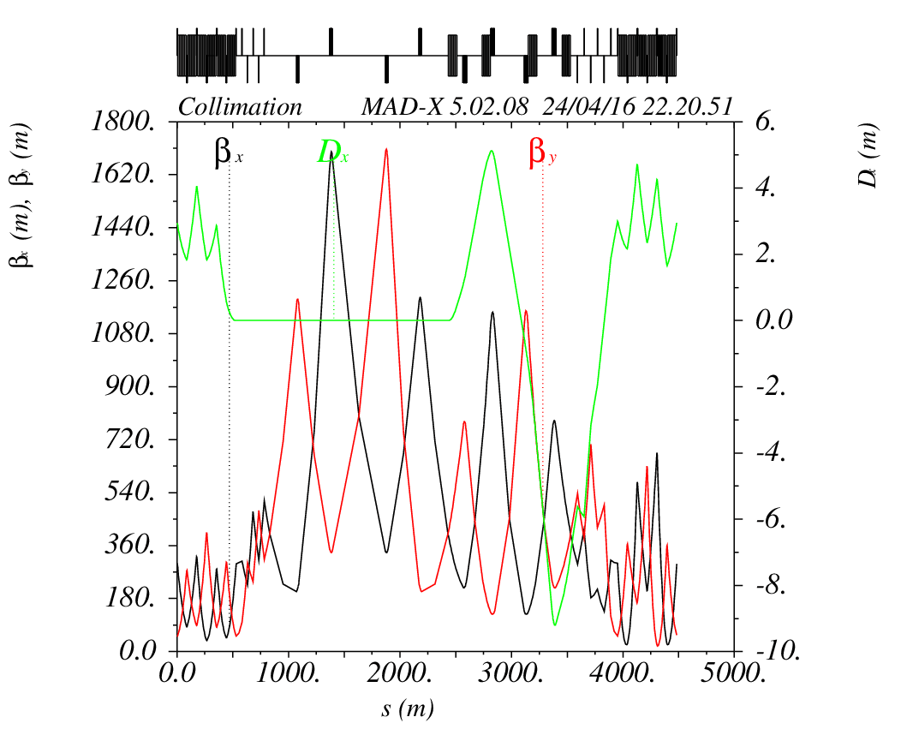
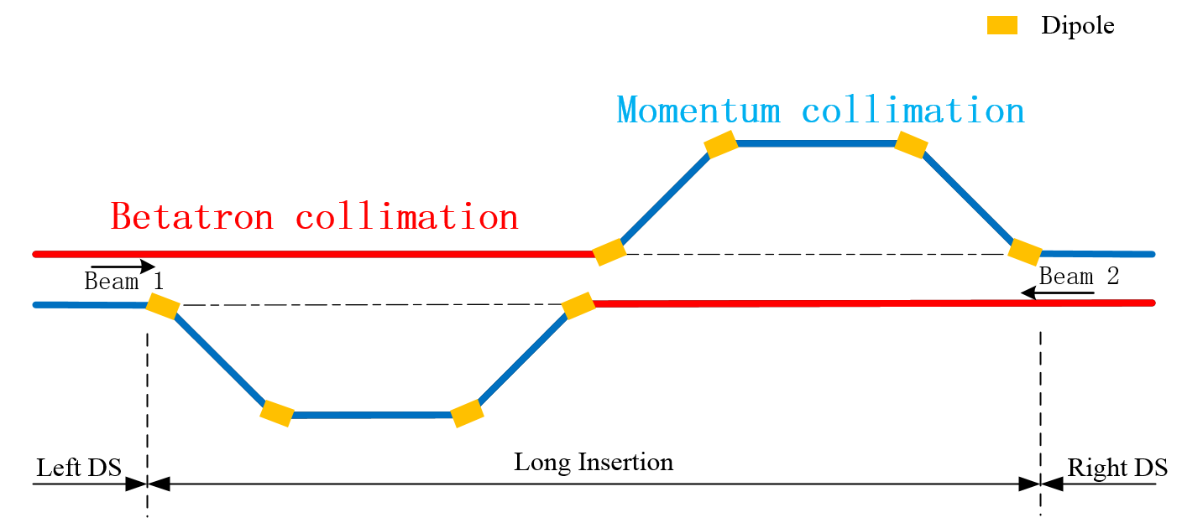
Lattice design for collimation
Yang Jianquan

Slide 11
Collimator settings
- Collimation system: preliminary setting, the same phase advances as the LHC
Betatron collimation
Functional type | Name | Plane | Number | Material for LHC | Aperture (σ)
Primary collimators | TCP | H,V,S | 6 | C | 6
Secondary collimators | TCSG | H,V,S | 22 | C | 7
Absorber | TCLA | H,V,S | 10 | Cu | 10
Momentum collimation
Functional type | Name | Plane | Number | Material for LHC | Aperture (σ)
Primary collimators | TCPM | H,V,S | 2 | C | 12
Secondary collimators | TCSGM | H,V,S | 8 | C | 15
Absorber | TCLAM | H,V,S | 8 | Cu | 18

Slide 12
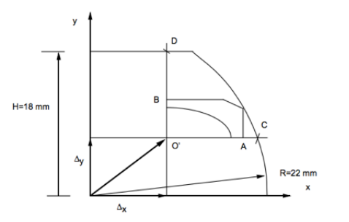
Aperture calculations
Important for collimation studies to identify potential aperture bottlenecks in the machine
definition of the collimator settings needed to protect machine aperture
feedback for improvements on the aperture and tolerances
According to the LHC
At injection found tight aperture in several locations:
minimum aperture in the arc is 10.4 σ
betatron cleaning insertion with 8.7 σ
At top energy the bottleneck is the triplet, with an aperture of 16.2 σ
Preliminary aperture settings: 25 mm

Slide 13
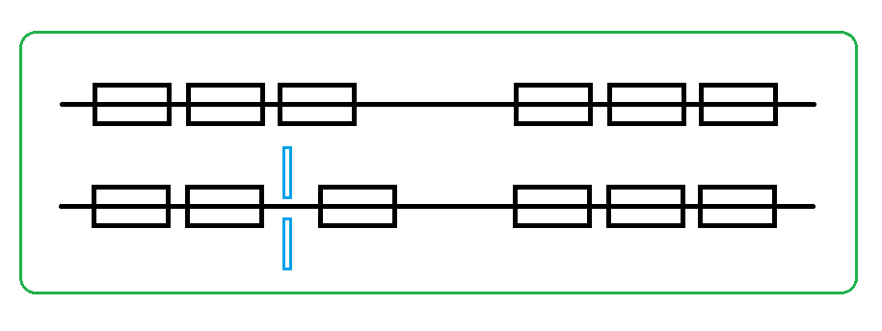
Collimator settings
One more collimator is added to protect the

Slide 14
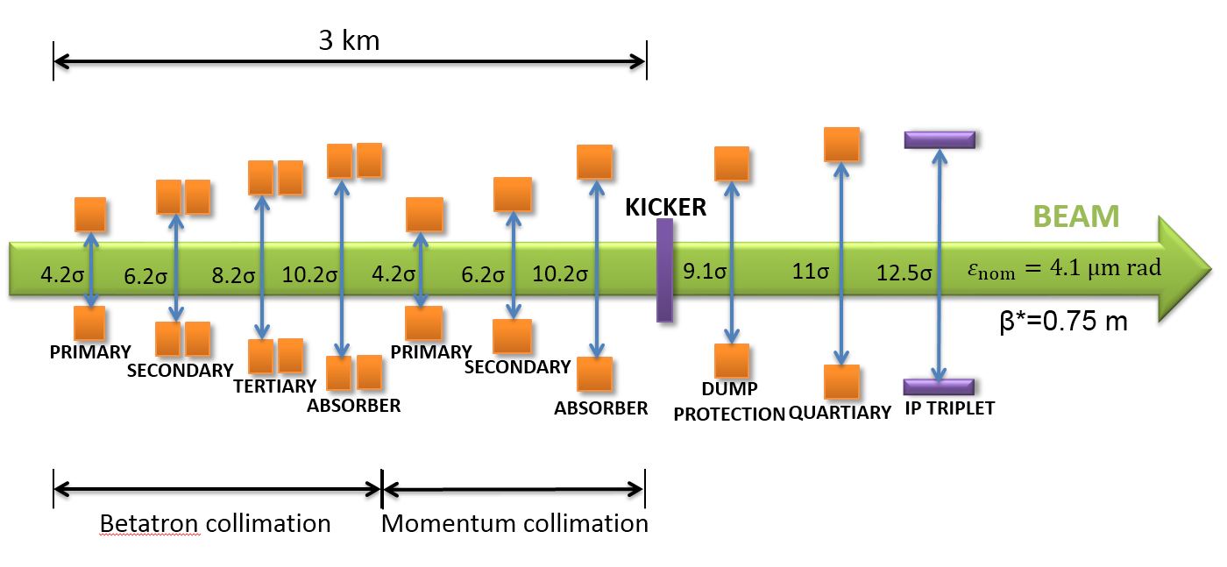
Materials for preliminary SPPC collimators
Very high stored energy (6.6 GJ)
CFC is not suitable for the collimator material with its low electrical conductivity
Good thermal stability, high robustness, good electrical conductivity
Novel composite materials might be suitable as the TCP, and TCSG materials, like MoGr, CuCD, or other composite materials
For the first step: all materials for collimators are the same as LHC

Slide 15
Simulation condition
Collimator settings – similar physical gaps as the LHC
Simulation code: MERLIN
35.7 TeV beam energy
Betatron: Primary 6 σ, Secondary 7 σ, Absorber 10 σ
Momentum: Primary 12 σ, Secondary 15 σ, Absorber 18 σ
Protection collimator: 11 σ
4.1 μm rad emittance
Horizontal beam halo – ring in x x’ , Gaussian in y y’
1 μm Impact factor on horizontal primary collimator
No beam energy spread
50 M particles
300 turns

Slide 16
Simulation condition
Particles only generated on the jaw face
Track particles and record the locations where impact the beam pipe or cleaned by a collimator
Use the loss locations to define the cleaning efficiency:
$$η_{c}=\frac{n_{i}}{n_{total}∆s}$$
ni is the number of particles lost in a bin of size Δs
$n_{total}$ is the total number of lost particles
The bin size use 10 cm

Slide 17
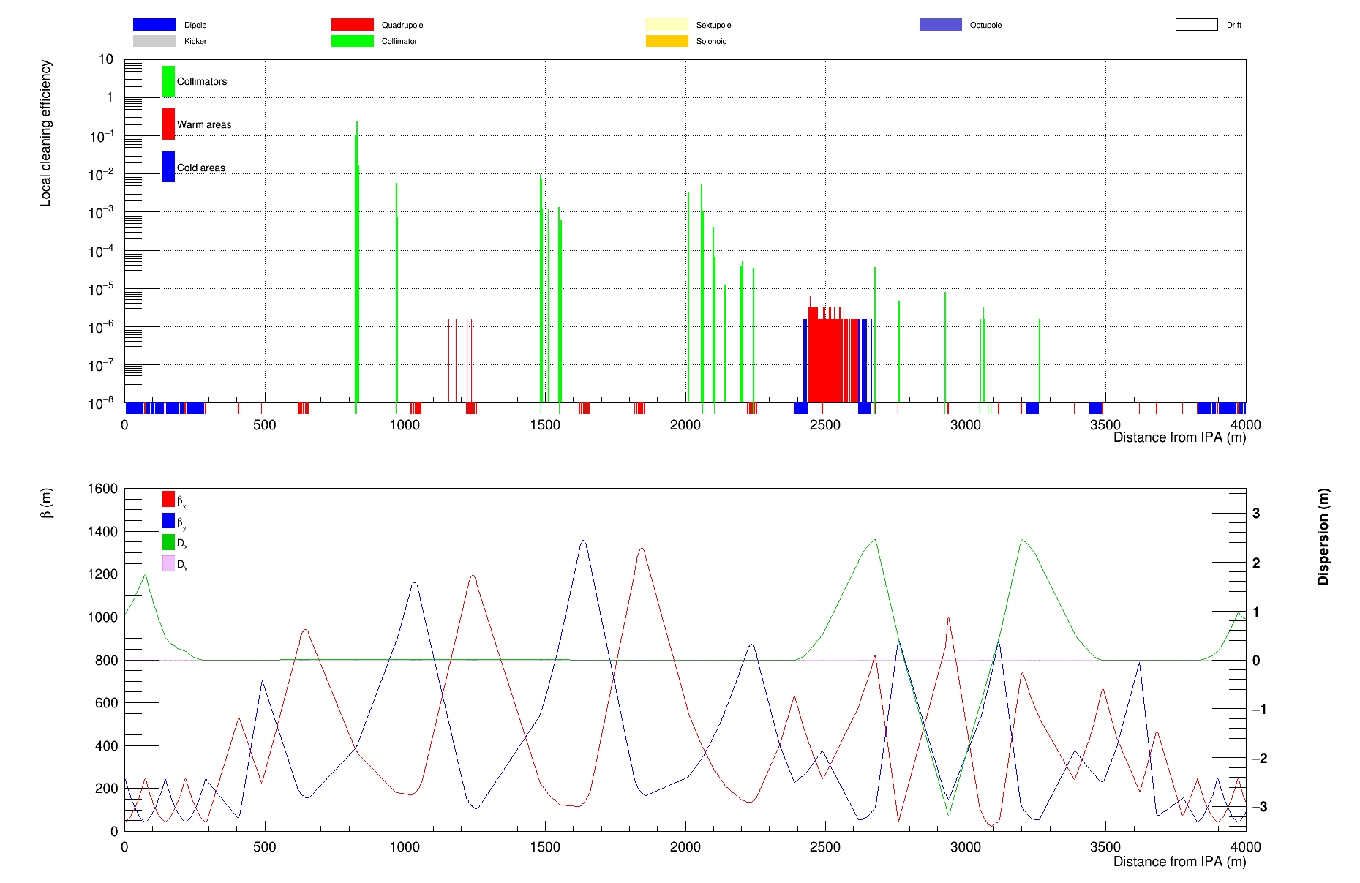
Multi-particle simulation results (without protection collimator)
Some beam loss at cold region could cause the superconducting magnet quenching!

Slide 18
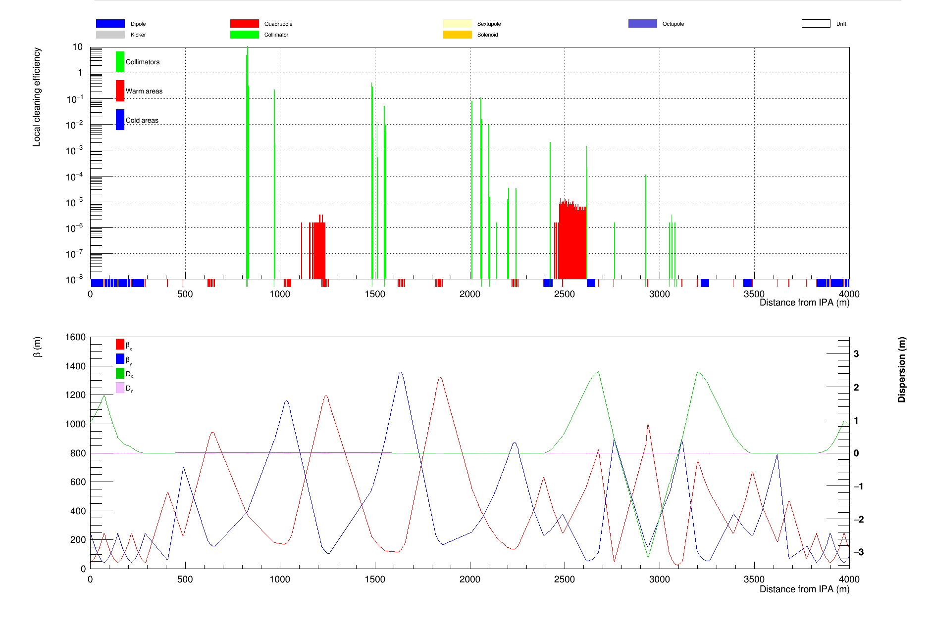
Multi-particle simulation results (with protection collimator)

Slide 19
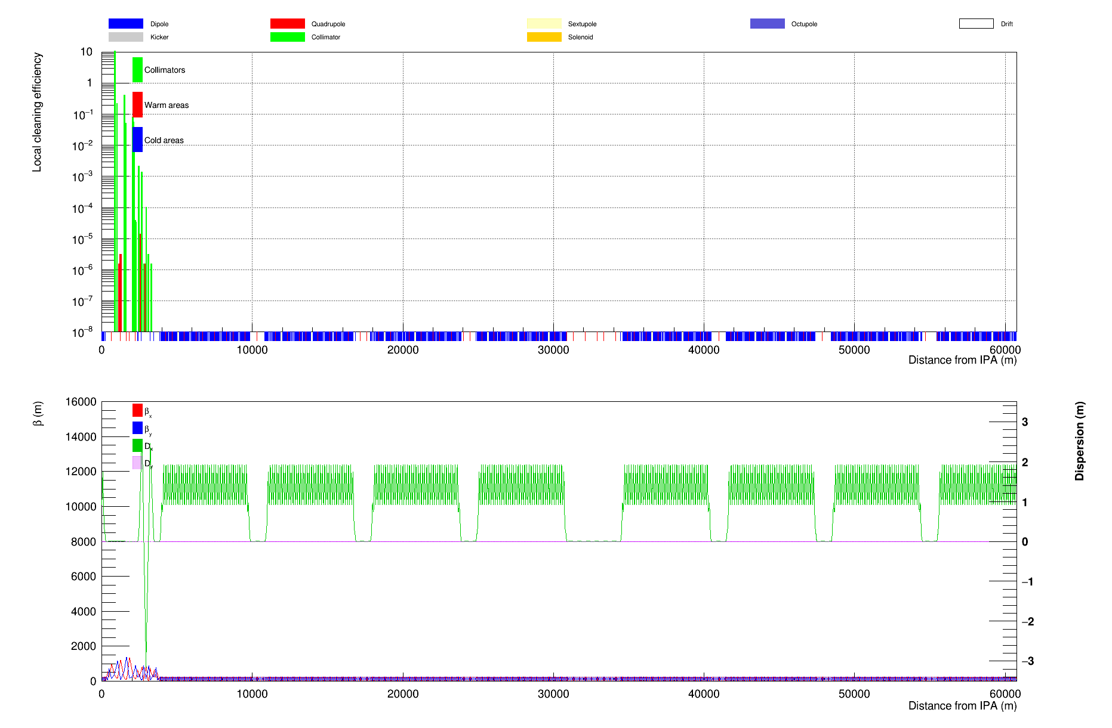
Beam loss distribution around the whole ring

Slide 20
Next step
Use another simulation code - SixTrack to do the multi-particle simulation to benchmark with MerLin code
Optimize the collimation method to obtain higher collimation efficiency

Slide 21
Thanks

