Slide 1

CEPC main ring magnets’ error effect on DA and MDI issues
Sha Bai, Dengjie Xiao, Yiwei Wang, Feng Su, Dou Wang, Tianjian Bian, Yuan Zhang, Huiping Geng, Yingshun Zhu, Qinglei Xiu, Hongbo Zhu
09-02-2016
CEPC-SppC Study Group Meeting

Slide 2
Outline
CEPC main ring magnets’ error effect on DA
  Magnet filed error effect on DA
  Multipole error effect on DA
  Misalignment error effect on DA
  Orbit correction
  DA after orbit correction
MDI issues
  Background
  Solenoid compensation

Slide 3
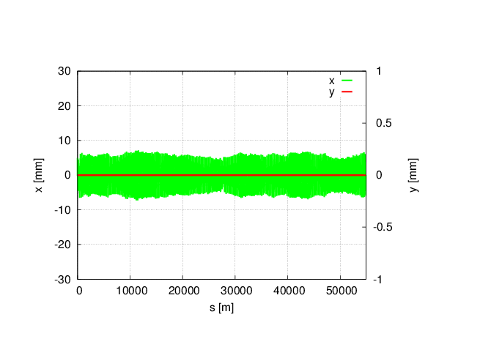
Magnet field error on DA in CEPC single ring
no error
With all (B,Q,S) B*L field errors, whole ring including FFS.
Tune has changed a lot: μ_{x}=0.0510854 μ_{y}= 0.1526778
Orbit correction and tune adjust are needed
Bend set to bend, and Quad and Sext set to be MULT
Tracking in 240 turns, coupling factor κ=0.003 for ε_{y}
Could be cured by adjusting the current during commissioning

Slide 4
Multipole errors effect on DA in CEPC single ring
Bend multipole errors (whole ring including FFS)
Quad multipole errors
(whole ring including FFS)
Sextupole multipole errors(whole ring including FFS)
(B,Q,S)multiple errors
(whole ring including FFS)
Off-momentum DA is not changed obviously, with 2% (1σ_{x}, 7σ_{y}), on-momentum DA is reduced to one third of the original.
Tune is kept, no effect on tune
Orbit is kept to be zero, no effect on orbit
Bend is set to be bend, but quadrupole and sextupole are set to be MULT
Tracking in 240 turns, Coupling factor κ=0.003 for emitty
Multipole errors can not be cured during commissioning, but could be accepted due to the not obvious change of off-momentum DA.

Slide 5
Magnet field error on DA in CEPC partial double ring
Main effect coming from the bending magnet
With bend B*L error
(whole ring including FFS)
μ_{x}= 0 μ_{y}= 0
Orbit in X
With bend B*L error
(whole ring including FFS)
Orbit in Y
With bend B*L error
(whole ring including FFS)
no error
With bending magnet field errors, horizontal orbit has changed a lot, but vertical has no change
Tune has changed to be an integer resonance, beam is not stable.
Orbit correction is needed in horizontal
Tracking in 240 turns, coupling factor κ=0.003 for ε_{y}
Could be cured by adjusting the current during commissioning

Slide 6
Multipole errors effect on DA in CEPC partial double ring
Multipole errors of all magnets
Multipole errors of bend
Multipole errors of quadurpoles
Multipole errors of sextupoles
Multipole errors reduce DA a little bit , but not much. It seems to have not much effect on DA, especially of off-momentum DA.
Orbit has no change due to multipole errors.

Slide 7
Misalignment errors on DA in CEPC partial double ring
With quads misalignment error
(whole ring including FFS)
μ_{x}= 0 μ_{y}= 0
Orbit in X
With quads misalignment error
(whole ring including FFS)
Orbit in Y
With quads misalignment error
(whole ring including FFS)
no error
Main error source is from the horizontal and vertical misalignment in Quadrupoles
Quadrupoles with their centers misaligned to the reference orbit cause dipole error, which will cause an angular deflection of the beam, causing the closed orbit to oscillate around the design orbit.

Slide 8
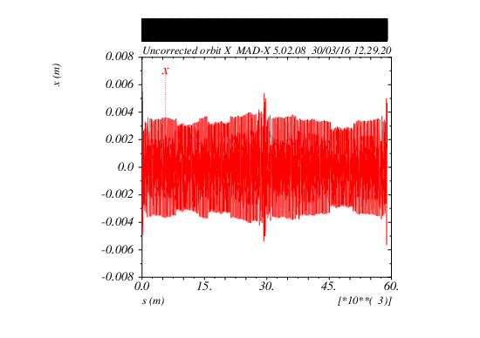
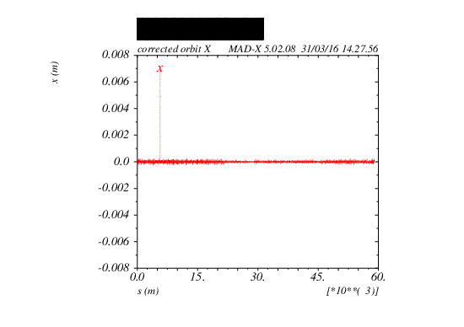
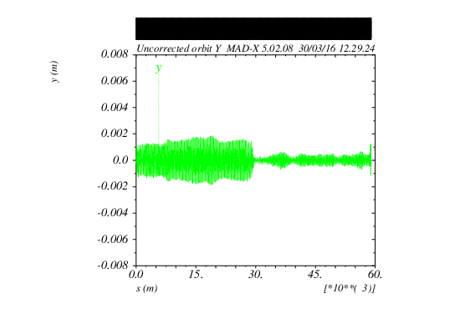
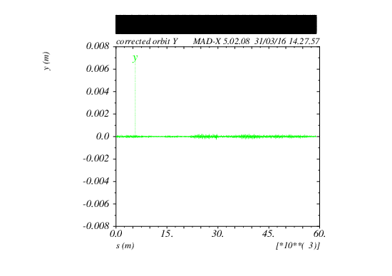
Orbit correction result
Before correction
After correction
Lattice version：
CEPC-ARC1.0-PDR1.0-FFS (WD1.0)

Slide 9
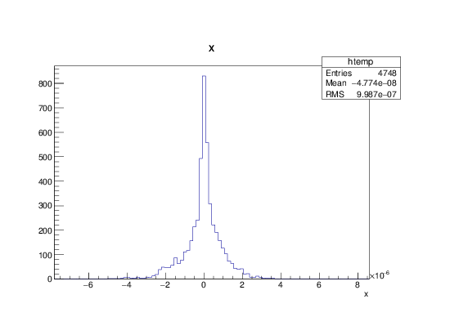
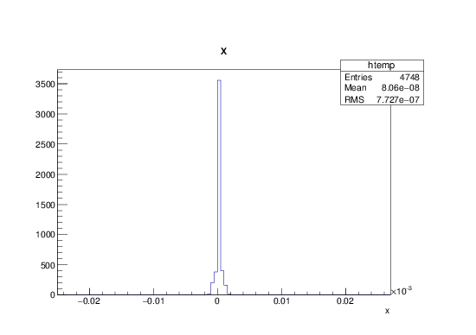
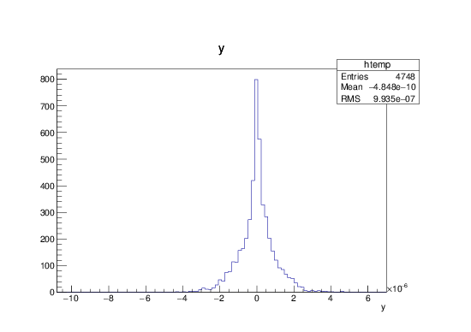
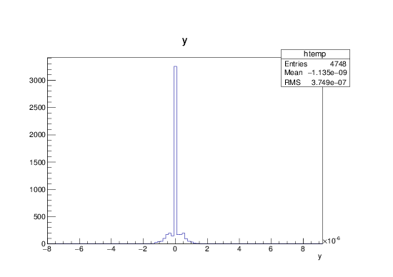
BPM readings and correctors strength statistic
BPM readings statistic
Correctors strength statistic
X CORRECTION:
about 1700 correctors used
Max strength ~ 23urad
RMS ~ 0.77urad
X CORRECTION
SUMMARY:
RMS before correction
2.127 mm
RMS after correction
0.0009987 mm
Y CORRECTION:
about 1700
correctors used
Max strength ~ 6.7urad
RMS ~ 0.37urad
Y CORRECTION
SUMMARY:
RMS before correction
0.6423 mm
RMS after correction
0.0009935 mm

Slide 10
DA(PDR) after orbit correction
Lattice version：CEPC-ARC1.0-PDR1.0-FFS (WD1.0)
No error
DA after orbit correction
(best seed)
DA after orbit correction
(worst seed)
Dynamic aperture can almost be recovered after orbit correction for most seeds.

Slide 11
DA after orbit correction statistics
For both on-momentum and off-momentum DA, most seeds can be recovered.

Slide 12
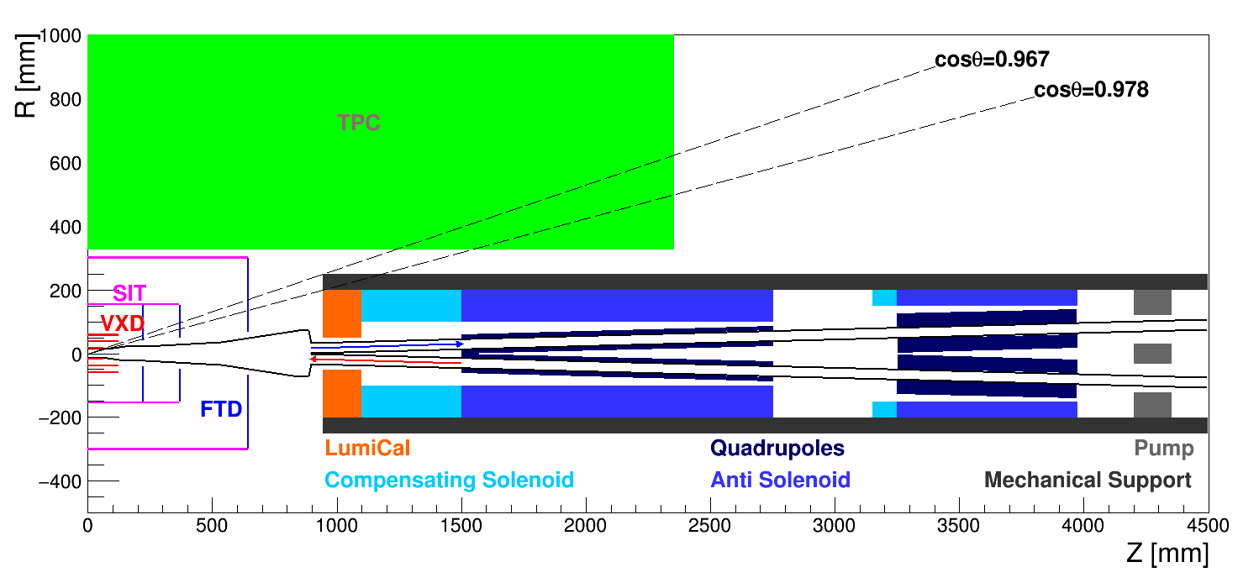
CEPC partial double ring IR layout
Background study in the preliminary lattice design: radiative Bhabha scattering, beamstrahlung, synchrotron radiation, Beam-gas scattering, beam thermal photons scattering.
SC magnets are designed. Solenoid compensation was first tried in the preliminary lattice design,13T compensating solenoid was designed.

Slide 13
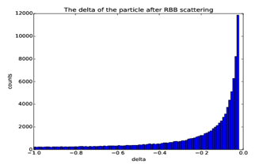
Radiative Bhabha scattering
Lost particles statistic
RBB generated at IP1, tracking for one turn in SAD
Generate 100000 particles
~ energy spread
Gaussian distribution energy spread adding to the 100000 particles generated by RBB generator
Only set aperture in Final doublet ~ 1.7cm in radius
The number of particle lost in the downstream of 1th turn is: 5153
The number of particle lost in the upstream of 1th turn is: 5651
Lattice version：CEPC-ARC1.0-PDR1.0-FFS(WD1.0)
The RBB generator using a Monte-Carlo random point method: randomly generate a two-dimention coordinate, x/y without correlation
Energy spread survived when point within the function curve

Slide 14
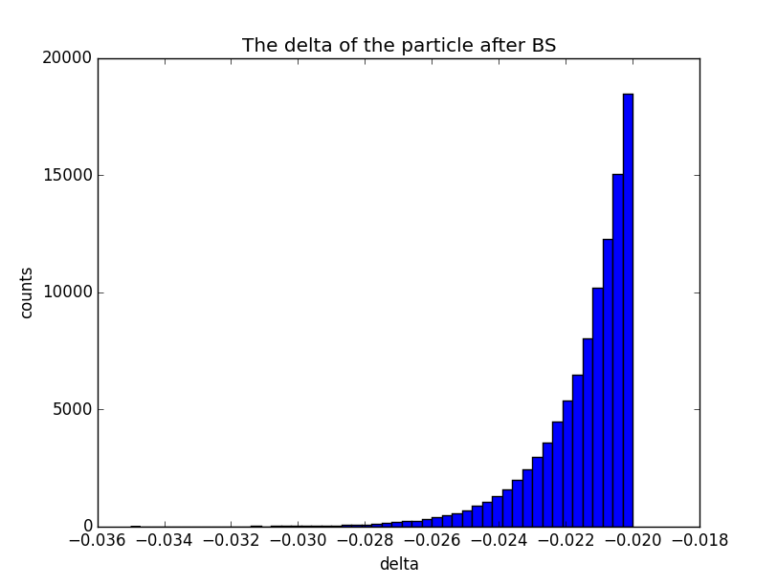
Lost particles statistic
BS generated at IP1, tracking for one turn in SAD
Beamstrahlung
Gaussian distribution energy spread adding to the 100000 particles generated by BS generator
Only set aperture in Final doublet ~ 1.7cm in radius
The number of particle lost in the downstream of 1th turn is: 0
The number of particle lost in the upstream of 1th turn is: 8728
Most of particles lost at the entrance of QF1
Particles lost too much, no need to do multi-turn tracking
IR lattice should be improved
Lattice version：CEPC-ARC1.0-PDR1.0-FFS(WD1.0)
Compared with the energy spread from RBB, beamstrahlung increases of exponent with energy spread, so most of the loss particles energy spread distributed in the area of slightly bigger than 2%.

Slide 15
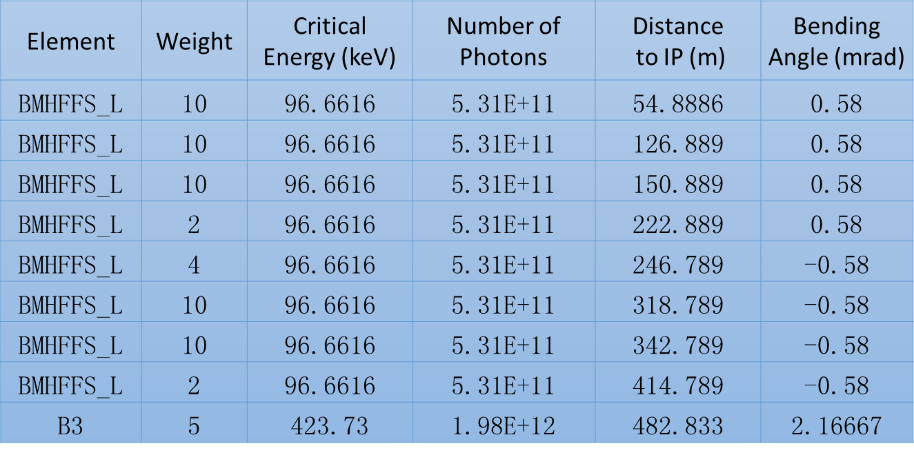
Synchrotron radiation from bending magnets
Lattice version：CEPC-ARC1.0-PDR1.0-FFS(WD1.0)
Critical energy of bending magnets in FFS are about ~ 100keV
Could be accepted by detector and radiation protection

Slide 16
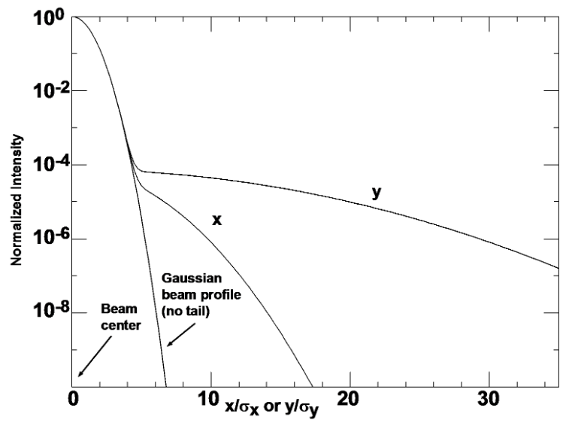
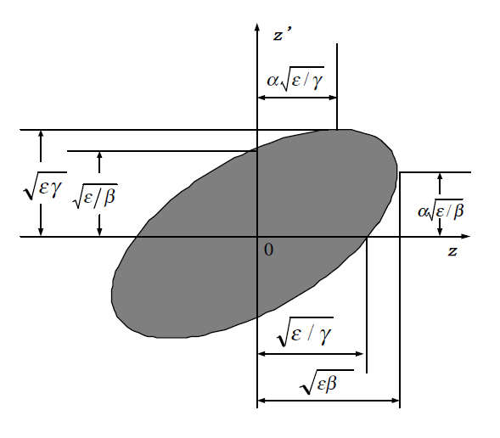
Synchrotron from Quadrupoles
Momentum distribution of beam particles are correlated with the position inside the bunch
Synchrotron from quadrupoles are mainly caused by the beam halo
Use a double Gaussian distribution to describe the beam distribution
The beam halo should be well suppressed to reduced photons from quadrupoles
  Better vacuum, collimators ……

Slide 17
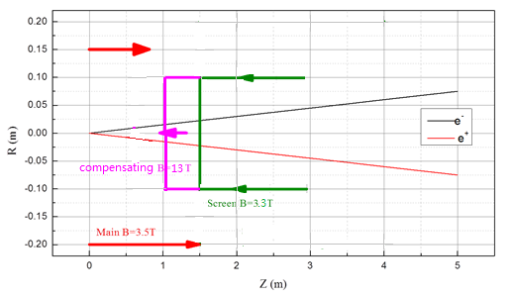
Solenoids layout-sketch
To minimize the effect of the longitudinal detector solenoid field on the accelerator beam, solenoid coils are introduced.
The total integral longitudinal field generated by the detector solenoid and solenoid coils should be zero.
Screening solenoid (at the same location of QD0): The longitudinal field inside the quadrupole bore should be 0.
Center field of screening solenoid :3.3T, magnetic length: the same as QD0.
Compensating solenoid options (before QD0):
1) length 1m, Center field: 5.2T (NbTi technology )
2) length 0.7m, Center field: 7.4T (NbTi technology )
3) length 0.4m, Center field: 13T (Nb₃Sn technology )
Compensation conditions:
B_main*L_main+B_comp*L_comp=0
L* = L_main +L_comp = 1.5m
Compensating solenoid is located between IP and QD0
crossing angle α = 30 mrad
Radius of: Length:
- compensating solenoid R = 0.1 m L=0.4m
- screening solenoid R = 0.1 m L=1.3m

Slide 18
Compensating and screening solenoids
Item | Compensating Solenoid | Screening-Solenoid(QD0)
Central field (T) | 13 | 3.3
Length (m) | 0.4 | 1.3
Conductor Type | Nb₃Sn, 4×2mm | NbTi-Cu, 4×2mm
Coil turns | 2300 | 2600
Coil layers | 23 | 8
Excitation current(kA) | 2.1 | 1.5
Stored energy (KJ) | 1150 | 215
Inductance(H) | 0.53 | 0.21
Peak field in Coil (T) | 13.4 | 3.5
Coil inner diameter (mm) | 200 | 200
Coil out diameter (mm) | 292 | 232

Slide 19
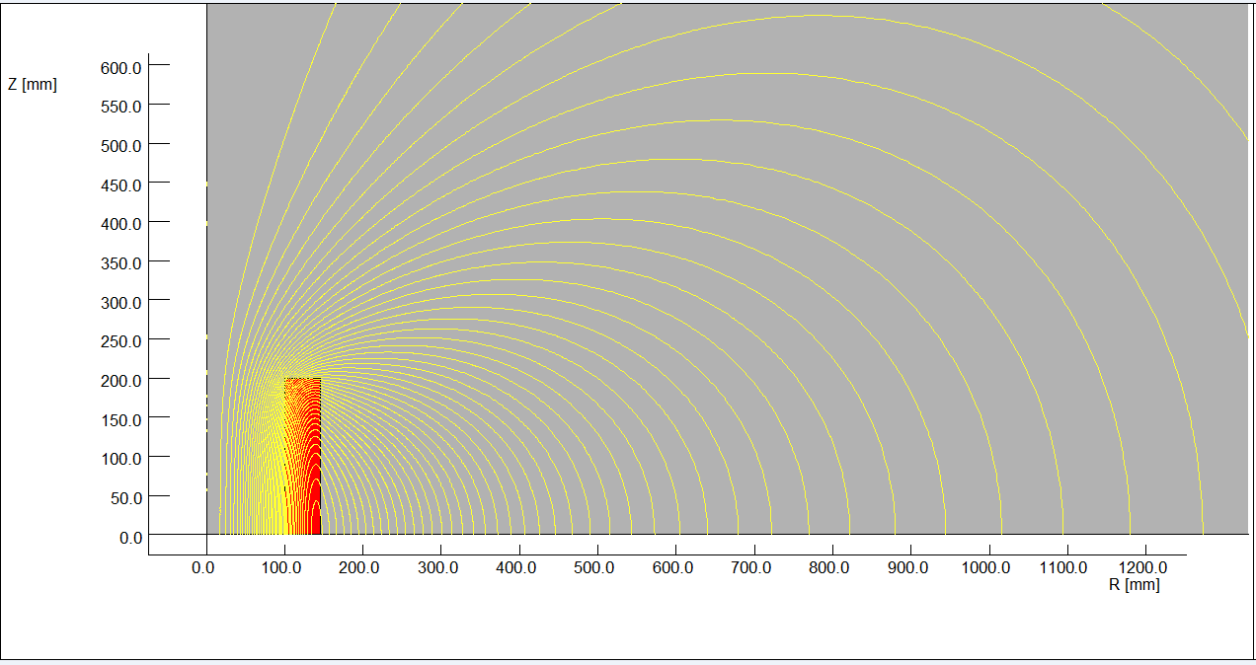
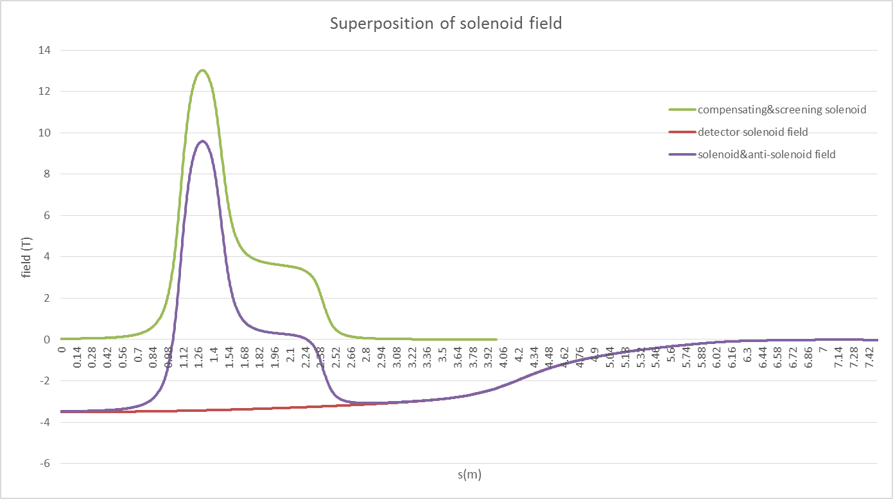
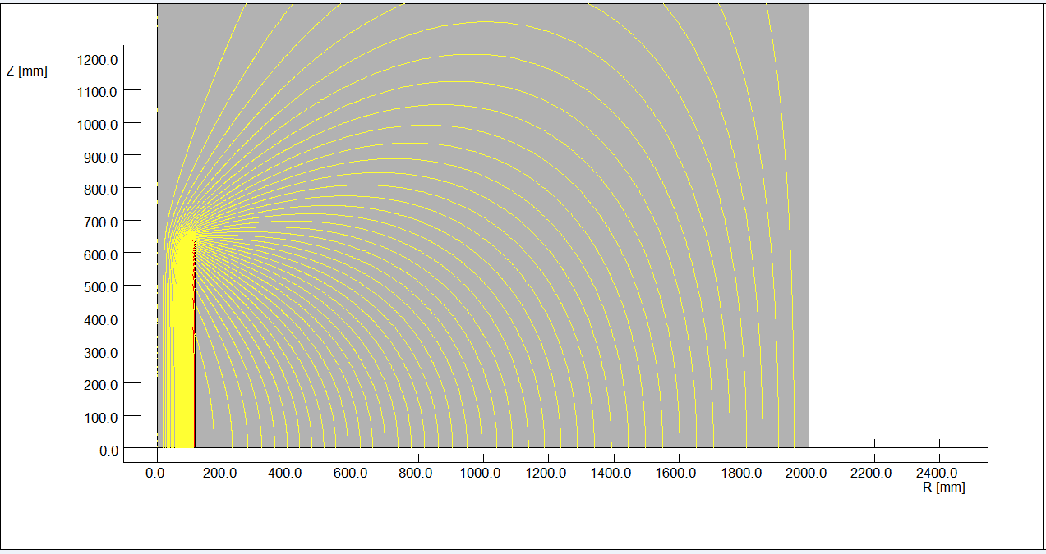

Solenoids field
Flux lines of compensating solenoid
The total integral longitudinal field generated by the detector solenoid and solenoid coils should be zero.
Magnetic field calculation is performed using axi-symmetric model, and main design parameters are obtained.
Flux lines of screening solenoid

Slide 20
Conclusions
Dynamic aperture can almost be recovered after orbit correction for most seeds.
For CEPC partial double ring, lattice version：CEPC-ARC1.0-PDR1.0-FFS (WD1.0), the error from multipoles has not much effect on dynamic aperture.
Background was simulated for CEPC partial double ring, which is depend on the lattice IR design.
Due to the limited longitudinal space, high field compensating solenoid with a central field of 13T is used, which is to shorten the length of compensating solenoid to avoid influence on Lumical.

Slide 21
Thank you

