Slide 1
Optimization of CEPC Dynamic Aperture
Yiwei Wang, Yuan Zhang, Feng Su, Tianjin Bian,
Dou Wang, Sha Bai, Huiping Geng, Jie Gao
CEPC-SppC Study Group Meeting
September 2-3, 2016, Beihang University

Slide 2
Outline
Lattice design and dynamic Aperture studies for CEPC partial double ring scheme
ARC region
Partial Double Ring (PDR) region
Interaction Region (IR)
Work to be done
Summary

Slide 3
CEPC parameter for PDR scheme
（wangdou20160325）
 | Pre-CDR | H-high lumi. | H-low power | W | Z
Number of IPs | 2 | 2 | 2 | 2 | 2
Energy (GeV) | 120 | 120 | 120 | 80 | 45.5
Circumference (km) | 54 | 54 | 54 | 54 | 54
SR loss/turn (GeV) | 3.1 | 2.96 | 2.96 | 0.59 | 0.062
Half crossing angle (mrad) | 0 | 15 | 15 | 15 | 15
Piwinski angle | 0 | 2.5 | 2.6 | 5 | 7.6
N_{e}/bunch (10¹¹) | 3.79 | 2.85 | 2.67 | 0.74 | 0.46
Bunch number | 50 | 67 | 44 | 400 | 1100
Beam current (mA) | 16.6 | 16.9 | 10.5 | 26.2 | 45.4
SR power /beam (MW) | 51.7 | 50 | 31.2 | 15.6 | 2.8
Bending radius (km) | 6.1 | 6.2 | 6.2 | 6.1 | 6.1
Momentum compaction (10⁻⁵) | 3.4 | 2.5 | 2.2 | 2.4 | 3.5
β_{IP} x/y (m) | 0.8/0.0012 | 0.25/0.00136 | 0.268 /0.00124 | 0.1/0.001 | 0.1/0.001
Emittance x/y (nm) | 6.12/0.018 | 2.45/0.0074 | 2.06 /0.0062 | 1.02/0.003 | 0.62/0.0028
Transverse σ_{IP} (um) | 69.97/0.15 | 24.8/0.1 | 23.5/0.088 | 10.1/0.056 | 7.9/0.053
ξ_{x}/IP | 0.118 | 0.03 | 0.032 | 0.008 | 0.006
ξ_{y}/IP | 0.083 | 0.11 | 0.11 | 0.074 | 0.073
V_{RF} (GV) | 6.87 | 3.62 | 3.53 | 0.81 | 0.12
f _{RF} (MHz) | 650 | 650 | 650 | 650 | 650
Nature σ_{z} (mm) | 2.14 | 3.1 | 3.0 | 3.25 | 3.9
Total σ_{z} (mm) | 2.65 | 4.1 | 4.0 | 3.35 | 4.0
HOM power/cavity (kw) | 3.6 | 2.2 | 1.3 | 0.99 | 0.99
Energy spread (%) | 0.13 | 0.13 | 0.13 | 0.09 | 0.05
Energy acceptance (%) | 2 | 2 | 2
Energy acceptance by RF (%) | 6 | 2.2 | 2.1 | 1.7 | 1.1
n_{γ} | 0.23 | 0.47 | 0.47 | 0.3 | 0.24
Life time due to beamstrahlung_cal (minute) | 47 | 36 | 32
F (hour glass) | 0.68 | 0.82 | 0.81 | 0.92 | 0.95
L_{max}/IP (10³⁴cm⁻²s⁻¹) | 2.04 | 2.96 | 2.01 | 3.09 | 3.09

Slide 4
Considerations on ARC lattice design
Sextupole scheme | interleave | Non-interleave
60 ° /60° | n=6 All 3rd RDT due to sextupoles cancelled All 4th RDT except 2Qx-2Qy due to sextupoles cancelled dQ(Jx,Jy): accumalte to be large dQ(δ): small even with 2 families DA on momentum: easy to optim. DA off momentum: easy to optim. | -
90 ° /60 ° | n=12 All 3rd RDT due to sextupoles cancelled All 4th RDT except 4Qx due to sextupoles cancelled dQ(Jx,Jy): accumalte to be large dQ(δ): small even with 2 families DA on momentum: easy to optim. DA off momentum: easy to optim. | -
90 ° /90 ° | n=4 All 3rd RDT due to sextupoles cancelled 4th RDT except 4Qx, 2Qx+2Qy, 4Qy, 2Qx-2Qy due to sextupoles cancelled dQ(Jx,Jy): accumalte to be large dQ(δ): small even with 2 families DA on momentum: - DA off momentum: - | n=5 All 3rd RDT due to sextupoles cancelled dQ(Jx,Jy): small dQ(δ): correct with many families DA on momentum: easy to optim. DA off momentum: with many families to correct dQ(δ) and –I break down

Slide 5
Considerations on ARC lattice design
FODO cell, 90 ° /90 °
non-interleaved sextupole scheme
n=5
All 3rd RDT due to sextupoles cancelled
Amplitude-dependent tune shift is very small
Ncell= 120
LB= 19.96
Lcell= 47.92
theta= .0032188449319567555
Lring= 54820.479999999996
Nstr1= 18
Nstr2= 20
Vrfc= 220625000
frf= 6.5e+08

Slide 6
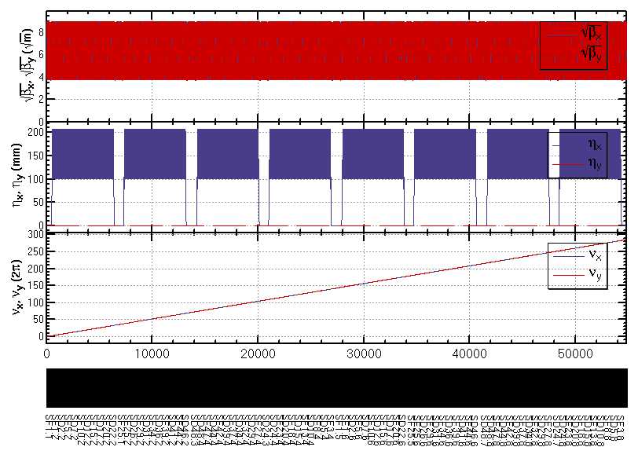
ARC lattice (w/o PDR, IR)

Slide 7
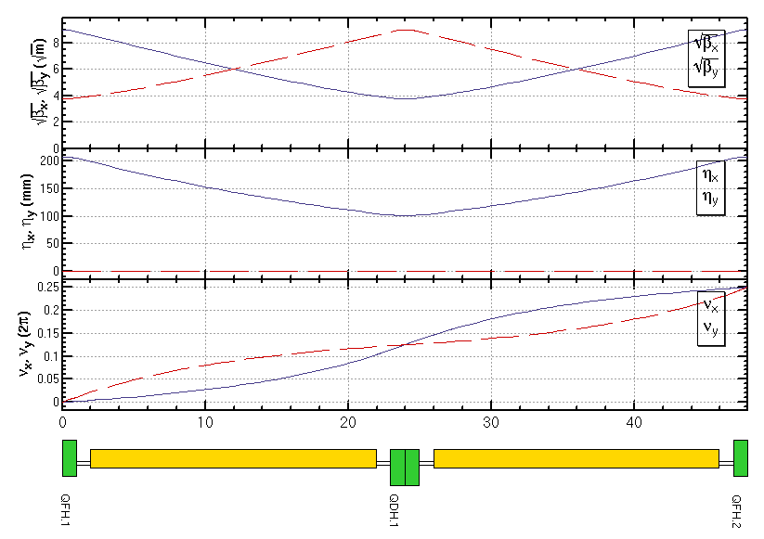
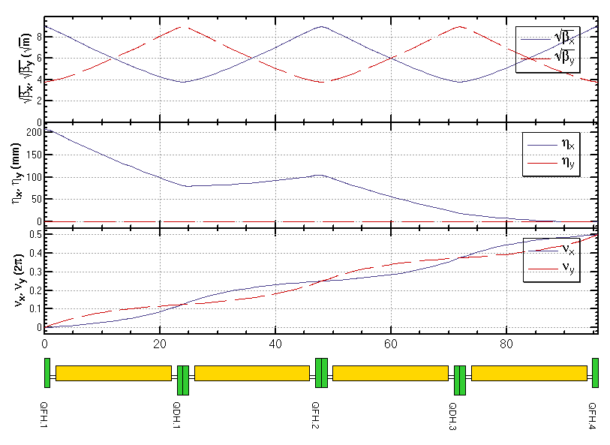
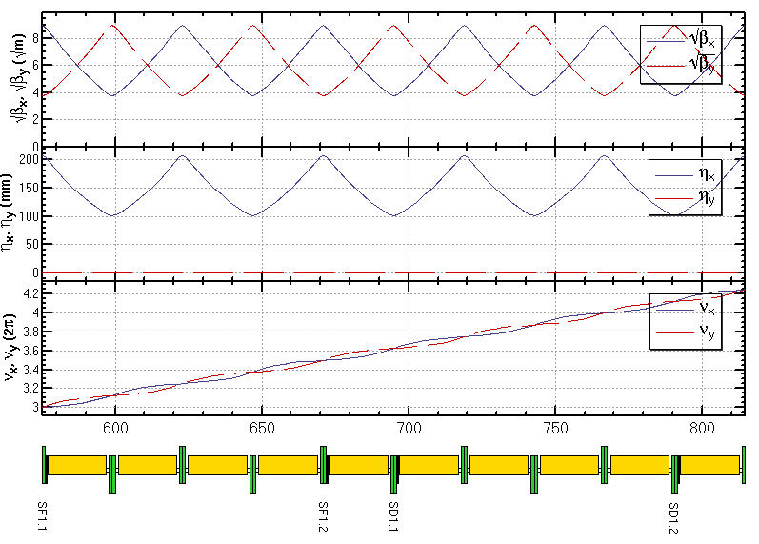
ARC lattice
FODO cell
Dispersion Suppressor
Sextupole configuration

Slide 8
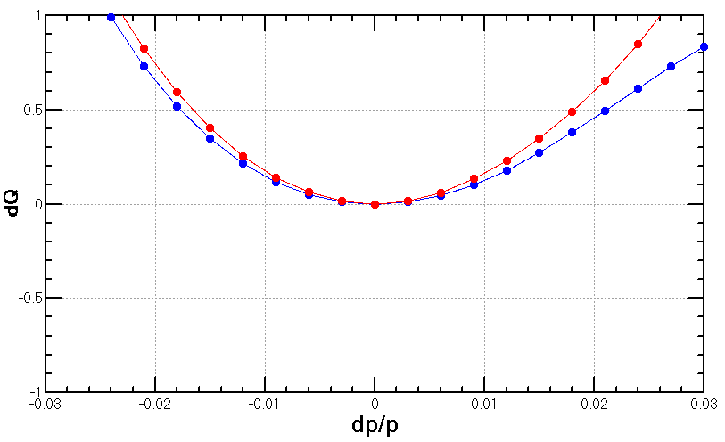
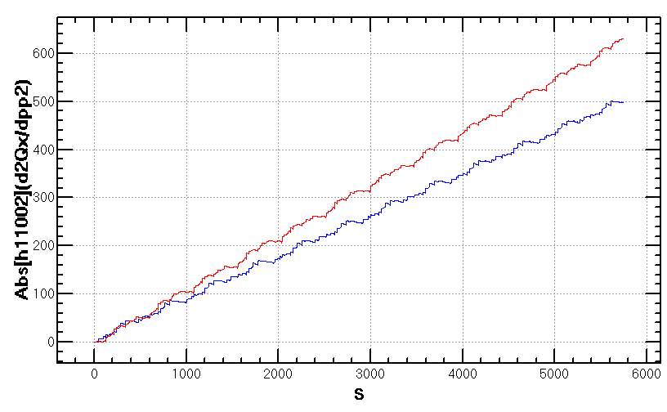
Chromaticity of the ARC lattice
Second order chromaticity due to non-interleaved sextupole scheme
accumulating with period=5 cells
dQ vs. dp/p for Whole ARC
Mainly second order chromaticity
ARC section: 24× 5 cells

Slide 9
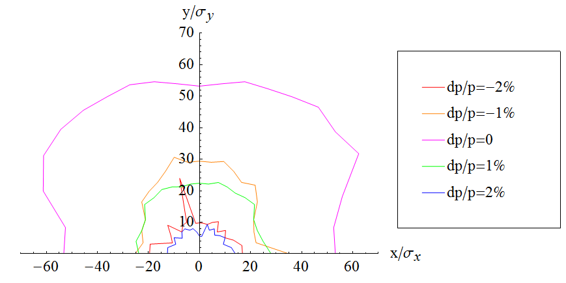
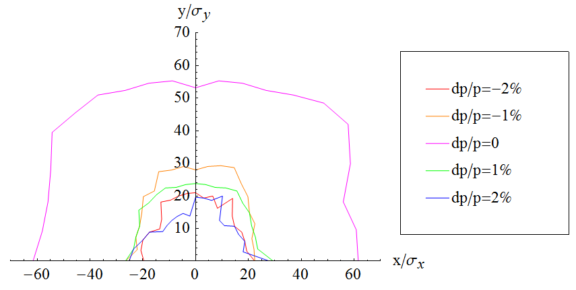
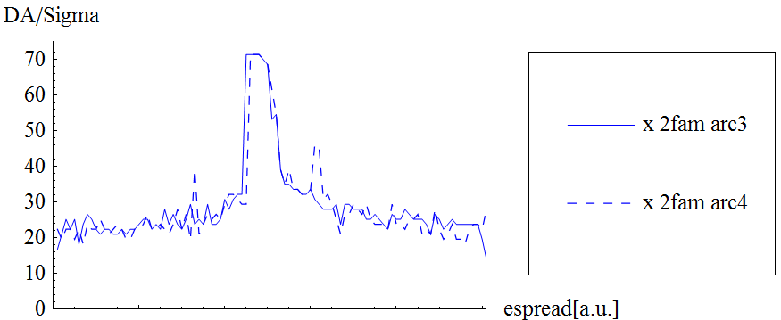
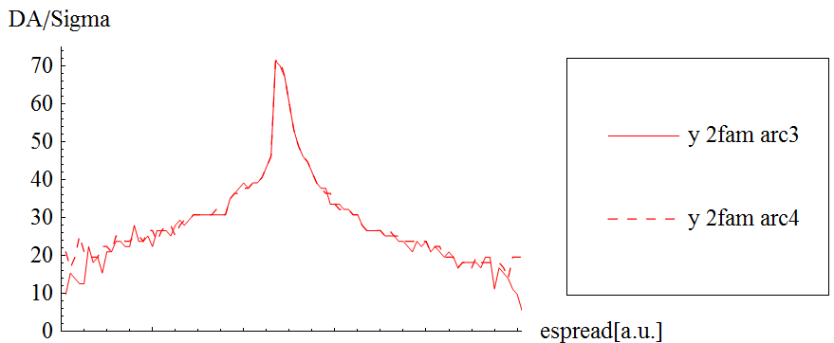
Tune phase advance between sections
Before
After

Slide 10
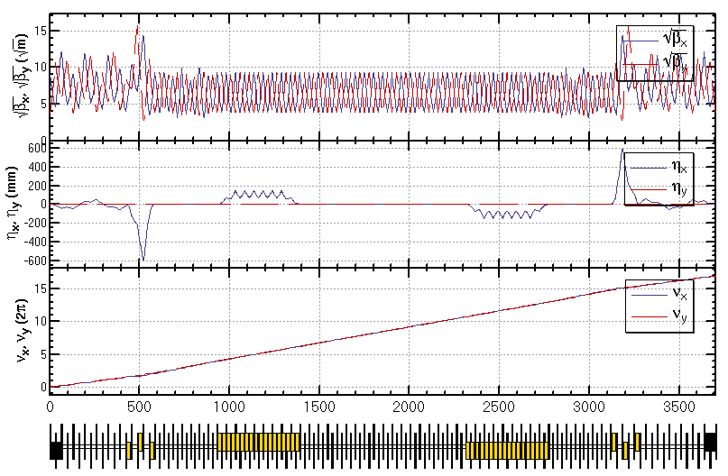
Partial double ring region (w/o IR)

Slide 11
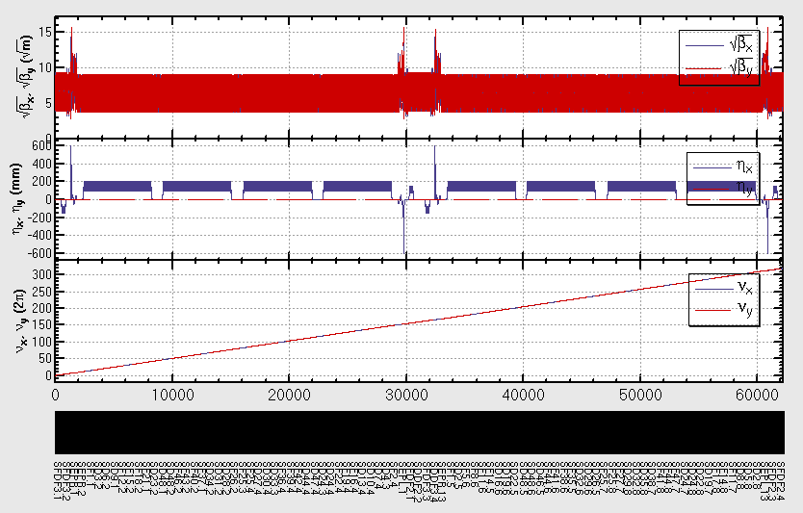
ARC + Partial double ring region (w/o IR)

Slide 12
Dynamic aperture optimization for
ARC + PDR (w/o IR)
The sextupoles in present PDR lattice don’t help much to the 1st order chromaticity correction, i.e. can’t make local correction. Possible way:
Keep lattice; correct 1st and high order chromaticity with only ARC sextupoles ; correct high order chromaticity with help from PDR sextupoles.
More sextupoles in PDR
Re-design PDR lattice

Slide 13
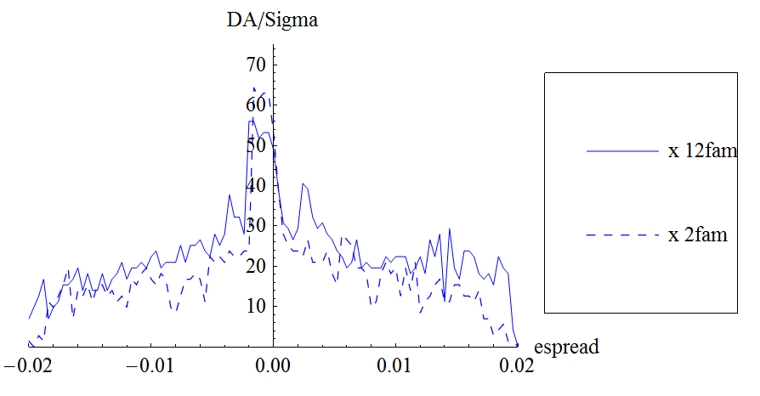
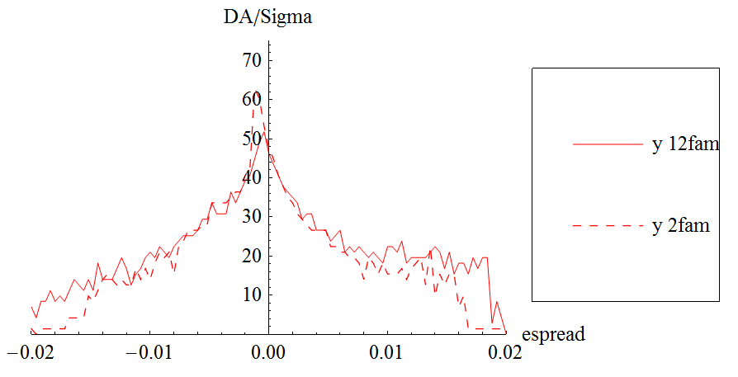
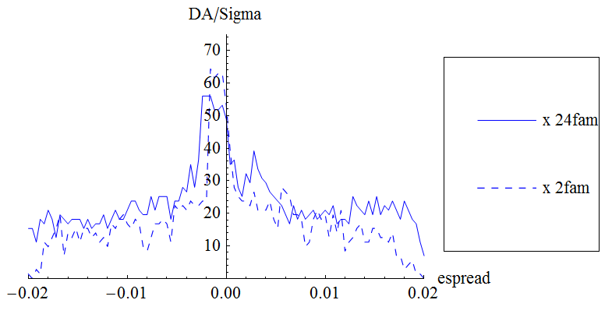
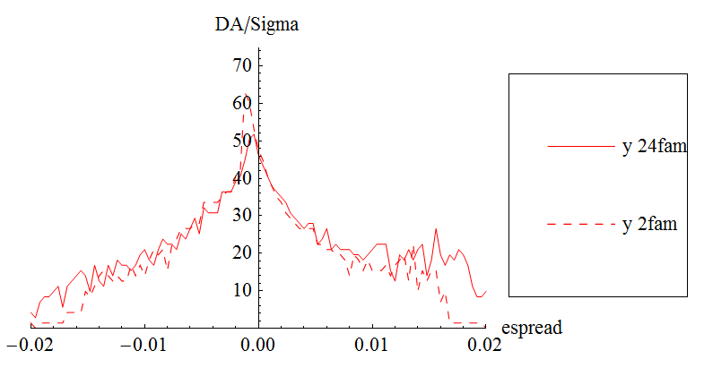
Dynamic aperture optimization for ARC + PDR (w/o IR)
Optimize DA directly
2, 4, 12, 24 families of sextupoles tried
DA increased significantly for large momentum particle (for dp/p=±2%, DA~5-15 σ) when 24 families of sextupoles in the ARC used
Further optimization is possible with more families

Slide 14
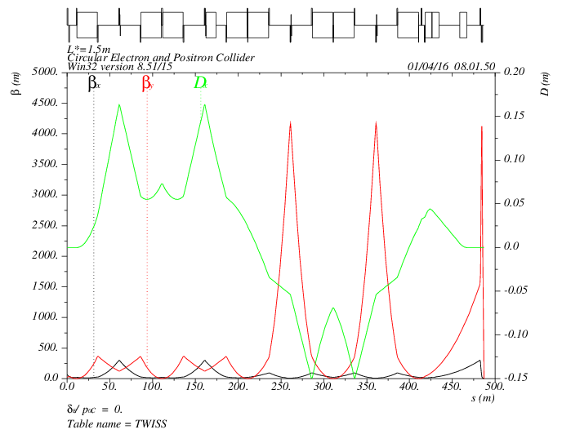
Lattice of Interaction Region
MT
CCX
CCY
FT
IP
L*= 1.5m
βx*= 0.22mm
βy*= 1mm
GQD0= -200T/m
GQF1= 200T/m
LQD0=1.69m
LQF1=0.90m

Slide 15
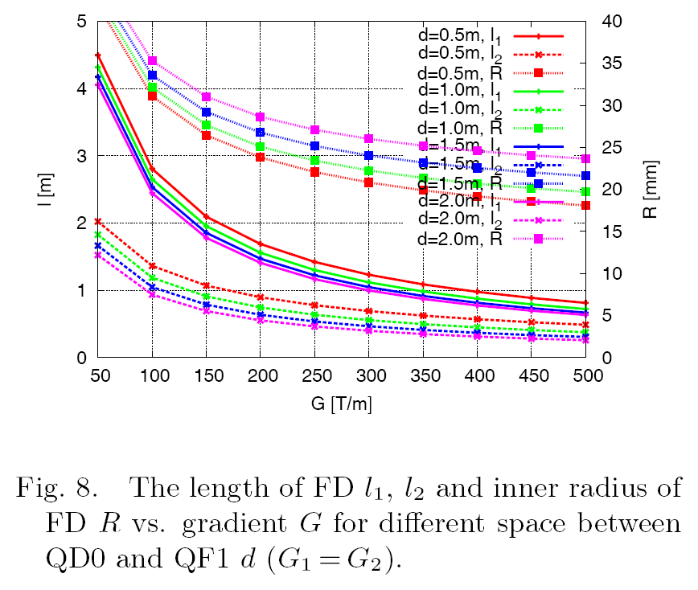
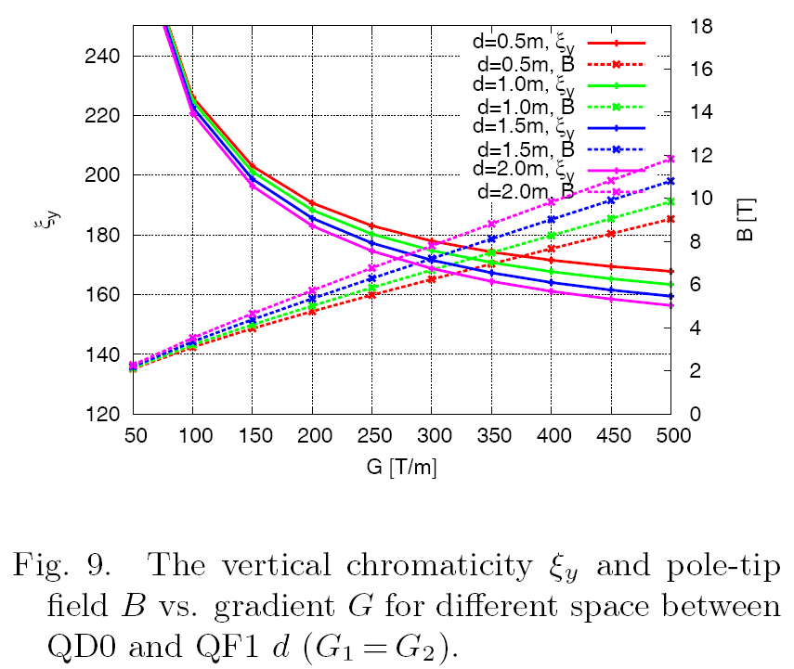
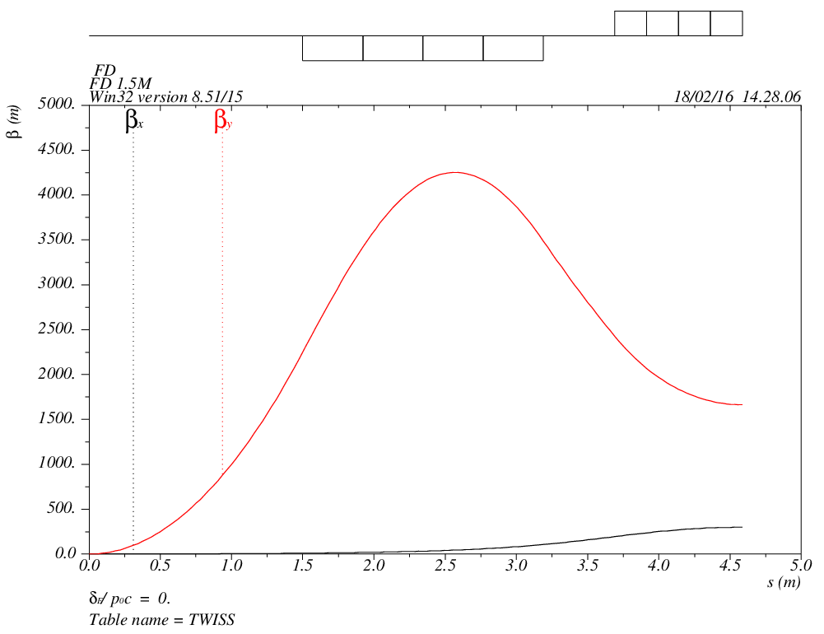
Final doublet
LD1 LD2 G1 G2 LQ1 LQ2 KSIY KSIX B1 B2
1.5 0.5 -200 200 1.68924427 0.8975406954 -190.6883514 -6.165431938 -4.762983257 4.762983257

Slide 16
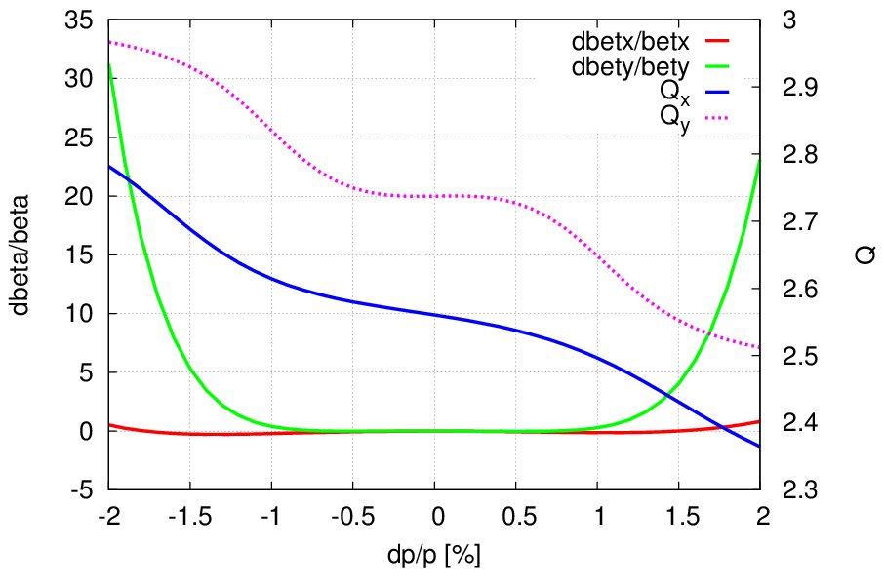
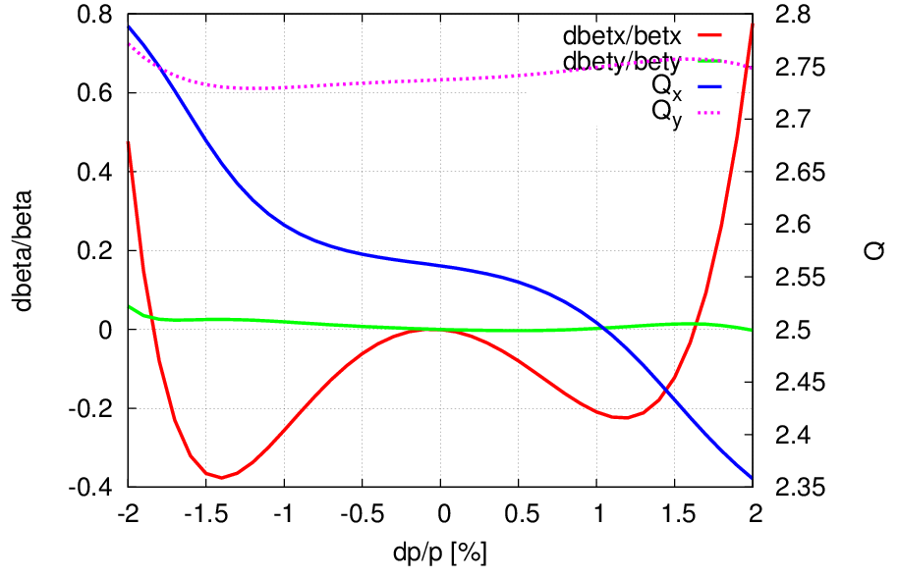
Chromaticity correction of IR
Correct 1st and 2nd order chromaticity
Correct 3rd order chromaticity
3rd order chromaticity in the horizontal plane could be corrected with an additional sextupole at second image point or ARC sectupoles

Slide 17
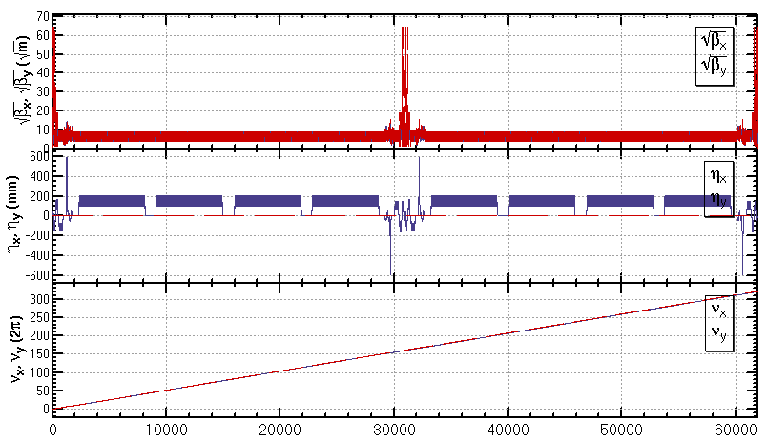
ARC+PDR+IR lattice
A lattice of the whole ring (ARC+PDR+IR) fulfilling the design parameters is ready.
Dynamic aperture optimization for this lattice is under going.

Slide 18
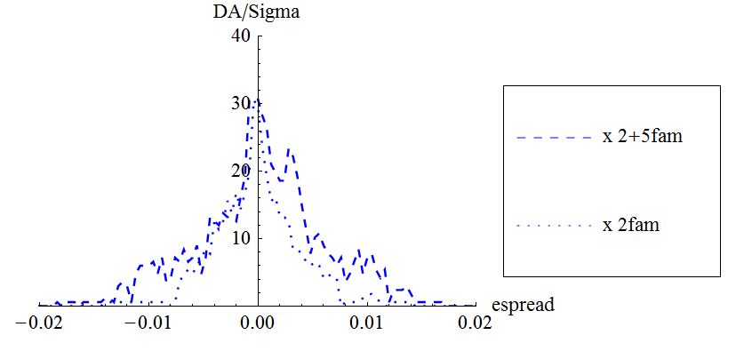
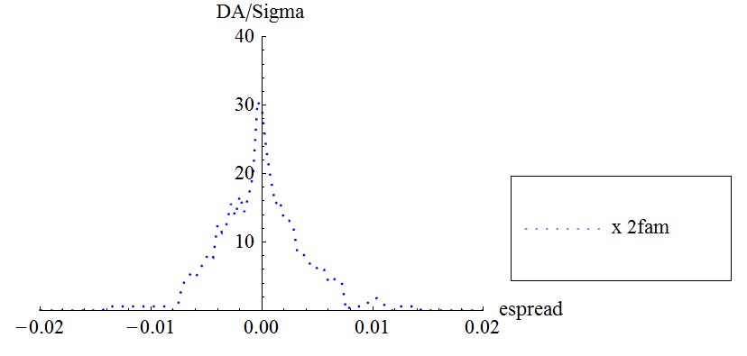
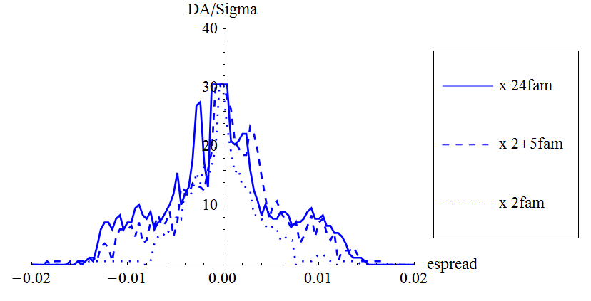
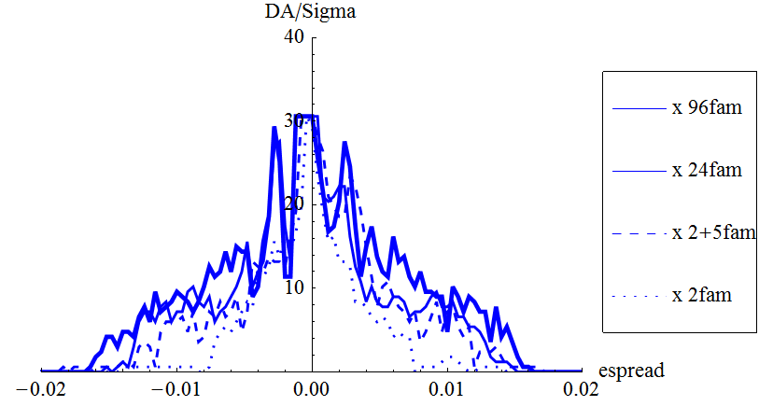
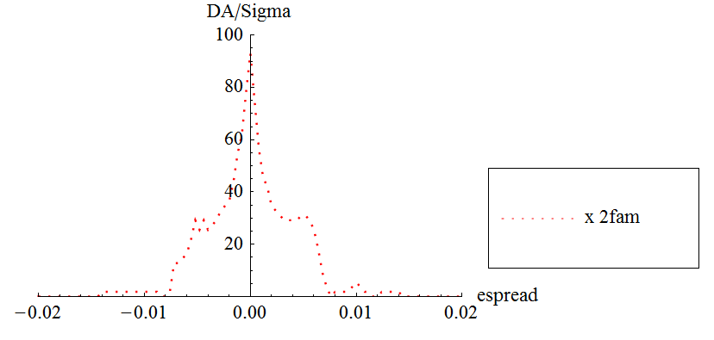
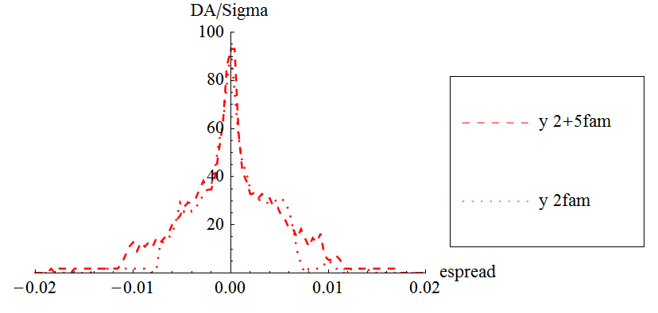
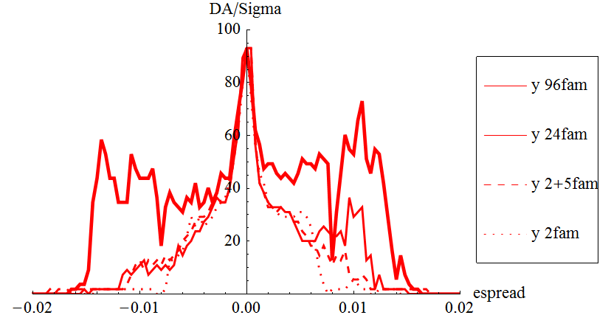
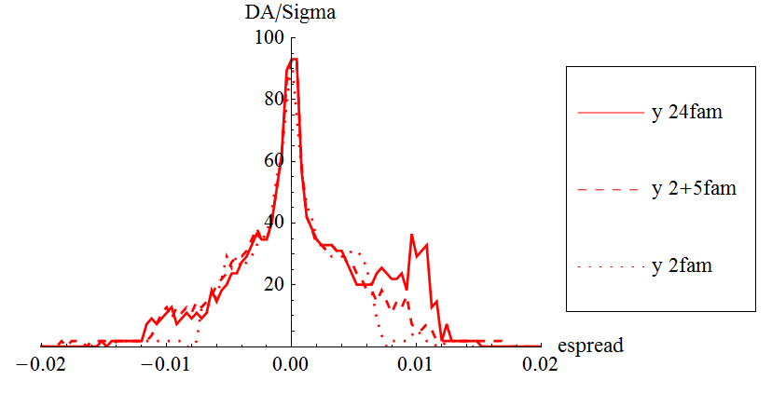
Dynamic aperture optimization
Dynamic aperture result
W/O error of the magnets
Synchrotron motion included, w/o damping
Tracking with around 1 times of damping time
Coupling factor κ=0.003 for εy
Working point (0.08, 0.22)
Many cases of sextupole families tried
Downhill Simplex algorithm applied
Some typical results
Further optimization is possible
Further optimization with these families
More families in IR
βy*= 1mm -> 1.36mm
Larger dispersion for IR sextupoles

Slide 19
Work to be done
More effects should be included
Radiation damping and fluctuation
Crab sextupoles
Solenoids
Fringe field
Errors and misalignments
Critical energy of synchrotron radiation in IR ( at least within 200m from IP) should be less than 100 keV
400keV for this lattice
A preliminary study show that it can be solved with softer and longer dipoles and specific layout of dipoles.

Slide 20
Summary
A lattice of the whole ring (ARC+PDR+IR) fulfilling the design parameters is ready.
Dynamic aperture study is made step by step
ARC/ ARC+PDR/ ARC+PDR+IR
Dynamic aperture for (ARC+PDR+IR) lattice is under going and significant progress has been made.
Further optimization is possible
More effects should be included
Re-optimize the linear lattice to reduce critical energy of synchrotron radiation

