Slide 1
Multi-objective optimization code development & application of DA optimization
Yuan Zhang, Dou Wang, Yiwei Wang, Feng Su, Huiping Geng
Institute of High Energy Physics
zhangy@ihep.ac.cn
Sep 2nd, 2016

Slide 2
Multi-objective genetic algorithm (MOGA)
Application in storage ring based light source is very popular and successful
  APS/DLS, ELEGANT, M. Borland, in 48th ICFA Beam Dynamics Workshop on Future Light Sources
  NSLSII，L. Yang, Y. Li, W. Guo and S. Krinsky, PRST-AB, 14, 054001 （2011）
  SLS, BMAD, M. Ehrlichman , arXiv: 1603.02459
  HEPS, Accelerator Toolbox, Y. Jiao and G. Xu, in this proceeding
  …

Slide 3
Different Algorithm
Particle Swarm, SPEAR3, X. Huang, J. Safranek, Nucl. Instr. Meth. In Phys. Research A. 757, 48, 2014
Differential Evolution, J. Qiang et al., IPAC’13
Downhill Simplex, SuperKEKB, FCC, K. Oide et al.
…….

Slide 4
Excitation
K. Oide, “A design of beam optics for FCC-ee”, Sep. 2015 @IHEP
255 sextupole pairs per half ring.
Resulting dynamic aperture alomost satisfies the requirements

Slide 5
Why we did the job?
We need to optimize the DA of CEPC
We want to try the direct DA optimization in collider, just as the community has done in light source
Different optimization algorithm is worth to be used
SAD(http://acc-physics.kek.jp/sad/) is used for the DA determination. It is a parallel code, but the scalability is not very good. A MPI-based parallel code to call SAD will be much more efficient.

Slide 6
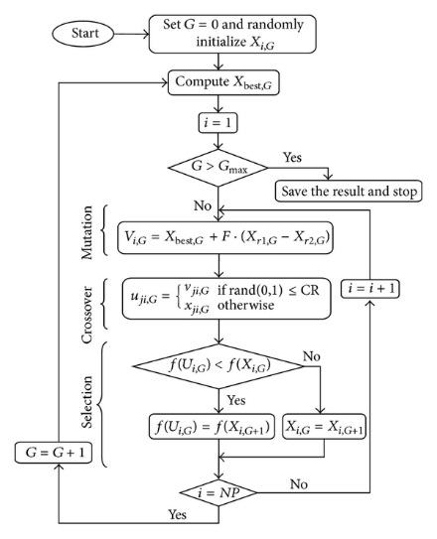
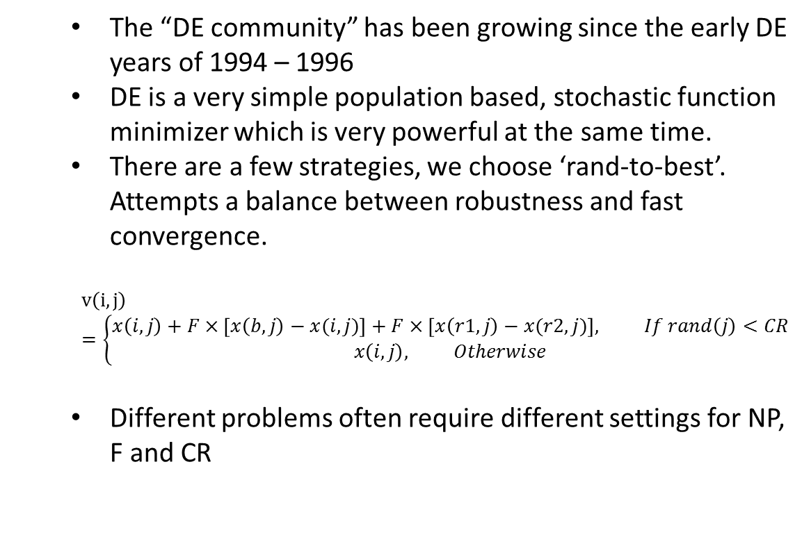
Differential Evolution Algorithm (single objective)
The “DE community” has been growing since the early DE years of 1994 – 1996
DE is a very simple population based, stochastic function minimizer which is very powerful at the same time.
There are a few strategies, we choose ‘rand-to-best’. Attempts a balance between robustness and fast convergence.
$$v\left(i,j\right)=\left\{\begin{matrix}x\left(i,j\right)+F×\left[x\left(b,j\right)−x(i,j)\right]+F×\left[x\left(r1,j\right)−x(r2,j)\right], If rand\left(j\right)<CR \\ x\left(i,j\right), Otherwise\end{matrix}\right.$$
Different problems often require different settings for NP, F and CR
http://www.hindawi.com/journals/ijap/2013/713680.fig.003.jpg

Slide 7
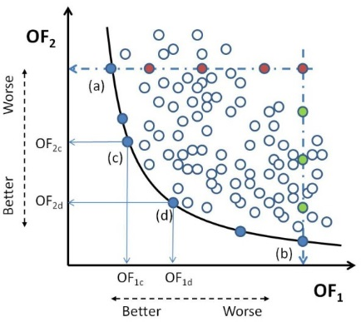
Multi-objective Optimization
Most problems in nature have several (possibly conflicting) objectives to be satisfied.
Many of these problems are frequently treated as single-objective optimization problems by transforming all but one objective into constraints.
The term optimize means finding such a solution which would give the values of all the objective functions acceptable to the decision maker.
Kung et al., J. ACM 22, 4 (Oct. 1975), 469-476
Giuseppe Narzisi, “Multi-Objective Optimization”, 2008

Slide 8
MODE:
Multi-Objective optimization by Differential Evolution
The parallel algorithm is referencing to J. Qiang(IPAC’13)
Initialize the population of parameter vectors
Generate the offspring population using the above differential evolution algorithm
Find the non-dominated population, which are treated as the best solutions in DE to generate offspring
Sorting all the population, select the best NP solution as the parents
Return to step 2, if stopping condition not met

Slide 9
MODE: Scalable Enough at 1000-nodes farm?
Yongjun Li, “Multi-objective Dynamic Aperture Optimization for NSLS-II Ring”, IAS program on HEP Conference 2016, Hong Kong

Slide 10
New Parallel Paradigm
High Parallel + High Scalability
Even the time taken by different task is different
Even some node is very busy
It is a must to do some file operations for each task.
It frequently break when the job is running at some network file system.
Need more time to find what’s wrong

Slide 11
Speed-up Method
Brute-force dynamic aperture tracking is very time consuming
The objective is first eased, for example only track 100 turns instead of 1000 turns.
Some constraints must be satisfied and may be much faster. Referencing to Ehrilichman’s work[arXiv: 1603.02459], the multi-objectives are classified into two kinds. The time consuming cost function be calculated only when the necessary constraints (or objective) be satisfied.

Slide 12
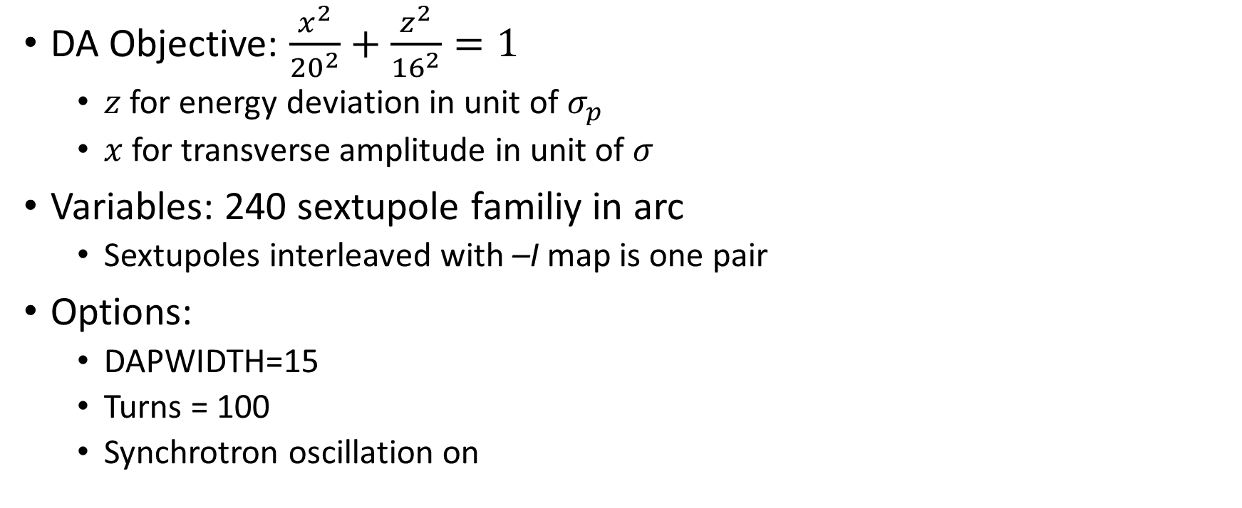
CEPC:
Dynamic Aperture Optimization
DA Objective: $\frac{x^{2}}{{20}^{2}}+\frac{z^{2}}{{16}^{2}}=1$
  $z$ for energy deviation in unit of $σ_{p}$
  $x$ for transverse amplitude in unit of $σ$
Variables: 240 sextupole familiy in arc
  Sextupoles interleaved with –I map is one pair
Options:
  DAPWIDTH=15
  Turns = 100
  Synchrotron oscillation on
DA almost satisfies the requirements

Slide 13

DA Optimization of LER
Momentum aperture is increased.
Objectives:
  $ν_{x}∈\left(0.53,0.66\right), ν_{y}∈\left(0.55,0.66\right),$
  for $δ_{p}∈\left(−0.019,0.019\right)$
  $\frac{x^{2}}{{50}^{2}}+\frac{z^{2}}{{26}^{2}}=1$, for z=Range[-24,24,3],
  $ε_{x,0}=1.89$nmrad, $δ_{p,0}$=7.7e-4
Variables: 68
  2 Octupoles
  54 sextupole pairs
  12 skew sextupole pairs

Slide 14
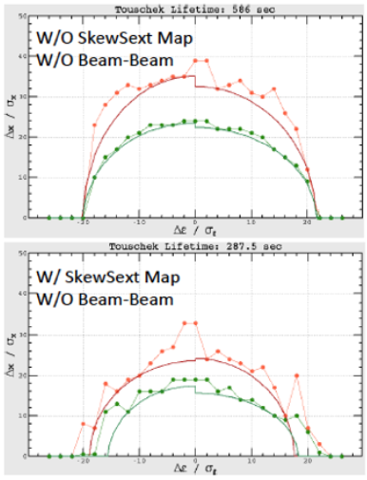
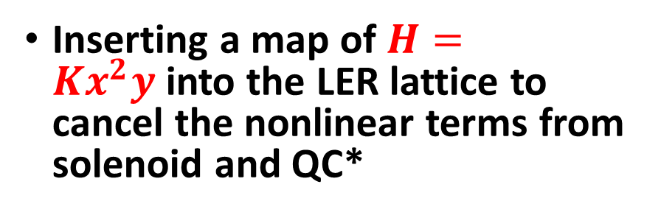
LER: beam-beam and lattice nonlinearity
Skew-sext resonance reduce the beam-beam performance
Inserting a map of $H=Kx^{2}y$into the LER lattice to cancel the nonlinear terms from solenoid and QC*
Skew-sext map cause loss in DA and lifetime
D. Zhou, “Beam Dynamics Issuses in SuperKEKB”, The 20th KEKB Accelerator Review Committee, Feb, 2015.
D. Zhou and et al, “Interplay of Beam-Beam Lattice Nonlinearity and Space Charge Effects in the SuperKEKB Collider”, IPAC’15

Slide 15
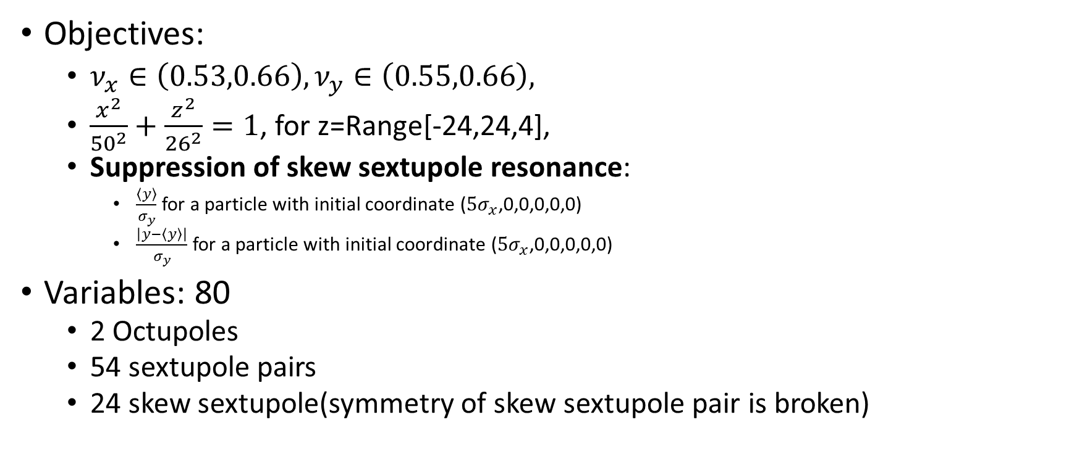
Optimization of LER
Objectives:
  $ν_{x}∈\left(0.53,0.66\right), ν_{y}∈\left(0.55,0.66\right),$
  $\frac{x^{2}}{{50}^{2}}+\frac{z^{2}}{{26}^{2}}=1$, for z=Range[-24,24,4],
  Suppression of skew sextupole resonance:
    $\frac{\left\langle y\right\rangle }{σ_{y}}$ for a particle with initial coordinate ($5σ_{x}$,0,0,0,0,0)
    $\frac{\left|y−\left\langle y\right\rangle \right|}{σ_{y}}$ for a particle with initial coordinate ($5σ_{x}$,0,0,0,0,0)
Variables: 80
  2 Octupoles
  54 sextupole pairs
  24 skew sextupole(symmetry of skew sextupole pair is broken)

Slide 16
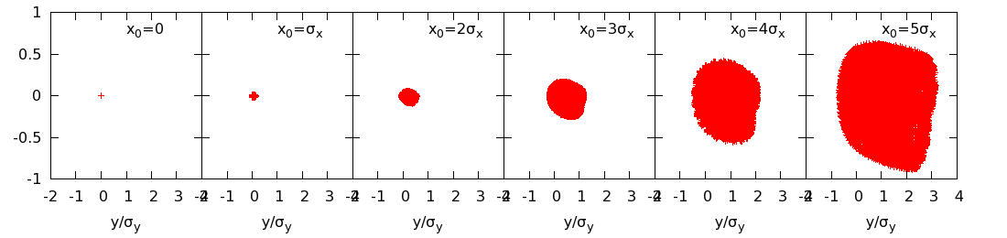
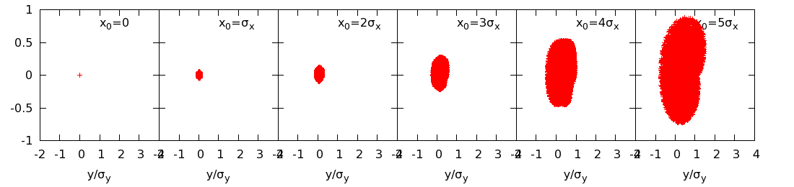
Optimization of LER (2)
Suppression of skew sextupole resonance

Slide 17
Part II PDR lattice DA Optimization

Slide 18

Main Parameters
D. Wang & F. Su
$β_{x}=0.25$m$, β_{y}=1.36$ mm
$ν_{x}=$319.21,$ν_{y}=$318.41
$ε_{x}=3.1$ nmrad
Arc sextupole: 2 groups
DA (on-momentum): 27σ_{x} × 57σ_{y}

Slide 19
1st objectives: Chromaticity correction
2nd objectives: Dynamic Aperture

Slide 20
Chromatic Correction with sextupoles in Arc
192 sext families in arc
Objective: Optics stable in DeltaP: (-0.01, 0.01) with step 0.001
Notes:
Test6: variable range (0.2, 1.8)
@x3500, 8-15, 8:45+

Slide 21
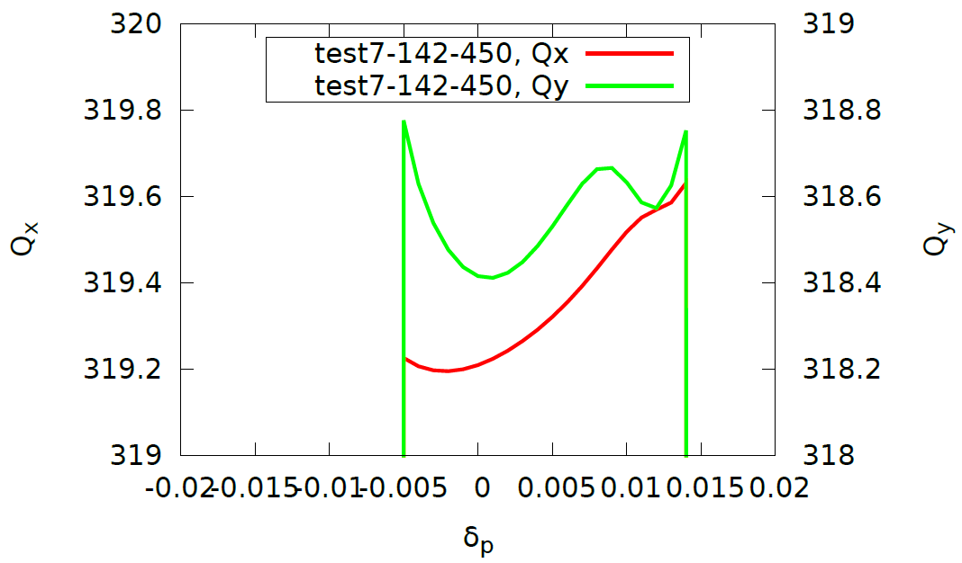
Chromatic Correction with sextupoles in IR
Sextupole knobs in IR, not the main chromaticity correction sextupole
Notes:
test7@acc-ap06, 8-15, 10:00, ~17:00 自己中断

Slide 22
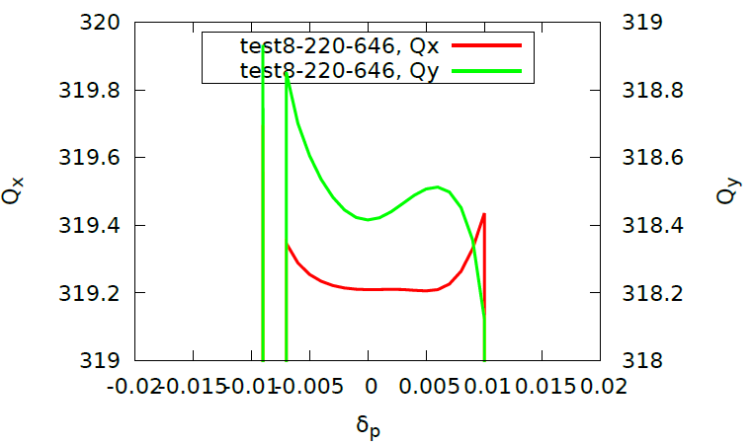
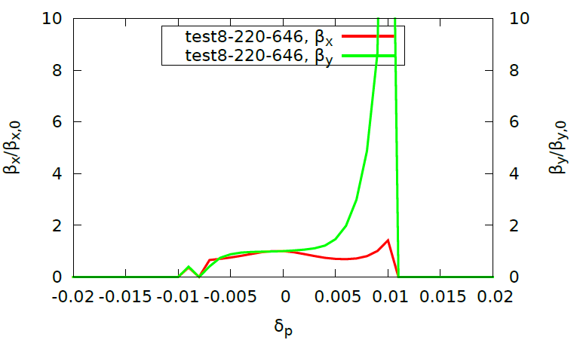
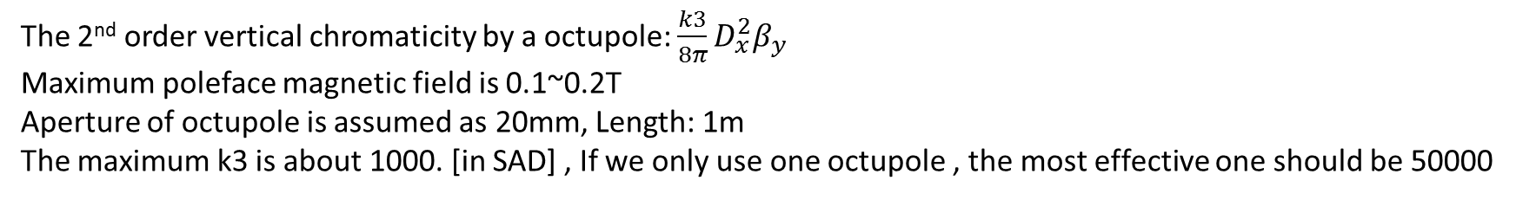
Chromatic Correction with Octupoles in IR
Since there exist strong 2nd order chromatcity in y, we try to use octupole knobs in IR to do chromaticity correction
2nd order chromaticity in y: 16500
The 2nd order vertical chromaticity by a octupole: $\frac{k3}{8π}D_{x}^{2}β_{y}$
Maximum poleface magnetic field is 0.1~0.2T
Aperture of octupole is assumed as 20mm, Length: 1m
The maximum k3 is about 1000. [in SAD] , If we only use one octupole , the most effective one should be 50000
Notes:
（test8，）@acc-ap06, 8-16, 8:55, 16:00 停止

Slide 23
K. Oide, ICHEP, 2016

Slide 24
DA without optimization
X
Y

Slide 25
DA Optimization with arc sextupoles
192 sextupole families
X
Y
Notes:
TEST16,@acc-ap04, 8-22, 16:33, 8-29, 9:30 非人为中断

Slide 26
DA Optimization with all IR sextupoles
X
Y
Notes:
test19

Slide 27
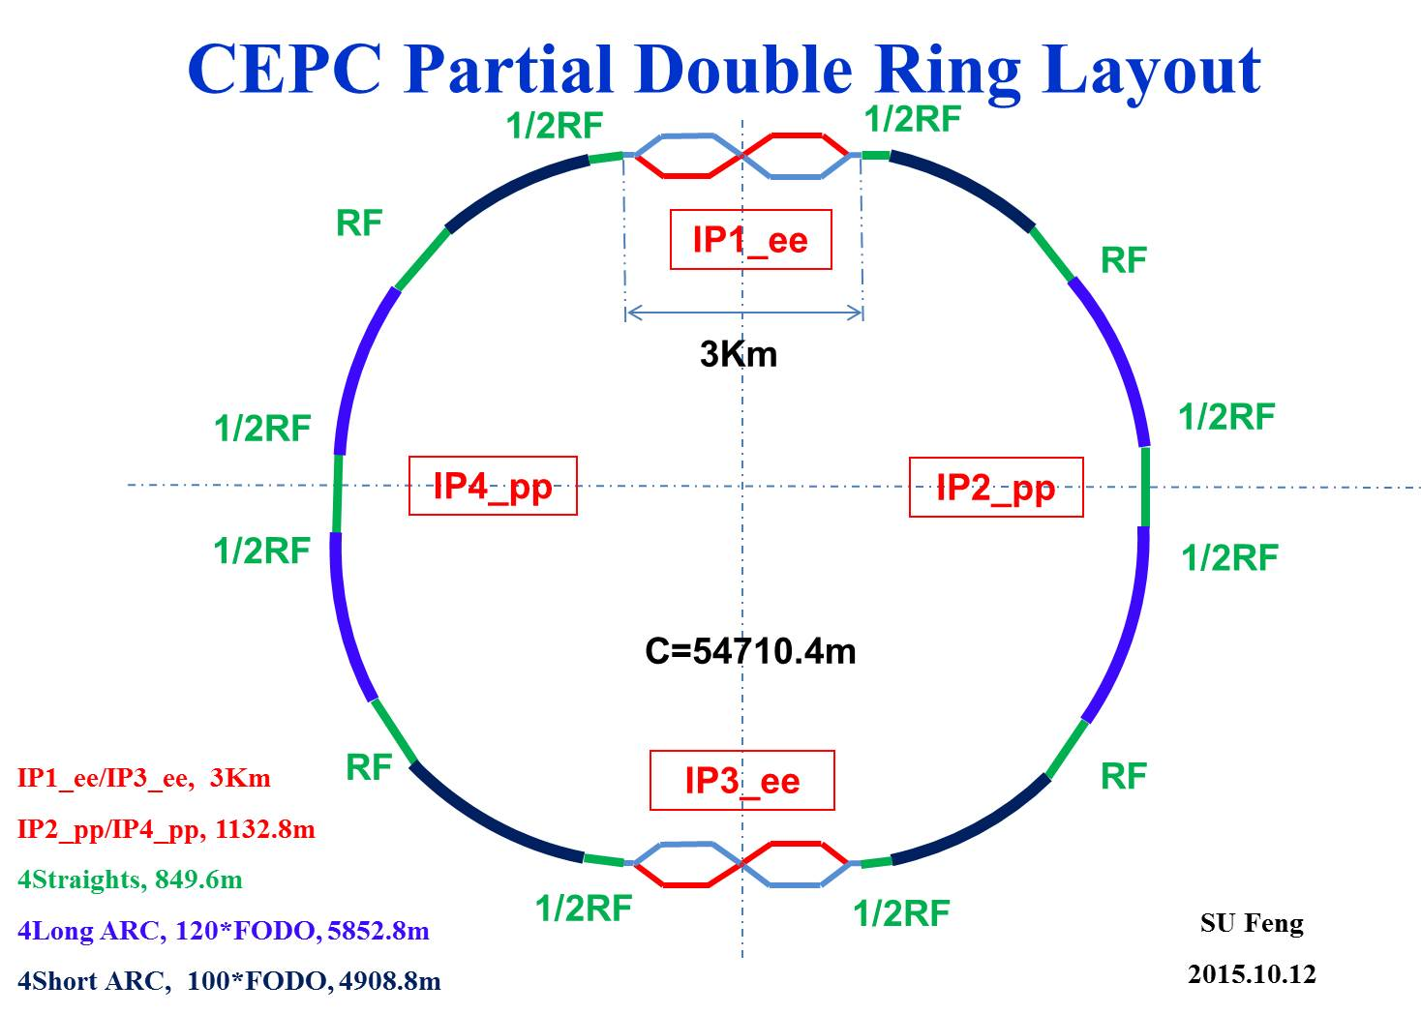
Phase Tuning
1
2
Phase tuning section
3
4
5
bypass (pp)
bypass (pp)
6
7
Phase tuning section
8

Slide 28
DA Optimization by tuning the phase advance
Notes:
test20

Slide 29
DA Optimization by tuning the phase advance with Damping

Slide 30
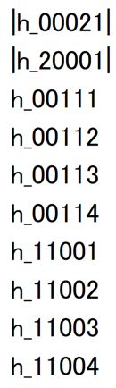
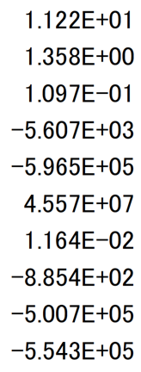
Preliminary analysis of chromaticity courtesy of D. Zhou (KEK)
Oide-FCC
CEPC
2nd order chromaticity comes from IR

Slide 31
Sawtooth effect of PDR
We could not find stable sawtooth orbit for the present lattice design.
The separator maybe too strong

Slide 32
Summary
A multi-objective optimization code based on differential evolution (MODE) is developed
Its functionality has been proven by the application in CEPC one ring scheme
We tried to do the optimization of the present partial double ring lattice design. It seems the lattice itself need more optimization, especially the IR.
  The arc sextpole enlarge the momentum acceptance
  The IR sextupole enlarge the transverse momentum aperture
  The phase advance tuning (include working point) enlarge the transverse momentum aperture.

