Slide 1
CEPC injector beam dynamics
Cai MENG , Guoxi PEI, Xiaoping LI, Jingru ZHANG, Shilun PEI, Xiangjian WANG
Institute of High Energy Physics, CAS, Beijing

Slide 2
Outline
1
Introduction
1
Electron linac
2
3
Positron linac
3
4
Summary & Plan
4
5

Slide 3
INTRODUCTION: Main parameters of Injector
Parameter | Symbol | Unit | Value
e⁻ /e⁺ beam energy | E_{e-}/E_{e+} | GeV | 6
Repetition rate | f_{rep} | Hz | 50
e⁻ /e⁺ bunch population @ 6 GeV | Ne-/Ne+ |  | 2×10¹⁰
 | Ne-/Ne+ | nC | 3.2
Energy spread (e⁻ /e⁺ ) | σ_{E} |  | <1×10-3
Emitance (e⁻ /e⁺ ) |  |  | <0.3 mm⋅ mrad
e⁻ beam energy on Target |  | GeV | 4
e⁻ bunch charge on Target |  | nC | 10

Slide 4
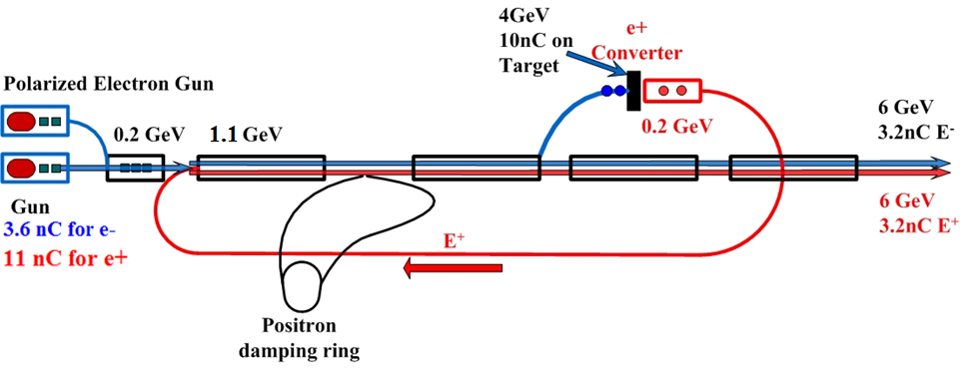
INTRODUCTION: Layout of Injector
Injection time
1.1 GeV damping ring
SLED (SLAC Energy Doubler): 200 MeV~1.1GeV without SLED
Accelerating gradient: different section & different accelerating tube
  Frequency of Booster: 1300 MHz=3.25MHz×400
  Frequency of Linac: 2856.75 MHz=3.25MHz×879
3.25 MHz

Slide 5
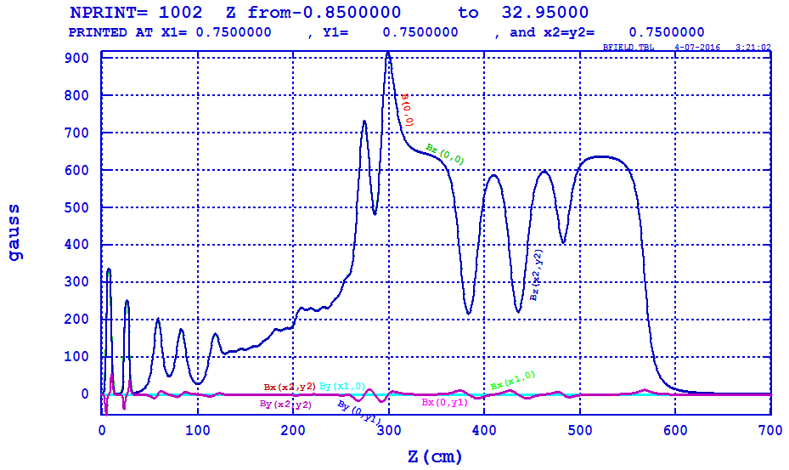
ELECTRON LINAC: Bunching system and pre-accelerating
Pei Shilun
Bunching System
  SHB1:142.8375 MHz
  SHB：571.35 MHz
  S-band Buncher (1): 2856.75 MHz
Pre-accelerating structure
  S-band accelerator (3): 2856.75 MHz ~ 24 MV/m

Slide 6
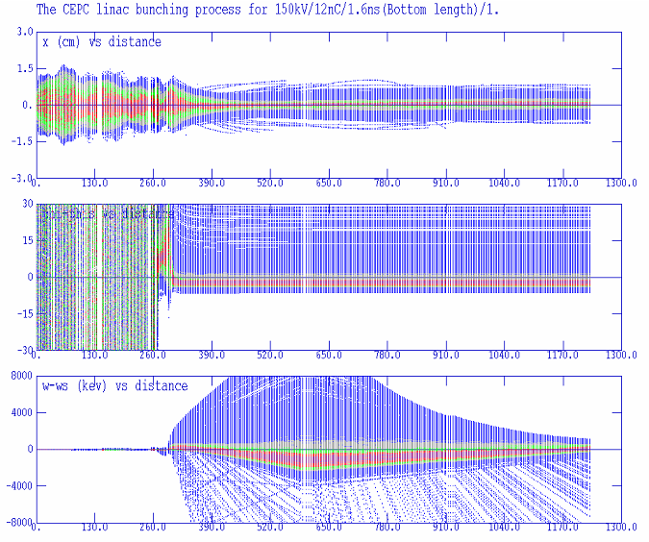
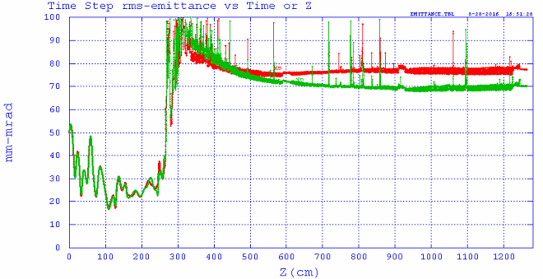
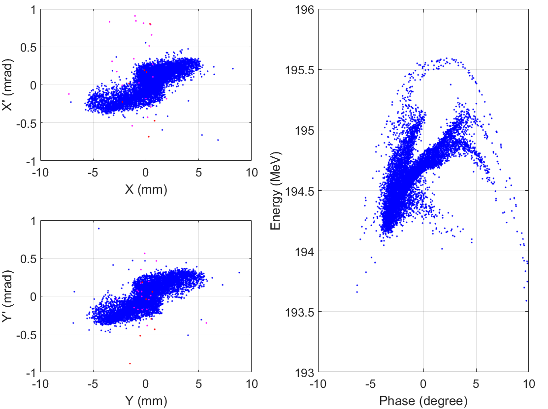
ELECTRON LINAC: Bunching system and pre-accelerating
Meng Cai
10 nC
Beam distribution @ pre-accelerating section exit

Slide 7
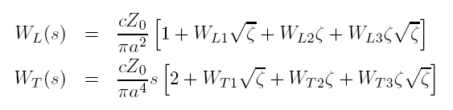
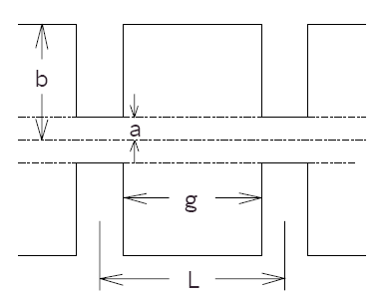
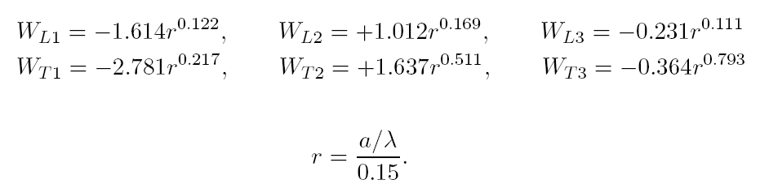

LINAC: Longitudinal Short-Range Wakefield
Yokoya's wakefield model for periodic linac structure:

Slide 8
LINAC: Longitudinal Short-Range Wakefield
Type | Freq. | 2a | 2b | t | L | Mode
 | MHz | mm | mm | mm | mm
S-band | 2856.75 | 22.6568 | 82.6276 | 5.842 | 34.9803 | 2π/3
C-band | 5713.5 | 14.2293 | 45.606 | 4.5 | 19.6764 | 3π/4

Slide 9
ELECTRON LINAC: High current linac design
Beam energy: 200 MeV-> 4GeV
  200 MeV->1.1 GeV: 15 MV/m (S-band without SLED)
  1.1 GeV-> 4GeV: 27 MV/m (S-band with SLED)
Beam charge per bunch: 10 nC
RMS beam size < 1 mm, have not considered all Errors

Slide 10
ELECTRON LINAC: Linac simulation with S-band
Beam energy: 200 MeV-> 6GeV
  200 MeV->1.1 GeV: 15 MV/m (S-band without SLED)
  1.1 GeV-> 4 GeV: 27 MV/m (S-band with SLED)
  4 GeV-> 6 GeV: 27 MV/m (S-band with SLED)
Beam charge per bunch: 3.2 nC
Energy spread (<1×10⁻³)
  1.1×10⁻³ , need more optimization

Slide 11
ELECTRON LINAC: Linac simulation with C-band
Beam energy: 200 MeV-> 6GeV
  200 MeV->1.1 GeV: 15 MV/m (S-band without SLED)
  1.1 GeV-> 4 GeV: 27 MV/m (S-band with SLED)
  4 GeV-> 6 GeV: 45 MV/m (C-band with SLED)
Beam charge per bunch: 3.2 nC
Energy spread (<1×10⁻³)
  2×10⁻³ , need more optimization
  Beam length is more critical for energy spread control

Slide 12
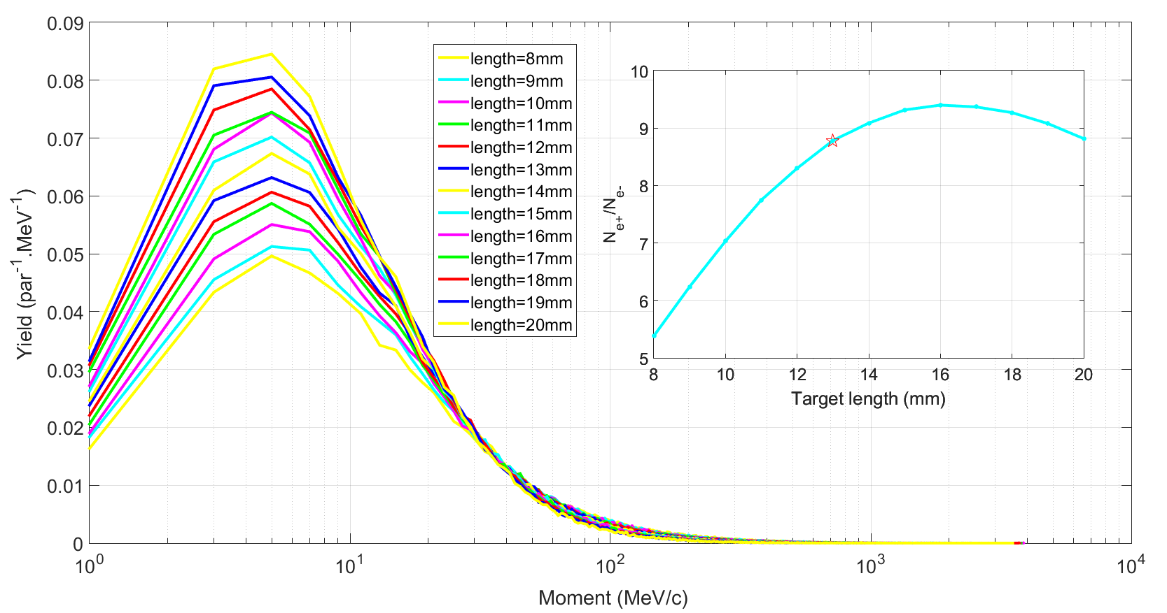
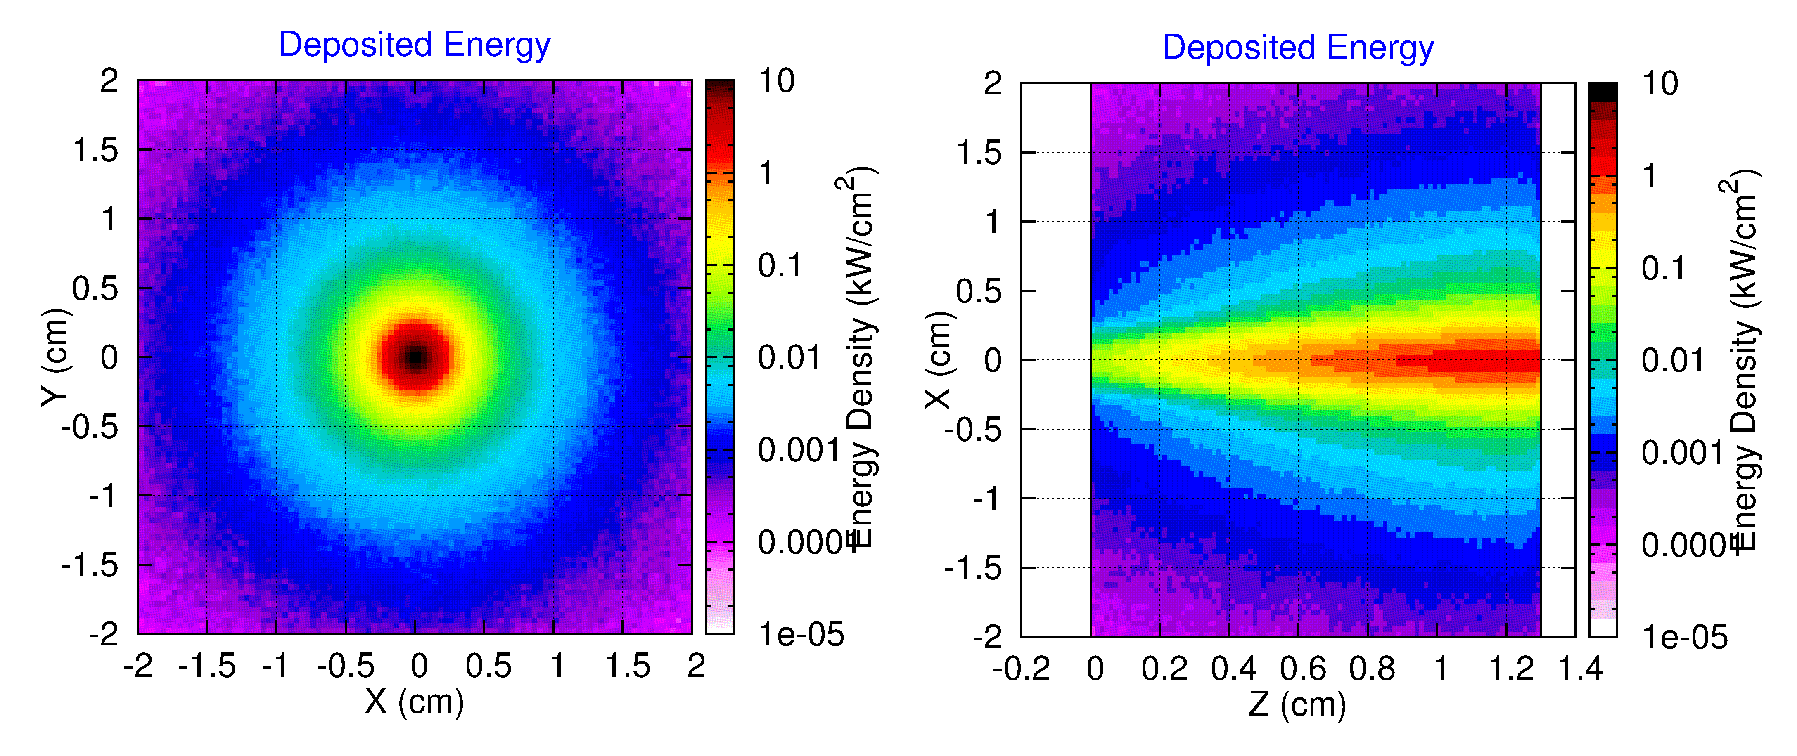
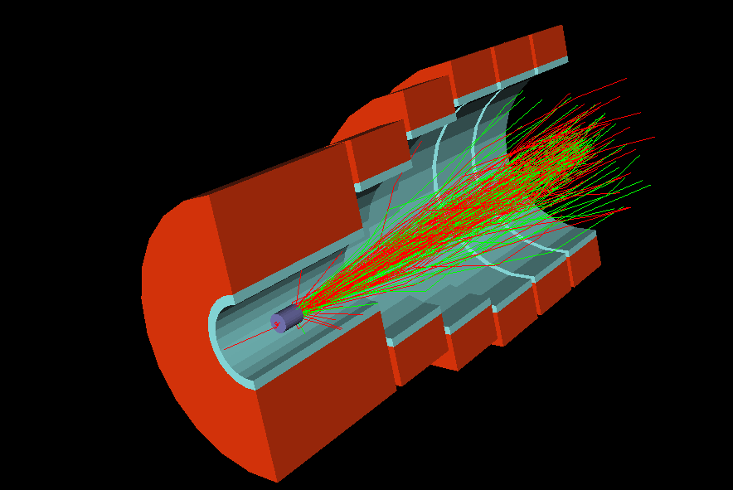
POSITRON LINAC: e⁺ source
e⁻ beam energy： 4 GeV
Beam rms size：1 mm @ Guass distribution
Target：L=13 mm && r=10 mm @ W
Deposited energy
Notes:
考虑产额和能量沉积，选择13mm，如果正电子产额不够，可以选16 mm

Slide 13
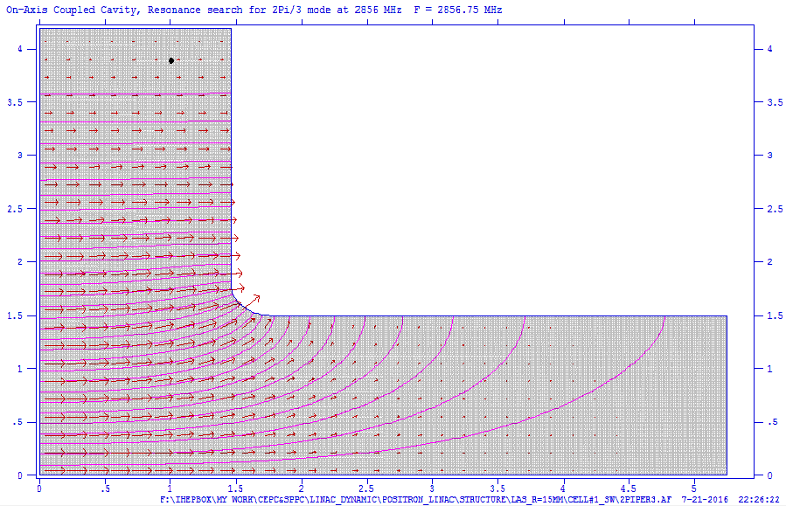
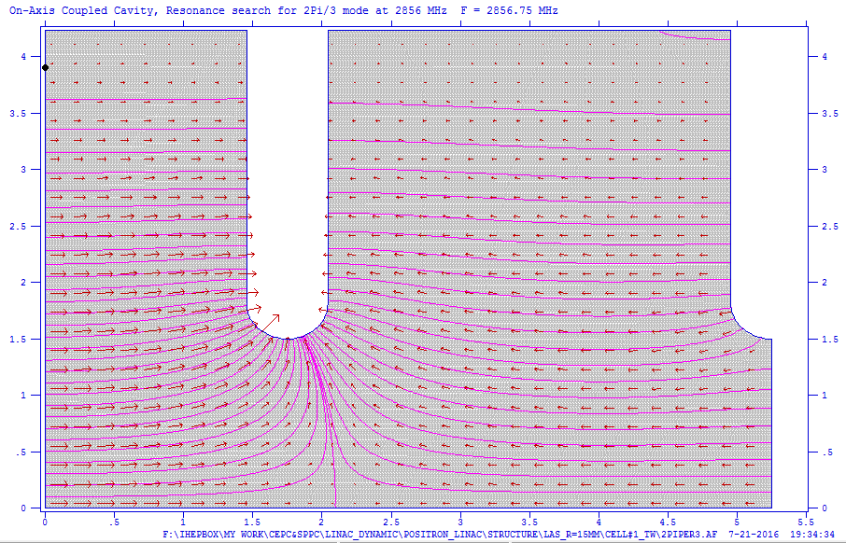
POSITRON LINAC: e⁺ capture and pre-accelerating
200MeV
Aperture: 15 mm
Average accelerating gradient: 18 MV/m
Magnetic field
Accelerating tube

Slide 14
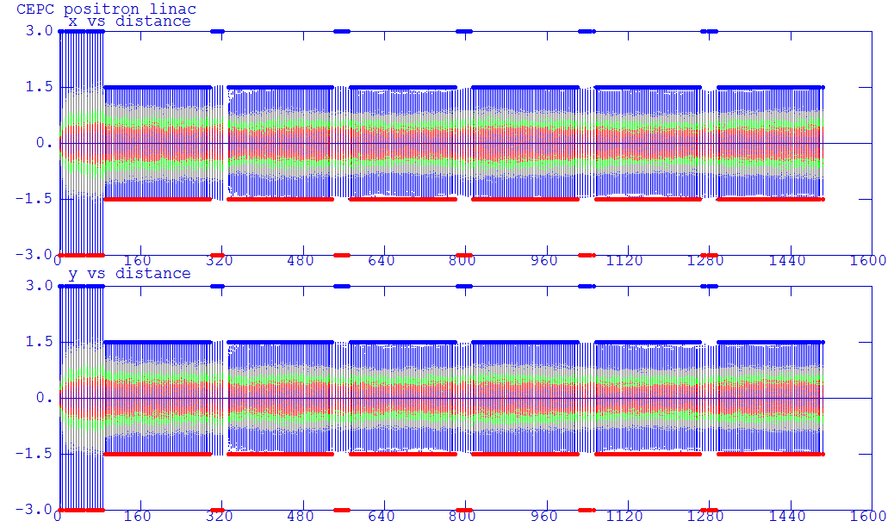
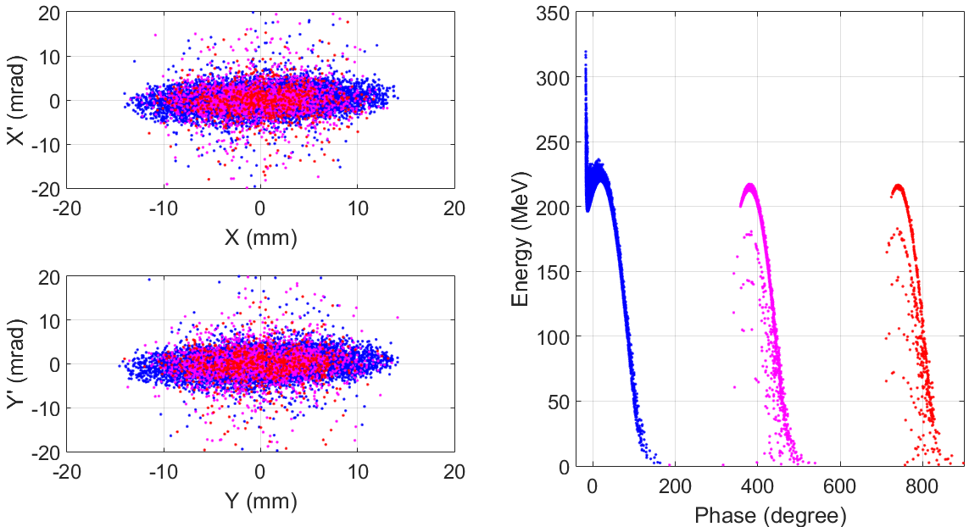
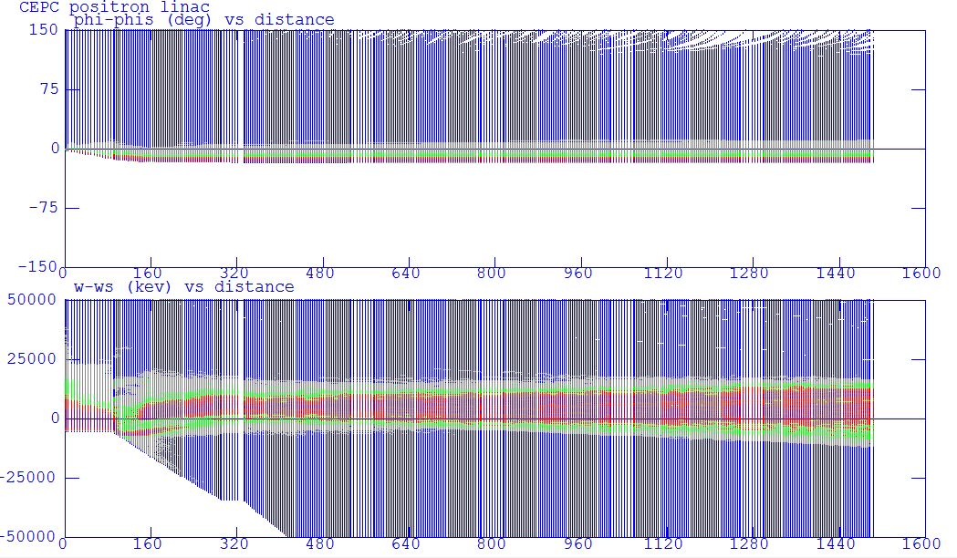
POSITRON LINAC: e⁺ capture and pre-accelerating
Beam envelope
X (cm)
Y (cm)
Phase (deg)
Beam distribution at pre-accelerating exit
ΔW (MeV)

Slide 15
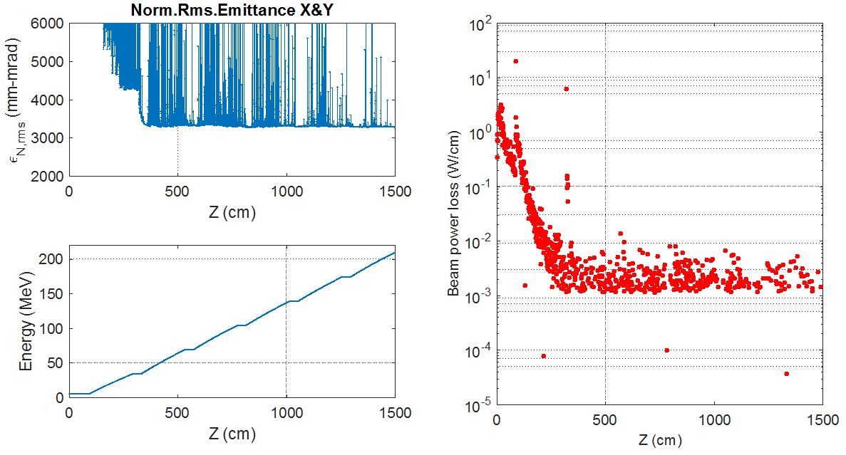
POSITRON LINAC: e⁺ capture and pre-accelerating
Collimator
Notes:
俘获段后记预加速开始部分需要准直器控制束流损失。

Slide 16
POSITRON LINAC: Linac simulation with S-band
Beam energy: 200 MeV-> 6GeV
  200 MeV->1.1 GeV: 15 MV/m (S-band without SLED)
  1.1 GeV-> 4 GeV: 27 MV/m (S-band with SLED)
  4 GeV-> 6 GeV: 27 MV/m (S-band with SLED)
Beam charge per bunch: 3.2 nC
Emittance: 0.302 mm-mrad
Energy spread (<1×10⁻³)
  1.2×10⁻³ , need more optimization

Slide 17
POSITRON LINAC: Linac simulation with C-band
Beam energy: 200 MeV-> 6GeV
  200 MeV->1.1 GeV: 15 MV/m (S-band without SLED)
  1.1 GeV-> 4 GeV: 27 MV/m (S-band with SLED)
  4 GeV-> 6 GeV: 45 MV/m (C-band with SLED)
Beam charge per bunch: 3.2 nC
Emittance: 0.302 mm-mrad
Energy spread (<1×10⁻³)
  2.2×10⁻³ , need more optimization
  Beam length is more critical for energy spread control

Slide 18
SUMMARY
Finished the preliminary design of electron linac with Wakefield /without errors, preliminary start-to-end simulation: bunching system/pre-accelerating(200 MeV)/high current linac design (10 nC @ 4 GeV)/baseline linac design (3.2 nC @ 6 GeV);
Finished the preliminary design of positron linac with Wakefield /without errors, preliminary start-to-end simulation: positron source/positron capture (AMD)/ pre-accelerating ( 200 MeV)/baseline linac design (3.2 nC @ 6GeV);
For emittance, electron linac can meet the requirement, positron linac can almost meet the requirement. Considering errors and damping ring for positron, emittance can meet the requirement;
For energy spread, both electron linac and positron linac need further optimization to meet requirement;
For high energy section (4 GeV~6 GeV), we have studied C-band accelerating tube, beam dynamics almost same as S-band accelerating tube and energy spread control is need more consideration.

Slide 19
Plan
Optimization of baseline linac design
Beam loss study and control
Considering errors of all elements in linac design
……
Thank you for your attention!

