Slide 1
CEPC APDR SRF and beam dynamics study
Zhenchao LIU
2016-9-2

Slide 2
Outline
APDR SRF scheme
Cavity requirement
Phase and voltage analysis
Booster

Slide 3
Advantage:
Avoid pretzel orbit
Accommodate more bunches at Z/W energy
Reduce AC power with crab waist collision
bypass (pp)
bypass (pp)
Problem: very low RF efficiency!!

Slide 4
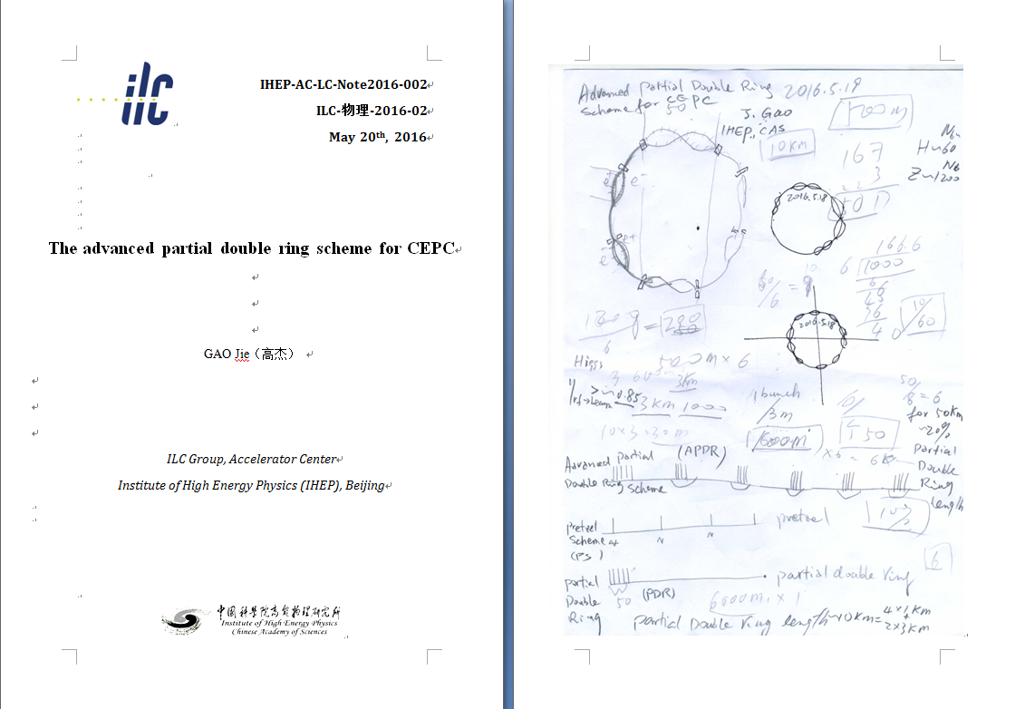
New idea：APDR

Slide 5
New SRF layout-6 ring
IP1
RF station
Double Ring
(1km/3km)
C≈60km
RF&DR center 30°equispaced
IP3

Slide 6
bunch
3.3us
t
26.7us

Slide 7
Nonconstant Voltage and Phase (NVP) Acceleration method
New acceleration method for CEPC to solve RF efficiency
The bunches in a bunch train will be accelerated at different Vc_{i}
The bunches in a bunch train will be accelerated at different synchrotron phase to keep constant energy gain.
Va_{i}=Vc_{i}*cosϕs_{i}=C

Slide 8
parameter for CEPC partial double ring （wangdou20160325）
 | Pre-CDR | H-high lumi. | H-low power | W | Z
Number of IPs | 2 | 2 | 2 | 2 | 2
Energy (GeV) | 120 | 120 | 120 | 80 | 45.5
Circumference (km) | 54 | 54 | 54 | 54 | 54
SR loss/turn (GeV) | 3.1 | 2.96 | 2.96 | 0.59 | 0.062
Half crossing angle (mrad) | 0 | 15 | 15 | 15 | 15
Piwinski angle | 0 | 2.5 | 2.6 | 5 | 7.6
N_{e}/bunch (10¹¹) | 3.79 | 2.85 | 2.67 | 0.74 | 0.46
Bunch number | 50 | 67 | 44 | 400 | 1100
Beam current (mA) | 16.6 | 16.9 | 10.5 | 26.2 | 45.4
SR power /beam (MW) | 51.7 | 50 | 31.2 | 15.6 | 2.8
Bending radius (km) | 6.1 | 6.2 | 6.2 | 6.1 | 6.1
Momentum compaction (10⁻⁵) | 3.4 | 2.5 | 2.2 | 2.4 | 3.5
β_{IP} x/y (m) | 0.8/0.0012 | 0.25/0.00136 | 0.268 /0.00124 | 0.1/0.001 | 0.1/0.001
Emittance x/y (nm) | 6.12/0.018 | 2.45/0.0074 | 2.06 /0.0062 | 1.02/0.003 | 0.62/0.0028
Transverse σ_{IP} (um) | 69.97/0.15 | 24.8/0.1 | 23.5/0.088 | 10.1/0.056 | 7.9/0.053
ξ_{x}/IP | 0.118 | 0.03 | 0.032 | 0.008 | 0.006
ξ_{y}/IP | 0.083 | 0.11 | 0.11 | 0.074 | 0.073
V_{RF} (GV) | 6.87 | 3.62 | 3.53 | 0.81 | 0.12
f _{RF} (MHz) | 650 | 650 | 650 | 650 | 650
Nature σ_{z} (mm) | 2.14 | 3.1 | 3.0 | 3.25 | 3.9
Total σ_{z} (mm) | 2.65 | 4.1 | 4.0 | 3.35 | 4.0
HOM power/cavity (kw) | 3.6 | 2.2 | 1.3 | 0.99 | 0.99
Energy spread (%) | 0.13 | 0.13 | 0.13 | 0.09 | 0.05
Energy acceptance (%) | 2 | 2 | 2
Energy acceptance by RF (%) | 6 | 2.2 | 2.1 | 1.7 | 1.1
n_{γ} | 0.23 | 0.47 | 0.47 | 0.3 | 0.24
Life time due to beamstrahlung_cal (minute) | 47 | 36 | 32
F (hour glass) | 0.68 | 0.82 | 0.81 | 0.92 | 0.95
L_{max}/IP (10³⁴cm⁻²s⁻¹) | 2.04 | 2.96 | 2.01 | 3.09 | 3.09

Slide 9
6 double ring/ | Pre-CDR Zhaijiyuan20160327 | PDR(HL) Zhaijiyuan20160327&0408 | APDR(HL V_{RF}=3.62) | APDR (H-low power) | APDR (Z)
Number of IPs | 2 | 2 | 2 | 2 | 2
Energy (GeV) | 120 | 120 | 120 | 120 | 45.5
Circumference (km) | 54 | 54 | 54 | 54 | 54
SR loss/turn (GeV) | 3.1 | 2.96 | 2.96 | 2.96 | 0.062
Half crossing angle (mrad) | 0 | 15 | 15 | 15 | 15
Piwinski angle | 0 | 2.5 | 2.5 | 2.6 | 8.5
N_{e}/bunch (10¹¹) | 3.79 | 2.85 | 2.85 | 2.67 | 0.46
Bunch number | 50 | 67 | 22x3 | 15x3 | 367x3
Beam current (mA) | 16.6 | 16.96 | 17 | 10.5 | 45.4
SR power /beam (MW) | 53.2 | 51 | 50 | 31.2 | 2.8
Bending radius (km) | 6.1 | 6.2 | 6.2 | 6.2 | 6.1
V_{RF} (GV) | 6.87 | 3.65 | 3.62 | 3.53 | 0.357/0/12
f _{RF} (MHz) | 650 | 650 | 650 | 650 | 650
Cavity No. | 384 | 384 | 384 | 384 | 48/24
Cavity gradient | 15.8 | 20.6 | 20.6 | 20 | 16.2/21.7
Accelerating phase | 63.1 | 35.2 | 35.2-32.3 | 33-30.9 | 80.2-79.8/58.9-56.9
CW power/cavity （kW） | 275 | 263.4 | 260 | 163 | 117/233
Peak power/train (kW) | / | 2220 | 2345 | 1148 | 1237
Total Power （MW) | 105.6 | 382.5 | 100.4 | 62.7 | 5.6
Cell/cavity | 5 | 2 | 2 | 2 | 2/1
Cavity/module | 4 | 6 | 8 | 8 | 4/4
Module/station | 6 | 10 | 8 | 8 | 2/1
Total module | 96 | 64 | 48 | 48 | 12/6
R/Q (Ω) | 514 | 206 | 206 | 206 | 206/103
G | 268 | 268 | 268 | 268 | 268
HOM loss factor/cavity (V/pC) | 1.8 | 0.54 | 0.54 | 0.54 | 0.54
HOM power/cavity (kW) | 3.6 | 0.8 | 0.838 | 0.485 | 0.361/0.18
Working Temperature（K） | 2 | 2 | 2 | 2 | 2
Q0 | 4E10 | 2E10 | 2E10 | 2E10 | 2E10
τ（ms） | 1.156 | 0.097 | 0.811 | 1.242 | 2.243/0.507
QL | 2.36e6 | 1.97e5 | 1.656e6 | 2.536e6 | 4.58e6/1.03e6
Bandwidth(kHz) | 0.28 | 3.3 | 0.196 | 0.128 | 0.071/0.314
Detuning F (kHz) | -0.27 | -1.16 | -0.138 | -0.083 | -0.234/-0.520
Stored energy/cavity(J) | 158.7 | 107.4 | 107.4 | 100 | 65.3/59.1
Frev(kHz) | 5.484 | 5.484 | 5.484 | 5.484 | 5.484
Gap length (us) | / | 0.3-160 | 26.7 | 26.7 | 26.7
η(RF to beam efficiency)(%) | 100 | 27% | ~100 | ~100 | ~100
Vc decrease(%) | / | / | 3.3 | 2.2 | 2.5/5.3
TB/τ | / | 1.7 | 0.0158 | 0.021 | 0.012/0.053

Slide 10
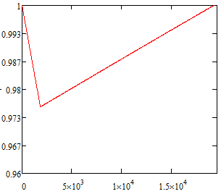
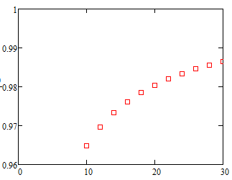
Accelerator gradient decrease in one RF cavity (Z)
Bunch train passing
Bunch train space
Assume matching
Final Eacc/Initial Eacc
Final Eacc/Initial Eacc
Initial Eacc(MV/m)
RF cycles
Field evolution in cavity
Field decrease vs. various initial field gradient of the cavity

Slide 11
New SRF layout-8 ring
IP1
RF station
Double Ring
(1km/3km)
C≈62km
RF&DR center 22.5°equispaced
IP3

Slide 12
bunch
3.3us
t
20us

Slide 13
8 double ring | Pre-CDR Zhaijiyuan20160327 | PDR(HL) Zhaijiyuan20160327&0408 | APDR(HL V_{RF}=3.62) | APDR (H-low power V_{RF}=3.53) | APDR (H-low power) | APDR (Z)
Number of IPs | 2 | 2 | 2 | 2 | 2 | 2
Energy (GeV) | 120 | 120 | 120 | 120 | 120 | 45.5
Circumference (km) | 54 | 54 | 54 | 54 | 54 | 54
SR loss/turn (GeV) | 3.1 | 2.96 | 2.96 | 2.96 | 2.96 | 0.062
Half crossing angle (mrad) | 0 | 15 | 15 | 15 | 15 | 15
Piwinski angle | 0 | 2.5 | 2.5 | 2.6 | 2.6 | 8.5
N_{e}/bunch (10¹¹) | 3.79 | 2.85 | 2.85 | 2.67 | 2.67 | 0.46
Bunch number | 50 | 67 | 17x4 | 11x4 | 11x4 | 275x4
Beam current (mA) | 16.6 | 16.96 | 17 | 10.5 | 10.5 | 45.4
SR power /beam (MW) | 53.2 | 51 | 50 | 31.2 | 31.2 | 2.8
Bending radius (km) | 6.1 | 6.2 | 6.2 | 6.2 | 6.2 | 6.1
V_{RF} (GV) | 6.87 | 3.65 | 3.62 | 3.53 | 5.16 | 0.357/0.12/0.12
f _{RF} (MHz) | 650 | 650 | 650 | 650 | 650 | 650
Cavity No. | 384 | 384 | 384 | 384/768/192 | 498 | 48/16/16
Cavity gradient | 15.8 | 20.6 | 20.6 | 20/20/20 | 22.6 | 16.2/16.3/32.6
Accelerating phase | 63.1 | 35.2 | 35.2-33 | 33-31.6/33-31.6/33-31.6 | 55.3-55 | 80.1-79.9/58.9-56.9/58.9-58
CW power/cavity （kW） | 275 | 263.4 | 260 | 163.3/81.6/326.6 | 126 | 117/350/350
Peak power/train (kW) | / | 2220 | 1389 | 843 | 843 | 884
Total Power （MW） | 105.6 | 382.5 | 100.4 | 62.7 | 62.7 | 5.6
Cell/cavity | 5 | 2 | 2 | 2/1/4 | 2 | 2/2/1
Cavity/module | 4 | 6 | 6 | 6/12/3 | 6(3,2) | 6/2/2
Module/station | 6 | 10 | 8 | 8/8/8 | 10(11） | 1/1/1
Total module | 96 | 64 | 64 | 64/64/64 | 126 | 8/8/8
R/Q (Ω) | 514 | 206 | 206 | 206/103/412 | 206 | 206/206/103
G | 268 | 268 | 268 | 268 | 268 | 268
HOM loss factor/cavity (V/pC) | 1.8 | 0.54 | 0.54 | 0.54/0.27/1.08 | 0.54 | 0.54/0.54/0.27
HOM power/cavity (kW) | 3.6 | 0.8 | 0.838 | 0.485/0.24/0.97 | 0.485 | 0.36/0.36/0.18
Working Temperature（K） | 2 | 2 | 2 | 2 | 2 | 2
Q0 | 4E10 | 2E10 | 2E10 | 2E10 | 2E10 | 2E10
τ（ms） | 1.156 | 0.097 | 0.811 | 1.242 | 2.045 | 2.243/0.76/0.76
QL | 2.36e6 | 1.97e5 | 1.656e6 | 2.53e6 | 4.18e6 | 4.58e6/1.55e6/1.55e6
Bandwidth(kHz) | 0.28 | 3.3 | 0.196 | 0.128 | 0.077 | 0.071/0.209/0.209
Detuning F (kHz) | -0.27 | -1.16 | -0.138 | -0.083 | -0.111 | -0.234/-0.347/-0.347
Stored energy/cavity(J) | 158.7 | 107.4 | 107.4 | 100 | 126.9 | 65.3/65.3/133
Frev(kHz) | 5.484 | 5.484 | 5.484 | 5.484 | 5.484 | 5.484
Gap length TB (us) | / | 0.3-160 | 20 | 20 | 20 | 20
η(RF to beam efficiency)(%) | 100 | 27% | ~100 | ~100 | ~100 | ~100
Vc decrease(%) | / | / | 2.5 | 1.6 | 1 | 1.7/5.3/2.5
TB/τ | / | 1.7 | 0.025 | 0.0098 | 0.0098 | 0.0089/0.0263/0.0263

Slide 14
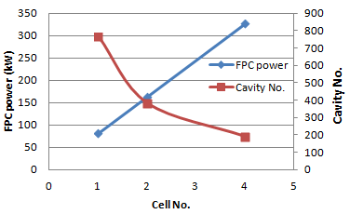
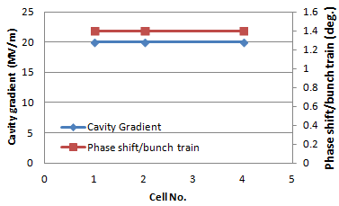
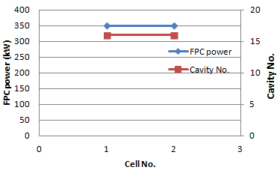
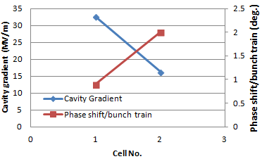
8 ring H-Low power mode
8 ring H-Low power mode
8 ring Z mode
8 ring Z mode

Slide 15
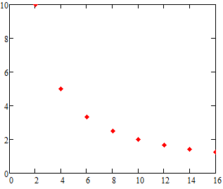
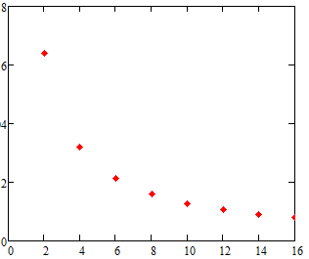
What is the best number of PDR?
P_{cw}<<P_{pulse} case:
There are 2n PDR in the circumference（n=1,2…).
Voltage decrease(%)
Voltage decrease(%)
Number of PDR
Number of PDR
HL mode
H-low power mode

Slide 16
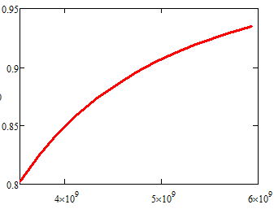
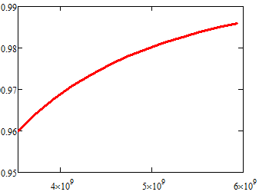
What is the best voltage?
R/Q=Vc^2/ωU, assume P_{pulse}>>P_{cw}
d, cavity effective length, q bunch charge, N_{b} bunches per train, N_{cav} cavity number.
H-low power case:
q=42.8nC,Vsr=2.96GV, N_{cav} =384
Assume matching
V_{c}’/V_{c}
N_{b}=50
V_{c}’/V_{c}
N_{b}=11
V_{RF} (GV)
V_{RF} (V)

Slide 17
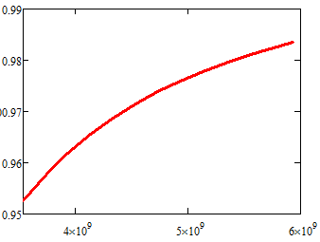
What is the best voltage?
R/Q=Vc^2/ωU, assume P_{pulse}>>P_{cw}
d, cavity effective length, q bunch charge, N_{b} bunches per train, N_{cav} cavity number.
H-low power case:
Nb=11,q=42.8nC,Vsr=2.96GV,
Assume matching & same gradient
N_{cav} =498
N_{cav} =384
V_{c}’/V_{c}
V_{c}’/V_{c}
Working V_{RF}
Working V_{RF}
V_{RF} (V)
V_{RF} (V)

Slide 18
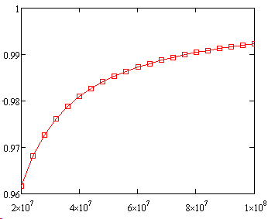
LEP
Assume:
φ_{e}= 1deg., φ_{s}=116deg., φ_{align}=3deg., I_{b}=0.45mA, h=31324, Q=40000, R_{s}=774MΩ（14 cavities）
V₀ (initial peak voltage)from 20MV-100MV
2.3MV/cavity(acc. voltage)
Voltage decrease:
V_{left}/V₀
1 bunch ~1%
4 bunches ~4%
APDR:
8 DR: 2.5%(HL)5.3/2.5%(Z)
6 DR: 3.3%(HL)
V₀(V)
Voltage drop is acceptable!

Slide 19
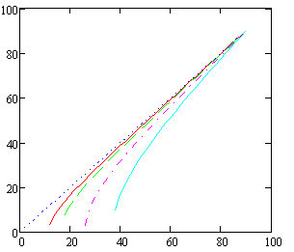
Phase shift
P_{cw}<<P_{pulse} case:
Larger synchrotron phase will make smaller phase shift for the bunches in a bunch train for the same voltage drop
Large voltage drop should choose larger synchrotron phase
Large synchrotron phase means more cavities (more cost)
2% Vc decrease
Phase shift
0% Vc decrease
Synchrotron phase
of last bunch (degree)
4% Vc decrease
10% Vc decrease
20%
10%
20% Vc decrease
0%
4%
2%
Synchrotron phase of first bunch (degree)

Slide 20
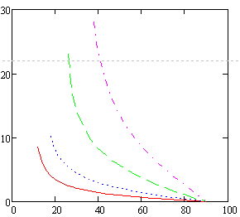
Phase shift
P_{cw}<<P_{pulse} case:
Larger synchrotron phase will make smaller phase shift for the bunches in a bunch train for the same voltage drop
Large voltage drop should choose larger synchrotron phase
Large synchrotron phase means more cavities (more cost)
2% Vc decrease
4% Vc decrease
Phase shift (degree)
10% Vc decrease
20% Vc decrease
Synchrotron phase of first bunch (degree)

Slide 21
CEPC APDR SRF Design
APDR SRF Challenge | Difficulty | Methods | CDR
Phase stability | ☆☆☆ | Feedback control, injection control, phase stability, SR damping,… | ±0.1%
Voltage control | ☆☆☆ | Feedback control, | ±1%
BBU | ☆☆ | Variation on bunch current, Low wake field excitation at bunch train length, High damping SC cavity, Radiation damping(wiggler), bunch spacing, feedback,… | >500mA (Z>1A)
HOM damping | ☆☆ | Single cell beam pipe/slotted cavity(multi-cell), … | 1-3kW
Longitudinal instability | ☆☆
Transverse instability | ☆☆
Impact bunch position control | ☆☆☆
Input coupler | ☆☆ |  | 130kW(1cell),260kW(2cell); Z:350kW(2cell),175kW(1cell)
Q₀ | ☆☆ | EP is very important | 2E10
Cavity gradient | ☆☆☆ | 20.6MV/m&Q₀=2E10@2K (☆☆) 32.6MV/m&Q₀=2E10@2K (☆☆☆, lower the Q₀) | H mode:2E10 Z mode:> 5E9

Slide 22
Cavity requirement

Slide 23
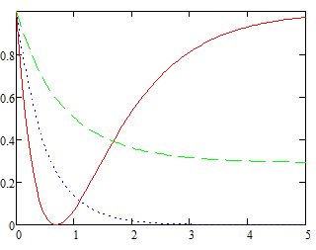
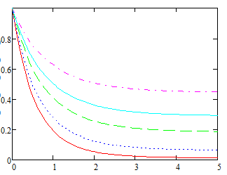
What is the best β？
β=4366
β=
β=0.3
P-/P+
P-/P+
0.2
0.3
0.4
β=1
0.6
0.8
t/τ
t/τ
P-, reflection power; P+, forward power.

Slide 24
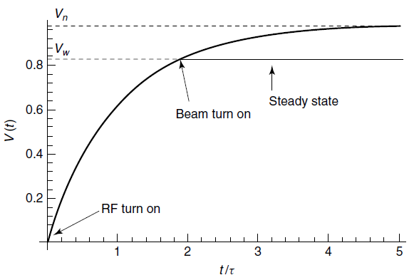

Slide 25
What is the best cavity for APDR?
R/Q=Vc²/ωU
A lower R/Q can give a high U at the same cavity voltage (or gradient)
The gradient is more stable at higher U when the input power is not enough at the pulse period.
It is an opposite design scheme comparing with low-loss cavity or others
Reduced R/Q can also decrease the detuning frequency
R/Q Riris loss factor
Cavity can work at a lower gradient with the same U

Slide 26
Phase and voltage analysis

Slide 27
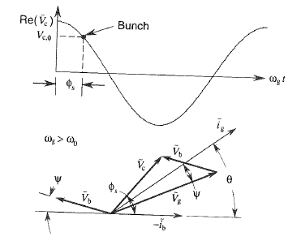
Power coupling
Phasor diagram
φ_{s}≠0 &ω_{g>}ω₀

Slide 28
Optimum coupling
With optimum coupling condition
ig
Vb
Vc
ψ
ϕs
ib
Vg
Ψ=-ϕs

Slide 29
Equispaced bunches
For equispaced bunches:
Consider H-Low power case, I₀=0.021mA,R_{a}=206x2x10¹⁰, beta=7.9x10³, ψ=-33deg.=-0.576
The amplitude of V_{b} is 9.2MV
V_{c}=20MV/m*0.46m=9.2MV, ϕ_{s}=0.576
V_{b}=0.021x206x2x10¹⁰xcos(-0.576)e^{-0.576i}/(1+7.9x10³)=-7.7x10⁶+5x10⁶i
Abs(V_{b})=9.2MV
Angle(V_{b})=-0.576
So, V_{b}=V_{c} & ψ=-ϕ_{s}

Slide 30
APDR bunches
Bunch train case, Tb is the bunch time interval in bunch train; TB is the time interval between bunch trains.
T_{b}≠T_{B}.
Tb<<TB&TB/td<<1
Tb/td=2.428e-4, TB/td=0.016, ϕs=33deg., f=650MHz
Tb
TB

Slide 31
What is beam loading？
It is not a beam in the cavity!!!
It is the beam induced voltage in the cavity!!!
When TB/Td<<1, the multi-bunches induced a constant V_{b}

Slide 32
Non-equispaced bunches
Consider H-Low power case, it is equal to 11x4bunches, I₀=0.021mA/11=1.91x10⁻³mA, R_{a}=206x2x10¹⁰, beta=7.9x10³, ψ=-33deg.=-0.576, f=650MHz, t’_{b}=196x77/f=2.322x10⁻⁵s, Q₀=2x10¹⁰
Phase shift is 1.4deg. with 11 bunches, the phase shift between two bunches is 0.14deg. m_{b}=196. So t_{b}=195.999611/f=3.015x10⁻⁷s.
Also we need to assume there is no phase shift between the first bunch of each bunch train.
0.14deg.
.
.
Bunch 1
Bunch 2
….
….
196x2π

Slide 33
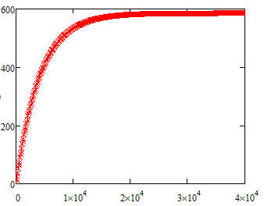
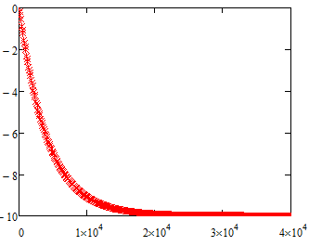
V_{br}=V_{ih}*A
65 circles
~0.012s
Im(A)
Re(A)
T (t_{b})
T (t_{b})
One circle=308t_{b}

Slide 34
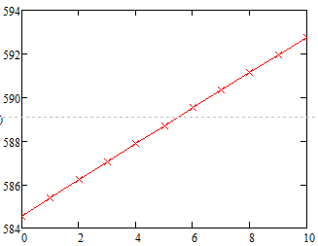
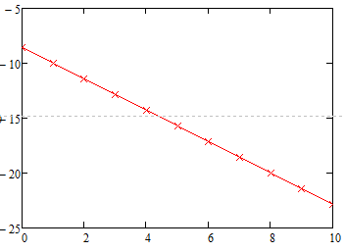
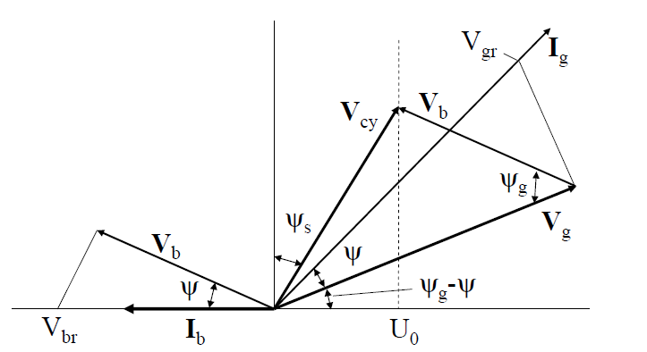
V_{br}=V_{ih}*A, A for bunches in a bunch train after 400000 circles.
Total phase shift of V_{b} is 1.37degree for 11 bunches.
Im(A)
Re(A)
Bunch
Bunch
V_{br} ≈ 1.865x10⁴Vx584.5=1.09x10⁷V
With optimum matching of minimum P_{g}, ψ=-ϕ_{s}
V_{b}=V_{br}cos(-33°)=9.14MV
As V_{c}=9.2MV, so V_{b}≈V_{c}

Slide 35
Vg
8-ring： Bunch No. | Re Vb | Im Vb | Re Vc | Im Vc | Re Vg | Im Vg | ABS Vg | Vg | Vg Angle (deg.) | Vg Angle shift (deg.)
1 | -7.67E+06 | 4.98E+06 | 7.72E+06 | 5.01E+06 | 1.54E+07 | 3.05E+04 | 1.539E+07 | 1.0000 | 0.00 | 0
2 | -7.66E+06 | 5.00E+06 | 7.72E+06 | 4.99E+06 | 1.54E+07 | -6.31E+03 | 1.537E+07 | 0.9991 | -0.13 | 0
3 | -7.64E+06 | 5.02E+06 | 7.72E+06 | 4.97E+06 | 1.54E+07 | -4.31E+04 | 1.536E+07 | 0.9983 | -0.27 | 0
4 | -7.63E+06 | 5.03E+06 | 7.72E+06 | 4.95E+06 | 1.53E+07 | -7.98E+04 | 1.535E+07 | 0.9974 | -0.41 | 0
5 | -7.62E+06 | 5.05E+06 | 7.72E+06 | 4.94E+06 | 1.53E+07 | -1.16E+05 | 1.533E+07 | 0.9966 | -0.54 | 0
6 | -7.60E+06 | 5.07E+06 | 7.72E+06 | 4.92E+06 | 1.53E+07 | -1.53E+05 | 1.532E+07 | 0.9958 | -0.68 | 0
7 | -7.59E+06 | 5.09E+06 | 7.72E+06 | 4.90E+06 | 1.53E+07 | -1.89E+05 | 1.531E+07 | 0.9949 | -0.82 | 0
8 | -7.58E+06 | 5.10E+06 | 7.72E+06 | 4.88E+06 | 1.53E+07 | -2.26E+05 | 1.530E+07 | 0.9941 | -0.96 | 0
9 | -7.56E+06 | 5.12E+06 | 7.72E+06 | 4.86E+06 | 1.53E+07 | -2.62E+05 | 1.528E+07 | 0.9933 | -1.09 | 0
10 | -7.55E+06 | 5.14E+06 | 7.72E+06 | 4.84E+06 | 1.53E+07 | -2.98E+05 | 1.527E+07 | 0.9924 | -1.23 | 0
11 | -7.54E+06 | 5.16E+06 | 7.72E+06 | 4.82E+06 | 1.53E+07 | -3.34E+05 | 1.526E+07 | 0.9916 | -1.37 | 0

Slide 36
Phase evolution
With optimum coupling condition (H low power 8ring)
ig
Vb11
Vb1
Vc=9.2MV
Vc1
Vb=9.2MV
Vc11
ψ
ϕs
Vg1
Vg=15.43MV
ib
1.37degree
Vg11
Ψ=-ϕs

Slide 37
Bunch No. | Pre CDR (CW, P_{g}=P_{avg}) |  | PDR (CW, P_{g}=P_{pulse}, very low RF efficiency) |  | APDR 8 ring (HL, CW, P_{g}=P_{avg}) |  | APDR 8 ring (H-low power, CW, P_{g}=P_{avg}) |  | APDR 8 ring (Z, P_{g}=P_{avg})
 | Vc | Phase shift | Vc | Phase shift | Vc | Phase shift | Vc | Phase shift | Vc | Phase shift
1 | 1 | 0 | 1 | 0 | 1 | 2.00 | 1 | 1.40 | 1 | 2.0000
2 | 1 | 0 | 1 | 0 | 0.9984 | 1.88 | 0.9984 | 1.26 | 0.9998 | 1.9927
3 | 1 | 0 | 1 | 0 | 0.9969 | 1.75 | 0.9968 | 1.12 | 0.9996 | 1.9855
4 | 1 | 0 | 1 | 0 | 0.9953 | 1.63 | 0.9952 | 0.98 | 0.9994 | 1.9782
5 | 1 | 0 | 1 | 0 | 0.9938 | 1.50 | 0.9936 | 0.84 | 0.9992 | 1.9709
6 | 1 | 0 | 1 | 0 | 0.9922 | 1.38 | 0.992 | 0.70 | 0.9990 | 1.9636
7 | 1 | 0 | 1 | 0 | 0.9906 | 1.25 | 0.9904 | 0.56 | 0.9988 | 1.9564
8 | 1 | 0 | 1 | 0 | 0.9891 | 1.13 | 0.9888 | 0.42 | 0.9987 | 1.9491
9 | 1 | 0 | 1 | 0 | 0.9875 | 1.00 | 0.9872 | 0.28 | 0.9985 | 1.9418
10 | 1 | 0 | 1 | 0 | 0.9859 | 0.88 | 0.9856 | 0.14 | 0.9983 | 1.9345
11 | 1 | 0 | 1 | 0 | 0.9844 | 0.75 | 0.984 | 0 | 0.9981 | 1.9273
15 | 1 | 0 | 1 | 0 | 0.9781 | 0.25 |  |  | 0.9973 | 1.8982
17 | 1 | 0 | 1 | 0 | 0.9750 | 0 |  |  | 0.9969 | 1.8836
50 | 1 | 0 | 1 | 0 |  |  |  |  | 0.9906 | 1.6436
67 |  |  | 1 | 0 |  |  |  |  | 0.9873 | 1.5200
275 |  |  |  |  |  |  |  |  | 0.0947 | 0
Assume V_{rf} is constant at the first bunch of bunch trains and the change of V_{b} is negligible.

Slide 38
Bunch No. | Pre CDR (CW, P_{g}=P_{avg}) |  | PDR (CW, P_{g}=P_{pulse}, very low RF efficiency) |  | APDR 6 ring (H-low power, CW, P_{g}=P_{avg}) |  | APDR 6 ring (HL, CW, P_{g}=P_{avg}) |  | APDR 6 ring (Z, P_{g}=P_{avg})
 | Vc | Phase shift | Vc | Phase shift | Vc | Phase shift | Vc | Phase shift | Vc | Phase shift
1 | 1 | 0 | 1 | 0 | 1 | 2.20 | 1 | 2.60 | 1 | 2.6000
2 | 1 | 0 | 1 | 0 | 0.9984 | 2.04 | 0.9984 | 2.48 | 0.9998 | 2.5929
3 | 1 | 0 | 1 | 0 | 0.9968 | 1.89 | 0.9969 | 2.35 | 0.9996 | 2.5858
4 | 1 | 0 | 1 | 0 | 0.9952 | 1.73 | 0.9953 | 2.23 | 0.9994 | 2.5787
5 | 1 | 0 | 1 | 0 | 0.9936 | 1.57 | 0.9937 | 2.10 | 0.9992 | 2.5716
6 | 1 | 0 | 1 | 0 | 0.992 | 1.41 | 0.9921 | 1.98 | 0.9989 | 2.5645
7 | 1 | 0 | 1 | 0 | 0.9904 | 1.26 | 0.9906 | 1.86 | 0.9987 | 2.5574
8 | 1 | 0 | 1 | 0 | 0.9888 | 1.10 | 0.9890 | 1.73 | 0.9985 | 2.5503
9 | 1 | 0 | 1 | 0 | 0.9872 | 0.94 | 0.9874 | 1.61 | 0.9983 | 2.5432
10 | 1 | 0 | 1 | 0 | 0.9856 | 0.79 | 0.9859 | 1.49 | 0.9981 | 2.5361
11 | 1 | 0 | 1 | 0 | 0.984 | 0.63 | 0.9843 | 1.36 | 0.9979 | 2.5290
15 | 1 | 0 | 1 | 0 | 0.9776 | 0 | 0.9780 | 0.87 | 0.9971 | 2.5005
22 | 1 | 0 | 1 | 0 |  |  | 0.9670 | 0 | 0.9956 | 2.4508
50 | 1 | 0 | 1 | 0 |  |  |  |  | 0.9897 | 2.2519
67 |  |  | 1 | 0 |  |  |  |  | 0.9861 | 2.1311
367 |  |  |  |  |  |  |  |  | 0.0923 | 0
Assume V_{rf} is constant at the first bunch of bunch trains and the change of V_{b} is negligible.

Slide 39
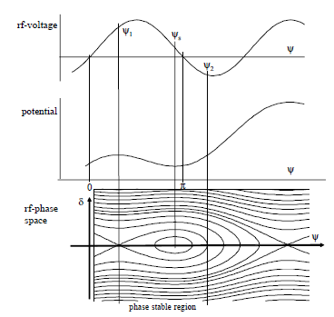
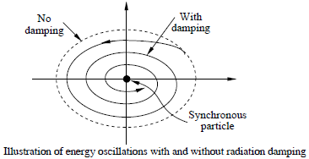
Bunch position
The e+ and e- bunch trains should be symmetry to the two IPs.
The phase shift of the synchrotron phase between each bunch in a bunch train is 0.14 degree for the H low power mode. The total phase shift is 1.4 degree.
After enough synchrotron damping, the bunches will be at its synchrotron phase separately.
If the transport matrix from cavity to IP is the same for e+ and e- bunch trains, there will be no shift for the position of colliding.
RADIATION DAMPING, R.P. Walker

Slide 40
Power reflection
In resonant operation：
For heavy beam loading, P_{c}<<P_{b},
For APDR steady state, P_{b} is constant. We make the first bunch of bunch train at optimal coupling, then P_{g}=P_{b}. P_{r}=0
The generator power is
Which simplifies to
H. Padamsee, RF superconductivity for accelerators, P387,P396

Slide 41
The first bunch of bunch train working at different synchrotron phase
The beam induced voltage and generator induced voltage are related with β.
Vc can be increased by lower β.
By increasing Vc and φs, keeping Vc*cos (φs)=C, →Pb is constant, Pg is constant. So

Slide 42
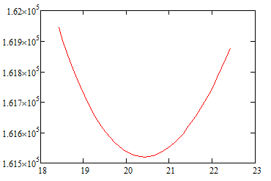
Bunches in a bunch train
In we set the β optimal to the first bunch, then the β is not optimal to others.
For example, H low power case, If we set β=7914 for the first bunch, keeping P_{b} constant (161.5kW). Pc=20.42W→Eacc=20MV/m. The last bunch, Pc=19.8W
。
The Pg needed for the last bunches is a little higher. But only 0.025%
Last bunch
Pg (W)
1st bunch
Pc (W)

Slide 43
Booster Parameters
Parameter List for Alternating Magnetic Field Scheme.
Parameter | Unit | Value
Beam energy [E] | GeV | 6
Circumference [C] | km | 63.84
Revolutionfrequency[f₀] | kHz | 4.69
SR power / beam [P] | MW | 2.16
Beam off-set in bend | cm | 1.2
Momentum compaction factor[α] |  | 2.33E-5
Strength of dipole | Gs | -129.18/+180.84
n_{B}/beam |  | 50
Lorentz factor [g] |  | 11741.71
Magnetic rigidity [Br] | T·m | 20
Beam current / beam [I] | mA | 0.92
Bunchpopulation[N_{e}] |  | 2.44E10
Bunch charge [Q_{b}] | nC | 3.91681
emittance-horizontal[e_{x}] inequilibrium | m·rad | 6.38E-11
injected from linac | m·rad | 3E-7
emittance-vertical[e_{y}] inequilibrium | m·rad | 0.191E-11
injected from linac | m·rad | 3E-7
Parameter | Unit | Value
RF voltage [Vrf] | GV | 0.2138
RF frequency [frf] | GHz | 1.3
Harmonic number [h] |  | 276831
Synchrotronoscillationtune[n_{s}] |  | 0.21
Energy acceptance RF | % | 5.93
SR loss / turn [U0] | GeV | 5.42E-4
Energyspread[s_{d}] inequilibrium | % | 0.0147
injected from linac | % | 0.1
Bunch length[s_{d}] inequilibrium | mm | 0.18
injected from linac | mm | ~1.5
Transversedampingtime[t_{x}] | ms | 4.71
 | turns
Longitudinaldampingtime[t_{e}] | ms | 4.71
 | turns
Tianjian Bian

Slide 44
Booster Parameters
Parameter List for Alternating Magnetic Field Scheme.
Parameter | Unit | Value
Beam energy [E] | GeV | 120
Circumference [C] | km | 63.84
Revolutionfrequency[f₀] | kHz | 4.69
SR power / beam [P] | MW | 2.16
Beam off-set in bend | cm | 0
Momentum compaction factor[α] |  | 2.54E-5
Strength of dipole | Gs | 516.71
n_{B}/beam |  | 50
Lorentz factor [g] |  | 234834.15
Magnetic rigidity [Br] | T·m | 400
Beam current / beam [I] | mA | 0.92
Bunchpopulation[N_{e}] |  | 2.44E10
Bunch charge [Q_{b}] | nC | 3.91681
emittance-horizontal[e_{x}] inequilibrium | m·rad | 3.61E-9
injected from linac | m·rad | 3E-7
emittance-vertical[e_{y}] inequilibrium | m·rad | 0.1083E-9
injected from linac | m·rad | 3E-7
Parameter | Unit | Value
RF voltage [Vrf] | GV | 6
RF frequency [frf] | GHz | 1.3
Harmonic number [h] |  | 276831
Synchrotronoscillationtune[n_{s}] |  | 0.21
Energy acceptance RF | % | 4.57
SR loss / turn [U0] | GeV | 2.34
Energyspread[s_{d}] inequilibrium | % | 0.12
injected from linac | % | 0.1
Bunch length[s_{d}] inequilibrium | mm | 1.36
injected from linac | mm | ~1.5
Transversedampingtime[t_{x}] | ms | 21.76
Longitudinaldampingtime[t_{e}] | ms
Tianjian Bian

Slide 45
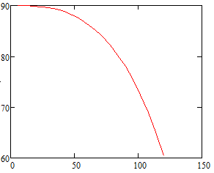
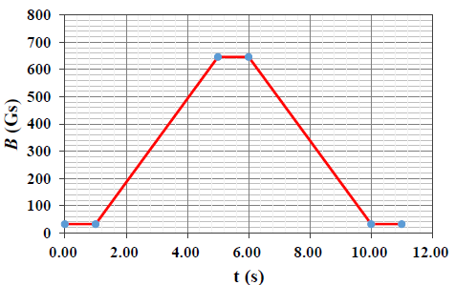
Synchrotron Phase
Inject phase (6 Gev) 89.855°
Extract phase (120 GeV）67.046°
Synchrotron phase φs=arccos(Vsr/Vrf)
Assume Vrf linearly increases
Synchrotron phase (degree)
Beam energy (GeV)

Slide 46
Conclusion
The 8-double ring and 6-double ring are available when using the same parameter as PDR(V_{RF}=3.62GV) for HL. The 8-double ring has a lower phase variation than the 6-double ring .
The phase region is from 35.2-33 degree for bunches in a bunch train for the 8-double ring HL mode. The phase region is from 35.2-32.3 degree for the 6-double ring HL mode.
The bunch energy gain in each cavity is constant.
The RF to beam efficiency is ~100%.
V_{b} is 9.14MV with a 1.37deg. phase shift in a bunch train of the APDR H low power of 8 ring case.
V_{b} reaches constant value after about 65 circles (I_{b}=C, ~0.012s).
Beam can be stored by increasing bunch charges stably (with reflection in low current).
V_{c} should keep constant phase and value for each bunch separately.

Slide 47
Thanks!

