Slide 1

CEPC parameter optimization and lattice design
Dou Wang, Jie Gao, Feng Su, Yuan Zhang, Yiwei Wang,
Jiyuan Zhai, Zhenchao Liu, Bai Sha, Huiping Geng,
Tianjian Bian, Na Wang, Cai Meng, Qing Qin
CEPC-SppC study group meeting, Beihang, Beijing, Sep. 2th -3th 2016

Slide 2
Difficulties of CEPC single ring scheme
 | H |  | Z
 | Pre-CDR | Low-HOM
Number of IPs | 2 | 2 | 2
Energy (GeV) | 120 | 120 | 45.5
Circumference (km) | 54 | 54 | 54
SR loss/turn (GeV) | 3.1 | 3.1 | 0.062
N_{e}/bunch (10¹¹) | 3.79 | 1.0 | 0.13
Bunch number | 50 | 187 | 4800 | 100
Beam current (mA) | 16.6 | 16.6 | 55.5 | 1.1
SR power /beam (MW) | 51.7 | 50 | 3.45 | 0.072
Bending radius (km) | 6.1 | 6.1 | 6.1
Momentum compaction (10⁻⁵) | 3.4 | 3.4 | 3.4
β_{IP} x/y (m) | 0.8/0.0012 | 0.06/0.001 | 0.4/0.0012
Emittance x/y (nm) | 6.12/0.018 | 6.13/0.018 | 0.9/0.018
Transverse σ_{IP} (um) | 69.97/0.15 | 19.2/0.13 | 18.9/0.15
ξ_{x}/IP | 0.118 | 0.031 | 0.072
ξ_{y}/IP | 0.083 | 0.074 | 0.028
V_{RF} (GV) | 6.87 | 6.87 | 0.68
f _{RF} (MHz) | 650 | 650 | 650
Nature σ_{z} (mm) | 2.14 | 2.13 | 1.5
Total σ_{z} (mm) | 2.65 | 2.4 | 1.5
HOM power/cavity (kw) | 3.6 | 1.0 | 0.55 | 0.01
Energy spread (%) | 0.13 | 0.13 | 0.05
Energy acceptance (%) | 2 | 1.5
Energy acceptance by RF (%) | 6 | 6.1 | 4.5
n_{γ} | 0.23 | 0.21 | 0.028
Life time due to beamstrahlung_cal (minute) | 47 | 46
F (hour glass) | 0.68 | 0.66 | 0.82
L_{max}/IP (10³⁴cm⁻²s⁻¹) | 2.04 | 2.1 | 1.04 | 0.022

Slide 3
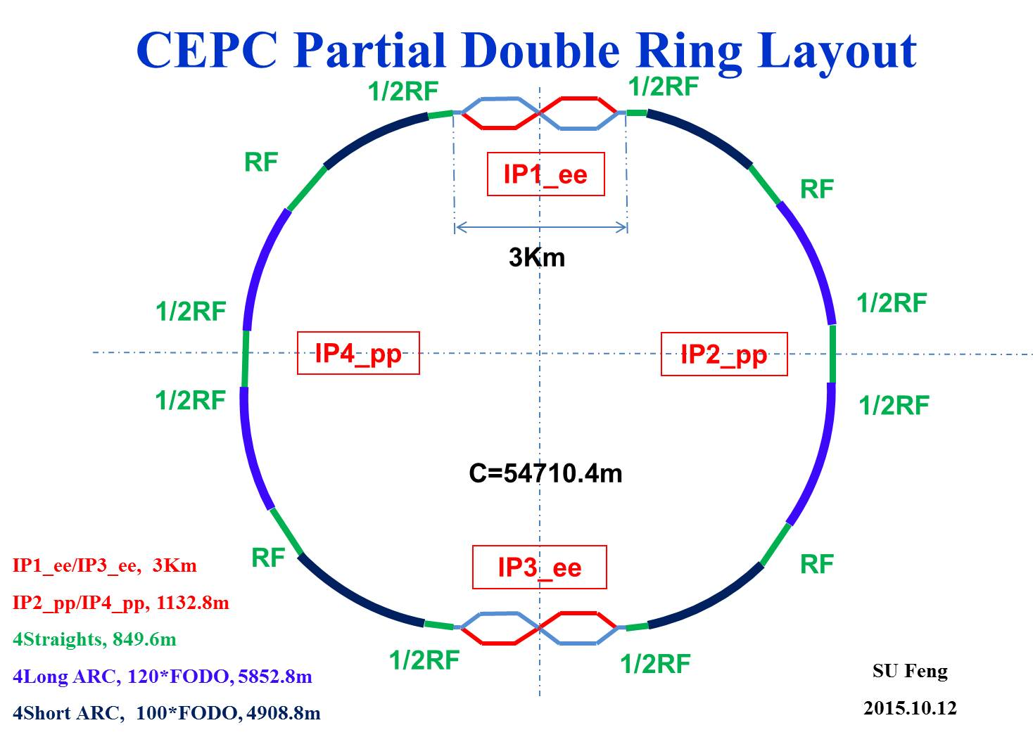
Advantage:
Avoid pretzel orbit
Accommodate more bunches at Z/W energy
Reduce beam power with crab waist collision
bypass (pp)
bypass (pp)

Slide 4
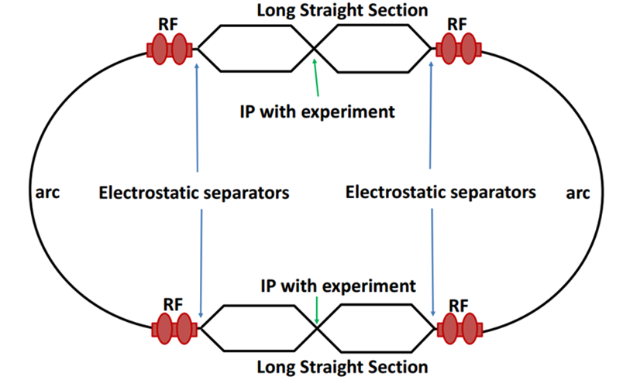
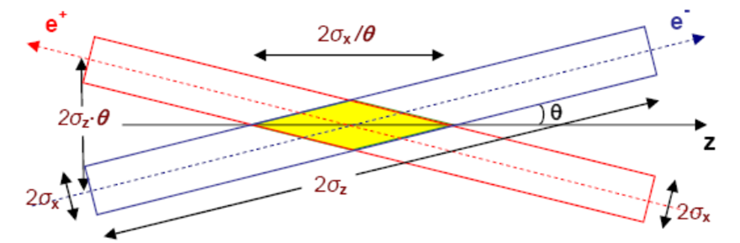
Machine constraints / given parameters
Energy E₀
Circumference C₀
N_{IP}
Beam power P₀
β_{y}*
Emittance coupling factor κ_{ε}
Bending radius ρ
Piwinski angle Φ
ξy enhancement by crab waist F_{l} ~1.5 (2.6)
Energy acceptance (DA)
Phase advance per cell (FODO)

Slide 5
Constraints for parameter choice
Limit of Beam-beam tune shift
F_{l}: ξy enhancement by crab waist
Beam lifetime due to beamstrahlung
BS life time: 30 min
V.I. Telnov
Beamstrahlung energy spread
A=δ₀/δ_{BS} (A≥3)
HOM power per cavity
*J. Gao, emittance growth and beam lifetime limitations due to beam-beam effects in e+e- storage rings, Nucl. Instr. and methods A533（2004）p. 270-274.

Slide 6
parameter for CEPC partial double ring
（wangdou20160325）
 | Pre-CDR | H-high lumi. | H-low power | W | Z
Number of IPs | 2 | 2 | 2 | 2 | 2
Energy (GeV) | 120 | 120 | 120 | 80 | 45.5
Circumference (km) | 54 | 54 | 54 | 54 | 54
SR loss/turn (GeV) | 3.1 | 2.96 | 2.96 | 0.59 | 0.062
Half crossing angle (mrad) | 0 | 15 | 15 | 15 | 15
Piwinski angle | 0 | 2.5 | 2.6 | 5 | 8.5/7.6
N_{e}/bunch (10¹¹) | 3.79 | 2.85 | 2.67 | 0.74 | 0.46
Bunch number | 50 | 67 | 44 | 400 | 1100
Beam current (mA) | 16.6 | 16.9 | 10.5 | 26.2 | 45.4
SR power /beam (MW) | 51.7 | 50 | 31.2 | 15.6 | 2.8
Bending radius (km) | 6.1 | 6.2 | 6.2 | 6.1 | 6.1
Momentum compaction (10⁻⁵) | 3.4 | 2.5 | 2.2 | 2.4 | 3.5
β_{IP} x/y (m) | 0.8/0.0012 | 0.25/0.00136 | 0.268 /0.00124 | 0.1/0.001 | 0.1/0.001
Emittance x/y (nm) | 6.12/0.018 | 2.45/0.0074 | 2.06 /0.0062 | 1.02/0.003 | 0.62/0.0028
Transverse σ_{IP} (um) | 69.97/0.15 | 24.8/0.1 | 23.5/0.088 | 10.1/0.056 | 7.9/0.053
ξ_{x}/IP | 0.118 | 0.03 | 0.032 | 0.008 | 0.005/0.006
ξ_{y}/IP | 0.083 | 0.11 | 0.11 | 0.074 | 0.084/0.073
V_{RF} (GV) | 6.87 | 3.62 | 3.53 | 0.81 | 0.12
f _{RF} (MHz) | 650 | 650 | 650 | 650 | 650
Nature σ_{z} (mm) | 2.14 | 3.1 | 3.0 | 3.25 | 3.9
Total σ_{z} (mm) | 2.65 | 4.1 | 4.0 | 3.35 | 4.0
HOM power/cavity (kw) | 3.6 | 2.2 | 1.3 | 0.99 | 0.99
Energy spread (%) | 0.13 | 0.13 | 0.13 | 0.09 | 0.05
Energy acceptance (%) | 2 | 2 | 2
Energy acceptance by RF (%) | 6 | 2.2 | 2.1 | 1.7 | 1.1
n_{γ} | 0.23 | 0.47 | 0.47 | 0.3 | 0.27/0.24
Life time due to beamstrahlung_cal (minute) | 47 | 36 | 32
F (hour glass) | 0.68 | 0.82 | 0.81 | 0.92 | 0.95
L_{max}/IP (10³⁴cm⁻²s⁻¹) | 2.04 | 2.96 | 2.01 | 3.09 | 3.61/3.09

Slide 7
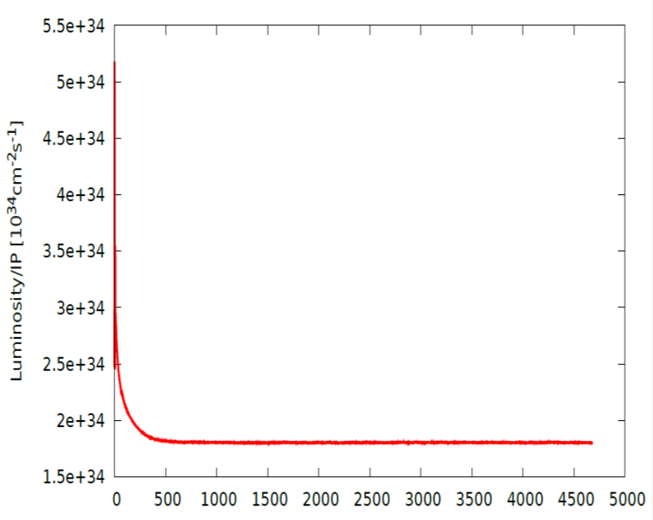
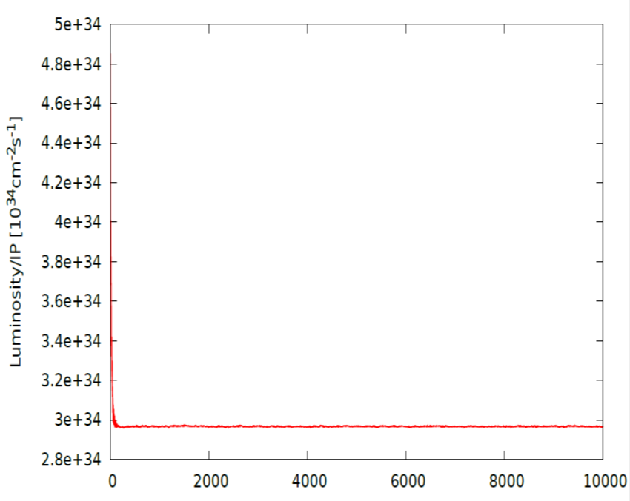
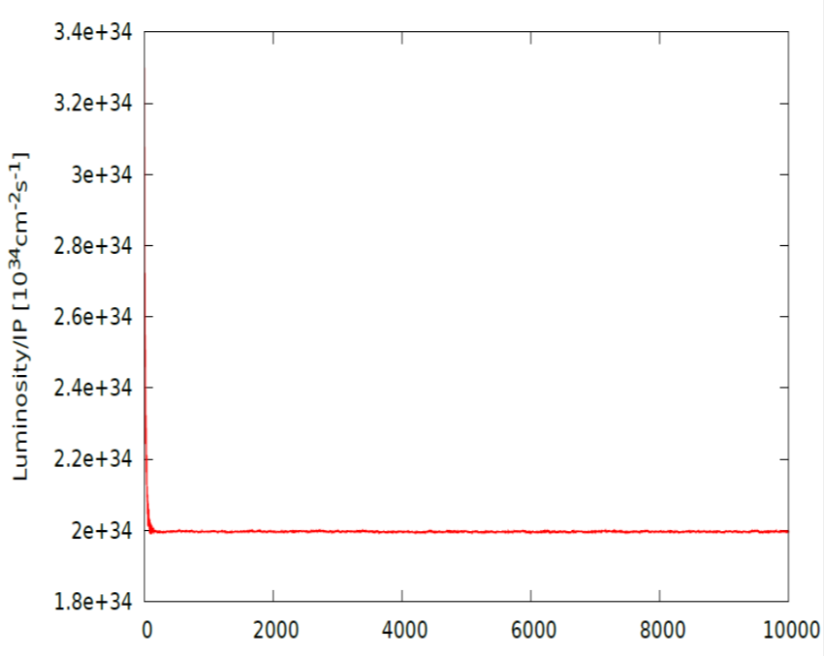
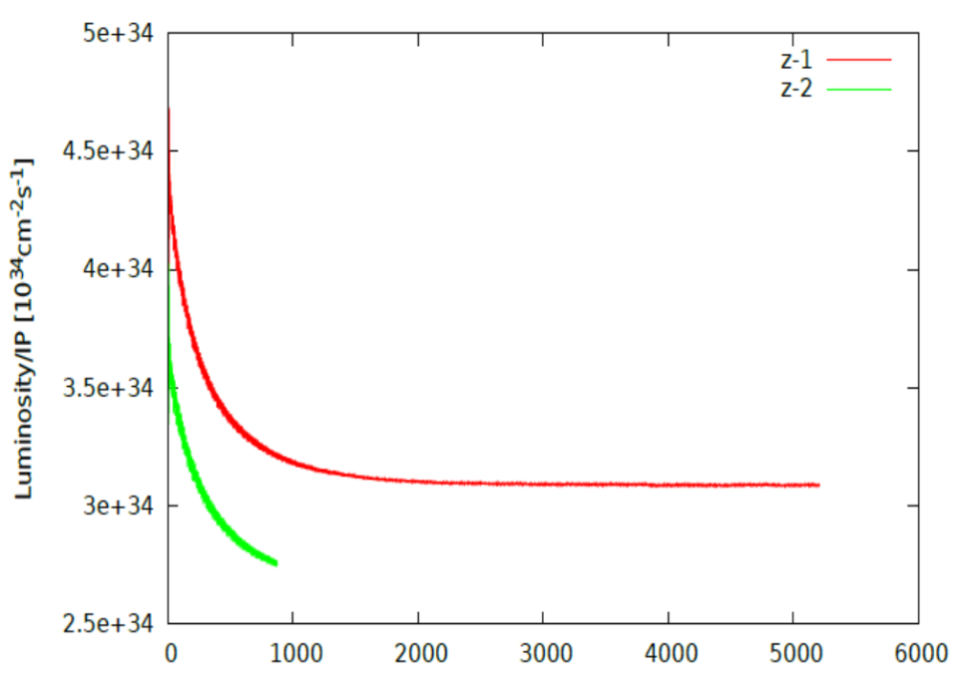



Beam-beam simulation
IBB: Strong-Strong Beam-Beam Code with Beamstrahlung effect
Developed by Y. Zhang@IHEP
Case: Pre-CDR
Case: H-high lum
Lifetime: 108 min(16$σ_{p}$)
Lifetime: 118 min(16$σ_{p}$)
Case: H-low power
Case Z
Lifetime: 97 min(16$σ_{p}$)

Slide 8
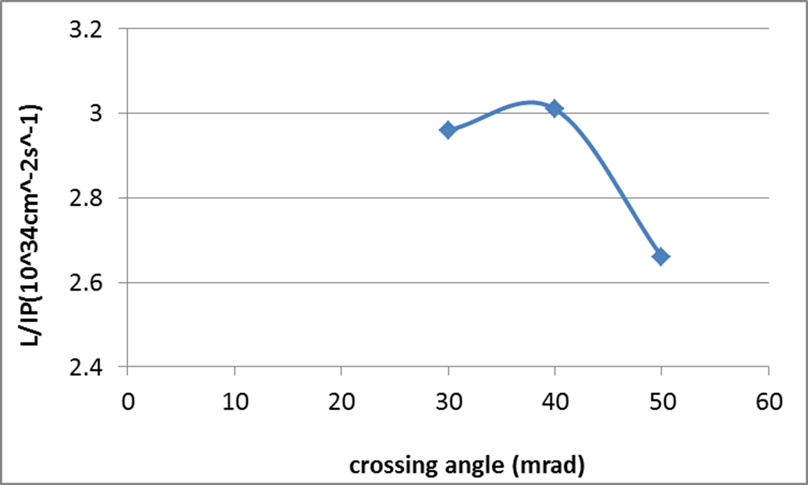
CEPC Higgs luminosity vs. crossing angle
54 km ring

Slide 9
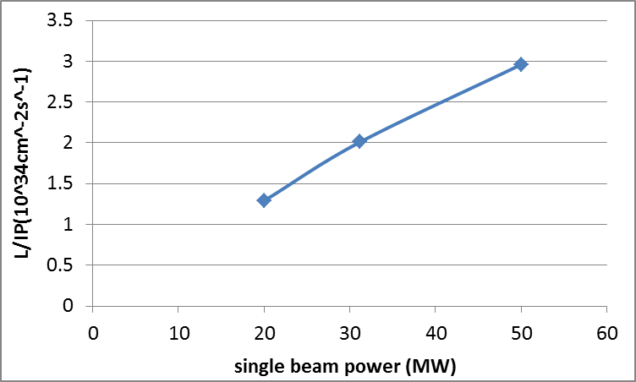
CEPC Higgs Luminosity vs beam power
54 km ring

Slide 10
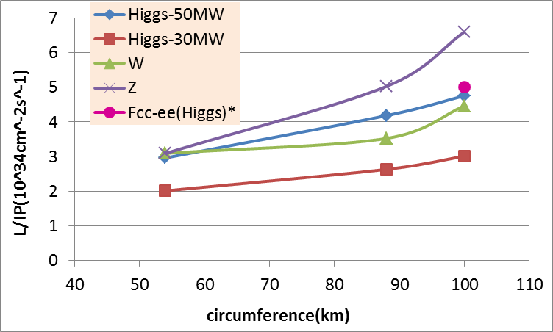
CEPC PDR Luminosity vs circumference
* Fabiola Gianotti, Future Circular ColliderDesign Study, ICFA meeting, J-PARC, 25-2-2016.

Slide 11
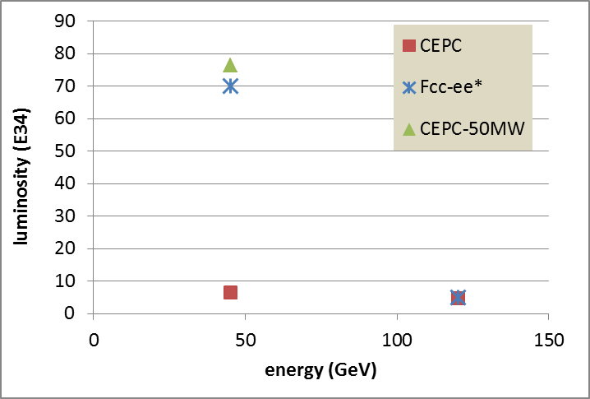
100km CEPC PDR vs Fcc-ee
P_{HOM,CEPC}=11.3 kw
The large difference of Z is due to the constraint for RF HOM power.
* Fabiola Gianotti, Future Circular ColliderDesign Study, ICFA meeting, J-PARC, 25-2-2016.

Slide 12
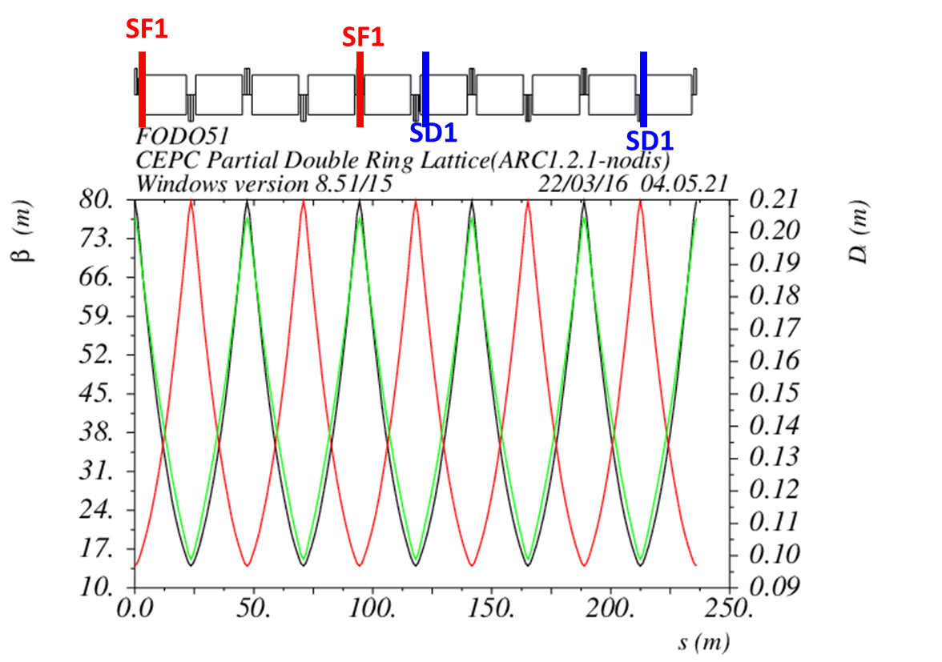
Non-interleave sextupoles in arc
(90°/90° FODO)

Slide 13
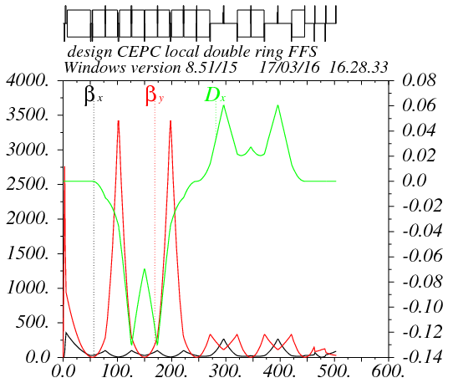
Partial double ring FFS design with crab sextupoles
Betax=0.25m
Betay=0.00136m
K2hs=26.8 m⁻³
K2vs=32.2 m⁻³
Crab sextupole
IP
Critical energy: Ec=190 keV
Dipole strength: B=0.019 T
The second FFS sextupoles of the CCS-Y section work as the crab sextupoles.

Slide 14
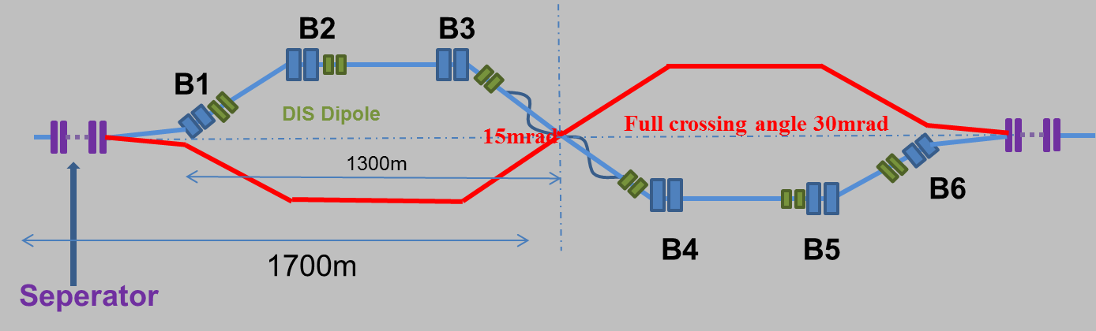
Combine with partial double ring lattice
30 mrad
10 m

Slide 15
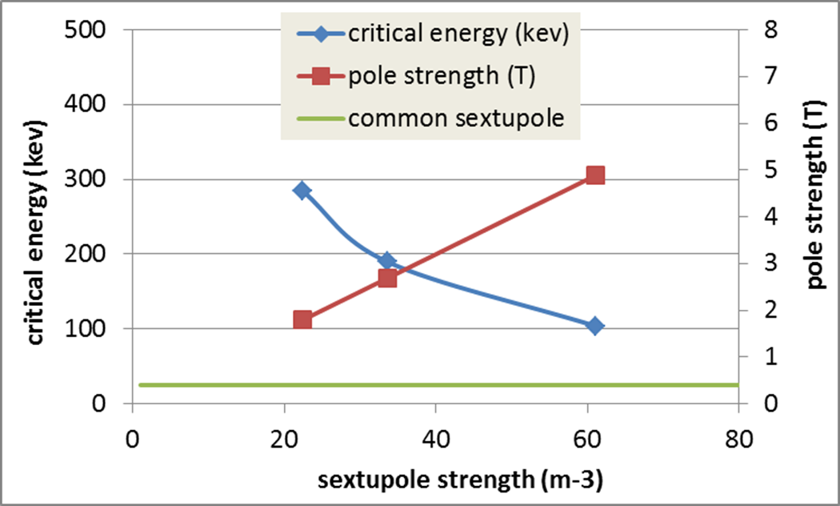
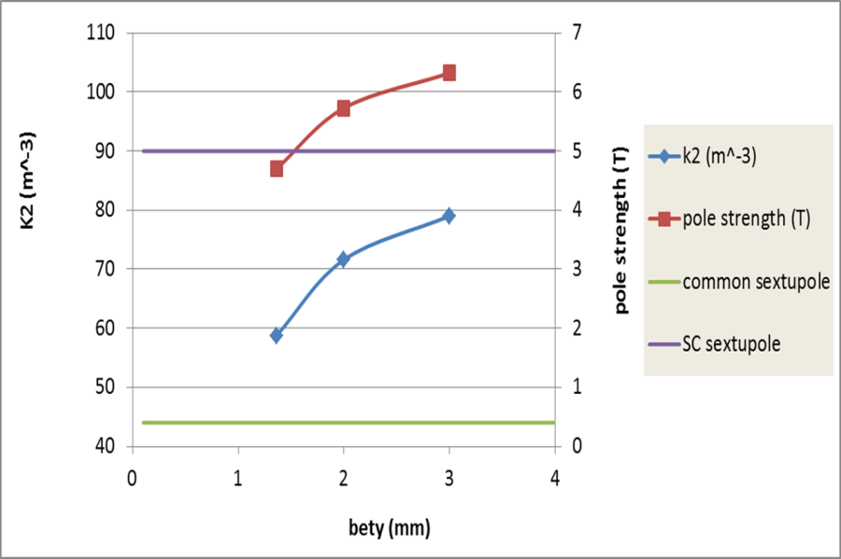
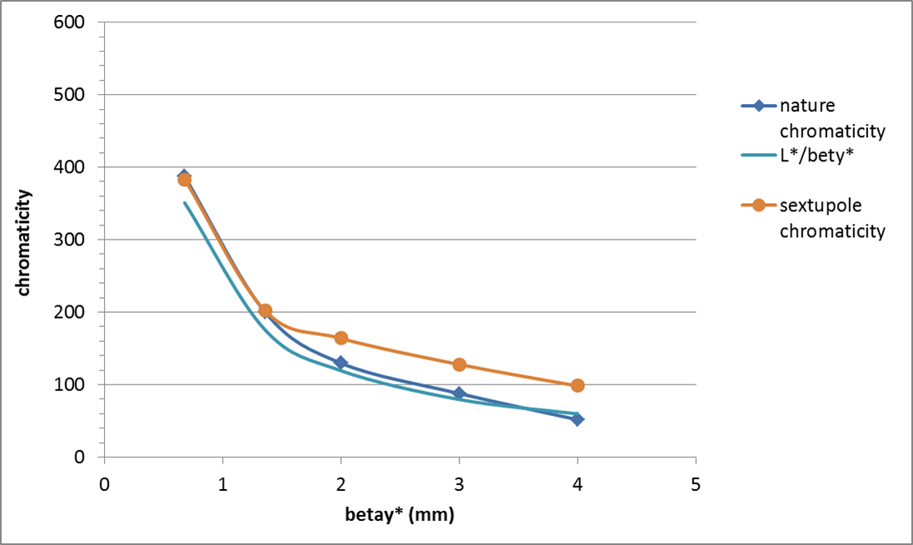
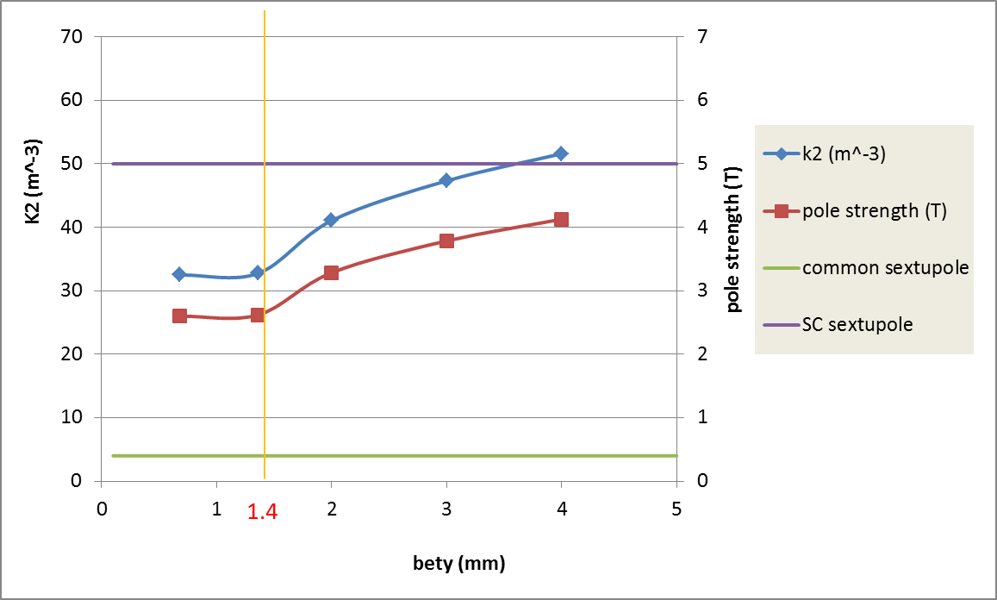
CEPC IR sextupole strength
Ec=100keV
Ec=190keV
Ec=190keV

Slide 16
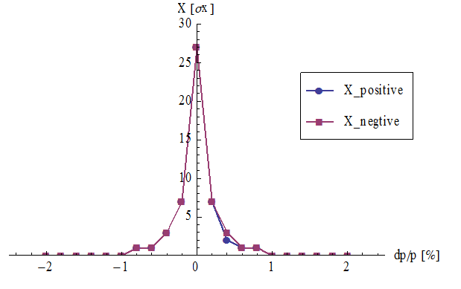
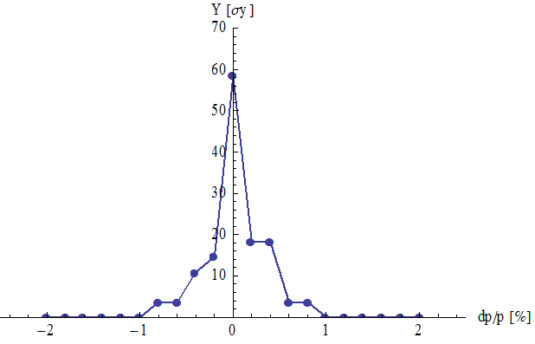
DA of the whole ring
(arc+PDR+bypass+FFS(incl. crab))
Arc sextupole: 2 groups
Crab sextupoles - off
Bandwidth = 0.8%
DA (on-momentum): 27σ_{x} × 58σ_{y}
DA (±0.5%): 2σ_{x} × 4σ_{y}

Slide 17
DA bandwidth optimization with MODE
(knob IR sextupoles)
test15 from Zhang Yuan@IHEP
Bandwidth = 1%.
DA for small energy deviation is better.
On momentum DA is smaller.

Slide 18
DA bandwidth optimization with MODE
(knob arc sextupoles)
test16 from Zhang Yuan@IHEP
Bandwidth = 1.4%.
Both on-momentum and off-momentum DA is better.
Next step:
- Combine arc sextupoles with IR sextupoles.
- Add symmetry in arc

Slide 19
CEPC Advanced Partial Double Ring Layout I
1/2RF
1/2RF
ARC1
IP1_ee
RF
RF
ARC2
APDR
3Km
APDR
ARC3
1/2RF
1/2RF
Bypass
about 42m
IP4_pp
IP2_pp
ARC4
1/2RF
1/2RF
IP1_ee/IP3_ee, 2.968Km
IP2_pp/IP4_pp, 1132.8m
APDR, 1052.87m
4 Short Straights, 141.6m
4 Medium Straights, 566.4m
4 Long Straights, 1132.8m
4 ARC1, 124*FODO, 5852.8m
4 ARC2, 24*FODO, 1132.8m
4 ARC3, 79*FODO, 3728.8m
2 ARC4, 24*FODO, 1132.8m
ARC3
APDR
C=62967.86m
APDR
RF
RF
ARC2
IP3_ee
ARC1
1/2RF
1/2RF
SU Feng
2016.5.23

Slide 20
CEPC Advanced Partial Double Ring Layout II
1/2RF
1/2RF
1/2RF
ARC
1/2RF
IP1_ee
1/2RF
APDR
APDR
1/2RF
3Km
1/2RF
1/2RF
APDR
APDR
1/2RF
1/2RF
C=65640.2m
IP1_ee/IP3_ee, 2.968Km
IP2_pp/IP4_pp, 1132.8m
APDR, 1052.87m
4 Short Straights, 94.4m
12 Long Straights, 566.4m
4 Long ARC, 124*FODO, 5852.8m
4 Medium ARC, 104*FODO, 4908.8m
4 Short ARC, 14*FODO, 660.8m
1/2RF
1/2RF
APDR
APDR
1/2RF
IP3_ee
1/2RF
1/2RF
1/2RF
SU Feng
2016.6.2

Slide 21
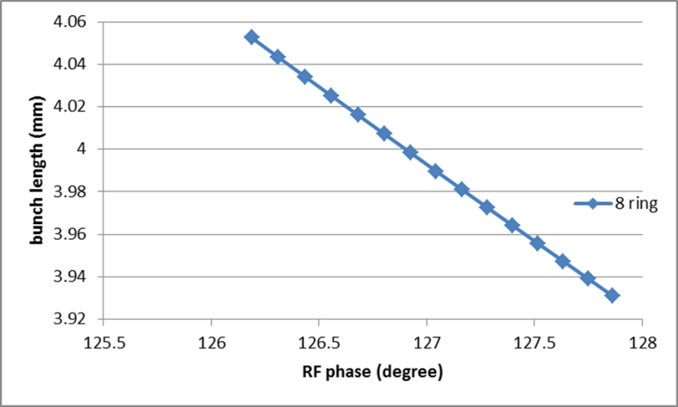
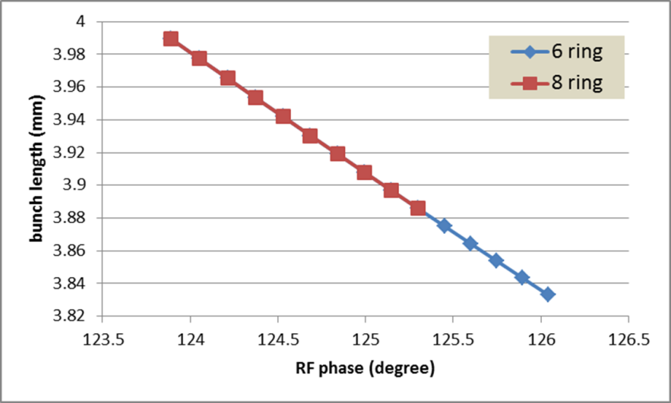
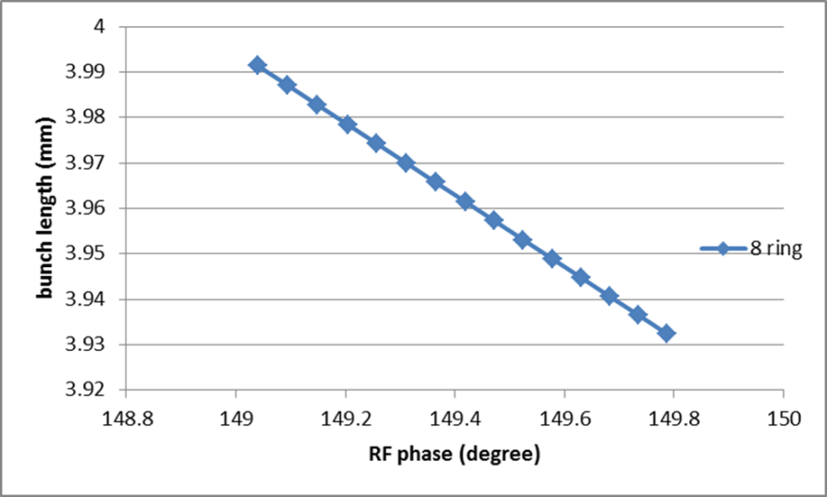
Bunch length error with RF phase adjustment
H-high lum
H-low power
For H-low power, error of bunch length: ~-4% (6 ring), ~-3% (8 ring)
Z
For H-high lum., error of bunch length: ~-3% (8 ring)
For Z, error of bunch length: ~-1.5% (8 ring)

Slide 22
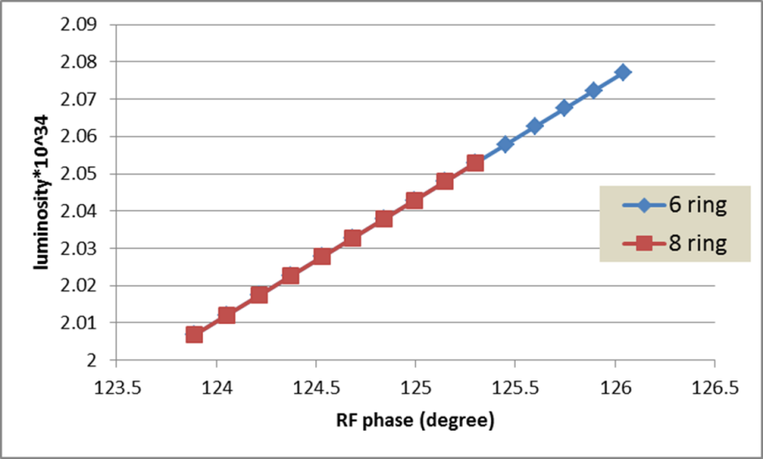
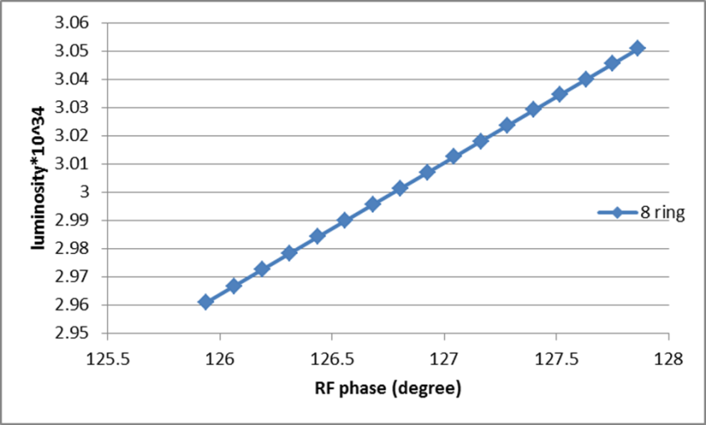
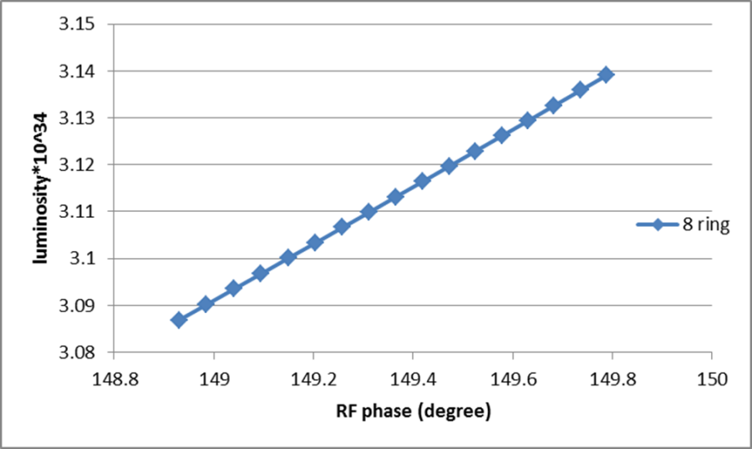
Luminosity change with RF phase adjustment
H-low power
H-high lum
For H-high lum., error of luminosity: ~3% (8 ring)
Z
For H-low power, error of luminosity: ~ 3.5% (6 ring), ~2.4% (8 ring)
For Z, error of luminosity: ~1.7% (8 ring)

Slide 23
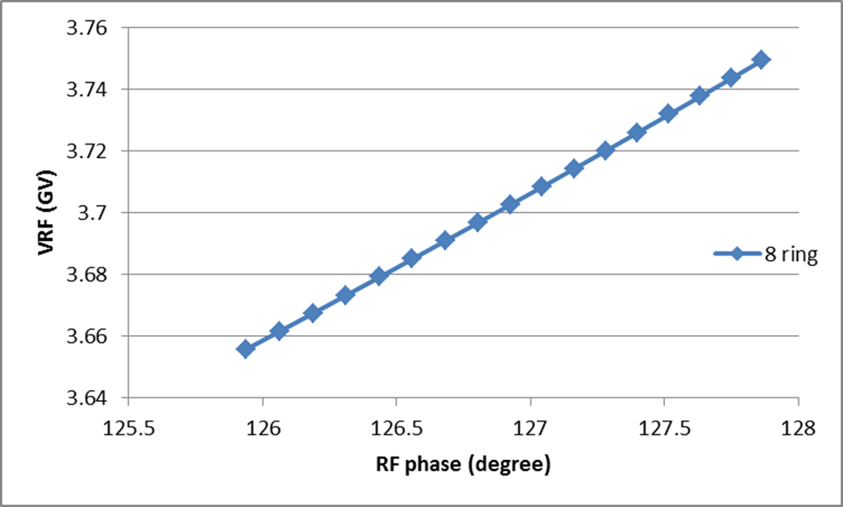
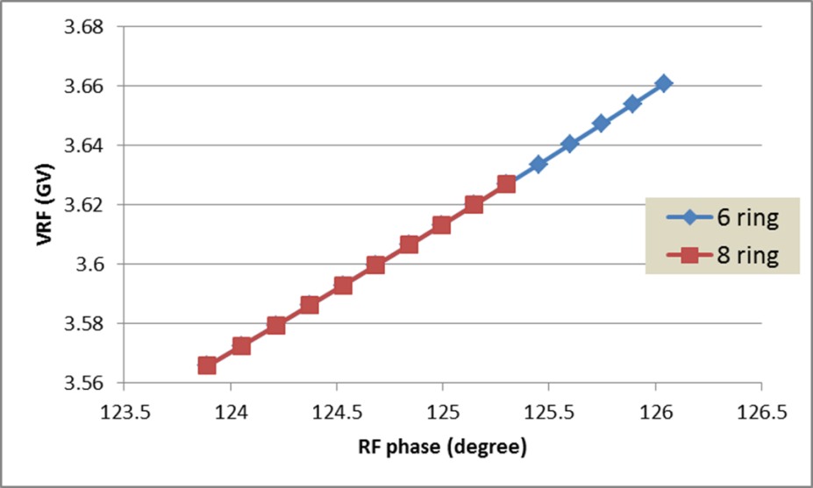
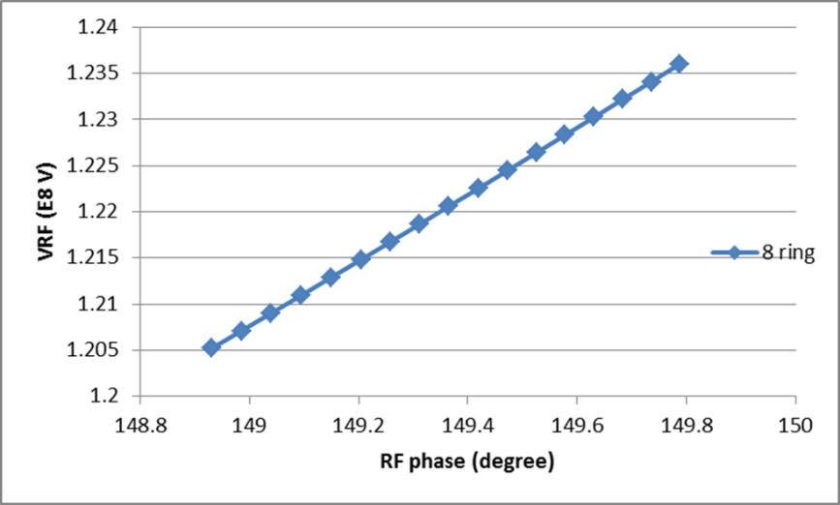
RF voltage change with RF phase adjustment
H-high lum
H-low power
For H-high lum., error of VRF: ~ 2.6% (8 ring)
Z
For H-low power, error of RF acceptance: ~ 2.8% (6 ring), ~ 2% (8 ring)
For Z, error of VRF: ~ 2.6% (8 ring)
RF efficiency will be a little lower than 100%.

Slide 24
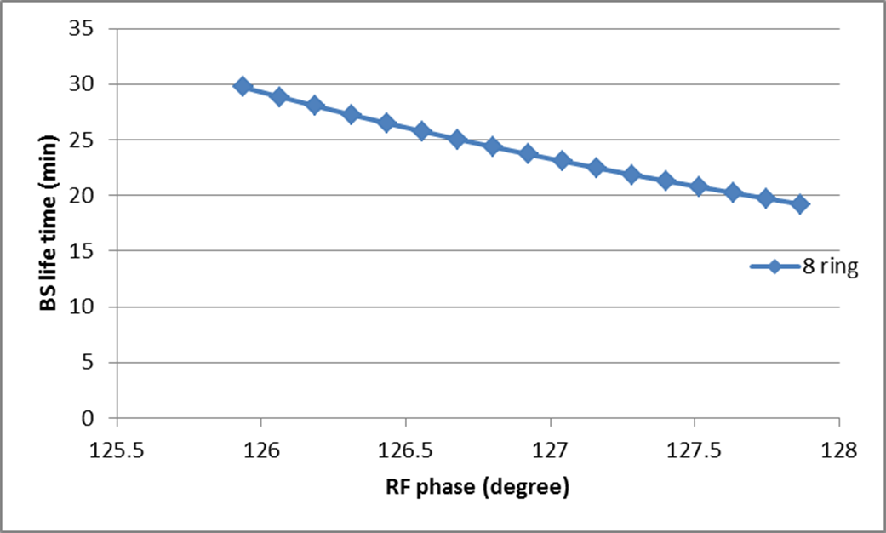
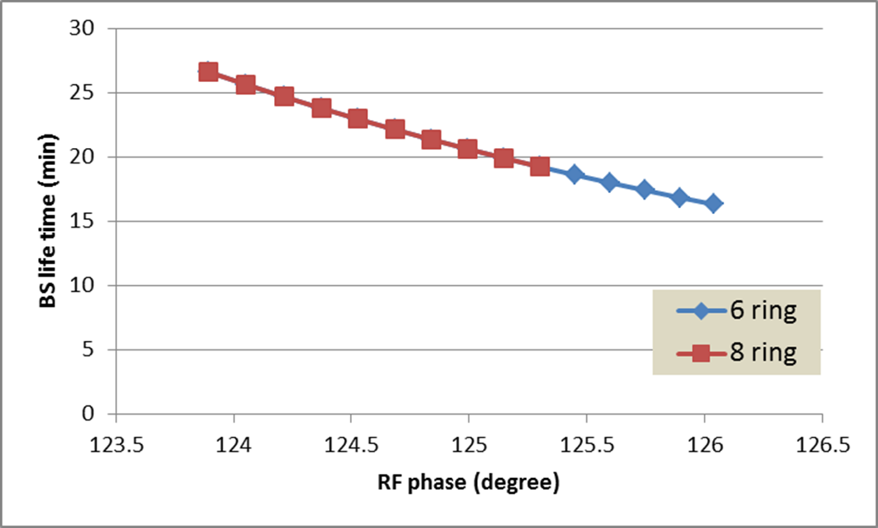
BS life time with RF phase adjustment
H-high lum
H-low power
For H-high lum., error of BS life time: ~-36% (8 ring)
For H-low power, error of BS life time: ~-37% (6 ring), ~-30% (8 ring)
BS life time will be lower than the requirement!!

Slide 25
CEPC damping ring requirement
Energy: 1.1GeV
Storage time: 20ms
Injected emittance (normalized): 3500 mm-mrad, injected energy spread ~ 0.25%
Transverse acceptance > 3*injection beam size
Extracted energy spread <1×10-3
No strong requirement for the extracted emittance (<0.5ε_{inj})!

Slide 26
CEPC DR design
 | DR V1.0
Energy (GeV) | 1.1
circumference | 58.5
Bending radius (m) | 3.6
B0 (T) | 1.01
U0 (keV/turn) | 35.8
Damping time x/y/z (ms) | 12/12/6
δ0 (%) | 0.047
ε0 (mm.mrad) | 302
Nature σz (mm) | 1.4 (4.7ps)
Extract σz (mm) | ~1.5 (5ps)
εinj (mm.mrad) | 3500
εext x/y (mm.mrad) | 434/145
δinj /δext (%) | 0.25 /0.047
Energy acceptance by RF(%) | 5
f_{RF}=650MHz
V_{RF}=42MV

Slide 27
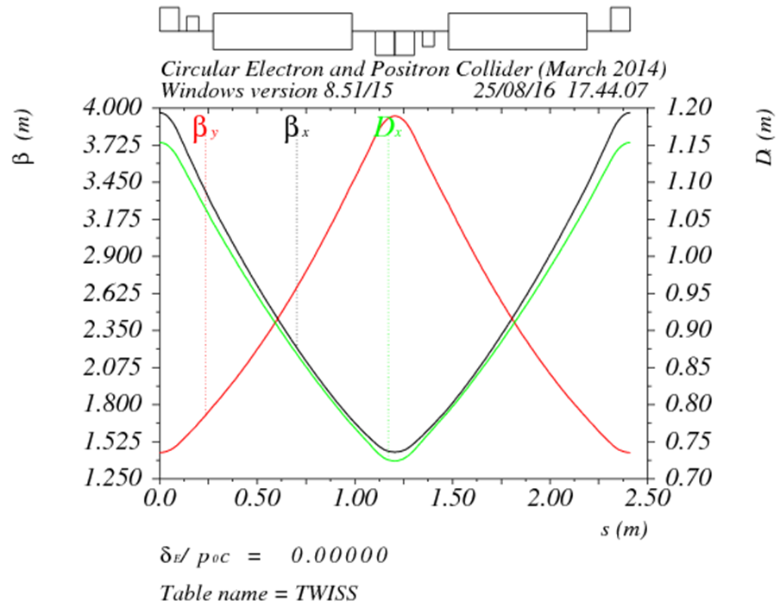
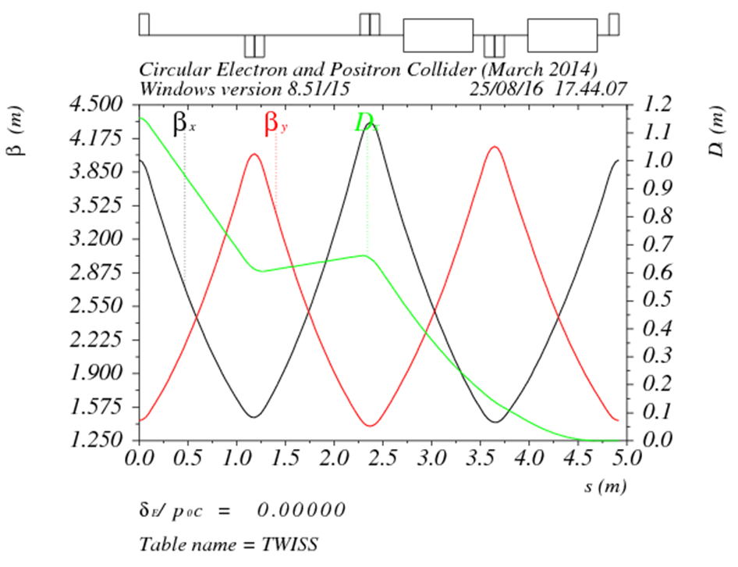
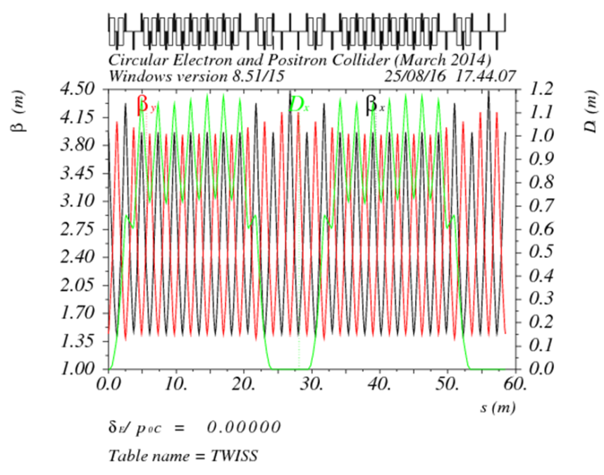
DR lattice design
FODO length (m) | 2.4
Phase per cell | 60°
Dipole length (m) | 0.71
Dipole strength (T) | 1.0
Quadrupole length (m) | 0.2
Quadrupole strength (m⁻²) | 4.1
Sextupole length (m) | 0.06

Slide 28
summary
A consistent calculation method for CEPC parameter choice with carb waist scheme has been created. Larger ring has the potential to reach higher luminosity.
Based on partial double ring scheme, we can get higher luminosity (+50%) keeping Pre-CDR beam power or to reduce the beam power (30 MW) keeping same luminosity.
FFS with crab sextupoles and lower emittance arc has been designed. On-momentum DA of whole ring is good enough and the optimization of DA bandwidth is ongoing.
Advanced partial double ring scheme has been proposed in order to improve the RF efficiency. Almost 100% efficiency can be achieved.
First version of CEPC damping ring design for the positron source has been given. Detail injection/extraction optics design and DA study is going on.

Slide 29
Thanks！

