Slide 1
SPPC General Progress
Tang Jingyu
4th CEPC-SPPC Collaboration Meeting
September 2-3, 2016, Bei-Han, Beijing

Slide 2
Outline
General information
Collider accelerator physics
Design concepts on the injector chain
Technical issues
R&D efforts and preparation
About team and collaboration
Summary

Slide 3
General information
Since the last CEPC-SPPC study group meeting (April 8-9, 2016)
Work on collider accelerator physics continues
Work on technical issues advances slowly
Schemes on injector chain updated
A new fund from MoST for CEPC R&D approved, though almost nothing going to SPPC
Monthly group meeting maintained, and some new youngers joined the study
International collaboration on some studies (collimation, beam dynamic aperture) established (LAL, LHC)
Information from participation at FCC-Week 2016 (Rome)
Xu Qingjin got a NSFC fund (HFM techniques) this year

Slide 4
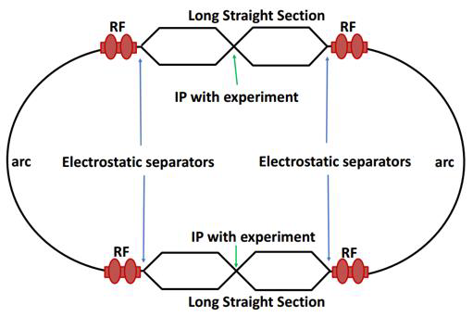
Collider Accelerator Physics
General parameters: all AP members (Tang Jingyu coordinates).
Lattice design: three persons (Su Feng, Chen Yukai, Zhang Linhao) continue to work on SPPC lattice
Race-track lattice to be compatible with CEPC partial double-ring: two very long straight sections
Different schemes (70, 100 TeV)
Dynamics aperture calculation

Slide 5
Collimation study: two persons (Zou Ye, Yang Jianquan) working on the study. Good progress has been made.
Novel method (combined transverse and longitudinal collimation in one long straight section) almost proved
MERLIN and SIXTRACK simulations
A paper in preparation

Slide 6
Instabilities: Liu Yudong continues to work on different instabilities
Luminosity leveling: Wang Lijiao just started to work on the topic
Emittance damping and control: Zhang Juntao is working on the topic
Injection/extraction: Li Guangrui continues to work on the topic
Longitudinal dynamics: Peng Yuemei continues to work on the topic
Beam-beam effects: Tanaj Sen of FNAL contributes to the study; Guo Yuanyuan continues to work on the topic
Other topics: needing more volunteers or engaged persons to put more time on

Slide 7
Design concepts for the injector chain
More efforts have been made in the injector chain
Updating the accelerator schemes and parameter lists
p-Linac/i-Linac: Lu Yuanrong and students are working on first design (RFQ, DTL, SC cavities)
p-RCS/i-RCS: Tang Jingyu/Zhang Linhao continue to work on the first design concepts (p-RCS updates, i-RCS just started)
MSS: no new report from the student
SS: Wang Xiangqi and students continue to work on the first design concept

Slide 8
Technical issues
High-field superconducting magnets
Continuous efforts by Xu Qingjin and his group
Collaboration efforts with Tiina Salmi
Workshop on High-Temperature and High-Field Superconducting Materials and Application Technology was held on April 28-29, 2016 in Shanghai
Beam screen and vacuum
Zhu Kun and Gan Pingping continue to study new schemes; recent discussion about strip-like structure looks interesting
Wang Yong (and students) studying SEY for different materials
RF systems
Dai Jianping is focusing on the high-Q ferrite-loaded RF systems for the injector accelerators
Other technical issues
Needing motivation and funds

Slide 9
R&D efforts and preparation
We need long-term R&D efforts to meet the requirements for building SPPC; some of key technologies are extremely challenging.
Both funds and manpower are needed
The CEPC project obtained the first R&D fund from MoST, while SPPC should try more efforts from NSFC (following Tang and Xu).
Paper work on key issues should be pursued, to learn the technical progress and tendency around the world; to provide evidence support for the future R&D applications

Slide 10
About team and collaboration
There are a few new students and also international experts joined the study
CEPC-SPPC is discussing to form an international collaboration structure. We will fit us within the frame
Collaboration with LAL (France) and LHC established; will seek further collaboration partners

Slide 11
Summary
We are making progress on SPPC study steadily.
New students and international experts joined the study team.
As no large funds for key R&D efforts, study will be focused on paper work.
Once the international collaboration structure is formed, there will be more efficiency organization of the study.
Updated design will be included in the paper to be published in PRAB.

Slide 12
Welcome comments!

