Slide 1
CEPC SRF System R&D
Jiyuan Zhai (IHEP)
On behalf of the CEPC SRF Working Group
CEPC-SPPC Study Group Meeting
Beihang University, Beijing, September 2, 2016

Slide 2
Acknowledgement
Materials from Peng Sha, Hongjuan Zheng, Fanbo Meng, Qiang Ma, Tongming Huang, Zhenghui Mi, Baiqi Liu, Rui Ge, Ruixiong Han etc.

Slide 3
Outline
CEPC SRF System Design
R&D Plan and Status
Phase Compensation of Bunch Train
Summary

Slide 4
CEPC SRF System Design
Main Ring crab waist scheme with H, W & Z luminosity ~ 2E34 cm⁻²s⁻¹
  Independent of fill pattern and separation scheme, i.e. same SRF System for double ring and partial double ring ... so as Power Source
  Common RF cavity for full double ring
  Difference-Frequency (DF) cavity to compensate bunch train phase variation
  Main Ring Components
  Cavity: 2-cell, standard elliptical shape, Nitrogen-doped Nb at 2 K
  HOM damper: detachable coaxial HOM coupler, HOM absorber at RT
  Input coupler: fixed coupling, assemble in cleanroom with cav.
  Tuner: cavity end, with piezo, cold motor, access port
  Cryomodule: XFEL/LCLS-II type
  Main Ring head-on (single ring) scheme as alternative (Pre-CDR)
  similar SRF components, power source and cryogenics
    5-cell vs 2, similar gradient, higher Q0
  Booster: TESLA-XFEL-ILC-LCLSII technology (voltage ramp)

Slide 5
CEPC Main Ring SRF Parameters
Parameters (top parameters of D. Wang 20160329) | H (Pre-CDR) | H | W | Z
650 MHz cavity (bulk Nb) | 5-cell | 2-cell
Cavity number | 384 | 480 | 160 | 32
V_{RF} (GeV) | 7 | 3.65 | 0.82 | 0.13
E_{acc} (MV/m) | 15.9 | 16.5 | 11.1 | 8.6
Q₀ @ 2 K | 4E10 | 2E10 | 2E10 | 2E10
Cryomodule number | 96 | 80 | 32 | 16
Max. phase shift of 4+4 trains (deg) | / | 3.9 | 7.4 | 12.9
RF power c.w. / cavity (kW) | 276 | 215 | 224* | 254*
Cavity number per klystron | 2 | 2 / 4
Total klystron number | 192 | 160
HOM power / cav. (kW) | 3.6 | 0.8 | 0.4 | 0.4
Total RF power (MW) | 106 | 104 | 36* | 8*
Total cav. wall loss @ 4.5 K eq. (kW) | 22.2 | 24 | 3.6 | 0.4
* include extra power due to coupler mismatch (optimal coupling fixed for Higgs)

Slide 6
CEPC SRF Hardware Specifications
Hardware | Qualification | Normal Operation | Max. Operation
650 MHz 2-cell Cavity | VT 4E10 @ 22 MV/m HT 2E10 @ 20 MV/m | 2E10 @ 16.5 MV/m | 2E10 @ 20 MV/m
1.3 GHz 9-cell Cavity | VT 3E10 @ 25 MV/m | 2E10 @ 20 MV/m | 2E10 @ 23 MV/m
650 MHz Input Coupler | HPT 300 kW sw | < 254 kW | 280 kW
1.3 GHz Input Coupler | HPT 20 kW peak, 4 kW avr. | < 15 kW peak | 18 kW peak
650 MHz HOM Coupler | HPT 1 kW | < 0.2 kW | 1 kW
650 MHz HOM Absorber | HPT 5 kW | < 2 kW | 5 kW
650 MHz Cryomodule (six 2-cell cavities) | static loss 5 W @ 2 K | static loss 8 W @ 2 K | static loss 10 W @ 2 K
Tuner (MR & Booster) | tuning range and resolution 400kHz/1Hz | 200 kHz / 1 Hz | 400 kHz / 1 Hz
LLRF (MR & Booster) | amp & phase stability 0.1%, 0.1 deg | amp & phase stability 1%, 1 deg | amp & phase stability 0.1%, 0.1 deg

Slide 7
Outline
CEPC SRF System Design
R&D Plan and Status
Phase Compensation of Bunch Train
Summary

Slide 8
CEPC SRF R&D Plan towards TDR
CDR (2016-2017), MOST-NKRD (2016-2021), TDR & CAS-SPRB (2017-2021?)
MR+BS+DR | 2016 | 2017 | 2018 | 2019 | 2020 | 2021
Milestone | SRF baseline in Sept. | CDR in Jun., N-doping | Components fab. & test | Components test & impr. | Test Module Assembly | Horizontal Test, TDR
System | baseline, physics | layout, cost, PS & CR | TDR design | TDR design | TDR design | TDR final
Cavity | RF design N-doping | Mechanical design, fab. | Process, VT, HV, Nb₃Sn | Q & Eacc impr. HV | Assembly, 1.3 GHz HT | Horizontal Test
Input Coupler | RF design | Mechanical design, fab. | High power test | Perfromance Improvement | Assembly, TDR design | Horizontal Test
HOM Damper | RF design | Mechanical design, fab. | Low & high power test | Perfromance Improvement | Assembly, TDR design | Horizontal Test
Tuner & LLRF | CDR design VT impr. | Mechanical design | Fab. & tes | LLRF test VT impr. | Assembly, TDR design | Horizontal Test
Cryomodule | Draft 3D model | Mechanical design | fabrication | cryogenics | Assembly, TDR design | Horizontal Test
SRF facility | N-doping, EP T-mapping | N-doping, EP T-mapping | Kyoto Camera | Building#1 | Klystron Cryogenics | Horizontal Test

Slide 9
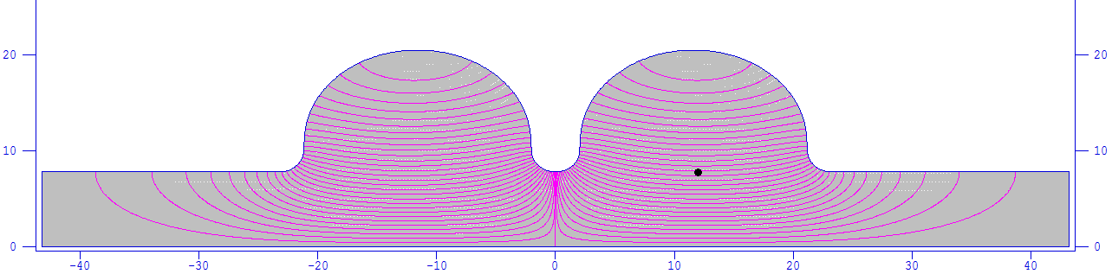
Main Ring 650 MHz 2-cell Cavity Design
Parameters | Value
Riris (mm) | 78
Alpha (deg) | 3.22
A (mm) | 94.4
B (mm) | 94.4
a (mm) | 20.123
b (mm) | 22.09
L (mm) | 115.3
D (mm) | 204.95
k | 2.86%
R/Q (Ω) | 213
G (Ω) | 284
Ep/Eacc | 2.4
Bp/Eacc [mT/(MV/m)] | 4.2
k_{loss} (total) [V/pC] | 0.81 (bunch length 4 mm)
Cut-off frequency of beam tube (MHz) | TE11：1126 TM01：1471

Slide 10
Q_{e} Limit for MR Coupled-Bunch Instability
monopole | f (MHz) | R/Q (Ω) (2 cell) | R/Q* (Ω) (1 cell) | Q_{e} (H-LP) | Q_{e} (Z-2 cell) | Q_{e} (Z-1 cell)
TM011 | 1165.536 | 63.4 | 33.63 | 4.74×10⁴ | 1.02×10³ | 1.95×10³
TM020 | 1384.302 | 1.128 | 0.095 | 2.24×10⁶ | 4.83×10⁴ | 5.85×10⁵
dipole | f (MHz) | R/Q (Ω/m) (2 cell) | R/Q** (Ω/m) (1 cell) | Q_{e} (H-LP) | Q_{e} (Z-2 cell) | Q_{e} (Z-1 cell)
TE111 | 844.666 | 276.62 | 131.03 | 5.86×10³ | 4.13×10² | 8.72×10²
TM110 | 907.469 | 414.84 | 353.04 | 3.91×10³ | 2.75×10² | 3.23×10²
TM111 | 1279.043 | ---- | 219.98 | ---- | ---- | 5.19×10²
TE121 | 1468.139 | 12.61 | 0.749 | 1.29×10⁵ | 9.06×10³ | 1.52×10⁵
k_{∥mode} = 2πf ·(R/Q) / 4 [V/pC] ** k_{⊥mode} = 2πf ·(R/Q) / 4 [V/(pC·m)]
Higgs: low power & 30 mrad crossing angle, 384 2-cell cavity, Z: 32 2-cell or 1-cell cavity
Qe limit using the pulse current of bunch train
Cavity frequency spread will increase Qe limit at least an order of magnitude
Beam feedback will be used for special requirement

Slide 11
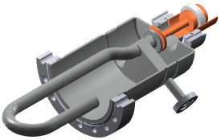
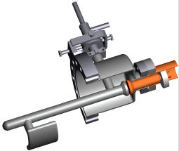
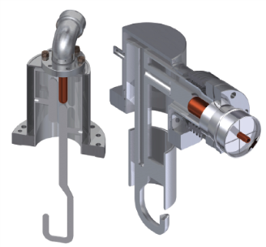
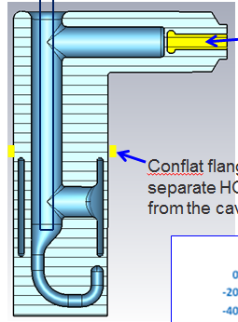
Coaxial HOM Coupler
Maximum HOM power is 0.8 kW per CEPC 2-cell cavity, 80 % above cut-off frequency of the 156 mm beam pipe.
Coaxial HOM coupler is the first choice for kW power level: LEP, LHC, HL-LHC crab cavity and 800 MHz Landau cavity, BNL ERL & eRHIC.
CEPC bunch train issue: higher peak HOM power (pulsed)
HL-LHC 2nd harmonic cavity (800 MHz): 2 hook + 2 probe / cavity. 525 W / hook & 61 W / probe
LEPII: 850 W / coupler (CW test)
LHC narrowband and broadband coupler: design 1 kW, test 600 W (4.5 K)
HL-LHC 400 MHz crab & DQW cavity: design 1 kW

Slide 12
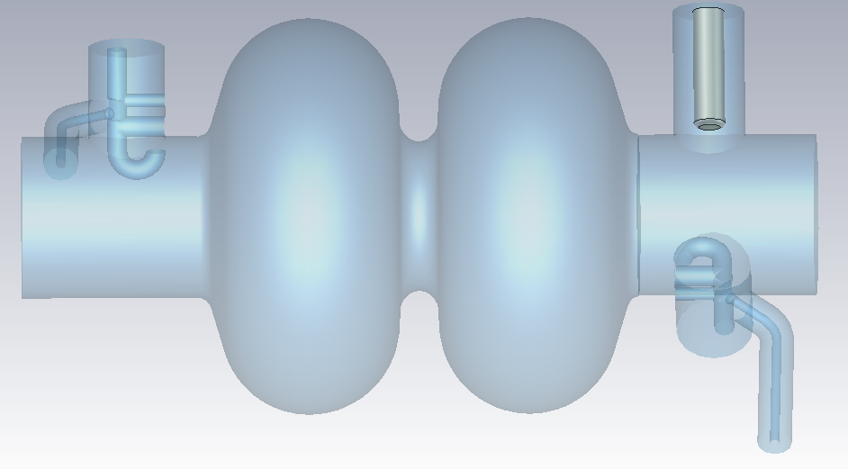
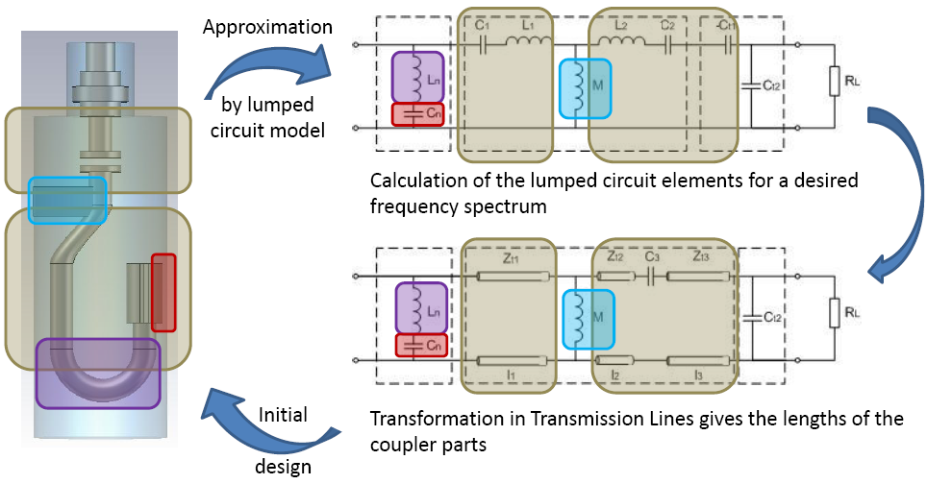
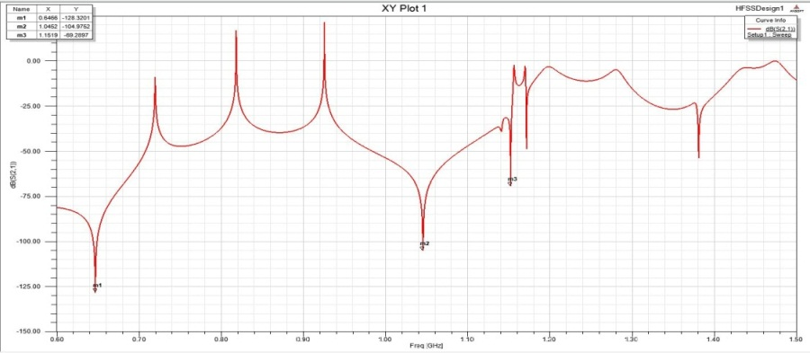
Coaxial HOM Coupler Design
Tuning procedure:
Equivalent circuit (transmission line model)
Component optimization based on S21 curve
Convert to 3D model
EM simulations: fine tuning (3D components)
Transmission line model:
Initial estimation for design by a TLM
CEPC: 2-cell 650 MHz cavity + 2 HOM couplers + FPC. LLRF test, HLRF test at RT and with cavity at 2 K.
S21 curve for the HOM coupler

Slide 13
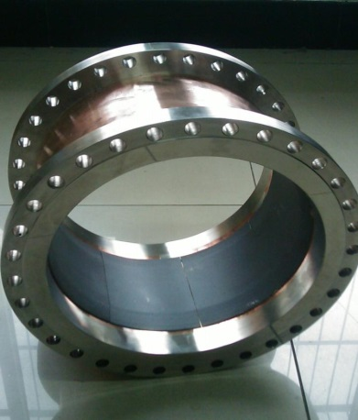
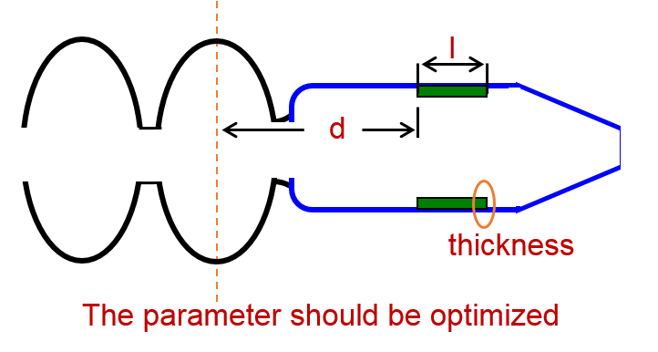
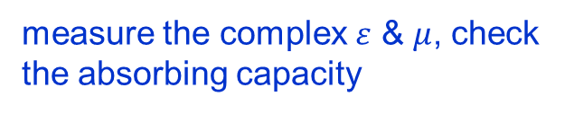
HOM Absorber Design
5 kW beam pipe absorber at RT for HOM of the high frequency part.
Design procedure:
according to f_{cutoff}
Choose the size of pipe
Select the absorber, prefer to ferrite
Optimize the absorber shape and position
Simulate the heating of damper
measure the complex $ε$ & $μ$, check the absorbing capacity
reduce Q_{L} of HOM in the system

Slide 14
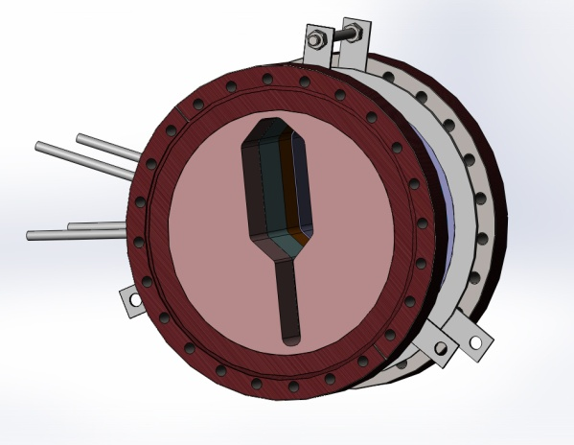
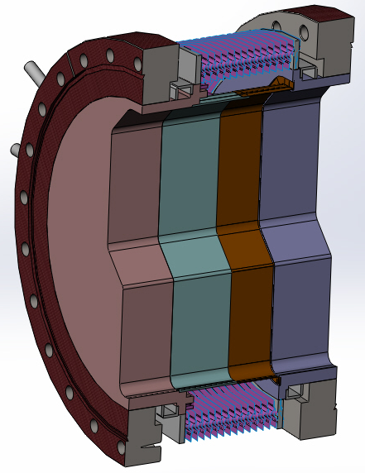
RF-Shielded Bellows for MR Cavity
RF-Shielded Bellows using in BEPCII
  Compensate dimensional error
  RF shielding
Challenge for CEPC SRF cavity
  Cleanliness: class 10
  Low temperature: 4 K
  Low surface resistance: copper plating
Related products
  VALQUA in Japan supply RF-Shielded Bellows using in BEPCII
  IHEP developed the same one cooperated with JJJvac in Shanghai and SEALTECH in Yingkou

Slide 15
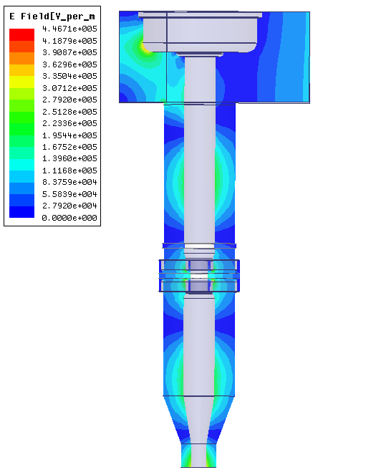
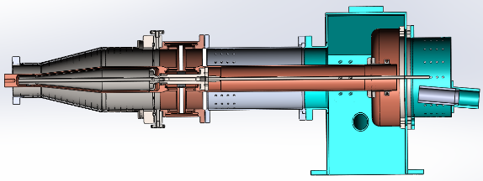
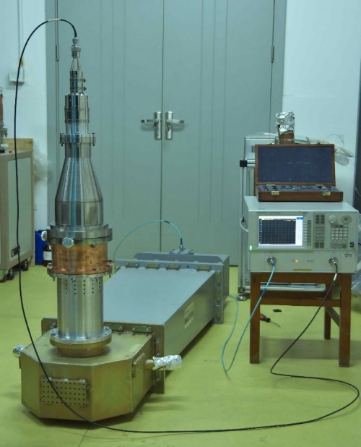
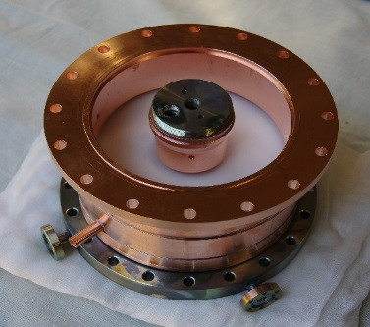
650 MHz Single-Window Input Coupler
Coaxial planner window
Diameter 150 mm
Capacity of handling very high power
Short vacuum side outer conductor
Enable clean assembly with high Q cavity
Cooling system
Inner conductor cooled with water
Outer conductor cooled with 5 K helium gas
Doorknob is cooled by forced air flow
Fabrication and LLRF test complete
ADS R&D, modified for CEPC main ring
reduce static heat load, improve cooling …

Slide 16
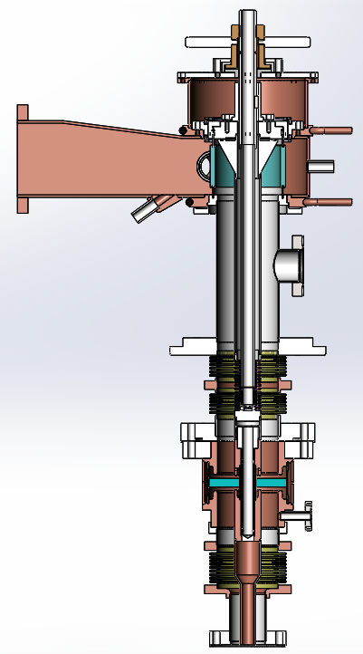
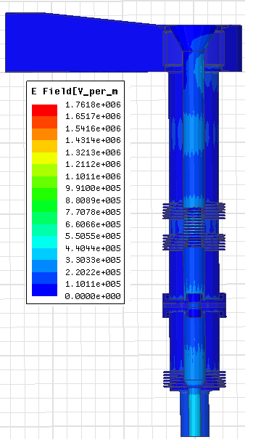
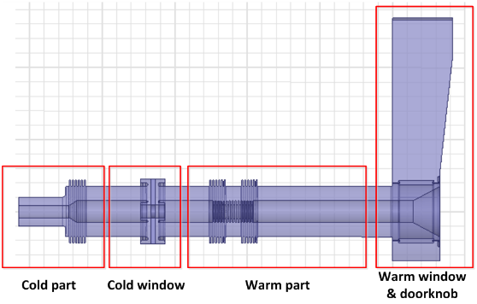
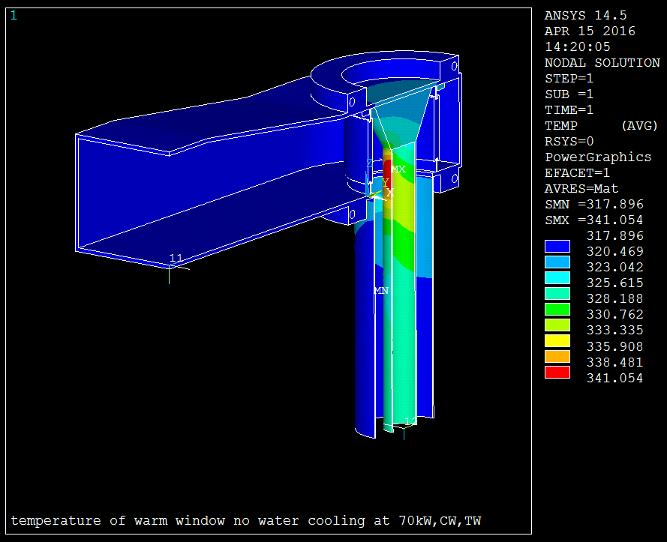
1.3 GHz Double-Window
Variable-Coupling CW Input Coupler
Complete RF, thermal and mechanical design
Fabrication and test in 2017-2018
Design power: 70 kW CW for ERL injector (CEPC Booster: 20 kW peak)

Slide 17
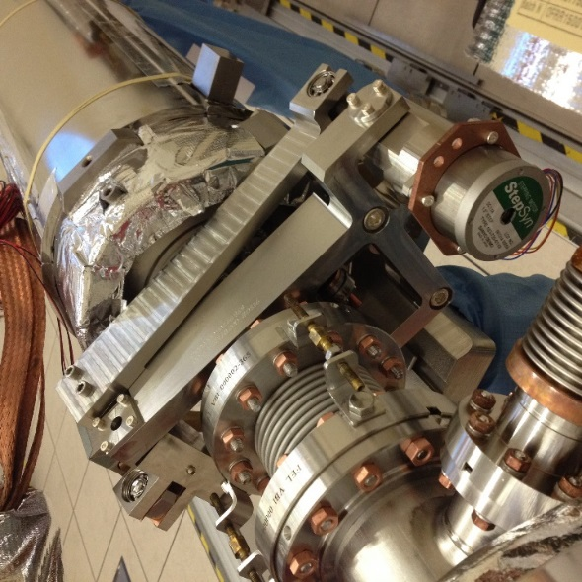
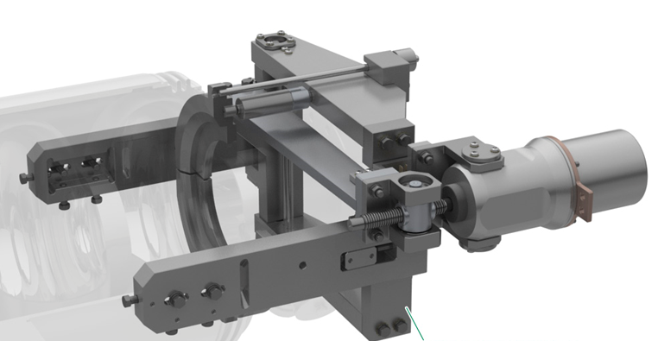
Tuning System
installed at the end of cavity (avoid interference with magnetic shielding)
high mechanical strength
piezo always compressed
high reliability
Tuning system requirements
Parameter | Tuner for 1.3 GHz cavity | Tuner for 650 MHz cavity
Coarse tuner frequency range | 420 kHz | ＞ 200 kHz
Coarse tuner frequency resolution | ＜ 20 Hz | ＜ 20 Hz
Fine tuner frequency range | 1 kHz | 1.5 kHz
Fine tuner frequency resolution | 1 Hz | 2 Hz
XFEL / LCLS-II Cavity Tuner

Slide 18
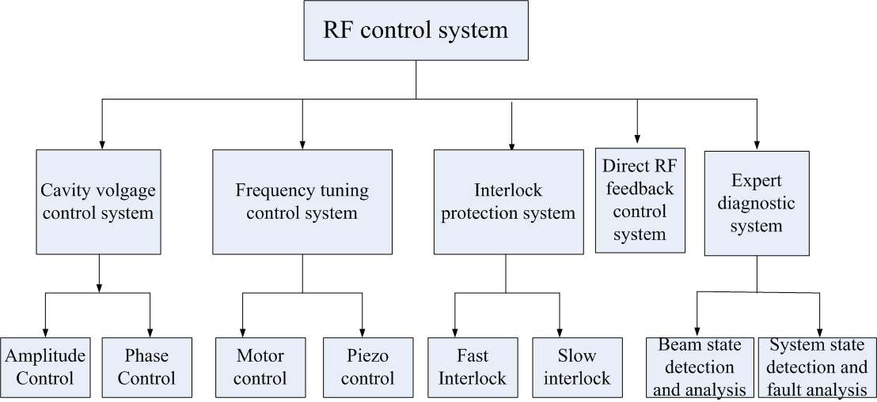
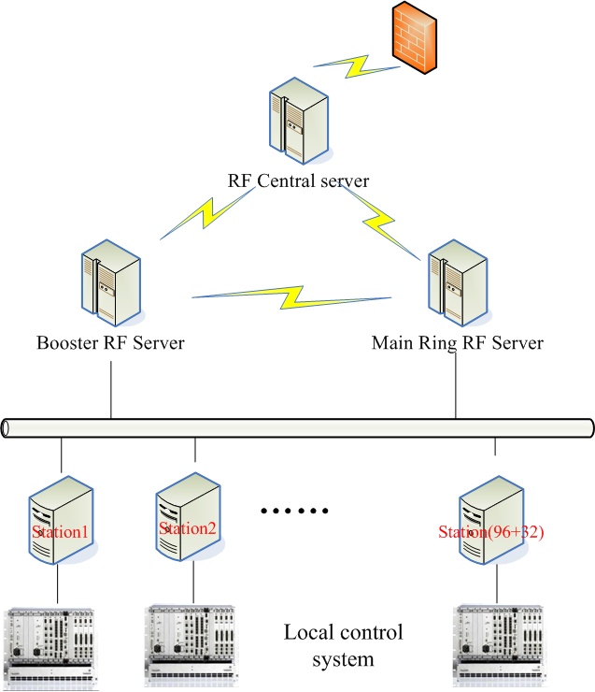
RF Controls Systems
Basic requirements
High degree of automation
Easy operation and maintenance
High reliability
System functional requirements
RF system start-up
The setting of the RF system parameters needed for beam operation
Beam loading compensation
Cavity detuning
System interlock protection
System fault diagnosis
Exception handling
Performance optimization

Slide 19
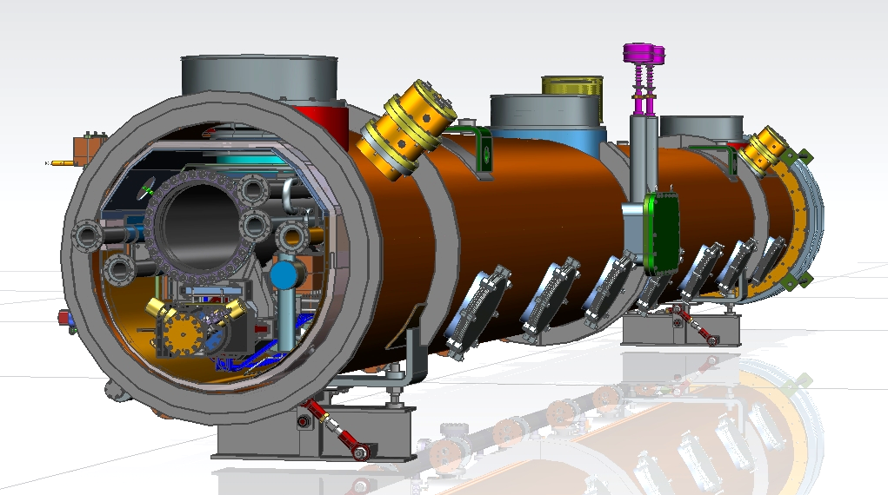
Cryomodule Design
Courtesy of FNAL
XFEL / LCLS-II type Cryomodule for High Q Cavity
(fast cool down, magnetic hygiene)

Slide 20
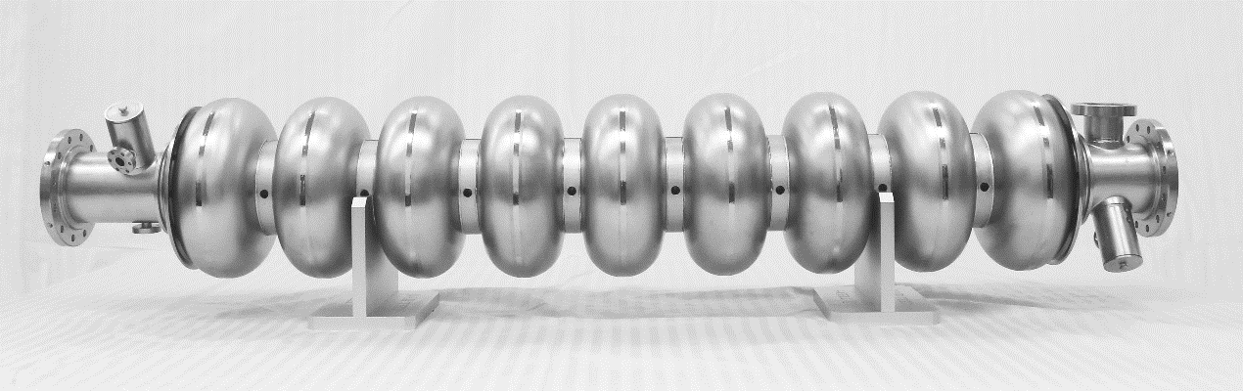

Chinese SRF Industry
  Niobium: OTIC (EXFEL 35% 7 t, FRIB 50% 5 t, LCLS-II 50% 5.6 t …)
  Cavity: OTIC, HERT, HIT, BIAM… (ILC, CADS, FRIB, HEPS …)
Coupler: HERT (ILC, CADS, RISP …), JNT …
Cryomodule: WXCX (EXFEL 60% 60, LCLS-II 100% 33, FRIB), HFJN…
Foreign company examples: RI, Zanon, CPI, HERAEUS …

Slide 21
CEPC SRF International Collaboration
SRF System: INFN-LASA, JLAB, CERN
Cavity: FNAL, JLAB, KEK, INFN-LASA
HOM Damping: HEPS (IHEP), BNL, CERN, Univ. of Rostock
Input Coupler: C-ADS (IHEP), KEK
Tuner: INFN-LASA
Cryomodule: XFEL, SLAC-FNAL-JLAB
First CEPC SRF International WG Meeting (tentative): Jan 2017.

Slide 22
SRF Experts List (not complete)
Region | Country | Institute | Name | Email | Expertise
Asia | Japan | KEK | Eiji Kako | eiji.kako@kek.jp | SRF general, coupler, cavity
Asia | Japan | KEK | Hitoshi Hayano | hitoshi.hayano@kek.jp | SRF general, infrastructure
Asia | Japan | KEK | Takaaki Furuya | takaaki.furuya@kek.jp | SRF general, coupler, cavity
Europe | Italy | INFN-LASA | Carlo Pagani | carlo.pagani@mi.infn.it | SRF general
Europe | Germany | CERN | Kai Papke | kai.papke@cern.ch | HOM coupler
Europe | Germany | CERN | Frank Gerigk | Frank.Gerigk@cern.ch | SRF general
Europe | Switzerland | CERN | Toon Roggen | toon.roggen@cern.ch | HOM coupler
Europe | Switzerland | CERN | Wolfgang Hofle | wolfgang.hofle@cern.ch | LLRF
Europe | Germany | DESY | Jacek. Sekutowicz | Jacek.Sekutowicz@desy.de | HOM coupler
Europe | Switzerland | CERN | Eric Montesinos | Eric.Montesinos@cern.ch | SRF general, coupler
Europe | Germany | DESY | Wolf-Dietrich Moller | wolf-dietrich.moeller@desy.de | SRF general, coupler
Europe | France | CEA-Saclay | Olivier Napoly | olivier.napoly@cea.fr | cryomodule
Europe | Germany | University of Rostock | Ursula van Rienen | ursula.van-rienen@uni-rostock.de | HOM damping

Slide 23
SRF Experts List (not complete)
Region | Country | Institute | Name | Email | Expertise
America | USA | FNAL | Sergey Belomestnykh | sbelomes@fnal.gov | SRF general
America | USA | FNAL | Anna Grassellino | annag@fnal.gov | cavity
America | USA | FNAL | Allan Rowe | arowe@fnal.gov | infrastructure
America | USA | FNAL | Tug Arkan | arkan@fnal.gov | cryomodule
America | USA | Cornell Univ. | Hasan Padamsee | hsp3@cornell.edu | SRF general
America | USA | JLAB | Robert Rimmer | rarimmer@jlab.org | SRF general
America | USA | JLAB | Haipeng Wang | haipeng@jlab.org | SRF general, HOM damping
America | USA | JLAB | Ari Palczewski | ari@jlab.org | cavity
America | USA | JLAB | Tom Powers | powers@jlab.org | LLRF
America | USA | JLAB | Curt Hovater | hovater@jlab.org | LLRF, tuner
America | USA | BNL | Wencan Xu | wxu@bnl.gov | HOM damping
America | USA | LBNL | Larry Doolittle | LRDoolittle@lbl.gov | LLRF

Slide 24
Outline
CEPC SRF System Design
R&D Plan and Status
Phase Compensation of Bunch Train
Summary

Slide 25

Voltage and Phase Variation
N_{t} trains of equal length and spacing (electron and positron beams in opposite direction can be regarded as the same)
N bunches in each train
T_{b}: bunch spacing
T_{g}: train spacing (gap duration)
N_{g} = T_{g}/ T_{b} -1: missing bunches in the gap
Steady state (transients of injection and phase moving vanish)
Ignore higher order modes
Due to symmetry, only consider one train and the gap followed
For n^{th} bunch in a train, the net voltage is:
K. Bane, etc. Compensating the unequal bunch spacing in the NLC damping ring, EPAC96
$$V_{c}^{n}=V_{b}^{n}+V_{g}^{n}$$
(1)

Slide 26






Voltage and Phase Variation
Generator voltage is independent of n:
where nominal synchrotron phase:
and beam induced voltage of even distribution:
where the cavity detuning angle, detuning frequency and filling time:
$$V_{g}=V_{c0}\exp\left(iφ_{0}\right)−V_{b0}$$
(2)
$$φ_{0}=\cos^{−1}{[(U_{0}+U_{HOM})/eV_{c0}}]$$
$$V_{b0}=− \frac{2I_{0}R}{1+β}\cos{ψ}e^{iψ}$$
(3)
$$ψ=\tan^{−1}{(}ΔωT_{F})$$
$$Δω=ω_{0}−ω_{rf}$$
$$T_{F}=2Q_{L}/ω_{rf}$$

Slide 27
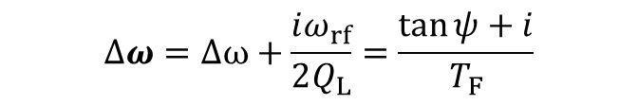
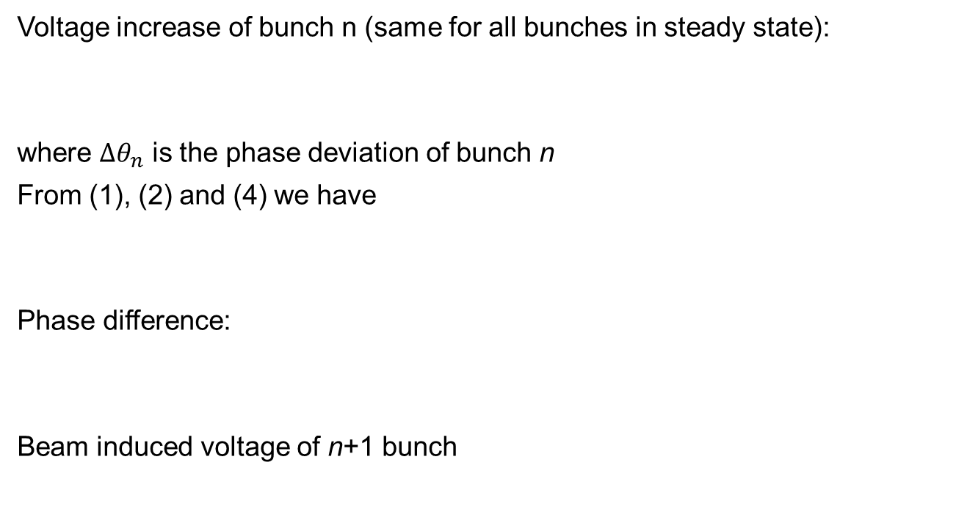
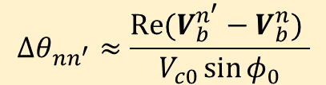
Voltage and Phase Variation
Voltage increase of bunch n (same for all bunches in steady state):
where $Δθ_{n}$ is the phase deviation of bunch n
From (1), (2) and (4) we have
Phase difference:
Beam induced voltage of n+1 bunch
$$Re[V_{c}^{n}\exp\left(iΔθ_{n}\right)]={(U}_{0}+U_{HOM})/e=V_{c0}\cos{φ_{0}}$$
(4)
$$\cos{φ_{0}}−\cos\left(φ_{0}+Δθ_{n}\right)=Re[{(V}_{b}^{n}−V_{b0})\exp\left(iΔθ_{n}\right)]/V_{c0}$$
(5)
$$Δθ_{nn^{′}}≈\frac{Re(V_{b}^{n^{′}}−V_{b}^{n}) }{V_{c0}\sin{φ_{0}}}$$
$$V_{b}^{n+1}=−2kq\exp\left(−iΔθ_{n+1}\right)+V_{b}^{n}exp⁡(iΔωT_{b})$$
$$Δω=Δω+\frac{iω_{rf}}{2Q_{L}}=\frac{\tan{ψ+i}}{T_{F}}$$

Slide 28

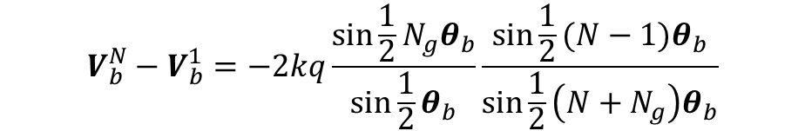

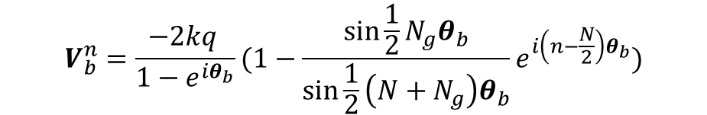
Voltage and Phase Variation
For bunch 1
For $Δθ_{n}≪1$, beam induced voltage of bunch n
Then
$$V_{b}^{1}=−2kq\exp\left(−iΔθ_{1}\right)+V_{b}^{N}exp⁡(iΔωT_{g})$$
$$V_{b}^{n}=\frac{−2kq }{1−e^{iθ_{b}}}(1−\frac{\sin{\frac{1}{2}N_{g}θ_{b}}}{\sin{\frac{1}{2}\left(N+N_{g}\right)θ_{b}}}e^{i\left(n−\frac{N}{2}\right)θ_{b}})$$
$$θ_{b}=ΔωT_{b}$$
$$V_{b}^{N}−V_{b}^{1}=−2kq\frac{\sin{\frac{1}{2}N_{g}θ_{b}}}{\sin{\frac{1}{2}θ_{b}}}\frac{\sin{\frac{1}{2}(N−1)θ_{b}}}{\sin{\frac{1}{2}\left(N+N_{g}\right)θ_{b}}}$$

Slide 29



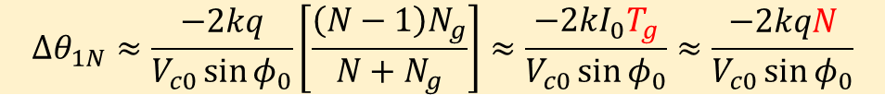
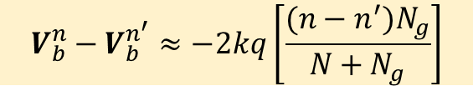
Voltage and Phase Variation
For short bunch train $\left|Δω{NT}_{b} \right|≪1$ and short gap $\left|Δω{N_{g}T}_{b} \right|≪1$,
Voltage variation
Total phase variation
$$V_{b}^{n}≈\frac{−2kq }{iθ_{b}}(\frac{N}{N+N_{g}})\left[1−iN_{g}θ_{b}(\frac{n}{N}−\frac{1}{2})\right]$$
$$V_{b}^{n}−V_{b}^{n^{′}}≈−2kq\left[\frac{(n−n^{′})N_{g}}{N+N_{g}}\right]$$
$$Δθ_{1N}≈\frac{−2kq}{V_{c0}\sin{φ_{0}}}\left[\frac{\left(N−1\right)N_{g}}{N+N_{g}}\right]≈\frac{−2kI_{0}T_{g}}{V_{c0}\sin{φ_{0}}}≈\frac{−2kqN}{V_{c0}\sin{φ_{0}}}$$
Max phase variation proportional to number of bunches in a bunch train, i.e. number of
bunch trains (for fixed total bunch number)
$\frac{N_{g}}{N}=9$for CEPC PDR and APDR

Slide 30






Beam Dynamic Effects of Phase Variation
Due to symmetry, phase variation will be the same for an electron and positron colliding bunch pair, interaction point will not move
Decrease longitudinal tune, tune spread between bunches enhances Landau Damping, good for instability suppression
Reduce Energy Acceptance and Beamstrahlung Lifetime
Increase bunch length, affect luminosity in crab waist collision
$$ΔV_{c}∝−2kqN$$
↓
$${η \sim η}_{RF}∝V_{c}(sinφ−φcosφ)$$
↓
$$τ_{BS}∝e^{Aη}η^{B}$$
↓
$$Δφ∝\frac{−2kqN}{V_{c0}\sin{φ_{0}}}$$
⇒
$$σ_{z}∝\sqrt{\frac{1}{V_{c}sinφ}}$$
⇒
↓
↓
$ℒ$ ?

Slide 31
Beam Dynamic Effects of Phase Variation
4 + 4 trains (top parameters of D. Wang 20160329) | H | Z
Cavity number | 480 | 32
V_{RF} (GeV) | 3.65 | 0.13
Max ΔV_{RF} (GeV) | - 0.14 | - 0.024
Max Δφ (deg) | - 3.9 | - 12.9
Max Δη | - 0.4 % | - 0.6 %
Max Δσ_{z}/σ_{z} | 8 % | 32 %
Max BS lifetime change | - 50 % | /

Slide 32
Beam Loading Compensation Methods
Compensation methods: Reduction + Correction
Reduction methods:
  increase cavity stored energy
  change fill pattern and RF distribution (spread as uniformly as possible)
  increase synchrotron phase (change beam parameters)
Correction methods: Global and Local
  Global correction: provide via the RF generator an additional current to fully cancel out beam current variations in each cavity. But needs special RF source with high peak power and high repetition rate. And special techniques are needed to reduce the filling power and average power.
  Local correction: travelling wave cavity, DF cavity …

Slide 33
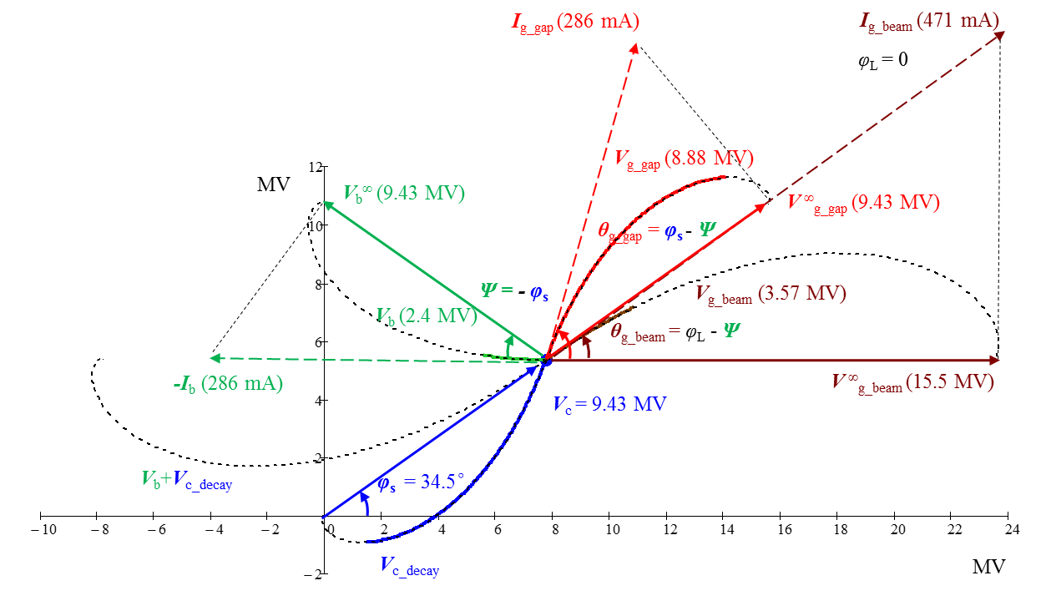
Phase Compensation with Pulsed Power
Perfect (Fixed Point) Correction
(HL Higgs, cavity near IP1&IP3)

Slide 34
RF-to-Beam Power Efficiency
 | CEPC SR-H | LEP 1 55 GeV*** | BEPCII Collision | ILC TDR-500 | CEPC PDR-H-HL
Revolution / Repetition time T₀ (μs) | 182.8 | 89 | 0.8 | 2E5 | 180.1
Bunch charge (nC) | 60.8 | 67 | 7.8 | 3.2 | 45.6
Bunch spacing T_{b} (μs) | 0.6~3.7 | 22.2 | 0.008 | 0.554 | 0.1585
Peak or average current (mA) | 33.3* | 6* | 910 | 5.8 | 268
Cavity time constant τ (μs) | 1157 | 57.8 | 108 | 1322 | 95
Bunch train length T_{p} (μs) | / | / | 0.76 | 727 | 10.7
Gap length T_{g} (μs) | / | / | 0.04 | 1.99E5 | 0.3 ~ 160
T_{b} / τ [max] | 0.003 | 0.38 | 7E-5 | 4E-4 | 0.0017
T_{g} / τ [max] | / | / | 4E-4 | 150 | 1.7
Filling time T_{f} (μs) | / | / | / | 923 | 160
Filling power P_{g1} (kW) | / | / | / | 190 | 823
Flat-top power P_{g} (kW) | 276 | 98 | 123 | 190 | 2274
Peak or average beam power P_{b} (kW) | 276 | 13.1 | 123 | 190 | 2274/268
RF to beam power efficiency ** | 100 % | 13 % | 100 % | 44 % | 27 %
* Two beams
** Not include waveguide loss and control margin
*** Normal conducting cavity with storage cavity
Perfect correction method.
Resonant filling may increase to 37 %

Slide 35
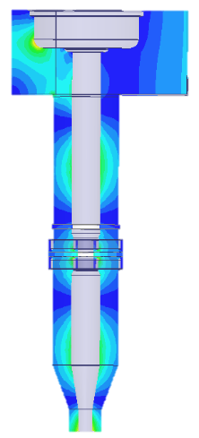
Fast RF Switch
Fast RF switch (work for all pulsed machine)
  Close waveguide port with the fast RF switch in beam gap, feed low power RF to keep the cavity voltage
  Switch types (J.Q. Qiu, IPAC2016): ferroelectric, semiconductor (laser-driven), plasma discharge, multipactor ignition (all-metal, small RF source, magnet)
Fast RF Switch
High Power RF
(one 2.2 MW klystron, two 5 kHz 10 μs modulators)
Low Power RF
(small coupling, < 100 W)
Double the operational coupler heat load by the cavity stored energy.

Slide 36
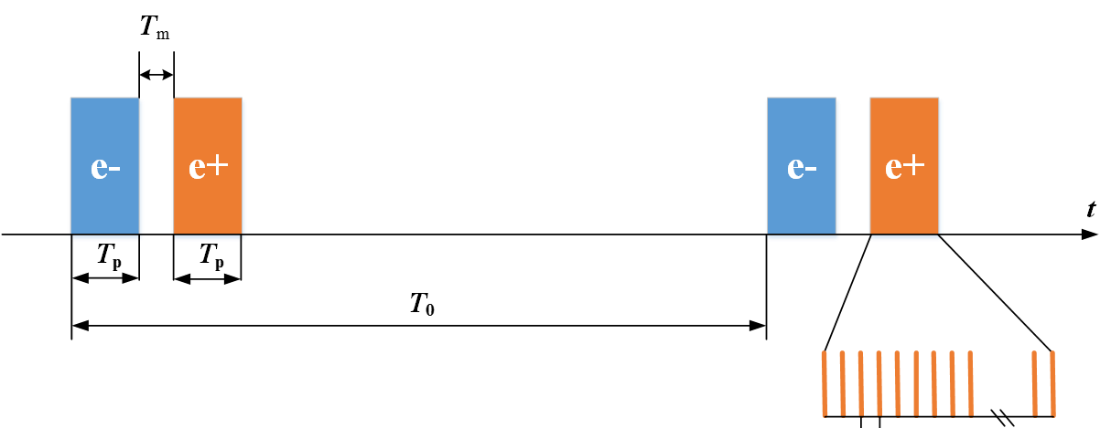
Change Fill Pattern and RF Distribution
More Bunch Trains
  Will alleviate beam loading effect, but can’t increase the RF-to-beam power efficiency using the same active full correction method. Parasitic crossing should be avoided by pretzel or adding more partial double ring parts (Advanced Partial Double Ring, or APDR, by Jie Gao).
However, quasi-equal-spacing of electron and positron bunch train (neglect RF station length) requires RF stations to be in the middle of crossing points. Otherwise complicated for local correction.

Slide 37
RF Asymmetry
RF next to the crossing points
  Pros: Dispersion can be suppressed simultaneously. IP is far from bending magnets separated by RF.
  Cons: e+ and e- pass through the RF nearly at the same time.
RF in the middle of arc
  Pros: Better beam loading and HOM damping because of uniform bunch train spacing.
  Cons: extra dispersion suppressors. IP SR shielding.
For simplicity, here assume symmetry RF in any bunch train number (i.e. only two RF stations in the case of 1+1 bunch train, and neglecting saw tooth effect).

Slide 38
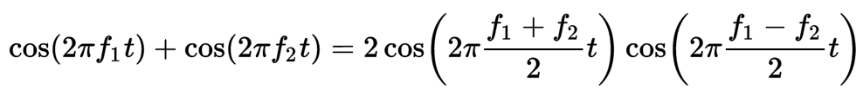
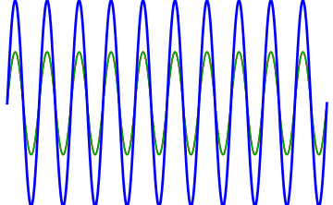
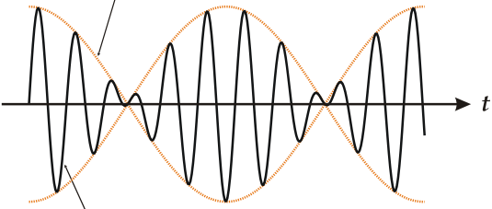

Phase Compensation with
Difference-Frequency (DF) Cavity
Tune freq of some RF sources and cavities slightly different from the normal RF sources (650 MHz) and cavities (optimal detuning) – beating
Use linear part of beat wave to compensate voltage and phase variation due to beam loading (non-linearity increases with train length, max. half-fill of the ring)
Higher order beats are more effective but more non-linear
$$f_{DF}=f_{RF}±mN_{t}f_{rev}$$
K. Kubo etc. Compensation of bunch position shift using sub-RF cavity in a damping ring, PAC93
electron bunch train
positron
bunch train
bunch train freq = train # x revolution freq = beat freq / m

Slide 39
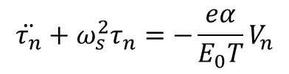
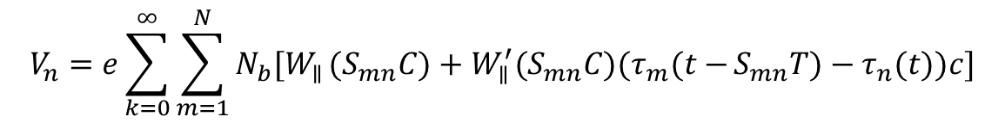
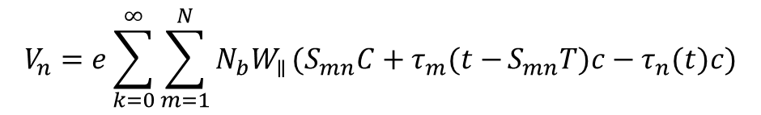
Phase Oscillation Equation
C ring circumference
L_{n} longitudinal position of bunch n in the ring
P_{n} = L_{n} / C, S_{mn} = k + P_{m} - P_{n}
N_{b} particle number in a bunch
Phase equation
where
expand
$$\ddot{τ_{n}}+ω_{s}^{2}τ_{n}=−\frac{eα}{E_{0}T}V_{n}$$
$$V_{n}=e\sum_{k=0}^{∞}{\sum_{m=1}^{N}{N_{b}W_{∥}}(S_{mn}C+τ_{m}(t−}S_{mn}T)c−τ_{n}(t)c)$$
$$V_{n}=e\sum_{k=0}^{∞}{\sum_{m=1}^{N}{N_{b}{[W}_{∥}}(S_{mn}C)+{W_{∥}^{′}(S_{mn}C)(τ}_{m}(t−}S_{mn}T)−τ_{n}(t))c]$$
change synchrotron phase
change synchrotron tune
bunch coupling, instability

Slide 40
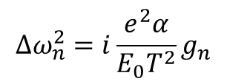
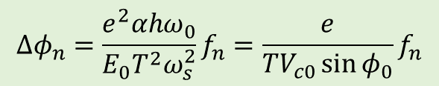
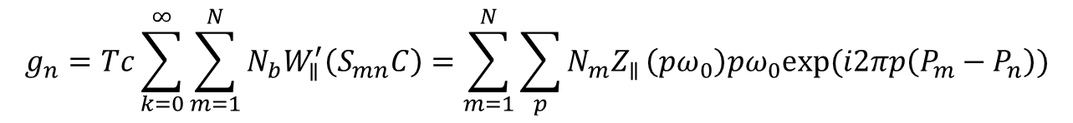

Phase and Tune Variation
Phase variation
$$∆φ_{n}=\frac{e^{2}αhω_{0}}{E_{0}T^{2}ω_{s}^{2}}f_{n}=\frac{e}{TV_{c0}\sin{φ_{0}}}f_{n}$$
Tune variation
$$∆ω_{n}^{2}=i\frac{e^{2}α}{E_{0}T^{2}}g_{n}$$
where
$$f_{n}=T\sum_{k=0}^{∞}{\sum_{m=1}^{N}{N_{b}W_{∥}}\left(S_{mn}C\right)=}\sum_{m=1}^{N}{\sum_{p}{N_{m}Z_{∥}}\left(pω_{0}\right)exp⁡(i2πp\left(P_{m}−P_{n}\right))}$$
$$g_{n}=Tc\sum_{k=0}^{∞}{\sum_{m=1}^{N}{N_{b}W_{∥}^{′}\left(S_{mn}C\right)=\sum_{m=1}^{N}{\sum_{p}{N_{m}Z_{∥}}\left(pω_{0}\right)pω_{0}exp⁡(i2πp\left(P_{m}−P_{n}\right))}}}$$

Slide 41



Phase Variation of the Fundamental Mode
For bunch n in a train
Cavity impedance
Real part of f_{n}
$f_{n}=\sum_{p}{N_{b}Z_{∥}\left(pω_{0}\right)exp⁡(iπp\frac{N+1−2n}{h}})\frac{sin⁡(π\frac{pN}{h})}{sin⁡(π\frac{p}{h})}exp⁡($i$πp\frac{(N+N_{g})(N_{t}−1)}{h})\frac{sin⁡(π\frac{p(N+N_{g})N_{t}}{h})}{sin⁡(π\frac{p(N+N_{g})}{h})}$
$$f_{n}=\sum_{p}{{N_{b}N}_{t}Z_{∥}\left(p{N_{t}ω}_{0}\right)exp⁡(iπpN_{t}\frac{N+1−2n}{h})\frac{sin⁡(π\frac{pN_{t}N}{h})}{sin⁡(π\frac{pN_{t}}{h})}}=N_{b}R_{s}\sum_{p=0}^{∞}{f_{np}}$$
$$Z_{∥}\left(ω\right)=\frac{R_{s}}{1+iQ\left(\frac{ω_{r}}{ω}−\frac{ω}{ω_{r}}\right)}$$
$$f_{np}≈N_{t}\frac{sin⁡(π\frac{pN_{t}N}{h})}{sin⁡(π\frac{pN_{t}}{h})}\frac{1}{1+{\tan{ψ}}^{2}}\left[\cos\left(πpN_{t}\frac{N+1−2n}{h}\right)+\tan{ψ\sin\left(πpN_{t}\frac{N+1−2n}{h}\right)}\right]$$
Only consider fundamental mode, main contribution of beam loading. p = h term very small, same for all the bunches. p = h ± 1 causes the beam loading deviation.

Slide 42


Beam Spectrum of Bunch Train smallest freq. spacing:
$$N_{t }ω_{rev}$$ impedance very small?

Slide 43



Phase Compensation with DF Cavity
Linear with bunch number n
For m = p – h
Passive DF cavity will add the term
$$f_{np}∝\frac{\sin\left(π\frac{mN_{t}N}{h}\right)}{\sin\left(π\frac{mN_{t}}{h}\right)}\frac{1}{m}\sin\left(mπN_{t}\frac{N+1−2n}{h}\right)∝+\frac{\sin\left(π\frac{mN_{t}N}{h}\right)}{\sin\left(π\frac{mN_{t}}{h}\right)} \frac{2πn}{N+N_{g}}$$
$$f_{DFn}∝− 4N_{b}R_{sDF}N_{t}\frac{\sin\left(π\frac{mN_{t}N}{h}\right)}{\sin\left(π\frac{mN_{t}}{h}\right)}\frac{πnm}{N+N_{g}}cosθ_{DF}$$
Compensate the beam loading phase variation of symmetry RF
$$θ_{DF}$$
is the detuning angle of DF cavity with respect to the nominal RF freq.
First order m = ±1 has linear compensation.

Slide 44

DF Cavity Configuration
For W and Z, we have enough cavities to act as DF cavity (passive or active).
  Cavity bandwidth ~ 1 kHz
  Beam spectrum spacing: 8 * 5.6 kHz = 45 kHz
  Detune of the stand-by cavity ~ 10 kHz
  First order DF cavity detuning: 8 * 5.6 kHz = 45 kHz
For Higgs, how many DF cavities are needed?
  Number of first order DF cavity needed for 4 + 4 trains
  Another 15 normal cavities will beat with the DF cavity, thus no acceleration of the first bunch in a train.
  We have enough margin of the cavity number and gradient
  Second order beat can be used to reduce the DF cavity number
$$N_{DFC1}=\frac{N_{cav}∆V_{c }}{{2V}_{c }T_{t}N_{t}ω_{rev}}=15$$

Slide 45
Summary and Outlook
CEPC SRF system design is converging towards the CDR in 2017 after two years of study
  SRF design for Higgs, W & Z luminosity ~ 2E34 cm⁻²s⁻¹
  independent of bunch fill pattern and separation scheme
  no fundamental show-stoppers of the current designs
DF cavity to compensate bunch train phase variation effectively
  tracking simulation to verify and optimize DF cavity configuration
  find a way of phase compensation for asymmetry RF distribution
TDR technical R&D just started and progress well
  MOST-NKRD fund (2016-2021, demonstrate key components)
  CAS-SPRB and other related funding on the way

