Slide 1
CEPC Nitrogen Doping Study
Peng Sha、Jiyuan Zhai
2016.09.02

Slide 2
Contents
Introduction
Research Progress
Summary

Slide 3
Contents
Introduction
Research Progress
Problem and Solution

Slide 4
CEPC cavity requirements
Cavity | Qualification | Normal Operation | Max. Operation
650 MHz 2-cell Cavity | VT 4E10 @ 22 MV/m HT 2E10 @ 20 MV/m | 2E10 @16.5 MV/m | 2E10 @ 20 MV/m
1.3 GHz 9-cell Cavity | VT 3E10 @ 25 MV/m | 2E10 @ 20 MV/m | 2E10 @ 23 MV/m
Too high for SC cavity
techniques present!

Slide 5
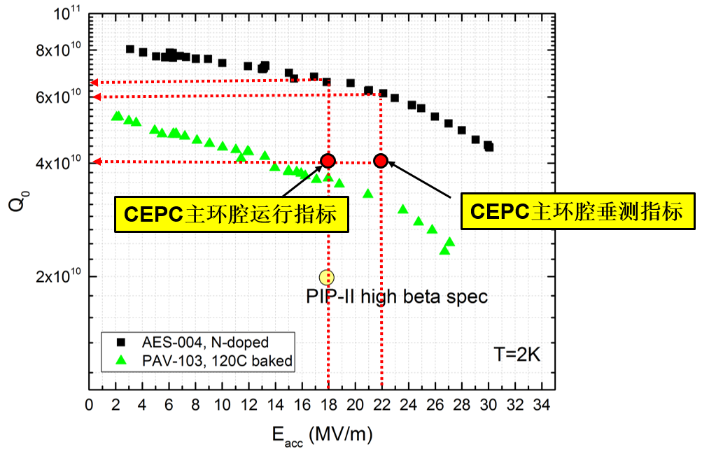
Study focuses at “high Q of SC cavity”
Research Content：Increasing Q₀(at high Electric field) of SC cavity through N-doping, Nb₃Sn……
Target：Q₀=2e10@E_{acc}=15.5MV/m （Vertical test at 2K）
Vertical test results of Fermilab 650 MHz single cell (beta=0.9) cavity
Vertical test target of CEPC 650MHz cavity
Operation target of CEPC 650MHz cavity
PIP-II cavity Bpk/Eacc=3.75
CEPC cavity Bpk/Eacc = 4.2
Alexander Romanenko,
FCC Week 2015

Slide 6
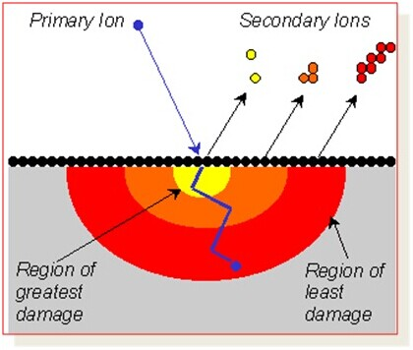
Secondary Ion Mass Spectrometry (SIMS)
Principle of SIMS
Hydrides cause Q slope, while Nitrogen doping may fully trap hydrogen.

Slide 7
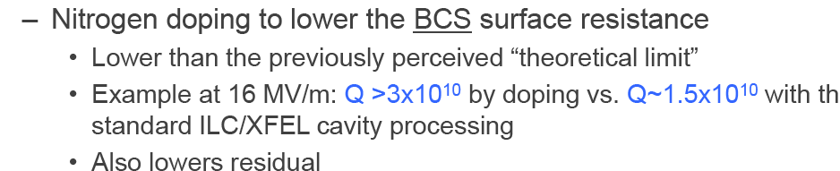
Principles and transfer-to-industry of N-doping
Immediate application: LCLS-II
FNAL and JLAB are transferring N-doping technology to cavity vendors: Zannon and RI

Slide 8
Contents
Introduction
Research Progress
Problem and Solution

Slide 9
Two steps of our research
1st step: N-doping of Nb sample, dose analysis via SIMS (at Tsinghua University)— N concentration within Nb increase or not?
2nd step: cavity N-doping, Electric Polishing, vertical test — Q₀ increase or not?

Slide 10
N-doping recipe at FNAL/JLAB/Cornell
Temperature ramp 160 minutes to 800℃ (<5 degrees/minute)
800℃ anneal 3 hours for Hydrogen degas
Nitrogen injection 2 minutes at ~3.5 Pa
Nitrogen anneal 6 minutes
Nature cooldown

Slide 11
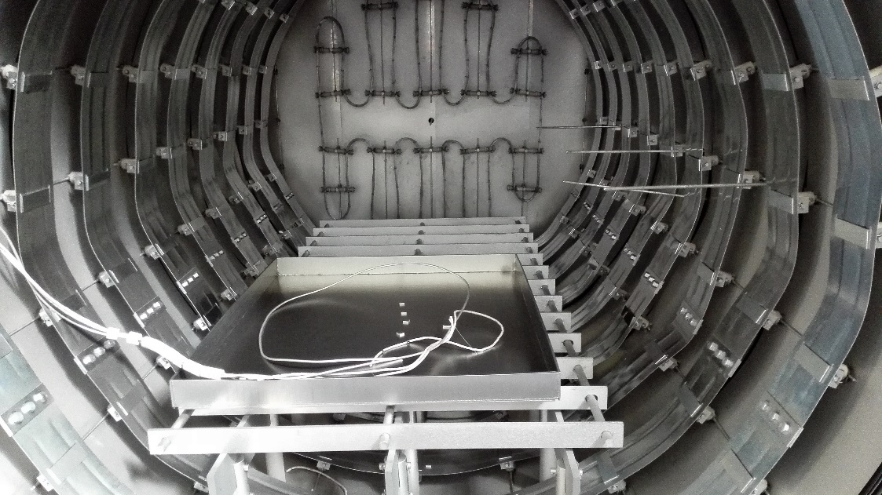
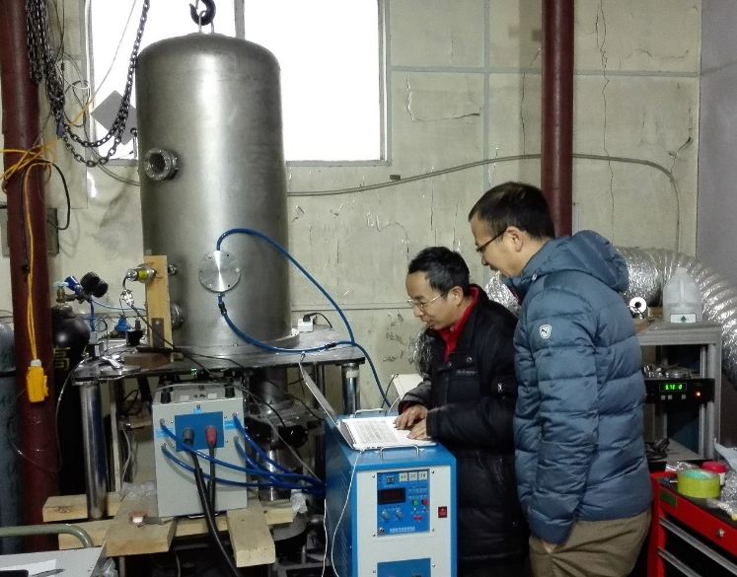
N-doping of Nb samples at IHEP
Furnace mainly used for 1.3GHz cavities at FNAL
Four Nb samples N-doped (totally adopting recipe of FNAL/JLAB/Cornell)
Furnace at IHEP
N-doping at PKU

Slide 12
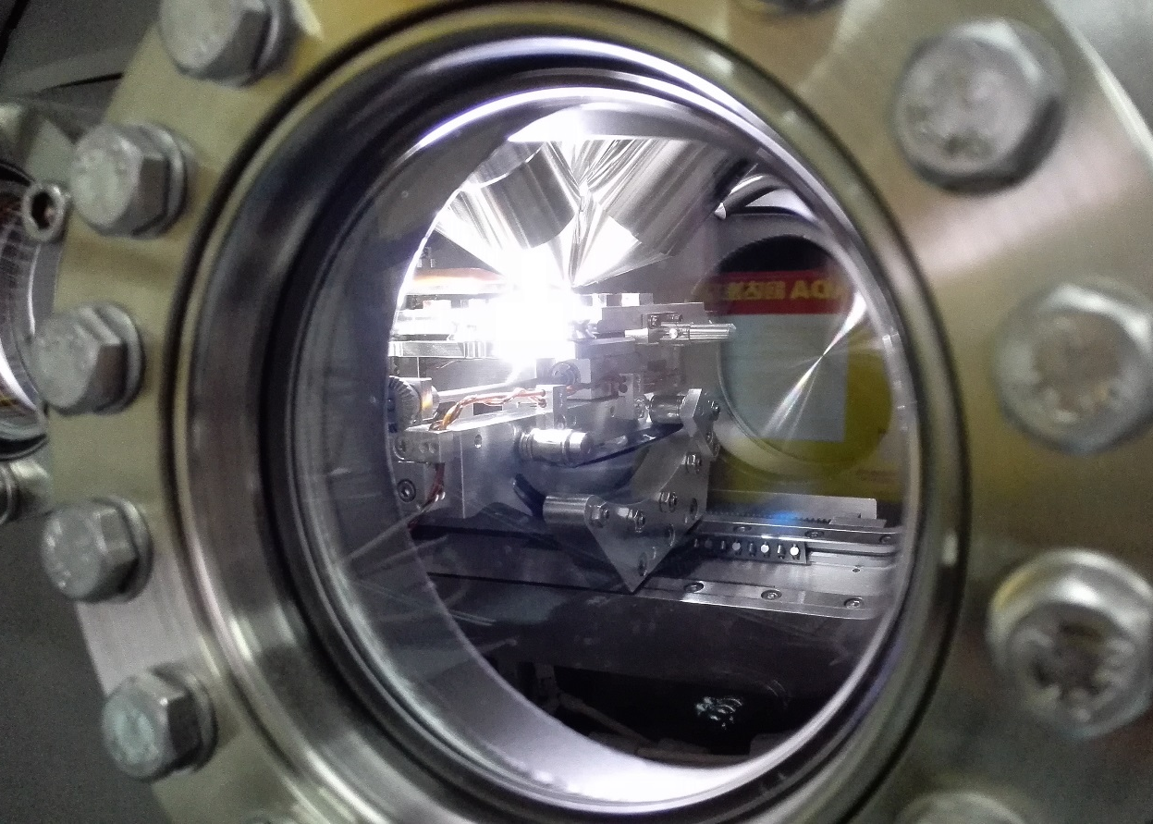
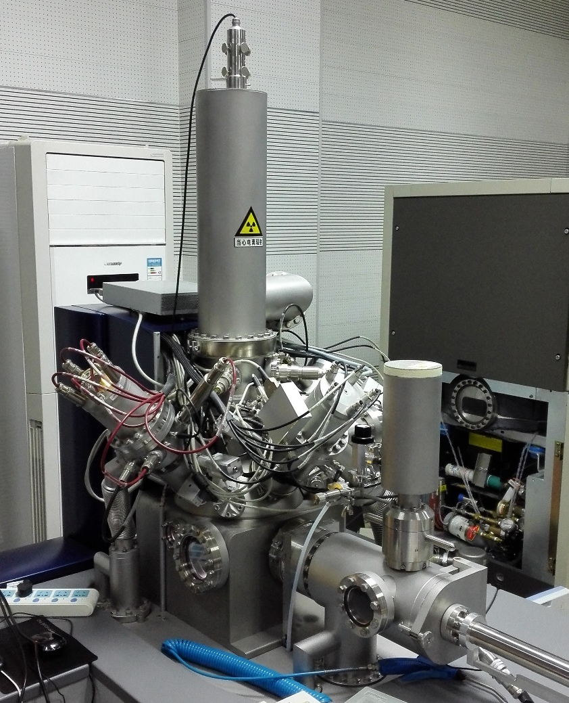
SIMS of Nb samples
Nb samples
SIMS experiments at Tsinghua University

Slide 13
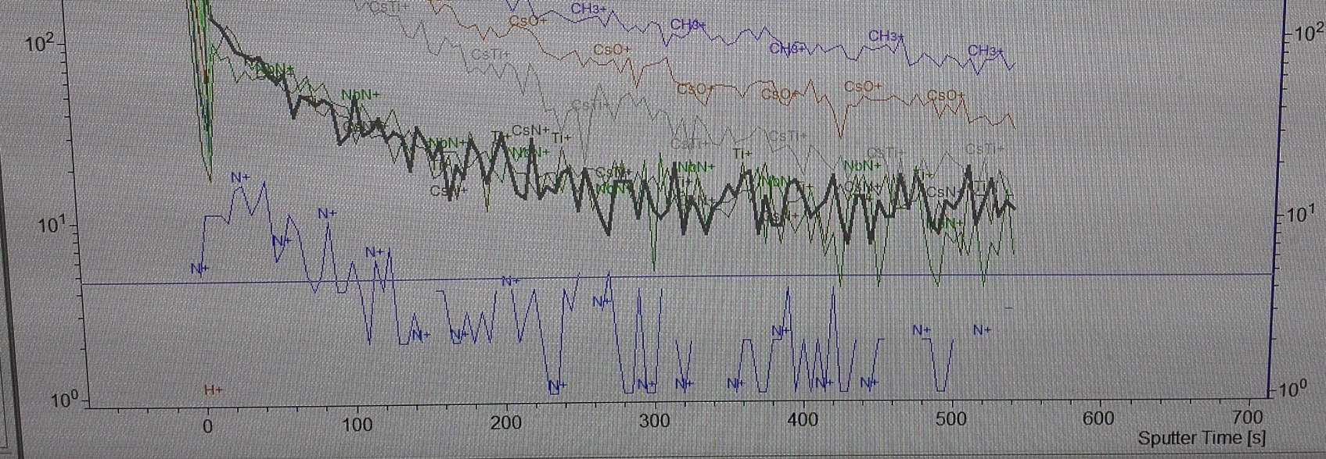
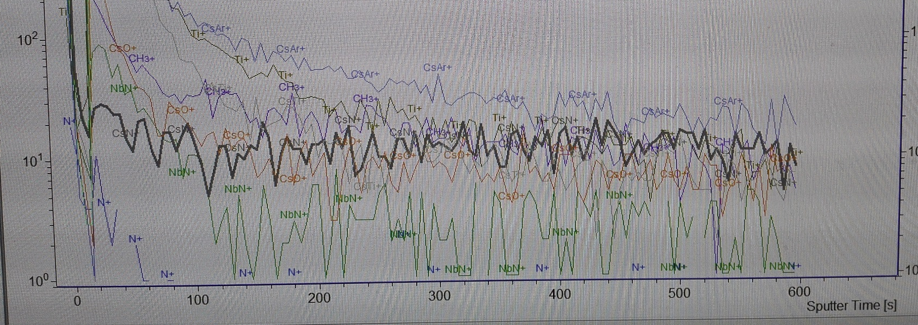
SIMS results (确认 Sputtering rate)
Nb sample
without N-doping
Sputtering rate is
1.5nm/second.
Quantity of N didn’t increase!
Nb sample
with N-doping

Slide 14
N-doping adopting recipe of FNAL/JLAB/Cornell
Many experiments of Nb sample have been held, but there’re no good results. SIMS results indicate that Nitrogen didn’t enter into Nb, which Auger Electron Spectroscopy (AES) also verified.
The same N-doping recipe has been used at Peking University. No Nitrogen enter into Nb, either.
N-doping in Japan was carried out following this recipe, which also failed.
Reasons are being fully studied (furnace, pump, valve……).

Slide 15
Ionizing N-doping
Ionizing N-doping is also tried, while the above molecule N-doping.
It’s a creative method, which seems useful (SIMS/AES results).

Slide 16
SIMS result before N-doping
Quantity of N (before N-doping)
Sputtering rate is 0.14nm/s.

Slide 17
SIMS result after N-doping
Quantity of N increase obviously after N-doping!
Sputtering rate is 0.14nm/s.

Slide 18
Auger Electron Spectroscopy (AES)
Sputtering rate is 22nm/min
Sputtering rate is 50nm/min
Quantity of N also
increase obviously!
Nb sample before N-doping
Nb sample after N-doping

Slide 19
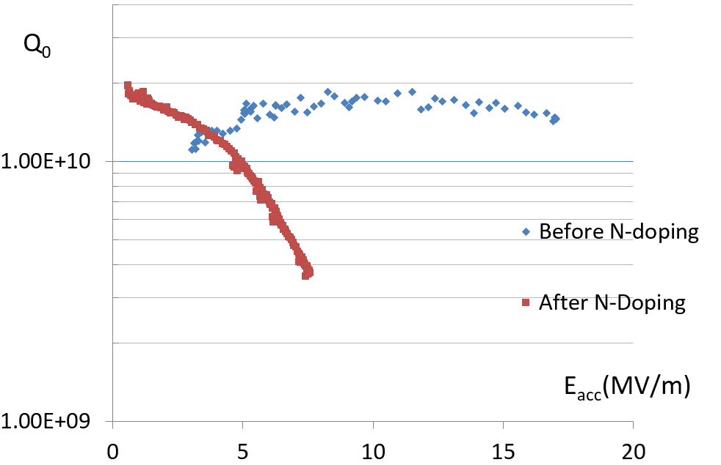
Vertical test of 1.3GHz cavity N-doped
1.3GHz cavities were N-doped after Nb sample experiments.
Several vertical tests were finished , but Q Value didn’t increase. One key reason: no Electrical Polishing (EP), just plasma cleaning or Buffered Chemical Polishing (BCP).

Slide 20
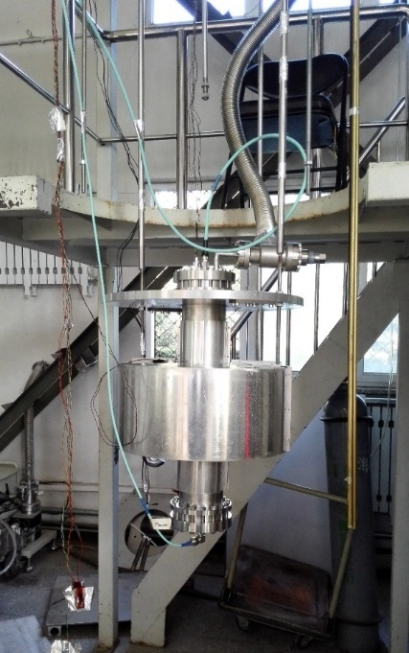
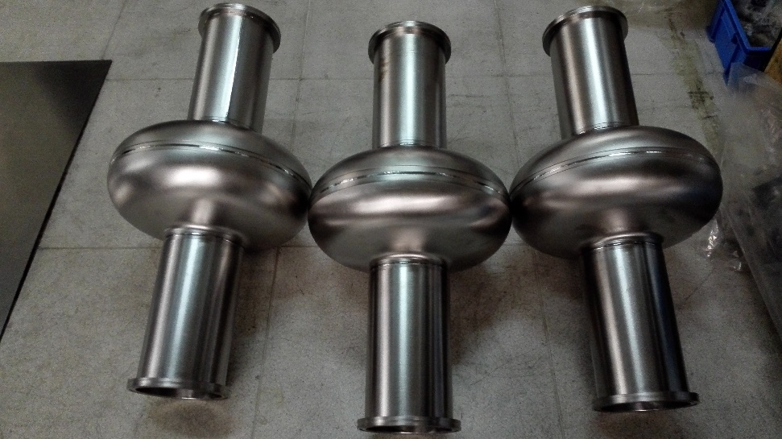
650MHz cavities
Three 650MHz single-cell cavities for CEPC finished fabrication, which are for N-doping.
One 650MHz single-cell cavity finished vertical test before N-doping: Q₀ > 5.1e10 at low Electric field. It verifies that the test method and equipment present can be used for high Q test.

Slide 21
3. Summary
Make sure Nitrogen enter into Nb?
Continue experiments of Nb sample to make sure that. Furnace at IHEP is always occupied (ADS cavity, ADS RFQ, C-band accelerating tube, high fault rate……), so there’s very little time left for me. High cost of AES, SIMS should be considered.
Build EP facility?
For all CEPC cavities (both 650MHz and 1.3GHz), EP is necessary no matter N-doping or not. Research of EP is underway in cooperation with company. EP facility costs more than 2 million Yuan, which is just funded by other program. Operation and maintenance are also important.
Helium cost of Vertical tests?
More than 150,000 ￥ once. If using refrigerator to produce Liquid Helium, high electricity fee (~30,000￥ once).

Slide 22
3. Problem and solution: collaboration overseas
Collaboration with FNAL and JLAB. Song Jin and I will visit FNAL to study N-doping and EP.
We would like to bring cavities to FNAL, where to do N-doping, EP and vertical tests. But it costs 30,000$ per cavity.

Slide 23
Thanks for your attention!

