Slide 1
Prototype of the twin-aperture superconducting FF quadrupole
Ivan Okunev, BINP
September 2, 2016

Slide 2

C-Tau IR design parameters
Crossing angle is 2Ɵ = 60 mrad
Vacuum chamber in SC lens is at the nitrogen temperature
Soft upstream bending magnets and no SR at the IP
We have 23σ in X and 60σ in Y in first lens

Slide 3
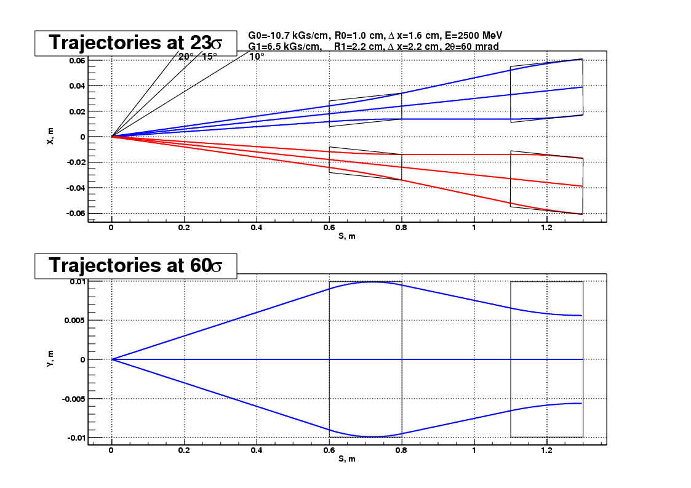
C-Tau IR Design

Slide 4
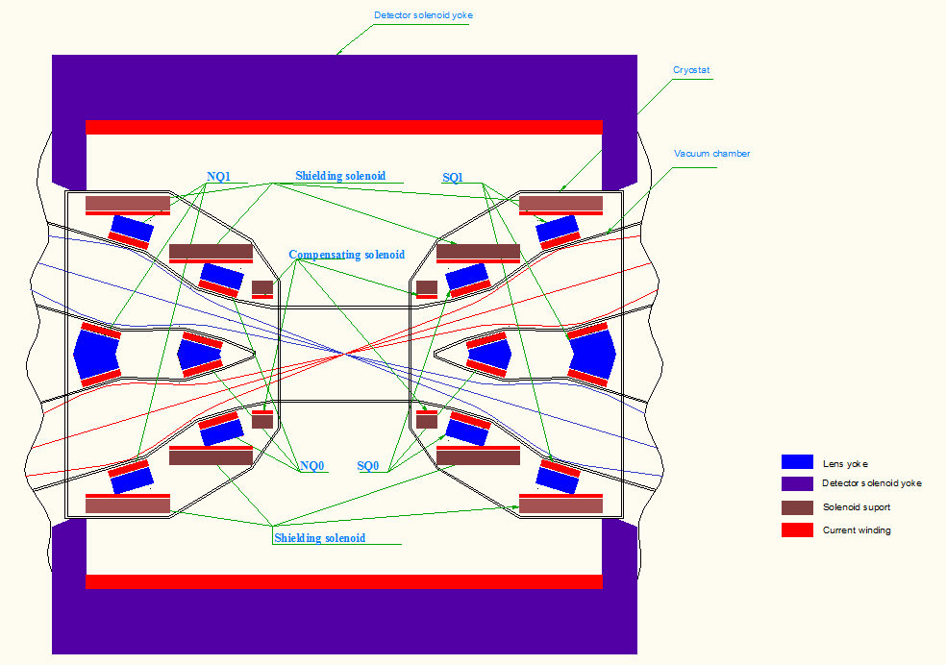
C-Tau IR layout in horizontal plane

Slide 5
C-Tau IR Parameters
 | Eff.length, mm | Azimuth, cm | Longitudinal field (kGs), or Gradient (kGs/cm) | Aperture radius, mm | ΔB/B or ΔG/G | Type
IP | ~ 0.6 mm | 0 cm | 10 kG | 40 mm | <1% | Interaction point
SС0 | ~ 100 mm | 45 cm | -45 kG | 45 mm | <1% | Superconducting solenoid
SSH1 | ~ 350-600 mm | 55 cm | -10 kG | - | <1% | Superconducting solenoid
SEQ0 (NEQ0) | 200 mm | 60 cm | -10.7 kG/cm | 10 mm | 1 - 5·10⁻⁴ | Superconducting double aperture quadrupole lens
SSH2 | ~ 700-900 mm | 85 cm | -10 kG | - | <1% | Superconducting double aperture quadrupole lens
SEQ1 (NEQ1) | 200 mm | 110 cm | 6.5 kG/cm | 22 mm | 1 - 5·10⁻⁴ | Superconducting double aperture quadrupole lens

Slide 6
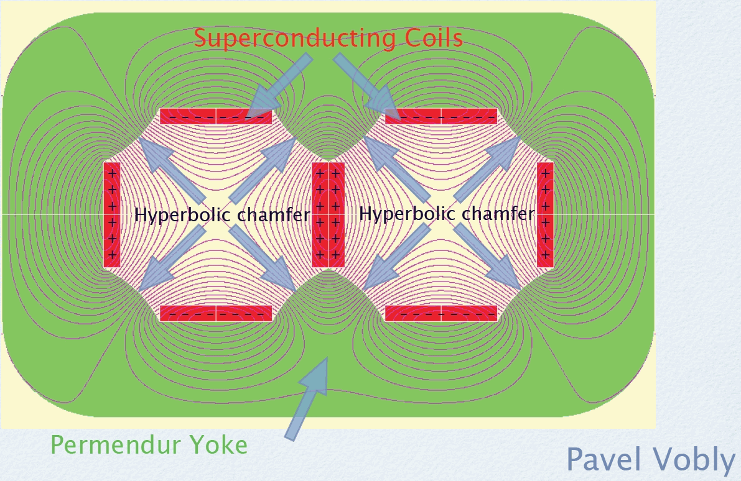
Scheme of a double-aperture lens

Slide 7
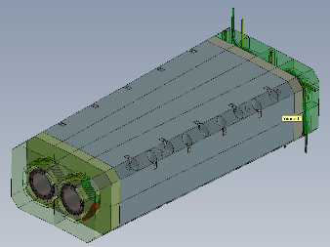
Calculation of the magnetic field
QD0 calculations in MERMAID
Harmonics of QD0 for different gradients at R = 1 cm
N | an | an | an
2 | -10.97 | -9.08 | -5.32
6 | -0.0038 | -0.0031 | -0.0019
10 | 0.0021 | 0.0018 | 0.0011
14 | 0.0006 | 0.00046 | 0.00027
18 | -2.2E-05 | -1.8E-05 | -1.1E-05
All 2D and 3D calculations were made by MERMAID
There is no yoke saturation at 11 kG/cm (vanadium permendure)
3D calculations give ∆G/G ±10⁻³ without chamfers
Chamfers are not optimized yet

Slide 8
QD0 gradient
QD0 harmonics for different energy

Slide 9
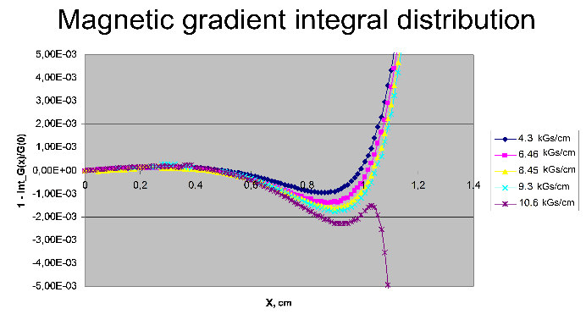
QD0 gradient

Slide 10
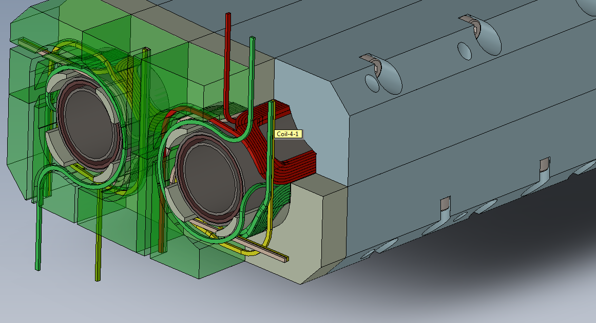
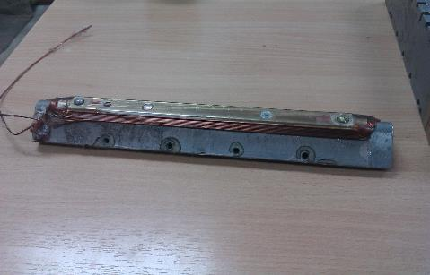
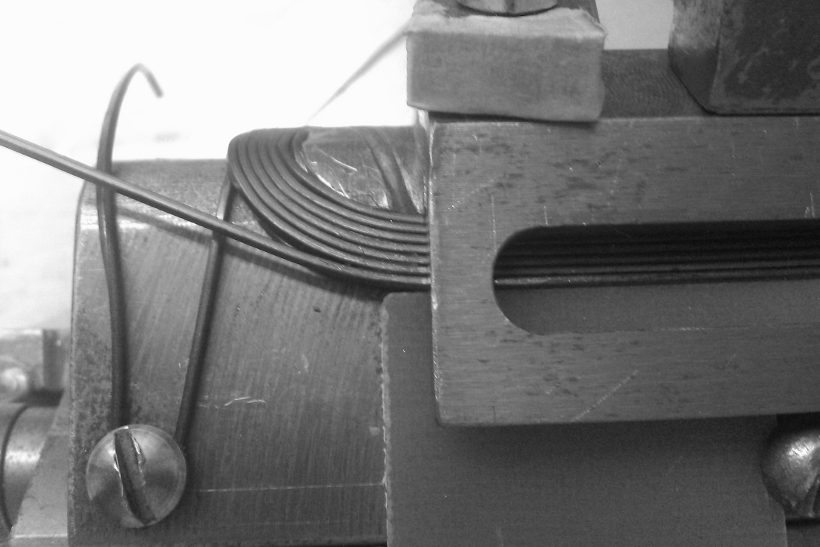
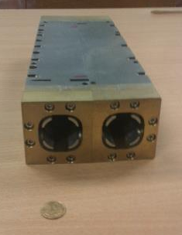
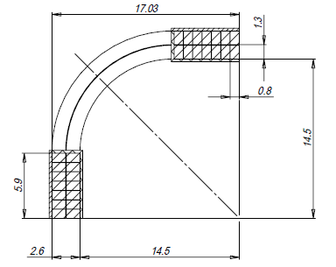
Prototype production

Slide 11
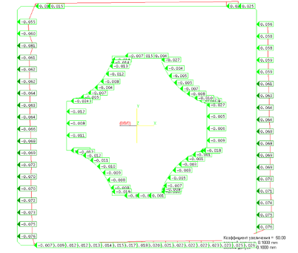
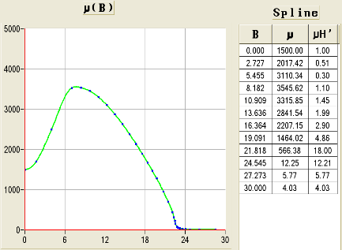
Materials
Saturation curve for Annealed Vanadium Permendur, MARMAID
Cu/Sc Ratio (nom) | Bare Size (mm) | Ins. Size (mm) | RRR | Ic Amps (min) | Length (m) | Spool ID
1.35:1 | 1.20x0.75 | 1.28x0.83 | >70 | 510@7T | 2,730 | 917
Maximum current at 2.5 GeV is 720 A
Maximum field in yoke at 2.5 GeV is 2 T
NbTi rectangular superconductor

Slide 12
Problems and solutions
Conclusions for the first prototype
It is possible to manufacture the yoke and poles with required accuracy
Manufacture of the two-layer saddle shaped coil was unsuccessful
It is difficult to ensure the accuracy and rigidity of construction

Slide 13
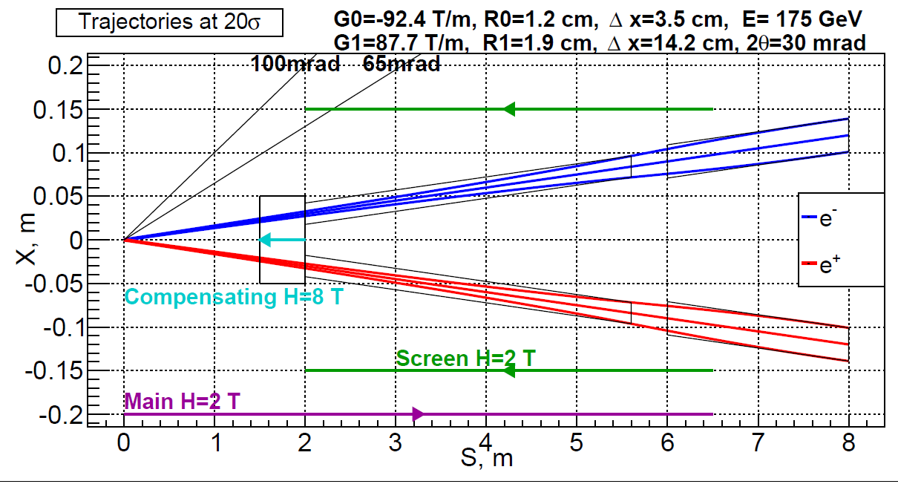
FCCee Final Focus layout
Final quads
Main detector solenoid
2
1
Quad screening solenoid
4
3
Compensating solenoid
1 – Half of main solenoid length ( 1 m)
2 – Length of compensating solenoid (0.7 m)
3 – Overlap of compensating and screening solenoids (5 cm)
4 – Length of screening solenoid ( 3.95 m)
Transverse half size:
- compensating solenoid - R = 0.1 m
- screening solenoid - R = 0.15 m

Slide 14
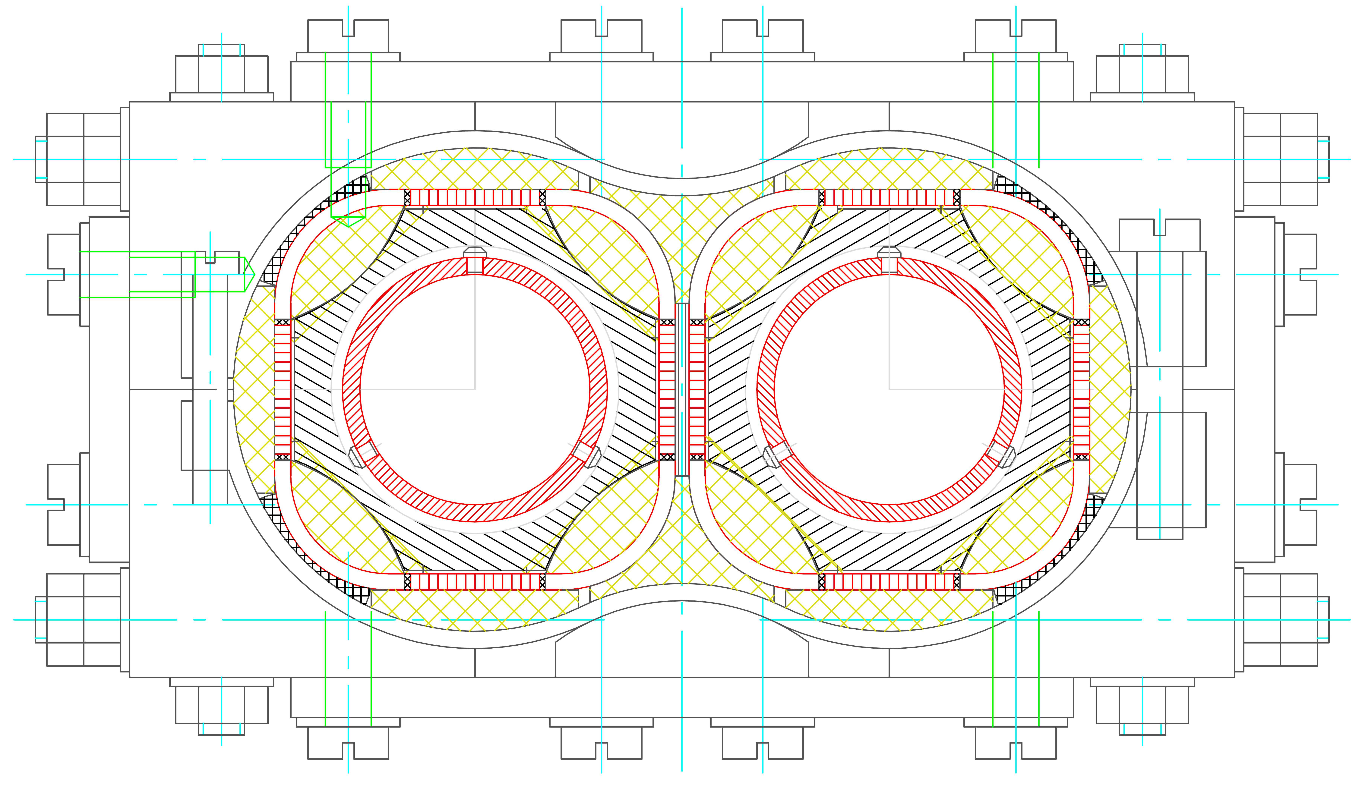
QD0 design, second edition

Slide 15
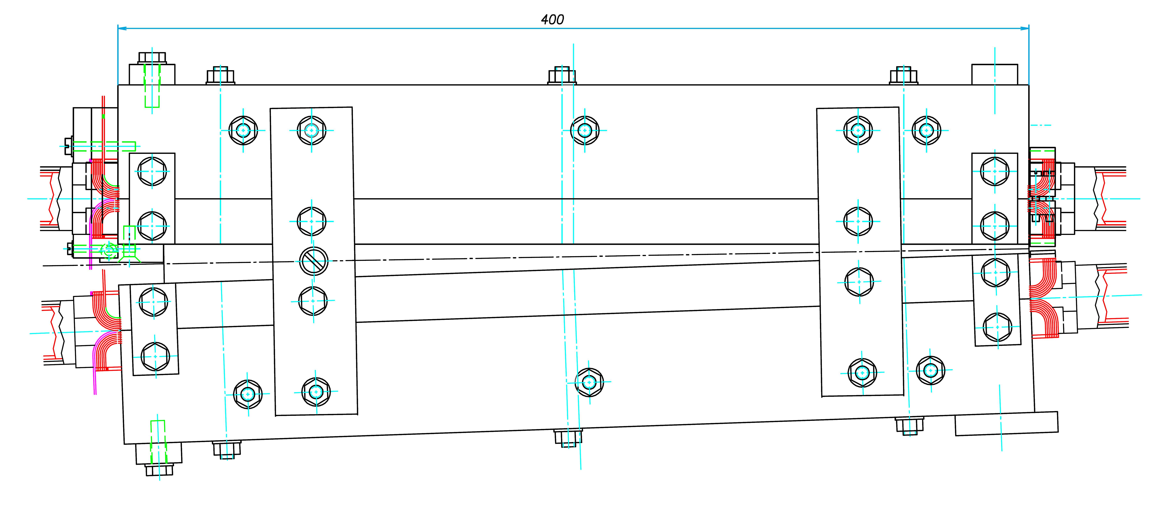
QD0 design, second edition

Slide 16
Parameters and materials
The height of this lens is 6 cm, and the width at the inlet of the lens is 5 cm (one part).
The inner diameter of the aluminum vacuum chamber is 2.6 cm.
Current 1000 amperes provides gradient 9.5 kG / cm.
Superconducting wire is a rectangular tavern size of 0.8 × 1.4 mm.
Stored energy 400 joules. Winding temperature superconductivity at failure increased only a few degrees.
NbTi rectangular superconductor
Cu/Sc Ratio (nom) | Bare Size (mm) | Ins. Size (mm) | RRR | Ic Amps (min) | Length (m) | Spool ID
1.35:1 | 1.20x0.75 | 1.28x0.83 | >70 | 510@7T | 2,730 | 917

Slide 17
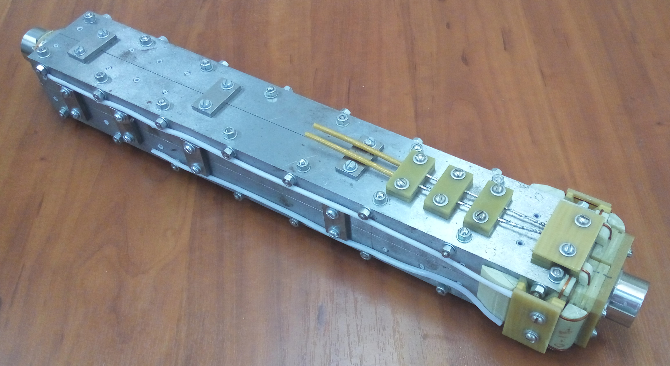
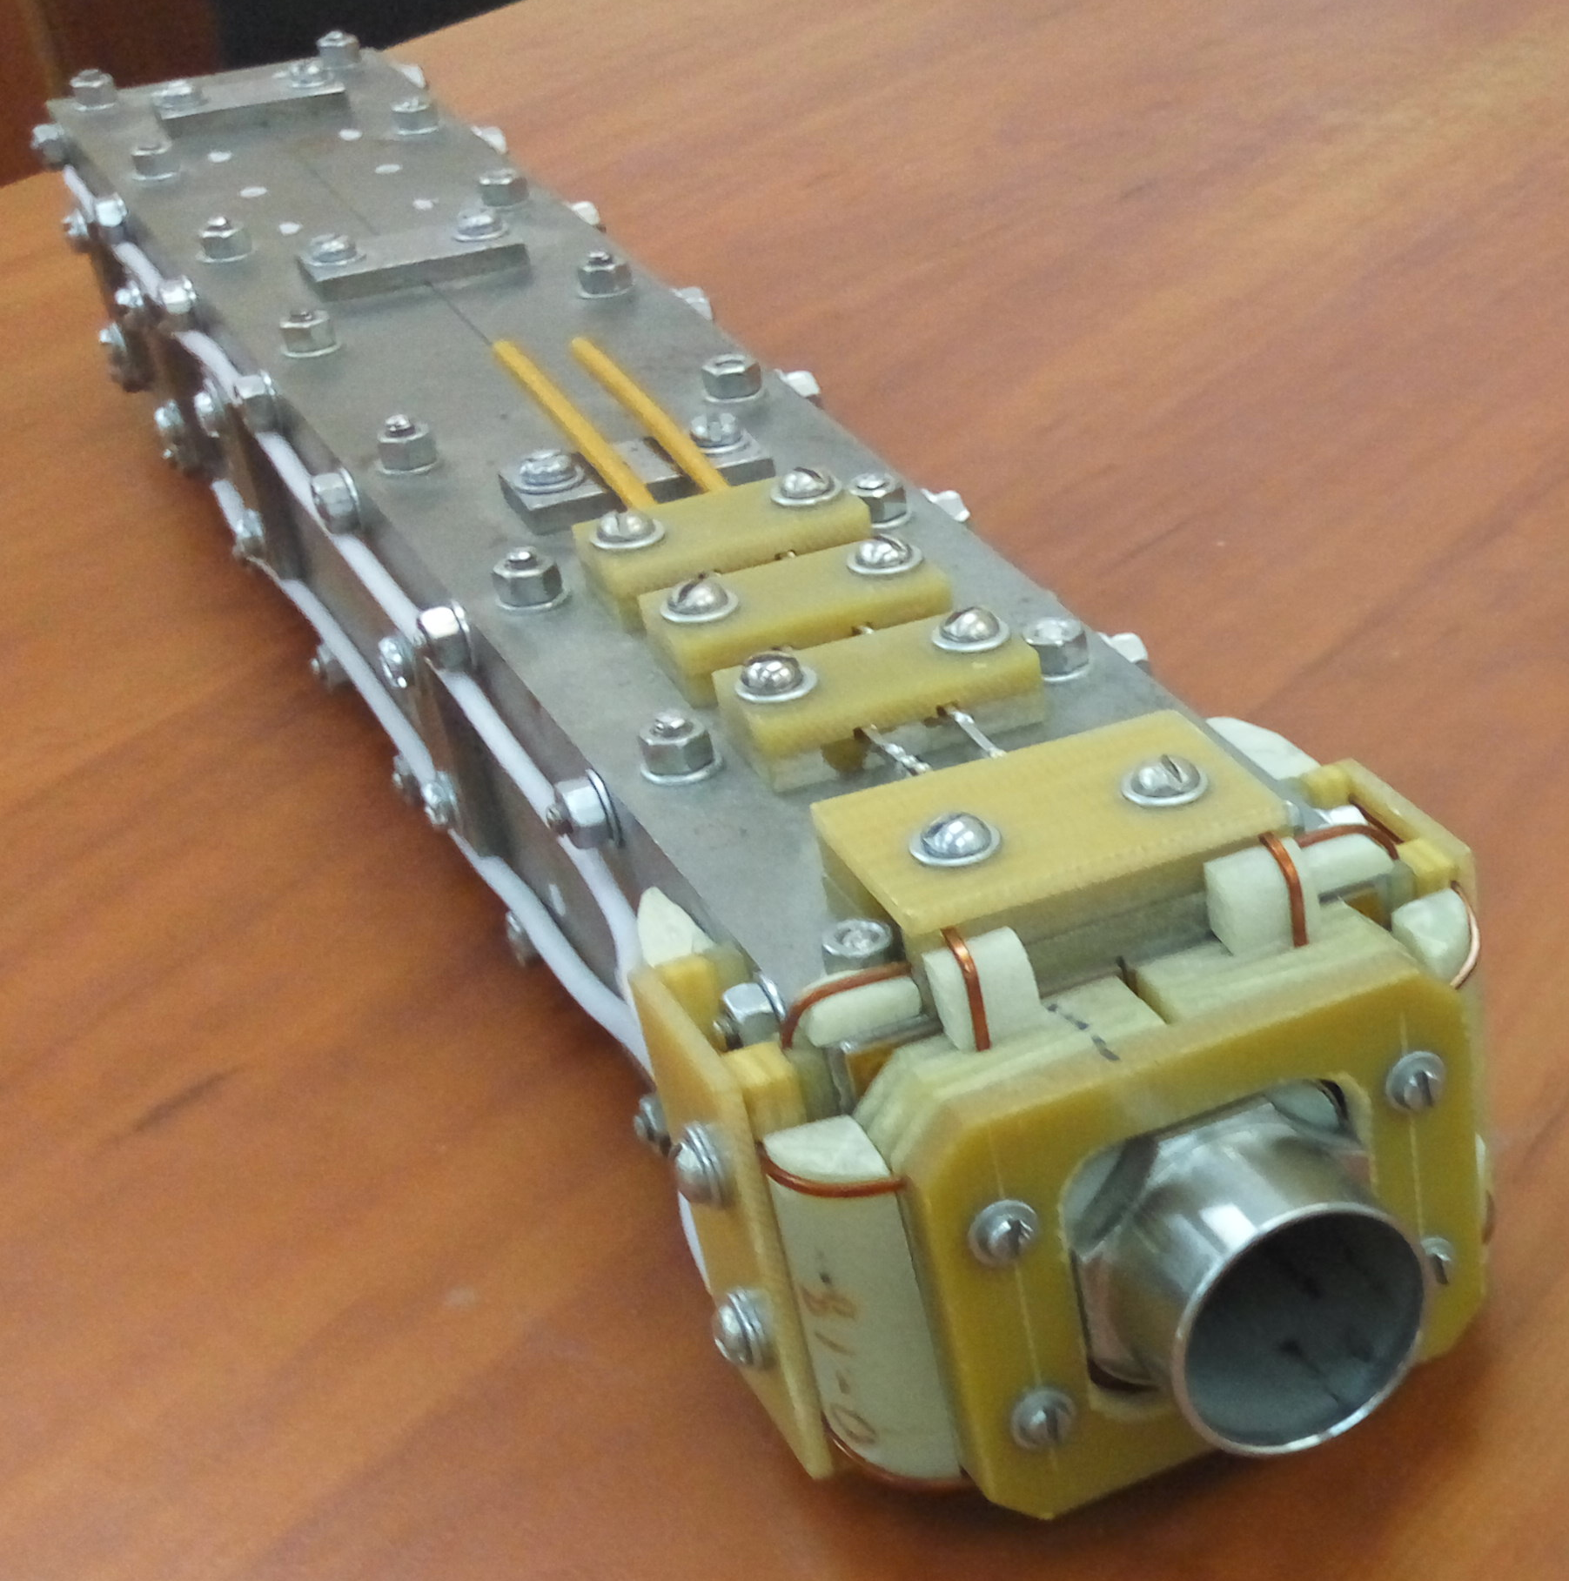
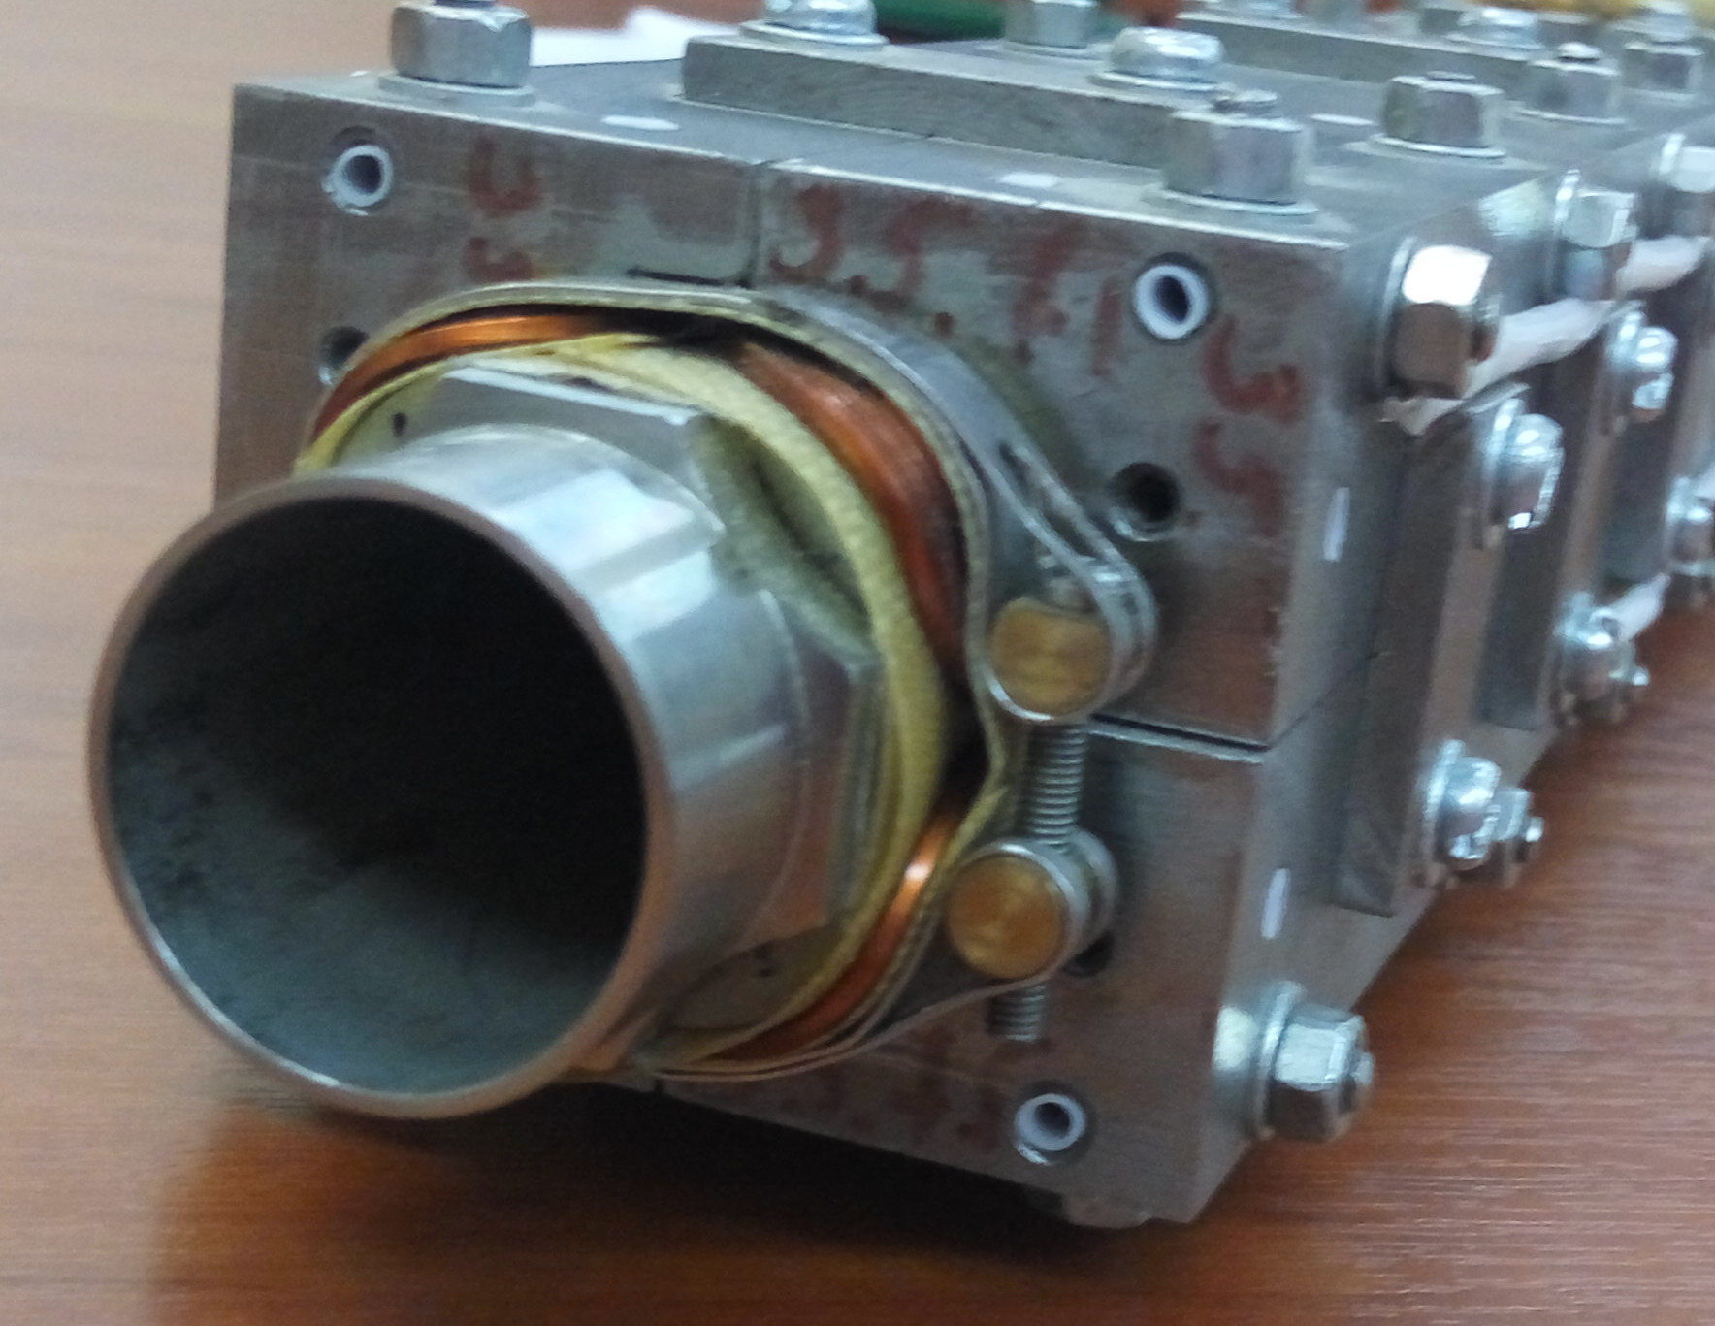
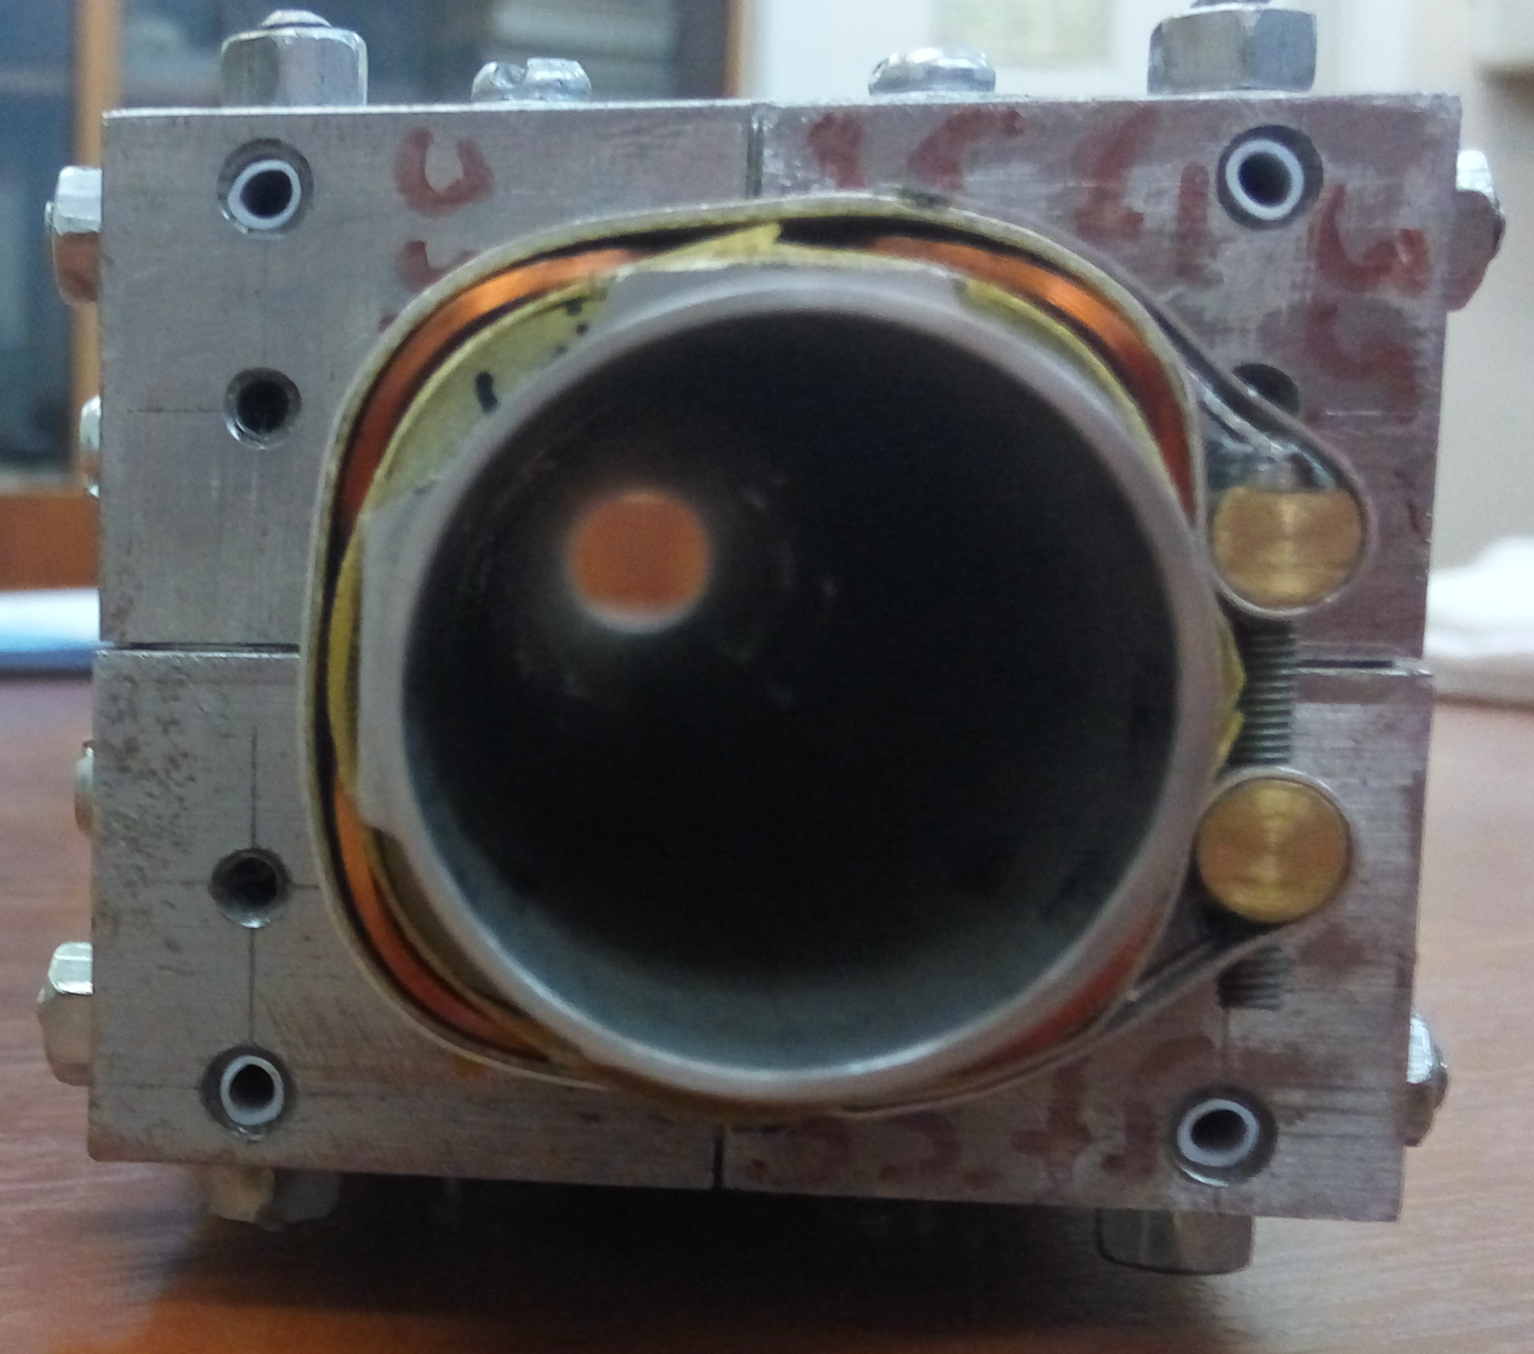
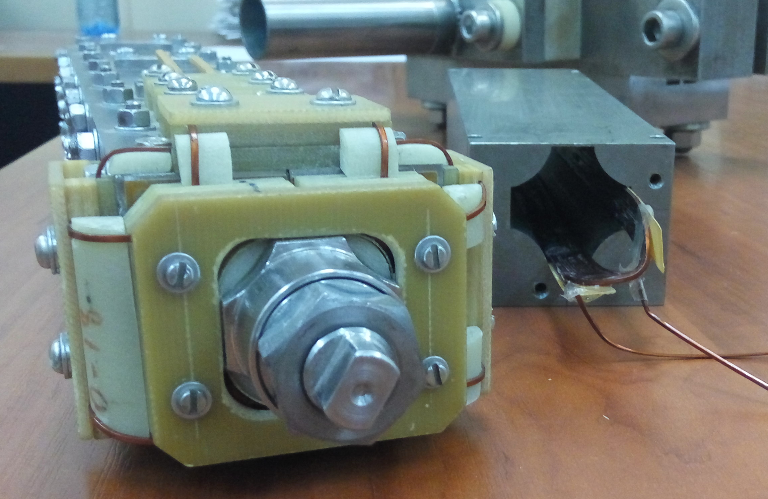
QD0 design, second edition
The figure shows the structure of a single lens. To obtain the two-aperture lens we need to join on the right side exactly the same lens.

Slide 18
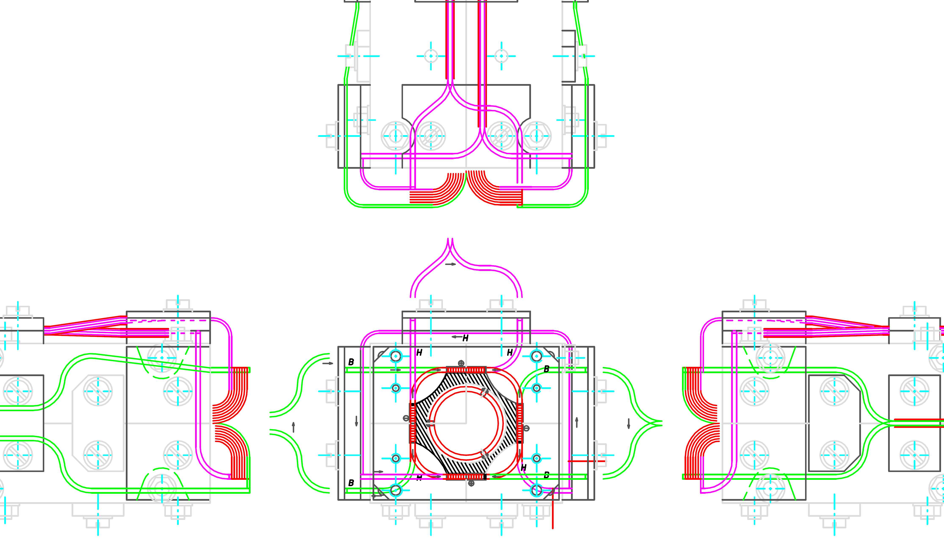
QD0 design, second edition
The figure shows the structure of a single lens. To obtain the two-aperture lens we need to join on the right side exactly the same lens.

Slide 19
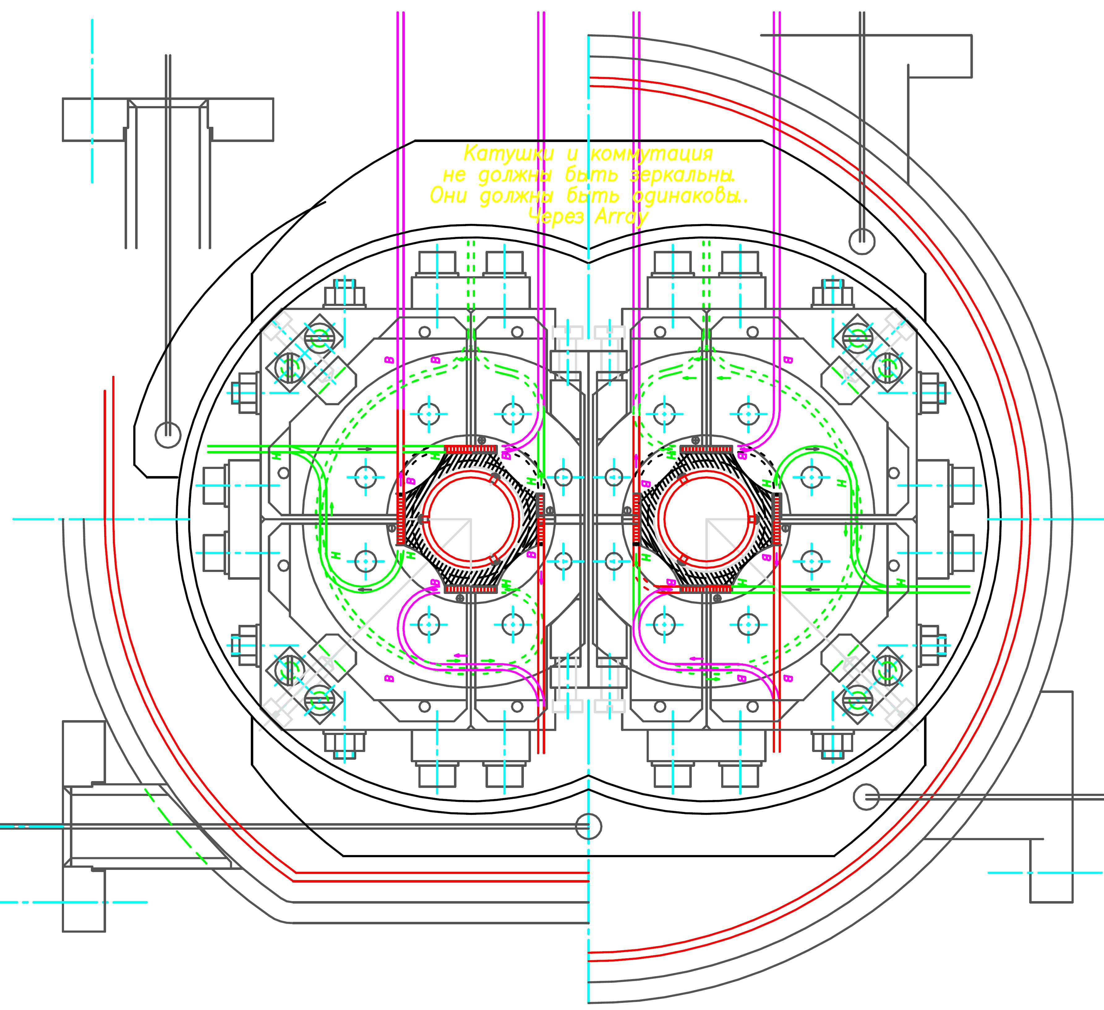
QD0 cryostat design

Slide 20
Tests
Cu/Sc Ratio (nom) | Bare Size (mm) | Ins. Size (mm) | RRR | Ic Amps (min) | Length (m) | Spool ID
1.35:1 | 1.20x0.75 | 1.28x0.83 | >70 | 510@7T | 2,730 | 917

Slide 21
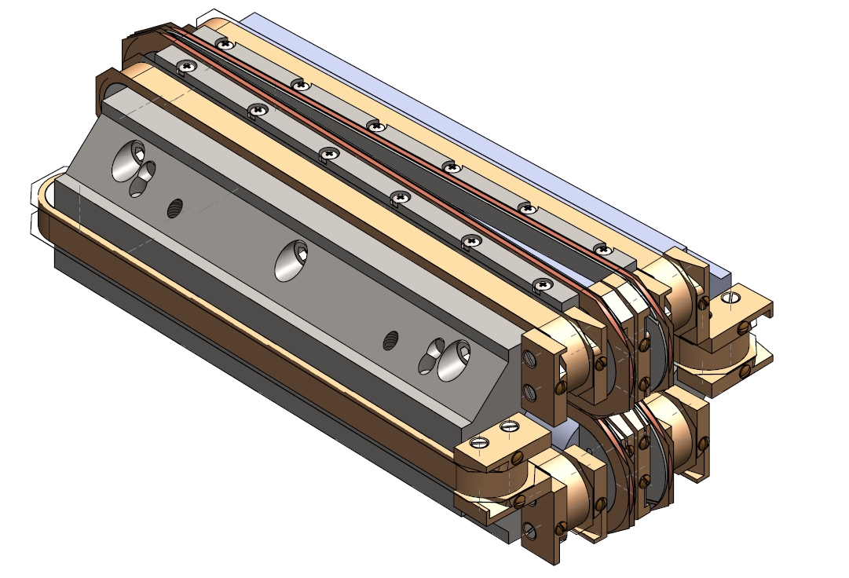
QD0 design type 2 (general view)
New design:
Coils more easy in manufacture
Yoke and poles have same shape
Round superconducting wire of Ø 0.75 mm
Maximum current of 400 A

Slide 22
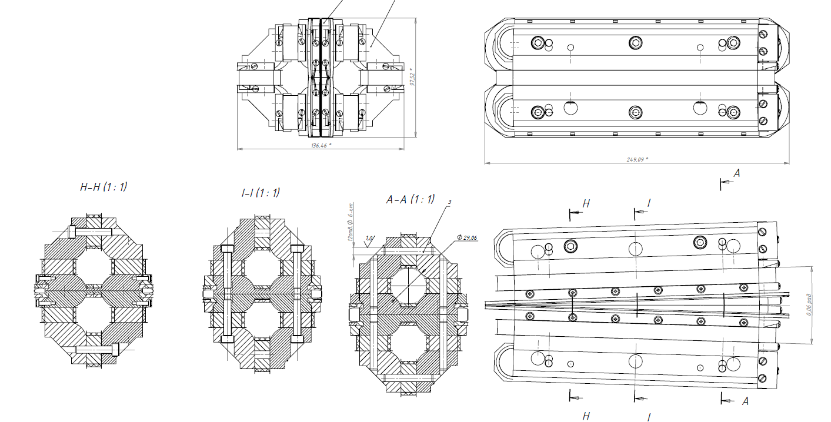
QD0 design type 2(drawings)

Slide 23
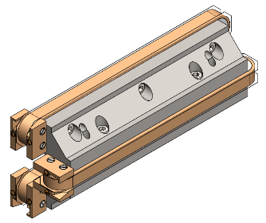
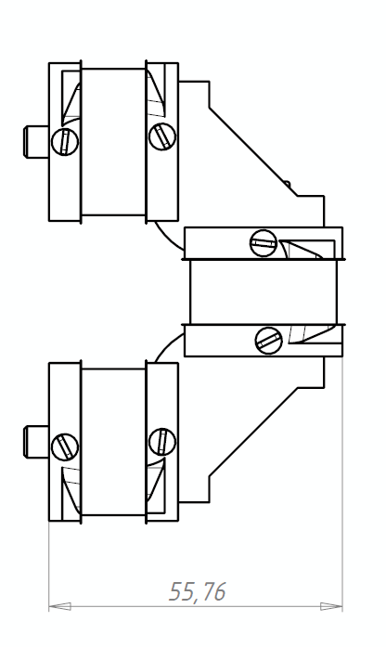
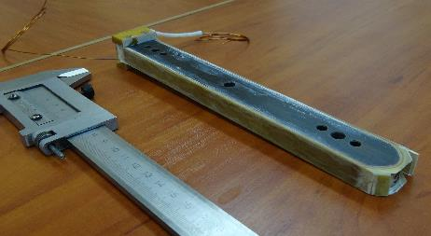
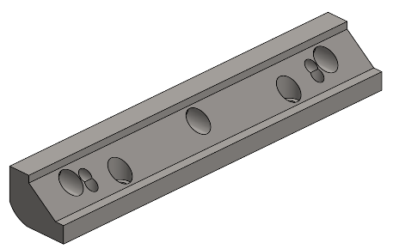
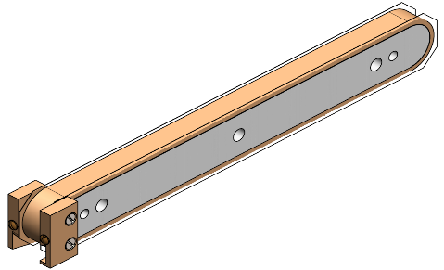
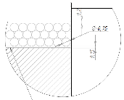
QD0 design type 2(first coil)

Slide 24
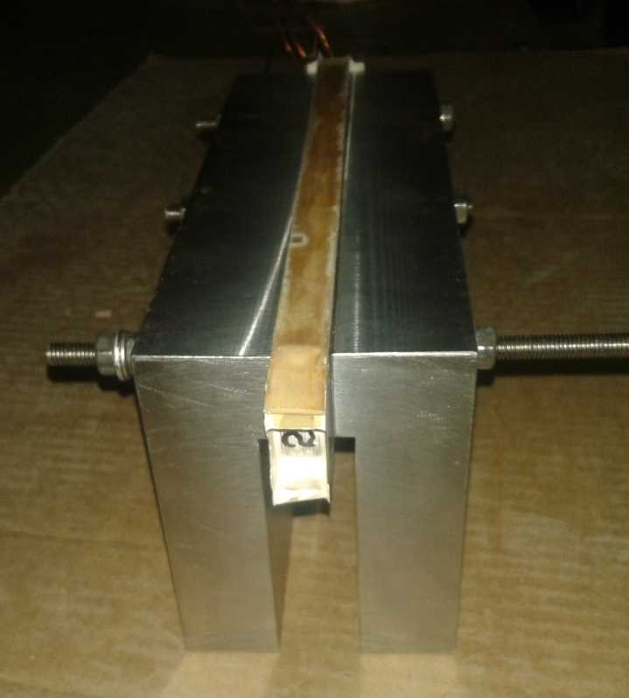
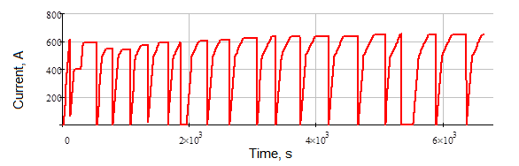
QD0 design type 2
Maximum current in the coil is 720 A

Slide 25
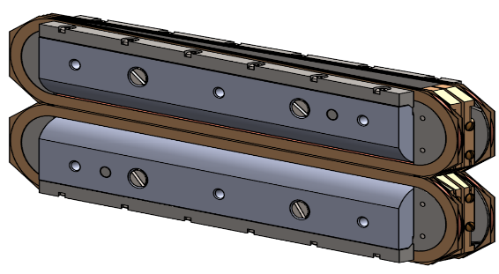
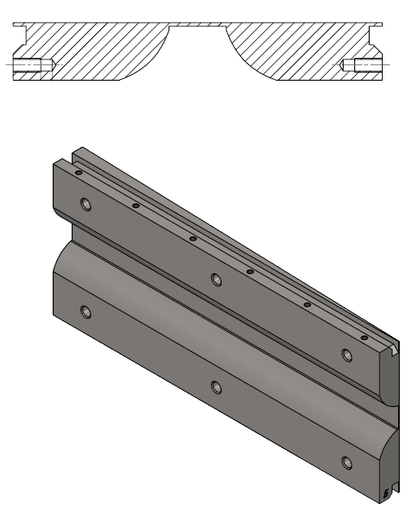
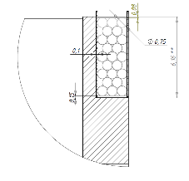
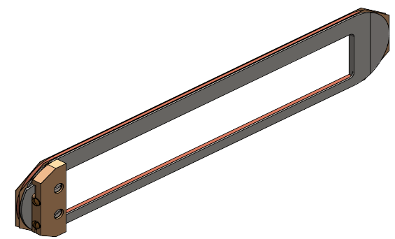
QD0 design type 2(second coil)

Slide 26
Status
Design of the SC quadrupole is completed
We have all materials for the quadrupole manufacture
We are ready manufacture the winding tool for the all types of the coil
The yoke and the second coil is under production
Test of the first type coil completed
Test of the second type coil – October

Slide 27
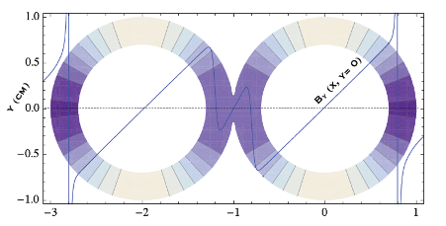
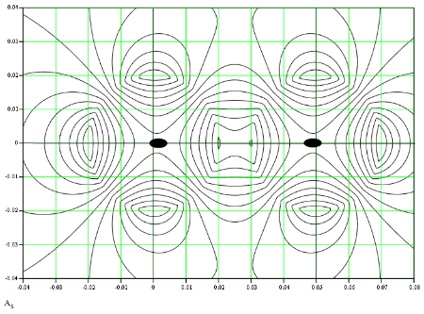
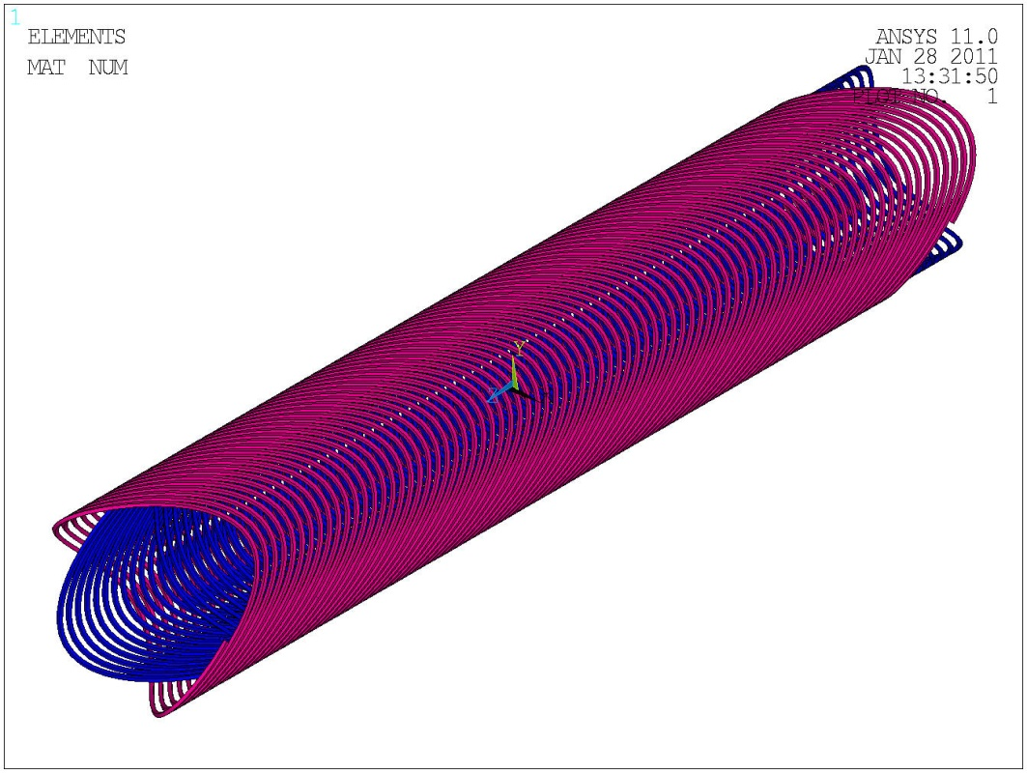
Basic layout: double helix qudrupole
The quadrupoles are done according the double helix principle. This lay-out allows to modulate the winding introducing suitable multipole corrections. The overall structure is compact and the effect of coil ends on field quality is minimal (wrt more conventional designs)

Slide 28
INTERACTION REGION DESIGN FOR THE SUPER-B FACTORY

Slide 29
INTERACTION REGION DESIGN FOR THE SUPER-B FACTORY

Slide 30
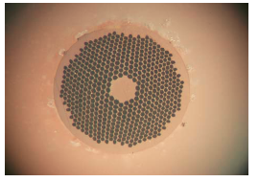

The superconducting wire
Preliminarly the sc wire chosen for these coils if a NbTi multifilamentary wire already involved in CMS conductor. The diameter is 1.28 mm; the Cu/SC ratio is 1.1

Slide 31
Thank you for your attention

Slide 32
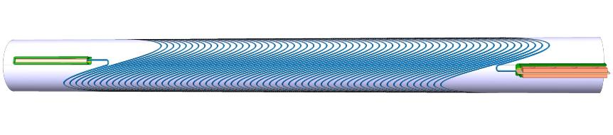
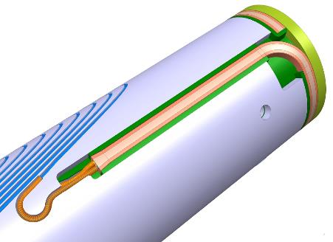
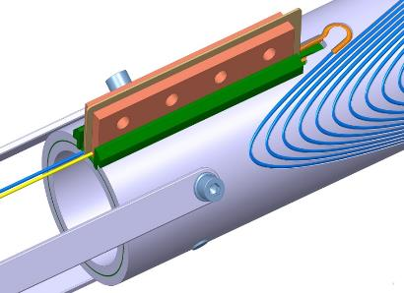
Actively developing double-aperture lenses
Cosine stile quadrupole lens

Slide 33
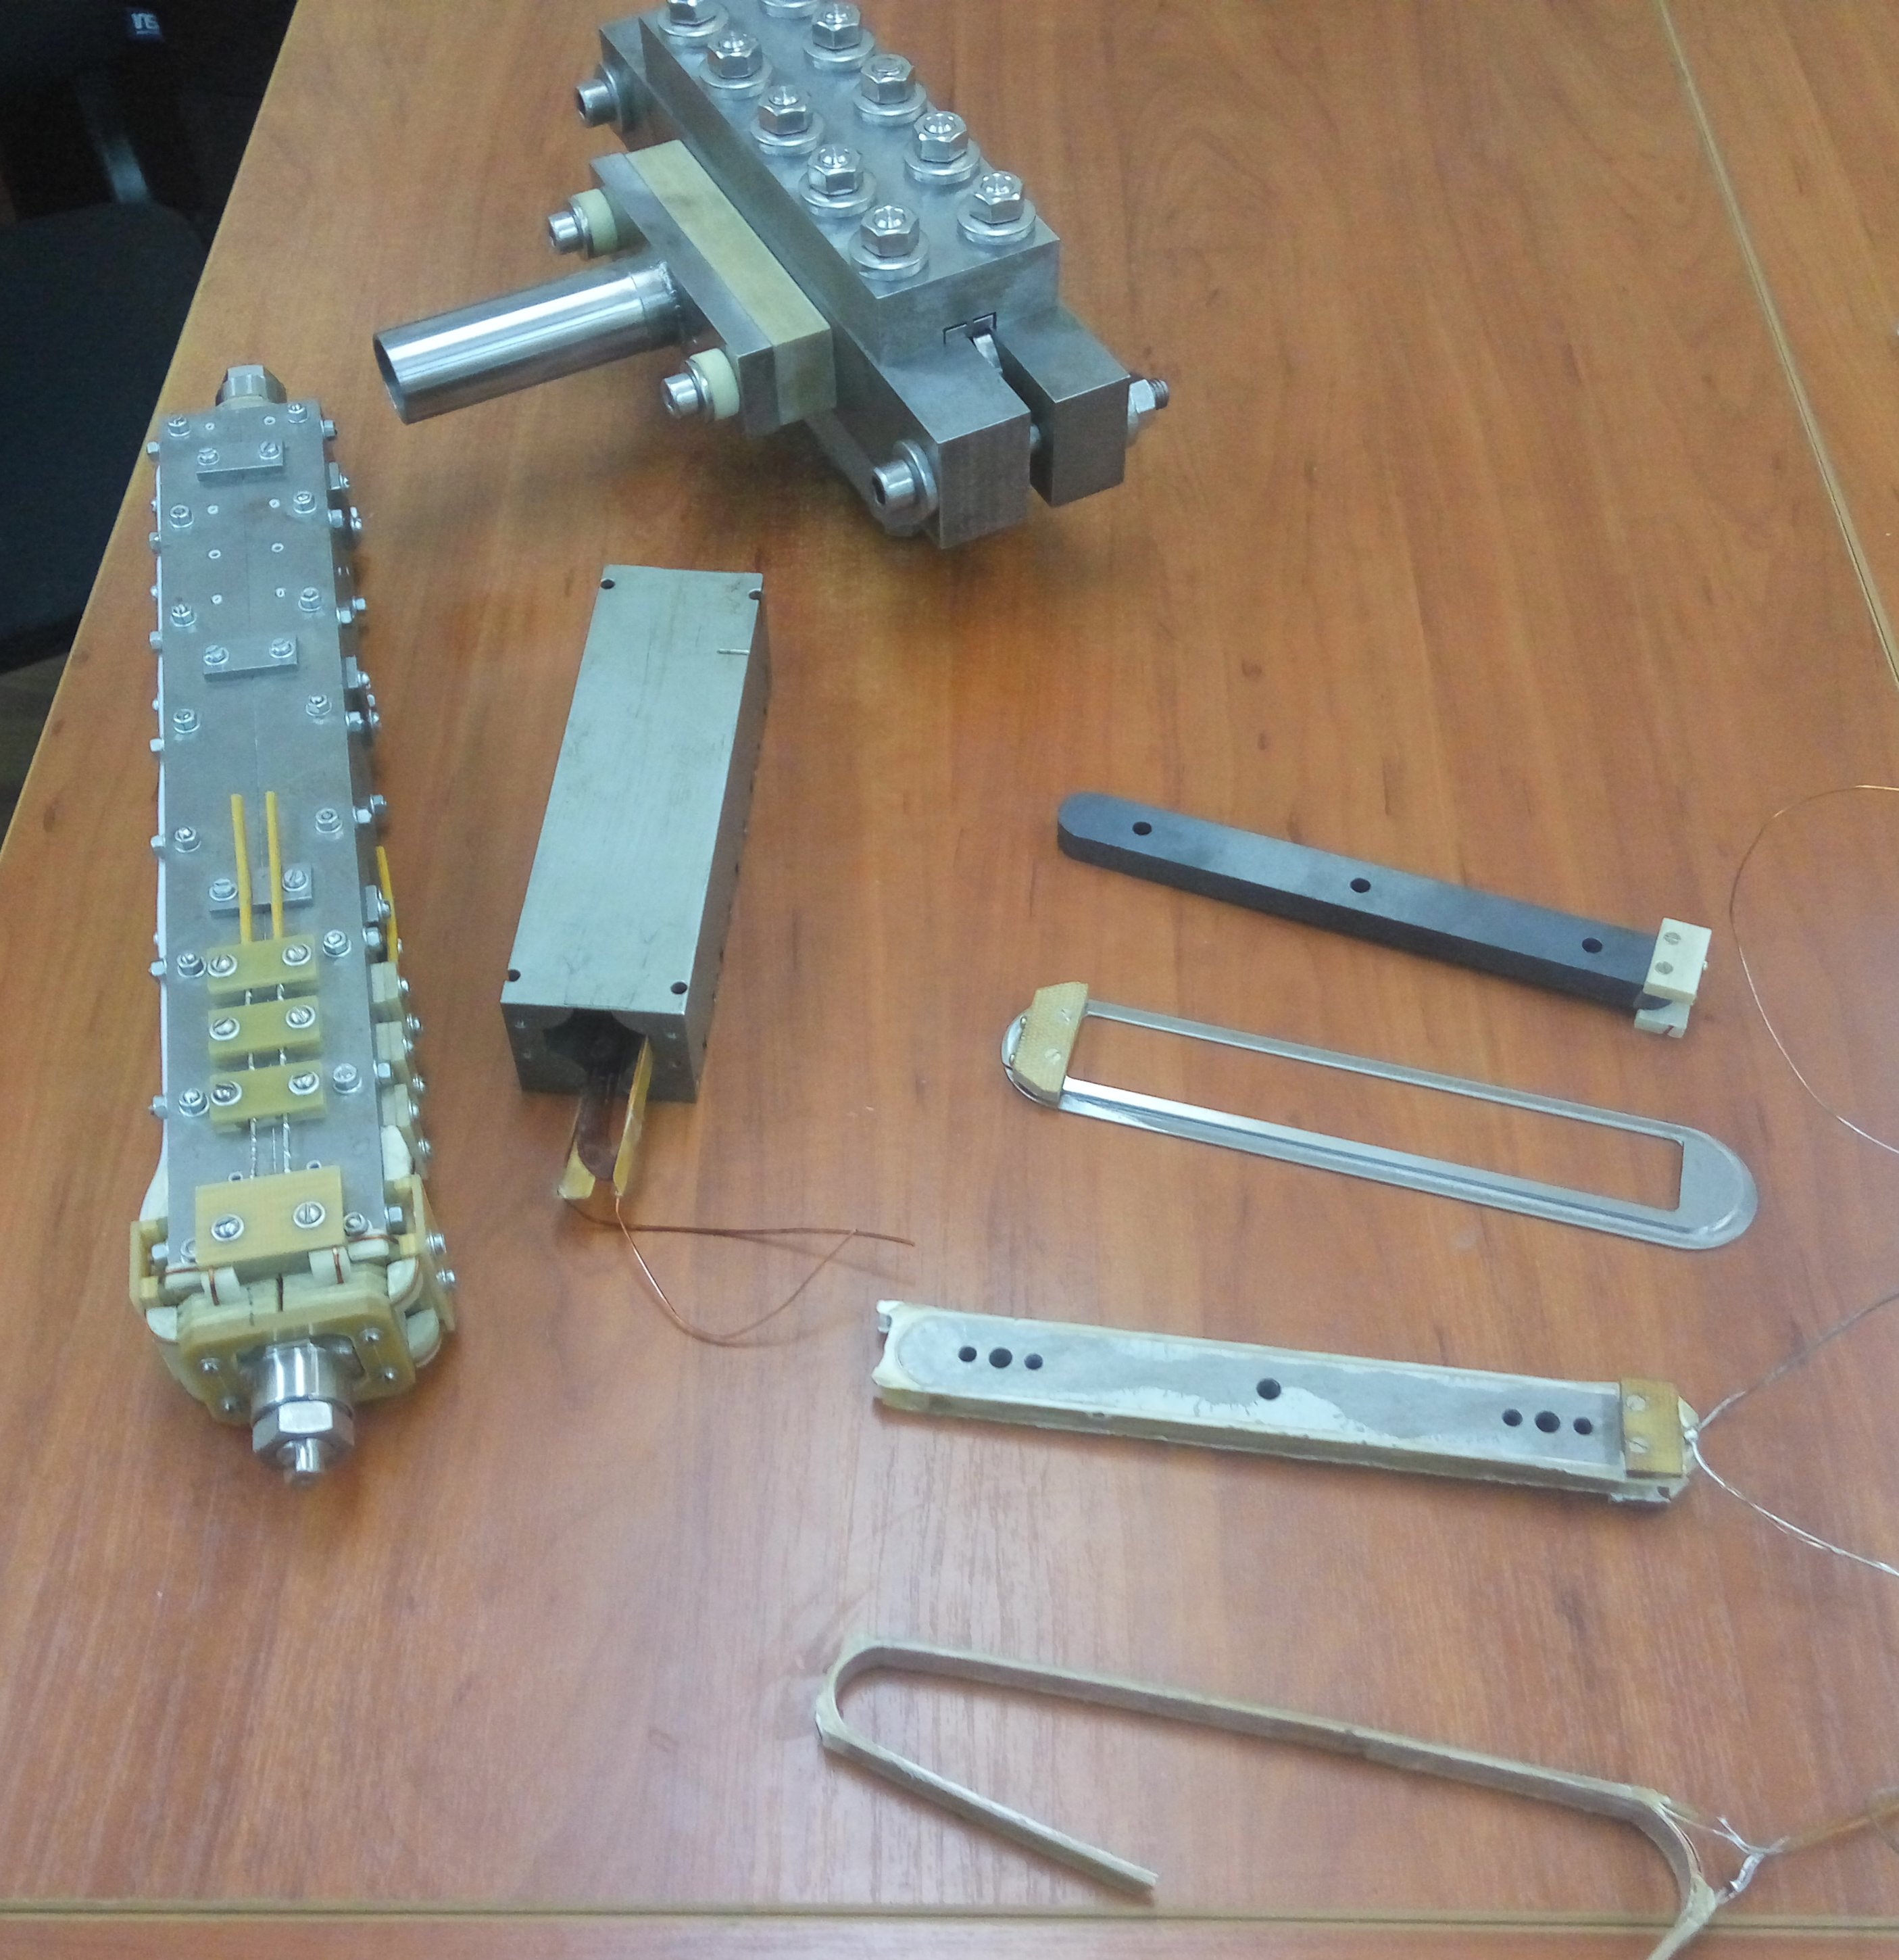
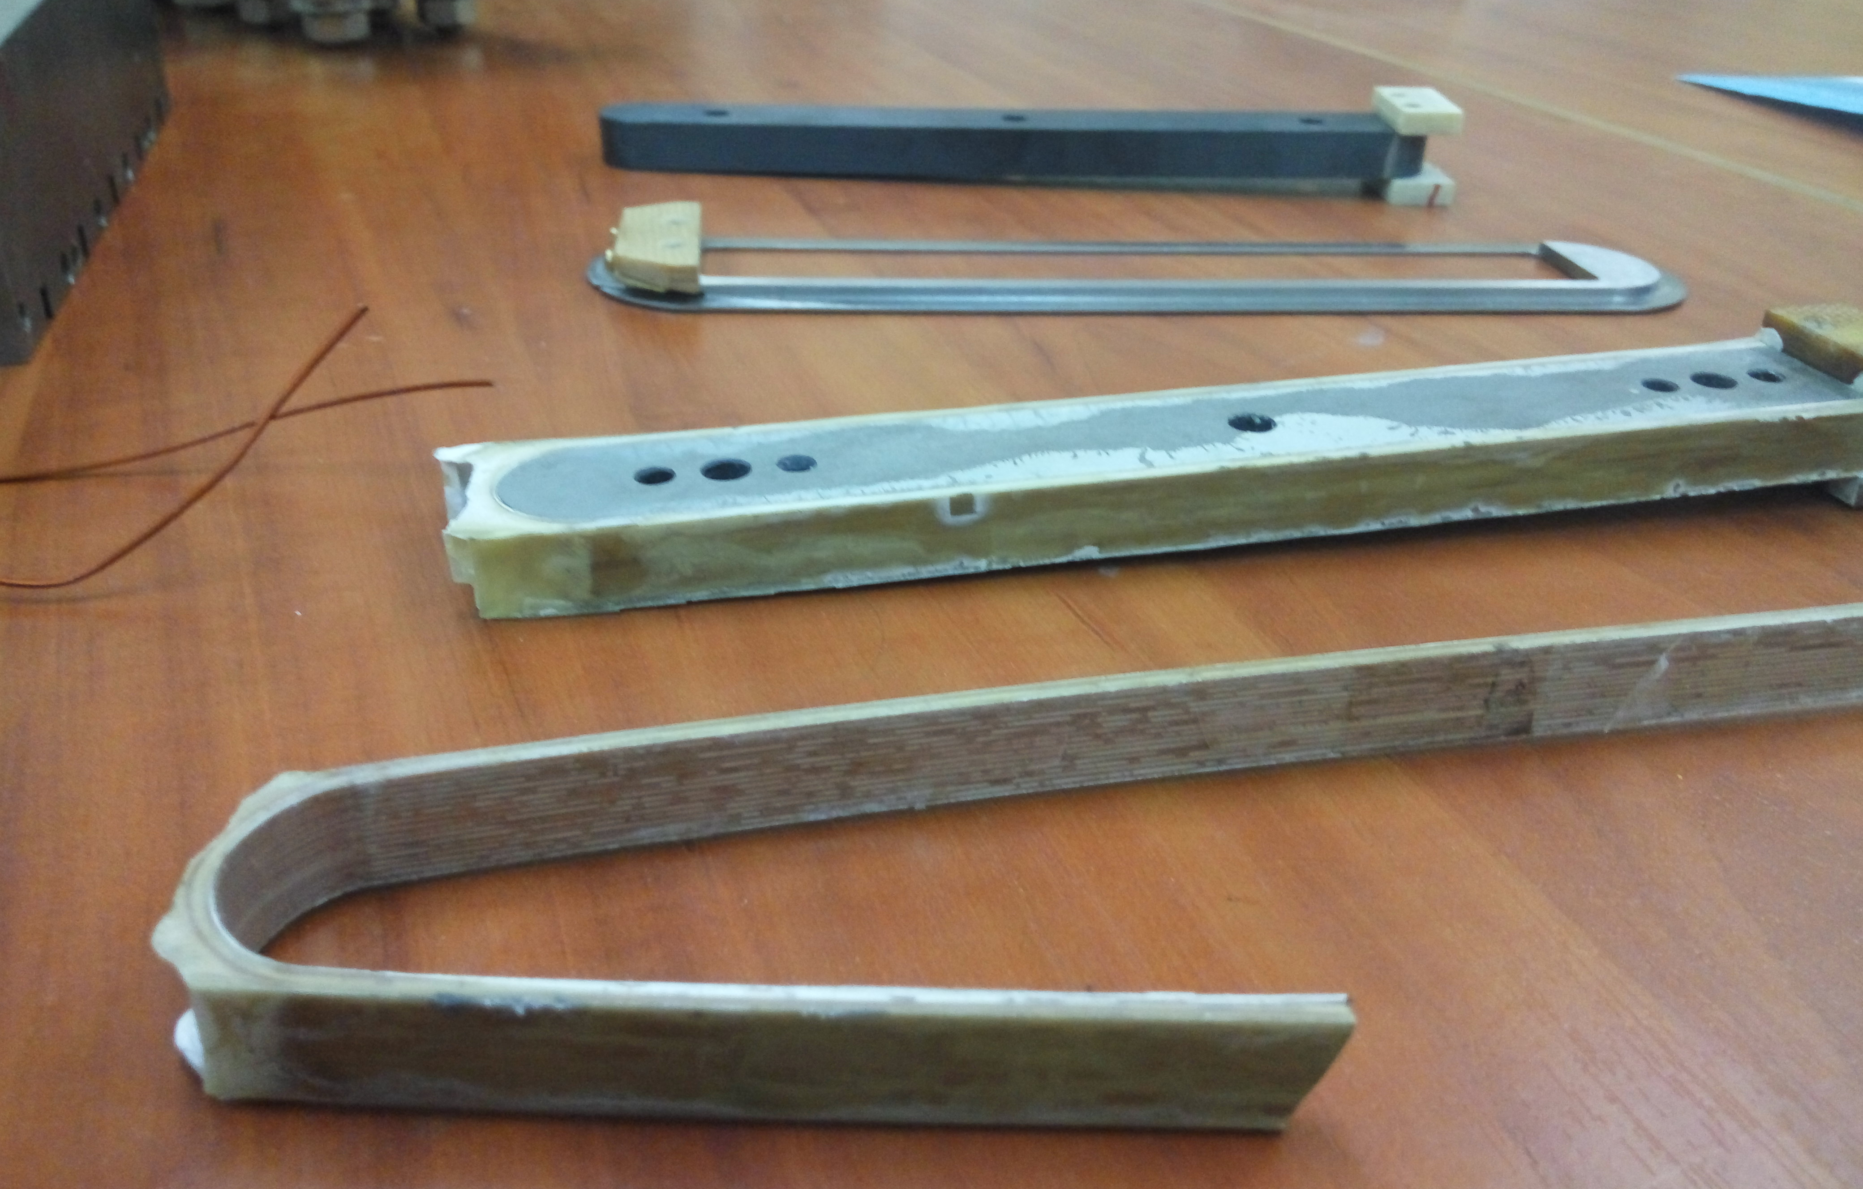

Slide 34
CEPC-SPPC Final Focusing
Preliminary Conceptual Design

