Slide 1

Lattice QCD:
Flavor Physics and Spectroscopy
Takashi Kaneko (KEK)
XXVIII International Symposium on Lepton Photon Interactions
at High Energies, 7 – 11 Aug. 2017 @ SYSU, Guangzhou, China

Slide 2
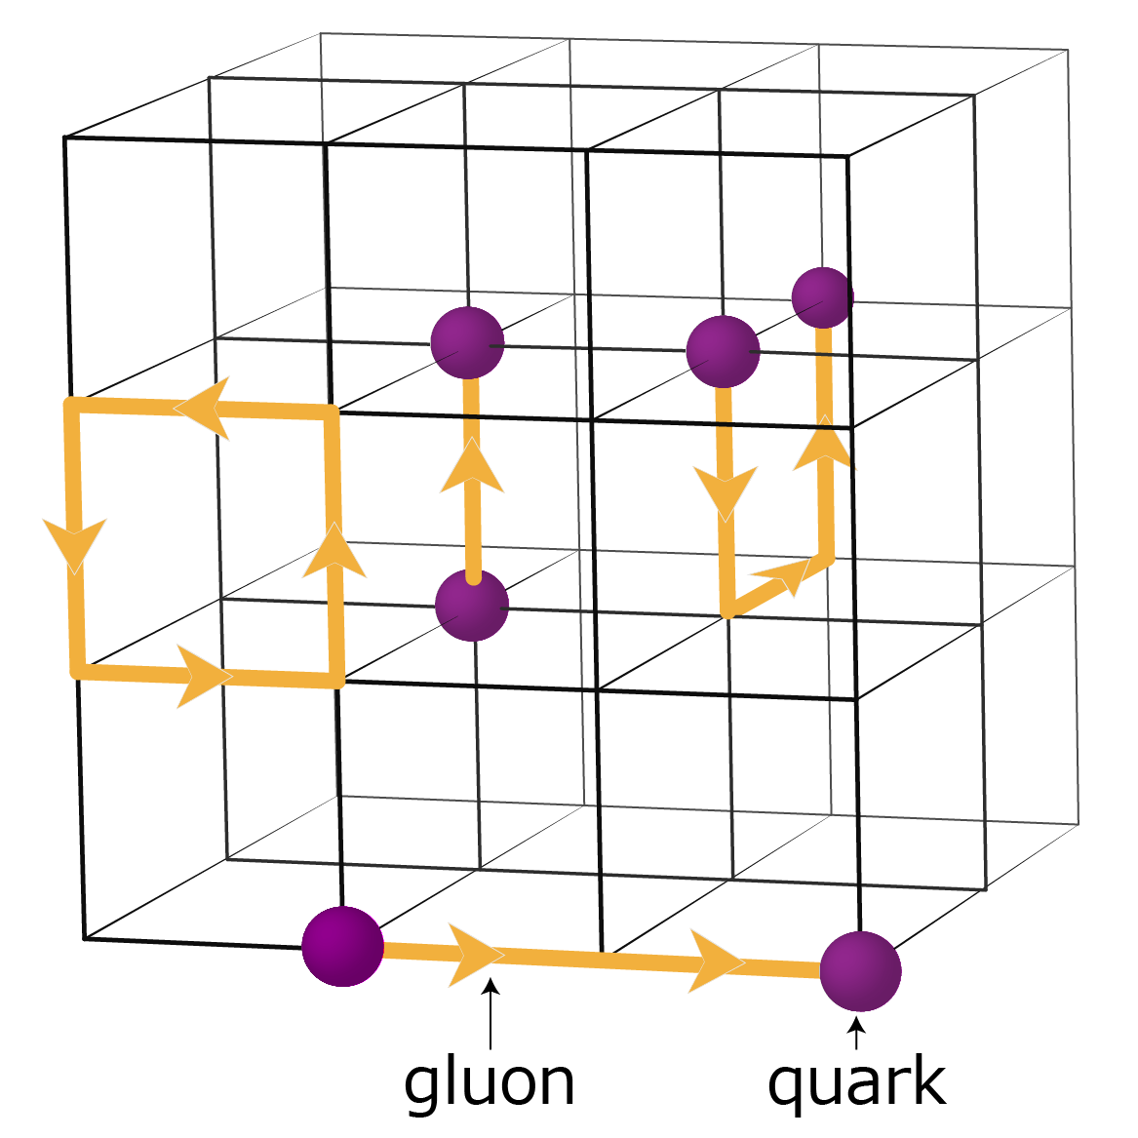
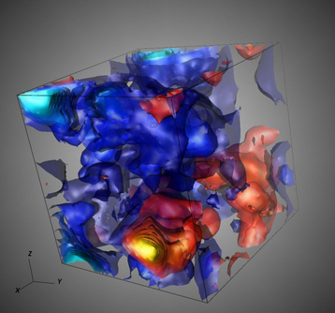
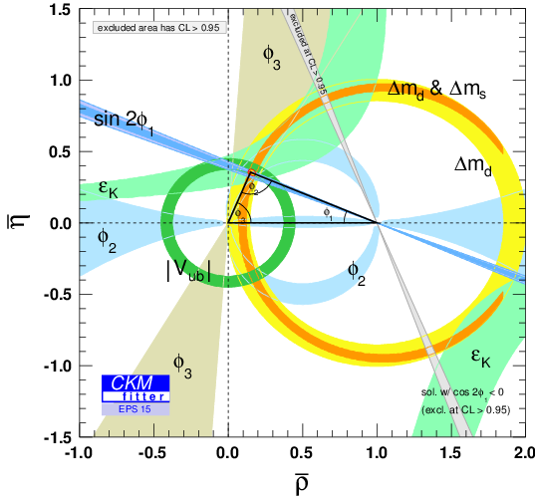
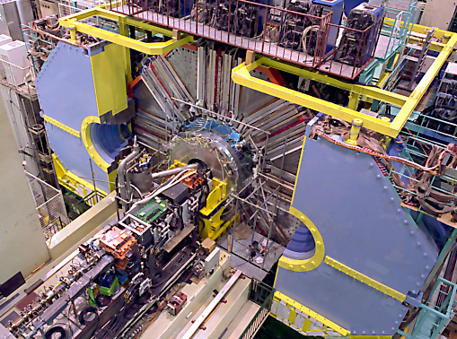
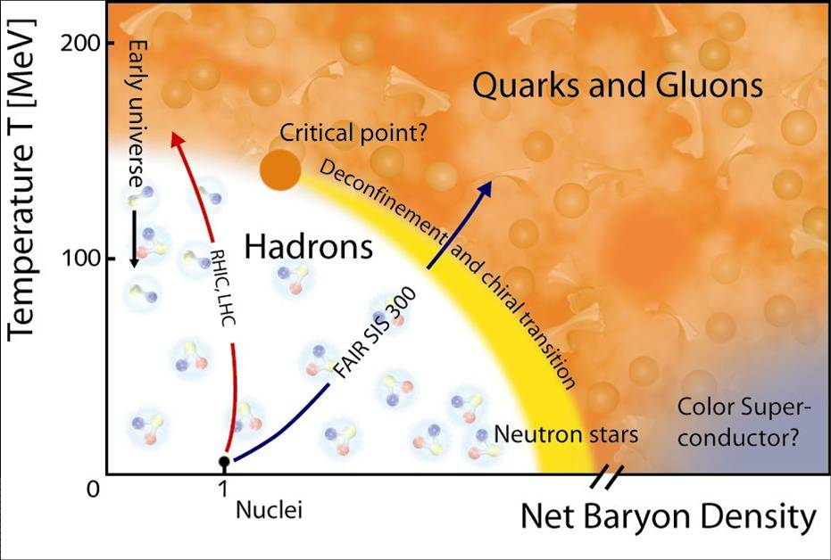
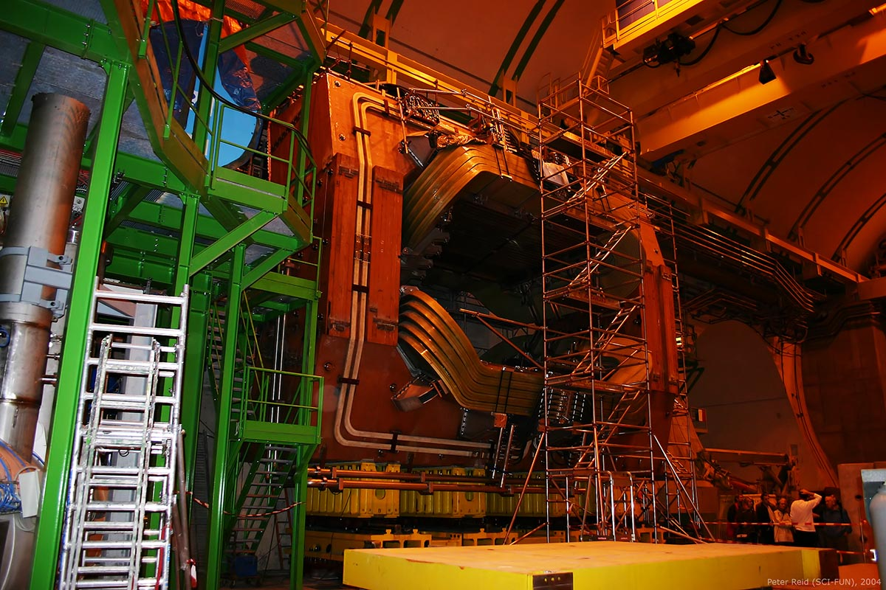
lattice regularization of QCD
1
…
control of stat. and sys. uncertainties
finite a, L, unphysical m_{u}=m_{d}, m_{b}, …
subjectively selected highlights
talk by Heng-Tong DING

Slide 3
1. Hadron Spectroscopy

Slide 4
stable / ignoring decays
interpolating fields w/ given quantum #’s
bb: Wurtz et al. ‘15
ccq: Perez-Rubio et al. ‘15
2017
impressive agreement w/ expr’t / guide for “yet un-observed”

Slide 5
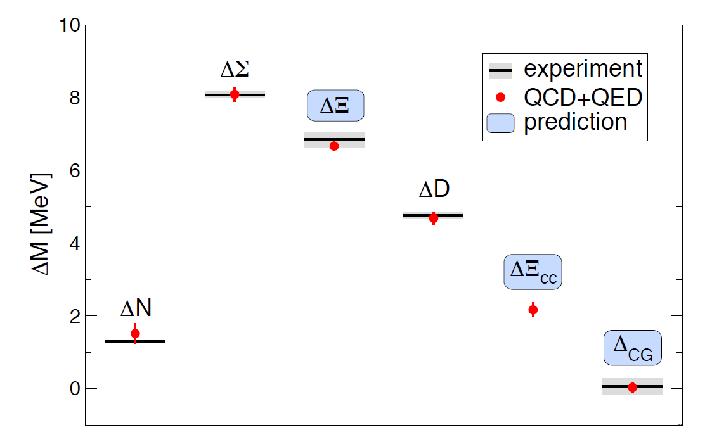
isospin splittings
‰ level needed ⇒ kaon, g-2 HVP
C boundary condition: Polley ‘93
m_{u} ≠ m_{d} : straightforward
EM corrections
⇔ QED on finite/periodic lattice
boundary condition / photon mass, field ⇒ Patella @ Lattice’16
QCDSF ‘15
BMW ‘15
1.4 ‰ n-p splitting reproduced w/ different QED implementations

Slide 6
unstable particles
finite V multi-particle state ≠ V=∞ in/out state
strong phase lost!
Miani-Testa ‘90
lattice correlator does contain information on interaction!
A
B
scattering matrix encoded in finite V energies
⇒ Lüscher ’86, ’91
potential ⇒ Ishii et al. ’07, HALQCD ‘12

Slide 7
ππ, ρ and σ
Lüscher method: successfully applied to 1 channel problems
I=1 ππ, e.g. RQCD 1512.08678 New!
I=0 ππ, HS 1607.05900 New!
HALQCD method : on-going test on ρ (Kawai @ Lat’17)

Slide 8

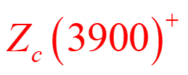
heavy quarkonia / exotics
can decay to various final states
⇒ rigorous treatment is still challenging
see also, Francis et al., 1607.05214 New!
“strongly-stable” udbb
Lüscher method
2-body coupled channel: OK
≥3-body : active development
e.g. Padmanath,… ’15
………
e.g. Lang,… ’15
active studies above a few thresholds
e.g. Prelovsek,… ’13
Fermilab/MILC ‘14
e.g. Lang et al. ’15
unobserved M=3966(20), Γ=67(18) MeV
⇔ Belle 1704.01872
“alternative χ_{c0}(2P) candidate”
………
e.g. Lang,… ‘15

Slide 9
X(5568)
Γ = 22(8) MeV, J^{P} unknown
in B_{s}π⁺ D0’16, not LHCb’16
if 4 flavors bsdu ⊕ J^{P} = 0⁺
⇒ decay only into B_{s}π⁺
expected
here
Lang et al. 1607.03185 New!
map out finite V energies
M, Γ, Lüscher formula
⇒ energy not found
deep BK bound state
do not support the existence of X(5568) w/ J^{P}=0⁺

Slide 10
Z_{c}⁺(3900)
Prelovsek et al. ‘15
M_{Zc} ～ M(DD*) + 20 MeV
Γ = 40(8) MeV
Y(4260) → π {J/ψπ, DD*}
BESIII ’13, Belle ’13, Xiao et al. ’13
charged, 4 quarks ccud
Prelovsek et al. ’13, ’15
Cheng et al. ’14
Lüscher approach
map out finite V energies
no extra energy level ～ Zc(3900), kinematical origin?

Slide 11
Z_{c}⁺(3900)
HALQCD 1602.03465 New!
HALQCD method
weak couplings among
strong ⇒ peaks in J/ψπ, DD*
no S-matrix pole ～ Z_{c}⁺
suggesting Zc(3900), as a threshold cusp
need physical M_{π} simulation

Slide 12
summary on spectroscopy
spectrum below thresholds
fully realistic simulations, impressive agreement w/ expr’t
finer structure
QED on the lattice, ‰ isospin splittings becoming accessible
heavy quarkonia / exotics
framework ready for coupled 2-body channels
shed light on states above a few thresholds
simulations are still unphysical set-up, single a, large M_{π}
states above more thresholds technically challenging
general framework for 3-body under active construction

Slide 13
2. Flavor Physics

Slide 14
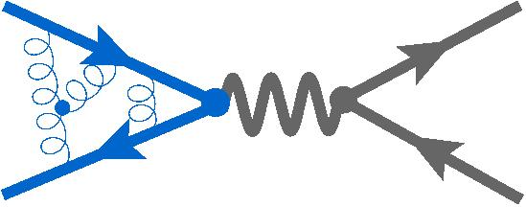
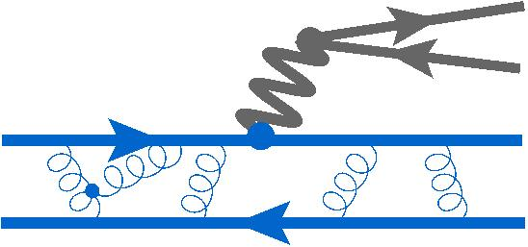
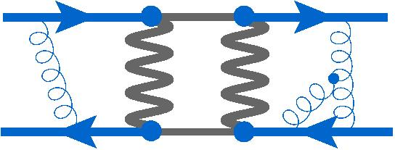
kaon physics
“gold-plated” : w/o initial/final state interaction
: 0.3-1.3%
Moulson @ CKM’16
K
f_{K}/f_{π} ⇒
|V_{us}|/|V_{ud}|
K
π
|V_{us}|
K
K
⇒ isospin corrections / hadronic decays

Slide 15

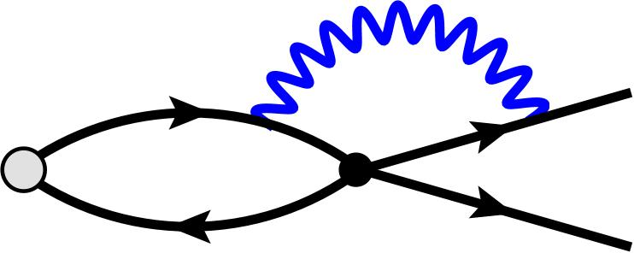
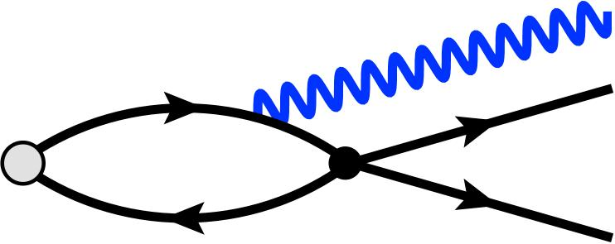
isospin corrections
Δ[ Γ_{Kl2} / Γ_{πl2} ]
Lubicz et al. 1610.09668 New!
IR singularity!
Carrasco et al. ‘15
lattice
ChPT
higher orders involve unknown LECs
systematically improvable / application to semileptonic decays

Slide 16
K→ππ
Lüscher relation → δ_{0,2} / Lellouch-Lüscher ’01 → A₀, A₂
RBC/UKQCD ‘15
Kelly @ Lattice’17 New!
renormalization of Q_{6,lat}
Wilson coefficients
(Kelly, Bruno @ Lat’17)
⇒ significant reduction in a few years (?)
≈1/2 reduction of stat. error
2H_{w} insertions ⇒ long distance ε_{K}; K→πνν, πll RBC/UKQCD ‘17

Slide 17
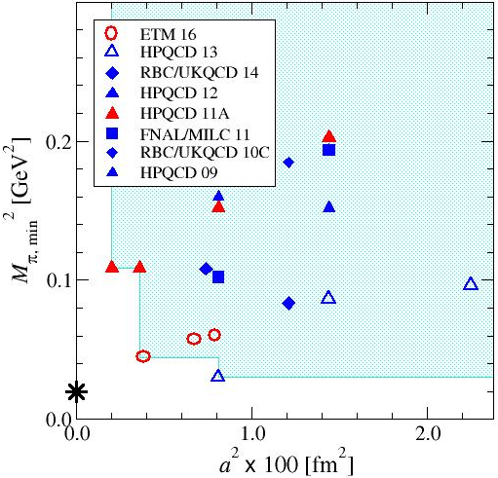
heavy meson decays
FLAG’16 average for f_{B(s)}
“relativistic QCD action”
m_{c} ≪ a⁻¹ ≲ m_{b} ⇒ m_{Q} ≪ m_{b}
good for charm
bottom needs inter-/
extra-polation to m_{b}
⇒ @ m_{b} in 5-10 yrs(?)
EFT-based (HQET, NRQCD)
directly at m_{c}, m_{b}
⇒ recent FFs, B_{P}’s
need matching to QCD,
often perturbative

Slide 18
decay constants
Flavor Lattice Averaging Group (FLAG) 1607.00299
+ RBC/UKQCD 1701.02644 New! + ETM 1603.04306 New!
f_{D(s)} : fully controlled, Δf_{D(s)} ～ 0.6% ⇔ ΔΓ/2 ～ 2% (HFAG ’16)
f_{B(s)} : Δf_{B(s)} ≲ 2% ⇔ ΔBR/2 ～ 3% (Belle II, 50 ab⁻¹)
competitive to expr’t / isospin corr.s becoming relevant

Slide 19
semileptonic decays
B→πlν : new analysis by FLAG ‘16
LQCD ～ expr’t
modern studies
by 1-2 groups
B→π
RBC/UKQCD ‘15
FNAL/MILC ‘15
B→D
FNAL/MILC ‘15
HPQCD ‘15
B→D*
FNAL/MILC ‘15
expect new studies e.g. B→πlν JLQCD, FNAL/MILC @ Lat’17
BSM, rare decays : e.g. B→π f_{T} FNAL/MILC 1507.01618
B → D* @ nonzero recoil (dΓ/dw∝(w²-1)^{1/2}) (cf. FNAL/MILC @ Lat’17)
in a few years …

Slide 20
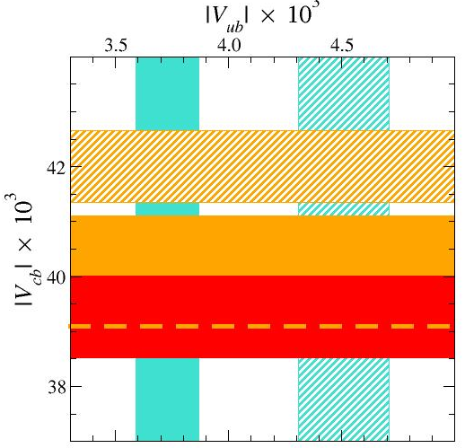
exclusive vs inclusive
Bigi-Gambino-Schacht ’17
w/ new Belle data ‘17
2 param.s for w-dep.
⇒ systematic shift in |V_{cb}|
⇔ LQCD @ nonzero recoil
other excl. modes may help / inclusive decays on the lattice?

Slide 21
non “conventional” modes
RBC/UKQCD 1501.05373
HPQCD 1703.09728 New!
+ ALPHA 1601.04277 New!
… and B_{c} decays Mathur@Lat’17
statistics + systematics : equally or better controlled
key = feasibility of precision experiments: σ, BGs, ν

Slide 22
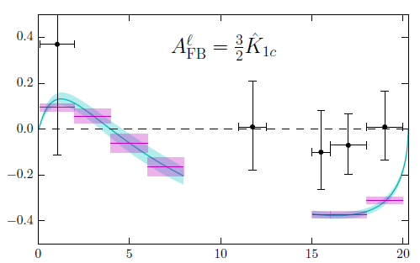
baryon decays
semileptonic decays provide independent determination of |V_{qq’}|
Detmold et al. ‘15: Λ_{b} → plν, Λ_{c}lν ⇒ |V_{cb}|/|V_{ub}|
Meinel 1611.09696 New!: Λ_{c} → Λlν ⇒ |V_{cs}|
Detmold-Meinel 1602.01399 New!
Λ_{b} → Λll rare decays
FFs ⇒ dBR/dq² and
angular observables
3.3σ tension in A_{FB}^{l}?
⇔ P₅’ anomaly in B→K*ll
(LHCb ’13,…)
lepton-side FB asymmetry
heavy M_{π}, finite V?
⇒ systematics to be checked, possible in relatively short term

Slide 23
inclusive decays
D, B strong decays : framework under development (long term)
Hashimoto 1703.01881 New!
hadronic tensor
forward scattering ME
exploratory
B_{s}→X_{c}lν @ q²=0
marginal agreement
w/ O(1/M,α_{s}⁰) HQE
q²≠0, B→X_{c}, X_{u}

Slide 24
inclusive decays
LQCD @ unphysical kinematics
contour integral using expr’tal data
and pQCD
a key = contour integral under BGs and experimental cuts
see also Hansen, Meyer, Robaina 1704.08993 New!

Slide 25
B meson mixing
FNAL/MILC 1602.03560 New!
x2-3 improvement: more realistic (stat., a⁻¹, M_{π}), renorm.
2σ tension in ΔM_{d}, ΔM_{d} /ΔM_{s} ⇒ independent calculations?
BSM and D-mixing MEs available FNAL/MILC 1706.04622 New!

Slide 26
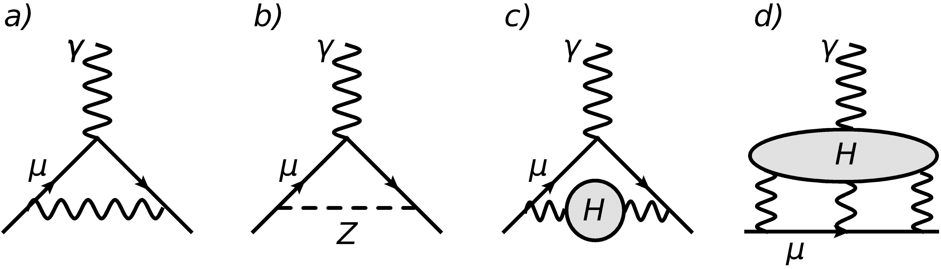
muon g-2 : HVP
R(e⁺e⁻→hadrons) ⇒ Δa_{μ}^{HVP} ～ 0.6%
purely theoretical estimate?
Lattice ’17: plenary Lehner
new results to control
stat. error
a≠0, V≠∞, m_{q}
isospin
charm
(also papers/talks by ETM,
PACS, Golterman et al.)
achieving 1 - 2% accuracy
combined w/ expr’t data

Slide 27
muon g-2 : LbL
4 point function
model estimate a_{μ}^{LbL}=10.5(2.6)x10⁻¹⁰
dominant contributions in QCD in progress
Gerardin et al. 1607.08174 New!
RBC/UKQCD 1610.04603 New!
π→γ*γ* FF
⇒ π pole
Knetcht-Nyfferer ’02
…
good consistency / systematically improvable

Slide 28
summary
substantial progress for the search of new physics in collaboration with flavor factories (Belle II, LHCb, BESIII, …)
“gold-plated” quantities: calculated with fully controlled errors
expecting more studies on semileptonic, rare decays, mixing
continuous efforts for K→ππ
framework under active development for D (and B)
new ideas for inclusive decays
more R&D both in theory and experiment sides

Slide 29
Backup slides

Slide 30
isospin splittings
‰ level needed
no fusion, heavy elements
m_{u} ≠ m_{d} :
straightforward
helium stars; inverse β decays
EM corrections
⇔ QED on finite/periodic lattice
boundary condition (QED_{C})
photon mass (QCD_{m})
photon field (QED_{{TL,L,SF}})
⇒ Patella @ Lattice’16
C boundary condition: Polley ‘93

Slide 31
EM correction
finite volume effects on M_{K0} and M_{K0}²-M_{K+}²
BMW, 1406.4088

Slide 32
kaon (semi)leptonic decays
Flavor Lattice Averaging Group (FLAG) ‘16
Moulson @ CKM’16
leptonic, f_{K} / f_{π}
semileptonic, f₊(0)
precision frontier: ΔMEs ～0.3% ⇔ Δ(BR,τ,SU(2)) ～ 0.2-0.6%
|V_{ud}|² + |V_{us}|² + |V_{ub}|² - 1 = -5(5)x10⁻⁴ ⇒ NP @ O(10) TeV
FF shape (ETM’16, JLQCD’17) / isospin correction (next)

Slide 33
FF shape
slopes of K→πlν FFs
ETM, 1602.04113
JLQCD, 1705.00884

Slide 34
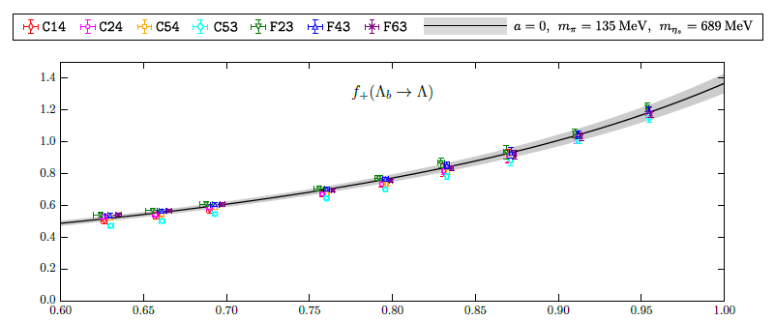
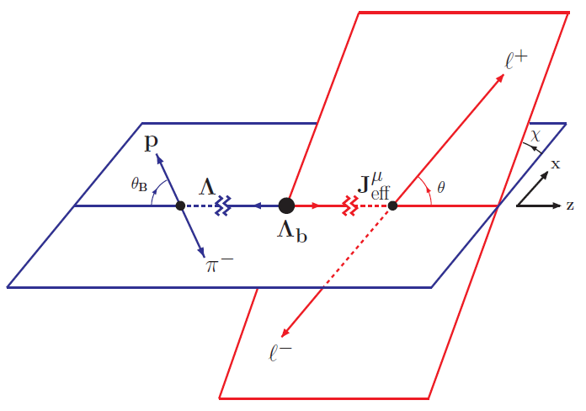
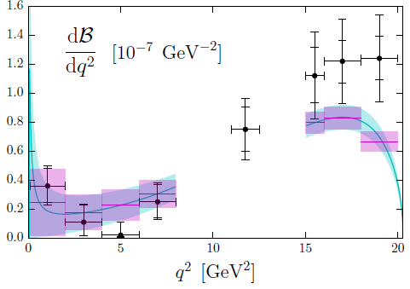
Λ_{b} decays

Slide 35
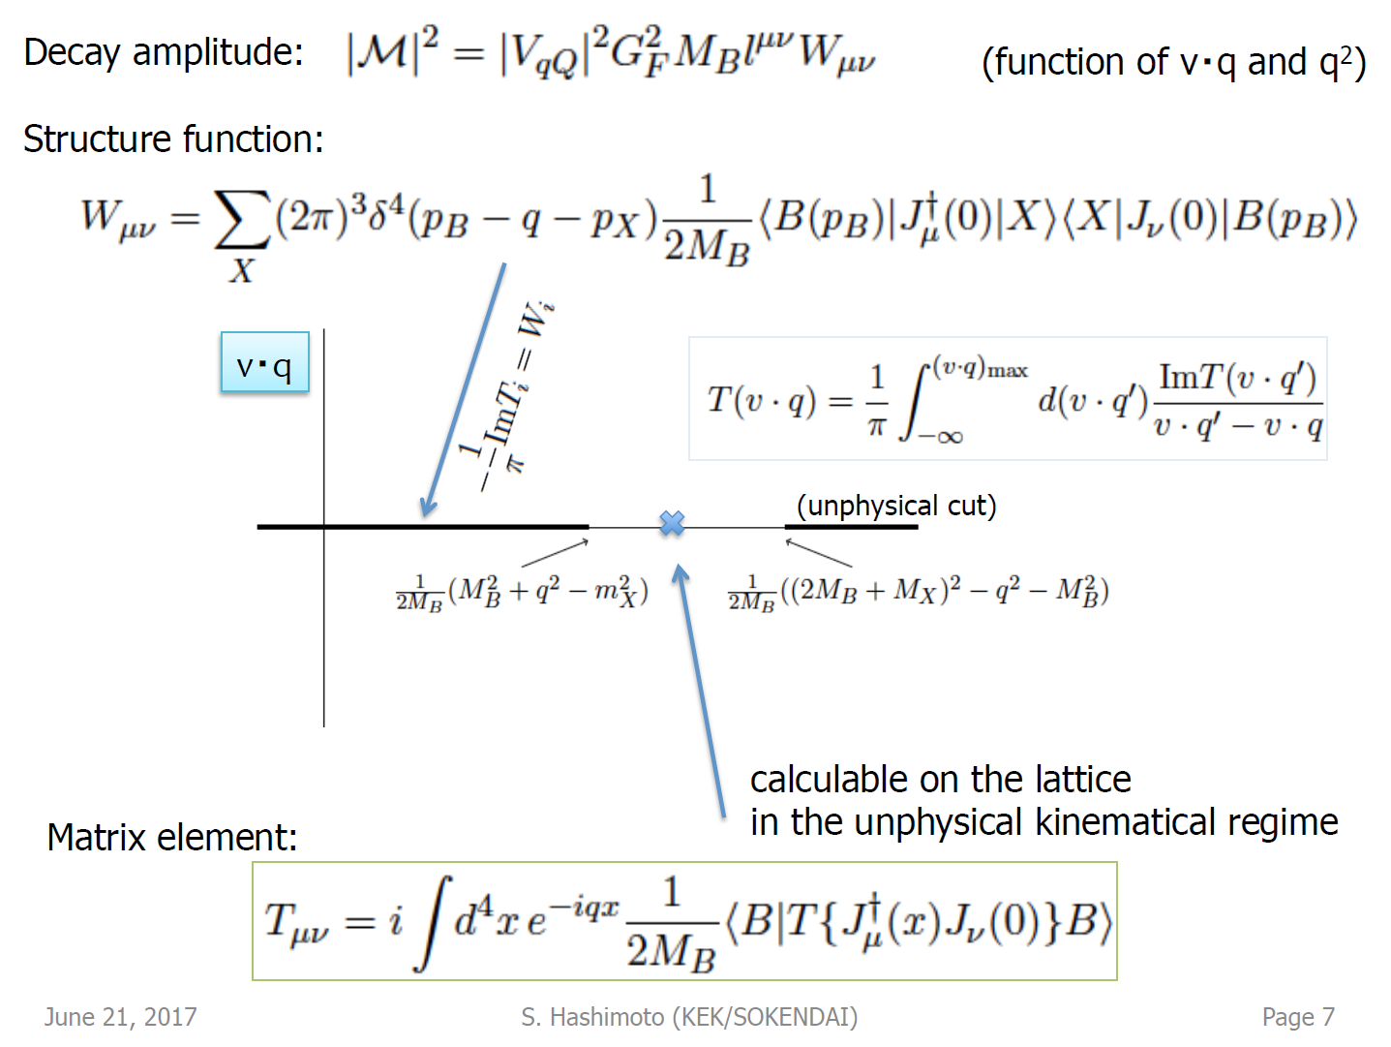
inclusive decays
Hashimoto @ Lattice ‘17
expr’t
including
|V_{cb}|²

