Slide 1
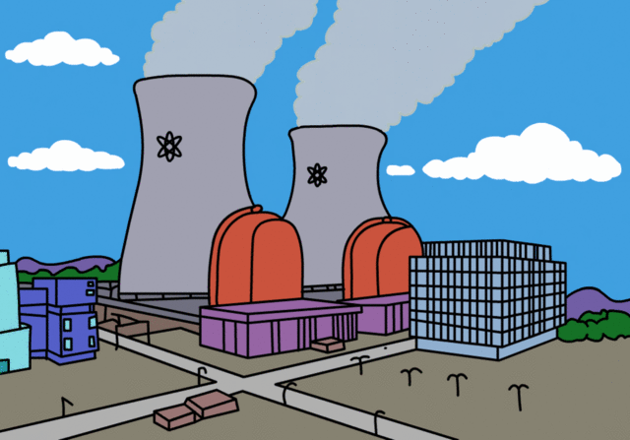
Short and Medium baseline Reactor Neutrino Experiments
Marcos DRACOS
IPHC-IN2P3/CNRS Université de Strasbourg

Slide 2
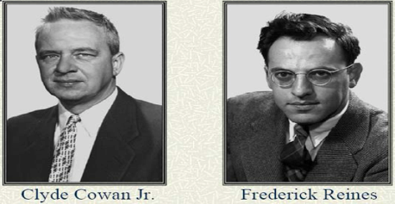
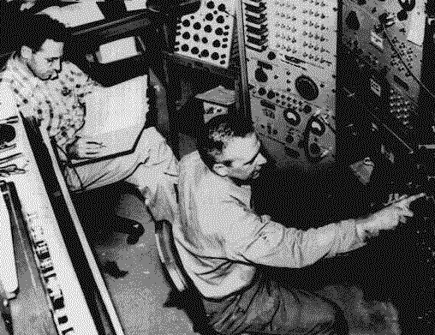
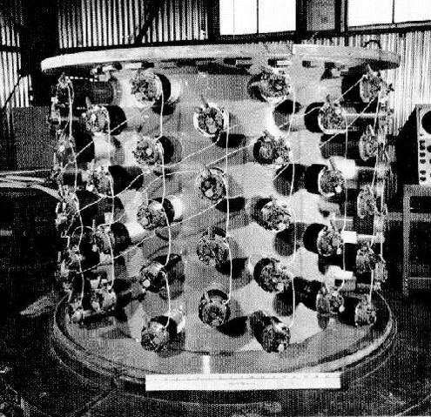
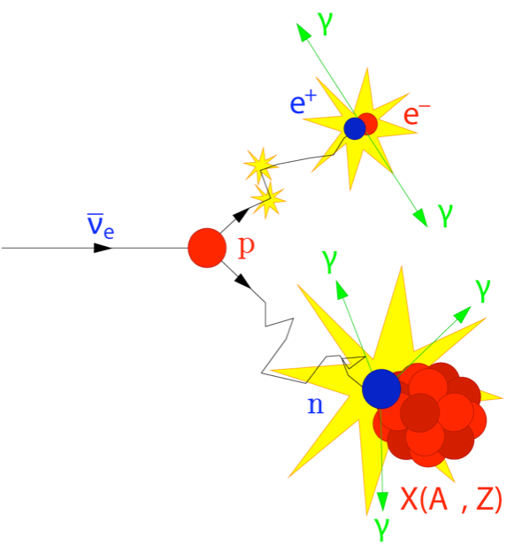
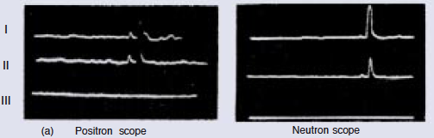
First neutrino detection
1956: Fred Reines and Clyde Cowan detect the first neutrino interactions near the nuclear reactor of Savannah River at the USA (11 m from the reactor and 12 m underground).
Nobel prize in 1995
about three neutrinos per hour
prompt
produced by the nuclear reactor
water, scintillator, CdCl_{2 (cadmium chloride)}
inverse β decay
∼200 μs
delayed
prompt
delayed

Slide 3
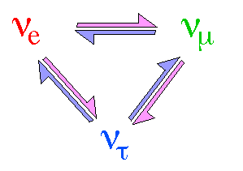
Neutrino Oscillations
Pontecorvo-Maki-Nakagawa-Sakata matrix
ν₃
well established now
θ₁₃
ν_{μ}
ν_{τ}
θ₂₃
θ₂₃
θ₁₂
ν₂
Usual parametrization
ν_{e}
ν₁
θ₁₂
θ₁₃
+ 2 Δm² mass splittings
atmospheric,
accelerators
reactors,
accelerators
CP violation
solar,
reactors
δCP for neutrinos
-δCP for anti-neutrinos

Slide 4
Present measurements
up to 2011
~δ_{CP} (almost) unknown
We can then write:
?
?
"large" mass splitting
"small" mass splitting
normal hierarchy
inverted hierarchy

Slide 5
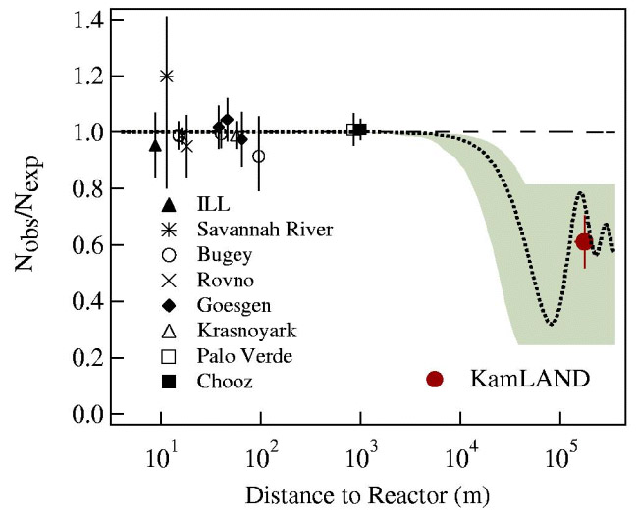
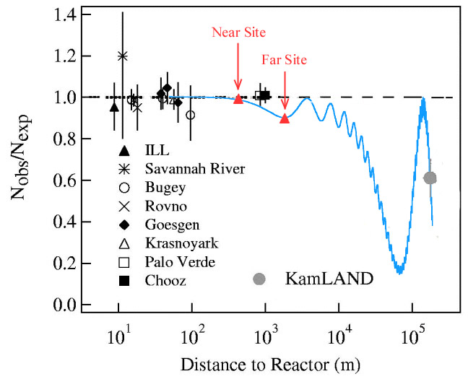
θ13 hunting
(<2012)
disappearance of electron anti-neutrinos using reactors
"old" measurements
θ13 ~ 10°
main limit on θ₁₃
More accurate experiments needed
Δm²₁₃ showing the right distance where to go.
Actually, we have almost neglected θ13 on this figure.

Slide 6
Sin²2θ₁₃ and the "new" reactor experiments
ν_{e}
isotropic electron anti-neutrino “well known” source
ν_{e}
Oscillations observed as an electron anti-neutrino deficit
ν_{e}
ν_{e}
ν_{e}
E_{ν} ≤ 8 MeV
ν_{e}
1.0
un-oscillated neutrino flux observed here (normalization)
sin²2θ₁₃
Probability ν_{e}
Distance
1000 to 1800 meters
reduced systematic errors
=1! =1!

Slide 7
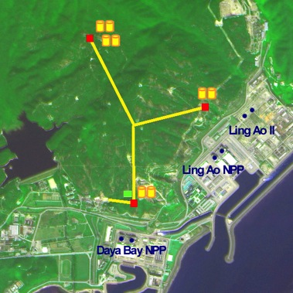
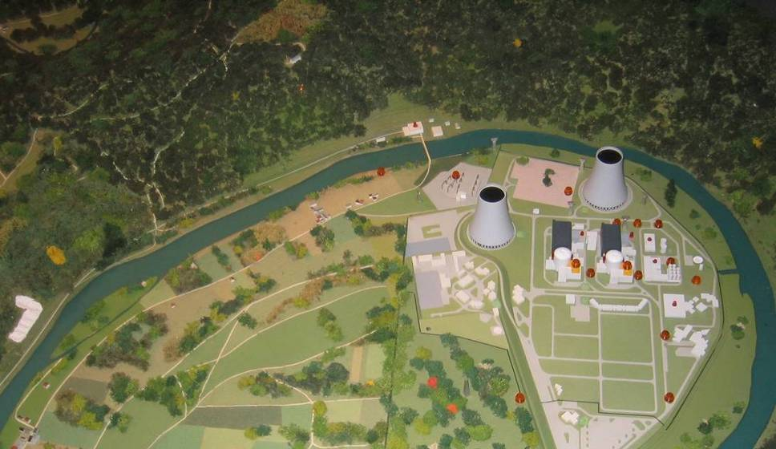
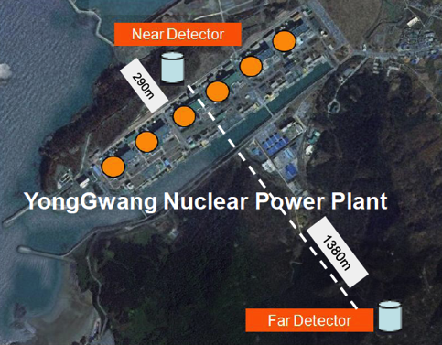
New Reactor Projects ready by 2011
Daya Bay
(China)
Double Chooz
(France)
RENO
(South Korea)
 | Reactor power (GW_{th}) | Overburden near/far (mwe) | Expected sensitivity | Start of data taking
Daya Bay | 17.4 | 270/950 | <0.01 | August 2011
Double Chooz | 8.5 | 80/300 | 0.02~0.03 | April 2011
RENO | 16.8 | 90/440 | ~0.02 | August 2011

Slide 8
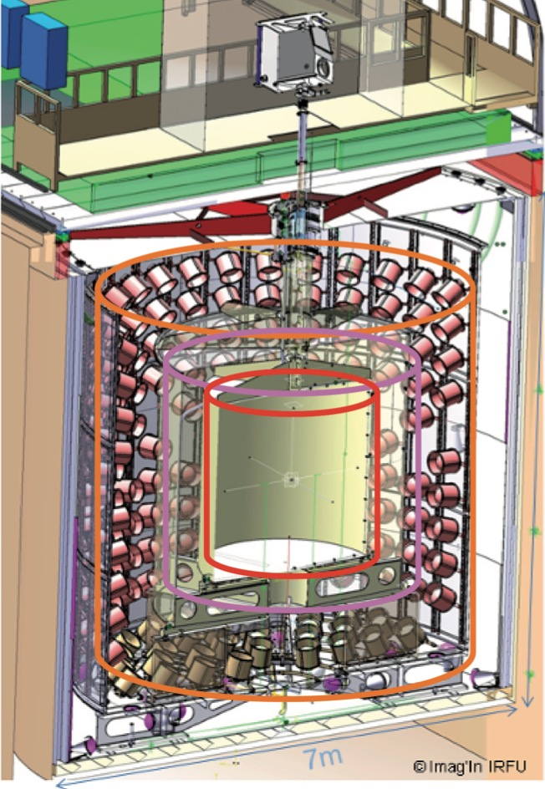

Reactor neutrino detectors
Outer Veto
(plastic scintillator)
Target (r=1.2 m)
acrylic vessel (8 mm)
8.3 tons Gd-scintillator
Shielding
(15 cm steel)
7 m
Gamma Catcher (e=0.55 m)
scintillator
Buffer (e=1.05 m)
steel (3 mm)
80 tons "oil"
390 PMTs (10")
Inner Veto
(liquid scintillator)
78 (8") PMTs

Slide 9
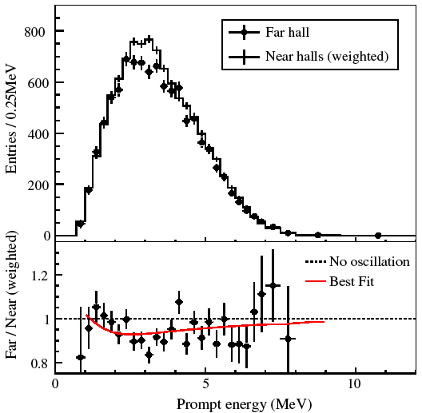
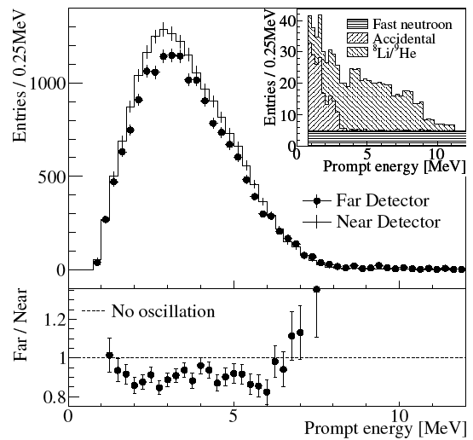
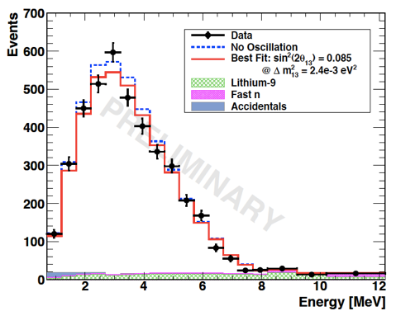
θ13 is large!!!
Daya Bay
(March 2012)
RENO
(April 2012)
Double Chooz
with only a far detector
(Nov. 2011)
now, the name of the game is MH and CPV,
proposed LBL beam facilities had to be readjusted…
θ₁₃>0 (C.L. > 5 σ)

Slide 10
Latest results
(presented at EPS2017)
(±3.9%)
(±9.1%)
(±13.4%)
DYB
RENO
DC
using data collected up to July 2015 (1230 days, >2.5 million IBDs)
new results presented at EPS2017 (up to Sep. 2015)
not yet publication with near+far detectors (near detector since beginning of 2015)
(11.1103/PhysRevD.95.072006)

Slide 11
Latest results
PRD 95, 072006 (2017)
DYB
clear L/E dependence
direct fit of Δm²_{ee}

Slide 12
Latest results
(precision era)
PRD 95, 072006 (2017)
DYB
χ²/NDF=232.6/263
1230 days
±7%
±3.4%
systematic error ~ statistical error
(=2.52±0.04 from all experiments, NH)

Slide 13
How these precise results have been obtained?
DYB
PRD 95, 072006 (2017)
many radioactive sources used to calibrate the detectors,
better understanding of systematic errors,
better background reduction.
grey band: remaining uncertainty
8.7% @ 1 MeV

Slide 14
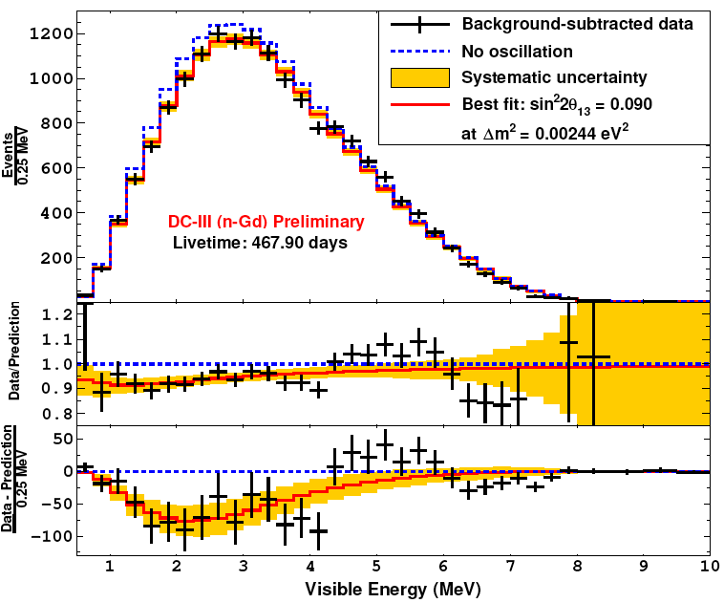
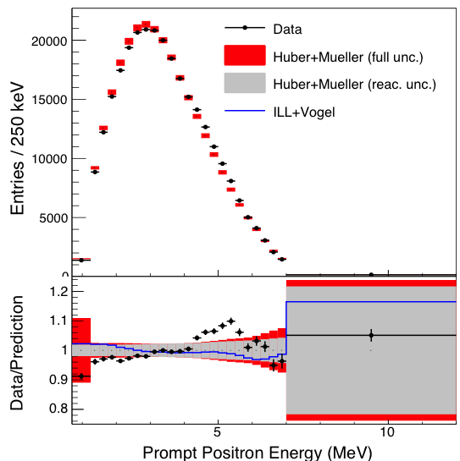
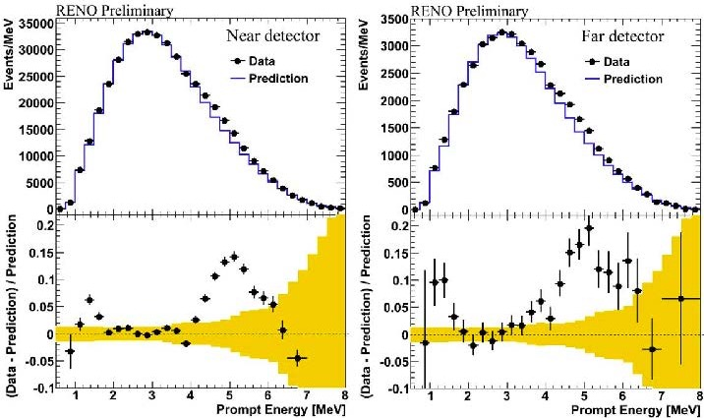
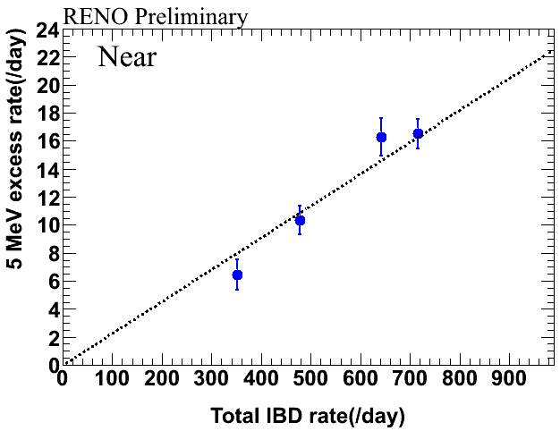
Oups… a problem!
DC
excess for 4<E<6 MeV
DB
RENO
~2.2% overall excess
⇒ excludes an "external" origin

Slide 15
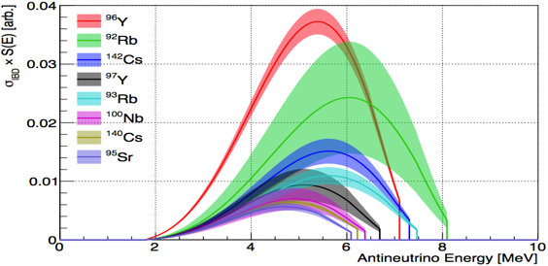
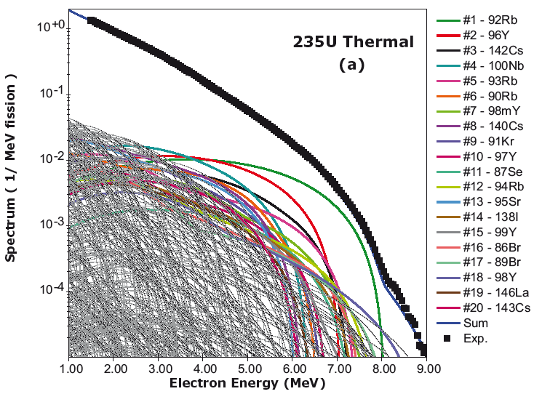
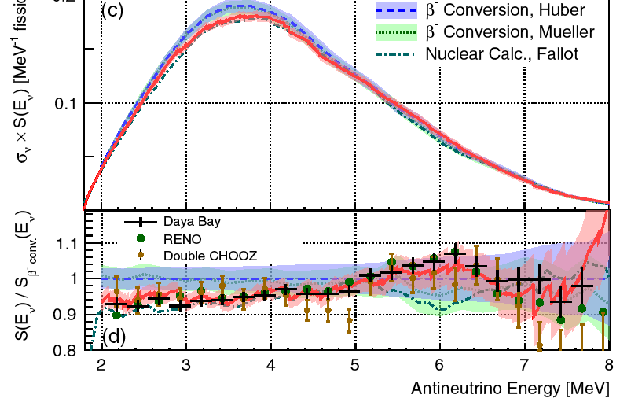
Possible explanations
A single β-branch or mono-energetic line cannot simulate this excess.
A possible explanation:
Decays of prominent fission daughter isotopes (~ 42% rate from ⁹⁶Y, ⁹²Rb, ¹⁴²Cs, ⁹⁷Y, ⁹³Rb, ¹⁰⁰Nb, ¹⁴⁰Cs, ⁹⁵Sr).
PRC 91, 011301(R) (2015)
PRL 114, 012502 (2015)
Summation (or ab initio ) method: makes use of all available information on the β decays of each fission fragment, summing each nuclide’s individual β spectrum weighted by its yield in fission.
"illustrative comparison…
the overall agreement between the measurements and ab initio calculation is surprising…"

Slide 16
5 MeV bump
("technical" problem?)
arXiv:1705.09434
The spectral shapes are not compatible with each others!
Calibration problem?
Possibility to reproduce all measurements by introducing extra residual non-linearities?
possible to explain in a "conventional way" the 5 MeV bump without influencing the reactor anomaly

Slide 17
Reactor Anomaly
(DYB+RENO)
PRL, 116, 061801 (2016)
Chinese Phys. C41, 13002 (2017)
R_{DYB}= 0.946 ±0.020
DYB
R_{RENO}= 0.946 ±0.021
RENO
Daya Bay’s result is consistent with previous world measurement
World average including Daya Bay is 0.9430 ± 008 (exp.)+-0.023 (model)
RENO 1500 days at near detector (411 m)
Data/Prediction (Huber+Mueller)= 0.946 ± 021 (exp.)
  The deficit of observed reactor neutrino fluxes relative to the prediction (Huber+Mueller model) indicates an overestimated flux or possible oscillation to sterile neutrinos.

Slide 18
Reactor anomaly
Δm²₁₄~1 eV2
sin²2θ₁₄~0.1

Slide 19
Anomalies (DYB)
PRL 118, 251801 (2017)
(effective fission fraction)
Absolute flux
prediction is
5.1% higher
relative IBD yield/fission
Measured evolution of reactor flux is about 2.8σ incompatible with the prediction of Huber-Mueller model + sterile neutrinos
Unambiguous Fuel-dependent Variation (at 10σ)
Energy-dependent evolution is observed
change in spectral shape as fuel composition evolves
excluded no spectral change hypothesis by 5.1σ
only the four primary fission isotopes are taken into account: ²³⁵U, ²³⁸U, ²³⁹Pu, ²⁴¹Pu
Measurements of reactor spectrum and absolute flux evolution indicate that uncertainties of model calculations are underestimated.

Slide 20
Anomalies
(DYB)
PRL 118, 251801 (2017)
PRL118, 251801 (2017)
 | cross-section (10⁻⁴³cm²/fission)
isotope | DYB | M-H model
²³⁵U | 6.17 ± 0.17 | 6.69 ± 0.15
²³⁹Pu | 4.27 ± 0.26 | 4.36 ± 0.11
Possible explanations to the reactor anomaly:
solely incorrect prediction of ²³⁵U
  favored by Daya Bay data with p-value 0.68
solely incorrect prediction of ²³⁹Pu: disfavored at 3.2σ.
equal deficit on all isotopes: disfavored at 2.8σ.
Daya Bay results suggest an overestimation of antineutrino flux from ²³⁵U in reactor models.
No major indication the 5 MeV "bump" comes from a particular isotope.
Improvements in systematic uncertainties (e.g. detection efficiency) and increase in statistics could help to better understand.

Slide 21
Anomalies
Giunti et al., arXiv:1708.01133
"Reactor Fuel Fraction Information on the Antineutrino Anomaly"
taking into account explicitly the uncertainties of the theoretical calculation of the 4 cross-sections per fission
 | 235 | 235+239 | OSC | 235+OSC | 239+OSC
χ²/dof | 0.54/0.83/0.79 | 0.60/0.74/0.80 | 1.36/0.53/0.74 | 0.60/0.55/0.67 | 0.63/0.55/0.58
GoF (%) | 80/71/79 | 73/82/78 | 22/100/85 | 72/100/91 | 71/100/100
r₂₃₅ | 0.927±0.022/0.939±0.012/0.934±0.010 | 0.922±0.025/0.950±0.013/0.934±0.009 | -/-/- | 0.937/1.025/ 0.987 | -/-/-
r₂₃₉ | -/-/- | 0.974±0.046/0.873±0.064/0.970±0.032 | -/-/- | -/-/- | 1.094/1.036/ 1.099
σ₂₃₅ | 6.17 ± 0.17/ 6.20±0.15/6.28±0.08/6.25±0.07 | 6.17±0.16/6.36±0.09/6.25±0.06
σ₂₃₉ | 4.27 ± 0.26 | 4.29±0.20/3.84±0.28/4.27±0.14
σ_{disfav.} | 2.8/2.6 (OSC) | 2.8/2.5(OSC) | 3.1/1.7 (235), 2.8/2.2 (235+239) | 2.4 (235) 1.8 (235) | 4.2 (235), 2.9 (235+239), 2.4 (OSC), 3.5 (235+OSC)
DYB
DYB_{1708.01133}
"Old" data
Combined (Old+DYB)
more experimental data needed

Slide 22
Sterile neutrinos
Δm²₁₄~1 eV2
sin²2θ₁₄~0.1
Δm²₁₄~0.03 eV²

Slide 23
Sterile neutrinos (DYB)
[1607.01174]
Δm²₁₄~0.03 eV2
sin²2θ₁₄~0.1
(Preliminary,
500 days)
[1607.01177]

Slide 24
Plans and Prospects
DC
  end of data taking: ~end of 2017
  proton recounting
Daya Bay
  end of data taking: 2020
  3% on sin²2θ₁₃
  better understanding of systematic errors (non-linearities, calibration,…)
  background reduction
RENO
  end of data taking: end of 2018
    possible extension up to 2021
  goal: reach 6% precision on θ₁₃

Slide 25
What's next using reactor neutrinos?
…within the context of "large" θ₁₃…

Slide 26
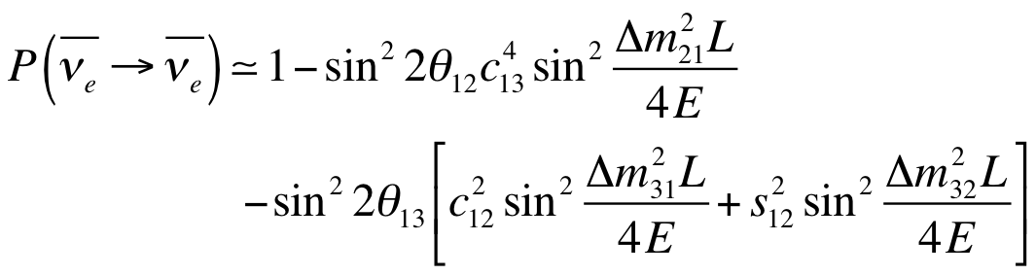

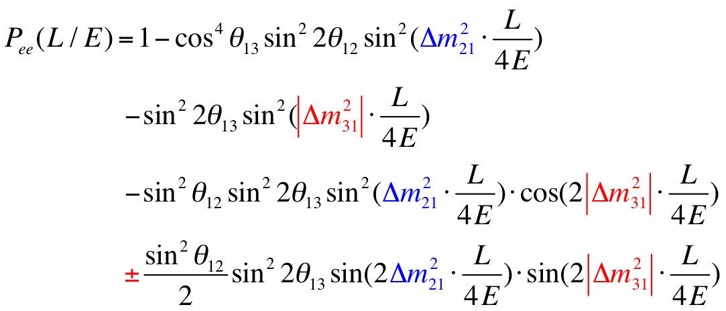
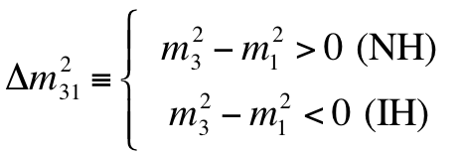
Neutrino Mass Hierarchy
with:
=(2n-1)π/2⇒ max. sens.
=nπ ⇒ no sensitivity

Slide 27
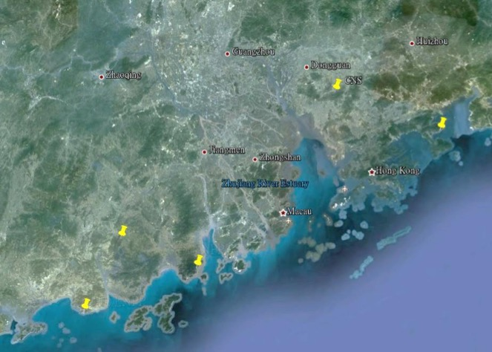

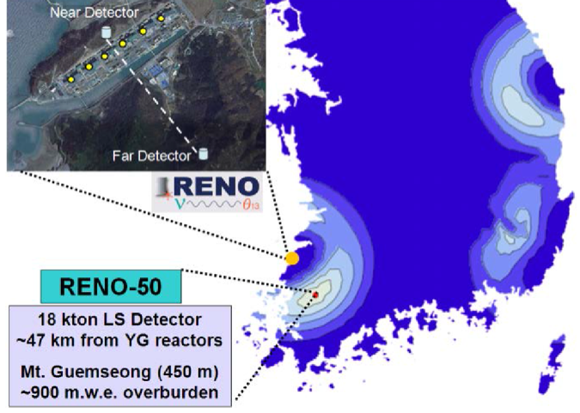
Two proposals
(by 2012)
JUNO (initially DAYA BAY2)
Rich physics program:
  Reactor neutrinos
    Mass Hierarchy
    precision measurements of oscillation parameters
  Supernovae neutrinos
  Geoneutrinos
  Solar neutrinos
  Atmospheric neutrinos
  Exotic searches
Guang Zhou
2.5 h drive
Shen Zhen
Zhu Hai
Daya Bay NPP
Hong Kong
53 km
Macau
53 km
Taishan
NPP
Yangjiang NPP
RENO-50

Slide 28

Neutrino spectrum
Daya Bay
DC
RENO
JUNO/RENO50
KamLAND
S.T. Petcov et al., PLB533(2002)94,
S.Choubey et al., PRD68(2003)113006,
J. Learned et al., PRD78 (2008) 071302,
L. Zhan, Y. Wang, J. Cao, L. Wen,
PRD78:111103, 2008, PRD79:073007, 2009
can we observe the difference?

Slide 29
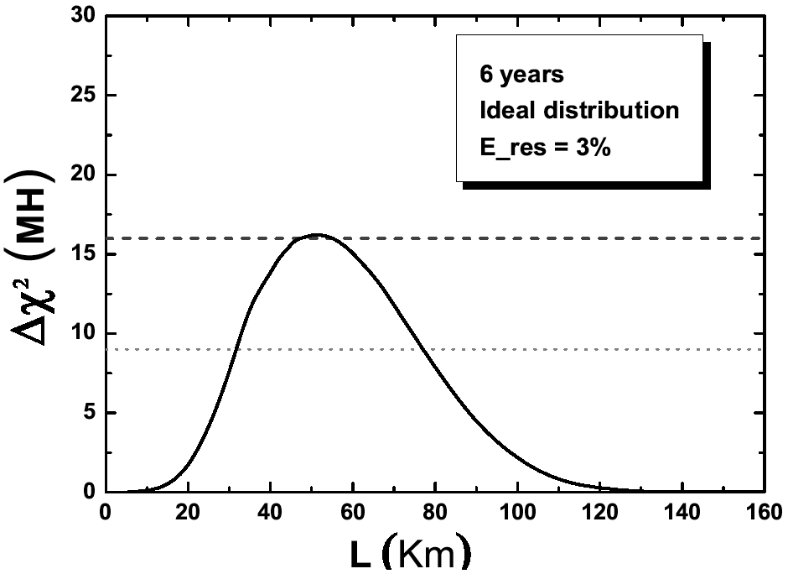
Energy resolution and detector position
20 kt detector
PHYS. REV. D 88, 013008 (2013)
The sensitivity will strongly depend on the energy resolution
Shift in energy spectrum of ~Δm₂₁²/Δm₃₁²~3%
An energy resolution of ~3% (for E~1 MeV) is needed
~53 km
Optimal sensitivity at a distance of ~53 km
Baseline

Slide 30
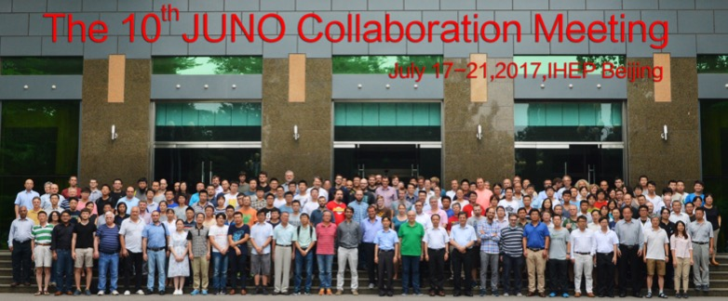
JUNO Experiment
Jiangmen Underground Neutrino Observatory
a multiple-purpose neutrino experiment,
approved in Feb. 2013,
~ 300 M$,
data taking: ~2020.
71 Institutions, 550 collaborators

Slide 31
JUNO detector

Slide 32
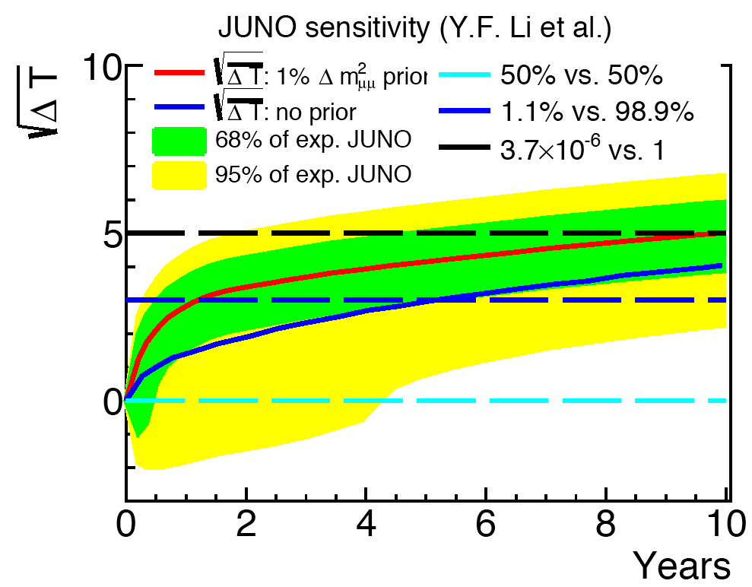

JUNO Performance
PRD 88 013008 (2013)
Δm²_{atm.}
Δm²_{solar}
 | KamLAND | BOREXINO | JUNO
LS mass | 1 kt | 0.5 kt | 20 kt
ΔE | 6%/√E | 5%/√E | 3%/√E
Light yield | 250 p.e./MeV | 511 p.e./MeV | 1200 p.e./MeV
accuracy to be achieved on oscillation parameters
 | Current | JUNO
Δm²₂₁ | ~2.3% | ~0.6%
Δm²_{ee} | ~4% | ~0.5%
sin²θ₁₂ | ~6% | ~0.7%
(JUNO Yellow Book:, J. of Phys. G: Nucl. Part. Phys. 43 (2016) 030401)

Slide 33
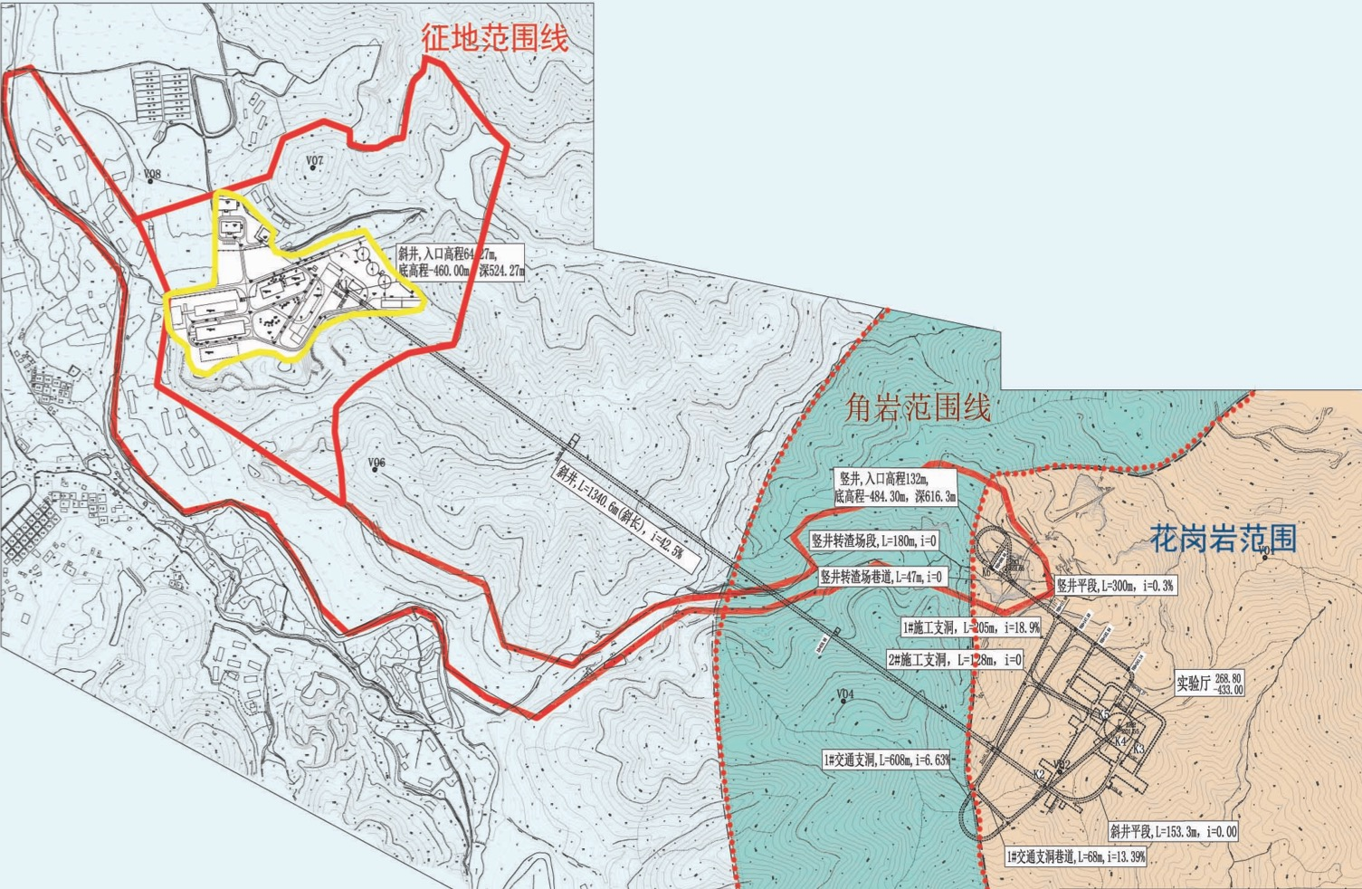
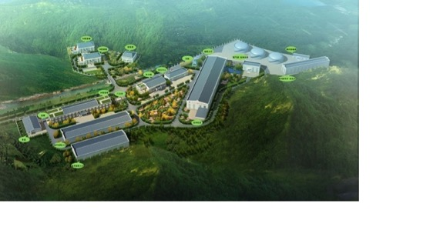
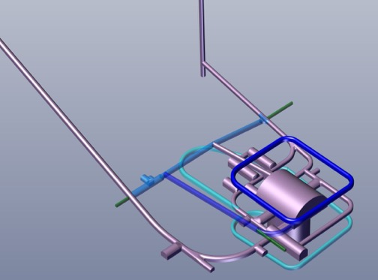
Experimental site
apartments
offices
dormitories
tunnel
assembling
+
storage
assembling
already constructed
Surface Campus
Vertical shaft: 564 meters
already constructed
竖井入口
Slope Tunnel：1266 meters @ slope of 42%
Experimental hall
Overburden: 680 m meters
Width: 49 meters
Length:55 meters

Slide 34
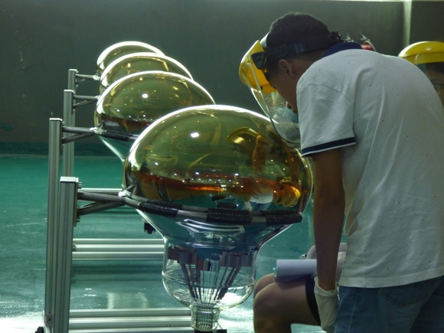
JUNO Photodetectors
Contracts were signed in 2015
15k MCP-PMT (75%) from NNVT
5k Dynode (25%) from Hamamatsu
container
20" PMT mass testing started

Slide 35
3" PMT
25000 3-inch PMTs, contracted to HZC (China)
Together with the 20-in PMT as a double calorimetry
  Increase photon statistics by 3%
  Energy measurement via “photon counting”, better control of systematics
  muon tracking, supernova detection …
(see poster on JUNO 3" PMT)

Slide 36
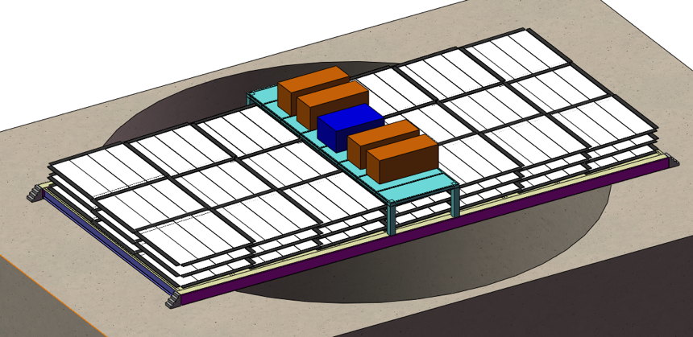
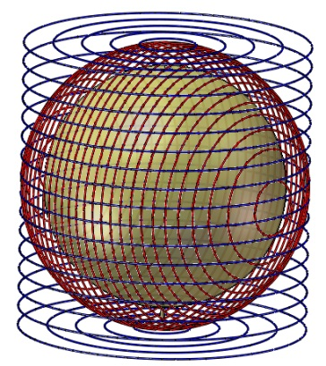
Veto
WC veto
Water Cherenkov detector
  ~2000 20” PMT
  35 kton ultrapure water
Top Tracker
  Re-using the OPERA’s Target Tracker
  Arrived in China in July
Top Tracker
(3 x-y layers)
Earth Magnetic Field shielding

Slide 37
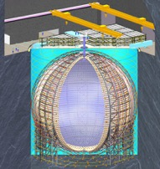

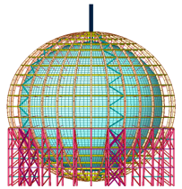
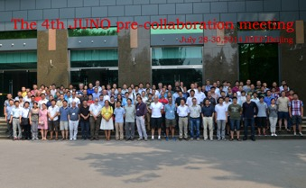
JUNO schedule
2017: Start PMT testing
2014: International collaboration established
start civil construction
2015: PMT production line manufacturing
2016: Start PMT and detector production
2018: PMT potting
2019: Start building central detector and LS filling
beginning of next decade: start data taking

Slide 38
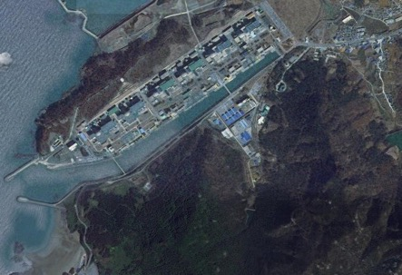
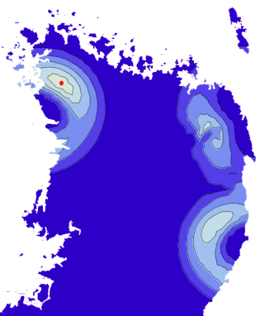

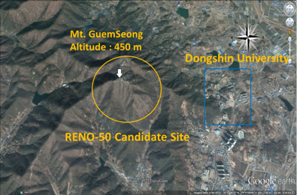
RENO-50
An underground detector consisting of 18 kton ultra-low radioactivity liquid scintillator & 15,000 20” PMTs, at 50 km away from the Hanbit (Yonggwang) nuclear power plant
Goals:
  Determination of neutrino mass hierarchy
  High-precision measurement of θ₁₂, Δm²₂₁ and Δm²_{ee}
  Supernova neutrino, Geo-neutrino and solar neutrino
Near Detector
Far Detector
(NEAR Detector)
(FAR Detector)
RENO-50
18 kton LS Detector ~47 km from YG reactors
Mt. Guemseong (450 m) ~900 m.w.e. overburden

Slide 39
R&D and current status
Develop LS purification methods → obtained att. length of ~25 m
■ Removal of LS impurities to obtain attenuation length of ~25 m
(successful!)
■ Reduction of LS radioactivity to 10⁻¹⁶ g/g of U and Th
(neutron activation in progress)
Measurement of radioactivity for the detector materials
Current Status:
  R&D efforts supported by the Samsung Science (US $2M for 3 years of 2015-2017) & Technology Foundation (2012-2016).
  Efforts on obtaining a full construction fund failed.
  Stop the RENO-50 effort and pursue the second detector of Hyper-Kamiokande in Korea (KNO: Korean Neutrino Observatory)
※※※ Use the remained R&D money for the T2HKK R&D project

Slide 40
Conclusions
Reactor experiments allowed the θ₁₃ measurement and opened now the door to:
  neutrino Mass Hierarchy determination
  observation of a possible CP violation in the lepton sector
Better reactor predictions are needed
  new very short baseline reactor experiments will probably do the job
  indications that the reactor anomalies are due to the reactor predictions
New Medium baseline large volume reactor experiments will very probably solve the Mass Hierarchy problem during the next 10 years:
  High energy resolution is needed.
  JUNO:
    Under construction in China
    Accurate measurement of neutrino oscillation parameters.
    Rich astrophysics programme
  RENO-50:
    After an R&D phase in S. Korea the project stopped due to lack of funding.
neutrino oscillations
(see associated posters)

Slide 41
Backup
neutrino oscillations

Slide 42
Reactor/detector configuration
Double Chooz
(France)
RENO
(South Korea)
Daya Bay
(China)
started only in 2015
8 t
16 t
16 t
8 t
arXiv:1003.5800[hep-ph]

Slide 43
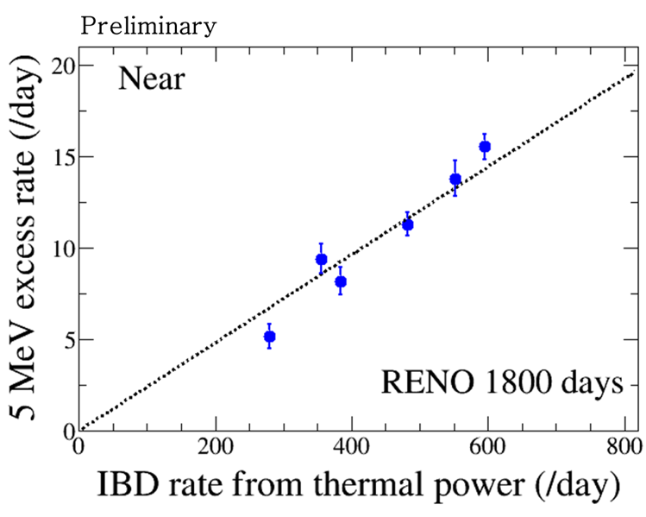
5 MeV bump now (RENO)
two or three reactors are off
All the six reactors are on
Correlation of 5 MeV excess with ²³⁵U isotope fraction?

Slide 44

Better background understanding and reduction
accidental
cosmic muons
cosmogenic
RENO
rate
uncertainty
⁹Li spectrum measured by DYB

Slide 45
Anomalies (DYB)
arXiv:1704.02276
Fit of the cross-sections/fission for ²³⁵U and ²³⁹Pu in absence of anomalies.

Slide 46
Use also of H for neutron capture to increase statistics
DYB
RENO
H with higher background
Gd
significant reduction of the background after signal treatment
DC
prompt DC signal
(gain of ~x2.5 in statistics)

Slide 47
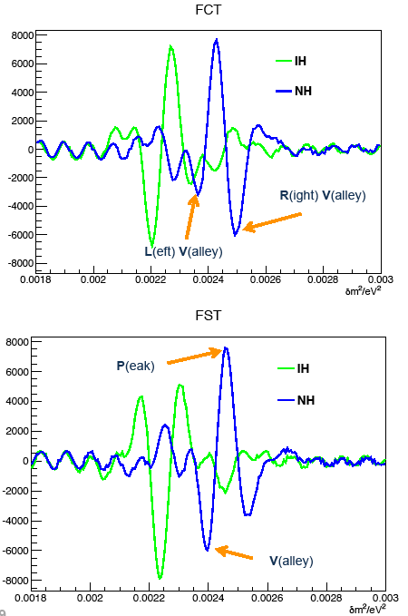
Spectral analysis
Fourrier transform of the energy spectrum F(t):
(t=L/E)
PHYS. REV. D 78, 111103(R) (2008)
Discriminant variables:
(for FCT)
(for FST)
RL>0 and PV>0 →NH
RL<0 and PV<0 →IH
Statistical test of RL+PV

Slide 48

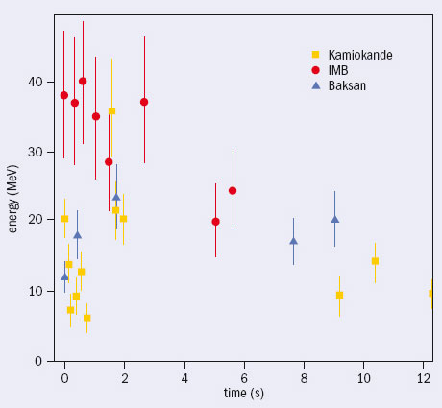
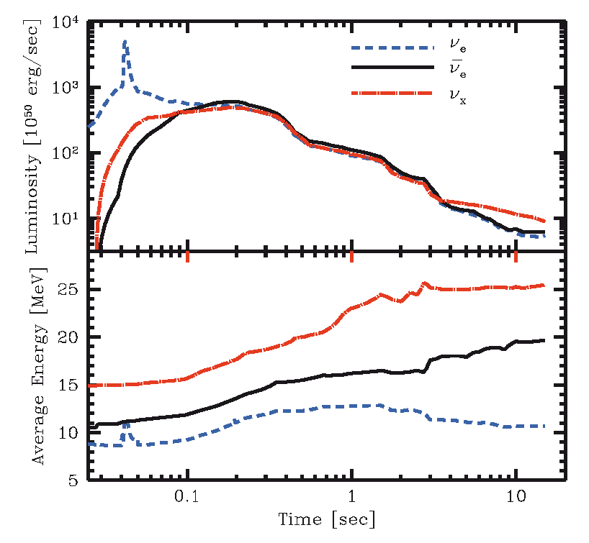
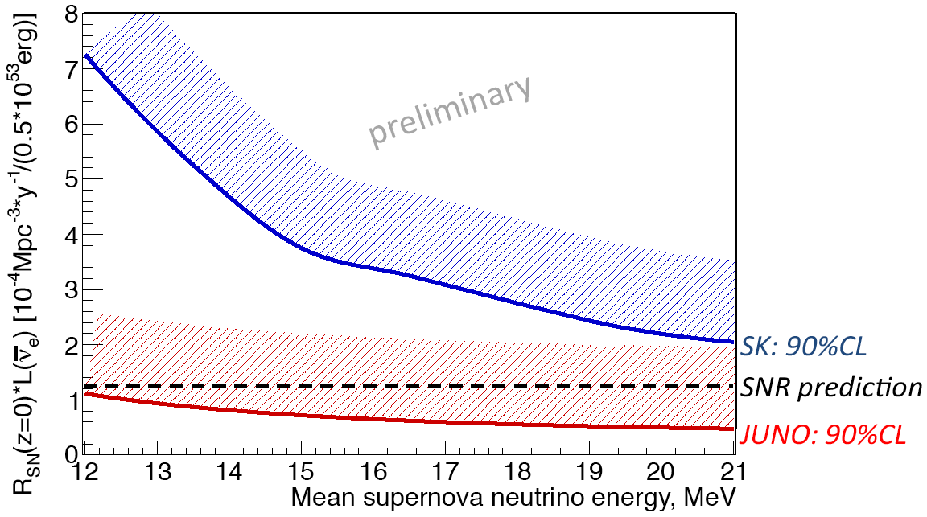
Supernovae explosions
5000 ν will be detected by JUNO if explosion at 10 kpc (centre of our galaxy)
  energy spectrum
  time distribution
better understanding of the explosion mechanisms
detection of relic neutrinos produced by previous explosions
SN1987A
in 10 years

Slide 49
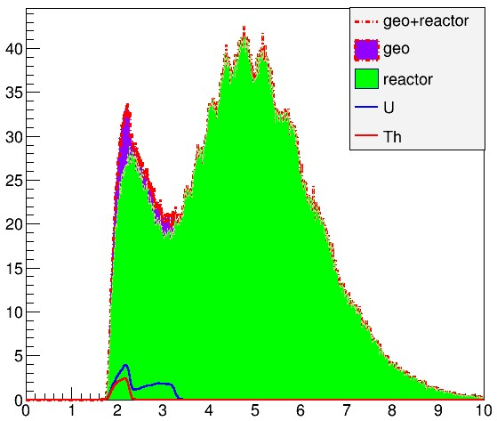
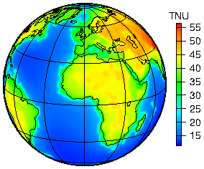
Geo-neutrinos in JUNO
JUNO ~700/year
Kamland 116/10 years
Borexino 14.3/5 years
KamLAND: 30±7 TNU
Borexino: 38.8±12.0 TNU
JUNO:
  reach an uncertainty of 3 TNU
  large background from reactors
  Aim: 37 ±10% (stat.) ±10% (syst.)
Events/10keV(10³² p y) ⁻¹
Neutrino Energy（MeV）
1.8-3.4MeV
  Reactor Neutrinos: 14±0.14/day
  Geo-neutrinos 2±0.5/day
(TNU ~ number of detected ν/year/kt LS (IBD, 10³² p)

Slide 50




Photodetectors
Insulated trestle table
Anode
MCP dodule
Bracket of the cables
Transmission Photocathode
Glass shell
Reflection Photocathode
Glass joint
20"

Slide 51


Detector Construction
(see poster on JUNO detector)
Chimney
Acrylic sphere
Latticed shell
node prototype
Acrylic sphere:
  ø35.4 m,
  thickness: 120 mm
  >200 pieces of panels bonded on site (600 t)
• Stainless steel: ø40.1-41.1m
Truss-supported structure
Acrylic bonding tests

Slide 52
Liquid Scintillator pilot plant
Purified 20 ton LAB to test the overall design of the purification system at Daya Bay by replacing the target LS in one detector
  Optimization of recipe, study of radioactivity background
Target properties:
  Optical: >20 m attenuation length @430nm
  Radio-purity: 10⁻¹⁵g/g (U, Th)
(see poster on JUNO LS)
pilot plant

Slide 53
JUNO Photodetectors
MCP-PMT
648 tubes
28% D.E.
NNVT
Dynode-PMT
960 tubes
27% D.E.
Hamamatsu

