Slide 1
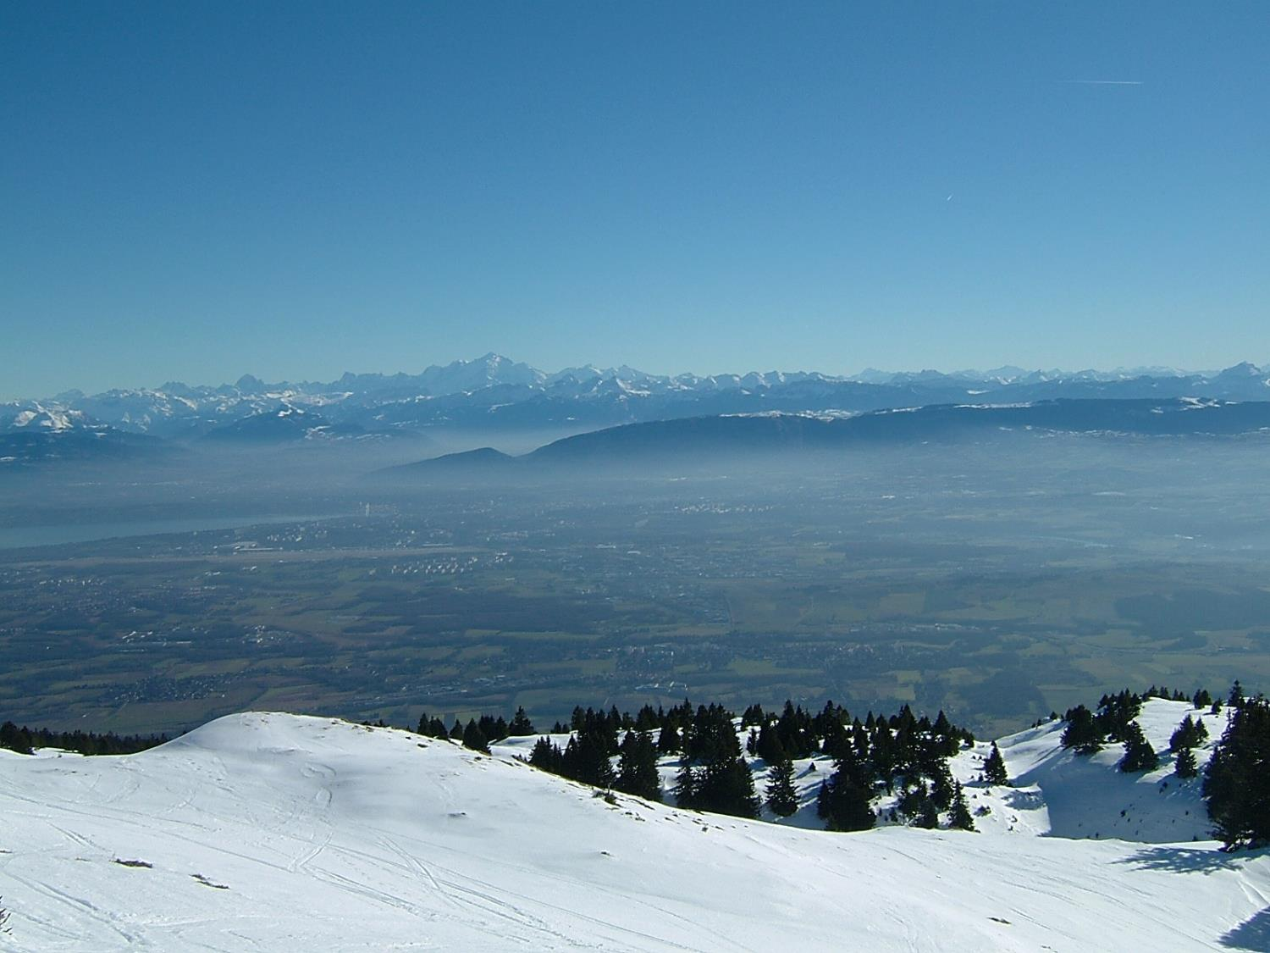
Status of FCC-ee/FCC-hh
a story of synergy and complementarity
see recent metings:
FCC physics workshop
https://indico.cern.ch/event/550509/
FCC week in Berlin
https://indico.cern.ch/event/556692/
courtesy J. Wenninger
Alain Blondel University of Geneva

Slide 2
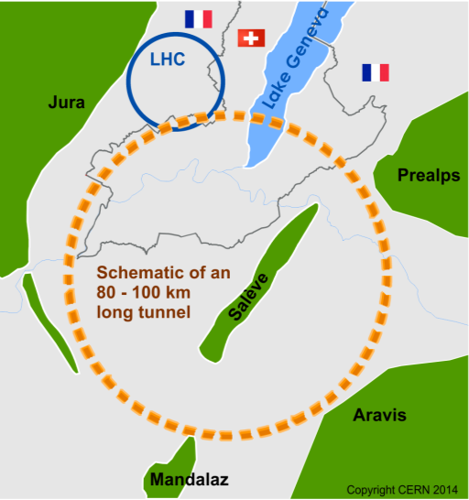
The Future Circular Colliders
CDR and cost review for the next ESU (2018)
International collaboration to Study Colliders fitting in a new ~100 km infrastructure, fitting in the Genevois
Ultimate goal:
100 TeV pp-collider (FCC-hh)
→ defining infrastructure requirements
Possible first steps:
e⁺e⁻ collider (FCC-ee)
High Lumi, E_{CM} =90-400 GeV
HE-LHC 16T ⇒ 28 TeV
in LEP/LHC tunnel
Possible add-on:
p-e (FCC-he) option
~16 T magnets
From European Strategy in 2013: “ambitious post-LHC accelerator project”
Study kicked-off in Geneva Feb 2014

Slide 3
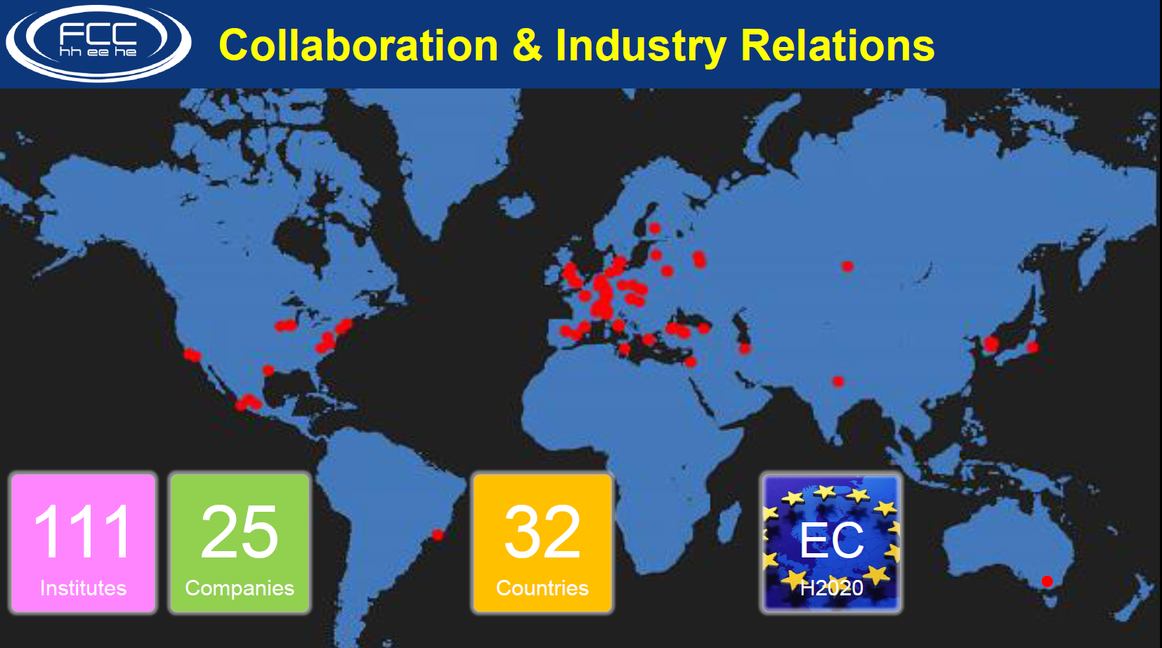

Slide 4
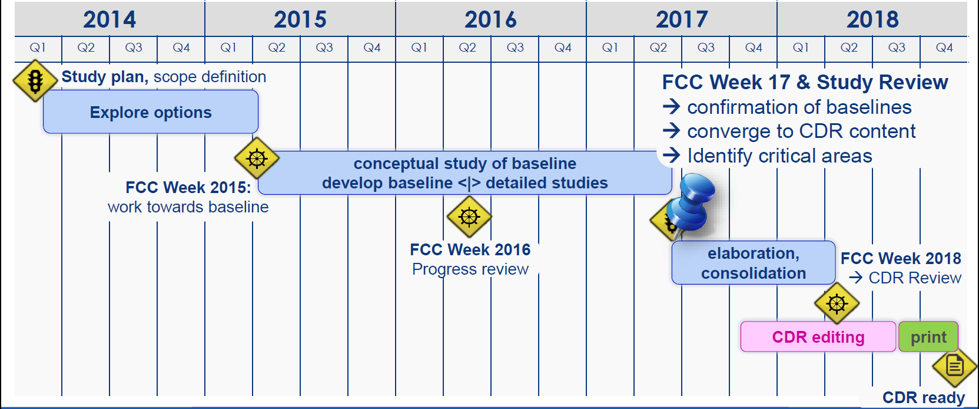
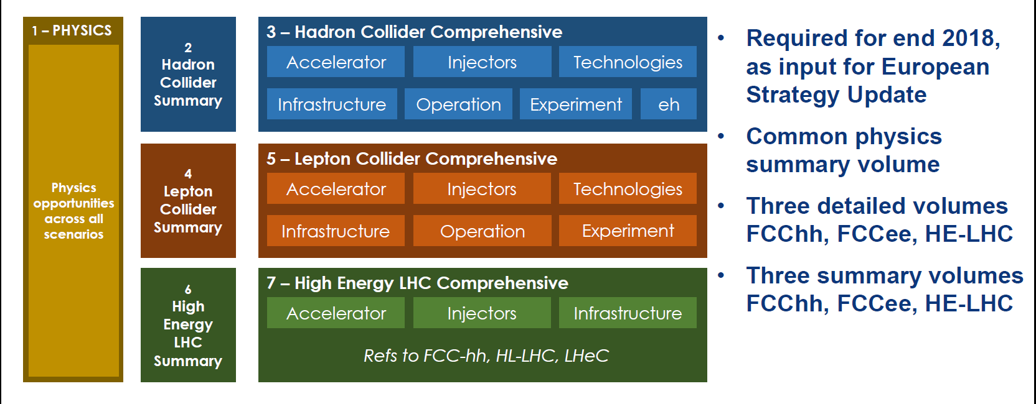
CDR plans

Slide 5
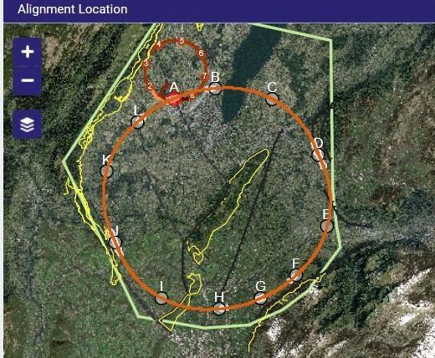
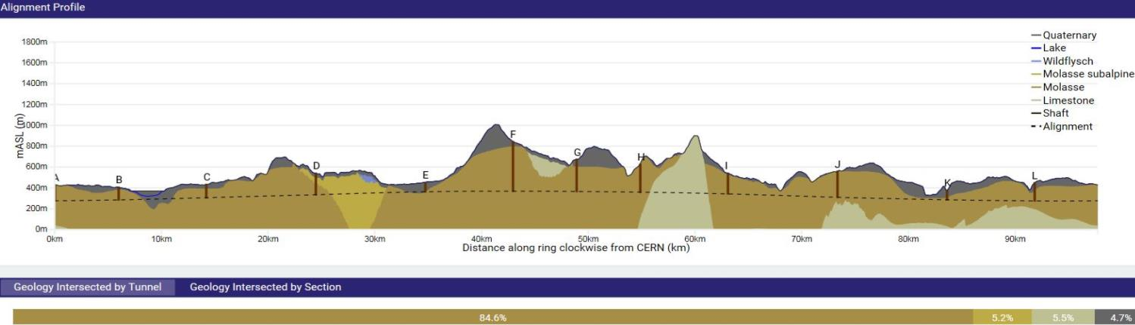
The FCC Home -- 2017
Optimisation in view of accessibility surface points, tunneling rock type, shaft depth, etc. optimum: 97.5 km
Tunneling
Molasse 90% (good rock),
Limestone 5%, Moraines 5% (tough)
Shallow implementation
~ 30 m below Léman lakebed
Reduction of shaft lengths etc...
One very deep shaft F (476m)
(RF or collimation), alternatives being studied, e.g. inclined access

Slide 6

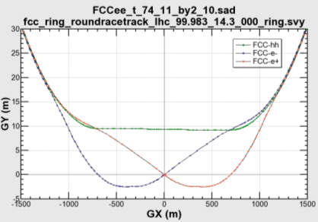

common layouts for hh & ee
11.9 m
IP
30 mrad
FCC-hh/
ee Booster
9.4 m
0.6 m
Lepton beams must cross over through the common RF to enter the IP from inside.
Only a half of each ring is filled with bunches.
Common
RF (tt)
Common
RF (tt)
Max. separation of 3(4) rings is about 12 m:
wider tunnel or two tunnels are necessary around the IPs, for ±1.2 km.
IP
FCC-ee 1, FCC-ee 2,
FCC-ee booster (FCC-hh footprint)
Asymmetric IR for ee, limits SR to expt
2 main IPs in A, G for both machines
Notes:
Check with Katsunobu to have latest layout.
Check with detector people if 9 m offset is acceptable for ee detector

Slide 7
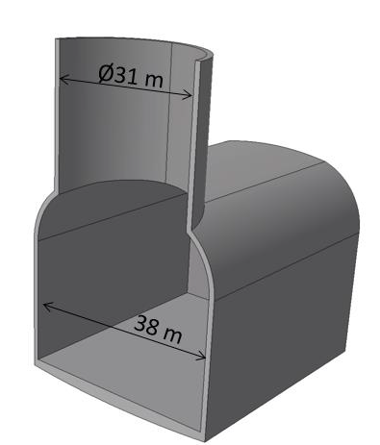
ee hh
Sharing the FCC experimental caverns
(Prelim. layout as of FCC-Rome meeting)

Slide 8
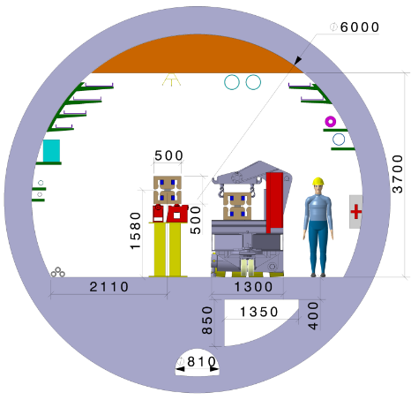
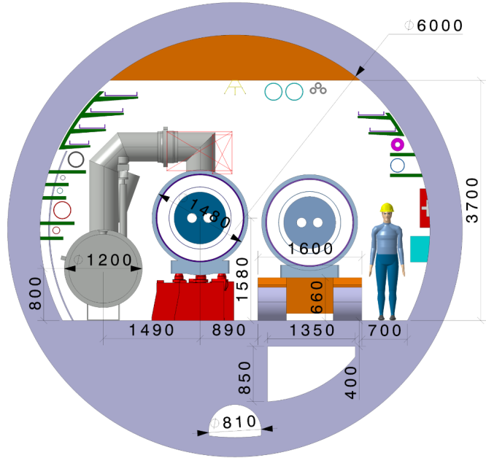
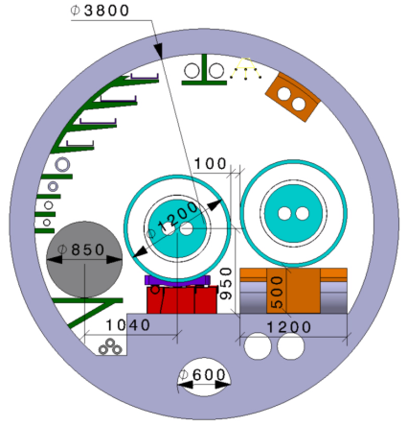
FCC-ee
FCC-hh
HE-LHC :
constraints:
No civil engineering, same beam height as LHC
→ Magnets OD ca. 1200 m max
QRL (shorter than FCC) OD ca. 850 mm (all included)
Magnet suspended during „handover“
from transport vehicle to installation transfer table
Compliant 16T magnet design ongoing
+ still many items to study!
If HE-LHC can
work in 3.8m ∅ ...
it will feed-back
to FCC tunnel
design!

Slide 9
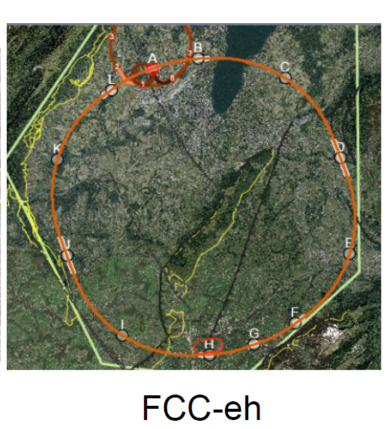
LHeC or FCC-eh function as an add-on to LHC or FCC-hh respectively:
additional 10km cicumference
Electron Reciculating Linac ERL.
The possibility to collide FCC-ee with FCC-hh is not considered in the framework of the study
In the case of FCC-eh it could profit from the -- then existing -- FCC-hh,
and, perhaps, from considerable RF of the -- then dismantled -- FCC-ee

Slide 10
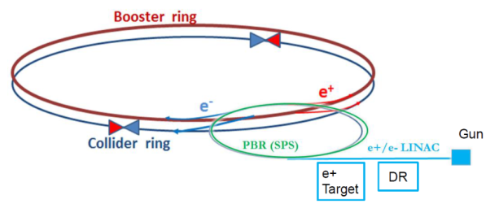
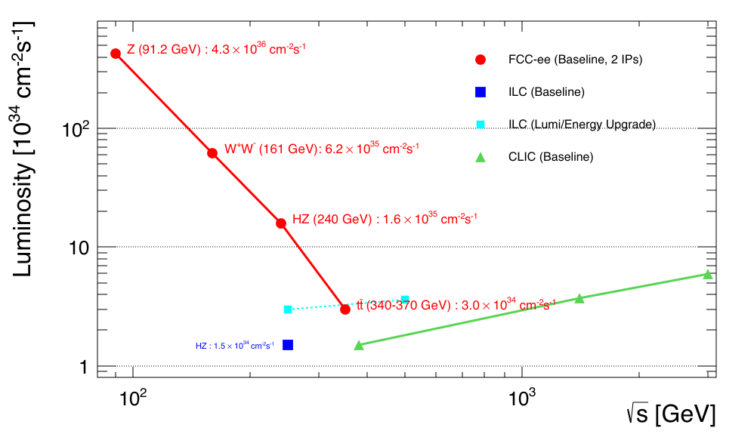
FCC-ee
AB, F. Zimmermann 2011 (LEP3@240 GeV)
Q: Why is luminosity so much higher than LEP?
A: inspired by b-factory designs
-- continuous injection (high efficiency)
-- e+ and e- separate (→many bunches)
-- fix 100 MW Synchrotron Radiation at all E
-- low β*_{y} , O(1mm)
-- larger ring (P_{SR}∝ E⁴/ρ)
-- beam cross at angle (30 mrad)
--
-- asymmetric IP to avoid SR → LEP levels
top-up injection for high duty factor
several schemes possible
Z WW HZ tt
LEPx10⁵!
Luminosity performance
dominated by
-- at Z, WW, H energies:
beam-beam instabilities
→ simulations
-- at top energy: beamstrahlung
depends on value of ε_{y}/ε_{x}
0.2% assumed (0.25%@superKEKB)
0.4% achieved at LEP
-- limit from injector is much higher
based on latest lumi optimization by Shatilov

Slide 11
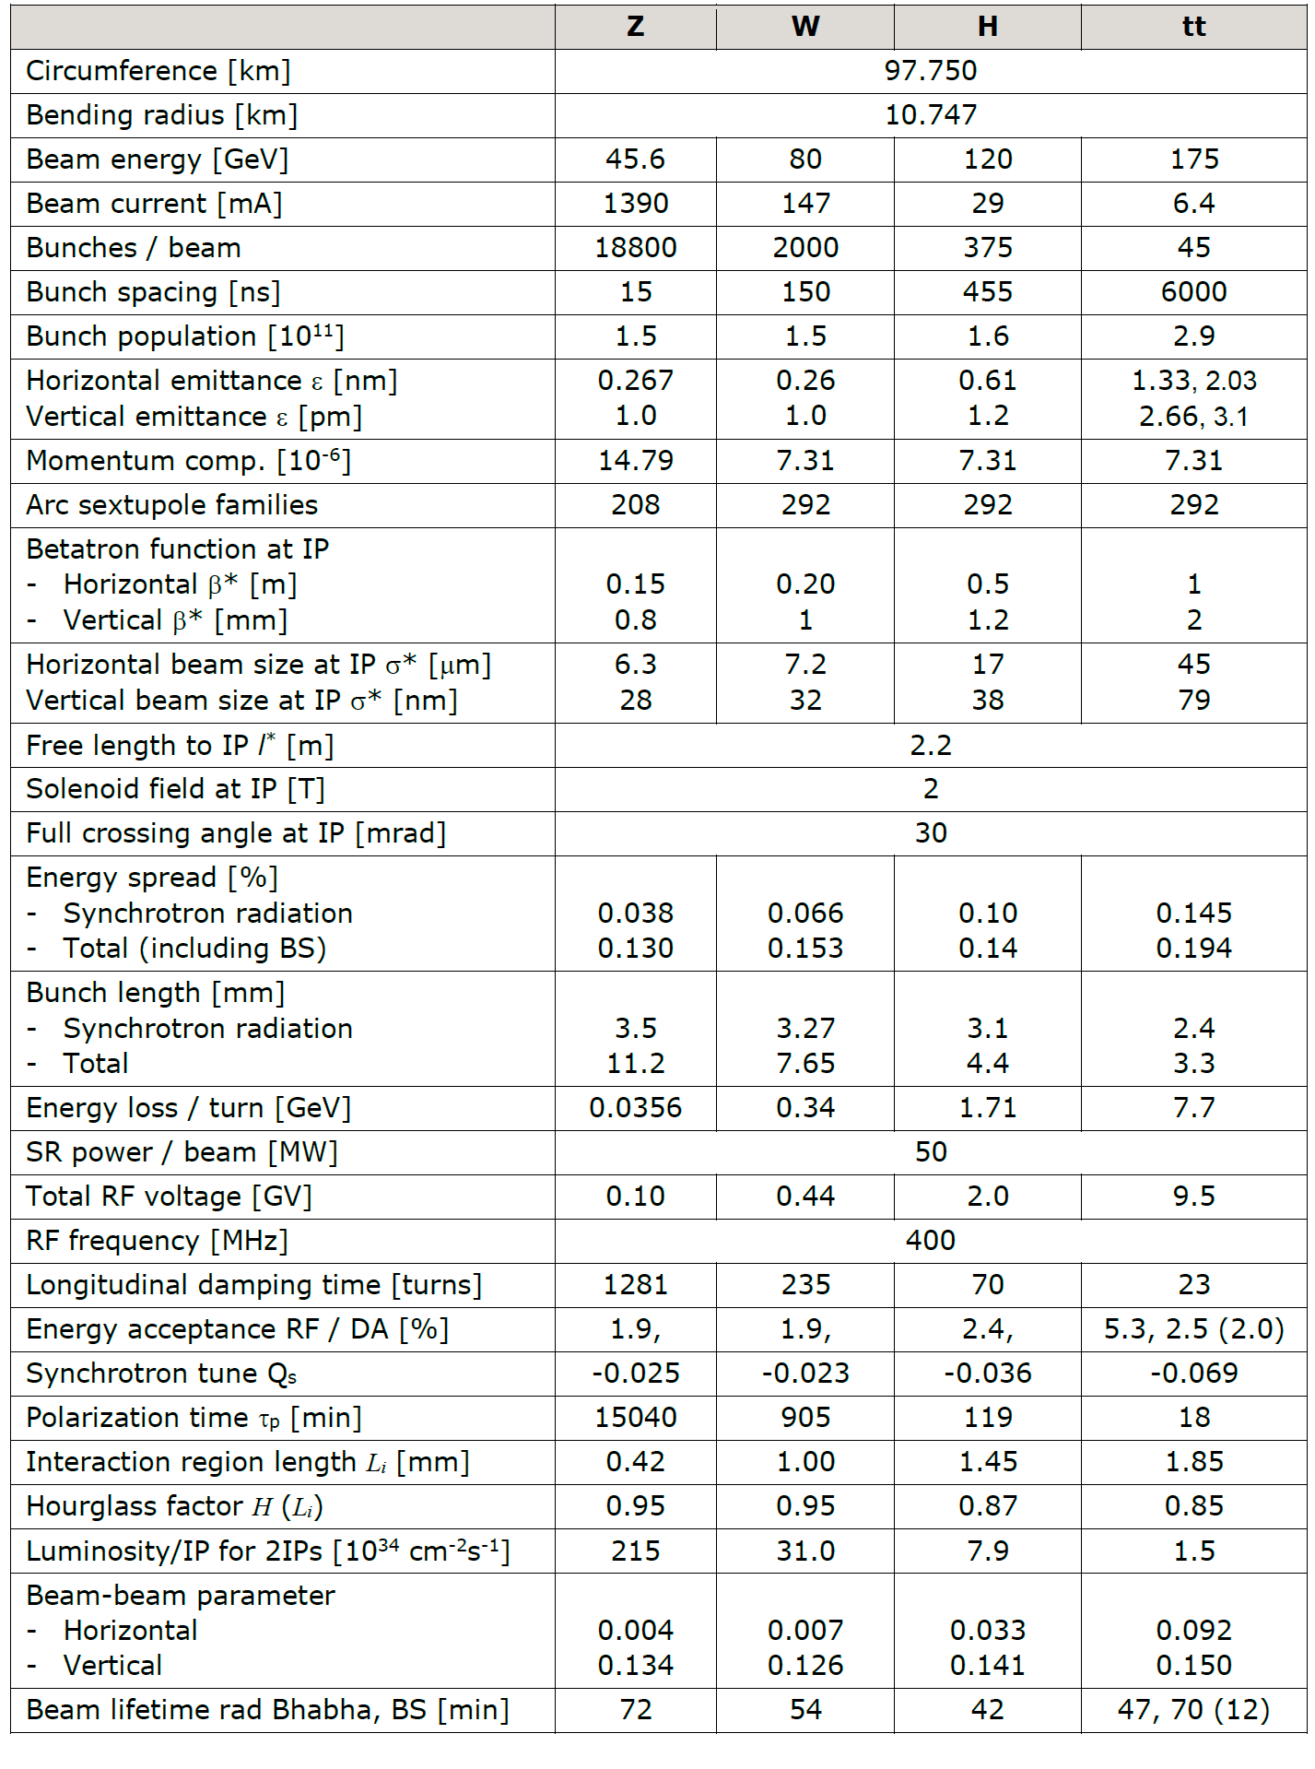
Recent FCC-ee parameter list

Slide 12
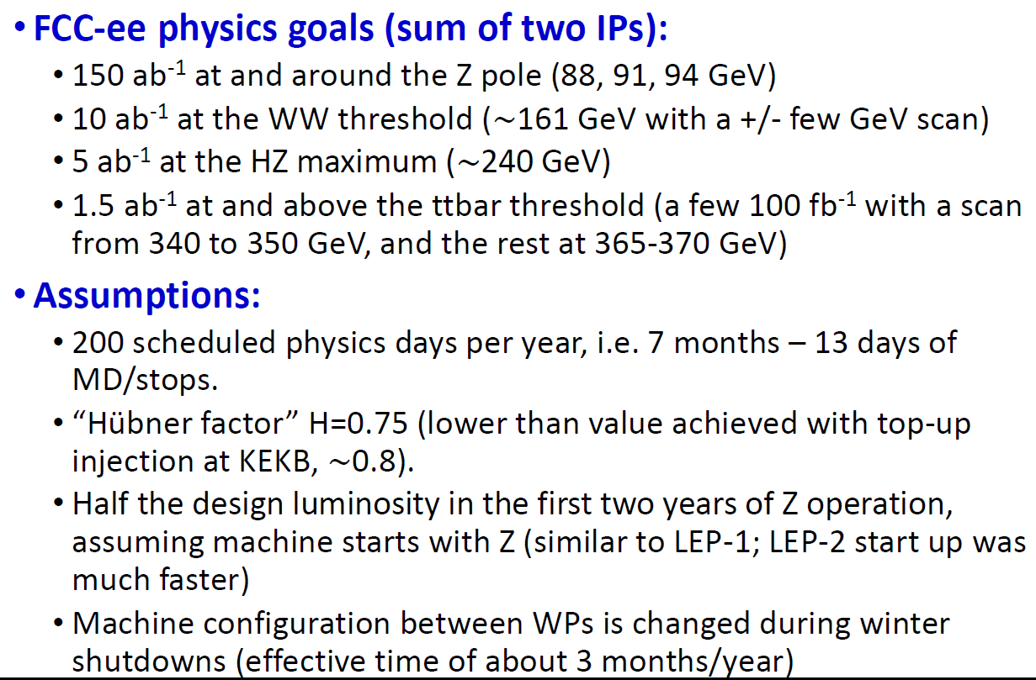
FCC-ee physics run

Slide 13
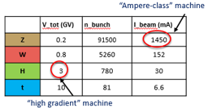
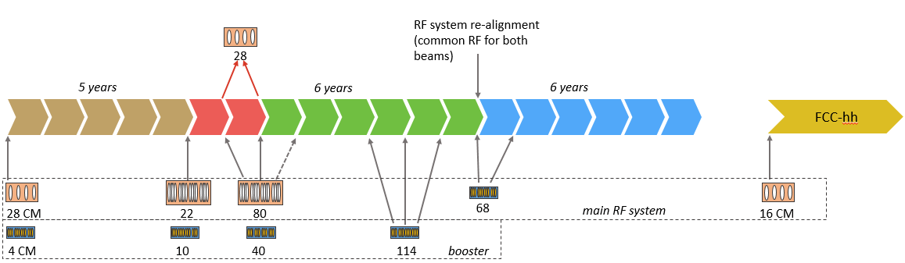
IMPLEMENTATION AND RUN PLAN
Three sets of RF cavities for FCCee & Booster:
Installation as LEP ( ≈30 CM/winter)
high intensity (Z, FCC-hh): 400 MHz mono-cell cavities, ≈ 1MW source
high energy (W, H, t): 400 MHz four-cell cavities, also for W machine
booster and t machine complement: 800 MHz four-cell cavities
Adaptable 100MW, 400MHz RF power distribution system
➔ Spreads the funding profile
Z 150 ab⁻¹
W 10 ab⁻¹
ZH thresh 5ab⁻¹
tt thresh + tt 365 1.5ab⁻¹
4 years
2 yrs
3 years
5 years
indicative: 2(comm) + 2 2 3 5 total ~14 years

Slide 14

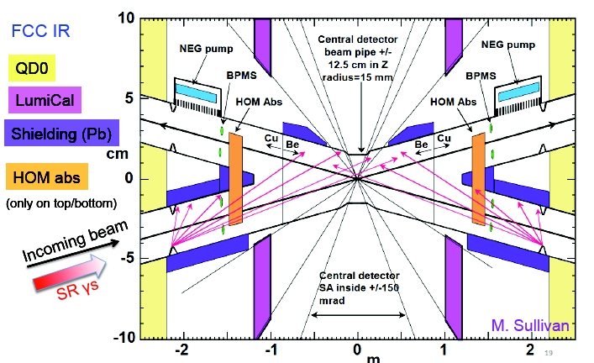
Detailed layout of the Interaction Region
Beam pipe radius at IP is 15mm ☺

Slide 15

Beam Polarization and Energy calibration
First priority is to achieve transverse polarization for precision energy calibration
in a way that allows continuous beam calibration by resonant depolarization
(energy measurement every ~10 minutes on ‘monitoring’ single bunches)
- This is a unique feature of circular e+e- colliders
- baseline running scheme defined with monitoring bunches, wigglers, polarimeter
- the question of the residual systematic error requires further studies of the
relationship between spin tune, beam energy at IRs, and center-of-mass energy
➔ target is O(±100keV) at Z and W pair threshold energies (averaged over data taking)
longitudinal polarization?
➔ lower priority
at Z, W, top: no information that we cannot obtain otherwise
from unpolarized A_{FB} asymmetries or final state polarization (top, tau)
+ too much loss of luminosity in present running scheme to provide gain in precision.

Slide 16
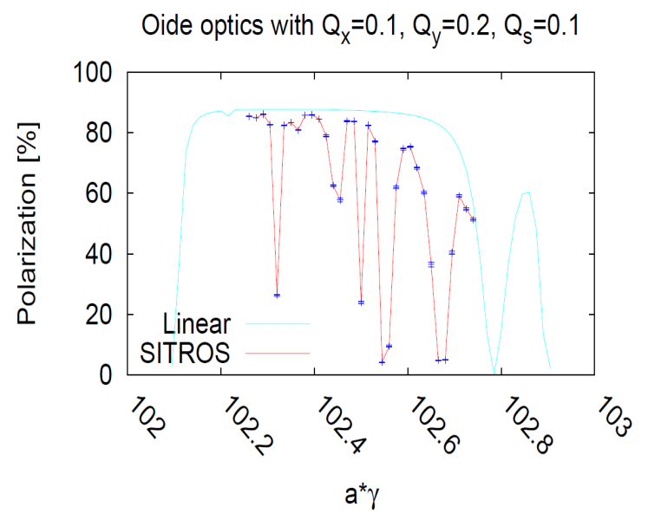
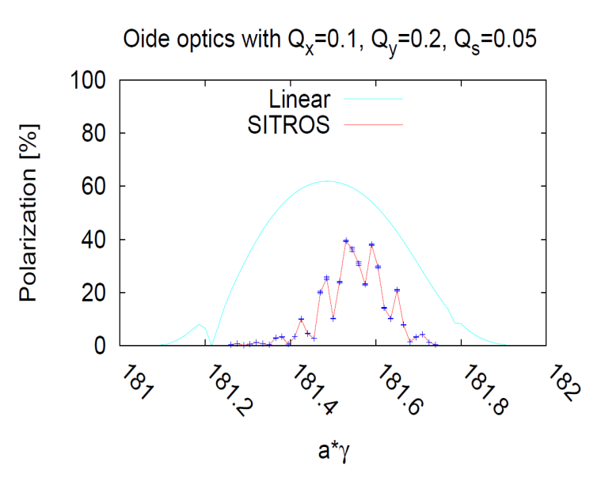
Beam Polarization and Energy calibration
45 GeV
80 GeV
At the Z obtain excellent polarization level
but too slow for polarization in physics
need wigglers for Energy calibration
– OK as long as σ_{Eb}< ~55 MeV
σ_{Eb} ∝ E_{b}²/ρ
At the W expectation similar to LEP at Z
→ enough for energy calibration
Simulations by Eliana Gianfelice

Slide 17
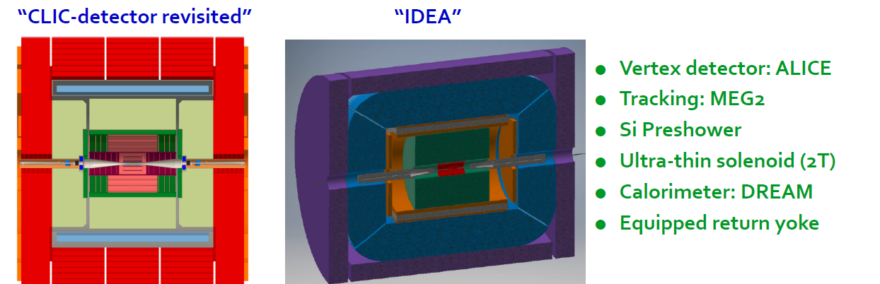
FCC-ee Detectors
Two integration, performance and cost estimates ongoing:
-- Linear Collider Detector group at CERN has undertaken the adaption of
CLIC-SID detector for FCC-ee
-- new IDEA, detector specifically designed for FCC-ee (and CEPC)
MAPS

Slide 18
FCC-ee discovery potential
Today we do not know how nature will surprise us. A few things that FCC-ee could discover :
EXPLORE 10-100 TeV energy scale (and beyond) with Precision Measurements
-- ~20-50 fold improved precision on many EW quantities (equiv. to factor 5-7 in mass)
m_{Z,} m_{W}, m_{top} , sin² θ_{w}^{eff} , R_{b} , α_{QED} (m_{z}) α_{s} (m_{z} m_{W} m_{τ}), Higgs and top quark couplings
DISCOVER a violation of flavour conservation or universality
-- ex FCNC (Z --> μτ , eτ) in 5 10¹² Z decays.
+ flavour physics (10¹² bb events) (B→s τ τ etc..)
DISCOVER dark matter as «invisible decay» of H or Z or in LHC loopholes.
DISCOVER very weakly coupled particle in 5-100 GeV energy scale
such as: Right-Handed neutrinos, Dark Photons etc…
+ an enormous amount of clean, unambiguous work on QCD etc….
NB the «Z factory» plays an important role in the ‘discovery potential’
“First Look at the Physics Case of TLEP”, JHEP 1401 (2014) 164,

Slide 19
100 TeV

Slide 20
Hadron collider parameters
parameter | FCC-hh |  | HE-LHC* | (HL) LHC
collision energy cms [TeV] | 100 |  | >25 | 14
dipole field [T] | 16 |  | 16 | 8.3
circumference [km] | 100 |  | 27 | 27
# IP | 2 main & 2 |  | 2 & 2 | 2 & 2
beam current [A] | 0.5 |  | 1.12 | (1.12) 0.58
bunch intensity [10¹¹] | 1 | 1 (0.2) | 2.2 | (2.2) 1.15
bunch spacing [ns] | 25 | 25 (5) | 25 | 25
beta* [m] | 1.1 | 0.3 | 0.25 | (0.15) 0.55
luminosity/IP [10³⁴ cm⁻²s⁻¹] | 5 | 20 - 30 | >25 | (5) 1
events/bunch crossing | 170 | <1020 (204) | 850 | (135) 27
stored energy/beam [GJ] | 8.4 |  | 1.2 | (0.7) 0.36
synchrotr. rad. [W/m/beam] | 30 |  | 3.6 | (0.35) 0.18
*tentative
Performance easier to achieve with 25 ns second spacing… 5ns preferred by expts!

Slide 21
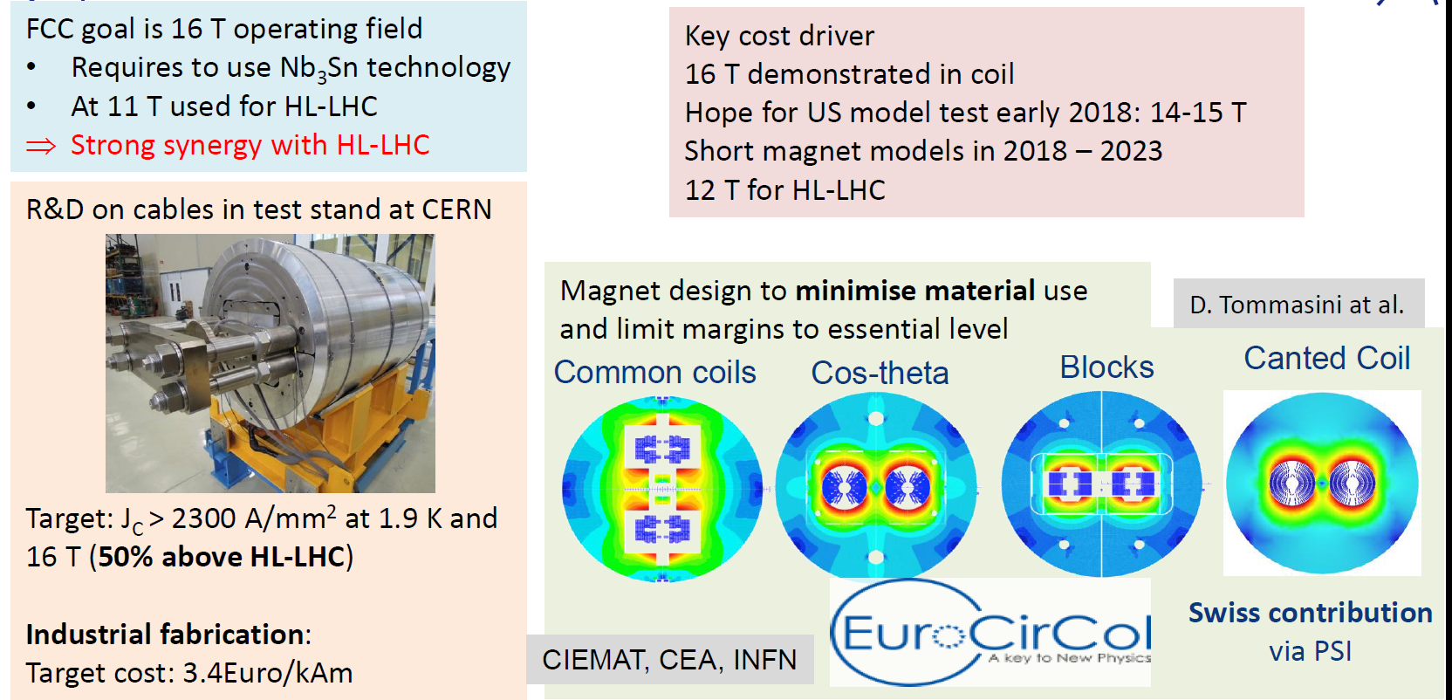
16 T magnets
D. Schulte, EPS’17
-- possible shorter term application SCSPS or HE-LHC
-- For longer timescale HTS is also studied → 20T

Slide 22


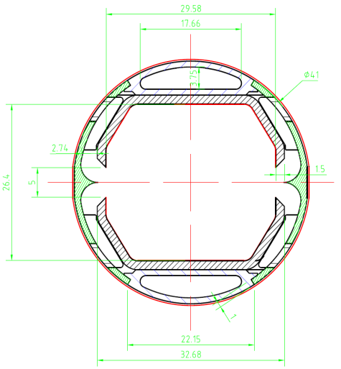
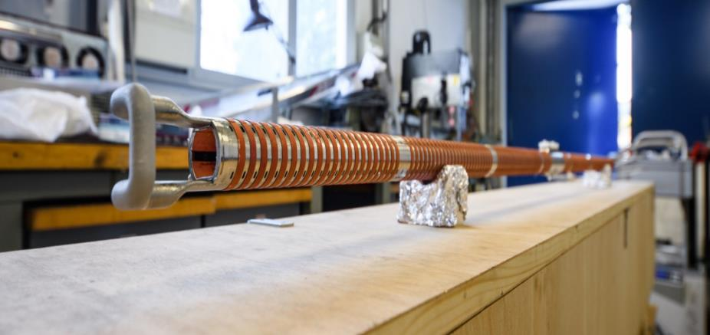
Cryogenic beam vacuum system
One of the most critical elements for FCC-hh
Absorption of synchrotron radiation at ~50 K for cryogenic efficiency (5 MW total power)
Provision of beam vacuum, suppression of photo-electrons, electron cloud effect, impedance, etc.
FCC Beamscreen prototype for test at ANKA:
External copper rings for heat transfer to cooling tubes

Slide 23
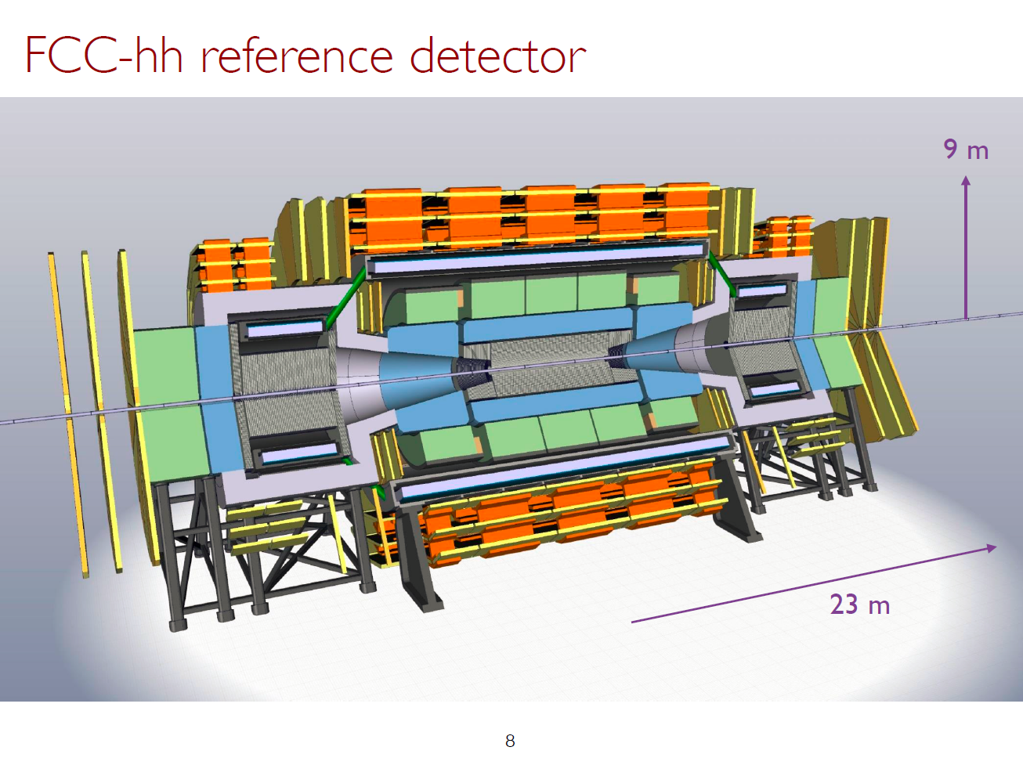
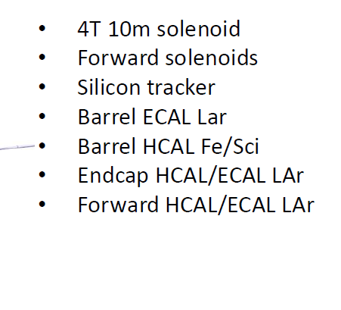
Solenoids in Central *and* forward areas no flux return.

Slide 24
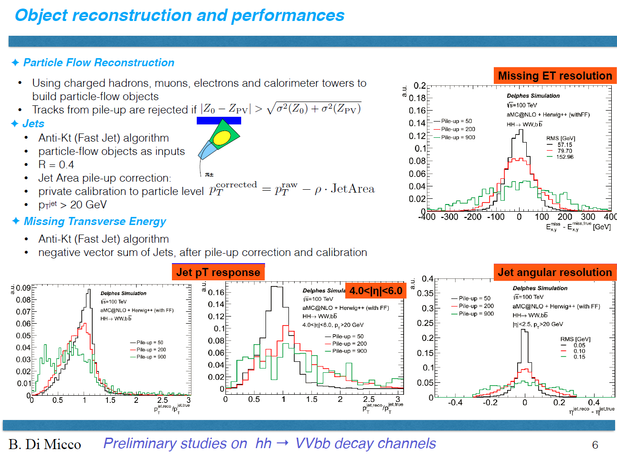

Slide 25
FCC-hh discovery potential
Highlights
FCC-hh is a HUGE discovery machine (if nature …), but not only.
FCC-hh physics is dominated by three features:
-- Highest center of mass energy –> a big step in high mass reach!
ex: strongly coupled new particle up to 50 TeV
Excited quarks, Z’, W’, up to ~tens of TeV
Give the final word on natural Supersymmetry, extra Higgs etc.. reach up to 5-20 TeV
Sensitivity to high energy phenomena in e.g. WW scattering
-- HUGE production rates for single and multiple production of SM bosons (H,W,Z) and quarks
-- Higgs precision tests using ratios to e.g. γγ/μμ/ ττ/ZZ, ttH/ttZ @% level
-- Precise determination of triple Higgs coupling (~3% level) and quartic Higgs coupling
-- detection of rare decays H→ Vγ (V= ρ,ϕ,J/ψ,ϒ,Z…)
-- search for invisibles (DM searches, RH neutrinos in W decays)
-- renewed interest for long lived (very weakly coupled) particles.
-- rich top and HF physics program
-- Cleaner signals for high Pt physics
-- allows clean signals for channels presently difficult at LHC (e.g. H→ bb)

Slide 26
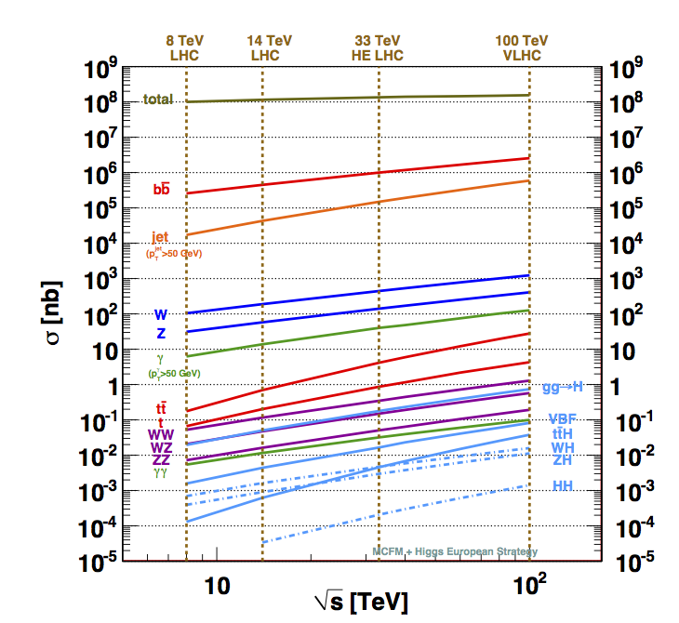
Hadron colliders: direct exploration of the “energy frontier”
Gianotti
Process σ (100 TeV)/σ (14 TeV)
Total pp 1.25
W ~7
Z ~7
WW ~10
ZZ ~10
tt ~30
H ~15 (ttH ~60)
HH ~40
stop ~10³
(m=1 TeV)
arXiv:1310.5189
With 40/ab at √s=100 TeV expect: ~10¹² top, 10¹⁰ H bosons, 10⁵ m=8 TeV gluino pairs, …
If new (heavy) physics discovered at the LHC → completion of spectrum is a “no-lose”
argument for future ~ 100 TeV pp collider: extend discovery potential up to m~50 TeV

Slide 27
FCC-hh discovery potential
Physics at a 100 TeV pp collider: CERN Yellow Report (2017) no.3
1) Standard Model processes: https://arxiv.org/pdf/1607.01831v1.pdf
2) Higgs and EW symmetry breaking studies: https://arxiv.org/pdf/1606.09408v1.pdf
3) Βeyond the Standard Model phenomena: https://arxiv.org/abs/1606.00947
4) Heavy ions at the Future Circular Collider: https://arxiv.org/abs/1605.01389
Now proceeding to ascertain these cross-section calculations with real detector and simulations…

Slide 28
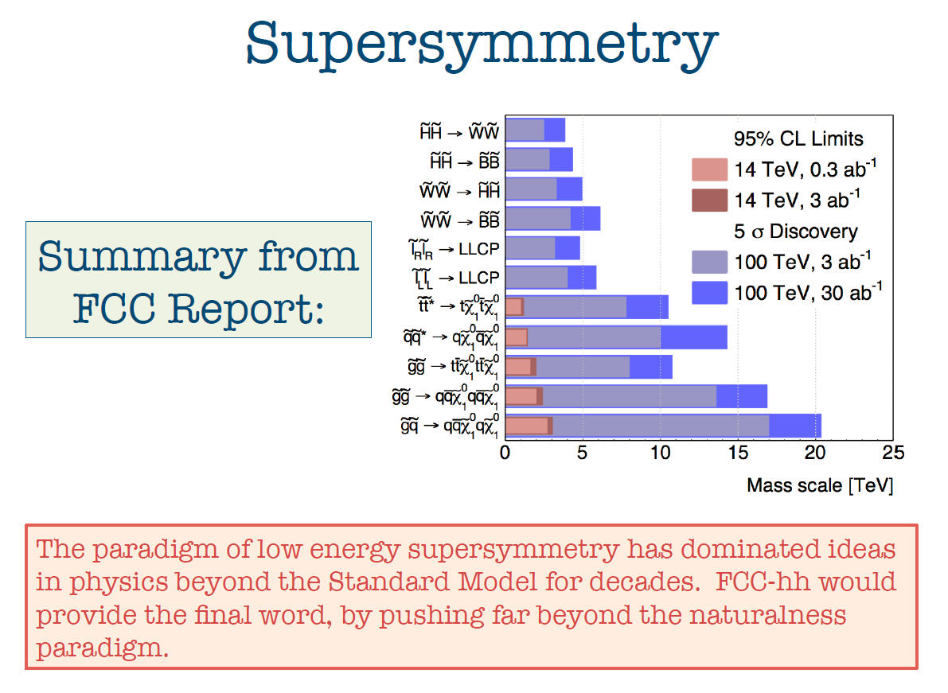

Slide 29
PHYSICS COMPLEMENTARITY
Some examples
Higgs Physics -- ee → ZH fixes Higgs width and HZZ coupling , (and many others)
-- FCC-hh gives huge statistics of HH events for Higgs self-coupling
Search for Heavy Physics
-- ee gives precision measurements (m_{Z} m_{W} to < 0.5 MeV, m_{top} 10 MeV, etc…)
sensitive to heavy physics up to … 100 TeV
-- FCC-hh gives access to direct observation at unprecedented energies
Also huge statistics of Z,W and top → rare decays
QCD -- ee gives α_{s} ± 0.0002 (R_{had} )
also H→gg events (gluon fragmentation!)
-- ep provides tructure functions and α_{s} ± 0.0002
-- all this improves the signal and background predictions
for new physics signals at FCC-hh
Heavy Neutrinos -- ee: very powerful and clean, but flavour-blind
-- hh and eh more difficult, but potentially flavour sensitive
NB this is very much work in progress!!

Slide 30
g_{Hxx} | FCC-ee | FCC-hh | FCC-eh
ZZ | 0.15 %
WW | 0.20%
Γ_{H} | 1%
γγ | 1.5% | <1%
Zγ | -- | 1%
tt | 13% | 1%
bb | 0.4% |  | 0.5%
ττ | 0.5%
cc | 0.7% |  | 1.8%
μμ | 6.2% | 2%
uu,dd | H→ ργ? | H→ ργ?
ss | H→ φγ ? | H→ φγ ?
ee | ee → H
HH | 30% | ~3% | 20%
inv, exo | <0.45% | 10⁻³ | 5%
HIGGS PHYSICS
Higgs couplings g_{Hxx} precisions
hh, eh precisions assume
SM or ee measurements

Slide 31
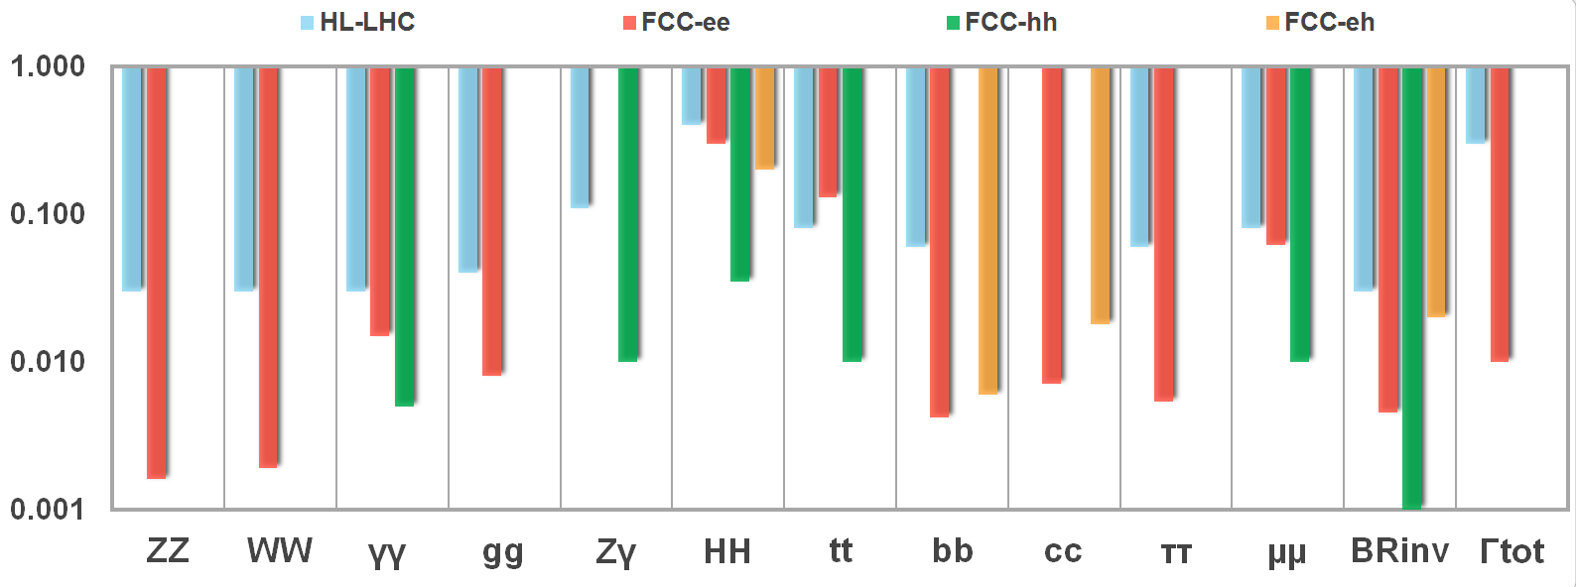
NB this is an ‘impression plot’ not the consistent result of a Higgs coupling fit!
hh, eh precisions assume SM or ee measurements!

Slide 32
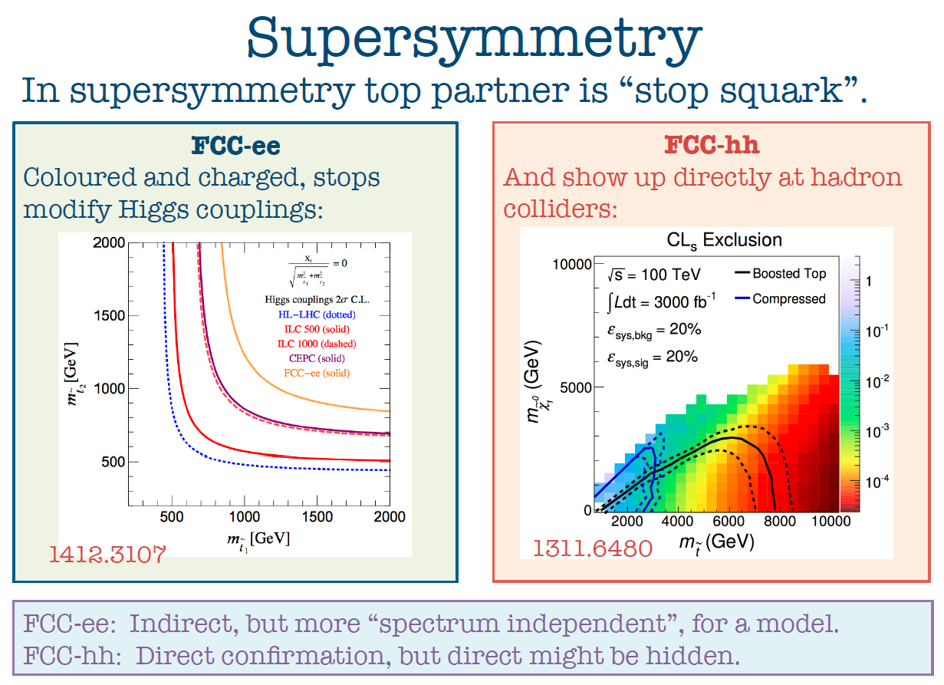

Slide 33
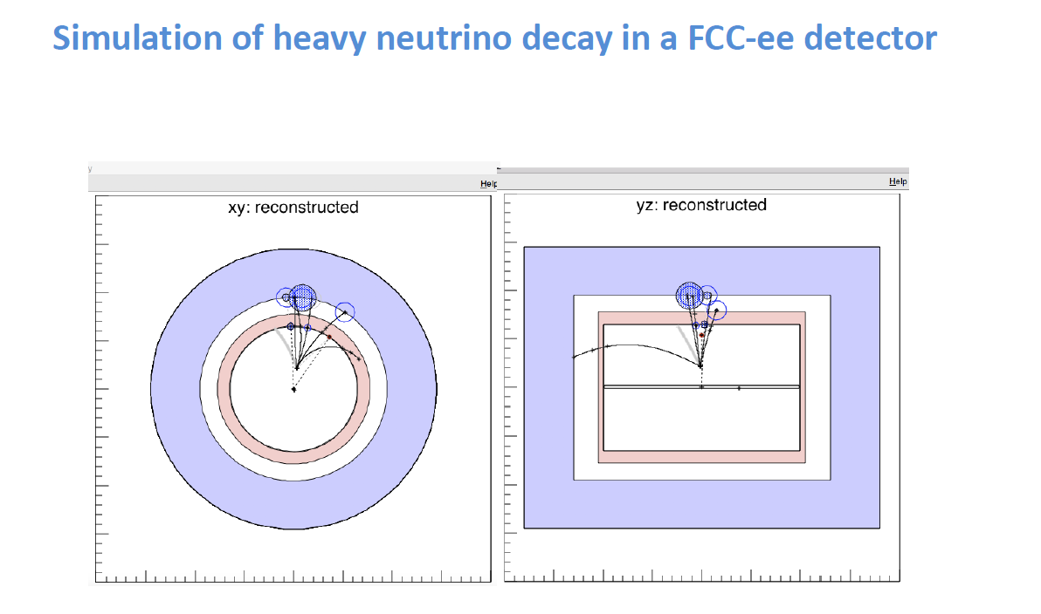

Slide 34
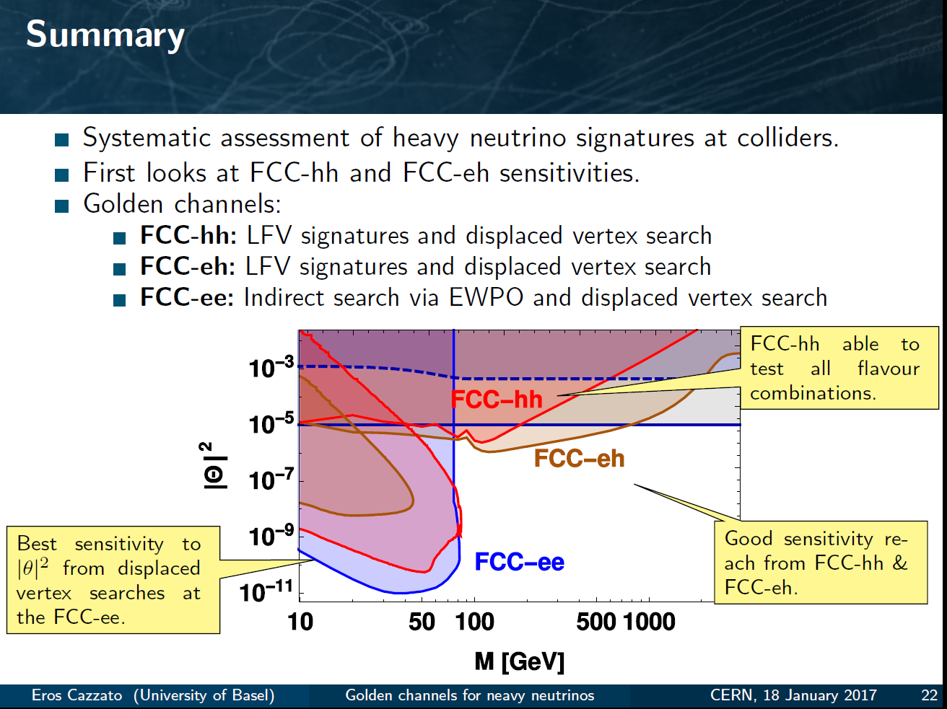
Another example of Synergy and complementarity
while ee covers a large part of space very cleanly ,
its either ‘white’ in lepton flavour or the result of EWPOs etc
Observation at FCC –hh or eh would test flavour mixing matrix!
EWPO
sensitivity
up to very high mass scales
detailed study required for all FCCs – especially FCC-hh to understand feasibility at all

Slide 35
CONCLUSIONS
CONCLUSIONS
-- The FCC design study is establishing the feasibility or the path to feasibility of an ambitious set of colliders after LEP/LHC, at the cutting edge of knowledge and technology.
-- Both FCC-ee and FCC-hh have outstanding physics cases
-- each in their own right
-- the sequential implementation of FCC-ee, FCC-hh, FCC-eh
would maximise the physics reach
-- Attractive scenarios of staging and implementation (budget!) cover more than 50 years of exploratory physics, taking full advantage of the synergies and complementarities.
-- the FCC are shaping up as the most natural, complete and powerful aspiration of HEP for its long-term future

Slide 36
CONCLUSIONS
CONCLUSIONS
-- The FCC design study is establishing the feasibility or the path to feasibility of an ambitious set of colliders after LEP/LHC, at the cutting edge of knowledge and technology.
-- Both FCC-ee and FCC-hh have outstanding physics cases
-- each in their own right
-- The sequential implementation of FCC-ee, FCC-hh, FCC-eh
would maximise the physics reach
-- Attractive scenarios of staging and implementation (budget!) cover more than 50 years of exploratory physics, taking full advantage of the synergies and complementarities.
-- the FCC are shaping up as the most natural, complete and powerful aspiration of HEP for its long-term future

Slide 37
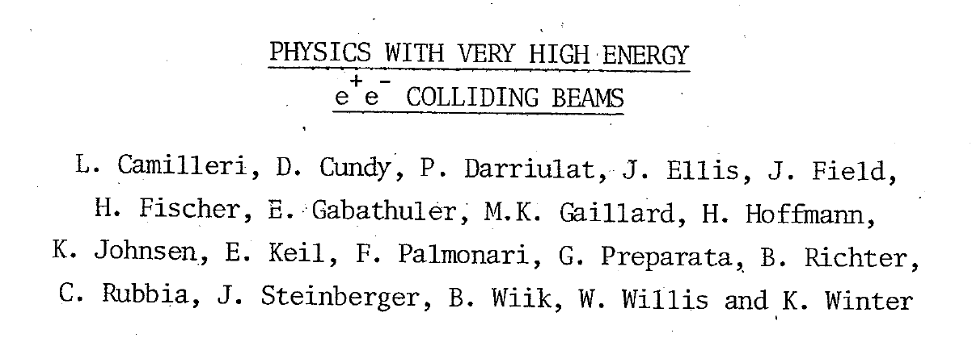
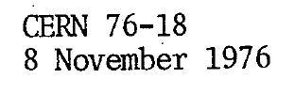
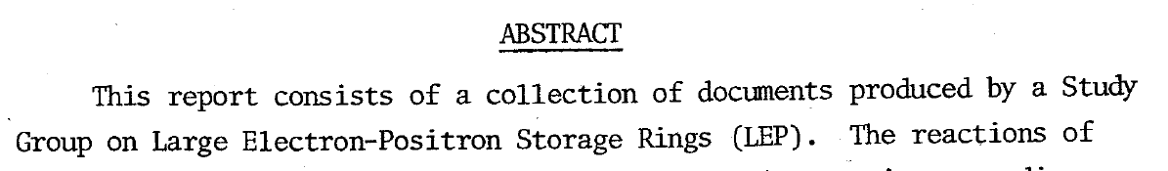
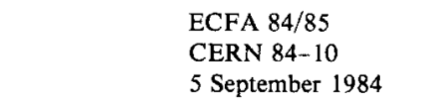
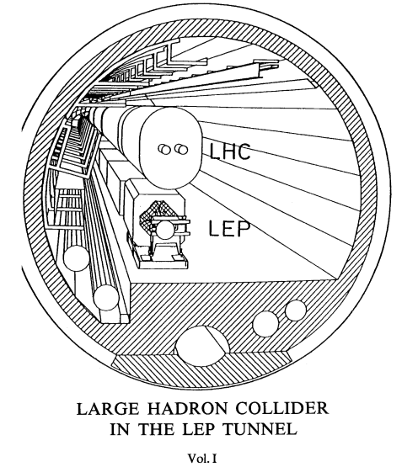
A successful model!
Did these people know that we would be running HL-LHC in that tunnel >60 years later?
e+e- 1989-2000
p p 2009-2039
Let’s not be SHY!

Slide 38
Back up slides

Slide 39
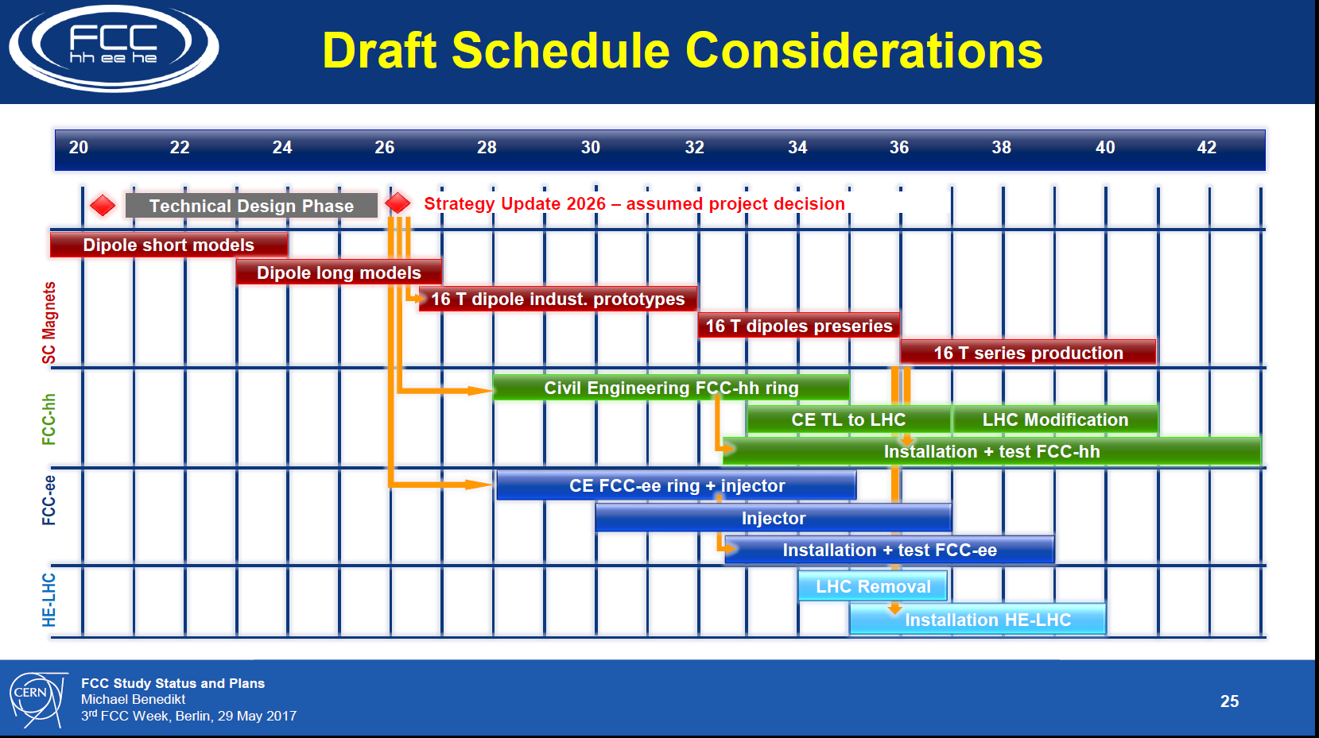

Slide 40
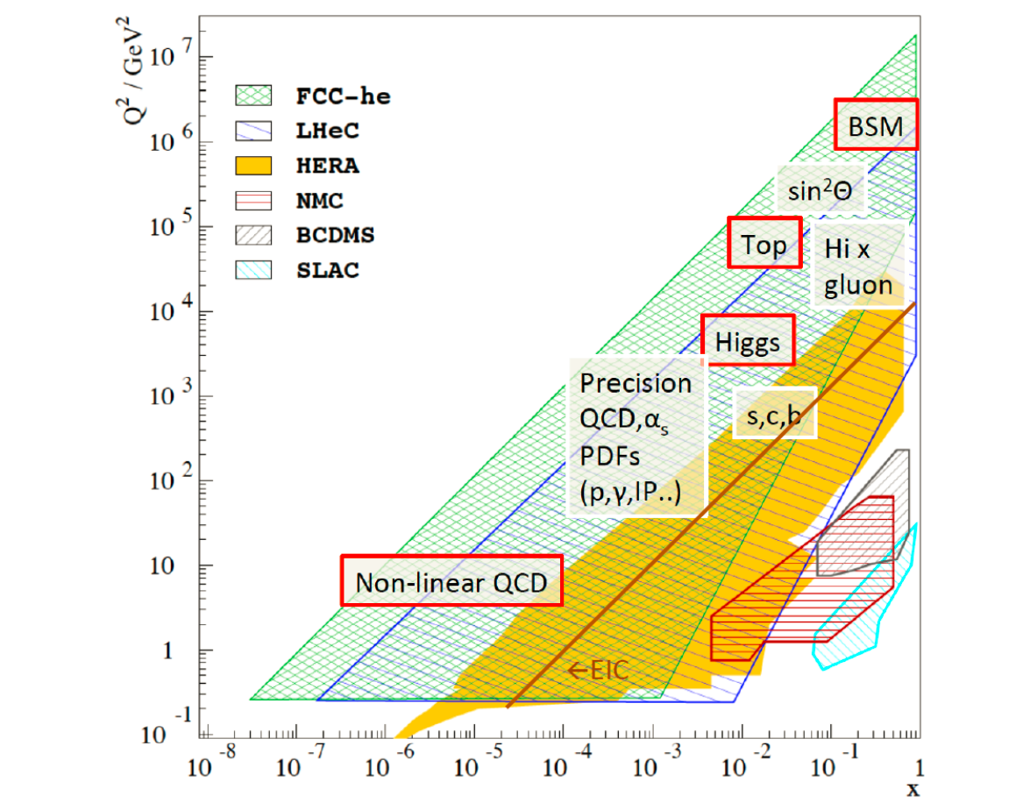

Slide 41
Physics references
FCC-ee
-- First look at the physics case of TLEP JHEP 1401 (2014) 164 arXiv:1308.6176
-- “Precision Observables and Radiative Corrections”, https://indico.cern.ch/event/387296/
-- “Higgs at FCC-ee”, https://indico.cern.ch/event/401590/
-- “High-precision α_{S} measurements: from LHC to FCC-ee”, https://indico.cern.ch/event/392530/
serie ongoing: FCC-ee physics Indico: https://indico.cern.ch/category/5259/
Physics at a 100 TeV pp collider: CERN Yellow Report (2017) no.3
1) Standard Model processes: https://arxiv.org/pdf/1607.01831v1.pdf
2) Higgs and EW symmetry breaking studies: https://arxiv.org/pdf/1606.09408v1.pdf
3) Βeyond the Standard Model phenomena: https://arxiv.org/abs/1606.00947
4) Heavy ions at the Future Circular Collider: https://arxiv.org/abs/1605.01389
LHeC and FCC-eh
• “A Large Hadron Electron Collider at CERN: Report on the Physics and Design Concepts for Machine and Detector”, J.Phys. G39 (2012) 075001
• LHeC Workshop (24-26 June 2015) https://indico.cern.ch/event/356714/
• Higgs at LHeC/FCC-eh: WG mtgs at https://indico.cern.ch/category/1874/

Slide 42
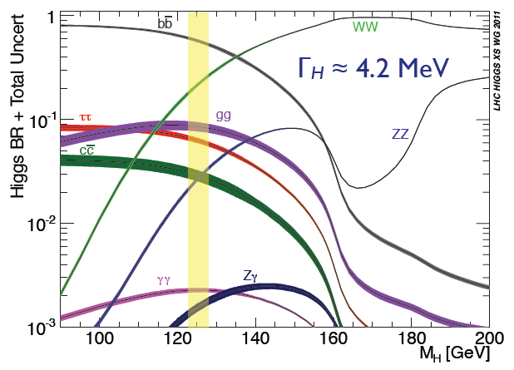
Higgs Physics
The only known spin = 0 elementary particle
We must study it as well and thoroughly as we can
Aram Apyan
Michelangelo Mangano
Biagio Di Micco
Fady Bishara
Ennio Salvioni
Masahiro Tanaka
Gilad Perez
μμ

Slide 43
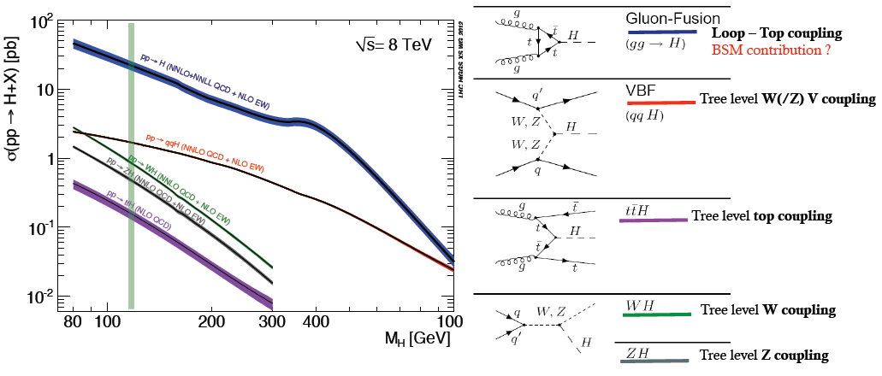
The LHC is a Higgs Factory !
Difficulties: several production mechanisms to disentangle and
significant systematics in the production cross-sections σ_{prod} .
Challenge will be to reduce systematics by measuring related processes.
σ_{i→f} ^{observed} ∝ σ_{prod} (g_{Hi} )²(g_{Hf})² overall normalization by Γ_{H} required
Γ_{H} this is also true for FCC-hh and FCC-ep

Slide 44
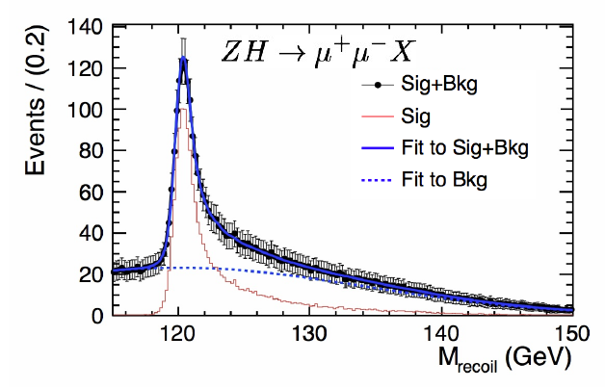
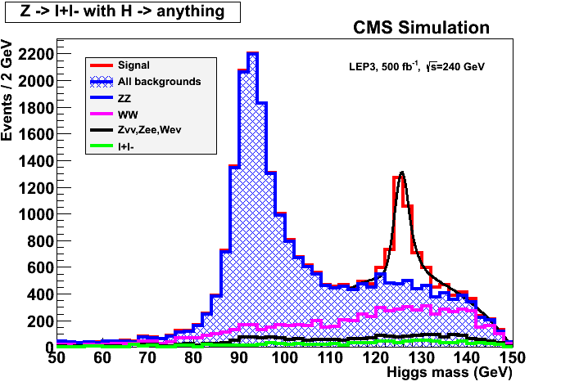
ILC
FCC-ee
H signal in missing mass
total rate ∝ g_{HZZ}²
ZZZ final state ∝ g_{HZZ}⁴/ Γ_{H}
➔ measure total width Γ_{H} and g_{HZZ}
empty recoil = invisible width
‘funny recoil’ = exotic Higgs decay
easy control below theshold
e⁻
H
Z*
e⁺
Z
UNIQUE!
The ability to measure the Higgs cross-section
without seeing the Higgs is crucial for this.

Slide 45
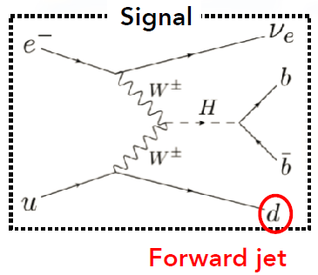
σ_{ep→H->bb} ^{observed} ∝ σ_{prod} (g_{Hww} )²(g_{Hbb})²
Γ_{H}
because Γ_{H→ bb}~ 0.6 Γ_{H} sensitivity to g_{Hbb} is
reduced by factor 1/(1-0.6) =2.5
0.4% meast of x-section→ 0.5 % on g_{Hbb} coupling
for complementarity study,
suggest to include bb, cc in global fit with ee results
simillarly for HH result

Slide 46
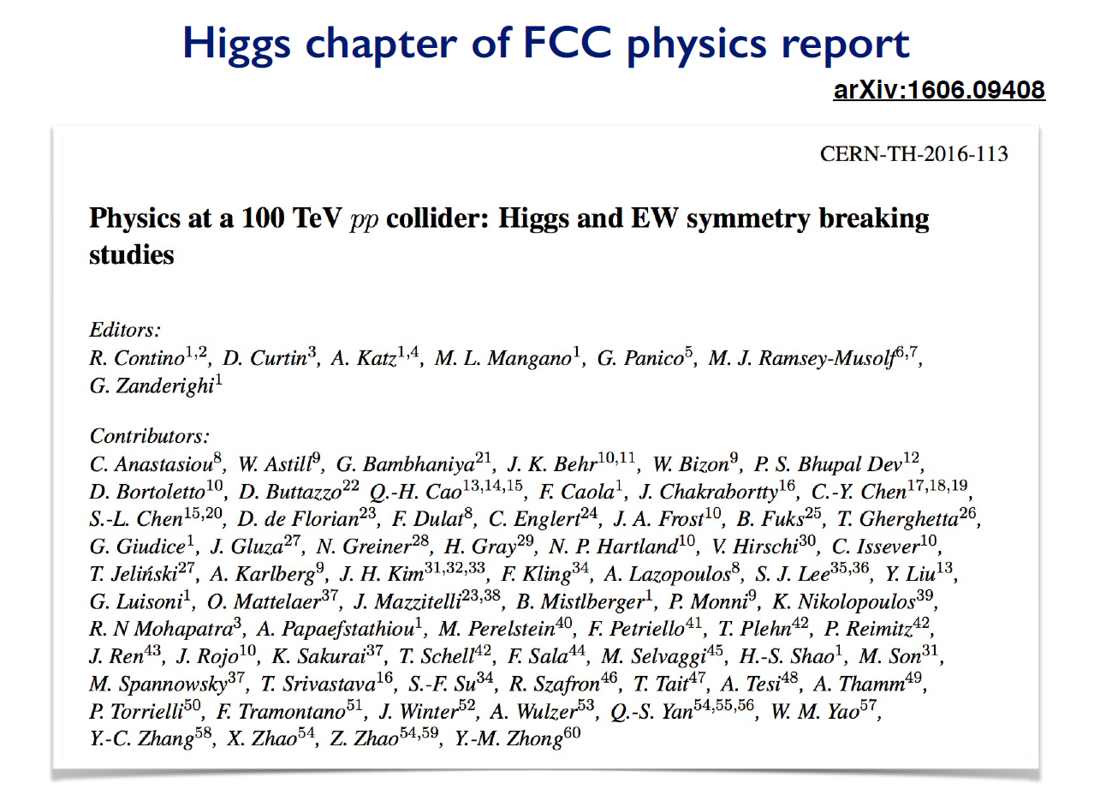

Slide 47
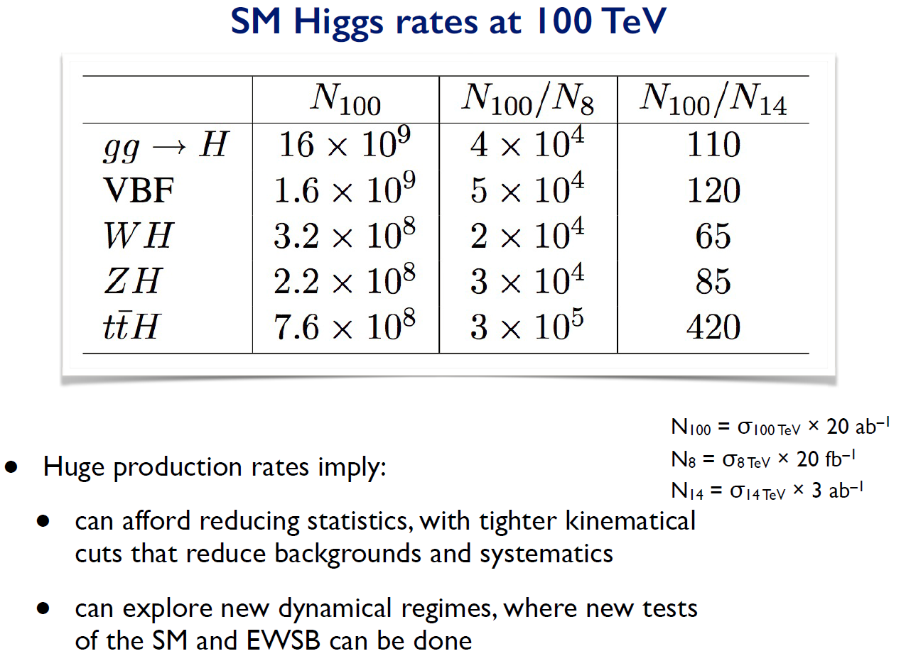
>10⁹ H produced

Slide 48
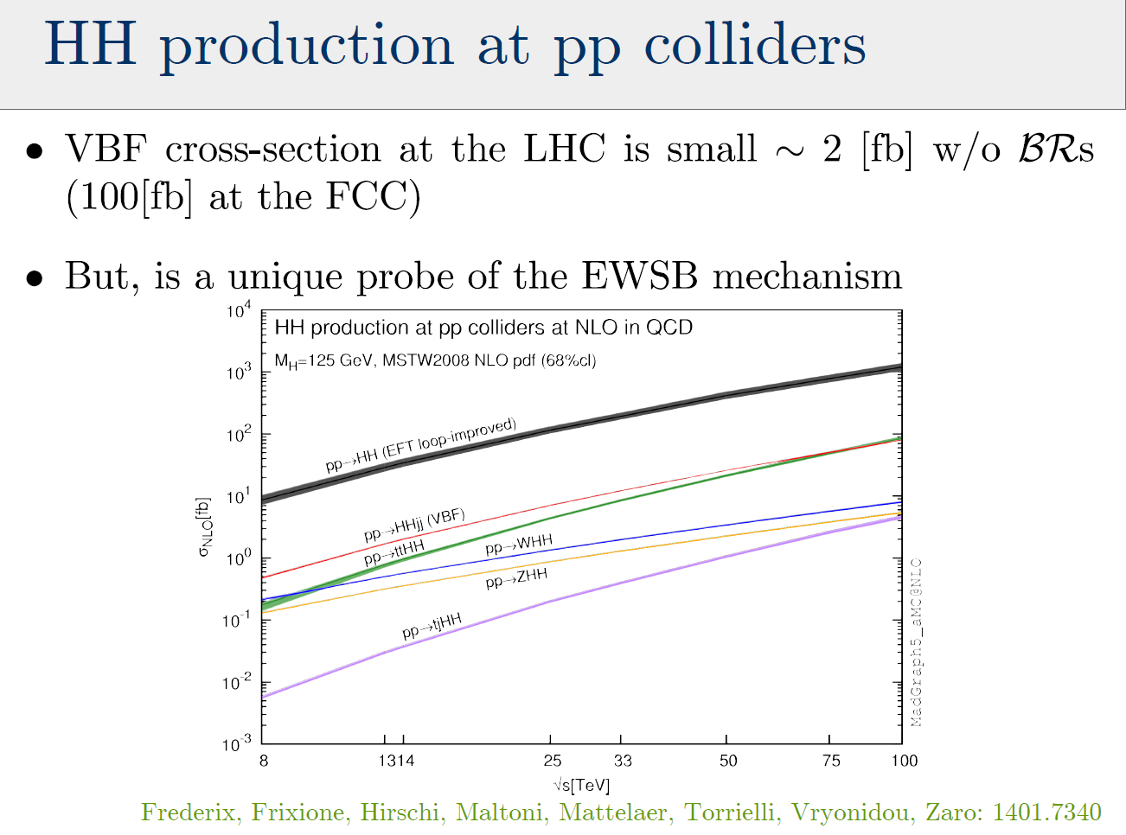

for L= 2 10³⁵/cm²
This is 200 times the LHC rate.

Slide 49


Slide 50
g_{Hxx} | FCC-ee | FCC-hh | FCC-eh
ZZ | 0.15 %
WW | 0.20%
Γ_{H} | 1%
γγ | 1.5% | <1%
Zγ | -- | 1%
tt | 13% | 1%
bb | 0.4% |  | 0.5%
ττ | 0.5%
cc | 0.7% |  | 1.8%
μμ | 6.2% | 2%
uu,dd | H→ ργ? | H→ ργ?
ss | H→ φγ ? | H→ φγ ?
ee | ee → H
HH | 30% | <5% | 20%
inv, exo | <0.45% | 10⁻³ | 5%
HIGGS PHYSICS
NB precisions on g_{Hxx}
hh, eh precisions assume ee measurements!

Slide 51
NB this is an ‘impression plot’ not the consistent result of a Higgs coupling fit!

Slide 52

Luminosity measurement challenging: L* is small.
Use mainly for Z line shape and fast lumi.
For absolute measurements can use large angle e+e- → γγ

Slide 53
A Sample of Essential Quantities:
X | Physics | Present precision |  | TLEP stat Syst Precision | TLEP key | Challenge
M_{Z} MeV/c2 | Input | 91187.5 ±2.1 | Z Line shape scan | 0.005 MeV <±0.1 MeV | E_cal | QED corrections
Γ_{Z} MeV/c2 | Δρ (T) (no Δα!) | 2495.2 ±2.3 | Z Line shape scan | 0.008 MeV <±0.1 MeV | E_cal | QED corrections
R_{l} | α_{s ,} δ_{b} | 20.767 ± 0.025 | Z Peak | 0.0001 ± 0.0002 | Statistics | QED corrections
N_{ν} | Unitarity of PMNS, sterile ν’s | 2.984 ±0.008 | Z Peak Z+γ(161 GeV) | 0.00008 ±0.004 0.0004-0.001 | ->lumi meast Statistics | QED corrections to Bhabha scat.
R_{b} | δ_{b} | 0.21629 ±0.00066 | Z Peak | 0.000003 ±0.000020 - 60 | Statistics, small IP | Hemisphere correlations
A_{LR} | Δρ, ε_{3 ,}Δα (T, S ) | 0.1514 ±0.0022 | Z peak, polarized | ±0.000015 | 4 bunch scheme | Design experiment
M_{W} MeV/c2 | Δρ, ε_{3 ,} ε_{2,} Δα (T, S, U) | 80385 ± 15 | Threshold (161 GeV) | 0.3 MeV <0.5 MeV | E_cal & Statistics | Backgrounds, QED/EW
m_{top} MeV/c2 | Input | 173340 ± 760 | Threshold scan | 10 MeV | E_cal & Statistics | Theory limit at 50 MeV?

Slide 54



Top physics
Top mas can be measured to O(10 MeV)
Beam energy calibration from WW, γZ, ZZ
Reduce th. errors due α_{S} meast @FCC-ee
Top beam energy is 185 GeV
Also:
CKM measurements
FCNC decays down to 10⁻⁶
All luminosity can be used!

Slide 55


Theoretical limitations
FCC-ee
R. Kogler, Moriond EW 2013
SM predictions (using other input)
0.0002
0.0001
0.0003
0.0005
0.0001
0.0000
0.0000015
0.000001
0.00001
0.00001
0.0000014
0.000000
Experimental errors at FCC-ee will be 20-100 times smaller than the present errors.
BUT can be typically 10 -30 times smaller than present level of theory errors
Will require significant theoretical effort and additional measurements!
Radiative correction : need for 3 loop calculations for the future!
Suggest including manpower for theoretical calculations in the project cost.

Slide 56


Slide 57

McCullough

Slide 58


Slide 59

McCullough

Slide 60


Slide 61


Slide 62










Electroweak eigenstates
$$\left({e \atop v_{e}}\right)$$
$$\left({ \atop v_{μ}}\right)$$
$$\left({ \atop v_{τ}}\right)$$
$$\left(e\right)$$
$$\left(\right)$$
$$\left(\right)$$
Q= -1
R
R
R
L
L
L
$$\left(_{e}\right)$$
$$\left(_{μ}\right)$$
$$\left(_{τ}\right)$$
Q= 0
R
R
R
I = 1/2
I = 0
Right handed neutrinos
are singlets
no weak interaction
no EM interaction
no strong interaction
can’t produce them
can’t detect them
-- so why bother? –
Also called ‘sterile’

Slide 63


Mass eigenstates
See-saw type I :
M_{R} ≠ 0
m_{D} ≠ 0
Dirac + Majorana
mass terms
see-saw
M_{R} = 0
m_{D} ≠ 0
Dirac only, (like e- vs e+):
ν_{L} ν_{R} ‾ν_{L} ‾ν_{R}
½ 0 ½ 0
4 states of equal masses
M_{R} ≠ 0
m_{D} = 0
Majorana only
ν_{L} ‾ν_{R}
½ ½
2 states of equal masses
M_{R} > m_{D} ≠ 0
Dirac + Majorana
ν N ‾ν ‾N
½ 0 ½ 0
4 states , 2 mass levels
m
m
m
I_{weak}=
dominantly:
I_{weak}=
I_{weak}=
Some have I=1/2 (active)
Some have I=0 (sterile)
All have I=1/2 (active)
m₁ have ~I=1/2 (~active)
m₂ have ~I=0 (~sterile)

Slide 64






Manifestations of right handed neutrinos
$v$ = light mass eigenstate
N = heavy mass eigenstate
≠ $vL$ , active neutrino
which couples to weak inter.
and ≠ N_{R}, which does’nt.
one family see-saw :
θ ≈ (m_{D}/M)
$mv$ ≈ $\frac{mD2}{M}$
m_{N} ≈ M
|U|² ∝ θ² ≈ $mv$/ m_{N}
$v= vL$ cosθ - ${Nc}_{R }^{} sin$θ
$N=N_{R}^{} \text{cos}\text{θ}+ vL$ ^{c} sinθ
what is produced in W, Z decays is:
$vL= v$ cosθ + $N_{ }^{}sin$θ
-- mixing with active neutrinos leads to various observable consequences
-- if very light (eV) , possible effect on neutrino oscillations
-- if in keV region (dark matter), monochromatic photons from galaxies with E=m_{N}/2
-- possibly measurable effects at High Energy
If N is heavy it will decay in the detector (not invisible)
➔ PMNS matrix unitarity violation and deficit in Z «invisible» width
➔ Higgs, Z, W visible exotic decays H→ ν_{i}‾Ν_{i} and Z→ ν_{i}‾Ν_{i} , W-> l_{i} ‾Ν_{i}
➔ also in K, charm and b decays via W*-> l_{i} ±‾Ν , Ν → l_{j} ±
with any of six sign and lepton flavour combination
➔ violation of unitarity and lepton universality in Z, W or τ decays
-- etc... etc...
-- Couplings are very small ($mv$/ m_{N}) (but who knows?) and generally seem
out of reach at high energy colliders.

Slide 65









Search for heavy right-handed neutrinos in collider experiments.
B factories
Hadron colliders
+
+
or$l$±ν
(*)
-
Z factory (FCC-ee, Tera-Z)
HE Lepton Collider (LEP2, CEPC, CLIC, FCC-ee, ILC, μμ)
arXiv:1411.5230
Phys. Rev. D 92, 075002 (2015)
arXiv:1503.05491

Slide 66



RH neutrino production in Z decays
Production:
multiply by 2 for antineutrino and add contributions of 3 neutrino species (with different |U|²)
Decay
Decay length:
cm
NB CC decay always leads to
≥ 2 charged tracks
Backgrounds : four fermion: e+e- → W*⁺ W*⁻ e+e- → Z*(vv) + (Z/γ)*
Long life time → deta ched vertex for ~<M_{Z}

Slide 67
Another example of Synergy
while ee covers a large part of space very cleanly ,
its either ‘white’ in lepton flavour or the result of EWPOs etc
Observation at FCC –hh or eh would test flavour mixing matrix!
EWPO
detailed study required for all FCCs – especially FCC-hh to understand feasibility at all

Slide 68

A successful model!
p p 2009-2039
e+e- 1989-2000

Slide 69

A successful model!
~60
years!
e+e- 1989-2000
p p 2009-2039

Slide 70
FCC-ee may serve as spring board for the FCC-hh 100 TeV pp collider, bringing a large tunnel, infastructure, cryogenics, time, addt‘l physics motivations + performance goals for FCC-hh Zimmermann

Slide 71


Slide 72


Slide 73
FCC-hh new layout
Two high-luminosity experiments (A & G)
Two other experiments combined with injection (L & B)
Two collimation insertions
  Betatron cleaning (J)
  Momentum cleaning (F)
Extraction insertion (D)
Clean insertion with RF (H)
Compatible with LHC or SPS as injector
New features:
Overall length 97.75 km
Economy length 2.25 km
Injections upstream side of experiments
Avoids mixing of extraction region and high-radiation collimation areas
Taking this layout as fixed
(for CDR preparation)

