Slide 1

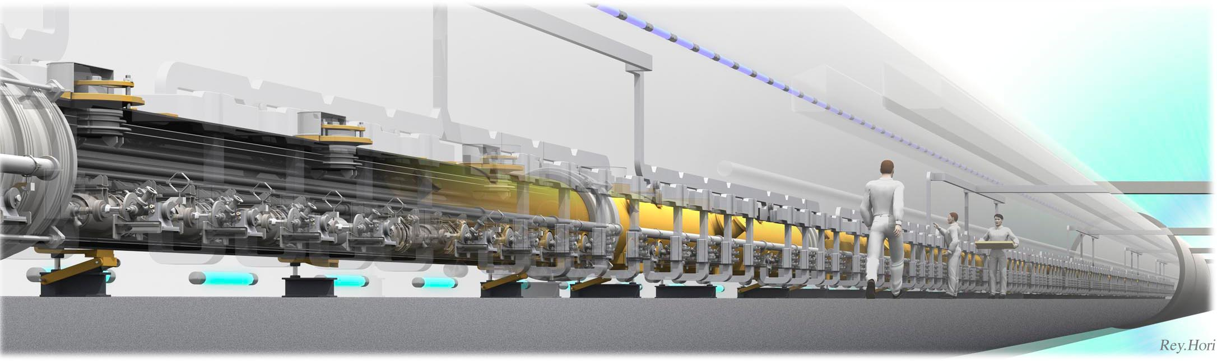
ILC Status
August 12, 2017
The 28th International Symposium on Lepton and Photon Interactions at High Energies
Sun Yat-Sen University, Guangzhou, China
M.Yamauchi
KEK

Slide 2
Outline
Introduction to the International Linear Collider
ILC accelerator à la TDR
Physics case of 250GeV/500GeV ILC
Status of ILC in Japan
R&D program for ILC
Summary and outlook

Slide 3
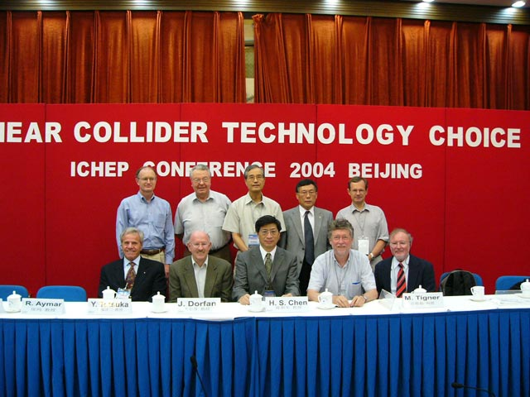
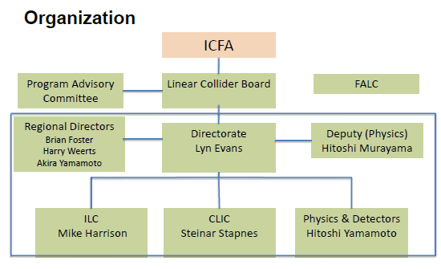
Introduction – Brief history of ILC
R&D for a future e+e- linear collider began more than 20 years ago in the three regions.
By early 2000’s, it became a consensus among the world HEP community that an e⁺e⁻ linear collider with the CM energy of about 500 GeV should be the next collider beyond the LHC.
ICFA chose the cold technology for LC as a global project, and set up a global team (GDE) for design and coordination of R&D for the ILC.
After eight years of works, the TDR of the ILC was published in June 2013. ICFA set up the Linear Collider Collaboration for engineering design phase.

Slide 4
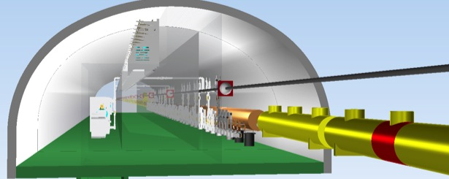
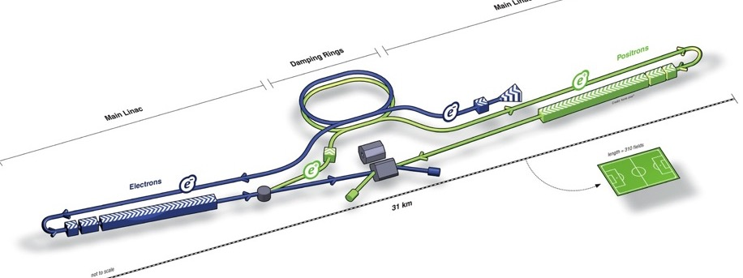
ILC accelerator à la TDR
RF Distribution
Cryomodules
RF Power Source
e- Source
Damping Ring
e+ Main Linac
e+ Source
Item | Parameters
C.M. Energy | 500 GeV
Length | 31 km
Luminosity | 1.8 x10³⁴ cm⁻²s⁻¹
Repetition | 5 Hz
Beam Pulse Period | 0.73 ms
Beam Current | 5.8 mA (in pulse)
Beam size (y) at FF | 5.9 nm
SRF Cavity G. Q₀ | 31.5 MV/m Q₀ = 1x10 ¹⁰
e- Main Linac
Key Technologies
Nano-beam Technology
SRF Accelerating Technology

Slide 5

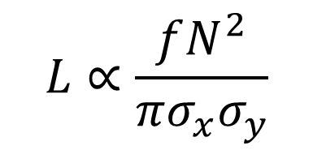
Nano beams
Beam power ~ cost
$$L∝\frac{fN^{2}}{πσ_{x}σ_{y}}$$
smaller beam cross section
Focusing beam
Stable Collision
Final Focus system

Slide 6
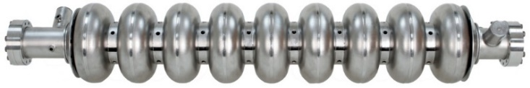
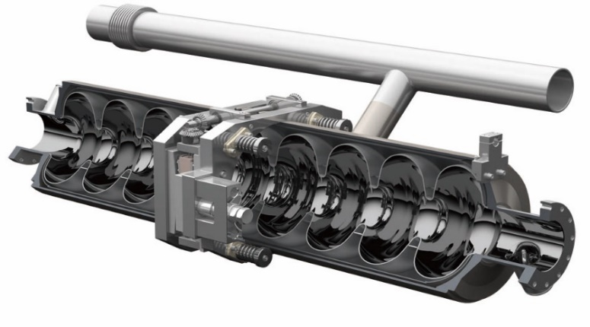
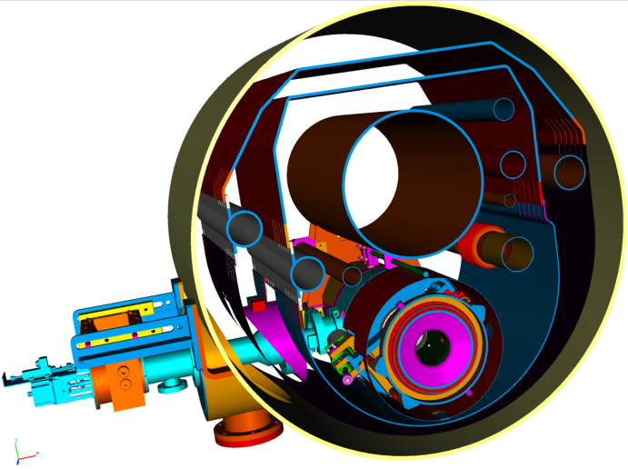
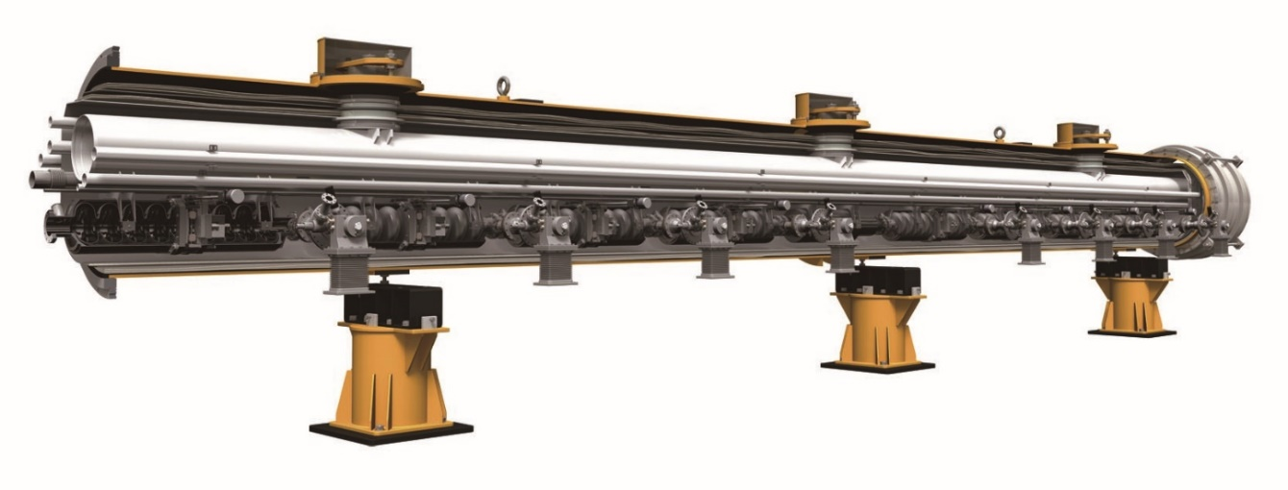
Accelerator complex
Liquied He
He vessel
1m
15,764
Cryomodules
1824
12m

Slide 7
Physics at ILC
Center-of-mass energy (GeV)

Slide 8

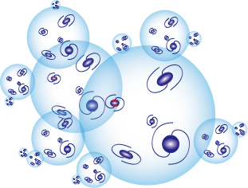
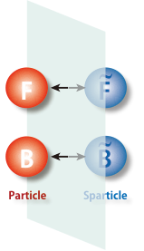
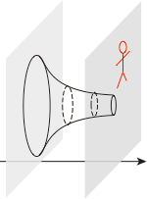




Big Fork in the Road
Revolution in the concept of space-time
Big step towards ultimate unification
Key = Precision Higgs and Top couplings
SUSY particle discovery
Jungle of new heavy (composite) particles in the TeV+ scale
Key = Precision Higgs and Top
couplings
Copernican revolution ?
Key = precision mt and mh
measurements
Fermionic Extra
-dim. = SUSY
Bosonic Extra
-dim. = RS (ADD)
© anysnapshot.com
Composite Higgs
Multi-verse
+ Anthropic Principle?
New strong force
The 2nd Road: Existence of a new stratum of Nature
No deviation
from SM
The 1st Road: Existence of another dimension
The 3rd Road: Existence of a myriad of universes ?
We are here!

Slide 9
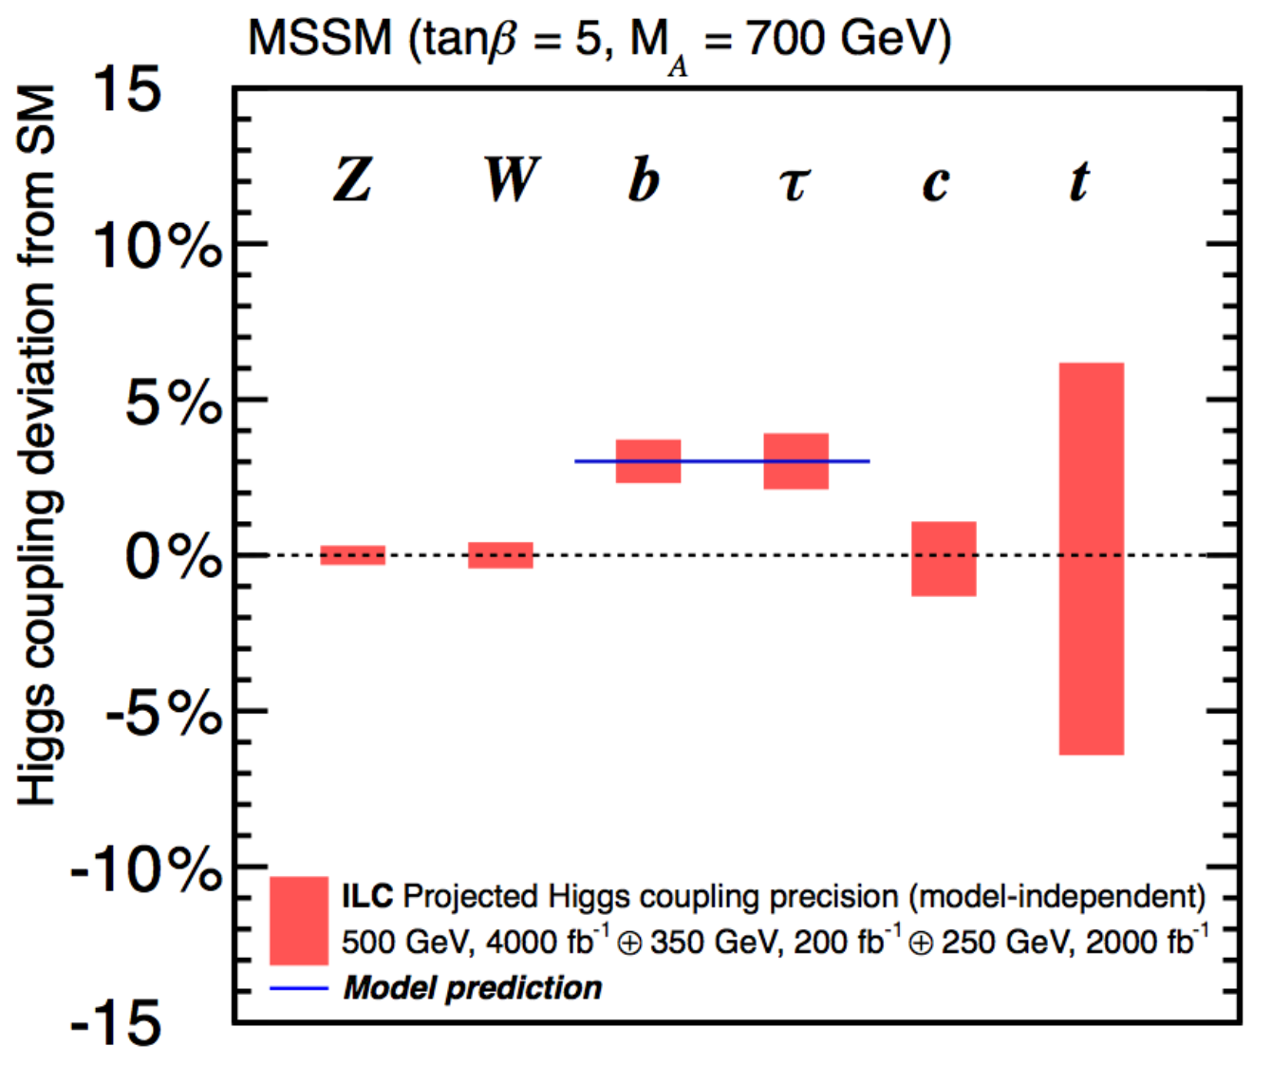
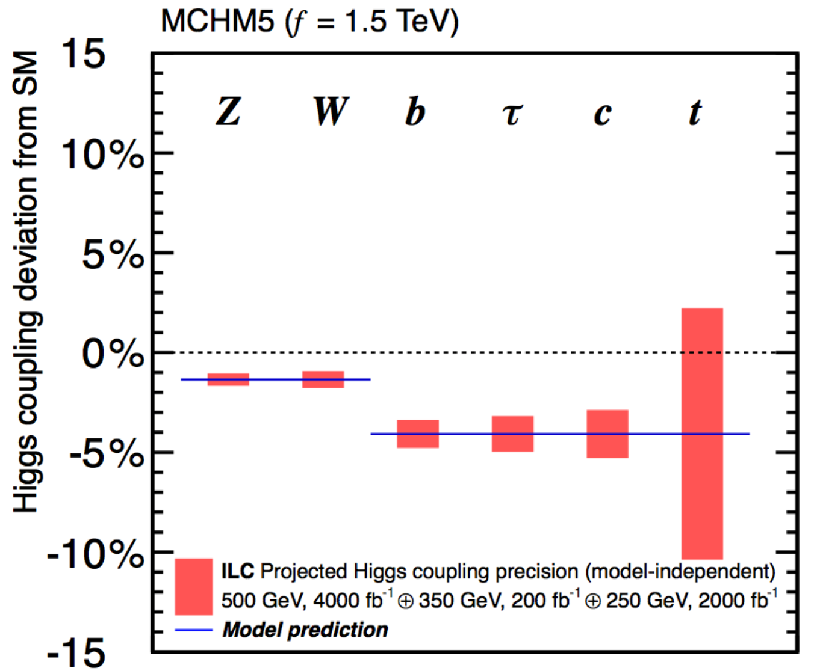
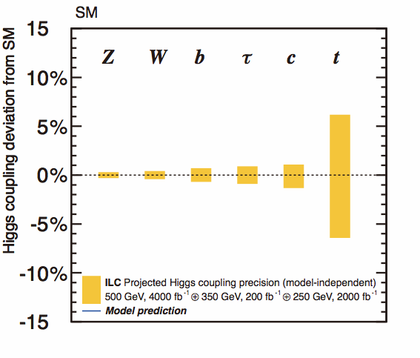
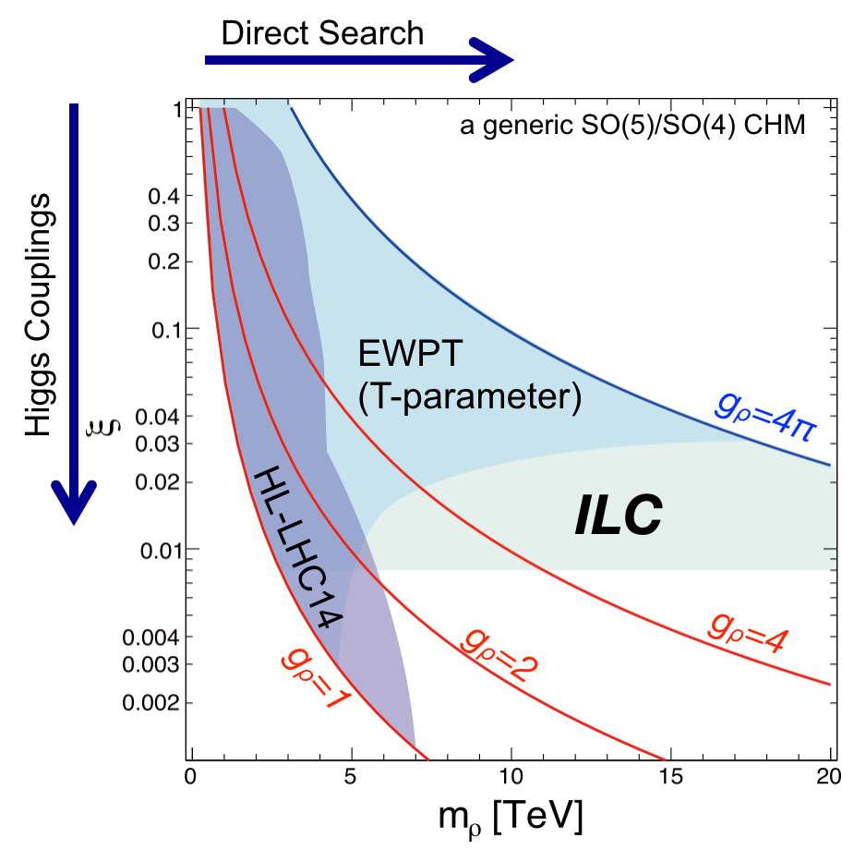
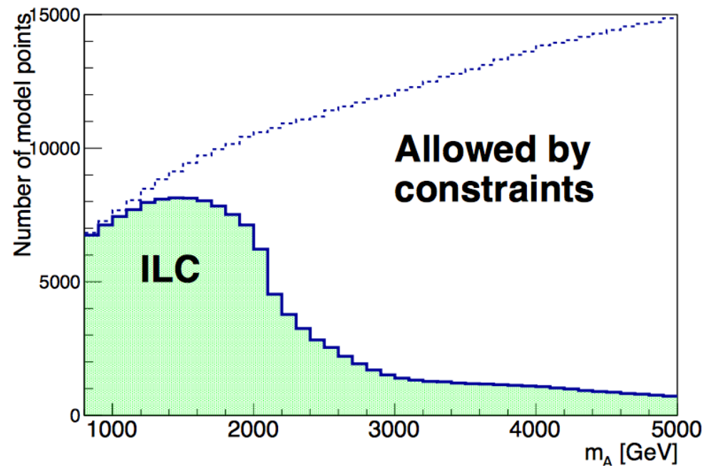

Which Way to Go?
Fingerprinting models with
Precision Higgs Measurements
H20 Scenario
ILC 250+500 LumiUP
arXiv: 1506.05992
arXiv: 1506.07830
Supersymmetry
(MSSM)
Composite Higgs
(MCHM5)
Multi-verse?
(Standard Model)
Downward shift for all the couplings
  Upward shift only for down-type fermions
No deviation at all
  MSSM Model Scan
arXiv 1502.03959
  Could be sensitive to mρ>10 TeV
Complementary to direct searches at LHC: Depending on parameters, ILC’s sensitivity goes well beyond that of LHC!
  Most model points accessible for mA<1.5 TeV
  sensitive
  region
Based on Contino, et al, JHEP 1402 (2014) 006

Slide 10
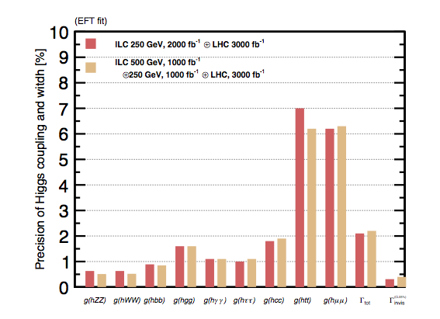


Staging from 250 GeV
What happens if we don’t have 500 GeV data?
So far LHC Run II saw no clear signal of physics beyond the Standard Model.
→No new particle in the ILC’s range or
it is in the LHC’s blind spot.
→Importance of precision Higgs
measurements enhanced.
Junping Tian
1st stage as a Higgs factory
Potential drawback:
Γh determination
Small
@ 250GeV
Solution: EFT
that relates hZZ and hWW couplings
For the same integrated luminosity, the 250 GeV ILC performs equally well.
Many EFT coefficients will have to be constrained by various SM processes that involve EW gauge bosons.
Beam polarization provides enough redundancy to test the validity of the EFT in case there is a light new particle

Slide 11
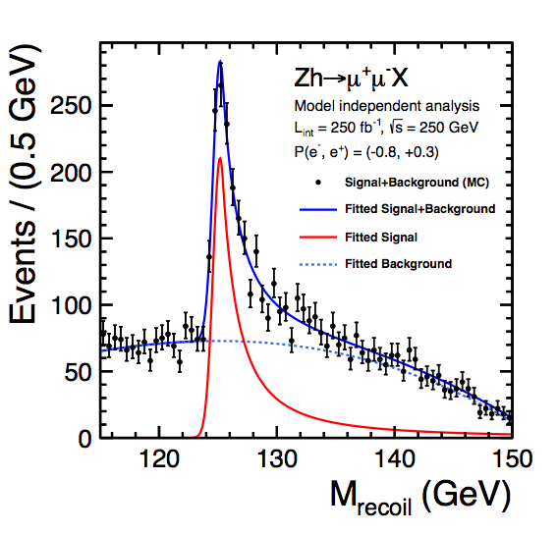




The Key
All the measurements are σ×BR measurements with one crucial exception, the σ measurement using recoil mass technique, that is the key to the model-independent determination of various Higgs couplings.
σ
from recoil mass
The Key
Can detect the Higgs without looking at it!

Slide 12
International Framework for ILC
FALC
Chair: Graham Blair
ICFA
Chair: Joachim Mnich
LCB
Chair: Tatsuya Nakada
LCC
KEK ILC Promotion
Office
LCC Director
Lyn Evans
Deputy
Hitoshi Murayama
CLIC
Collaboration
Public Relations
ILC
Associate Director:
Shin Michizono
CLIC
Associate Director: Steinar Stapnes
Physics & Detectors
Associate Director:
Jim Brau

Slide 13
Brief History of ILC in Japan
In October 2012, after the discovery of the Higgs boson at LHC, Japanese HEP community proposed to host the ILC in Japan as a global project.
This proposal was welcomed by worldwide HEP communities.
The European Strategy for Particle Physics Update 2013
US P5 report (May 2014)
ICFA statements (January and July 2014)
ACFA/AsiaHEP Statement on the ILC (September 2013)
MEXT set up ILC Advisory Panel in May 2014 with WG’s. The Panel released “Summary of ILC Advisory Panel’s Discussions to Date” after the 4th meeting in June 2015 based on reports of two WGs.
MEXT= Ministry of Education, Culture, Sports, Science & Technology in Japan

Slide 14
ILC Advisory Panel in MEXT
MEXT
Under ILC TF chaired by
State Minister of MEXT
Research contract
ILC Advisory Panel
Survey of technological
spin-offs, research trends
and technical feasibility
May 2014 ~
Working groups under the ILC Advisory Panel
Organization and Management
Particle and Nuclear Physics
Human Resources
TDR Validation
June 2014 ~
June 2014 ~
Nov. 2015 ~
Feb. 2017 ~

Slide 15
Interim Report from the ILC Advisory Panel
“Summary of Discussions” released by the ILC Advisory Panel (August 2015)
  Recommendation 1: Share the cost internationally and Find a clear vision on the discovery potential of new particles.
  Recommendation 2: Closely monitor and analyze the development of the LHC experiments and Mitigate cost risk.
  Recommendation 3: Obtain general understanding by the public and science communities.

Slide 16
Dialogue between US DOE and MEXT
Officials from MEXT visited their counterparts in US DOE in May 2016, and it was agreed to start “the US-Japan discussion group for ILC”, co-chaired by the officials from both.
Agenda of the discussion
  Issues to be clarified
  Possibilities of collaborative research for cost reduction
  … etc.

Slide 17
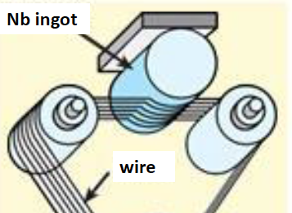
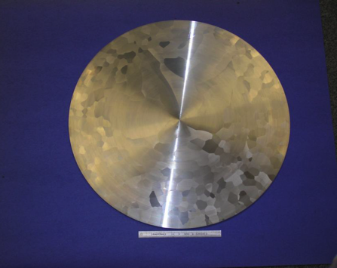
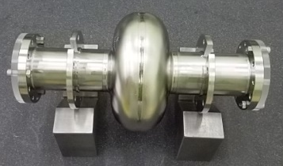
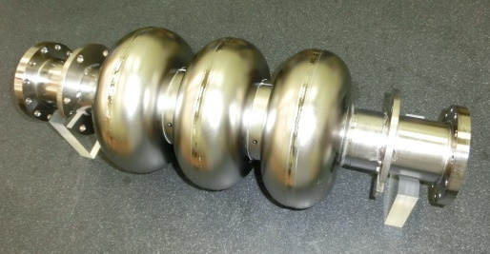
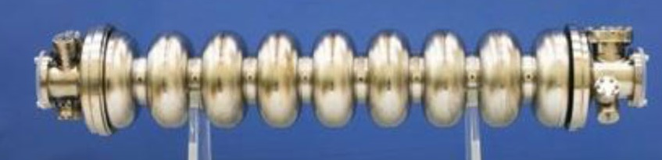
1. Cost reduction in Nb material preparation
Optimize the ingot purity with a lower residual resistivity ratio (RRR).
Simplify the manufacturing method such as forging, rolling, slicing and tube forming.
 | 2016 | 2017 | 2018 | 2019
KEK Masashi Yamanaka
Feasibility study using
3-cell cavities (ongoing)
Preparing
materials
Manufacture
8x9-cell cavities
Evaluation
(Vertical&Horizontal tests)
Medium or High RRR sheet for cells
Low RRR tube
for stiffener and beam pipe
Quality of Nb for the end part will be optimized at this stage.

Slide 18
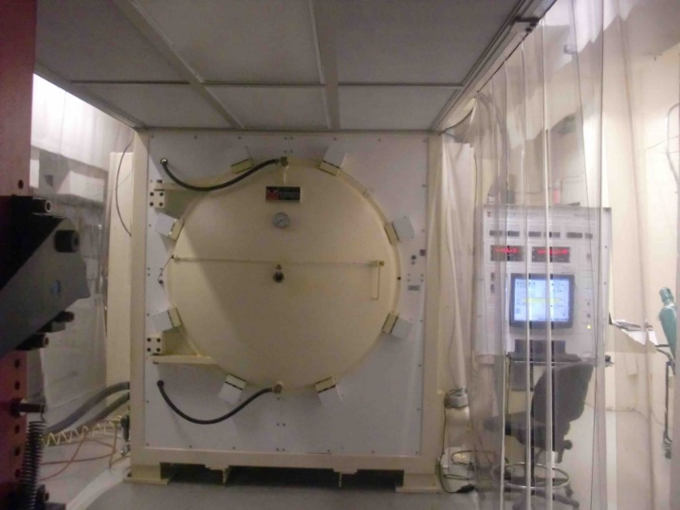
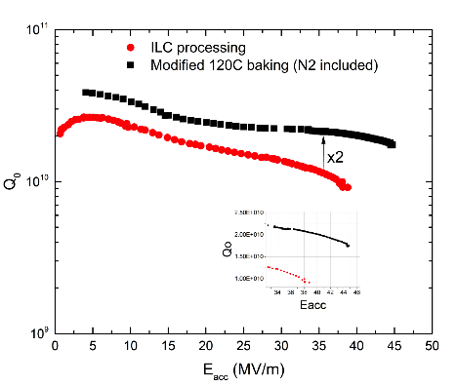
2. High-Q high-gradient SRC with nitrogen infusion
Confirm reproducibility of the nitrogen infusion method to improve Q and field gradient of SC RF cavity.
High statistics test of the yield by fabricating 8 9-cell cavities.
example of Cornell
Anna Grassellino, FNAL
 | 2016 | 2017 | 2018 | 2019
KEK Hitoshi HAYANO
FNAL process
1 cell processing
Performance test
Preparation for cryomodule
Preparation of vacuum furnace
3-9cell performance
8 - 9cell cavities fabrication
Performance test

Slide 19
Impact on the ILC cost
Possible cost reduction and budget plan
 | ILC cost reduction
1. Nb material | 2-3%
2. High-Q high-G | 8-9%
sum | 10-12%

Slide 20
KEK’s role for the ILC
KEK:
Conducts R&D program at ATF, STF and CFF facilities collaborating with the international teams.
Provides the ILC Advisory Panel with appropriate information to help their timely conclusions.
Develops our Action Plan to prepare for approval given by MEXT.
Conducts programs for the general public to gain better understanding of the project, so we can gain additional support.
Gives seminars and symposia to improve understanding by scientists in other research fields (27 seminars and lectures given in 2016).
Develops applications of SCRF to other purposes such as EUV-FEL, RI production for medical use, etc.

Slide 21
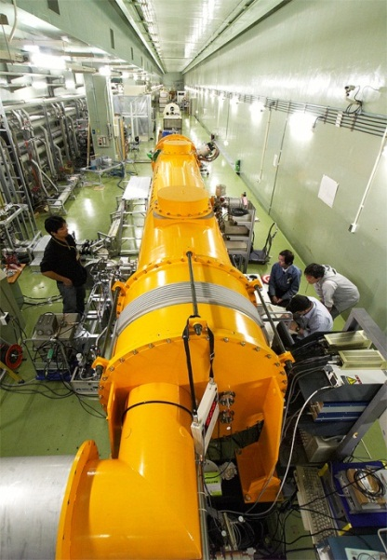
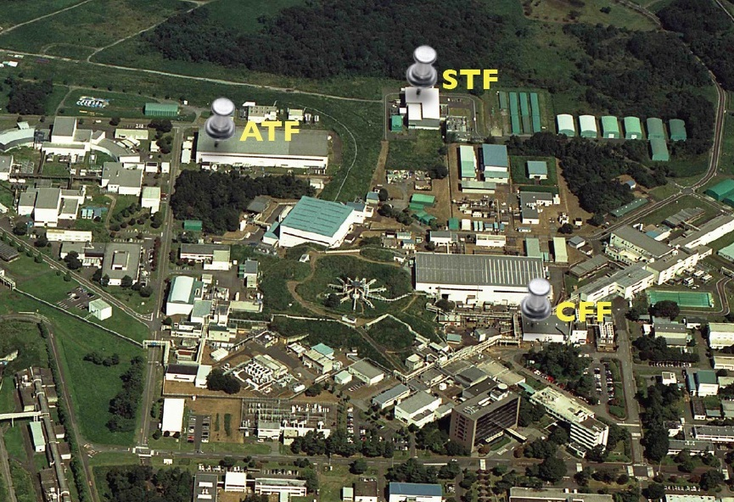
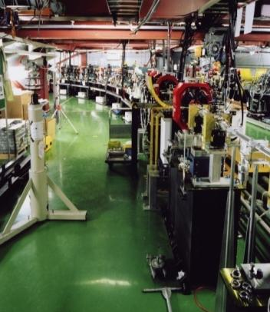
ILC R&D at KEK

Slide 22
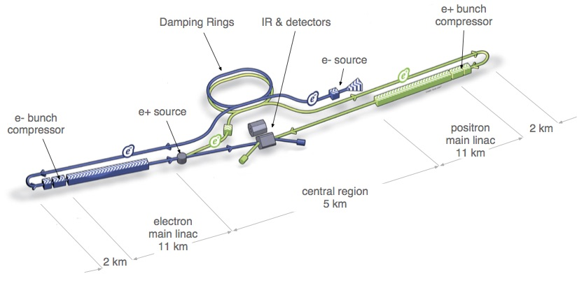
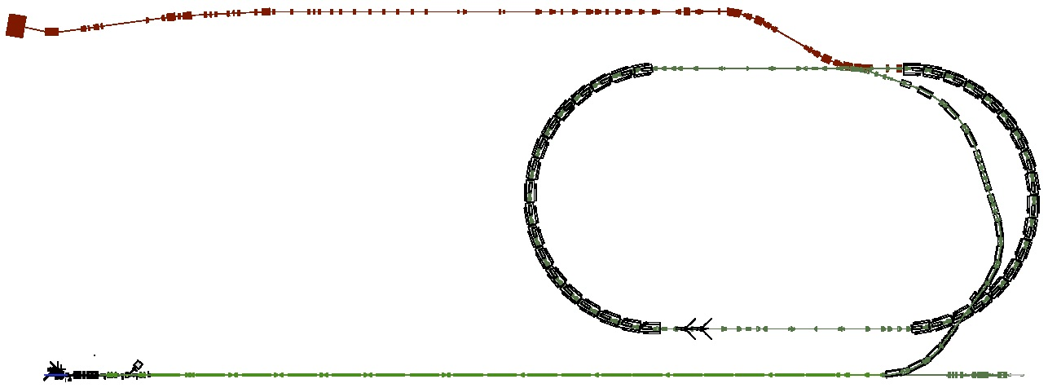
ATF/ATF2: Accelerator Test Facility
Develop the nanometer beam technologies for ILC
Key of the luminosity maintenance
6 nm beam at IP (ILC)
Layout of ILC
ATF2: Final Focus Test Beamline
  Goal 1:Establish the technique for
  small beam
  Goal 2: Stabilize beam position
Damping Ring (~140m)
Low emittance electron beam
1.3 GeV S-band Electron LINAC (~70m)

Slide 23
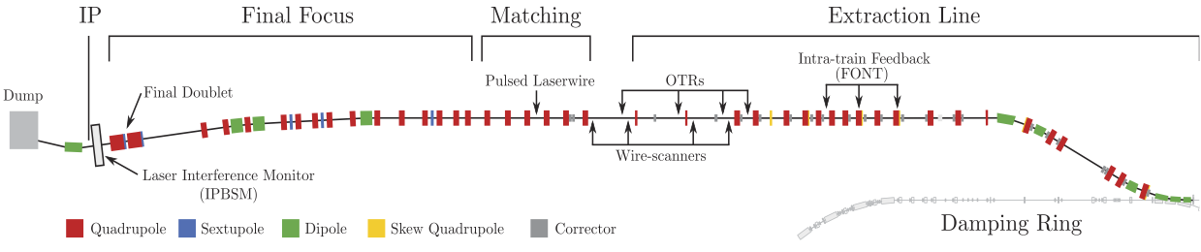
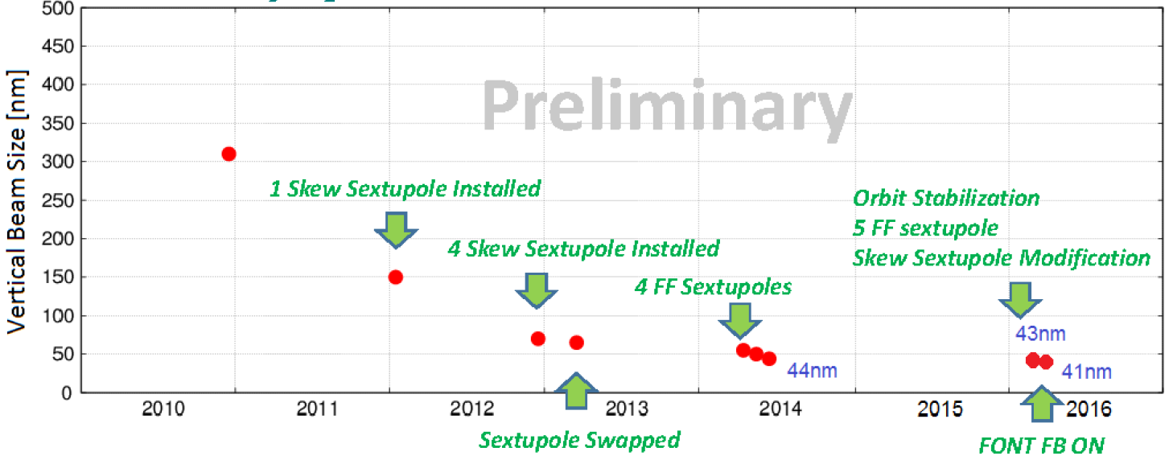
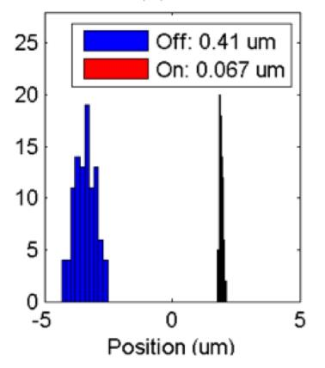
Progress in FF beam size and stability at ATF2
Goal 1: Establish the ILC final focus method with same optics and comparable beamline tolerances
ATF2 Goal : 37 nm → ILC 6 nm
  Achieved 41 nm (2016)
Goal 2: Develop a few nm position stabilization for the ILC collision
FB latency 133 nsec achieved
(target: < 300 nsec)
positon jitter at IP: 410 → 67 nm (2015) (limited by the BPM resolution)
Nano-meter stabilization at IP
History of ATF2 small beam

Slide 24
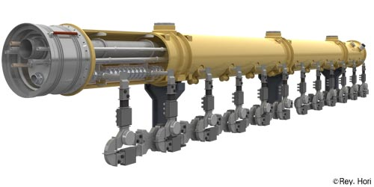
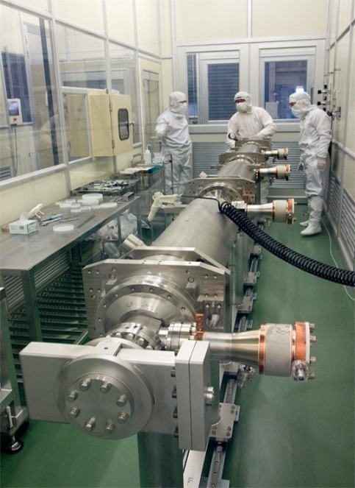
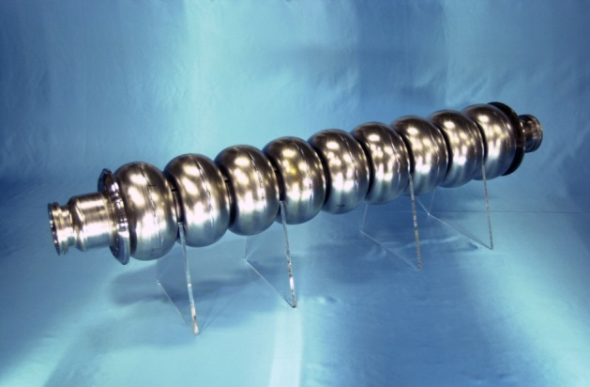
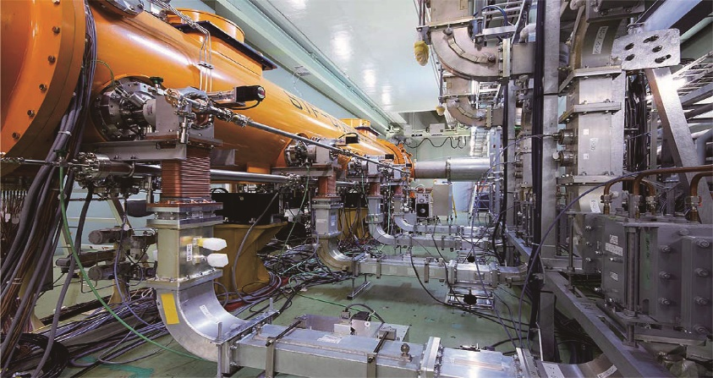

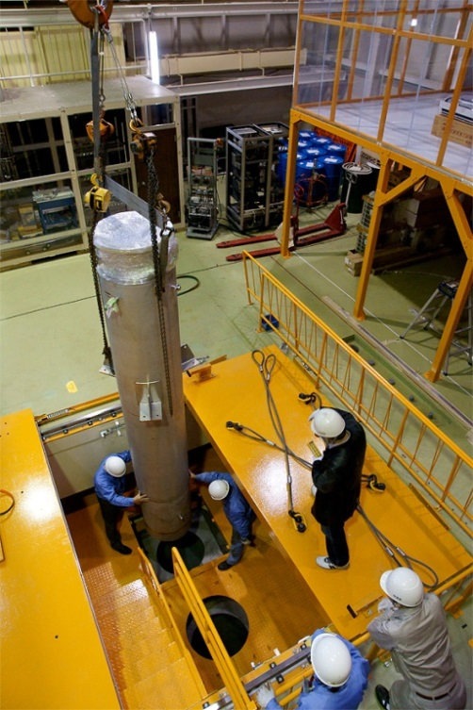
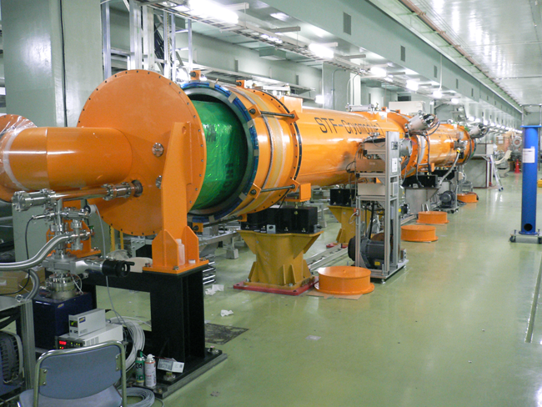
Superconducting Accelerator Test Facility

Slide 25
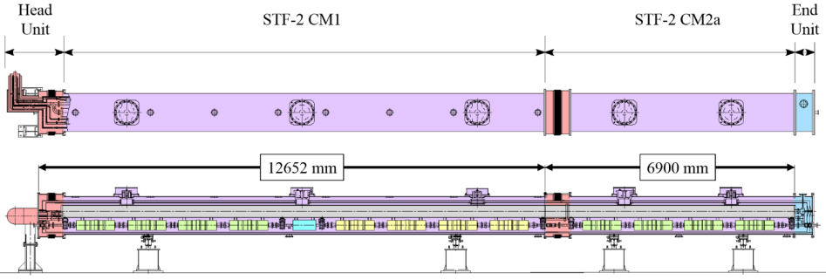
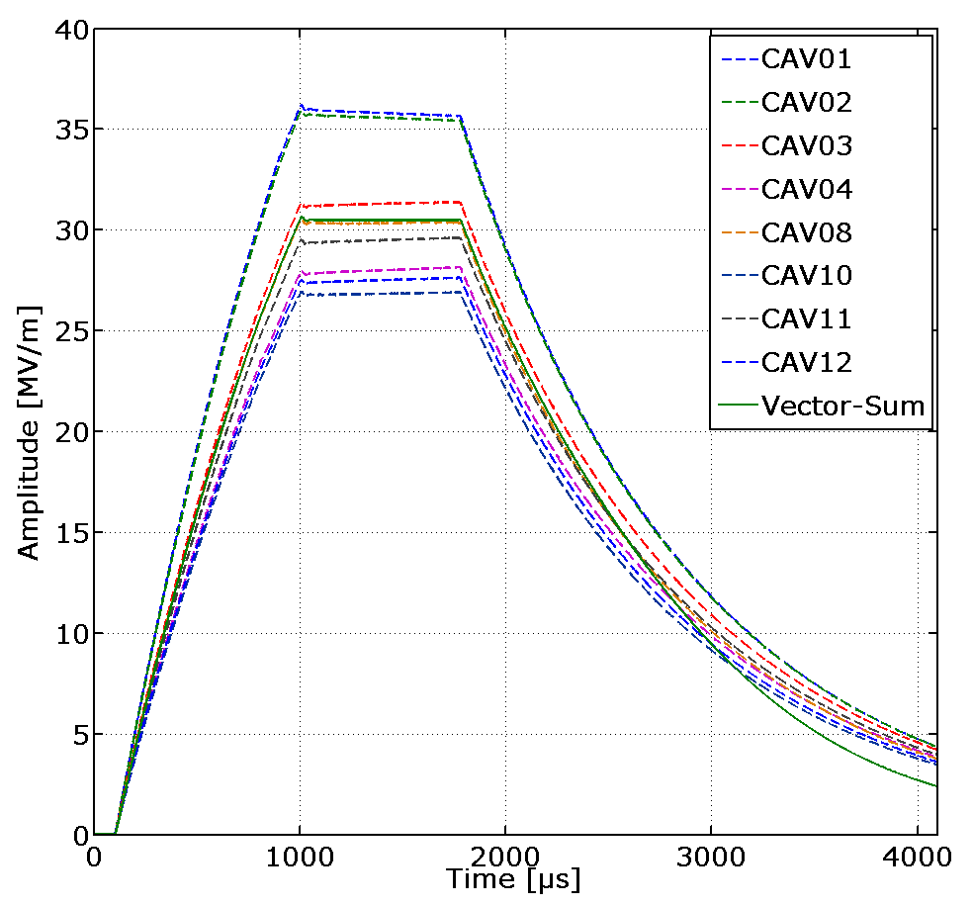
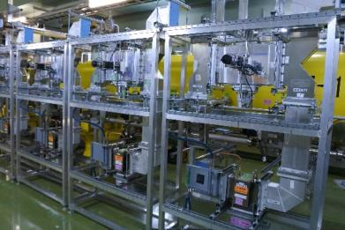
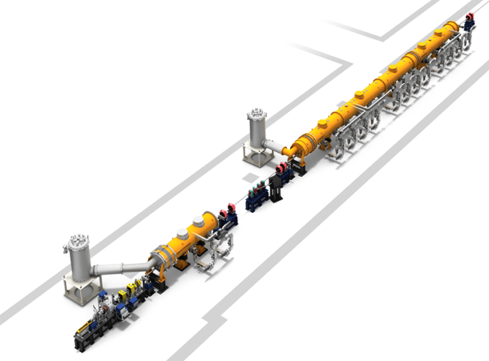
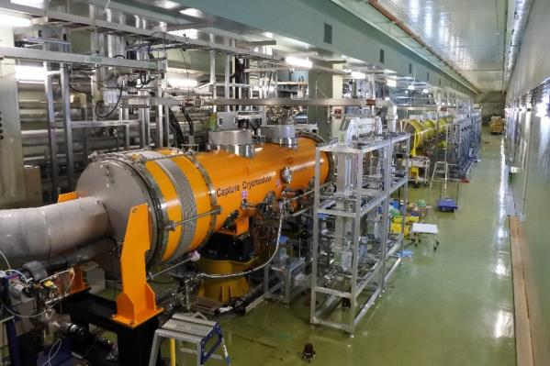
STF-2 Accelerator cryomodule test
8 Cavities were tuned on resonance by piezo, and vector-sum operation was done at 31MV/m.
CM2a
Waveguide system
View from upstream
Cold box
CM1
Capture CM
Cold box
To be constructed
RF Gun

Slide 26
The Reality of ILC
Despite our continued efforts over the last five years since we proposed ILC to the Japanese government in 2012, we realized that the cost for the ILC described in the TDR is beyond financial capabilities for the Japanese government to initiate international negotiation in a reasonable timeframe.
We need substantial cost reductions.
  Improvement of the SCRF performance and reduction of the manufacturing cost of the cavities
  Reduction of the energy of the collider down to 250GeV
  Note that ILC250 possesses the potential for its upgrades to reach the higher energy of new physics that the findings of ILC250 may indicate.
We hope to propose a less costly ILC to the Japanese government together with ICFA as an international project to be hosted in Japan, and request the Japanese government to come to a conclusion in a short time based on the findings they have made.
Strong support is expected from the Federation of the Diet Members and AAA.

Slide 27
Statement by the Japanese HEP Community
A subcommittee⁽*⁾ was formed under the Japanese HEP committee to deliberate the scientific significance of the 250GeV ILC. JAHEP examined the report from the subcommittee carefully, and issued the following statement recently.
http://www.jahep.org/files/JAHEP-ILCstatement-170722-EN.pdf
“As discussed above, the scientific significance and importance of ILC has been further clarified considering the current LHC outcomes. ILC250 should play an essential role in precision measurement of the Higgs boson and, with HL-LHC and SuperKEKB, in determining the future path of new physics. Based on ILC250’s outcomes, a future plan of energy upgrade will be determined so that the facility can provide the optimum experimental environment by considering requirements in particle physics and by taking advantage of the advancement of accelerator technologies. It is expected that ILC will lead particle physics well into the 21st century.
To conclude, in light of the recent outcomes of LHC Run 2, JAHEP proposes to promptly construct ILC as a Higgs factory with the center-of-mass energy of 250 GeV in Japan. ”
* The subcommittee consists of 10 physicists: two from ATLAS, two from Belle II, one from ILC physics group and five theorists.

Slide 28
Summary and Outlook
ILC is the next generation linear e⁺e⁻ collider with E_{CM}~250-500GeV to be constructed as an international project. The possibility to host it in Japan is being carefully studied by the Japanese Government.
International organization has been formed under ICFA to accelerate the project. Accelerator development is being carried out at ATF and STF (KEK), and other laboratories in the framework of LCC.
It was proposed to reduce the initial collision energy down to 250GeV (i.e., Higgs factory) for early start of the project. If this option is approved by ICFA, it will be proposed to MEXT with request for speedy conclusion.
ILC of 250GeV possesses the potential for its upgrades to reach the higher energy of new physics that the findings of ILC250 may indicate.

