Slide 1



Form factor measurements with PANDA at FAIR
Egle Tomasi-Gustafsson
IRFU, SPhN-Saclay, and IN2P3- IPN Orsay France
(on behalf of the collaboration)
Beijing, 13-16 October 2009

Slide 2
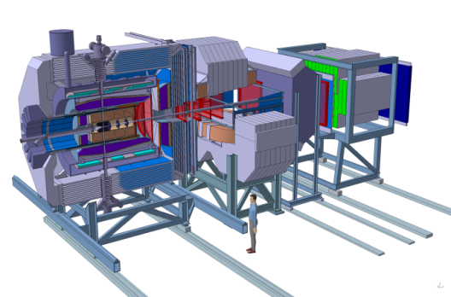
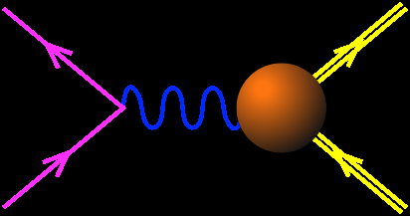
PLAN
Introduction:
Panda at Fair
Proton Form Factors
in SL and TL regions
What PANDA will bring:
  Knowledge of proton form factors
  Transition to QCD: Asymptotics
  Reaction mechanism (1 or 2 γ exchange)
Conclusions
e⁺
p
q²>0
p
e⁻
  ….Model Independent Statements

Slide 3


: Facility for Antiprotons and Ions Research
(Darmstadt, Germany)
SIS
_
HESR
P
ANDA
CR
RESR
NESR
http://www.gsi.de/fair/
Notes:
Kick-Off Events 7-8 Nov. 2007
CDR 2001
Seminal technical Dev @ GSI
Since 90’s
New/ future international complex accelerator
Connected to GSI accelerator
From SIS 18 => SIS 100/300 (Magnetic rigidity 100/300 T.m) Superconducting Synchrotron on top of each other = central part.

Slide 4


FAIR
FAIR: Experiments and Facilities:
NUSTAR: Nuclear STructure Astrophysics and Reactions
Super – FRS , rare isotope beams
PANDA: antiProton ANihilations at DArmstadt
hadron spectroscopy
CBM: Compressed Barionic Matter
States and phases of strongly interacting matter
FLAIR: Facility for Low energy Antiproton Research
Antihydrogen, CPT

Slide 5
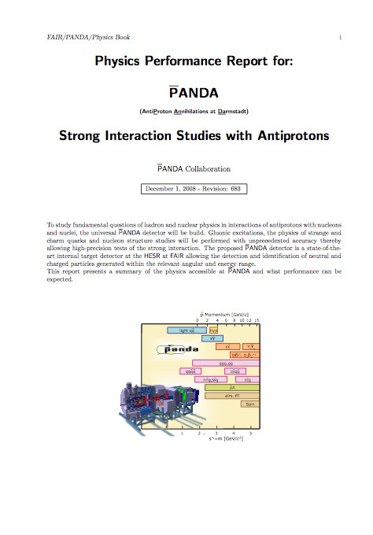
Non-Pertubative QCD
proton-antiproton annihilation
charmonium spectroscopy
gluonic excitations (hybrids, glueballs)
open and hidden charm in nuclei
γ-ray spectroscopy of hypernuclei
J/ψ-N scattering
Electromagnetic physics
  Time-like form factors
  Drell-Yan, TDA..
  ………..
PANDA Physics Book
- Detailed simulations
- Benchmark channels
e-Print: arXiv:0903.3905 [hep-ex]

Slide 6
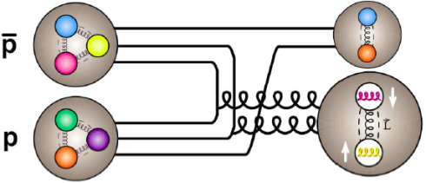
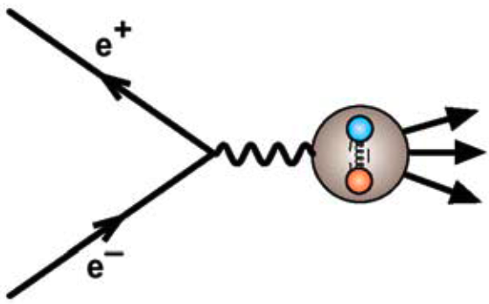
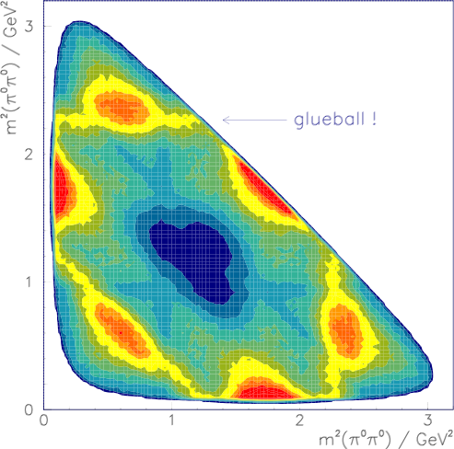
What is Experimentally Needed?
gluon-rich environment
⇒ proton-antiproton anihilations
J^{PC} = 1⁻ ⁻
all quantum numbers
⇒ production exp. i.e. large acc. detector, fixed target
precise resonance scan
⇒ high precision hadron beam (cooled)
high statistics samples
⇒ high luminosity and production cross section
physics topics
Crystal Barrel
p_{p} = 1.5 - 15 GeV/c
f₀(1500)
⇒ energy range
s-hyperon, c-meson, c-hyperon pairs
hybrids
c-hybrids
glueballs
charmonium
I. Lehmann
1
2
3
4
5
6
M [GeV/c²]

Slide 7
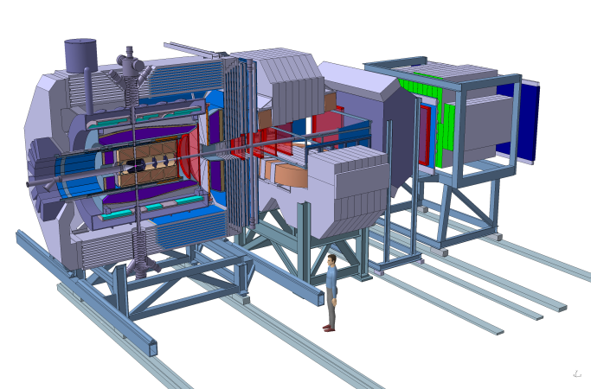
_
_
pp: Pellet or Cluster target
pA: wire target
P
~ 12m
Target Spectrometer
Solenoid magnet for high p_{t} tracks:
Superconducting coil & iron return yoke
(B=2T)
Forward Spectrometer
Dipole magnet for forward tracks
(2T.m)

Slide 8

















http://www-panda.gsi.de/
• At present a group of 420 physicists
from 55 institutions of 17 countries
Austria – Belaruz - China - Finland - France - Germany – India - Italy – The Nederlands - Poland – Romania - Russia – Spain - Sweden – Switzerland - U.K. – U.S.A..
Basel, Beijing, Bochum, IIT Bombay, Bonn, Brescia, IFIN Bucharest, Catania, Cracow, IFJ PAN Cracow, Cracow UT, Dresden, Edinburgh, Erlangen, Ferrara, Frankfurt, Genova, Giessen, Glasgow, GSI, Inst. of Physics Helsinki, FZ Jülich, JINR Dubna, Katowice, KVI Groningen, Lanzhou, LNF, Lund, Mainz, Minsk, ITEP Moscow, MPEI Moscow,
TU München, Münster, Northwestern, BINP Novosibirsk, IPN Orsay, Pavia, Piemonte Orientale, IHEP Protvino, PNPI St.Petersburg, KTH Stockholm, Stockholm, INFN Torino, Torino, Torino Politecnico, Trieste, TSL Uppsala, Tübingen, Uppsala, Valencia, SINS Warsaw, TU Warsaw, SMI Wien

Slide 9
Electromagnetic proton Form Factors
Over a period of time lasting at least 2000
years, Man has puzzled over and sought an
understanding of the composition of matter…
F1
F2
Q²=1 GeV²

Slide 10
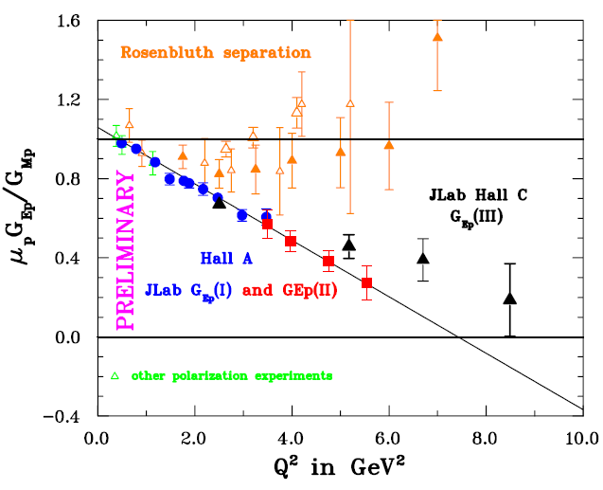
Polarization experiments GEP -Jlab
  Space-like region
  "standard" dipole function for the nucleon magnetic FFs GMp and GMn
  2) linear deviation from the dipole function for the electric proton FF GEp
  3) contradiction between polarized and unpolarized measurements
A.I. Akhiezer and M.P. Rekalo, 1967
PRELIMINARY
Charles Perdrisat

Slide 11
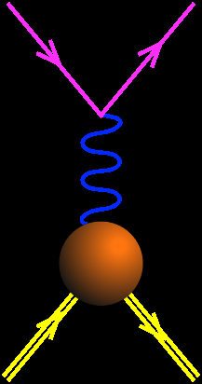
Analyticity
Space-like
Asymptotics
- QCD
- analyticity
e⁻
e⁻
Time-like
q²<0
GE(0)=1
e⁺
p
GM(0)=μ_{p}
q²>0
p+p ↔ e⁺+e⁻ +π
Unphysical region
p
p
e⁻
p
_
FFs are real
FFs are complex
_
q²=4m_{p}²
q²
e+p → e+p
p+p ↔ e⁺+e⁻
GE=GM

Slide 12
Form Factors with
p+p e⁺+ e⁻
What PANDA will bring:
  1) Knowledge of proton form factors up to large q²
  2) Transition to QCD: Asymptotics
  3) Reaction mechanism (1 or 2 photon exchange)

Slide 13
Form Factors with
p+p e⁺+ e⁻
What PANDA will bring:
  1) Knowledge of proton form factors up to large q²
  2) Transition to QCD: Asymptotics
  3) Reaction mechanism (1 or 2 photon exchange)

Slide 14
Crossing Symmetry
Scattering and annihilation channels:
- Described by the same amplitude :
- function of two kinematical variables, s and t
- which scan different kinematical regions
k₂ → – k₂
p₂ → – p₂

Slide 15
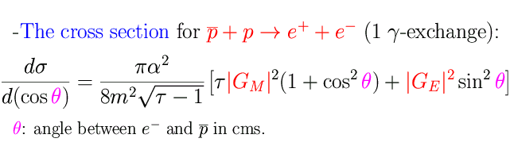
Time-like observables: | G_{E}| ² and | G_{M}| ² .
A. Zichichi, S. M. Berman, N. Cabibbo, R. Gatto, Il Nuovo Cimento XXIV, 170 (1962)
B. Bilenkii, C. Giunti, V. Wataghin, Z. Phys. C 59, 475 (1993).
G. Gakh, E.T-G., Nucl. Phys. A761,120 (2005).
As in SL region:
- Dependence on q² contained in FFs
- Even dependence on cos²θ (1γ exchange)
- No dependence on sign of FFs
- Enhancement of magnetic term
but TL form factors are complex!

Slide 16
Physical Background
M. Sudol et al., arXiv:0907.4478 [nucl-ex]
3 body reactions
      kinematical constraints
      PID
2 body reactions (hadrons)
π⁺π⁻, K⁺K⁻
High statistics GEANT4 simulations
< few ⁰/₀₀ misidentified events / cosθ_{CM} bin
< 1% on the total cross section up to 16 GeV²
It is possible to discriminate e⁺e⁻ from π⁺ π⁻
D. Marchand, IPN Orsay
16

Slide 17
Expected Results
M. Sudol et al, arXiv:0907.4478 [nucl-ex]
L = 2 ⋅ 10 ³² cm⁻² s⁻¹
100 days
R=GE/GM
BaBAR
Individual
determination of
GE and GM
up to large Q²
PS170
PANDA sim

Slide 18
Form Factors with
p+p e⁺+ e⁻
What PANDA will bring:
  1) Knowledge of proton form factors up to large q²
  2) Transition to QCD: Asymptotics
  3) Reaction mechanism (1 or 2 photon exchange)

Slide 19
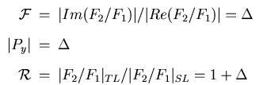
Phragmèn-Lindelöf theorem
Asymptotic properties for analytical functions
If f(z) →a as z→∞
along a straight line,
and f(z) →b as z→∞
along another
straight line,
and f(z) is regular
and bounded
in the angle between,
then a=b and f(z) →a uniformly in the angle.
Δ=0.05, 0.1
E. T-G. and G. Gakh, Eur. Phys. J. A 26, 265 (2005)

Slide 20
Phragmèn-Lindelöf theorem
Connection with QCD asymptotics?
L = 2 ⋅ 10 ³² cm⁻² s⁻¹
100 days
Applies to NN and NN
Interaction
(Pomeranchuk theorem)
t=0 : not a QCD regime!
E. T-G. and M. P. Rekalo, Phys. Lett. B 504, 291 (2001)
E. T-G. e-Print: arXiv:0907.4442 [nucl-th]

Slide 21
Form Factors with
p+p e⁺+ e⁻
What PANDA will bring:
  1) Knowledge of proton form factors up to large q²
  2) Transition to QCD: Asymptotics
  3) Reaction mechanism (1 or 2 photon exchange)

Slide 22


Unpolarized cross section
Two Photon Exchange:
Induces four new terms
Odd function of θ:
Does not contribute at θ =90°
G. Gakh, E.T-G., Nucl. Phys. A761,120 (2005).

Slide 23

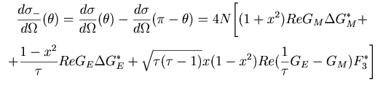

Symmetry relations
Differential cross section at complementary angles:
The SUM cancels the 2γ contribution:
The DIFFERENCE enhances the 2γ contribution:

Slide 24
N=a₀+a₂cosθ sin²θ +a₁ cos²θ, a₂~2γ
1γ
2γ 0.02
q²=5.4 GeV²
2γ 0.05
2γ 0.2

Slide 25


Mpp=1.877-1.9
A=0.01±0.02
Mpp=2.4-3
E. T.-G., E.A. Kuraev, S. Bakmaev, S. Pacetti, Phys. Lett. B (2008)

Slide 26
Conclusions
In annihilation processes all the information
on FFs AND reaction mechanism is contained
in a precise measurement of the angular distribution
Determination of time-like form factors up to large q²
Tests of validity of pQCD and analiticity
Study of the validity of one photon exchange
approximation: basic question for deriving information
on the hadron structure
Comparison of scattering and annihilation channels: model
independent statements
basic program : Panda Physics Performance Report
e-Print: arXiv:0903.3905 [hep-ex]
http://www-panda.gsi.de/

Slide 27


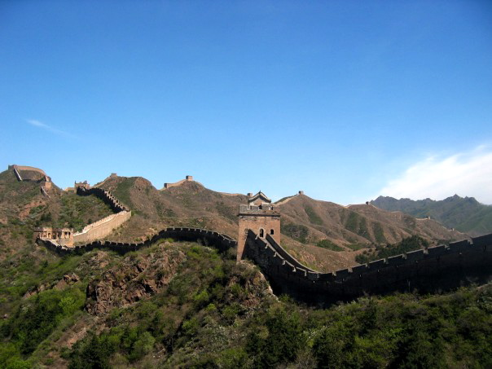

感谢您的关注 !

Slide 28
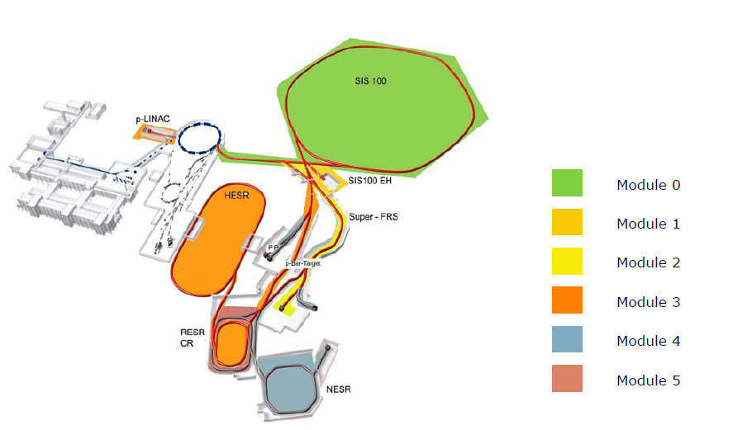
Re-evaluation of costs
within 8 years
All projects preserved

Slide 29
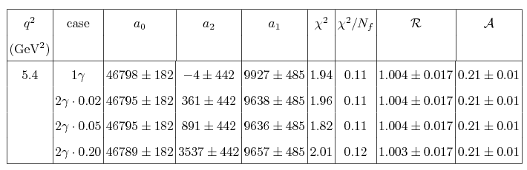
N=a₀+a₂cosθ sin²θ +a₁ cos²θ, a₂~2γ
2γ visible from F3/GM ~ 0.05

Slide 30




Fitting the angular distributions..
The form of the differential cross section:
is equivalent to:
Cross section at 90⁰
Angular asymmetry
E. T-G. and M. P. Rekalo, Phys. Lett. B 504, 291 (2001)

Slide 31
Simulations
q²=5.4,8.2,13.8 GeV²
Main effect:
odd cosθ - distribution
Approximations:
  Neglect contributions to GE,GM
  Consider only real part

Slide 32
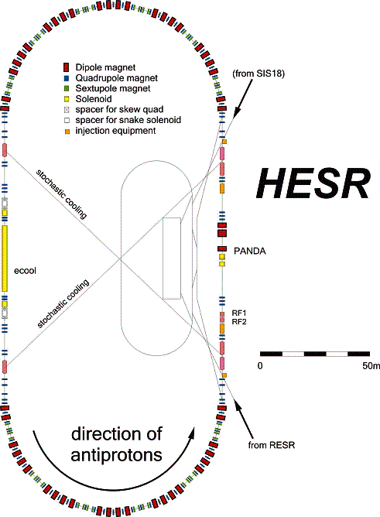
Parameters of the High Energy Storage Ring (HESR)
_
p
Momentum : 1.5 – 15 GeV/c
(E_{kin} : 0.8 – 14 GeV)
_
(2.3 ≤ √s ≤ 5.5 GeV)
N_{stored} 10¹¹ p
2 modes of operation:
⇨
High Luminosity Mode:
L = 2 ⋅ 10 ³² cm⁻² s⁻¹
δp/p ~ 10⁻⁴ (stochastic cooling)
Electron Cooler
Internal Target
Detector
⇨
High Resolution Mode:
Production rate
up to 2x10⁷/s
δp/p ~ 10⁻⁵ (electron cooling)
_
L = 10 ³¹ cm⁻² s⁻¹
p
From RESR

Slide 33
_
_
pp: Pellet or Cluster target
pA: wire target
P
~ 12m
Target Spectrometer
Solenoid magnet for high p_{t} tracks:
Superconducting coil & iron return yoke
(B=2T)
Forward Spectrometer
Dipole magnet for forward tracks
(2T.m)

Slide 34
Tracking
MVD
STT/TPC
Silicon MicroVertex
Central Tracker
GEM Detectors
Drift Chambers

Slide 35
Particle IDentification
Muon Detectors
Forward RICH
Barrel DIRC
Barrel TOF
Endcap DIRC
Forward TOF
Plastic Scintillator

Slide 36
PbWO₄ EMC
10 000 crystals
Forward Shashlyk EMC

Slide 37
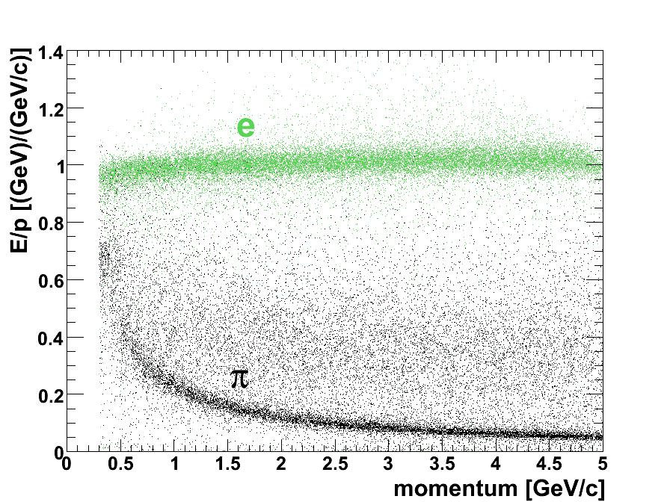
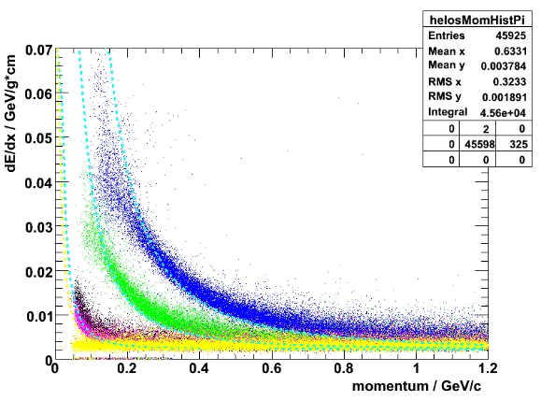
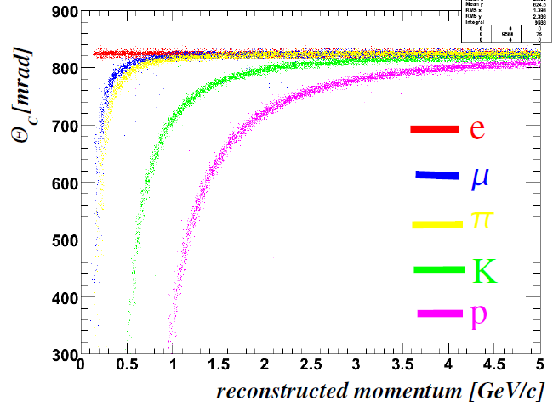
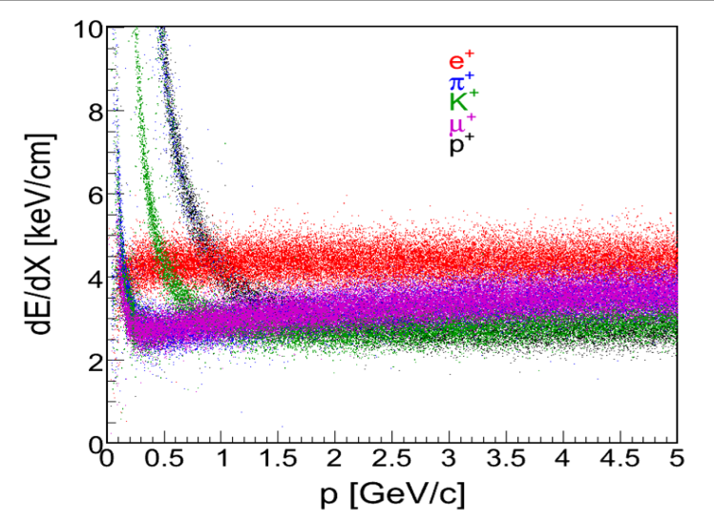
Particle Identification with PANDA
EMC
PANDA PID Requirements:
particle identification essential for PANDA
momentum range 200 MeV/c – 10 GeV/c
Extreme high rates 2·10⁷ Hz
good particle separation (K-π, e−π)
  different detectors needed for PID
DIRC
STT
MVD

Slide 38
Two photon exchange
The calculation of the box amplitude requires the
description of intermediate nucleon excitation and
of their FFs at any Q²
Different calculations give quantitatively different
results
Theory not enough constrained!
Model independent statements

Slide 39
How to proceed?
Our Suggestion:
Search for model independent statements
Exact calculation in frame of QED (p~μ)
Prove that QED box is upper limit of QCD box diagram
Our Conclusion
Two photon contribution is negligible (real part)
Radiative corrections are huge: take into account higher order effects (Structure Functions method)
E.A. Kuraev, Yu. Bystritsky, V. Bytev, E. T.-G. , (2006-2008)

Slide 40
Model independent statements
In presence of 2γ exchange :
Non linearity in the Rosenbluth fit and
Charge asymmetry in the crossed channel
Non vanishing odd polarization observables
Different cross section for electron/positron – proton elastic(inelastic) scattering
M. P. Rekalo, E. T.-G. , EPJA (2004), Nucl. Phys. A (2003)

Slide 41

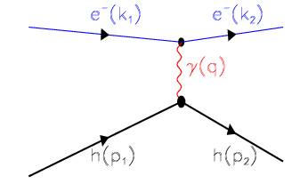
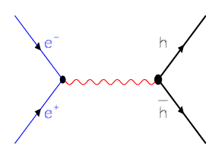
Crossing Symmetry
Scattering annihilation
- Described by the same amplitude :
- function of two kinematical variables, s and t
- which scan different kinematical regions
p₂ → – p₂
k₂ → – k₂

Slide 42
STATUS on EM Form factors
  Time-like region
  No individual determination of |GE| and |GM|
  Assume GE=GM (valid only at threshold)
  TL nucleon FFs are twice larger than SL FF
  VMD or pQCD inspired parametrizations
  (for p and n):
  A(p) = 56.3 GeV⁴
A(n) = 77.15 GeV⁴
Λ _{QCD} =0.3GeV

Slide 43
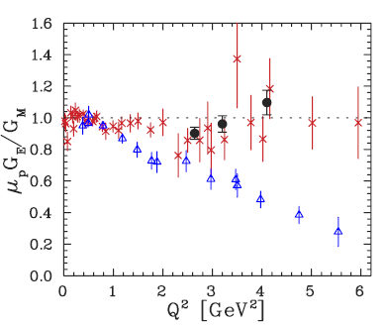
Two-photon exchange
  Different results with different
  experimental methods !!
  - Both methods based on the
  same formalism
  - Experiments repeated
  New mechanism?
1γ-2γ ~ α=e²/4π=1/137
1970’s: Gunion, Lev…

Slide 44
1γ-2γ interference
M. P. Rekalo, E. T.-G. and D. Prout, Phys. Rev. C60, 042202 (1999)
1γ
2γ
{
1{g
{

Slide 45
Angular asymmetry

Slide 46
Linearity of the Rosenbluth fit

Slide 47
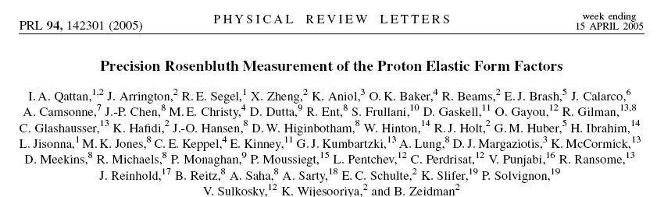
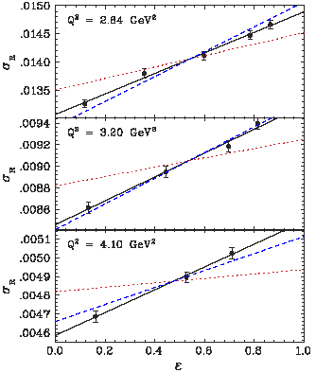

Slide 48

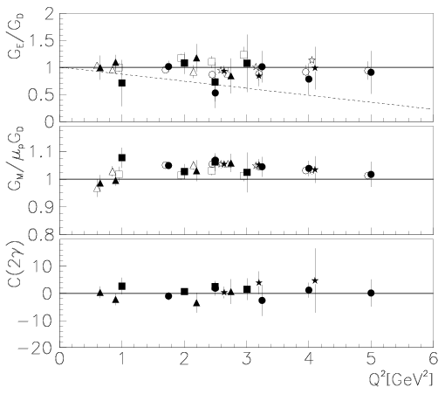
Parametrization of 2γ-contribution for e+p
From the data:
deviation from linearity
<< 1%!
E. T.-G., G. Gakh, Phys. Rev. C 72, 015209 (2005)

Slide 49
2γ-Gamma Models and Data
C. Perdrisat,L. Pentchev
Expt. Jlab 04-019 measured
Ratio PL/PT for Q²=2.49 GeV²
at 3 values of ε
PRELIMINARY
NO ε-dependence
at 0.01 level
NO evidence of
2γ contribution
The inclusion of hard 2γ exchange:
Chen et al (2003) with GPDs,
Blunden et al (2003) in hadronic model
Bystriskyi et al., LSF
PR C75, 015207 (2007)
_{10/16/2009}
₄₉
Notes:
₄₉

Slide 50
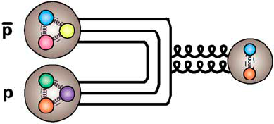
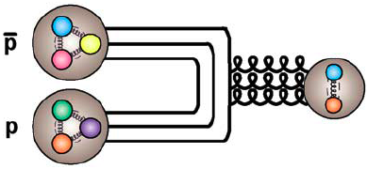
Proton-Antiproton Annihilation
gluon-rich environment
all quantum numbers
J = 0,2,.. C = +
J^{PC} = 1⁻ ⁻
J = 1,.. C = -

Slide 51
The nucleon form factors
E. T.-G., F. Lacroix, Ch. Duterte, G.I. Gakh, EPJA 24, 419 (2005)
Electric
Magnetic
VDM : IJL
F. Iachello..PLB 43, 191 (1973)
proton
To update…so many new data!
Extended VDM (G.-K. 92):
E.L.Lomon PRC 66, 045501 2002)
Hohler
NPB 114, 505 (1976)
Bosted
PRC 51, 409 (1995)
neutron

Slide 52
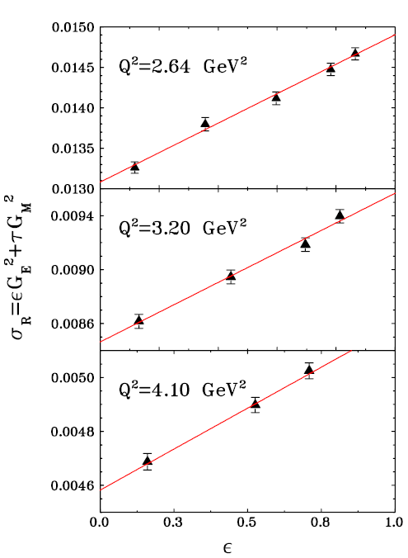
The Rosenbluth separation
Q² fixed
Linearity of the reduced cross section
ε
        tan²θ_{e} dependence
Holds for 1γ exchange only
PRL 94, 142301 (2005)

Slide 53
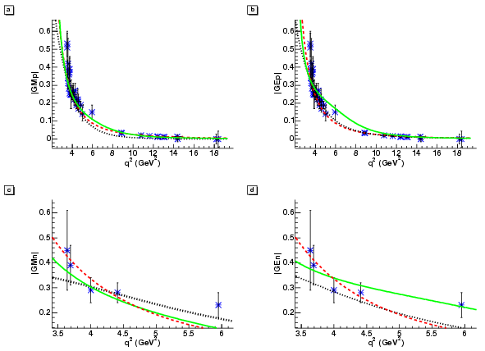
Time-Like Region
proton
VDM : IJL
F. Iachello..PLB43 191 (1973)
Extended VDM (G.-K. 92):
E.L.Lomon PRC66 045501(2002)
neutron
‘QCD inspired’
E. T-G., F. Lacroix, C. Duterte, G.I. Gakh, EPJA 24, 419 (2005)

Slide 54
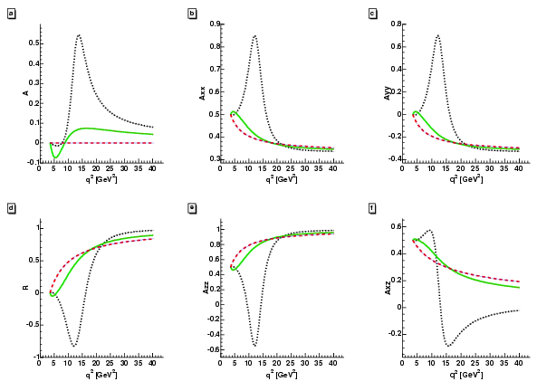
Models in T.L. Region (polarization)
Ay
Axx
Ayy
VDM : IJL
Ext. VDM
‘QCD inspired’
Axz
Azz
R
E. T-G., F. Lacroix, C. Duterte, G.I. Gakh, EPJA 24, 419(2005)

Slide 55


Space-like and Time-like
  E.T-G, Phys. Part. Nucl. Lett. 4, 281 (2007)
F_{M}=σ_{Μ}/σ_{tot}
F_{E}=εG²_{E}/σ_{red}
5 GeV²
ε=0.8
----- 8 GeV²
ε=0.5
ε=0.2
F_{E}=σ_{Ε}/σ_{tot}

Slide 56

Space-like and Time-like
  E.T-G, Phys. Part. Nucl. Lett. 4, 281 (2007)
F_{E}=εG²_{E}/σ_{red}
10%
10%
ε=0.8
ε=0.5
ε=0.2

Slide 57
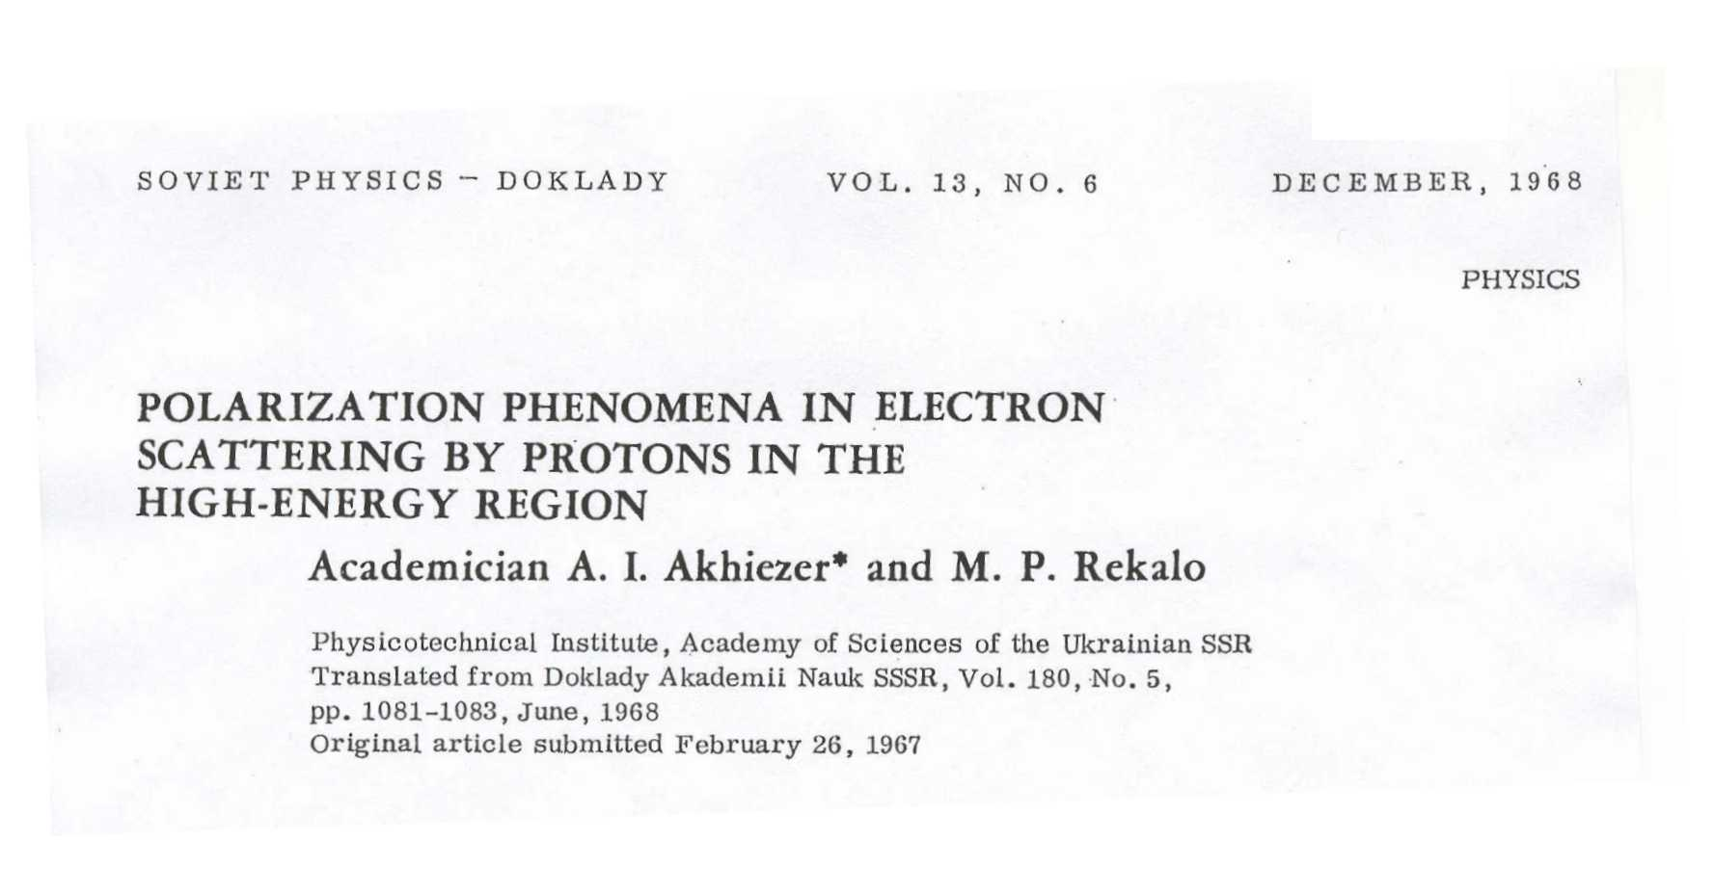
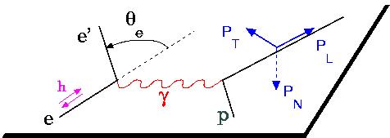
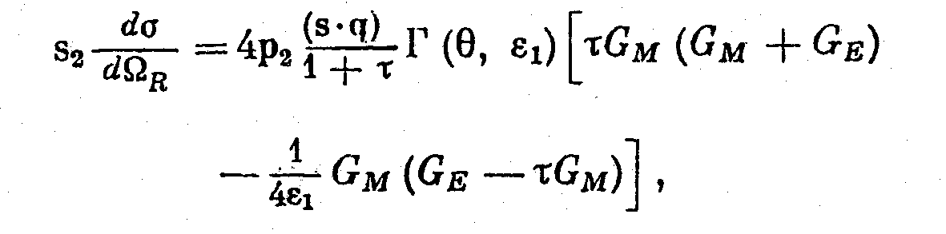
The polarization method (1967)
The polarization induces a term proportional to G_{E} G_{M}
Polarized beam and target or
polarized beam and recoil proton polarization

Slide 58
STATUS on EM Form factors
  Space-like region
  "standard" dipole function for the nucleon magnetic FFs GMp and GMn
  2) linear deviation from the dipole function for the electric proton FF GEp
  3) contradiction between polarized and unpolarized measurements
  4) non vanishing electric neutron FF, GEn.

