Slide 1
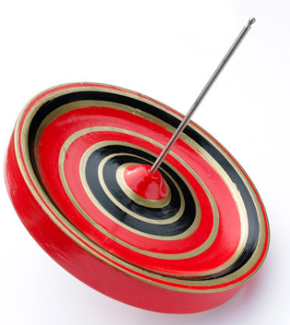
New g-2 experiment at J-PARC
October 14, 2009
Tsutomu Mibe (三部 勉）
KEK
tsutomu.mibe@kek.jp

Slide 2
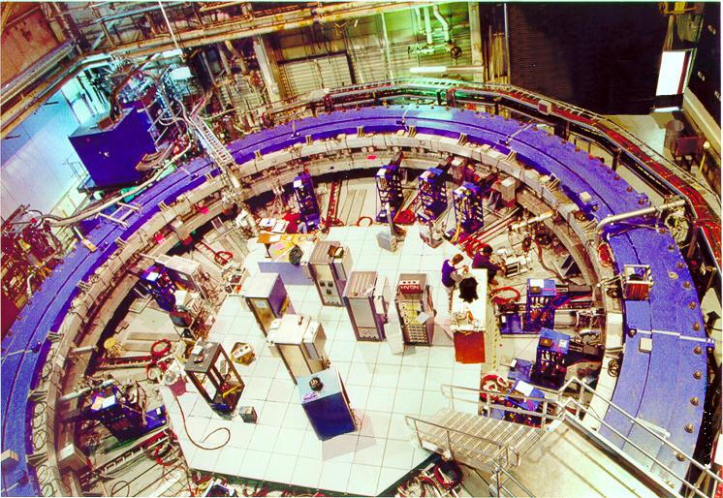
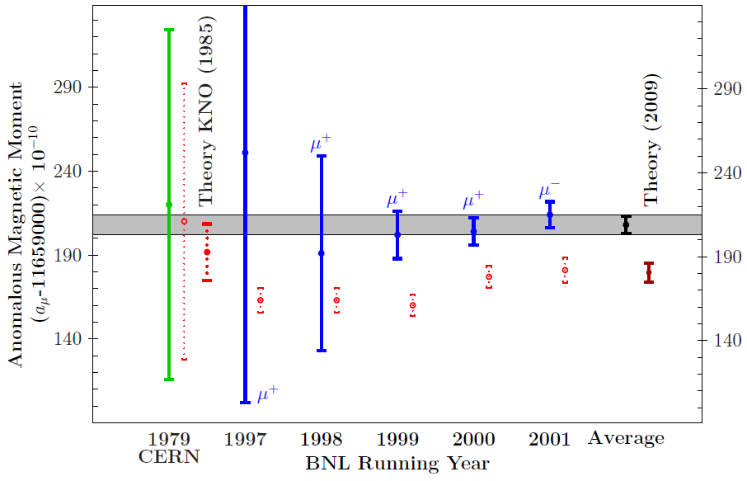
+e⁺e⁻ data
Experiment
Confirmation(s) of the discrepancy by future experiments are extremly important.
Coutecy F. Jergerlehner, arXiv:0902.3360

Slide 3
Muon anomalous spin precession in B and E-field
Precession frequency
Focusing electric field to confine muons in the storage ring.
At the magic momentum
1/(γ²-1) = a_{μ}
γ = 29.3, p = 3.094 GeV/c
EDM term can safely be neglected in g-2 measurement.

Slide 4
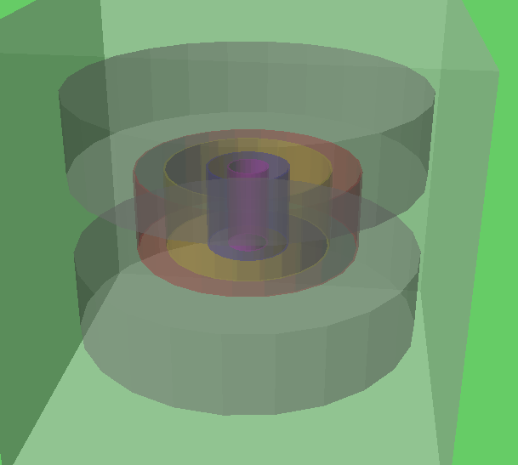
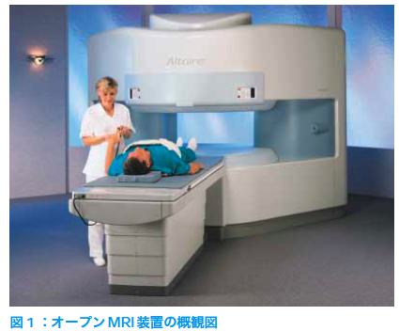
New approach: Going to lower momentum
Disadvantages
No longer at magic momentum.
Muon decays more quickly.
… However, experimental apparatus can be compact.
Better accuracy of B-field, e.x. 1 ppm local accuracy with MRI application
Stronger B-field, i.e. more precession
Better environmental control
temperature, EM noise shielding etc.
Completely different systematics than the BNL E821
Ok, but how do we deal with the β×E term?
Zero electric field
80 cm
Compact g-2 ring
H. Iinuma
Hitachi co.

Slide 5
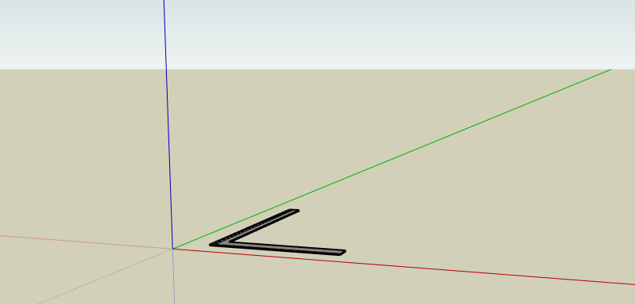
Another way to vanish the βxE term
Zero Electric field
Equations of spin motion is as simple as those at the magic momentum
spin motion
muon orbit
muon
Fine, but how do we confine muons without focusing E-field?
→ Re-acceleration of ultra-slow muons

Slide 6
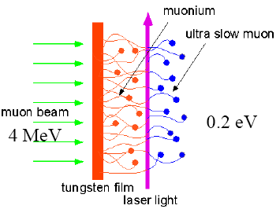
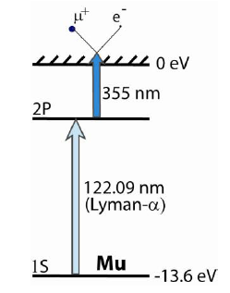
Ultra-slow muon
Surface muon beam
Polarization ~ 100%
Momentum p(μ⁺) ~27 MeV/c
Muonium production
Surface muon stops in the target
Formation of muonium by electron capture
Thermal diffusion to vacuum
ρ _{Mu}(E) = exp(-E/kT)
p ~ 2.6 keV/c (p_{T} ~ 2.1 keV/c) @300K
Laser resonant ionization
1S→2P→unbound
122nm(Lyman-α)+355nm
Initially realized at KEK, a dedicated BL operated at RAL ~20 μ^{+/}sec
-V
GND
Mu (μ⁺e⁻)
surface
Production Target
Laser
Re-acceleration to 300 MeV/c → pencil muon beam p_{L}/p_{T} ~10⁻⁵

Slide 7
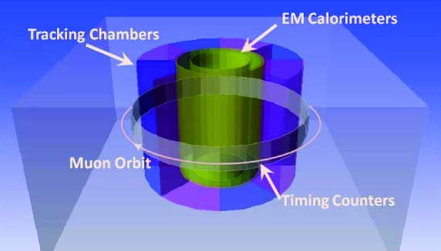
New Generation of Muon g-2@J-PARC
New generation of muon g-2 experiment is being explored at J-PARC
To establish the deviation by improving the statistics and systematics
To further explore new physics
With completely new technique
Off magic momentum with
ultra-cold muon beam at 300 MeV/c
Stored in ultra-precision B field
without E-field so that the β x E term
drops
80 cm
H. Iinuma
Muonium
Primary
production
target
Muonium
production
target
Laser
Ultra Cold
Muon Beam
(μ+ 10⁶/sec)
Proton beam
(3 GeV, 1MW )
Surface Muon
(~30 MeV, 4x10⁸/s)
Muon Linac (300 MeV/c)

Slide 8
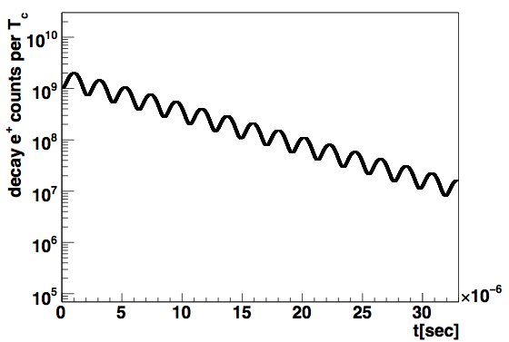
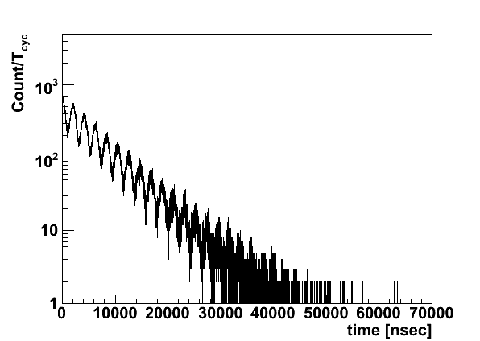
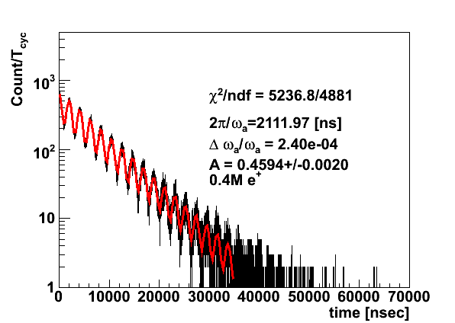
Expected g-2 “Wiggle Plot”
P=300 MeV/c, B=3T
H. Iinuma
Statistical precision (1 year)
μ⁺ in storage ring 1.2×10¹³
detected e⁺ decay 1.5×10¹²
δa_{μ} = 0.11ppm

Slide 9
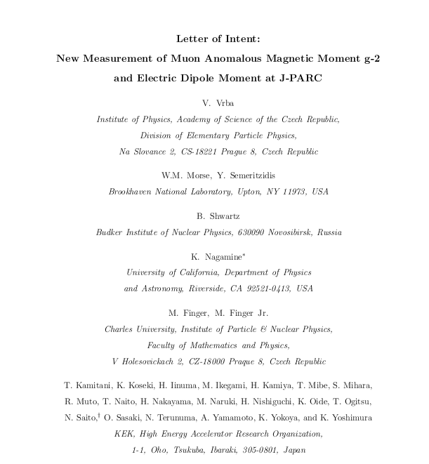
Collaboration
Letter of intent submitted to J-PARC PAC (July 2009)
Naohito Satio (KEK) (contact person)
45 authors
14 institutions
Collaborators increasing since then
Full proposal is being prepared
Proto-collaboration meeting in November

Slide 10
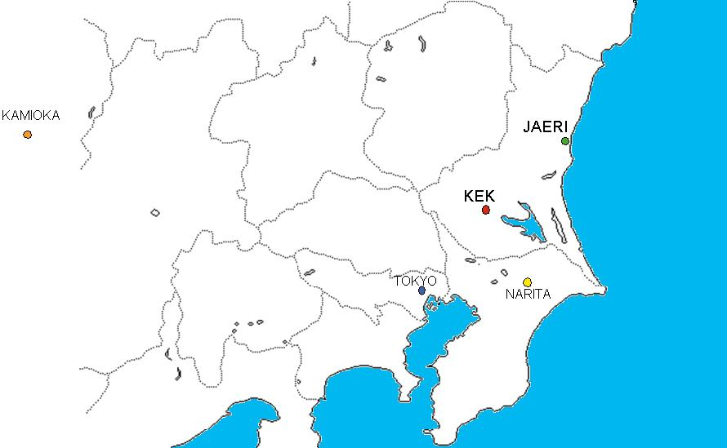
J-PARC at Tokai, Japan
295 km
J-PARC
1 hour
Tsukuba
Pacific
Oscan

Slide 11
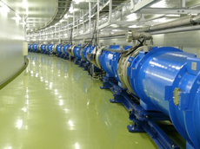
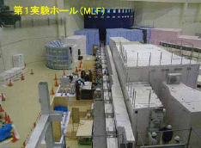
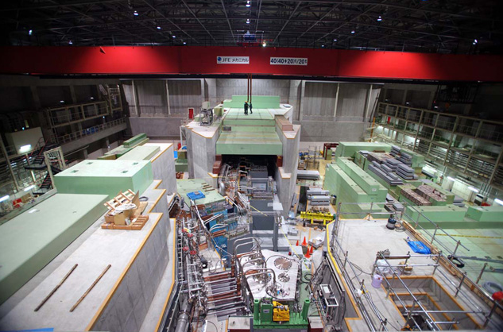
Aerial view of J-PARC

Slide 12
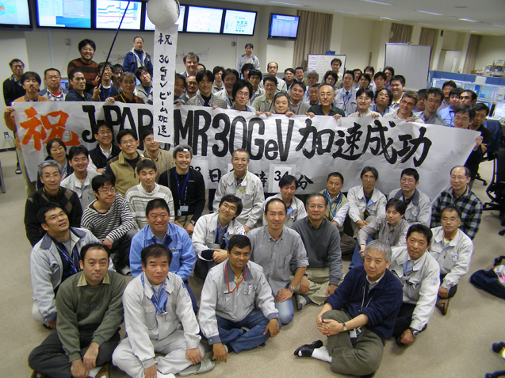
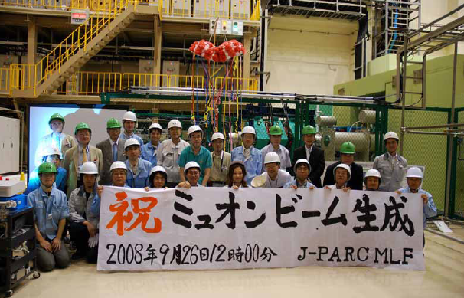
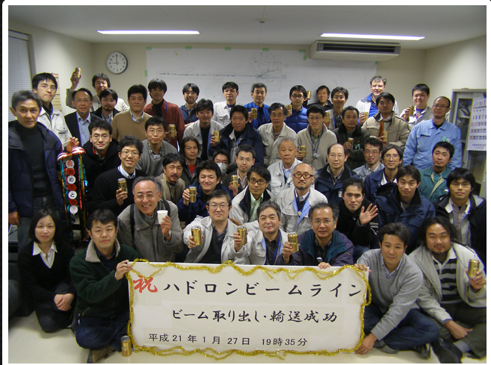
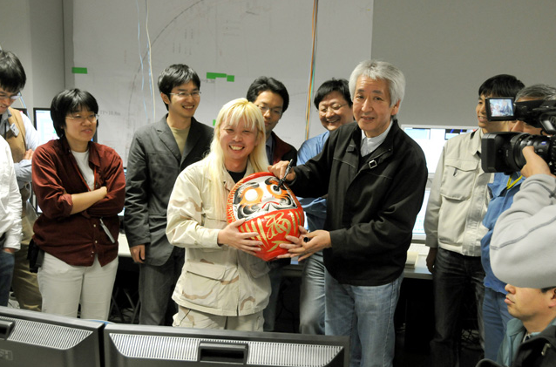

Slide 13
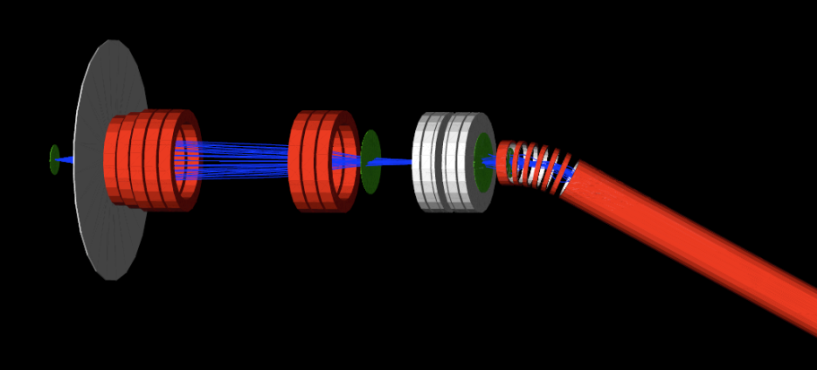
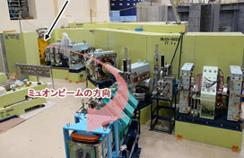
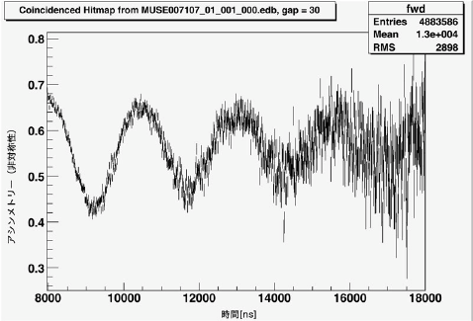
Muon beamlines in material and life science facility
R. Muto
3 GeV proton
?
μSR in Al
Coutecy of MLF muon group

Slide 14
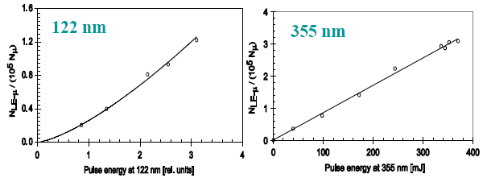
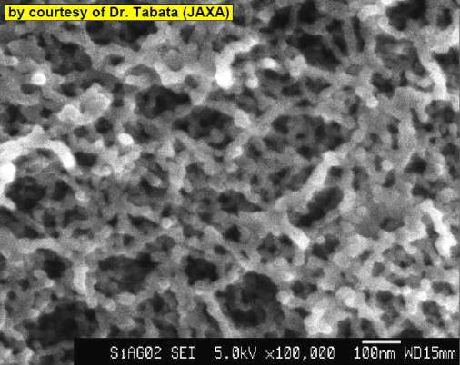
Muon source
40000 times more muons than RAL is required.
Muonium production
Laser ionization
Upto 300 times more surface muons are expected at J-PARC.
Colder muoniums (2000K → 300K)
High density aerogel (RIKEN/Chiba-U)
Measurement of yield, and space-time distributions @TRIUMF
High power laser (RIKEN)
100 times higher power.
Linearity probably holds (need confirmation by data).
Exercise laser ionization of Mu from a room temp. target.
Plan to do these series of tests at RAL

Slide 15
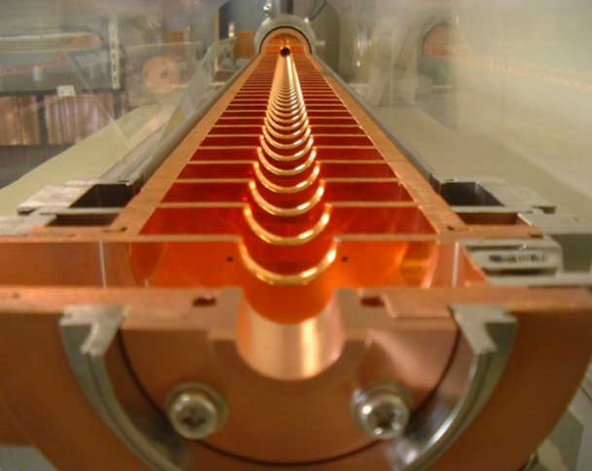
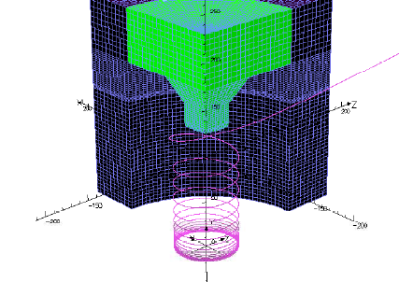
Linac, storage magnet, detector
Ikegami, Kamitani
Conceptual design of the linac
Combination of J-PARC (low-β) + KEKB (high-β)
Storage magnet
Spiral injection
Ultra precision B-field monitor
Electric field monitor
Detector system
Tracking detector + calorimeter(absorber)
H. Iinuma

Slide 16
Summary
A new muon g-2 experiment is being explored:
Off-magic momentum
Ultra-slow muon + linac + compact g-2 ring
Complementary to g-2@FNAL
J-PARC is the ideal place to realize such an experiment.
We intend to start the experiment in 5 years!

Slide 17
backup

Slide 18
BNL, FNAL, and J-PARC
complimentary
 | BNL-E821 | Fermilab | J-PARC
Muon momentum | 3.09 GeV/c |  | 0.3 GeV/c
gamma | 29.3 |  | 3
Storage field | B=1.45 T |  | 3.0 T
Focusing field | Electric quad |  | None
# of detected μ+ decays | 5.0E9 | 1.8E11 | 1.5E12
# of detected μ- decays | 3.6E9 | - | -
Precision (stat) | 0.46 ppm | 0.1 ppm | 0.11 ppm

