Slide 1
Status report on H->μ⁻+μ⁺ at CEPC
Zhenwei Cui,Qiang Li,Gang Li,Manqi Ruan,Xin Mo,Lei Wang
2016/8/29
Notes:
My report is about Higgs decay to di-moun’s study at CEPC.

Slide 2
OUTLINE
1.Intruction
2.Signal and background
3.Cut-base optimization
4.BDT optimization
Notes:
The report include 4 parts：
The introduction. the components about signal and background. cut optimization and BDT .

Slide 3
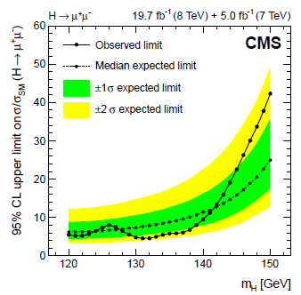
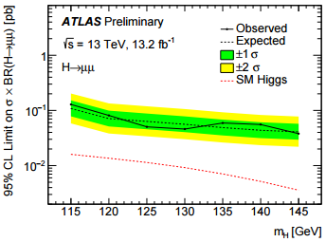
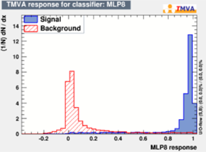
Introduction
“Search for a standard model-like Higgs boson in the μ⁻μ⁺ and e⁻ e⁺ decay channels at the LHC” 22 Apr 2015
the observed upper limit at the 95% confidence level is 7.4 times SM predictions.
“Search for Higgs bosons decaying into di-muon in pp collisions at √ s = 13 TeV with the ATLAS detector” 2 Aug 2016
upper limit at the 95% confidence level is 3.5 times SM predictions.
“H→μ⁻μ⁺ at ILC Talk presented at the International Workshop on Future Linear Colliders”11 2015
1TeV 500fb⁻¹
Significance is 2.75σ

Slide 4
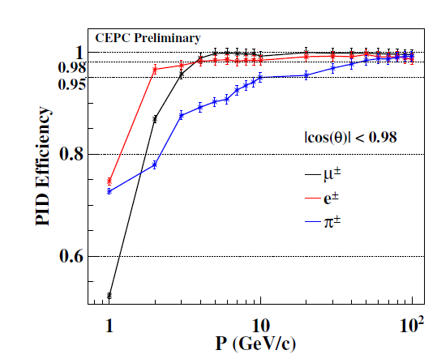
PID Efficiency at CEPC
Notes:
The PID efficiency at CEPC used a lot of conditions and it is higher than 90 percent when the momentum is more than 10 GeV.

Slide 5
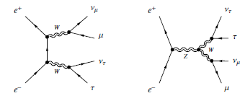
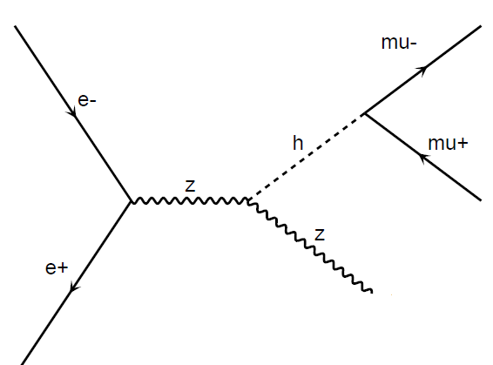
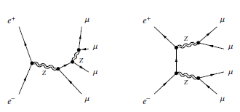
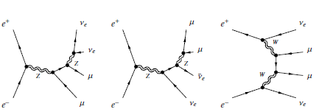
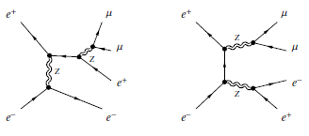
Signal and Background
Nsig : 250,000 fb⁻¹
Nbkg : 5000 fb⁻¹
MC sample
Signal: Higgs →μ⁺+μ⁻
Bkg: | 4f_ZZ
 | 4f_WW(SW)
 | 4f_SZ
 | 4f_ZZorWW
 | 2f
full
Event generator:WHIZARD 1.95
fast
Detector simulation: MOKKA(cepc_v1 model)
Particle reconstruction: arbor_v1
Notes:
This page shows the components of signal and Backgound.
Signal’s feiman diagram is this , electron positron collide, and generate Higgs and Z boson. higgs decay to .(di-moun system) it’s generated by full simulation. background consists of all possible cases and is divided it into 5 types which all generated by fast simulation.
The event generator I use is whizard

Slide 6
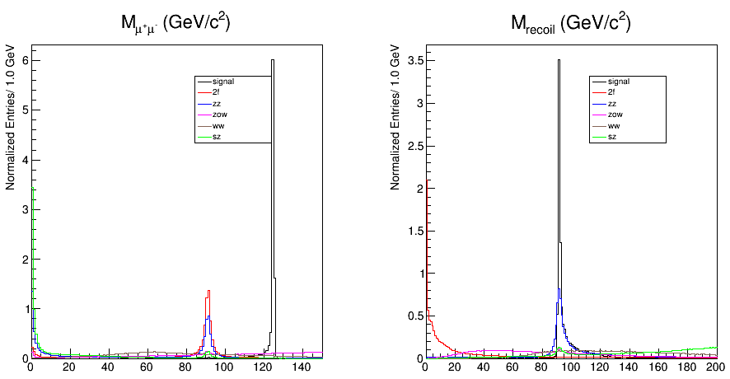
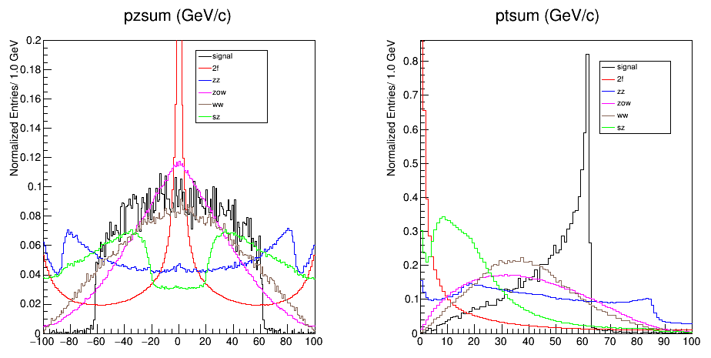
InvMass | di-moun’s invariant mass
RecMass | di-moun’s recoil mass
Ptsum | Transverse momentums of di-muon system
Pzsum | Z direction momentums of di-muon system
cosup | polar angle of μ⁺
cosum | polar angle of μ⁻
Ptuu | the angle between the muons’ transverse momentums
Notes:
This page and the next page shows the distribution of different variables,

Slide 7
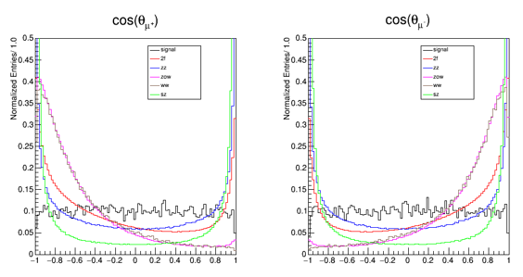
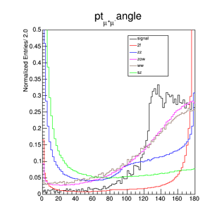
Divide the signal equally with random number.
Part A : Find sections.
Part B : Get test result.
All vars in Part A:
Part B: test and fit
Z=S/sqrt(S+B)
Pre-section
Find the max Z
Section
(End:Z_{old}>Z or (cutL/R_{old}-cutL/R)<e)

Slide 8
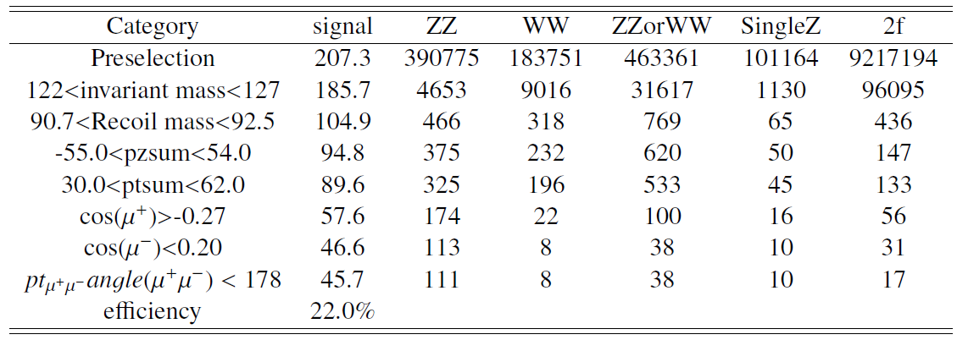
Cut-base optimization

Slide 9
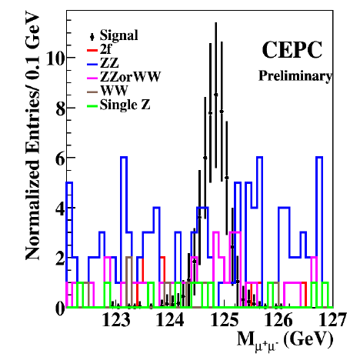
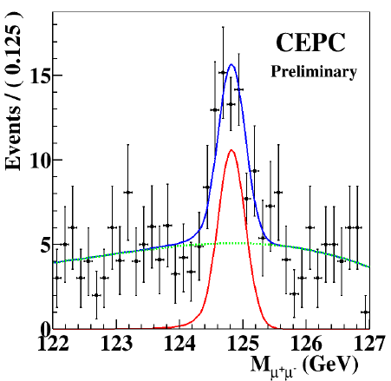
BKG：second order Chebychev function
Signal：CBShape function
Significance： 5.89
Uncertainty：
3sigma: 0.63-1.38
1sigma: 0.8-1.18

Slide 10
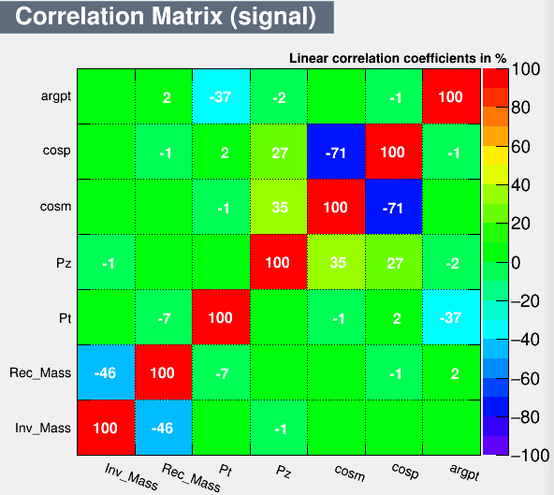
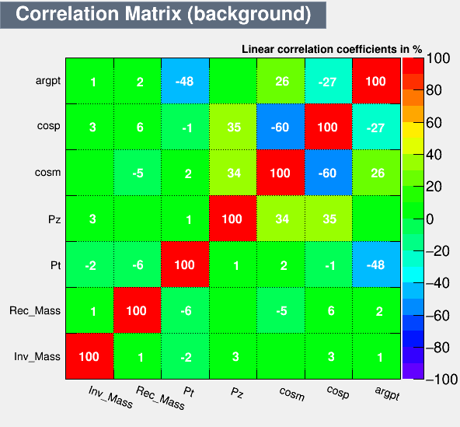
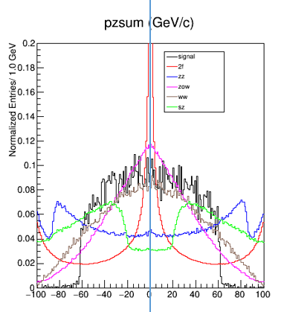
BDT optimization
Ptsum
Abs(Pzsum)
cosum
cosup
Ptuu
InvMass
RecMass
BDT response
Notes:
Then I used 5 vars to do BDT optimization to I mprove the result. And use bdt result Invant mass and recoil mass to do the cut base.

Slide 11
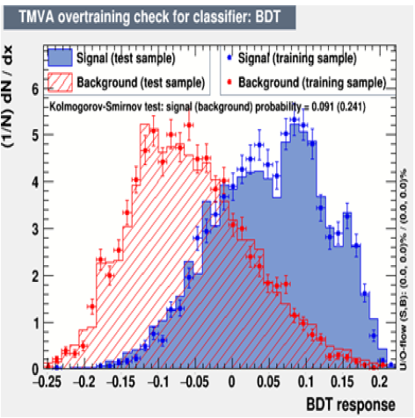
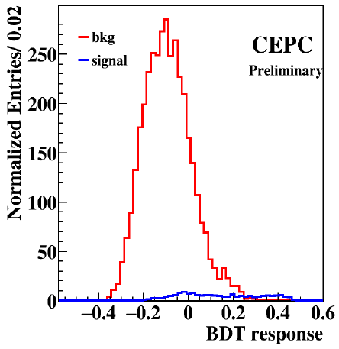
Max Significance: 6.00 at bdt=0.01
Notes:
So, finally I got the sign

Slide 12
Next Step:
Z decay $e^{+}+e^{−}$：cut-base
Z decay $μ^{+}+μ^{−}$：choose$μ$pairs
Z decay $jet+jet ：$simply code
Z decay $v_{l}+\overline{v_{l}}$ $：$simply code
……

Slide 13
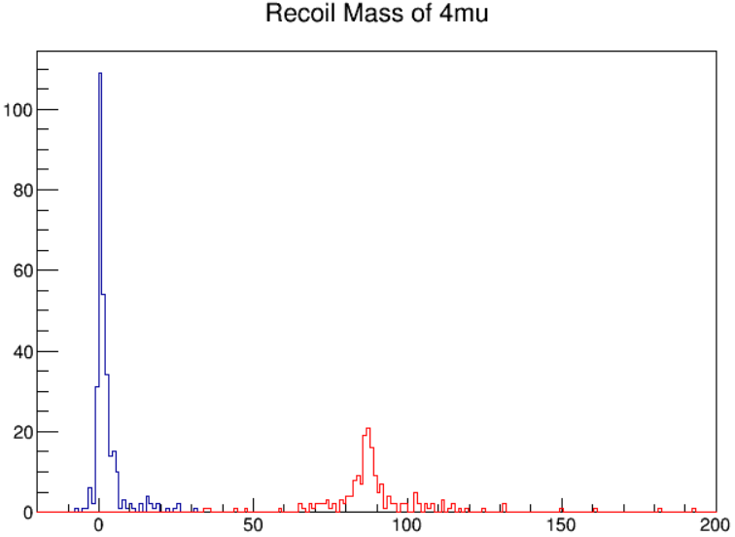
Z->e⁺+e⁻ and H->u⁺+u⁻
ZeeHuu | signal | sz | zz | ww(sw) | zow | 2f(qq)
Presection | 272 | 2045762 | 1890 | 210 | 1 | 1894
120<(di-mu).M<130 | 241 | 1806 | 5 | 0 | 0 | 0
89<(di-e).M<92 | 104 | 82 | 0 | 0 | 0 | 0
cos(em)<0.56&cos(ep)>-0.28 | 75 | 12 | 0 | 0 | 0 | 0
-0.8<cos(um)<0.64 | 61 | 10 | 0 | 0 | 0 | 0
Z->u⁺+u⁻ and H->u⁺+u⁻
Efficiency=22%
Recoil4mu.M()<31
Fake rate=0.

Slide 14
THANK YOU

Slide 15
a summary status about the ZH to dileptonic channel
LeiWang

Slide 16
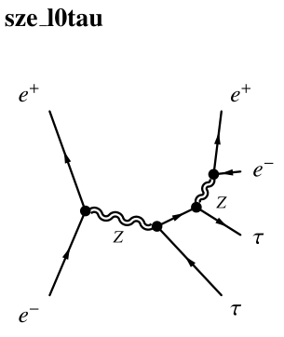
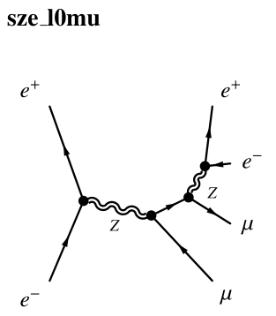
ZH->mumuee channel
signal sample:
ee->zh->zee
background sample:
fast simulation
Preselection:
E>10GeV Ne>0 Nμ>0
choose the e pair close to
125GeV(BSR correction)
choose the μ pair close to
91.2GeV
Variance for optimization:
invmass recoilmass
Pt Pz δφ
cosθ Ntrack MET

Slide 17
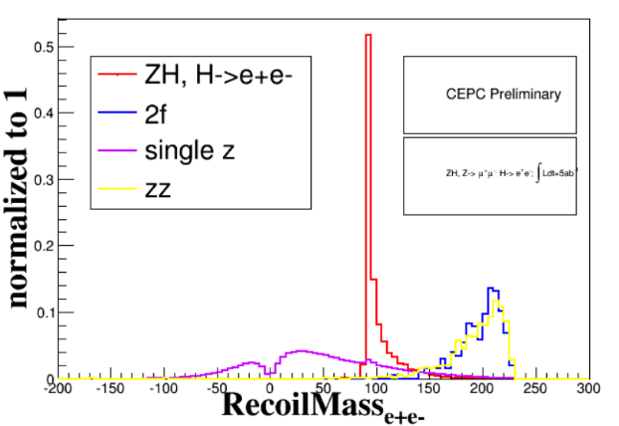
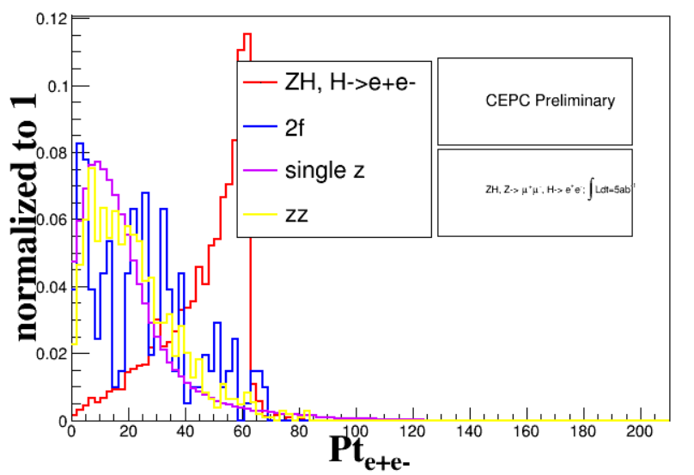
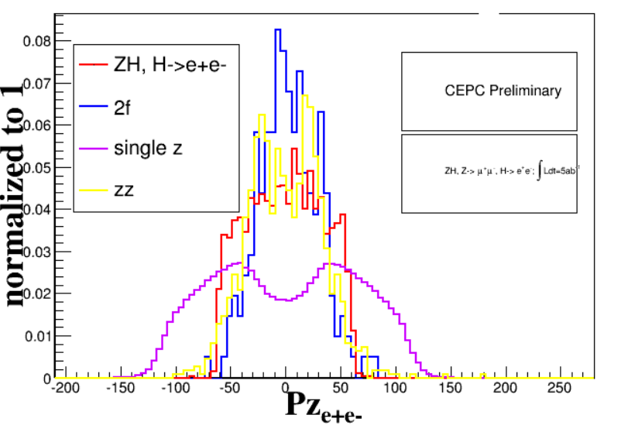
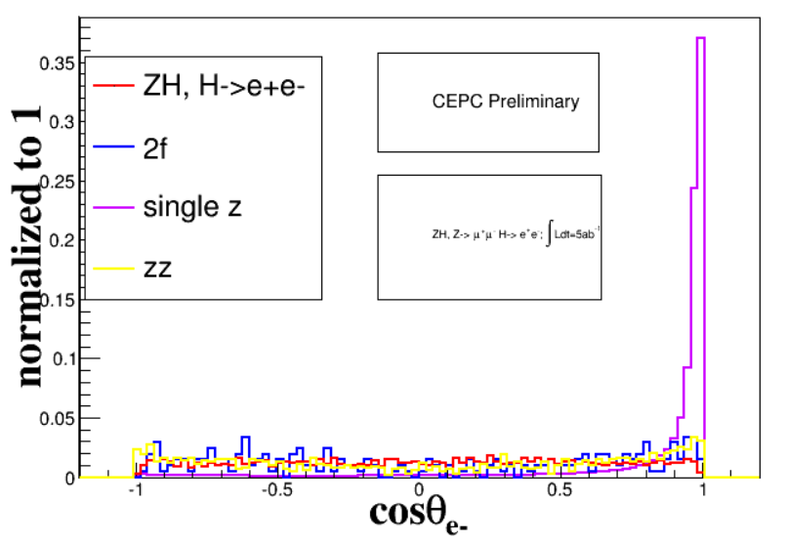

Slide 18
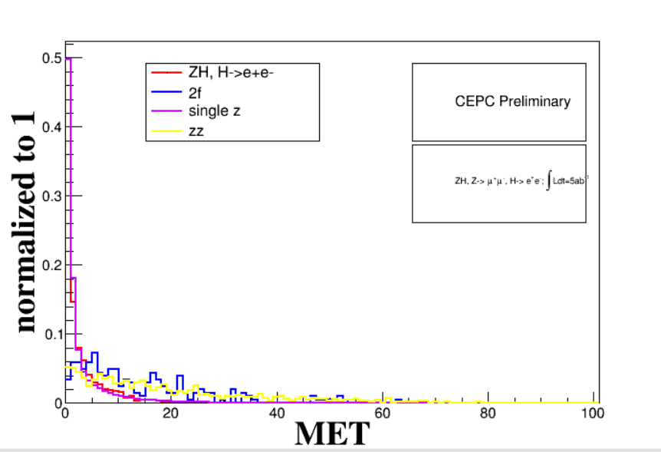
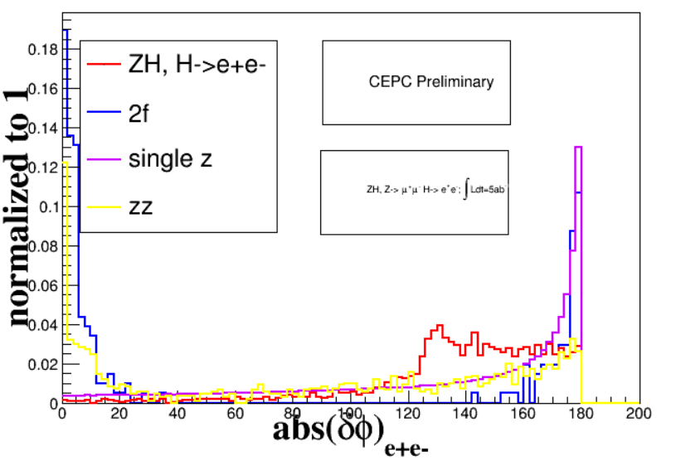

Slide 19
cut chain table
zh->zee
 | signal | 2f | sz | zz | higgs_bkg | others | all bkg
initial | 50000 | 418194802 | 7913405 | 4967152 | 852687 | 89468572
pre selection: E>10GeV Ne>0,Nμ>0 | 2867 | 206 | 830622 | 1104 | 1490 | 2 | 833424
120<$M_{inv}<130$ | 1885 | 0 | 47404 | 1 | 0 | 0 | 47405
89<$M_{recoil}$<95 | 1487 | 0 | 2050 | 0 | 0 | 0 | 2050
52<Pt<65 | 866 | 0 | 209 | 0 | 0 | 0 | 209
-34<Pt<34 | 864 | 0 | 195 | 0 | 0 | 0 | 195
|δφ|<180 | 864 | 0 | 195 | 0 | 0 | 0 | 195
MET<3GeV | 845 | 0 | 152 | 0 | 0 | 0 | 152
cose+<-0.12 | 482 | 0 | 4 | 0 | 0 | 0 | 4
cose-/Ntrack | no influence

Slide 20
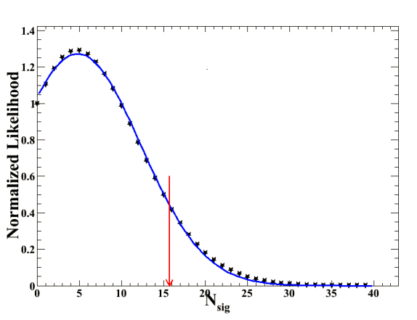
something about upper limit set
As we know the usual method we use to extract the upper limit is to suppose one $N_{s}$ value,and we could get one likelihood value
Then we could suppose more $N_{s}$ and get the corresponding likelihood value.
Ultimately we could get the likelihood vs $N_{s}$ plots
It is a gaussisan distribution according to the large number theorem
we calculate the 95% area as the $N_{s}$ upper limit value for 95% C.L.

Slide 21
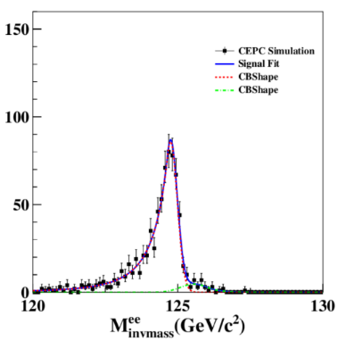
something about upper limit set
For the ZH->Zee inclusive channel
the remain background is 804,
we could fit it and extract the upper limit from the shape
the upper limit is 0.1665‰ at 95% confidence level
For the ZH->mumuee exculsive channel
the remain background is 4
After learning a lot from the WeiHai summer school and I establish the roostats code to calculate the upper limit
the upper limit is 0.7197‰ at 95% confidence level
95% lower limit and upper limit obtained from roostats on s is : [0.0805, 6.938]

Slide 22
something about upper limit set
I am not quite experienced about the roostats part so there are a lot of code details and parameters to examine and try,but at least the orders of magnitude seems reasonable
I will discuss it with Qiang and Zhenwei soon
To explain the inclusive result is better than the exclusive one: it is because that we obtain the inclusive result through the fit procedure .To some extent,fit procedure is also help us suppress the background furtherly
There are also two other methods to make a cross check
1.To naivly estimate the upper limit according to the S/$\sqrt{B}，$it is sensitive when S=4,so the BR is about $\frac{4}{482∗20}$=
0.415‰ (20 is normalized factor)
2.use formula to calculate the upper limit
I will try it ASAP

Slide 23
Next step for zh->zee
I will finish the statistical part of the zh->mumuee channel
I will begin other zh->zee exclusive channel ASAP

Slide 24
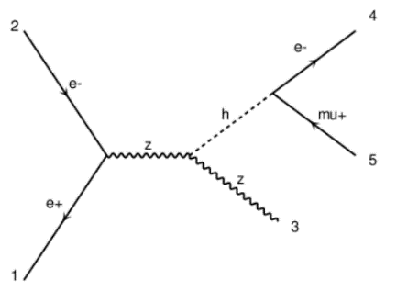
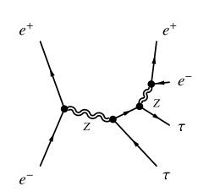
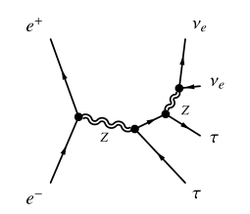
ZH->Zeμ channel
signal sample:
ee->zh->zeμ
background sample:
fast simulation

Slide 25
ZH->Zeμ channel(cut chain)
Best significance | signal |  | 2f |  | sZorsW | single Z |  | signle W |  | WW |  | ZZ |  | WWorZZ | Total bkg
total generate | 10000 |  | 418194802 |  |  | 7913405 |  | 17190655 |  | 16887172 |  | 4967152
$N_{e}$≥1,$N_{\text{μ}}\text{≥}$1 E>10GeV | 9199 |  | 1191574 |  | 0 | 2479527 |  | 2464930 |  | 274512 |  | 66530 |  | 0 | 6517160
120≤$M_{inv}\text{≤}$130 | 7197 |  | 21761 |  |  | 117365 |  | 159882 |  | 17233 |  | 745 |  |  | 317671
90≤$M_{recoil}\text{≤}$93 | 5377 |  | 524 |  |  | 2739 |  | 8875 |  | 1332 |  | 55 |  |  | 13535
46≤${Pt}_{ee}\text{≤}\text{63}$ | 4878 |  | 391 |  |  | 767 |  | 6736 |  | 979 |  | 32 |  |  | 8910
-42≤${Pz}_{ee}\text{≤}$41 | 4840 |  | 373 |  |  | 675 |  | 6434 |  | 928 |  | 28 |  |  | 8443
|δφ|≥166 | 4791 |  | 107 |  |  | 667 |  | 6402 |  | 909 |  | 28 |  |  | 8118
$\cos_{e+}\text{≥}$0.04,$\cos_{\text{μ}+}\text{≥}$ -0.09 | e+ | $\text{μ}$+ | e+ | $\text{μ}$+ |  | e+ | $\text{μ}$+ | e+ | $\text{μ}$+ | e+ | $\text{μ}$+ | e+ | $\text{μ}$+ |  | e+ | $\text{μ}$+
 | 1115 | 1384 | 10 | 15 |  | 53 | 85 | 192 | 265 | 18 | 19 | 4 | 4 |  | 277 | 388
$\cos_{e−}\text{≤}$0.07,$\cos_{\text{μ}−} \text{≤}$-0.21 | $\text{μ}$- | e- | $\text{μ}$- | e- |  | $\text{μ}$- | e- | $\text{μ}$- | e- | $\text{μ}$- | e- | $\text{μ}$- | e- |  | $\text{μ}$- | e-
 | 1010 | 1009 | 10 | 14 |  | 52 | 66 | 122 | 93 | 12 | 2 | 4 | 4 |  | 200 | 179
after all cut | 2019 |  | 24 |  |  | 118 |  | 215 |  | 14 |  | 8 |  |  | 379

Slide 26
ZH->Zeμ channel (BR= 0.12‰)
Next step for ZH->Zeμ
1.Need TMVA method to improve the result
2.Need to do the research on the exclusive channel

Slide 27
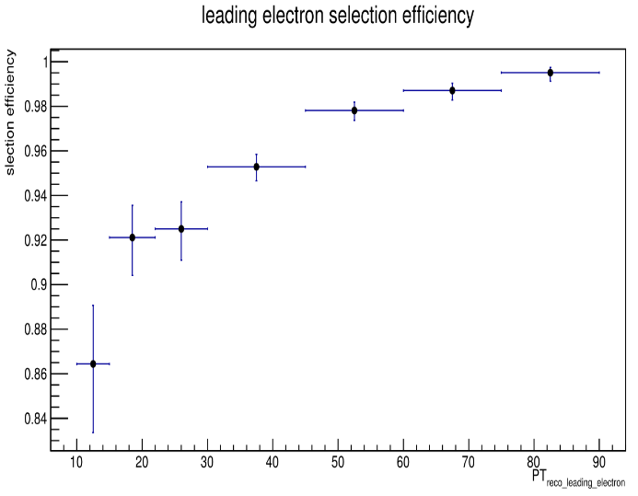
ZH->Zetau channel
signal sample:
ee->zh->zetau
already have reasonable analysis code

Slide 28
background
Next step for ZH->Zetau
1.run the background sample for the ZH->Zetau
2.give the relevant statistical result
deno:input events
numr:DR_reco_mc<0.1
Invmass of zh->mumuetau on reco level

