Slide 1
The Semi-Digital Hadronic Calorimeter for Future Leptonic Collider experiments
I. Laktineh
On behalf of the the
CALICE Collaboration

Slide 2
Outline
SDHCAL technological prototype
Description
Test Beam results
Hadronic shower studies
R&D for large SDHCAL modules
Detectors
Electronics
DAQ
New challenges
Conclusion

Slide 3
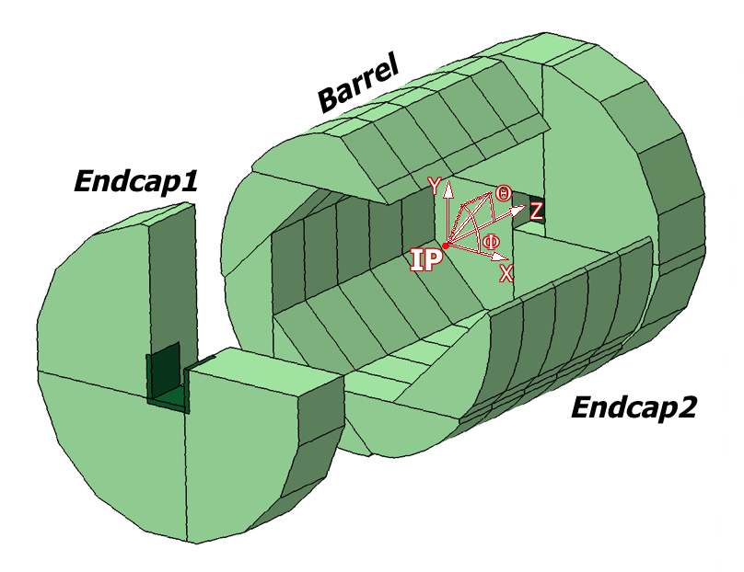
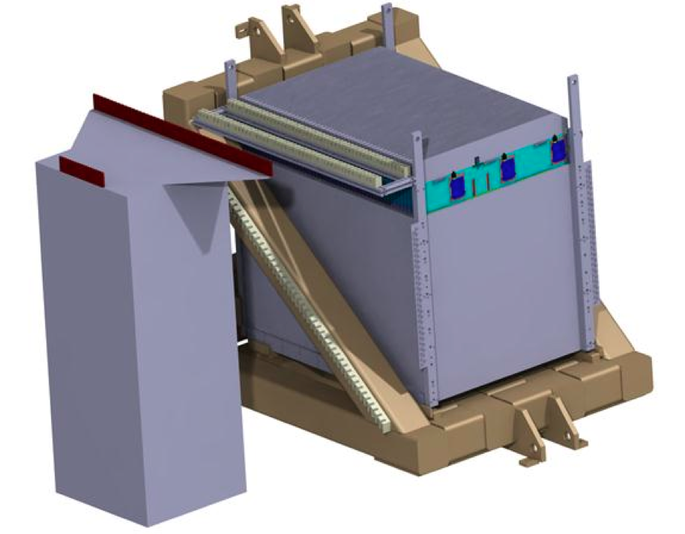
SDHCAL-ILD
The SDHCAL-GRPC is one of the two HCAL options based on PFA and
Proposed for ILD of ILC. Modules are made of 48 RPC chambers (6λ_{I})
equipped with semi-digital, power-pulsed electronics readout and placed
in self-supporting mechanical structure to serve as absorber
as well.
The structure proposed for the SDHCAL-ILD :
very compact with negligible dead zones
Eliminates projective cracks
Minimizes barrel / endcap separation
(services leaving from the outer radius)
SDHCAL Technological Prototype should
be as much as possible similar to the ILD module
and able to study hadronic showers
Challenges
-Homogeneity for large surfaces
-Thickness of only few mms
-Lateral segmentation of 1 cm X 1 cm
-Services from one side
-Embedded power-cycled electronics
-Self-supporting mechanical structure

Slide 4
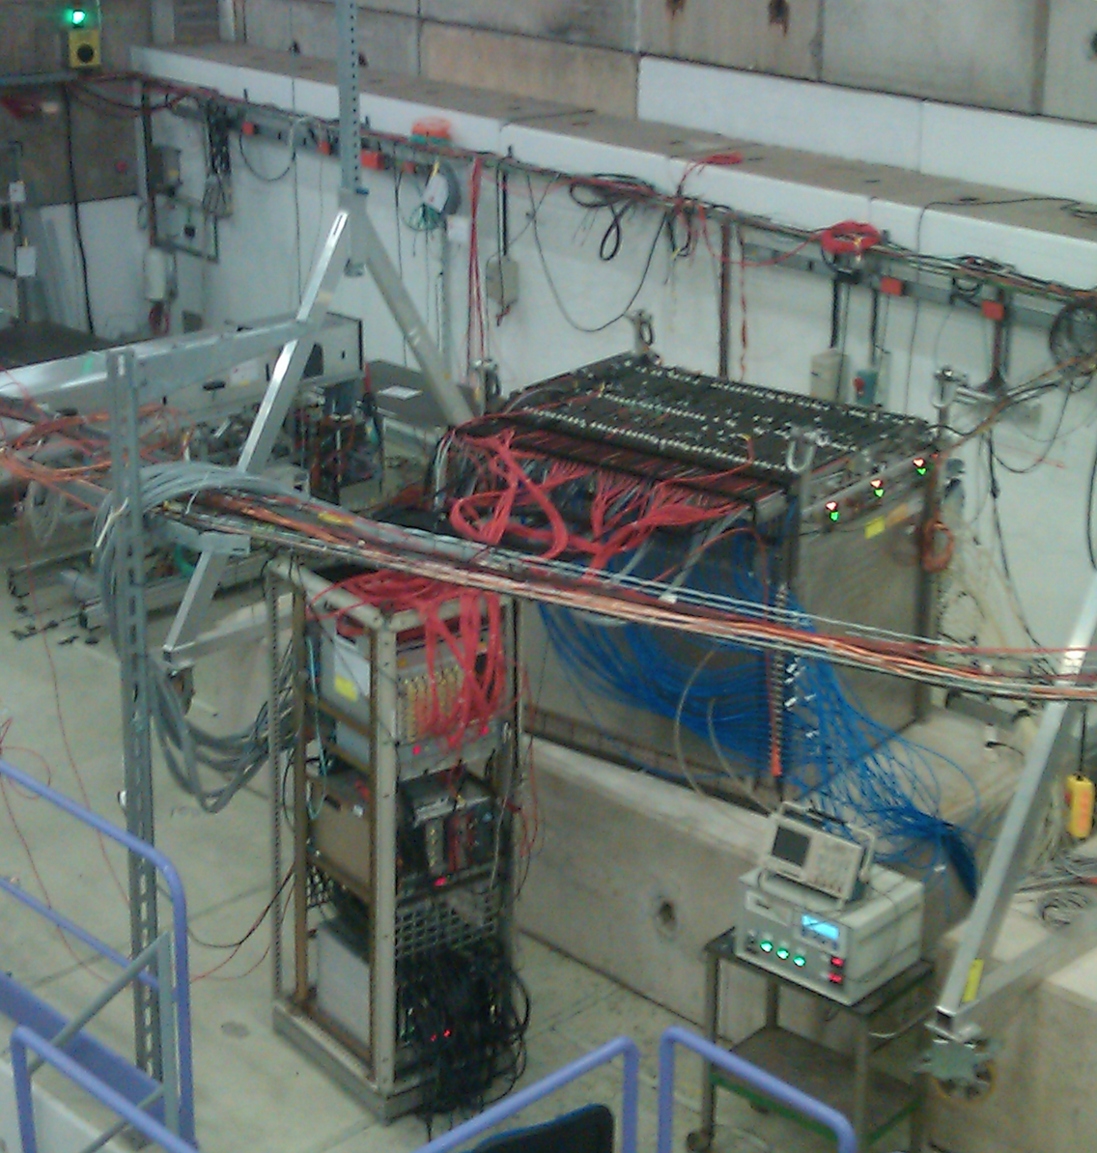
SDHCAL-ILD
The SDHCAL-GRPC is one of the two HCAL options based on PFA and
Proposed for ILD of ILC. Modules are made of 48 RPC chambers (6λ_{I})
equipped with semi-digital, power-pulsed electronics readout and placed
in self-supporting mechanical structure to serve as absorber
as well.
The structure proposed for the SDHCAL-ILD :
very compact with negligible dead zones
Eliminates projective cracks
Minimizes barrel / endcap separation
(services leaving from the outer radius)
SDHCAL Technological Prototype should
be as much as possible similar to the ILD module
and able to study hadronic showers
Challenges
-Homogeneity for large surfaces
-Thickness of only few mms
-Lateral segmentation of 1 cm X 1 cm
-Services from one side
-Embedded power-cycled electronics
-Self-supporting mechanical structure

Slide 5
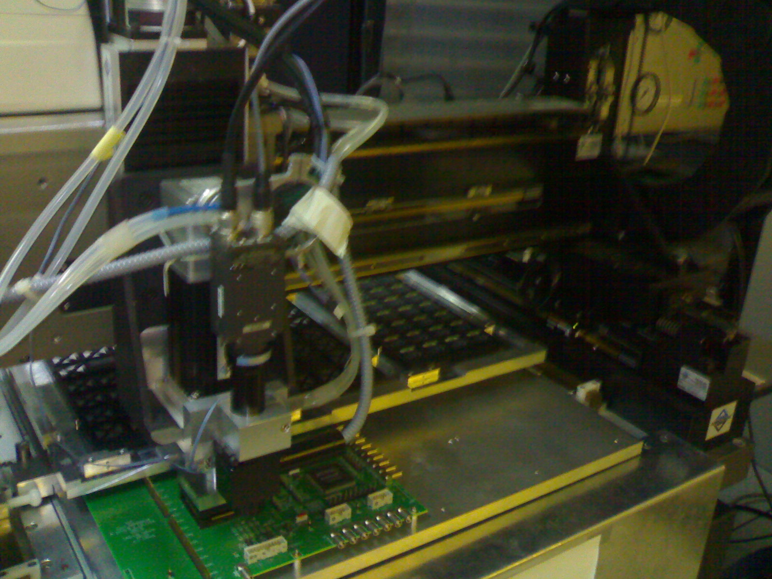
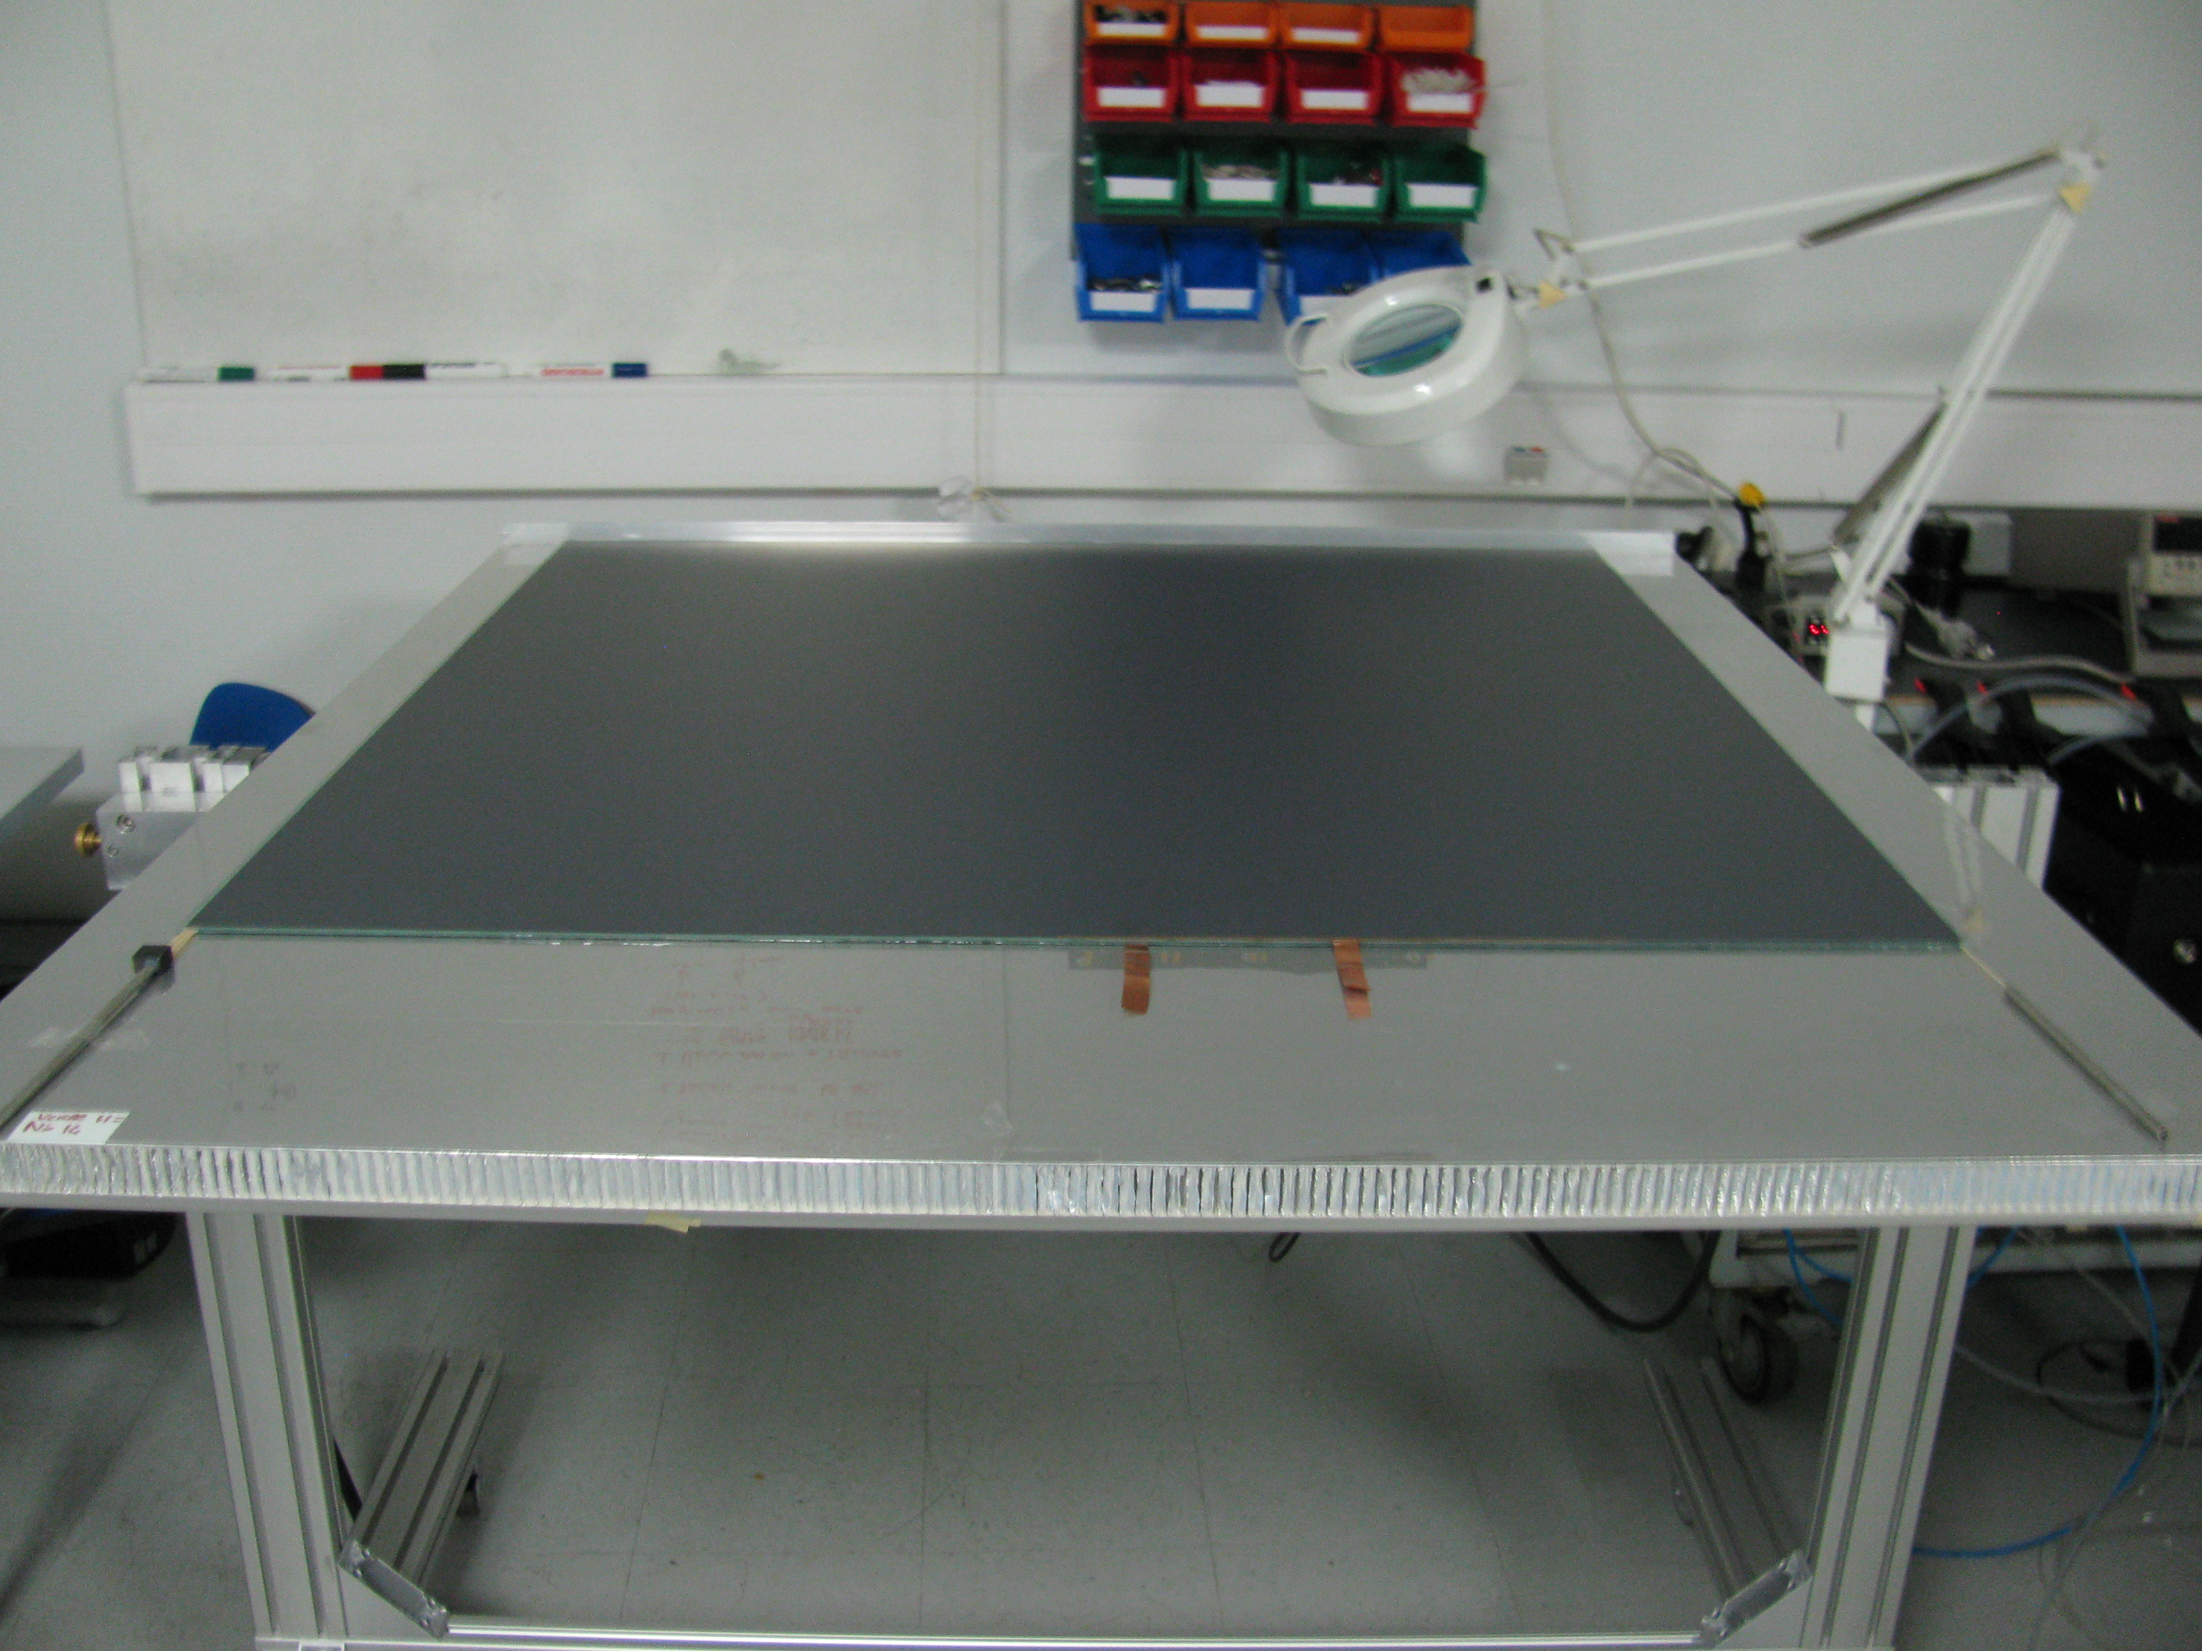
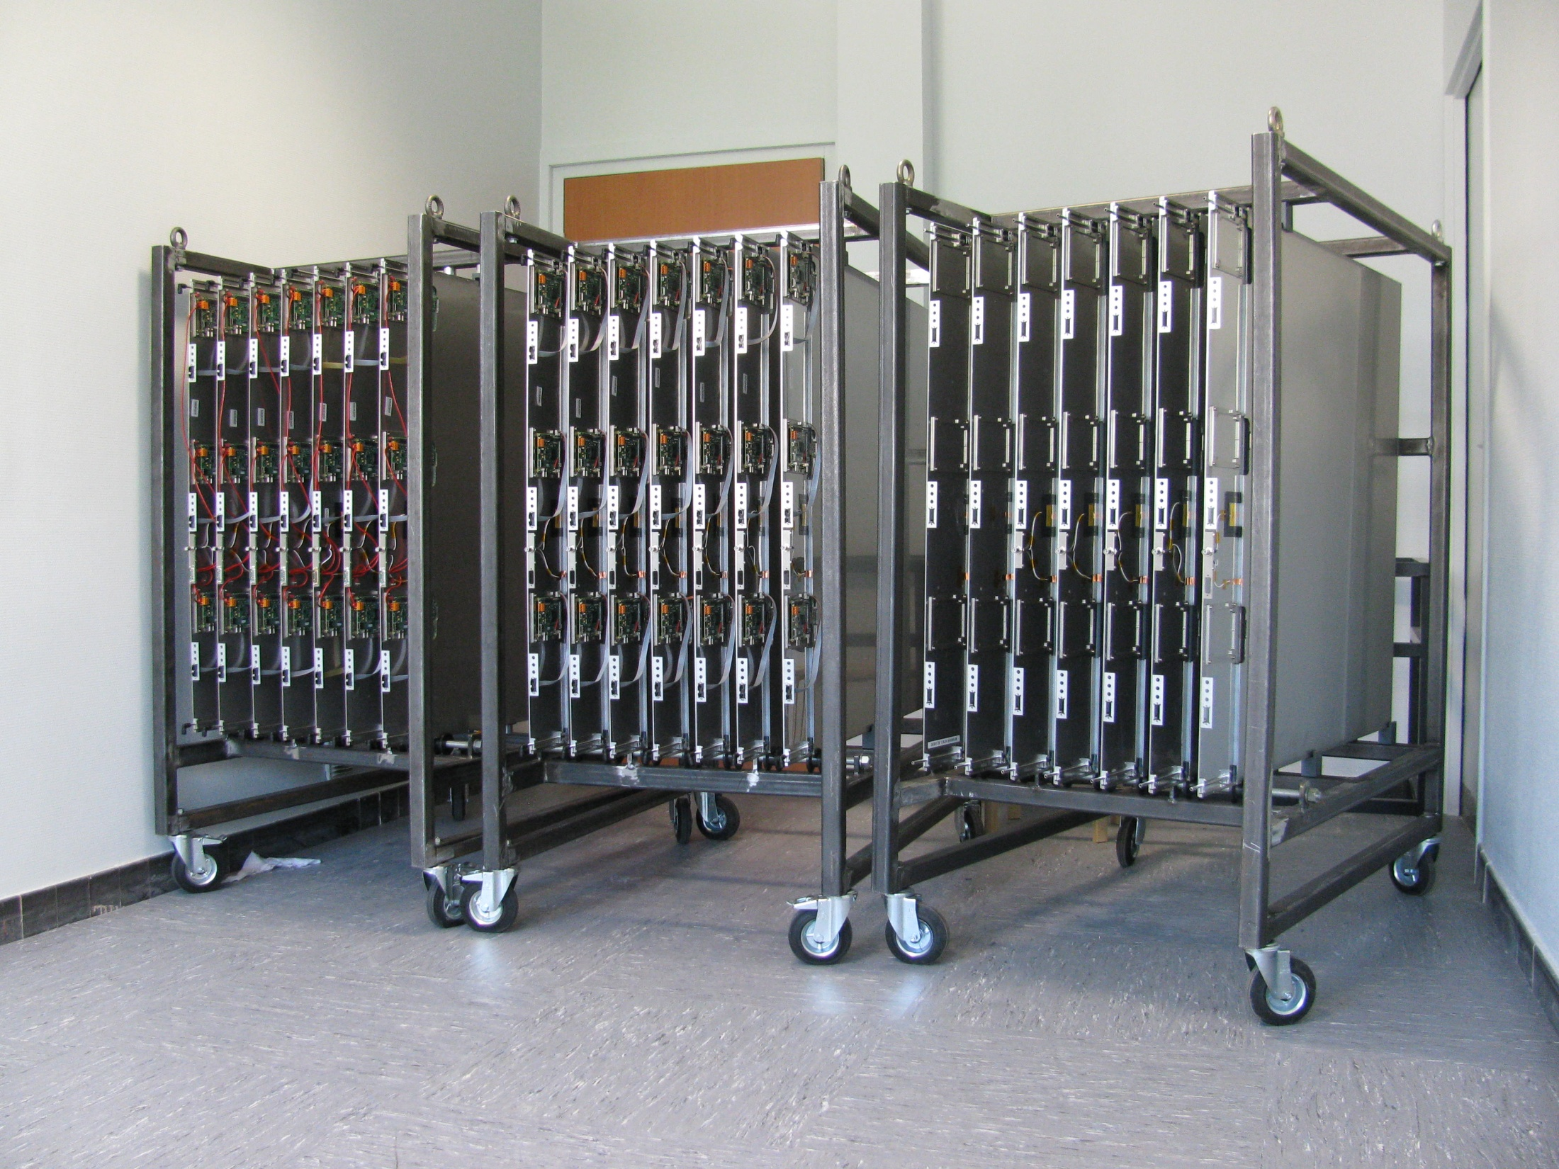
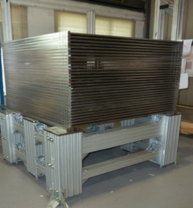
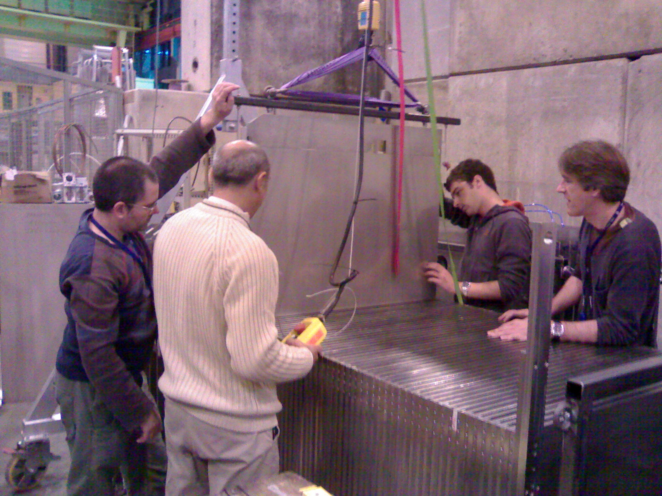
SDHCAL prototype construction
10500 64-ch ASIC were tested and calibrated using a
dedicated (ASICs layout : 93% ).
310 PCBs were produced, cabled and tested.
They were assembled by sets of six to make 1m² ASUs
170 DIF, 20 DCC were built and tested.
50 detectors were built and assembled with
their electronics into cassettes.
Self-supporting mechanical structure.
DAQ system using both USB and HTML protocol
was developed and used.
Full assembly took place at CERN.

Slide 6
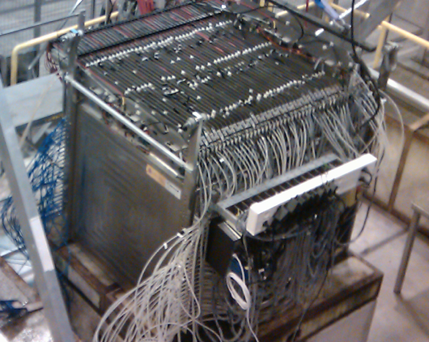
SDHCAL prototype construction
10500 64-ch ASIC were tested and calibrated using a
dedicated (ASICs layout : 93% ).
310 PCBs were produced, cabled and tested.
They were assembled by sets of six to make 1m² ASUs
170 DIF, 20 DCC were built and tested.
50 detectors were built and assembled with
their electronics into cassettes.
Self-supporting mechanical structure.
DAQ system using both USB and HTML protocol
was developed and used.
Full assembly took place at CERN.
Published: JINST 10 (2015) P10039

Slide 7
SDHCAL performance
The SDHCAL prototype was exposed to hadron, muon and electron
beams in 2012, 2015 and 2016 on PS, H6 and H6
and these days H8-SPS lines.
Power-pulsing using the SPS spill structure was used to reduce the
power consumption.
Self-triggering mode is used but external trigger mode is possible
The threshold information helps to improve on the energy rec.
by better accounting for the number of tracks crossing one pad
New data were taken in 2015 with an improved DAQ system

Slide 8
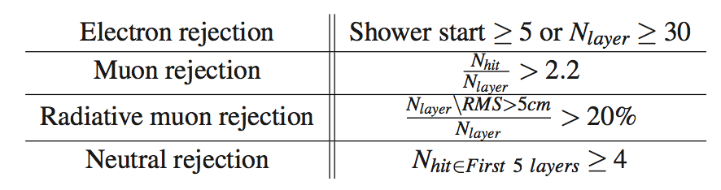
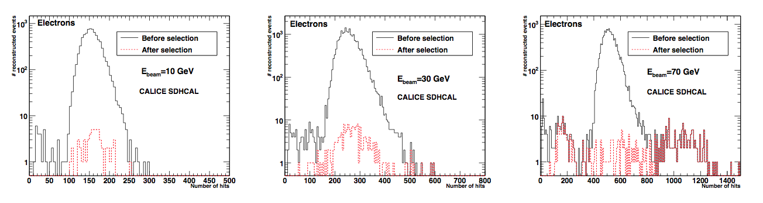
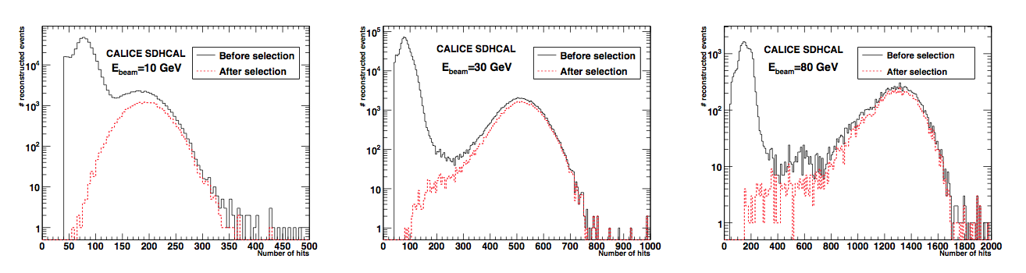
Event selection
No containment selection.
No Cerenkov detector

Slide 9
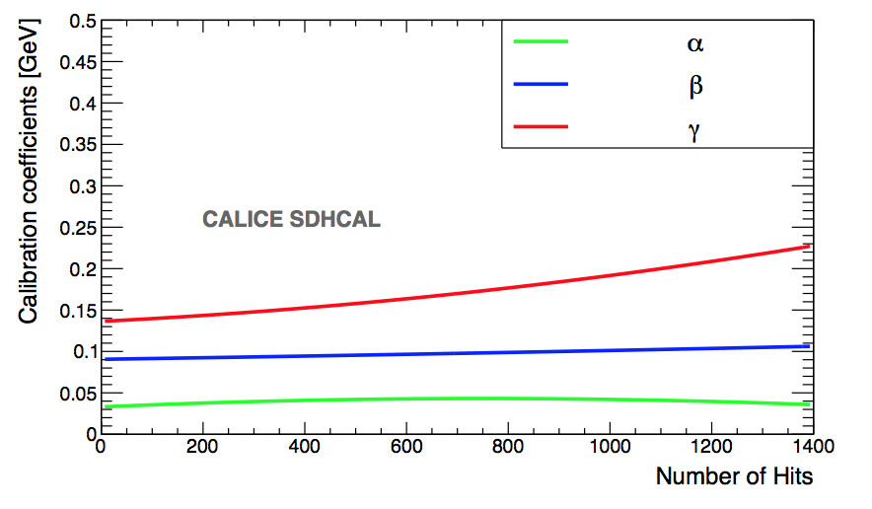
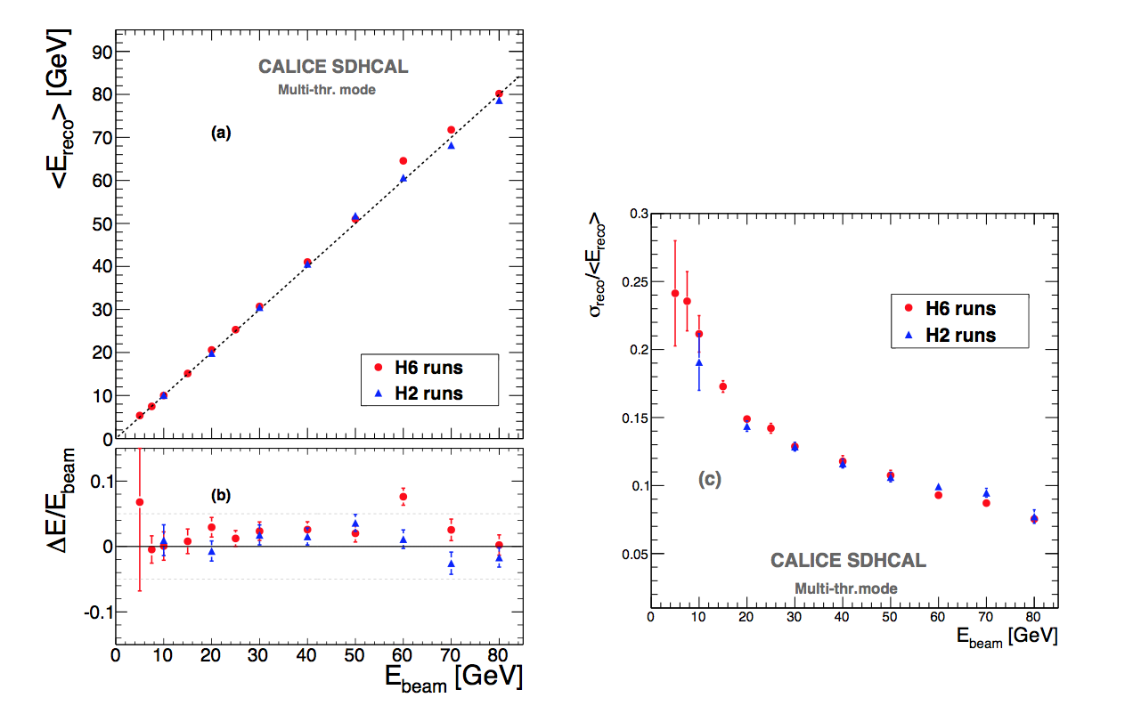
Energy estimation
The thresholds weight evolution with the total number
of hits obtained by minimizing a χ²
Χ² = (E_{beam}-E_{rec})²/E_{beam}
E_{rec =} α (N_{tot}) N₁ + β(N_{tot}) N₂ + γ(N_{tot}) N₃
N₁,N₂ and N₃ : exclusive number of hits associated to first,
second and third threshold.
α, β, γ are quadratic functions of the total number of hits (N_{tot})
Events of H2 runs corresponding to energies : 5, 10, 30 , 60
and 80 GeV were used to fit the 9 parameters.
Then the energy of hadronic events in
both H2( only pions) and H6 (presence of protons)

Slide 10
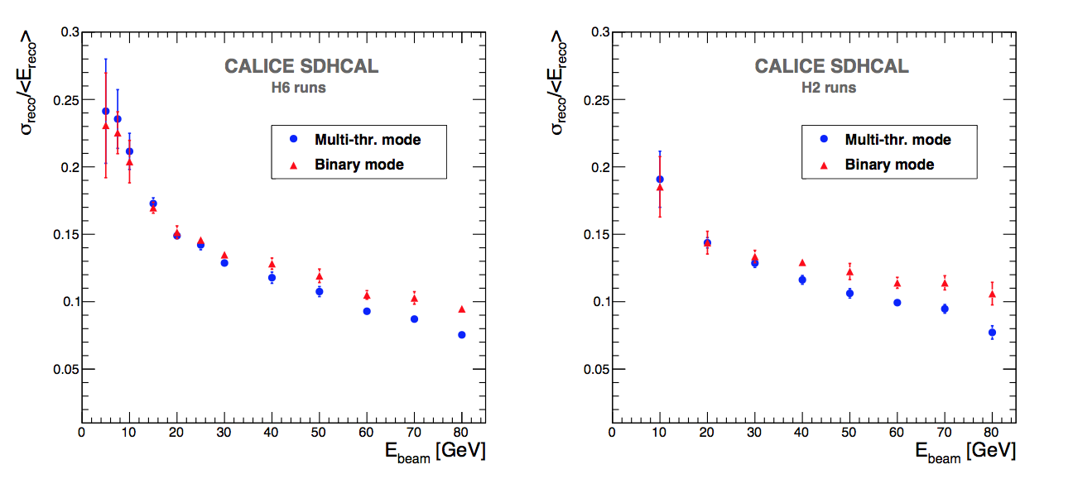
Energy estimation
Comparison semi-digital versus binary readout
E_{rec} (binary) = C N _{tot} + D N² _{tot} + F N³_{tot}
E_{rec} (semi-digital) = α (N_{tot}) N₁ + β(N_{tot}) N₂ + γ(N_{tot}) N₃
Substantial improvement a energy > 30 GeV
Published: JINST 11 (2016) P04001

Slide 11
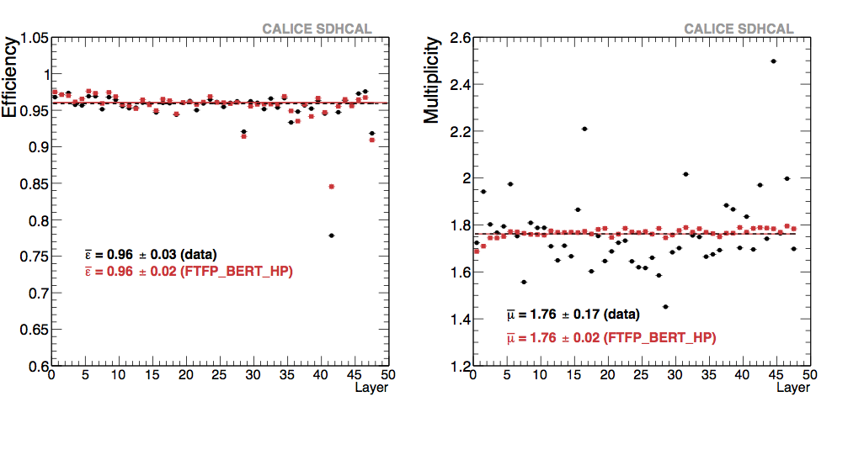
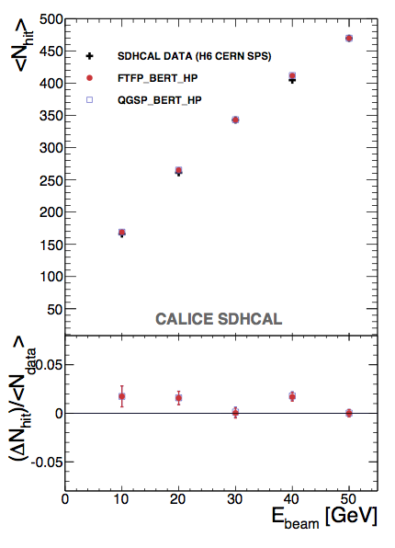
SDHCAL Simulation
A digitizer to describe the RPC response was developed. Parameters tuned using muons and electrons. Detector inefficiencies (dead channels) are included.
Muons
Muons
Electrons

Slide 12
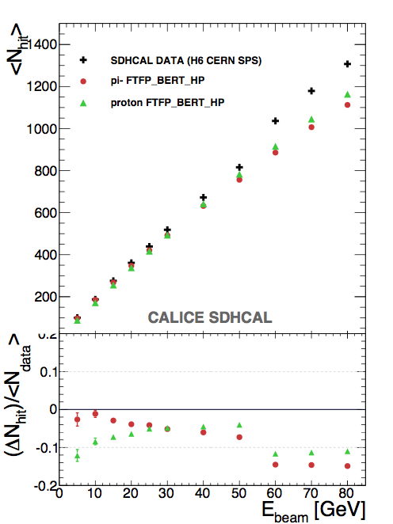
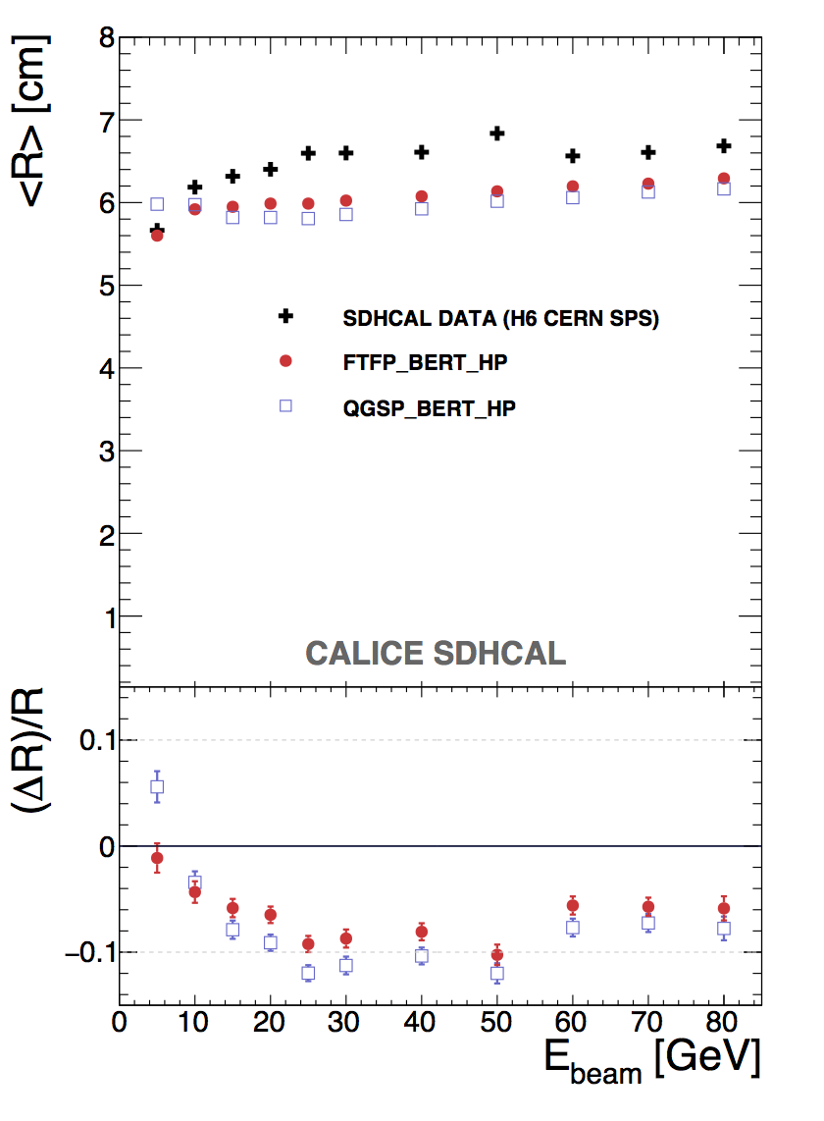
Comparison data/simulation
Published: JINST 11 (2016) P06014

Slide 13
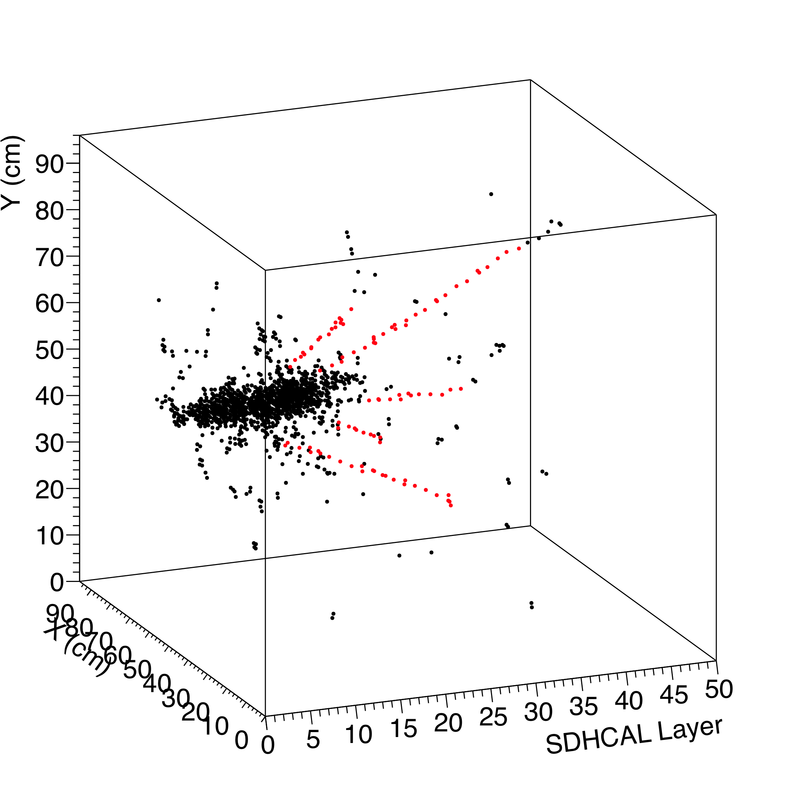
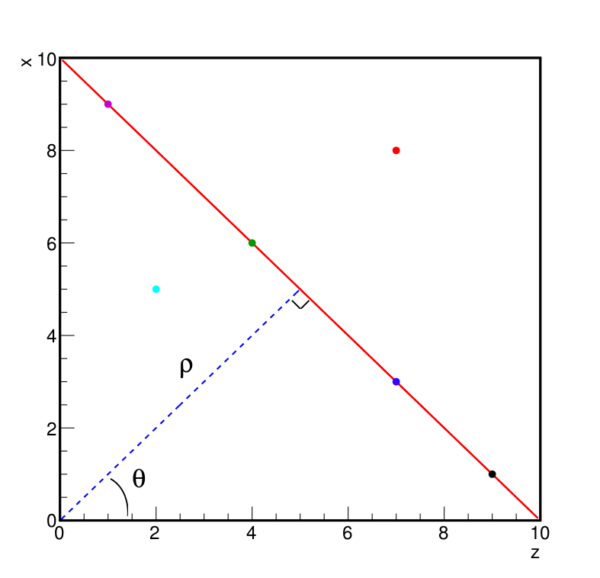
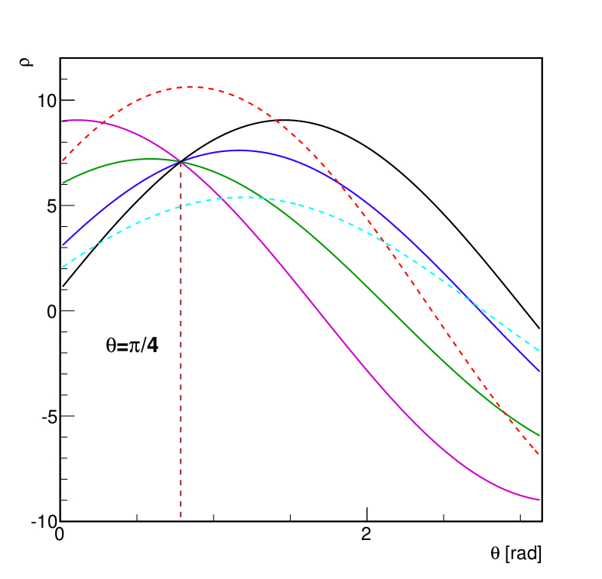
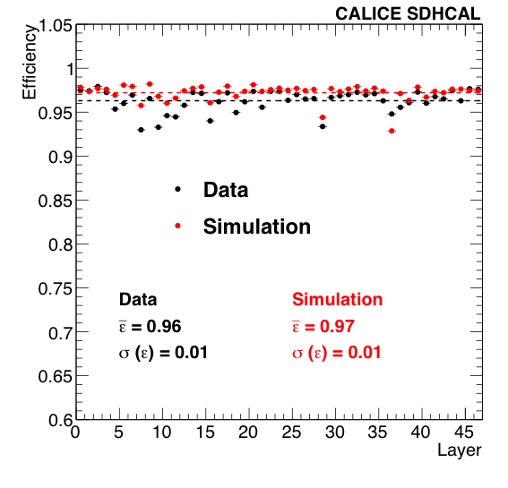
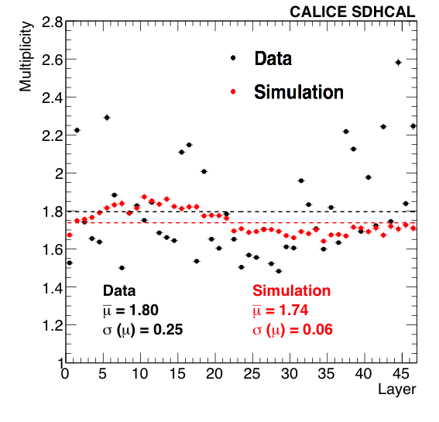
SDHCAL High-granularity impact
Hough Transform is an example to extract tracks within hadronic showers and to use them to control the calorimeter in situ
ρ_{xz} = z sin(θ) + x cos(θ)
Excellent agreement with results obtained with cosmic and beam-muons.
Excellent agreement data/MC

Slide 14
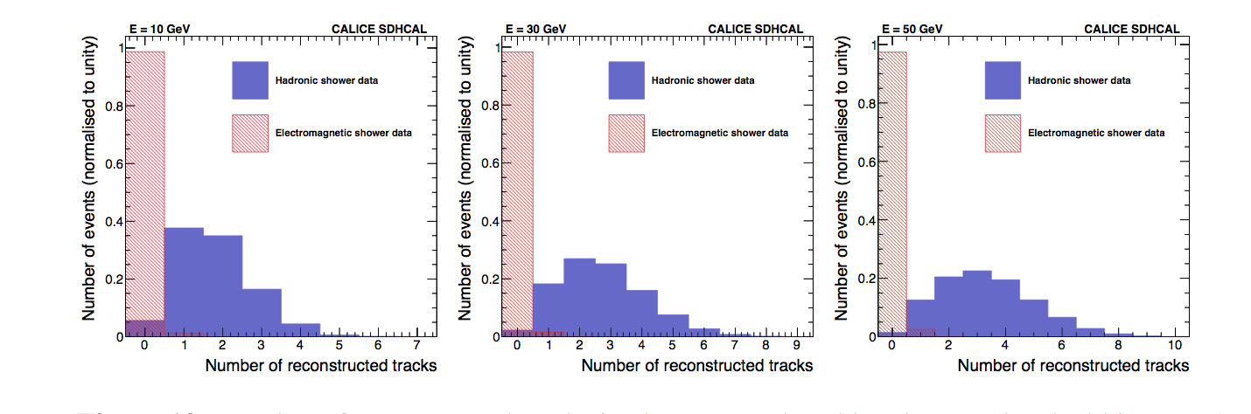
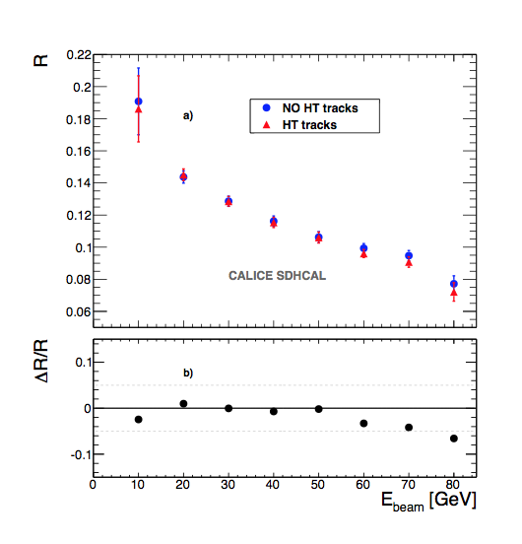
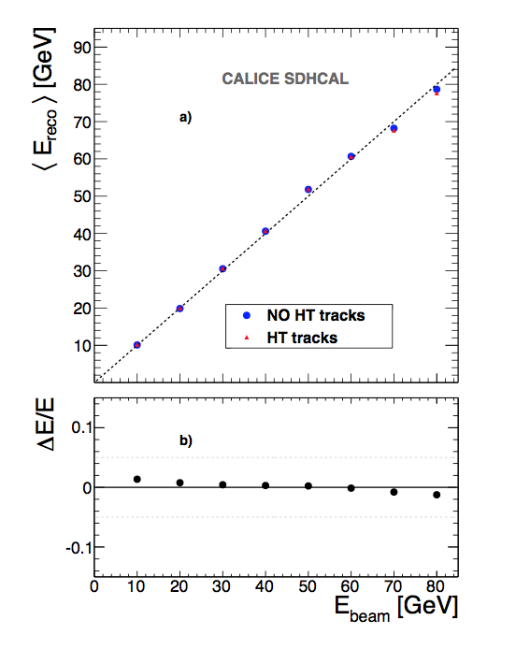
SDHCAL High-granularity impact
Good tool to discriminate electron/hadron
It improves on the energy reconstruction by dealing with the hits belonging to the track segments independently of their threshold
Published:
JINST 12 (2017) P05009
The technique could be extended to hadronic showers in the presence of magnetic field.

Slide 15
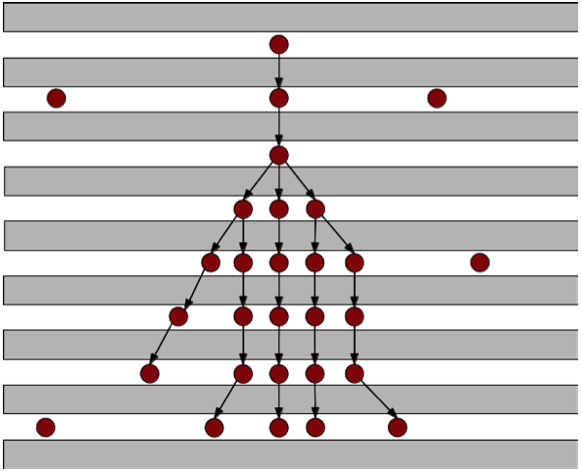
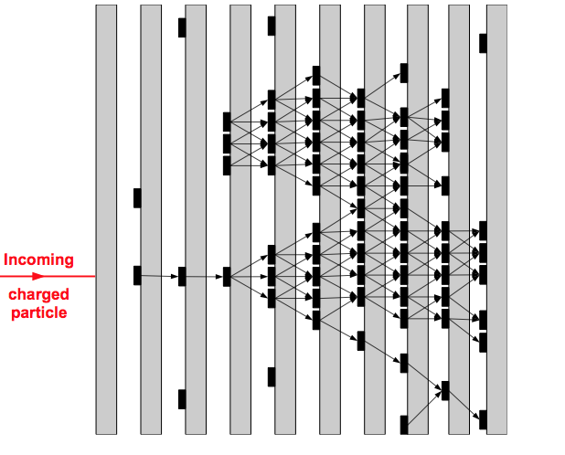
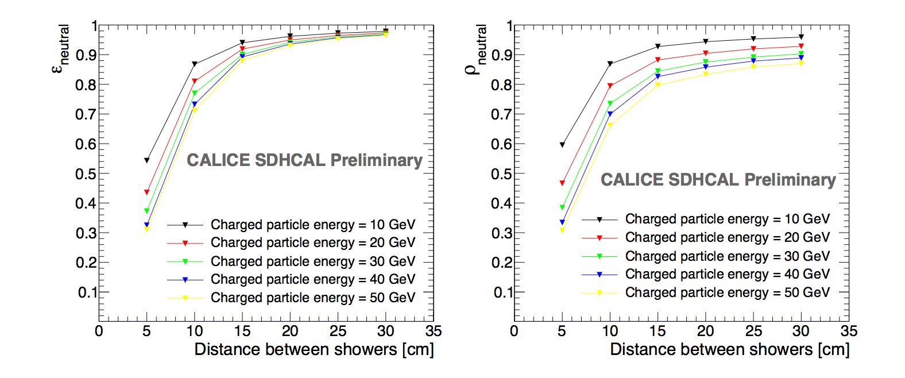
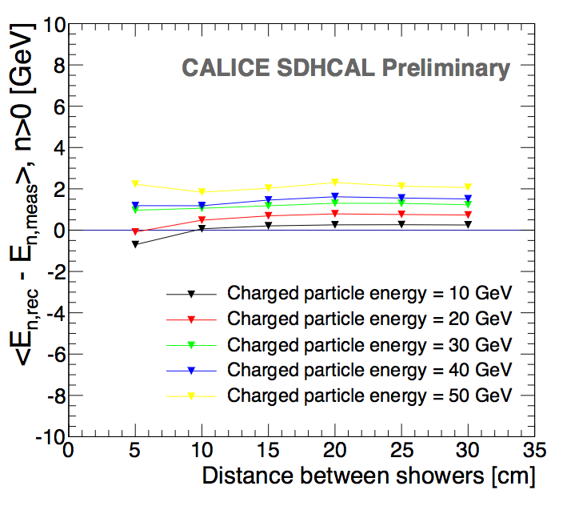
SDHCAL high granularity is good
It helps to optimize the connection of hits belonging to the same shower by using first the topology and then the energy information
ArborPFA algorithm*:
It connect first hits and then their clusters using distance and orientation information
Then correct using tracker information
Efficiency
ΔE
Purity
CALICE note CAN054
* Algorithm idea was first developed by ALEPH collaboration

Slide 16
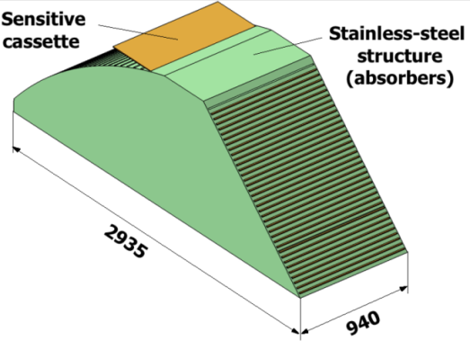
SDHCAL for future experiments
GRPC
Glass Resistive Plate Chambers
Detectors as large as 3m X 1m need to be built
Electronic readout should be the most robust with
minimal intervention during operation.
DAQ system should be robust and efficient
Mechanical structure to be similar to the final one
Envisage new features such timing, etc..
SDHCAL
ILD Module
Goal: to build new prototype with few but large GRPC with the new components

Slide 17
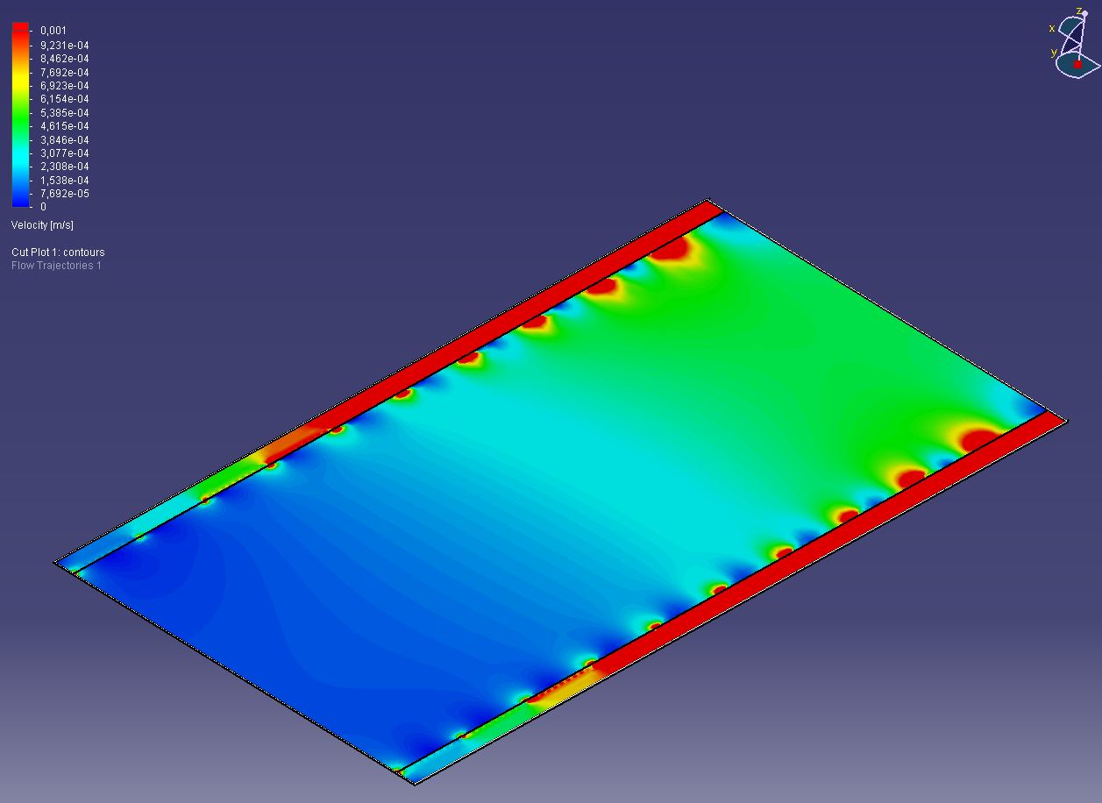
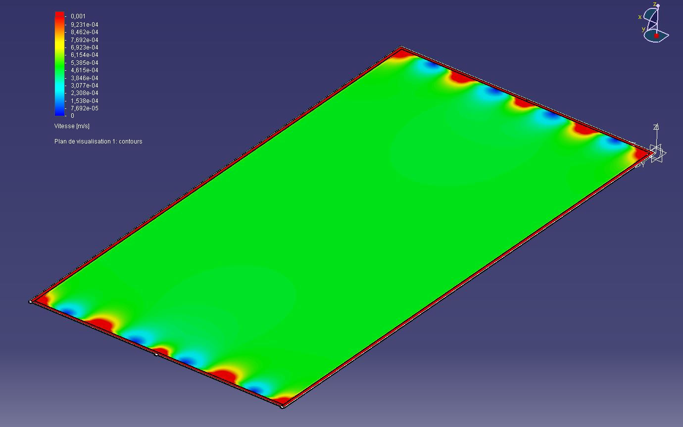
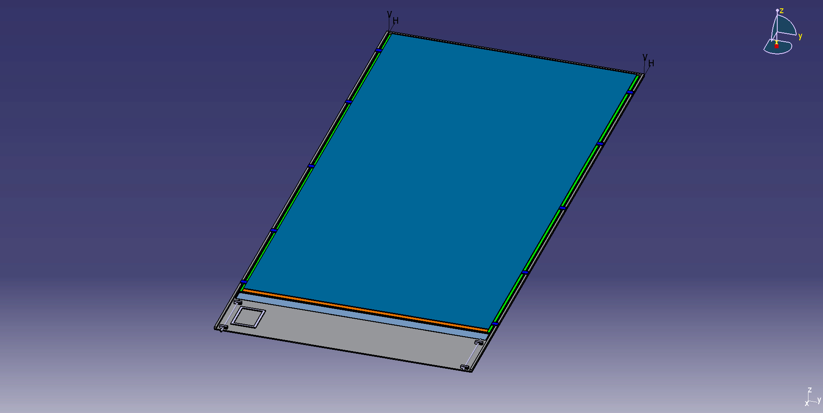
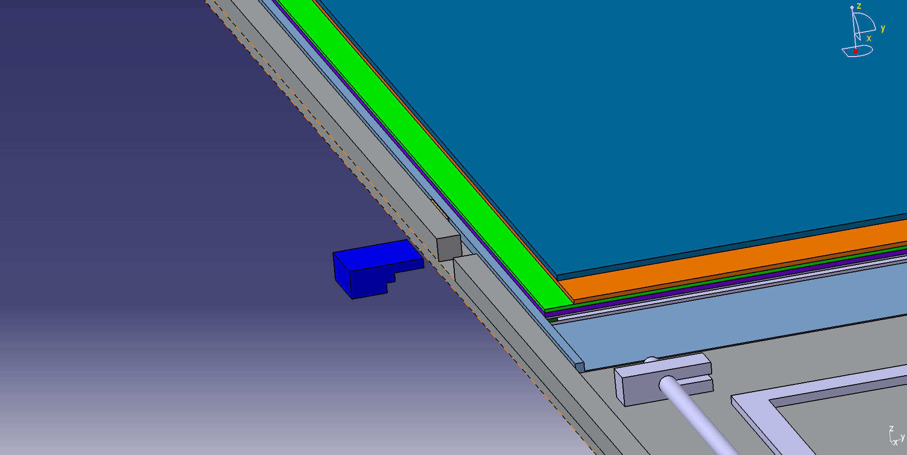
Detector conception
Construction and operation of large GRPC necessitate some improvements with respect to the present scenario.
Gas distribution : new scheme is proposed
Prototype circulation system
New circulation system
inlet
outlet
1 m
2 m
Cassette conception to ensure good contact between the detector and electronics is to be improved

Slide 18
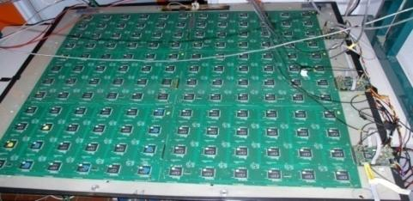
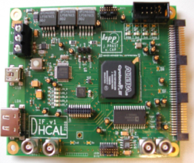
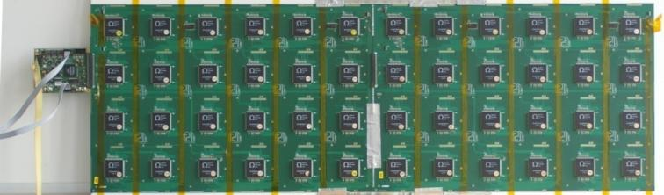
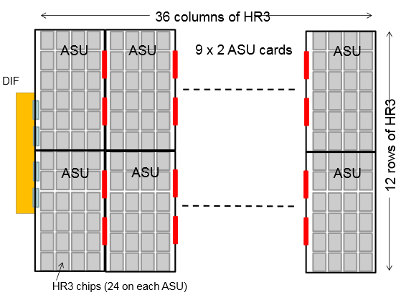
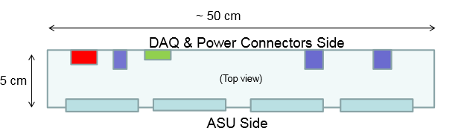

New electronics
Electronics readout for the 1m³ prototipo
HADROC chip
(ASIC)
1m² board ➔ 6 ASUs hosting 24 ASICs
3072 ch
DIF #1
144 ASICs= 9216 channels/1m²
USB
ASU1
ASU2
33 cm
DIF #2
HDMI
DIF
100 cm
DIF #3
1 DIF (detector InterFace) for 2 ASU (Active Sensor Unit.- PCB+ASICs) ➔ 3 DIFs for ONE 1m2 GRPC detector
Electronics readout for the final detector
Only 1 DIF per GRPC (any size) with small dimensions to fit in the small space available at the ILD detector
DIF dimensions
ASUs of 1000 mmx333 mm are being produced

Slide 19
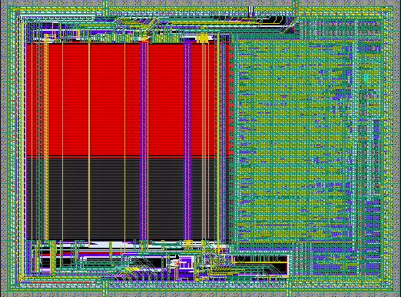
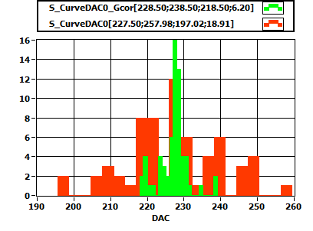
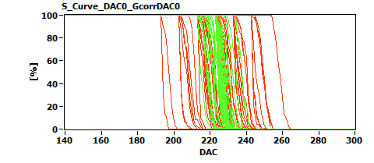
6,3 mm
New electronics: ASIC
HARDROCR3 main features:
  Independent channels
  Zero suppress
  Extended dynamic range (up to 50 pC)
  I2C link with triple voting for slow control parameters
  packaging in QFP208, die size ~30 mm²
  Consumption increase (internal PLL, I2C)
4,7 mm
H3B TESTED : 786, Yield : 83.3 %

Slide 20
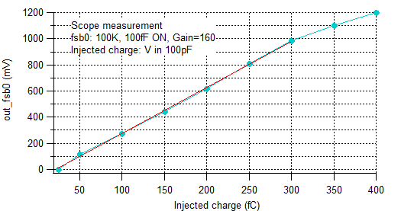
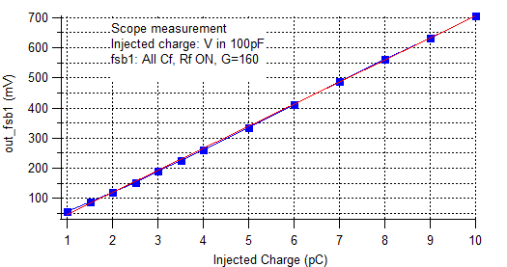
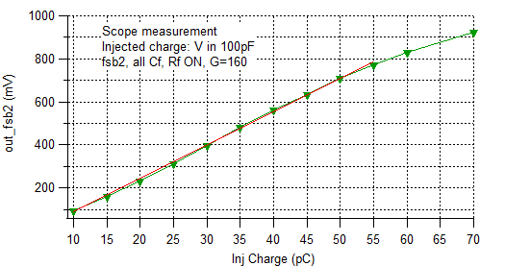
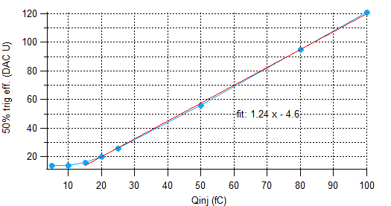
HARDROC3: Analog linearity
Fast shaper outputs (mV) vs Qinj (fC)
FSB0
FSB1
Up to 10 pC
50% trig. Eff. (DAC units) vs Qinj (fC)
FSB0: 5σ noise limit= 15 fC
FSB2
Up to 50 pC
Dynamic range: 15fC - 50 pC

Slide 21
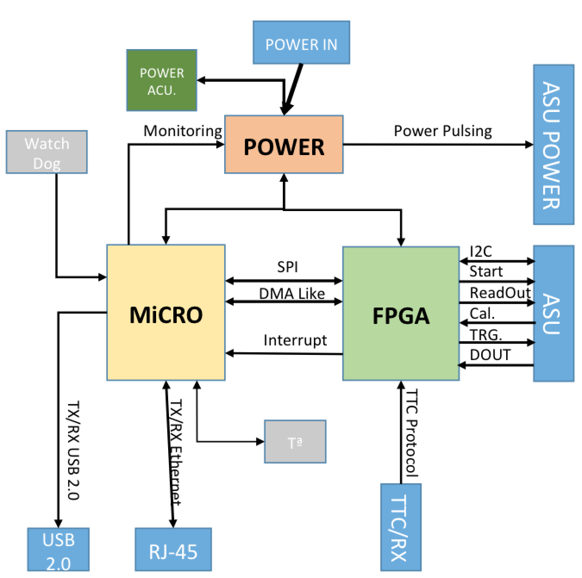
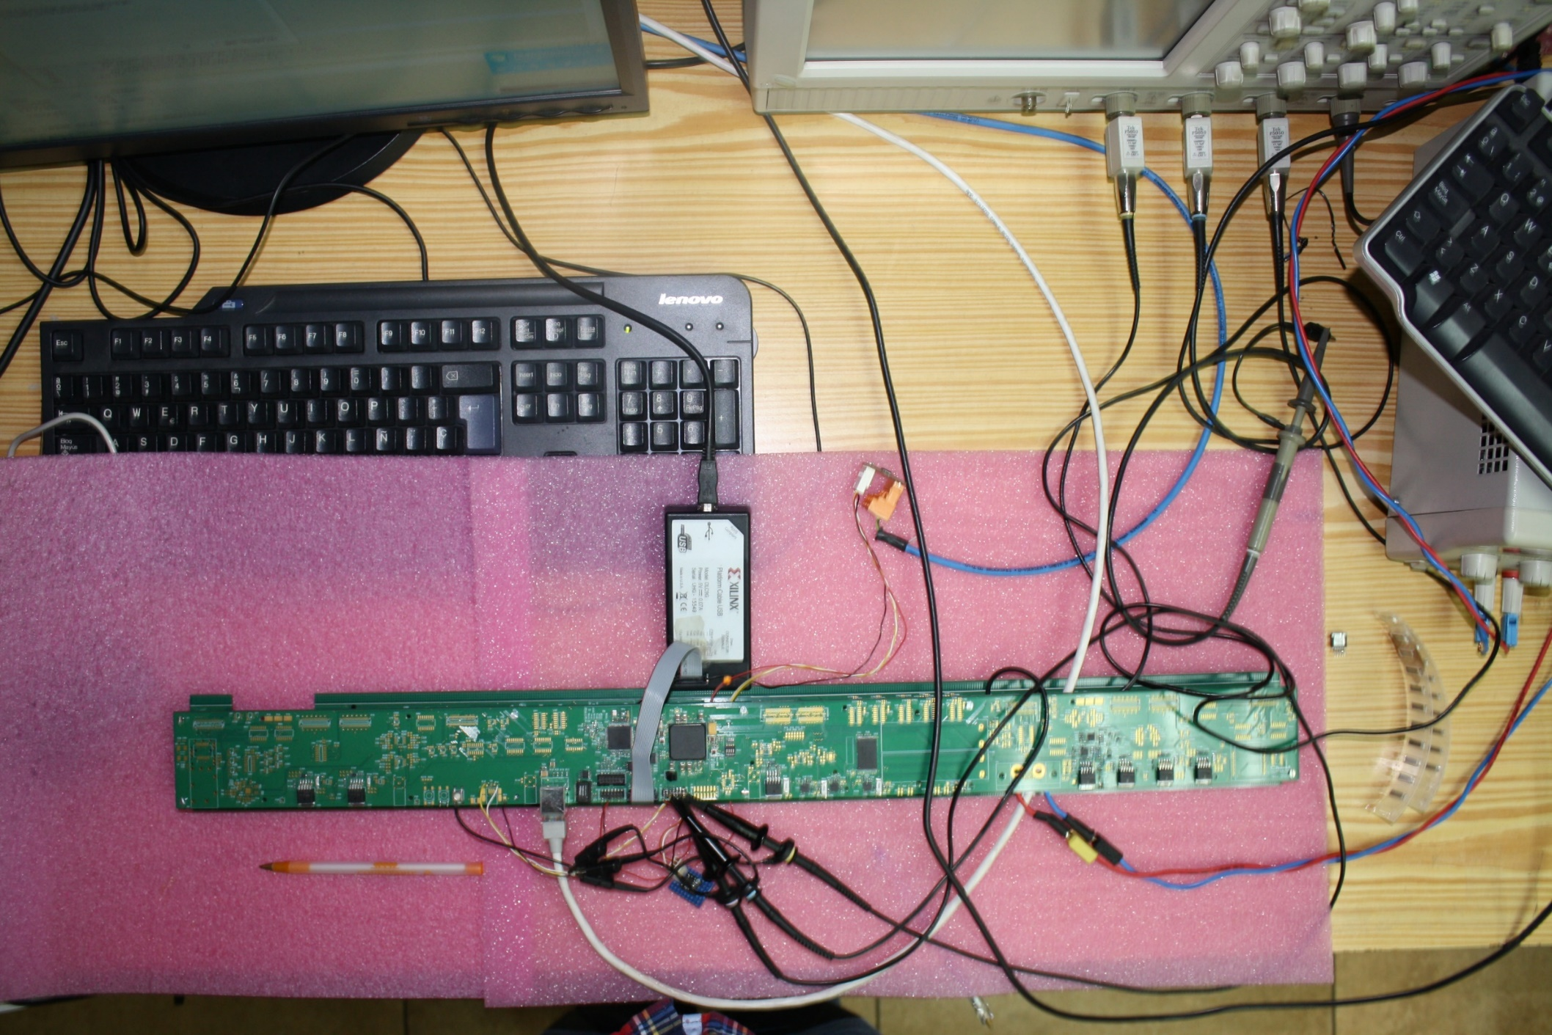
New electronics : DIF
DIF sends DAQ commands (config, clock, trigger) to front-end and transfer their signal data to DAQ. It controls also the ASIC power pulsing
• Only one DIF per plane (instead of three)
• DIF handle up to 432 HR3 chips (vs 48 HR2 in previous DIF)
• HR3 slow control through I2C bus (12 IC2 buses).
Keeps also 2 of the old slow control buses as backup & redundancy.
• Data transmission to/from DAQ by Ethernet
• Clock and synchronization by TTC (already used in LHC)
• 93W Peak power supply with super-capacitors
(vs 8.6 W in previous DIF)
• Spare I/O connectors to the FPGA (i.e. for GBT links)
• Upgrade USB 1.1 to USB 2.0
TEXAS TM4C1294U
FPGA XC7A35TFGG484
POWER
POWER
POWER

Slide 22





Mechanical Structure
Improvement on the present system is being made by using Electron Beam Welding rather than bolts to reduce the deformation and the spacers thickness.
Industrial production of flat large absorber plates (3 m X 1 m) by roller leveling process

Slide 23

Mechanical Structure
Promising results but better performance is still needed
Very good flatness (< 1mm)

Slide 24

DAQ system
Implementation of a GBT-based communication system for ROC chips. This aims to reach higher performance using robust and well maintained system in the future
Global system architecture
Front-End control and data collection
SLC
Async cdes
PC
data
GLIB
DIF
Roc based ASU
gEth
GBT
For now, KC705
HR2, HR3, Petiroc..
GLIB
PC
GBT
gEth
Clk
Sync cdes
Veto, trg
Clocking and main FSM

Slide 25






Next step : Timing
Timing could be an important factor to separate showers and better reconstruct their energy
Multi-gap RPC are excellent fast timing detectors
Several were designed and built . Excellent efficiency when tested with HARDROC ASICs. Next step use PETIROC (< 20 ps time jitters)

Slide 26


Next step : cooling
Cooling becomes necessary if the power pulsing scheme is not possible (CEPC project)
1.5 m
0.5 m
108 chips
Rectangular section tubes : 2x1 mm
Copper plate over: 1.5 mm
Flow out
symmetry
Flow in
PCB plate under: 1.4 mm
symmetry
Water cooling :
h = 10000 W/m²/k
Thermal load :
80 mW/chip without power pulsing
27.147 (max) – 24.591 (min) =2.556 ºC
Simulation ¼ structure pcb + chips

Slide 27
Conclusions and perspectives
SDHCAL is the first technological prototype to be conceived
and built for future leptonic experiments.
Results of beam tests validate the concept
New prototype is on the rails and in principle could be achieved before the end of 2017.
New features such as timing and cooling will play important role in future R&D for future colliders.

Slide 28


Slide 29


Tests of small mechanical structures prototypes
Before assembly the big prototype (~3x1m2), welding tests with smaller prototypes are foreseen
Prototype after welding
First small prototype: 4 plates 1x1 m2
+0.26
+0.13
-0.56
+0.22
+1.01
+0.72
-0.52
+0.5
+0.59
+1.11
+0.73
-0.51
+0.43
+0.49
+0.53
+0.24
+0.1
-0.54
+0.07
+0.1
+0.49
+0.51
-0.51
+0.11
+0.16
+0.57
+0.57
+0.53
-0.50
+0.21
+0.81
+0.64
-0.49
Coordinate measuring machine
+0.54
+0.62
-0.48
+0.85
+0.06
+0.14
+0.18
After comparing the measurements before and after welding deformations found (~1mm) bigger than expected in X-axis. O.K in Y-axis
➔ Probably due to the welding sequence used
Differences with respect to the initial status of the plate in Z.
Differences with respect to the initial status of the distance between plates
Measurements have been done AFTER REMOVING the PIECES used FOR RIDIGITY (the picture includes them)

Slide 30


2nd Prototype before welding
Second small prototype: 4 plates 1x0.5 m2
Welding performed changing a bit the welding sequence with respect to the first prototype
zoom
Photogrammetry targets
Deformations measure using photogrammetry

Slide 31

Gas purifier
-Goal: reduce the gas consumption to reduce the cost.
-Gas renewal of 5-10% rather than 100%
-Conceived by the CERN gas group

Slide 32

Online monitoring
DQM4HEP: Data Quality Monitoring for High Energy Physics
This is a generic C++ framework to perform online data analysis and data quality report. It deals with online application workflow, inter-process communication and memory management.
Main features :
-Event distributed system (client / server architecture)
-Set of user interfaces designed for data quality analysis
-Monitor element distributed system
-Graphical user interface for data visualisation (Qt Gui)
-Large scale remote process management
-Generic IO support for different experiments
-Designed for simple prototype monitoring up
to complex systems like ILD or LHC detectors
-Logbook interface (ELog)

Slide 33

Example: Hit map control

