Slide 1
CPIXTEG3b: An SOI pixel sensor with in-pixel binary counter
Inter-University Research Institute Corporation
High Energy Accelerator Research Organization
Y. Lu¹, R. Hashimoto², S. Kishimoto², R. Nishimura³, L. Song^{1,4}, Y. Zhou¹, Z. Wu^{1,4}, Y. Arai⁵, Q. Ouyang¹
¹ State Key Laboratory of Particle Detection and Electronics, Institute of High Energy Physics, CAS
² Institute of Materials Structure Science, KEK
³ School of High Energy Accelerator Science, SOKENDAI
⁴ University of Chinese Academy of Sciences
⁵ Institute of Particle and Nuclear Studies, KEK
International Conference on Technology and Instrumentation in Particle Physics,
May 22-26, 2017, Beijing, CHINA

Slide 2
Outline
Motivation
To solve digital pickup issue in SOI technology
To pursue a high resolution low noise detector for material science
Design concepts
Diode, Pixel circuit, Readout architecture
Double-SOI oriented optimization
Test structures
Single pixel test
Analog signal inspection
Dedicated pickup measurement
Infrared laser test
Matrix test
Threshold
Noise
Synchrotron beam test
Conclusion
TIPP2017, Y. LU

Slide 3
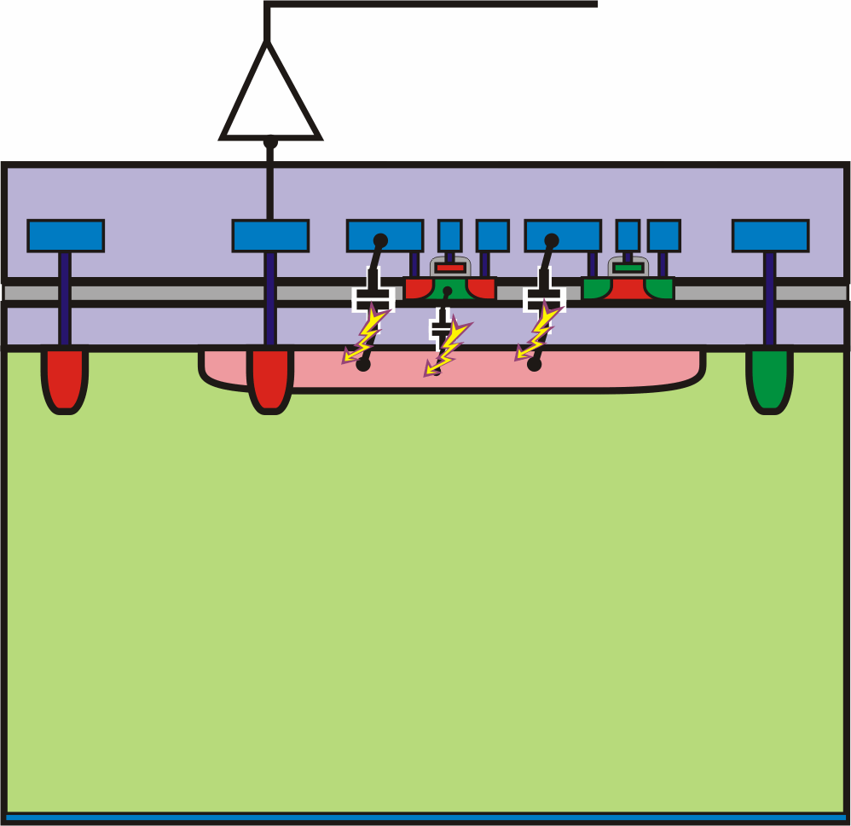
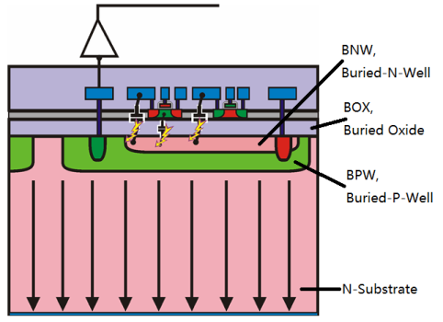
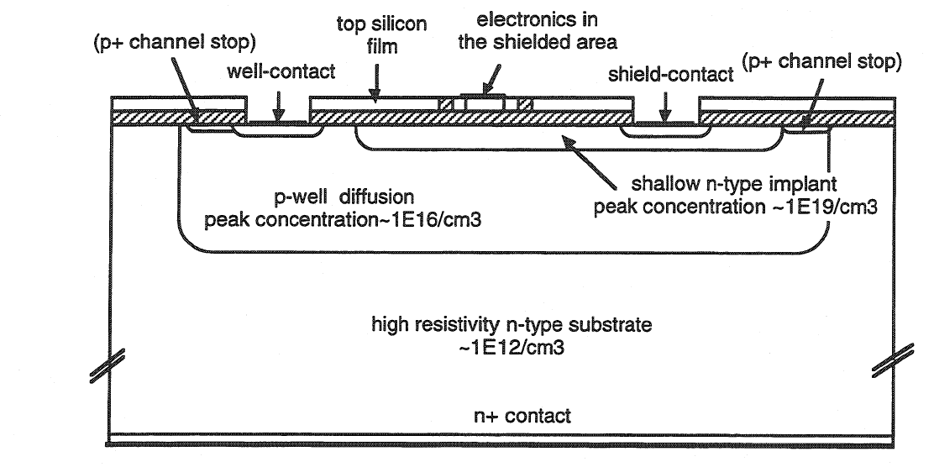
Motivation #1: to solve the digital pickup issue
SOI pixel technology is particularly affected by the digital pickup issue.
Long history of investigation, but limited by the process available then.
recognized and understood by CERN RD19 in 1990’s;
Continued efforts on Nested-Wells in the beginning of 2010’s.
BOX,
Buried OXide
G. DEPTUCH, SOIPIX 2010
9.4kΩ/□
~10kΩ/□
0.2kΩ/□
Shielding-well proposed by F. X. Pengg in his dissertation “Monolithic Silicon Pixel Detectors in SOI Technology”
Monolithic Active Pixel Matrix with Binary Counters ASIC with nested wells
F. Fahim, Pixel2012
3
TIPP2017, Y. LU

Slide 4
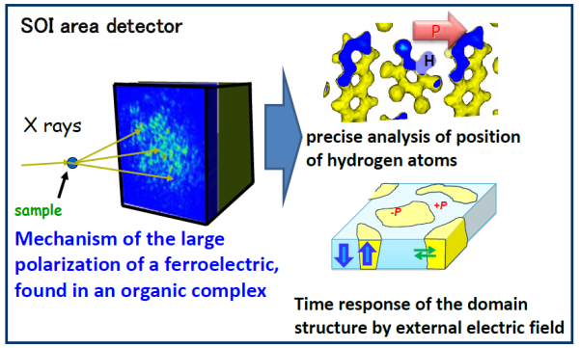
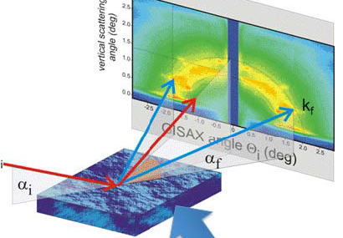
Motivation #2: high resolution low noise detector for the material science
New ferroelectric materials study requires measurement of the intensity of specific diffraction spots with
30um square pixel;
1k frame/s;
14-bit counter each pixel;
Determination of structure change of cell membrane
Grazing-incidence small-angle X-ray scattering (GISAXS);
Minimum area 20~30mm²;
2.1~4.5keV, thin entrance widow < 1um;
TIPP2017, Y. LU

Slide 5
Sensor diode
> 1kΩ-cm high resistive substrate
P type
300um thick
Charge collection electrode
N type
Consists of NS and BNW
N-in-P sensor
Peripheral BNW as single GR
P-stop ring needed (PS implant)
Substrate Implantation
BNW Implantation
Buried
Oxide
(BOX)
SOI Si
Pixel
Peripheral
NS
BNW
Cut Top Si and BOX
High Dose
Keep Top Si not affected
Low Dose
TIPP2017, Y. LU

Slide 6
Pixel circuit
Counter
Charge sensitive preamplifier
Cf = 4fF
Constant current feedback (0.5 - 10nA adjustable)
Shaper with inverse polarity
AC coupled
Voltage gain = 5
Diode-biased inverter as the discriminator
AC coupled
Global I_{threshold} tuned by a 4-bit local DAC
6-bit ripple counter
Switchable to shift register mode for readout;
Counting depth compromised to achieve a small pixel pitch of 50um;
6-bit shift register
For control of each individual pixel;
DAC setting, Pixel mask, Calibration enable.
SOI2 contacts
PREAMP
SHP
Signal processing chain in-pixel
TIPP2017, Y. LU

Slide 7
Readout architecture
Counter
Counters and registers are accessed by a 6-bit data bus
64*64 pixels
Driven by a 20MHz clock
Readout time ~ 200us/frame
SOI2 contacts
PREAMP
SHP
Pixel(0,0)
…...
Pixel(0,62)
Pixel(0,63)
Data chain organized in column
TIPP2017, Y. LU

Slide 8
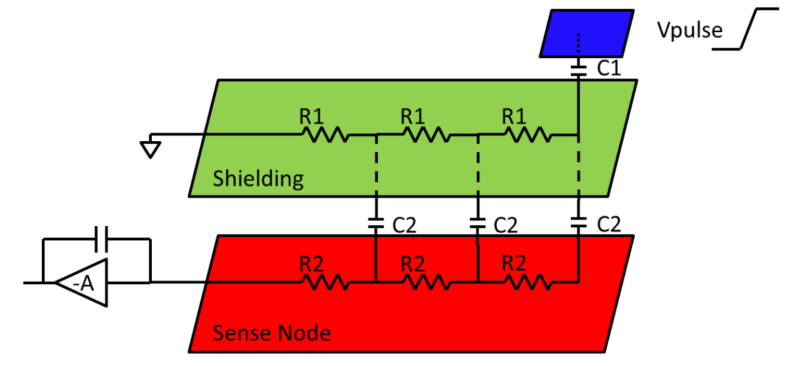
Double-SOI process
Advantages:
Back-gate under control;
Flexible scheme of shielding;
Compensation to the trapped charge in BOX (SiO₂);
Disadvantages:
Capacitance between BNW and SOI2 (C2 ~ 0.23fF/um²);
High sheet resistance of SOI2 (R1 ~ 30kΩ/□).
~ 30kΩ/□
SOI2
SOI2-related Capacitance and sheet resistance
TIPP2017, Y. LU

Slide 9
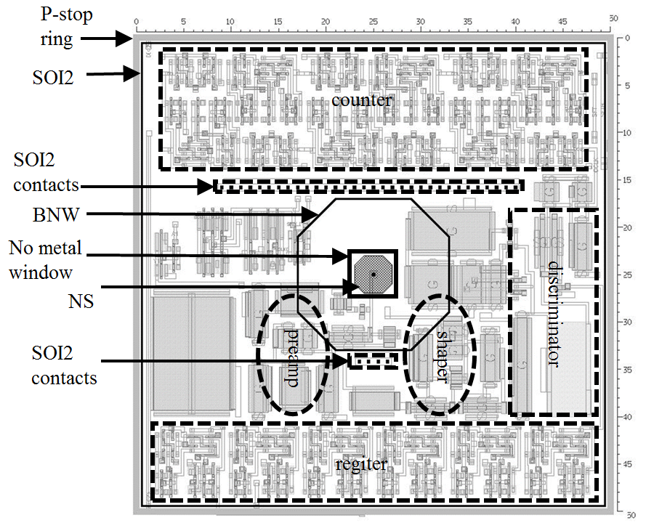
Critical design choices to enhance shielding
The collection electrode kept clear of counter/discri., which leaded to
A small collection electrode of 16 um to reduce diode capacitance
A small pixel pitch at 50 um with a concerning on CCE
The shield grounding improved by
As many SOI2 contacts (2CT) as possible
Local bypass capacitor on SOI2 ground
P-stop ring isolating pixels
SOI2 island formed by PS cutting
SOI2
Double-SOI cross-section view
Pixel layout
TIPP2017, Y. LU

Slide 10
Test structures
3 test pixels with different configuration:
Pixel(0,0), disconnected from sensor, frond-end only
Pixel(0,31), a complete chain of signal processing
Pixel(0,63), an alternative clock to its counter
Chip layout
Pixel(0,0)
Pixel(0,31)
Pixel(0,63)
TIPP2017, Y. LU

Slide 11
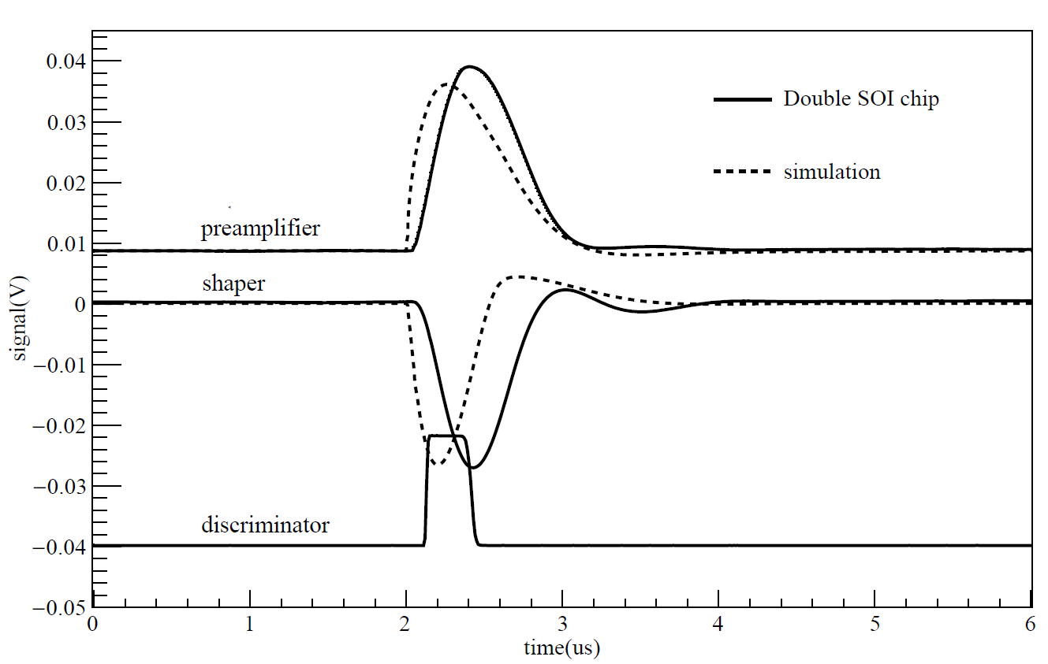
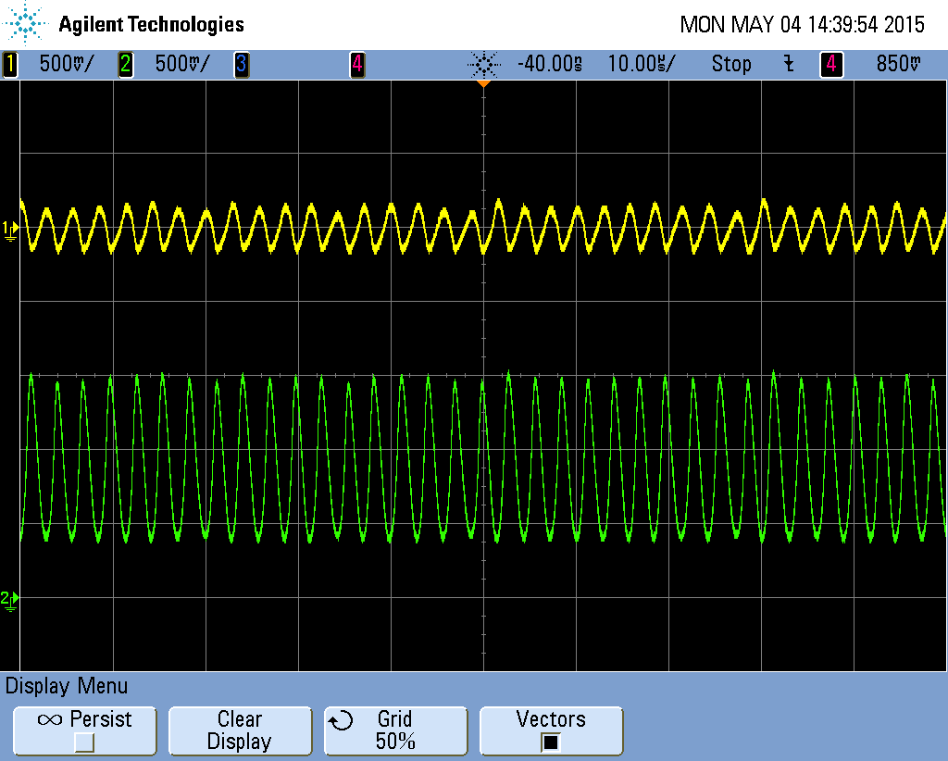
Analog signal inspection
Double-SOI chips worked
Slower leading edge was caused by improper cabling;
In the contrary, Single-SOI chips showed self-sustained oscillation
Managed to stop it by decreasing gain of shaper
A clue of positive feedback loop
Preamp Shaper
Sensor
Waveform observed on oscilloscope (average mode)
X 1/5
Pixel(0,31)
X 1/100
Self-sustained oscillation observed on single-SOI chips
128 frames averaged
TIPP2017, Y. LU

Slide 12
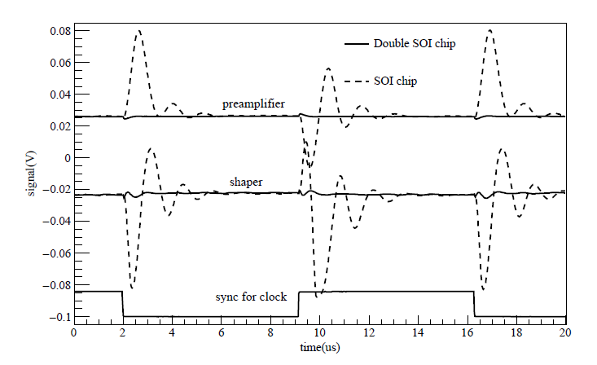
Dedicated measurement of pickup from counter
Counter driven by external clock as a source
5mV @ shaper output for Double-SOI chip
74 e⁻ referred to input charge
Submerged in noise floor (ENC ~ 52e⁻)
95mV for Single-SOI chip
~3770e⁻ referred to input charge
Waveform observed on oscilloscope (average mode)
X 1/5
Pixel(0,63)
(peak to peak) | Double-SOI | Single-SOI
Preamp output | 3.7mV | 60mV
Shaper output | 5mV | 95mV
128 frame averaged
TIPP2017, Y. LU

Slide 13
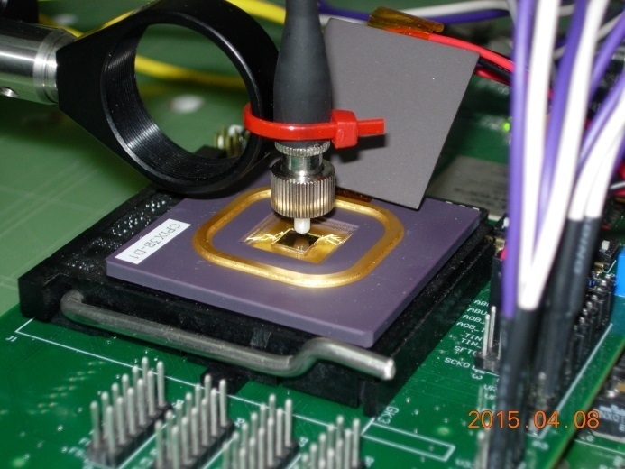
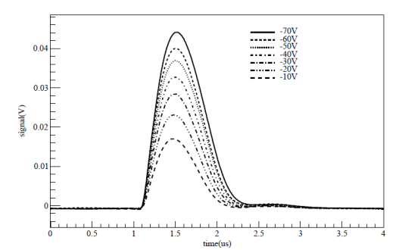
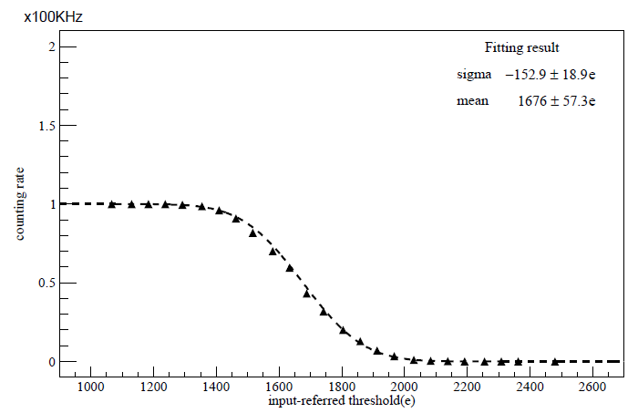
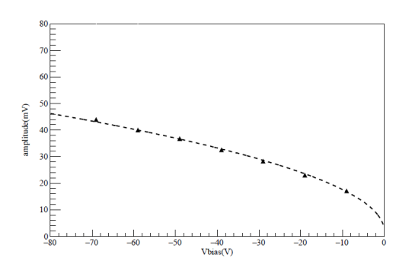
Laser test
Infrared laser beam
1064nm, simulating MIP tracks in silicon;
Sub-ns pulses duration and maximum 1MHz;
Signal amplitude increased as a function of V_{bias}
Proportional to $\sqrt{Vbias}$;
Counting rate decreased as the threshold lifting
S-curve fitting resulted in 153e⁻;
1676 e⁻ generated by single laser pulse
Pixel(0,31)
Preamp output waveform (us)
Amplitude vs Vbias
Counting rate vs input-referred threshold
TIPP2017, Y. LU

Slide 14
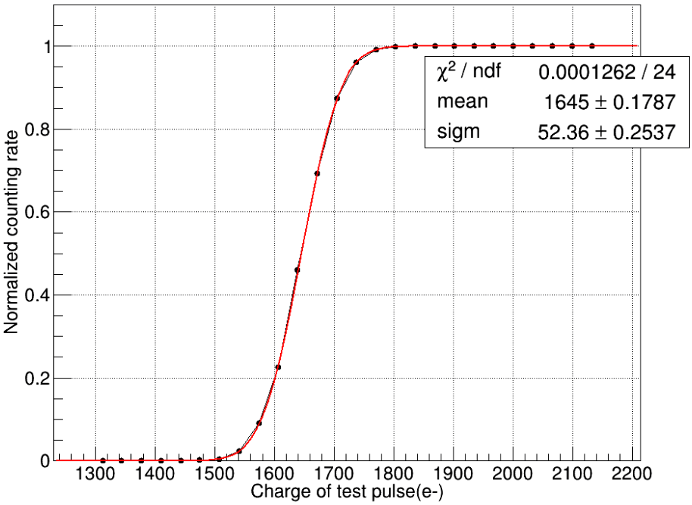
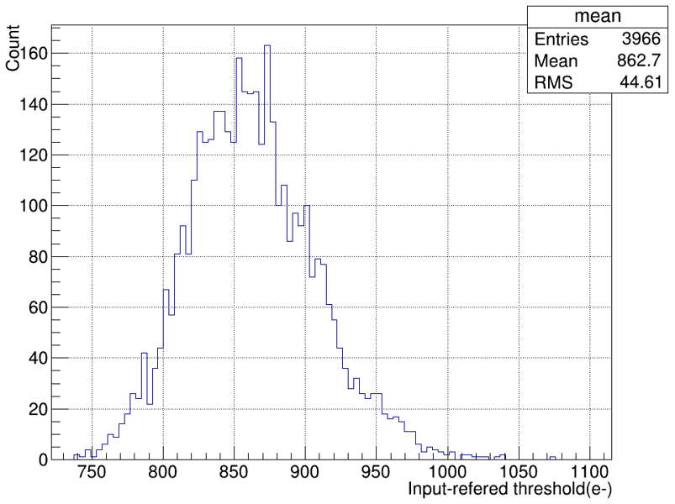
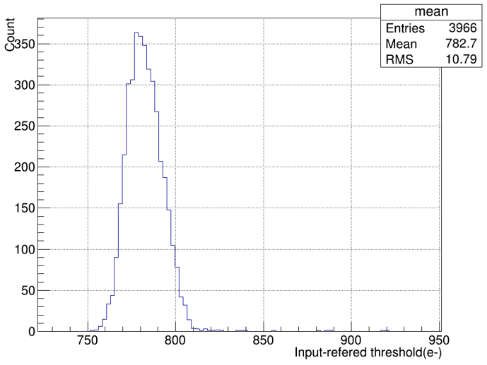
Threshold distribution
Typical S-curve fitting
Test pulse amplitude scan
S-curve fitting
3966 pixels
Excellent threshold distribution
44.6e- before tuning
10.8e- after tuning
44.6e⁻
10.8e⁻
Threshold dispersion before tuning
Threshold dispersion after tuning
TIPP2017, Y. LU

Slide 15
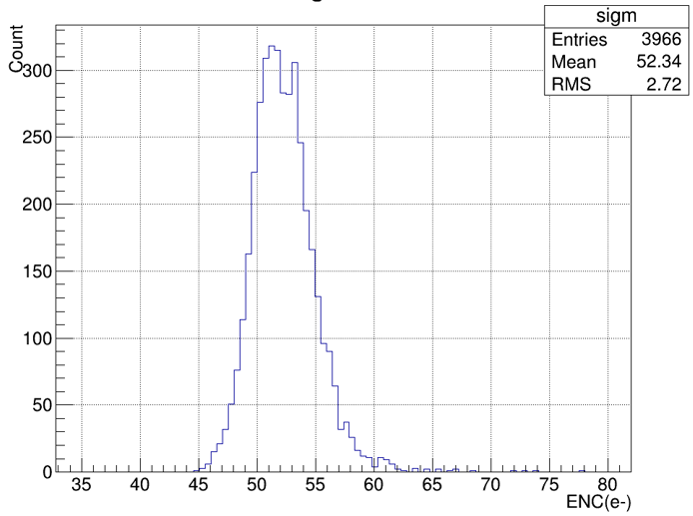
Low noise level
Average noise 56.7e⁻
3966 pixels
“Zero” noise hit
Threshold = 830e⁻ (3keV)
10s ×360 frames (for long exposure time and small data set)
Only a few events recorded from environmental radiation
Pixels broke up for test
52.3e
Col. 0
disabled
Noise distribution
Environmental background events in 1 hour
TIPP2017, Y. LU

Slide 16
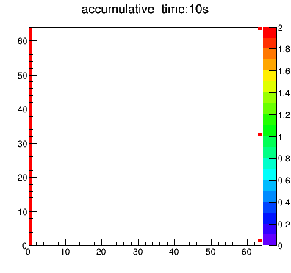
Environmental background events (10s ×360 frames)
TIPP2017, Y. LU

Slide 17
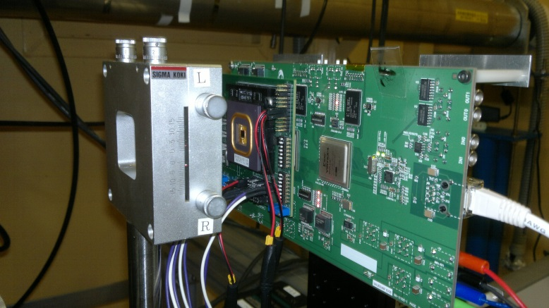
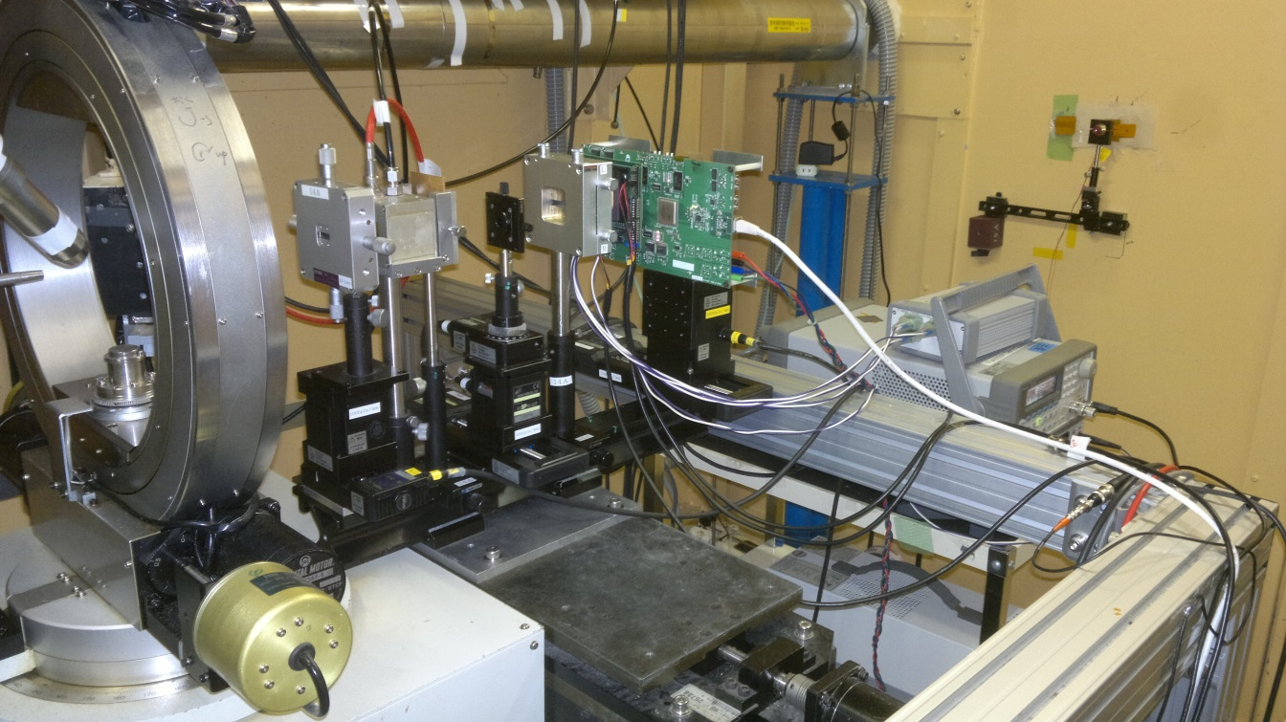
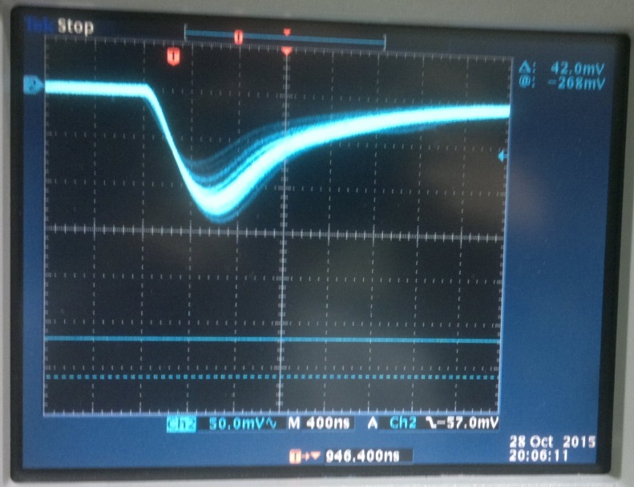
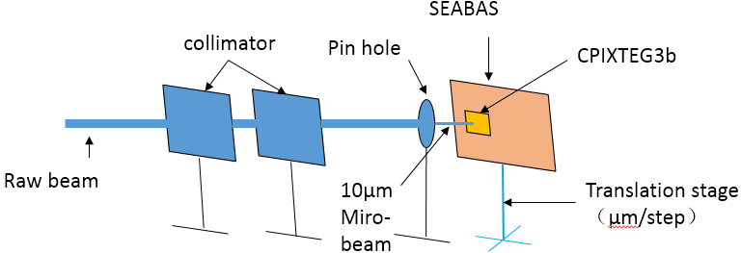
Synchrotron beam test
KEK PF BL-14A
Beam spot 0.8mm in diameter
optional pin hole, 10um micro-beam
16 keV X-ray signal(shaper)
Beam profile measured by CPIXTEG3b
65419 photons
16×19 pixels
(16keV, threshold~1600e⁻)
TIPP2017, Y. LU

Slide 18
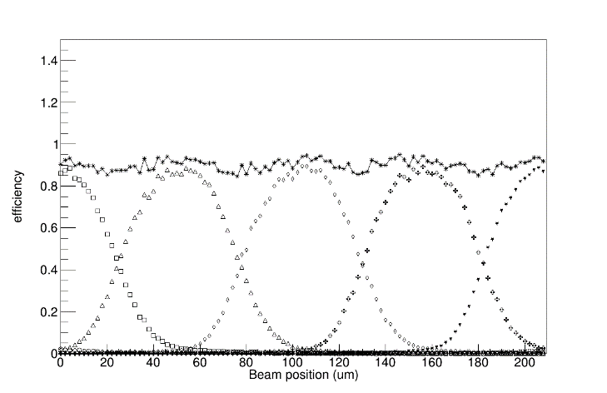
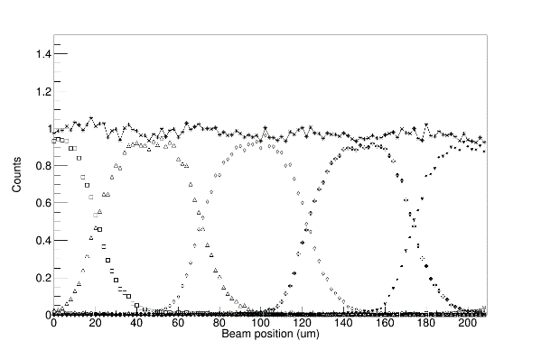
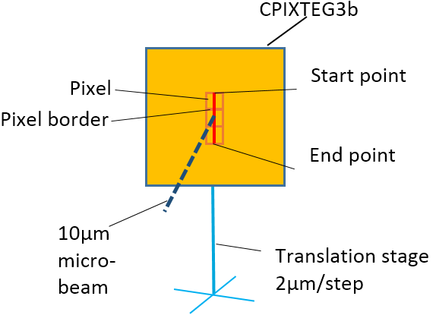
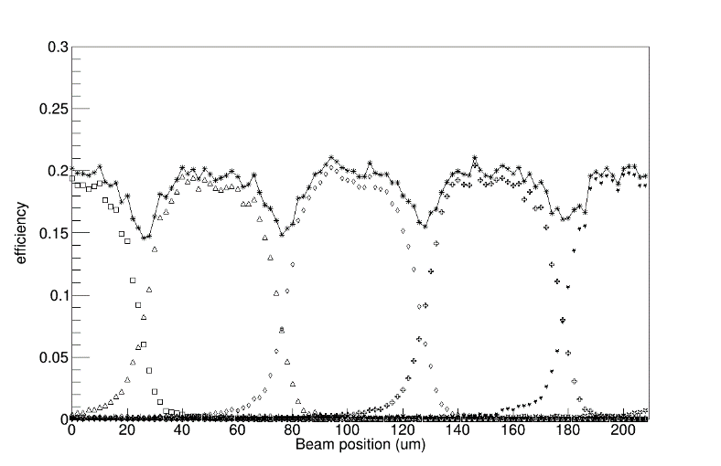
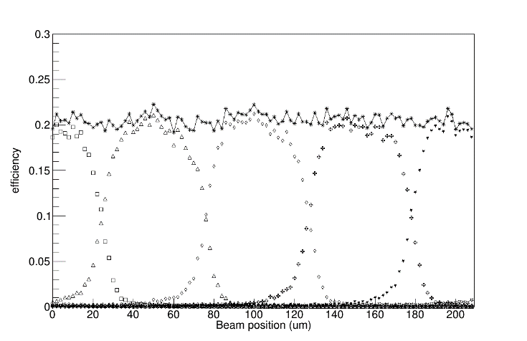
Micro-beam 1D scan
6keV, threshold ~ ½ E_{photon}
Scan across 4 pixels from center to center
Starting at the center of Pixel(30,37)
Ending at the center of Pixel(30,41)
Step = 2um
NaI + MCA used as a reference detector
Uniform efficiency can be achieved
Threshold = ½ E_{photon}
8keV, threshold ~ ½ E_{photon}
sum
Individual
Pixel(30,37)
Pixel(30,39)
Pixel(30,41)
Pixel(30,38)
Pixel(30,40)
16keV, threshold ~ ½ E_{photon}
16keV, threshold > ½ E_{photon}
1-dimentional scan across 4 pixels
TIPP2017, Y. LU

Slide 19
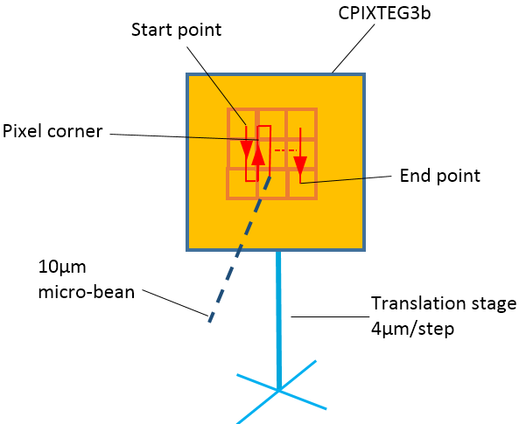
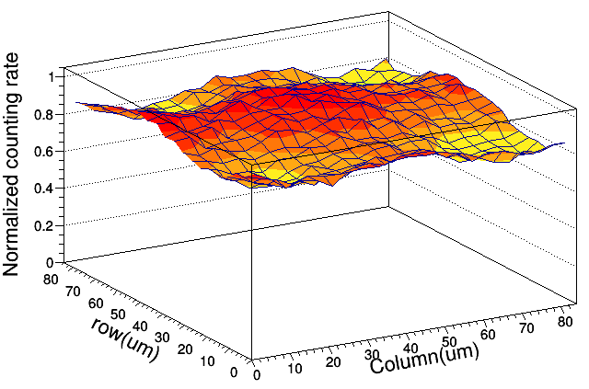
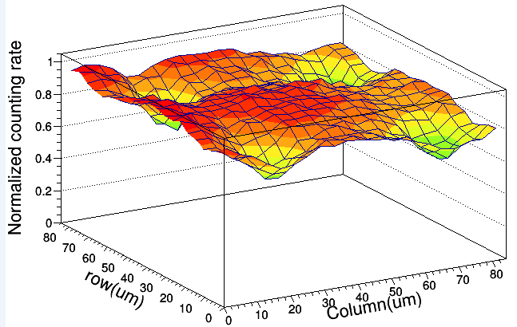
Micro-beam 2D scan
Across 3×3 pixel-square
Step = 4um
Inevitable loss of efficiency at the corner
Threshold = ½ E_{photon}
Charge shared by 4 pixels adjoined
Pixel corner
6keV
16keV
2-dimentional scan of pixel corners
TIPP2017, Y. LU

Slide 20
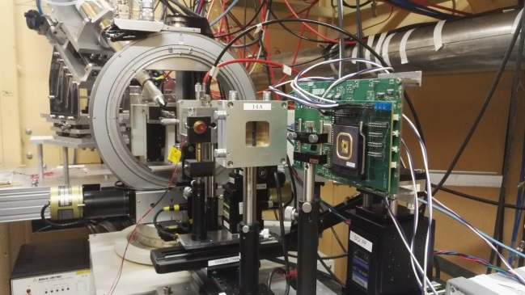
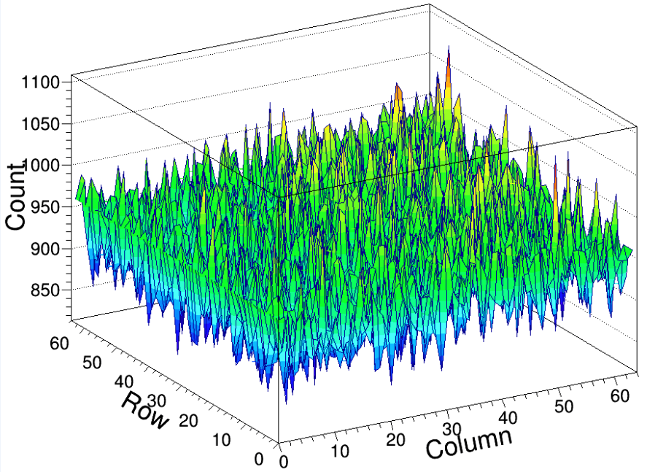
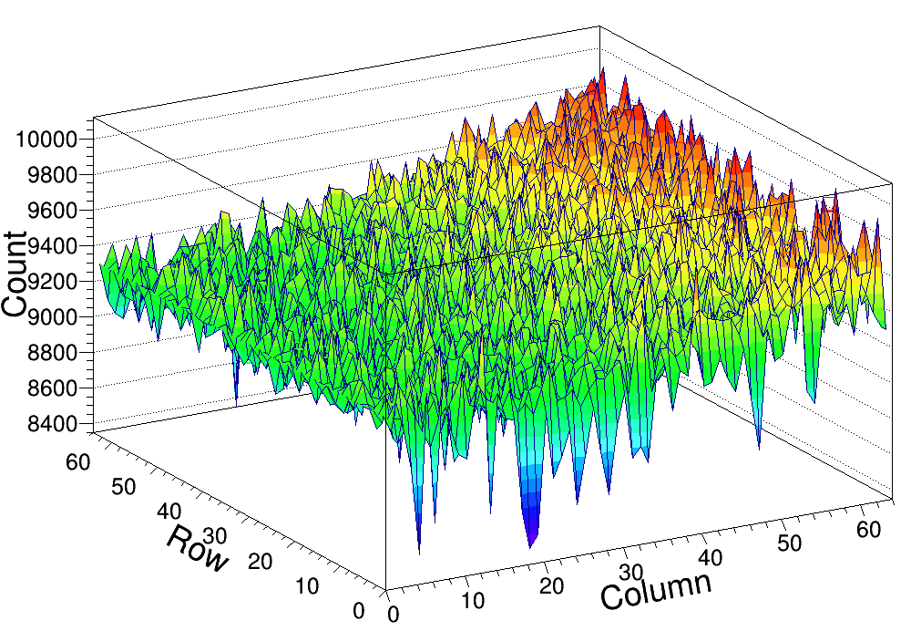
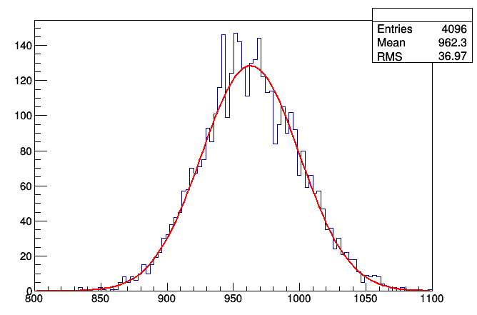
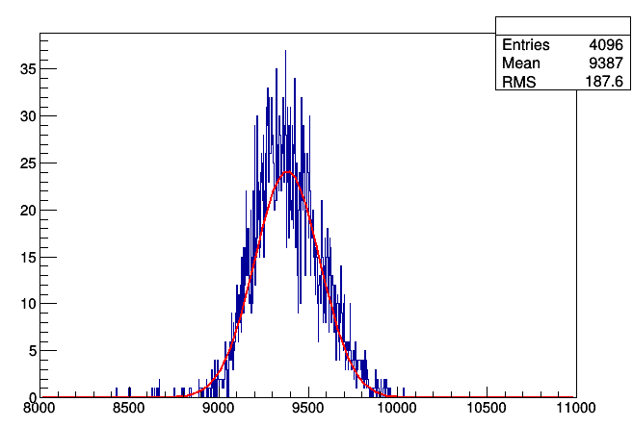
Flat field response
Beam scattered by glassy carbon
Sensor placed in 90⁰ with respect to the beam line
Full pixel array illuminated.
“Relative uniformity” 3.8% and 2.0%
6keV
16keV
Mean:962.9
RMS:36.9
3.8%
Mean:9382.5
RMS:183.0
2.0%
Counting rate histogram
TIPP2017, Y. LU

Slide 21
Conclusion and outlook
Digital pickup issue can be treated properly with Double-SOI process
Further improvements to meet the needs of material science
Charge sharing decision logic;
Compact layout of counter to accommodate more bits.
CPIXTEG3b demonstrated the potential of SOI technology
Zero noise hit
Excellent threshold distribution
Depleted HR substrate up to 700um (or thinning down to 75um)
High density connection between sensor and electronics
TIPP2017, Y. LU

