Slide 1
SLAC Electron Beam Test Facilities
5 MeV to 16 GeV
FACET ● ESTB ● NLCTA ● ASTA
Focus on ESTB
Carsten Hast, SLAC
TIPP 2017, May 25th, Beijing 2017

Slide 2
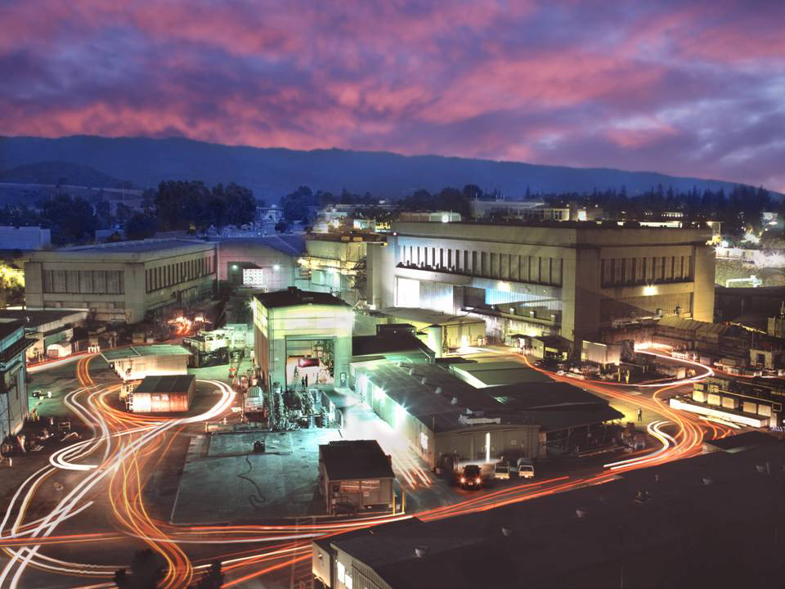
10 GeV
5 MeV
2-16 GeV
& single e⁻
FACET-II
ASTA
NLCTA
ESTB
60-160 MeV

Slide 3
SLAC Beam Test Facilities Overview
Facility | Purpose | Parameters
FACET-II | Accelerator R&D, Material Science, THz | Very focused and short bunches at 10GeV e+/-
ESTB | Detector R&D, LC MDI, Radiation Tests | 2-16GeV primary LCLS beam or single e-
NLCTA | Accelerator R&D, Medical, Radiation Tests | 60 to 160 MeV, small emittance, very versatile infrastructure
ASTA | Gun and RF Testing, RF processing, Ultrafast Electron Diffraction Beam Line | <50MeV, X- and S-Band RF power
All supported by SLAC’s Test Facilities Department
http://facet.slac.stanford.edu and http://estb.slac.stanford.edu
e-mail: hast@slac.stanford.edu
Search for: SLAC FACET or SLAC ESTB
Carsten Hast, SLAC, SLAC Electron Beam Test Facilities

Slide 4
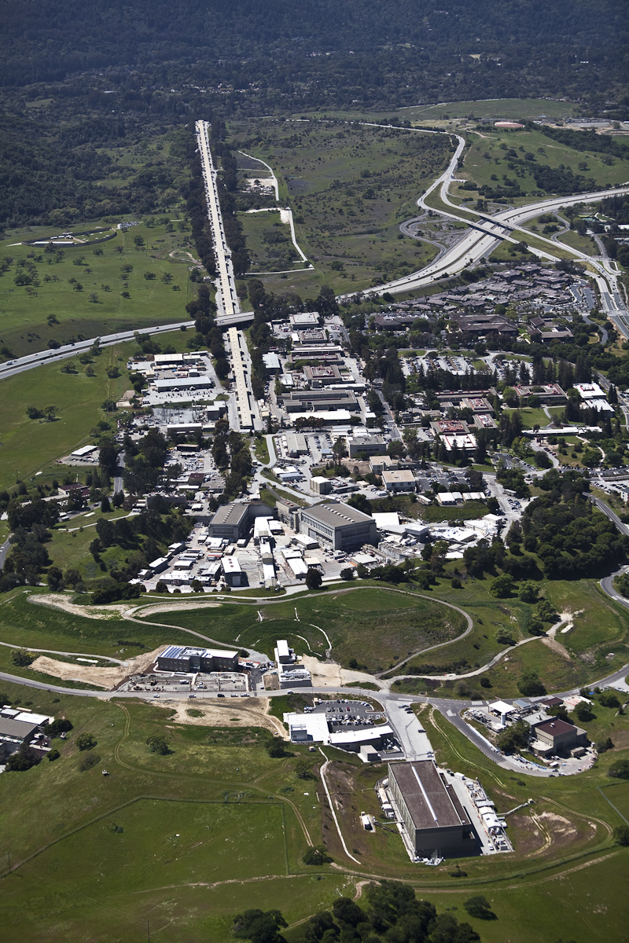
LCLS-II 1st 3rd SLAC LINAC
Start 2019
FACET-II middle 3rd SLAC LINAC
Start 2019
LCLS last 3rd SLAC LINAC
SSRL
End Station A
ESTB
LCLS
Experimental Hutches

Slide 5
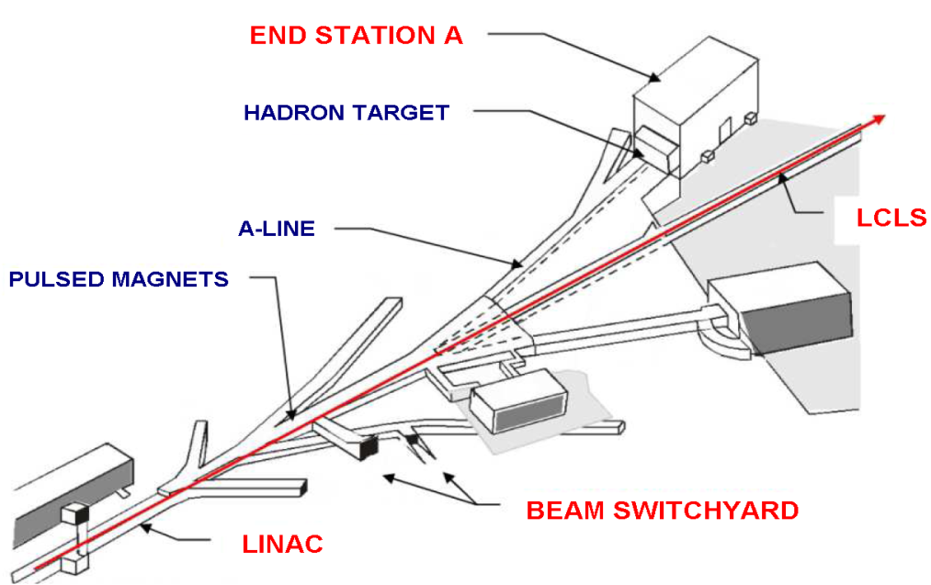
End Station Test Beam (ESTB)
  LCLS beam is deflected to ESTB at 5Hz
  Kicker magnets in Beam Switch Yard
    Primary beam up to 16GeV
  Secondary particle production target in BSY
    Just kick beam onto 6mm of Cu
    Secondary electrons up to <15GeV
  Beam is bend by 24.5^{O} into ESA
  Multi stage collimation system for energy selection and rate adjustment
  Very Clean
  High Energy
  Electron Beams
Carsten Hast, SLAC, SLAC Electron Beam Test Facilities

Slide 6
LCLS and ESTB Electron Beams
LCLS beam
  Energy: 2.2 –16.6 GeV (typically 3-6GeV or 12-14GeV)
  Repetition rate: 120Hz
  Beam charge: 20 to 250 pC (typically 180pC ~ 10⁹ e⁻/pulse)
  Beam availability > 95%
  User are scheduled in 2 shifts 9am to 9pm and 9pm to 9am
    User beam is typically Thursday 9am to Tuesday 9am following week
    Machine development and maintenance Tuesday and Wednesday
    Typically beam energy changes at shift change (~1h)
ESTB beam
  Kick the LCLS beam towards ESA @ 5Hz
  Primary beam 2.2 -16.0 GeV
    Beam energy determined by LCLS
    Typically 180pC ~ 10⁹ e⁻/pulse
  Clean secondary electrons
    2 GeV to 15 GeV (always lower than primary beam)
    1, or a few, up to a few 100 e⁻/pulse (Poisson distributed)
Carsten Hast, SLAC, SLAC Electron Beam Test Facilities

Slide 7
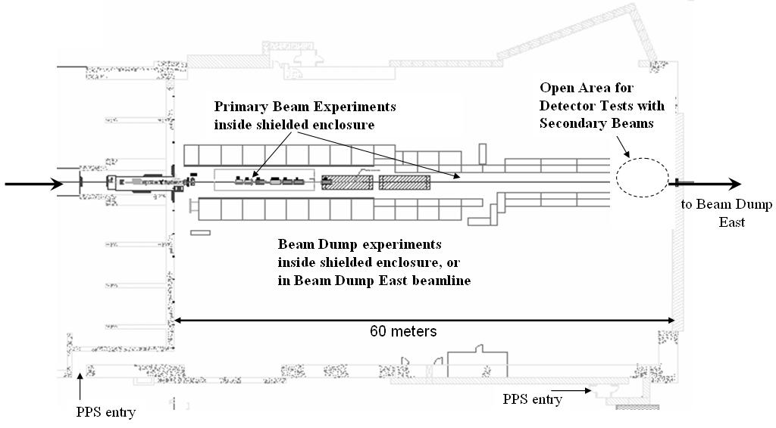
End Station A (ESA)
Beam
Carsten Hast, SLAC, SLAC Electron Beam Test Facilities

Slide 8
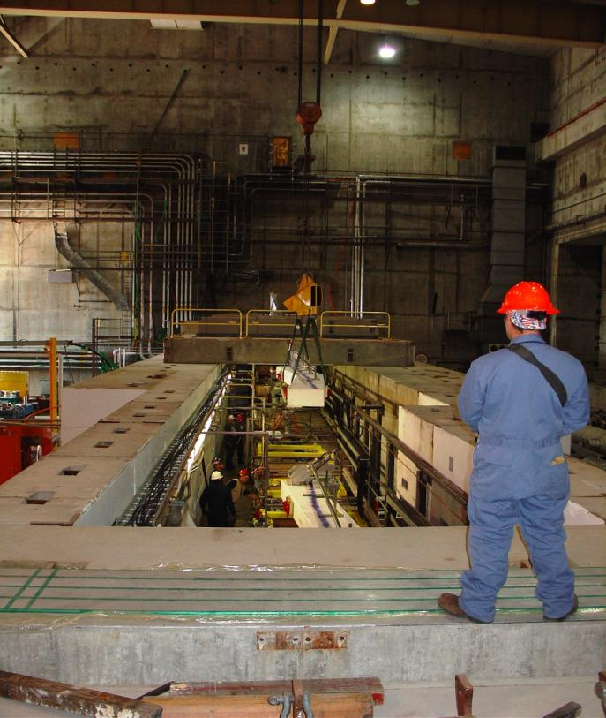
End Station A (ESA)
ESA has massive shielding
  Pretty good temperature stability
Beam line is at 6’10”=208cm height
Crane coverage
Vacuum up to your experiment
Beam path is straight for about 150m after the last bend magnet
Protection collimators limit spot size to about 20mm diameter max
Primary beam can be focused to 50-100 microns
Secondary beam can be focused to about 1mm
Energy resolution is in the per mill range
Divergence is < 0.1mrad
Carsten Hast, SLAC, SLAC Electron Beam Test Facilities

Slide 9
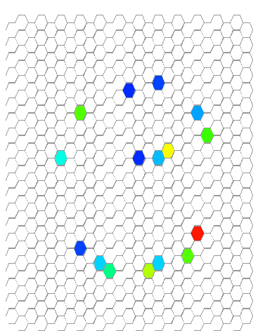
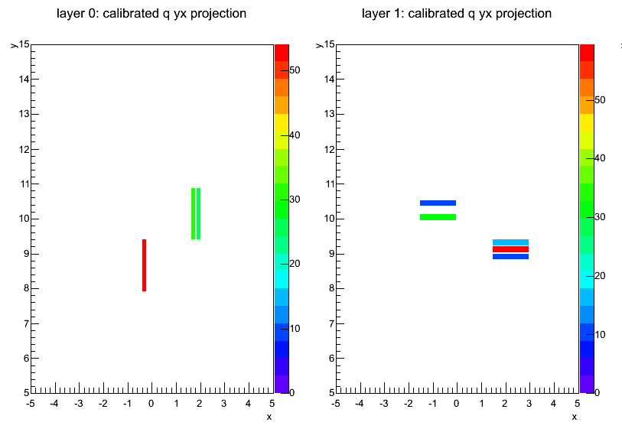
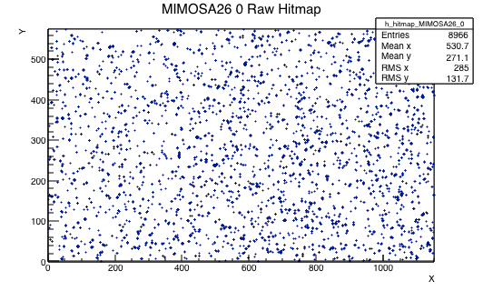
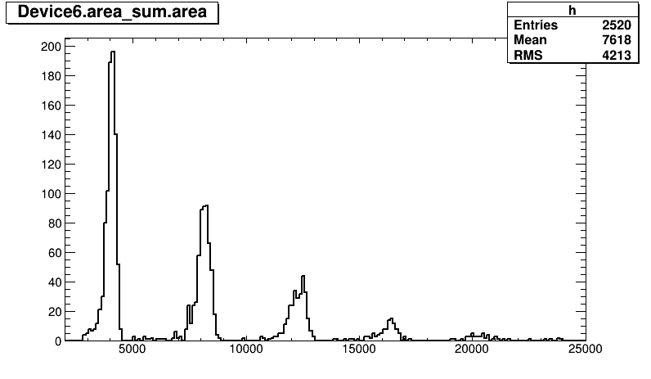
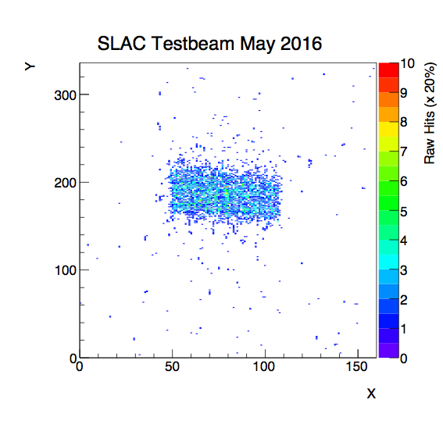
ESTB
Different Beam Configurations for 1 to 100 Electrons
Single electron per event
Multiple, well separated
electrons per event
10th to hundreds of
electrons per event
Homogeneous distribution or well defined beam spot
1 e⁻
2 e⁻
3 mm
336 pixels x 50 μm
3 e⁻
4 e⁻
5 e⁻
6 e⁻
12 mm
Carsten Hast, SLAC, SLAC Electron Beam Test Facilities
160 pixels x 250 μm

Slide 10
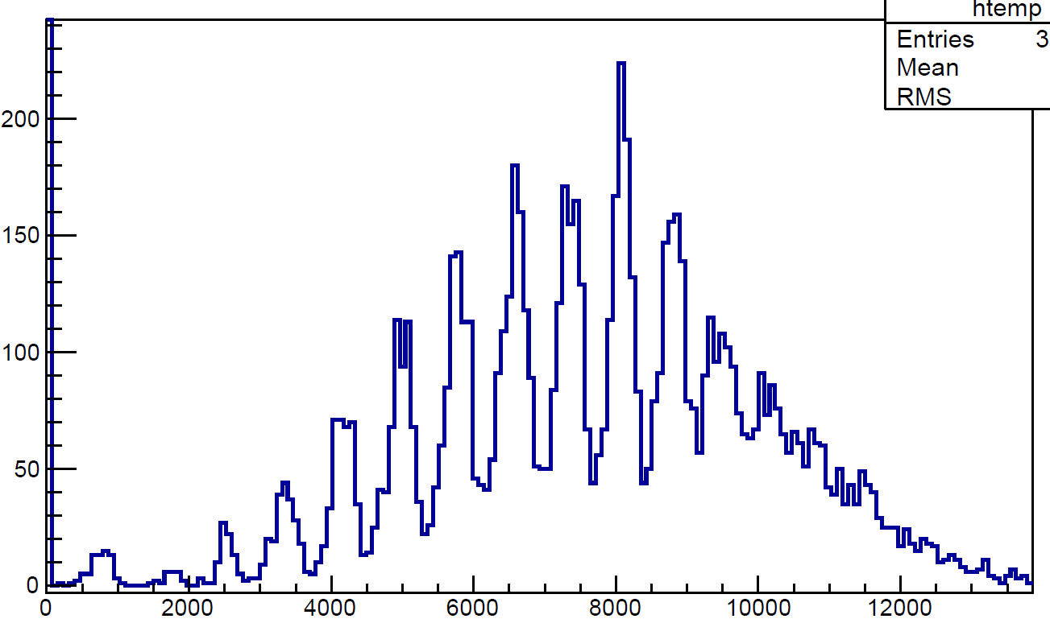
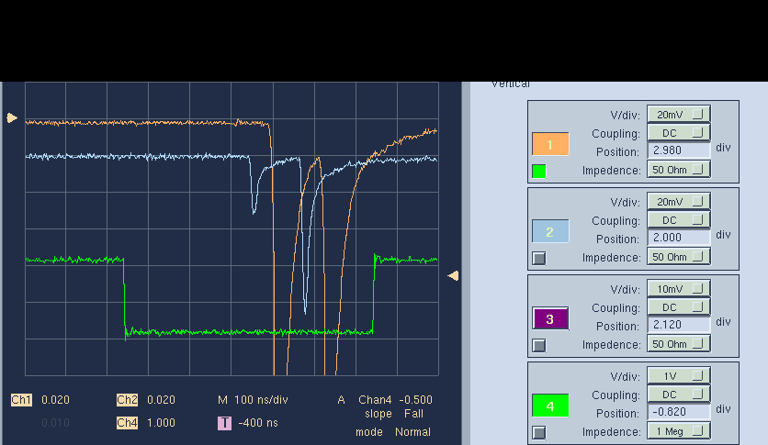
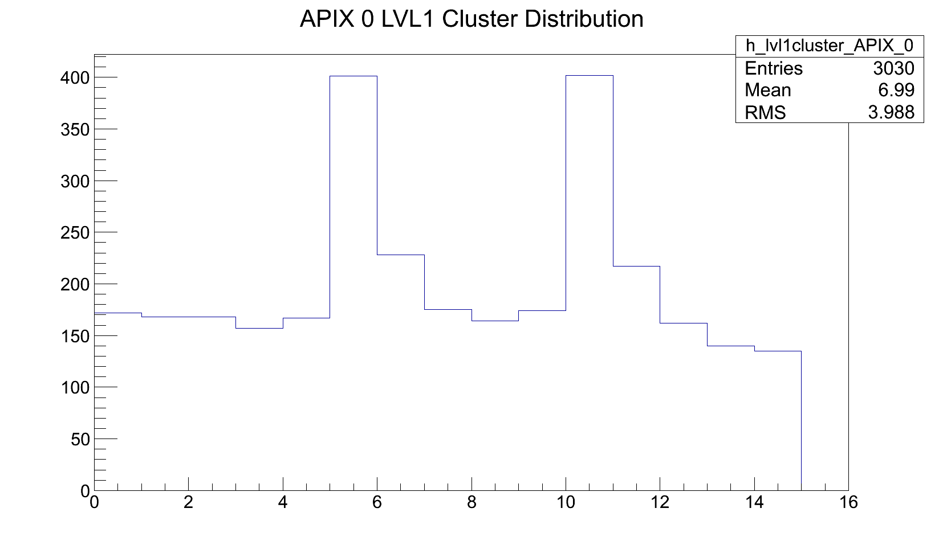
More Beam Configurations
8
6
4
10
12
2
14
That’s how a Poisson multiplicity distribution of 8 electrons per pulse looks like (g-2)
2 x 2 mm² spot size on g-2 calorimeter
LCLS sending double pulse 122ns apart
ATLAS pixel with 25ns time resolution can separate it
Carsten Hast, SLAC, SLAC Electron Beam Test Facilities

Slide 11
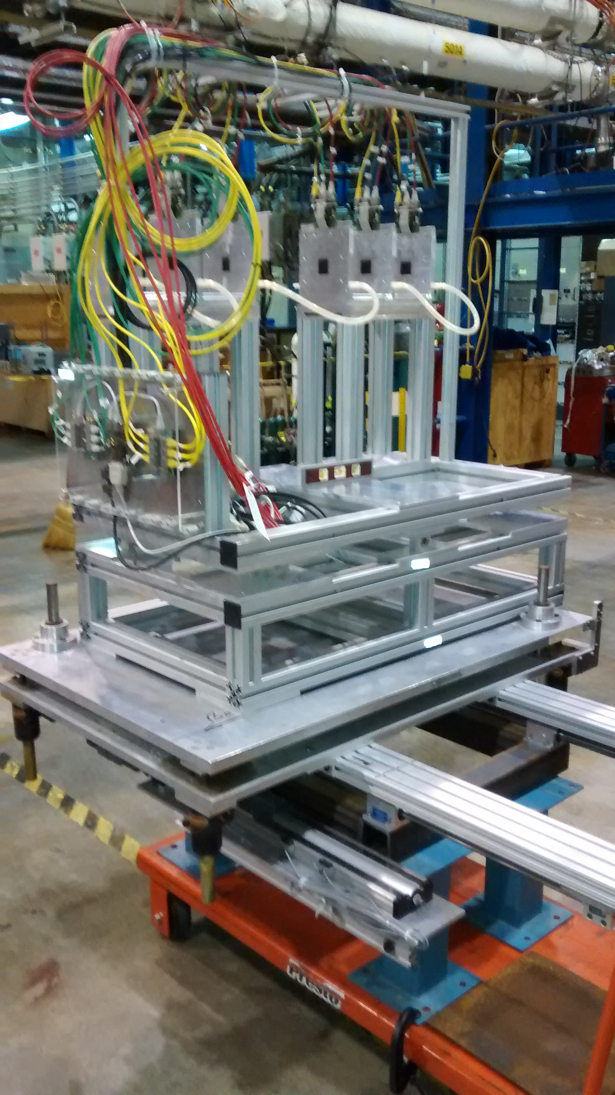
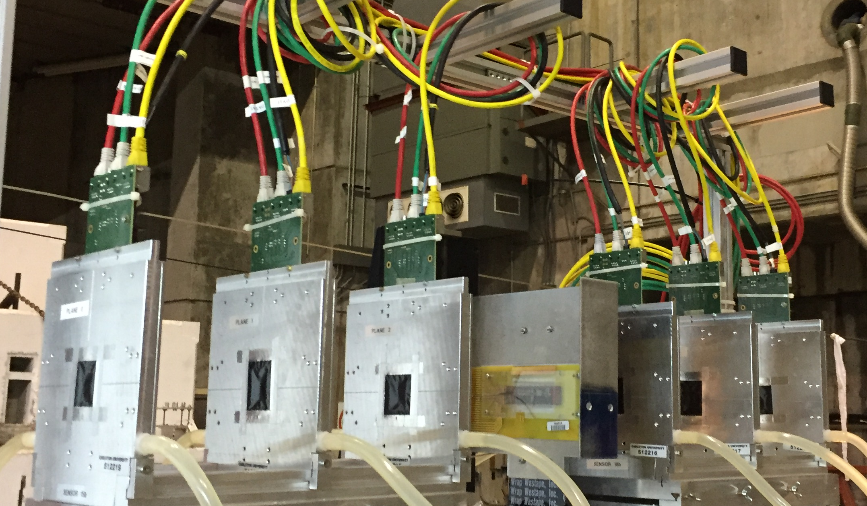
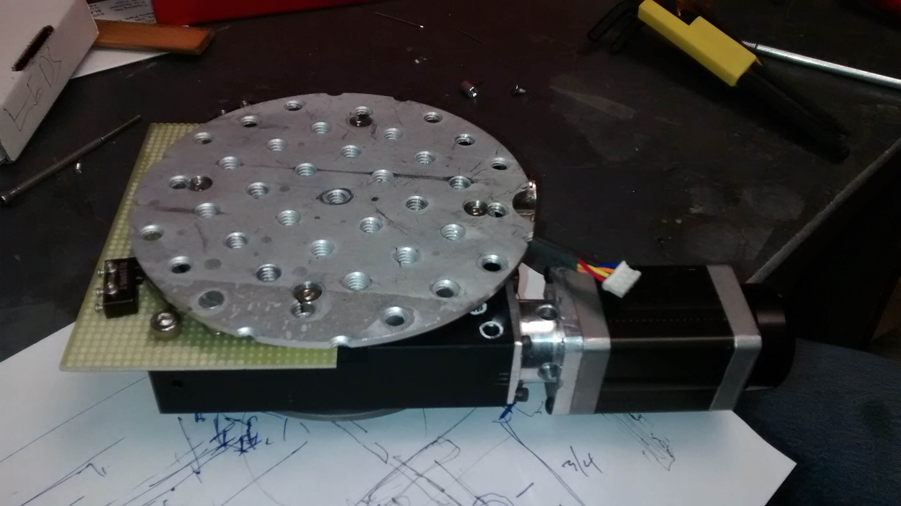
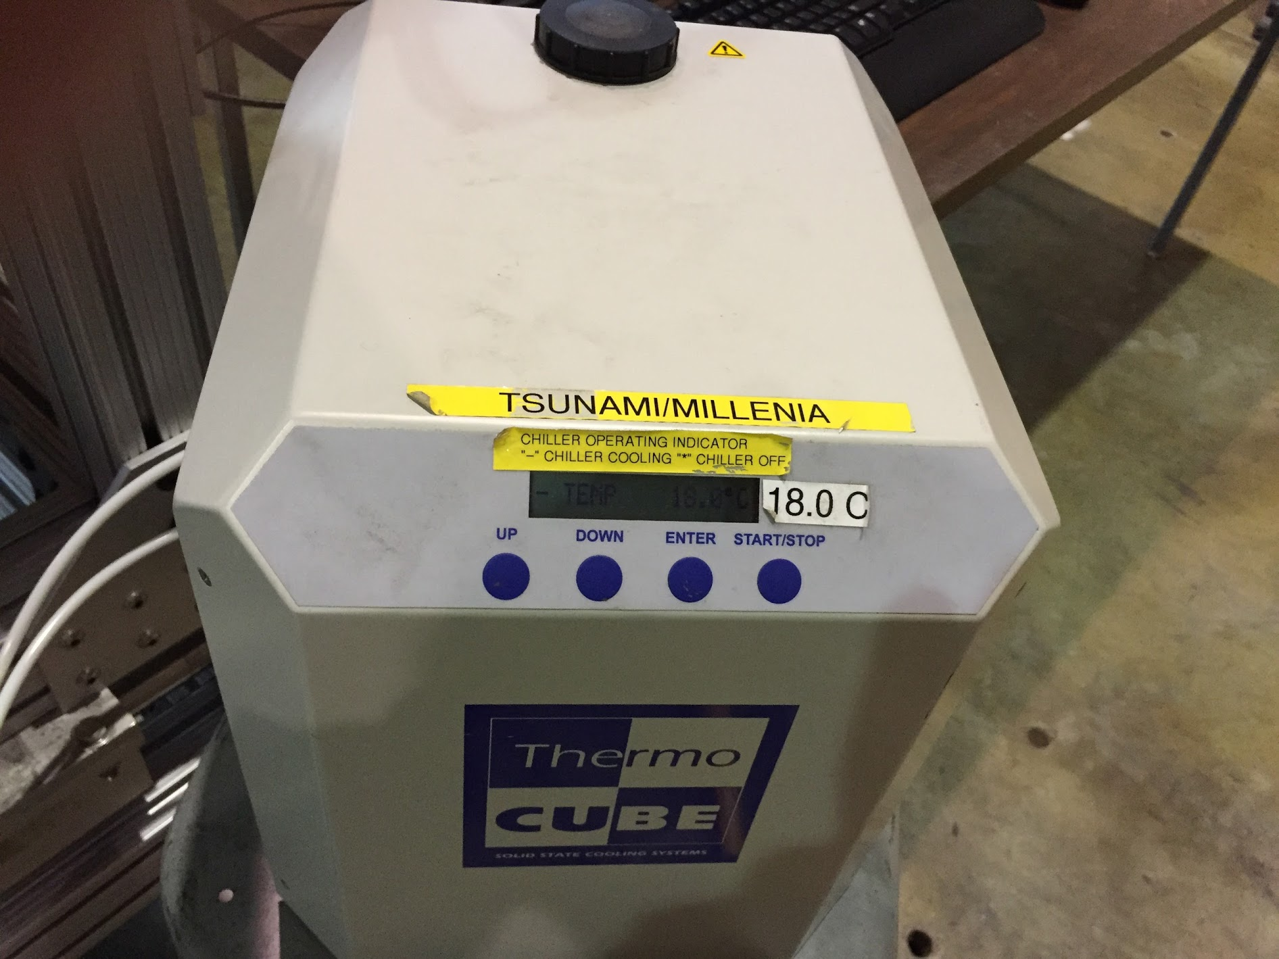
Caladium Silicon Telescope at ESTB
  Carleton University, Ottawa, Canada loaned their telescope to SLAC
  Motorized x-y and rotation stage for the DUT
  Have cooling
  Have Precise Beam Trigger, NO scintillation counters necessary

Slide 12
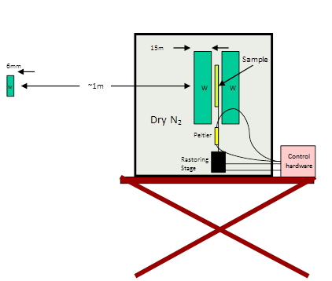
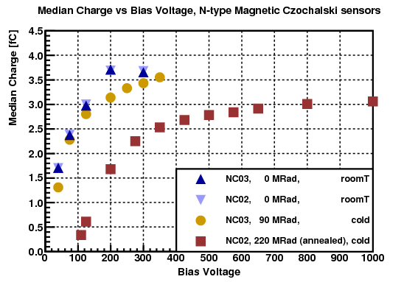
Electron Irradiation: Replicated Radiation Environment of LC Interaction Area
  T-506, PI: Bruce A. Schumm, UC Santa Cruz
  Physics Goals: Test of radiation tolerance
  of various silicon sensor technologies in realistic shower spectra for ILC forward detectors
15 Mrad/h
Beam Cal
100MRad/y
Carsten Hast, SLAC, SLAC Electron Beam Test Facilities

Slide 13
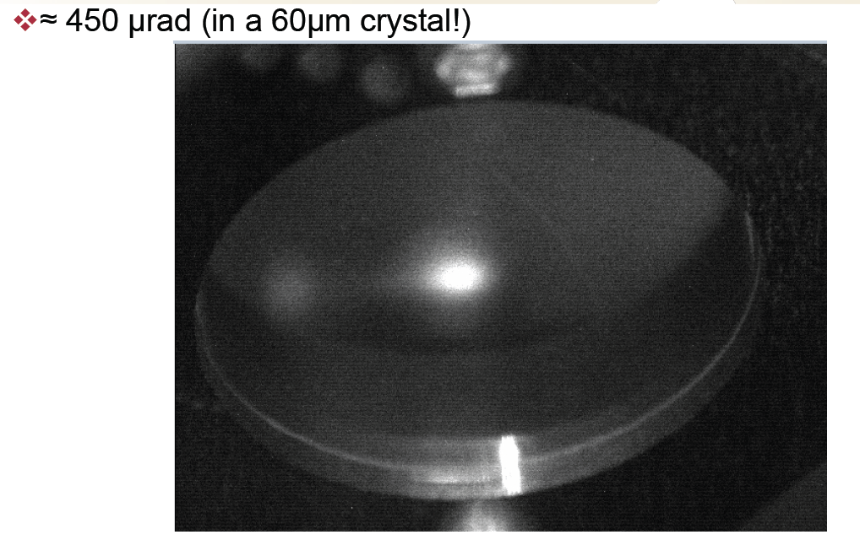
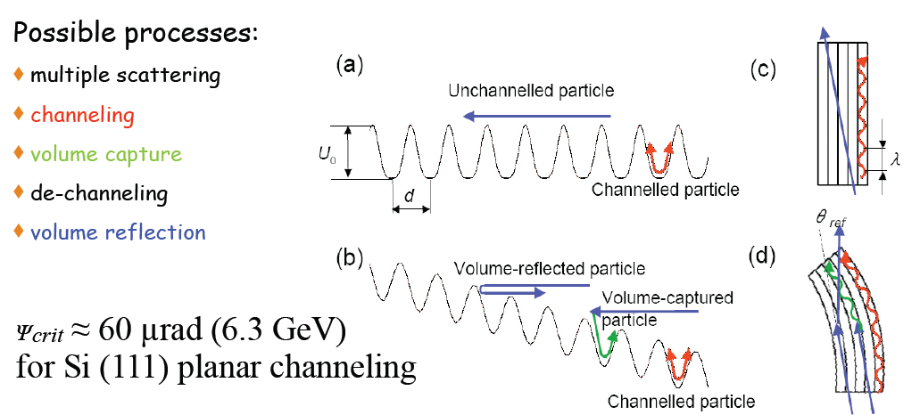
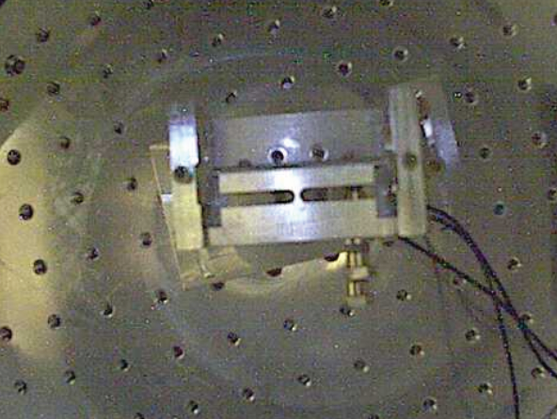
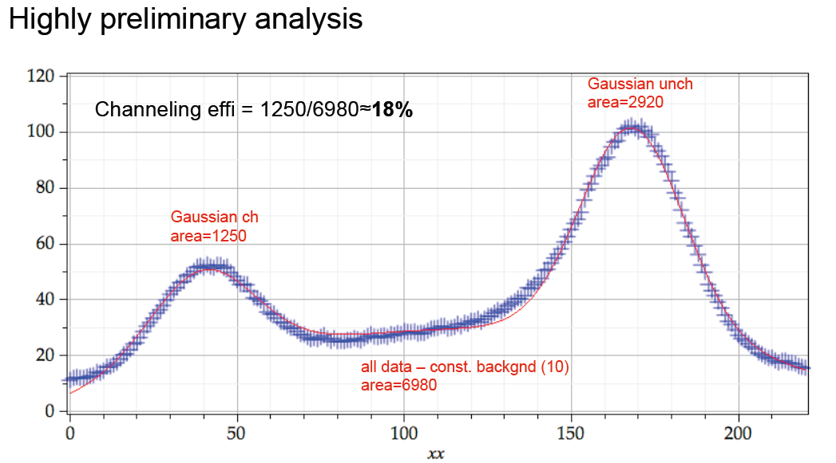
T-513: Channeling and Volume-Refection in Crystals
Uli Wienands, SLAC
Beam Collimation
Multi MeV gamma ray generation
Channeled Beam
Primary Beam
Corresponds to a 150T magnet
18% channeling efficiency
Carsten Hast, SLAC, SLAC Electron Beam Test Facilities

Slide 14
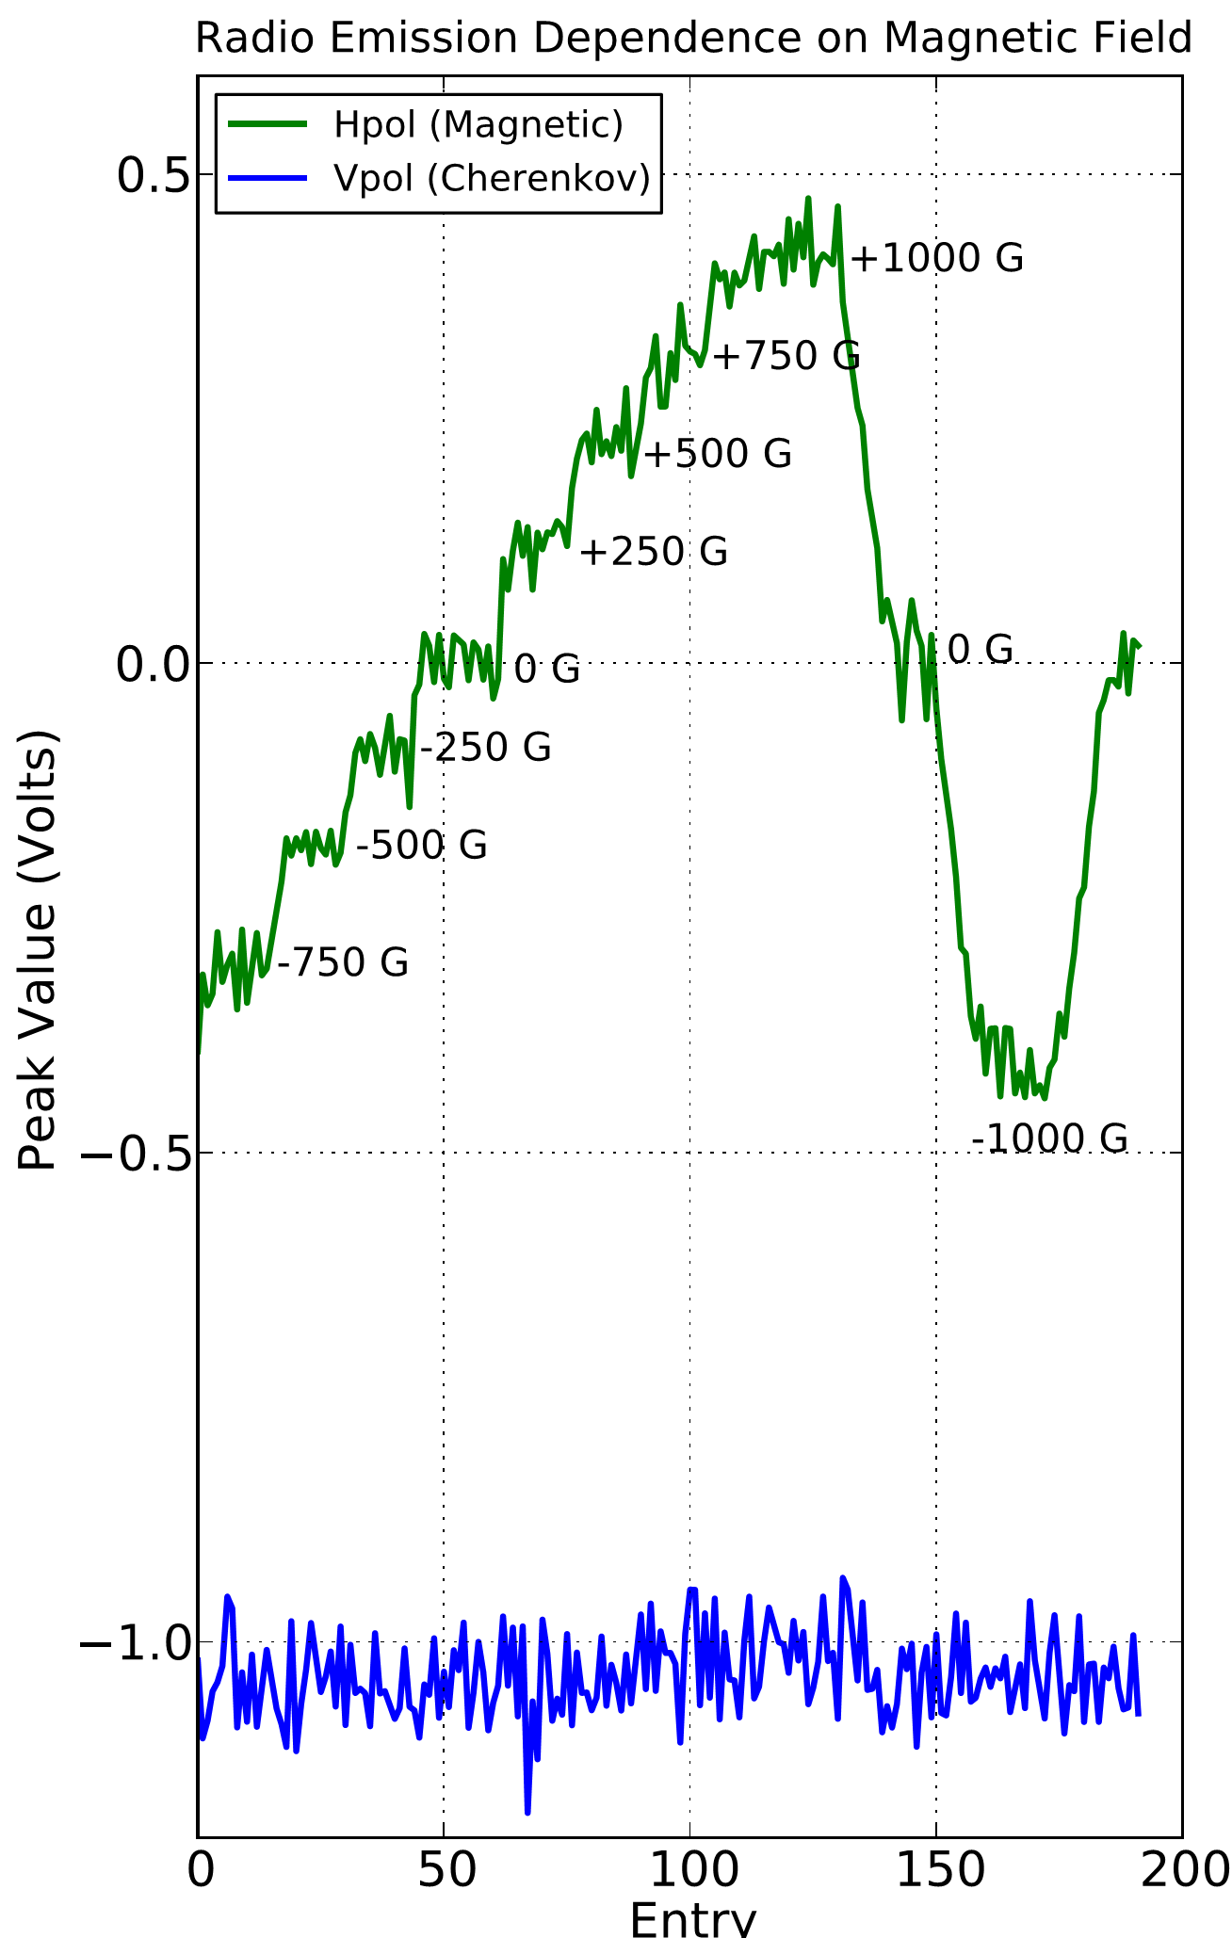
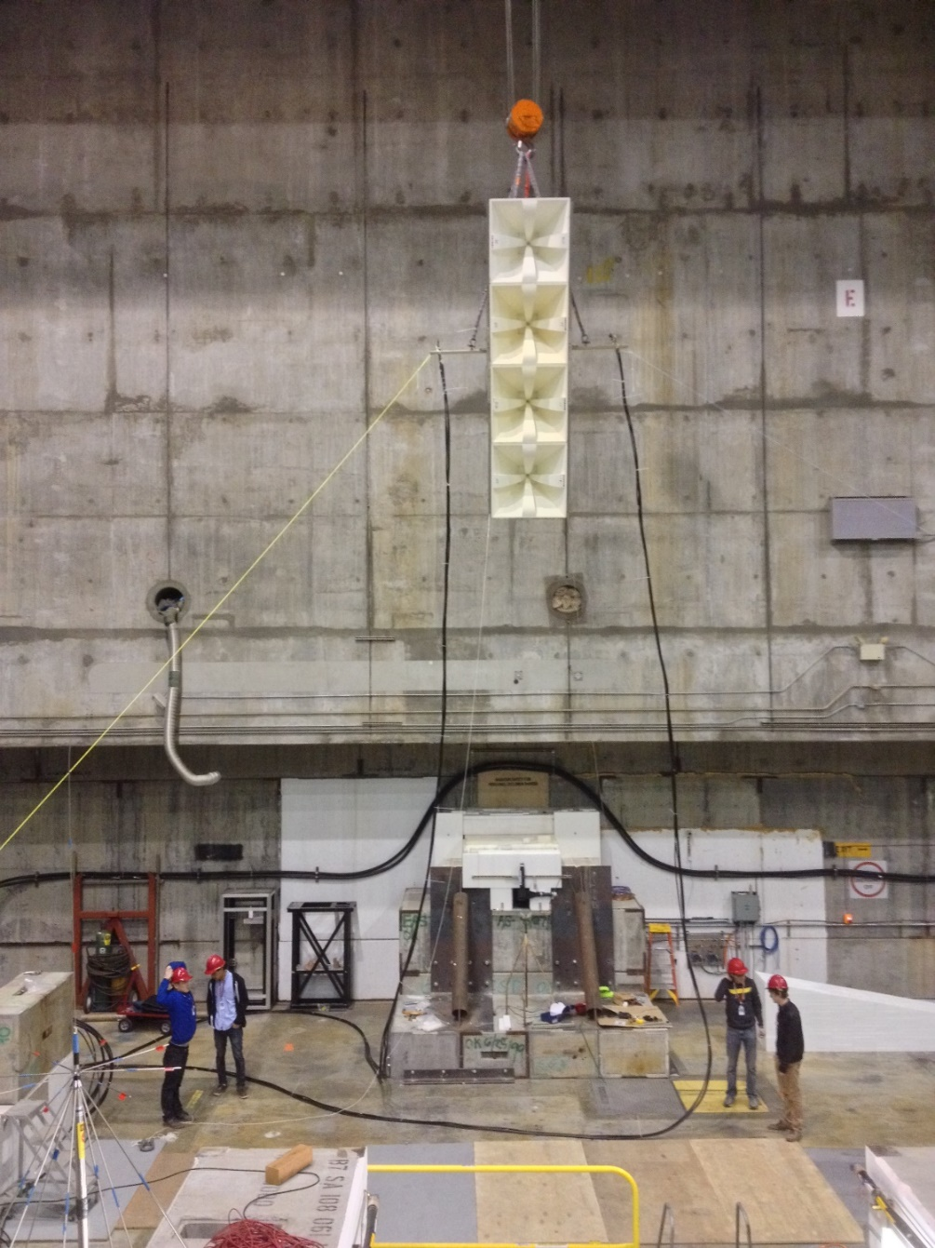
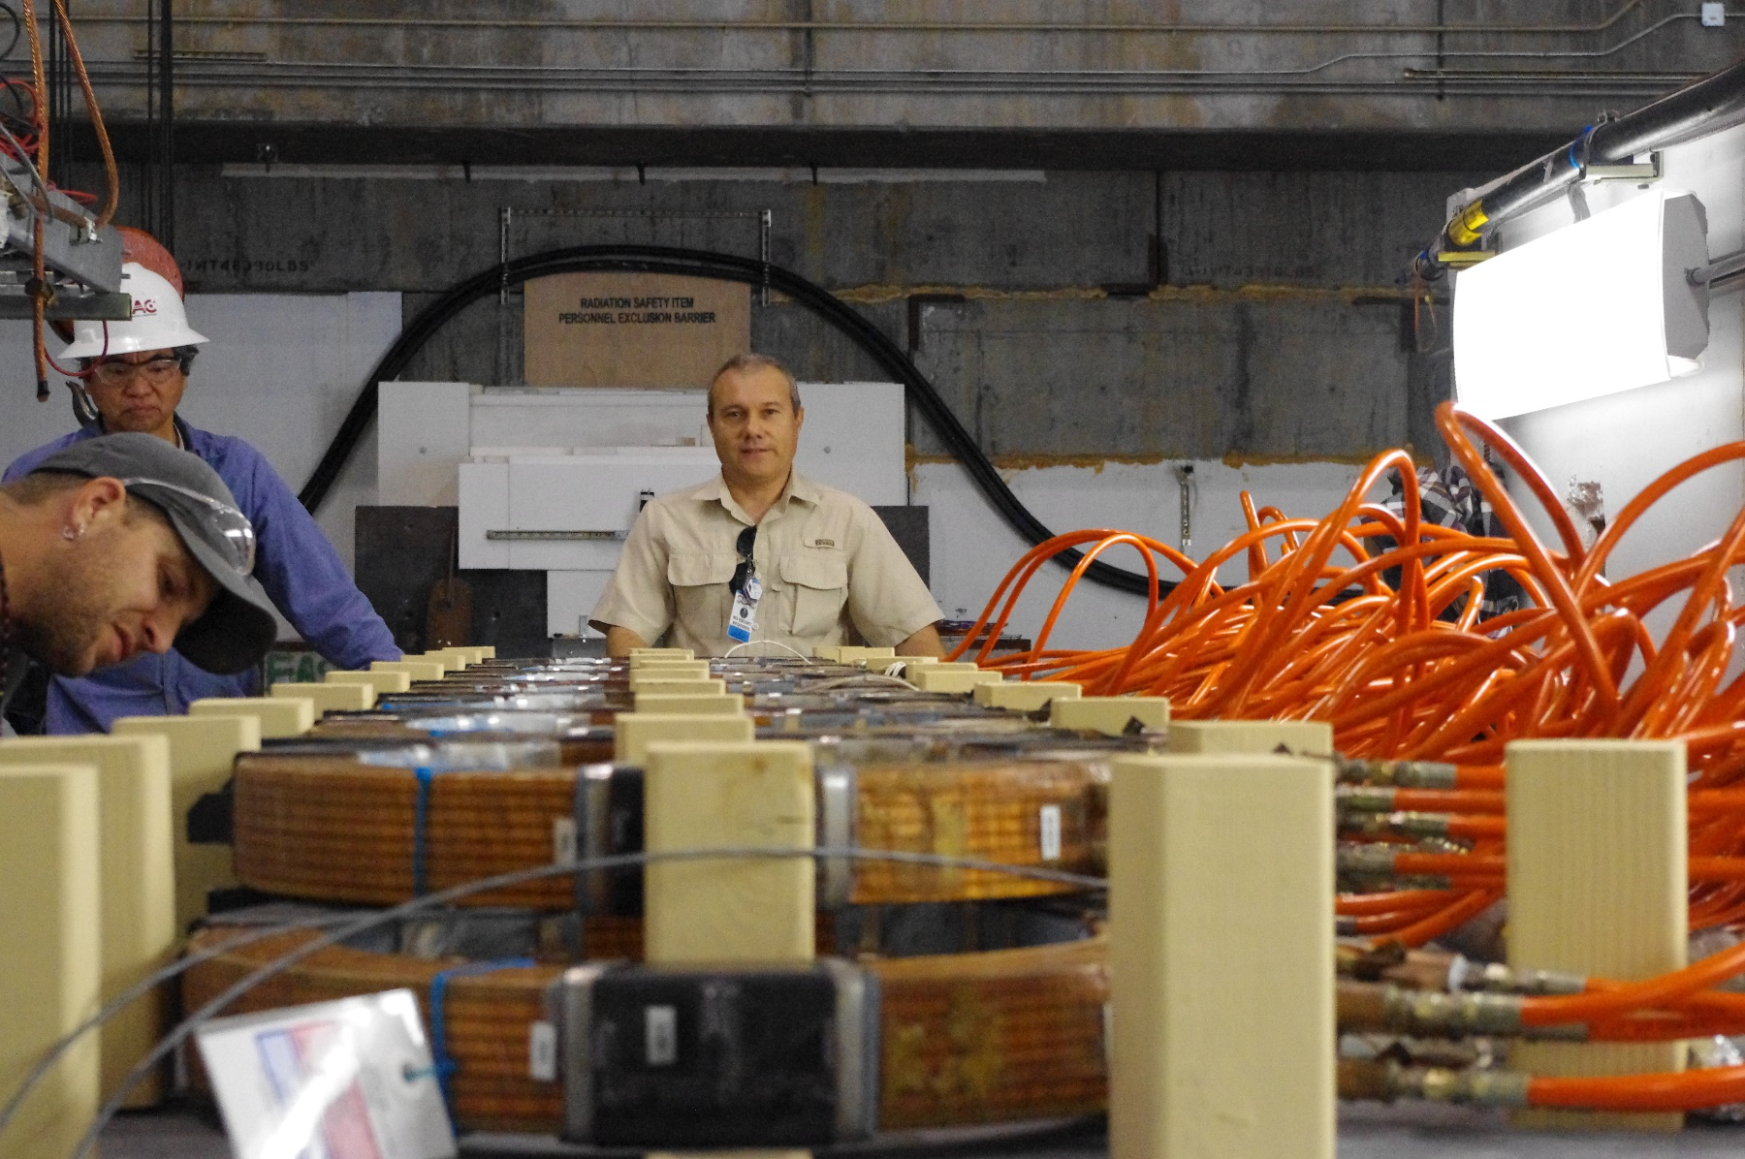
T-510: Geosynchrotron emission from extensive air showers
Anita is looking for UHECRs with a balloon at Antarctica
4th mission flew November/December 2016
It measured air showers with RF antennas
Need to verify the shower model in a magnetic field
T-510 Setup at ESTB
T-510: Reproduce atmosphere and earth magnetic field at ESTB and replace one ultra-high energetic cosmic ray with the LCLS electron beam
Carsten Hast, SLAC, SLAC Electron Beam Test Facilities
Notes:
PI: Konstantin Below, in the middle of the picture
4.5m polyethylene target and 0.1T magnet and 5GeV 10^9 electron beam are the equivalent of earth’s atmosphere, earth magnetic field and a single cosmic ray
The shower generates Cherenkov type RF. They mapped out the Cherenkov cone in 3 dimensions.
Idea of T-510 is to change the relative strength of the horizontal and vertical polarization of the RF with the magnetic field and be able to understand the Monte Carlo simulations.
Their paper will be send to PRL.

Slide 15
ESTB User Experiments FY13-16
FY 2013
  T-505: Tests of 3D silicon pixel sensors for ATLAS, P. Grenier, SLAC
  T-506: EM Shower Damage to Si Diode Sensors, Bruce Schumm, UCSC
  T-507:Test of a RICH-Prototype Based on CsI-GEMs for an Electron-Ion Collider, T. Hemmick, Stony Brook University
  T-508: HERA-B ECal modules beam test for G_{Ep}(5) at Jefferson Lab, E. J. Brash, Christopher Newport University
  T-511: Test of a Silicon-Tungsten Electromagnetic Calorimeter for the ILC SiD, R. Fry, Univ. of Oregon
FY 2014
  T-505: Tests of 3D silicon pixel sensors for ATLAS, P. Grenier, SLAC
  T-512: Calibration of the g-2 calorimeter, D. Hertzog, Univ. of Washington
  T-513: Channeling and Volume-Reflection Studies of High-Energy Electrons in Crystals, U.Wienands, SLAC
  T-510: Geosynchrotron radio emission from extensive air showers to detect ultra-high energetic neutrinos at Antarctica, K. Belov, UCLA
  T-513: Channeling and Volume-Reflection Studies of High-Energy Electrons in Crystals, U.Wienands, SLAC
  T-509: Develop a Neutron Beam Line for Calibration of Dark Matter Detectors, J. Va’Vra, SLAC
  T-506: EM Shower Damage to Si Diode Sensors, Bruce Schumm, UCSC
  T-516: ATLAS Inner Tracker (ITK) Upgrade, Test of several pixel sensor technologies, M. Bomben (Paris), P. Grenier (SLAC), S. Grinstein (Barcelona), D. Muenstermann (Geneva) and J. Weingarten (Gottingen), on behalf of the ATLAS-ITK Pixel Group
  T-520: Radiation Test of Epoxy for LCLS Delta Magnet, C. Field, SLAC
  T-517: PHENIX MPX-EX Calorimeter, T. Hemmick, Stony Brook University
  T-516: ATLAS Inner Tracker (ITK) Upgrade, Test of several pixel sensor technologies, ATLAS-ITK Pixel Group
  T-519: Calibration of the g-2 calorimeter, D. Hertzog, Univ. of Washington
FY2015
  T-506: EM Shower Damage to Si Diode Sensors, Bruce Schumm, UCSC
  T-523: Channeling of Electrons in Crystals, U. Wienand, SLAC
  T-525: Atlas IBL Pixel, A. Pranko, LBNL
  T-529: Radiation Testing of LCLS-II Kicker Electronics, T. Beukers, SLAC
  T-530:Microwave Cherenkov Calorimeters for Ultra-high Intensity Beams, P.Gorham, U.Hawaii
  E-222: Development of Electron Radiography for Material Science. F. Merrill, LANL
FY2016
  T-506: EM Shower Damage to Si Diode Sensors, Bruce Schumm, UCSC
  T-534: Commissioning, characterization and improvement of the Carleton University Silicon Telescope, C Hast, SLAC
  T-537: Radiation testing of pyroelectric detector with preamp for LCLS-II BLEN system, L. Sapozhnikov, SLAC
  T-539: SLAC Atlas Silicon Pixel Tests and various follow on experiments Su Dong, SLAC, et al.
  T-540: 3D Position Reconstruction via Depth-Dependent Diffusion (ePix), C. Kenney, SLAC
  T-541: Testing Beam-Loss Detectors for LCLS-2, A. Fisher, SLAC
  T-536: Test of the Final PbF2 Calorimeter Systems for the Muon g-2 Experiment, D. Hertzog, Univ. of Washington
  T-530: Microwave Cherenkov Calorimeters for Ultra-high Intensity Beams, P.Gorham, U.Hawaii
  E-222: Development of Electron Radiography for Material Science, F. Merrill, LANL
  T-542: sFlash (Fluorescence and phosphorescence from alumina air showers), P.Sokolsky, Univ. Utah
  T-539: SLAC Atlas Silicon Pixel Tests, Su Dong, SLAC
  T-545: LBNL Pixel Devices, Maurice Garcia-Sciveres, LBNL
  T-523: Undulator Radiation from Channeling of Electrons in Crystals, U. Uggerhoj, DPAAU
  T-546: Characterization of dump generated neutron background, D. Snowden-Ifft, Occidental College
Carsten Hast, SLAC, SLAC Electron Beam Test Facilities

Slide 16
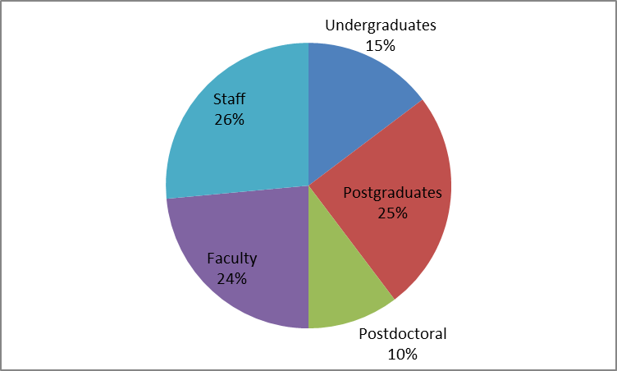
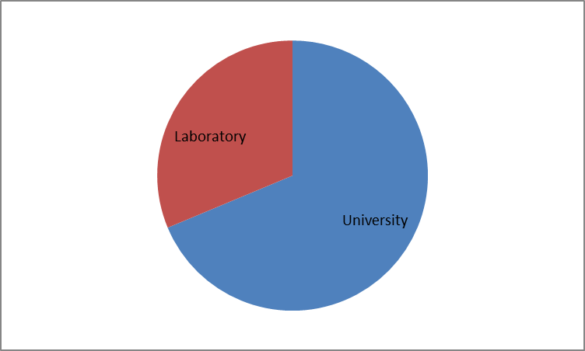
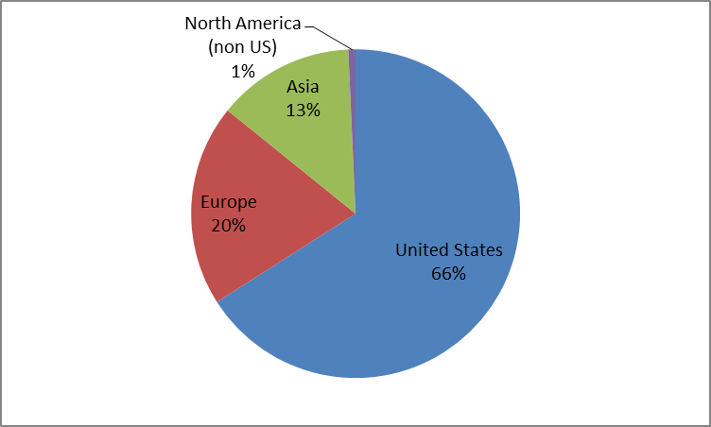
ESTB User Statistics FY13-16
Fiscal Year | # Experi- ments | # Users
2013 | 6 | 91
2014 | 11 | 207
2015 | 6 | 54
2016 | 15 | 140
Large educational component: 40% students
Carsten Hast, SLAC, SLAC Electron Beam Test Facilities

Slide 17
ESTB Operations Schedule
Sep. 2016 User Operation ended due to LCLS-II construction
Jan. 2017 to May 2017 Relocation of kicker system in BSY and vacuum upgrade (done)
Jul. 2017 to Sep. 2017 User Operations (pending operations funds)
Oct. 2017 to May 2018 User Operations
Jun. 2018 to May 2019 One year down due to LCLS-II Construction
Jun. 2019 User Operations start again with NC Linac
2020 LCLS-II Superconducting Linac starts up
  Possibility to bring secondary MHz beam to ESA (DASEL)
  Allows operation with either NC or SC Linac for years to come
10GeV, 2nC, 10µm³, e⁻ & e⁺
ESTB will continue to enable research for a
broad User Community and
continues to be a fertile training ground for students
Carsten Hast, SLAC, SLAC Electron Beam Test Facilities
17

Slide 18
Summary
ESTB delivers primary and secondary electron beams between 2 and 16 GeV
38 experiments so far
Caladium telescope is available for Users
Cover broad research themes in Detector R&D and accelerator physics
User and technical support is via Test Facilities Department
Formal proposal review processes for ESTB
http://estb.slac.stanford.edu
Hope to see you all at SLAC’s ESTB in the future
Carsten Hast, SLAC, SLAC Electron Beam Test Facilities

Slide 19
Additional Information

Slide 20
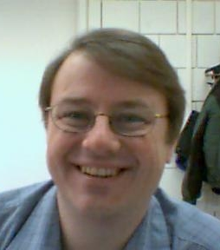

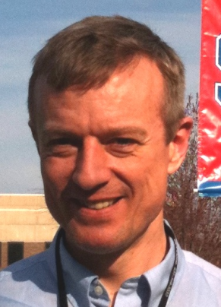
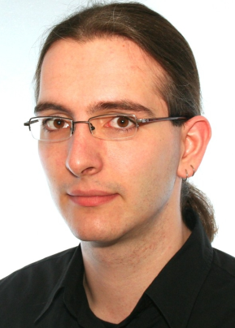
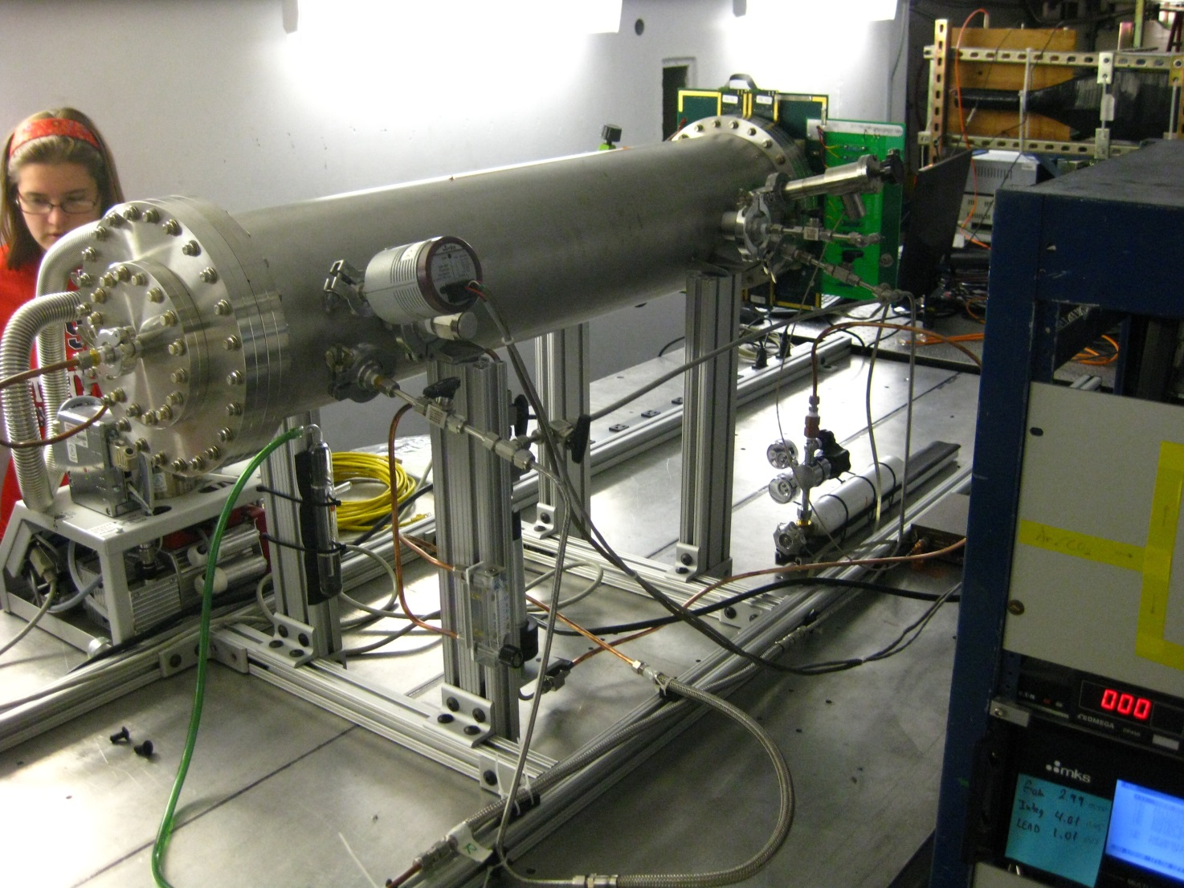
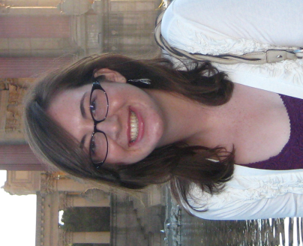
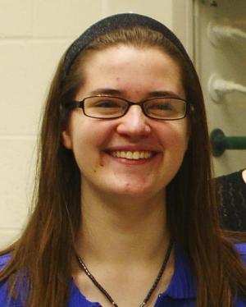
T-507: Test of a RICH-Prototype Based on CsI-GEMs for an Electron-Ion Collider
  T. Hemmick, Stony Brook Uni.
  Single electrons @ 5 Hz, 9 GeV
  4 24h days from 5/31 to 6/03 2013
Recorded 1.4 million triggers
Ran for 84% of wall clock time
Tom
Hemmick
Abhay
Deshpande
Klaus
Dehmelt
Nils
Feege
Stephanie
Zajac
Marie
Blatnik
T.Hemmick is leading T-517 Phenix Calorimeter later this year
20

Slide 21
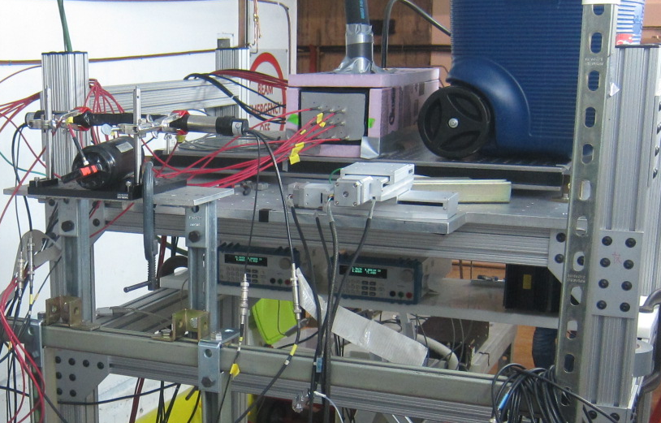
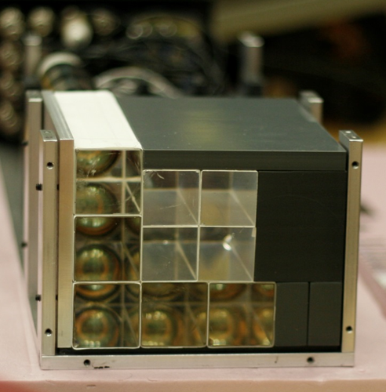
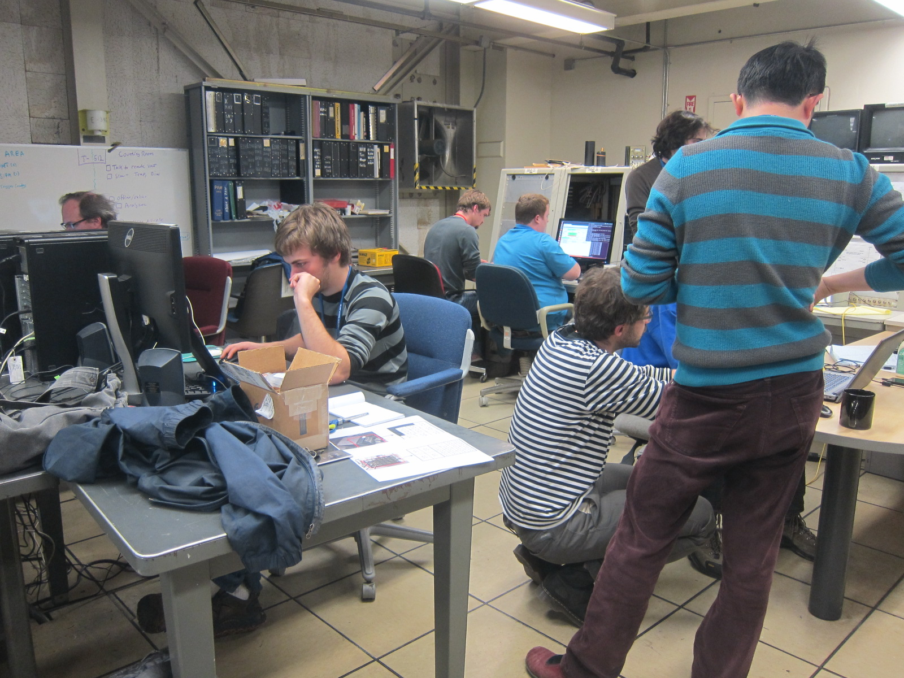
T-512: Test of FNAL g-2 Calorimeter
  D.Hertzog, Univ. of Washington
  8 collaborating institutions
  Single electrons @ 5 Hz, 2-6 GeV
3 GeV electron
1 e⁻
2 e⁻
3 e⁻
4 e⁻
5 e⁻
6 e⁻
g-2 back at ESTB in 2016 for final calorimeter calibration (T-536)

Slide 22
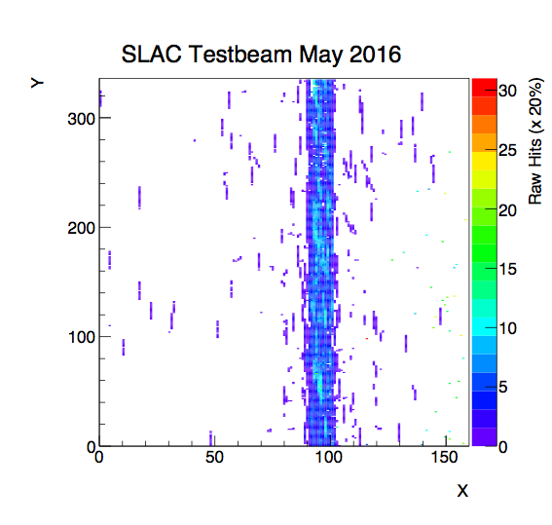
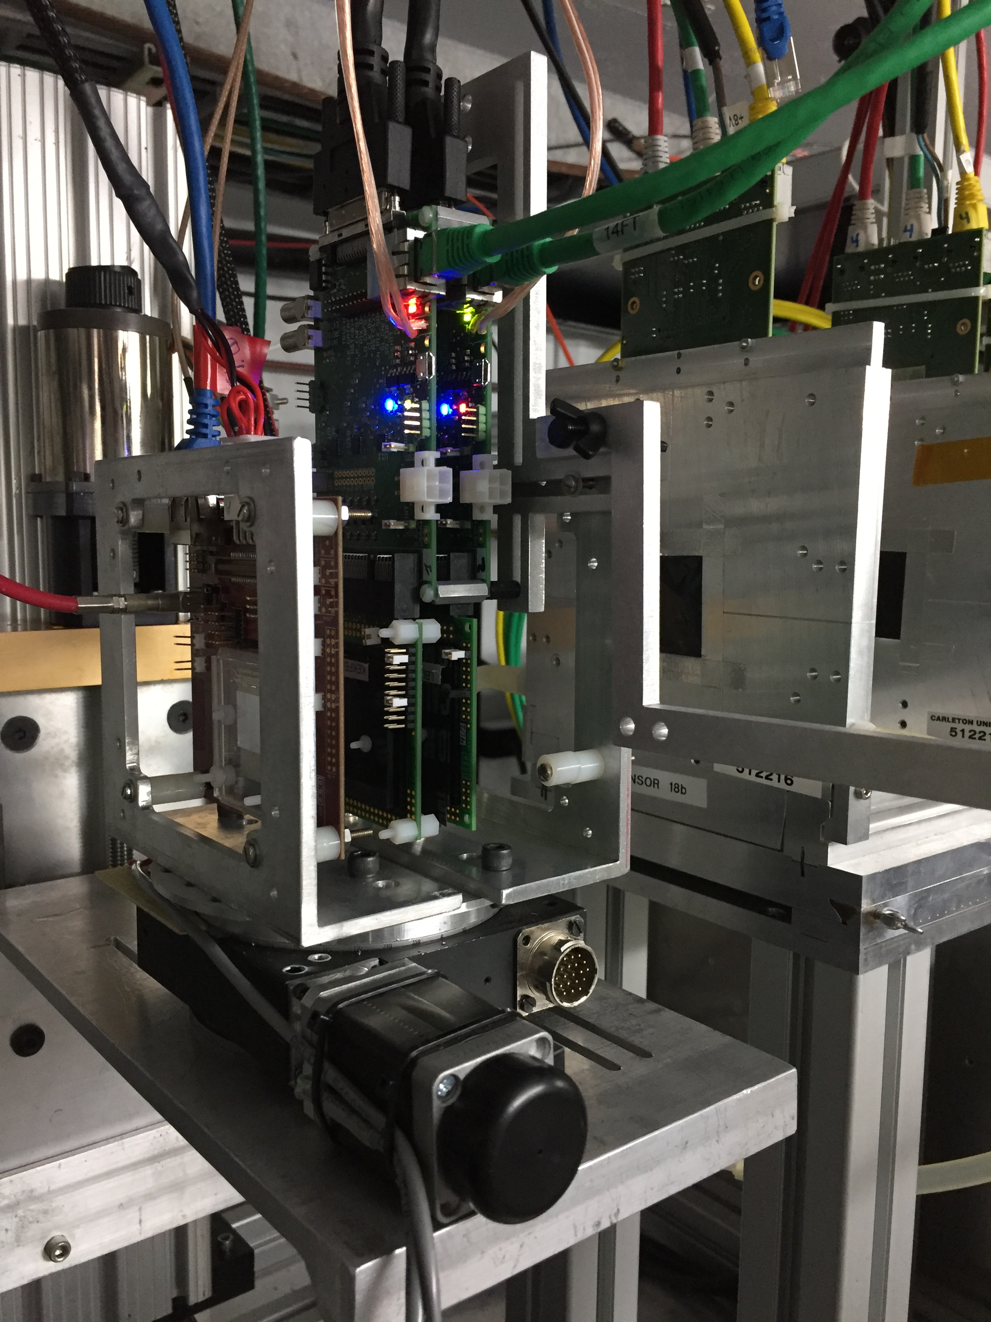
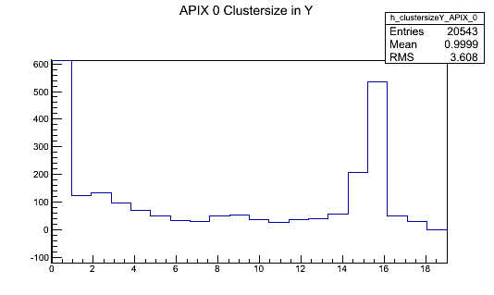
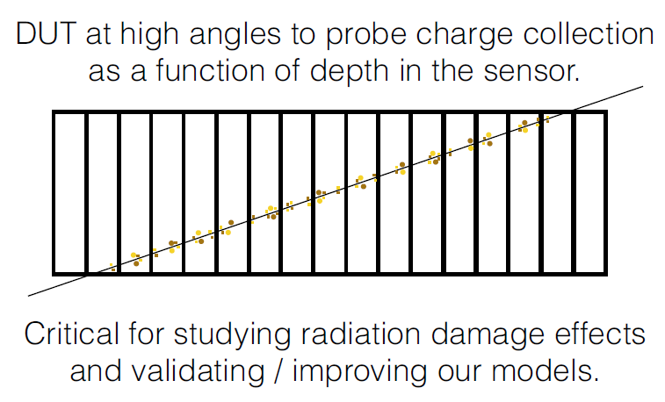
Caladium at ESTB, mainly used by ATLAS Silicon Groups but available to everyone
  Tilted Sensor Data
DUT occupancy:
long clusters
(~15 pixels)
~15 pixel long streaks
Cluster length in φ
Caladium is up and running and available to YOU
ESTB can deliver 10th to 100s of clean well separated electrons per event

Slide 23
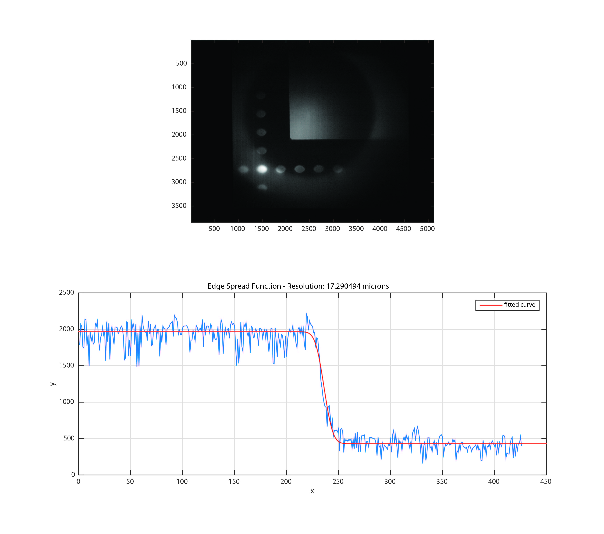
E-222: Multi-GeV Electron Radiography
Frank Merrill (LANL)
Charged particle radiography is used in material science
High energy electron radiography is new and will be part of “Marie”
Matter-Radiation Interactions in Extremes - Los Alamos National Laboratory
Build a new beam line in ESA with
  target station, multiple quadrupole magnifying lens, collimator for clean up and camera
…a mechanical watch…
2mm high letters in a
2mm thick Cu block
17 micron res.
Worked quite nicely. Additionally they did melting and freezing experiments of heavy metals and have movies of that
Carsten Hast, SLAC, SLAC Electron Beam Test Facilities
Notes:
PI: Konstantin Below, in the middle of the picture
4.5m polyethylene target and 0.1T magnet and 5GeV 10^9 electron beam are the equivalent of earth’s atmosphere, earth magnetic field and a single cosmic ray
The shower generates Cherenkov type RF. They mapped out the Cherenkov cone in 3 dimensions.
Idea of T-510 is to change the relative strength of the horizontal and vertical polarization of the RF with the magnetic field and be able to understand the Monte Carlo simulations.
Their paper will be send to PRL.

Slide 24
Summary
ASTA-NLCTA-ESTB-FACET span a broad spectrum
    e⁻ energy between a few MeV to 15 GeV
Together they cover broad research themes
    Novel and better acceleration techniques
      RF, X-Band, WFA, DLA, GTL, FEL Seeding, UED
    BDL/MDI for Linear Colliders
    Detector R&D
User and technical support is via Test Facilities Department
Formal proposal review processes for FACET and ESTB
  Please submit your proposals
    Formal call is coming out this week for review in September
    http://facet.slac.stanford.edu and http://estb.slac.stanford.edu
Need Electrons? Come to SLAC !

