Slide 1



Study of Radiation-induced Soft-errors in FPGAs for Applications at High-luminosity e+e- Colliders
Raffaele Giordano^{1,2}, Gennaro Tortone¹ and Alberto Aloisio^{1,2}
¹ Università degli Studi di Napoli “Federico II”, I-80126, Italy
² INFN Sezione di Napoli, I-80126, Italy
Contact: rgiordano@na.infn.it

Slide 2
Overview
Motivation
The SuperKEKB collider
FPGA setup at the IP
Results
Conclusions

Slide 3

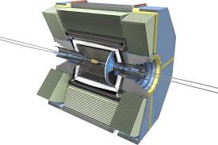

FPGAs in HEP Experiments
SRAM-based FPGAs are high-speed programmable logic devices
commercial grade FPGAs widely adopted in trigger and data acquisition systems for HEP
sensitive to radiation
soft errors in configuration memory may alter design functionality
RadHard SRAM-based FPGAs exist but they are very expensive (~50k$ per unit), not sustainable for HEP (thousands of units needed per experiment)
one possibility is to characterize commercial grade devices and find solutions for mitigating radiation effects

Slide 4
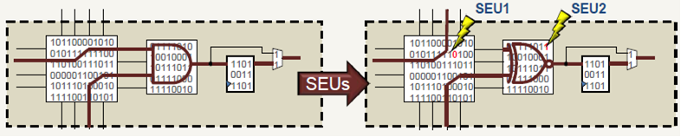
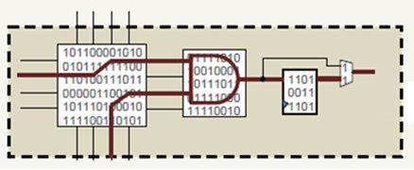
Soft Errors in SRAM-based FPGAs
Usage of SRAM-based FPGAs is limited in radiation areas
  Configuration (stored in static RAM) may be altered by radiation
Radiation environment has to be known in order to have an estimated bit upset rate => design failure rate
mitigation of radiation effects possible at different levels
  Logical => Triple Modular Redundancy (lower the failure probability of each module, must be coupled to configuration scrubbing)
  Layout => Placement and routing hardening ( R. Giordano et al., IEEE Trans. On Nucl. Sci., Vol. 62, no. 6, Dec. 2015, pp. 3177-3185, Open Access http://ieeexplore.ieee.org/stamp/stamp.jsp?arnumber=7348785 )

Slide 5
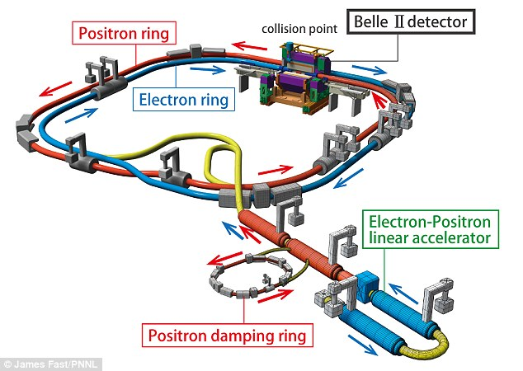
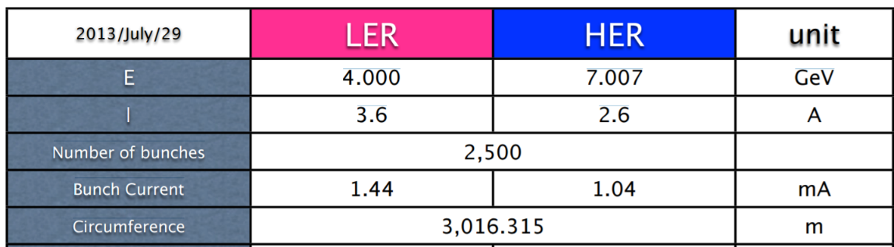
The SuperKEKB Collider
SuperKEKB e+e- KEK (Tsukuba, Japan)
B factory, designed for search of new physics at the intensity frontier
Main design parameters
  Target L= 8×10³⁵ Hz/cm²
  LER (e+) 4 GeV, HER (e-) 7 GeV
Single collision point: Belle2 detector
Phase 1 commissioning completed (Feb. to Jun. 2016)

Slide 6
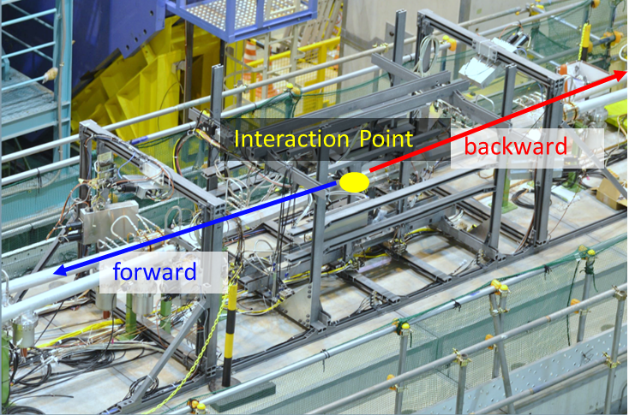

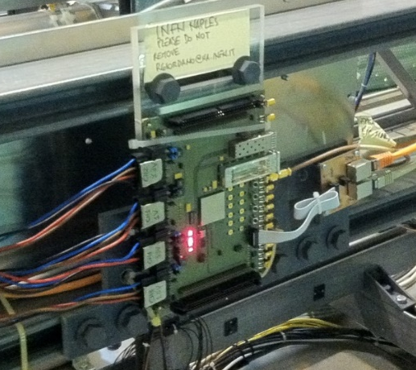

FPGA Setup at SuperKEKB
BEASTII frame
The radiation environment at SuperKEKB is not well known
In situ measurement of upsets in FPGA configuration memory
X
BEASTII commissioning detector aimed at measuring machine backgrounds
Several BEASTII-related talks at TIPP2017 given by
  Chiara La Licata, Miroslav Gabriel, Hendrik Windel, Igal Jaegle, Hua Ye
FPGA installed on the BEASTII support frame (~1 m from the beam pipe)

Slide 7
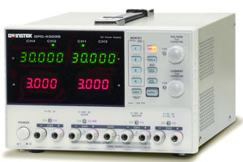
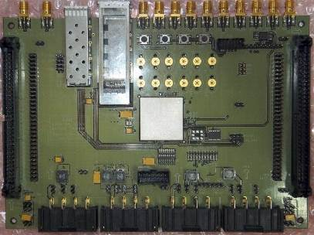
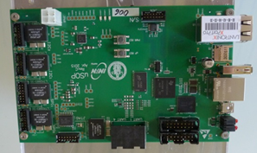
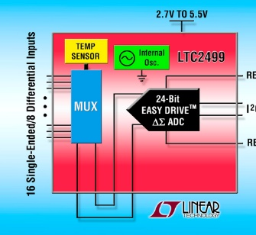
Test Setup
Power Supply
GW-Instek GPD4303S
SuperKEKB IP
DAQ room
USB
Testboard based on
Kintex-7 325T
uSOP single-board
computer
14
3.3V
2.5V
1.8V
1.0V
~40m
I²C
JTAG
Power supply
8
14
Remote Voltage sense
CAT7-
14pin
Adapter
8
CAT7-
14pin
Adapter
ΔΣ ADC
Linear LTC2499
24-Bit 8 diff. chan
JTAG over CAT7 cable
8
Custom designed FPGA testboard, no other active components
USB-controlled power supply, 4 channels for FPGA supply domains
24-bit sigma-delta ADC for voltage sense at FPGA
uSOP single-board computer, controls power supply, ADC and FPGA configuration/readback via JTAG, remote control via LAN
More details on uSOP in talk by F. Di Capua (given on monday)
Remote
Control (LAN)

Slide 8
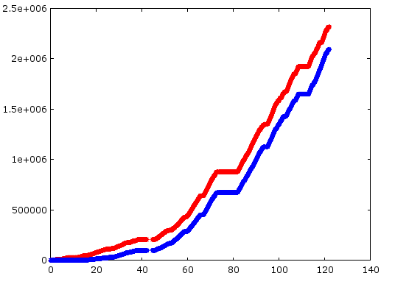
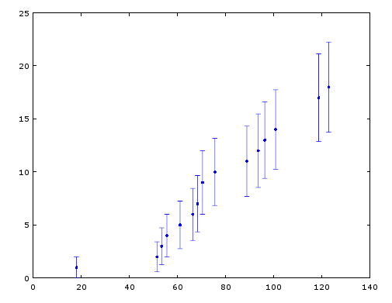


Upsets vs Integrated Currents
During SuperKEKB operation from Feb. 14th to June 11th 2016
FPGA upset count (N) had a similar trend to integrated beam current (97% correlation coefficient)
18 configuration errors detected out of 91.5∙10⁶ configuration bits
Average rate 0.15 SEUs/day (or 1 SEU every 6.7 days)
Results from PIN diodes at BEASTII (M. Nayak, 25th Belle2 General Meeting) => total dose @FPGA < 300 krad
Negligible variation in currents absorbed by FPGA (< 1mA, i.e. no TID effects)
FPGA is still fully functional, no permanent damage
No collisions between HER and LER in phase1
HER
LER
Integrated Beam Currents (C)
Time (days)
$$ρ\left(Q_{LER},N\right)=97.4\%$$
$$ρ\left(Q_{HER},N\right)=96.6\%$$
FPGA
N of config errors
Time (days)

Slide 9
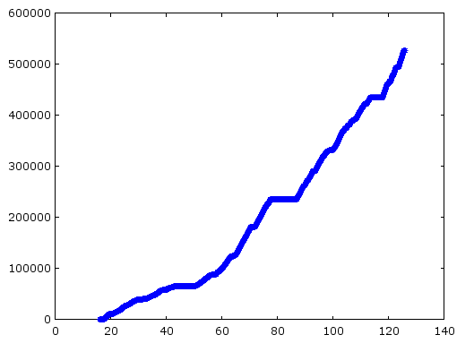
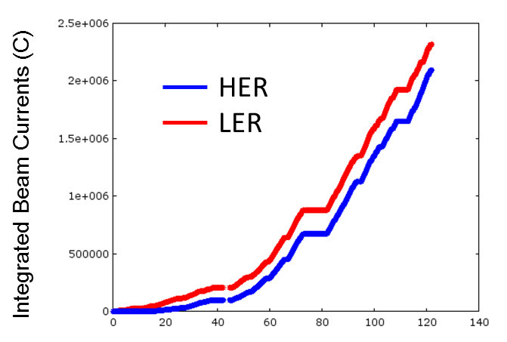
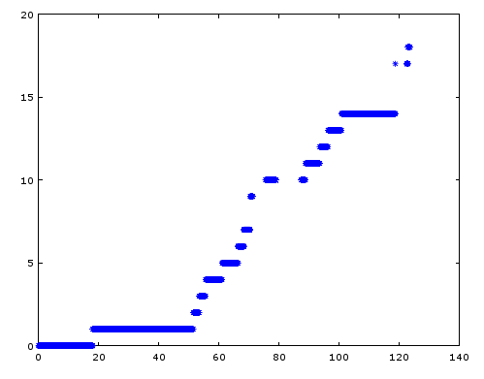
Upsets vs He3 Tube Events
He3 Tube at φ=0°
Integrated rate (A.U.)
Time (days)
Four He3 tubes were installed around the beam pipe, at distance of nearly 1 m from IP, at φ=0°, 90°, 180°and 270°
FPGA test board behind tube at φ=0°
He3 Tube integrated rate follows integrated beam current very well
So does FPGA error count
FPGA
# of config errors
Time (days)

Slide 10
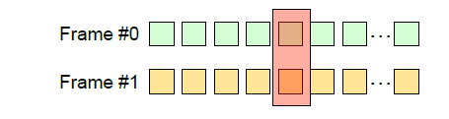
Error Logs
Readback time
(i.e. uncertainty in SEU time stamp)
Extract from error logs
date = 04/13/2016:23:15:41 | total_errors = 0 | Verify of 28291 frames took 917 seconds
date = 04/13/2016:23:30:58 | total_errors = 0 | Verify of 28291 frames took 917 seconds
date = 04/13/2016:23:46:15 | total_errors = 0 | Verify of 28291 frames took 917 seconds
…
date = 04/20/2016:17:21:45 | total_errors = 838 | Verify of 28291 frames took 911 seconds
ERROR(s) | date = 04/20/2016:17:24:27 | frame_addr = 00021B16 | flipped bits = 0328:0->1 total_errors = 839
ERROR(s) | date = 04/20/2016:17:26:32 | frame_addr = 00042620 | flipped bits = 2077:0->1 total_errors = 840
ERROR(s) | date = 04/20/2016:17:26:33 | frame_addr = 00042621 | flipped bits = 2077:0->1 total_errors = 841
ERROR(s) | date = 04/20/2016:17:32:18 | frame_addr = 0044070B | flipped bits = 1947:0->1 total_errors = 842
…
MCU
Adjacent frames
same bit
offset
Custom script for JTAG readback
For each detected upset we log time stamp, frame address and bit offset
Due to frame interleaving in K7, some MBUs appear as SEUs
All the measured errors can be corrected by 7 series FPGA embedded configuration error correcting code
Total 18 upsets
  16 SEUs
  1 MBUs (2 upsets)
[1] M J Wirthlin et al., 2014 JINST 9 C01025

Slide 11
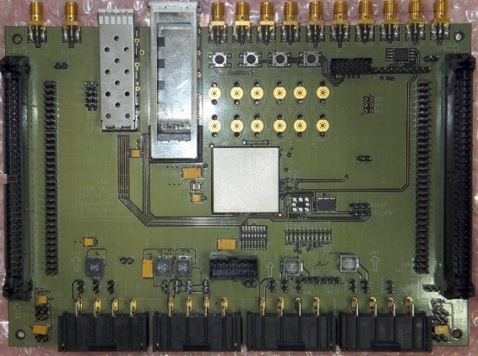
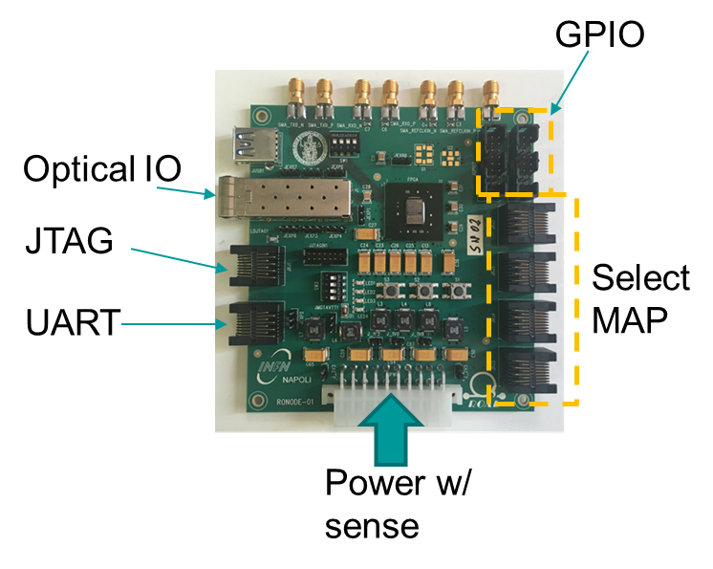
A New Test Board for Phase2
Old version
Kintex-7 325T
In SuperKEKB Phase1 no focusing => no collisions
In Phase2 beam currents will increase and beams will be focused, so data taking is going to continue
New FPGA test board ready and tested
2 units will be installed along SuperKEKB beam pipe
Based on Xilinx Kintex-7 70T and passives (no active components other than FPGA)
RJ45 connectors for long-haul connection over CAT7 cables (JTAG, RS232 and parallel configuration)
Kintex-7 70T
New version

Slide 12
Conclusions and…
FPGA installed in BEASTII provided us with preliminary information about the expected upset rate
Negligible TID effects in FPGA power consumption
Measured upset rate is very low (0.15 upsets/day)
  Most of observed upsets were single bit errors in a frame
  7-Series built-in error correcting code can fix those
  soft error mitigation (SEM) controller could be employed to fix double upsets per frame
Beam currents will increase and so will backgrounds => SEU monitoring will continue in BEAST phase2 (Belle2 detector rolled in and final focusing magnets in place)

Slide 13
Acknowledgement
We thank S. Vahsen, P. Lewis, H. Nakayama, A. Beaulieu, S. De Jong, I. Jaegle, M. Hedges and all the other members of the BEASTII community for supporting this activity
This work is part of the ROAL project (grant no. RBSI14JOUV) funded by MIUR in the framework of the 2014 Scientific Independence of young Researchers program

Slide 14
Backup slides

Slide 15

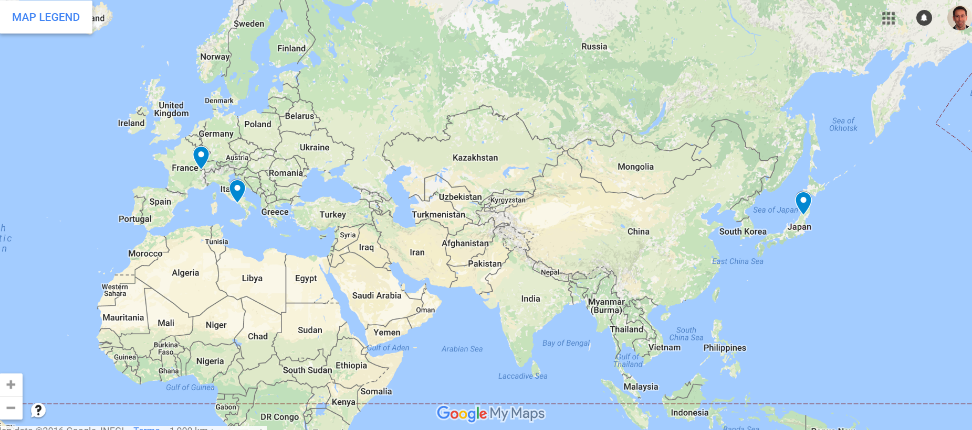





The ROAL project
Started Jan. 2016, funded by Italian Ministry for Research
Goal: development of high-speed (5-13 Gbps) links based on FPGAs for on-detector applications
Based at University of Naples and INFN Naples
Includes test beams at INFN Laboratori Nazionali del Sud (Catania, Italy) and in-situ irradiation activities at international laboratories such as KEK (Tsukuba, Japan) and CERN (Geneva, Switzerland)

Slide 16
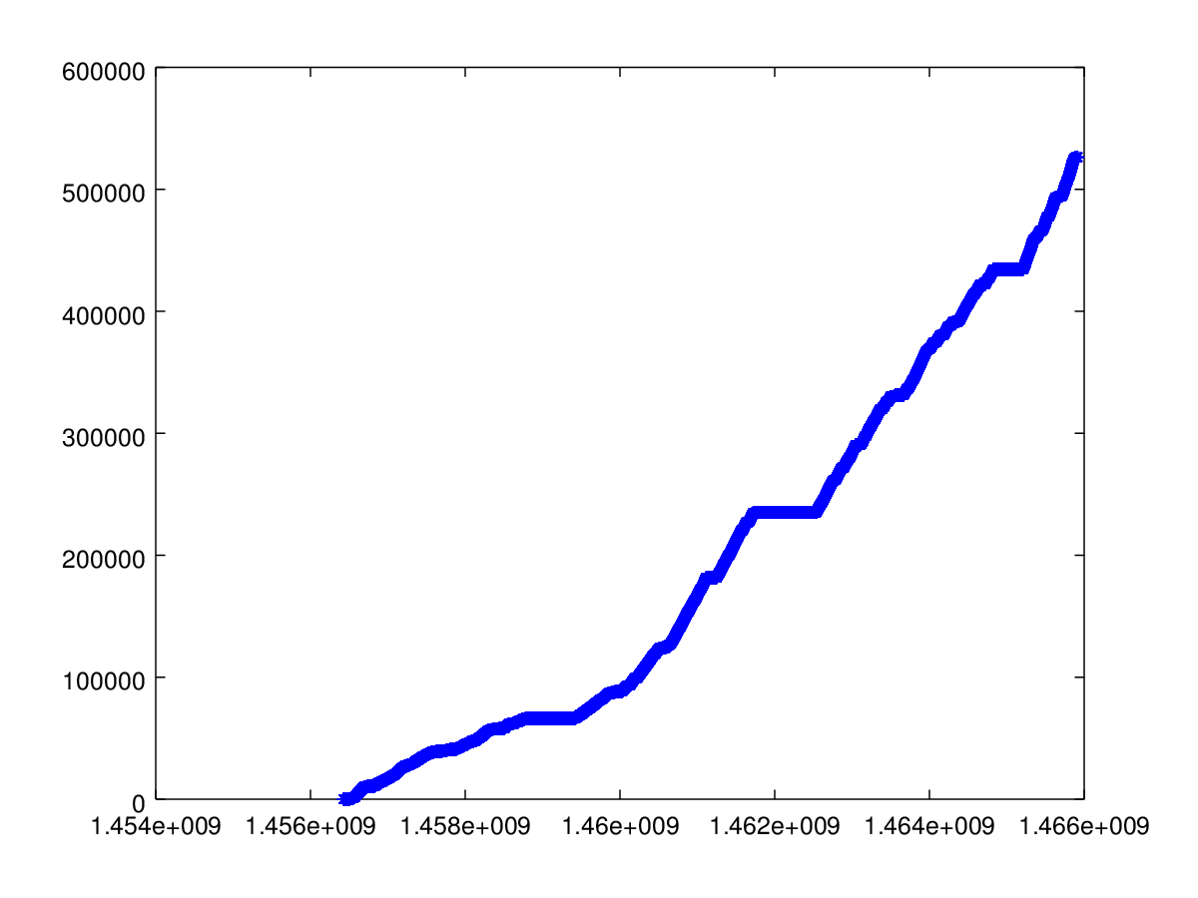
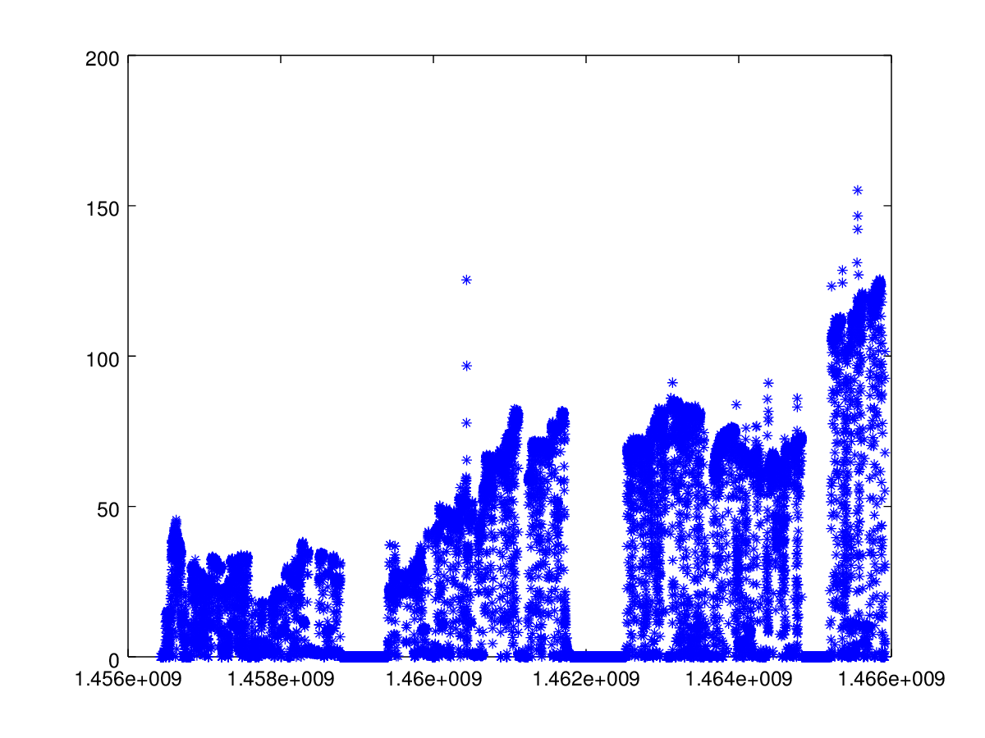
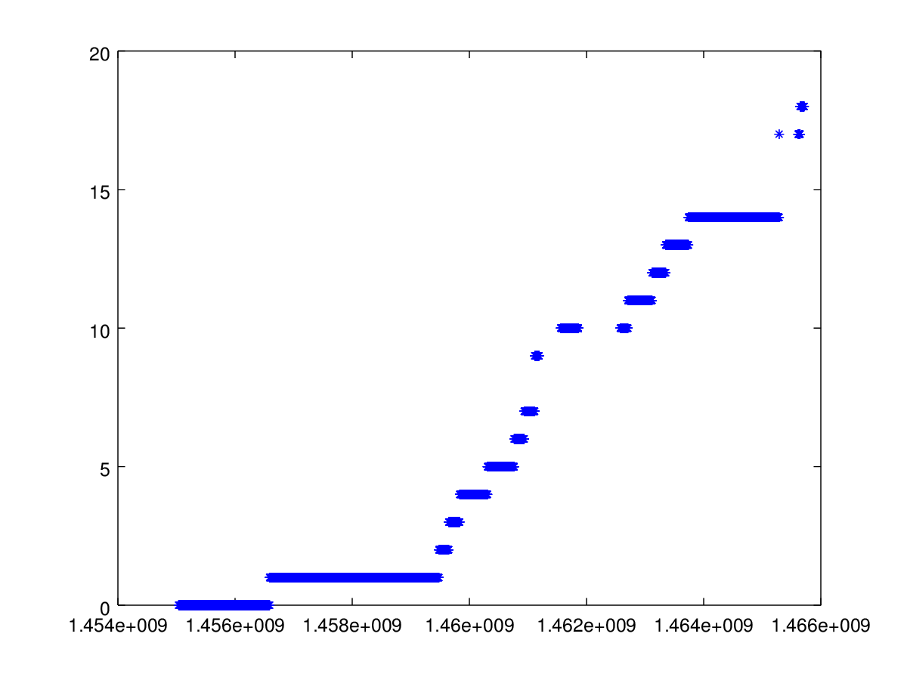
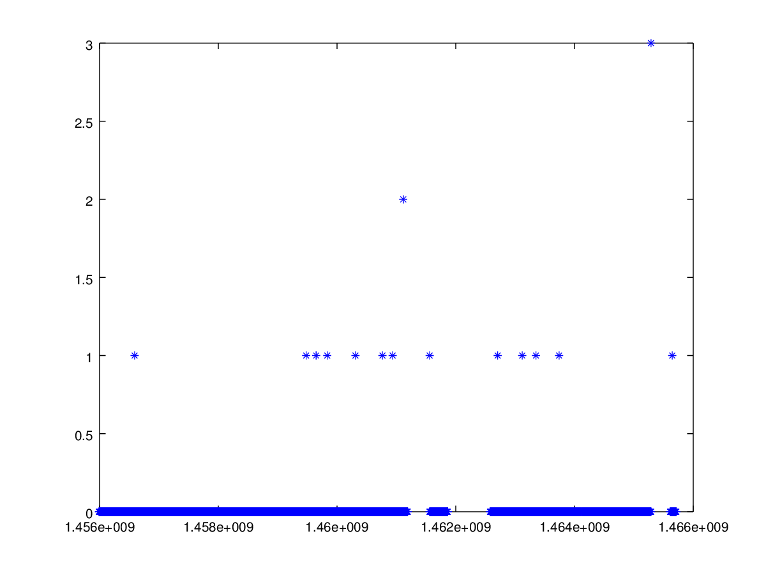
SEUs vs He3 Tube Rates
He3 Tube at φ=0°
He3 Tube at φ=0°
Rate (A.U.)
Integrated rate (A.U.)
"Hua Ye
"Hua Ye
Time (s)
Time (s)
FPGA
# of config errors
Time (s)
Time (s)

Slide 17

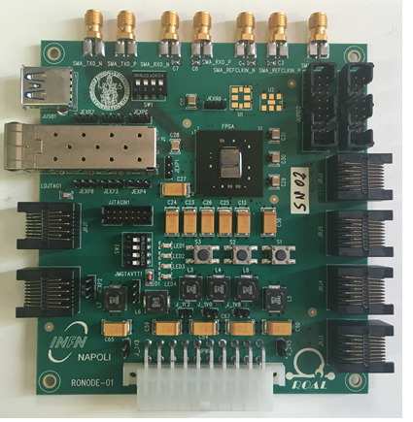
Monitor FPGA Soft Errors in Phase2?
Old version
New FPGA test board ready
Smaller than previous one, nearly half size
Based on Xilinx Kintex-7 70T and passives (no active components other than FPGA)
RJ45 connectors for long-haul connection over CAT7 cables (JTAG, RS232 and parallel configuration)
Board just produced, needs testing
Could it be installed for BEAST phase2? Where? When? How?
New version
GPIO
Optical IO
JTAG
Select
MAP
UART
Power w/
sense

Slide 18
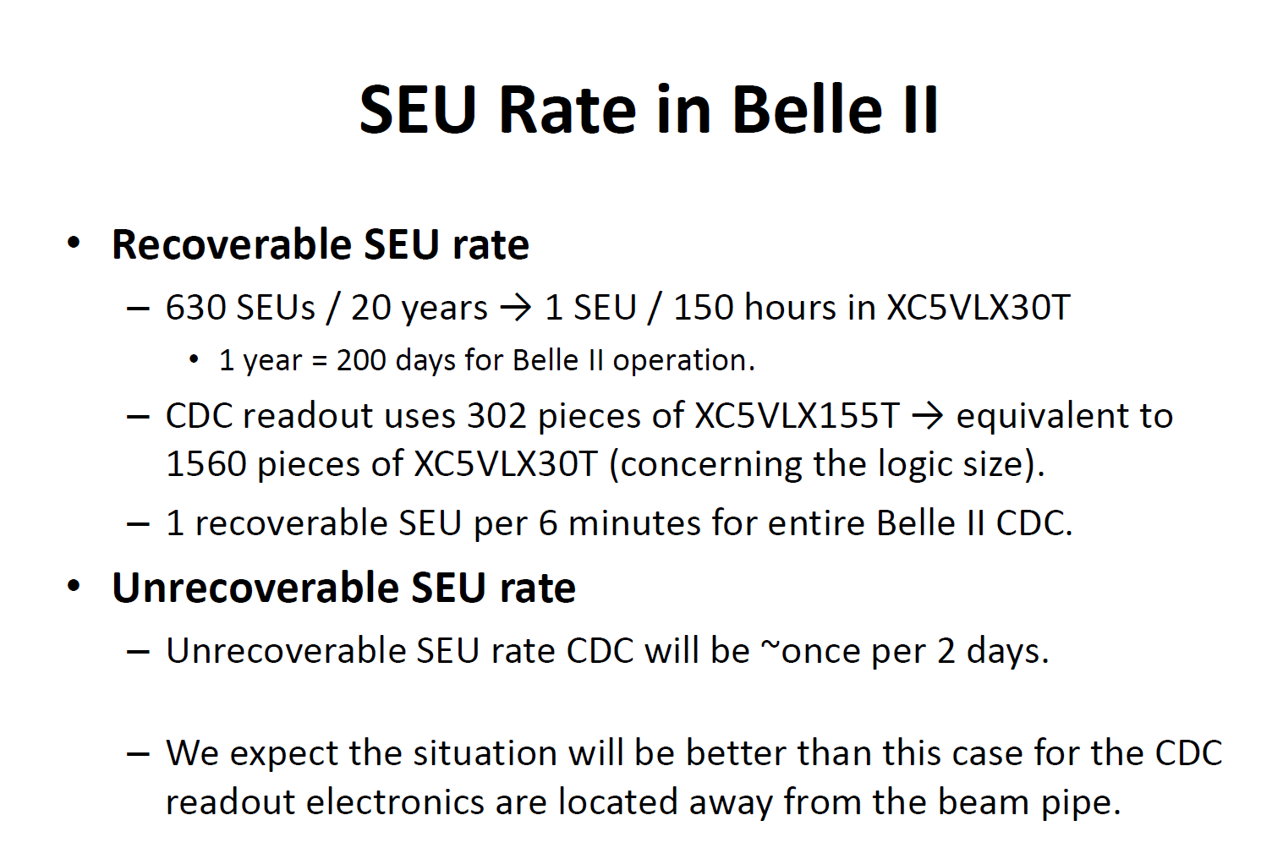
Expected
From T. Higuchi (KEK) talk at TWEPP2011
“Radiation Tolerance of Readout Electronics for Belle II”

Slide 19
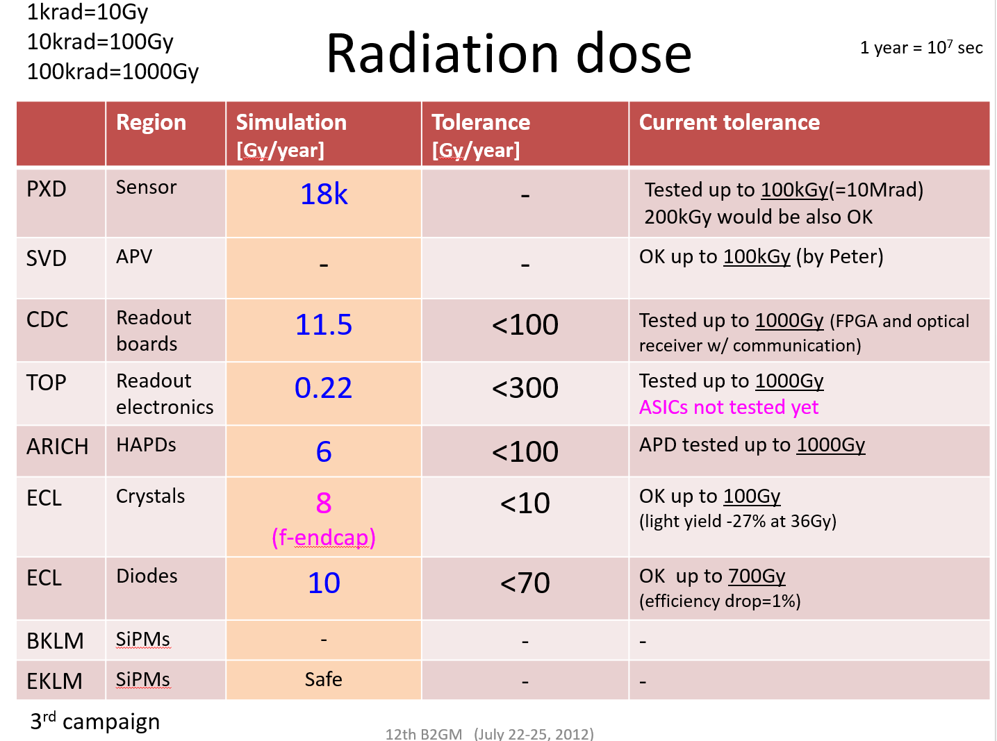
From. Hiroyuki NAKAYAMA (KEK) Talk at 12th B2GM

Slide 20
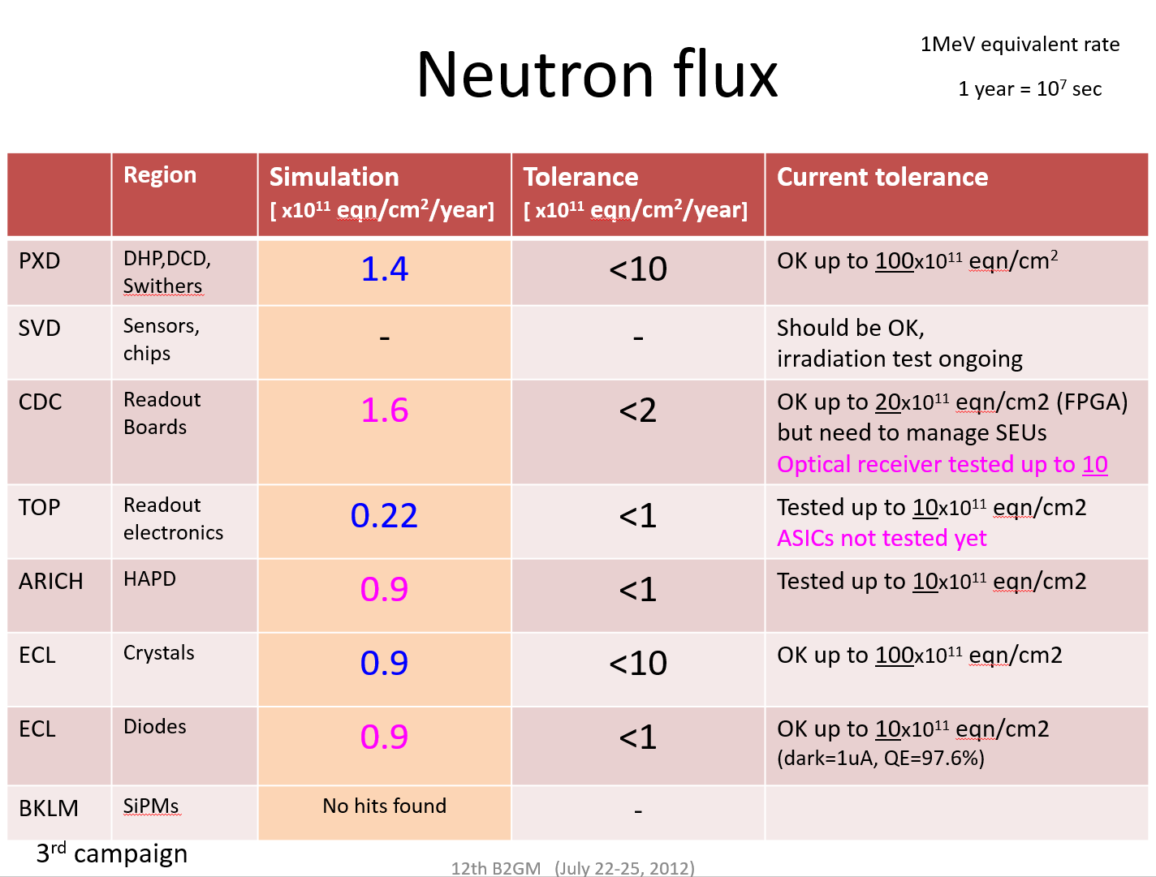
From. Hiroyuki NAKAYAMA (KEK) Talk at 12th B2GM

Slide 21
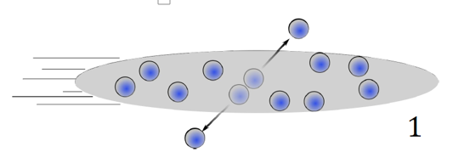
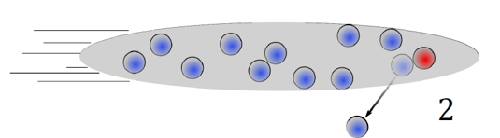
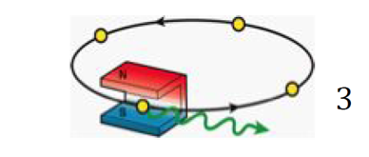
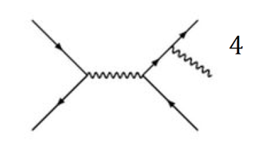
BEASTII Commissioning Detector
Among the technical challenges at Belle2, there are beam backgrounds
In Belle/KEKB, unexpected backgrounds burnt a hole in the beam pipe and damaged inner detectors
Especially dangerous at SuperKEKB:
  Temporary damage or faults in electronics
  Obscure physics processes
  Fake interesting physics signals
  Rejecting fake signals also lowers efficiency
This is where BEASTII comes in...
Touschek scattering
Beam-gas scattering
Synchroton radiation
Radiative Bhabbha

Slide 22
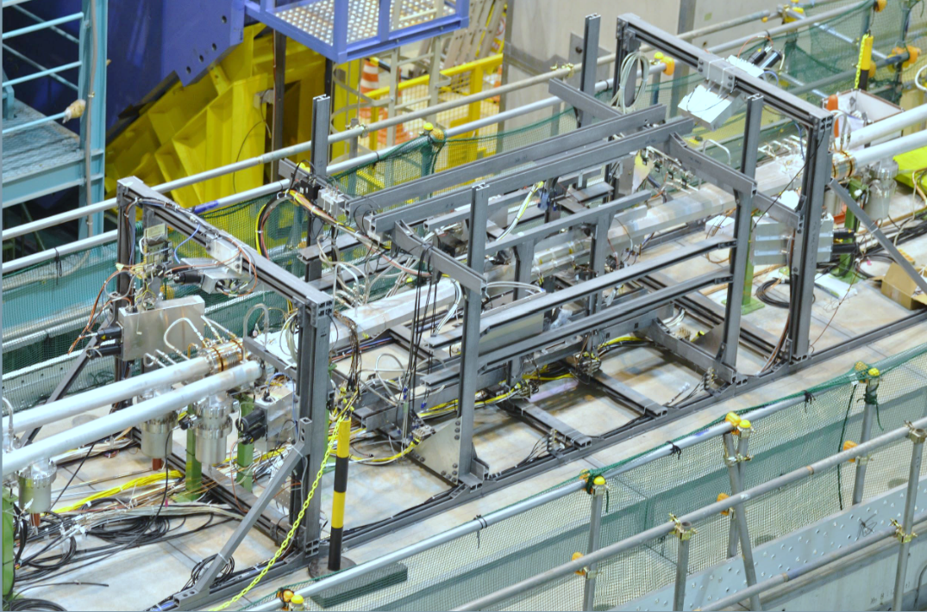
BEAST II Goals
Instrument SuperKEKB before Belle II is rolled in
Measure beam backgrounds where BelleII will operate to:
  Tune simulations in
  Ensure radiation level is safe for detectors
  Identify and shield background “hot spots”
  Test systems that measure radiation levels for feedback to SuperKEKB
Interaction Point
backward
forward
BEASTII fiberglass frame
supporting background detectors
(PIN diodes, TPCs, Diamonds, He3 tubes,
BGOs, Calorimeter crystals)

Slide 23
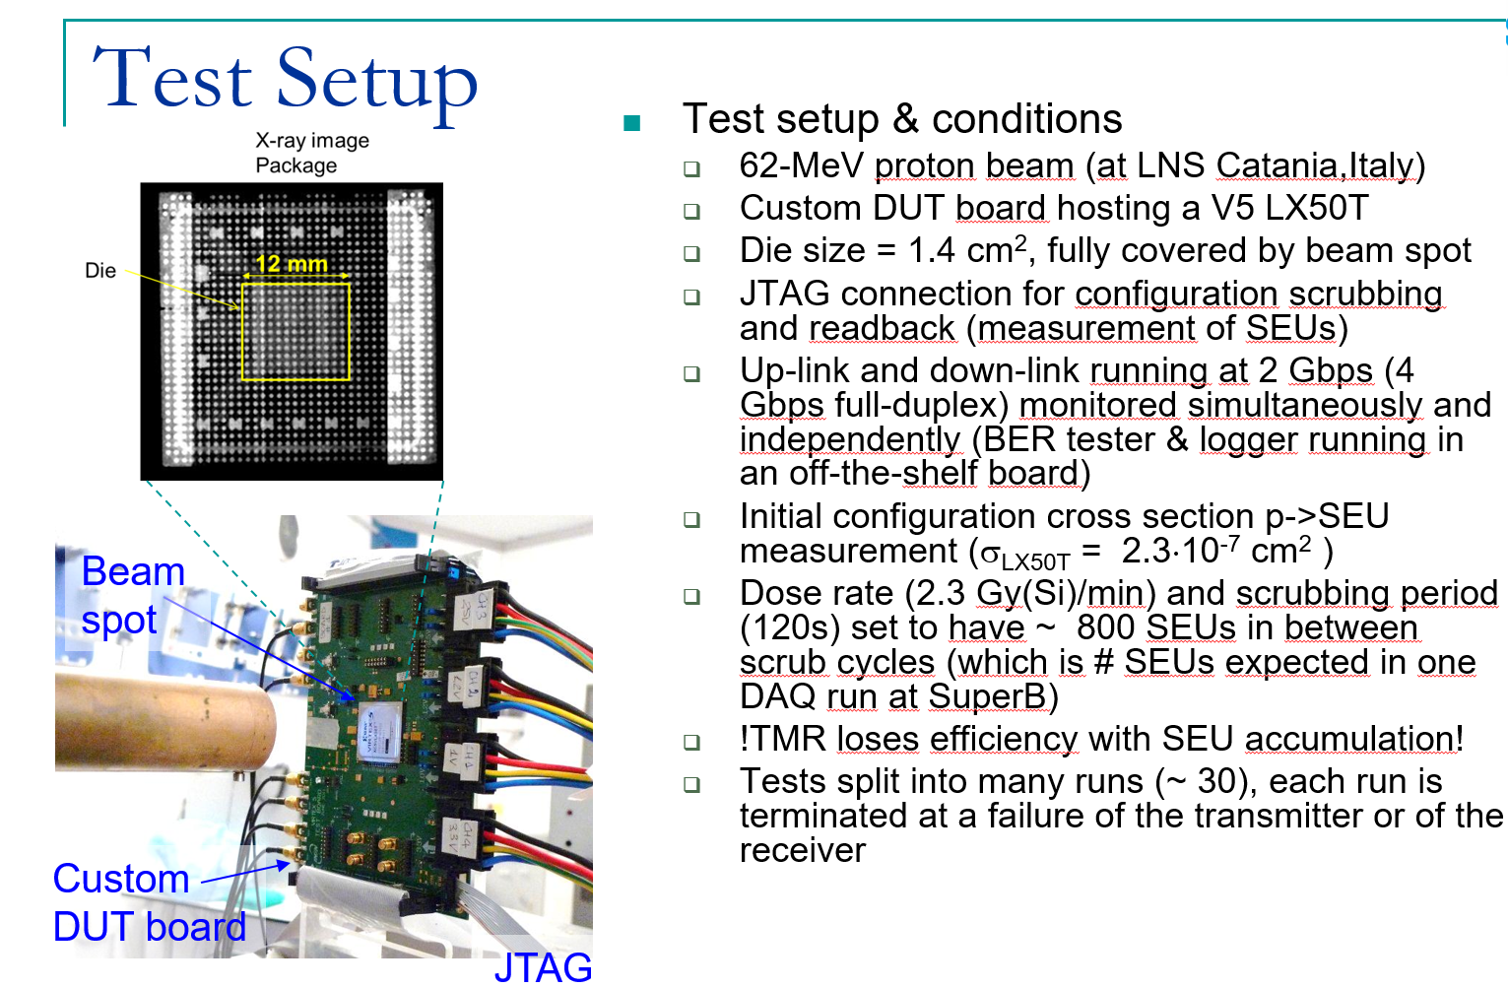

Slide 24
Configuration Memory Results
Test conditions
  Total 8 runs
  dose rates from 1.1 to 2.6 Gy/min (Si), average 1.8
X-Section results:
  Virtex-5
  σ_{bit} = 1.74⋅10⁻¹⁴ cm² ⋅ bit⁻¹
  A factor 2 lower than previous results, different batch, different foundry, perhaps improved process
  Virtex-6
  σ_{bit} = 1.05⋅10⁻¹⁴ cm² ⋅ bit⁻¹
  Published value for neutrons
  σ_{bit} = 1.02⋅10⁻¹⁴ cm² ⋅ bit⁻¹
Test Methodology
Start a new run
Program the FPGA
Read-back the configuration via JTAG and compare it to the initial one
Log number of differences (errored bits)
Go back to 3, until total desired dose reached
The test loop (pts 3,4,5) has been executed at the maximum speed permitted by JTAG
  1 readback every 15 seconds for V5, 1 every 45s for V6

Slide 25
Current During SEU Tolerance Tests
Core Static and Dynamic currents trends
Run #20-21(Jul. ‘11) - TMR project
Accumulation of SEUs in configuration memory leads to current increase (‘switching on’ of unused elements, clashes)
Dynamic and static core currents exhibit very similar trends
Other currents (IO, AUX, MGT) remain constant
Initial current drawn is restored after FPGA reconfiguration, i.e. no persistent effects
No significant change in current drawn by the device after the total integrated dose of all the tests (1.2 kGy (Si)) => no TID effects at this dose
Irrad. Stop
FPGA
reconfig
25 Gy(Si)
Is (A)
Id (A)
SEU
accumulation
Irrad. start
Time (s)
Irradiation @ 3 Gy/min (Si)
5174 SEUs in 484 s (time to failure)
641 SEU/min => 209 SEU/Gy (Si)
Total current increase 15mA => 2.8 uA/SEU

Slide 26

Correlation Matrix

Slide 27
Macro
Option Explicit
Public Sub ChangeSpellCheckingLanguage()
Dim j As Integer, k As Integer, scount As Integer, fcount As Integer
scount = ActivePresentation.Slides.Count
For j = 1 To scount
fcount = ActivePresentation.Slides(j).Shapes.Count
For k = 1 To fcount
If ActivePresentation.Slides(j).Shapes(k).HasTextFrame Then
ActivePresentation.Slides(j).Shapes(k) _
.TextFrame.TextRange.LanguageID = msoLanguageIDEnglishUS
End If
Next k
Next j
End Sub

