Slide 1







The Tynode
a new vacuum electron multiplier for ultra fast pixelised particle detectors with sufficient yield
enabling the construction of TipsyZero
On behalf of the Membrane project:
Harry van der Graaf, Jeff de Fazio, Conny C.T. Hansson
Hong Wah Chan, Annemarie Theulings, Violeta Prodanović, John Smedley, John Sinsheimer, Kees Hagen, Carel Heerkens, Lina Sarro, Gert Nützel, Serge D. Pinto, Neil Budko, Behrouz Raftari, Wouter de Landgraaf, Henk van Zeijl
Supported by ERC – Advanced 2012 “MEMBrane” 320764
TIPP Beijing
May 26, 2017

Slide 2
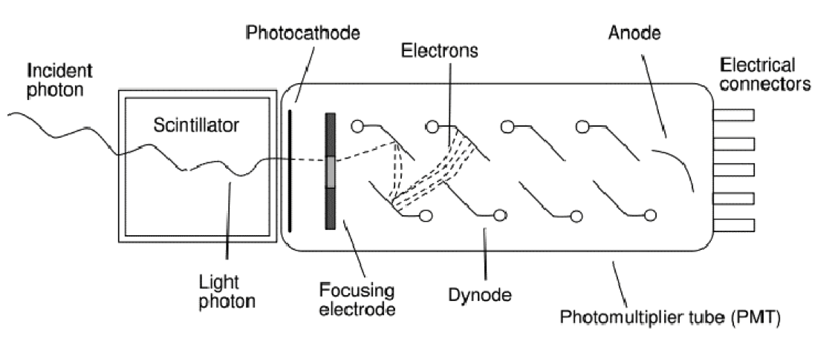
A very successful photon detector: the Photomultiplier (1934 -1936)
‘good’ quantum efficiency
rather fast
low noise @ high gain: very sensitive
little dark current, no bias current
radiation hard
quite linear
voluminous, bulky & heavy
no spatial resolution, not even 1D
expensive
quite radioactive
can’t stand B fields
Amplification by multiplication: low noise!

Slide 3
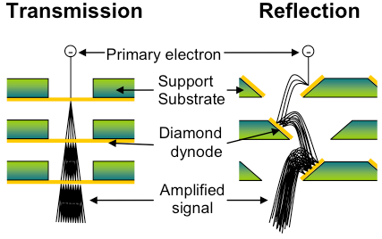
Dynode: amplification by multiplication
New: the Transmission Dynode
Tynode®
Trynode®

Slide 4

The Timed Photon Counter TiPC “Tipsy”concept: advancing PMT’s
Photomultiplier tubes
High gain
Low noise
Secondary Electron Yield (SEY)
j
Gain = δ^{N}
…Can we make it smaller?
Transmission dynodes – Tynodes
Dark noise free electron multiplication mechanism
Stacking the photocathode, Tynodes and pixel chip → compact device
Pixelated detector → spatial resolution (imaging)
Operation of the detector in high B-field.
Time resolution: few ps due to form factor and straight electron path’s
2D spatial resolution = 10 µm
4

Slide 6

Path towards first prototype
We have created many tynodes of various sizes and materials
Most recently, we have achieved transmission yields of 5.5 with 5 nm MgO membranes, coated with 2.5 nm TiN, without other special surface treatments
Now working towards building a first prototype device
MEMS technology

Slide 7

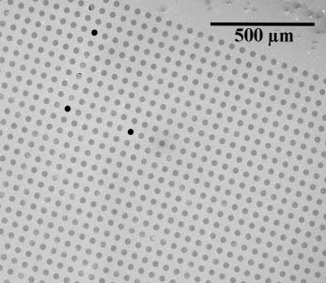
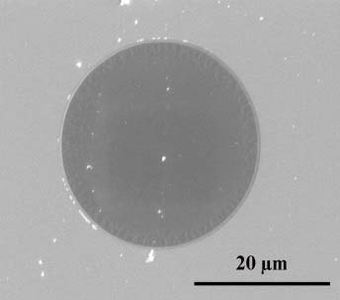
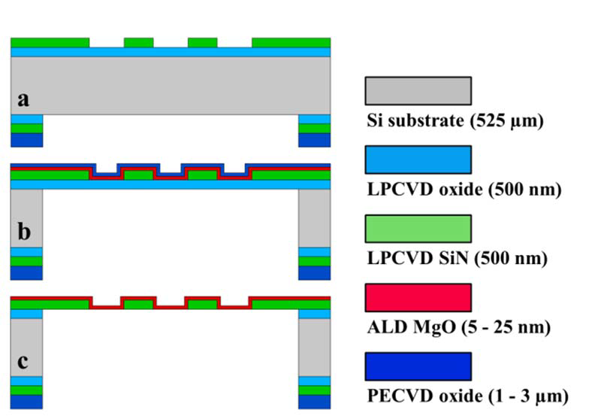
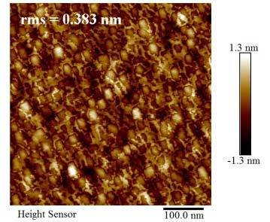
MEMS fabriaction of Tynodes: ALD MgO
Thermal ALD reactor with (Mg(Cp)₂) and H₂O as precursors
Deposition temperature: 200 °C
Measured stress: ~ -200 MPa
Growth rate = 0.165 nm/cycle (3 + 15 + 1 + 15 sec)
SEM captures of 5 nm thin MgO membranes in 64 x 64 array
7
AFM image of released 25 nm thin MgO
membrane

Slide 8
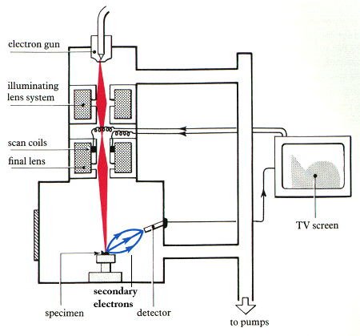
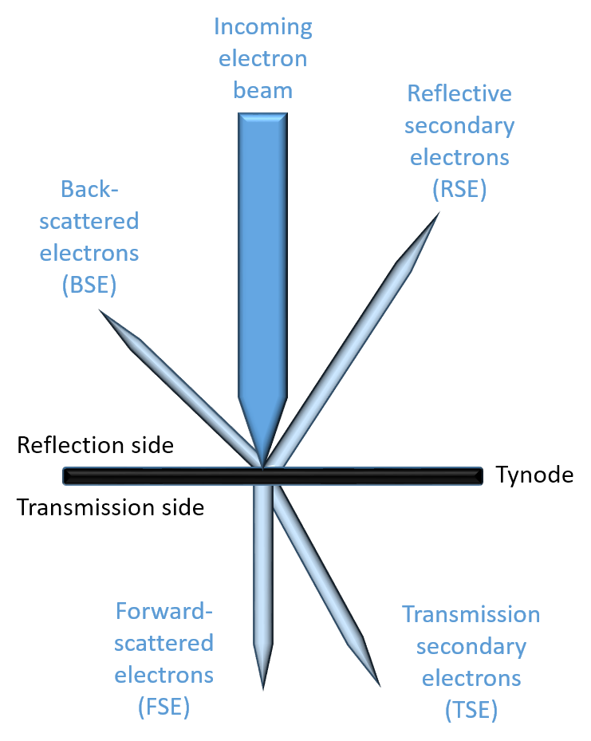

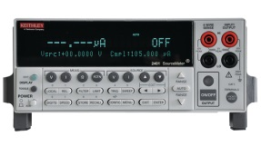
TSEY Measurement in SEM
Scanning Electron Microscope:
  Electron beam energy
  Measure beam current
  Acquire image (4.2 min)
Keithley 2450 Sourcemeters
  Measure Sample Current
  Measure anode Collector Current
Repeat for different beam energies
Process data
SEM e⁻ beam
sample holder
anode
Keithley source meters

Slide 10
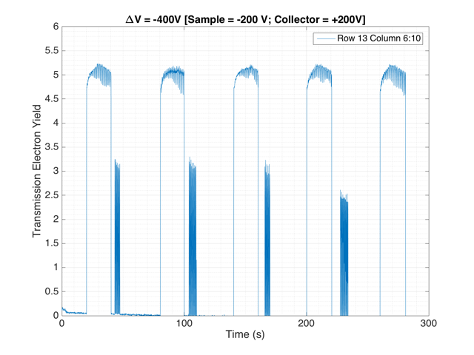
!! 5.2 !!
TSEY
November 2016: TSEYmax = 5.5

Slide 11
Al₂O₃ Measurements and Simulation using
low-energy GEANT extensions
Measurement
Simulations
10 nm
25 nm
50 nm
A decrease in yield, combined with increase in optimum primary electron energy is observed as a function of sample thickness
Good correlation to measurements seen for the simulations.

Slide 12
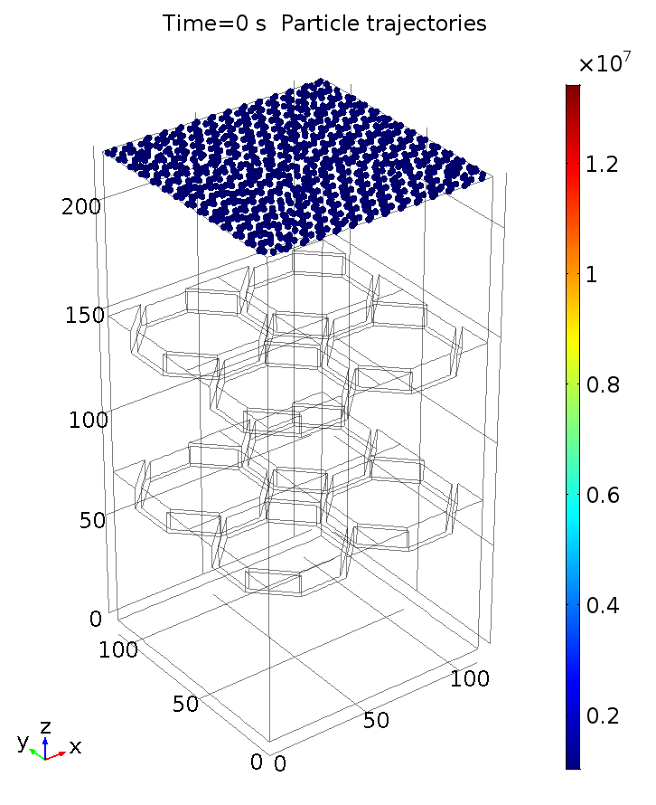
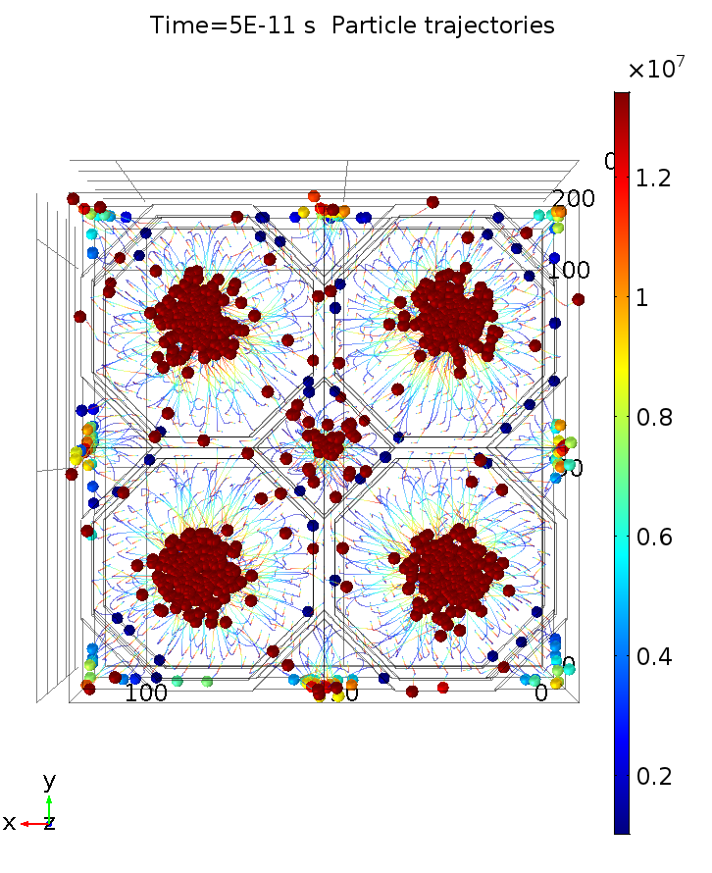
Tynode 2.0: ALD Metamaterials

Slide 13
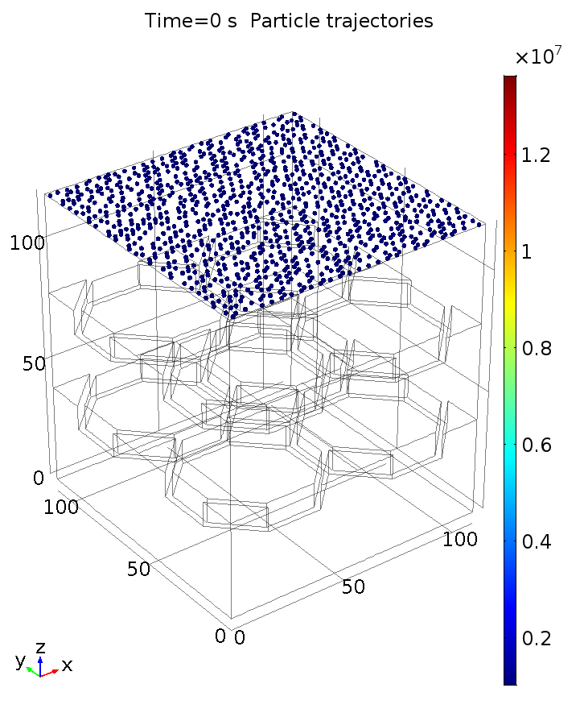
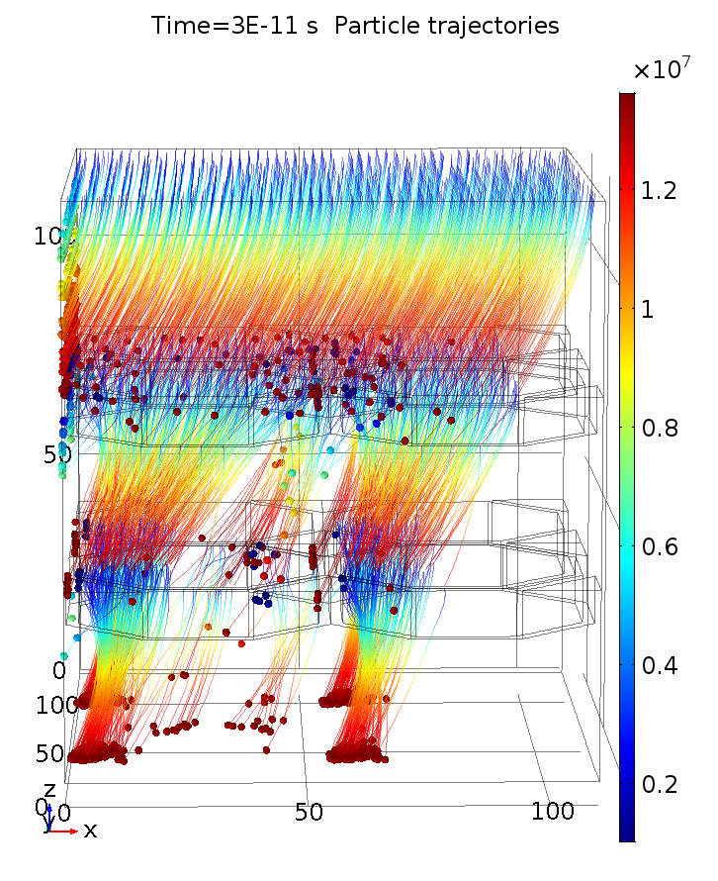
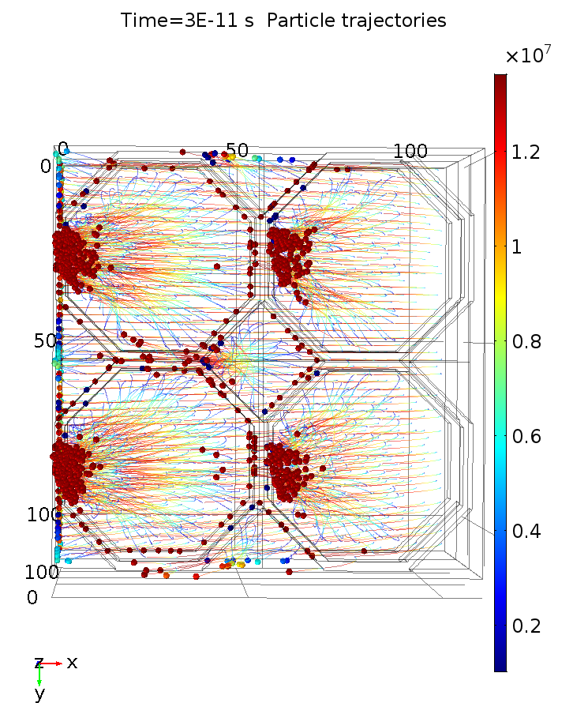
Magnetic field

Slide 14
Timed Photon Counter – TipsyZero – Fabrication of First Prototype
Finalized layout of MgO domes
Sputtered TiN (2 nm)
ALD MgO (5 - 25 nm)
LPCVD SiN (500 nm)
Thermal oxide (500 nm)
PECVD oxide (> 2 um)
Si (525 um)
We intend to manually stack 5 of these tynodes and place the stack above a TimePix-1 chip
When in a close stack, we may achieve higher yields from close, extracting fields:
  There is a report¹ that, with a single Si membrane, yields of 200 has
  been reached due to a strong extracting field. We may have an even
  much higher extracting field!
1) Qin, Kim, Blick. APL 91, 183506 (2007).

Slide 15
Concept - Fabrication TipsyZero into a Photonis PLANACONTM Style Device
TimePix-1 pixel chip on Kyocera carrier board
● Ultra high vacuum compatible, sealing with Planacon window, photocathode compatible
TipsyZero will be limited to the 10 ns bin size of TPX-1 or 1 ns bin size of TPX-3
a new TimePix NN with 10 ps time resolution
Fan-out ceramic with metalized top-traces for HV distribution
Metal studs and weld ribbons to electrode rings
Backside metalized ASIC (TIMEPIX) with tynodes eutectic bonded into envelope + wirebonds

Slide 16
Further yield improvement:
  fully exploration of Extracting Field Bonus
  Surface termination
  Tynode annealing
  better vacuum
  bake out
  the active Tynode - Trynode
graphene
bulk ALD: ~ 100 atomic layers
1 V bias
graphene
Negative Electron Affinity layer
(Cs, H, B termination)
Extracting field E

Slide 17
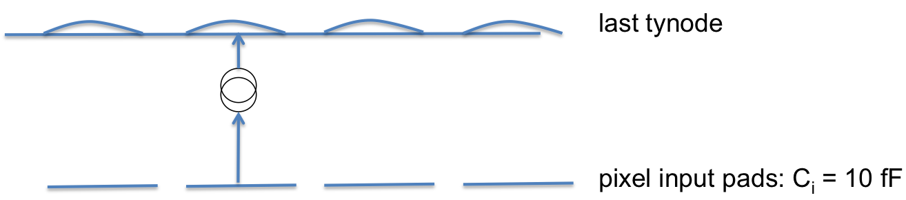
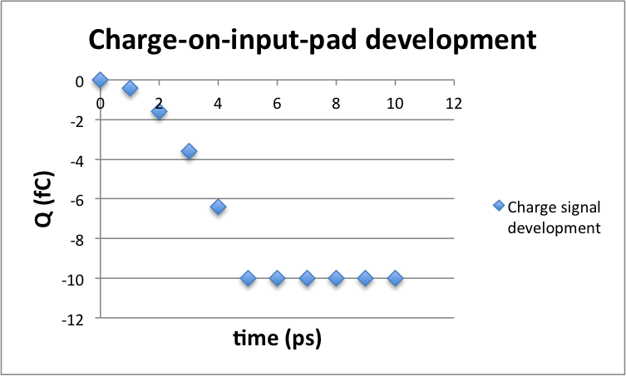
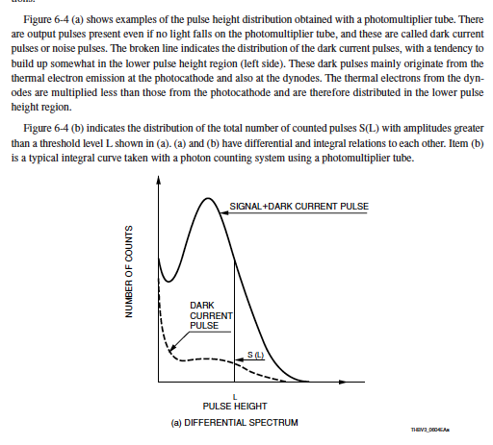
Why is Tipsy so fast?
signal is build when
electrons cross the last gap
electron mobility in vacuum: free electron!
amplitude distribution
60 k e⁻

Slide 18
Trend in Si PMs: 3D separation of sensor and pixel chip
avalanche sensor
bump bondings
pixel chip
Digital (single photon sensitive) detector: input capacitance ~ 10 fF
With time resolution better than 20 ps: pixelisation: no signal processing possible
Time resolution below 10 ps: limited by present Si technology
➔ development of PIX 20: a digital pixel chip with a 20 ps TDC per pixel

Slide 19
a high Quantum Efficiency photocathode

Slide 20
single (digital) soft photon detectors
time resolution
2D spatial resolution
detection efficiency: Quantum Efficiency QE

Slide 21
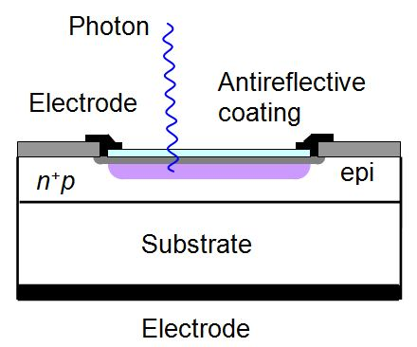
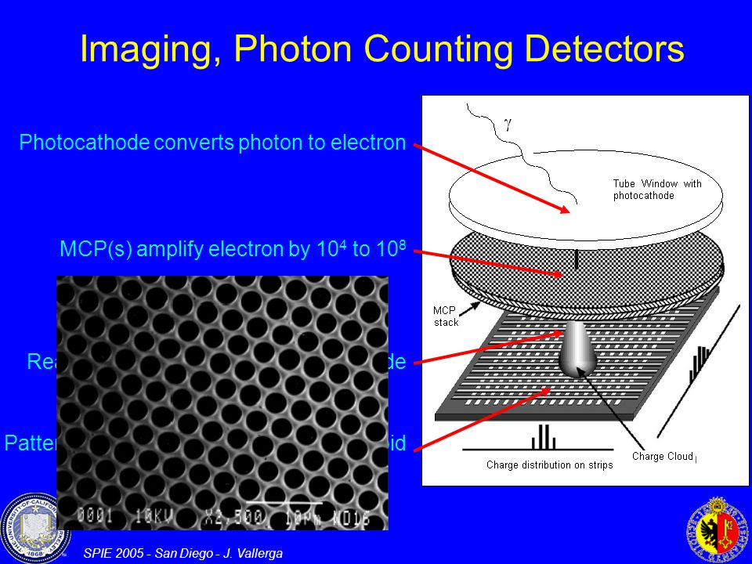
(new) developments
noise QE ΔT
✔
Si PMs
MCPs + pixel chip
Planacon Photonis
John Vallerga
Nicolas Wyrsch
the Tynode: Tipsy
MEMBrane project
✔
✔
✔
✔✔

Slide 22
The QE of
MCP
Tynode
Gas
based soft photon detectors
is determined by the QE of
photocathodes

Slide 23
Principle
Window
glass, quartz, sapphire
(bi) alkali layers
absorption
diffusion
emission
QE never exceeds 0.5
real practical solutions (Photonis, Hamamatsu) are classified

Slide 24
Tipsy’s only limitation: its efficiency equals the QE of photocathodes: 0.4 at best
Therefore: the High Quantum-Efficiency (QE) Photocathode
Window
glass, quartz, sapphire
graphene
[Alkali] monolayers
graphene
termination (Cs, H)
δ V
Active photocathode: drift field pushing electrons to emission vacuum surface
electric field created in between by potential defining graphene planes
all layers build up individually by atomic layer deposition ALD
electron emission stimulated by negative electron affinity by termination
First designed after ab initio simulations of 3D atomic building blocks
Proposal for theoretical concept study: let us first understand the present state-of-the-art

Slide 25
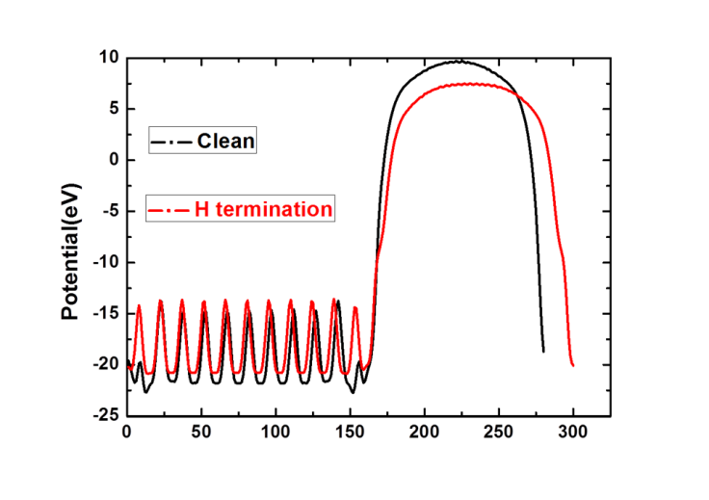
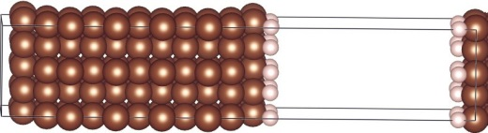
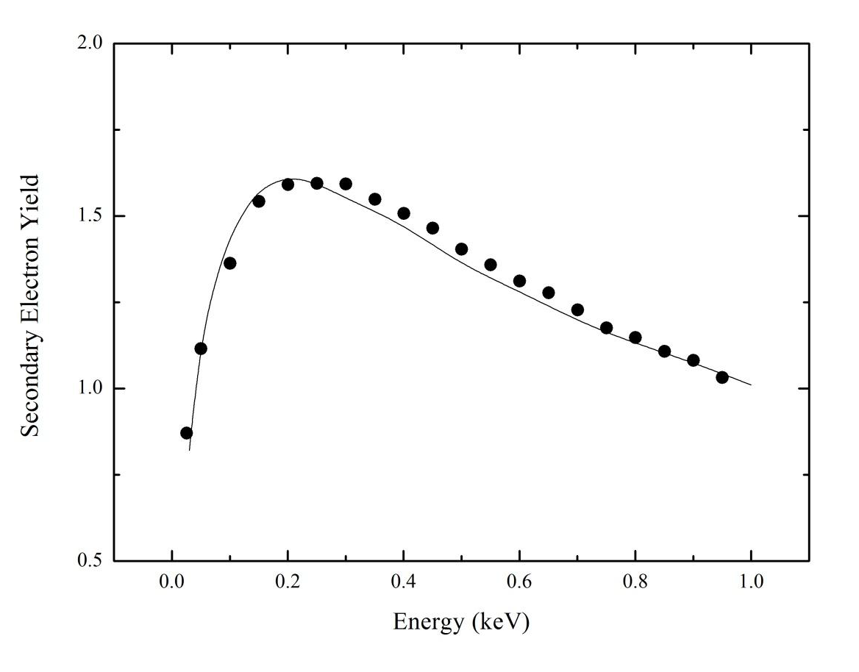
Solid State Physics
Density Functional Theory simulations
Electron density, energy distributions
density structure,
band gap
work function,
optical data
Monte Carlo simulations
Vienna Ab-Initio Simulation Program
VASP
(T) SEY

Slide 26
Tipsy’s only limitation: its efficiency equals the QE of photocathodes: 0.4 at best
Therefore: the High Quantum-Efficiency (QE) Photocathode
Window
glass, quartz, sapphire
graphene
[Ge?] monolayers
graphene
termination (Cs, H)
δ V
Active photocathode: drift field pushing electrons to emission vacuum surface
electric field created in between by potential defining graphene planes
all layers build up individually by atomic layer deposition ALD
electron emission stimulated by negative electron affinity by termination
First designed after ab initio simulations of 3D atomic building blocks
Proposal for theoretical concept study: let us first understand the present state-of-the-art

Slide 27
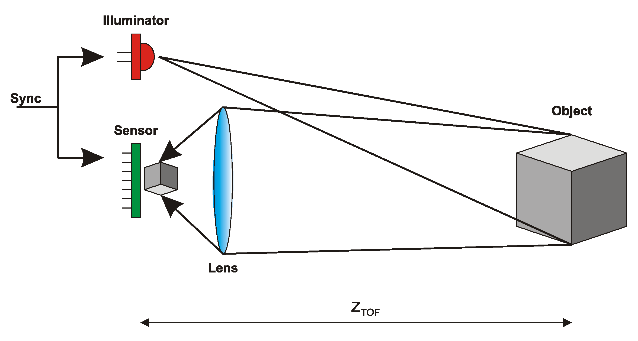
Tipsy applications
(assuming high QE and 20 – 10 ps time resolution)
3D Machine viewing: robotics
Self-driving of vehicles: situation info source
Prompt 3D Imaging with
z-resolution of 0.5 mm
Tipsy in iPhoneS10 (2022)?

Slide 28
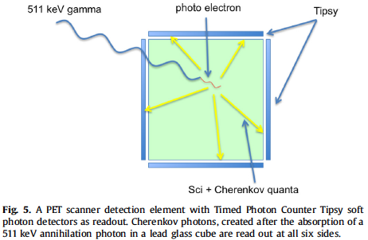
The Cherenkov-ToF-PET scanner
4D (X,Y,Z,t) measurement of conversion point of 511 keV quantum:
only 3 ChQs are required for 4D fix using GPS algorithm

Slide 29
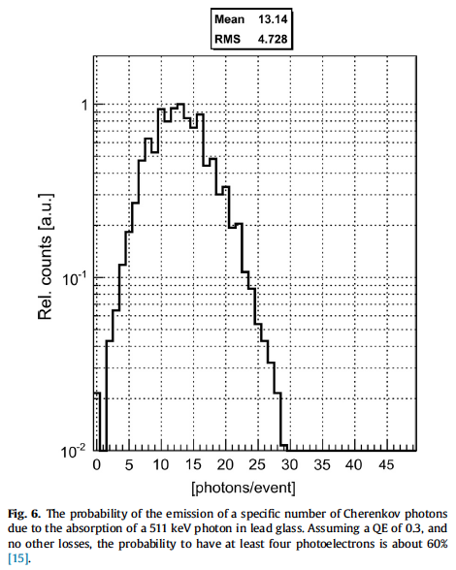
Cherenkov photons emitted
by 511 keV photo-electron
in lead glass

Slide 30
with 10 ps time resolution:
Reconstruction of
interaction point:
origin of all prompt
Cherenkov photons:
4D GPS analysis method:
Only 3 Cherenkov photons
are required for fix.

Slide 31
the future: the Cherenkov tracker
Ch Photon + MIP detector
transparent (mylar) foil
Vacuum!
Cherenkov photons are emitted with given angle with track
see TORCH

Slide 32
Future inner (central) tracker in collider experiments:
the Cherenkov tracker
very low detector mass
Tipsy layer at safe distance from interaction point
no extrapolation
Tipsy
Cylindrical layer
thin transparent foils
generating Cherenkov photons
The Vacuum Cherenkov CentralTracker

Slide 33
With high-QE 10 ps soft photon detectors:
Machine viewing: self-driving of automobiles: no stereo reconstruction
prompt 3D viewing by measuring ToF of photons from ps flashlight
Cherenkov photons are prompt & rapid: scintillator photons are slow ………..and outdated?

Slide 34
Ultra fast, digital (single electron) detectors must be pixelised in order to limit the input capacitance to a minimum and the total counting rate to a maximum.
Transient recording (and processing) per pixel is not practical/possible
Ultra fast detectors require a specific digital pixel chip with a (counting) TDC per pixel.
A stack of tynodes may generate the so far fastest detector charge signal, completed within 5 ps
The time resolution of a Tipsy detector may be limited by what can be achieved with Si CMOS electronics (or GaAs, ……)
Cherenkov photons are prompt & rapid: scintillator photons are slow ………..and outdated as soon as the QE is improved.
Conclusions

Slide 35
The Tynode: a Transmission Dynode
with sufficient yield enabling the
construction of TipsyZero
On behalf of the Membrane project:
Harry van der Graaf, Jeff de Fazio, Conny C.T. Hansson
Hong Wah Chan, Annemarie Theulings, Violeta Prodanović, John Smedley, John Sinsheimer, Kees Hagen, Carel Heerkens, Lina Sarro, Gert Nützel, Serge D. Pinto, Neil Budko, Behrouz Raftari, Wouter de Landgraaf, Henk van Zeijl
Supported by ERC – Advanced 2012 “MEMBrane” 320764
TIPP Beijing
May 26, 2017
H. van der Graaf et al.: The Tynode: A new vacuum electron multiplier.
Nucl. Instr. & Methods, in press. http://dx.doi.org/10.1016/j.nima.2016.11.064. T
H. van der Graaf et al.: Potential applications of electron emission membranes in medicine.
Nucl. Instr & Methods, special Medical Physics issue on “Advances in detectors and
applications for Medicine”. A809 (2016) 171-174. http://dx.doi.org/10.1016/j.nima.2015.10.084.

