Slide 1
Detectors For Electron Ion Colliders
Rik Yoshida
Jefferson Lab
May 22, 2017
TIPP2017, Beijing, China

Slide 2
Introduction
Current Electron-Ion Collider Concepts

Slide 3
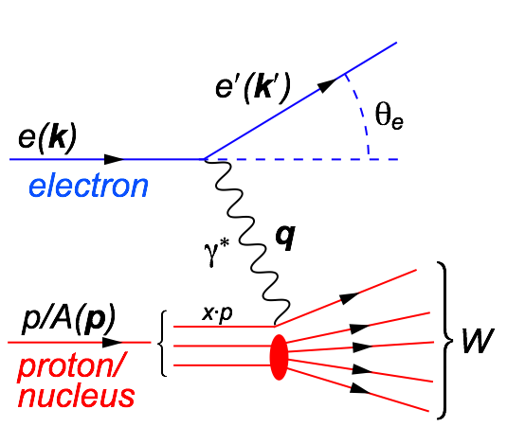
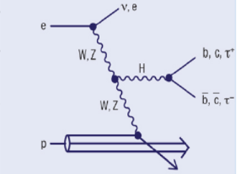
Electron Ion Collider (EIC)
Electron Ion Collider (EIC)
  It is a Deep Inelastic Scattering Collider
  Point-like probe interacts with p/A
  Science aims of the EIC
    Probe Nuclear and Nucleon Structure
    Laboratory for Quantum Chromo Dynamics.
    Search for certain types of BSM particles (e.g. Leptoquarks)
    Higgs Factory with excellent kinematic control. (Scattered electron fixes the kinematics)
  Which aims play the primary role depends on the parameters of the EIC, such as the center-of-mass energy, luminosity, etc.
NP oriented
HEP oriented

Slide 4
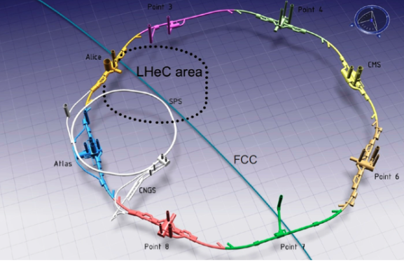
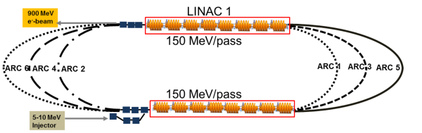
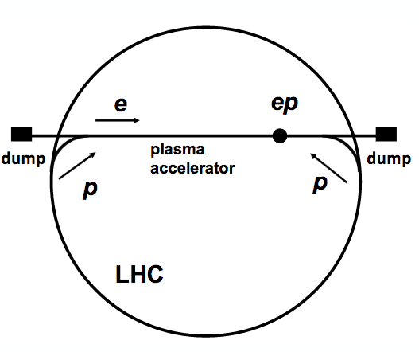
Concepts for Electron-Ion Colliders
High Energy Physics oriented EICs
  LHeC/FCC-eh: Build 60 (120) GeV electron ERL at CERN and collide with LHC/FCC
  hadrons.
    √s = 1.3/3.5 (1.6/7.0) TeV
    Luminosity = 10³⁴ cm⁻²s⁻¹
    Information
    Studies continuing to EU2019 planning cycle.
  Very High Energy Electron Proton Collider (VHEeP): Use proton beam driven plasma accelerator (AWAKE) at the LHC to produce 3 TeV electron beams and collide with the LHC beam.
    √s = 9 TeV
    Luminosity = 4 × 10²⁸ cm⁻²s⁻¹
    Very early concept stage: Workshop, Munich June 1,2 2017
  CepC × SppC?

Slide 5
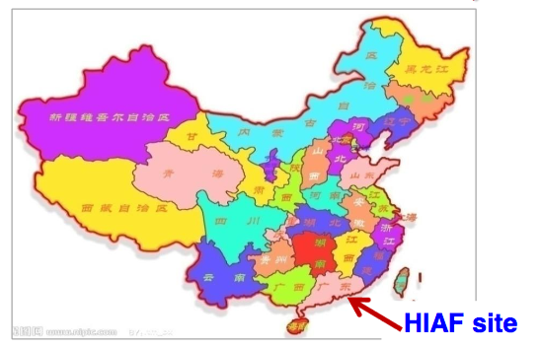
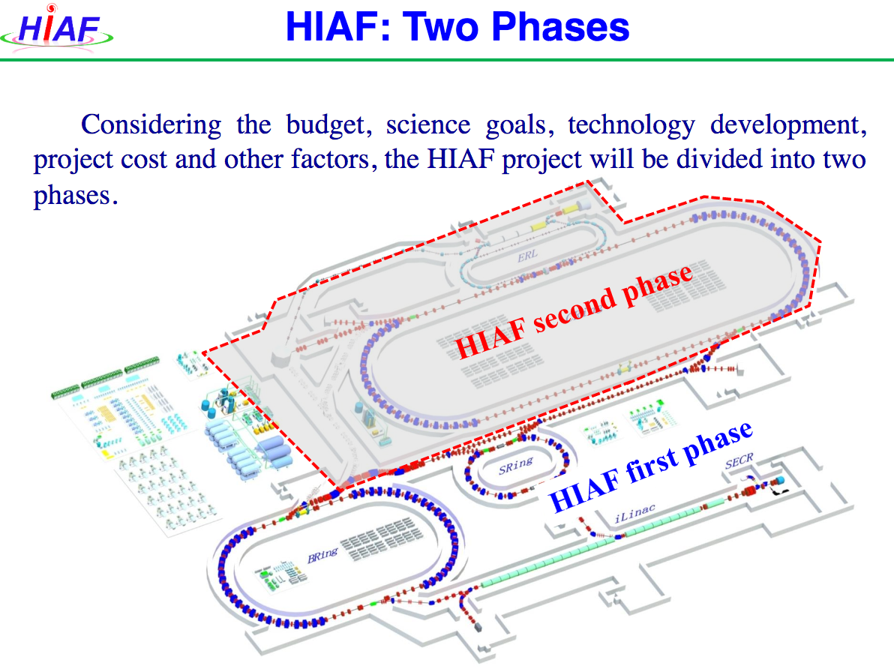
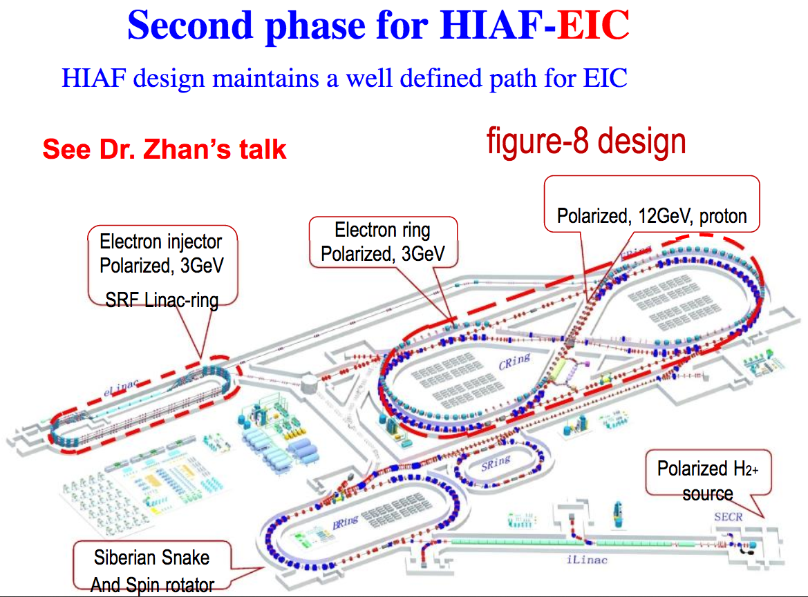
Concepts for Electron-Ion Colliders
Nuclear Physics oriented EICs
  EIC@HIAF (Phase 2 HIAF)
    √s = 15 GeV
    Luminosity: 3-5×10³² cm⁻² s⁻¹
    Polarized beams
Taken from Xurong Chen talk at the 8th Workshop on Hadron Physics in China
9th Workshop on H.P. in China
Nanjing, July 24-28, 2017
Heavy Intensity Heavy Ion Accelerator Facility (HIAF)
Phase 1 approved 2015

Slide 6
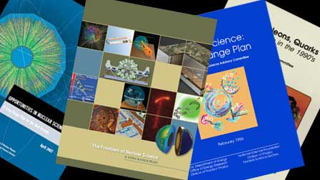

Concepts for Electron-Ion Collider
The Electron-Ion Collider in the US
  US Nuclear Physics Long Range Planning: has been highly successful.
Every 5-7 years the US Nuclear Science community produces a Long-Range Planning (LRP) Document.
October 2015 -> Latest Report Finalized (Including cost review of EIC)
High Energy Electron-Ion Collider is the highest priority for new facilities in the next decade (after FRIB completion)
USDOE (NP) is acting based on this planning
US National Academy of Science Review on-going
(The EIC case must be endorsed by the larger
science community)

Slide 7


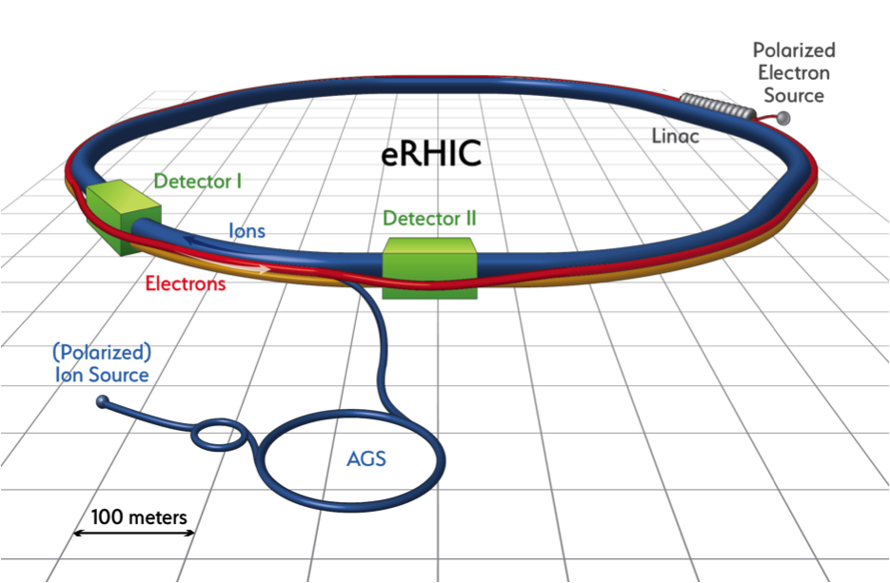
US EIC Parameters and Realization Plans
US EIC Machine design aims from the EIC Whitepaper
  Highly polarized (~70%) electron and nucleon beams.
  Ion beams from deuterons to the heaviest nuclei (uranium or lead).
  Variable center of mass energies from ~20 - ~ 100 GeV, upgradable to ~140 GeV.
  High luminosity: ~10 ³³⁻³⁴ cm⁻² s⁻¹
  Possibility of having more than one interaction region.
Two proposed realization plans
  Jefferson Lab: building on the existing 12 GeV CEBAF. JLEIC Design.
  BNL: building on the existing RHIC. eRHIC Design.
  Recent review of acc. R&D
Similar performances, cost according to LRP assessment.
US EIC will likely be down-selected from one of these proposals.
Jefferson Lab
Brookhaven Lab

Slide 8
US EIC Timeline
A US National Academy of Sciences study has been initiated and the committee is now formed. Charge: “assess the scientific justification for a U.S. domestic electron ion collider facility, “
The NAS committee plans to finalize its report in 7-8 months from now.
  DOE project “CD0” (Establish Mission Need) will be after the NAS study: i.e end 2017, early 2018 most optimistically.
  EIC construction has to start after FRIB completion, with FRIB construction anticipated to start ramping down near or in FY20.
Most optimistic scenario would have EIC construction start (CD3) in FY20, perhaps more realistic FY22-23 timeframe
Best guess for EIC completion: 2025-2030.

Slide 9
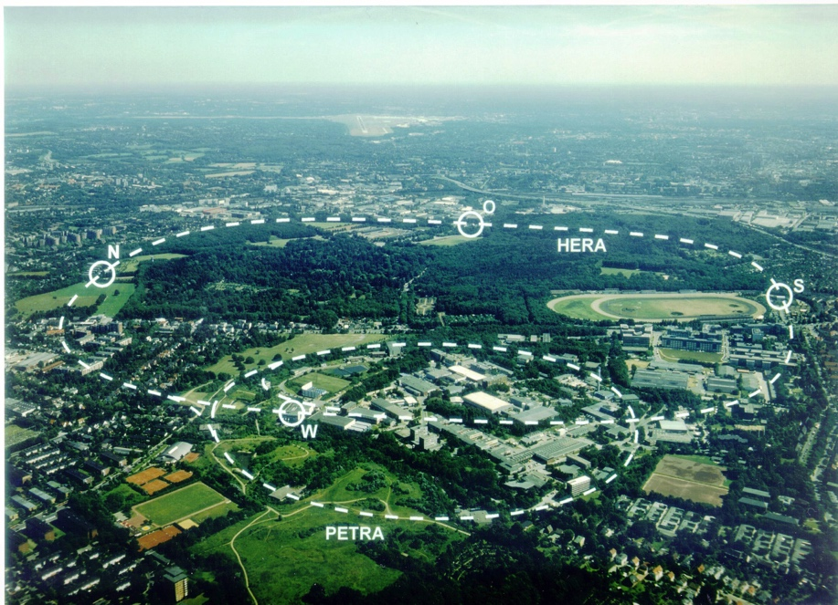
Physics Aims and Detector Requirements
In this talk, I will concentrate on the detectors for Nuclear Physics oriented realizations of Electron-Ion Colliders… and stick to general requirements.
Implications for detectors
  Center of mass energy is lower (15 – 140 GeV) as opposed to (1.3 to 9 TeV)
    The collisions will not be extremely asymmetric (e.g. 60 GeV x 50000 GeV for FCC-eh).
  The most demanding performance requirements will be driven by measurements of the nucleon and nuclear structure.
What about HERA collider (1992-2007) detectors (H1 and ZEUS) as reference?
DESY laboratory in Hamburg, Germany
H1
ZEUS
√s = 300 GeV
Luminosity ~ 10³¹cm⁻²s⁻¹
HERMES
electrons
Turns out next generation EICs have
different needs.
protons
HERA-b

Slide 10
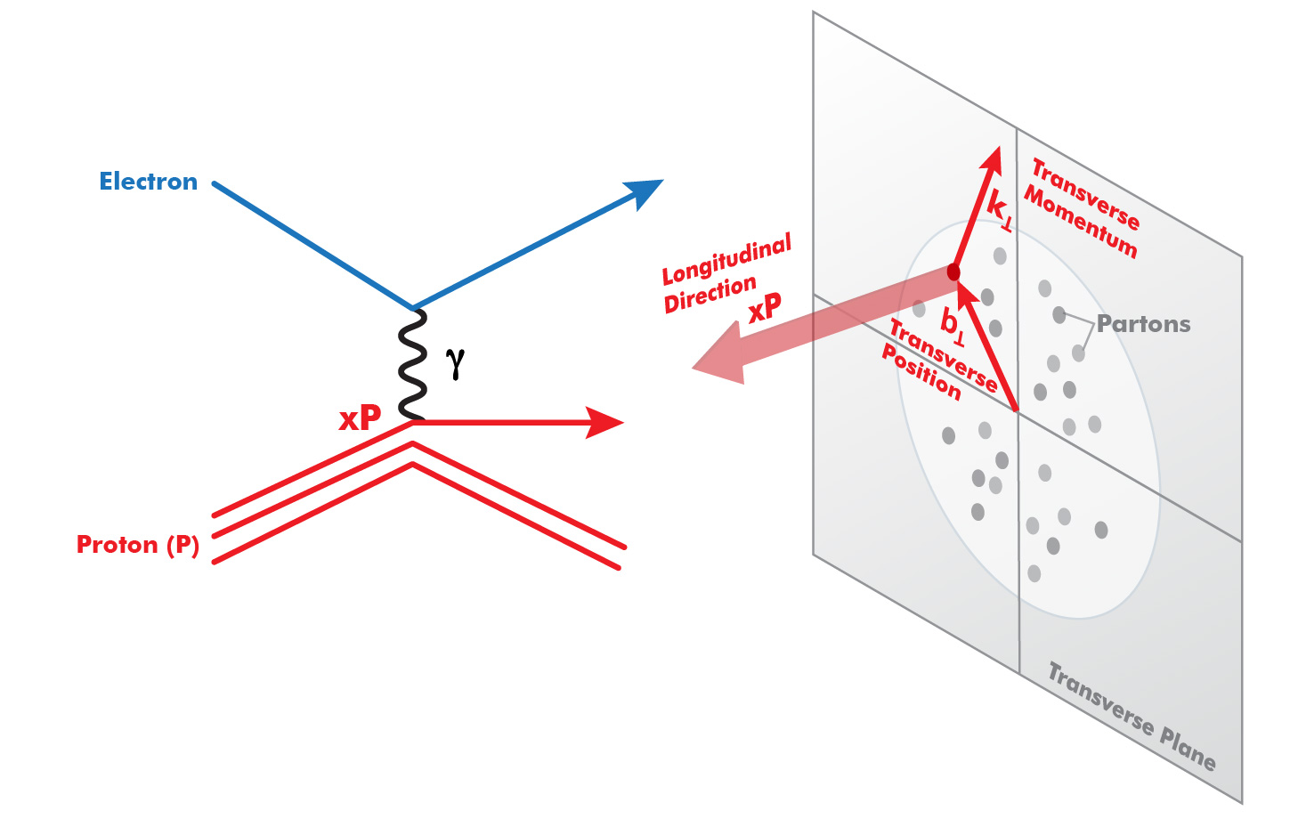
Progress in pQCD Theory (~1980-~2010)
“HERA”
“EIC”
(Q²)
Parton Distribution Functions:
Longitudinal only—
No way to interpret nucleon
partonic structure in rest frame
3D (Transverse) Structure
TMD’s, GPD’s—
Now we know what to measure to
understand the partonic structure of nucleons
Jefferson Lab 12 GeV program based on this progress.
How do we get the complete picture:
origin of mass, spin, nuclear forces…? EIC!

Slide 11
Detectors for EICs
General Design Considerations

Slide 12

DIS and Final State Particles
Aim of EIC is nucleon and nuclear structure beyond the longitudinal description.
This makes the requirements for the machine and detector different from all previous colliders including HERA.
Ion beamline
E_{ion}
E_{electron}
Electron beamline
Need more than this

Slide 13

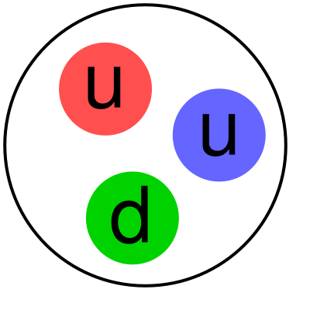
Final State Particles in the Central Rapidity
Products of the hard
electron-quark collision
Scattered electron
Ion beamline
Photons
E_{ion}
E_{electron}
Electron beamline
Particles associated with struck parton
Transverse and flavor structure measurement of the nucleon and nuclei:
The particles associated with struck parton must have its species identified and measured. Particle ID much more important than at HERA

Slide 14
Final State Particles in the Central Rapidity
Boosted towards ion beam
Ion beamline
E_{ion}
E_{electron}
Electron beamline
Boosted towards ion beam
Asymmetric collision energies will boost the final state particles in the ion beam direction: Detector requirements change as a function of rapidity

Slide 15
Particles Associated with the Initial Ion
For EIC, particles of the “target remnant” is
as important as the struck parton
Ion beamline
E_{ion}
E_{electron}
Electron beamline
Particles Associated with Initial Ion
Was not considered at HERA initially.
Close to the beamline
Not analyzed by central solenoid.
Aim for ~100% acceptance and good resolution at EIC.
Remember acceptance is equally
important as luminosity!

Slide 16
Particles Associated with the Initial Electron
Forward Electron area:
Tag photoproduction (Q²≈0)
Measure Luminosity
Measure electron polarization
Ion beamline
E_{ion}
E_{electron}
Electron beamline
Photons
beam electron (or low Q²)
Apply lessons from HERA, JLab and elsewhere

Slide 17
Final State Particles
The aim is to get ~100% acceptance
for all final state particles, and measure
them with good resolution.
Scattered electron
Ion beamline
Photons
Electron beamline
Photons
Particles Associated with Initial Ion
beam electron (or low Q²)
Particles associated with struck parton
Beam Elements
Central
Detector
Beam elements limit forward acceptance
Central Solenoid not effective for forward
Beam Elements

Slide 18
Interaction Region Concept: eRHIC
NOT TO SCALE!
Large beam crossing angle creates
room for high acceptance forward
detectors.
Solenoid
Ion beamline
Electron beamline
Dipole
10 mr
Forward
Detectors
Beamline magnets analyze the forward particles

Slide 19
Interaction Region Concept: JLEIC
NOT TO SCALE!
Very large beam crossing angle
(50 mr) creates room for
forward dipoles
Solenoid
Ion beamline
Electron beamline
Dipole (1 of 4)
50 mr
Dipole (1 of 3)
Dipoles analyze the forward particles
and create space for detectors in the forward direction

Slide 20

Interaction Region Concept
Possible to get ~100% acceptance for the whole event
Ion beamline
Electron beamline
Total acceptance detector (and IR)

Slide 21
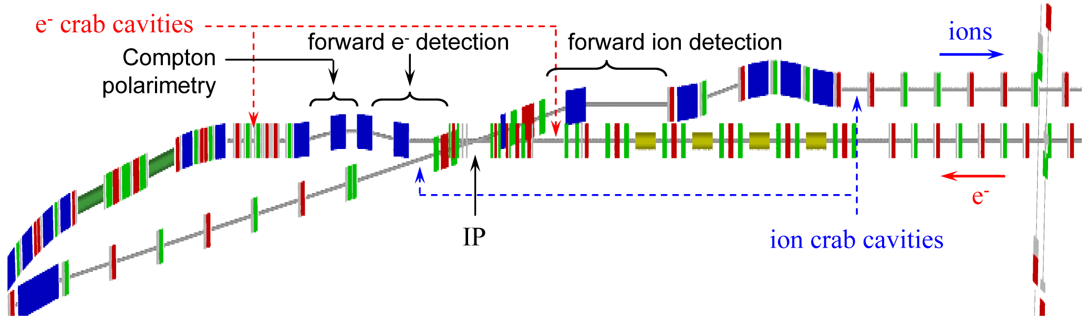
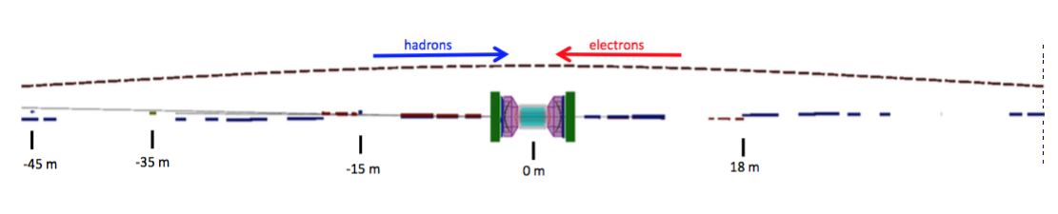
EIC Detector and IR Layout
Extended detector: 80+ m
JLEIC
eRHIC
EIC detectors must be extremely well integrated with the accelerator

Slide 22
Central Detector

Slide 23
Final State Particles in the Central Detector
Products of the hard
electron-quark collision
Scattered electron
Took away radiated photon
for simplicity
E_{electron}
E_{ion}
Took away the (exaggerated)
beam crossing for simplicity
Particles associated with struck parton

Slide 24
Basic Kinematic Reconstruction
Q² → Measure of resolution
y → Measure of inelasticity
x → Measure of momentum fraction
of the struck quark in a proton
Q² = s x y
E’_{e}
θ_{e}
θ_{jet}
E’_{e,}θ_{e ,}E_{jet ,}θ_{jet} : any two of these, in principle, sufficient to reconstruct x and Q².
What are the detector
requirements?
E_{jet}

Slide 25
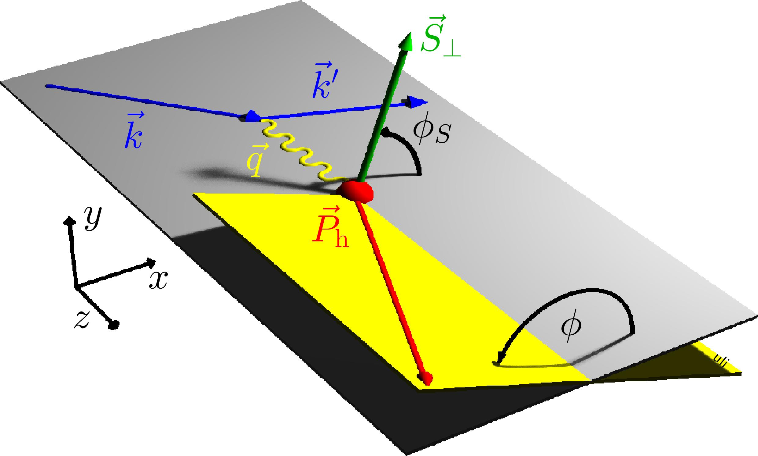
Reconstruction for Transvers Structure
Looking at out-of –plane component in the final state
Need to identify and measure
these particles
What are the detector
requirements?
Note: multiplicities are low (~20 for ep)
Cross-sec x Lumi < 0.01 x HLLHC
< 0.1 interaction/crossing

Slide 26
How Boosted is the Final State?
No Monte Carlo needed to Determine
Boosted towards ion beam
E_{electron}= 10 GeV
E_{ion}= 100 GeV
E’_{e,}θ_{e ,}E_{jet ,}θ_{jet} : any two of these, in principle, sufficient to reconstruct x and Q².
Given x and Q², E’_{e,}θ_{e ,}E_{jet ,}θ_{jet} are all
fixed

Slide 27
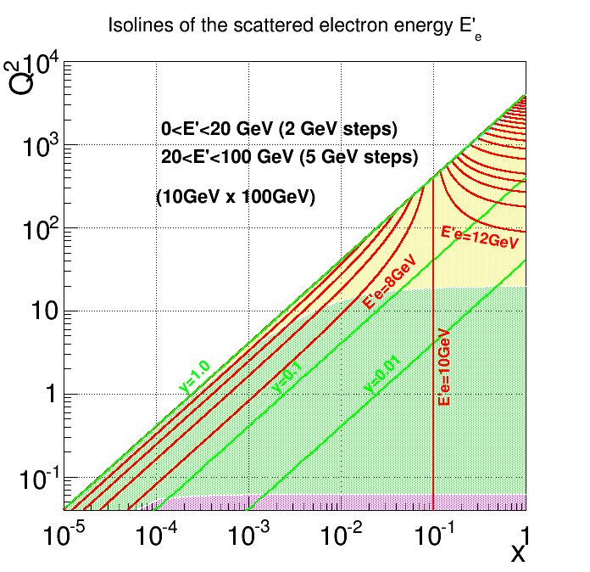
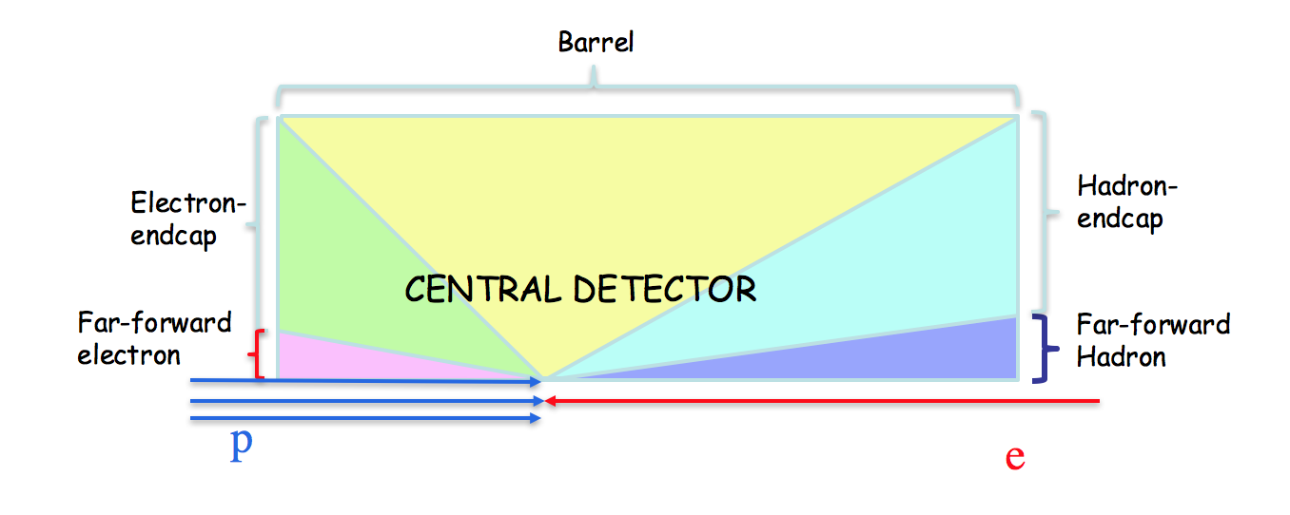
Electron Isoline Plot
Hadron Endcap
Barrel
Electron Endcap
Far-forward Electron
(out of central detector)

Slide 28
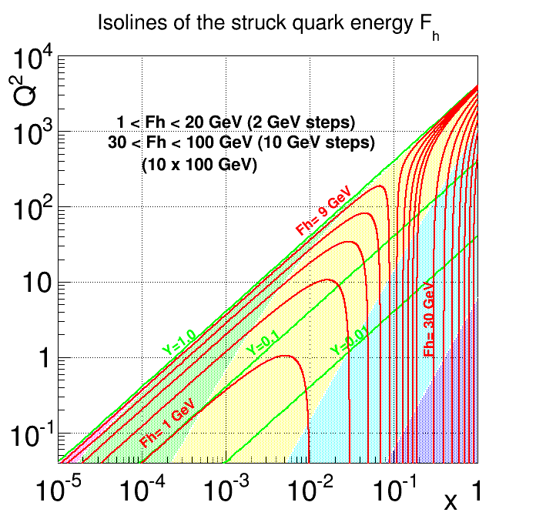
Quark(Jet) Isoline Plot
(E_{jet})
Barrel
Hadron Endcap
Far-forward Hadron
(Out of central detector)
Electron Endcap

Slide 29
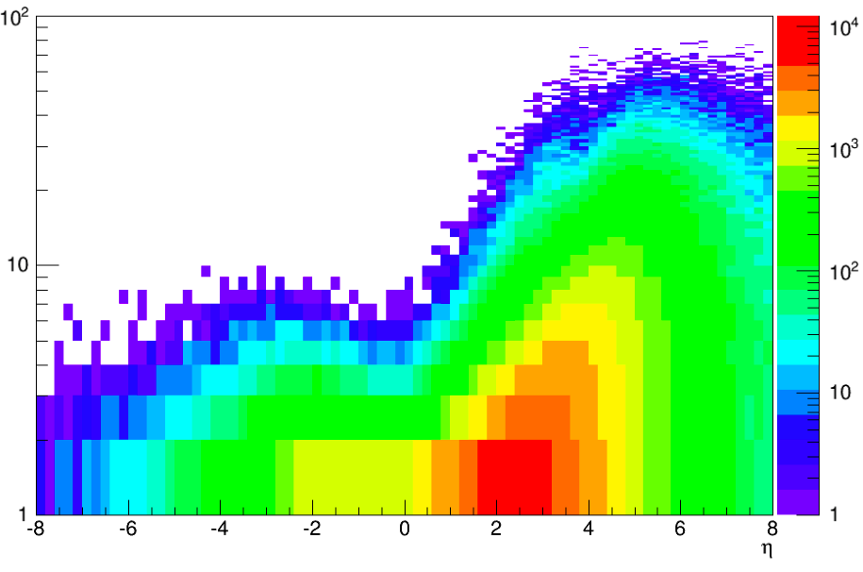
Particle Distribution
E-endcap
Barrel
H-endcap
E'e
<8 GeV
8-50 GeV
>50 GeV
Ejet
<10 GeV
~10-50 GeV
20-100 GeV
E,hadrons
<10 GeV
<15 GeV
~15-50 GeV
Pythia MC
occupancy
low
medium
high
π± Energy
100
10
GeV
η

Slide 30
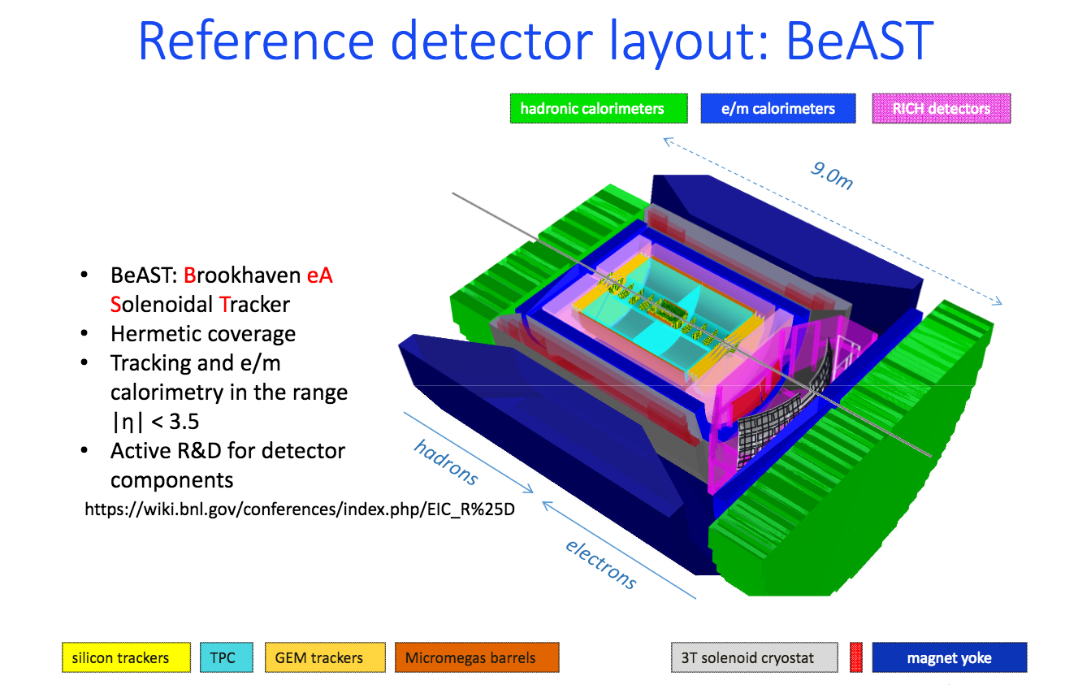
Example 1: BNL Reference Detector

Slide 31
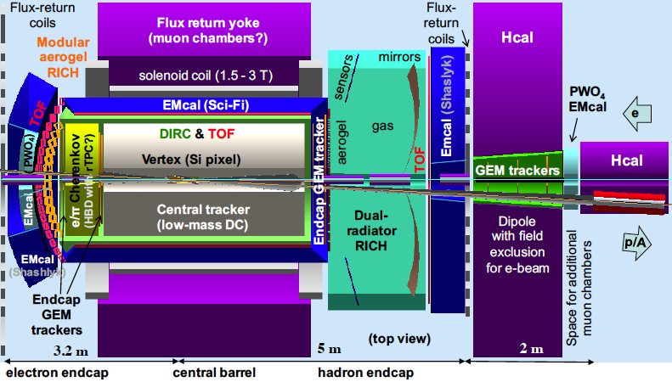
Example 2: Current Jefferson Lab Concept

Slide 32
Electron-Beam line Detectors

Slide 33
Chicane for Electron Forward Area for JLEIC
Extended detector: 80+ m

Slide 34
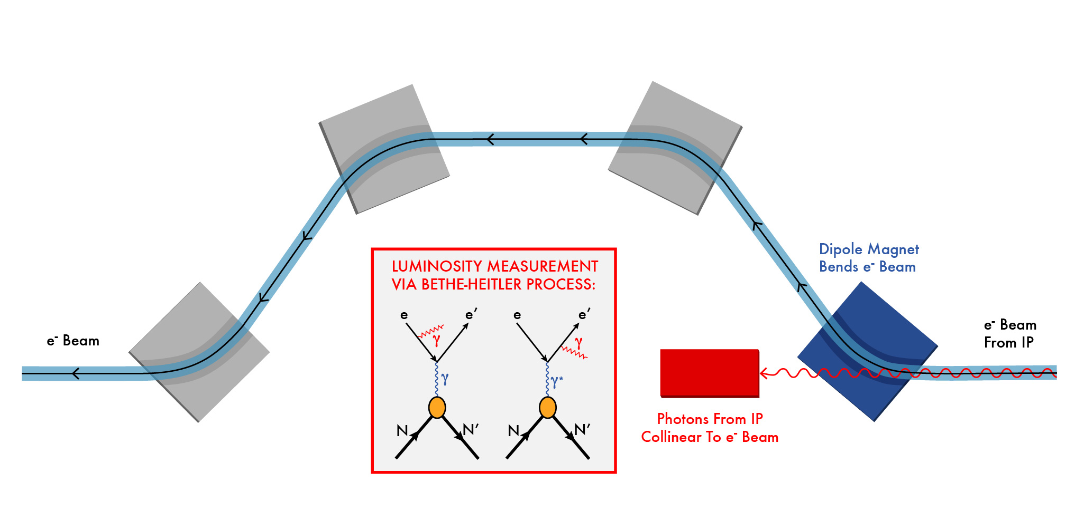
Luminosity Measurement
Use Bethe-Heitler process to monitor luminosity: same as HERA

Slide 35
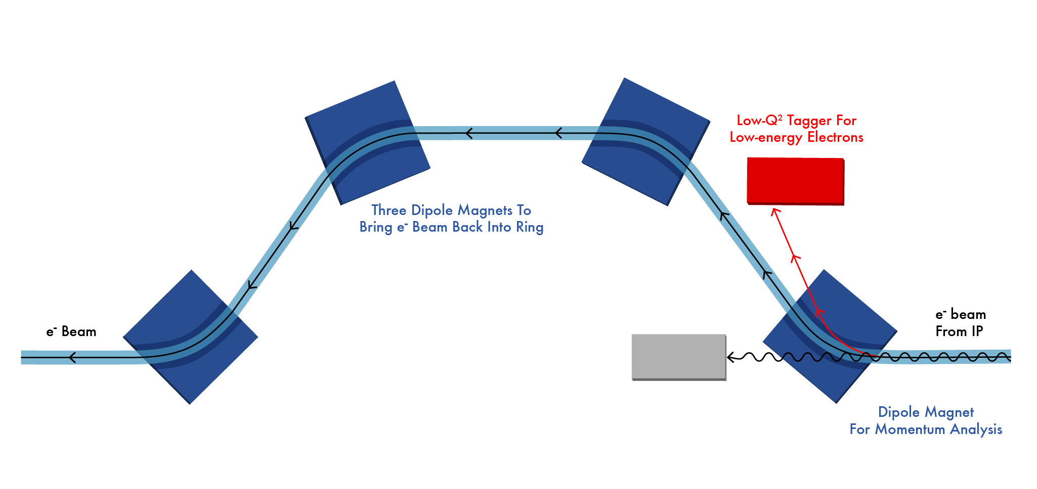
Low Q² Tagger

Slide 36
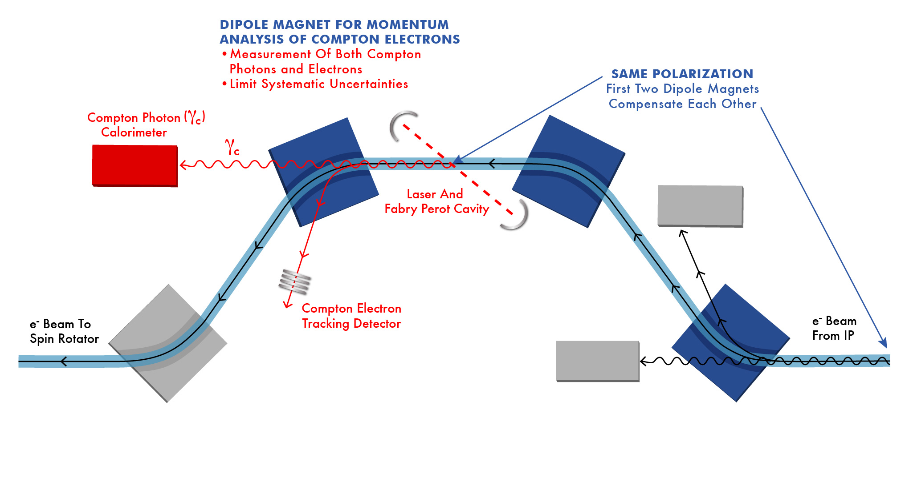
Polarization Measurement
Note the off-momentum electrons from IP does not enter the
Compton tracker for polarimetry.

Slide 37
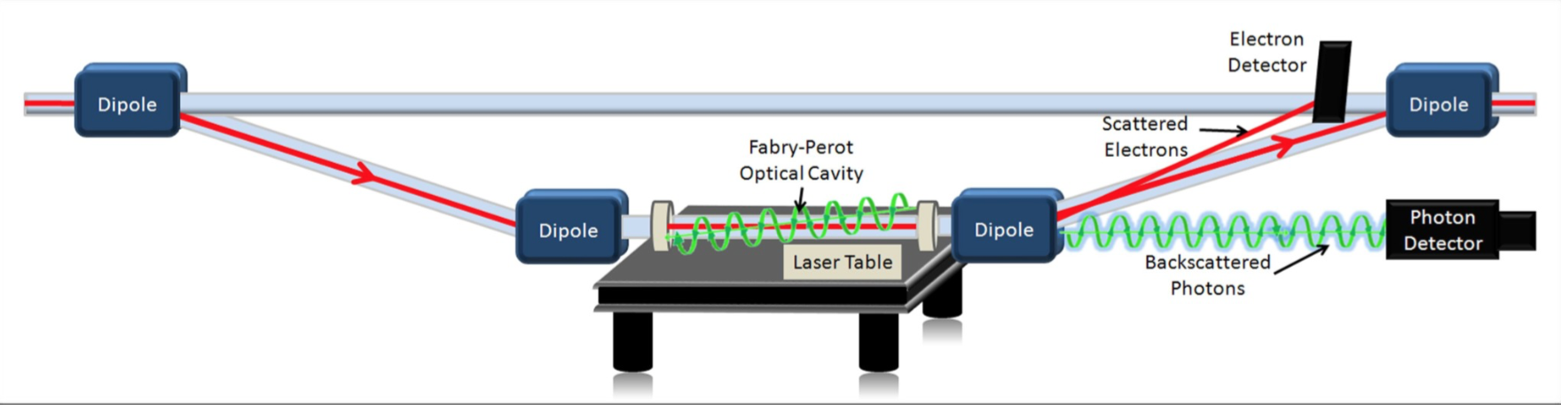
Compton Polarimetry
Existing Polarimeter in Hall C at JLab: Achieved 1% Precision

Slide 38
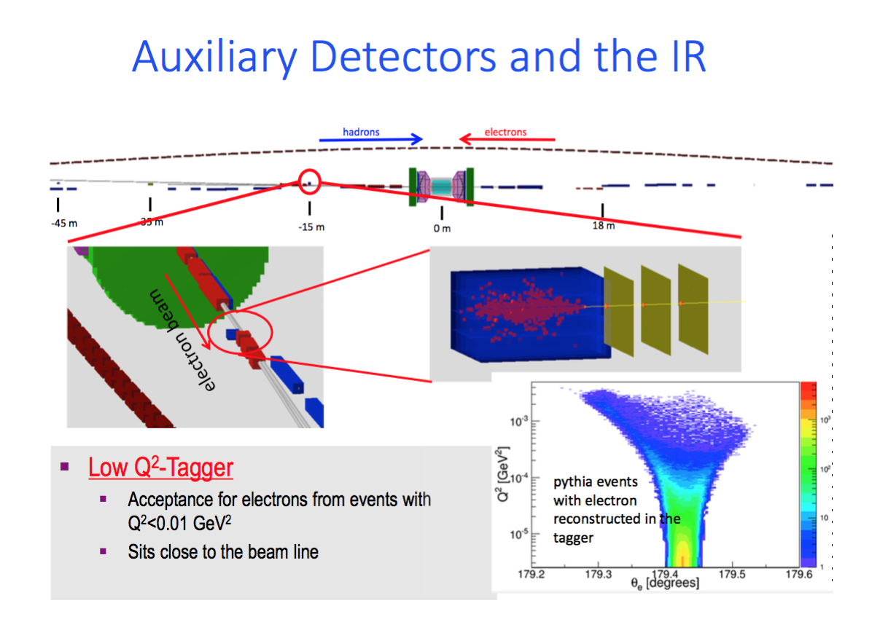
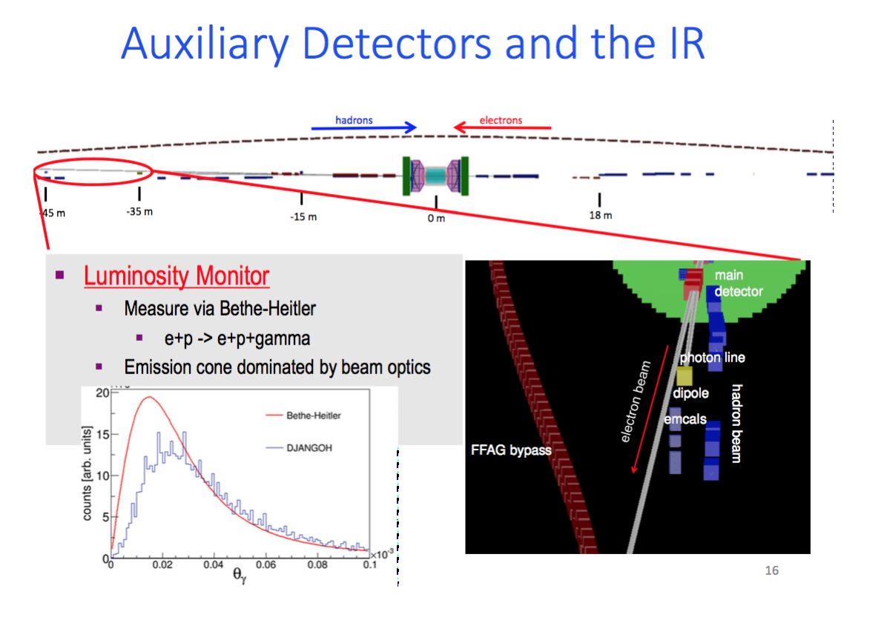
Luminosity Monitor and Low-Q² Tagger at eRHIC
Richard Petti: Spin’16

Slide 39
Forward Hadron Direction

Slide 40
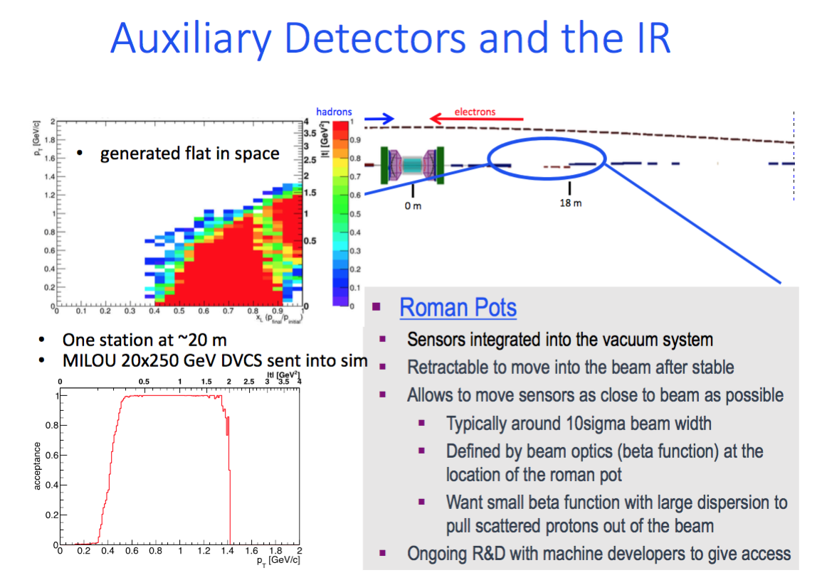
eRHIC Forward Hadron Detector Concept
Richard Petti Spin 2016

Slide 41
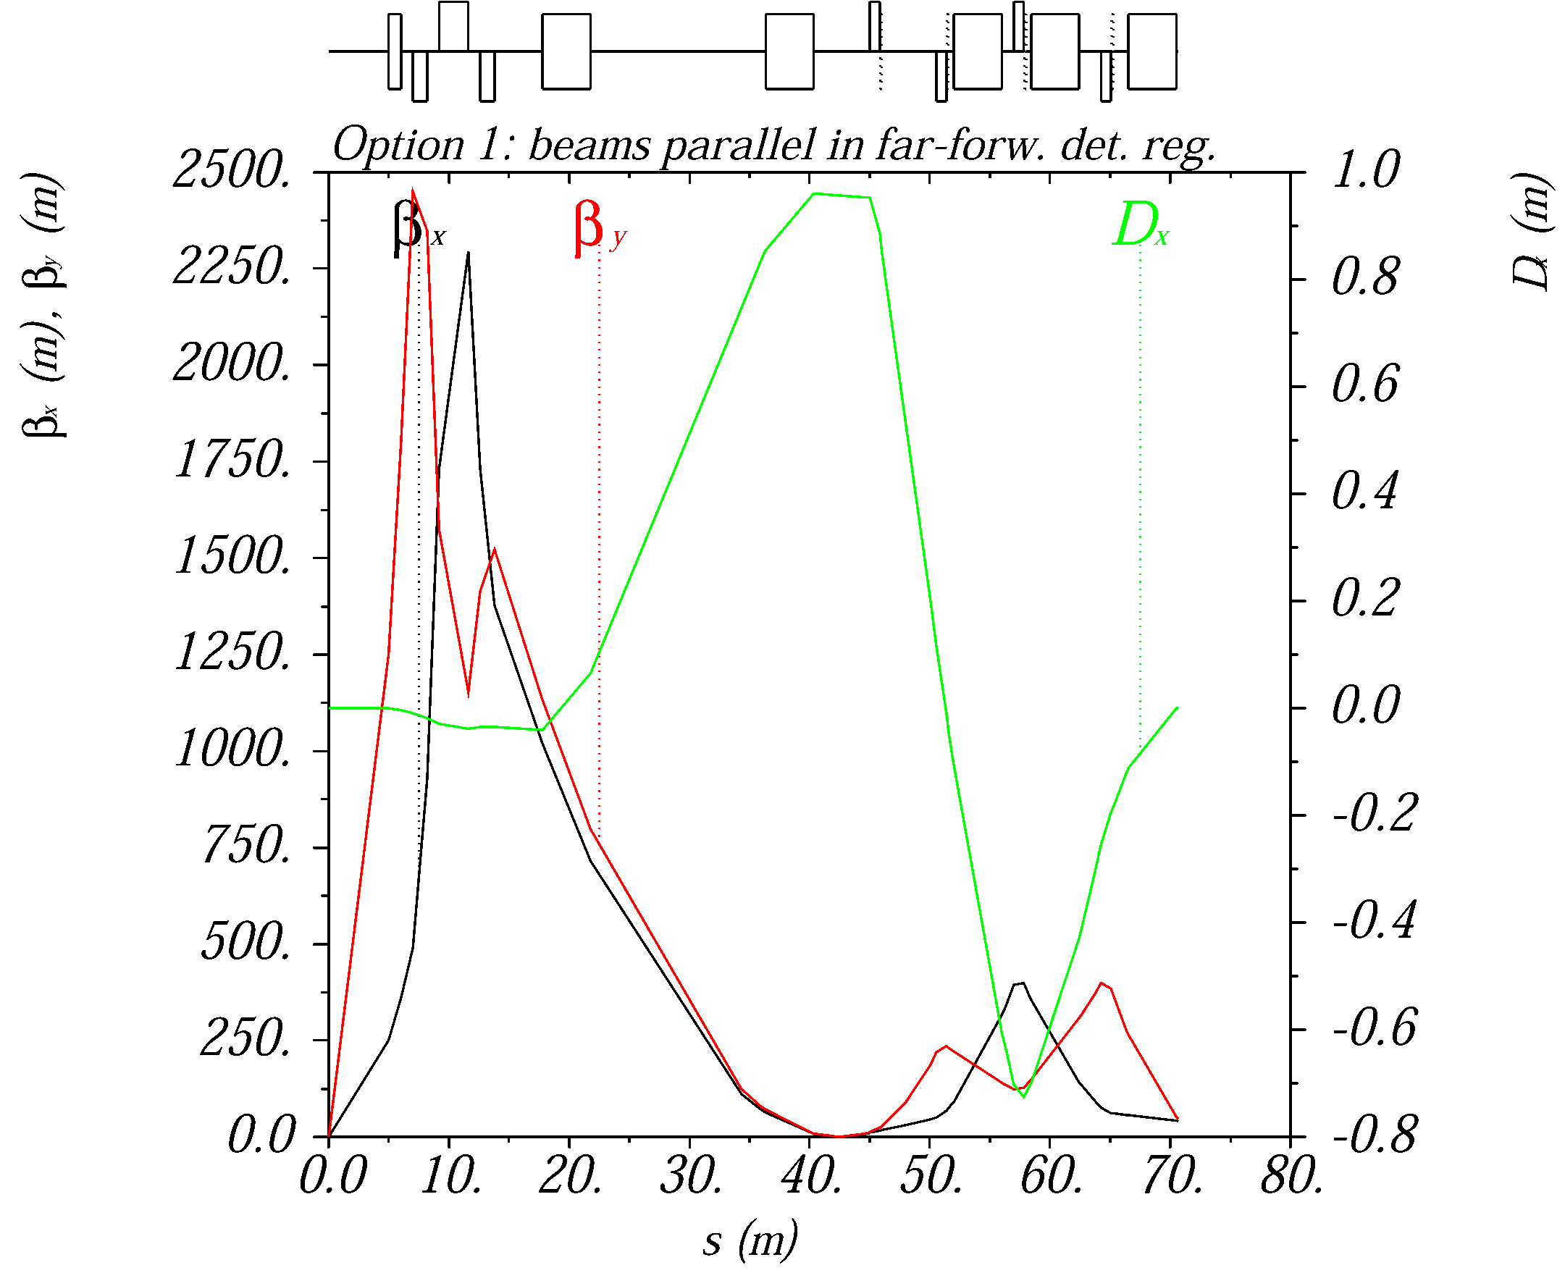
Ion optics for near-beam detection
Extended detector: 80+ m
A large dispersion at the detection point separates scattered (off-momentum) particles from the beam.
A second focus and small emittance (cooling) allows moving detectors closer to the beam
2nd focus on
Roman pots

Slide 42
EIC forward detection requirements
Good acceptance for recoil nucleons (rigidity close to beam)
  Diffractive processes on nucleon, coherent nuclear reactions
  Small beam size at detection point (to get close to the beam)
    Secondary focus on roman pots, small beam emmittance (cooling)
  Large dispersion (to separate scattered particles from the beam)
Good acceptance for fragments (rigidity different than beam)
  Tagging in light and heavy nuclei, nuclear diffraction
  Large magnet apertures (low gradients)
  Detection at several points along a long, aperture-free drift region
Good momentum- and angular resolution
  Free neutron structure through spectator tagging, imaging
  Both in roman pots and fixed detectors

Slide 43
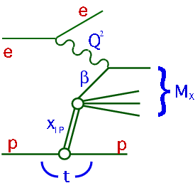
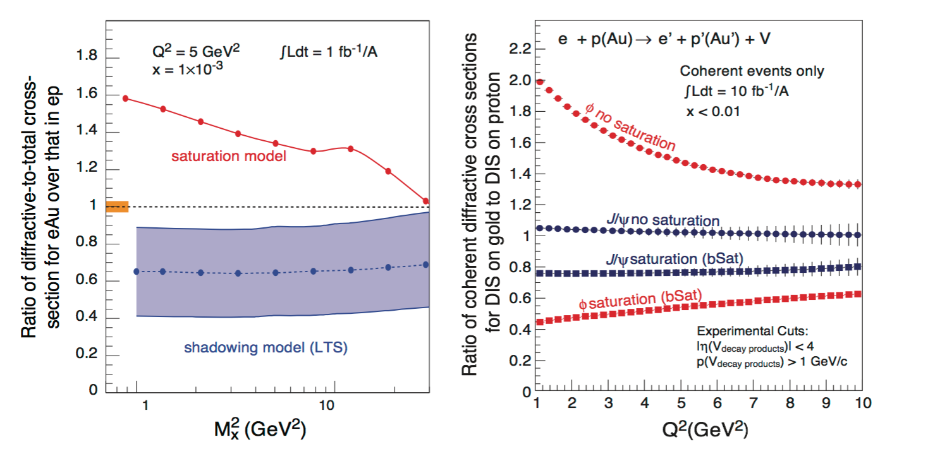
An Example: Diffractive DIS
Signature for Saturation (among other things)
Identify the scattered proton: distinguish from proton dissociation
Measure X_{L}= E_{p}’/E_{p}, and P_{t} (or t) (equiv. to measuring M_{x})

Slide 44
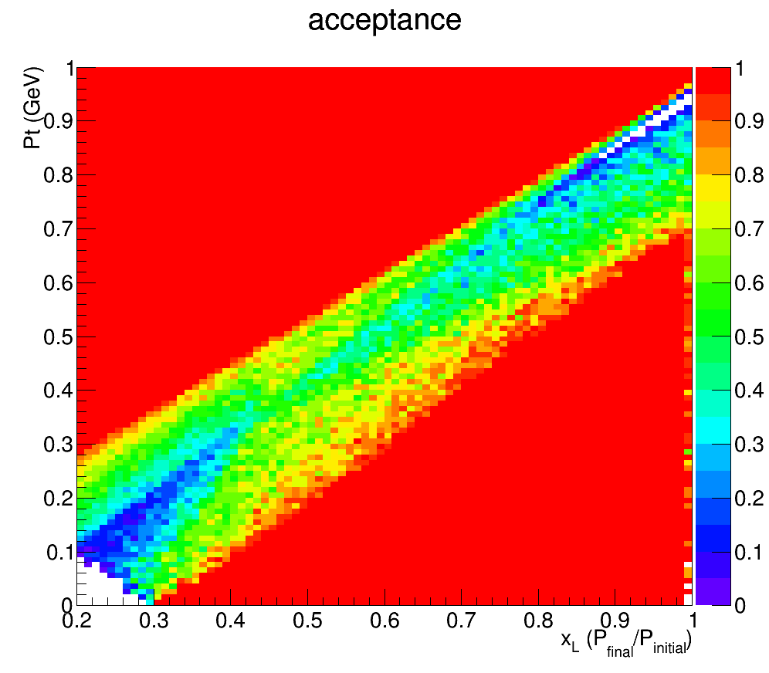
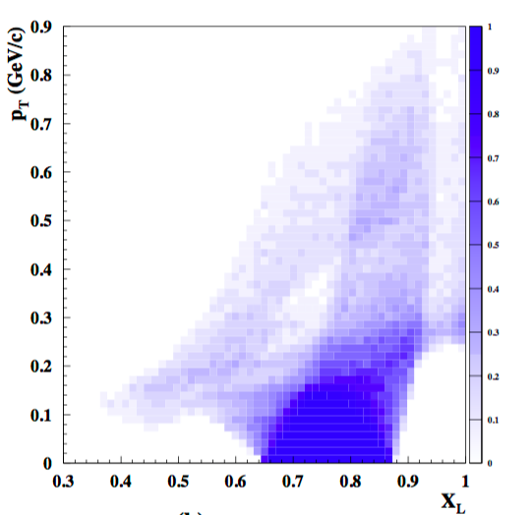
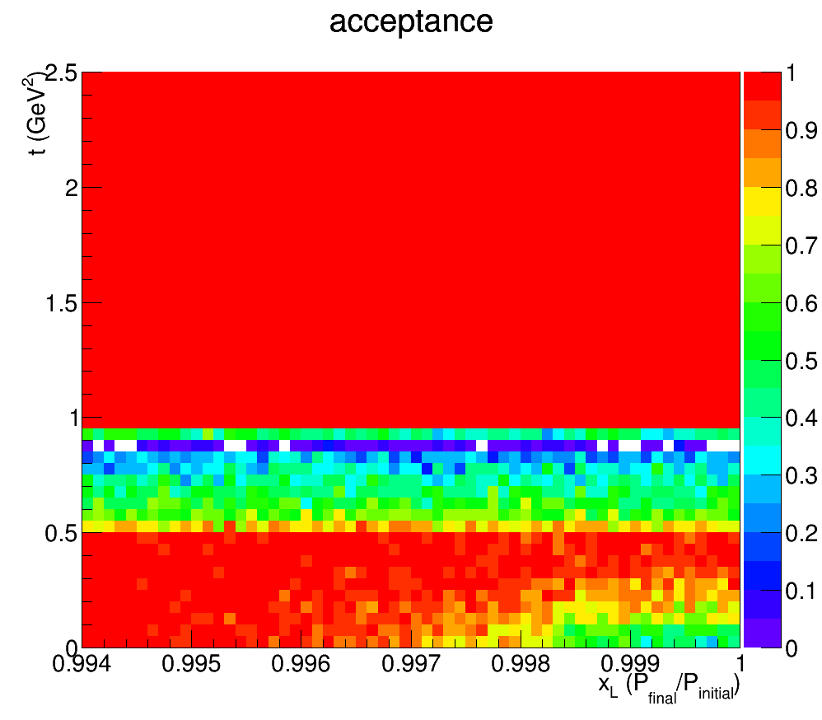
Acceptance for p’ in DDIS
JLEIC
ZEUS
Leading Proton Spectrometer
P_{t}
1
(GeV)
Region 1
Region 2 (Hi. Res)
0
0.2
1
X_{L}
t
2.5
(GeV²)
Acceptance in diffractive peak (X_{L}>~.98)
ZEUS: ~2%
JLEIC: ~100%
0.994
1
X_{L}

Slide 45
Conclusions

Slide 46
Conclusions
Plans for Nuclear Physics oriented Electron-Ion Colliders are advancing in the US and China.
  Currently modest R&D funding available from US DOE NP
    Directed Detector R&D for Electron-Ion Collider
    Call for proposals for FY18 (Due June 16, 2017)
I discussed the general design considerations of a NP oriented EIC detector.
  More specific detector information can be found, for example at
    Richard Petti at SPIN 2016 (here)
    Yulia Furletova at the 3D Modeling Workshop (here)
The physics of EIC demands a total acceptance detector with special characteristics.
  Some features/requirements not discussed:
    Many different ion species
    Variable center of mass energy (20 to 140 GeV)
    Variable solenoid field?
The detector design is still in very early stages. Plenty of scope for you to get involved!

Slide 47

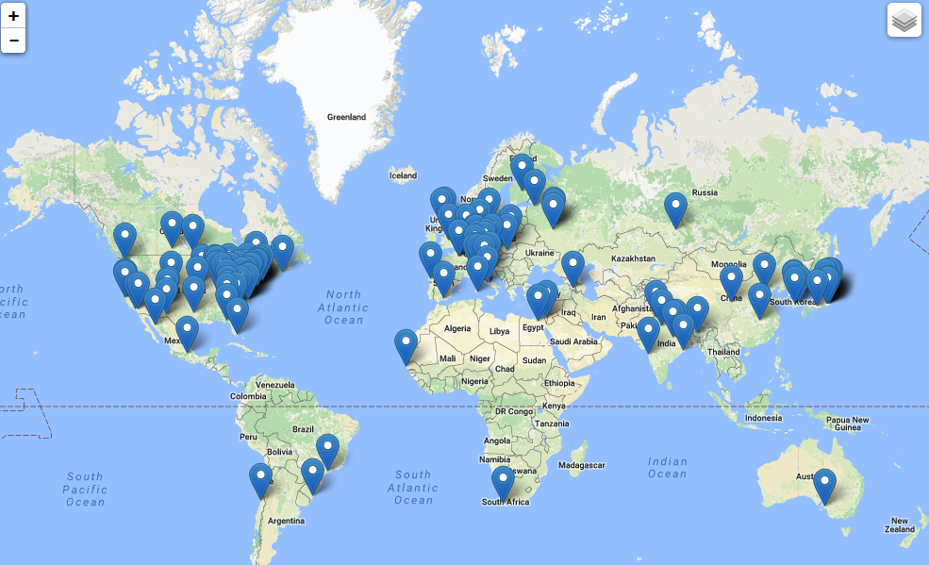
The EIC Users Group: EICUG.ORG
(no students included as of yet)
670 collaborators, 28 countries, 150 institutions... (December, 2016)
The EIC Users Meeting at Stony Brook, June 2014:
  http://skipper.physics.sunysb.edu/~eicug/meeting1/SBU.html
The EIC UG Meeting at University of Berkeley, January 6-9, 2016
  http://skipper.physics.sunysb.edu/~eicug/meeting2/UCB2016.html
The EIC UG Meeting at Argonne National Laboratory July 7-10, 2016
  http://eic2016.phy.anl.gov
Next meeting:
July 18-22, 2017 Trieste, Italy (Detectors will be one of the topics)

Slide 48


Slide 49

JLEIC Detector and IR Document
Can be found at the JLEIC Public Wiki page
at: https://eic.jlab.org/wiki
This a short 9-page general introduction
for people new to JLEIC.
More specific and detailed documents
to follow.

Slide 50
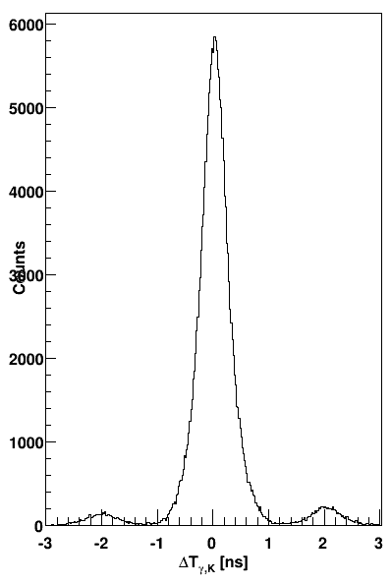
Bunch spacing and identification
Existing detectors (CLAS, BaBar, etc) at machines with high bunch crossing rates have not had problems in associating tracks with a specific bunch.
Example: CLAS detector at JLab 6 GeV
  2 ns bunch spacing (500 MHz rep. rate)
  0.2 ns TOF resolution (0.5 ns FWHM)
  The figure shows time matching of kaons in CLAS with electrons in the (low-Q²) tagger, in turn matched to the accelerator RF signal
    The 2 ns bunch structure is clearly resolved
  CLAS12 aims at a TOF resolution of 80 ps
K-e coincidence time in CLAS 6 GeV data
electron-kaon counts
The bunch spacing in the MEIC is similar to CLAS and most e⁺e⁻ colliders
  PEP-II/BaBar, KEKB/Belle: 8 ns
  Super KEKB/Belle II: 4 ns (2 ns with all RF buckets full)
  MEIC: 1.3 ns [750 MHz]
  CERN Linear Collider (CLIC): 0.5 ns [2 GHz]
Δt [ns]

Slide 51
Instantaneous rates
For a given luminosity, increasing the crossing rate reduces the number of collisions per crossing, making it easier to resolve individual events.
  Note that the average collision rate does not depend on the bunch structure
The number of collisions per crossing in the MEIC is comparable to HERA.
Events (e-p collisions) per bunch crossing | 1.33 ns spacing (MEIC) | 133 ns spacing (~HERA)
DIS @ L=10³⁴ | 10⁻³ | 10⁻¹
photo @ L=10³⁴ | 10⁻¹ | 10
DIS @ L=10³² | 10⁻⁵ | 10⁻³
photo @ L=10³² | 10⁻³ | 10⁻¹
Event spacing is particularly important for time matching of tracks in the central and far-forward detectors.
  Only the former pass the vertex tracker
  Photoproduction events also give rise to hadrons at small angles.
Matching is further improved by good resolution in the far-forward detectors.
  Angular for path-length corrections
  Momentum for β corrections
  Timing < 1 ns
Order-of-magnitude estimates of the instantaneous DIS and photoproduction rates based on a 7.5 mb total e-p cross section.

Slide 52
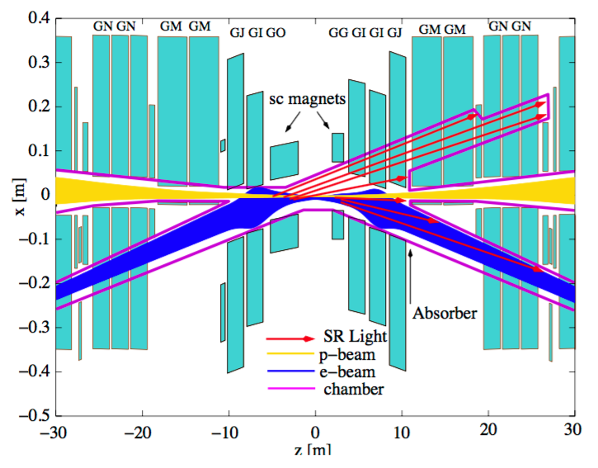
DIS Collider: Beam background
HERA II IR
JLEIC IR
JLEIC
HERA II
No electron bend before IP. (last bend 120 m away)
Two beams share only 2 m of beam pipe.
Synchrotron from final focus doe not go in the proton beam direction.
95% of background: proton-(synch-induced)gas from this region.
Electron bends at ~10 m for head-on collision with proton. Synch fan.
The two beams share ~20m beam pipe
Synchrotron from final focus goes in the proton beam direction
Should be much better but needs quantification and validation

