Slide 1
Design and performances of the Electromagnetic Particle Detector and the prototype array for LHAASO-KM2A
Liu jia
Institute of High Energy Physics, CAS
TIPP2017

Slide 2
Outline:
Introduction
Experiment set up
Performances of LHAASO-KM2A prototype array
Conclusion

Slide 3
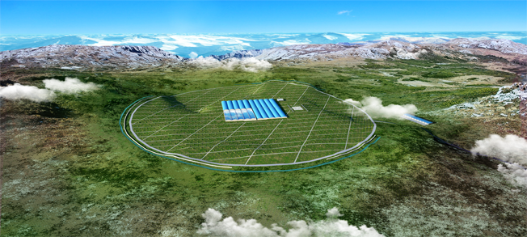
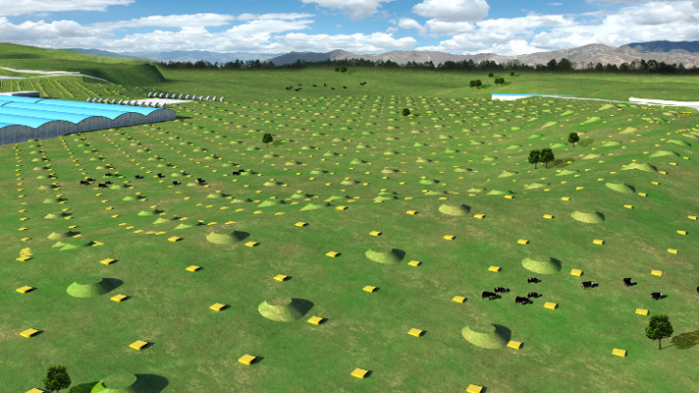
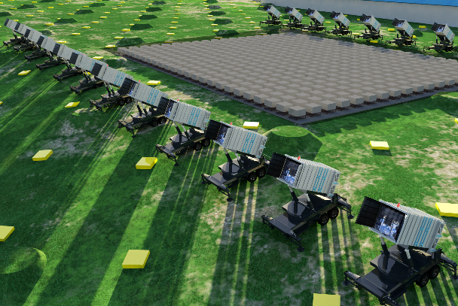
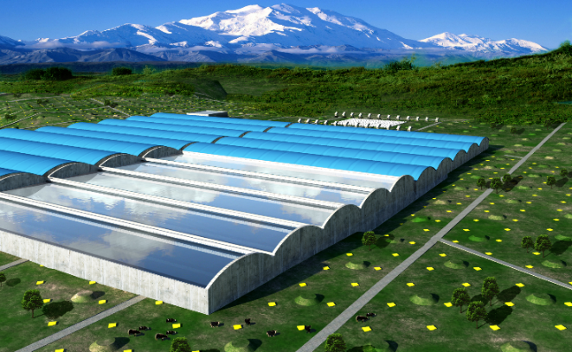
LHAASO
KM2A
WFCTA
WCDA

Slide 4
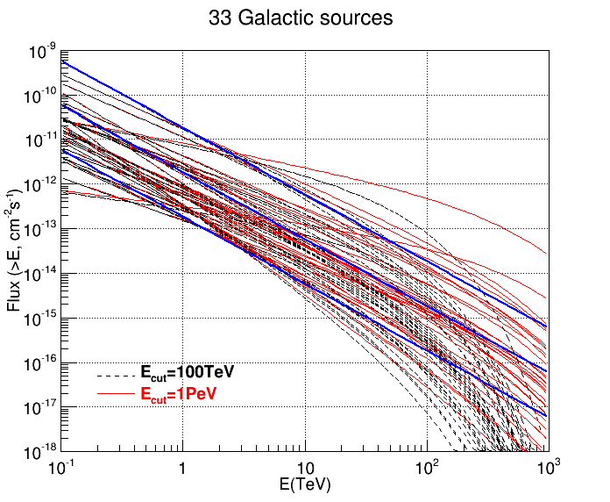
KM2A: Gamma ray astronomy beyond 10 TeV
Wide field of view
Energy resolution: 20%@100TeV
Sensitivity: 1%I_{Crab}@100TeV
10 photons/year/km²
Background free
Exposure/year:
>2000 km²hr
γ/p discrimination power:10⁻⁴-10⁻⁵
1km² array
Electromagnetic Particle Detector(ED) coverage 0.5%
  ~5000m²
Muon detector (MD) coverage 5%
  ~50000m²

Slide 5
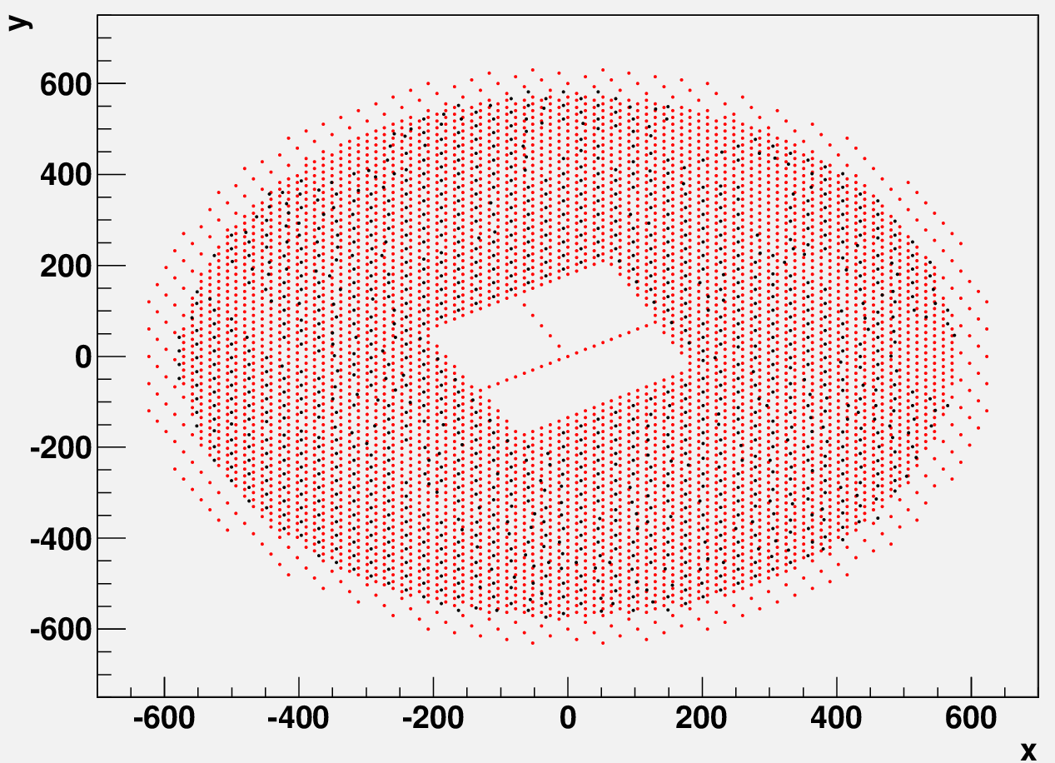
KM2A
5261 EDs, 1 m² each, 15m spacing
1146 MDs, 36 m² each, 30m spacing

Slide 6
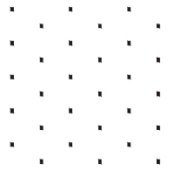
ED Specifications
Item | Value
Effective area | 1 m²
Thickness of tiles | ~2 cm
Number of WLS fibers | 32/tile×4 tile
Detection efficiency (> 5 MeV) | >95%
Dynamic range | 1-10,000 particles
Time resolution | <2 ns
Particle counting resolution | 25% @ 1 particle 5% @ 10,000 particles
Aging (<20%) | >10 years
Spacing | 15 m
Total number of detectors | 5261
15 m
15 m
15 m
15 m
15 m
15 m
15m
15 m
15 m
15 m

Slide 7
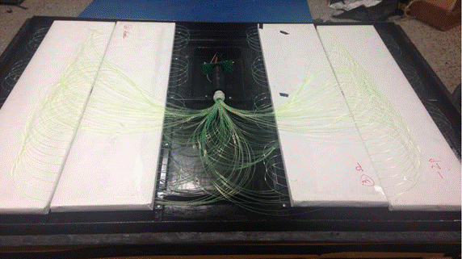
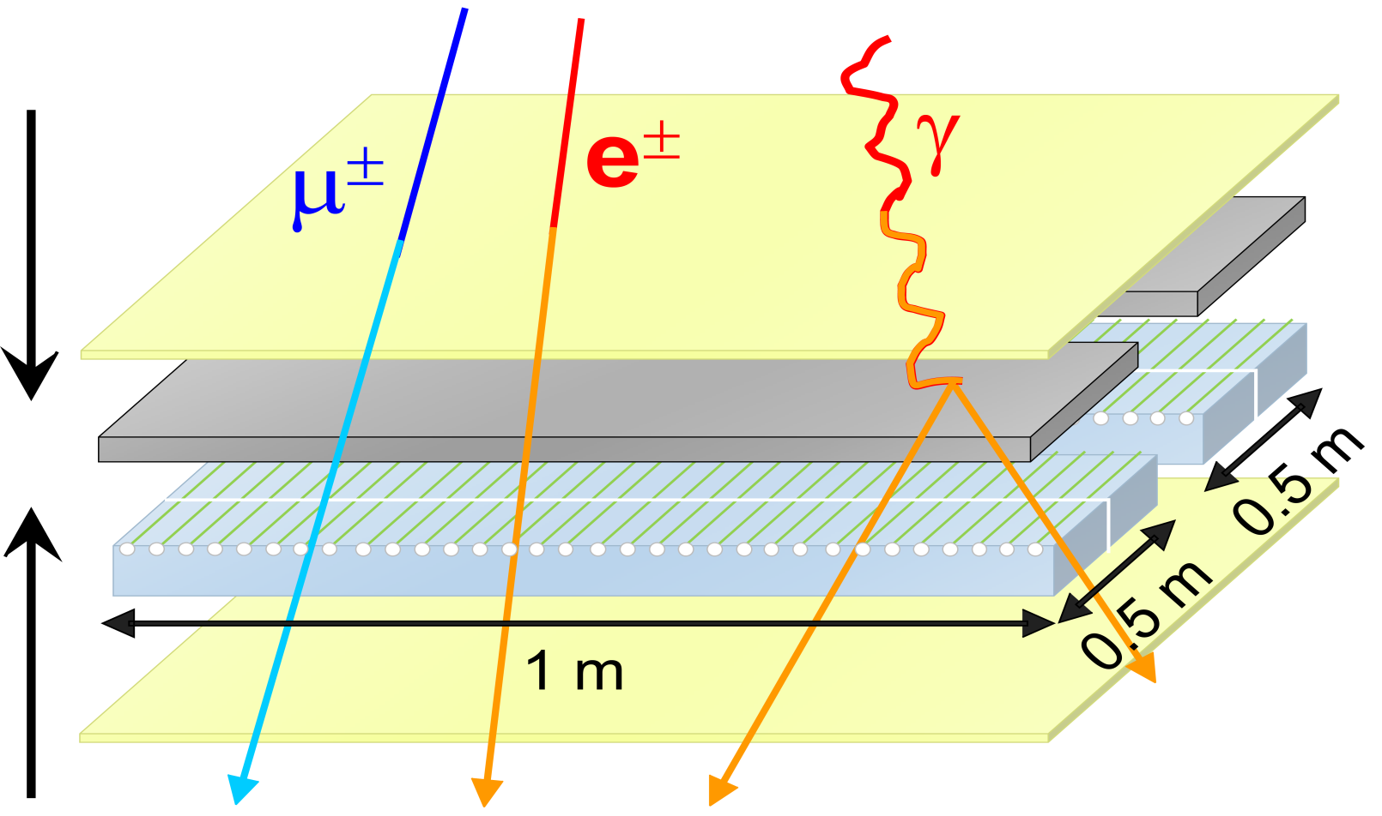
Electromagnetic Particle Detector (ED)
Steal Case
Lead(0.5cm)
SC Tiles
Steal Case
1 m
0.25 m
A sketch map

Slide 8
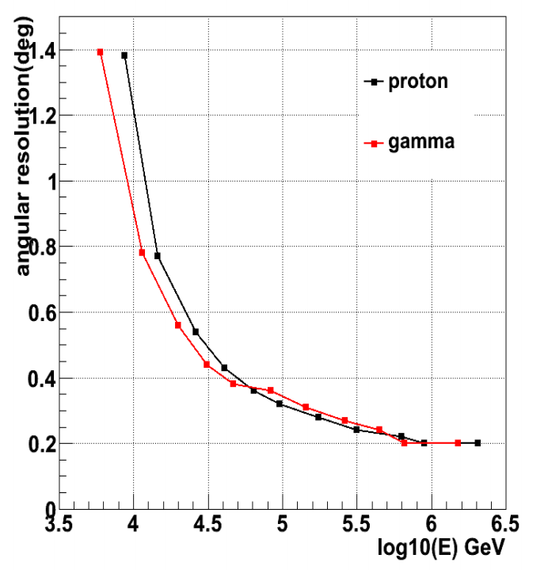
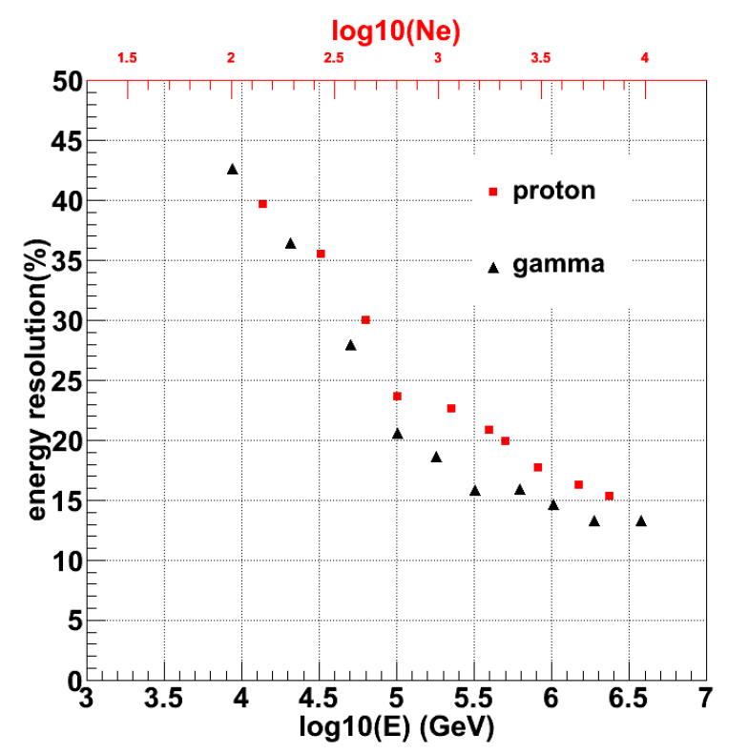
The performance of KM2A array according to the simulation：
Angular resolution：
Energy resolution：
For proton and gamma rays, the angular resolution is about 0.5 degree at 30TeV and 0.2 degree at 1 PeV.
When 20 ntrig fired，the angular resolution is about 1.4 degree.
For proton and gamma rays, the energy resolution is about 35% at 30TeV and 15% at 1 PeV.

Slide 9
KM2A prototype array @Tibet-YBJ
Introduction of two prototype array：
A 42-ED array fully overlapping with ARGO-YBJ (2010.10---2012.10)
A 42-ED+2MD array with front-end digitization, WR and “triggerless” DAQ (2014.10---2016.10)

Slide 10
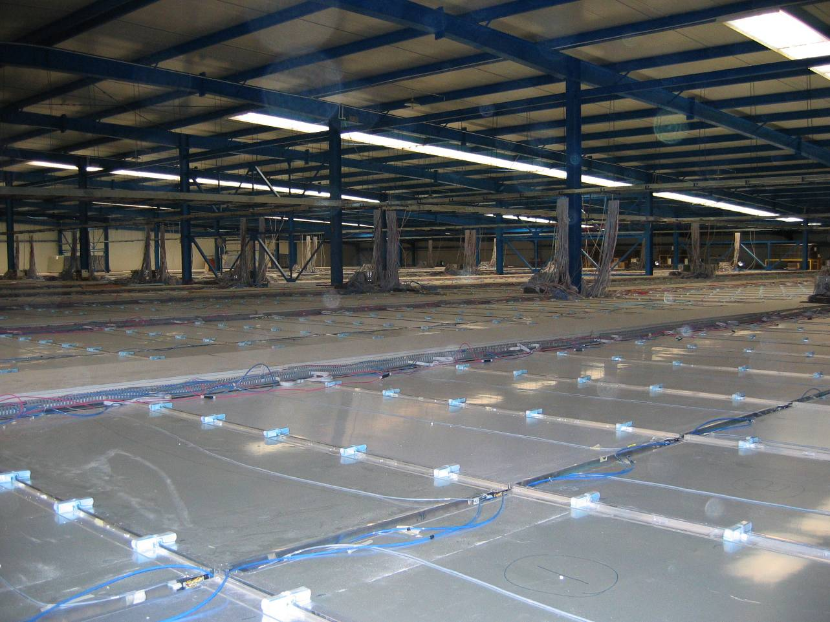




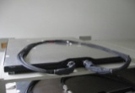
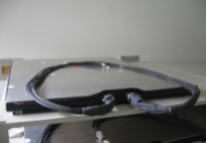
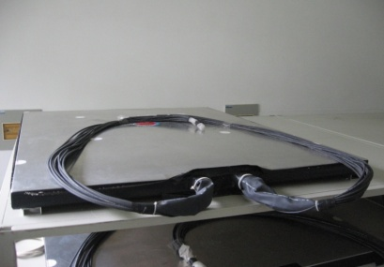
The prototype array overlaps with the ARGO array, so we can match event one by one. (above 95% event of km2a prototype array can match to ARGO’s)
75m
The prototype array of about 1% size of KM2A was built at ARGO Hall
An example shower front observed by ARGO (blue) and the prototype array (red).

Slide 11
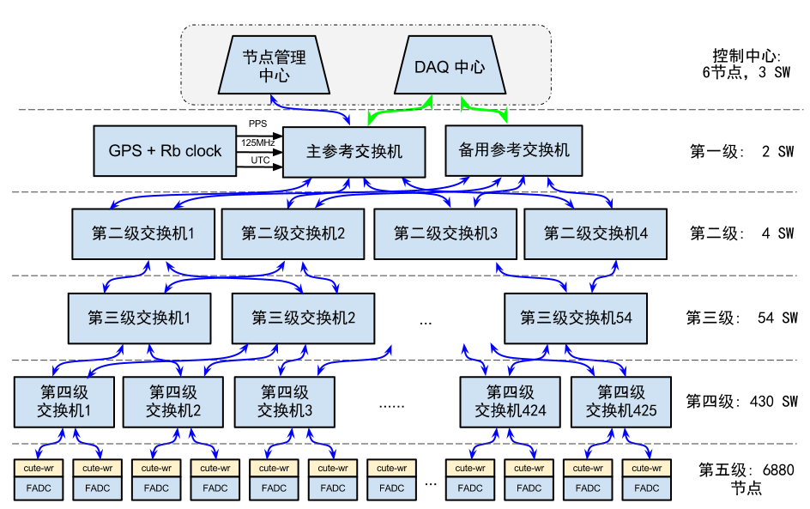
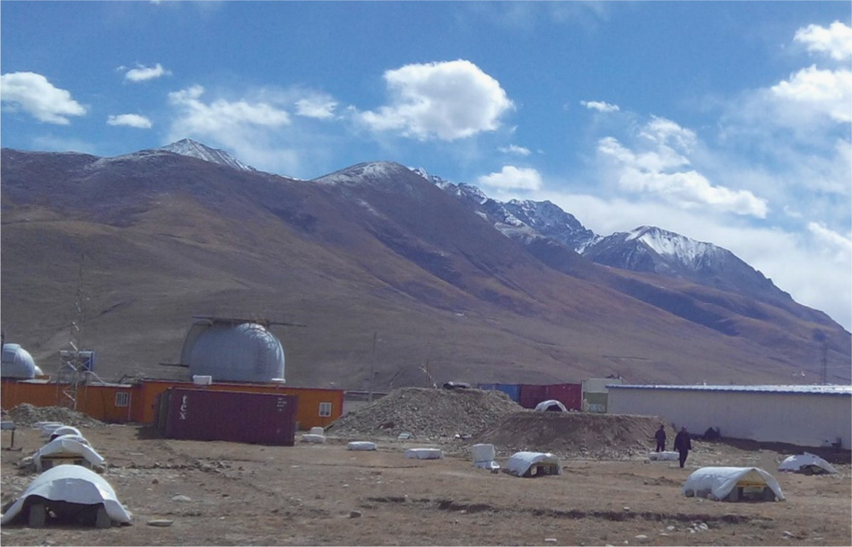
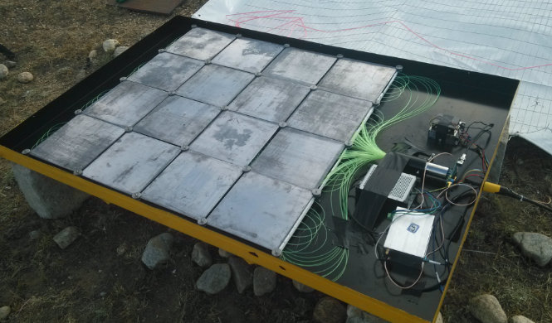
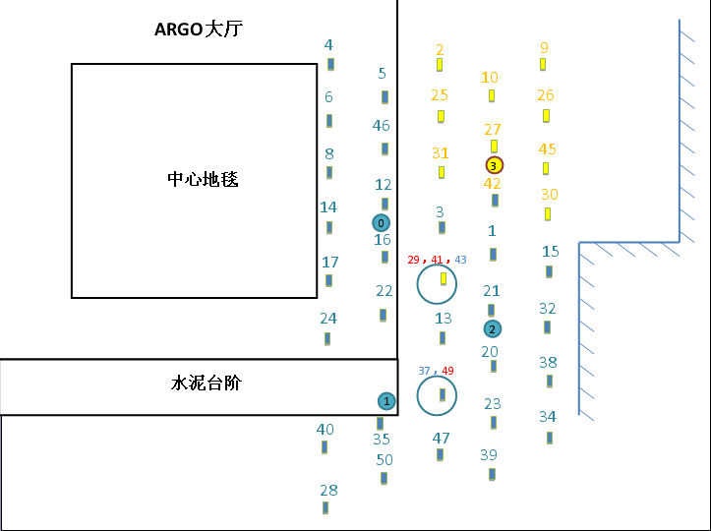
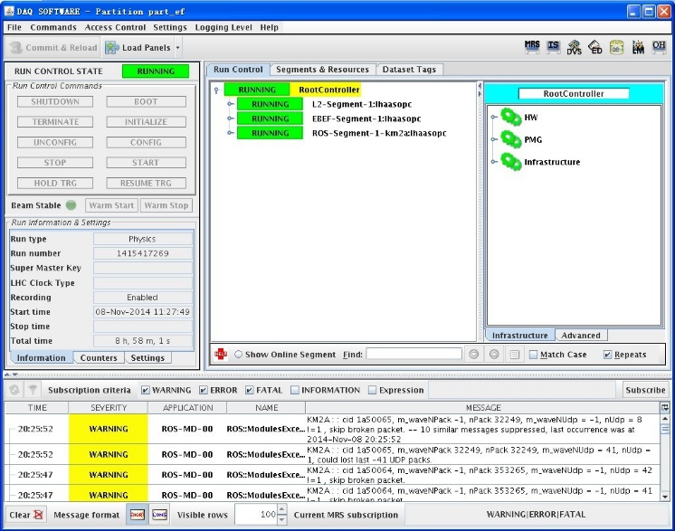
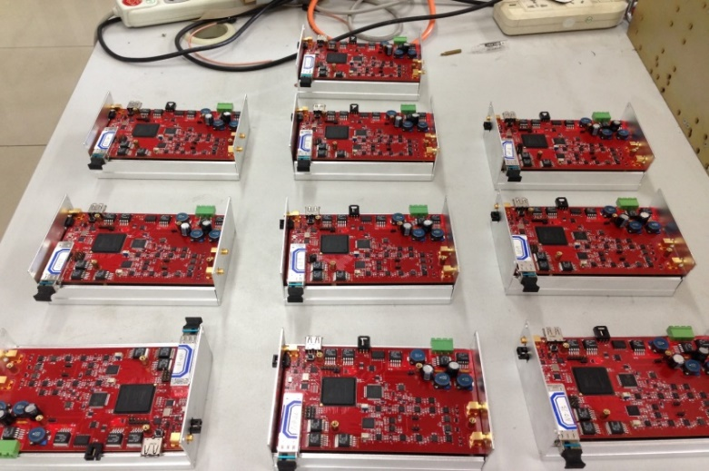
WR time system
5mm lead plate on the plastic scintillation tiles
ARGO HALL Hall
front-end digitization
“Triggerless” DAQ

Slide 12
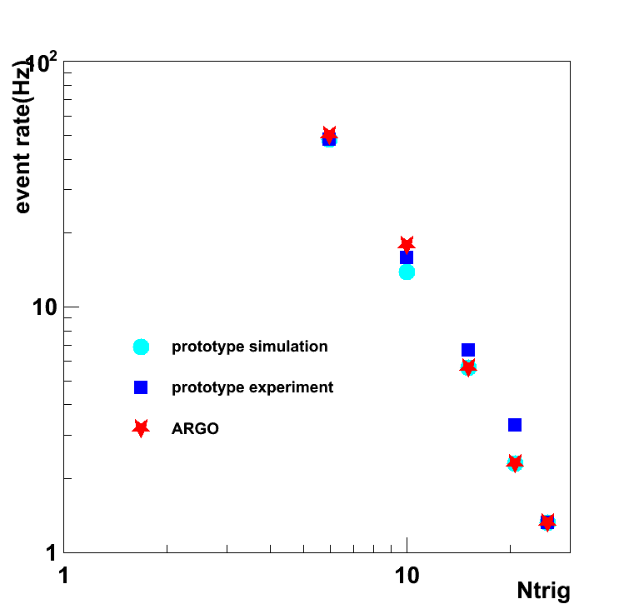
Performances of the KM2A prototype array:
Event Rate:
Event rate agrees with MC and ARGO-YBJ

Slide 13
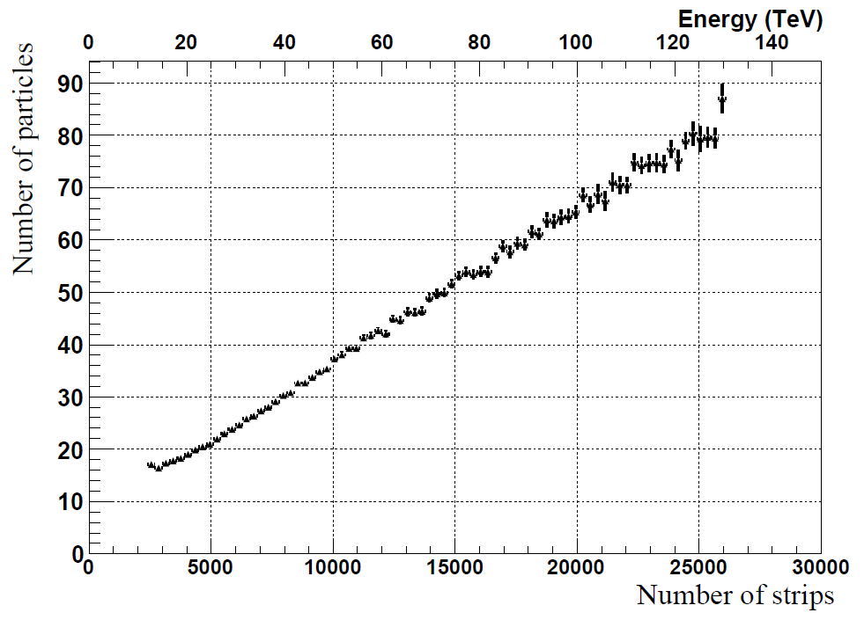
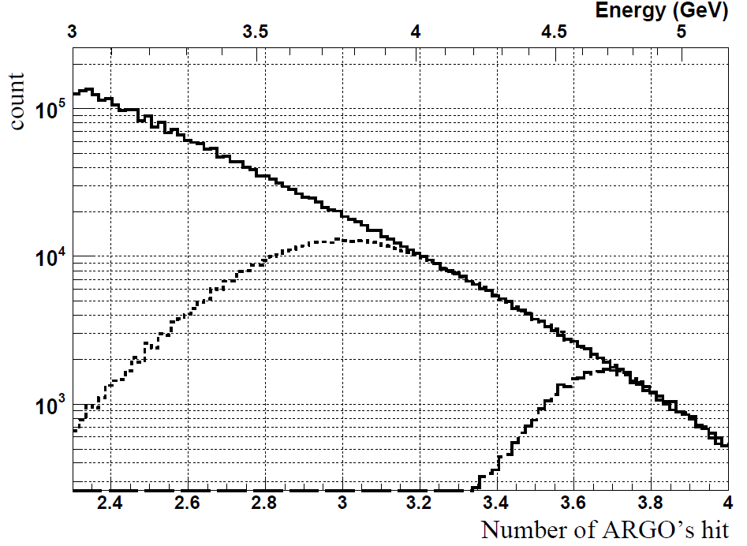
Energy response ：
Prototype array's number of particles vs. ARGO's number of strips.
The distribution of number of hits (in log-
scale) registered by ARGO-YBJ for ARGO-YBJ events (solid) and hybrid events with prototype array's number of hits > 5 (dotted) and > 20(dashed).
Notes:
The reconstructed en-
ergy by ARGO-YBJ is indicated by the upper
scale.

Slide 14
Shower direction reconstruction
The zenith angle distribution of ARGO(blue) and prototype array(red)
The azimuth angle distribution of ARGO(blue) and prototype array(red)

Slide 15
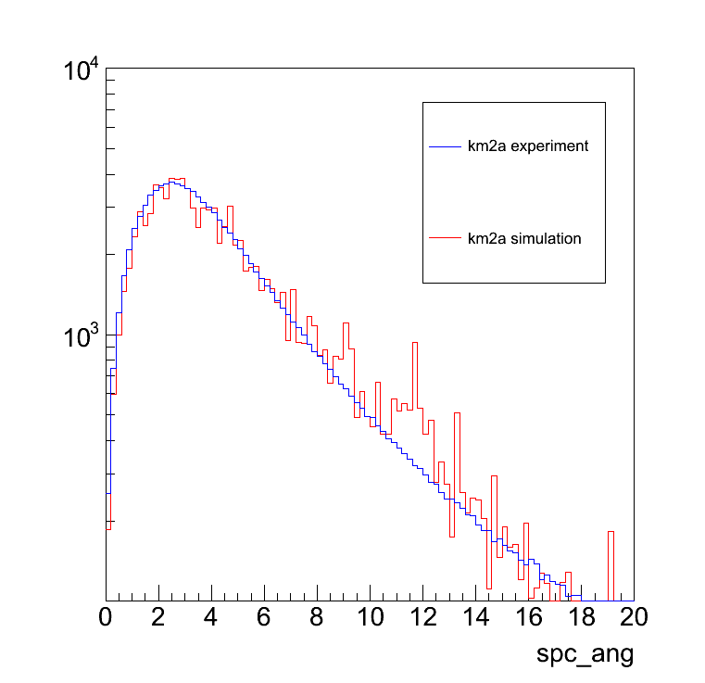
Space angle:
Distribution of space angles between the shower directions measured by the KM2A prototype array and the ARGO-YBJ experiment.
Event selection: nhit> =20 hits core reconstructed by ARGO location within 10 m to the center of the array

Slide 16
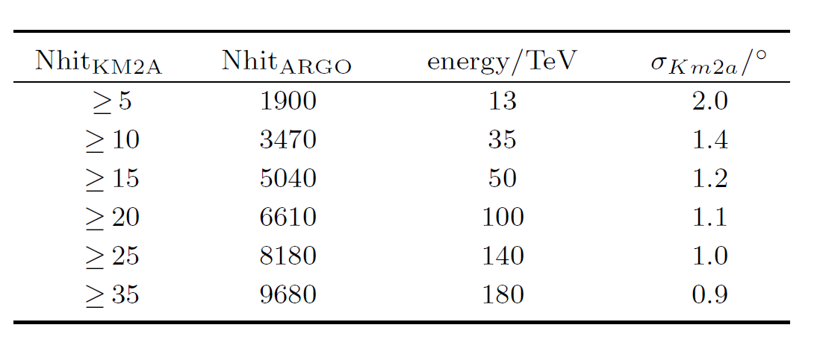
Angular resolution in different hit range:
Formula of estimating angular resolution :

Slide 17
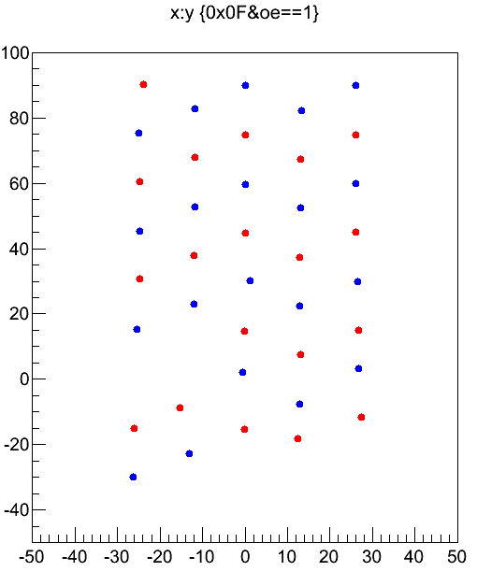
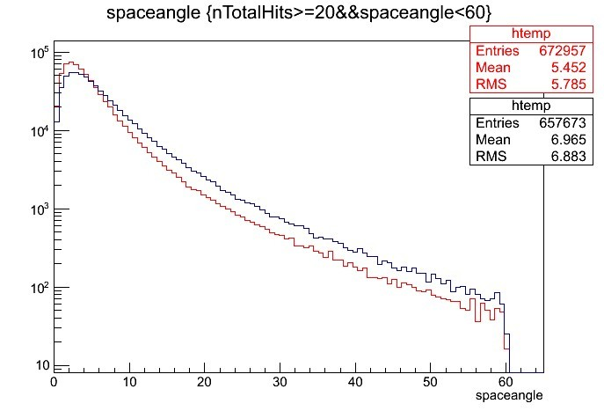
The improvement of angular resolution with 0.5cm-thick lead:
The even-odd space angle before and after the lead was placed. The improvement of the angular resolution is a factor 1.35
The angular resolution of the prototype array has been estimated by Chess-board

Slide 18
Cosmic ray moon shadow
The significance map of the sky around the Moon. Observed moon shadow by 5.8σ in 2 years.

Slide 19
Conclusion
The two KM2A prototype arrays stable operation more than two years.
The performances of KM2A prototype array meet design requirement.

Slide 20

Thanks for your attention

Slide 21
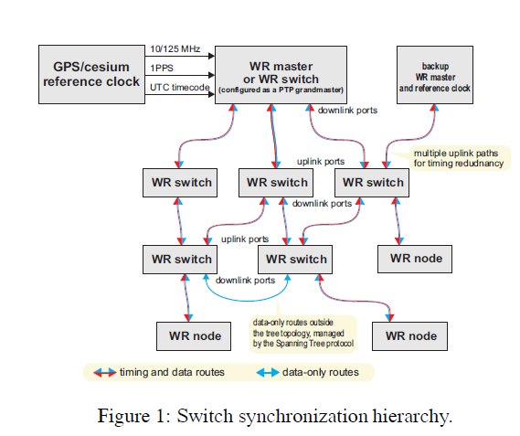

Slide 22
Long term stability:
The event rate of the prototype array (hollow) and the air pressure (solid) varying with time. Change of event rate (hollow) agrees with air pressure change.
The relative variation of average charge in case of MIPs for an ED (solid) and its ambient temperature (hollow) varying with time. Signal charge (solid) varies <±1%, agrees with PMT temperature coefficient (-0.2%/ºC).
Notes:
Change of event rate (hollow) agrees with air pressure change.
Signal charge (solid) varies <±1%, agrees with PMT temperature coefficient (-0.2%/ºC).
The resulting temperature coefficient of about
0.2% per degree is consistent with that of the PMT.

