Slide 1
The SLAC Instrumentation and Control Platform
R. Claus, M. D’Ewart , J. Dusatko, R. Herbst, K. Kim ,
L. Ma , U. Legat, J. Olsen, B. Reese, L. Ruckman,
L Sapozhnikov, S. Smith, T. Straumann J. Vasquez
D. Van Winkle , M. Weaver, E. Williams, C. Xu, A. Young

Slide 2
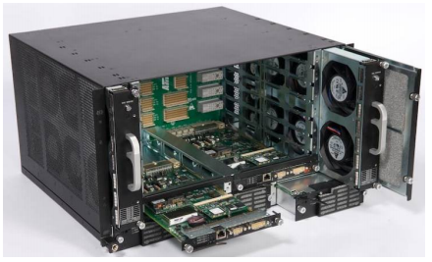
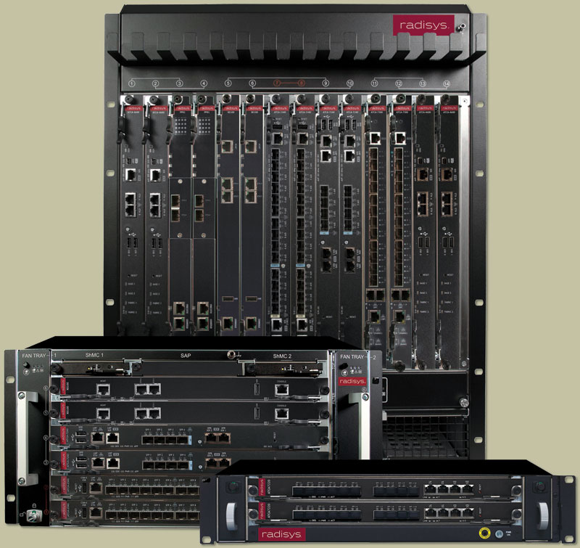
The ATCA Common Platform
Developed at SLAC for high performance distributed control systems
Based on the Advanced Telecommunications Computing Architecture (ATCA)
Growing multi-billion dollar market
Continuously improving technology
High density, backplane carries all global signals
ATCA Crate “shelf”
Standard hardware, SLAC application:
Available from 1 slot to 16 slot
Power supply with hot swap
Management
Networks
Cooling
Designed for high-reliability applications

Slide 3
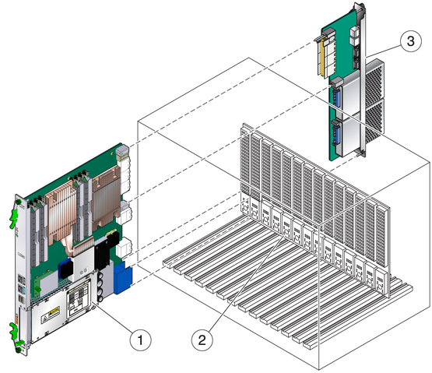
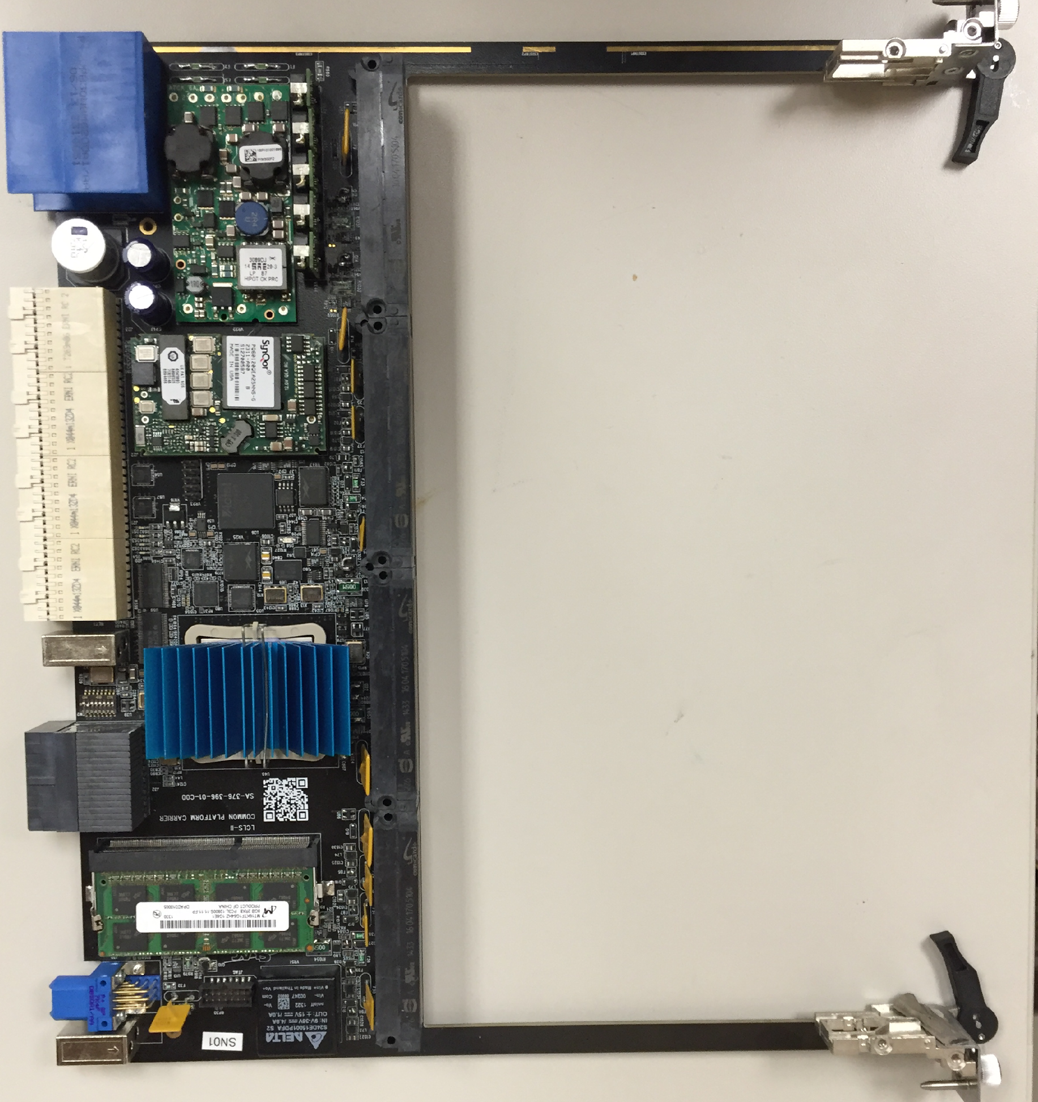
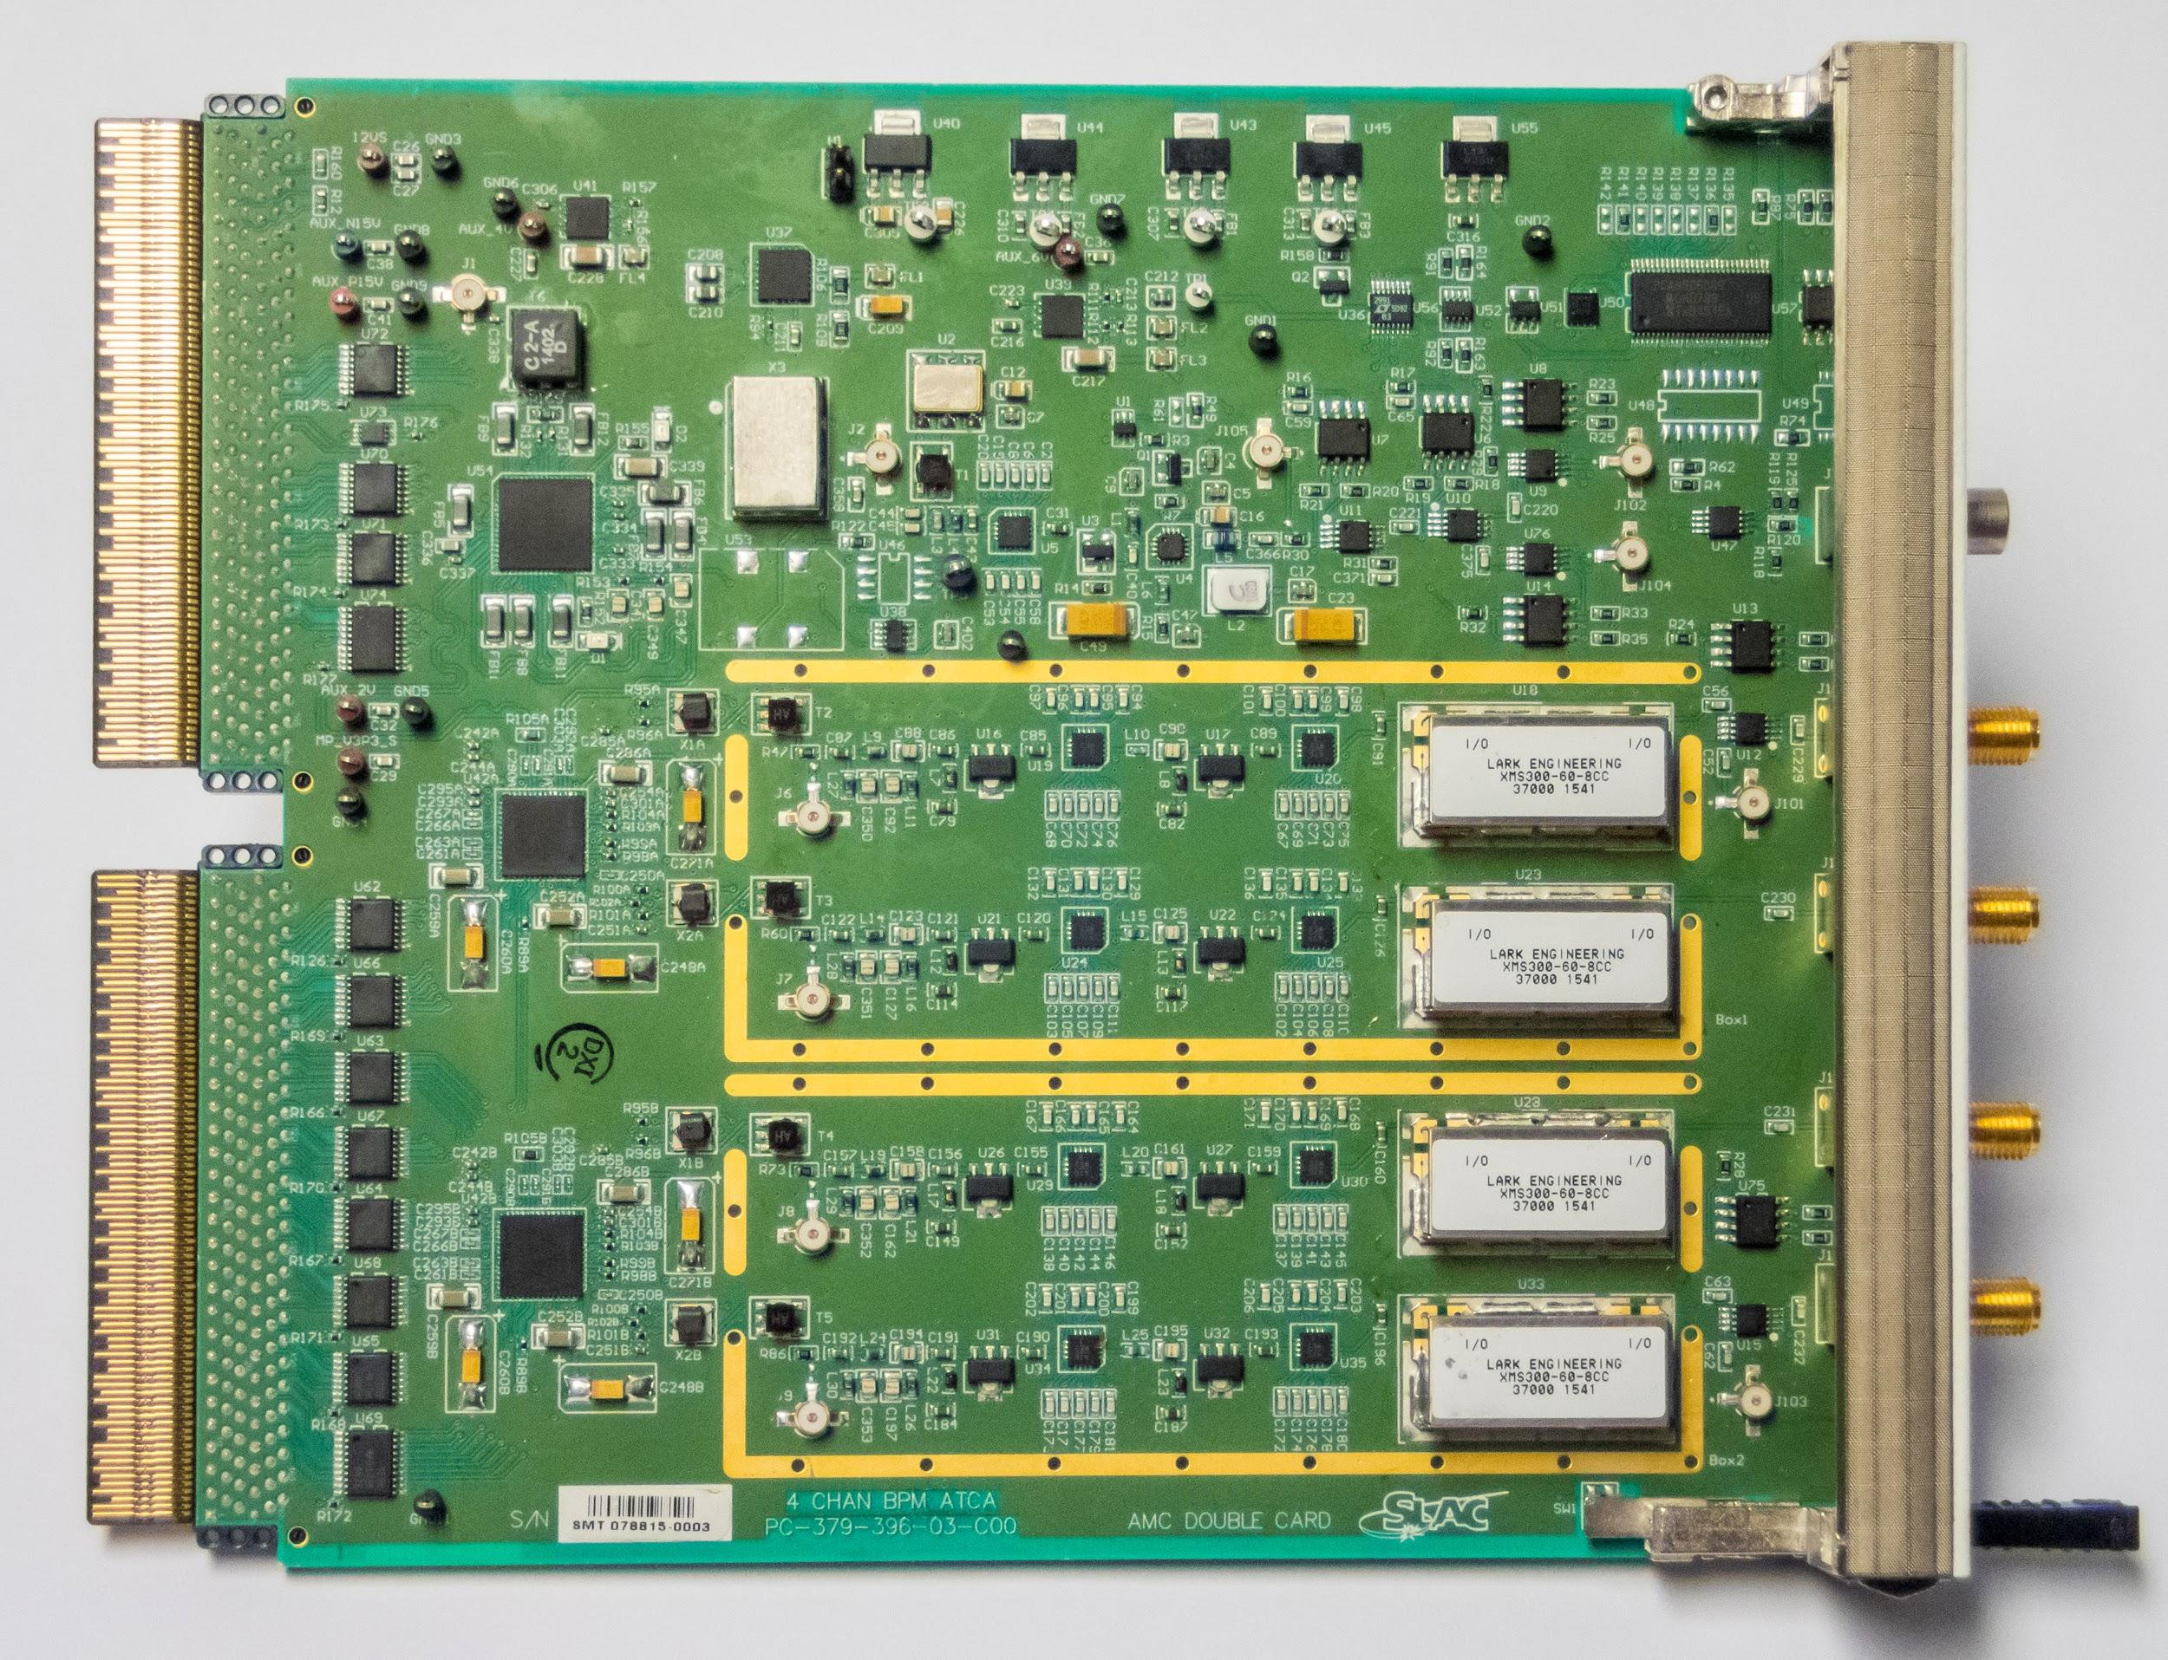
Common Platform
SLAC hardware and software application on ATCA
1: Carrier Card
2: Crate
3: RTM
Each carrier supports 2 AMC application cards
Carrier card: FPGA, memory, backplane connections
AMC cards: ADCs, DACs, high performance front end electronics
RTM: General purpose IO, extra networks, miscellaneous

Slide 4
ATCA Backplane (As used in SLAC Common Platform)
Ethernet for data / control (10Gbit, 10/40 uplink)
IPMI
10G / 40G data
Timing data stream (3.75Gbit)
Machine protection / uplink (1.25Gbit)
MPS
Slot 1
switch
IPMI management network
Slot 2
payload
payload
Timing
All carrier cards can also serve as slot 2 nodes
For most applications, all networks are carried on the backplane, minimal external connections
payload
payload
Single cards can be used with rear transition module networking
payload
payload
payload
Crates available from 1 to 16 cards

Slide 5
More on Backplane Networks
IPMI provides control to power cycle and hot-swap individual cards.
Operates independently of FPGAs on carrier cars.
Ethernet network used for normal control and data.
10Gbit to each card from switch
10 or 40Gbit uplink to main network
Timing data stream provides synchronization
Each carrier card decodes the data stream to generate internal or external triggers. Multiple data streams supported:
Micro-Research “event receiver”
SLAC LCLS2 “timing system”
Straightforward to support other serial timing systems
Machine Protection / uplink
Used at SLAC LCLS2 to provide an independent uplink path for interlock data.
Available for other real-time uplink use if MPS is not required
For typical applications there is one set of networks connected to the crate, but no networks to the individual cards

Slide 6
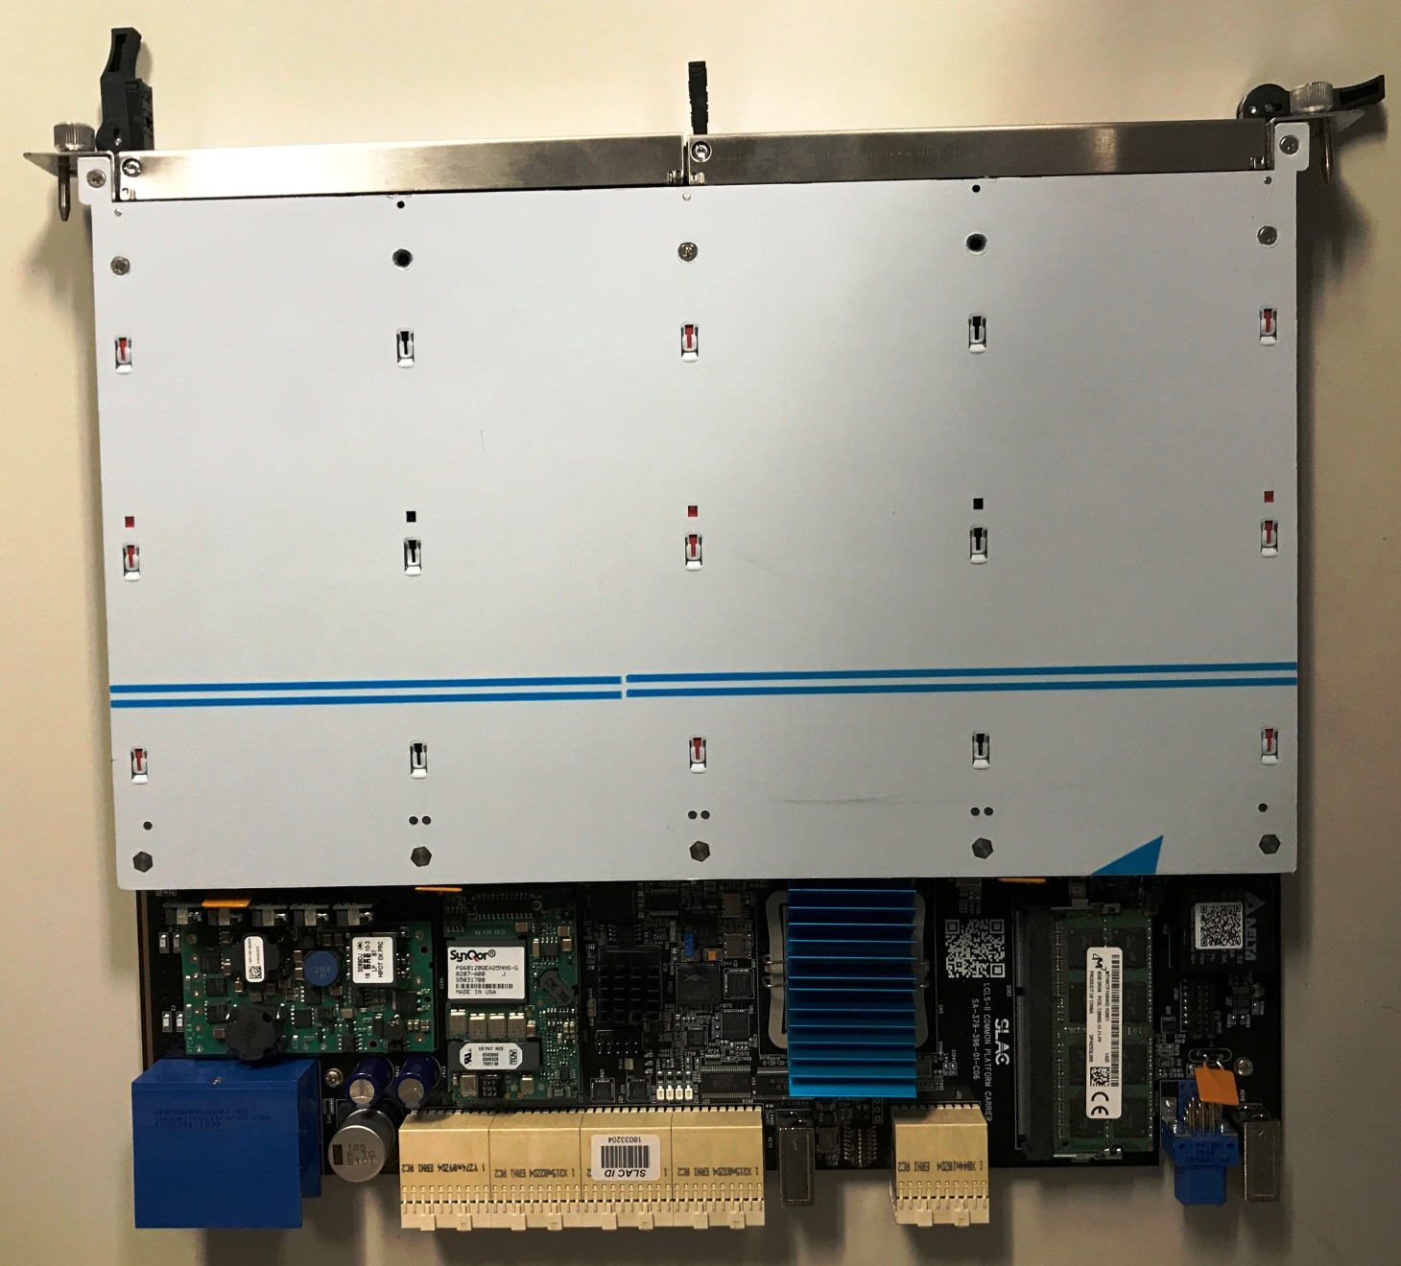
Carrier Card
AMC ADC/DAC cards
DRAM
FPGA
Connector to RTM
Power supplies for AMCs
Power connector
Connector to backplane

Slide 7
Carrier Card
Xilinx “Kintex Ultrascale” FPGA
KCU040 or KCU060: 2760 DSP slices, 200Gbit bidirectional bandwidth for ADC / DACs
Power supplies for AMC cards
+3V, +4V, +/- 6V, +/-15V, +12V (9A)
No switching supplies required on AMCs for most applications
8GB DDR3 memory (in addition to 3MB on-chip fast memory)
Supports Common Platform networks and management
Carrier card is very complex but a single design is used for all applications

Slide 8
AMC Cards
AMC = Advanced Mezzanine Card
ATCA double width, full height AMC card.
Fully backwards compliant with AMC standards, with additional features
Full height card provides space for RF shielding and daughter cards
Combined ADC / DAC and analog front end
ADC/DAC requirements usually tied to a specific front end design
Analog engineers can work independently of digital engineers
A variety of AMC cards have been developed
ADC/DAC, Loopback test, Beam position monitor, Parallel Digital IO, High speed serial IO, Precision trigger generator. Low level RF system, high performance ADC/DAC
Some example AMC cards shown on the next slides

Slide 9
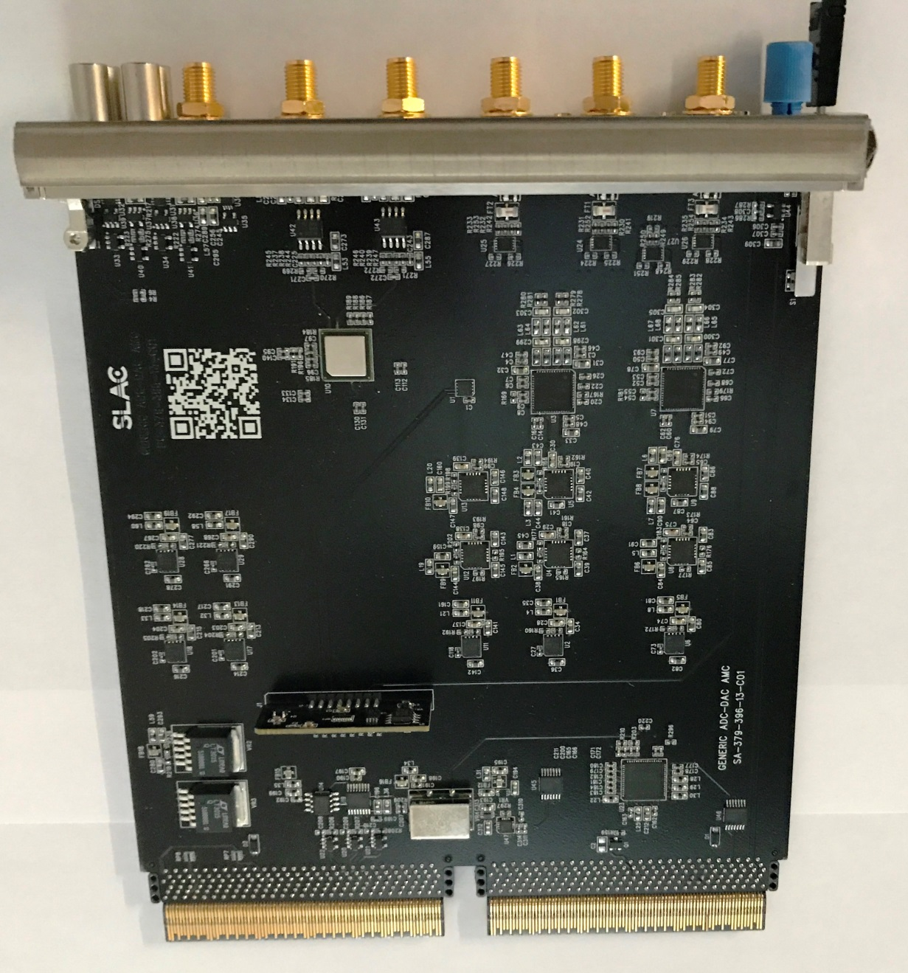
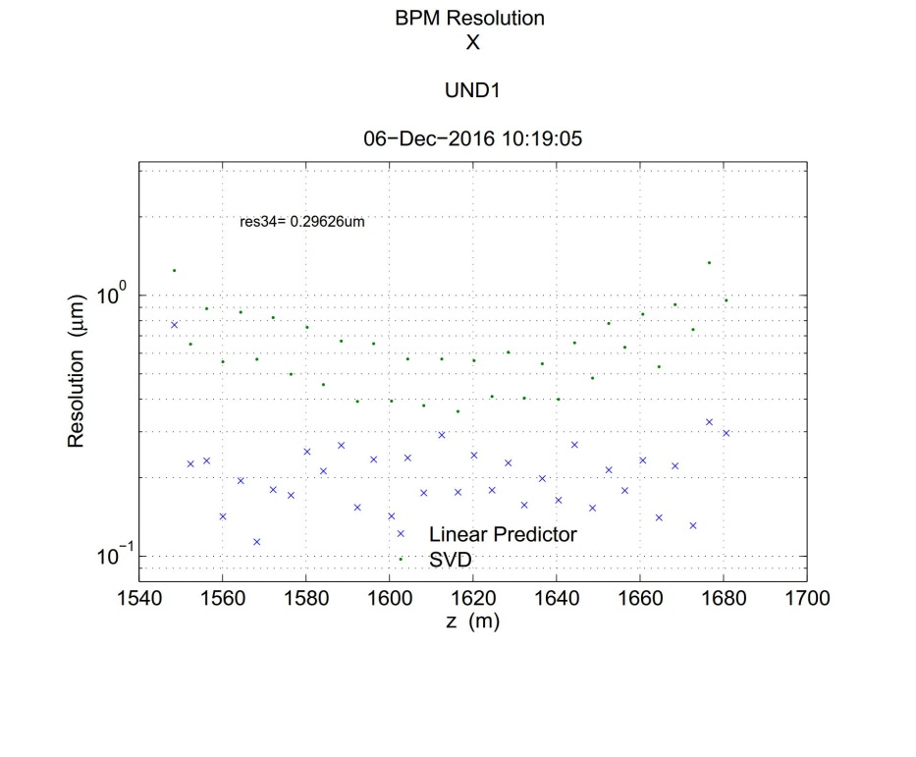
General Purpose A-D / D-A card
4X 16 bit 370 Ms/s ADC
TI ADC16DX370
One channel for read back of timing system for precision synchronization (sub-sample)
2X 16 bit 370Ms/s DAC
TI DAC37J82
ADC/DAC clock
DAC driven VCXO for locked or unlocked operation
Low phase noise clock oscillator
Fast trigger reference output
2X DIN, 2X DOUT
Fiber output for triggering
Status: In Production
Used for 300nm resolution cavity BPMs
Larry. Ruckman

Slide 10
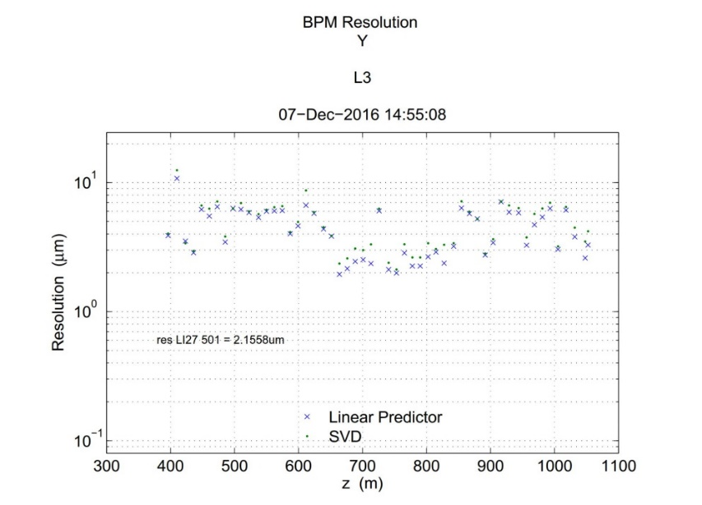
Stripline e-Beam Position Monitor
BPM signal processing
300MHz, 30MHz BW filters
Distributed amplification /attenuation for high linearity
370Ms/s ADC
Calibration function
Inject signals on BPM strips
Measure induced signal in perpendicular strips
Corrects for cable and electronics drifts
Status: In Production
2 micron resolution at 180pC
RF shields removed for picture
Andrew Young

Slide 11
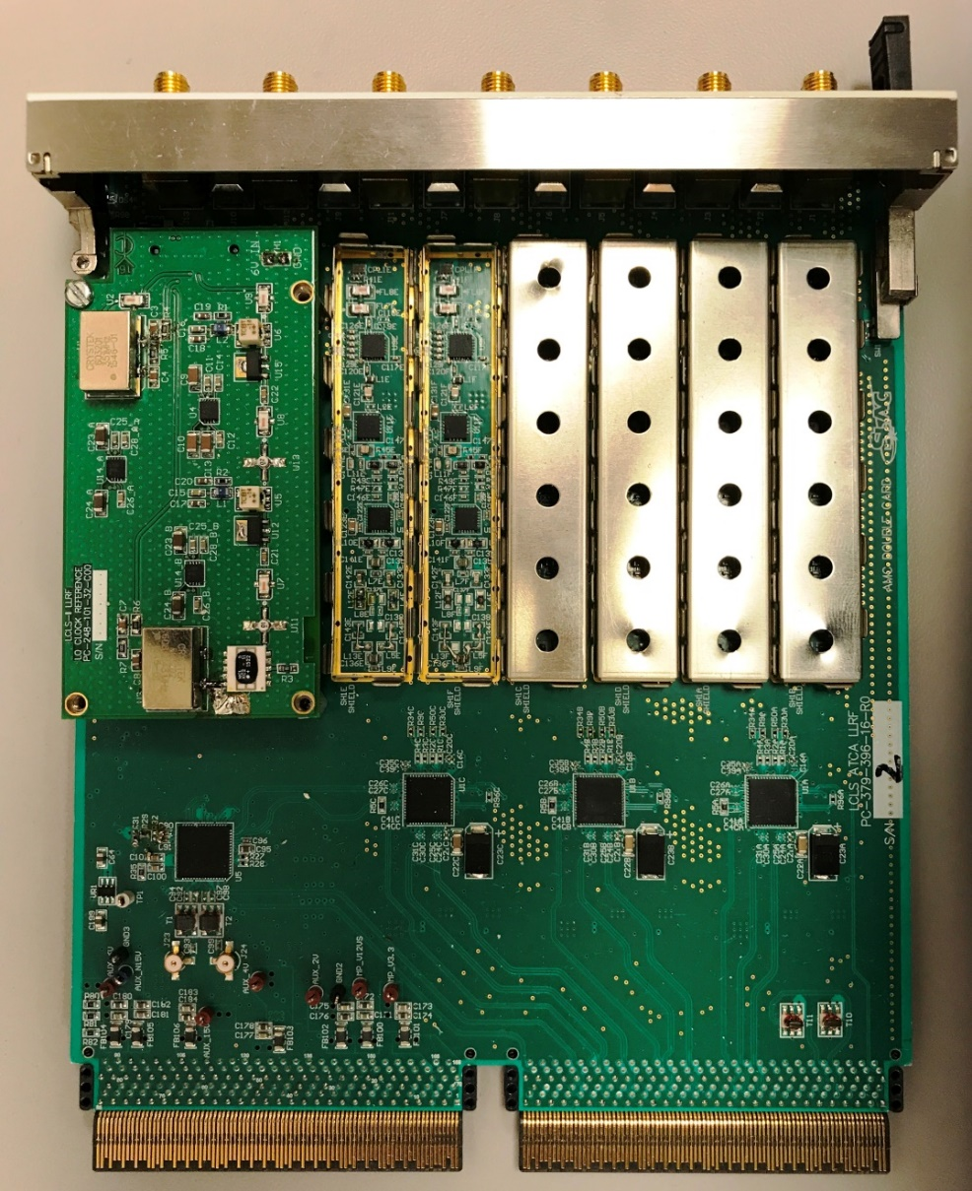
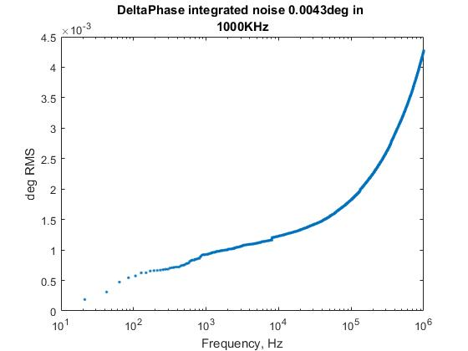
Low Level RF Controller
2 AMC cards on a single carrier
(receiver shown).
10X RF input channels
1X RF output channel
2X fast DC ADC (370Ms/s)
300MHz to 3GHz range with different oscillator daughter cards
Clocks and LO phaselocked to timing reference system.
FPGA provides closed loop RF control.
Very low measurement noise
4.3 femtoseconds RMS in 1MHz bandwidth
1 femtosecond RMS in 1KHz bandwidth
Status: Operational
Dan Van Winkle

Slide 12
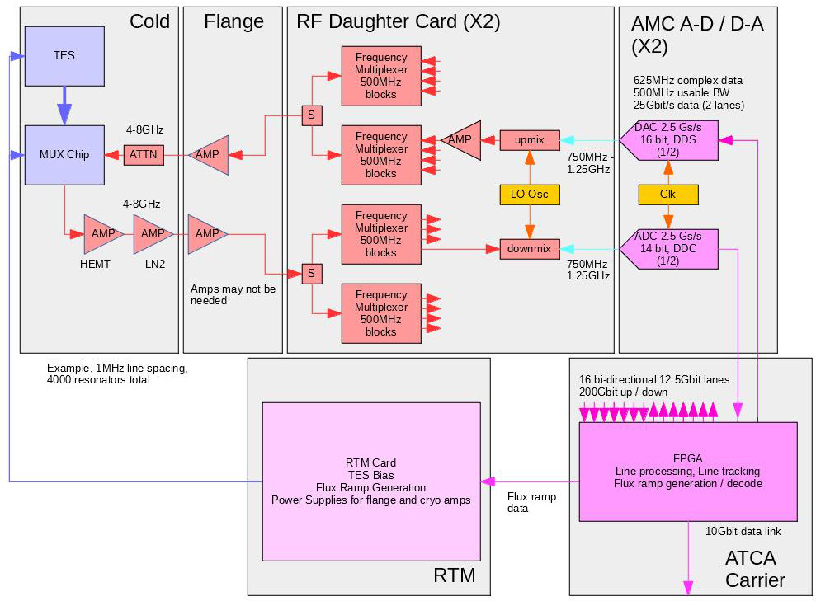
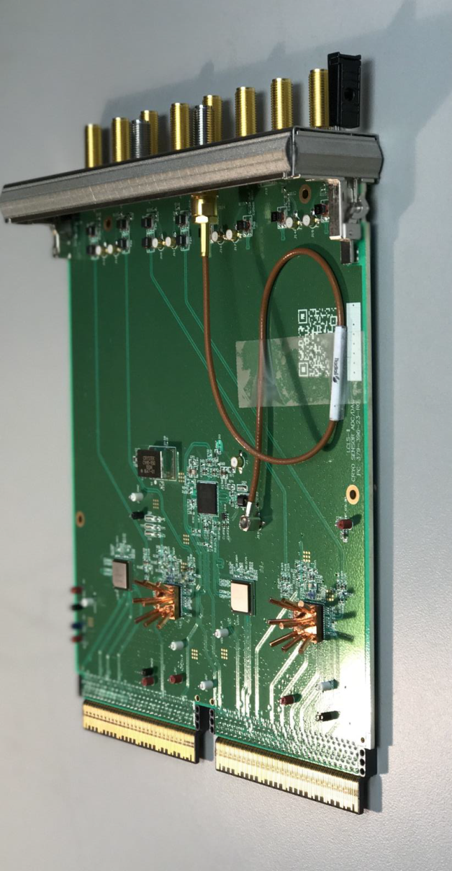
High Speed A-D / D-A
4X 2.5Gs/s 14 bit ADC, 4X 2.5Gs/s 16 bit DAC
200Gbit/s raw ADC / DAC bandwidth, reduced in ADCs / DACS to 100Gbit/s to the FPGA
Designed for cryogenic sensor arrays (RF MUX SQUID / TES detectors) [Kent Irwin et. al.]
Cosmic microwave background
High energy resolution X-ray detectors
Designed to interface to RF daughter card
RF multiplexing filters
Synthesizers and mixers
Status: Testing 1st prototype

Slide 13
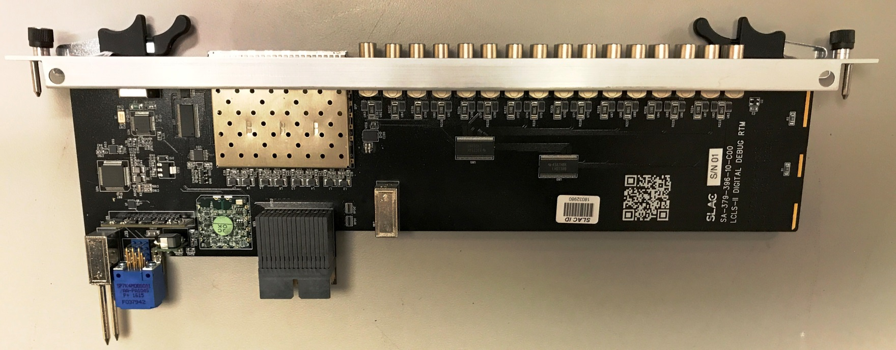
Rear Transition Modules
Direct connection to carrier card FPGA and to AMC cards
3X high speed serial lanes. 2X for network and timing data stream, 1 for on-board use
Parallel digital IO to FPGA
Digital IO to AMC modules – can be used for clocks or interlocking
Often contain simple programmable logic (CPLD) for interlocks that need to be independent of the main FPGA code for high reliability operation.
Several variants for different applications.
Digital IO, laser locker, low level RF, interlocks, trigger output etc.

Slide 14
ATCA Common Platform Projects
SLAC / LCLS Low Level RF upgrade
83 ATCA cards for SLAC LCLS operations
Additional for SPEAR ring and FACET2 accelerator
SLAC LCLS 2, Instrumentation
Cavity BPMs, stripline BPMs, bunch length monitor, bunch charge monitor, machine protection, beam loss monitors
Approximately 500 ATCA cards
Cosmic microwave background telescope projects
Approximately 100K sensor channels, 25 ATCA cards.
LCLS2 cryogenic X-ray sensor
Approximately 10K high bandwidth sensor channels, 10 ATCA cards.
SLAC RF femtosecond timing system
Laser locker, RF-over-fiber timing
Approximately 30 ATCA cards

