Slide 1

Spherical Measuring Device of Secondary Electron Emission Coefficient Based on Pulsed Electron Beam
Kaile Wen Shulin Liu Baojun Yan Yuzhen Yang Yang Yu
5/24/2017

Slide 2
Outline
Purpose
Measuring device
  Energy spectrum measurement
  Measurement methods
Result
  Measurement in pulse mode
  SEE vs Energy
  SEE vs Angle
Automatic measurement system
Advantages
Summary

Slide 3
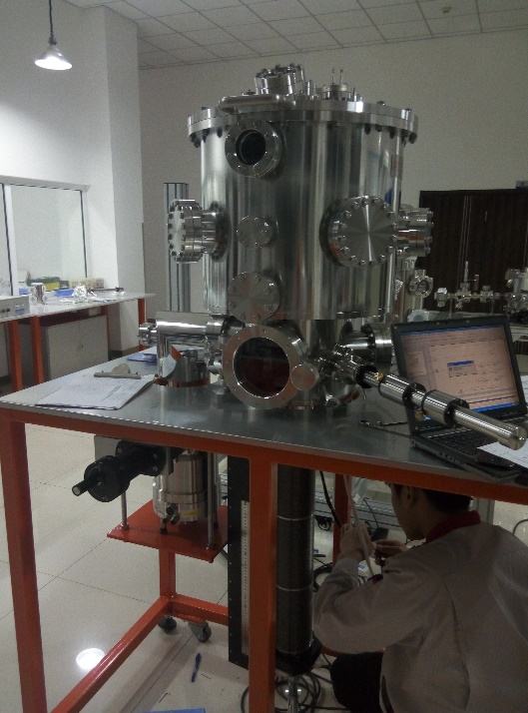
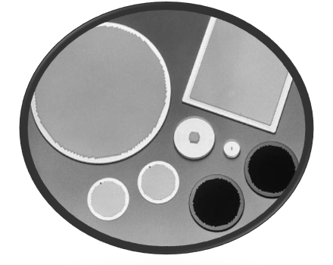
Purpose
In order to improve the performance of MCP, we need a material with high secondary electron emission coefficient, and the performance of this material needs to be accurately measured.
For this purpose, we have designed this measuring equipment as shown on the right.

Slide 4
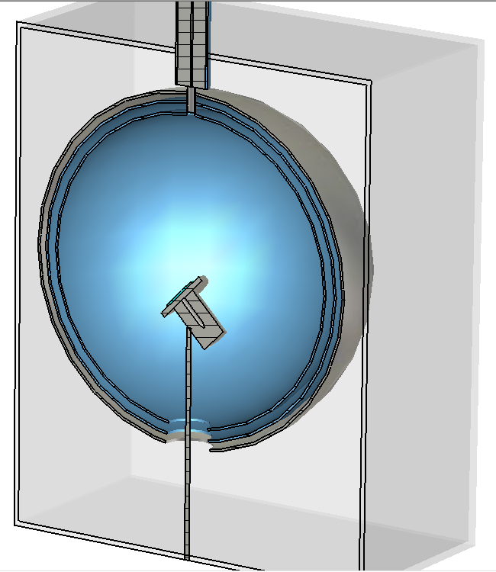
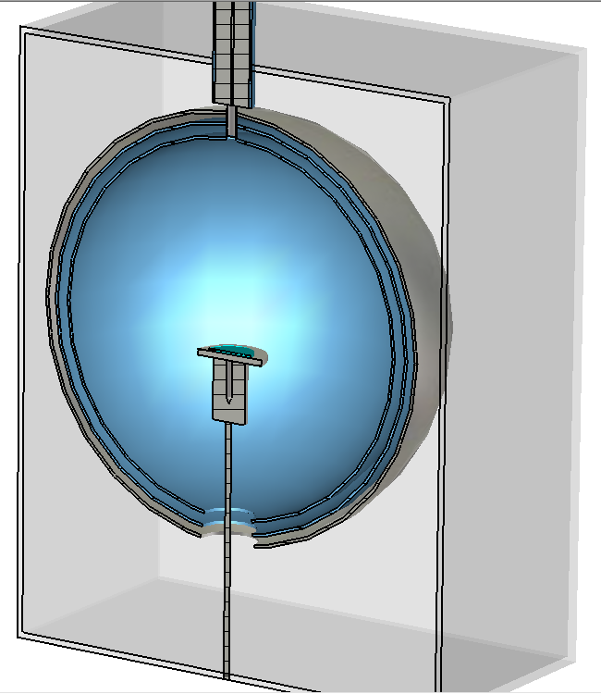
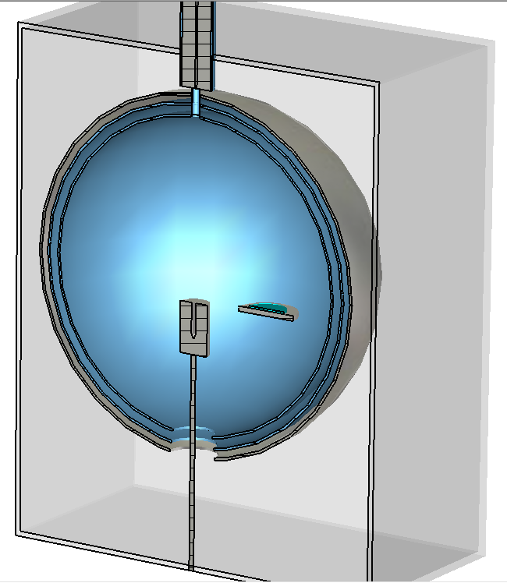
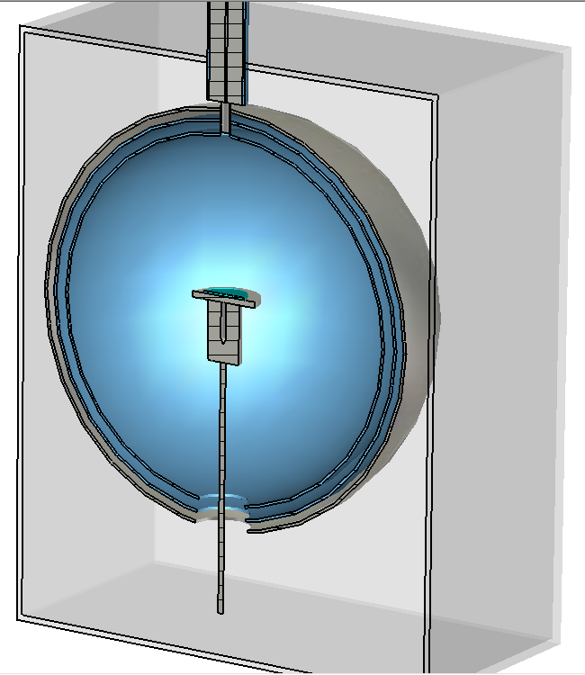
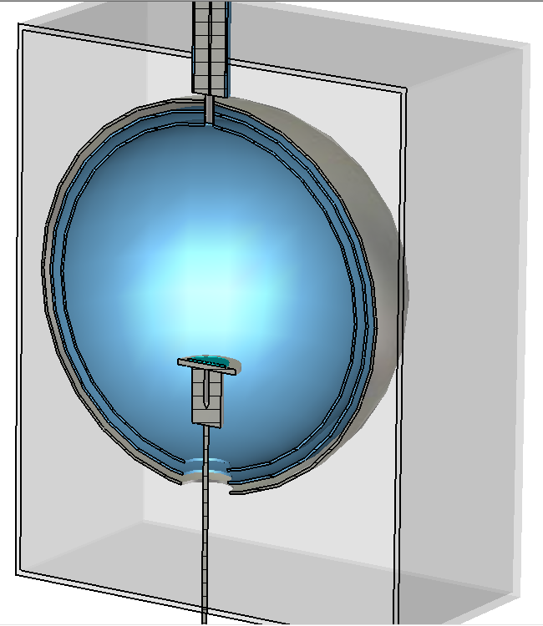

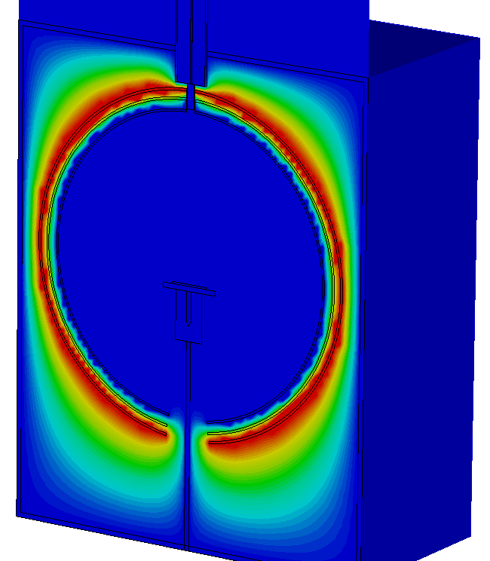
Measuring device
Electron gun : 100eV—10keV
Spherical collector :
Collecting secondary electrons
Multi - layer grid mesh :
Shielding electric field，
Measure the energy spectrum
Sample stage :Move and rotate
Faraday Cup :
Measure the incident electron current
Vacuum chamber :
Provide a vacuum environment
If the sample stage is removed, there is a Faraday cup below, which can be used to measure the incident electron current.
The sample stage can be moved and rotated to provide different primary electron incident angles, The incident angle can be adjusted from 0 to 85 degrees
There are two layers of grids inside the collector. By grounding the inner grid and the sample stage, and connecting the collector to the positive voltage , a uniform electric field can be generated on the inside, and the generation of secondary electrons will not be affected by the electric field.
When the equipment is in operation, the electron beam generated by the gun will be irradiated on the sample, the secondary electrons emitted by the sample will diverge to the surroundings and collected by the spherical collector, and the current of the secondary electrons will be measured.
Notes:
When the equipment is in operation, the electron beam generated by the gun will be irradiated on the sample, the secondary electrons emitted by the sample will diverge to the surroundings and collected by the spherical collector, and the current of the secondary electrons will be measured.
There are two layers of grids inside the collector. By grounding the inner grid and the sample stage, and connecting the collector to the positive voltage , a uniform electric field can be generated on the inside, and the generation of secondary electrons will not be affected by the electric field.
The sample stage can be moved and rotated to provide different primary electron incident angles, The incident angle can be adjusted from 0 to 85 degrees
If the sample stage is removed, there is a Faraday cup below which can be used to measure the incident electron current. And the vacuum chamber can be used to provide a vacuum environment.

Slide 5
Energy spectrum measurement
50V
-50V
0V
80eV
20eV
120eV
20eV
80eV
120eV
Collector
Outer
grid mesh
Inner
grid mesh
The inner grid is earthed, the outer grid is connected with minus 50V, and the collector is connected to plus 50V. When secondary electrons pass through the grid, electrons with energies below 50 eV are bounced off and only electrons with energies above 50 eV can be collected by the collector.

Slide 6
Energy spectrum measurement
50V
-100V
0V
80eV
20eV
120eV
20eV
80eV
120eV
Collector
Outer
grid mesh
Inner
grid mesh
When we increase the voltage of the outer grid to minus 100V, only the electrons with energy greater than 100eV can be collected by the collector.

Slide 7
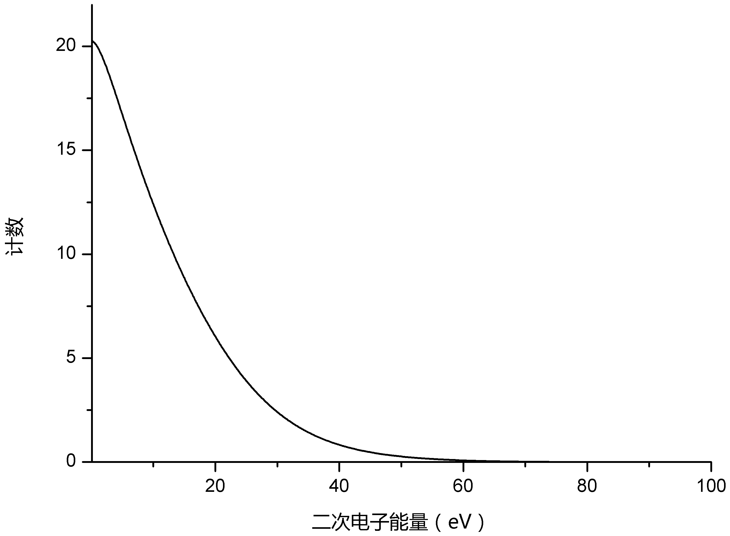
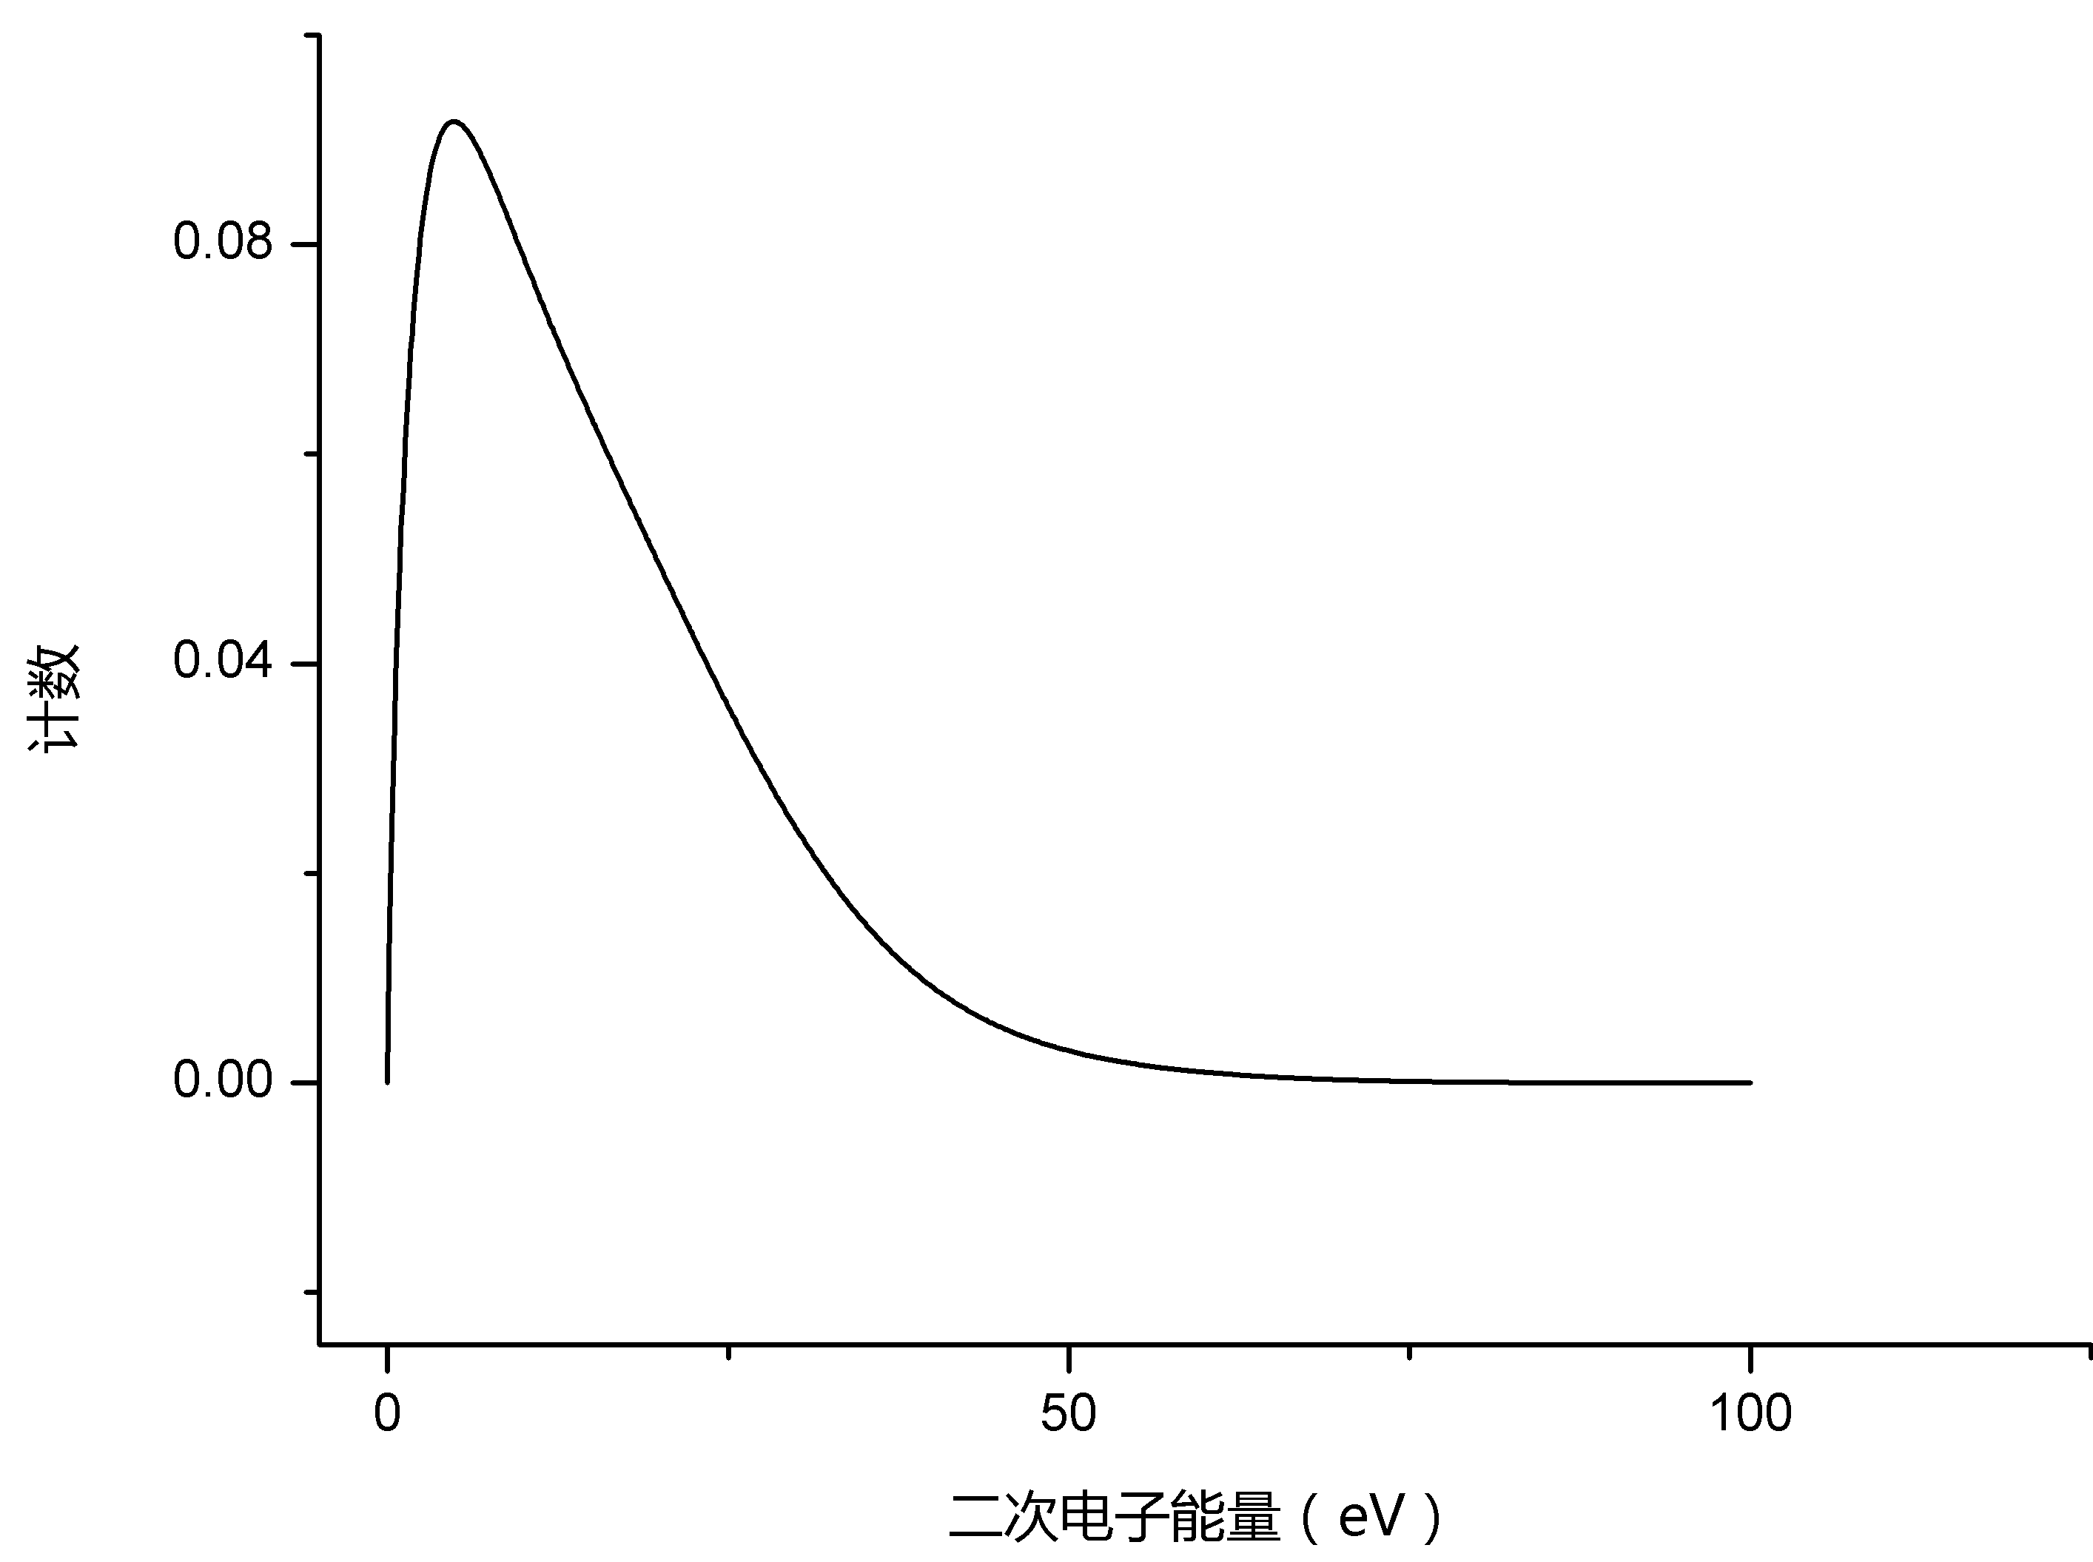
Energy spectrum measurement
50V
-50V
0V
Integral energy spectrum
Sweep Voltage
Differential
Energy spectrum
Collector
Outer
grid mesh
Inner
grid mesh
By sweeping the voltage on the outer grid, we can get the integral energy spectrum of the secondary electron, by differential, we can get the secondary electron energy spectrum.

Slide 8
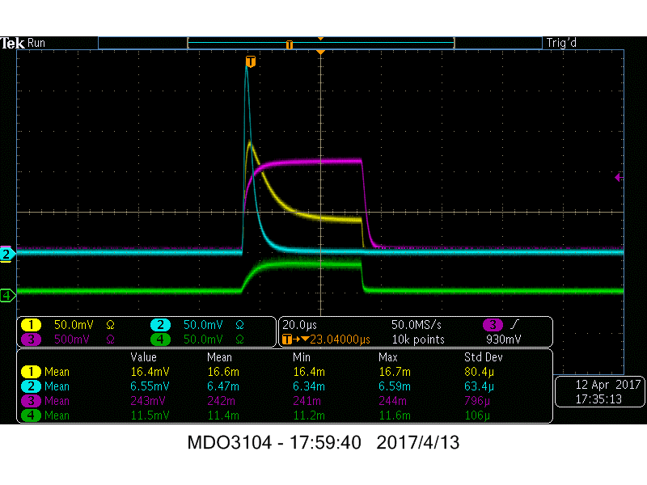
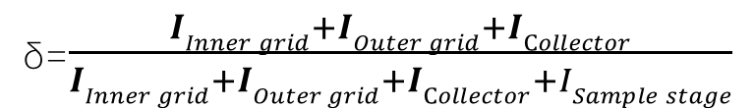
Measurement methods
δ=$\frac{IInner grid+IOuter grid+ICollector}{IInner grid+IOuter grid+ICollector+ISample stage}$
示波器
Amplifier
In order to reduce the effect of sample charging, the electron gun is in pulse mode and the pulse width is adjustable between 200ns and 200us during the measurement. We connect the collector to the amplifier, transforming the current signal into voltage signal and collecting the waveform with an oscilloscope. Then use the integral method to calculate the number of charges under the pulse, and divided by the electron gun pulse width, and the result is taken as the measured current value.

Slide 9
Measurement methods
δ=$\frac{IInner grid+IOuter grid+ICollector}{IInner grid+IOuter grid+ICollector+ISample stage}$
示波器
Amplifier
But because the secondary electrons need to first through the two layers of grid, to reach the collector. And the grid has a blocking effect on the secondary electrons, so if only the current measured by the collector is used as the secondary electron current, it will be smaller than the actual value.

Slide 10
Measurement methods
δ=$\frac{IInner grid+IOuter grid+ICollector}{IInner grid+IOuter grid+ICollector+ISample stage}$
示波器
Amplifier
Thus, we also measured the current in the inner grid, the outer grid, and the sample stage. The current on inner grid, outer grid, and collector are summed, as the secondary electron current，and the current on inner grid, outer grid, collector, and sample stage are summed, as the primary current; The ratio of the secondary current to the primary current is the secondary electron emission coefficient.

Slide 11
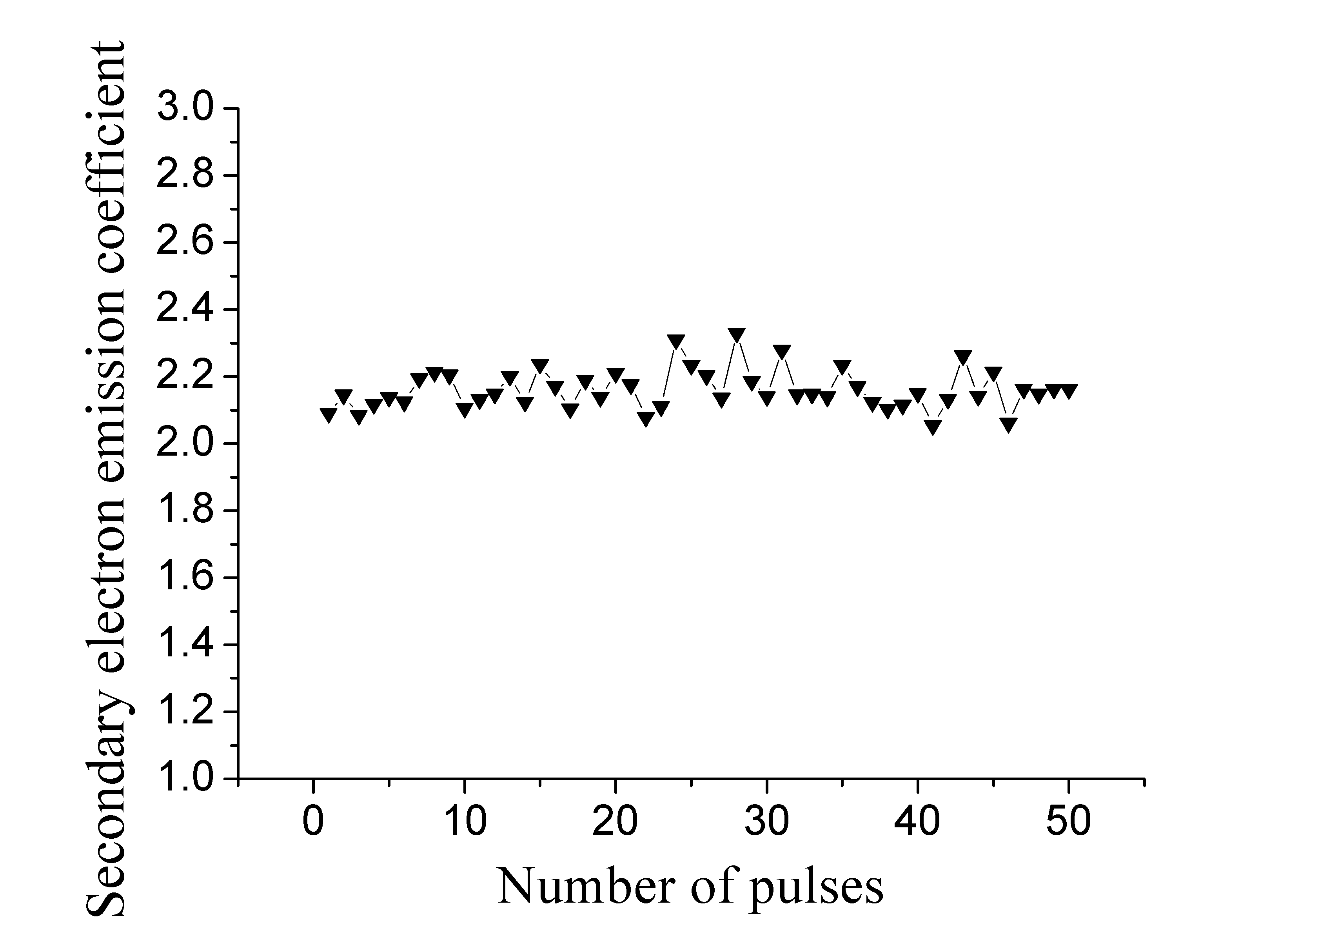
Measurement in pulse mode
In order to study the phenomena and effects of sample charging, the secondary electrons generated by each pulsed electron beam at the same incident energy and incident angle were measured during the measurement.
Sample: Al₂O₃ (10nm)
Substrate: N-type Si
Incident energy: 180 eV
Incident angle: 0°
Pulse width: 20us
pulse interval: 2s
The following figure shows the distribution of secondary electron emission coefficient with number of pulses. As can be seen from this figure, no apparent sample charging was observed, and the measured secondary electron emission coefficient hardly changed with the number of pulses.

Slide 12
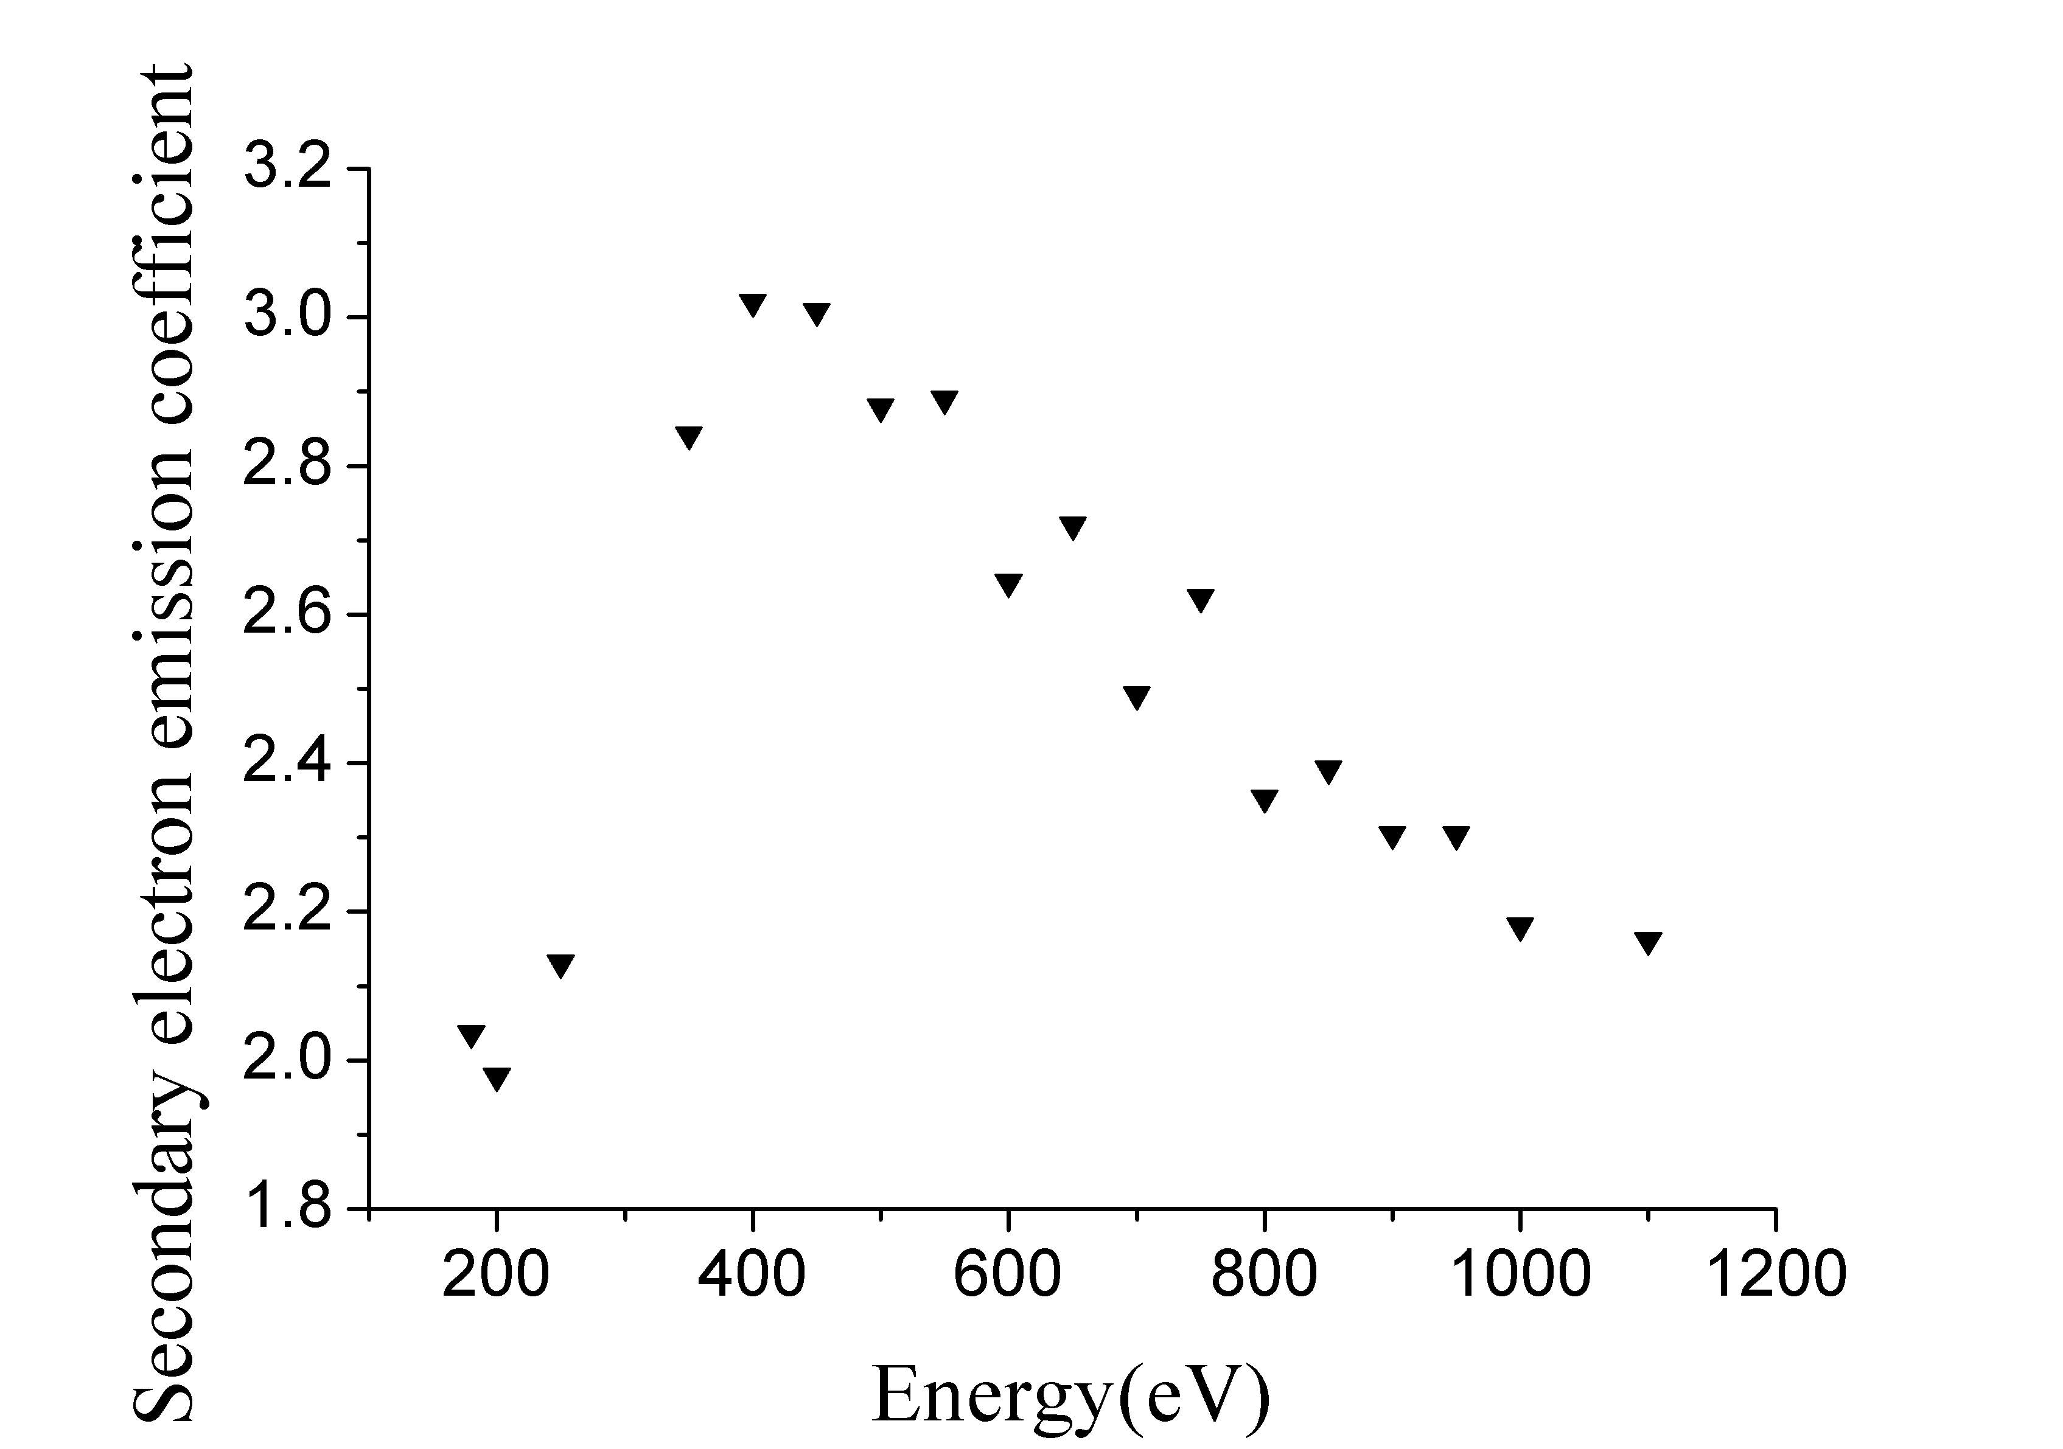
Result
This is the distribution of secondary electron emission coefficient with incident energy, it can be seen that the trend of first rise and fall is obvious, and the secondary electron emission coefficient under each energy is also in good agreement with the known literature.
Sample: Al₂O₃ (10nm)
Substrate: N-type Si
Incident angle:0°
dx.doi.org/10.1016/j.nima.2016.11.064
Due to time constraints, we have not yet measured the secondary electron emission coefficient at an incident energy of 300 eV.
Will be re-measured in the subsequent experiment.

Slide 13
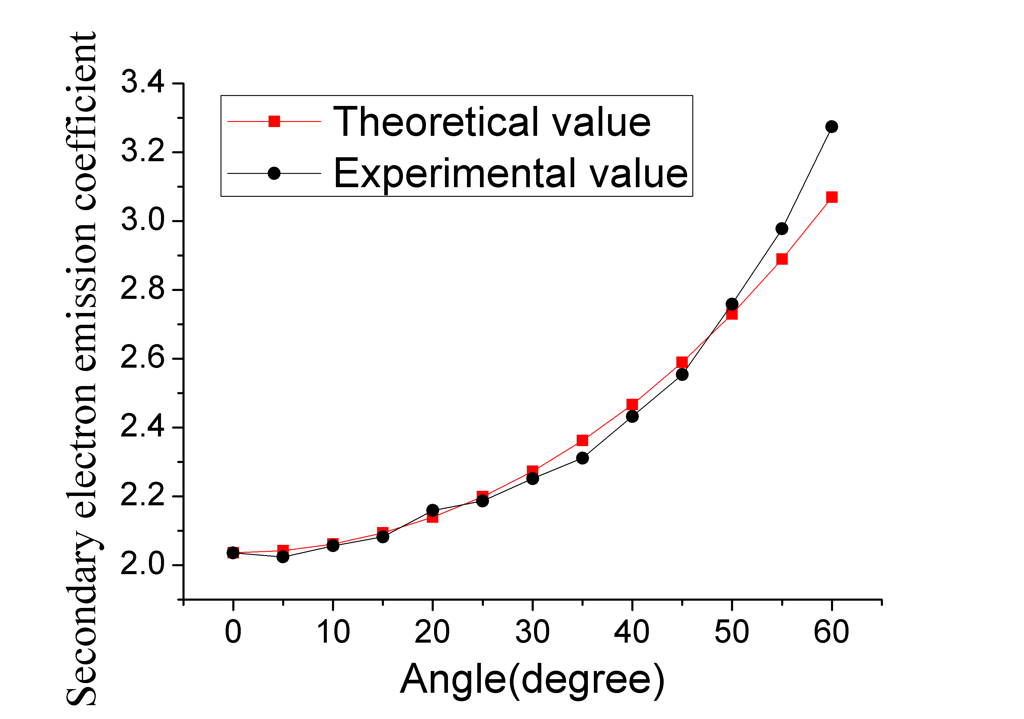
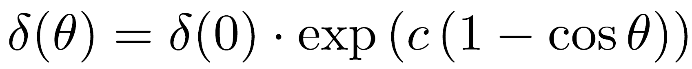
Result
The distribution of secondary electron emission coefficient with incident angle.
Sample: Al₂O₃ (10nm)
Substrate: N-type Si
Incident energy: 180 eV
The red one is the theoretical value calculated by the formula, and the black one is the experimental result. The experimental results are in good agreement with the theoretical expectations.

Slide 14
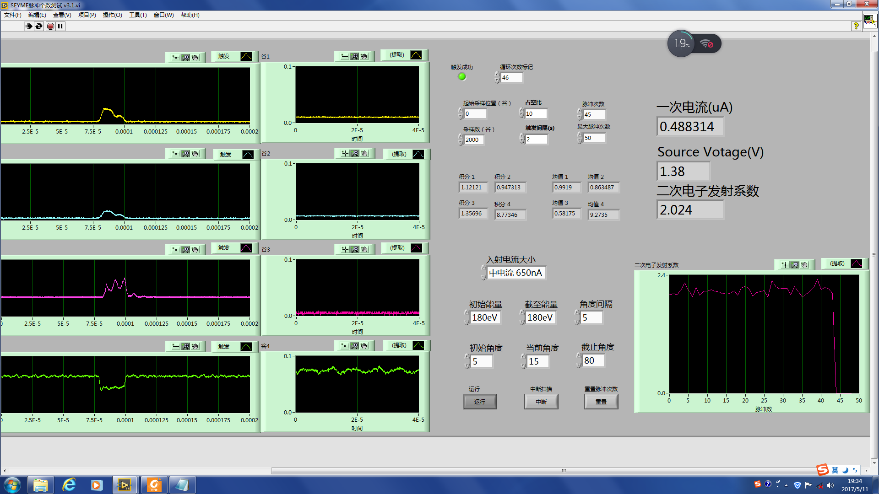
Automatic measurement system based on LabVIEW
The above measurements require a lot of operation, and there are about 20 different energies that need to be measured. And at each energy, there are 18 angles of incidence that need to be measured. At the same time, there are dozens of pulses that need to be measured for each incident energy and incident angle.

Slide 15
Automatic measurement system based on LabVIEW
So, through LabVIEW, we programmed a fully automated measurement system. The system implements the automatic measurement and data storage of the above measurement process. At the same time, the system will automatically analyze the data, real-time display of incident electron current and the second electron emission coefficient. And when the measurement data is recorded, the required distribution map can be calculated directly.

Slide 16
Advantages
The spherical collector means that the electron loss rate is low, the secondary electrons in all directions can be collected, and secondary electrons at different incident angles can be measured by rotating the sample stage.
the spherical structure also means that the distribution of measurement area is spherically symmetric, and the equipment is isotropic, which can reduce the error caused by the equipment.

Slide 17
Summary
What we have achieved：
1. We can measure the secondary electron emission coefficient of each pulse separately in pulsed mode
2. By calculating the integral, we are able to measure the incident electron current and the secondary electron emission coefficient in real time.
3. The distribution of secondary electron emission coefficient with incident energy and incident angle can be measured successfully.
4. The automation of the above measurement process is realized
What we plan to do：
1. Through the PID control, to stabilize the incident electron current
2. To further enhance the performance of the amplifier
3. To achieve its ability to measure the energy resolution of secondary electrons, And to automate the measurement process
That is all, thank you for listening

Slide 18
Summary
In order to improve the performance of MCP and find a high secondary electron emission coefficient material, we designed a measuring equipment that can measure the secondary electron emission coefficient and Energy spectra with different incident energies and incident angles.
we optimized the Faraday cup of this equipment, improved the collection efficiency of the Faraday cup.
Through computer simulation, the magnetic shielding scheme using one-dimensional Helmholtz coils was determined.
In order to measure the secondary electrons in different incident angles, a spherical collector was used.
In order to eliminate the influence of the sample charging, we used a pulsed electron beam as the incident electron.
That is all, thank you for listening

Slide 19
Advantages——Pulsed electron beam
The use of pulsed electron beams as incident electrons is to eliminate the effect of sample charging. When the insulating sample is measured, the sample produces secondary electrons. If the electrons in the insulating layer are too late to be replenished, the sample will be charged, making the secondary electron more difficult to escape. So that the measured secondary electrons will be reduced.
By using a pulsed electron beam, since the current of the electron beam is small and the insulating layer is thin, the insulating layer has enough time between each pulse to replenish the electrons, thereby eliminating the effect of sample charging.
>
-
-
Insulating
layer
+nV
+
-
-
+
-
-
+
-
-
-
0V
+
+
-
+
+
-
-
+
+
+
Conducting layer

Slide 20
二次电子的特性参数
二次电子：是指不同能量的电子入射材料表面，当入射电子能量大于材料发射电子的阈值时，则会导致材料发射次级电子的过程，这部分次级电子称为二次电子。
二次电子发射系数：产生的二次电子与入射的初级电子之间的比值，随入射的初级电子的能量与角度不同而变化。
二次电子发射能谱：产生的二次电子存在一定的能量分布。
该设备的主要目的
测量不同入射能量，入射角度下二次电子发射系数及二次电子发射能谱

Slide 21
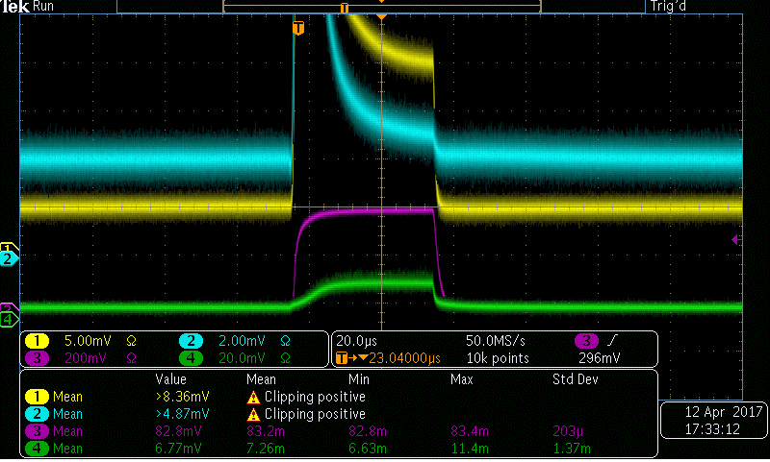
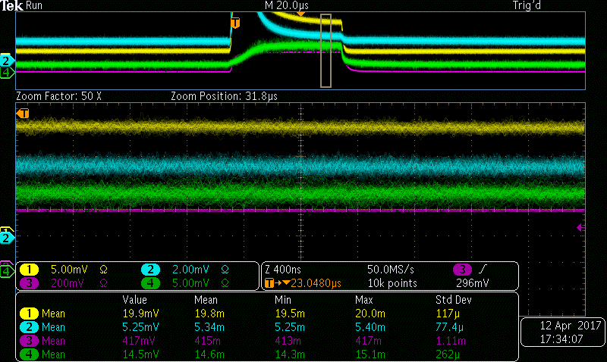
电路测量结果
1.收集极测得电流最大，栅网与样品台测得电流明显偏小
2.内层栅网测得波形与外层栅网类似，但测量结果略高于外层栅网
3.内层栅网与外层栅网测得波形存在强烈的上冲。

Slide 22
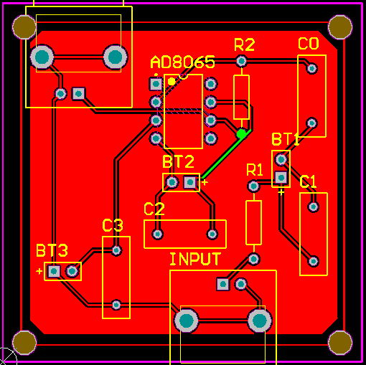
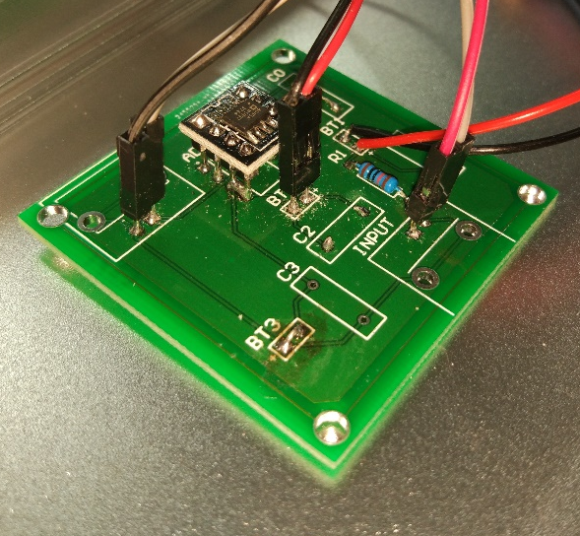
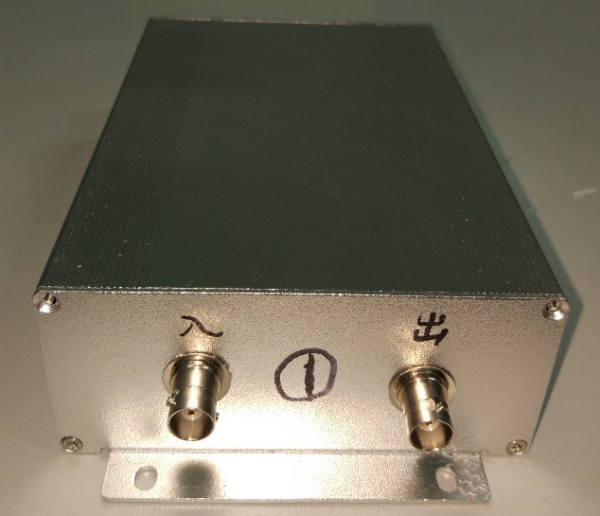
电路设计与制作
收集极
I输入
设计
制图
50V
100kΩ
1kΩ
-
示波器
+
AD8065
接地
焊接
装盒

Slide 23
Summary
In order to improve the performance of MCP and find a high secondary electron emission coefficient material, we designed a measuring equipment that can measure the secondary electron emission coefficient and Energy spectra at different incident energies and incident angles.
And through computer simulation, the magnetic shielding scheme using one-dimensional Helmholtz coils was determined.
In order to measure the secondary electrons at different incident angles, a spherical collector was used. In order to eliminate the influence of the sample charging, we used a pulsed electron beam as the incident electron. And we use the operational amplifier in the readout electronics to ensure that the voltage at the collector is stable during the measurement.

Slide 24
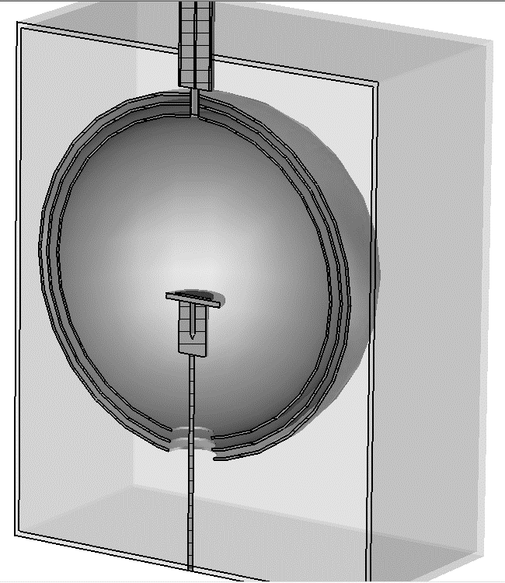
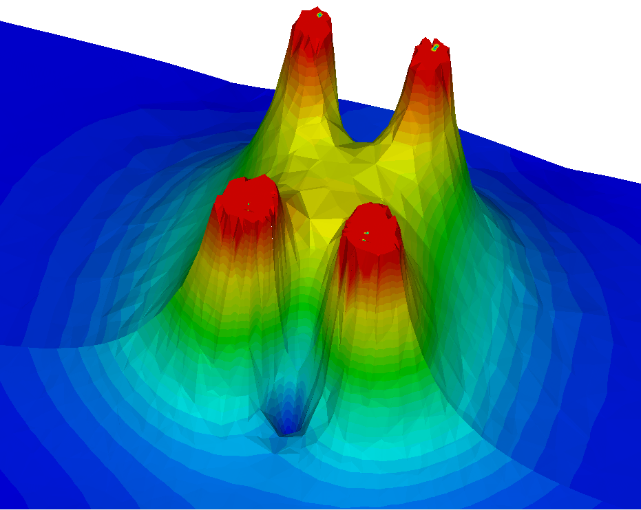
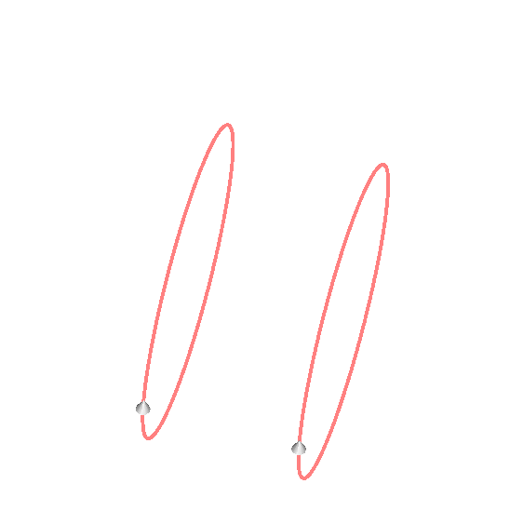
Electron gun：100eV—10keV
Spherical collector：收集二次电子
Grid:可屏蔽电场，做能量分辨
Sample stage：可上下,可旋转
Faraday Cup：
Measure the incident electron current
Vacuum chamber ：
Provide a vacuum environment

Slide 25
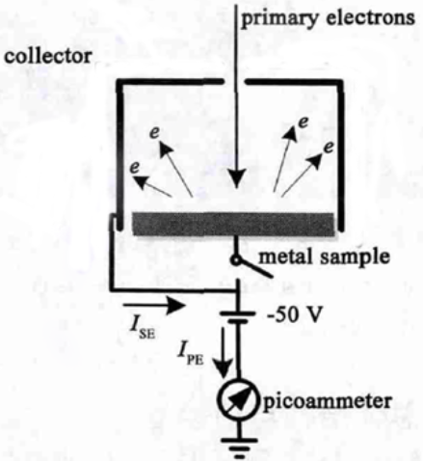
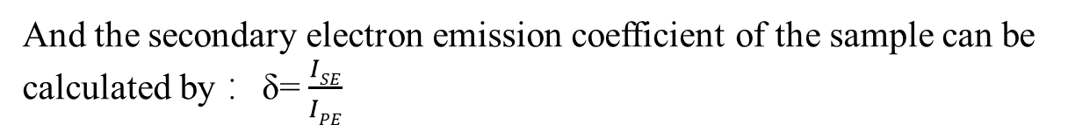
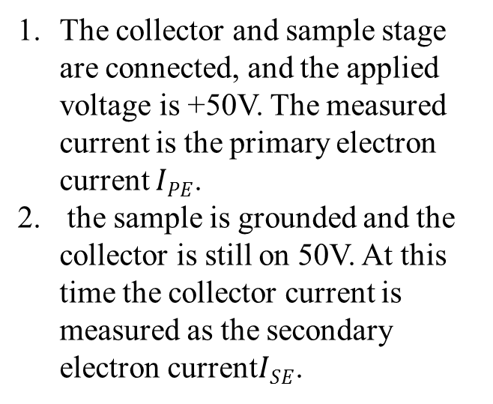
Measurement method
The collector and sample stage are connected, and the applied voltage is +50V. The measured current is the primary electron current $IPE$.
the sample is grounded and the collector is still on 50V. At this time the collector current is measured as the secondary electron current$ISE$.
And the secondary electron emission coefficient of the sample can be calculated by： δ=$\frac{ISE}{IPE}$

Slide 26
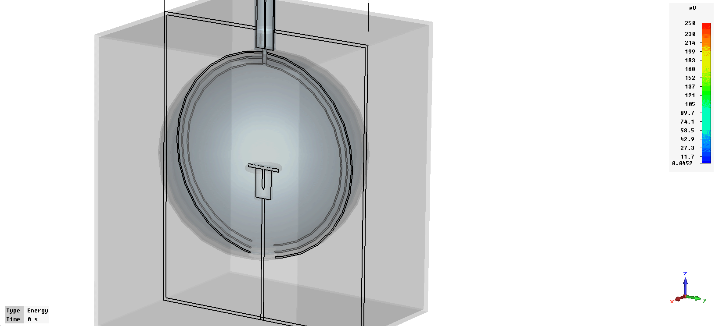
电子枪：100eV—10keV
收集球：收集二次电子
栅网:可屏蔽磁场，做能量分辨
样品台：可上下,可旋转
法拉第杯：测量初级电子
真空腔：提供真空环境

Slide 27
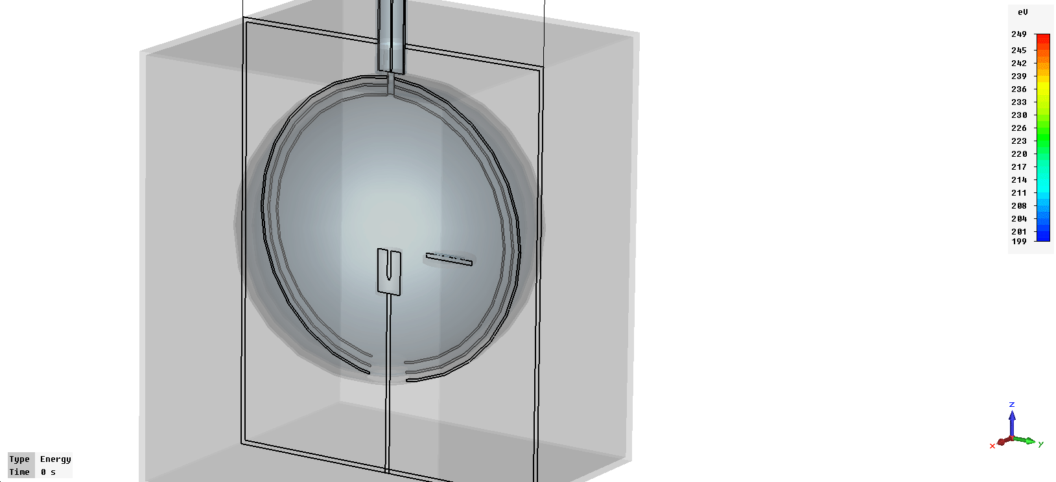
电子枪：100eV—10keV
收集球：收集二次电子
栅网:可屏蔽电场，做能量分辨
样品台：可上下,可旋转
法拉第杯：测量初级电子
真空腔：提供真空环境

Slide 28
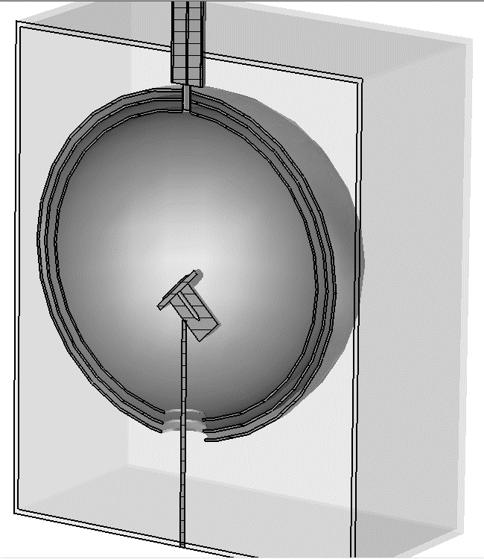

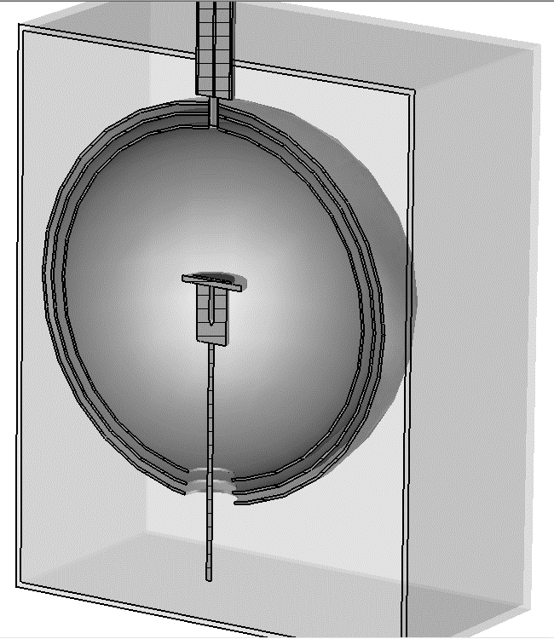
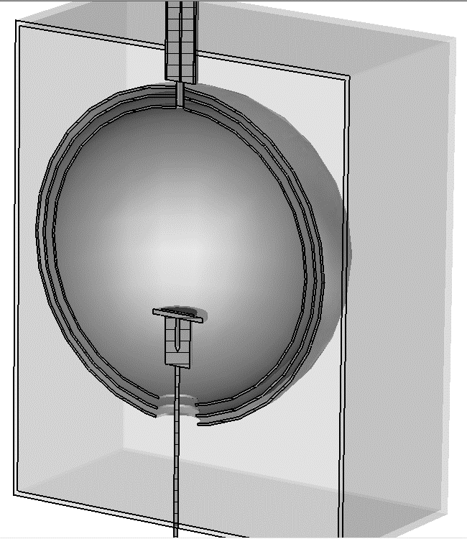
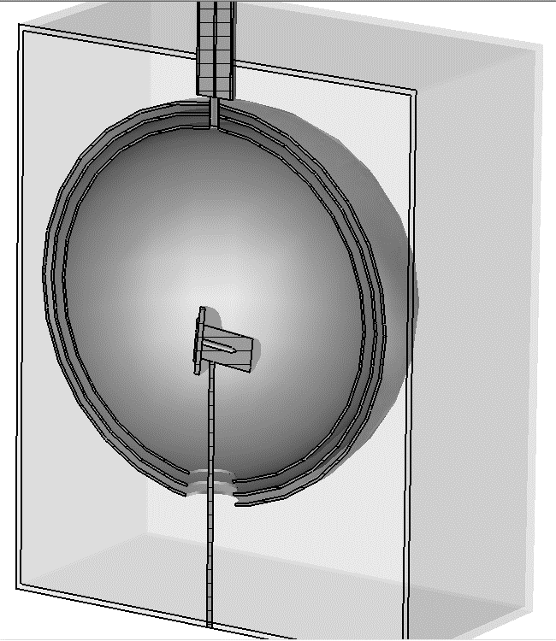
电子枪：100eV—10keV
收集球：收集二次电子
栅网:可屏蔽磁场，做能量分辨
样品台：可上下,可旋转
法拉第杯：测量初级电子
真空腔：提供真空环境

