Slide 1
The 2st International Iopp 9421 Conference
IOPP 9421 Conference
IOPP, Room 9410.
Nov.19—Nov.20

Slide 2
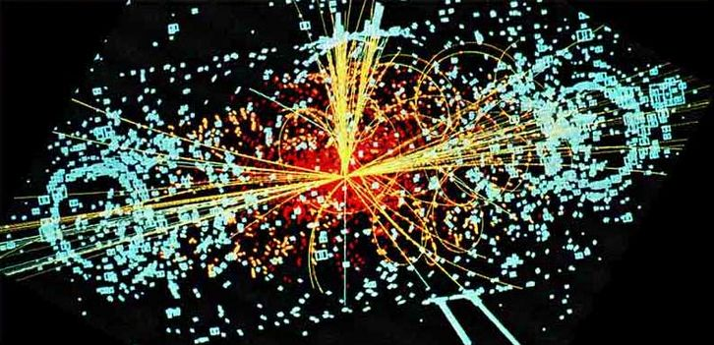
Rindler 坐标图景与匀加速流体力学解 II
Ze-fang Jiang, Chun-bin Yang
Csörgő Tamás, Mate Csanád

Slide 3
Outline
A detailed description of accelerating solutions of relativistic perfect fluid hydrodynamics;
(T. Csörgő, M. I. Nagy, M. Csanád. Phys. Lett. B663 (2008) 306)
(M. I. Nagy, T. Csörgő, M. Csanád. Phys. Rev. C77 (2008), 024908)
Pseudorapidity distribution and Initial energy density of Charged particle at CERN-LHC Energies;
Outlook.

Slide 4
Part 1. Hydrodynamic solution
1.1 Rindler coordinates (Minkovswki Vacuum);
1.2 Metric and covariant derivative;
1.3 Hydrodynamic equation with Rindler coordinates;
1.4 Accelerating solution of relativistic perfect fluid hydrodynamics.

Slide 5
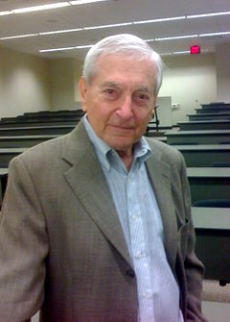
1.1 Rindler coordinates (Minkovswki Vacuum)
What is the Rindler coordinates?
1.In relativistic physics, the Rindler coordinate chart is an important and useful coordinate chart representing part of flat spacetime, also called the Minkowski vacuum.
2.The Rindler coordinate frame describes a uniformly accelerating frame of reference in Minkowski space. In special relativity, a uniformly accelerating particle undergoes hyperbolic motion.
Reference:
Einstein, Albert; Rosen, Nathan (1935). "A Particle Problem in the General Theory of Relativity". Physical Review. 48: 73.
Rindler, Wolfgang (1969). Essential Relativity. New York, Van Nostrand Reinhold Co. doi:10.1007/978-1-4757-1135-6. ISBN 978-0-387-90201-2.
Wolfgang Rindler

Slide 6
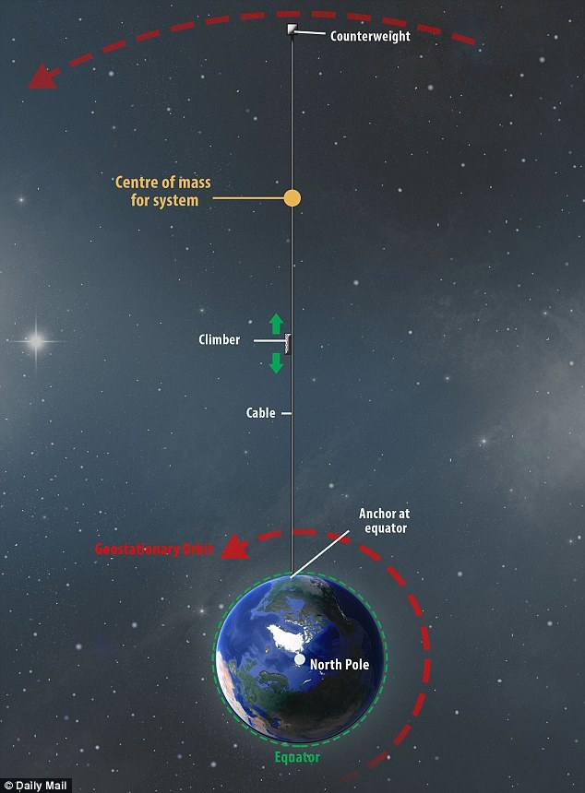
1.1 Rindler coordinates (Minkovswki Vacuum)
What is the acceleration Observer?
What is the proper acceleration
(along the hyperbola)?
What is the difference between Newton's inertial frame?
Koks, Don: Explorations in Mathematical Physics (2006), pp. 240-252
http://astroreview.com/issue/2012/article/black-hole-horizons-and-how-they-begin

Slide 7
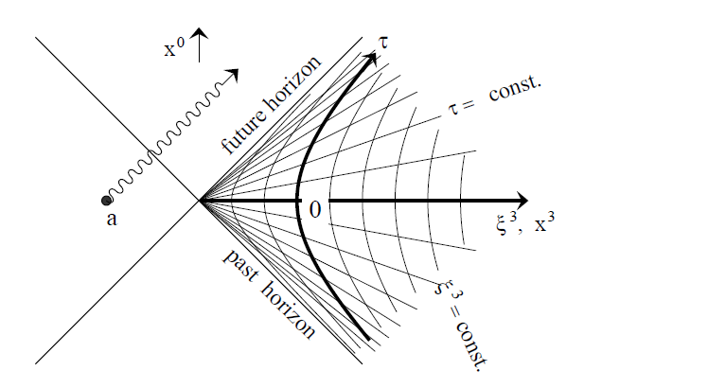
1.1 Rindler coordinates (Minkovswki Vacuum)
Rindler Chart , And why apply to hydrodynamic
Lightcone Rindler Chart
acceleration parameter g=1/r

Slide 8
双曲线运动是变速直线运动？
运动沿惯性系 Σ 系的 x 轴方向，Σ' 系为沿 Σ 系 x 轴以速度 v 运动的某一瞬时惯性系。由洛伦兹变换关系：
其中
c 是光速。
速度变换公式；
相对论下的加速度变换公式；

Slide 9
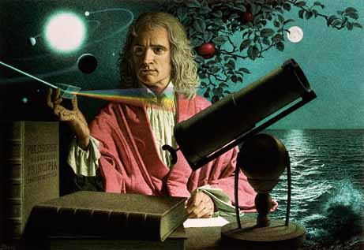
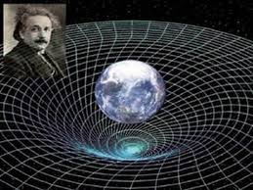
相对论加速度变换公式与牛顿经典力学的区别与对比：
牛顿经典力学遵从伽利略相对性原理，不同的惯性系对同一运动物体的速度描述不同，但对加速度的描述是相同的。在一个惯性系中看到的匀加速运动，在其他惯性系中也都认为是匀加速运动，而且其加速度数值都一致相同。
相对论中，无论从运动学或动力学的角度考虑，没有哪一个惯性系能观察到加速度为定值的运动，否则超光速成为可能。在相对论中提到的匀加速运动，是对作变速直线运动物体的无穷多个瞬时惯性系来讲，各瞬间相对物体静止的每个瞬时惯性系中看到的加速度都相同。这种匀加速运动就是我们讨论的双曲线运动(匀加速运动)。

Slide 10
相对论中的加速度：
物体 Σ' 系相对于瞬时惯性系（ Σ' 系）静止（不妨设 t=0 时刻），加速度为常值 g 加速度（Σ' 系中），在 Σ 系中的观察者看来，由逆变公式，加速度为：
中的 v 为瞬时惯性系（Σ' 系）相对于 Σ 系的速度.
固定加速度物体t=0时刻，v=0
v不是常值，而是t的函数
结论：在Σ 系中看到该物体的加速度随 t 增大而减小。

Slide 11
共动观察者的观测量 I
当知道在 Σ 系中（从 t₀=0 到任意 t 观测到）的物体末速度为 v_{f}
此刻的时间
此刻的固有时（外光锥中）
此刻的位置（外光锥中）

Slide 12
共动观察者的观测量 II
固有时与速度的逆关系：
结论：当在 Σ 系中观测时，当固有时 时，观测到的做匀加速运动的物体末态速度极值为 c 而不会超过光速 c 。
带入末速度到时间与位置信息中，可得到与固有时相关的时间和位置为:

Slide 13
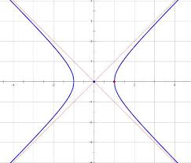
共动观察者的观测量 III
Σ 系时空图：
Σ 系中当 时，t=0, x=0, 当选取合适的坐标原点时（往-x方向平移 单位）得到在 Σ 系描述匀加速运动的方程：
渐近线：

Slide 14
共动观察者的观测量 IV
双生子佯谬：
乘坐飞船的G不可能总相对于某一惯性系静止，否则他将一去不复返，不能再与B相会。
若 B 待在地球，G乘坐飞船做直线运动从地球开始以重力 g 的加速度匀加速2年，再以g匀减速2年到达旅行地点；到达后，立即以g加速2年，接着以 g 减速2年回到地球，飞船上的G认为她飞行了8年，那么地球上的B计算要等待了多久？
E点出发，D点加速完毕，G点减速完毕，到达；H点加速完毕，F点回到地球。
对ED段，
君生我未生，我生君已老； 恨不生同时，日日与君好；
我生君未生，君生我已老；我离君天涯，君隔我海角。

Slide 15
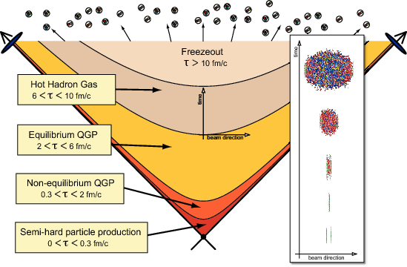
1.1 Rindler coordinates (Minkovswki Vacuum)
Heavy Ion Collision figure

Slide 16
1.2 Metric and covariant derivative;
Useful Background about perfect fluid hydrodynamic solution:
Landau Hydrodynamic and Hwa-Bjorken Hydrodynamic solution
L. D. Landau, Izv. Akad. Nauk Ser. Fiz. 17, 51 (1953);
R. C. Hwa, Phys. Rev. D 10, 2260 (1974)
J. D. Bjorken, Phys. Rev. D 27, 140 (1983).
Why hrdrodynamic can be used in heavy ion collision?
P. F. Kolb, and U. Heinz, arXiv: 0305084 [nucl-th].

Slide 17
1.2 Metric and covariant derivative;
The definiTion of the Rindler coordinates :
Ω stands for the rapidity of the flow.
The domain of the variables is

Slide 18
1.3 Hydrodynamic equation with Rindler coordinates;
The energy-momentum tensor (prefect fluid):
The metric tensor:
u^{μ} and ε, and p are, respectively, the 4-velocity, energy density, and pressure of fluid. ε and p are related by the equation of state(EoS):
is the speed of sound.

Slide 19
The energy-momentum conservation law
The relativistic Euler equation and the energy conservation equation as below:
The general form of the charge conservation equations is as follows

Slide 20
Write down these equations also in a three-dimensional notation.
The thermodynamical quantities obey genreal rules.

Slide 21
Using the assumption :
Rewetring and rerranging the Euler and energy conservation equations :
The solution is easily obtained as (Inside the forward lightcone)

Slide 22
1.4 Accelerating solution of relativistic hydrodynamics
The only possible non-trivial solution in above case, which are 4 different sets of the paremeters λ, κ, d and K the possible cases as follows (λ = 1 is the Hwa-Bjorken solution in 1+1 dimensions.):
Case | λ | d | κ | ϕ
a.) | 2 | R | d | 0
b.) | 1/2 | R | 1 | (κ+1)/κ
c.) | 3/2 | R | (4d-1)/3 | (κ+1)/κ
d.) | 1 | R | R | 0
e.) | R | R | 1 | 0
In all cases, the velocity field and the pressure is expressed as :

Slide 23
2.1 The rapidity distribution
Freeze-out condition: the freeze-out hypersurface is pseudo-orthogonal to the four velocity field u^{u} , and the temperature at η = 0 reachs a given T_{f} valve.
The expression of rapidity distribution in the 1+1 dimensional is as below:
with

Slide 24
2.2 The energy density estimation
Follow Bjorken's method, the initial energy density for acclerationless, boost-invariant Hwa-Bjorken flows
J. D. Bjroken, Phys. Rev. D 27, 140 (1983)
For an accelerating flow, the initial energy density
Here is the proper-time of thermalization, and
is the proper-time of freeze-out.

Slide 25
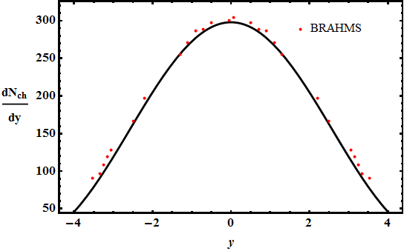
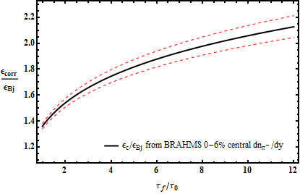
The conclusion of 200 GeV AUAU collision at RHIC eneriges.
I. G. Bearden el al [BRAHMS], Phys. Rev. Lett 94, 162301 (2005)
M. Csanad, T. Csorgo, Ze-Fang. Jiang and Chun-Bin. Yang, arXiv:1609.07176.

Slide 26
Part 2. Initial energy density of pp collision at the LHC

Slide 27
1. The pseudo-rapidity distribution
The relation between rapidity can be writen as follows:
The relation between rapidity with pseudo-rapidity can be writen as follows:
From Buda-Lund model

Slide 28
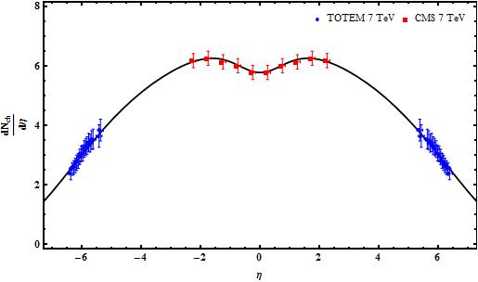
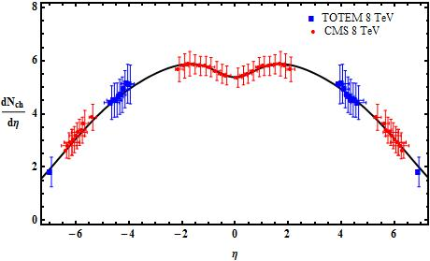
The pseudo-rapidity distribution at CMS+TOTEM
7 TeV and 8 TeV pp collision data.
1. V. Khachatryan, el al [CMS], Phys. Rev. Lett 105, 022002 (2010);
2.The TOTEM Collaboration, Eur. Phys. Lett, 98 (2012) 31002.
3. G. Antchev, el al[TOTEM], arXiv: 1411.4963 (2014);
4. The CMS and TOTEM Collaborations, Eur. Phys. J. C (2014) 74:3053;

Slide 29
The energy density estimation at CMS+TOTEM
7 TeV and 8 TeV pp collision.
Estimation made by Bjorken
The initial energy density are under-eatimatied by Bjorken formula, the corrected are:
Pressure/energy/non-ideal EoS
Effect of the pressure
The expansion of intial volume element

Slide 30
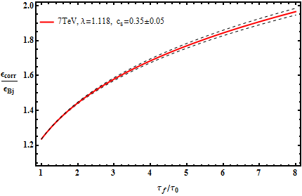
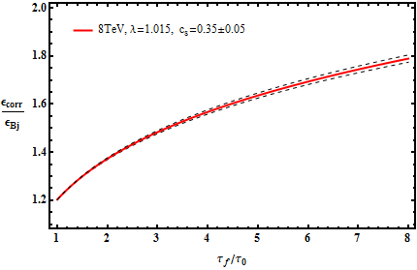
CMS+TOTEM 7 TeV and 8 TeV pp collision.
 |  |  |  | λ
7 TeV | 0.902 | 1.20989 | 1.3001 | 1.118 | 0.12 | 5.895(NSD)
8 TeV | 0.902 | 1.16283 | 1.2367 | 1.101 | 0.12 | 5.38(Inelastic)

Slide 31
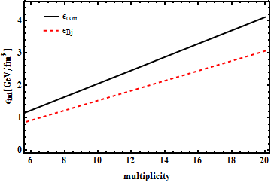
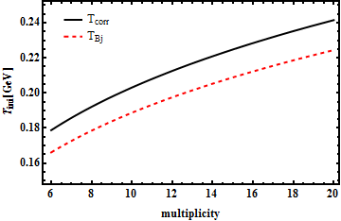
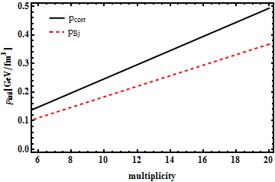
The initial energy density, Temperature and pressureestimate at CERN-LHC
CMS+TOTEM 7 TeV

Slide 32
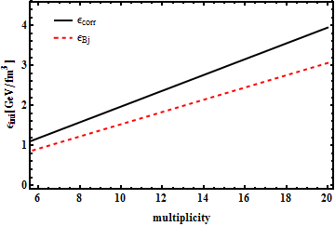
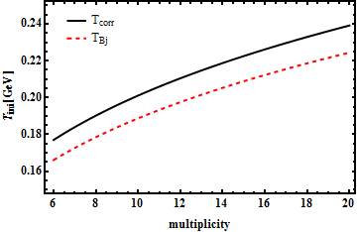
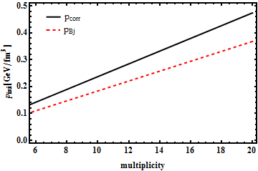
The initial energy density, Temperature and pressureestimate at CERN-LHC
CMS+TOTEM 8 TeV

Slide 33
Part 3. Outlook

Slide 34
1. Heavy ion collision initial energy density estimate.
2. Critial point for QGP.
3. Other Hydrodynamic conclusion.

Slide 35
Thank you

