Slide 1
Boost-Invariant (2+1)-dimensional Anisotropic Hydrodynamics
Wu Xiangyu (CCNU)

Slide 2
Outline
Motivation
Tensor basis
Ideal Hydrodynamics
Azimuthally-Symmetric Anisotropic Hydrodynamics
Initial Conditions
Numerical Methods
Results

Slide 3
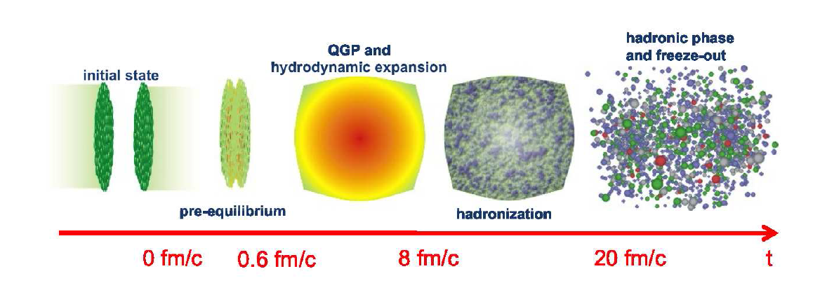
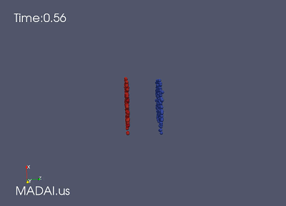
Motivation
Ideal Hydrodynamics
Viscous Hydrodynamics
Weakness:
isotropy in the momentum space

Slide 4
Approximate solutions
Dirk’s method:
$$f\left(x,p\right)=f_{eq}\left(x,p\right)\left(1+φ\left(x,t\right)\right)=f_{eq}\left(x,p\right)(1+c\left(x,t\right)+c_{u}p^{\left\langle u\right\rangle }+c_{uv}p^{\left\langle u\right.}p^{\left.v\right\rangle }+c_{uvλ}p^{\left\langle u\right.}{p^{v}p}^{\left.λ\right\rangle }⋯⋯)$$
Where $p^{\left\langle u_{1}\right.}p^{\left.u_{2}\right\rangle }=∆{}_{v_{1}v_{2}}^{u_{1}u_{2}}{p^{v_{1}v_{2}}}$ stands for symmetrized tensors, orthogonal to $u^{u},$
irreducible tensor basis
An alternative equivalent method:
$p^{u}=Eu^{u}+\sum_{i=1}^{3}{p_{i}{x^{u}}_{i} }$
Where ${x^{u}}_{i}$ is a set of space-like and orthogonal vectors

Slide 5
Tensor basis
A general tensor (4-vector)
$$X{}_{0,LRF}^{u}≡u{}_{0,LRF}^{u}≡(1,0,0,0)$$
$$X{}_{0,LRF}^{u}≡x{}_{0,LRF}^{u}≡(0,1,0,0)$$
$$X{}_{0,LRF}^{u}≡y{}_{0,LRF}^{u}≡\left(0,0,1,0\right)$$
$$X{}_{0,LRF}^{u}≡z{}_{0,LRF}^{u}≡(0,0,0,1)$$
Metric tensor
$$g^{uv}=X{}_{0}^{u}{X{}_{0}^{v}{−\sum_{i}^{3}{X{}_{i}^{u}{X{}_{i}^{v}{}}}}}$$
Projection operator
$$Δ_{}^{uv}=g^{uv}−\sum_{i}^{3}{X{}_{i}^{u}{X{}_{i}^{v}{}}}$$

Slide 6
2nd-rank Tensors
A general rank two tensor can be decomposed using the 4-vectors $X{}_{α}^{u}{}$
$$A^{uv}\left(t,x\right)=\sum_{α,β=0}^{3}{c_{αβ}X{}_{α}^{u}{X{}_{β}^{v}{}}=c_{00}X{}_{0}^{u}{X{}_{0}^{v}{+\sum_{i=1}^{3}{c_{ii}X{}_{i}^{u}{X{}_{i}^{v}{+\sum_{\begin{aligned}α,β=0 \\ α≠β\end{aligned}}^{3}{c_{αβ}X{}_{α}^{u}{X{}_{β}^{v}{}}}}}}}}}$$
$$={}_{}^{}{c_{00}g{}_{}^{uv}{+\sum_{i=1}^{3}{{(c}_{ii}+c_{00})X{}_{i}^{u}{X{}_{i}^{v}{+\sum_{\begin{aligned}α,β=0 \\ α≠β\end{aligned}}^{3}{c_{αβ}X{}_{α}^{u}{X{}_{β}^{v}{}}}}}}}}$$
$$=c_{00}g^{uv}+\sum_{i=1}^{3}{d_{ii}X{}_{i}^{u}{X{}_{i}^{v}{+\sum_{\begin{aligned}α,β=0 \\ α≠β\end{aligned}}^{3}{c_{αβ}X{}_{α}^{u}{X{}_{β}^{v}{}}}}}}$$
If It is a two tensor
$$A^{uv}\left(t,x\right)=c_{00}g^{uv}+\sum_{i=1}^{3}{d_{ii}X{}_{i}^{u}{X{}_{i}^{v}{+\sum_{\begin{aligned}α,β=0 \\ α>β\end{aligned}}^{3}{c_{αβ}(X{}_{α}^{u}{X{}_{β}^{v}{+X{}_{β}^{u}X{}_{α}^{v})}}}}}}$$
So there are only ten independent terms

Slide 7
Ideal Hydrodynamics
Energy-momentum tensor
$$T^{uv}\left(t,x\right)=t_{00}g^{uv}+\sum_{i=1}^{3}{t_{ii}X{}_{i}^{u}{X{}_{i}^{v}{+\sum_{\begin{aligned}α,β=0 \\ α>β\end{aligned}}^{3}{t_{αβ}(X{}_{α}^{u}{X{}_{β}^{v}{+X{}_{β}^{u}X{}_{α}^{v})}}}}}}$$
In the rest frame , we have
$$T{}_{LRF}^{00}{=ε } T{}_{LRF}^{ii}{=P_{i} T{}_{LRF}^{ij}{=0 }i,j=1,2,3}$$
So we can get
$$T{}_{LRF}^{00}{=t_{00} } T{}_{LRF}^{ii}{=P=−t_{00}+t_{ii} T{}_{LRF}^{ij}{=t_{ij}=0 }i,j=1,2,3}$$
Using the conventional notation $X{}_{0}^{u}{=u^{u}}$
$$T{}_{}^{uv}{=(ε+P)}u^{u}u^{v}−Pg^{uv}$$

Slide 8
Azimuthally-Symmetric Anisotropic Hydrodynamics
Considering momentum-space particle distribution is azimuthally symmetric.
$$T{}_{LRF}^{00}{=ε=t_{00}}$$
$$T{}_{LRF}^{xx}{=P_{⊥}={−t}_{00}+t_{11}}$$
$$T{}_{LRF}^{yy}{=P_{⊥}={−t}_{00}+t_{22}}$$
$$T{}_{LRF}^{zz}{=P_{L}={−t}_{00}+t_{33}}$$
Due to azimuthal symmetry $t_{11}=t_{22}$,the energy-momentum tensor is
$$T^{uv}\left(t,x\right)=εg^{uv}+(P_{⊥}+ε)\sum_{i=1}^{2}{X{}_{i}^{u}X{}_{i}^{v}{+\left(P_{L}+ε\right)X{}_{3}^{u}X{}_{3}^{v}{}}}$$
$$=\left(ε+P_{⊥}\right)X{}_{0}^{u}X{}_{0}^{v}{−P_{⊥}g^{uv}+\left(P_{⊥}+P_{L}\right)X{}_{3}^{u}X{}_{3}^{v}{}}$$
Relabeling $X{}_{0}^{u}{=u^{u}}$ and $X{}_{3}^{u}{=z^{u}}$
$$T^{uv}\left(t,x\right)=\left(ε+P_{⊥}\right)u{}_{}^{u}u{}_{}^{v}{−P_{⊥}g^{uv}+\left(P_{⊥}+P_{L}\right)z{}_{}^{u}z{}_{}^{v}{}}$$

Slide 9
Explicit Forms of the Basis Vectors
Ensure the four-vector $z^{u}$ has no transverse components in all frames
$$X{}_{α,LAB}^{u}{={(L_{x}R_{z}L_{z})}^{−1}X{}_{α,lRF}^{u}{={(L_{z}^{})}^{−1}{(R_{z}^{})}^{−1}{(L_{x}^{})}^{−1}X{}_{α,LRF}^{u}{}}}$$
$$X{}_{α,LAB}^{u}{=\left(\begin{matrix}\begin{matrix}coshy & 0 \\ 0 & 1\end{matrix} & \begin{matrix}0 & sinhy \\ 0 & 0\end{matrix} \\ \begin{matrix} 0 & 0 \\ sinhy & 0\end{matrix} & \begin{matrix}1 & 0 \\ 0 & coshy\end{matrix}\end{matrix}\right)\left(\begin{matrix}\begin{matrix}1 & 0 \\ 0 & cosφ\end{matrix} & \begin{matrix}0 & 0 \\ −sinφ & 0\end{matrix} \\ \begin{matrix}0 & sinφ \\ 0 & 0\end{matrix} & \begin{matrix}cosφ & 0 \\ 0 & 1\end{matrix}\end{matrix}\right)\left(\begin{matrix}\begin{matrix}coshψ & sinhψ \\ sinhψ & coshψ\end{matrix} & \begin{matrix}0 & 0 \\ 0 & 0\end{matrix} \\ \begin{matrix}0 & 0 \\ 0 & 0\end{matrix} & \begin{matrix}1 & 0 \\ 0 & 1\end{matrix}\end{matrix}\right)X{}_{α,LRF}^{u}{}}$$
$$u^{0}=coshψcoshy$$
$u^{1}=sinhψcosφ$
$$x^{0}=sinhψcoshy$$
$$x^{1}=coshψcosφ$$
$$u^{2}=sinhψsinφ$$
$$x^{2}=coshψsinφ$$
$$u^{3}=coshψsinhy$$
$$x^{3}=sinhψsinhy$$
$$y^{0}=0$$
$$z^{0}=sinhy$$
$$y^{1}=−sinφ$$
$$z^{1}=0$$
$$y^{2}=cosφ$$
$$z^{2}=0$$
$$y^{3}=0$$
$$z^{3}=coshy$$
Boost invariant
$$y=η_{s}$$

Slide 10
Dynamical Equations
Boltzmann equation
$$p^{u}{∂ }_{u}f\left(x,p\right)=−C[f]$$
$$\hat{I_{n}}=\int{dχ}p^{u_{1}}p^{u_{2}}⋯p^{u_{n}}$$
Nth moment integral operator
Zeroth moment of the Boltzmann equation
$$\int{dχ}p^{u}∂_{u}f=J_{0}$$
$$∂_{u}\int{\frac{d^{3}p}{{(2π)}^{3}}}\frac{p^{u}}{p^{0}}f=J_{0}$$
$$∂_{u}J^{u}=J_{0}$$
$${(J}_{0}≡−\hat{I_{n}}C[f])$$
Rewrite $J^{u}=nu^{u}$
$$∂_{u}J^{u}=Dn+nθ$$
Where D=$u^{u}∂_{u} θ=∂_{u}u^{u}$
First moment of the Boltzmann equation
$$\int{dχ}p^{u}P^{v}∂_{u}f=−\int{dχp^{u}P^{v}C[f]}$$
$$∂_{u}T^{uv}=0$$
Where using collision invariant

Slide 11
Ideal Hydrodynamics
Energy-momentum tensor
$$T{}_{}^{uv}{=(ε+P)}u^{u}u^{v}−Pg^{uv}$$
$$∂_{u}T^{uv}=0$$
$$∂_{u}T^{uv}=u^{v}D\left(ε+P\right)+u^{v}\left(ε+P\right)θ+\left(ε+p\right)Du^{v}−∂^{v}P$$
One takes projections of $∂_{u}T^{uv}=0$ parallel and perpendicular to $u^{u}$
$$u_{v}∂_{u}T^{uv}=Dε+\left(ε+P\right)θ=0$$
$${Δ_{}^{α}}_{v}∂_{u}T^{uv}=\left(ε+P\right){Δ_{}^{α}}_{v}Du^{v}−{Δ_{}^{α}}_{v}∂^{v}P=0$$
Changing to Merlin coordinate
$$u_{τ}=u_{0} { u}_{η_{s}}=0$$
$$\left(ε+P\right)Du_{x}+u_{x}DP+∂_{x}P=0$$
$$\left(ε+P\right){Δ_{}^{α}}_{v}Du^{v}−{Δ_{}^{α}}_{v}∂^{v}P=0$$
$$\left(ε+P\right)Du_{y}+u_{y}DP+∂_{y}P=0$$
$$\left(ε+P\right)Du_{τ}+u_{τ}DP+∂_{τ}P=0$$
So there are (3+1(EOS)) unknown equations and 4 unknown variables. Problem can be solved.

Slide 12
Azimuthally-Symmetric Anisotropic Hydrodynamics
Rotational symmetry in the $P_{⊥}−P_{L}$plane is broken.
Energy-momentum tensor
$$∂_{u}T^{uv}=u^{v}D\left(ε+P_{⊥}\right)+u^{v}\left(ε+P_{⊥}\right)θ+\left(ε+P_{⊥}\right)Du^{v}−∂^{v}P_{⊥}+z^{v}D_{L}\left(P_{L}−P_{⊥}\right)+z^{v}\left(P_{L}−P_{⊥}\right)θ_{L}+\left(P_{L}−P_{⊥}\right)D_{L}z^{v}=0$$
As before we take projections of $∂_{u}T^{uv}=0$ parallel and perpendicular to
$$u_{v}∂_{u}T^{uv}=Dε+\left(ε+P_{⊥}\right)θ+\left(P_{L}−P_{⊥}\right)u_{v}D_{L}z^{v}=0$$
$$Δ{}_{v}^{α}{∂_{u}T^{uv}}=\left(ε+P_{⊥}\right)Du^{α}−∇^{α}P_{⊥}+z^{α}D_{L}\left(P_{L}−P_{⊥}\right)+z^{α}\left(P_{L}−P_{⊥}\right)θ_{L}+\left(P_{L}−P_{⊥}\right)D_{L}z^{α}−\left(P_{L}−P_{⊥}\right)u^{α}u_{v}D_{L}z^{v}=0$$
Changing to Merlin coordinate
Parallel
$$Dε+\left(ε+P_{⊥}\right)θ+\left(P_{L}−P_{⊥}\right)\frac{u_{0}}{τ}=0$$
Transverse
$$\left(ε+P_{⊥}\right)Du_{x}+u_{x}DP_{⊥}+∂_{x}P_{⊥}+\left(P_{⊥}−P_{L}\right)\frac{u_{0}u_{x}}{τ}=0$$
$$\left(ε+P_{⊥}\right)Du_{y}+u_{y}DP_{⊥}+∂_{y}P_{⊥}+\left(P_{⊥}−P_{L}\right)\frac{u_{0}u_{y}}{τ}=0$$
$$\left(ε+P_{⊥}\right)Du_{0}+u_{0}DP_{⊥}−∂_{τ}P_{⊥}+\left(P_{⊥}−P_{τ}\right)\frac{u_{0}u_{x}}{τ}=0$$
Where $D_{L}=z^{u}∂_{u} θ_{L}=∂_{u}z^{u}$

Slide 13
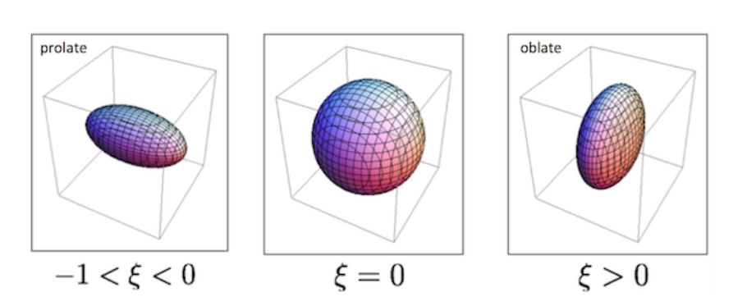
Distribution function for azimuthally-symmetric systems
Consider the one-particle distribution $f$
$$f\left(t,x,p\right)=f_{RS} (P,ξ,Λ)=f_{iso}\left(\sqrt{{\overline{p}}_{u}^{}Ξ^{uv}\left(t,x\right){\overline{p}}_{v}}\right)=f_{iso}(\sqrt{[P{}_{⊥}^{2}{+\left(1+ξ\right)P{}_{z}^{2}]}/Λ^{2}})$$
Anisotropy parameter$ξ$ and hard momentum $Λ$

Slide 14
Number density and Energy-Momentum Tensor
$$n\left(ξ,Λ\right)=\int{\frac{d^{3}p}{{(2π)}^{3}}f_{RS}=\frac{n_{iso}(Λ)}{\sqrt{1+ξ}}}$$
Number density
Energy-momentum tensor
$$T^{uv}=\int{\frac{d^{3}p}{{\left(2π\right)}^{3}}}\frac{p^{u}p^{v}}{p_{0}}f(τ,x,p)$$
$$ε\left(Λ,ξ\right)=T^{ττ}=R(ξ)ε_{iso}(Λ)$$
$$P_{⊥}\left(Λ,ξ\right)=\frac{1}{2}(T^{xx}+T^{yy})=R_{⊥} (ξ)P_{iso}(Λ)$$
${n_{iso}\left(Λ\right),ε}_{iso}\left(Λ\right),P_{iso}(Λ)$ are the isotropic number density ,isotropic density and energy density
$$P_{L}\left(Λ,ξ\right)=−T{}_{ξ}^{ξ}=R_{L} (ξ)P_{iso}(Λ)$$
Where
$$R\left(ξ\right)=\frac{1}{2}(\frac{1}{1+ξ}+\frac{arctan\sqrt{ξ}}{\sqrt{ξ}})$$
$$R_{⊥}\left(ξ\right)=\frac{3}{2ξ}(\frac{1+\left(ξ^{2}−1\right)R(ξ)}{1+ξ})$$
$$R_{L}\left(ξ\right)=\frac{3}{ξ}(\frac{\left(ξ−1\right)R\left(ξ\right)−1}{1+ξ})$$

Slide 15
Dynamical Equations of Motion
Relaxation time approximation
$$C\left[f_{RS}\right]=p_{u}u^{u}Γ[f_{RS}\left(p,ζ,Λ,η_{s}\right)−f_{eq}(\left|p\right|,T)]$$
Zeroth moment of the Boltzmann equation
$$\frac{1}{1+ζ}Dζ−6D\left(logΛ\right)−2θ=2Γ(1−R^{\frac{3}{4}}\left(ξ\right)\sqrt{1+ζ})$$
Energy-momentum conservation
$$R^{′}\left(ζ\right)Dζ+4R\left(ζ\right)D\left(logΛ\right)=−\left(R\left(ζ\right)+\frac{1}{3}R_{⊥}\left(ζ\right)\right)Δ_{⊥}−\left(R\left(ζ\right)+\frac{1}{3}R_{L}\left(ζ\right)\right)\frac{u_{0}}{τ}$$
$$\left[3R\left(ζ\right)+R_{⊥}\left(ζ\right)\right]Du_{⊥}=−u_{⊥}[{R^{′}}_{⊥}\left(ζ\right)\tilde{D}ζ+4R_{⊥}\left(ξ\right)\tilde{D}\left(\log\left(Λ\right)\right)+\frac{u_{0}}{τ}(R_{⊥}\left(ζ\right)−R_{L}\left(ζ\right))]$$
$$u{}_{y}^{2}{\left[3R\left(ζ\right)+R_{⊥}\left(ζ\right)\right]}D\left(\frac{u_{x}}{u_{y}}\right)=R{}_{⊥}^{′}{(ζ)}D_{⊥}ζ+4R_{⊥}(ζ)D_{⊥}(logΛ)$$
Where
$$\tilde{D}=u_{0}∂_{τ}+\frac{{u_{0}^{}}^{2}}{{u_{⊥}^{}}^{2}}u_{⊥}∇_{⊥}$$
$$∆_{⊥}=∂_{τ}u_{0}+∇_{⊥}u_{⊥}$$
$$D_{⊥}={u_{x}∂}_{y}−{u_{y}∂}_{x}$$

Slide 16
Ideal Boost Invariant Dynamics with Transverse Expansion
4-Velocity
$$u^{u}=(coshψcoshη,sinhψcosφ,sinhψsinφ,coshψsinhη)$$
Relabel the components of $u^{u}$
$$u^{u}=(u_{0}coshη,u_{x},u_{y},u_{0}sinhη)$$
Where the constraint $u{}_{0}^{2}{=1+u{}_{x}^{2}+u{}_{y}^{2}{}}$
Changing to Merlin coordinate
$$u_{τ}=u_{0} { u}_{η_{s}}=0$$
$$\left(ε+P\right)Du_{x}+u_{x}DP+∂_{x}P=0$$
$$\left(ε+P\right){Δ_{}^{α}}_{v}Du^{v}−{Δ_{}^{α}}_{v}∂^{v}P=0$$
$$\left(ε+P\right)Du_{y}+u_{y}DP+∂_{y}P=0$$
$$\left(ε+P\right)Du_{τ}+u_{τ}DP+∂_{τ}P=0$$

Slide 17
Motivation
Ideal Hydrodynamics
Soft collective flow and single spectra
Now: Viscous Hydrodynamics $η/s$
Weakness: isotropy in the momentum space
Conception setup: relaxing the isotropy in the momentum space

