Slide 1
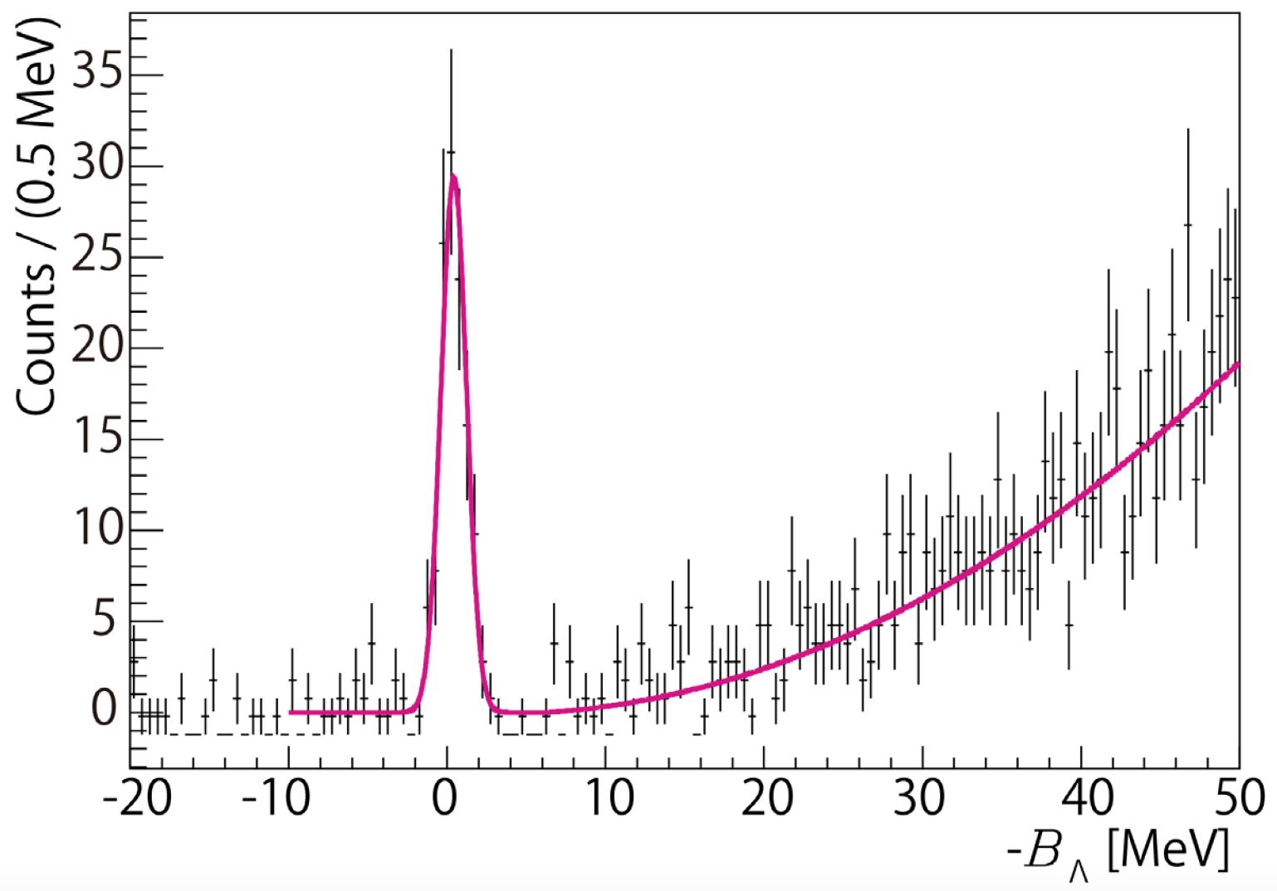
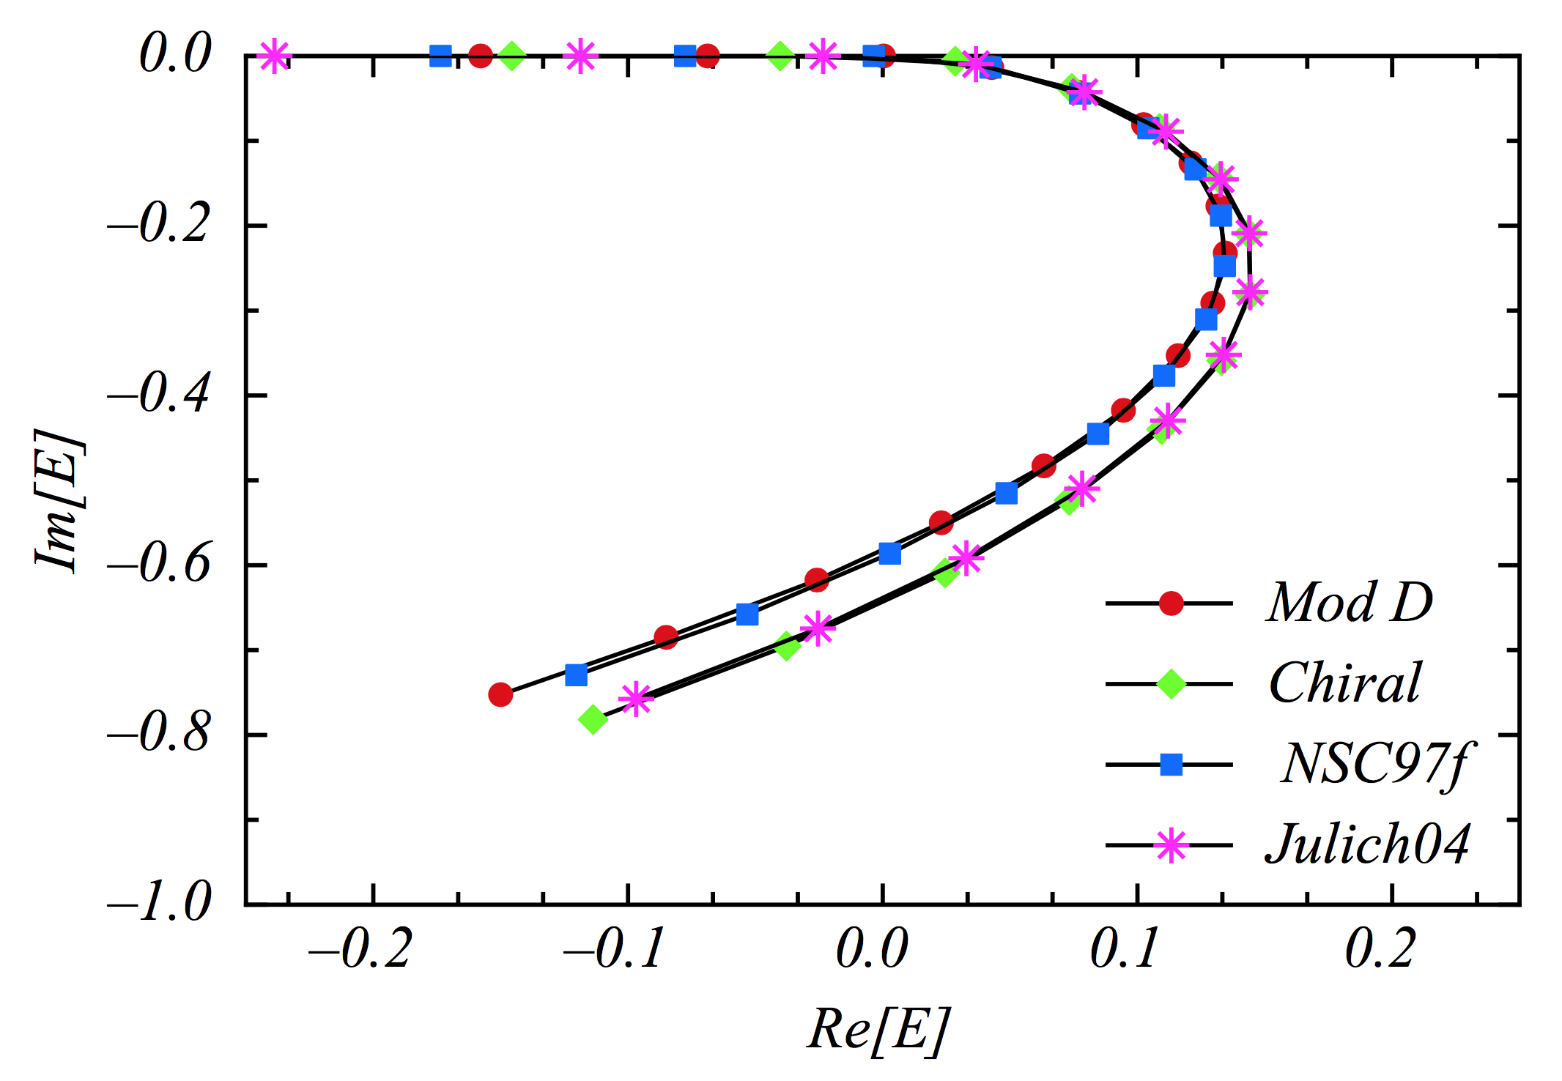
Determining the Unknown Λn Interaction by Investigating the Λnn Resonance
Production of Hypernuclei at JLab
with CW Electron Beam
L. Tang
Hampton University / JLAB
On behalf of Hall A collaboration
APFB 2017, Guilin, China, August 26 - 30, 2017

Slide 2
INTRODUCTION
Understanding the bayronic interaction with all flavors is one of the essential goals of nuclear physics.
For NN interaction, there are plenty of scattering data, while for the YN and YY interactions scattering data are extremely limited or none. For the JLab program on hypernuclei we focus on the ΛN interaction.
Experimental data from study of hypernuclei have so far made significant contribution in acquiring indirect or supplemental information on the ΛN interact, such as the high precision spectroscopy obtained from the JLab hypernuclear experiments.
However, the standing puzzles (such as Charge-Symmetry-Breaking and “Hyperon Puzzle” on neutron star’s mass) may still be better resolved by direct ΛN interaction data.

Slide 3
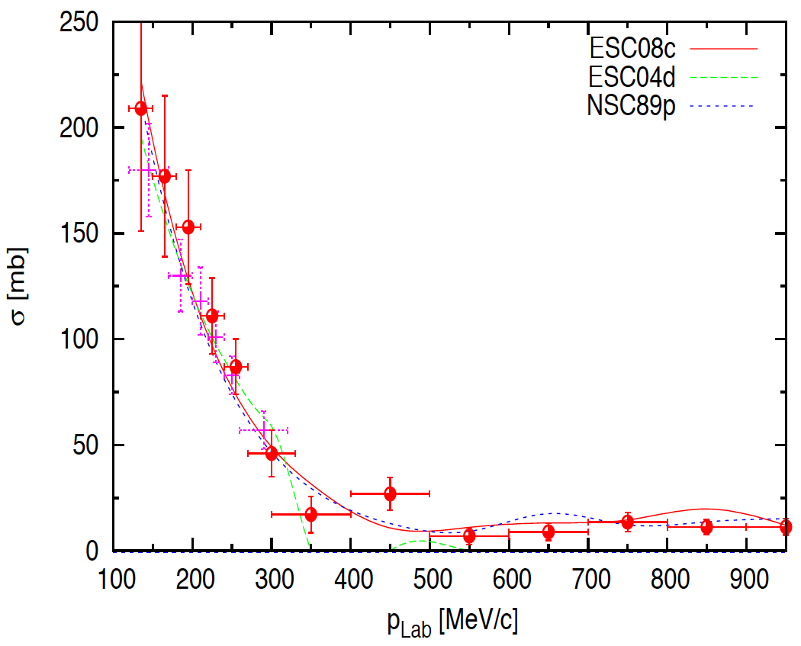
MODELING THE B-B INTERACTION
APPROACH: Combined analysis with input from available NN, YN, YY scattering data, nuclear and hypernuclear data on BE and U_{Y}, plus hadron physics (Experiments and Theory on flavors, quarks, QCD dynamics)
N-N Scattering
> 4000 events
+ low energy part
This made NN interaction much better understood
Λ-p Scattering
~ A few hundred events
Uncertainty >20% at low energy
(Need further improve)
Λ-n Scattering
None!
Based on the NN interaction, the Λn interaction is treated to have the same property as that of Λp interaction

Slide 4
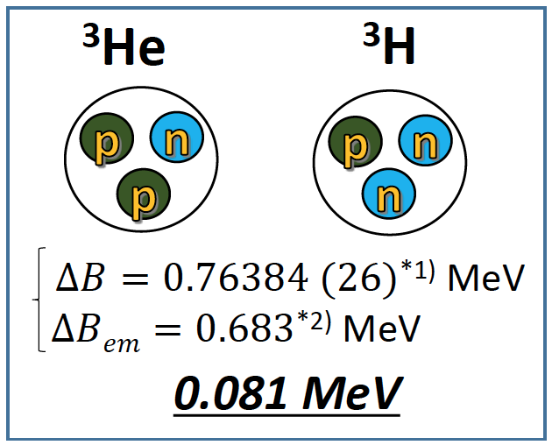
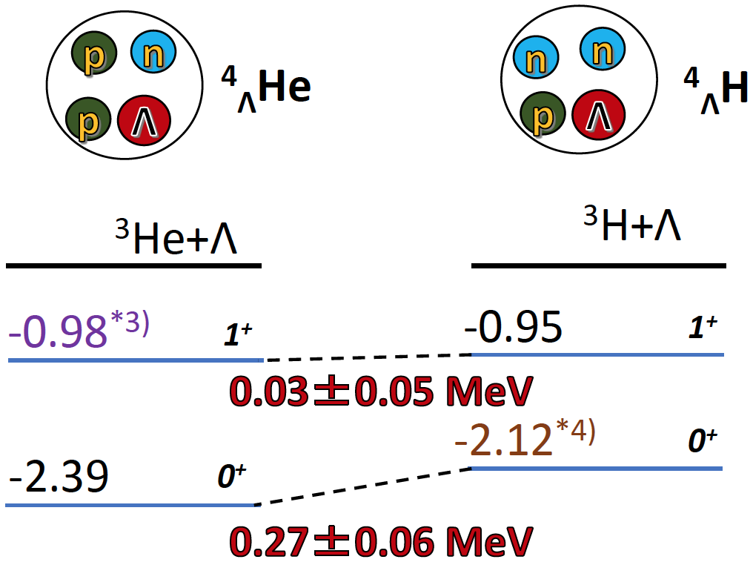
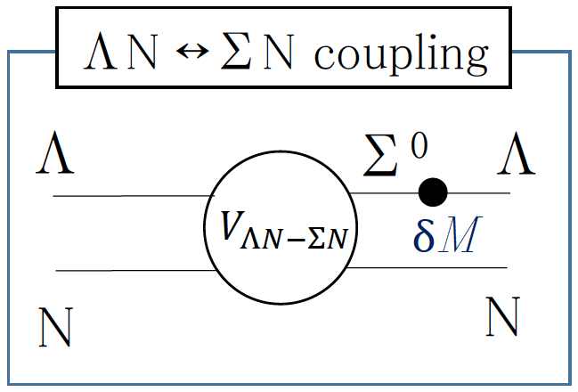
CHARGE SYMMETRY BREAKING (CSB)
N-N Interaction
Λ-N Interaction
-
-
*1) J.H.E. Mattauch et al., Nucl. Phys. 67, 1 (1965).
*2) R.A. Brandenburg et al., NPA 294, 305 (1978).
*3) T.O. Yamamoto et al., Phys. Rev. Lett. 115, 222501 (2015).
*4) A. Esser et al., Phys. Rev. Lett. 114 232501 (2015).
This leads to:
Good approximation w/o CSB.
Common for B-B interactions,
i.e. Λp and Λn interactions are
treated basically identical.
D. Gazda, A. Gal, Nucl. Phys. A 954, 161 (2016).
A. Gal, Phys. Lett. B 744 352 (2015).
Experimental data of Λn interaction becomes extremely valuable

Slide 5
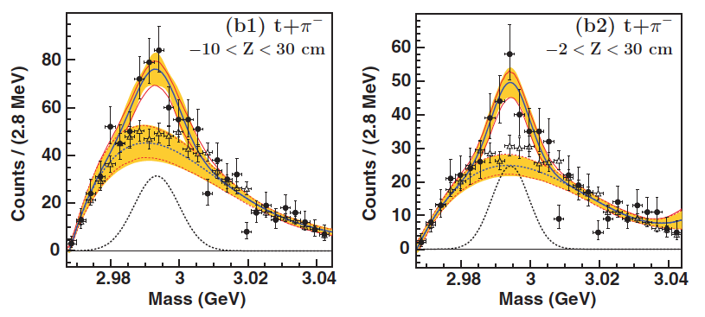
DISCOVERY OF A Λnn SYSTEM
⁶Li (2A GeV) on ¹²C target and study the invariant mass of final state particles
JJ
JJ
C. Rappold et al., Phys. Rev. C 88, 041001(R) (2013)
It was claimed to a bound state.
All theoretical analyses applying the current YN interaction modes ruled it out.
Question 1: Can it be a physical resonance?
Question 2: If it is a resonance, does it provide us for the first time the
experimental information about Λn interaction?

Slide 6
THEORY INVESTIGATION ON Λnn RESONANCE
Iraj R. Afnan and Benjamin F. Gibson, Phys. Rev. C 92, 054608 (2015)
Pairwise interactions of rank one, i.e. separated potentials for nn and Λn interactions.
Four different baryonic potential models were used to fit for the effective range parameters of the nn and Λp interactions from the existing scattering data.
Solving the Λnn Faddeev equations into the second complex energy (E) plane and examining the eigenvalue.
Assume Λn and Λp interactions are the same to begin. Continuously scaling up Λn strength, 2.5% per step, to obtain an eigenvalue spectrum.
A Λnn 3-body system
>25%
(Bound)
Real
resonance
(MeV)
Start
5%
Sub-threshold
resonance
(MeV)
The observed Λnn system is likely to be pure T=1 3-body resonance
By measuring the BE and Width of the resonance peak, the Λn interaction strength relative to Λp interaction can be determined for the first time by an experimental data.

Slide 7
A UNIQUE EXPERIMENT ONLY AT JLAB
Production: ³H(e, e’K⁺)(Λnn) reaction.
With good CEBAF beam quality (δE/E ≈ 10⁻⁴), excellent HRS spectrometer resolutions on momentum (δp/p ≈ 10⁻⁴) and angle (δϑ ≤ 5 mr), and simultaneous production of Λ and Σ⁰ from a H₂ target,
Δ(BE)_{sys} < ±0.1 MeV (absolute mass)
Energy resolution (peak width) < 1.8 MeV FWHM.
The opportunity is unique and not possible elsewhere.
A T₂ target will be available for the five approved experiments in Hall A:
E12-10-103, E12-11-112, E12-14-109 (single arm)
E12-14-011 and E12-17-003 (coincidence)

Slide 8
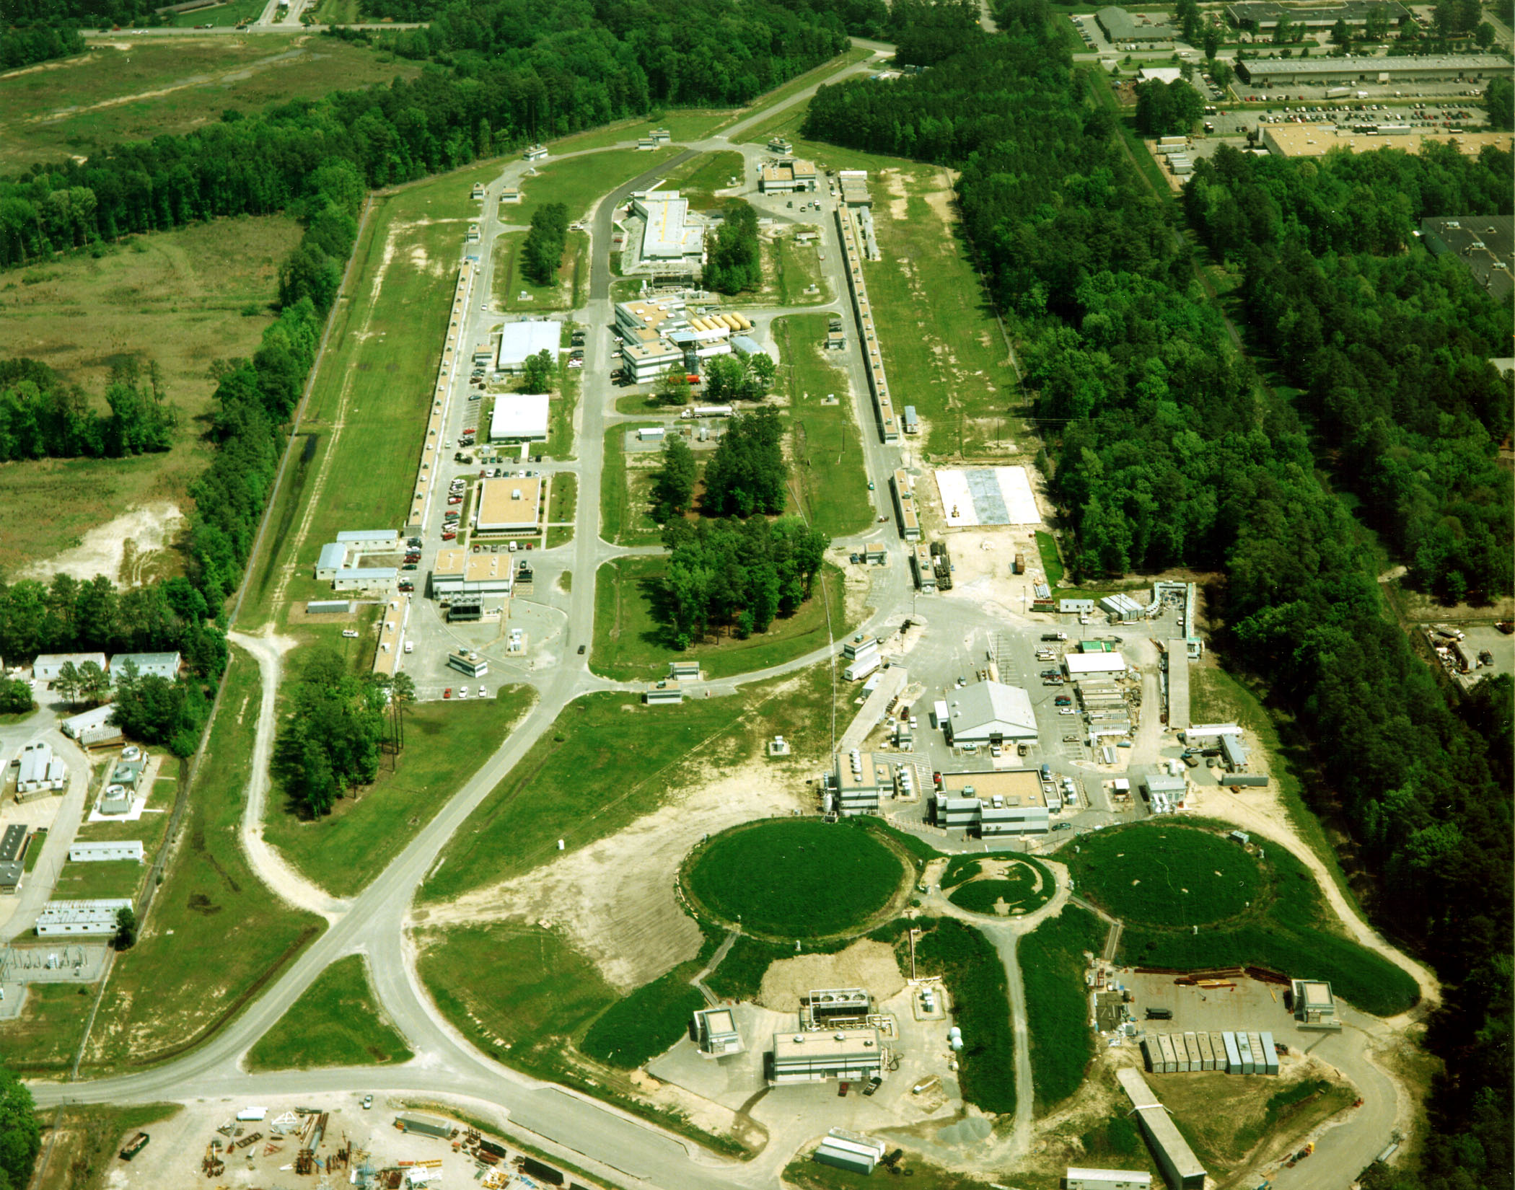
EXPERIMENT E12-17-003 IN HALL A
Continuous Electron Beam Accelerator Facility (CEBAF)
Hall A and HRS spectrometers
D
East Arc
North
Linac
FEL
South
Linac
MCC
West Arc
Injector
A
C
B
Kinematics configuration (q ≈ 383 MeV/c)
Beam energy (2-passes, 2.2 GeV per pass)/Current | 4.3 GeV/20 μA
e’ HRS central momentum (acceptance) | 2.224 GeV/c (±4.5%)
e’ HRS central angle (acceptance) | 12.5° (6 msr)
K⁺ HRS central momentum (acceptance) | 1.8 GeV/c (±4.5%)
K⁺ HRS central angle (acceptance) | 12.75° (6 msr)

Slide 9
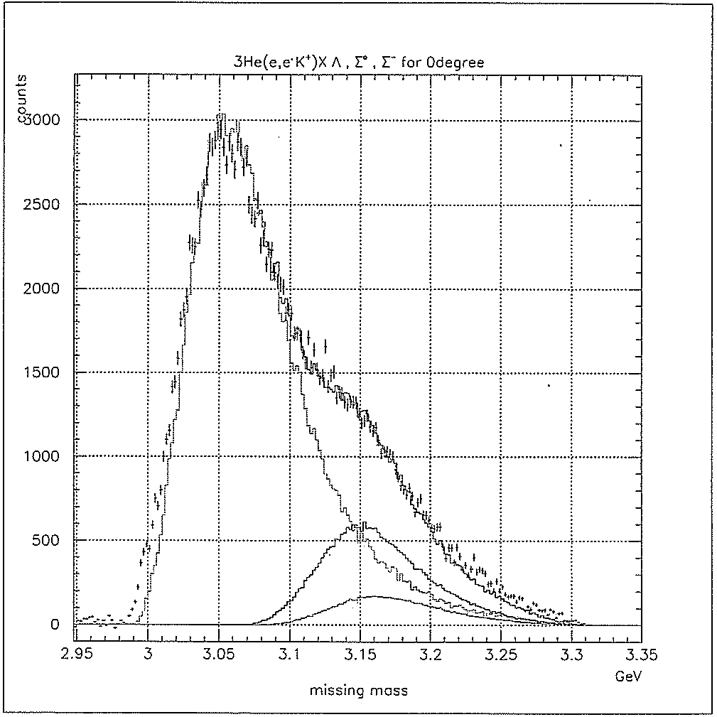
HALL C E91-016: PROVIDED KNOWN INFOMATION
³He(e,e’K⁺) Reaction
Q² and q to Λ are identical to the proposed experiment.
T = 1 Λpn and Λnn systems are identical.
T₂ target: Λ and Σ⁰ productions are reduced by 2 while Σ⁻ increases by 2.
Λnn resonance is expected to locate within ~1 MeV above threshold, no quasi-free distribution influence.
The known information from E91-016 helped to a reliable estimate on yield, singles rate, and ACC rate.
Λd, T = 0 and 1
Λpn, T = 1
Λ
Σ⁰
Σ⁻
Missing Mass (GeV)
A. Uzzle, Ph.D. dissertation and F. Dohrmann et al., PRL 93, 242501 (2004).
Expected Resonance Yield Rate
Ratio of FSI events over the entire Λ production: ≥ 3% (excluding Σ⁰ and Σ⁻).
The entire FSI should be pulled into the expected resonance.
Taking 3% as the minimum, ~120 counts from 10 approved PAC days.

Slide 10
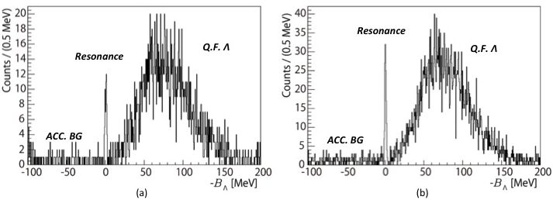
EXPECTED RESULT - SIMULATIONS
At the level of ~ 60 counts
At the level of ~ 120 counts
Assumptions: Gaussian peak @ B_{Λ} = 0.5 MeV, Γ = 0.5 MeV, energy resolution 2 MeV FWHM
With about 60 counts, a peak should be observed - Minimum
With 120 counts, a solid determination on B_{Λ} and Γ can be achieved with reasonable statistical uncertainty.

Slide 11
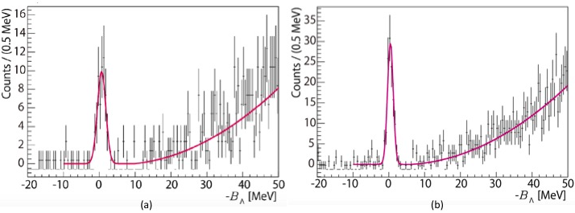
UNCERTAINTIES – SIMULATIONS
At the level of ~ 60 counts
At the level of ~ 120 counts
Statistics / Uncertainty | δB_{Λ} | δΓ
60 counts | ± 0.18 MeV | ± 0.20 MeV
120 counts | ± 0.09 MeV | ± 0.07 MeV

Slide 12
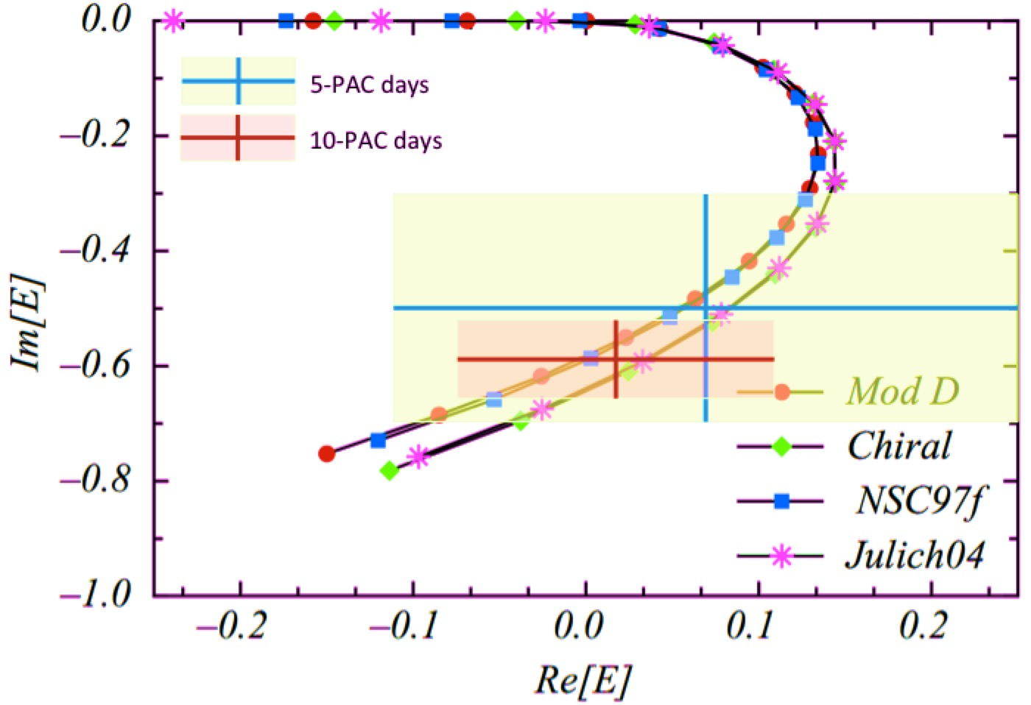
UNCERTAINTY VS IMPACT
Uncertainty size is NOT for judging the correctness of baryonic models.
It marks a REGION that determines the strength and low energy property of the Λn interaction.
Further significant reduction comes from improving Energy Resolution.

Slide 13
SUMMARY
Λnn resonance can be a unique tool to determine the unknown Λn interaction.
A JLab experiment using the (e,e’K⁺) reaction is the only possible experiment to determinate the Λn interaction for the first time experimentally.
The experiment will be carried out in October, 2018.
The result may be the only experimental source to investigate the Λn interaction for long time.
Welcome to HYP2018, June 24 – 29, 2018
https://www.jlab.org/conferences/hyp2018/
Norfolk, Virginia, U.S.A

Slide 14
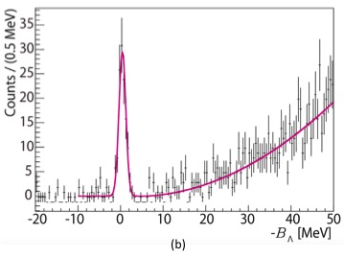
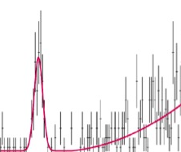
EFFECT FROM 15% ³He CONTEMINATION
Λnn Resonance
³_{Λ}H g.s.
or FSI
(T₂ kinematics)
Λ quasi-free

Slide 15
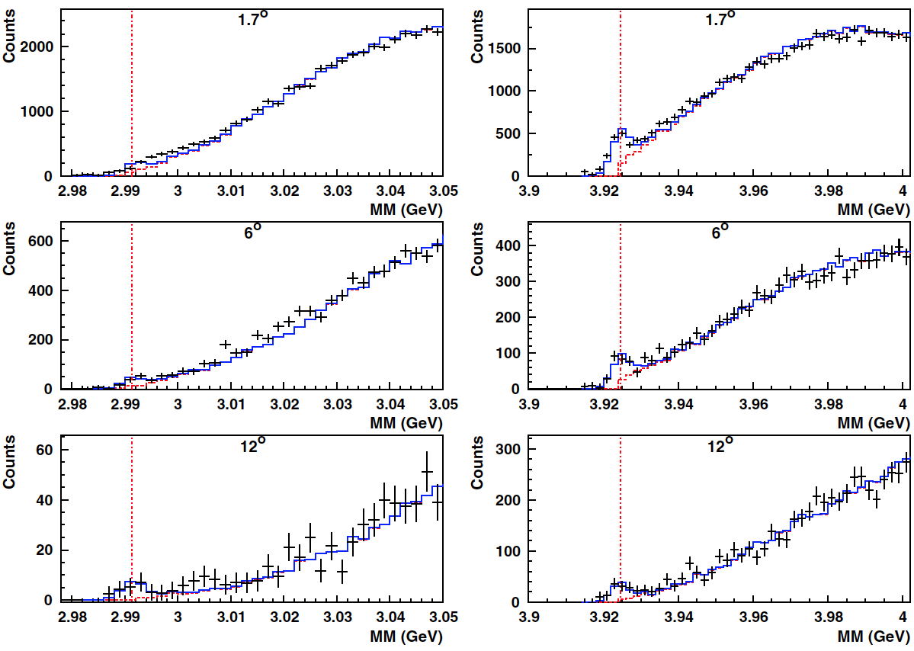
PUBLISHED E91-016 RESULT ON PRL (2004)
³He(e,e’K⁺)(³_{Λ}H, Λd & Λpn)
⁴He(e,e’K⁺) ⁴_{Λ}H
Red vertical line: Threshold
Red solid line: Simulation on Λ quasi-free
Cross points: Data
Blue solid line: Quasi-free plus a suggested fitted Gaussian peak

