Slide 1
s, pentaquarks or excited heavy baryons, or both?
Hyun-Chul Kim
Department of Physics
Inha University
APFB2017@Guilin, 25-29 August, 2017, China

Slide 2
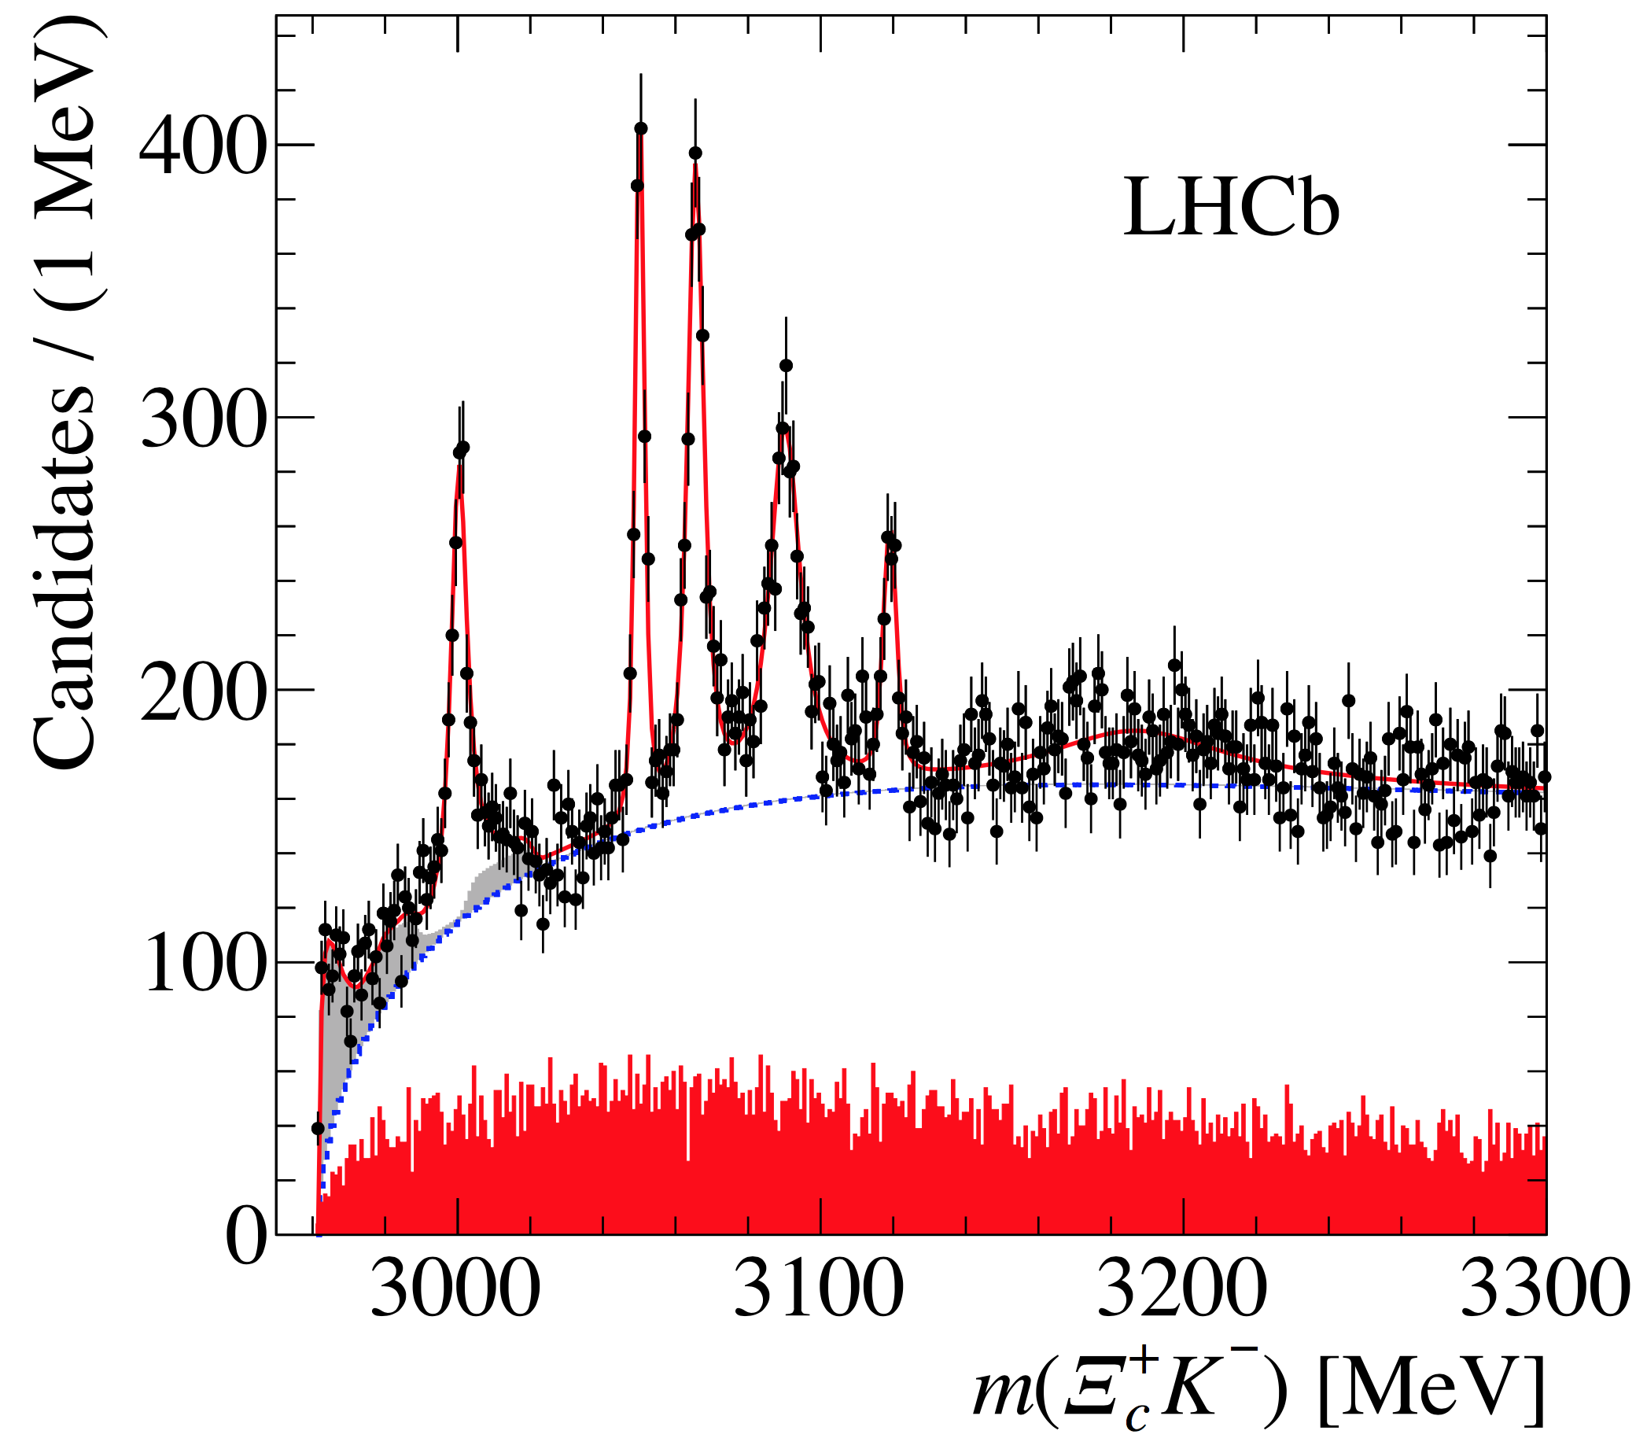
LHCb Findings: New five Omega_cs
Five s were
announced by LHCb Coll.
LHCb Collaboration, PRL 118 (2017) 182001

Slide 3
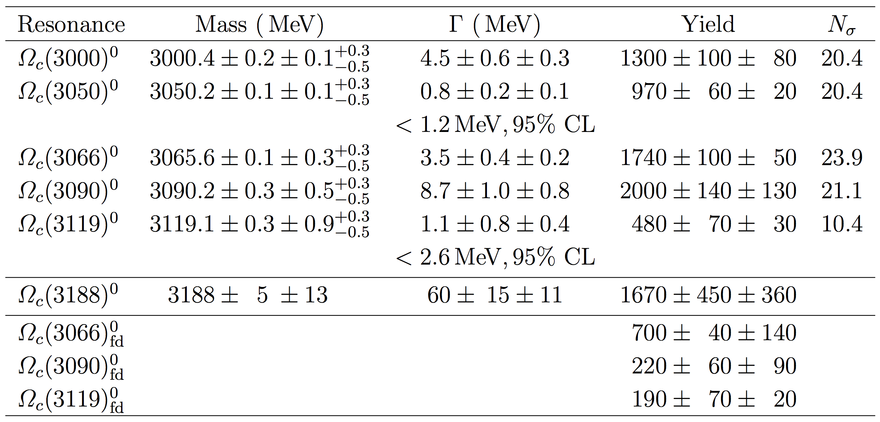
LHCb Findings: New five Omega_cs
The Widths are rather small, even if we consider the fact that heavy baryons have smaller widths than light ones.
LHCb Collaboration, PRL 118 (2017) 182001

Slide 4
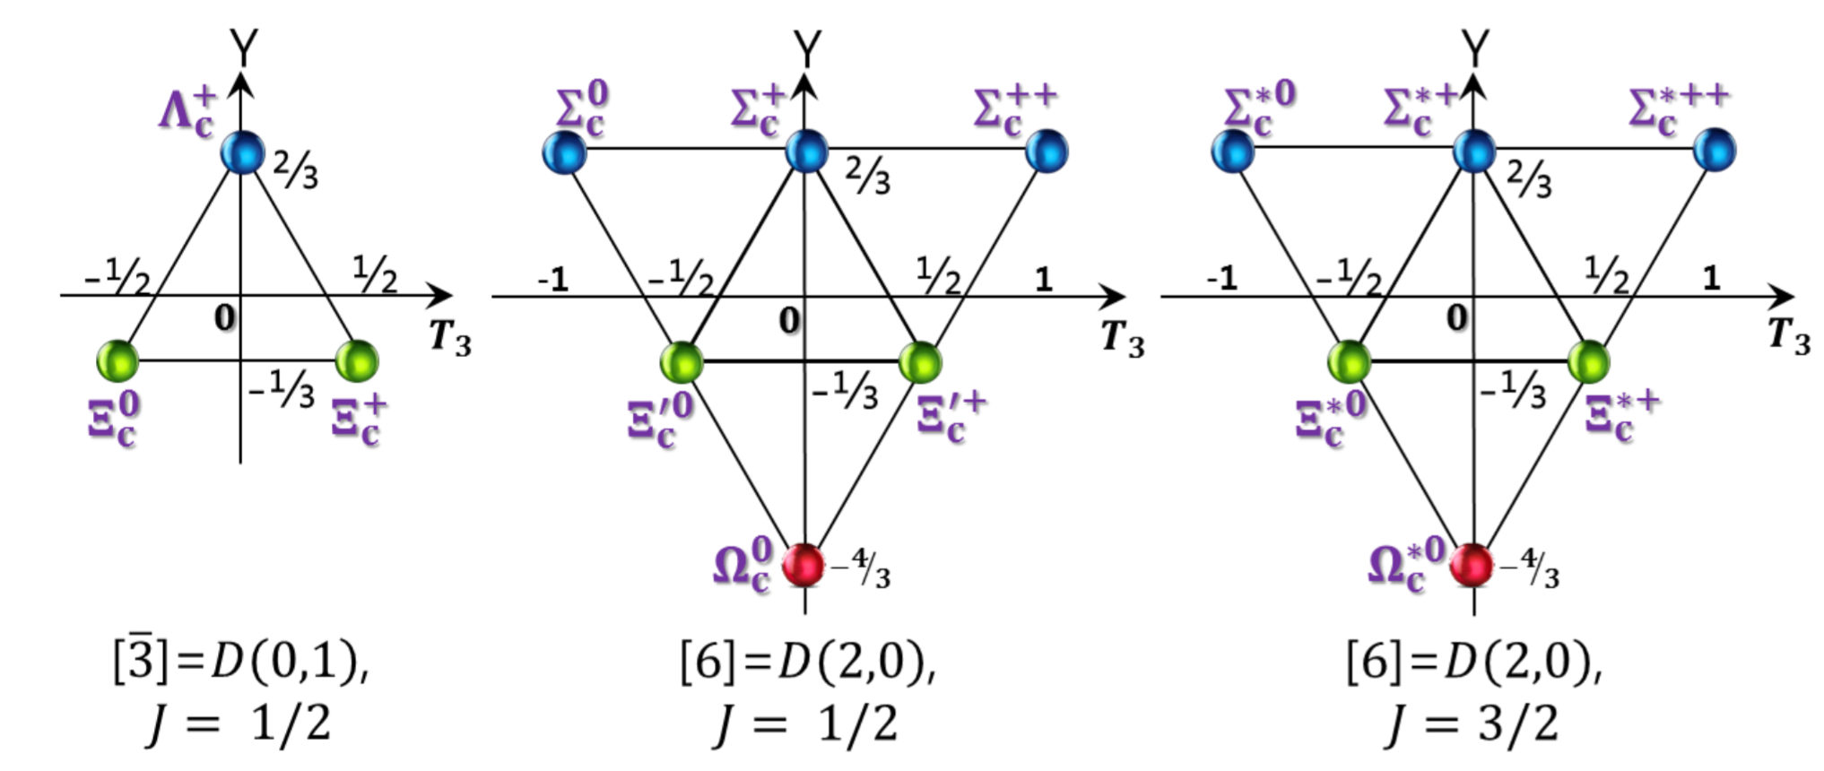
SU(3) representation for heavy baryons
In the heavy quark mass limit, a heavy quark spin is conserved, so light-quark spin is also conserved.
In this limit, a heavy quark can be considered as a color static source.
Dynamics is governed by light quarks.

Slide 5
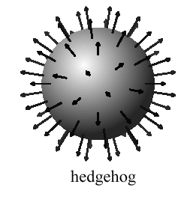
Baryons
A baryon can be viewed as a state of Nc quarks bound by mesonic mean fields (E. Witten, NPB, 1979 & 1983).
Its mass is proportional to Nc, while its width is of order O(1).
Mesons are weakly interacting (Quantum fluctuations are suppressed by 1/Nc: O(1/Nc).
Meson mean-field approach (Chiral Quark-Soliton Model)
Baryons as a state of Nc quarks bound by mesonic mean fields.
Key point: Hedgehog Ansatz
It breaks spontaneously
12 profile functions are only allowed.
Diakonov, Petrov, Vladimirov, PRD 88, 074030 (2013)

Slide 6
Light baryons in mean fields
u, d
s
u,d quark levels are classified by the grand spin .
s quark levels are classified by the grand spin .
Grand spin:
Diakonov, Petrov, Vladimirov, PRD 88, 074030 (2013)

Slide 7
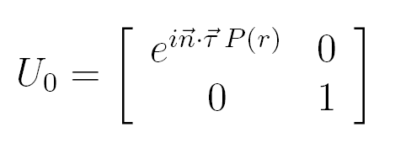
Collective Quantization
Witten’s embedding
Collective (Zero-mode) quantisation
HChK et al. Prog. Part. Nucl. Phys. Vol.95, (1995)

Slide 8
Lowest-lying light baryons
Right hypercharge
K^{P}=0⁺
E=0
Nc quark gives the baryon number in the XQSM.
Ground state

Slide 9
Collective Hamiltonian
Collective rotational Hamiltonian
classical nucleon mass
Right hypercharge: Constraint on the quantization of the chiral soliton This constraint selects a tower of the allowed rotational excitations of the SU(3) hedgehog.

Slide 10
Excited baryons
Excited light baryons are under investigation.

Slide 11
Hyperon mass splitting
Collective Hamiltonian for excited baryons
Wave functions for excited baryons

Slide 12
Heavy baryons
Valence quarks are bound by the meson mean fields.
Light quarks govern a heavy-light quark system.
Heavy quarks can be considered as merely static color sources.
Ground-state heavy baryons
Right hypercharge
A heavy quark: Static color source to make a heavy baryon color singlet.
D. Diakonov, arXiv:1003.2157 [hep-ph].

Slide 13
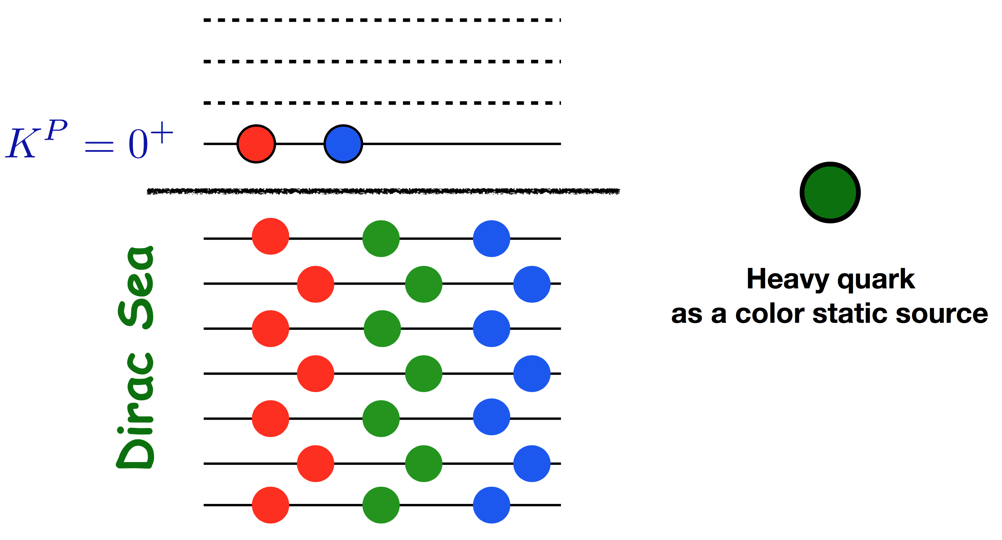
Heavy baryons
Nc-1 light quarks govern a singly heavy baryon.

Slide 14
Collective Hamiltonian
Nc-1 quarks represent heavy-baryon spectra.
Grand spin:
The lowest rotationally excited states
T=0 for a anti-triplet: J=0 for it. Combining a charm quark with spin 1/2, we have one anti-triplet.
T=1 for a sextet: J=1. We have two sextets with a charm quark. (1/2, 3/2).

Slide 15
Collective Hamiltonian
Modifying Collective rotational Hamiltonian
Nc-1 soliton mass (B=2/3)
Moments of Inertia and Sigma pi-N term: sum over valence quark states:

Slide 16
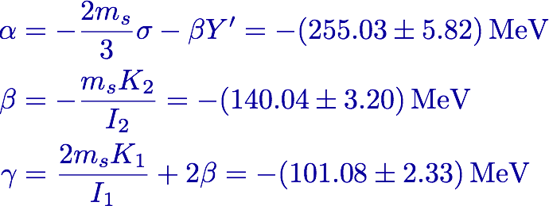
SU(3) symmetry breaking
The collective Hamiltonian for SU(3) symmetry breaking
In the light-quark sector, we have fixed already these dynamical parameters as
G. S. Yang, HChK, PTP, 128, 397 (2012).

Slide 17
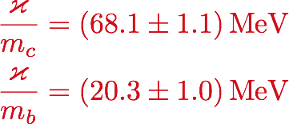
Hyperfine mass splittings (only new parameter)
Y
Y
⅔
⅔
-1
-½
½
1
-1
-½
½
1
-⅓
-⅓
Hyperfine splitting between different spin states
The ratio can be determined by the center values of the sextet masses
Remind you that all the parameters are the same as in the light baryon sector except for the hyperfine interaction.

Slide 18
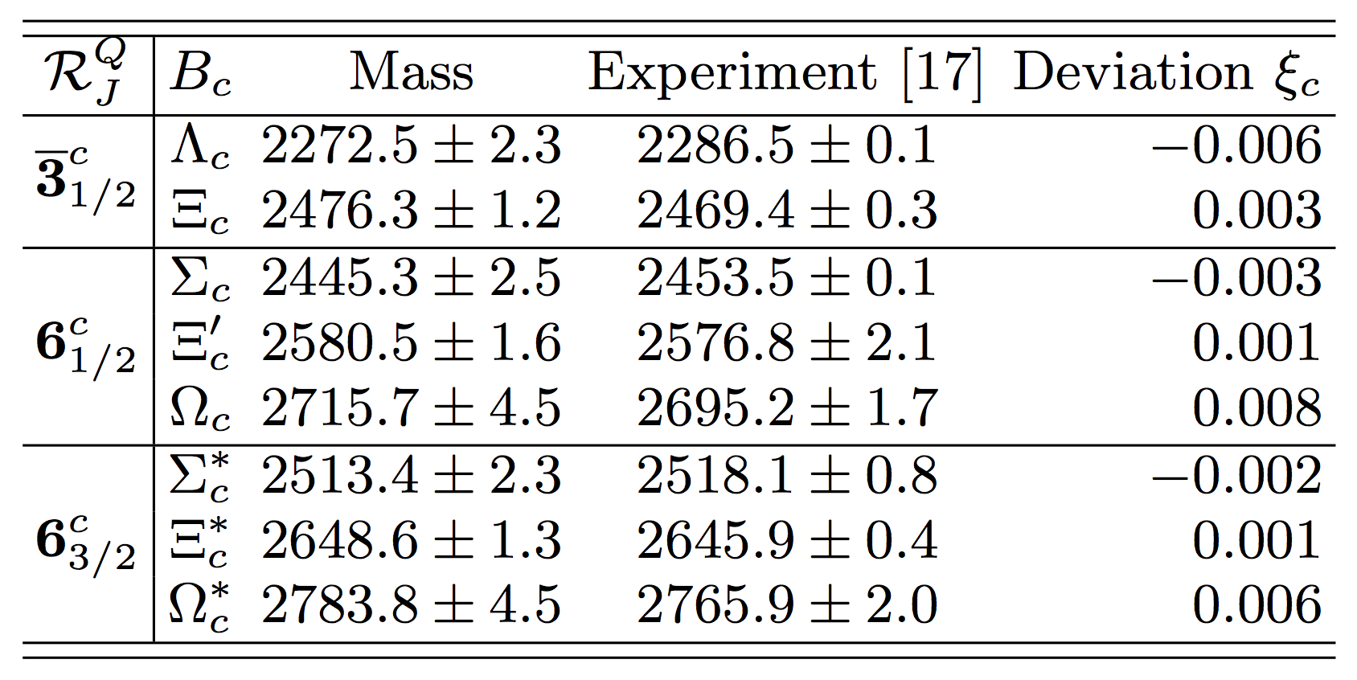
Results for the charmed baryon masses
Gh.S. Yang, HChK, M. Polyakov, M. Praszalowicz, PRD 94, 071501(R) (2016)

Slide 19
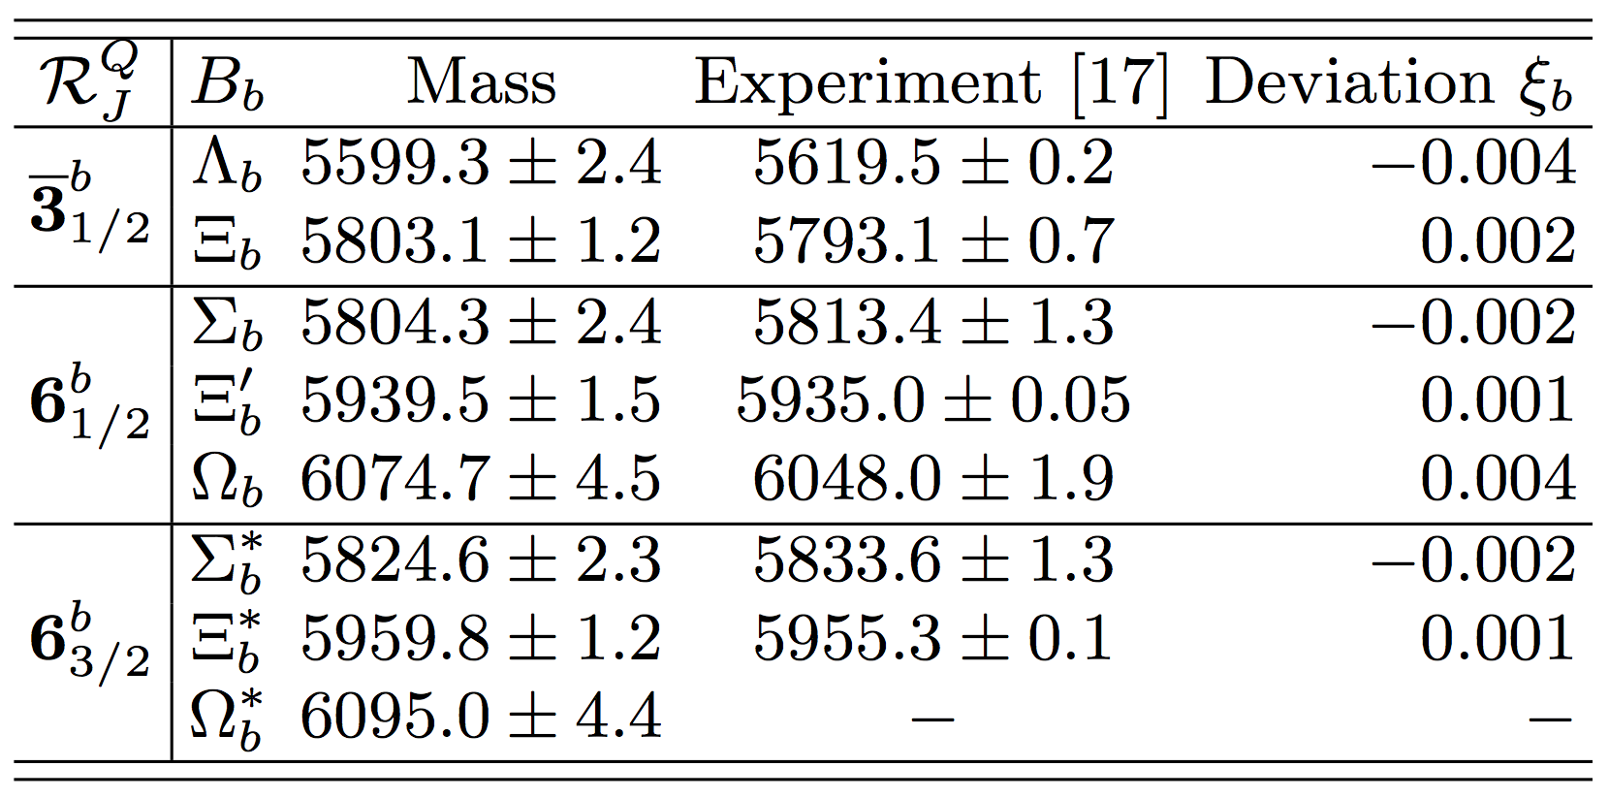
Results for the bottom baryon masses
Prediction from the present work
Gh.S. Yang, HChK, M. Polyakov, M. Praszalowicz, PRD 94, 071501(R) (2016)

Slide 20
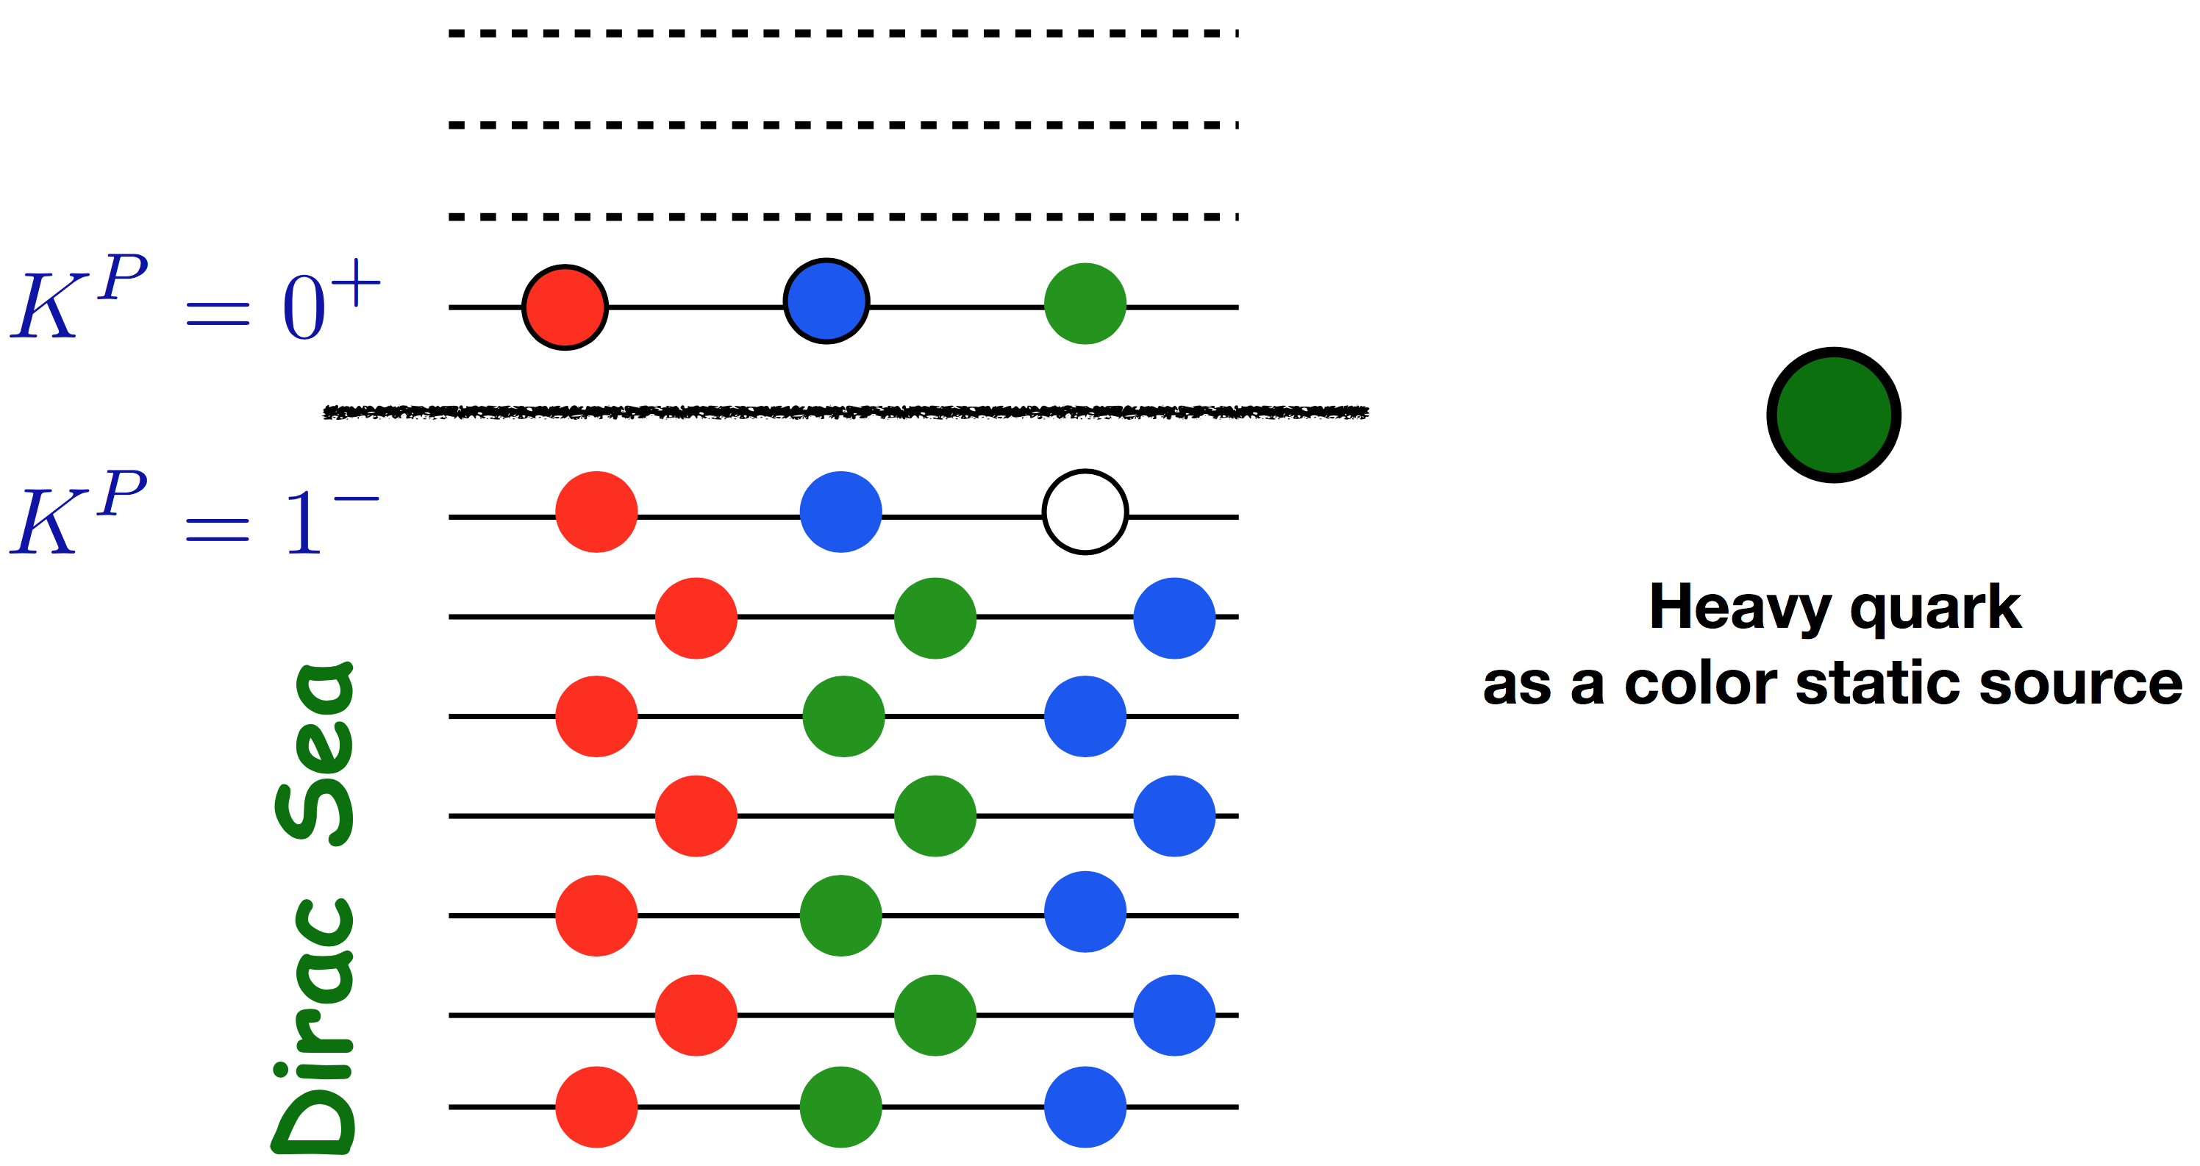
Excited anti-triplets and sextets
HChK, M. V. Polyakov, M. Praszalowicz, PRD 96, 014009 (2017)

Slide 21
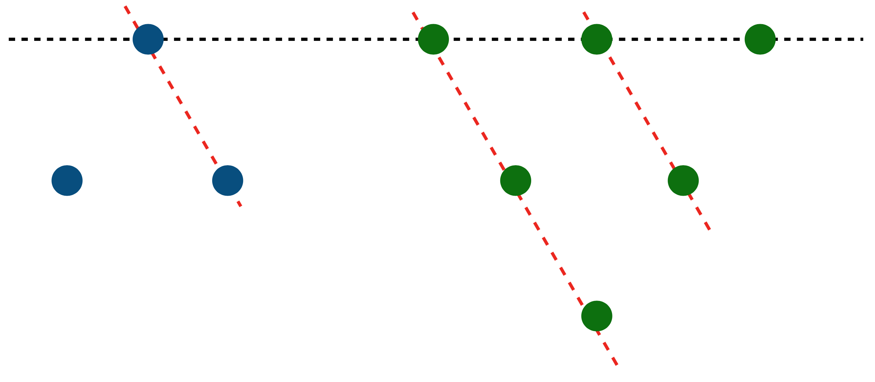
Excited anti-triplets and sextets
Grand spin:
Quantization of excited baryons yield two anti-triplet and FIVE sextets.
T=0 for a anti-triplet: J=1 for it. Combining a charm quark with spin 1/2, we have two anti-triplets.
T=1 for a sextet: J=0,1,2 for 6. We have five sextets with a charm quark. (1/2), (1/2, 3/2), and (3/2, 5/2)!

Slide 22
Hyperfine splittings for excited anti-triplets
Candidates for excited anti-triplets
HChK, M. V. Polyakov, M. Praszalowicz, PRD 96, 014009 (2017)

Slide 23
Hyperfine splittings for excited sextets
The mean-field approach (XQSM) predicts five excited sextet states!
HChK, M. V. Polyakov, M. Praszalowicz, PRD 96, 014009 (2017)

Slide 24
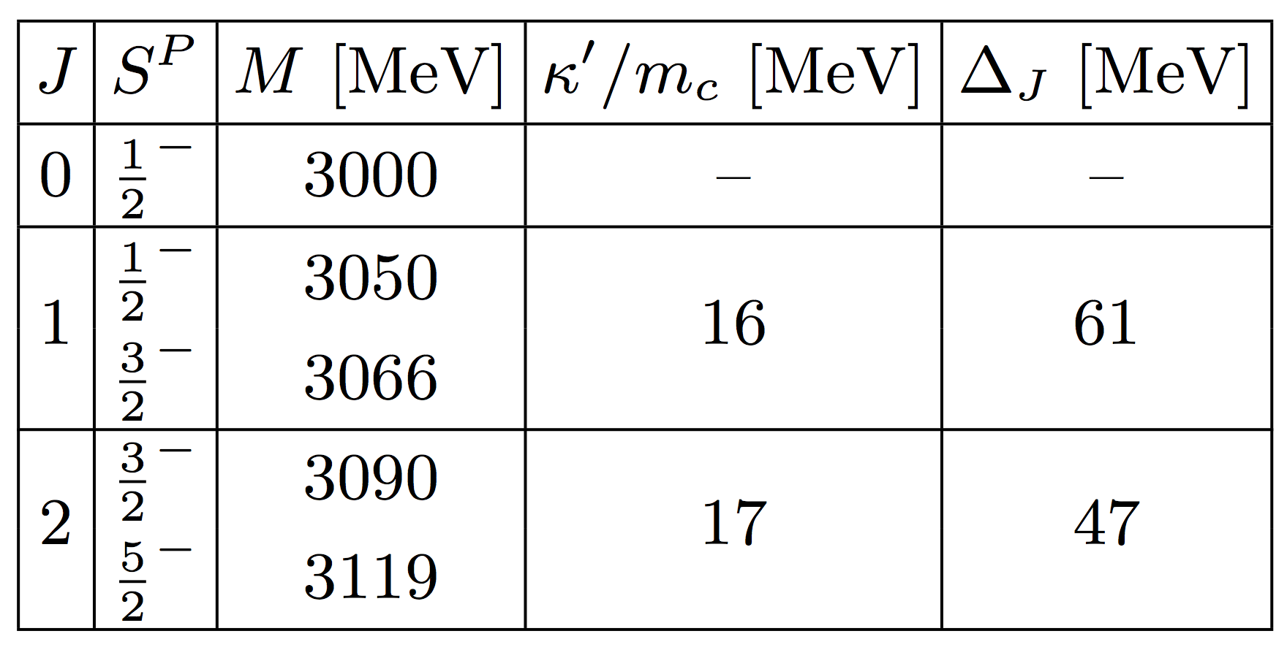
Scenario I
Assertion: Five s belong to excited sextets.
The HF splittings are very much deviated from what we have determined from the excited anti-triplet.

Slide 25
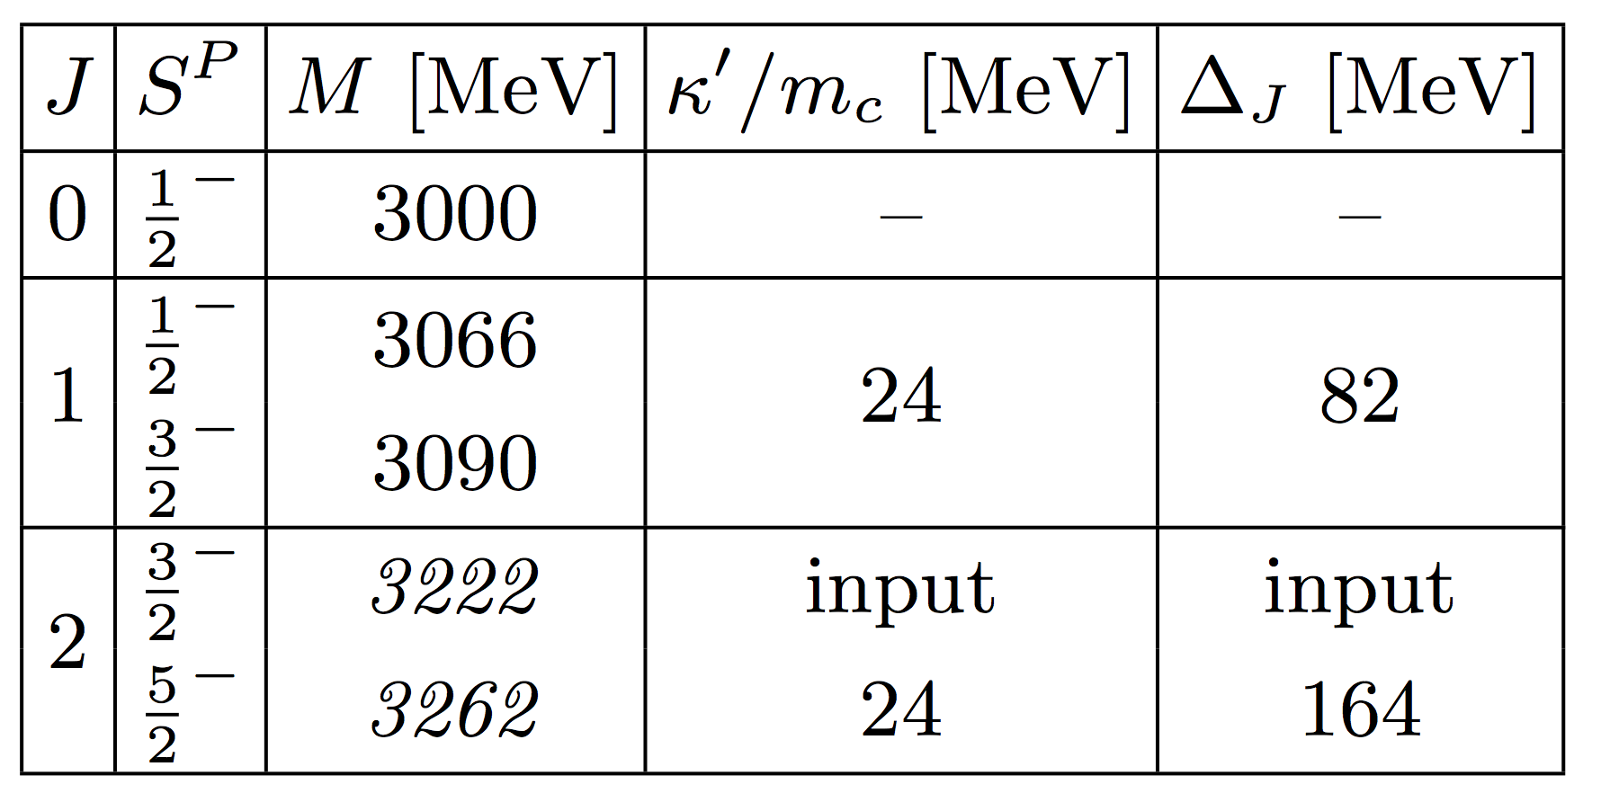
Scenario II
Assertion: Three s belong to excited sextets, whereas two s with smaller widths are the members of the anti-15plet.
Bump structure above 3.2 GeV in the data
What about other two s?
We assume that Omega(3050) and Omega(3119) belong to the third rotational excitation of the ground states: They will be then pentaquarks!

Slide 26
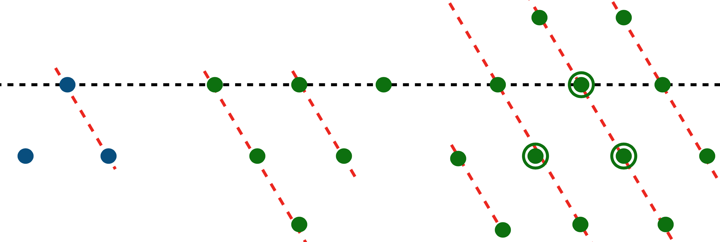
Anti-15plet
In the heavy-quark sector, we have yet the third representation, i.e. the anti-15plet.
For the anti-15plet
Combined with a charm quark:
In the limit of infinitely heavy quark mass, 1/2 & 3/2 are degenerate, which will be lifted by a hyperfine interaction.
:
in excellent agreement with the ground-state value!

Slide 27
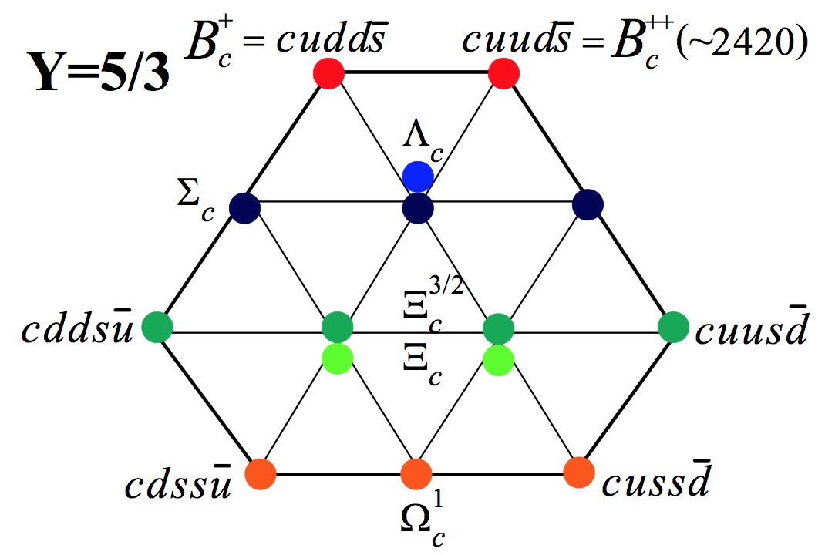
Anti-15plet
Exotic anti-15plet naturally arises from the XQSM.
All parameters were fixed in the light baryon sector except for the hyperfine interaction.
Considering almost all theoretical uncertainties, we get the following:

Slide 28
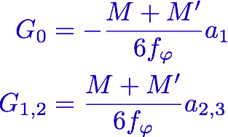
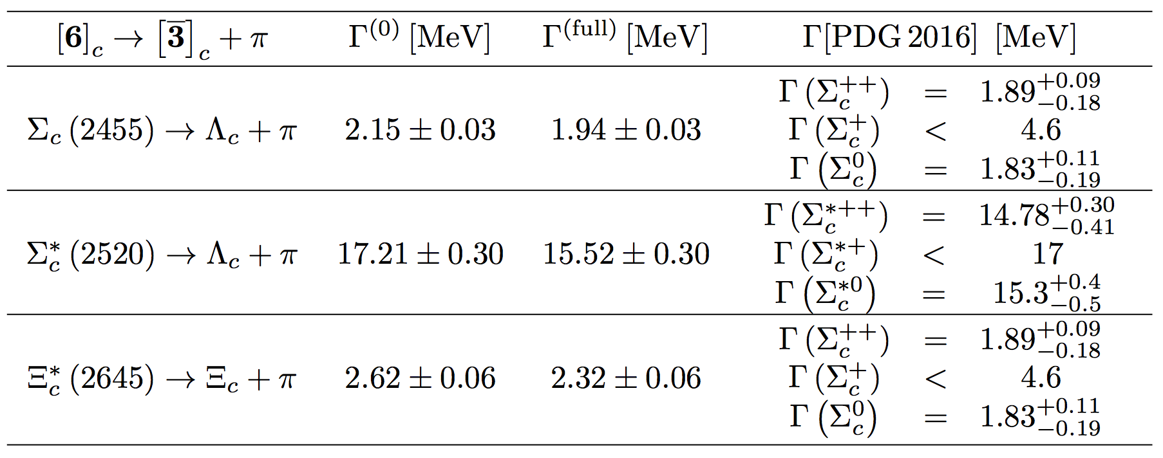
Decay widths of
Collective operator for the strong vertices in SU(3) symmetric case
G. Yang and HChK, PRC 92, 035206 (2015)
No additional free parameter!
HChK, Polyakov, Praszalowicz, Yang, in preparation

Slide 29
Decay widths of
Results for the Omega_c decay widths
Exp.
Exp.
Decay into the ground Omega_c
In the constituent quark limit
Change of the mean field:
Decay widths of Omega_cs are of order
HChK, M. V. Polyakov, M. Praszalowicz, PRD 96, 014009 (2017)

Slide 30
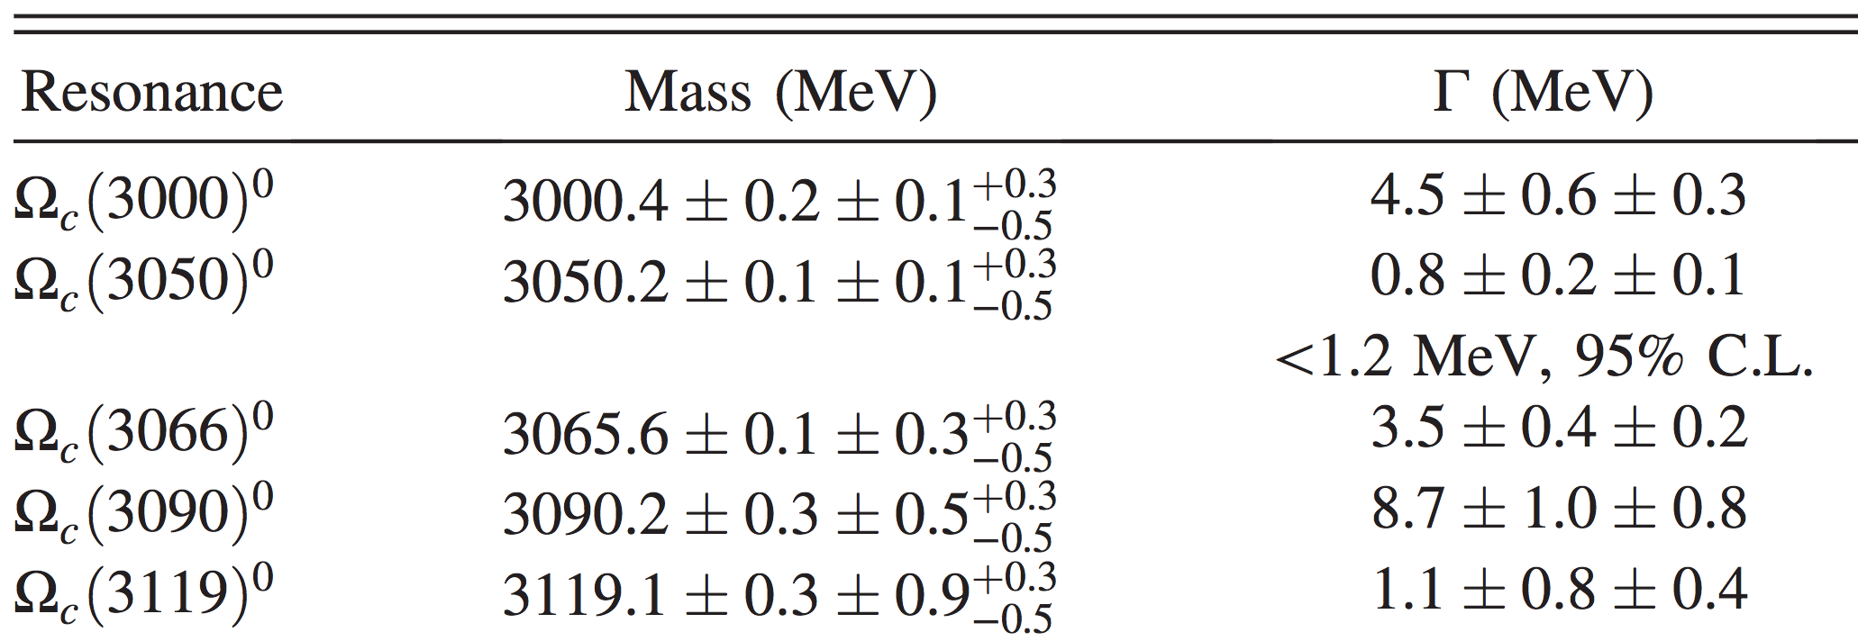
Interpretation of the LHCb data
In the present picture
&

Slide 31
How can one falsify the present idea?
Anti-15plet consists of three Omega_cs (Isovector baryons).
The same peaks with the same strength can be found not only in the channel but also in and .
&

Slide 32
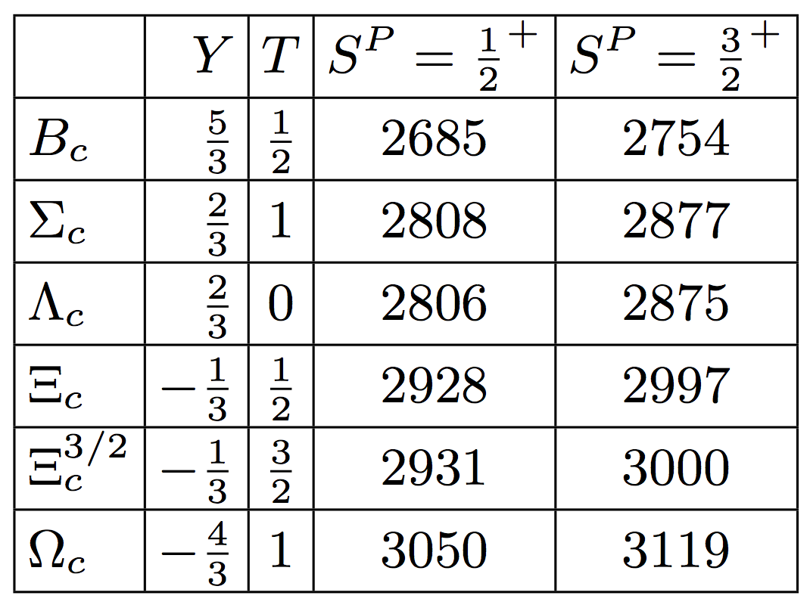
LHCb Findings: New five Omega_cs
Bc baryons will decay weakly, if they exist. So, they should be stable.
D. Diakonov, arXiv:1003.2157 [hep-ph].

Slide 33
Summary
We have aimed in this talk at how to interpret the newly found five Omega_cs by the LHCb within a mean-filed approach (Witten).
The meson mean fields describe well both the lowest-lying singly heavy baryons and the excited anti-triplet.
We have predicted Five excited sextet and Two members in the anti-15plet.
Suggestions to the LHCb Collaboration
Can you perform the PWAs to determine the quantum numbers of Omega_c’s?
Can you scan channels and in the range of the invariant masses between 3050 MeV and 3119 MeV to find isovector Omega_cs?
The present works were done in collaboration with Ghil-Seok Yang, Maxim Polyakov, and Michal Praszalowicz.

Slide 34
Though this be madness, yet there is method in it.
Hamlet Act 2, Scene 2
Thank you very much!

