Slide 1
Hadronic decay properties of newly observed Ω_c baryons
Ze Zhao
Shanghai University
2017-08-26
Ze Zhao, Dan-Dan Ye, Ailin Zhang, Phys. Rev. D 95, 114024
Notes:
Good afternoon! Thanks for the opptunity to give this presentation. I would like to introduce some work that we conducted a few months ago. So the topic is “Hadronic decay properties of newly observed Ω_c baryons”.

Slide 2
Outline
>>1 Introduction
>>2 The structure of charmed baryons
>>3 Hadronic decays of Ω_c
>>4 Conclusions and discussions
Notes:
And here is the outline. I would like to give this lecture from these four aspects. First, the introduction about some experimental information and theoretical studies. Second, it’s the structure of charmed baryons. And third, it’s about the phenomenological model and some calculations. Finally, we give some conclusions and discussions.

Slide 3
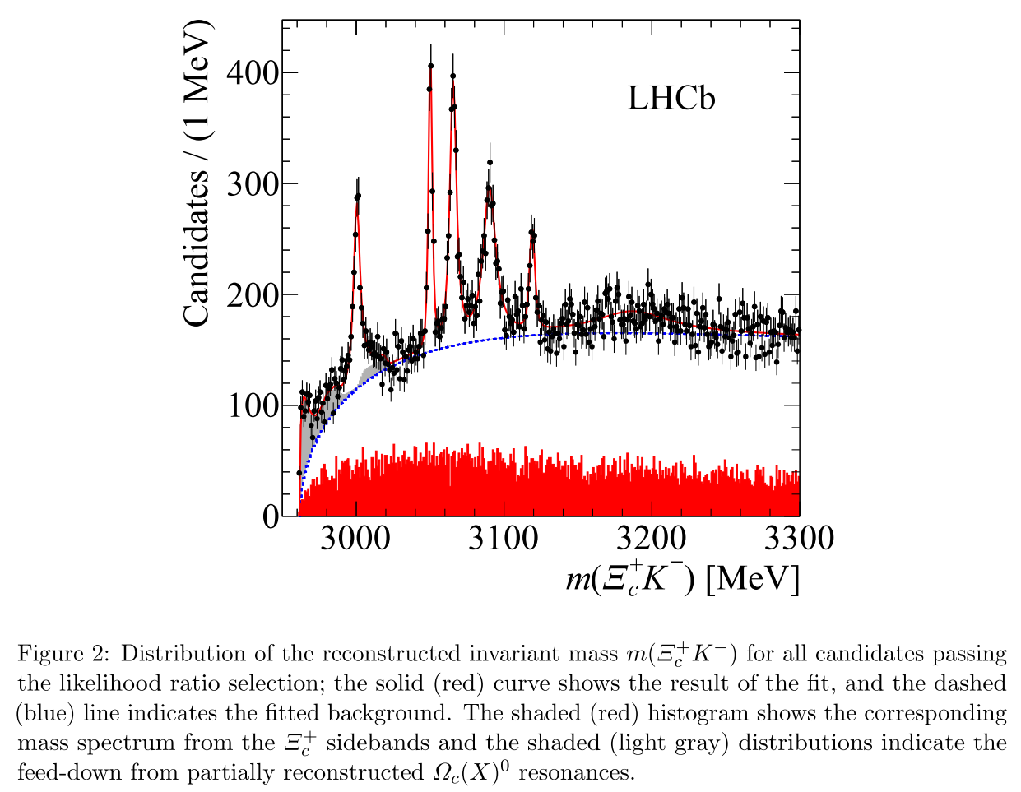
1 Introduction
R. Aaij et al. [LHCb Collaboration], Phys. Rev. Lett. 118.182001,arXiv:1703.04639[hep-ex]
Observation of five new narrow Ω_c states decaying to
Notes:
Earlier in this year, the LHCb collaboration reported the observation of five new Ω_c states decaying to Xi_c K. This is the figure they provided and from which we can see five peaks explicitly.

Slide 4
Very recently, five narrow excited Ω_c baryons were reported by the LHC_b collaboration, their masses and widths read as:
(css) through
Their widths are very narrow.
Notes:
This is the information of the five Ω_c baryons they provided. Their masses are about 3000 MeV and the decay widths are all very narrow, especially for the Ω_c(3050) and (3119). However, except for their masses and decay widths, the quantum numbers and spin parity of these five new baryons are still unknown. Our motivation of this work is to try to identify them by the quantum numbers.

Slide 5
Particle Data Group (PDG)
C. Patrignani et al. [Particle Data group], Chin. Phys. C 40, 100001 (2016).
1S-wave,
ground states
>>B. Aubert et al. (The BABAR Collaboration), Phys.Rev.Lett.97.232001(2006)
>>B. Aubert et al. (The BABAR Collaboration), Phys.Rev.Lett.99.062001(2007)
>>E. Solovieva et al. (The Belle Collaboration), Phys. Lett. B 672 (2009) 1–5
>>…
Notes:
From Particle Data Group, in Ω_c baryon section we see that two ground S-wave states have been established a few years ago with spin one half and three halves. No more Ω_c baryons were reported until the recent LHCb’s publication of the five states.

Slide 6
Spectrum studies
>>D. Ebert, R. N. Faustov, and V. O. Galkin, Phys. Rev. D 84, 014025 (2011).
>>W. Roberts and M. Pervin, Int. J. Mod. Phys. A 23, 2817(2008)
>>D. Ebert, R. N. Faustov and V. O. Galkin, Phys. Lett. B 659, 612 (2008)
>>H. Garcilazo, J. Vijande, and A. Valcarce, J. Phys. G 34(2007) 961
>>T. Yoshida, E. Hiyama, A. Hosaka, M. Oka and K. Sadato, Phys. Rev. D 92, 114029 (2015).
>>Z. Shah, K. Thakkar, A. K. Rai and P. C. Vinodkumar, Chin. Phys. C 40, 123102 (2016).
>>S. Capstick and W. Roberts, Prog. Part. Nucl. Phys. 45, S241 (2000).
>>E. Klempt and Jean-Marc Richard, Rev. Mod. Phys. 82, 1095 (2010).
>>V. Crede and W. Roberts, Rep. Prog. Phys. 76, 076301(2013)
>>...
The mass spectrum of Ω_c baryons were studied in the literatures above.
Notes:
There have been a lot of spectrum studies of charmed baryons including the Ω_c baryons. Here we list some known literatures , in which the Ω_c baryons were studied. In these works, different theoretical models are employed and some of the results are close or similar, while some can have large differences.

Slide 7
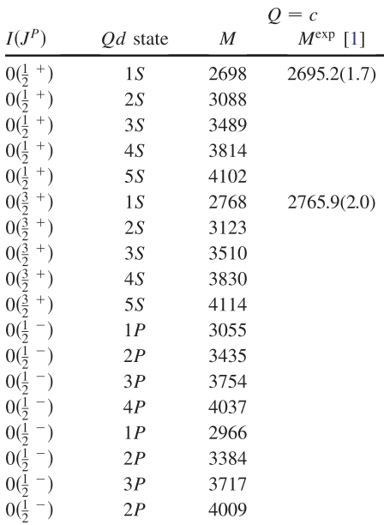
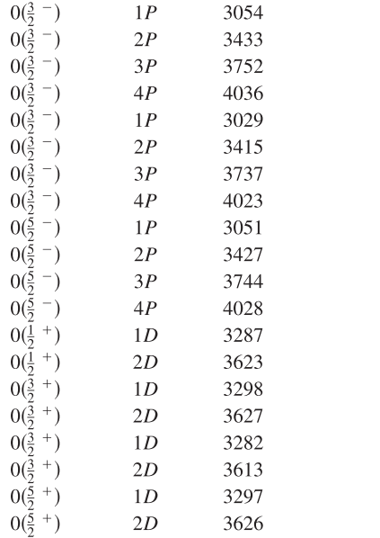
Spectrum studies
>>D. Ebert, R. N. Faustov, and V. O. Galkin, Phys. Rev. D 84, 014025 (2011).
Notes:
This is a work of Ω_c baryon spectrum in 2011. It compares the results to the existed experimental data, the deviation can be very little. And from this work we can see that the masses of the first orbitally excitations may match the five new states.

Slide 8
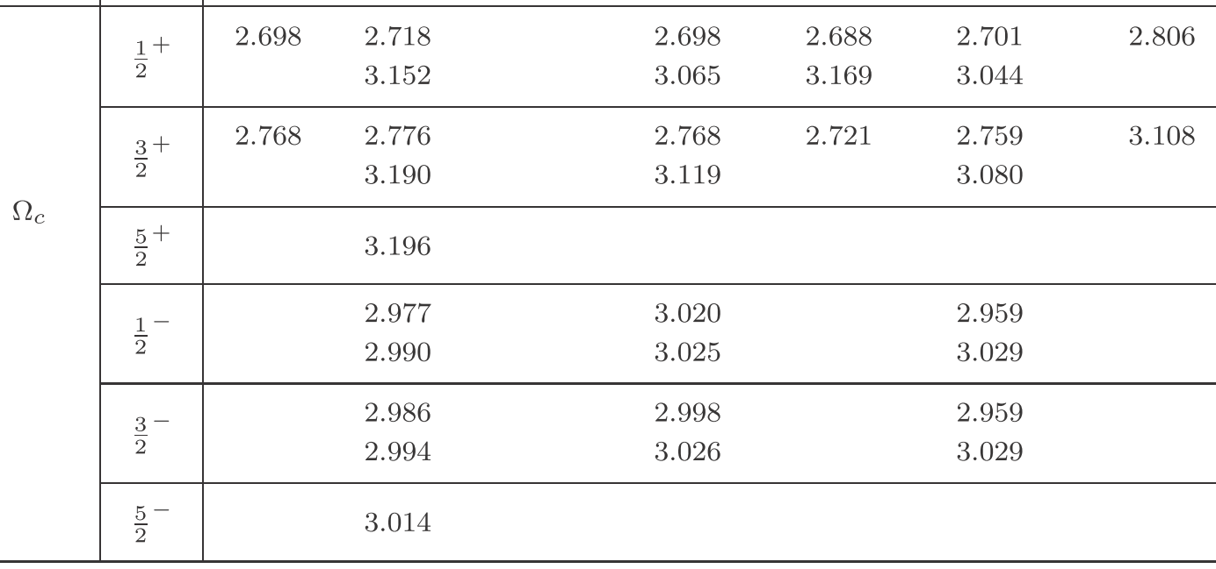
Spectrum studies:
Expt.
mass
Ref. 1
Ref. 2
Ref. 3
Ref. 4
Ref. 5
1 W. Roberts and M. Pervin, Int. J. Mod. Phys. A 23, 2817(2008).
2 D. Ebert, R. N. Faustov and V. O. Galkin, Phys. Lett. B 659, 612 (2008).
3 S. Migura, D. Merten, B. Metsch and H. R. Petry, Eur. Phys. J. A 28, 41 (2006).
4 H. Garcilazo, J. Vijande and A. Valcarce, J. Phys. G 34, 961 (2007).
5 S. M. Gerasyuta and D. V. Ivanov, Nuovo Cimento A 112, 261 (1999).
The mass deviation can be 100~200 MeV.
Assumption: 1P, 2S, 1D
Notes:
This is the comparison among some other spectrum studies. From this comparison we see that the mass deviation can be as large as 100 to 200 MeV when considering highly excitations. Taking this into account, with the experimental data of their masses, we can make the assumption that the possible assignments of these five newly observed Ω_c baryons are the P-wave, the D-wave and the first radially excited S-wave.

Slide 9
Recent theoretical studies
http://inspirehep.net/search?ln=zh_CN&p=refersto%3Arecid%3A1517483
>>S. S. Agaev, K. Azizi, H. Sundu, arXiv:1703.07091,
On the nature of the newly discovered Ω_c states.
>>Hua-Xing Chen, Qiang Mao, Wei Chen, Atsushi Hosaka, Xiang Liu, Shi-Lin Zhu,
Phys. Rev. D 95, 094008 (2017) arXiv:1703.07703,
Decay properties of P-wave charmed baryons from light-cone QCD sum rules.
>>Marek Karliner, Jonathan L. Rosner, Phys. Rev. D 95, 114012 (2017)a rXiv:1703.07774,
Very narrow excited Ω_c baryons.
>>Gang Yang, Jialun Ping, arXiv:1703.08845,
The structure of pentaquarks Ω_c^0 in the chiral quark model.
>>Kai-Lei Wang, Li-Ye Xiao, Xian-Hui Zhong, Qiang Zhao, Phys. Rev. D 95, 116010 (2017) arXiv:1703.09130,
Understanding the newly observed Ω_c states through their decays.
>>Wei Wang, Rui-Lin Zhu, Phys. Rev. D 96, 014024 (2017) arXiv:1704.00179,
Interpretation of the newly observed Ω_c^0 resonance.
>>M. Padmanath, Nilmani Mathur, Phys. Rev. Lett. 119. 042001arXiv:1704.00259,
Quantum numbers of recently discovered Ω_c^0 baryons from lattice QCD.
Notes:
Sine the LHCb’s report, it has attracted a lot of attentions. These are some theoretical studies focusing on the Ω_c baryons.

Slide 10
Recent theoretical studies
>>Hai-Yang Cheng, Cheng-Wei Chiang, Phys. Rev. D 95, 094018 arXiv:1704.00396,
Quantum Numbers of Ω_c States and Other Charmed Baryons.
>>Hongxia Huang, Jialun Ping, Fan Wang, arXiv:1704.01421,
Investigating the excited Ω_c^0 states through Ξ_cK and Ξ′cK decay channels.
>>Zhi-Gang Wang, Eur.Phys.J. C77 (2017) arXiv:1704.01854,
Analysis of the Ωc(3000), Ωc(3050), Ωc(3066), Ωc(3090) and Ωc(3119) with QCD sum rules.
>>S. Sakai, L. Roca, E. Oset, arXiv:1704.02196,
Charm-beauty meson bound statesfrom B(B∗)D(D∗) and B(B∗)D¯(D¯∗) interaction.
>>Bing Chen, Xiang Liu, arXiv:1704.02583,
Six Ω_c^0 states discovered by LHCb as new members of 1P and 2S charmed baryons.
>>Yizhuang Liu, Ismail Zahed, Phys.Rev. D 95, 116012 arXiv: 1704.03412,
Heavy Baryons and their Exotics from Instantons in Holographic QCD.
>>T.M.Aliev, S.Bilmis, M.Savci, arXiv: 1704.03439,
Are the new excited {Ω_c} baryons negative parity states?
>>Hyun-Chul Kim, Maxim V. Polyakov, Michał Praszałowicz,
Phys. Rev. D 96, 014009 arXiv: 1704.04082,
Possibility of the existence of charmed exotica.
>>……
Notes:
These are some other articles which study the newly observed baryons.

Slide 11
Theoretical approaches
QCD
sum rules
chiral quark model
heavy quark effective theory
EHQ decay formula
lattice QCD
……
Spectrum and decay properties
……
1P or 2S states
Notes:
Usually, if we wish to understand something, we need to study it from different directions with different approaches. These are the theoretical approaches that have been conducted in previous works, like the QCD sum rules, the chiral quark model, the HQET, the lattice QCD and so on. Most of them have focused on the spectrum of the baryons and some on the decay properties. The main conclusion about these five new Ω_c baryons is that they are the P-wave or the first radially excited states. And of course there are also other explanations about them.

Slide 12
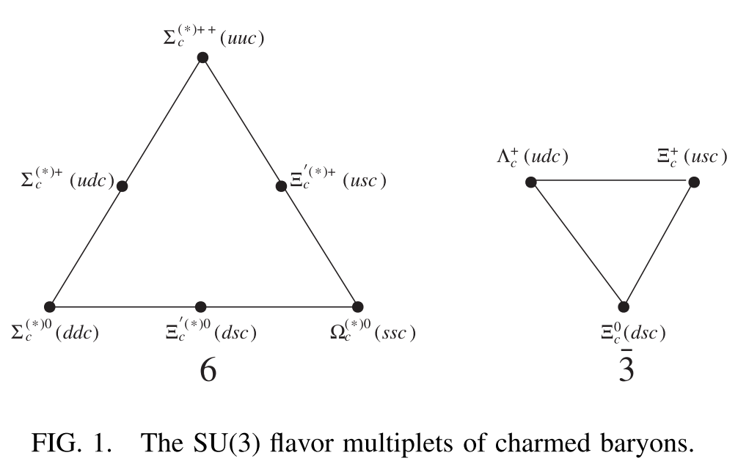
2 The structure of charmed baryons
S-wave
>>Hai-Yang Cheng and Chun-Khiang Chua, Phys. Rev. D 75, 014006(2007).
>>H.-X. Chen, W. Chen, Q. Mao, A. Hosaka, X. Liu and S.-L. Zhu, Phys. Rev. D 91, 054034 (2015).
>>C. Chen, X.-L. Chen, X. Liu, W.-Z. Deng and S.-L. Zhu, Phys. Rev. D 75, 094017 (2007).
Notes:
In 2007, a classifying scheme of charmed baryons according to their quantum numbers and spin-parity was proposed. And it was soon employed by many groups studying charmed baryons, like the Lambda_c, the Sigma_c or the Xi_c baryons. This figure shows the ground S-wave SU(3) multiplets of charmed baryons, and the Ω_c baryons are included also.

Slide 13
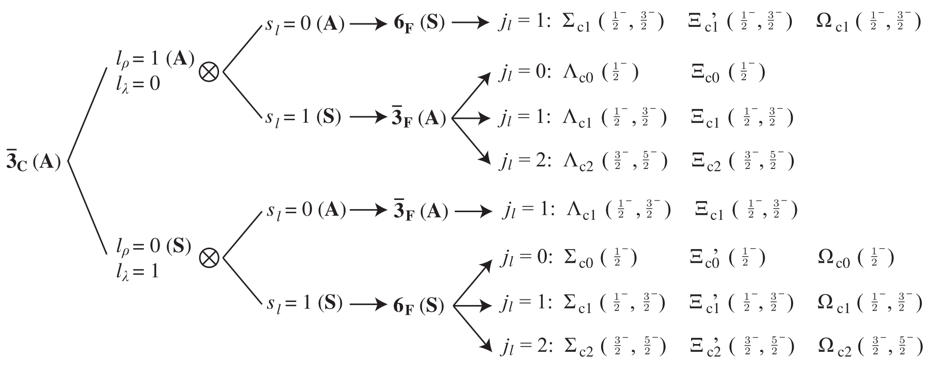
P-wave
>>Hai-Yang Cheng and Chun-Khiang Chua, Phys. Rev. D 75, 014006(2007).
>>H.-X. Chen, W. Chen, Q. Mao, A. Hosaka, X. Liu and S.-L. Zhu, Phys. Rev. D 91, 054034 (2015).
>>C. Chen, X.-L. Chen, X. Liu, W.-Z. Deng and S.-L. Zhu, Phys. Rev. D 75, 094017 (2007).
Notes:
And these are the P-wave states of the baryons, in which the Xi_c baryons and the Ω_c baryons have the same quantum numbers.

Slide 14
D-wave
.
.
.
too complicated to be listed in figure
>>H.-X. Chen, Q. Mao, A. Hosaka, X. Liu and S.-L. Zhu, Phys. Rev. D 94, 114016 (2016).
Notes:
These are the D-wave states, we are not able to list them all because it’s too complicated to be listed in one figure. One can refer to the article listed below if he wants to know them all.

Slide 15
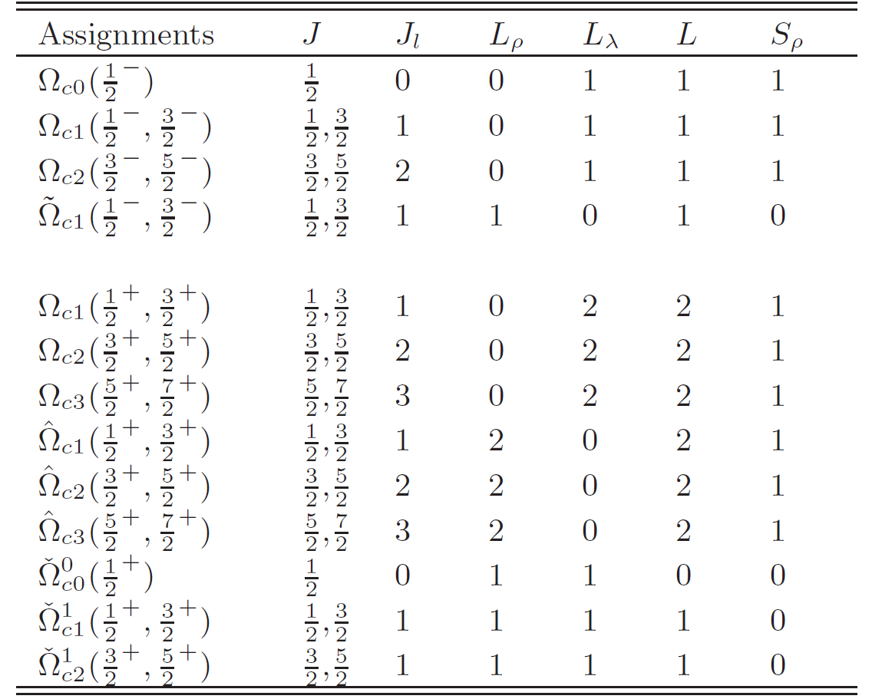
The structure of Ω_c baryons:
Quantum numbers of Ω_c baryons
ρ-excited
s
s
c
s
s
λ-excited
c
J： The total angular momentum of the baryon
L： The total orbital angular momentum
J_l： The angular momentum of the c-quark and the two light quarks
S_ρ：The total spin quantum numbers of the ‘ss’ quarks.
->>Hai-Yang Cheng and Chun-Khiang Chua, Phys. Rev. D 75, 014006(2007).
Notes:
Here we give the quantum numbers of P-wave and D-wave states explicitly in table as we are going to use them in our calculations. It has to mention that when come to the orbital excitation, there are two kinds of them in the three-body baryons, the excitation between the two light quarks, known as ρ-excited, and the excitation between the c-quark and the two light quarks, known as the λ-excited. Here L is the total orbital quantum number, and J_l represents the total spin of the orbital quantum number and the total spin of the two light quarks. Finally, the J means the total spin of the baryon.

Slide 16
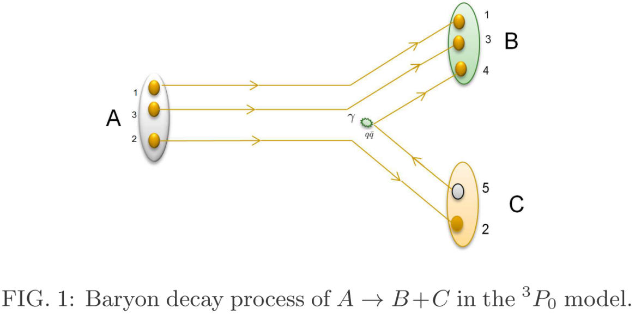
3 Hadronic decays of Ω_c
Decay properties in a 3P_0 model
Also known as Quark-Pair Creation model (QPC model), it can be employed to calculate the OZI-allowed decay channels.
>>L. Micu, Nucl. Phys. B 10, 521 (1969).
>>A. Le Yaouanc, L. Oliver, O. P’ene and J.C. Raynal, Phys.Lett. 71, 397 (1977); 72, 57 (1977).
>>A. Le Yaouanc, L. Oliver, O. P’ene and J.C. Raynal, Hadron Transitions in the Quark Model, Gordon and Breach Science Publishers, New York, 1987.
>>W. Roberts and B. Silvestre-Brac, Few Body Syst. 11, 171 (1992).
>>S. Capstick and W. Roberts, Phys. Rev. D 47, 1994(1993).
>>S. Capstick and W. Roberts, Phys. Rev. D 49, 4570(1994).
>>C. Chen, X.-L. Chen, X. Liu, W.-Z. Deng and S.-L. Zhu, Phys. Rev. D 75, 094017 (2007).
>>Ze Zhao, Dan-Dan Ye and Ailin Zhang, Phys. Rev. D 94, 114020 (2016).
>>Ze Zhao, Yu Tian, and Ailin Zhang, Phys. Rev. D 94, 114035 (2016).
Notes:
This is a picture showing the baryon hadronic decay process in the third P-wave zero model. The model is phenomenologically proposed in 1969. It assumes that a pair of quark-antiquark is created from the vacuum and then two final states were formed through regrouping. So it is also known as the Quark-Pair Creation model. It can be employed to calculate the OZI-allowed decay channels.

Slide 17
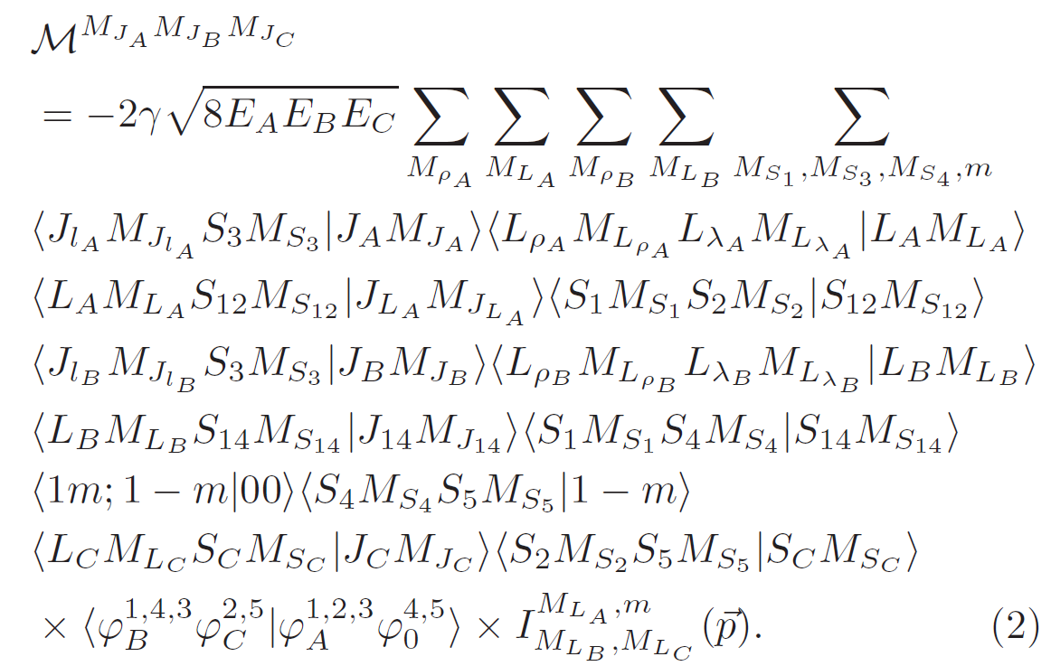
The model:
Helicity amplitude
Notes:
This is the helicity amplitude in the model. It is almost all about the masses and quantum numbers of the initial and the final states. The gamma in lower case is a dimensionless coefficient that represents the creation strength of the quark pair. The capital I of momentum p is the space integral.

Slide 18
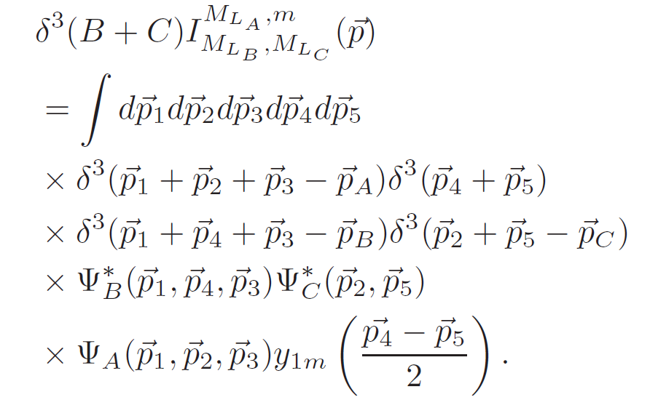
The model:
Space integral
Decay widths
Notes:
The space integral is about the wave function of the states. And here we adopt the simple harmonic oscillator wave function in the integration. Finally the decay width can be written as the function of the helicity amplitude and the mass and total spin of the initial baryon state, the particle A.

Slide 19
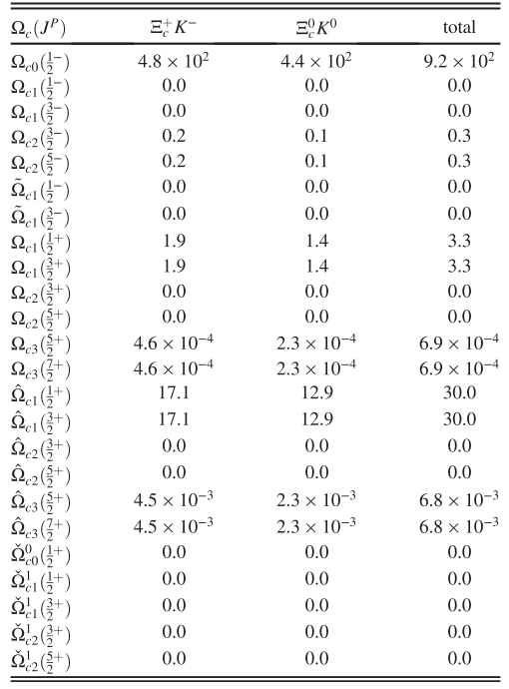
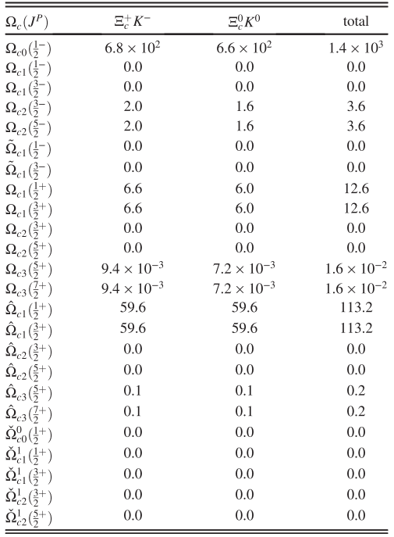
Numerical results
Notes:
This is the numerical results we obtained. Maybe it’s too small for you to see the numbers clearly. We marked the suitable assignments in the red rectangulars. On the left it’s the Ω_c(3000), and on the right it’s 3050.

Slide 20
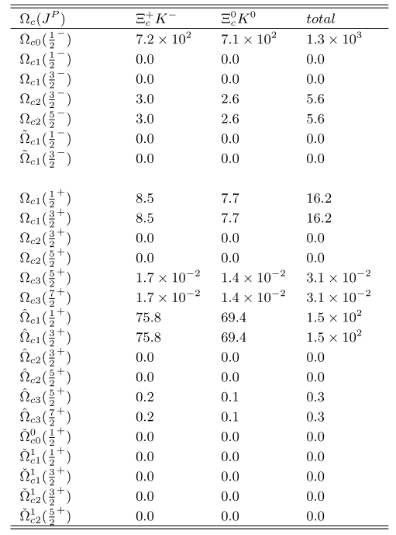
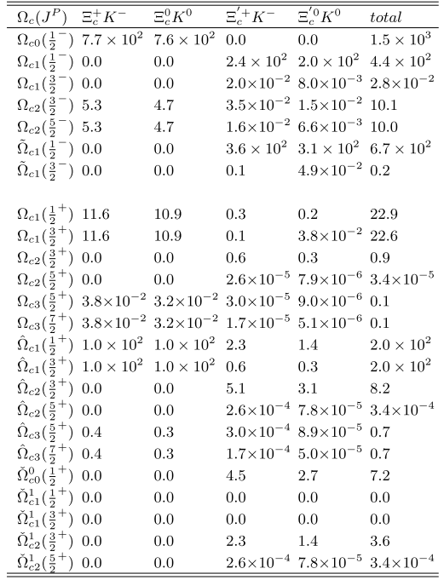
Notes:
Here is the Ω_c(3066) and 3090, respectively.

Slide 21
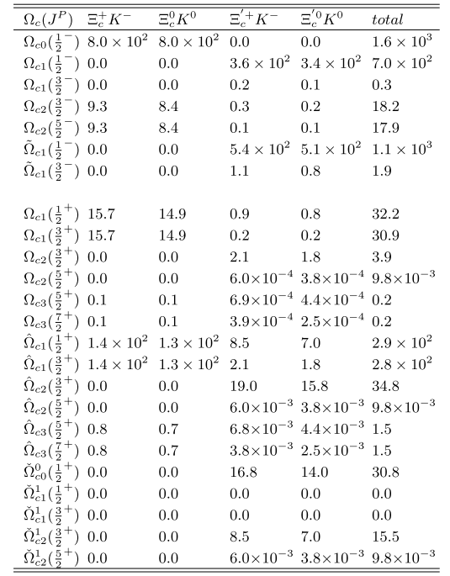
Notes:
And this is the result of Ω_c(3119), in which, four possible assignments are marked.

Slide 22
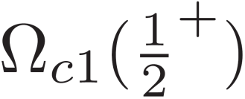
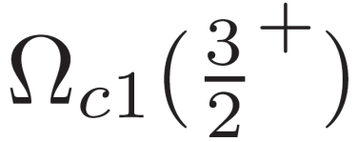
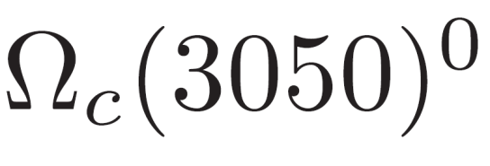
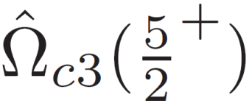
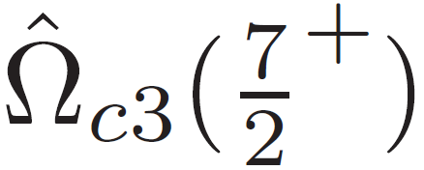
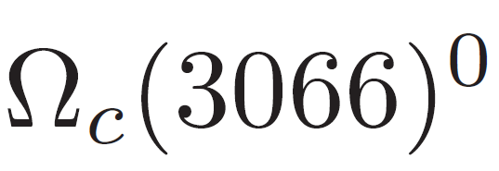
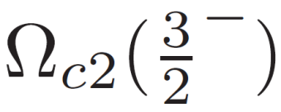
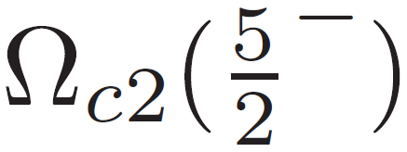
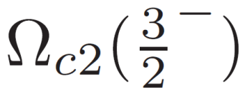
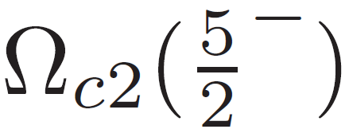
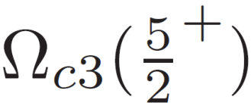
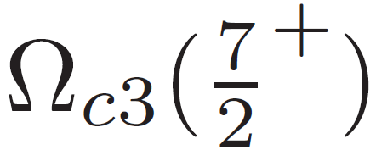
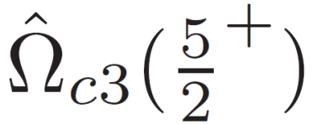
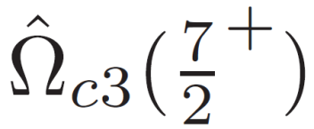
4 Conclusions and discussion
Ω_c(X) could be P−wave or D−wave baryons
:
or
:
or
:
or
:
or
,
,
:
or
Notes:
We here briefly conclude that these newly observed Ω_c baryons to be the P-wave or D-wave, according to their hadronic decay properties. The first four lower states have two possible assignments, respectively and the last one has lager uncertainties, which has four possible assignments.

Slide 23
Discusions:
Quark-Pair Creation model
decay properties
1P or 1D states
Notes:
In summary, we conduct the QPC model to study the newly observed Ω_c baryons. And we conclude that they are the first and second orbitally excited states, that is, the P-wave and D-wave states.

Slide 24
Discusions:
There exist a lot of other different theoretical approaches such as the QCD sum rules, the chiral quark model, the heavy quark effective theory, lattice QCD and so on.
1P , 2S , 1D
Penta-quark states , exotics…
spin parity, inner structure, more Ω_c baryons ?
More studies and more experimental data is needed.
Notes:
There exist a lot of works using other theoretical approaches such as the QCD sum rules , the chiral quark model, the heavy quark effective theory, the lattice QCD and so on. They conclude that the Ω_c baryons to be the P-wave or the first radially excited S-wave states, as well as penta-quark states, the exotics and other explanations, all these results may help us to understand the nature of these Ω_c baryons. And we think that, to finally settle these problems, more studies and more experimental data is needed.
I think most of you must be a little hungry, so here comes to the end of my presentation. It’s my pleasure to take some questions as possible as I can. Thanks for the listening.

Slide 25
Thank you!

