Slide 1
EIC in the US
Zein-Eddine Meziani
Temple University
Outline:
Towards an EIC in the U.S.
  Building the science case; the next QCD frontier
  The Nuclear physics community Long Range Plan
  The National Science Academy Science Evaluation of an EIC in the U.S.
Summary

Slide 2
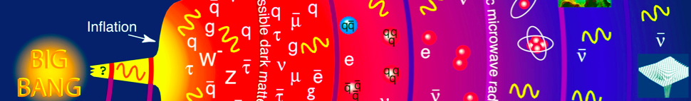

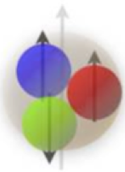
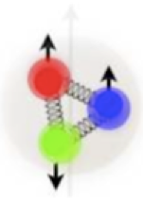
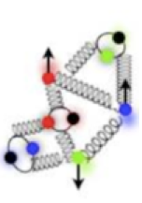
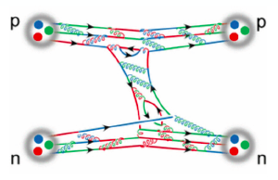
The next QCD frontier
What is the role of QCD in the evolution of the universe?
How hadrons emerge from quarks and gluons?
How does QCD make up the properties of hadrons?
Their mass, spin, magnetic moment, …
What is the QCD landscape of nucleon and nuclei?
Color Confinement
Asymptotic freedom
200 MeV (1 fm)
2 GeV (1/10 fm)
Probing
momentum
How does the nuclear force arise from QCD?
We have to understand the role of glue!

Slide 3
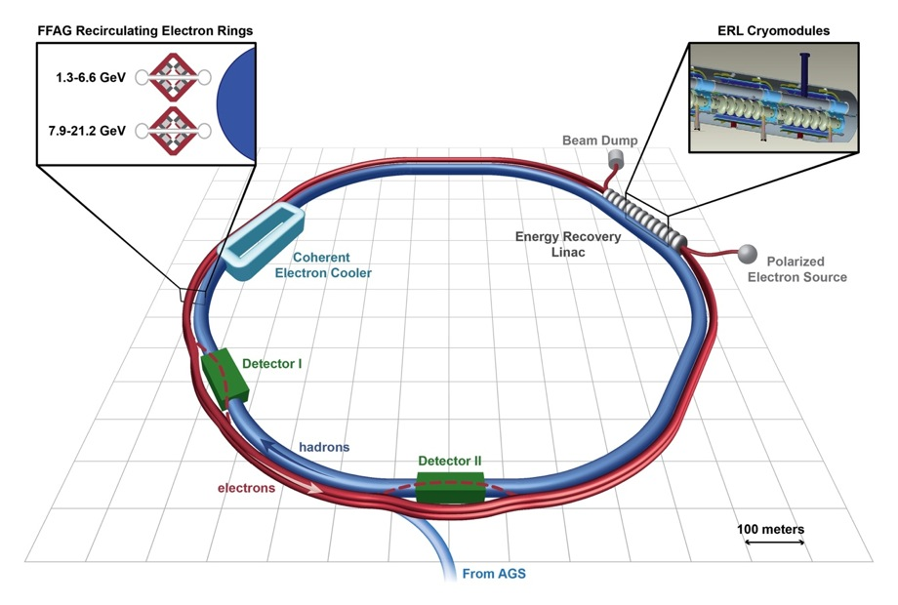
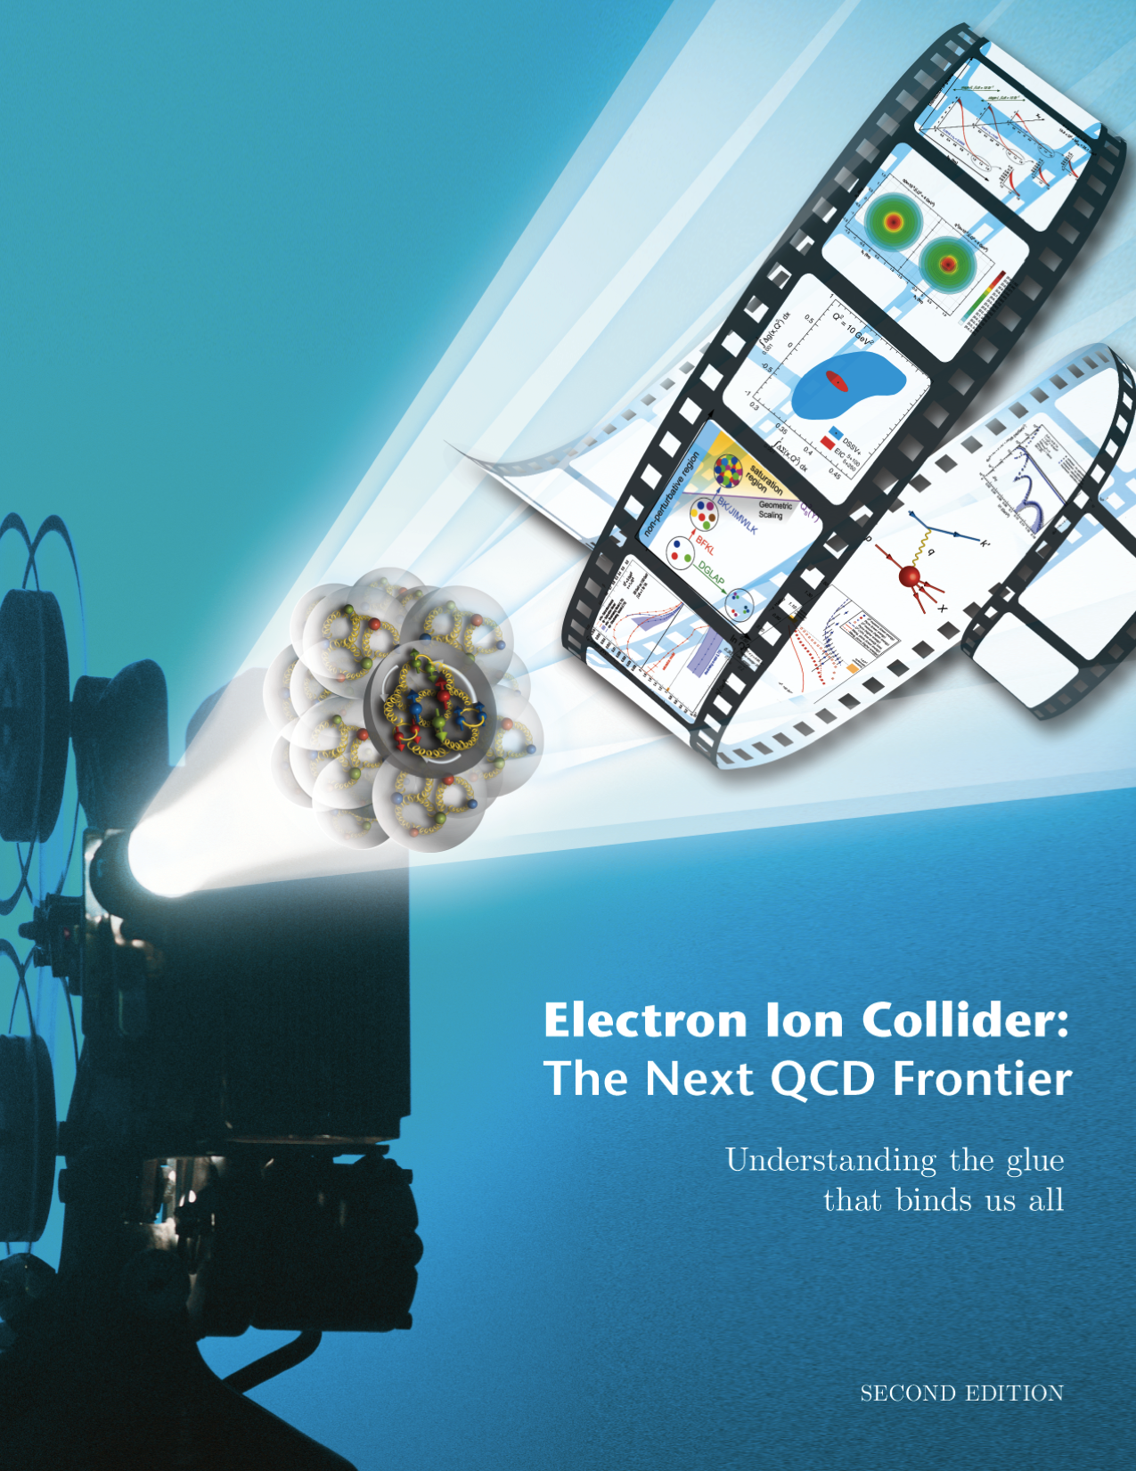
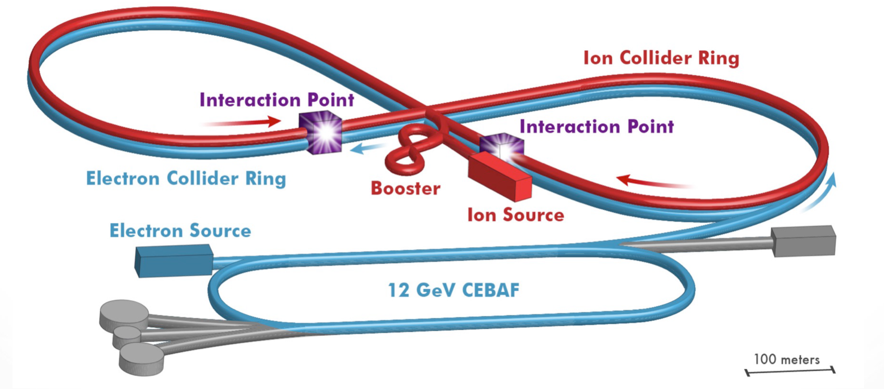
The Electron Ion Collider
Two proposals for the realization of the science
eRHIC
1212.1701.v3
A. Accardi et al
INT-Write-Up, “Gluons and the quark sea at high energies: distributions, polarization, tomography”, 500 pages, e-Print: arXiv:1108.1713 [nucl-th].
EIC-White Paper, “Electron-Ion Collider: Next QCD Frontier”,150 pages, e-Print: arXiv:1212.1701.v3 [nucl-ex]
JLEIC

Slide 4

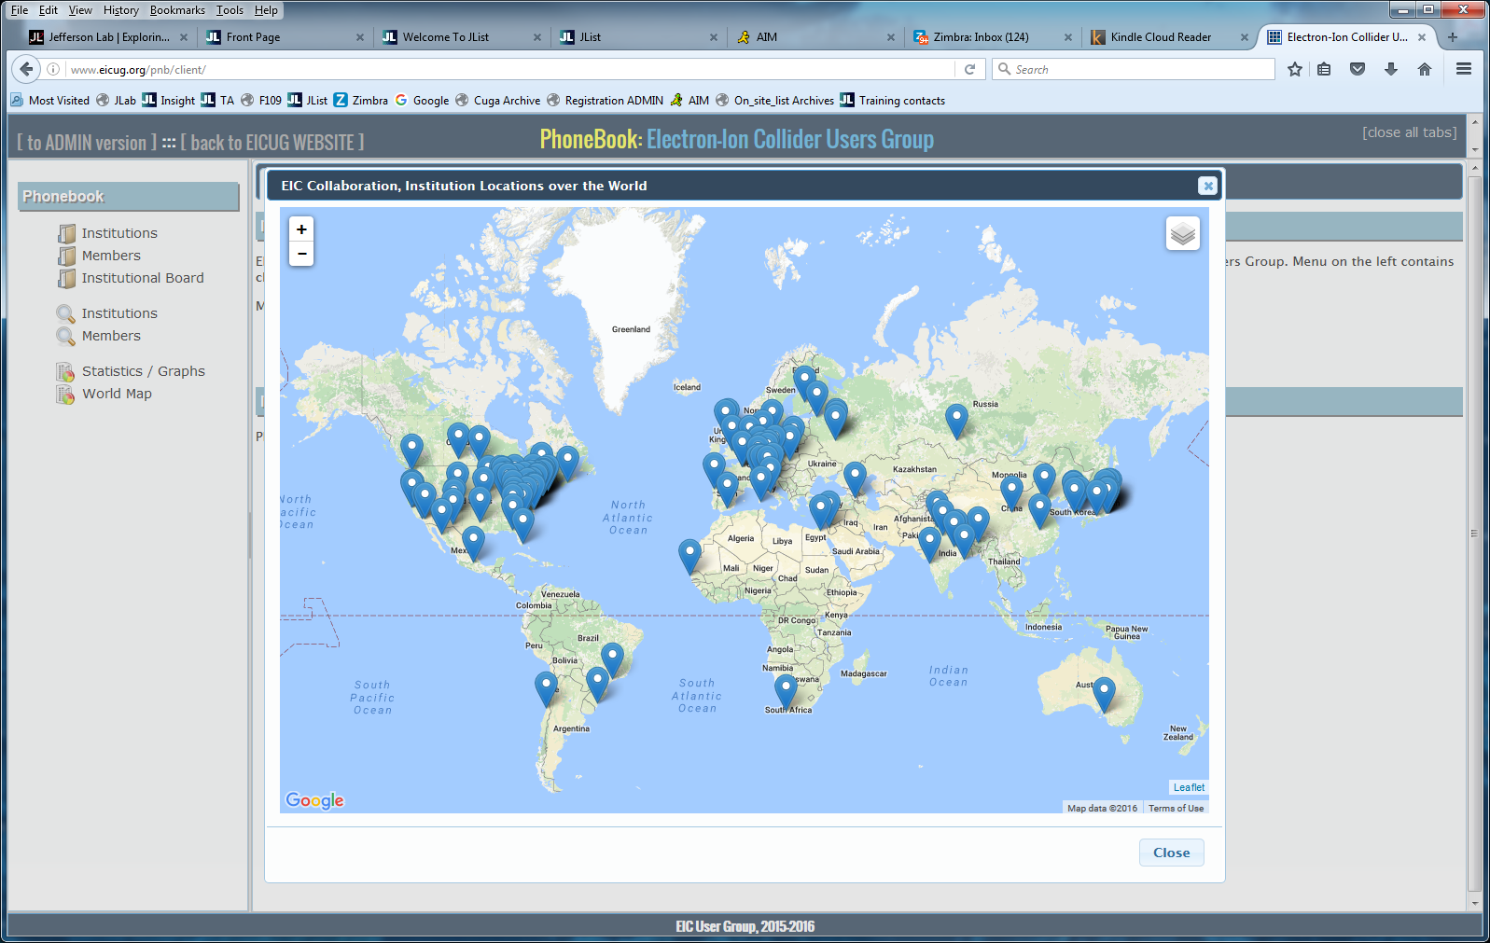
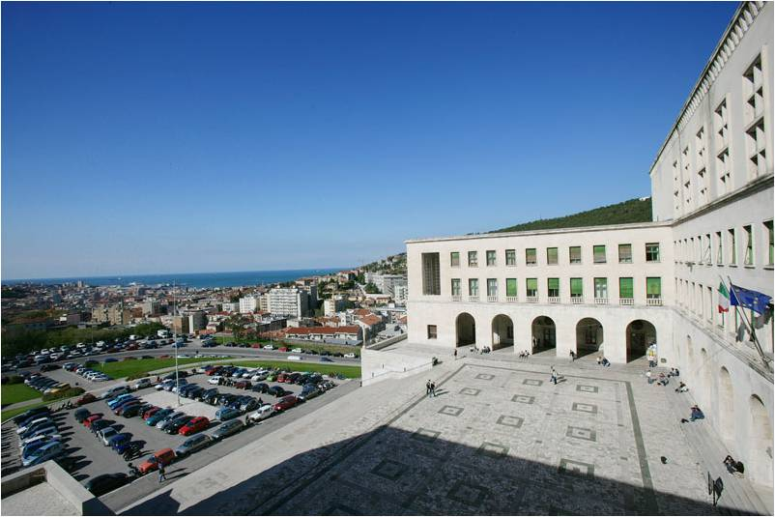
The EIC Users Group: EICUG.ORG
(no students included as of yet)
694 collaborators, 28 countries, 151 institutions... (June 29, 2017)
Map of institution’s locations
The EIC Users Meeting at Stony Brook, June 2014:
  http://skipper.physics.sunysb.edu/~eicug/meeting1/SBU.html
The EIC UG Meeting at University of Berkeley, January 6-9, 2016
  http://skipper.physics.sunysb.edu/~eicug/meeting2/UCB2016.html
Recent EICUG Argonne National Laboratory July 7-10, 2016
  http://eic2016.phy.anl.gov
Remote/Internet: meeting: March 16th : For NAS Review preparation
Most recent meeting:July 18-22, 2017 Trieste, Italy
eicug2017.ts.infn.it

Slide 5
The Intellectual Challenge in this Field!
Facts:
We probe with leptons/hadrons and measure/detect leptons and hadrons
No modern machine (detector) has been able to produce (see) quarks and gluons in isolation!
The challenge:
How to probe the quark-gluon dynamics, quantify the hadron structure, study the emergence of hadrons, …, when we cannot see free quarks and gluons?
In response, facing this challenge:
Theory advances:
QCD factorization – matching the quarks/gluons to hadrons with controllable approximations!
Unified picture of hadron structure, Wigner distributions, GTMDs
Lattice QCD ab initio calculations
Experimental breakthroughs:
Advances in luminosity and detection – Unprecedented resolution, event rates, and precision probes, especially EM probes, …
Quarks – Need a probe to “see” their existence, …
Gluons – Varying the probe’s resolution to “see” their effect, …

Slide 6
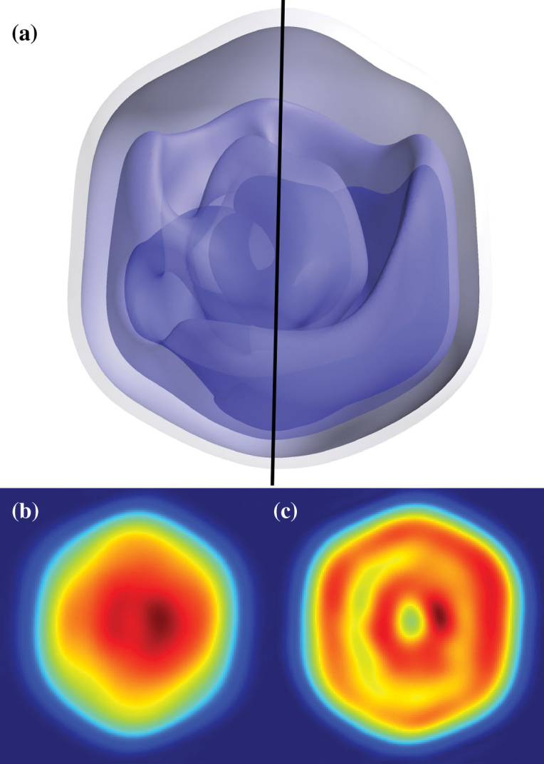
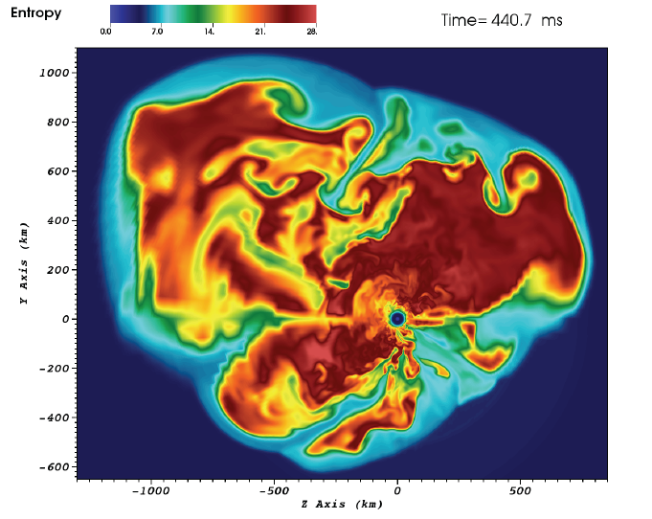
Science in 3-Dimensions
3D simulation of 15M supernova (ORNL)
Mimivirus imaged at LCLS (SLAC)

Slide 7
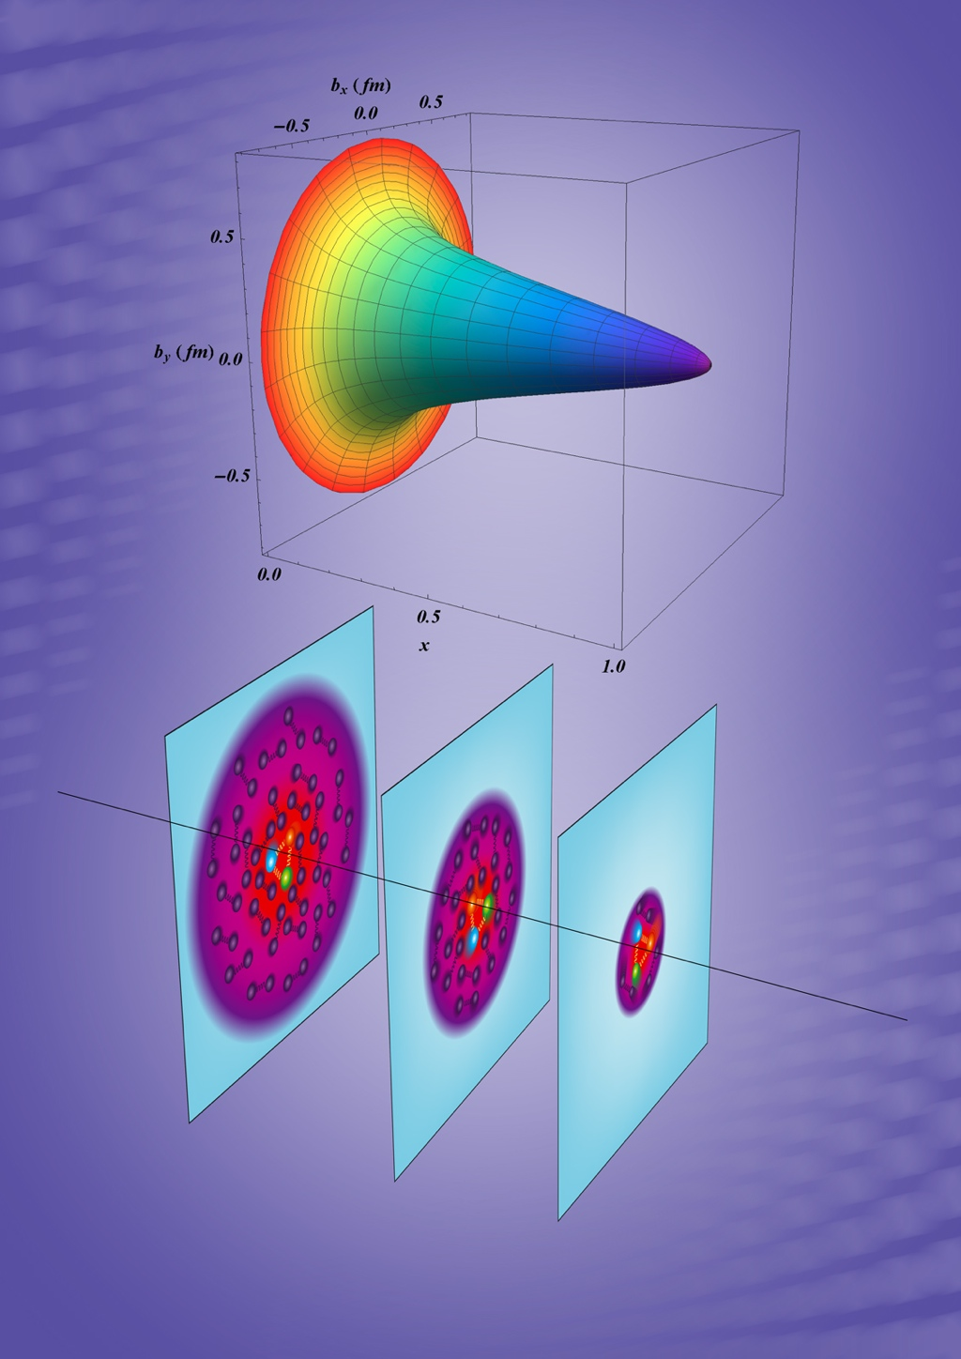
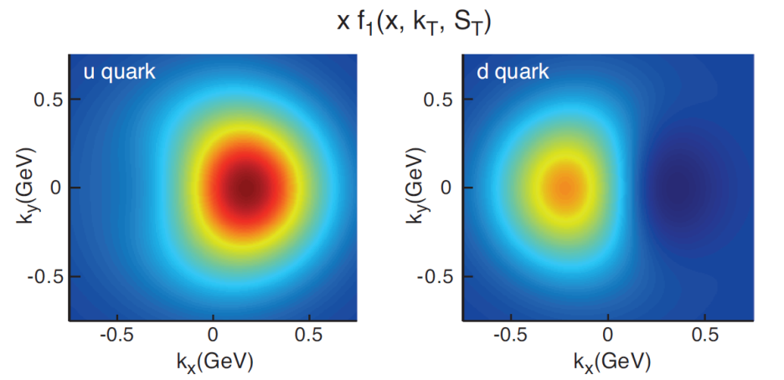
Paradigm shift: 3D Imaging of Nucleons & Nuclei
Transformational!
New theoretical framework within QCD
  Non-local matrix elements linked to measurements
  Wigner distribution for a unified picture
  GPDs, TMDs: 3D images in space and momentum
Valence Quarks; Jlab 12 GeV
Gluons & Sea Quarks; EIC
X=0.1
Courtesy: A. Prokudin
Courtesy: M. Vanderhaeghen
Predicted quark Transverse Momentum Distributions for a polarized proton
Accessible with Jlab @ 12 GeV
2D+1 quark spatial distribution in a proton
accessible with JLab @ 12 GeV

Slide 8
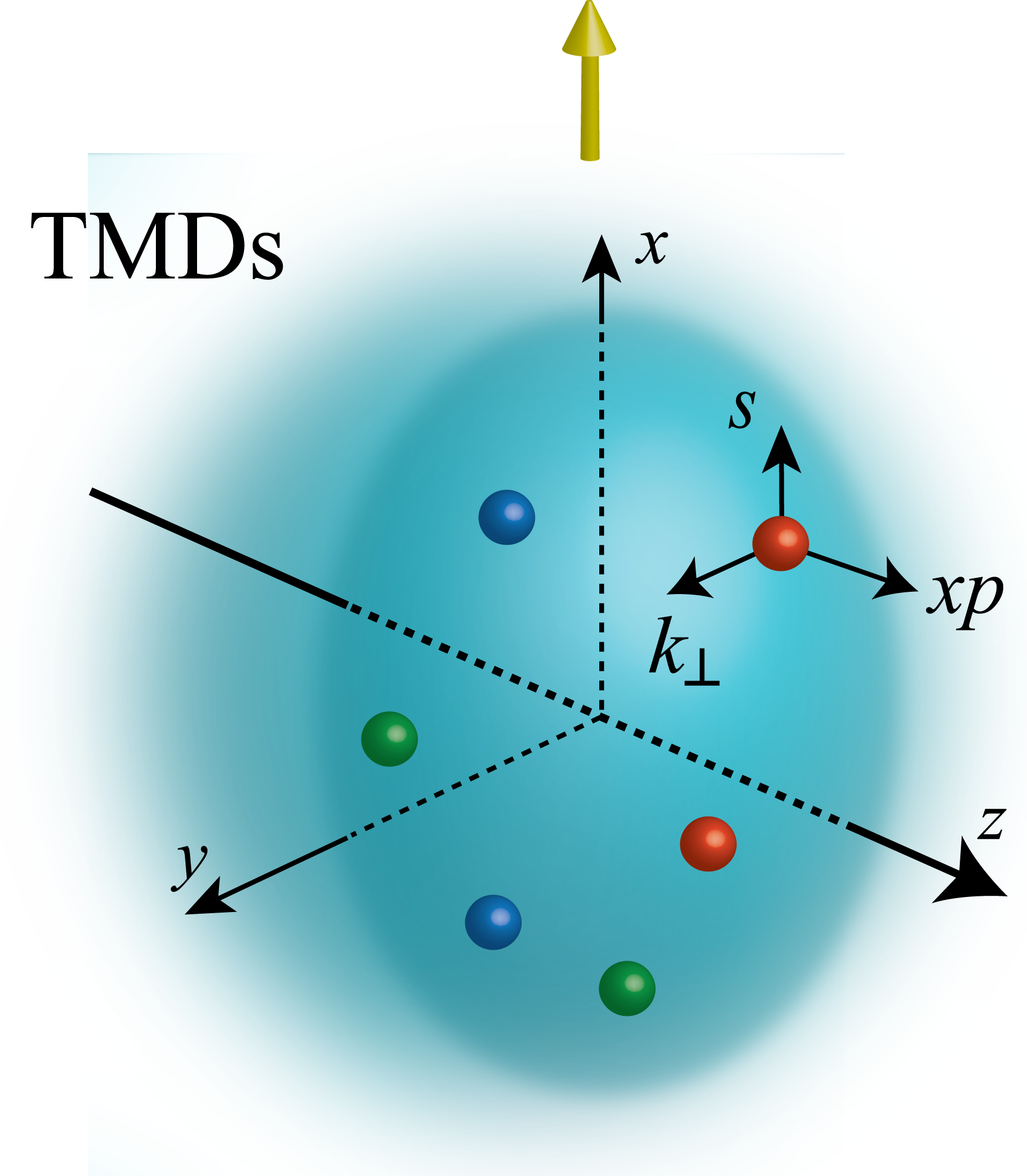
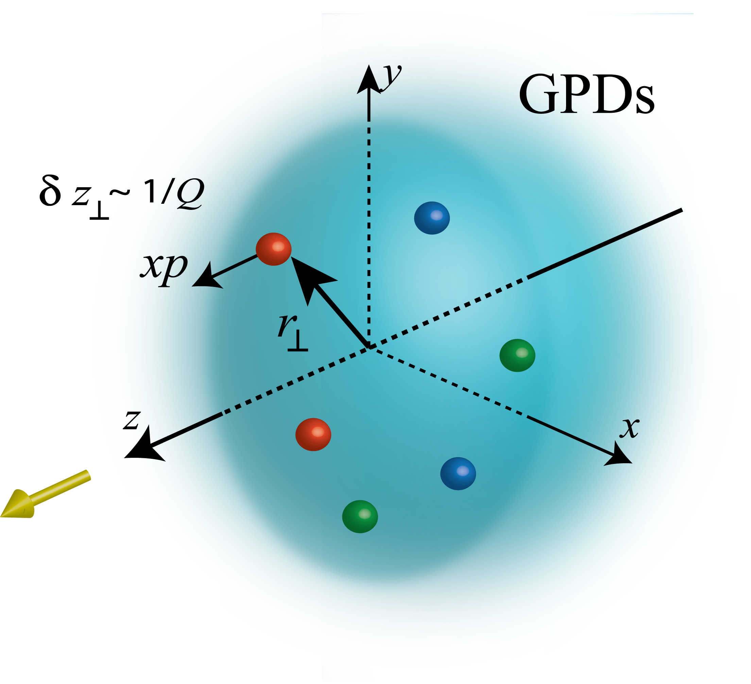
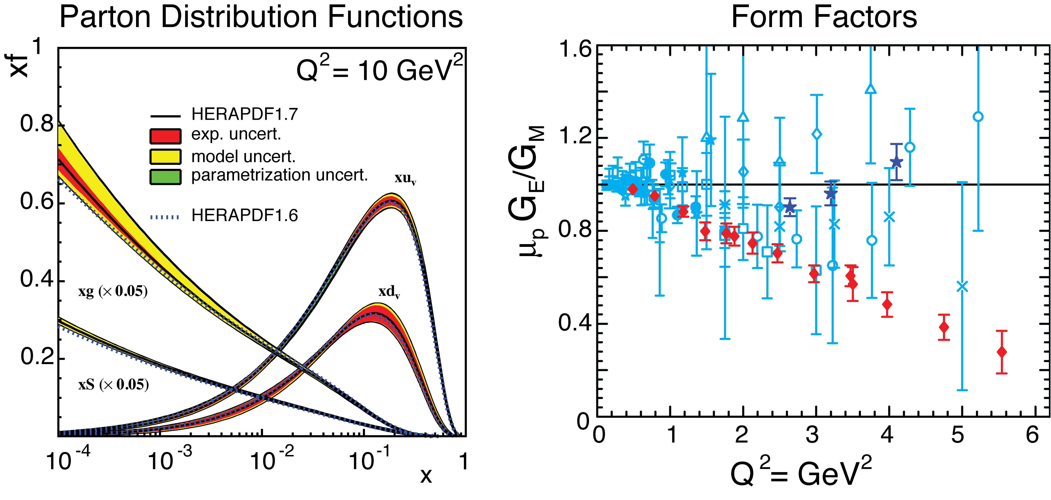
Unified View of Nucleon Structure
5D Dist.
W_{p}^{u}(x,k_{T},r_{T} ) Wigner distributions
Transverse Momentum Dist.
Generalized Parton Dist.
dr_{T}
d²k_{T}
TMD f₁^{u}(x,k_{T}), h₁^{u}(x,k_{T})‏
GPD
“3D” imaging
d²k_{T}
dx &Fourier Transformation
d²r_{T}
PDFs
f₁^{u}(x), .. h₁^{u}(x)‏
Form Factors
G_{E}(Q²),
G_{M}(Q²)‏
1D

Slide 9
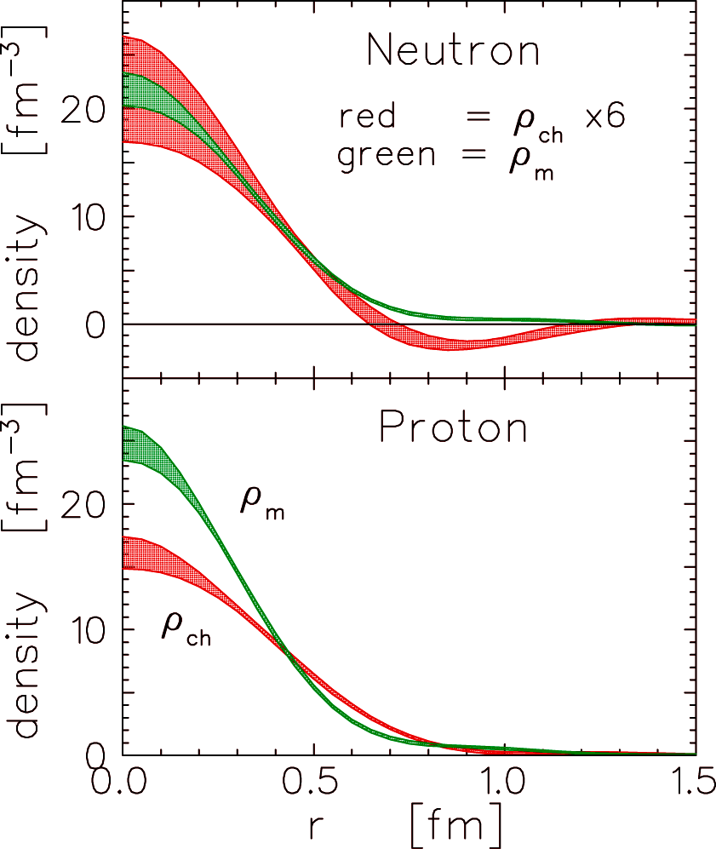
How is charge distributed inside the proton?
Electric charge distribution:
Elastic electric form factor
Charge distributions
empirical quark transverse densities in Neutron
ρ_{T}
ρ₀
densities : Miller (2007); Carlson, Vanderhaeghen 2007)
induced EDM : d_{y} = F_{2n} (0) . e / (2 M_{N})

Slide 10
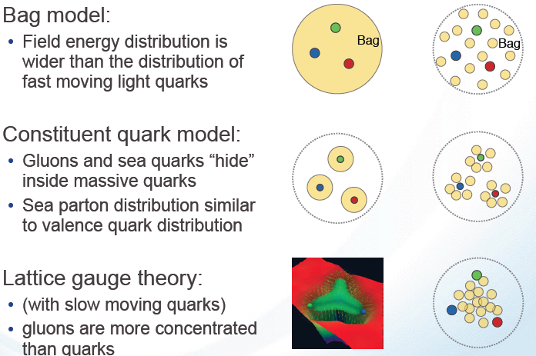
An example for why 3D nucleon structure?
Spatial distributions of quarks and gluons:
Static Boosted
Bag Model:
Gluon field distribution is wider than the fast moving quarks.
Gluon radius > Charge Radius
Constituent Quark Model:
Gluons and sea quarks hide inside massive quarks.
Gluon radius ~ Charge Radius
Lattice Gauge theory (with slow moving quarks):
Gluons more concentrated inside the quarks
Gluon radius < Charge Radius
3D Confined Motion (TMDs) + Spatial Distribution (GPDs)
Relation between charge radius, quark radius , and gluon radius ?

Slide 11
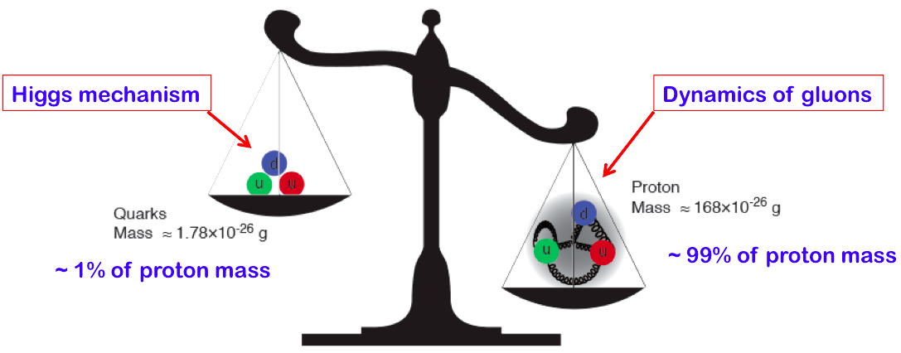
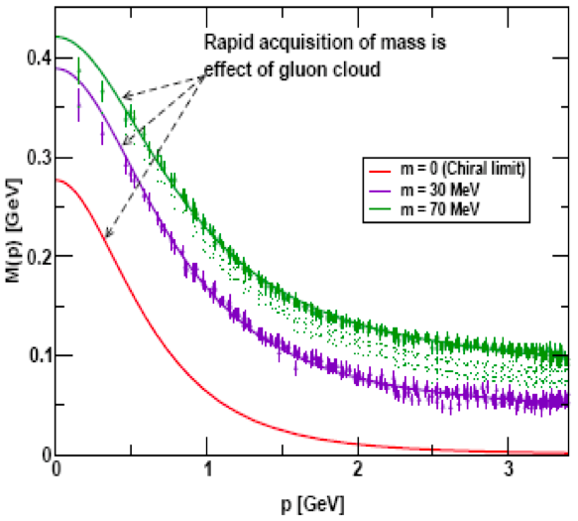
What Susskind has to say about proton mass and the Higgs mechanism.
How does QCD generate its Mass & Spin?
“…QCD takes us a long stride towards the Einstein-Wheeler ideal of mass without mass
Close examples in nature: proton, blackhole
Frank Wilczek (1999, Physics Today)
Massless, yet, responsible for nearly all visible mass
“Mass without mass!”
Bhagwat & Tandy/Roberts et al
https://youtu.be/JqNg819PiZY?t=2403

Slide 12
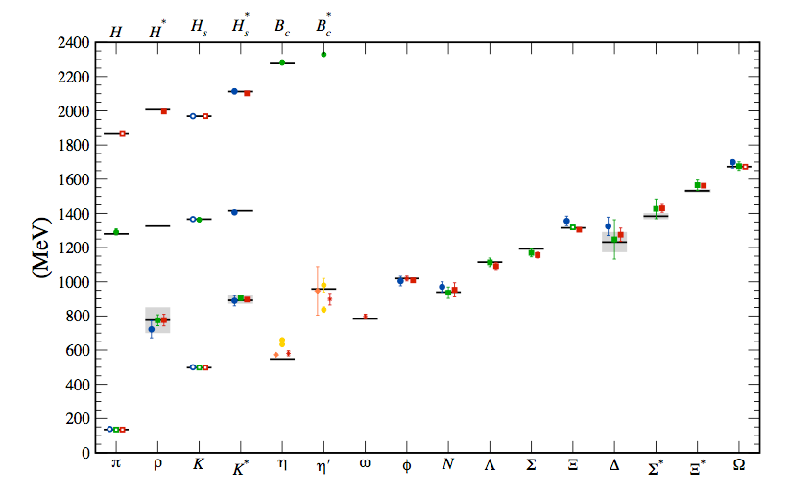
How does QCD generate the nucleon mass?
“… The vast majority of the nucleon’s mass is due to quantum fluctuations of quark-antiquark pairs, the gluons, and the energy associated with quarks moving around at close to the speed of light. …”
The 2015 Long Range Plan for Nuclear Science
Hadron mass from Lattice QCD calculation:
Input
How does QCD generate this? The role of quarks vs that of gluons?
If we do not understand proton mass, we do not understand QCD

Slide 13

How does QCD generate nucleon mass?
Four-pronged approach to explore the origin of hadron mass
Lattice QCD
Mass decomposition – roles of the constituents
Model calculation – approximated analytical approach
Measurements of the parts in a decomposition
https://phys.cst.temple.edu/~meziani/proton-mass-workshop-2016/

Slide 14
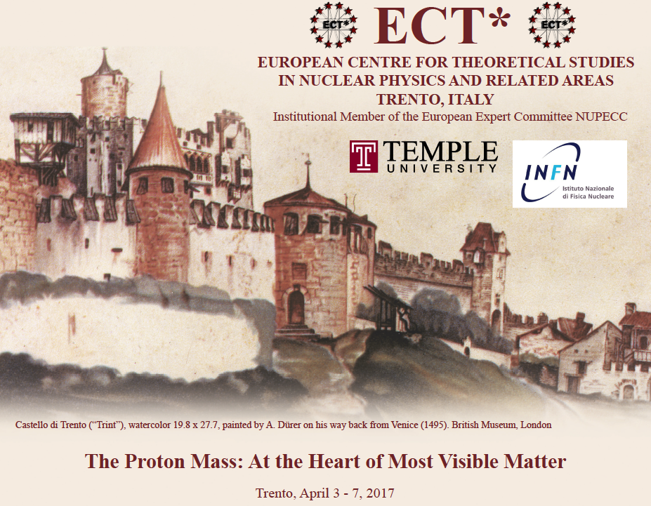
How does QCD generate its Mass & Spin?
Three-pronged approach to explore the origin of hadron mass
Lattice QCD
Mass decomposition – roles of the constituents
Model calculation – approximated analytical approach
Measurements of the parts in a decomposition
http://www.ectstar.eu/node/2218

Slide 15
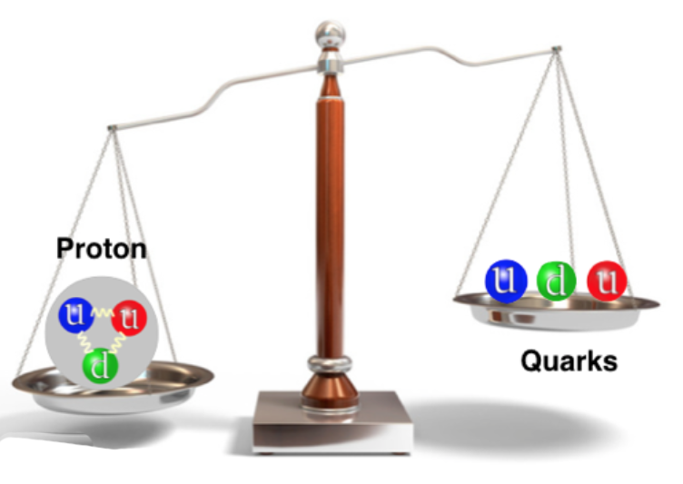
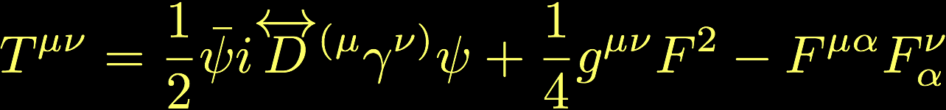
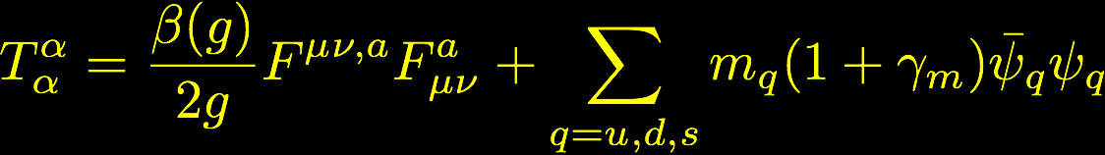
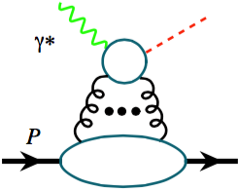

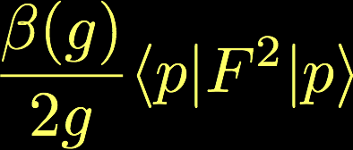
How does QCD generates the nucleon mass?
Role of quarks and gluons?
QCD energy-momentum tensor:
Trace of the QCD energy-momentum tensor:
QCD trace anomaly
Mass, trace anomaly, chiral symmetry breaking, …
J/Ψ, Υ, …
Chiral limit
Heavy quarkonium production near the threshold, from JLab12 to EIC

Slide 16
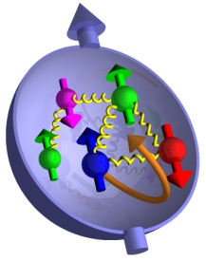
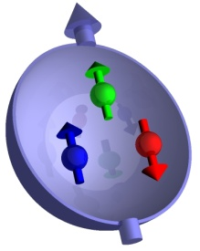

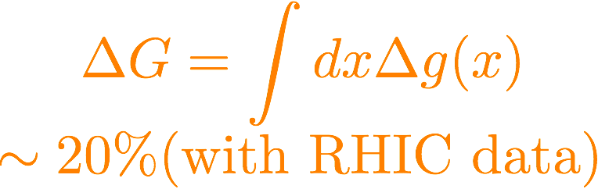

How does QCD generate the Nucleon Spin?
Proton Spin
Orbital Angular Momentum
of quarks and gluons
Little known?
Gluon helicity
Start to know
Quark Helicity
Best known from DIS
If we do not understand proton spin, we do not understand QCD

Slide 17






Experimental Tools: Scattering
Inclusive reactions: e+p/A → e’+X
  Detect only the scattered lepton in the detector
Semi-Inclusive reactions: e+p/A → e’+h(p,π,K)+X
  Detect the scattered lepton in
  coincidence with identified hadrons (mesons)
Exclusive reactions: e+p/A → e’+ p’/A’+ ( π,K,…)
  Detect all final states including proton (or its fragments)
Deep Inelastic Scattering
(DIS)
Elastic
Scattering
Deep Virtual
Compton Scattering:
Deep Virtual Meson Production
(DVMP)

Slide 18
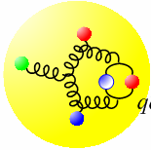
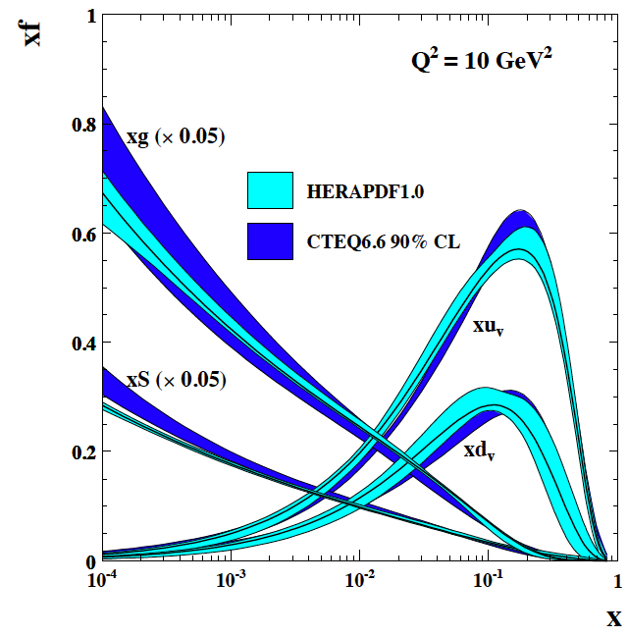
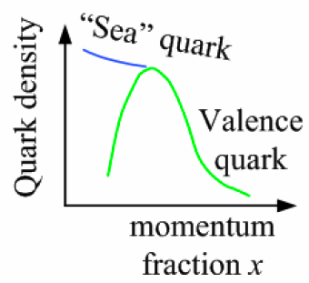
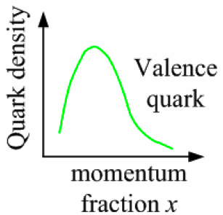
Why Polarization, large kinematic coverage , and Luminosity are critical
non-linear
dynamic Regime
QCD radiation
dominated Regime
Many-body
Regime
Few-body/
valence quark
Regime
x (proton)
10⁻⁵
10⁻⁴
10⁻³
10⁻²
10⁻¹
1
?
large kinematic coverage:
access to x and Q² over a wide range → from large to small x
polarized electron and hadron beams:
access to spin structure of nucleons and nuclei
Spin vehicle to access the spatial and momentum structure of the nucleon in 3D
Full specification of initial and final states to probe q-g structure of NN and NNN interaction in light nuclei
nuclear beams:
accessing the highest gluon densities
Filter to color propagation and hadron formation
high luminosity:
mapping the spatial and momentum structure of nucleons and nuclei in 3d
access to rare probes

Slide 19
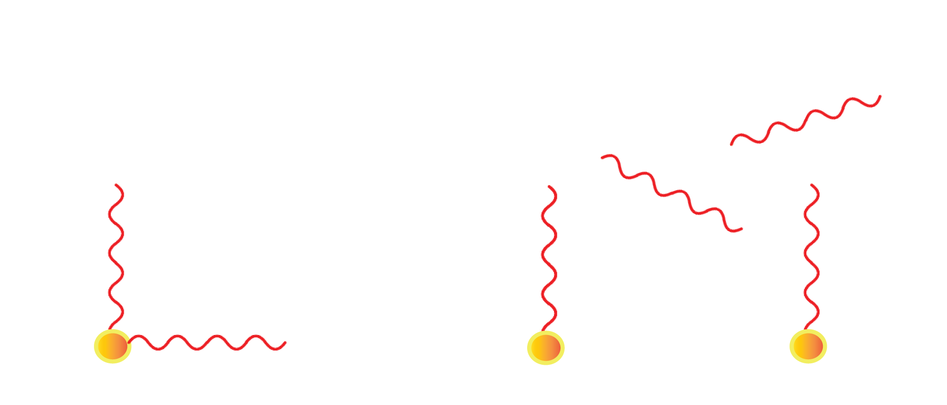





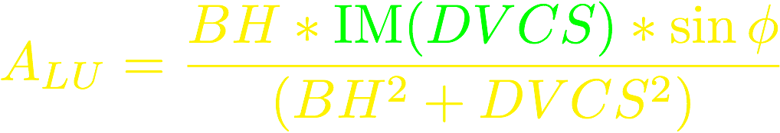

Deeply Virtual Compton Scattering
A clean probe of GPDs
k’
Q² >> 1 GeV²
k
2
GPDs
p
p’
At large Q²: QCD factorization theorem
At twist-2: 4 quark helicity conserving GPDs
Key: Q² leverage needed to test QCD scaling

Slide 20
Separating GPDs Through Polarization
ep epγ
σ⁺ − σ⁻
σ⁺ + σ⁻
Δσ
2σ
ξ = x_{B}/(2-x_{B})
A =
=
k = -t/4M²
Polarized beam, unpolarized target:
~
~
Δσ_{LU} ~ sinφ{F₁H + ξ(F₁+F₂)H +kF₂E}dφ
H, H, E
Kinematically suppressed
Unpolarized beam, longitudinal target:
~
~
H, H
Δσ_{UL} ~ sinφ{F₁H+ξ(F₁+F₂)(H + … }dφ
Unpolarized beam, transverse target:
H, E
Δσ_{UT} ~ sinφ{k(F₂H – F₁E) + ….. }dφ
Global analysis of polarized and unpolarized data needed for GPD separation

Slide 21
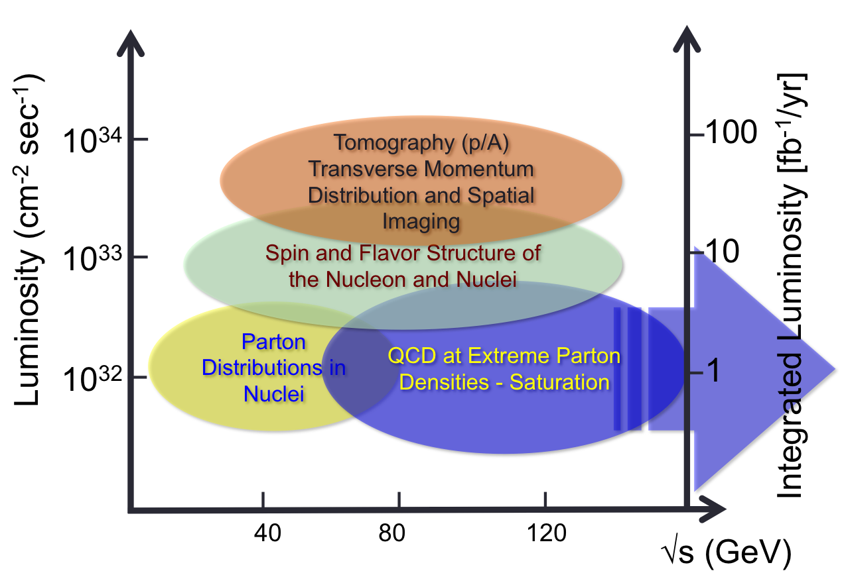
EIC vs DIS facilities
10⁴⁰
FIXED TARGET
PERLE
HERA and CERN
MESA
JLab 6 & 12
EIC Projects
10³⁸
SLAC
10³⁶
Luminosity (cm⁻² sec⁻¹)
US EIC Realization
Plans
FCC-eh
10³⁴
COMPASS
LHeC
CEIC
US-EIC:
Spin, ion species together with its luminosity and √s coverage makes it a completely unique machine.
BCDMS
10³²
HERMES
NMC
HERA
10³⁰
0.1
1
10
100
1000
10000
CMS Energy [GeV]

Slide 22
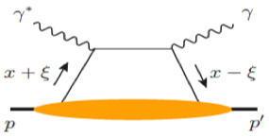
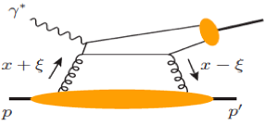
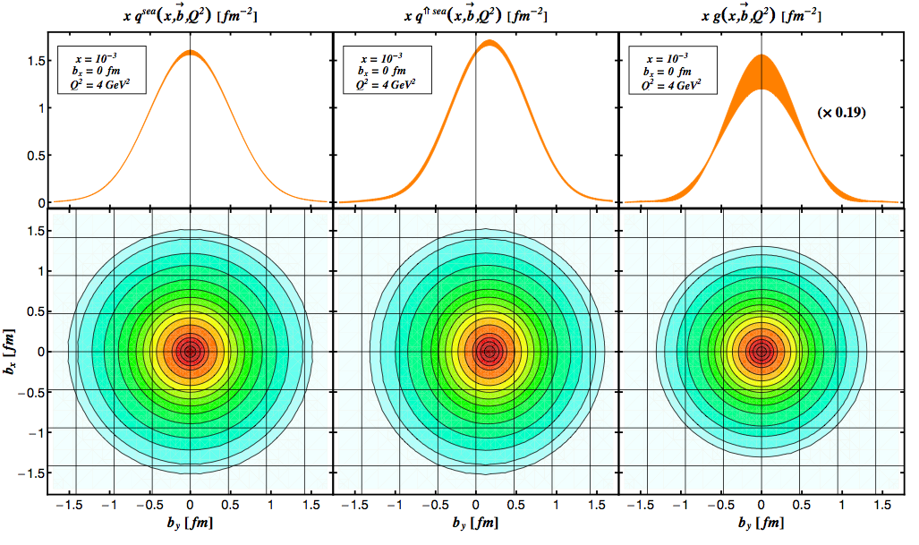
Spatial Imaging of Sea Quarks & Gluons
Exclusive Deep Virtual Compton Scattering
Exclusive Deep Virtual Meson Production
ρ, Φ, J/ψ
x= 10⁻³ , Q² = 4 GeV²
Spatial density distributions
Gluon imaging from simulation
How far does it
spread?
Sea quarks
unpolarized
Sea quarks
polarized
Gluons
JLab 12 GeV: Valence quarks
EIC: Sea quarks and gluons
From EIC white paper: arXiv:1212.1701.v3
Notes:
We measure cross sections and polarization asymmetries (AUT)
Assuming a functional form of the GPDs, one can extract both GPD E and H in a fit to the DVCS cross section and transverse proton spin asymmetry
Given the Q2 level arm, the fit can also determine the gluon density profile from evolution effects
2D images for different slices in x

Slide 23
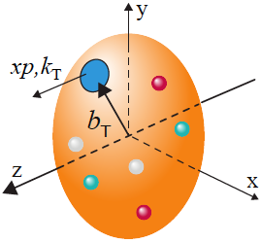
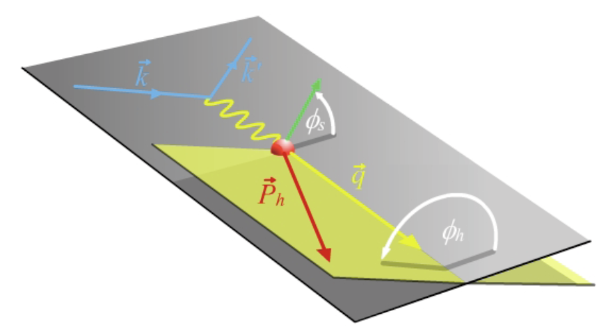
TMDs: Confined Motion in a Nucleon
SIDIS is the best tool to probe TMDs
TMDs are rich in quantum correlations
Two scales (TMD factorization)
high Q - localized probe
Low p_{T} - sensitive to confining scale
Two planes
Angular modulation to separate TMDs
Separation of TMDs:
Collins Fragmentation
Function (e⁺e⁻ collisions)
Notes:
Hard, if not impossible, to separate TMDs in hadronic collisions
Using a combination of different observables (not the same observable): jet, identified hadron, photon, …

Slide 24
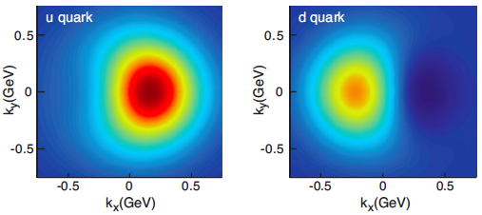
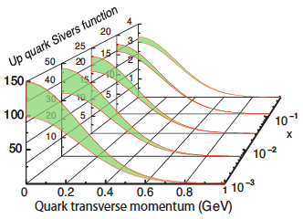
Confined Motion in a Polarized Nucleon
Sivers function: unpolarized quarks inside a transversely polarized nucleon
Sivers effect requires OAM in nucleon wave function
x = 0.1
Density distribution of an unpolarized quark in a proton moving in z direction and polarized in y-direction
Quark distributions are azimuthally asymmetric in transverse momentum space
JLab12
For
Large-x
From EIC white paper: arXiv:1212.1701
Q² evolution of TMDs
No other machine in the world can do this!

Slide 25
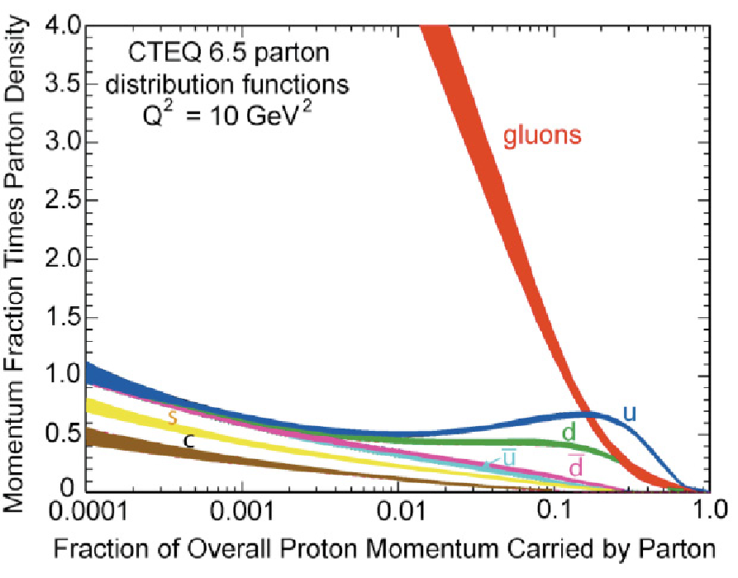
Gluon density at small x, and consequences
Runaway gluon density at small x?
What causes the low-x rise?
gluon radiation
– non-linear gluon interaction
What tames the low-x rise?
gluon recombination
– non-linear gluon interaction
QCD vs. QED:
QCD – gluon in a proton:
At very small-x, proton is “black”, positronium is still transparent!
QED – photon in a positronium:
Recombination of large numbers of glue could lead to saturation phenomena

Slide 26
Gluon density at low x, and consequences
Run away gluon density at small x?
What causes the low-x rise?
gluon radiation
– non-linear gluon interaction
What tames the low-x rise?
gluon recombination
– non-linear gluon interaction
Particle vs. wave feature:
Gluon saturation – Color Glass Condensate
Radiation = Recombination
=
at Q_{s}
Leading to a collective gluonic system?
with a universal property of QCD?
new effective theory QCD – CGC?
Expectation: x=10⁻⁵ in a proton at Q²=5 GeV²

Slide 27
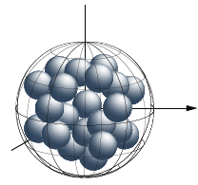
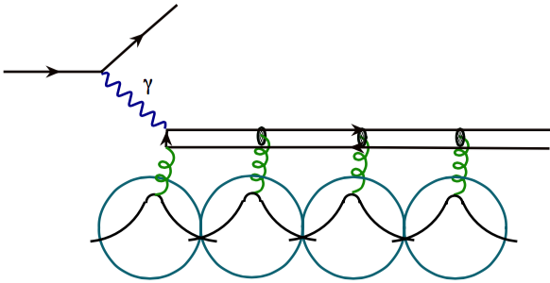
DIS on a large nucleus; Is there a color overlap between nucleons?
If we only see quarks and gluons, …
NLO in α_{s} ,
neglects LO
2
Could there be overlap of color between nucleons?
If color is localized inside the nucleon, using a large nucleus does not change gluon dynamics inside nucleon
– no advantage for seeing the gluon saturation,
– but, provides an opportunity to study QCD multiple scattering
If color leaks outside of the nucleon inside a large nucleus, color interaction between nucleons modifies the nuclear landscape
– large nucleus could have an advantage for discovering the
universal properties of the gluon saturation “earlier”

Slide 28
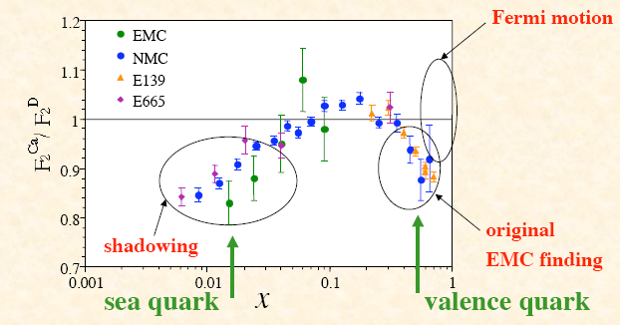
An example, Ratio of F₂: Shadowing vs. Saturation
J.-W. Qiu
Color localized inside nucleons
Saturation in RF₂
=
No saturation in F₂^{A}
Collision
effects
A simple question:
Will the suppression/shadowing
continue to fall as x decreases?

Slide 29
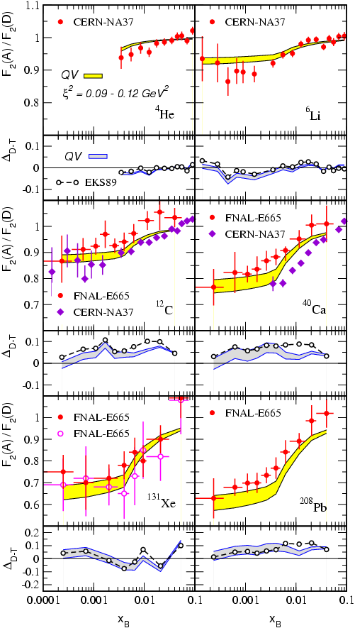

DIS on a large nucleus
If the color is localized inside nucleon, …
Qiu, Vitev, PRL2004
ξ² = 0.09 – 0.12 GeV²
One number for all x_{B}, Q, and A dependence !

Slide 30
An exExample, Ratio of F₂: Shadowing vs. Saturation
J.-W. Qiu
Color localized inside nucleons
Plateau in RF₂
=
No saturation in F₂^{A}
Collision
effects
Color leaks
outside
nucleons
Soft gluon
radius is
larger
A simple question:
Saturation
in nucleon
Will the suppression/shadowing
continue to fall as x decreases?

Slide 31

Saturation/CGC: Another example
Many ways to get to gluon distribution in nuclei, but diffraction most sensitive:
At HERA
  ep: 10-15% diffractive
At EIC eA, if Saturation/CGC
  eA: 25-30% diffractive
Notes:
Amazing events: in the rest frame a 1 TeV e-beam on Nucleus (~binding energy of 10s MeV) and nothing happens to the nucleus 1/3 of time. The gluon matter is so “DISK” like that even when probed with high resolution probe acts like a “solid” Dark object, creating diffractive patters. Nuclei have a lot more gluons than protons, so the object is DARKER, and hence the diffractive part of the cross section RISES above 1 in ratio. If there is no saturation, then the nucleus may break more often, and hence the ratio of diffraction in nuclei to proton actually decreases.

Slide 32

T. Hallman at
EIC Users Meeting in Trieste

Slide 33


Slide 34
NAS charge
Questions 1: What is the merit and significance of the science that could be addressed
by an electron ion collider facility and what is its importance in the overall context of
research in nuclear physics and the physical sciences in general?
Question 2: What are the capabilities of other facilities, existing and planned, domestic
and abroad, to address the science opportunities afforded by an electron-ion collider?
What unique scientific role could be played by a domestic electron ion collider facility
that is complementary to existing and planned facilities at home and elsewhere?
Question 3: What are the benefits to U.S. leadership in nuclear physics if a domestic
electron ion collider were constructed?
Question 4: What are the benefits to other fields of science and to society of
establishing such a facility in the United States?

Slide 35
Summary
EIC is an ultimate QCD machine:
1) to discover and explore the quark/gluon structure and properties of hadrons and nuclei,
2) to search for hints and clues of color confinement, and
3) to measure the color fluctuation and color neutralization
EIC is a gluon and sea quark tomographic machine for nucleons and nuclei with a resolution better than 1/10 fm
EIC designs explore the polarization and intensity frontier,
as well as the frontier of new accelerator/detector technology
EIC@US is sitting at a sweet spot for rich QCD dynamics – capable of taking us to the next QCD frontier
Thanks!

Slide 36
Roster for the Committee on U.S.-Based Electron Ion Collider Science Assessment
Dr. Gordon A. Baym,Chair NAS
Professor Emeritus Department of Phyysics
University of Illinois at Urbana-Champaign 1110 West Green Street
Urbana, IL 61801
Phone: (217) 333-4363
Email: gbaym@uiuc.edu
Email: gao@phy.duke.edu
Dr. Kawtar Hafidi Associated Chief Scientist Medium Energy Physics Laboratory Directed Research
and Development Argonne National Laboratory 9700 Cass Avenue
Lemont, IL 60439
Phone: (630) 252-4012
Fax: (630) 252-3903
Email: kawtar@anl.gov
Dr. Christine Aidala Associate Professor Department of Physics University of Michigan 450 Church Street Ann Arbor, MI 481069 Phone: (737) 764-7611
Email: caidala@umich.edu
Dr. Wick Haxton NAS
Professor of Physics Department of Physics University of California Berkeley 431 Old LeConte Hall
MC 7300
Berkeley, CA 94720
Phone: (510) 664-4321
Email: haxton@berkeley.edu
Dr. Ani Aprahamian Freimann Professor Experimental Nuclear Physics Department of Physics University of Notre Dame 225 Nieuwland Science Hall Notre Dame, IN 46556 Phone: (574) 631-8120
Email: aapraham@nd.edu
Dr. John Jowett Accelerator Physicist CERN
L07500, CERN
CH,-1211 Geneva 23, Switzerland Phone: +44 22 76-7643
Email: john.jowett@cern.ch
Dr. Peter Braun-Munzinger
Scientific Director
ExtreMe Matter Institute (EMMI) at GSI Technische Universitat Darmstadt Schlossgartenstrabe 9
64289 Darmstadt Phone: +4*-6159-712760
Email: p.braun-munzinger@gsi.de
Dr. Larry McLerran
Director
Institute for Nuclear Theory Physics/Astronomy Building PAT C411B
University of Washington Seattle, WA 98195
Phone: (206) 616-0792
Email: lmcler@uw.edu
Dr. Haiyan Gao NAE
Henry Newson Professor Physics/Astronomy Building Duke University
Ffsc 2313 Science Drive Durham, NC 27708
Phone: (919) 660-2622
Fax: (919) 660-2634

Slide 37
Dr. Zein-Eddine Meziani Professor of Physics Department of Physics Temple University
1925 N. 12th Street Philadelphia, PA 19122
Phone: (215) 204-5971
Email: meziani@temple.edu
BPA Staff
David Lang, BPA Program Officer,
Study Director
Phone: 202-334-2395
dlang@nas.edu
James Lancaster, BPA Director Phone: 202-334-1936
jlancaster@nas.edu
Dr. Richard Milner
Professor
Laboratory for Nuclear Science’s Hadronic Physics Group
Massachusetts Institute of Technology 77 Massachusetts Avenue
MS 26-411
Cambridge, MA 02139
Phone: (617) 258-5439
Email: milner@mit.edu
Linda Walker, Program Coordinator Phone: 202-334-1311
lwalker@nas.edu
Henry Ko, Research Assistant Phone: 202-334-3458
hko@nas.edu
Dr. Thomas Schaefer Professor of Physics Department Physics
North Carolina State University Raleigh, NC 27695
Phone: (919) 513-7199
Fax: (919) 515-6538
Email: thomas_schaefer@ncsu.edu
Board on Physics and Astronomy The National Academies
500 Fifth Avenue, NW Washington, DC 20001
Phone: (202) 334-3520
Fax: Email:
(202) 334-3575
bpa@nas.edu
Dr. Ernst Sichtermann Senior Scientist Nuclear Science Division
:awrence Berkeley National Laboratory 1 Cyclotron Road
MS 70R0319
Berkeley, CA 94720
Phone: (510( 486-5401
Email: epsichtermann@lbl.gov
Dr. Michael S. Turner NAS
Bruce V. Rauner Distinguished Service Professor
University of Chicago 5640 South Ellis Avenue Chicago, IL 60637
Phone: (773) 702-7974
Email: mturner@uchicago.edu

