Slide 1

Chengping Shen
Review on tetraquark states from experimental results
9th Workshop on Hadron physics in China and
Opportunities Worldwide
2017年7月26日

Slide 2
Chengping Shen
Review on XYZ states from experimental results
9th Workshop on Hadron physics in China and
Opportunities Worldwide
2017年7月26日

Slide 3

Outline
Introduction
Recent experimental results on X states
Recent experimental results on Y states
Recent experimental results on Z states
The future plan
Summary
Notes:
In this talk, we present the most recent study of the X(3872) from Y(4260) radiative decay, the Y states from Initial state radiation and from electron positron collision, as well as the charged Z states.

Slide 4
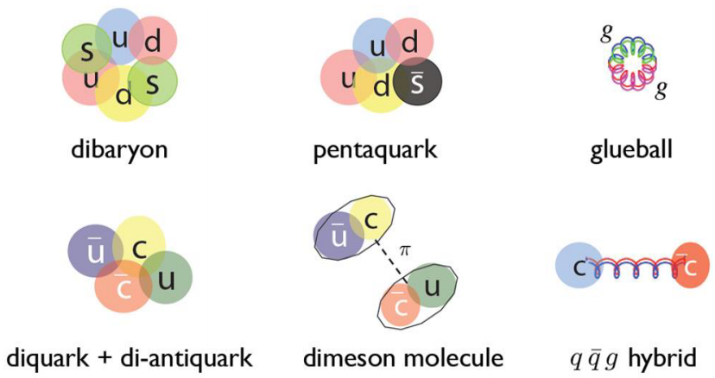
Hadrons: normal & exotic
Quark model: hadrons are composed from 2 (meson) quarks or 3 (baryon) quarks
QCD does not forbid hadrons with N_{quarks}≠2, 3
  Glueball： N_{quarks} = 0 (gg, ggg, …)
  Hybrid： N_{quarks} = 2 (or more) + excited gluon
  Multiquark state： N_{quarks} > 3
  Molecule： bound state of more than 2 hadrons
  …

Slide 5
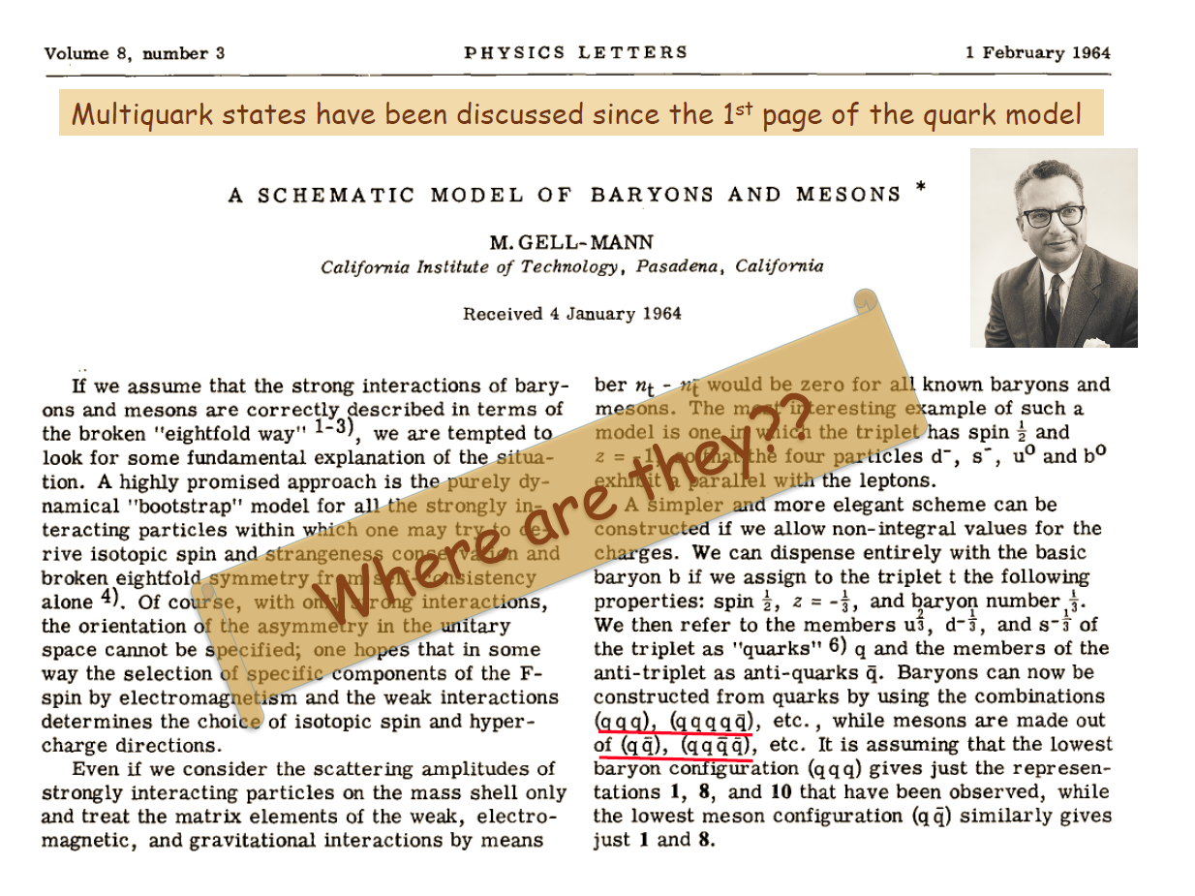
M. Gell-Mann, Phys. Lett. 8, 214 (1964)
5

Slide 6
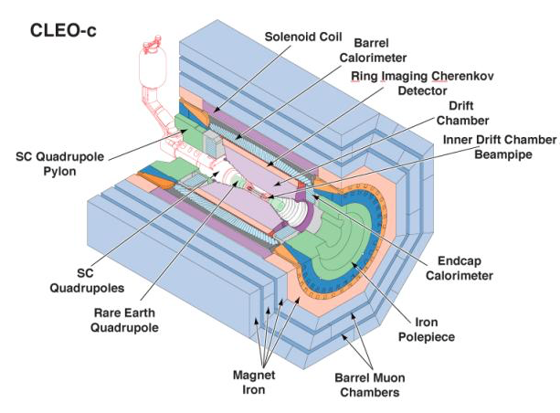
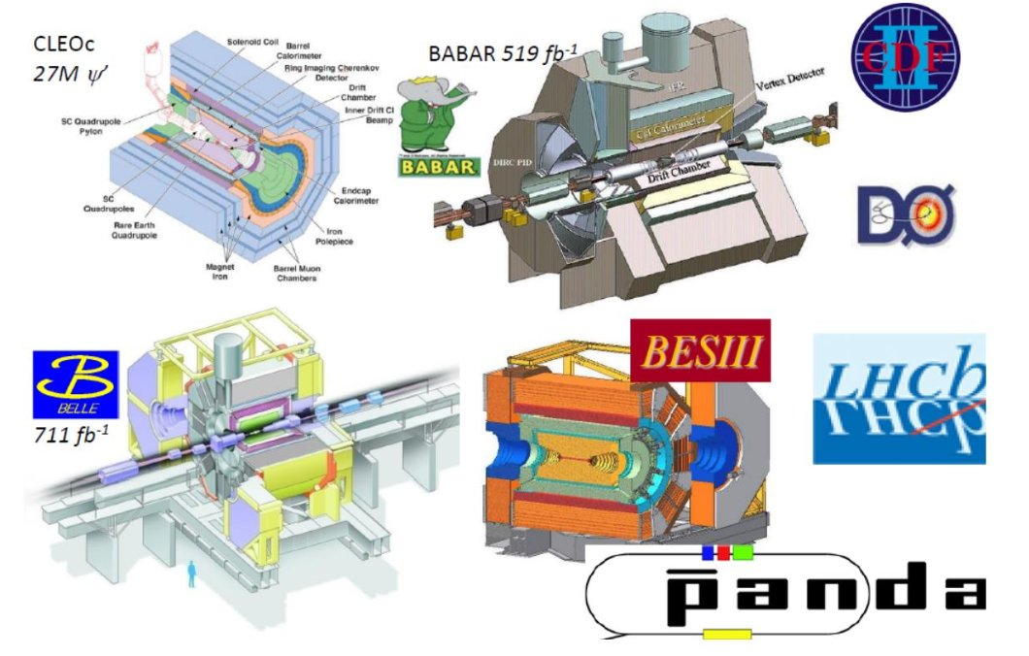

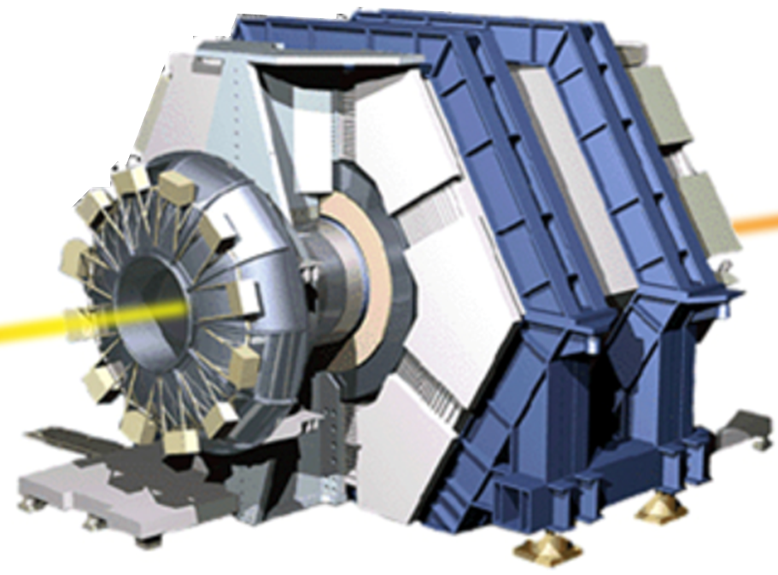

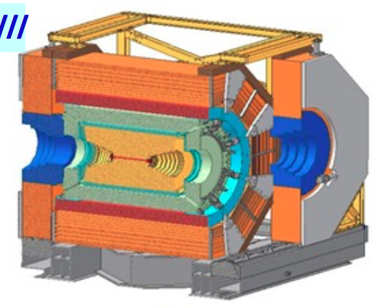

Main Suppliers of Exotics

Slide 7
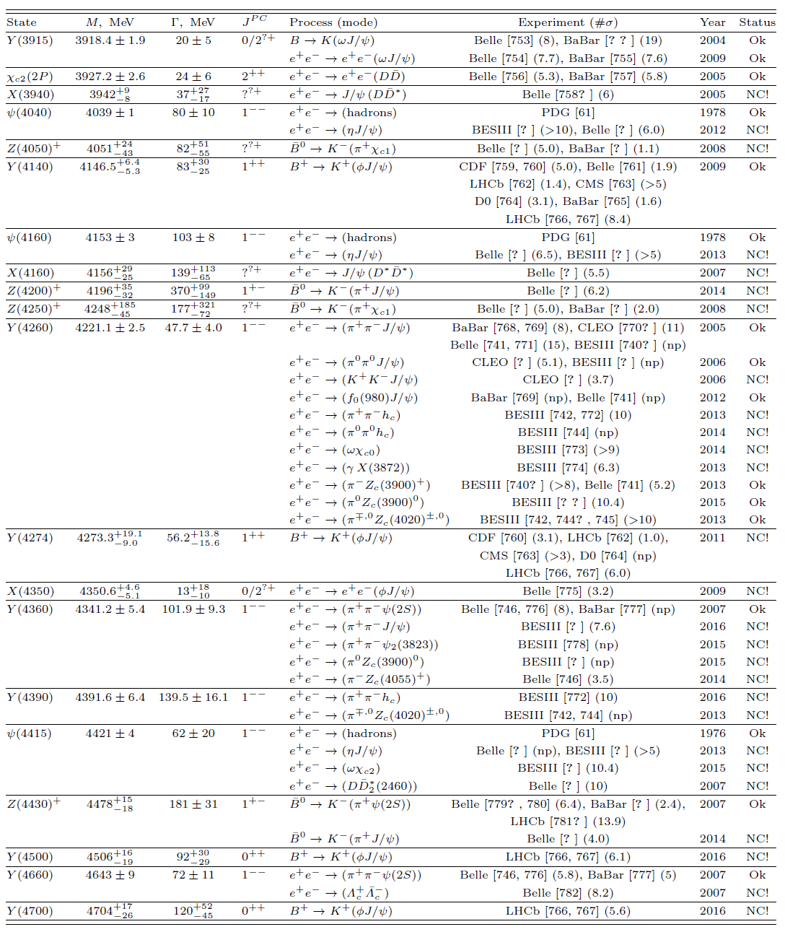
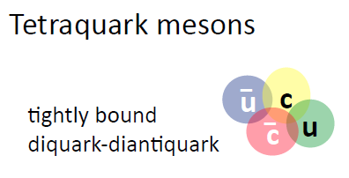
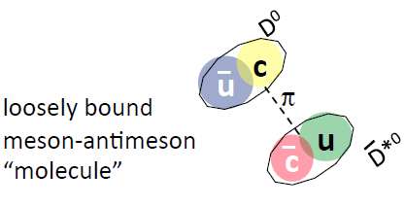

Particle “Zoo” again !
7

Slide 8
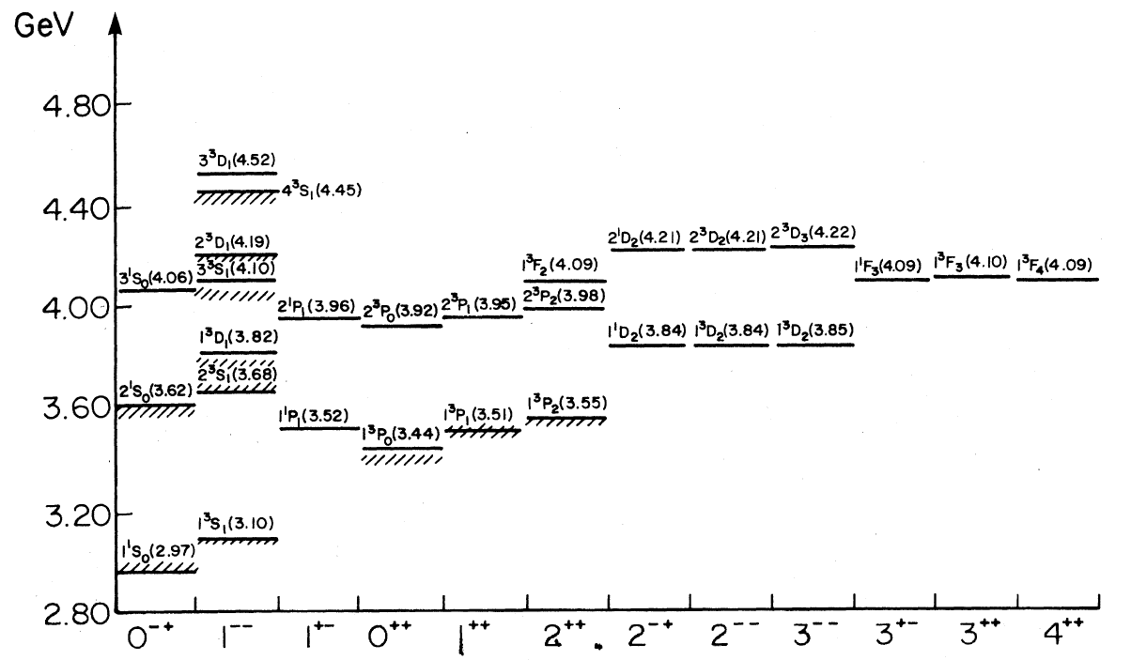
XYZ particles
n^{(2S+1)}L_{J}
n radial quantum number
S total spin of c & cbar
L orbital angular momentum
L = 0, 1, 2 ... correspond to S, P, D, …
J = S + L
P = (–1)^{L+1} parity
C = (–1)^{L+S} charge conj.
Charmonium-like (XYZ) particles
New type of hadron (multi-quark …)?
Too many vector states! Exotics?
X(3823)
X(3872)
X(3915)
X(4350)
Y(4008)
Y(4260)
Y(4140)
Y(4360)
Y(4660)
Y(4630)
…
m(D+D)
XYZ(3940)
Hybrids ~ 4.2-4.5 GeV
Tetraquarks ~ 3.9-4.7 GeV
DD*/D*D*/D*_{s}D*_{s}/DD₁ molecule
~ 3.9-4.4 GeV
Z_{c}(3900)
Z_{c}(4020)
Z(4430)
Z(4250)
Z(4050)
…
h_{c} (¹P₁)
Godfrey & Isgur, PRD32, 189 (1985)

Slide 9
Too many models !
  Theory 1: screened potential
  Theory 2: hybrids with excited gluons
  Theory 3: tetraquark states
  Theory 4: meson molecules
  Theory 5: cusps effect
  Theory 6: final state interaction
  Theory 7: coupled-channel effect
  Theory 8: mixing of normal quarkonium and exotics
  Theory 9: mixture of all these effects
  Theories …
Notes:
9

Slide 10

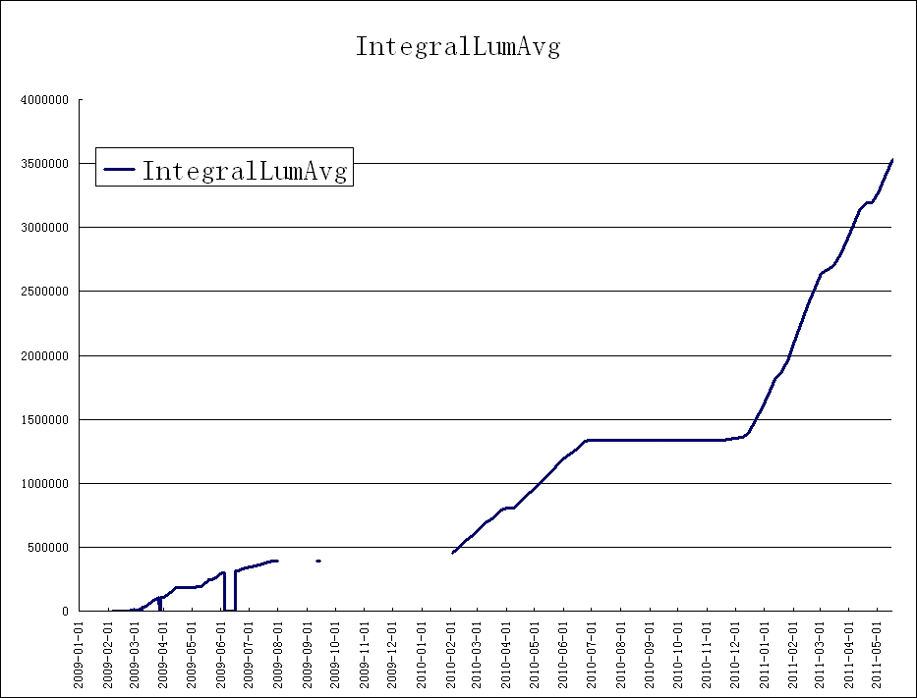
BESIII data samples
Note that luminosity is lower at J/ψ,
and machine is optimal near ψ’’ peak
2012:
ψ′ & J/ψ
[0.35B & 1.1B]
Int. lum.: Jan. 2009– Mar. 2017
about 17 fb⁻¹ @ different energies
Note increase in slopes!
ψ(4160): 3.2 fb⁻¹ [2016]
ψ(3770): 2.9 fb⁻¹
ψ′: 0.5 B
J/ψ: 1.3 B
XYZ: 11 fb⁻¹ [2013-17]
2011: ψ’’ &
ψ(4040)
2009: ψ′ & J/ψ
2010: ψ’’

Slide 11
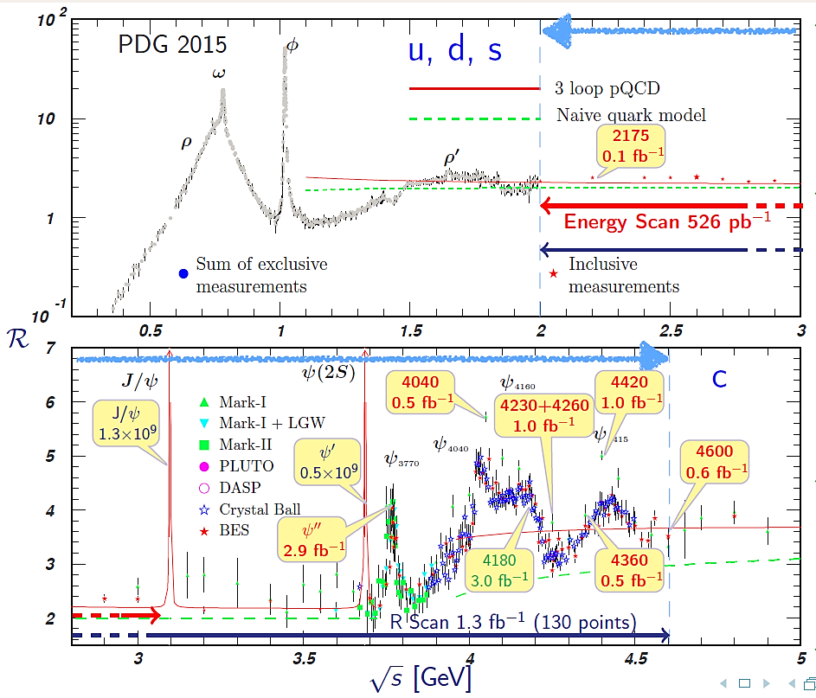
4230+4260
2.0 fb⁻¹

Slide 12
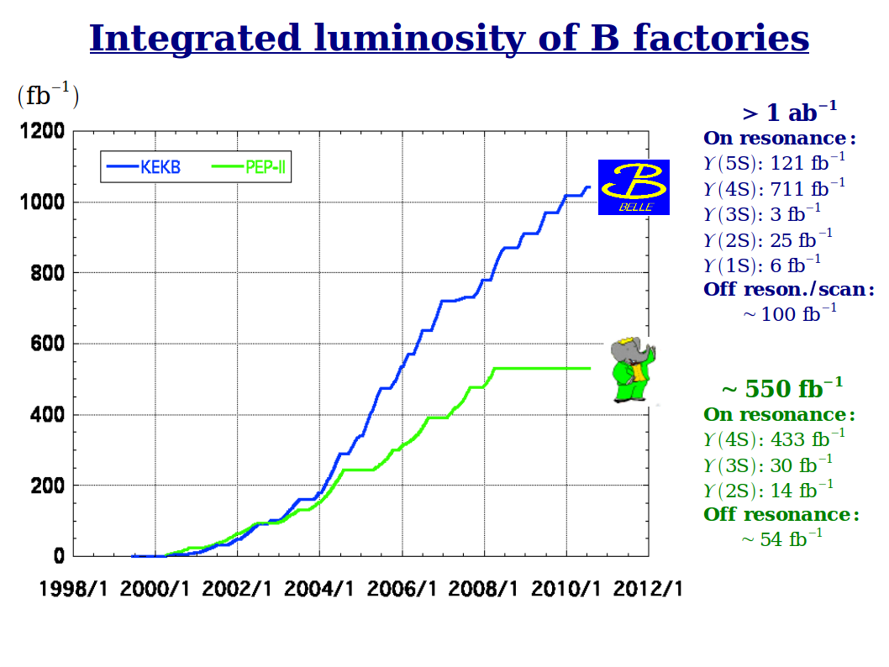
Ecm (GeV) | N^{points} | Lum per point (fb⁻¹) | Physics analyses
10.865 | 1 | 121.4 | ϒππ, h_{b}ππ, B^{(*)}B^{(*)}π
10.63-11.02 | 6+16 | ~1 | R_{b}, ϒππ, h_{b}ππ
10.75-11.05 | 61 | ~0.05 | R_{b}
10.52 | 1 | 1.03 | Continuum bkg. est.

Slide 13
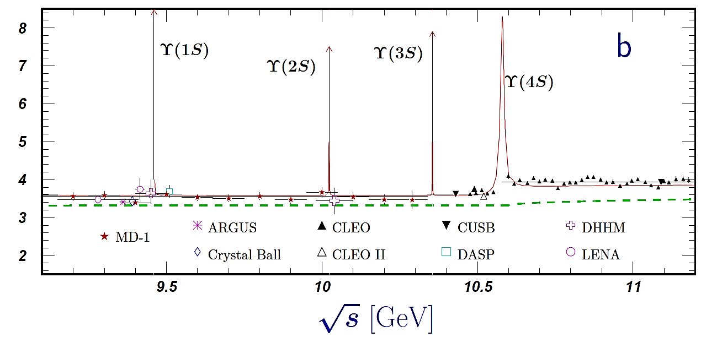
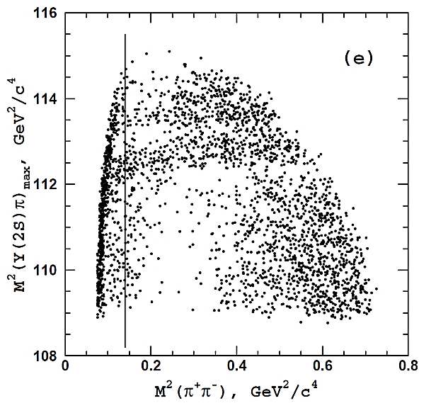
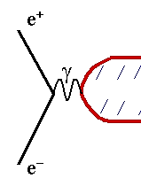
e⁺e⁻ annihilation to vector bottomonia
}
J^{PC} = 1⁻⁻
ϒ(nS), Y_{b}…

Slide 14
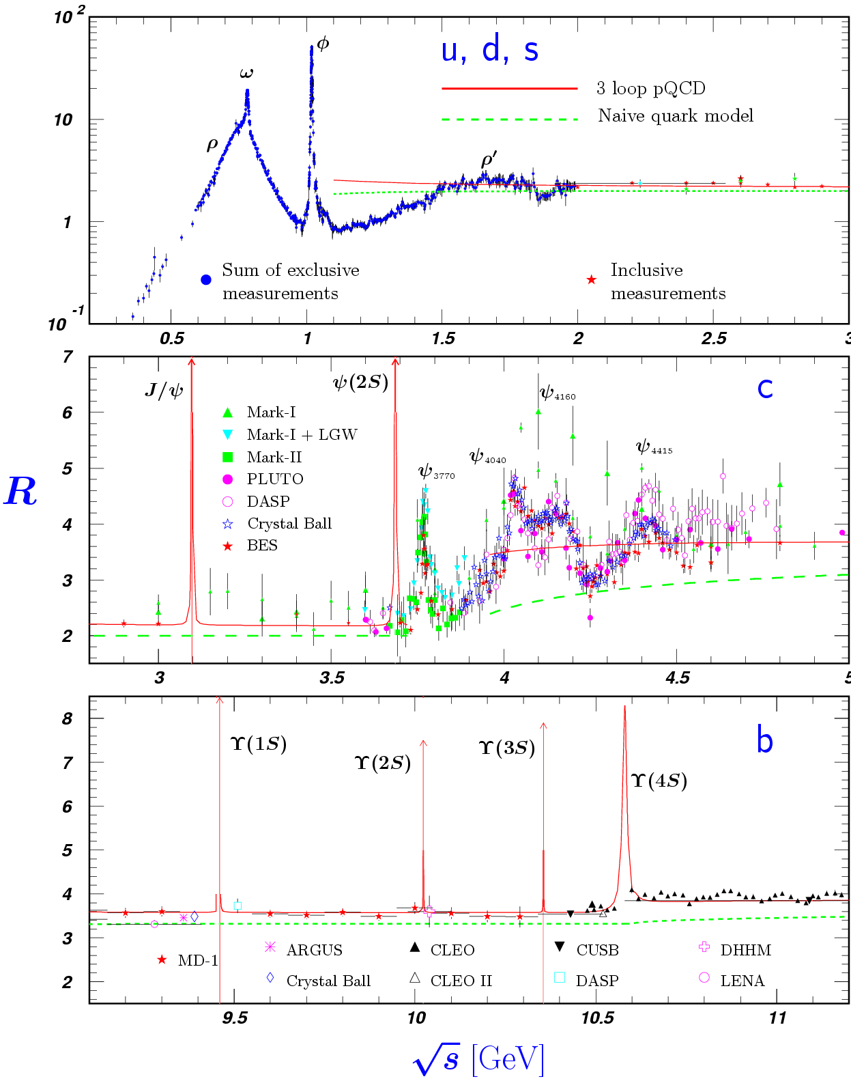
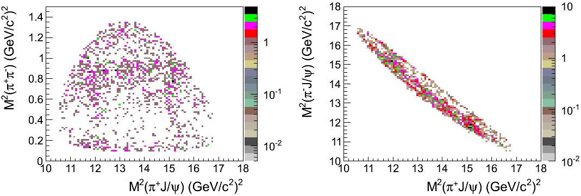
ISR production of vector charmonia
}
J^{PC} = 1⁻⁻
ψ’, ψ’’, Y…

Slide 15
X States
X(3872), X(5568), X_{b} …
Observed in B decays and (suggestively) in decays of Y type states

Slide 16
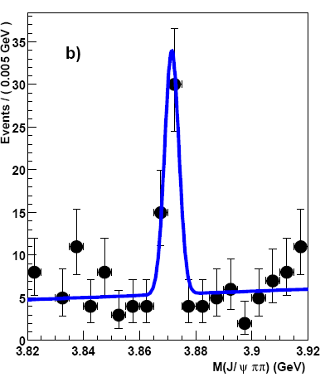
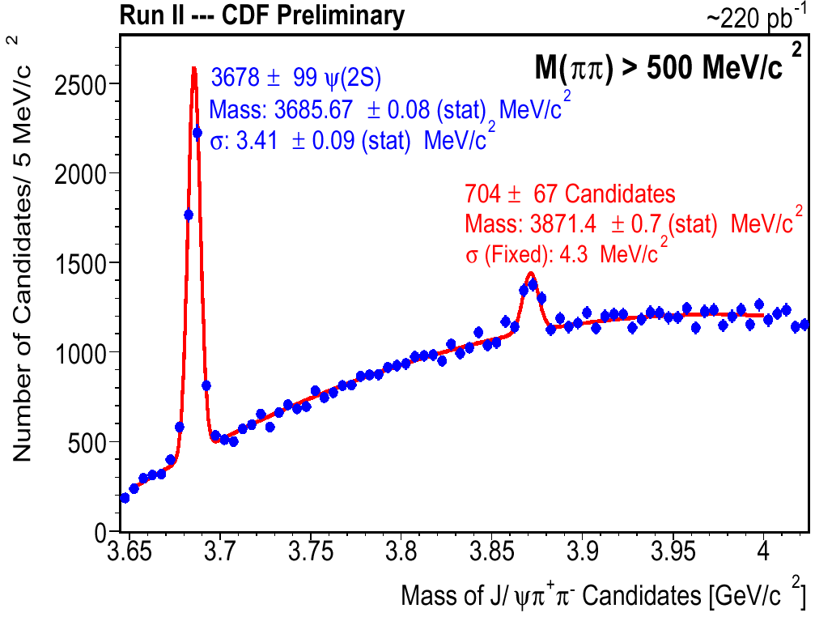
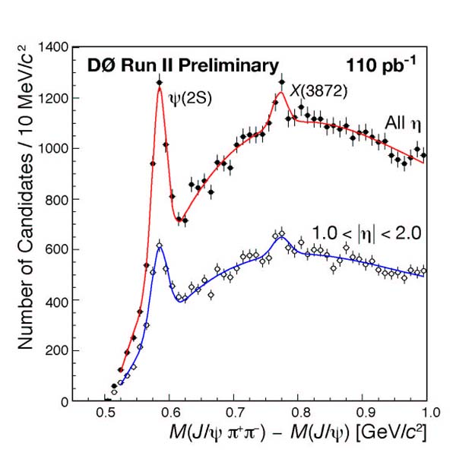
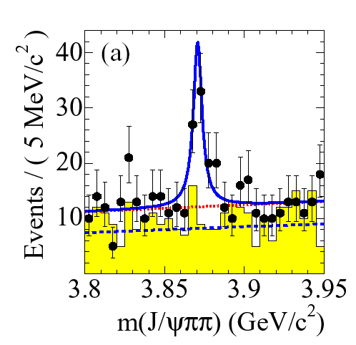



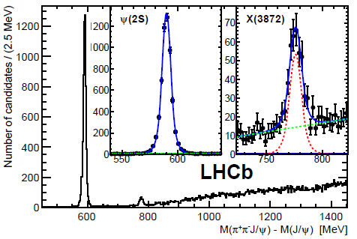


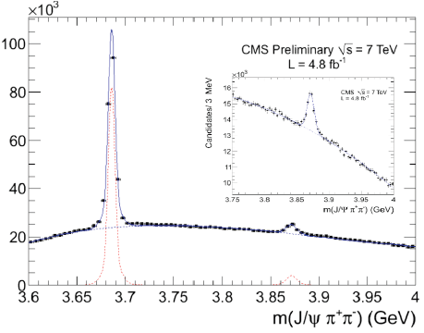
X(3872)→J/ψπ⁺π⁻
Belle’s most cited paper: 1200+
10σ
first observed by Belle in B→K J/ψπ⁺π– PRL91, 262001 (2003)
M_{X} close to D⁰D^{*0} threshold M = 3871.68 ± 0.17 MeV
(not clear below or above: Δm = – 0.16 ± 0.32 MeV)
surprisingly narrow: Γ_{tot}< 1.2 MeV at 90% CL
M(J/ψππ)
PRL93, 072001 (2004)
PRL93, 162002 (2004)
PRD73, 011101 (2006)
JHEP 04, 154 (2013)
X(3872)→J/ψγ: C-even
Angular analysis:
Belle 2006: J^{PC} = 1⁺⁺ or ≥2
CDF 2008: J^{PC} = 1⁺⁺ or 2^{–+}
Belle 2011: J^{PC} = 1⁺⁺ or 2^{–+}
EPJ C72 1972 (2012)
LHCb 2013: J^{PC} = 1⁺⁺

Slide 17
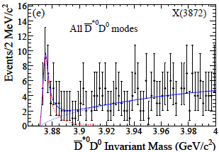
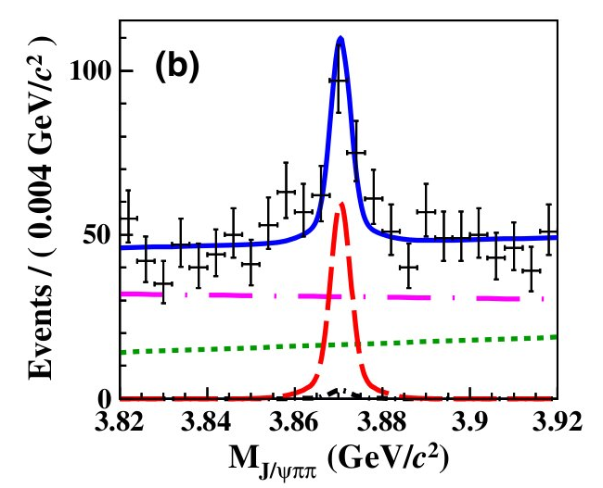
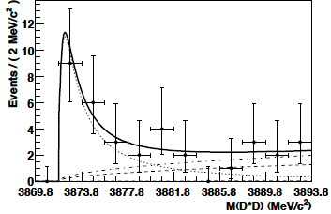
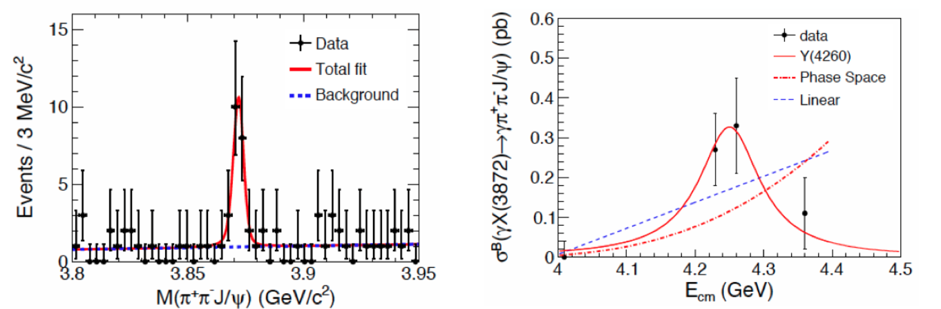
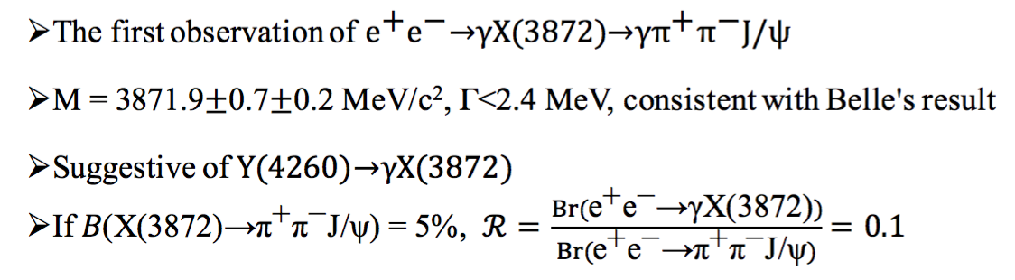
X(3872): Other Decay Modes
ππ = ρ means Isospin violation!
X(3872) → J/ψω is seen: confirms isospin violation
B(X(3872) → J/ψω)/B(X(3872) → J/ψππ)=0.8±0.3
Radiative decays: Belle&Babar good agreement for X →J/ψγ; not consistent for X →ψ(2S)γ. LHCb confirms BaBar’s not vanishing X →ψ(2S)γ.
X(3872) → DD* - dominant mode
B→X(3872)Kπ non-resonant Kπ dominates!
PRD 81, 031103 (2010)
PRD 77, 011102 (2008)
PRD 91, 051101(R) (2015)
PRL 112, 092001 (2014)

Slide 18
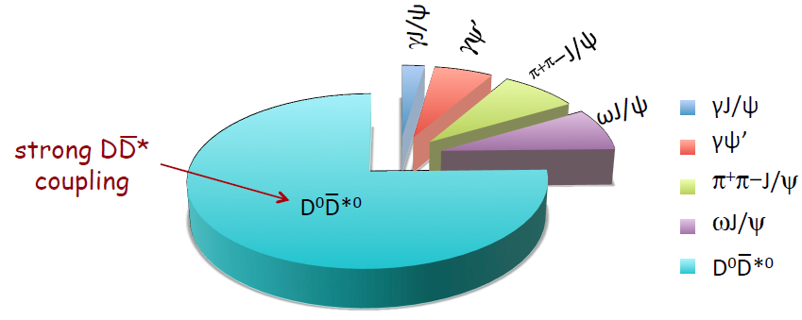
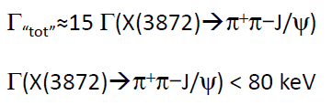
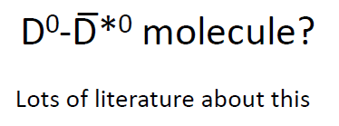
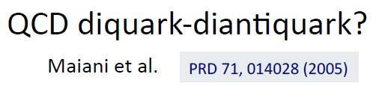
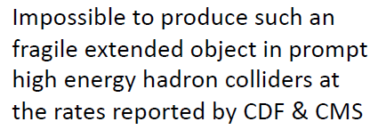
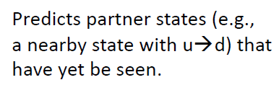


X(3872) decay channels
18

Slide 19
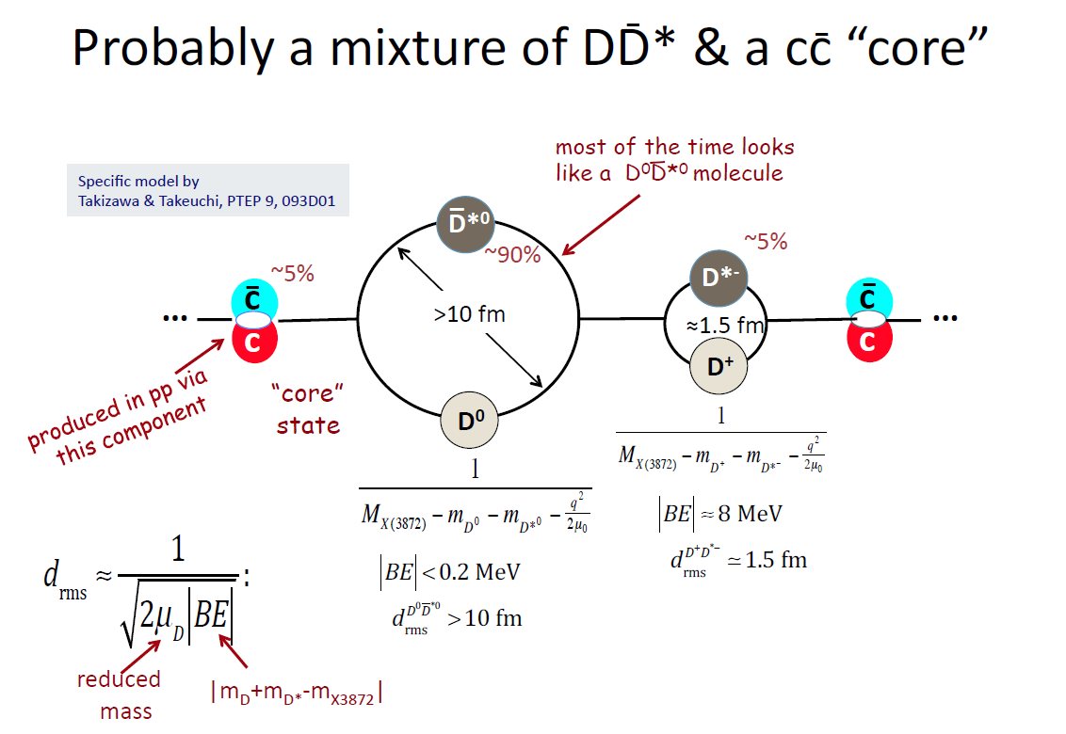



Slide 20
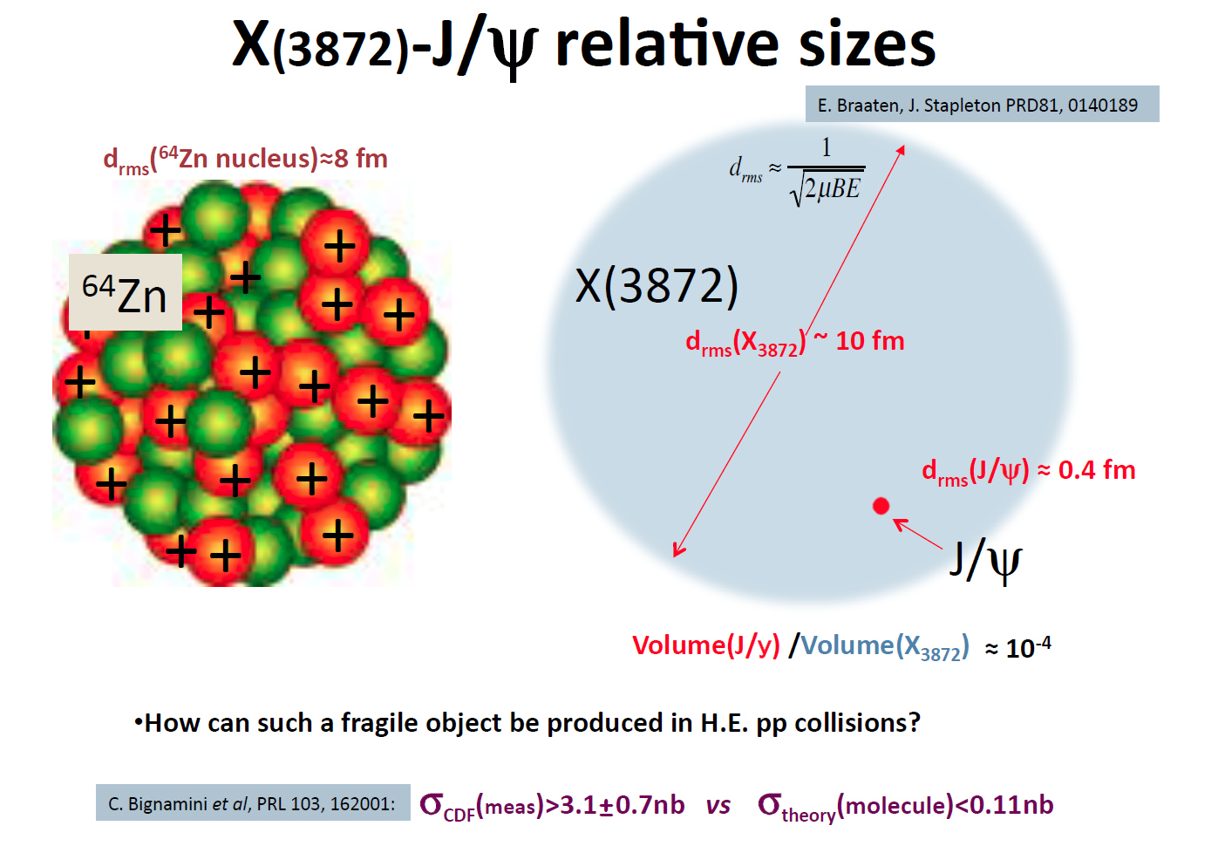


Slide 21
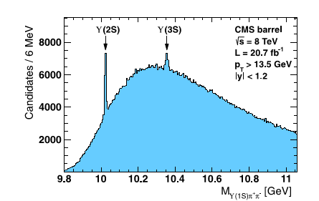

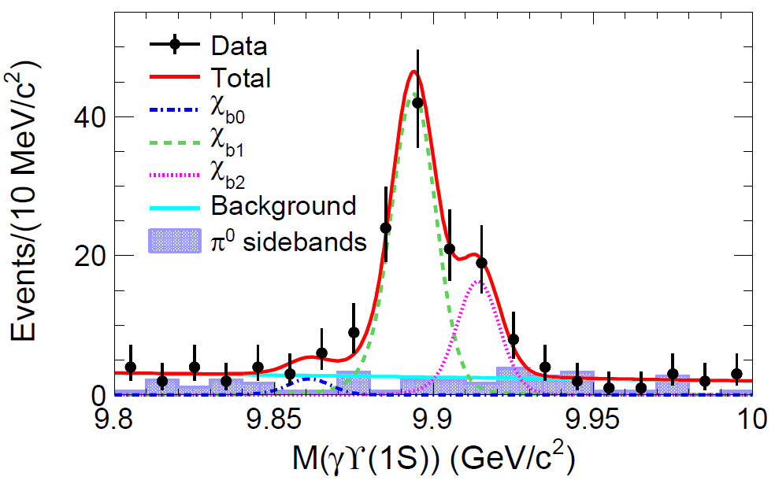
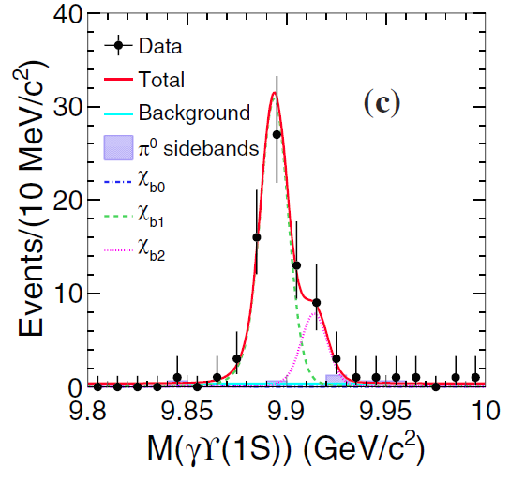
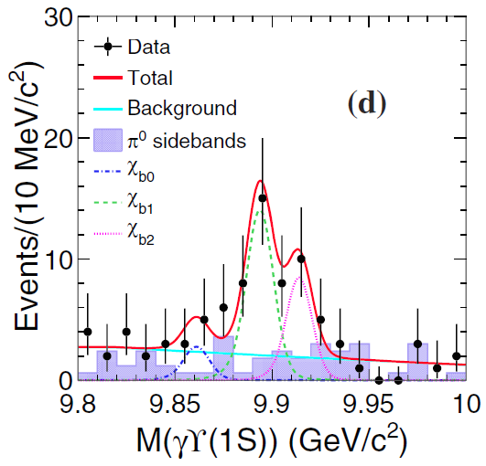
Search for X_{b} in e⁺e⁻ → ɣπ⁺π⁻π⁰Y(1S) at 10.867 GeV
The X(3872) counterpart in the bottomonium
sector X_{b}, NOT observed decay channel π⁺π⁻ϒ(1S).
As X_{b} is above ωY(1S) threshold, this Isospin-conserving process should be a more
promising decay mode. [PRD88, 054007].
PLB 727, 57 (2013) .
118 fb⁻¹
12σ
5.9σ
Large Brs of Y(5S) to π⁺π⁻π⁰χ_{b1/b2},
ωχ_{b1/b2}are observed for the first
time and their ratios are measured:
hadronic loop effect ?
arXiv:1406.6763
PRL 113, 142001 (2014)
Assuming X_{b} is narrow, the
upper limit on the product
branching fraction was given.
4.9σ
3.1σ

Slide 22
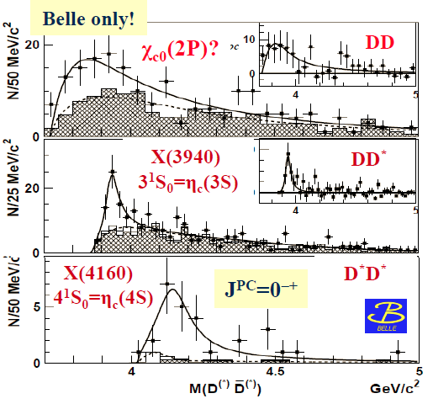
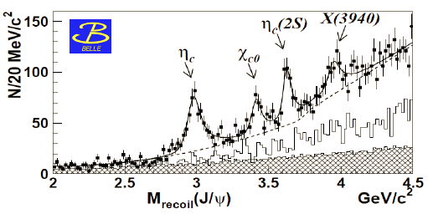
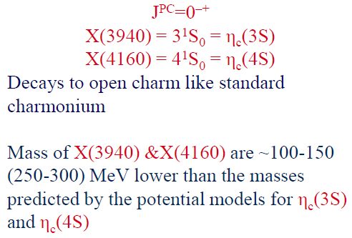
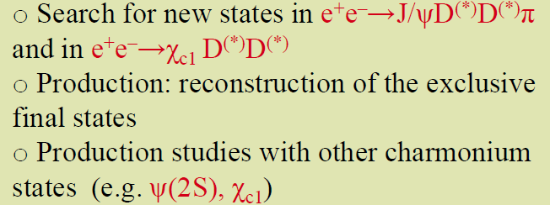

e⁺e⁻→J/ψ+X
X(3940) and X(4160) (Exotic ? Standard ?)
PRL 100, 202001 (2008)
PRL 98, 082001 (2007)

Slide 23
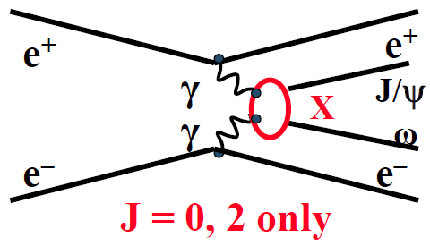
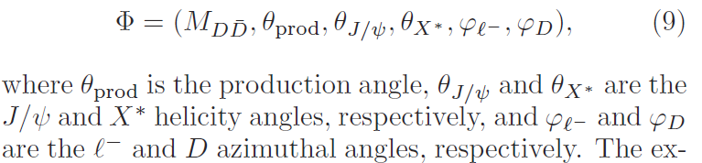

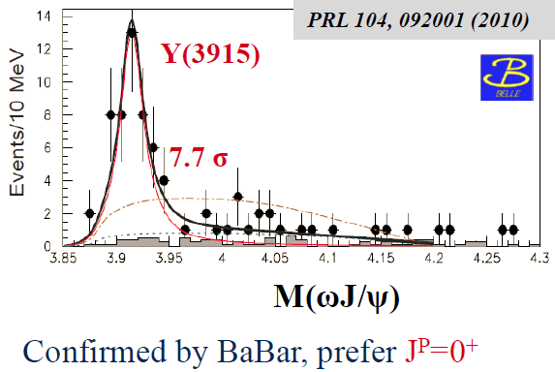
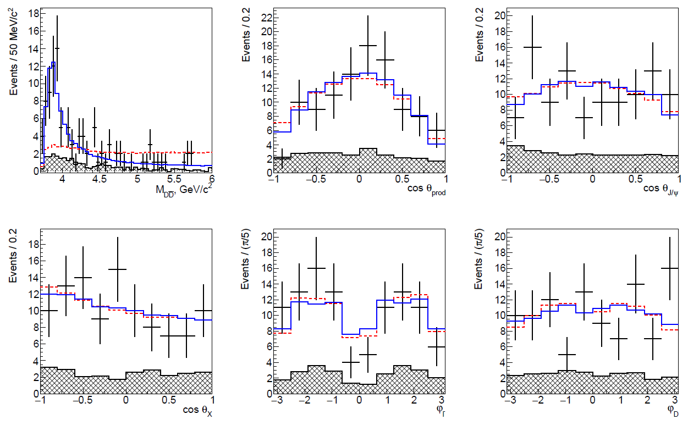
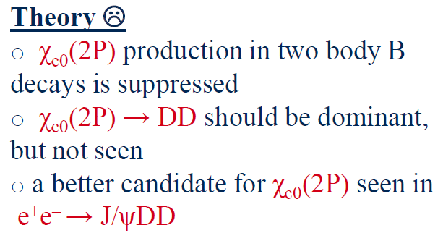




X*(3860) ($χ_{c0}$(2P))
PRD 95， 112003 (2017)
A 6D amplitude analysis was done to e⁺e⁻ →J/ψ$D\overline{D}$
X(3915)
Fit results
Without X*
0⁺⁺ is favored over the 2⁺⁺ at 2.5 σ
PDG: Y(3940)=X(3915)=$χ_{c0}$(2P)
X*(3915): 8.5σ, 0⁺⁺, M=3862⁺²⁶⁺⁴⁰₋₃₂₋₁₃ MeV/c²
Γ=201⁺¹⁵⁴⁺⁸⁸₋₆₇₋₈₂ MeV
The parameters of X*(3915) are <2.7σ difference from the predicted $χ_{c0}$(2P)
PDG 2016: X(3915)≠$χ_{c0}$(2P)
23

Slide 24



24

Slide 25






X(5568)
PRL117,152003(2016)
PRL117, 152003 (2016)

Slide 26





X(5568)
D0 Conference Note 6494
$$\overline{p}$$
3.6

Slide 27

Y States
Y(4260), Y(4360), Y(4660)…
Observed in the e+e- annihilation (with ISR)

Slide 28









e⁺e⁻→π⁺π⁻J/ψ cross section
BABAR PRL95,142001(2005)
PDG
PDG
D⁰
J/ψ
Hadro-charmonium
D₁
D⁰ – D₁ “molecule”

Slide 29


29

Slide 30


e⁺e⁻→π⁺π⁻J/ψ cross section at BESIII
PRL118, 092001 (2017)
data
data
8.2 fb⁻¹
19 points
0.8 fb⁻¹
103 points
Most precise cross section measurment to date from BESIII
Fit I =|BW₁+BW₂*e^{iφ2}+BW₃*e^{iφ3}|² or Fit II =|exp+BW₂*e^{iφ2}+BW₃*e^{iφ3}|² (other fits ruled out)
M = 4222.0±3.1±1.4 MeV (lower)
Γ = 44.1±4.3±2.0 MeV (narrower)
A 2nd resonance Y₂ with M=4320.0±10.4±7.0 MeV/c²
Γ=101.4^{+25.3}_{-19.7}±10.2 MeV
Observed for the first time, significance > 7.6σ

Slide 31






Updated e⁺e⁻ → π⁺π⁻ψ(2S)
PRD 91, 112007 (2015)
PRD89, 111103 (2014)

Slide 32


M(π⁺π⁻ ψ(2S)) with Y(4260,4360,4660)

Slide 33


Comparsion of e⁺e⁻→π⁺π⁻ψ(2S) cross section
BESIII (16 energy points; L_{tot}=5.1fb⁻¹)
ψ(2S) Reconstructed modes:
  Mode I: Ψ(3686)→π⁺π⁻J/ψ, J/ψ→l⁺l⁻ (l=e/μ)
  Mode II: Ψ(3686)→neutrals+J/ψ, neutrals=(π⁰π⁰, π⁰, η and γγ) J/ψ→l⁺l⁻ (l=e/μ)
Mode I
Y(4260)
Y(4360)
Mode I
The measured Born cross sections of two modes are combined by considering the correlated and uncorrelated uncertainties.

Slide 34

Updated e⁺e⁻ →K⁺K⁻J/ψ
PRD 89,072015(2014)
Event selections are almost the same as in Phys. Rev. D 77, 011105(R) (2008)
Shaded hist.: J/ψ mass sidebands
+one resonance.
Fit with ψ(4415)
980fb⁻¹
Y(4260)
χ²/ndf=30/11
M=4747±117MeV
Γ=671±86 MeV
7.8% sys. error was
not included.
4-6 GeV: 213 events
35 bkg, 178±16 signal

Slide 35
e⁺e⁻→ π⁺π⁻h_{c}(1P) at BESIII
h_{c}→γη_{c}, η_{c} →hadrons [16 exclusive decay modes]
  pp, π⁺π⁻K⁺K⁻, π⁺π⁻pp, 2(K⁺K⁻), 2(π⁺π⁻), 3(π⁺π⁻)
  2(π⁺π⁻)K⁺K⁻, K_{S}⁰K⁺π⁻+c.c., K_{S}⁰K⁺π⁻π⁺π⁻+c.c., K⁺K⁻π⁰
  ppπ⁰, K⁺K⁻η, π⁺π⁻η, π⁺π⁻π⁰π⁰, 2(π⁺π⁻)η, 2(π⁺π⁻π⁰)
E_{cm}=4.415 GeV
E_{cm}=4.415 GeV
Method same as in PRL111, 242001 (2013)
35
Notes:
BESIII observed the production of pi+pi-h_c with the data samples at a few energy points. Here, hc is reconstructed with its E1 transition to eta_c, and eta_c is reconstructed with its 16 hadronic decay modes. From the plot we can see very clear eta_c signal in the invariant mass of the hadronic system, and very clear h_c signal at gamma and eta_c invariant mass. If we select only the events in the eta_c mass region, we get …

Slide 36

e⁺e⁻→π⁺π⁻h_{c} cross section at BESIII
PRL118, 092002 (2017)
~6 fb⁻¹
First precise cross section measurement from threshold to 4.6 GeV
Fit with |BW₁+BW₂*e^{iφ2}|² , two resonant structures are evident

Slide 37
e⁺e⁻→π⁺π⁻h_{c} cross section at BESIII
PRL118, 092002 (2017)
~6 fb⁻¹
M₁=4218.4^{+5.5}_{-4.5}±0.9 MeV/c², Γ₁= 66.0^{+12.3}_{-8.3}±0.4 MeV → Y(4220)
M₂=4391.5^{+6.3}_{-6.8}±1.0 MeV/c², Γ₂=139.5^{+16.2}_{-20.6}±0.6 MeV → Y(4390)

Slide 38



$e^{+}e^{−}→π^{+}D^{0}D^{∗−}$+c.c.
Reconstruct $D^{0}→K^{−}π^{+}$
Select the combination closest to $D^{0}$ mass (m($D^{0}$))
Find an additional $π^{+}$;
1.9 < $M(D^{∗−})$ (RM$\left(D^{0}π^{+}\right)+M\left(D^{0}\right)−m\left(D^{0}\right)$) < 2.1 GeV/$c^{2}$
select the candidate closest to $D^{∗−}$ mass
BESIII Preliminary
An un-binned maximum likelihood fit
Signal shape: MC convoluted with a Gaussian;
The isospin partner background (dotted line) is parameterized with MC;
A linear function for other bkg

Slide 39




Fit to the dressed cross section of $e^{+}e^{−}→π^{+}D^{0}D^{∗−}$+c.c.
$$σ_{dress}=\frac{N^{obs}}{ℒ\left(1+δ^{r}\right)B\left(D^{0}→K^{−}π^{+}\right)ε}$$
BESIII Preliminary
Fit with a constant (pink dashed triple-dot line) and two constant width relativistic BW functions (green dashed double-dot line and aqua dashed line).

Slide 40


Resonant parameters
The error are statistical only.
BESIII Preliminary
Statistical significance is greater than 10σ.
Consistent with those of Y(4220) and Y(4390) in $e^{+}e^{−}→π^{+}π^{−}h_{c}$.

Slide 41









More precise measurements are helpful !
“Y(4260)” in different channels?
PRL 118, 092002 (2017)
PRD 93, 011102(R) (2016)
$$e^{+}e^{−}→π^{+}π^{−}h_{c}$$
$$e^{+}e^{−}→ωχ_{c0}$$
PRL118, 092001 (2017)
$$e^{+}e^{−}→π^{+}π^{−}J/ψ$$
$$e^{+}e^{−}→D^{0}D^{∗−}π^{+}+c.c.$$
preliminary
All above four channels show a structure at around 4.22 $GeV/c^{2}$.

Slide 42



Combined fit to understand the Y(4220) better
PRD95,092007(2017)
X.Y.Gao, *C.P.Shen, C.Z.Yuan
$M=4219.6±3.3\left(stat\right)±5.1\left(sys\right) MeV/c^{2}$ $Γ=56.0±3.6\left(stat\right)±6.9\left(sys\right) MeV$
A combined fit is performed to extract the resonant parameters of the Y(4220) assuming it decays dominantly to the above four modes and their isospin symmetric modes

Slide 43


Slide 44





Maiani et al. PRD89,114010

Slide 45
Charmonium(like) spectroscopy
Instead of clarify the situation, we made it messier :(
charged
Y(4660)
Z_{c}(3900)
ψ(4415)
Y(4390)
Y(4360)
Y(4260)➔Y(4220)
ψ(4160)
ψ(4040)
χ_{c2}(2P)
2015 BESIII
ψ(3770)
X(3872)
ψ(1³D₂)
ψ(2S)
η_{c}(2S)
2005
h_{c}(1P)
χ_{c1}(1P)
χ_{c2}(1P)
χ_{c0}(1P)
1974
unpredicted, discovered
J/ψ
η_{c}(1S)
predicted, discovered
Godfrey & Isgur, PRD32, 189 (1985)

Slide 46
Z States
Zc(3900), Zc(4020), Zb(10610), Zb(10650), …
Observed in B decays and in decays of Y states

Slide 47




Slide 48


Slide 49



Bingding energy=20±30 MeV

Slide 50

50

Slide 51

51

Slide 52



Z_{c}(3900) State
Observed in e⁺e– → (γ)Y(4260) → J/ψπ⁺π–

Slide 53
Z_{c}(3900) State

Slide 54

Z_{c}(3900) State
4.26 GeV
4.23 GeV
4.26 GeV

Slide 55


Z_{c}(4020) & Z_{c}(4025) States
4.23+4.26+4.36 GeV
4.23+4.26+4.36 GeV
4.26 GeV

Slide 56

Summary on Z_{c} States by BESIII

Slide 57





Z_{c}(4050)
Observed by Belle in ISR
e⁺e– → Y(4360) → ψ(2S)π⁺π–
PRD 91, 112007 (2015)
J/ψπ⁺π–
μ⁺μ–
Z_{c}(4050)?
3.5σ
J/ψπ⁺π–
μ⁺μ–
No clear signal found in the Y(4660) region
Another Z_{c} state? Need confirmation

Slide 58



Search for Z_{c}→$π$ψ(2S) at BESIII
Not like π J/ψ, the structures in π ψ(2S) vs. Ecm are much more complicated !

Slide 59


Slide 60







Z_{b} → Open Beauty
±
B⁽*⁾B⁽*⁾π + BBγ

Slide 61




Summary on Z_{b} Decays by Belle
Assuming that Z_{b} decays are saturated by the ϒ(nS)π, h_{b}(mP)π and B⁽*⁾B* channels, one can calculate a table of relative branching fractions:
B⁽*⁾B* channels dominate the Z_{b} decays

Slide 62




Charm vs. Beauty: I
What is in common?
ϒ(10860)/Y(4260) demonstrates anomalously large coupling to ϒπ⁺π⁻/ψπ⁺π⁻ and h_{b}π⁺π⁻/h_{c}π⁺π⁻ final states.
Z_{c}(3900) is produced in Y(4260)→Z_{c}π→ ψπ⁺π⁻
→ Z_{c}π→ DD*
Z_{c} signal
reflection
Z_{b}(10610) is produced in ϒ(10860)→Z_{b}π→ ϒ(nS)π⁺π⁻
→ Z_{b}π→ BB*
MISSING PLOT

Slide 63
Charm vs. Beauty: II
What is difference?
Both Z_{b}(10610) and Z_{b}(10650) isotriplets are observed in the ϒ(nS)π, (n=1,2,3) and h_{b}π final states.
Only Z_{c}(3900) is observed in the J/ψπ while both Z_{c}(3900) and Z_{c}(4020) are observed in the h_{c}π final state. None of them is observed in the ψ(2S)π final state (instead, another Z_{c}(4430) is found).
ϒ(10860)→h_{b}π⁺π⁻ is saturated by the intermediate two-body Z_{b}π produc-tion.
Large non Z_{c}π component is observed in the Y(4260)→h_{c}π⁺π⁻ amplitude.

Slide 64
The plan for BESIII
— a fine scan with large statistics —
Ecm=4.0 up to 4.6+ GeV
10 MeV step (slight adjust ~ thresholds, skip those points we have already collected large samples)
500 pb⁻¹/point
➔ total luminosity ~ 25 fb⁻¹
With peak luminosity of 10³³/cm²/s
Top-up injection at BEPCII !
This plan can be finished in about 5 years!
2016-17 running year: Ecm=4.19, 4.20, 4.21, …, 4.30 GeV
2017-18 running year: Ecm=4.31, 4.32, 4.33, …, 4.40 GeV?

Slide 65



BelleII Status
BelleII Roll-In completed April 11, 2017
First Cosmics in a B field:
Inner BEAST Phase II VXD Cartridge
Notes:
Here I aim to give an introduction and “big picture”. For each system I will outline the progress and issues or problems. This talk is not comprehensive and is NOT a substitute for the plenary talks on each topic but does replace the many introductory talks at the previous generation of B2GM’s. I would like to express my deep appreciation to the various coordinators and leaders who helped me assemble this talk.

Slide 66



Slide 67


ISR at Belle II vs. BESIII
ISR produces events at all CM energies BESIII can reach
With > 5(10) ab⁻¹ data sample, ISR e⁺e⁻→a charmonium+light hadrons[π⁺π⁻J/ψ, π⁺π⁻ψ(2S), Κ⁺Κ⁻J/ψ, Κ⁺Κ⁻ψ(2S), γX(3872), π⁺π⁻X(3872), π⁺π⁻hc, π⁺π⁻hc(2P), ωX_{cJ}, φ X_{cJ,} ηJ/ψ, η’J/ψ, ηψ(2S), η hc]; and charm meson pair+light hadrons [DD, DD*, DD*π, . . .]

Slide 68

Status of BelleII Physics Book
Notes:
Software Highlights

Slide 69

Summary
A hole new field of exotic physics discovered in last decade; new information is still coming from both completed (Belle & BaBar) and currently ongoing (BESIII, D0, LHCb, CMS, …) experiments
However (much) more data required for a better understanding (BelleII, BESIII, LHCb, …)
BESIII is getting more data; start of the Belle II is approaching
Input from Belle II is crucial to push exotic studies into bottomonium sector. Energy scan up to 11.24 GeV is accessible by the SuperKEKB.
Common features between charmonium and bottomonium sectors is gradually emerging. No direct identity however.
No clear understanding of the nature of new states yet. Theory needs to catch up with a flow of new data/puzzles from experiments.

Slide 70

What is the X(3872)?
Belle, 2003
140/fb
Mass: Very close to D⁰D^{*0} threshold
Width: Very narrow, < 1.2 MeV
J^{PC}=1⁺⁺
Production
  in pp/pp collison – rate similar to charmonia
  In B decays – KX similar to cc, K*X smaller than cc
  Y(4260)→γ+X(3872) (?)
Decay BR: open charm ~ 50%, charmonium~O(%)
Nature (very likely exotic)
  Loosely D⁰D^{*0} bound state (like deuteron?)?
  Mixture of excited χ_{c1} and D⁰D^{*0} bound state?
  Many other possibilities (if it is not χ’_{c1}, where is χ’_{c1}?)
M(ππJ/ψ) –M(J/ψ) [GeV]
Notes:
The X(3872) was first observed by Belle ten years ago, then confirmed by other experiments[CDF, D0 BaBar], its mass is very close to neutral DD* threshold and its width is very narrow. Since its observation, it has stimulated special interests on its nature. In both Belle and BaBar, its decay to gamma Jpsi has been observed, which supports it being a C-even state. The angular distribution study from CDF and most recently from LHCb determined it being a 1++ state. In the theoretical side, it was interpreted as a good candidate for a hadronic molecule or a tatrequark state. Currently, X(3872) was only observed in B decays, proton proton collision. Since its quantum number is determined to be 1++, it could be produced trough radiative transition of a vector charmonium or charmonium-like states, such as excited psi or Y states.

Slide 71










X(4140) and X(4270)

Slide 72

X(4140) at LHCb
PRD95, 012002(2017)

Slide 73




Is X(3915) = χ_{c0}’?
PDG ascribe Y(3915) to vacant χ_{c0}’ state, based on BaBar’s measurement of J=0 in γγ → Y(3940) → ωJ/ψ
strongly criticized by theoreticians
χ_{c0}’ production in two body B decays suppressed
χ_{c0}’ → DD should be dominant, but not seen in B decays and γγ
there is a better candidate for χ_{c0}’!
γγ→DD
χ_{c0}’?
Theory does not like conventional interpretation, but suggests no good explanation for X(3915)…
Panda meeting, ITEP, 19 May, 2015
P. Pakhlov

Slide 74


Slide 75





Y(4220) leptonic width
Considering the isospin symmetry, we estimate the lower limit on the $Γ_{e^{+}e^{−}}($Y(4220)). For an isospin-zero charmoniumlike state, we expect
Taking Solutions with the smallest ${B×Γ}_{e^{+}e^{−}}$,
$Γ_{e^{+}e^{−}}>\left(29.1±2.5\left(stat\right) ±7.0\left(sys\right)\right)+… eV$
Taking Solutions with the largest ${B×Γ}_{e^{+}e^{−}}$,
$Γ_{e^{+}e^{−}}>\left(202.2±12.9\left(stat\right) ±23.4\left(sys\right)\right)+… eV$
For the most interesting mode $Y(4220)→ππJ/ψ$
For the case of highest ${B×Γ}_{e^{+}e^{−}}$
$B_{ππJ/ψ}=\left(12.9±1.3±3.9\right)\%$
For the case of smallest ${B×Γ}_{e^{+}e^{−}}$
$B_{ππJ/ψ}=\left(11.2±1.1±1.9\right)\%$
For the most extreme case, taking smallest ${B×Γ}_{e^{+}e^{−}}$ for $ππJ/ψ$ while largest ${B×Γ}_{e^{+}e^{−}}$ for other mode
$B_{ππJ/ψ}=\left(2.1±0.3±0.7\right)\%$

Slide 76

Y or ψ structures
Parameters | Y(4220) in π⁺π⁻h_{c} | Y(4260) | ψ(4160) | Structure in ωχ_{c0}
M (MeV) | 4218.4±4.0±0.9 | 4251±9 | 4191±5 | 4226±8±6
Γ_{tot} (MeV) | 66.0±9.0±0.4 | 120±12 | 70±10 | 39±12±2
Parameters | Y(4390) in π⁺π⁻h_{c} | Y(4360) | ψ(4415)
M (MeV) | 4391.6±6.3±1.0 | 4362±13 | 4421±4
Γ_{tot} (MeV) | 139.5±16.1±0.6 | 74±18 | 62±20

Slide 77
Search for Z_{cs}→KJ/ψ states
J/ψ
J/ψ
PRD 89,072015(2014)
No evident structure in K⁺⁻J/ψ mass distribution under current statistics

Slide 78




Z_{b} Production at ϒ(6S)
±
ϒ(6S) Data:
5 fb⁻¹
1st obs. of ϒ(6S)→π⁺π⁻h_{b}(nP)
3.5σ for 1P, 5.3σ for 2P.
The two Z_{b} states can not be separated with current statistics
ϒ(6S) → h_{b}(mP)π⁺π⁻ transition is dominated (saturated) by the intermediate Z_{b}± production.
Two Z_{b} can be separated at Belle II !

Slide 79


Slide 80


Slide 81

Y(1S) to inclusive XYZ
PRD 93, 112013 (2016)

Slide 82


PWA on Zc(3900) state
preliminary

Slide 83







PWA on Zc(3900) state
Zc line shape
parameterized with
Flatte-like formula
4.23 GeV
4.26 GeV
preliminary

Slide 84



Comparison of fit results
Mass, g₁' and Log-likelihood
preliminary
Zc favors the quantum number J^{P}=1⁺

