Slide 1
Continuum Computation of Parton Distributions
Craig Roberts

Slide 2
Collaborators: 2014-Present
Students, Postdocs, Profs.
Jing CHEN (Peking U.)
Bo-Lin LI (Nanjing U.)
Ya LU (Nanjing U.)
Khépani RAYA (U Michoácan);
Chien-Yeah SENG (UM-Amherst) ;
Chen CHEN (UNESP - São Paulo, USTC & IIT);
Zhu-Fang CUI (Nanjing U.) ;
J. Javier COBOS-MARTINEZ (U Michoácan);
Minghui DING (Nankai U.) ;
Fei GAO (Peking U.) ;
L. Xiomara GUTIÉRREZ-GUERRERO (MCTP)
Cédric MEZRAG (ANL, Irfu Saclay) ;
Mario PITSCHMANN (Vienna);
Si-xue QIN (Chongqing, ANL, U. Frankfurt, PKU);
Eduardo ROJAS (Antioquia U.)
Jorge SEGOVIA (TU-Munich, ANL);
Chao SHI (ANL, Nanjing U.)
Shu-Sheng XU (Nanjing U.)
Adnan Bashir (U Michoácan);
Daniele Binosi (ECT*)
Stan Brodsky (SLAC);
Lei Chang (Nankai U. ) ;
Bruno El-Bennich (São Paulo);
Tanja Horn (Catholic U. America)
Yu-Xin Liu (PKU);
Hervé Moutarde (CEA, Saclay) ;
Joannis Papavassiliou (U.Valencia)
M. Ali Paracha (NUST, Islamabad)
Jose Rodriguez Qintero (U. Huelva) ;
Franck Sabatié (CEA, Saclay);
Sebastian Schmidt (IAS-FZJ & JARA);
Peter Tandy (KSU);
Shaolong WAN (USTC) ;
Hong-Shi ZONG (Nanjing U)
41% of this international collaboration is Chinese

Slide 3
A New Era for hadro-particle physics

Slide 4
A New Era
QCD is the first place that we fully experience the collisions and collusions between relativity and quantum mechanics.
In attempting to match QCD with Nature, we confront the innumerable complexities of nonperturbative, nonlinear dynamics in relativistic quantum field theory, e.g.
the loss of particle number conservation,
the frame and scale dependence of the explanations and interpretations of observable processes,
and the evolving character of the relevant degrees-of-freedom.
Origin and distribution of mass, momentum, spin within hadrons, e.g. where is the proton’s spin and how is the pion spinless?
Don’t forget the latter!
How do all the spin-1/2 quarks and spin-1 gluons combine to make a massless, J=0 composite mode?

Slide 5
Overarching Science Challenges for the coming decade
What is origin of mass in our Universe?
What is the nature of confinement in real (dynamical-quarks) QCD?
How are they connected?
How can any
answers,
conjectures
and/or conclusions
be empirically verified?
Physics is an
Empirical Science

Slide 6
Parton Distributions – What is Needed?
Parton Distribution Amplitudes
At accessible empirical scales, what does QCD predict for their pointwise behaviour?
How can QCD predictions be validated?
Parton Distribution Functions (1D)
QCD-based parton model makes clear predictions for the large-x behaviour: at ζ_{H}, q_{V} ∝ (1-x)^{n}, where n is the number of valence partons
Must have precise QCD-connected computations of their behaviour on the valence-quark domain
Need an array of empirical observables (DIS, Drell-Yan, etc.) so that predictions can be validated
Low-order moments and broad-band curves are NOT sufficient
Inadequate as a tool to validate QCD
E.g. infinitely many PDAs/PDFs, whether reasonable looking or not, have the same first moment = same momentum, spin fraction etc.

Slide 7
Gluon Gap Equation
Pinch Technique: Theory and Applications
Daniele Binosi & Joannis Papavassiliou
Phys. Rept. 479 (2009) 1-152

Slide 8
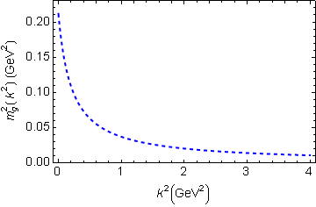
In QCD: Gluons become massive!
Bridging a gap between continuum-QCD and ab initio predictions of hadron observables, D. Binosi et al., arXiv:1412.4782 [nucl-th], Phys. Lett. B742 (2015) 183-188
Running gluon mass
Gluons are cannibals – a particle species whose members become massive by eating each other!
Expression of trace anomaly:
Massless glue becomes massive
gluon mass-squared function
Power-law suppressed in ultraviolet, so invisible in perturbation theory
5%
Interaction model for the gap equation, S.-x.Qin et al., arXiv:1108.0603 [nucl-th], Phys. Rev. C 84 (2011) 042202(R) [5 pages]
Class A: Combining DSE, lQCD and pQCD analyses of QCD’s gauge sector

Slide 9
Massive Gauge Bosons!
Gauge boson cannibalism
… a new physics frontier … within the Standard Model
Asymptotic freedom means
… ultraviolet behaviour of QCD is controllable
Dynamically generated masses for gluons and quarks means that QCD dynamically generates its own infrared cutoffs
Gluons and quarks with
wavelength λ > 2/mass ≈ 1 fm
decouple from the dynamics … Confinement?!
How does that affect observables?
It will have an impact in
any continuum study
Possibly (probably?) plays a role in gluon saturation ...
In fact, could be a harbinger of gluon saturation?

Slide 10
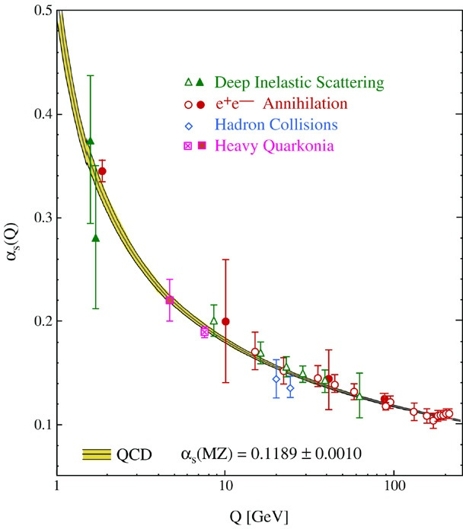
QCD’s Running Coupling
⇐
What’s happening
out here?!

Slide 11
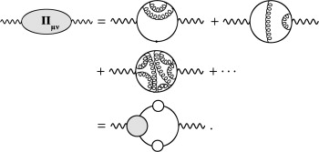
QED Running Coupling
Quantum gauge field theories in four spacetime dimensions,
Lagrangian couplings and masses come to depend on a mass scale
Can normally be related to the energy or momentum at which a given process occurs.
QED, owing to the Ward identity:
a single running coupling
measures strength of the
photon-charged-fermion vertex
can be obtained by summing the virtual
processes that dress the bare photon,
viz. by computing the photon vacuum polarisation.
QED's running coupling is known to great accuracy
and the running has been observed directly.

Slide 12
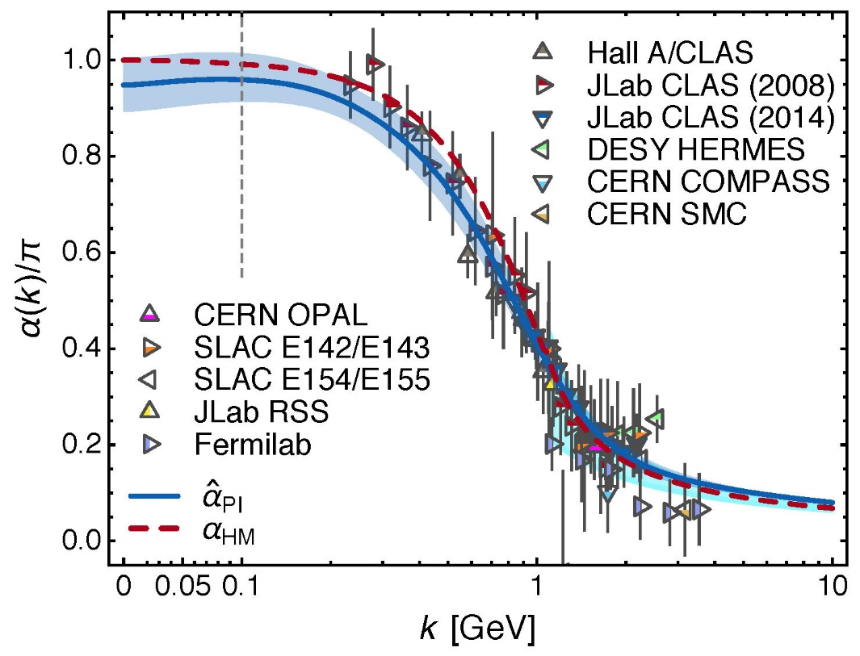
Process-independent effective-charge in QCD
Process independent strong running coupling
Binosi, Mezrag, Papavassiliou, Roberts, Rodriguez-Quintero
arXiv:1612.04835 [nucl-th]
Modern continuum & lattice methods for analysing gauge sector enable analogous quantity to be defined in QCD
Combined continuum and lattice analysis of QCD’s gauge sector yields a parameter-free prediction
N.B. Qualitative change in α̂_{PI}(k) at k ≈ ½ m_{p}

Slide 13
QCD Effective Charge
Process independent strong running coupling
Binosi, Mezrag, Papavassiliou, Roberts, Rodriguez-Quintero
arXiv:1612.04835 [nucl-th]
The QCD Running Coupling,
A. Deur, S. J. Brodsky and G. F. de Teramond,
Prog. Part. Nucl. Phys. 90 (2016) 1-74
Near precise agreement between process-independent α̂_{PI} and α_{g1}
and α̂_{PI} ≈ α_{HM}
Perturbative domain:
difference = (1/20) α_{M̅S̅}²
Parameter-free prediction:
curve completely determined by results obtained for gluon & ghost two-point functions using continuum and lattice-regularised QCD.
Data: process dependent effective charge: α_{g1} defined via Bjorken Sum Rule

Slide 14
QCD Effective Charge
α̂_{PI} is a new type of effective charge
direct analogue of the Gell-Mann–Low effective coupling in QED, i.e. completely determined by the gauge-boson two-point function.
Prediction for α̂_{PI} is parameter-free
Draws best from continuum & lattice results for QCD’s gauge sector
Prediction for α̂_{PI} smoothly unifies the nonperturbative and perturbative domains of the strong-interaction theory.
α̂_{PI} is
process-independent
appears in every one of QCD’s dynamical equations of motion
known to unify a vast array of observables
α̂_{PI} possesses an infrared-stable fixed-point
Nonperturbative analysis demonstrating absence of a Landau pole in QCD
QCD is IR finite, owing to dynamical generation of gluon mass-scale

Slide 15
QCD – A Paradigm for Extending the Standard Model?
How do quantum field theories fail?
Ultraviolet and infrared divergences
Asymptotic freedom ⇒ QCD is well-defined at UV momenta
Dynamical generation of gluon mass function, large on k² ≃ 0,
⇒ the infrared domain of QCD is self-regularizing
QCD is therefore unique amongst known four-dimensional quantum field theories
Potentially self-consistent
Defined & internally consistent at all momenta (e.g., no Landau pole)

Slide 16
QCD – a paradigm for extending the Standard Model?
How do quantum field theories fail?
Ultraviolet and infrared divergences
Asymptotic freedom ⇒ QCD is well-defined at UV momenta
Dynamical generation of gluon mass function, large on k² ≃ 0,
⇒ the infrared domain of QCD is self-regularizing
QCD is therefore unique amongst known four-dimensional quantum field theories
Potentially self-consistent
Defined & internally consistent at all momenta (e.g., no Landau pole)
If all this is true,
then QCD can serve as a basis
for theories that take physics
beyond the Standard Model

Slide 17
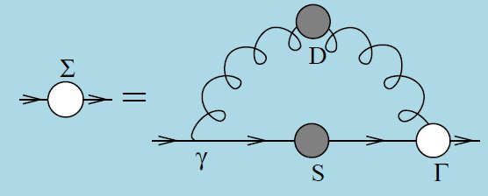
Quark Gap Equation

Slide 18
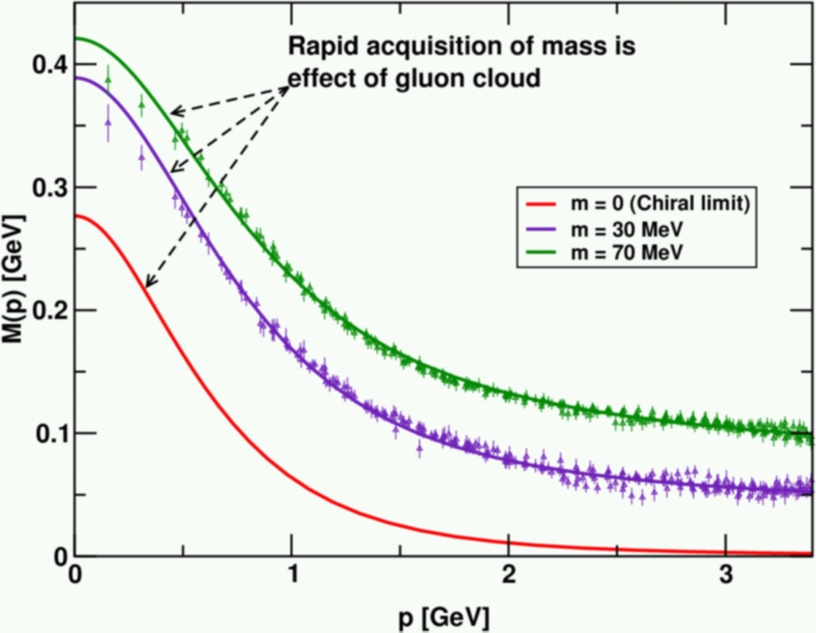
DCSB
Dynamical chiral symmetry breaking (DCSB) is
a key emergent phenomenon in QCD
Expressed in hadron wave functions not in vacuum condensates
Contemporary theory indicates that DCSB is responsible for more than 98% of the visible mass in the Universe; namely, given that classical massless-QCD is a conformally invariant theory, then DCSB is the origin of mass from nothing.
Dynamical, not spontaneous
Add nothing to QCD ,
No Higgs field, nothing!
Effect achieved purely
through quark+gluon
dynamics.
Trace anomaly: massless quarks
become massive
Combining DSE, lQCD and pQCD analyses of QCD’s gauge and matter sectors

Slide 19
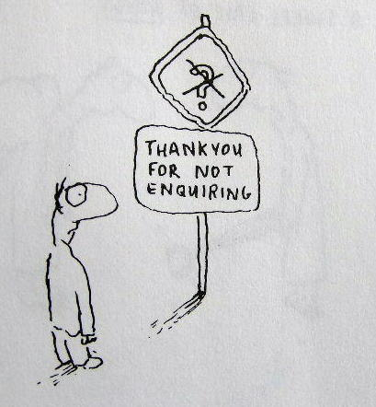
Enigma of Mass

Slide 20
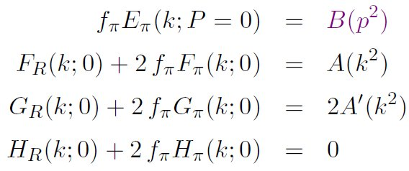
Pion’s Goldberger -Treiman relation
Maris, Roberts and Tandy
nucl-th/9707003, Phys.Lett. B420 (1998) 267-273
Pion’s Bethe-Salpeter amplitude
Solution of the Bethe-Salpeter equation
Dressed-quark propagator
Axial-vector Ward-Takahashi identity entails
B(k²)
Owing to DCSB
& Exact in
Chiral QCD
Miracle: two body problem solved, almost completely, once solution of one body problem is known

Slide 21
The most fundamental expression of Goldstone’s Theorem and DCSB
Rudimentary version of this relation is apparent in Nambu’s Nobel Prize work
Model independent
Gauge independent
Scheme independent
f_{π} E_{π}(p²) = B(p²)

Slide 22
Pion exists if, and only if, mass is dynamically generated
Rudimentary version of this relation is apparent in Nambu’s Nobel Prize work
Model independent
Gauge independent
Scheme independent
f_{π} E_{π}(p²)⇔ B(p²)

Slide 23
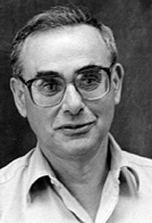
Enigma of mass
f_{π} E_{π}(p²) = B(p²)
This algebraic identity is why QCD’s pion is massless in the chiral limit
The quark level Goldberger-Treiman relation shows that DCSB has a very deep and far reaching impact on physics within the strong interaction sector of the Standard Model; viz.,
Goldstone's theorem is fundamentally an expression of equivalence between the one-body problem and the two-body problem in the pseudoscalar channel.
This emphasises that Goldstone's theorem has a pointwise expression in QCD
Hence, pion properties are an almost direct measure of
the dressed-quark mass function.
Thus, enigmatically, the properties of the massless pion
are the cleanest expression of the mechanism that is
responsible for almost all the visible mass in the universe.

Slide 24
Observing Mass

Slide 25
Confinement ⇔ DCSB
Signals for these (equivalent?) emergent phenomena are ubiquitous
Manifestations do not always appear the same in different systems
Studying a diverse array of systems and/or observables therefore exposes different aspects of the underlying mechanisms
Examples …
Spectrum of hadrons (level ordering, existence of exotics …)
Hadron (meson & baryon) elastic and transition form factors
Distribution amplitudes and functions, in all their guises
Origin of the nucleon-nucleon interaction and emergence of nuclei
Complete understanding of QCD – the toughest, most interesting part of the Standard Model – will only be found in a unified description of all these phenomena
All the basic subjects of hadro-particle physics

Slide 26
Observing Mass: Examples

Slide 27
Pion Mass
Hadron masses are continuous functions of the current-quark masses.
Scalar form factor at zero momentum transfer measures the response of the meson's mass-squared to a change in current-quark mass
Pseudoscalar mesons
Use Gell-Mann – Oakes – Renner relation,
compute expectation value of QCD mass-term in pion state
Pion (and any other Nambu-Goldstone mode) possesses a peculiar property:
Thus, in the neighbourhood of the chiral limit,
100% of the pion mass-squared owes to the current-mass in L_{QCD}
All operator contributions from trace anomaly cancel amongst themselves
Pion's spin-flip partner, i.e. ρ-meson, s_{ρ}(0) ≈ 0.06 m_{ρ}²
Just 6% of ρ-meson's mass-squared generated by current-mass term in L_{QCD}
Follows from Poincaré invariance
in quantum field theory

Slide 28
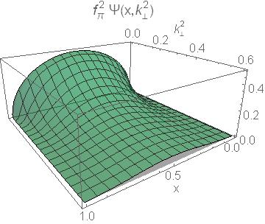
Pion’s Wave Function

Slide 29
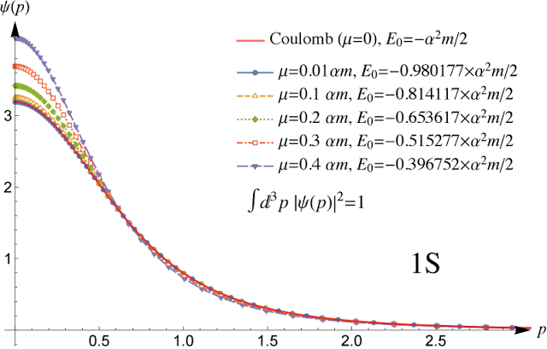
Pion’s valence-quark Distribution Amplitude
Wave function for S-wave ground state of two body system in nonrelativistic quantum mechanics
… Yukawa potential
… equal-mass constituents
Peaks at zero relative momentum
Natural for a bound state
… the particles are
moving together
No reason to imagine that things might be different in relativistic quantum field theory. Bound states are still bound.

Slide 30
Pion’s valence-quark Distribution Amplitude
Imaging dynamical chiral symmetry breaking: pion wave function on the light front, Lei Chang, et al., arXiv:1301.0324 [nucl-th], Phys. Rev. Lett. 110 (2013) 132001 (2013) [5 pages].
Methods have been developed that enable direct continuum computation of the pion’s light-front wave function
φ_{π}(x) = twist-two parton distribution amplitude = projection of the pion’s Poincaré-covariant wave-function onto the light-front
Results have been obtained with the DCSB-improved DSE kernel, which unifies matter & gauge sectors
ϕ_{π}(x) ∝ x^{α} (1-x)^{α}, with α≈0.5

Slide 31
How was the result obtained?
Conformal QCD:
Meson PDA is actually a function of two variables
φ_{P}(u,τ), τ=1/ζ, where ζ is the energy-scale relevant to the process
In the neighbourhood τΛ_{QCD} ≃ 0, QCD is invariant under the collinear conformal group SL(2,R)
Hence,
where a_{j}^{3/2} → 0 as τΛ_{QCD} → 0
Gegenbauer- α= 3/2 polynomials are the irreducible representations of SL(2,R). (A correspondence with the spherical harmonics expansion of the wave functions for O(3)-invariant systems in quantum mechanics is plain.)
However, the conformal expansion is invalid at any energy scale that is foreseeable.
Expansion in Gegenbauer polynomials

Slide 32
How was the result obtained?
Accept that at all accessible scales, the pointwise profile of PDAs is determined by nonperturbative dynamics
Hence PDAs should be reconstructed from moments by using Gegenbauer polynomials of order α, with this order − the value of α − determined by the moments themselves, not fixed beforehand.
Generalisation to case of mesons constituted from light-quarks with unequal masses: expansion in Jacobi polynomials (u^{bar} = 1-u)
In actual calculations, this procedure is refined but the idea is unchanged
Continuum QCD can produce arbitrarily many moments
Can therefore reconstruct PDA of any system

Slide 33
Lattice QCD?
Bayesian Approach
Distribution amplitudes of light-quark mesons from lattice QCD Jorge Segovia et al., arXiv:1311.1390 [nucl-th] , Phys. Lett. B 731 (2014) pp. 13–18
Lattice-QCD can only produce two moments
Therefore set a_{j}=0 and work with only α,β

Slide 34
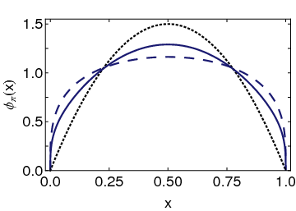
Pion’s valence-quark Distribution Amplitude
Imaging dynamical chiral symmetry breaking: pion wave function on the light front, Lei Chang, et al., arXiv:1301.0324 [nucl-th], Phys. Rev. Lett. 110 (2013) 132001 (2013) [5 pages].
Continuum-QCD prediction:
marked broadening of φ_{π}(x), which owes to DCSB
Conformal QCD
DB
RL
Real-world PDAs are squat and fat

Slide 35
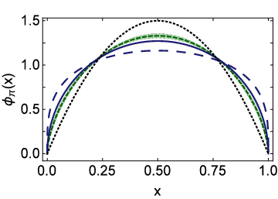
Lattice-QCD & Pion’s valence-quark PDA
Flavour symmetry breaking in the kaon parton distribution amplitude, Chao Shi et al., arXiv:1406:3353 [nucl-th], Phys. Lett. B 738 (2014) pp. 512–518
Isolated dotted curve = conformal QCD
Green curve & band = result inferred from the single pion moment computed in lattice-QCD
Blue solid curve = DSE prediction obtained with DB kernel
DSE & lQCD predictions are practically indistinguishable
See also … arXiv:1702.00008, Pion Distribution Amplitude from Lattice QCD
Jian-Hui Zhang, Jiunn-Wei Chen, Xiangdong Ji, Luchang Jin, Huey-Wen Lin

Slide 36
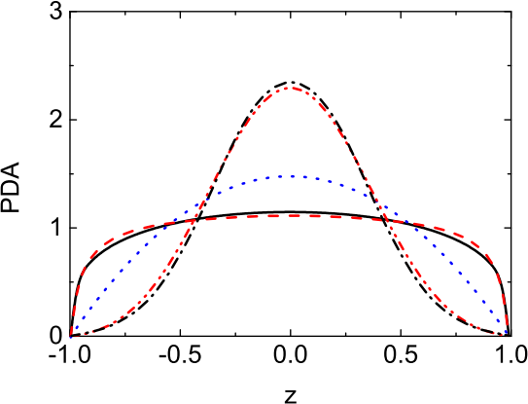
Alternative procedure: Maximum Entropy Method
Compute parton distribution amplitude(PDA) from the Euclidean Bethe-Salpeter wave function.
Essential step: extract weight function in the Nakanishi representation of the Bethe-Salpeter wave function in Euclidean space, which is an ill-posed inversion problem
Use maximum entropy method(MEM)
The Nakanishi weight function as well as the corresponding light-front PDA can be determined.
Results of previous studies, using completely different method, confirmed
Solid – MEM
Dashed – Many moments reconstruction,
Bayesian choice for Gegenbauer expansion
η_{c}
π
Bayesian extraction of the parton distribution amplitude from the
Bethe–Salpeter wave function, Fei Gao, Lei Chang, Yu-xin Liu,
Phys. Lett. B770 (2017) 551-555

Slide 37
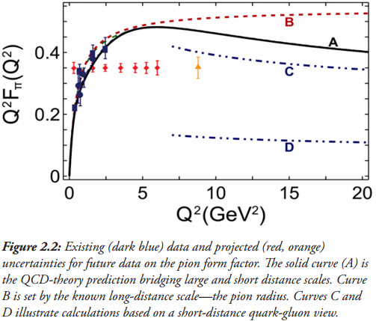
Pion’s electromagnetic form factor
Pion electromagnetic form factor at spacelike momenta L. Chang et al., arXiv:1307.0026 [nucl-th], Phys. Rev. Lett. 111, 141802 (2013)
A: Internally-consistent DSE prediction
PDA Broadening has enormous impact on understanding F_{π}(Q²)
C: Hard-scattering formula with broad PDA

Slide 38
Pion’s electromagnetic form factor
Pion electromagnetic form factor at spacelike momenta L. Chang et al., arXiv:1307.0026 [nucl-th], Phys. Rev. Lett. 111, 141802 (2013)
A: Internally-consistent DSE prediction
PDA Broadening has enormous impact on understanding F_{π}(Q²)
Appears that JLab12 is within reach of first verification of a QCD hard-scattering formula
C: Hard-scattering formula with broad PDA

Slide 39
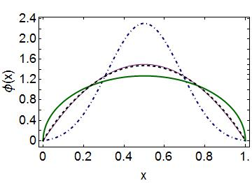
Emergent Mass vs. Higgs Mechanism
Parton distribution amplitudes of S-wave heavy-quarkonia Minghui Ding, Fei Gao, Lei Chang, Yu-Xin Liu and Craig D. Roberts arXiv:1511.04943 [nucl-th], Phys. Lett. B 753 (2016) pp. 330-335
When does Higgs mechanism begin to influence mass generation?
limit m_{quark}→ ∞
φ(x) → δ(x-½)
limit m_{quark} → 0
φ(x) ∼ (8/π) [x(1-x)]^{½}
Transition boundary lies just above m_{strange}
Comparison between distributions of light-quarks and those involving strange-quarks is obvious place to find signals for strong-mass generation
conformal
c+c_{bar}: Higgs
s+s_{bar}:
on the border
q+q_{bar}: Emergent

Slide 40
Kaon electromagnetic form factor
Chiral limit
π & K are degenerate
Internal structure is identical
QCD’s Nambu-Goldstone modes
But … in physical kaon, the Higgs mechanism plays a role
s-quark current mass is much greater than that of the u-quark
m_{s} ∼25 m_{u}
Translates into IR difference in running masses
M_{s}(0) ∼ 1.25 M_{u}(0)
Comparison between π & K properties provides direct access to
interplay
feedback
between strong and electroweak mass generating mechanisms

Slide 41
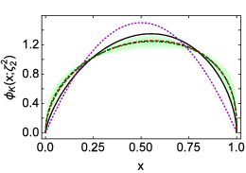
Kaon electromagnetic form factor
Techniques developed for pion
PDA
Form factor
also directly applicable to kaon
Isolated dotted curve = conformal QCD
Green curve & band = result inferred from the single pion moment computed in lattice-QCD
Black solid and red dashed curves = band of DSE predictions
Agreement between DSE & lQCD predictions, within errors
Flavour symmetry breaking in the kaon parton distribution amplitude, Chao Shi, Chen Chen, Lei Chang, Craig D. Roberts, Sebastian M. Schmidt and Hong-Shi Zong, arXiv:1406:3353 [nucl-th], Phys. Lett. B 738 (2014) pp. 512–518

Slide 42
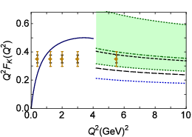
Kaon electromagnetic form factor
Solid blue curve = DSE (Maris-Tandy 2000) prediction
Hard-scattering formula
Short- and long-dashed curves = DSE-2014 prediction for PDA yields result within this area
Green band = broad, skewed lQCD PDA
Skewing is not the issue: 12%-15%, DSE- and lattice-QCD agree
It’s extent of the broadening that generates the uncertainty
JLab 12 has potential to settle the issue … Meantime, extend F_{π}(Q²) analysis on entire spacelike domain → F_{K}(Q²)
The pion: an enigma within the Standard Model Tanja Horn and Craig D. Roberts arXiv:1602.04016 [nucl-th], J. Phys. G 43 (2016) 073001/1-46

Slide 43
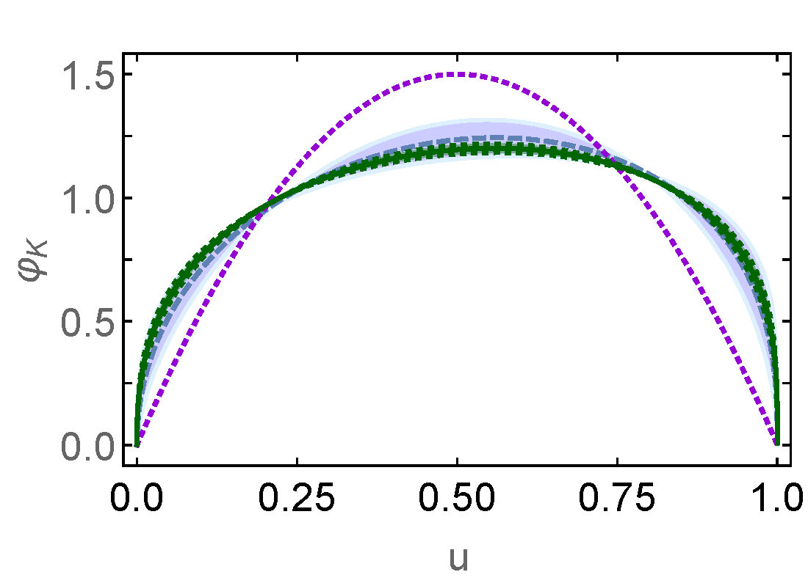
Kaon electromagnetic form factor
Off-shell persistence of composite pions and kaons Si-Xue Qin, Chen Chen, Cédric Mezrag and Craig D. Roberts arXiv:1702.06100 [nucl-th]
Exposing strangeness: projections for kaon electromagnetic form factors Fei Gao, Lei Chang, Yu-Xin Liu, Craig D. Roberts and Peter C. Tandy arXiv:1703.04875 [nucl-th]
Direct computation of the pion and kaon form factors
PDA for pion is known accurately
Use ratio F_{K}/F_{π} at Q² = 8 GeV² to constrain kaon PDA
Mauve band = lQCD PDA developed earlier
Green curve and band = updated constraint from direct form factor calculations
Agreement (within errors).
Error band on updated PDA is estimate based upon known error in lQCD pion PDA

Slide 44
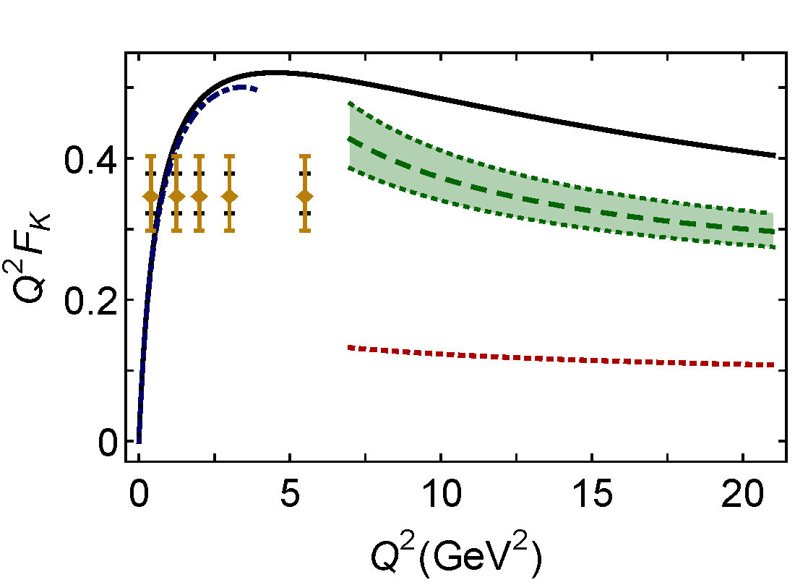
Kaon electromagnetic form factor
Exposing strangeness: projections for kaon electromagnetic form factors, Fei Gao, Lei Chang, Yu-Xin Liu, Craig D. Roberts and Peter C. Tandy, arXiv:1703.04875 [nucl-th]
Dashed purple curve = DSE (Maris-Tandy 2000) prediction
Solid black curve = modern DSE prediction
Hard-scattering formula
Updated PDA
Long-dashed green curve, with error band marking uncertainty in dilation of the PDA
Result highlights the impact of broadening
Now have concrete QCD-connected prediction that can be tested at JLab 12
realistic PDA
conformal limit
Two successful comparisons of experiment and theory couldn’t be an accident!

Slide 45
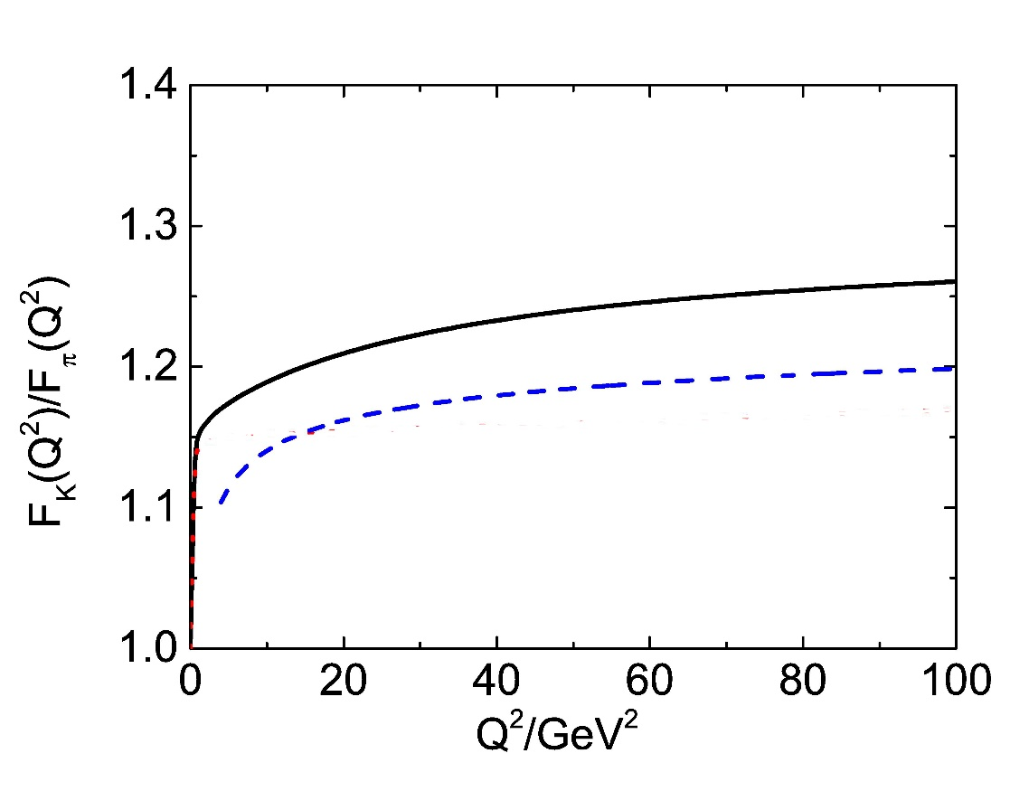
Kaon cf. pion form factor
Exposing strangeness: projections for kaon electromagnetic form factors, Fei Gao, Lei Chang, Yu-Xin Liu, Craig D. Roberts and Peter C. Tandy, arXiv:1703.04875 [nucl-th]
QCD prediction …
as Q² → ∞
F_{K}(Q²)/F_{π}(Q²) = f_{K}²/f_{π}² = 1.4
Logarithmic approach to pQCD limit
Direct calculation confirms validity of hard-scattering formula on Q² > 8 GeV²
Q²-evolution of
wave functions
interaction current
essential to agreement between trends of direct calculation and hard scattering formula
Restore hard-gluons omitted in all truncations used heretofore
DSE Prediction
Hard scattering formula, using DSE-predicted PDA
Models typically tuned to generate correct power law, but then produce wrong anomalous dimension
General defect of uneducated use of covariant framework, anticipated in Lepage-Brodsky Phys.Rev. D 22 (1980) 2157 [p.2168]
Remedied here, following Structure of the neutral pion and its electromagnetic transition form factor, K. Raya, L. Chang, A. Bashir, J.J. Cobos-Martinez, L.X. Gutiérez-Guerrero, C.D. Roberts and P.C. Tandy, arXiv:1510.02799 [nucl-th] , Phys. Rev. D93 (2016) 074017/1-9

Slide 46
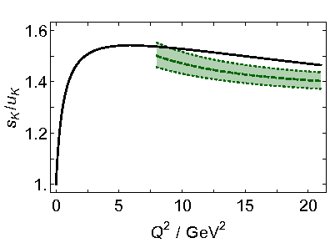
Kaon form factor – flavour separation
Exposing strangeness: projections for kaon electromagnetic form factors, Fei Gao, Lei Chang, Yu-Xin Liu, Craig D. Roberts and Peter C. Tandy, arXiv:1703.04875 [nucl-th]
Current conservation
F_{uss}(0) = F_{uus}(0)
Under evolution:
ϕ_{K} → 6 x (1-x) ⇒ ω_{s̅} → ω_{u} ⇒ Ratio → 1
Agreement between direct calculation and hard-scattering formula, using consistent PDA
Ratio never exceeds 1.5 and
Logarithmic approach to unity
Typical signal of DCSB-dominance in flavour-symmetry breaking:
M_{s}(0) ∼ 1.25 M_{u}(0)
but this scale difference becomes irrelevant under evolution
[ s̅ γ s u_{spectator} / u̅ γ u s_{spectator} ]² ≤ 1.5
DSE Prediction
Hard scattering formula, using DSE=lQCD predicted PDAs

Slide 47
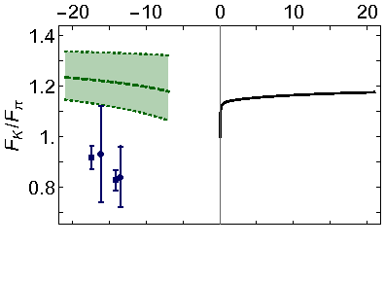
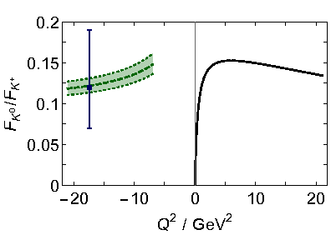
Kaon cf. pion form factor timelike
Exposing strangeness: projections for kaon electromagnetic form factors, Fei Gao, Lei Chang, Yu-Xin Liu, Craig D. Roberts and Peter C. Tandy, arXiv:1703.04875 [nucl-th]
Hard-scattering formulae are valid on Q² > 8 GeV²
At leading order in pQCD, spacelike and timelike form factors are identical
Confidence in prediction at timelike momenta, using direct mapping of spacelike behaviour
Data … problems?:
F_{π} = factor of 2 too-large compared with DSE maximum
F_{K} = factor of 1.5 too-large compared with DSE maximum
Check normalisation
Repeat experiments
DSE Prediction, based on dilated PDA
resonances
CLEO data
Seth et al. PRL 110 (2013) 022002
resonances
Such errors
cancel in this ratio

Slide 48
Kaon cf. pion form factor timelike
Exposing strangeness: projections for kaon electromagnetic form factors, Fei Gao, Lei Chang, Yu-Xin Liu, Craig D. Roberts and Peter C. Tandy, arXiv:1703.04875 [nucl-th]
Hard-scattering formulae are valid on Q² > 8 GeV²
At leading order in pQCD, spacelike and timelike form factors are identical
Confidence in prediction at timelike momenta, using direct mapping of spacelike behaviour
Data … problems?:
F_{π} = factor of 2 too-large compared with DSE maximum
F_{K} = factor of 1.5 too-large compared with DSE maximum
Check normalisation
Repeat experiments
DSE Prediction, based on dilated PDA
resonances
CLEO data
Seth et al. PRL 110 (2013) 022002
Holt & Gilman, Rept. Prog. Phys. 75 (2012) 086301: “The prospect for improving the measurements in the time-like region is excellent because of the e⁺e⁻ colliders in operation or recently in operation.”
resonances
Such errors
cancel in this ratio

Slide 49
Structure of Baryons

Slide 50
Baryon Structure
R.T. Cahill et al.,
Austral. J. Phys. 42 (1989) 129-145
Poincaré covariant Faddeev equation sums all possible exchanges and interactions that can take place between three dressed-quarks
Confinement and DCSB are readily expressed
Prediction: owing to DCSB in QCD, strong diquark correlations exist within baryons
Diquark correlations are not pointlike
Typically, r₀₊ ~ r_{π} & r₁₊ ~ r_{ρ} (actually 10% larger)
They have soft form factors

Slide 51
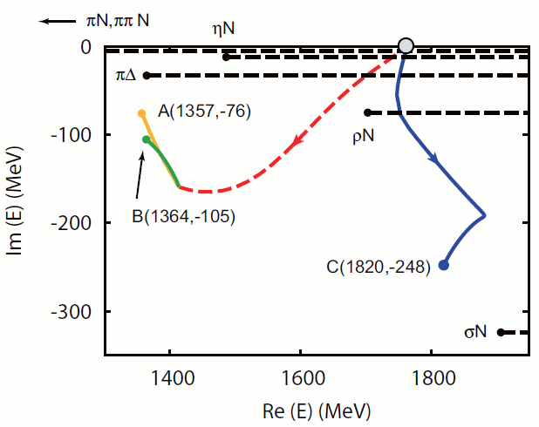
Roper Resonance

Slide 52
Roper Resonance
Completing the picture of the Roper resonance, Jorge Segovia et al.,, arXiv:1504.04386 [nucl-th], Phys. Rev. Lett. 115 (2015) 171801
Diquark content: Nucleon vs Roper
“Image”-nucleon = orthogonal solution of Faddeev equation at the Roper mass, with eigenvalue λ>1
Roper & Nucleon have same diquark content
Completely different to prediction of contact-interaction, wherein P_{J=0}≃0
With richer kernel, orthogonality of ground and excited states is achieved differently
 | Nucleon | Roper | Image-Nucleon
P_{J=0} | 62% | 62% | 30%
P_{J≠0×0} | 38% | 38% | 70%

Slide 53
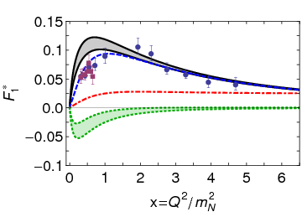
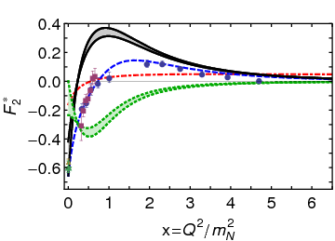
γ N → Roper
Completing the picture of the Roper resonance, Jorge Segovia et al.,, arXiv:1504.04386 [nucl-th], Phys. Rev. Lett. 115 (2015) 171801
Predicted transition form factors
Excellent agreement with data on x>2 (3)
Like γN → Δ, room for meson cloud on x<2 … appears likely that cloud
Is a negative contribution that depletes strength on 0<x<2
Has nothing to do with existence of zero; but is influential in shifting the zero in F₂* from x=¼ to x=1
Is irrelevant on x>2 (3)
Core dominance
Core dominance
DSE Contact
DSE Realistic
Inferred meson-cloud contribution
Anticipated complete result
M. Dugger et al., Phys. Rev. C79, 065206 (2009).
I. Aznauryan et al., Phys. Rev. C80, 055203 (2009).
I. G. Aznauryan et al., arXiv:1108.1125 [nucl-ex].
V. I. Mokeev et al., Phys. Rev. C86 (2012) 035203

Slide 54
γ N → Roper
Completing the picture of the Roper resonance, Jorge Segovia et al.,, arXiv:1504.04386 [nucl-th], Phys. Rev. Lett. 115 (2015) 171801
Predicted transition form factors
Excellent agreement with data on x>2 (3)
Like γN → Δ, room for meson cloud on x<2 … appears likely that cloud
Is a negative contribution that depletes strength on 0<x<2
Has nothing to do with existence of zero; but is influential in shifting the zero in F₂* from x=¼ to x=1
Is irrelevant on x>2 (3)
After 35 years, the Roper is now understood
First radial excitation of the nucleon’s dressed-quark core
But the core is accompanied by a meson cloud,
reduces the core’s mass by 20%
contributes measurably to transition form factors on x<2.
Roper emulates the pattern established by the Δ resonance
Core dominance
Core dominance
DSE Contact
DSE Realistic
Inferred meson-cloud contribution
Anticipated complete result
M. Dugger et al., Phys. Rev. C79, 065206 (2009).
I. Aznauryan et al., Phys. Rev. C80, 055203 (2009).
I. G. Aznauryan et al., arXiv:1108.1125 [nucl-ex].
V. I. Mokeev et al., Phys. Rev. C86 (2012) 035203

Slide 55
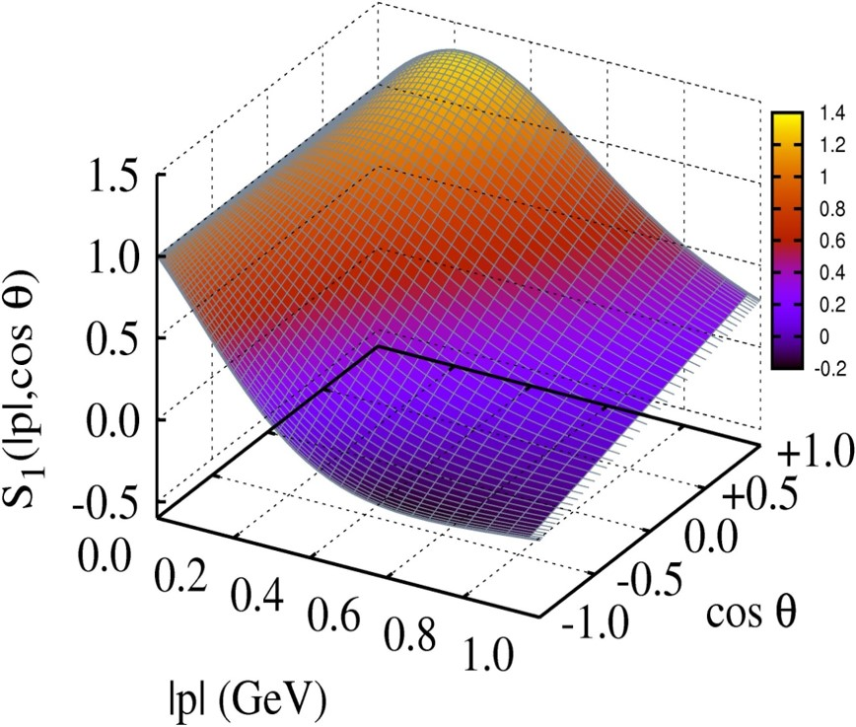
Baryon Wave Functions

Slide 56
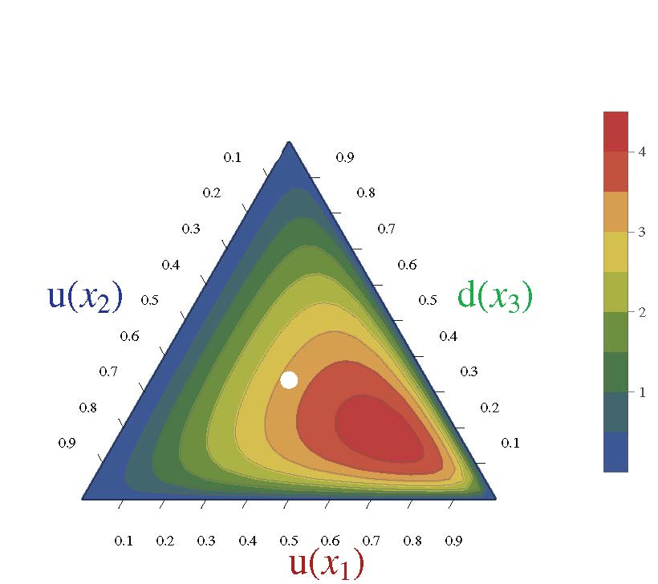
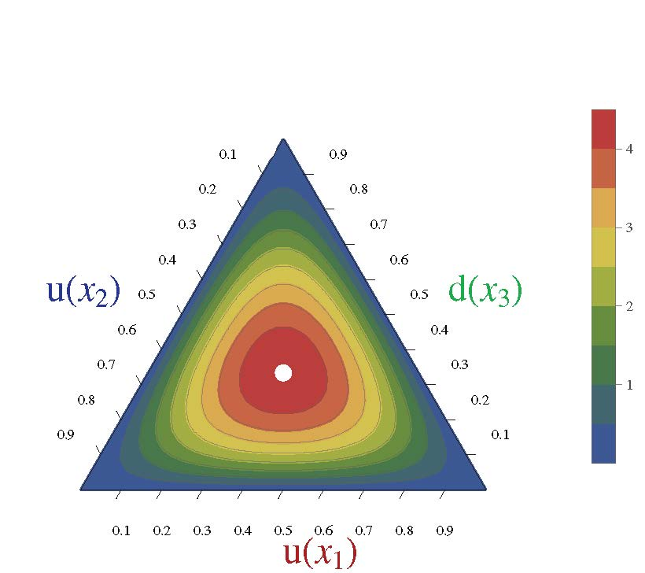
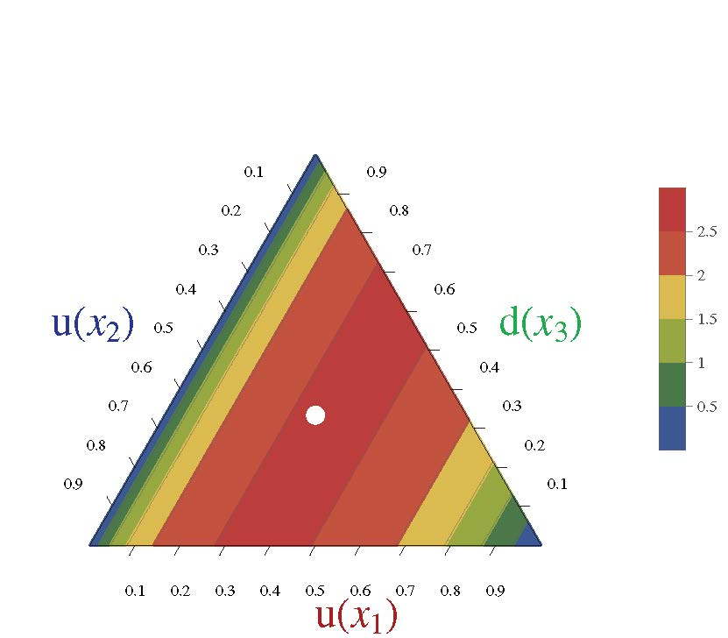
Nucleon Parton Distribution Amplitudes
C. Mezrag, C. D. Roberts and J. Segovia,
Near completion
Computations underway. First results available.
Realistic, finite size (0.7fm) 0⁺ diquark [u(x₂)d(x₃)]
Diquark clustering skews the distribution toward the dressed-quark bystander, which therefore carries more of the proton’s light-front momentum
(0.6,0.2,0.2)
conformal limit:
120 x₁x₂x₃
〈x_{i}〉=⅓ … peak of the distribution
Pointlike 0⁺ diquark [u(x₂)d(x₃)]

Slide 57
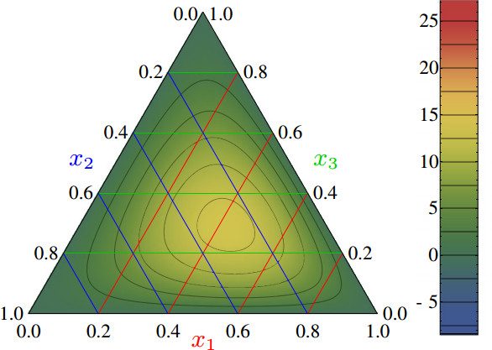
Nucleon PDAs & lQCD
Light-cone distribution amplitudes of the nucleon and negative parity nucleon resonances from lattice QCD
V. M. Braun et al., Phys. Rev. D 89 (2014) 094511
Light-cone distribution amplitudes of the baryon octet
G. S. Bali et al. JHEP 1602 (2016) 070
First lQCD results for n=0, 1 moments of the leading twist PDA of the nucleon are available
Used to constrain strength (a₁₁) of the leading-order term in a conformal expansion of the nucleon’s PDA:
Φ(x₁,x₂,x₃)
= 120 x₁ x₂ x₃ [ 1 + a₁₁ P₁₁(x₁,x₂,x₃) + … ]
Shift in location of central peak is consistent with existence of diquark correlations within the nucleon
(0.5,0.25,0.25)
Notes:
The calculation is done using Nf = 2 + 1 flavors of dynamical (clover) fermions on lattices of different volumes and pion masses down to 222 MeV. Significant SU(3) flavor symmetry violation effects in the shape of the distribution amplitudes are observed.

Slide 58
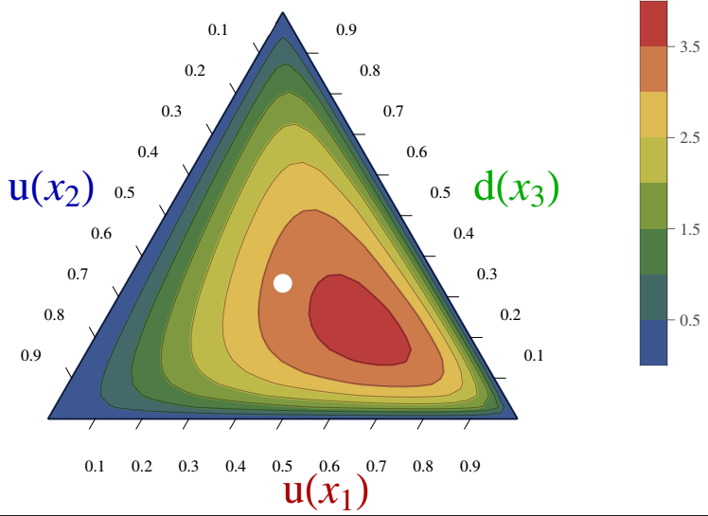
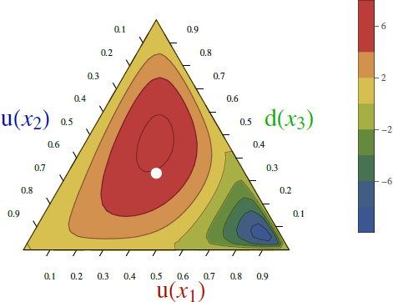
PDAs: Nucleon vs. Roper
Realistic N & R = 0⁺ (0.8) ⊕ 1⁺ (0.2) ⇒ 0⁺ (62%) ⊕ 0⁺ (38%)
Presence of diquark correlations has striking consequences
 | Conformal (uncorrelated) | Nucleon (qq 0⁺ only) | Nucleon | Roper (qq 0⁺ only) | Roper | R-N difference
〈 x₁ 〉 | 0.33 | 0.44 | 0.39 | -0.30 | 0.12 | -69%
〈 x₂ 〉 | 0.33 | 0.28 | 0.29 | 0.65 | 0.40 | +34%
〈 x₃ 〉 | 0.33 | 0.28 | 0.32 | 0.65 | 0.48 | +50%
Nucleon
Roper
Roper PDA has a line of zeros

Slide 59
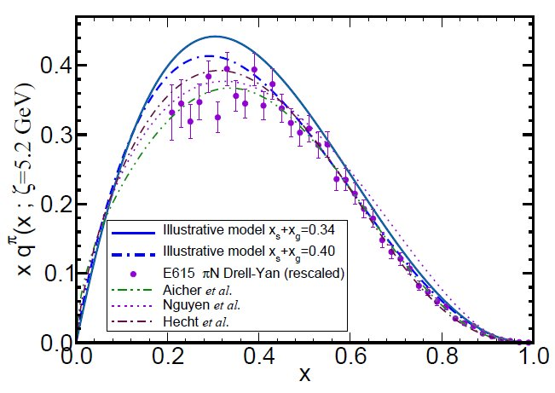
π & K Valence-quark Distribution Functions

Slide 60
π & K PDFs
Experimental data on π & K PDFs obtained in mesonic Drell-Yan scattering from nucleons in heavy nuclei; but it’s old: 1980-1989
Newer data would be welcome:
persistent doubts about the Bjorken-x ≃1 behaviour of the pion’s valence-quark PDF
single modest-quality measurement of u^{K}(x)/u^{π}(x) cannot be considered definitive.
Approved experiment, using tagged DIS at JLab 12, should contribute to a resolution of pion question; and a similar technique might also serve for the kaon.
Future:
new mesonic Drell-Yan measurements at modern facilities could yield valuable information on π and K PDFs,
as could two-jet experiments at the large hadron collider;
EIC would be capable of providing access to π and K PDFs through measurements of forward nucleon structure functions.
Gribov-Lipatov reciprocity (crossing symmetry) entails connection between PDFs and fragmentation functions on z ≃ 1 (z ≥ 0.75)
D_{H/q}(z) ≈ z q^{H}(z)
Reliable information on meson fragmentation functions is critical if the worldwide programme aimed at determining TMDs is to be successful

Slide 61
Pion’s Valence-Quark Distribution Function
One of the earliest predictions of the QCD parton model (1974,1975):
q^{π}(x) ∼ (1-x)²
Owing to the validity of factorisation in QCD,
q^{π}(x) is directly measurable in πN Drell-Yan experiments
E615 @ FNAL (Conway:1989fs): leading-order analysis of πN Drell-Yan
q^{π}(x) ∼ (1-x)¹
Apparent disagreement with QCD.
Nevertheless (often) used to produce “modern” PDF fits

Slide 62
E615 Controversy
q^{π}(x) ∼ (1-x)¹
Numerous “explanations”
Nambu – Jona-Lasinio model, translationally invariant regularisaion
q^{π}(x) ∼ (1-x)⁰,
which becomes ≈1 after evolving from a low resolution scale
NJL models with a hard cutoff & also some duality arguments:
q^{π}(x) ∼ (1-x)¹
Relativistic constituent quark models:
q^{π}(x) ∼ (1-x)^{0…2}
depending on the form
of model wave function
Instanton-based models
q^{π}(x) ∼ (1-x)^{1…2}
Any power you might like in models possessing no connection with QCD.
What can be learnt from this?
Is QCD threatened?

Slide 63
Valence-quark PDFs within mesons
Basic features of the pion valence-quark distribution function,
Lei Chang, Cédric Mezrag, et al.,
arXiv:1406:5450 [nucl-th], Phys. Lett. B 737 (2014)pp. 23–29
Valence-quark distribution functions in the kaon and pion,
Chen Chen, Lei Chang et al.
arXiv:1602.01502 [nucl-th], Phys. Rev. D93 (2016) 074021/1-11
Compute PDFs from imaginary part of virtual-photon – pion forward Compton scattering amplitude:
γ π → γ π
Handbag diagram is insufficient. Doesn’t even preserve global symmetries. Exists a class of leading-twist corrections that remedies this defect ⇒
Similar expressions for u_{V}^{K}(x), s_{V}^{K}(x)
Projection onto light-front
Partial derivative wrt relative momentum
Measurable quantities
Directly related to dynamically generated quark masses
& bound-state wave functions

Slide 64
Valence-quark PDFs within mesons
Basic features of the pion valence-quark distribution function,
Lei Chang, Cédric Mezrag, et al.,
arXiv:1406:5450 [nucl-th], Phys. Lett. B 737 (2014)pp. 23–29
Valence-quark distribution functions in the kaon and pion,
Chen Chen, Lei Chang et al.
arXiv:1602.01502 [nucl-th], Phys. Rev. D93 (2016) 074021/1-11
Formulae guarantee that valence-quark PDFs satisfy, independent of any and all structural details:
Algebraic proof that at an hadronic scale ζ ≈ 0.5 GeV
q_{V}^{M}(x ≃ 1) ∝ (1-x)^{2n}
in any theory with (1/k²)^{n} vector-boson exchange interaction

Slide 65
Valence-quark PDFs within mesons
x=1 values of ratios of PDFs are invariant under DGLAP evolution
Consequently, they’re a scale invariant discriminator between competing pictures of hadron structure
On the other hand
Owes to inexorable growth in both mesons’ gluon and sea-quark content driven by pQCD splitting mechanisms.
Analogous to the convergence of all meson PDAs to conformal form as Λ_{QCD}/ζ → 0

Slide 66
Realistic distributions
Pion distribution at ζ_{H}
DSE prediction, following from analysis of leptonic decay: π contains 5% sea
Assume GRV analysis of πN Drell-Yan is reliable, then 30% of π momentum carried by glue
Adopting standard PDF parametrisations, this additional information is sufficient to completely fix realistic u_{π}(x; ζ_{H}) = valence + sea + glue
Kaon distribution at ζ_{H}
Owing to heavier mass of intermediate states that can introduce sea-quarks, safe to assume sea-quark content of kaon is effectively zero
Treat momentum fraction carried by glue as a parameter to be used in understanding u^{K}(x)/u^{π}(x)
… owing to heavier mass of s-quark,
expect 〈x〉_{g}^{K} < 〈x〉_{g}^{π};
… but how much less?

Slide 67
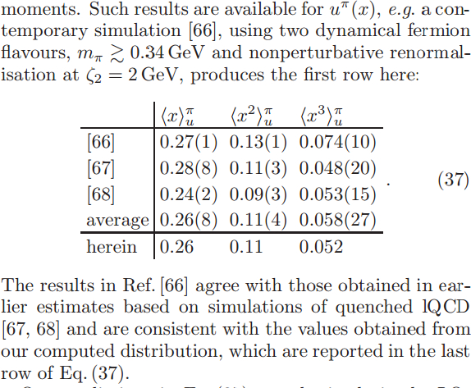
Pion: DSE comparison with lQCD moments
All lQCD studies agree with each other, within errors
[66]: Brommel et al. (2007)
[67]: Best et al. (1997)
[68]: Detmold et al. (2003)
DSE and lQCD agree, within errors; and DSE at level of 4% with lQCD-average
On light-front, just 52% of the pion’s momentum is carried by valence-quarks at ζ₂ = 2GeV, down from 65% at ζ_{H}= 0.51GeV

Slide 68
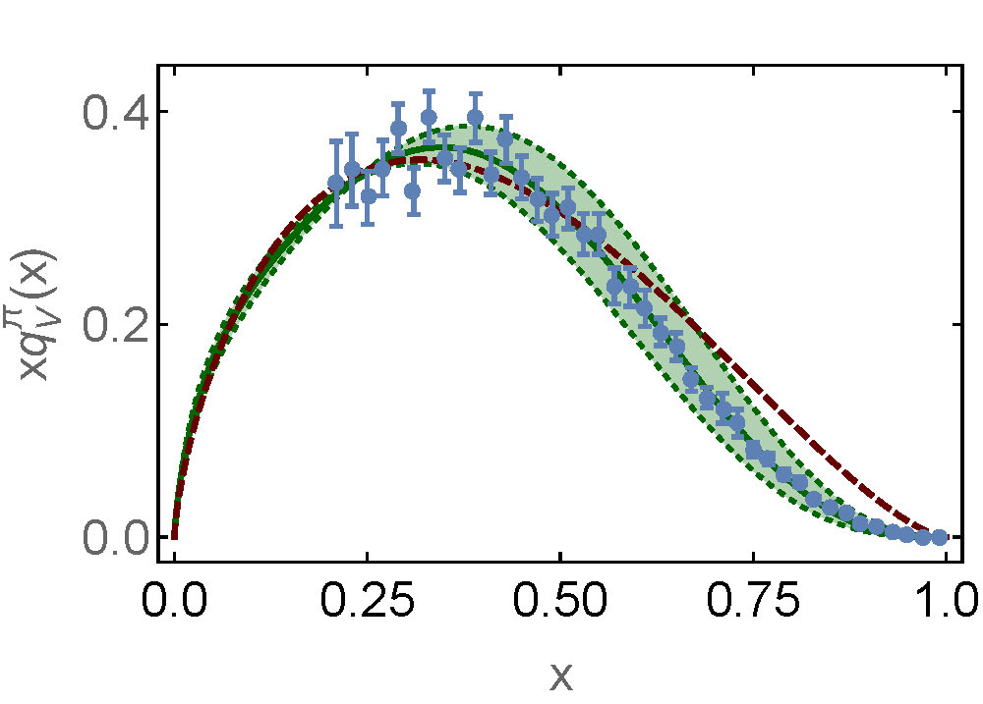
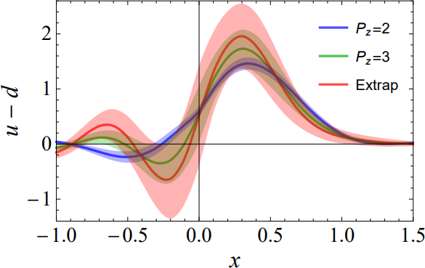
Precision Required for pion PDF
“random model”
(1-x)^{1.5}
General shape is known
… all PDFs look the same
Key Question … what is the valence-domain exponent?
Plainly … brute force computation via lQCD is not yet competitive
Can it become competitive?
If so, realistically, when?
Data: (1-x)^{2.9±0.3}
Parton Distribution Function with Non-perturbative Renormalization
from Lattice QCD, Jiunn-Wei Chen et al. arXiv:1706.01295 [hep-lat]

Slide 69
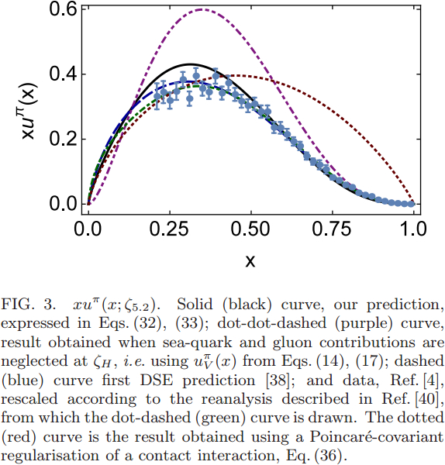
Pion PDF
DSE
2000 2016
Purple dot-dot-dash = prediction at ζ_{H}
Data = modern reappraisal of E615: NLO analysis plus soft-gluon resummation (ASV)
Solid black curve, prediction evolved to ζ=5.2GeV, the scale associated with the experiments
Blue dashed curve = first DSE prediction, in 2000 (ζ=5.2GeV)
Dotted red curve = result obtained with momentum-independent gluon exchange (contact interaction, ζ=5.2GeV)
CI: (1-x)^{1.0±0.1}
ζ=5.2GeV
DSE: (1-x)^{3.0±0.1}

Slide 70
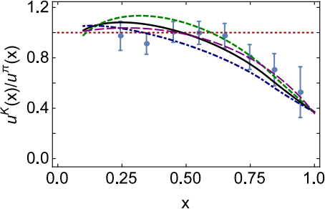
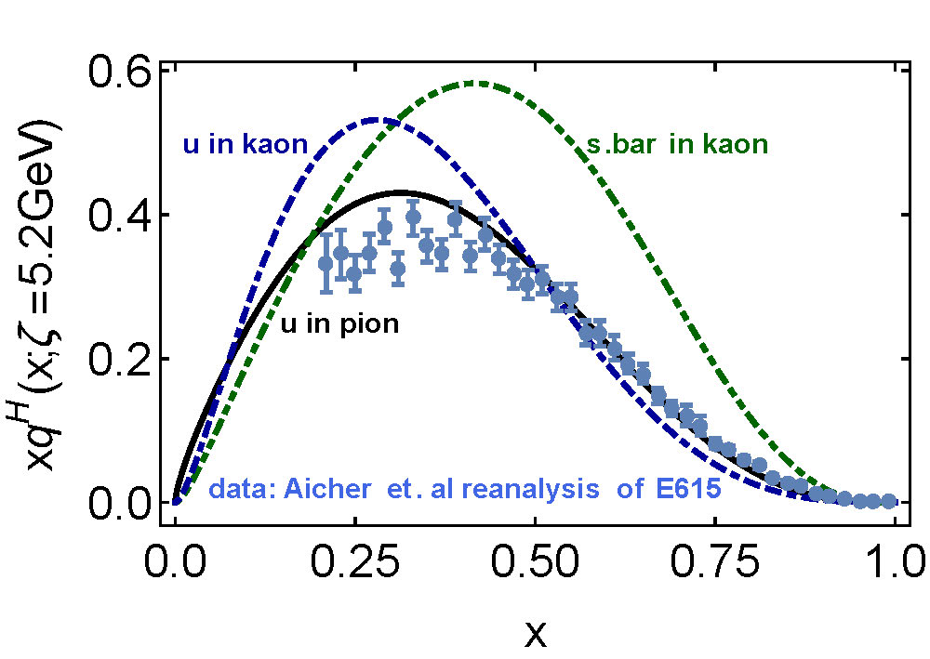
Kaon’s gluon content
0%
10%
〈x〉_{g}^{K}(ζ_{H}) = 0.05 ± 0.05
⇒ Valence quarks carry
95% of kaon’s
momentum at ζ_{H}
Evolved to ζ₂
Valence-quarks carry ⅔ of kaon’s light-front momentum
1st DSE analysis (Tandy et al., fully numerical DSE solutions)

Slide 71
π & K PDFs
Valence-quark distribution functions in the kaon and pion,
Chen Chen, Lei Chang et al.
arXiv:1602.01502 [nucl-th], Phys. Rev. D93 (2016) 074021/1-11
Marked differences between π & K gluon content
ζ_{H}:
Whilst $\frac{1}{3}$ of pion’s light-front momentum carried by glue
$Only \frac{1}{20}$ of the kaon’s light-front momentum lies with glue
ζ₂² = 4 GeV²
Glue carries $\frac{1}{2}$ of pion’s momentum and $\frac{2}{3}$ of kaon’s momentum
Evident in differences between large-x behaviour of valence-quark distributions in these two mesons
Signal of Nambu-Goldstone boson character of π
Nearly complete cancellation between
one-particle dressing and binding attraction
in this almost massless pseudoscalar system
2 M + U ≈ 0

Slide 72
π & K PDFs
Valence-quark distribution functions in the kaon and pion,
Chen Chen, Lei Chang et al.
arXiv:1602.01502 [nucl-th], Phys. Rev. D93 (2016) 074021/1-11
Existing textbook description of Goldstone’s theorem via pointlike modes is outdated and simplistic

Slide 73
π & K PDFs
Valence-quark distribution functions in the kaon and pion,
Chen Chen, Lei Chang et al.
arXiv:1602.01502 [nucl-th], Phys. Rev. D93 (2016) 074021/1-11
The appearance of Nambu-Goldstone modes in the Standard Model is far more interesting
Nambu-Goldstone modes are nonpointlike!
Intimately connected with origin of mass!
Quite probably inseparable from expression of confinement!
Difference between gluon content of π & K is measurable … using well-designed EIC
Write a definitive new chapter in future textbooks on the Standard Model

Slide 74
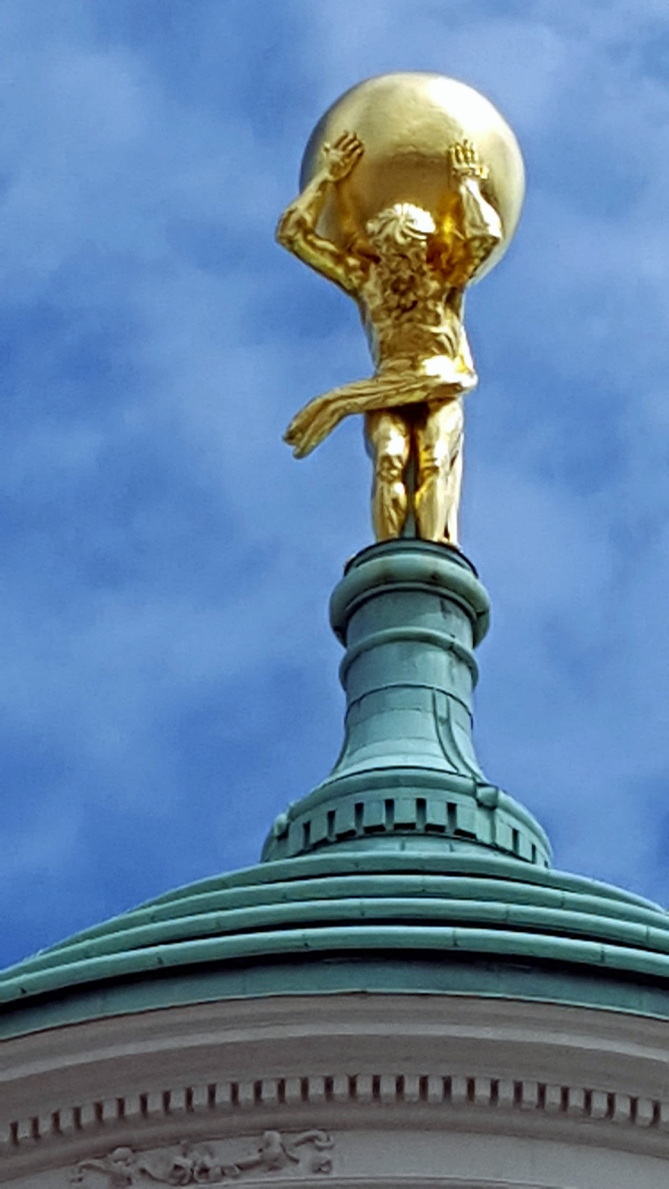
Epilogue

Slide 75
Epilogue
Challenge: Explain and Understand
the Origin of the vast bulk of Visible Mass
Current Paradigm: Quantum Chromodynamics
QCD is plausibly a mathematically well-defined quantum field theory,
The only one we’ve ever produced
Consequently, it is a worthwhile paradigm for developing Beyond-SM theories
Challenge is to reveal the content of QCD
Parton distributions are measurable, but for QCD validation
Unsound model computations and rough sketches are inadequate
Need precise QCD-connected predictions of their pointwise behaviour
Continuum bound-state methods in QCD
Past 20 years have seen vast improvement in understanding and consequent reduction in model-dependence
Exist now an array of exciting predictions; ripe for validation
Raft of potential future applications
includes parton distributions of all types

Slide 77
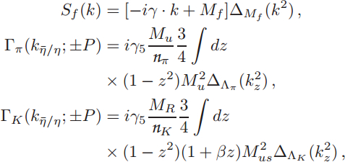
Valence-quark PDFs within mesons
Algebraic analysis
Δ_{f}(k²)=1/[k²+M_{f}²]
M_{R}=M_{us}²/[M_{u}+M_{s}]
M_{us}² = M_{u} M_{s}
M_{u} , M_{s} = dressed-quark mass-scales: M_{u}=0.4GeV and M_{s}=1.2M_{u} from most sophisticated DSE analyses
β = 1 is kaon asymmetry parameter, fixed to reproduce best DSE result for first moment of kaon PDA
Λ_{π,K} = widths of meson Bethe-Salpeter amplitudes: chosen to ensure f_{π,K} reproduce empirical values
Could use sophisticated DSE input, like Tandy et al. arXiv:1102.2448 [nucl-th]; but, as demonstrated in arXiv:1602.01502 [nucl-th], nothing material is gained
Predictions of algebraic framework are indistinguishable and provide additional, novel insights

